Slide 1
Lung Cancer
Elizabeth Lancaster
Johannes Kratz
October 12, 2016

Slide 2
Epidemiology
Most common cause of cancer death in men and women
  14.5% of all new cancer diagnoses
  27.6% of all cancer deaths
African American men have the highest incidence and highest death rate from lung cancer
Declining incidence in men and stabilized incidence in women since 2001
Smoking increases risk HR 4.2
Other environmental exposures
  Asbestos, arsenic, chromium, radon, organic chemicals, nickel, iatrogenic radiation, air pollution
  2nd hand smoke
10 yrs of cessation and risk of death goes back to that of never smoker

Slide 3
Screening
National Lung Screening Trial (NLST)
  Ages 55-74
  Significant smoking history (>30 pack years)
  >53,000 patients
  Randomized to three annual CXR vs low dose helical CT
CT group reduced rates of death from lung cancer by 20%, reduced all cause mortality by 6.7%
Did MH warrant screening CT?

Slide 4
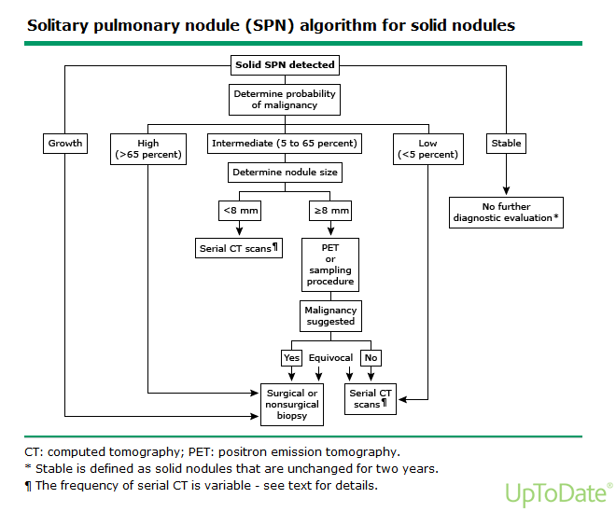
Management
Guidelines for management of small pulmonary nodules detected on CT scans: a statement from the Fleischner Society. Radiology 2005;237:395-400.)

Slide 5
Staging - Primary Tumor (T)
T Stage | Size | Other Criteria
T1 | <3cm T1a <2cm T1b >2cm but <3cm | Surrounded by lung/visceral pleura No endoscopic evidence of invasion more proximal than lobar bronchus
T2 | >3cm but <7cm T2a >3cm but <5cm T2b >5cm but <7cm | Involves main bronchus <2cm from carina Invades visceral pleura Atelectasis/PNA extending to hilum but not involving entire lung
T3 | >7cm | Invades chest wall, diaphragm, phrenic n, mediastinal pleura, parietal pericardium Involves main bronchus <2cm from carina Atelectasis of entire lung Separate tumor nodules in same lobe
T4 | Any size | Invades mediastinum, heart, great vessels, trachea, recurrent laryngeal n, esophagus, vertebral body, carina Separate tumor nodules in ipsilateral lobe

Slide 6
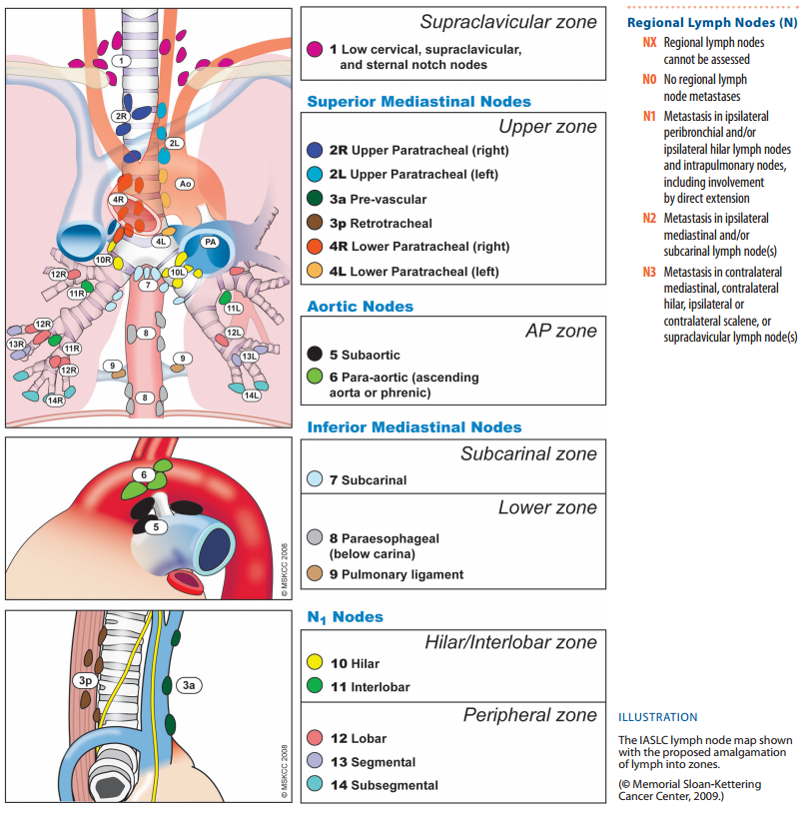
Staging - Regional
Lymph Nodes (N)
N Stage
NX | Regional lymph nodes cannot be assessed
N0 | No regional lymph node metastasis
N1 | Metastasis in ipsilateral peribronchial and/or ipsilateral hilar lymph nodes and intrapulmonary nodes, including involvement by direct extension
N2 | Metastasis in ipsilateral mediastinal and/or subcarinal lymph node(s)
N3 | Metastasis in contralateral mediastinal, contralateral hilar, ipsilateral or contralateral scalene, or supraclavicular lymph node(s)

Slide 7
Staging – Distant Metastases (M)
M Stage
MX | Distant metastasis cannot be assessed
MO | No distant metastasis
M1a | Separate tumor nodule(s) in a contralateral lobe; tumor with pleural nodules or malignant pleural (or pericardial) effusion
M1b | Distant metastasis

Slide 8
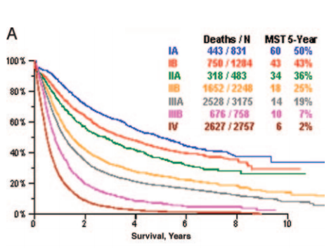

Slide 9
Management
Greenfield's Surgery: Scientific Principles and Practice, 5e

