Slide 1
Family Demography and Intro to Life tables

Slide 2
Marco family processes
Family and kinship processes
  Co-residence
  Marriage and divorce (timing)
  Parenthood (timing), spacing of children
Why important for health researchers?
  Use family structure as predictors of health outcomes
    Do children from single-parent families have poorer health?
  Use health to predict family structure
    Are healthy people more likely to marry?

Slide 3
Examples of outcomes and predictors
Type of marriage
  Polygamous, monogamous
Type of family
  1 vs 2 parents
Intergenerational exchange
  Co-residence
  Extended vs nuclear households

Slide 4
Assumption
The group being studied has a culturally and historically specific set of kinship rules, which may be formal (written into the law) or informal, or a mixture, and which could be accurately described by any legitimate and competent group member under the right kind of questioning
There is a very complex relationship between a particular set of kinship rules and a particular schedule of fertility, mortality, marriage rates, and migration levels
Demographic rates affect kinship structure − Kinship structure affects demographic rates

Slide 5
Family Structure, trends over time

Slide 6
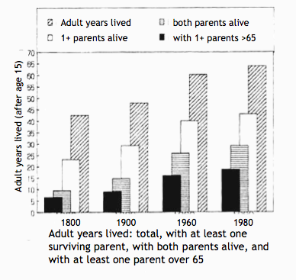
Years lived with parents over 65+
Obligations (on both sides) go on much longer
Benefits (on both sides) go on much longer
Happened simultaneously with a decline in fertility, so obligations on parent side reduced and on child side increased

Slide 7
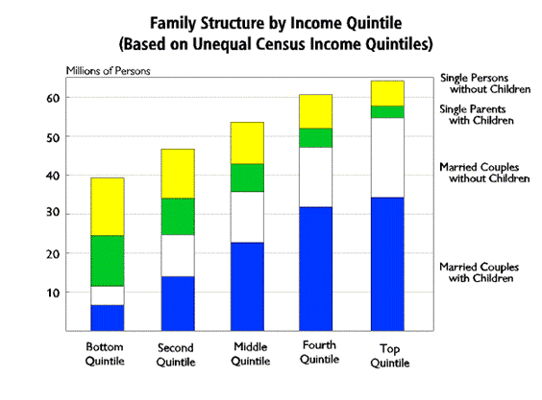
Wealth differentials

Slide 8
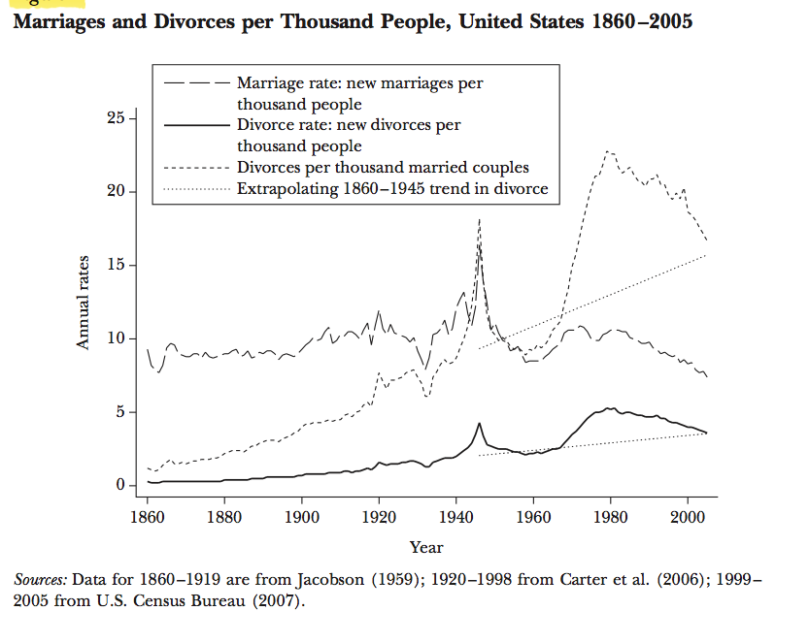

Slide 9
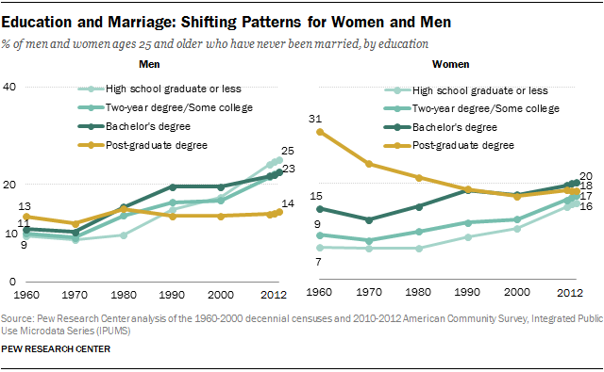
Educational differentials

Slide 10
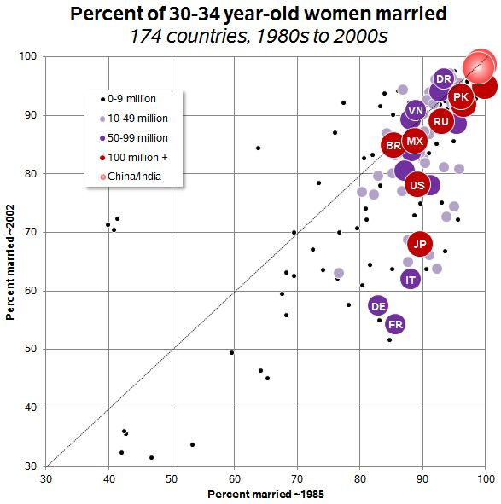
Marriage on the decline globally

Slide 11
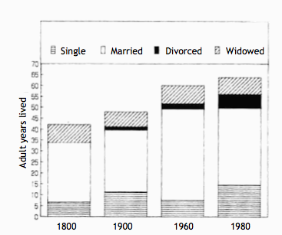
Adult years spent in each state

Slide 12
Marriage, divorce, life expectancies: a hypothesis
Number of years married rose from 27 to 42 and then declined to 35
  Rising age at marriage and increase in divorce totally overcome by declining death rates
Puts enormous strains on married couples
  In 1800, a certain number of “bad” marriages ended by death before they could consider divorce

Slide 13
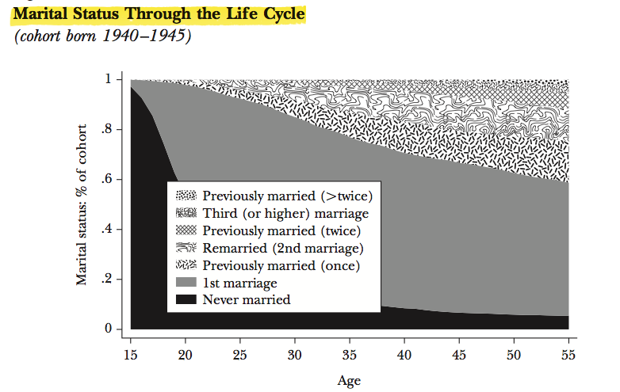

Slide 14
How does kinship affect demographic processes? Examples
Polygamy decreases fertility
  Mixed evidence, mostly support this
  Why? Think about proximate determinants of fertility
    Age, fecundability (male)
    Coital frequency
    Fewer men marry
    Conflict between co-wives
Late marriage in Europe caused low natural fertility

Slide 15
Measures of marriage and divorce
Crude marriage rate=
General marriage rate=
(can do for men
or women)
Age specific marriage rate=

Slide 16
More measures of marriage and divorce
Order specific marriage rate=
Can do age and order
Total marriage rate
TMR = Total number of marriages a person will have at the end of his/her marriageable age if he/she follows the given schedule of marriage

Slide 17
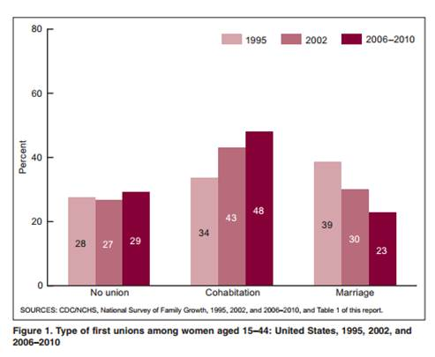
Increases in cohabitation

Slide 18
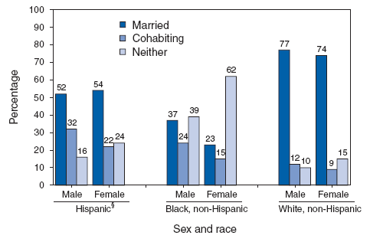
Differences in cohabitation

Slide 19
Cohabitation
Short lived
  Half-life of cohabitation is 2 years, either marry or break up
People who marry less likely to divorce within 5 years than people who cohabit
  Need to consider time before marriage
  Also need to consider remarriage
Cohabitation and mortality
  Married>cohabitating>divorced, single, widowed

Slide 20
Second demographic transition
Delay in marriage
Delay in childbearing
Increase in cohabitation
Increase in divorce
Increase in women working
Outcome:
  Big changes in children’s living arrangements
    Poor for child outcomes? Socioeconomic status

Slide 21
Life tables

Slide 22
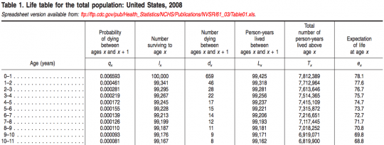
Life table: US mortality

Slide 23
Life Tables
The life table conceptually traces a cohort of newborn babies through their entire life under the assumption that they are subject to the current observed schedule of age- specific mortality rates
The life table records the passage of a cohort from birth to extinction, or when the last member has died, according to a set of fixed age specific probabilities of death/failure
As age increases, the number of survivors of the original group declines
Life Tables looks at the likelihood of an event occurring in the next time period (day, week, year) given survival to the beginning of the time period

Slide 24
Not just life and death!
Mortality/Survival (people, cars, appliances)
Recidivism
Disability (Active Life Expectancy)
Marriage/cohabitation
Working Life (retirement, unemployment)
Contraceptive Use (effectiveness, discontinuation, switching)
Fertility (1st and higher order births, spacing, time to first sex)
Breastfeeding
Cancer survival

Slide 25
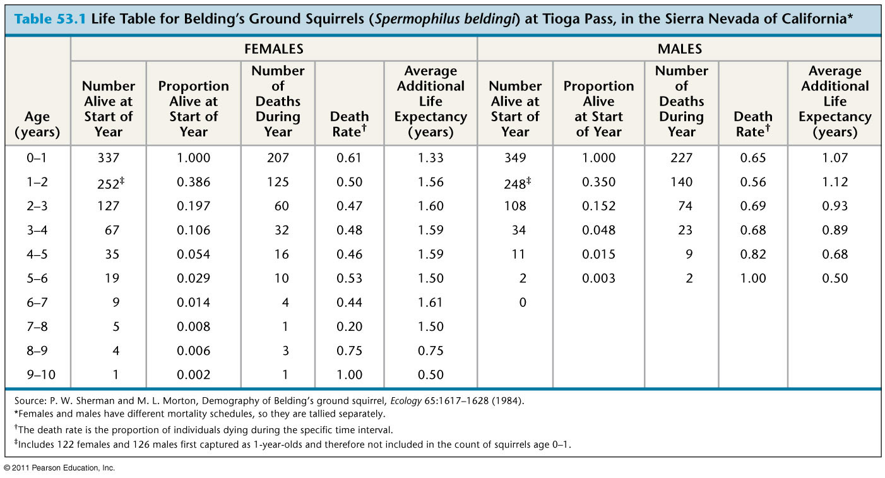
Squirrels!

Slide 26
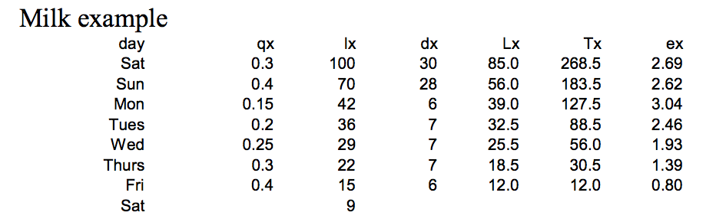
Milk being sold

Slide 27
Simplest form
Single decrement= people only go one way
Closed population
  Population growth constant
  No migration in or out

Slide 28
More advanced forms: multistate
Lets try to model marriage/divorce/death/widowhood

Slide 29
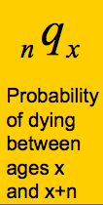
Life table notation:
The subscript before a symbol defines the width of the interval
The subscript after the symbol defines the starting point of the interval
lx, Tx and ex never have a left subscript as they refer to exact age x

Slide 30
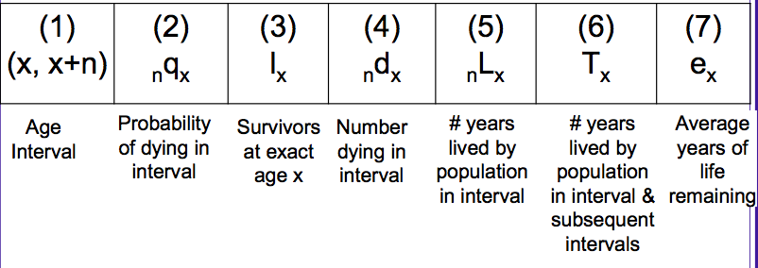
Life table

Slide 31
Practice
probability of dying between age 0 and 1
  ₁q₀
Number of deaths between age 40 and 45
  ₅d₄₀

Slide 32
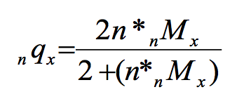
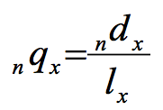
Usually start with age specific death rates (_{n}M_{x})
Can convert _{n}M_{x} to _{n}q_{x}
1)
Where n is the length of the interval (usually 5 years)
2)

Slide 33
lx= Survivors
l₀ =who are the survivors to age 0?
  Everyone born!
  The radix population, could choose anything, usually start with 100,000
l₁ = Survivors at the start of year 1?
l₁ = l₀- (l₀* ₀q₁)
Say ₀q₁ = 0.0582, how many people die in year 1?
582
How many people are alive at the start of year 1?
100,000-582= 99,418 = l₁
582 is _{n}d_{x} =deaths between age n and n+x

Slide 34
0-1 | 0.0582 | 100,000 | 582
1-2 |  | 99,418

Slide 35
Why do we use life tables?
Any question that concerns the probability of an event
To analyze any measurable process that involves a time pattern of exit from or entry into a particular state (e.g., births and deaths)
Estimate age/time specific risks
Examine changes in rates
Population growth and change (generate projections of the size and characteristics of future populations based on some initial base population.)
Compare health levels across two populations or one population over time

Slide 36
Thank you!
Questions?
Notes:
Final boiler plate language: 2 versions
Through its singular focus on health, UCSF is leading revolutions in health.
UCSF is driven by the idea that great breakthroughs are achieved when the best research, the best education and the best patient care converge.

