Slide 1

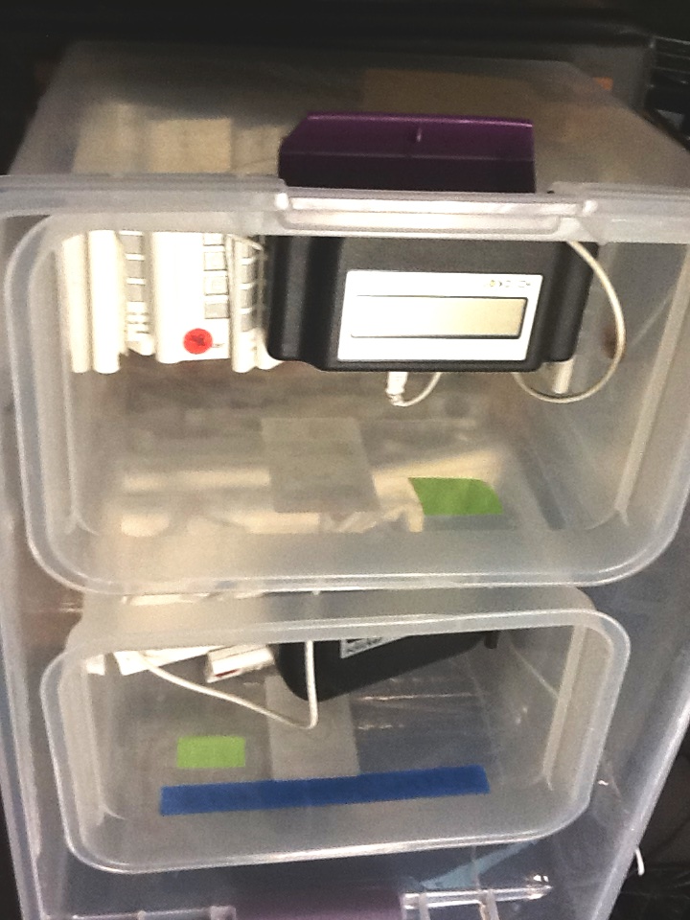
Please take an i>clicker from the bins by the door

Slide 2
Epidemiologic Methods
Unifying theme of study design: sampling underlying cohorts
Design begets measures
Notes:
Let’s take a moment to review where we have been so far in this course, now that we are a bit over 1/3 of the way through. We’ve spent the first 5 lectures discussing study designs, measuring disease (or outcomes) occurence in these designs, and evaluating associations between exposures and outcomes (e.g., diseases). We talked about how the ultimate goal of these measures of association was either causation or prediction. We also discussed measures of disease attribution.
In particular, we have stressed the unifying theme that all study designs are simply a means of sampling human populations as they are moving through time – i.e., sampling underlying cohorts, either fixed or dynamics. Sometimes these underlying populations are very real and tangible and other times they are hypothetical. In particular, we have emphasized how case-control studies are just efficient means of sampling an underlying cohort.
The types of measures of disease occurrence that we can get from these studies depends upon the exact design. We then can compare measures of disease occurrence across levels of exposure with either ratio or difference comparisons. Again, the study design dictates what kinds of measures of association can be derived.
We expect that you are moving from being accepting consumers of this material to active and skeptical creators of this kind of work and that you are getting a good understanding of what is going on underneath the hood.

Slide 3
Notes:
And here is where we are going. Now that we have laid out the basics of design and analysis, we need to discuss the various threats we face to getting the right answer, in other words, what we formally call the “threats to validity”. We’ll start today by discussing selection bias, then devote two sessions to properties of measurement and measurement bias, and then devote 3 entire sessions to probably the biggest threat we face in observational research - that being confounding.
We will also have a few more journal clubs along the way, which will help to solidify the concepts learned in lecture by applying them to real-world literature. The reason we have the journal clubs is because there is often a very big gap between learning the theory in didactic settings and recognizing and applying it in the real-world. We are therefore reading these articles to facilitate your learning how it applies in the real world.

Slide 4
What best characterizes case-control studies?
Efficient means of sampling an underlying cohort - A
Require rare outcome - B
More biased than cohort studies - C
Are retrospective - D
Notes:
4
Let’s get some practice with the i>clickers. Here is a question that exemplifies our first 5 weeks. What best characterizes case-control studies?

Slide 5
What best characterizes case-control studies?
Efficient means of sampling an underlying cohort - A
Require rare outcome - B
More biased than cohort studies - C
Are retrospective - D
Notes:
5
We hope that everyone appreciates that case-control studies are efficient means of sampling underlying cohorts. By efficient, we mean that case-control studies can examine only a fraction of the subjects in an underlying cohort and still get an unbiased measure of association.
In the past, there were misconceptions that case-control studies required rare outcomes in the underlying population, but this is not true. It is also not true to say that case-control studies are more biased than cohort studies. There are more opportunities to make mistakes in case-control studies but they are not inherently more biased. Each individual study needs to be judged on its own merits.
Finally, we hope to remove from your vocabulary the ambiguous terms retrospective and prospective as they relate to study design. These terms are not reproducibly understood between scientists and have become empty in their meaning. Hence, don’t let anyone fool you by assigning value to retrospective vs prospective when labeling a study. Instead, pay attention to the details of the study in order to understand its validity and value. Don’t judge a book by its cover.

Slide 6
Bias in Clinical Research:
General Aspects and Focus on Selection Bias
Framework for understanding error in clinical research
  systematic error, aka threats to internal validity, or bias
  random error, aka sampling error, or chance
Selection bias (a type of systematic error)
  according to study objective: descriptive or analytic
  mechanisms by study design:
    cross-sectional
    case-control
    longitudinal studies (cohort: observational or experimental)
Notes:
Here is our roadmap for today. We are going to start with a general discussion about error in clinical research. We will describe a general framework you can use when thinking about your own work or critiquing others’ work. In particular, we will distinguish between the two types of error: systematic error and random error. Systematic error, also known as bias, poses a threat to internal validity. Random error is the chance result of sampling error.
Among the different forms of bias, we’ll then focus specifically today on selection bias. We will start off by describing how -- the mechanisms -- selection bias may occur. We will discuss selection bias according to the research objective, meaning descriptive or analytic, and also by study design. In case you have not encountered the terms, descriptive means where the goal is to estimate measures of disease occurrence, and analytic means estimating measures of disease association (Is some exposure associated with some outcome?). We will discuss selection bias in cross-sectional, case-control, and longitudinal studies (i.e., a cohort study, which can be observational or an experimental trial).
By the way, I hope that by now everyone is suitably convinced that randomized interventional trials or even non-randomized interventional trials (interventional designs are also known as experimental designs) are just like cohort studies except that the exposure is given by the investigator instead of naturally occurring. So, given that I think everyone here is doing either observational or experimental work, this discussion is pertinent to everyone.

Slide 7
WARNING: SHIFTING GEARS
Today (and much of the remainder): A lot of theory
  No equations or cook-book algorithms
Why?
  Identifying (or preventing) bias not a formulaic process
  Requires deft human intelligence
    sound knowledge of methodologic theory and your subject matter
We will often depart considerably from textbook
Notes:
Before we get too far today, we need to warn everyone that we are shifting gears in the course and today will feature a lot of theory. We won’t have many equations or cook-book algorithms. Why is this? It is because identifying, or importantly in the design of your studies, preventing, bias is not a “plug and play” or formulaic process. In other words, there is nothing automatic you can do, no software that you will do it for you. Identifying bias requires human intelligence and that means it requires sound knowledge of theory and deep subject matter expertise.
Finally, we will often depart considerably from the S and N textbook, attempting to give a clearer view of the material, and, in some cases, a more modern view.

Slide 8
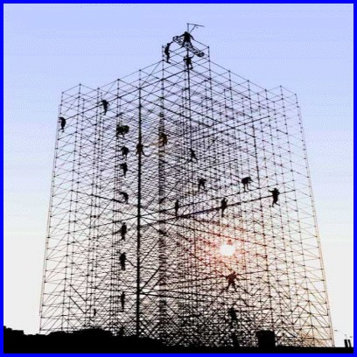
A Framework for Classifying Error
Notes:
Let us start by establishing a framework of understanding error.

Slide 9
Clinical and Epidemiologic Research:
Sample
Measure
(Intervene and make more measurements)
Analyze relationship between measurements
Infer (i.e., make an inference)
Inference
  Webster’s: act of passing from sample data to generalizations, with unknown degree of certainty
  All we can do is make educated guesses about the soundness of our inferences
  Those who are more educated will make better guesses
Notes:
The basic elements of clinical and epidemiologic research are pretty simple. We sample human subjects, make measurements on them, sometimes perform an intervention, analyze the relationships between these measurements, and then make inferences.
Just to make sure we are all on the same page, what do we mean by an inference? Well, if you look up inference in Webster’s dictionary, you will find that it is the “act of passing from sample data to generalizations, usually with calculated degrees of certainty”.
In other words, when we make inferences from our samples to larger populations we always do so with a certain amount of trepidation.
What makes this a difficult business is that there is no way for us to really know just how accurate our inferences are. All we can do is to make educated guesses about how accurate our inferences are. Those who are more educated will make better guesses than others.

Slide 10
Theme for Rest of Course
Anyone can get a numeric answer in research
The challenge is to tell if it is correct
Notes:
Stated another way, the theme for the rest of the course is that anyone can derive a numeric answer in a research study (i.e., push the buttons in Stata).
The challenge is to tell if the number is correct. This is the highest art form in our field.

Slide 11
Schematic of the process of inference
OTHER POPULATIONS
Inference
Disease
+ -
+
-
Exposure
Inference
REFERENCE/
TARGET/
SOURCE POPULATION
aka
STUDY BASE
Two types of inferences
STUDY SAMPLE
Notes:
Here is what the process of inference looks like schematically. All we ever have in our studies is our study sample, here on the right. However, we are first interested in forming inferences about a reference or target or source population. We’ve also called this the study base, especially when we were talking about case-control studies. In other words, to understand something about our source population, we almost always are forced to sample it - i.e. only study a fraction of the source population.
But, in truth, in addition to making inferences about the source population, we are usually interested in making inferences outside of our source population. There are usually many “other populations”, shown here in three boxes in the upper left hand corner, outside of the target population that we are interested in.
Note: there is tremendous variability in the methodologic and applied literature as to what the middle population in our schema is called. In fact, sometimes these terms are applied to other populations. For example, the term “target” population is sometimes given to the “other population” that we show in the far upper left of the slide. The newly evolving field of “transportability” focuses on making inferences on these external “target” populations. Hence, for any study, it is important to be very clear what population is being referred to by the short hand language of the authors – i.e., what are the characteristics of the population.
See the Extra Slides for a slightly more elaborate schematic of this process, which includes insertion of the accessible population.

Slide 12
20 to 65 year olds, in Europe
>65 years old
in U.S.
Inference
Disease
+ -
+
-
Exposure
Inference
20 to 65 year olds, in U.S., outside of San Francisco
San Franciscans, 20 to 65 years old
SAMPLE of San Franciscans,
20 to 65 yrs old
Notes:
For example, if our study sampled San Francisco residents age 20 to 65, our study base (or source population) would indeed be all persons in San Francisco age 20 to 65. However, we would naturally also want to know if the results pertained to persons of this age range living in other parts of the U.S. Or, persons 20 to 65 living in other parts of the world, like Europe. Or, persons over age 65.

Slide 13
Attempts in study design to enhance the second inference are often in conflict with goal of making a sound first inference
Most important inference is the first one
Disease
Without an accurate first inference, there is little point considering the second inference
+ -
+
-
Exposure
Inference
REFERENCE/
TARGET/
SOURCE POPULATION
aka
STUDY BASE
STUDY SAMPLE
Notes:
Although there are two types of inferences, it is important to note that the whole process of inference starts with using the study sample (remember this is all you have) and making an inference about the source population. The goal is to make a correct inference. Without an accurate first inference, there is no point considering the second inference. Attempts in study design to enhance the second inference, typically by including more diverse populations, are often in conflict with goal of making a sound first inference.

Slide 14
Error in Clinical Research
The goal of any study is to make an accurate (true) inference, i.e.:
  measure of disease occurrence in a descriptive study
  measure of association between exposure and disease in an analytic study
Ways of getting the wrong answer:
  systematic error; aka “threat to validity” or “bias”
    any systematic process in nature or in the conduct of a study that causes a distortion from the truth in a predictable direction
    captured in the validity of the inference
  random error; aka “chance” or “sampling error”
    occurs because we cannot study everyone (we must sample)
    related to sample size; direction is random and not predictable
    captured in the precision of the inference (e.g., SE and CI)
Notes:
So, if the goal of any study sample is to find the truth about the source population (for a descriptive study, this would be the measure of disease occurrence (or exposure occurrence), and for an analytic study this would be the measure of association between the exposure and disease), then what are the ways of missing the truth (i.e., getting the wrong answer)? There are two ways:
One is systematic error and the other is random error. Systematic error is also known by the terms “threat to validity” or “bias”. It is any systematic process in nature (i.e., not created by the investigators) or in the conduct of a study (some of which are in the control of the investigator and some are not) that results in the incorrect estimate of a measure of disease occurrence or measure of association. Because it is a systematic process, it will cause a distortion from the truth in a predictable (not random) direction. We say that the amount of systematic error is captured in the validity of the inference. Systematic error is not influenced or ameliorated by sample size. In other words, large sample sizes will not reduce systematic error.
In contrast to systematic error, random error occurs because we cannot sample everyone in our studies; we are always forced to just sample a fraction of the source population. Just by chance alone we might draw a sample that is not representative of the source population. That’s why random error is synonymous with chance and the direction of the error is random and not predictable. We say that random error is captured in the precision of the estimate and is usually described in the standard error or confidence interval of our estimate. Random error is in the realm of biostatistics, and we won’t in this course be describing the theory about how to generate confidence intervals for the various things you do. We will essentially just be pointing out how to generate confidence intervals in Stata. Random error can cause either over or underestimation in descriptive studies and can cause you to either declare an association in an analytic study when one does not really occur (this is a type I error) or miss an association when one truly does occur (this is a type II error). Increasing sample size will, on average, decrease the amount of random error that is present.

Slide 15
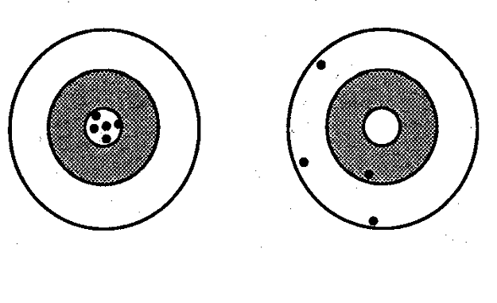
Validity and Precision of an Inference:
Each Shot at Target Represents the ‘Inference’ from a Study Sample of the Same Sample Size of a Given Study Design
Center of target = truth
Good Validity
Good Precision
Poor Validity
Poor Precision
Notes:
Let us graphically illustrate these concepts of validity and precision of an inference. These figures should be familiar to you from the Hulley et al. textbook used in the Summer Designing Clinical Research Course. They graphically show the difference between validity and precision. Consider that at the center of the target is the truth and that each shot at the target represents the inference from a study you conduct -- a sample of subjects whom you select -- to find the right answer. Here we show five different studies (samples) of the same sample size of the same study design, i.e., 5 different samples of the source population. Of course, what you want is this - good validity and good precision. We say that this is good validity because the average or tendency of the different attempts (different samples) gives you an answer that is right on the truth. We say that this is good precision because the differences between the individual samples is very close; there is very little random error.
Contrast this situation to the target on the right where the average of the different studies would be somewhere around here (point) which is far off from the center of the target – this is poor validity. Each of the different estimates is also pretty far away from each other – this is poor precision.

Slide 16
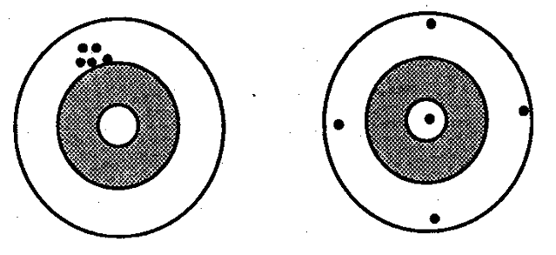
Validity and Precision of an Inference
Poor Validity
Good Precision
Notes:
How about here? We have good precision, the different shots are tightly bunched, but their average is far away from the center of the target – this is poor validity.

Slide 17
Validity and Precision of an Inference
Validity? Precision?
Good validity; Good precision - A
Good validity; Poor precision - B
Poor validity; Good Precision - C
Poor validity; Poor precision - D
Notes:
17
Here is perhaps a harder example. How about this scenario?

Slide 18
Validity and Precision of an Inference
Validity? Precision?
Good validity; Poor precision - B
Good validity; Good precision - A
Poor validity; Good Precision - C
Poor validity; Poor precision - D
Notes:
18
Precision is not very good. Validity, however, is good in that the average of the different attempts is right on the center. There is nothing systematically wrong with the inferences of these studies.

Slide 19
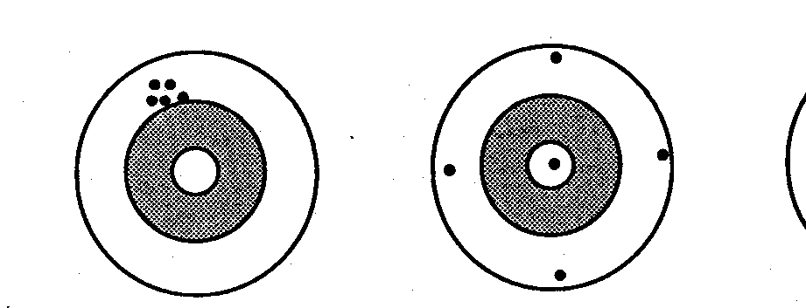
Validity and Precision
Random error (chance)
Random error (chance)
No
Systematic error
Systematic error (bias)
Poor Validity
Good Precision
Good Validity
Poor Precision
Notes:
Just to make sure everyone understands this, the difference between the average of different attempts (which is shown in the red dot) and the truth (at the center of the target) is the measure of validity; it is known as the systematic error or bias. The difference we see between any two of the different estimates is random error. In the panel on the right, there is no systematic error. In other words, there is no systematic process that is leading to a systematic deviation from the truth.

Slide 20
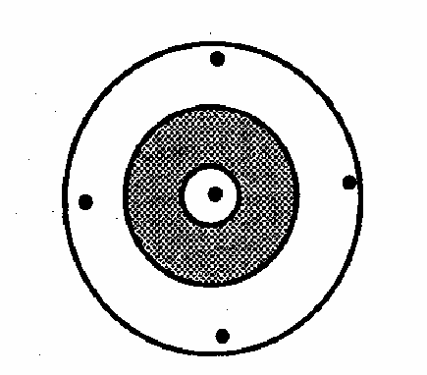
So Far, Just Theory. When Performing an Actual Study:
You Only Have One Shot
Only judgment can tell you about systematic error (validity)
Field of “statistics” can tell you the random error (precision) with formulae for confidence intervals
Judgment requires subject matter and methodologic knowledge
(i.e., you)
Notes:
The past several slides represented theory; in other words, we talked about would happen if you had many attempts at performing a study. In reality, when you perform a study you have just have one shot, as shown here in red, and you don’t know where the center of the target is. The field of statistics remarkably can tell you the random error of your one shot, with definite formulae for confidence intervals, but it cannot tell you anything about how close you are to the center. It is really only your judgment and the judgment of other scientists who review your work that can help you guess about systematic error. It is really only the person who has both subject matter knowledge of the clinical, biological, or behavioral problem as well as methodological knowledge of clinical and epidemiologic research who can make the best guess about systematic error.
The person who has the joint requisite knowledge in both subject matter and methodologic realms is you.

Slide 21
? EXTERNAL VALIDITY (generalizability; transportability)
OTHER POPULATIONS
Inference
Disease
+ -
+
-
Inference
? INTERNAL VALIDITY
Exposure
REFERENCE/
TARGET/
SOURCE POPULATION
Two Types of Inferences
Correspond to Two Types of Validity
STUDY SAMPLE
Notes:
Remember, earlier we talked about two kinds of inferences, the first is making an inference from the study sample to the source population and the second is from the study sample to other external populations. Accordingly, there are two flavors of validity: internal and external. Here is what internal and external validity look like schematically. Internal validity is a measure of how accurately our study sample represents our source population. But remember there are usually many other populations outside of the target population that we are interested in. For example, if our study predominantly looked at 20 to 65 years old in California, we would naturally also want to know if the results also pertained to older persons living in other parts of the US or elsewhere. External validity, also called generalizability, is what this is called. A relatively new term, transportability, is also used in this regard. Transportability refers to an emerging set of formal processes to determine how to transport the results from a study to an external population.

Slide 22
Two Types of Inferences
Correspond to Two Types of Validity
1. Internal validity
  Do the results obtained from the actual study participants accurately represent the target/reference/source population?
  Epidemiologic theory guides assessment
2. External validity (generalizability; transportability)
  Do the results obtained from the actual study participants pertain to persons outside of the source population?
  Internal validity is a prerequisite for external validity
  Assessment traditionally more vague; cutting edge of new methods
“Validity” typically means internal validity
  “Threat to validity” = threat to internal validity
  Identifying threats to validity is a critical aspect of research
Notes:
Once again, the two types of inferences correspond to two types of validity.
Stated another way, internal validity asks the question “do the results obtained from the actual study participants accurately represent the source population?” It is the various threats to this type of validity that we will discuss over the rest of the course, starting today with selection bias. We can use epidemiologic theory to guide this assessment, and we are going to learn this theory in the rest of the course. This is the inference to concentrate on first.
External validity -- also called generalizability or transportability -- asks the question “do the results obtained from the actual study subjects pertain to persons outside of the source population”? As you can imagine, internal validity is a prerequisite to external validity. Whether or not your inferences generalize to another external population and how they might be modified is has traditionally been a much more vague and speculative process. Up until recently, making this assessment was often just a guess and it still is for most researchers, although this is an area of active methodologic development. Formalizing the assessment of how the results from the study sample will play out in an external population is known as the process of transportability. We will not cover this process in this course, although aspects of effect modification (to be covered later in the course) are important in the process. Judea Pearl at UCLA is one of the leaders in this area.
Although there are two flavors of validity, when we (and most others) say threats to validity, we are usually talking about threats to internal validity. Thus, when we say “threat to validity” in this course, we mean threat to internal validity. A big part of research is looking for threats to validity. As researchers, we are in constant surveillance for threats to validity.

Slide 23

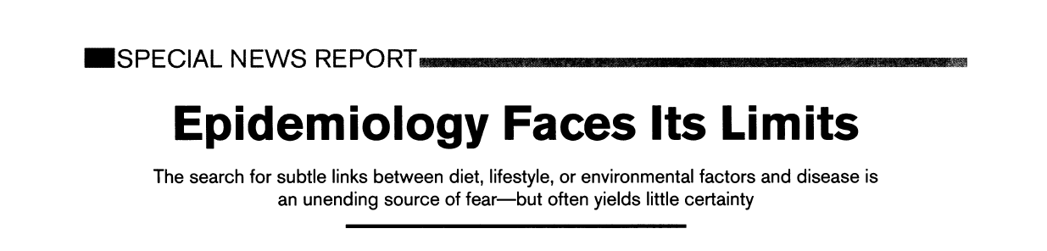

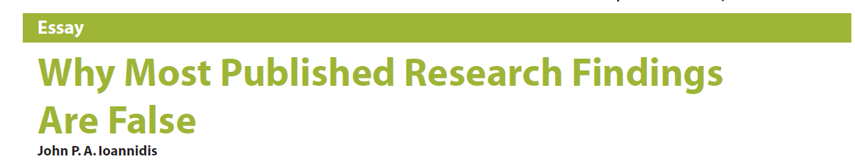
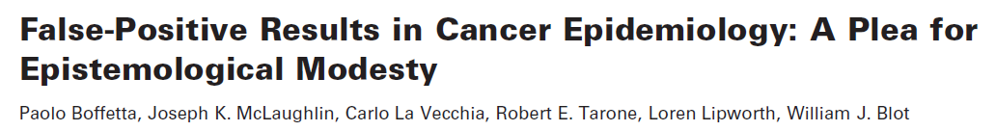
Why Do We Need Internally Valid Studies?
Notes:
This need for validity is not just an academic issue but instead a very practical one because clinical and epidemiologic research is under attack for its veracity by fellow researchers and scientific writers. These articles are some of the most prominent examples.

Slide 24
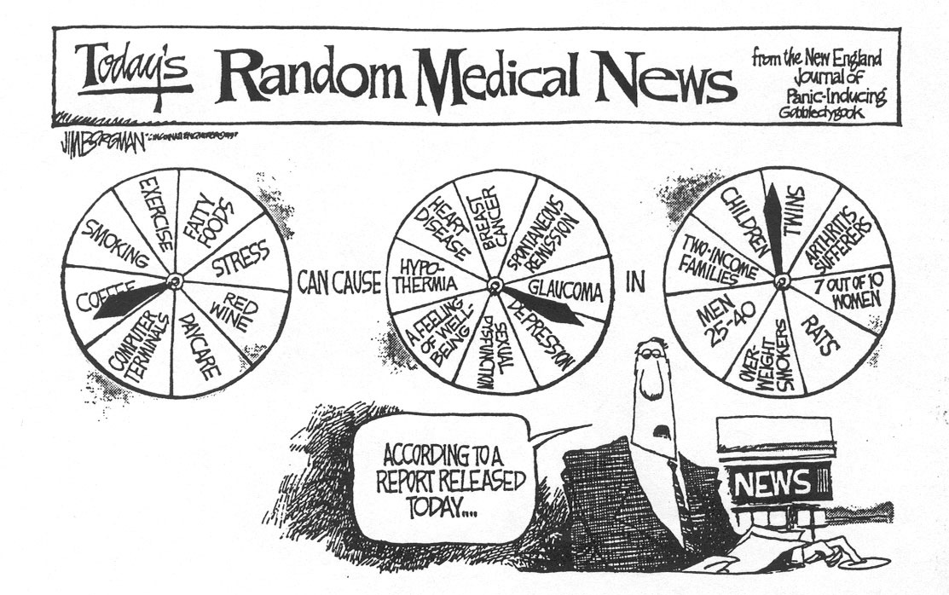
Why Do We Need Internally Valid Studies?
Notes:
This is not limited to academic discourse but instead extends to the general public as exemplified in this cartoon. Here we have a news broadcaster with three pinwheels -- one for exposure, one for outcome, and one for population -- and the broadcaster is randomly spinning these wheels.
Obviously, this cartoon reflects how at least some portion of the public feels about what we do in clinical and epidemiologic research. Having a given exposure cause a given disease one day but not the next causes the public to lose faith in our work. Since it is the public by in large who funds our work, it is incumbent upon us to be very careful.

Slide 25
Error in Clinical Research: Our Focus on Bias
The goal of any study is make an accurate (true) inference, i.e.:
  measure of disease occurrence in a descriptive study
  measure of association between exposure and disease in an analytic study
Ways of getting the wrong answer:
  Our focus: systematic error = threats to validity = bias
    any systematic process in nature or in the conduct of a study that causes a distortion from the truth in a predictable direction
    captured in the validity of the inference
  random error; aka chance or sampling error
    occurs because we cannot study everyone (we must sample)
    direction is random and not predictable
    captured in the precision of the inference (e.g., SE and CI)
Notes:
Among systematic error (or bias) and random error (chance), as I mentioned, we are going to focus on systematic error in this course leaving discussion of chance to the statisticians. Remember, there are 3 terms meaning the same thing. Systematic error = threat to validity = bias. Typically, we are going to use the shorthand word bias when we are referring to systematic error because this is what you will most typically see elsewhere.

Slide 26

MetLife Is Settling Bias Lawsuit
BUSINESS/FINANCIAL DESK
MetLife said yesterday that it had reached a preliminary settlement of a class-action lawsuit accusing it of charging blacks more than whites for life insurance from 1901 to 1972.
MetLife, based in New York, did not say how much the settlement was worth but said it should be covered by the $250 million, before tax, that it set aside for the case in February.
We don’t mean prejudice
Notes:
When we say bias in clinical and epidemiologic research, what do we mean? We don’t mean the popular use of the word bias, as shown here in the New York Times “MetLife is Settling Bias Lawsuit”, where bias is referring to some sort of prejudice. This is not what we mean.

Slide 27
“Bias” in Webster’s Dictionary
1 : a line diagonal to the grain of a fabric; especially : a line at a 45° angle to the selvage often utilized in the cutting of garments for smoother fit
2 a : a peculiarity in the shape of a bowl that causes it to swerve when rolled on the green b : the tendency of a bowl to swerve; also : the impulse causing this tendency c : the swerve of the bowl
3 a : bent or tendency b : an inclination of temperament or outlook; especially : a personal and sometimes unreasoned judgment : prejudice
c : an instance of such prejudice
d (1) : deviation of the expected value of a statistical estimate from the quantity it estimates
(2) : systematic error introduced into sampling or testing
4 a : a voltage applied to a device (as a transistor control electrode) to establish a reference level for operation b : a high-frequency voltage combined with an audio signal to reduce distortion in tape recording
Notes:
Indeed, if we refer back to Webster’s, we find many definitions for the word bias and if we look hard enough we can find the scientific definition we are looking for . . . A systematic error introduced into sampling or testing.

Slide 28
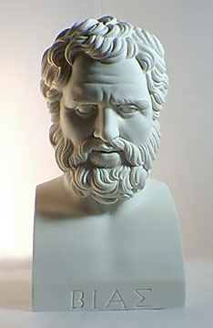
Bias of Priene (600 - 540 BC)
One of the 7 sages of classical antiquity
Consulted by Croesus, King of Lydia, about the best way to deploy warships against the Ionians
Bias wished to avoid bloodshed, so he misled Croesus, falsely advising him that the Ionians were buying horses
Bias later confessed to Croesus that he had lied.
Croesus was pleased with the way that he had been deceived by Bias and made peace with the Ionians.
Bias = deviation from truth
BMJ 324:1071, 2002
Notes:
So, indeed the definition we are looking for is in the dictionary, but nonetheless it is a peculiar word, and I’ve always been interested in its origins. It appears to come from the scholar Bias, of the region called Priene (which today is in Turkey), who was one of the 7 sages of classical antiquity. Legend has it that Bias was once consulted by King Croesus (KREE sus) about the best way to deploy warships against the Ionians. Because Bias wanted to avoid a war, he falsely advised the king that the Ionians were planning to use horses. Bias later confessed to the King that he had lied, but the King was so pleased about his motives that he made peace with the Ionians. Subsequently, a deviation from truth became known as bias.

Slide 29
In the language of bias
Unbiased
Precise
Biased
Imprecise
Notes:
Here are the same target diagrams from before, but now we use the language of “bias”.

Slide 30
Unbiased
Imprecise
Biased
Precise
Notes:
30

Slide 31
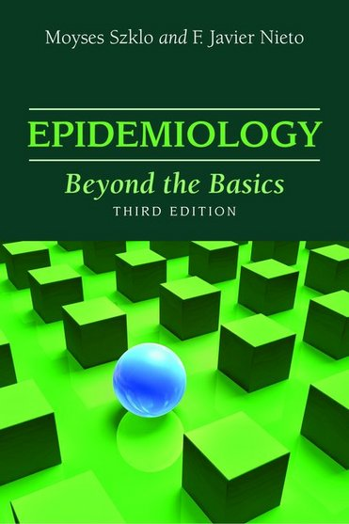
One More Big Picture Framework Item:
Classification Schemes for Bias
Common Approach (which we will use)
  Bias (Systematic error)
    Selection Bias
    Measurement/Information Bias
    Confounding Bias
  Chance (Random error)
Szklo and Nieto
  Bias (Systematic error)
    Selection Bias
    Measurement/Information Bias
  Confounding
  Chance (Random error)
Think of the “BIG 4” in all of your work
Notes:
Before we go on, there is one more big picture framework items to describe, and this is the major classification schemes for bias.
In what is probably the most common approach, bias is split into 3 types: selection bias, measurement/information bias, and confounding bias. We are discussing selection bias today, measurement bias for the next 2 weeks, and then confounding for the 3 weeks after that. These three can be distinguished by their causes (or origins), consequences, and solutions (aka cures or fixes). There is, however, not absolute clarity about the distinctions between these three by different investigators, normative bodies, and textbooks. This ambiguity is explained well in Schwartz et al. Towards clarification in the taxonomy of bias…Epidemiology 26:216, 2015. In practice, it is not critical that all of these are reproducibly named. Instead, it is important that they are recognized and acted upon.
Systematic error is in distinction to random error or chance. Every time you think about your own work or read someone else’s work, you should run down this list and ask yourself: is there selection bias present, measurement bias present, or confounding present and what is the role of chance? If you can remember these four things, you should be able to cover all of the bases. These are what we call the BIG 4. Think of the BIG 4 in all of your work.
We should point out, however, that our textbook, by Szklo and Nieto, considers selection bias and measurement/information bias to be the major forms of bias and considers confounding to be a separate process. We actually do not agree with this approach, but in any case, it is semantics, and we simply want to point this out to you to avoid confusion.

Slide 32
Bias in Clinical/Epidemiologic Research:
General Aspects and Focus on Selection Bias
Framework for understanding error in clinical research
  systematic error, aka threats to internal validity, or bias
  random error, aka sampling error, or chance
Selection bias (a type of systematic error)
  according to study objective: descriptive or analytic
  mechanisms by study design:
    cross-sectional
    case-control
    longitudinal studies (cohort: observational or experimental)
Notes:
Getting back to our roadmap for today. Now that we have discussed a general framework for bias, we will spend the rest of the session on selection bias. In particular, we will describe how selection bias may occur. We will discuss selection bias according to the research objective, meaning descriptive or analytic, and also by study design

Slide 33
Selection Bias
Definition: When study sample is systematically not representative of source population
In a Descriptive Study
  Bias caused when persons in source population have different (unequal) probabilities of being selected for/retained in study sample
  Occurs when the participants/follow-up in the study sample are not representative of the persons/follow-up in the source population
In an Analytic Study (Where most of the attention goes)
  Bias caused when persons in source population have different (unequal) probabilities of being selected for/retained in study sample
    And these differing (unequal) probabilities are influenced by (or associated with) both exposure and outcome of interest
  Occurs when participants in study sample have different relationship between exposure & outcome than persons in source population
Notes:
So, with that introduction, let’s move on to discussing selection bias, which is defined as what happens when the study sample is not representative of the source population. We will return again and again to this basic definition.
The more nuanced definition of selection bias depends upon whether you are referring to a descriptive or analytic study. In a descriptive study, selection bias is the bias that is caused when persons in the source population have different (unequal) probabilities of being selected for initially or, subsequently, retained in the study sample. In other words, this bias occurs because the subjects or their follow-up that we observe in the study sample are NOT representative of the persons/follow-up in the source population. What I mean by not representative is in terms of the entity under study, be it of an exposure or an outcome.
In an analytic study – and I will say that this is where most of the attention rests for selection because it is considerably more complicated than descriptive studies – the definition is that selection bias is the bias that is caused when persons in the source population have different (unequal) probabilities of being selected for/retained in the study sample. The critical aspect of these different probabilities of being selected for study inclusion are influenced by both the person’s exposure and outcome of interest. By influence, we mean either that selection is caused by the exposure and outcome or caused by something that also influences exposure and outcome (and thus exposure and outcome are associated with being selected for the study). Selection bias occurs when people in the source population don’t all have the same chance of landing in the study sample. It occurs when the people who do land in the study sample have a different relationship between exposure and outcome than the source population.
Hence, the overarching issue in selection bias is that it occurs when we are not able to get a study sample that is representative of our source population. It is important to point out that the reason for a non-representative sample is not chance; it is some systematic problem.

Slide 34
Selection Bias
What can cause the study sample to not be representative of the source population?
Answer: any systematic problem in the process of selecting persons initially or — in a longitudinal study — in the process that determines which persons fall out of observation
  Problems caused by:
    Investigators: Faulty study design processes
    Human behavior: People, by choosing not to participate/ending participation
    Normal life: Competing events
    (or all of the above)
Unique to human subjects research
Notes:
If selection bias is the result of the study sample not being representative of the source population, how might this happen? In other words, what are the problems that cause selection bias? What are the mechanisms?
The answer is any systematic problem in the process of selecting persons initially or – in a longitudinal study – in the process of that determines which persons fall out of observation. We can classify the problems into 3 categories. First, are those problems caused by the investigators via faulty study design processes. The second stems from human behavior of the participants (or rather, sometimes, the non-participants), by the act of refusing to participate in the first place or declining to continue to participate. As soon as we have some people who should be participating but choose not to, you have the potential for selection bias. Interestingly, this problem is unique to human subjects research. The drosophila or mice researchers don’t have this problem. Our field is not called human subjects research for nothing; humans will be humans and when they are, it causes problems for research. The third issue is just that normal life often gets in the way of science in the form of competing events. Or, you might have all of these 3 operating at the same time.

Slide 35
Bias in Clinical Research:
General Aspects and Focus on Selection Bias
Framework for understanding error in clinical research
  systematic error, aka threats to internal validity, or bias
  random error, aka sampling error, or chance
Selection bias (a type of systematic error)
  according to study objective: descriptive or analytic
  mechanisms by study design:
    cross-sectional
    case-control
    longitudinal studies (cohort: observational or experimental)
Notes:
Let’s now talk about selection bias in the different major study designs we have discussed in the course to date.

Slide 36
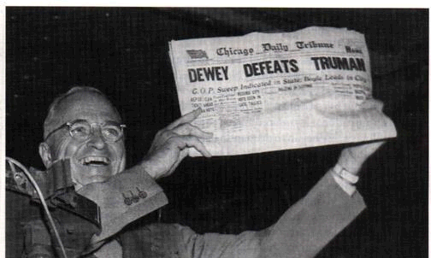
Selection Bias in a Descriptive Study
Fulminant example: Surveys for 1948 President election
  various cross-sectional studies used to find participants
  most favored Thomas Dewey
Election results
  Harry Truman beat Dewey
Explanation: Bad Study Design
Although from social science, ushered in realization of the importance of representative (random) sampling in all fields
Notes:
We will talk first about a descriptive study, and although this is outside of our biomedical realm, one of the most fulminant examples of selection bias in a descriptive study occurred in the pre-election surveys for the 1948 Presidential election in the U.S. The pre-election surveys used various cross-sectional survey methods to find subjects and most of these surveys found that the largest % of persons favored Dewey. Even newspaper were printing headlines stating that Dewey had won (shown in the picture is Truman holding up such a newspaper; he was later vindicated). However, as those of you from the US know, the truth was seen in the general election results where Truman beat Dewey. What was the problem here? Who was at fault? In retrospect, these polls used bad study designs of non-representative samples, including allowing pollsters simply to survey the easiest people to find. Although this was in the field of social science, the errors made in the pre-election polls really turned the entire science of sampling on its head and ushered in an era where we live today where we recognize the importance of representative (or random) sampling in all fields.

Slide 37
Sample
Actual vote
(N = 894)
(N = 8,526,096)
Pre-Election Poll (Survey)
Should Gov. Davis be recalled?
Yes 4,717,006 (55%)
No 3,809,090 (45%)
Election polls provide opportunity to later look at truth and evaluate bias in poll study design
Luxury rarely occurs in clinical/epidemiologic research
Survey conducted 1 week prior to election among random sample of voters in Oct. 7 recall election
Notes:
Are we still making this kind of mistake? In the California governor recall election several years ago, this is what the pre-election poll/survey showed. This was a poll in the San Francisco Chronicle, a local newspaper, about a week before the recall election, showing that in a sample of 894 persons, 57% favored recalling the governor. A week later the election was held and now we can tell how good our sample was: Indeed the sample was very close – with just 894 subjects – to what was found in the general election of nearly 8.5 million persons. The sample estimate was very close, within sampling error, of the 55% who later voted yes in the actual election.
Why are these election polls such a great way to learn about sampling and descriptive estimates in cross-sectional study designs? Because they are one of the few situations where we actually get to learn the truth about the source population, on election day, and can thus get a handle on whether there was bias in the survey. Unfortunately, we don’t get this luxury in clinical/epidemiologic research.

Slide 38
Descriptive Study:
“Box and Sticks” Depiction of No Selection Bias (Unbiased Sampling)
Arrow/stick is the probability of someone in study population participating in study sample
Equal weighting of arrows = Equal selection probabilities
SOURCE POPULATION
STUDY SAMPLE
Notes:
Here is a schematic representation, with boxes and sticks (or arrows), that depicts what we hope to do when sampling in a descriptive study in terms of having no selection bias. On the left, we depict the reference or target or source population (remember this from the previous slide about validity) and on the right is our study sample. Our goal is to have the study sample validly represent the source population which we are showing here by an equal weighting of arrows stemming from the source population to the study sample.

Slide 39
Descriptive Study:
Depiction of Selection Bias (Biased Sampling)
Unequal weighting of arrows = Unequal selection probabilities
SOURCE POPULATION
e.g., Dewey backers were over-represented
See Extra Slides for Biomedical Example
STUDY SAMPLE
Notes:
This is what selection bias looks like in a descriptive study. Here we see that the study sample has an over-representation of this portion of the source population (in the upper right portion of the box) as you can see depicted by the unequal weighting of arrows. This is what happened in the 1948 U.S. pre-election survey. Those persons who favored Dewey were over-represented in the study sample, the pre-election polls.

Slide 40
Longitudinal descriptive study
Geng et al. JAMA 2008
Mortality following initiation of antiretroviral therapy in Uganda
In the presence of 39% loss to follow-up (drop out) at 3 years (n ~ 800 lost)
Notes:
Here is another example from a study with a descriptive objective; this time, it is a longitudinal study and in the biomedical arena. This study evaluated mortality after initiation of antiretroviral therapy in Uganda by our colleague, Elvin Geng. Elvin had to contend with substantial losses to follow-up, 39% at three years after starting therapy. This amounted to over 800 lost patients. In his initial estimate, Elvin did what most people would do. He censored observation at the time of drop out. Doing so, he made the assumption that the losses to follow-up were non-informative, in other words, that the losses had the same incidence of mortality as those who stayed. After all, if you don’t know what happened to these patients, you don’t have many options.

Slide 41
Mortality following initiation of
antiretroviral therapy in Uganda
In the presence of 39% loss to follow-up (drop out) at 3 yrs
What else to do at this point?
Assume all lost are dead - A
Match losses to nat’l death index - B
Consult a biostatistician - C
Hopeless; choose another project - D
Some other idea - E
Notes:
41
What would you do at this point?

Slide 42
Mortality following initiation of
antiretroviral therapy in Uganda
In the presence of 39% loss to follow-up at 3 yrs
What else to do at this point?
Some other idea - E
Assume all lost are dead - A
Match losses to nat’l death index - B
Consult a biostatistician - C
Hopeless; choose another project - D
Notes:
42
Answer: Some other idea. In this case, the other idea was to sample the drop outs and try very hard to find out what happened to them.
Assuming all of the lost are dead would be a form of sensitivity analysis, but with 39% lost this is really going to be a wildly high estimate. It is just not realistic to believe that they are all dead.
It is a nice thought to consider matching these subjects to some external data source, like a national death index, but there is not a national death registry in Uganda. This is the case in many countries.
A biostatistician is not going to get you out of this mess. There is no magic that they can do with just the data at hand.
You might indeed consider that this is a hopeless situation, for which no estimate of mortality should be attempted, but it turns out that there was a feasible solution.

Slide 43
Mortality following initiation of antiretroviral therapy in Uganda
Accounting for losses to follow-up by tracking down vital status of a sample of the lost in the community
Sample-Corrected estimate
Selection bias
(5-fold change)
Naive estimate
Notes:
Answer: track down a random sample of the lost and determine their vital status. Elvin looked high and low in the community for these patients to determine if they were dead or alive. In this case, a 15% sample of the lost was looked for, and for about 85% of them, an updated vital status was document. When Elvin did this and incorporated the new outcomes he found into the analysis, the new estimate of mortality, which is called the corrected estimate, was considerably higher than the original estimate, five-fold higher. The difference between the original, or naïve, estimate, which we know is wrong, and the corrected estimate is selection bias. We rarely get this direct measure of selection bias in clinical and epidemiologic research.

Slide 44
Selection Bias (It is not just selection)
Definition: When study sample not representative of source population
In a Descriptive Study
  Bias caused when persons in source population have different (unequal) probabilities of being selected for/retained in study sample
  Occurs when the participants/follow-up in the study sample are not representative of the persons/follow-up in the source population
In an Analytic Study (Where most of the attention goes)
  Bias caused when persons in source population have different (unequal) probabilities of being selected for/retained in study sample
    And these differing (unequal) probabilities are influenced by (or associated with) both exposure and outcome of interest
  Occurs when subjects in study sample have different relationship between exposure & outcome than persons in source population
Notes:
This example takes us back and reminds us of the basic definition of selection bias in a descriptive study. Selection bias is not just about who gets selected for a study. It also about who gets retained and is available for analysis. When the participants who are left during follow-up in study sample ARE NOT representative of the source population’s follow-up, selection bias will ensue.

Slide 45
Descriptive Study:
Depiction of Selection Bias (Biased Sampling)
Unequal weighting of arrows = Unequal selection probabilities
e.g., patients who had died in follow-up became under-represented in study sample
SOURCE POPULATION
Informative censoring leads to selection bias
STUDY SAMPLE
Notes:
This is what the Uganda example looks like in a box and stick diagram. Some patients who had died during follow-up became underrepresented in the study sample towards the end. Earlier, we referred to this as informative censoring. Now, we can see how it leads to selection bias.

Slide 46
Analytic Study:
Depiction of No Selection Bias (Unbiased Sampling)
Disease
+ -
Given that a person resides in one of the 4 cells in the source population, the selection probability is the probability he/she will be represented in that cell in the study sample.
+
-
Exposure
SOURCE POPULATION
Equal weighted arrows = Equal selection probability = No selection bias
STUDY SAMPLE
Notes:
Let’s move on to analytic studies, where we are looking for the association between exposures (or interventions in the case of experimental studies) and diseases. We depict an analytic study by the presence of a 2 x 2 table with exposure (present or absent) along the rows and disease (present or absent) over the columns. This is what the schematic looks like in the presence of unbiased sampling and no selection bias. These arrows represent the selection probability, which is the percentage of persons in one of the cells in the source population that is found in the study sample. Here, the arrows all have the same weight, and therefore there is an equal probability of being selected into the study no matter which of the 4 cells you are in in the source population. In this situation, no selection bias can ensue.

Slide 47
Analytic Study:
Depiction of No Selection Bias (Unbiased Sampling)
Disease
+ -
PR = (40,000/50,000)/(10,000/50,000) = 4
+
-
40000
10000
Equal selection probability in all 4 cells:
No Selection Bias
Exposure
1%
10000
40000
1%
SOURCE POPULATION
1%
1%
400
100
PR = (400/500)/ (100/500) = 4
For selection bias to occur, selection probabilities must differ according/related to both exposure and disease
100
400
STUDY SAMPLE
Notes:
Here is a numeric example from a cross-sectional study. Let’s say we have 40,000 persons in the source population who are exposed and diseased, 10,000 exposed and non diseased, 10,000 unexposed and diseased, and 40,000 unexposed and non-diseased. This equates to a prevalence ratio in the source population of 4.0.
Now, let’s conduct our actual study and obtain our study sample. Let’s say that the selection probability is 1%, and that it is equal in all cells. This results in this study sample. To no surprise, the prevalence ratio in the study sample is 4.0.
So, the rule is: If there is an equal probability of being selected no matter which of the 4 cells you live in, no selection bias can result. Formally, the weight of the arrows is equal to the selection probability for each of the cells, which is sometimes called the sampling fraction.
Stated another way, for selection bias to occur, selection probabilities must differ according to (i.e. related to) both exposure and disease.

Slide 48
Analytic Study:
Depiction of Selection Bias (Biased Sampling)
Disease
+ -
PR = (40,000/50,000)/(10,000/50,000) = 4
+
-
40000
10000
0.6%*
Unequal selection probability isolated to one cell:
Underestimate of Exposure Effect
Exposure
1%
10000
40000
1%
0.5%
0.6%
1%
PR = (200/300)/ (100/500) = 3.3
SOURCE POPULATION
1%
1%
200
300
100
For selection bias to occur, selection probabilities must differ according/related to both exposure and disease
500
100
400
500
300
*300/50000 = 0.6%
STUDY SAMPLE
Notes:
What if the selection probabilties are not equal? Here is the schematic of what selection bias might look like in an analytic study. I like these box and stick diagrams because they help me keep straight what is going on and help me predict the direction of the bias. Here we depict with a lighter shaded arrow that those persons who are exposed and diseased are undersampled relative to the other 3 cells.
Numerically, let’s say that 3 of the cells have a selection probability of 1% but that the exposed and diseased cell has a selection probability of 0.5%. What would you predict would be the manifestation or direction of this bias? Any process that artificially lowers the number of persons in this cell will underestimate the effect of any association between the presence of the exposure and the disease. It might even serve to indicate that an exposure is spuriously protective.
Here the prevalence ratio is biased downward at 3.3.
So, the unequal selection probability is not just affecting exposed persons or diseased persons. It is affecting exposed and diseased persons. This depiction illustrates how for selection bias to occur, selection probabilities must differ according to both exposure AND disease. In other words, the selection probabilities must be related to both exposure and outcome. We can see this better by looking at the margins. We first see, in red, that being exposed has an overall selection probability of 0.6%. We get this by 300 divided by 50,000. Likewise, in green, we see that disease is associated with selection probability. When both exposure and disease are affecting selection probabilities, selection bias will ensue.

Slide 49
Analytic Study:
Depiction of Selection Bias (Biased Sampling)
Disease
+ -
Unequal selection probability:
Overestimate of Effect
+
-
Exposure
SOURCE POPULATION
For selection bias to occur, selection probabilities must differ according/related to both exposure and disease
STUDY SAMPLE
Notes:
What if we have this situation where exposed and diseased persons, this cell in the upper left hand corner, has a higher probability of being in the study sample. Well, if exposed and diseased are overrepresented relative to the other cells, then, to no surprise, this will result in an overestimate of effect of the exposure.
Again, selection is related to exposure (exposed persons have a higher selection probability than unexposed) and also to outcome (diseased persons have a higher selection probability than non-diseased). When this happens, selection bias ensues.

Slide 50
Analytic Study:
Depiction of Selection Bias (Biased Sampling)
Disease
+ -
Unequal selection probability:
Overestimate of Effect
+
-
Exposure
SOURCE POPULATION
For selection bias to occur, selection probabilities must differ according/related to both exposure and disease
Artificial excess of unexposed/non-diseased gives false impression of higher effect of exposure
STUDY SAMPLE
Notes:
Here, unexposed/non-diseased are overrepresented. This results in an overestimate of the effect of the exposure. A way to think about this is that in the unexposed group (the reference group), it spuriously appears that most persons are non-diseased. The more this occurs, the more that any exposed/diseased stands out as being different and hence the effect of exposure is overestimated.

Slide 51
Analytic Study:
Depiction of Selection Bias (Biased Sampling)
Disease
+ -
Unequal selection probability:
Underestimate of Effect
+
-
Exposure
SOURCE POPULATION
For selection bias to occur, selection probabilities must differ according/related to both exposure and disease
STUDY SAMPLE
Notes:
How about here where the exposed but non-diseased are overrepresented? Too many exposed and non-diseased would appear to indicate that exposure does not cause disease and hence there is underestimation of the effect of the exposure.

Slide 52
Analytic Study:
Depiction of Selection Bias (Biased Sampling)
Disease
+ -
Unequal selection probability:
Underestimate of Effect
+
-
Exposure
SOURCE POPULATION
For selection bias to occur, selection probabilities must differ according/related to both exposure and disease
STUDY SAMPLE
Notes:
Completing the loop. How about here where the unexposed but diseased are overrepresented? Too many unexposed and diseased would appear to indicate that exposure does not cause disease and hence there is underestimation of the effect of the exposure.

Slide 53
Analytic Study:
Depiction of No Selection Bias (Unbiased Sampling)
Disease
+ -
Unequal selection probability but only according to exposure:
No Selection Bias
+
-
Exposure
SOURCE POPULATION
For selection bias to occur, selection probabilities must differ according/related to both exposure and disease
STUDY SAMPLE
Notes:
How about here? These two cells are underrepresented relative to these two, but is this is a problem for our analytic objective? No, it just means you enrolled fewer exposed persons but this had nothing to do with disease status. This is unequal selection according just to exposure only, not to disease. Remember, the rule is that for selection bias to occur, selection probabilities must differ according to both exposure and disease. So, no selection bias ensues.

Slide 54
Analytic Study:
Depiction of No Selection Bias (Unbiased Sampling)
Disease
+ -
PR = (40,000/50,000)/(10,000/50,000) = 4
+
-
40000
10000
Unequal selection probability but only according to exposure:
No Selection Bias
Exposure
0.1%
10000
40000
0.1%
SOURCE POPULATION
1%
1%
40
10
PR = (40/50)/ (100/500) = 4
For selection bias to occur, selection probabilities must differ according to both exposure and disease
100
400
STUDY SAMPLE
Notes:
Here is a numeric example. Let’s say that both exposed diseased and exposed non-diseased are sampled with a 0.1% selection probability. If we work through the math, the prevalence ratio is unchanged at 4.
For selection bias to occur, selection probabilities must differ according to both exposure and disease.

Slide 55
Analytic Study:
Depiction of No Selection Bias (Unbiased Sampling)
Disease
+ -
Unequal selection probability but only according to disease:
No Selection Bias
+
-
Exposure
What type of study design is this?
SOURCE POPULATION
For selection bias to occur, selection probabilities must differ according to both exposure and disease
STUDY SAMPLE
Notes:
How about here? Same thing. Unequal selection only according to disease but not according to exposure. The non-diseased have a lower selection probability than the diseased. Therefore, no selection bias ensues.
This selection pattern depicts a familiar study design. It is a case-control study. We know this because the non-diseased have a much lower selection probability than the diseased.

Slide 56
Typically, in practice, you don’t know all of the selection probabilities
You usually select study sample without firm enumeration of source population
Usually, best we can do regarding evaluation of presence of selection bias is make educated guesses based upon context
Disease
+ -
+
-
Exposure
?
?
SOURCE POPULATION
?
?
STUDY SAMPLE
Notes:
Of course, as most of you have recognized, the problem is that unless you have enumerated the entire underlying source population, then you don’t know the selection probabilities in the various 4 cells of your study sample. And, if you had enumerated the entire underlying source population, there would be no reason to do the study. You would just analyze the source population.
We depict our lack of knowledge about the selection probabilities here by placing question marks by the arrows. We don’t, in practice, know their intensity or weight. We don’t, in practice, know the selection probabilities. The best we can do – if anything -- is make educated guesses based upon the context if the selection probabilities are equal or unequal.

Slide 57
Guesses are informed by remembering basic rules for selection bias
For selection bias to occur: A person’s selection/retention must be influenced by/associated with BOTH his/her exposure and outcome
Selection/retention
Exposure
Disease
Other factors
Other factors
Selection/ retention
Selection/ retention
Exposure
Disease
Exposure
Disease
Other factors
Other factors
Selection/retention
Exposure
Disease
Notes:
These guesses can be made keeping the requirements for selection bias in mind and how the study sample was identified. To summarize, for selection bias to occur we need to see that people’s selection into a study or retention in the study must be influenced by (or associated with) both his/her exposure and outcomes.
This top figure is the way to remember what is needed. It shows how both exposure status and disease status are directly influencing selection and/or retention.
Actually, exposure need not be directly responsible for selection. Exposure might just be associated with selection. And, disease status need not be directly associated but rather it can just be associated with selection. These are shown in the second row of figures.
Or, as shown in the bottom panel, both exposure and disease may only be associated with selection/retention; they are not directly responsible.
We are going to return to these diagrams, which we will call directed acyclic graphs, later in the course. They turn out to be very handy in understanding selection bias. You can also read about them in the optional reading for this week if you want to get started now.

Slide 58
Why does selection that is influenced by exposure and outcome induce bias?
Example
Study: relationship between family wealth & intelligence in young adults
Study sample: Undergraduates at Harvard
Widely rumored/appreciated that admission to Harvard is related to:
  Intelligence
  Family wealth
Participant | Family wealth | Intelligence
1 | Rich | Low
2 | Poor | High
3 | Rich | Low-medium
4 | Poor | Very high
Data not surprising because the more a participant has of one attribute that got him into the sample, the less he will need of the another
Or, if participant has none of one attribute, he/she must have a lot of the other
Data, in aggregate, will show family wealth and intelligence to be inversely related
This is not the case in target population (all young adults); this is selection bias
Notes:
Here is another way to understand why selection into a study sample in ways that are related with exposure and outcome can induce bias.
As an example, let’s say that we want to study the relationship between intelligence and family wealth in young.
And, let’s say that we are going to do this study among undergraduates at Harvard, a university where it is widely rumored/appreciated that admission is related to intelligence or family wealth.
Here are the data.
These data are not surprising because the more a subject has of one attribute that got him into the sample, the less he will need of the another. If you don’t believe that, you will certainly believe that if a subject has none of one attribute, he must have a lot of the other. Otherwise, he would not be at Harvard.
In the end, the data will show a relationship between intelligence and family wealth in the study sample. This will be an inverse or indirect relationship. We know, of course, that this not true in the true target population of all young adults. There likely is no inherent relationship between family wealth and native intelligence. If one does exist, it is not an inverse one. This wrong inference is the result/manifestation of selection bias.
(Note: These are fictitious data and are not meant to reflect on any particular university in any way.)

Slide 59
Bias in Clinical Research:
General Aspects and Focus on Selection Bias
Framework for understanding error in clinical research
  systematic error, aka threats to internal validity, or bias
  random error, aka sampling error, or chance
Selection bias (a type of systematic error)
  according to objective: descriptive or analytic
  mechanisms by study design:
    cross-sectional
    case-control
    longitudinal studies (cohort: observational or experimental)
Many of the examples that follow are unusual situations where investigators went the extra mile to illustrate selection bias
Notes:
Now that we understand the basics about selection bias, let’s discuss it specifically by analytic study design. To do this, most of the examples that follow are unusual situations where the investigators went the extra mile, in one shape or form, to illustrate selection bias.

Slide 60
Selection Bias in a Cross-sectional Study:
Presence of exposure and disease at study outset raises potential for selection bias
Disease
+ -
+
-
Exposure
?
?
SOURCE POPULATION
?
?
STUDY SAMPLE
Notes:
As we consider selection bias in cross-sectional studies, the one thing that should cross your mind immediately with cross-sectional studies is that the presence of exposure AND disease at the time you select subjects sets the stage for the potential for selection bias.

Slide 61
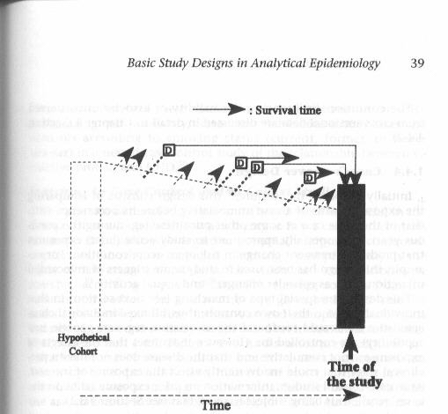
Mechanisms of Unequal Selection Probabilities in Cross-Sectional Studies
Assuming that the goal is to identify determinants of disease development (causal research)
CE
Unwise choice of a study sample as representative of target population.
  Study sample influenced by both exposure and outcome (e.g., Harvard study)
Non-participation amongst eligibles whom you have approached
  “Non-response” (eligible subjects in accessible population decline participation according to exposure & outcome)
Some people whom you would like to sample never become available to ask
  Drop out, competing events, and/or death from disease influenced by/associated with both exposure and disease
Notes:
That said, let’s think about the generic mechanisms that can lead to unequal selection probabilities in cross-sectional studies. Let’s do this by remembering our schematic which is that all cross-sectional studies are sampled from an underlying cohort. In this case, we have depicted a fixed cohort, but it could also be a dynamic one. Remember this figure from the text? With this in mind, and assuming that the goal is to identify determinants of disease development (etiologic/causal research and not survival after disease), what are the mechanisms of how unequal selection probabilities – which are related to exposure and disease -- might occur in cross-sectional studies?
There are really three basic mechanisms, and they can be inferred by looking at the figure. The first is making an unwise choice of a study sample. For example, if it was your goal to study the relationship between intelligence and family wealth, it would be an unwise choice by the investigators to choose a sample of Harvard students for the study for the reasons we explained earlier. The second mechanism is because of non-participation among those eligibles that you do actually have a chance to access. This is called “non-response” or “refusal”, which means that of the persons who are eligible to be in the study (i.e. they are alive and accessible at the time you conduct the study), some might refuse to participate. If they do so according to the exposure and outcome status, then unequal selection probabilities and selection bias ensue. This is depicted here in item 2.
The third mechanism comes from recalling that there is a lot going on in cross-sectional studies that influences if people are around at the time of your study. In other words, in the underlying cohort, some people may never become accessible to ask to see if they want to participate. This is because of drop out, a competing event, or death from the disease in question. If these mechanisms of following out of the available study population are influenced by/associated with both exposure and outcome, then selection bias will ensue.

Slide 62
Selection Bias in a Cross-sectional Study:
Effect of Non-Responders
History of Heart Attack
+ -
+
-
Hyper-lipidemia
?
?
SOURCE POPULATION
?
25
347
?
A seemingly good overall 83% Response
45
2312
Austin, AJE 1981
Survey of S. California adults
OR observed = 3.6
STUDY SAMPLE
Notes:
Are there any empiric examples of these mechanism? What we just listed are the theoretical mechanisms and typically we cannot be sure if they are occurring, unless investigators go the extra mile to investigate. In this example, a cross-sectional population-based study of cardiovascular disease in adults in Southern California, the researchers tracked down the participants who initially refused to participate. In one of the analyses, the authors were studying the association between hyperlipidemia (high levels of fat in the blood) and presence of cardiovascular disease, as evidenced by history of heart attack. In this 2 x2 table are the results using the participants who agreed to participate. Overall, 83% of approached subjects agreed to participate. You would typically think this is pretty good, but you actually don’t know the individual selection probabilities into the 4 cells.

Slide 63
Selection Bias in a Cross-sectional Study:
Effect of Non-Responders
History of Heart Attack
Investigators made the extra effort to track down and question the initial non-responders
+ -
+
-
30
401
Hyper-lipidemia
100%
100%
63
2807
100%
100%
CORRECTED
STUDY SAMPLE
SOURCE POPULATION
Response %
OR true = 3.3
Austin, AJE 1981
Survey of S. California adults
Notes:
As I mentioned, the authors went the extra mile and tracked down those subjects who initially declined to participate. This is similar to what Elvin did in his Ugandan work. They would not take no for an answer. Here is what they found when they added in the responses from the initial non-responders. The %’s in the cells are the percentages of subjects queried originally that participated. In these cells, we state that the percentages were 100%, because the authors got answers from everyone who was initially approached. Hence, this 2 x 2 therefore can be considered truth (assuming no other threats from selection bias, or measurement bias, or confounding). The odds ratio is 3.3.

Slide 64
Agreement to participate
Selection Bias in a Cross-sectional Study:
Effect of Non-Responders
Hyper-lipidemia
Hx of MI
History of Heart Attack
Investigators made the extra effort to track down and question the initial non-responders
+ -
+
-
30
401
Hyper-lipidemia
100%
100%
63
2807
100%
100%
CORRECTED
STUDY SAMPLE
SOURCE POPULATION
OR true = 3.3
25
347
83%
87%
Response %
Selection bias
45
2312
Austin, AJE 1981
Survey of S. California adults
72%
83%
OR biased = 3.6
STUDY SAMPLE
Notes:
Remember, this compares to an odds ratio of 3.6 that the authors derived solely from the subjects who responded. Now that we know the numbers of persons in the 4 cells in the source population, as seen in the table in the upper right, we can set them to 100%. We can then figure out the selection probabilities that led to the study sample. They are listed here. You can now see that they are not equal in the 4 cells and they do differ according to both exposure and disease. This cell (exposed/non-diseased) is slightly overrepresented but this cell (unexposed/diseased) is very underrepresented. The net result is that this is going to tend to overerestimate the association between hyperlipidemia and heart attack. The difference between 3.6 and 3.3, about 10%, is from selection bias.
It can also be shown that an odds ratio of the response probabilities represents the factor by which the observed odds ratio is biased in relation to the truth. In this case, (0.83)(0.83)/(0.87)(0.72) = 1.10. The true odds ratio, 3.3, time the response probability odds ratio, 1.1, is equal to the observed odds ratio of 3.6.
It is not easy to explain what human behavior or motivation would lead to this result. Sometimes, a “worried well” pattern occurs when persons with risk factors but not actual disease have the highest response percentages, but when this occurs there is an underestimate in the observed data between the risk factor and disease. A higher response probability in the worried well did occur here (87%), but this was overshadowed by a low response percentage among those with disease but no risk factor. The study’s authors were not able to explain this, which illustrates how the direction and magnitude of non-response is not easy to predict.

Slide 65
Effect of unequal response probabilities in a cross-sectional study
Group | Exposure | Outcome | Bias in OR due to non-response
Men | Family h/o MI | Heart failure | +63%
 | Hypertension | Stroke | -32%
Women | Family h/o stroke | Stroke | +59%
 | Family h/o diabetes | Stroke | -34%
Mechanism: Non-participation among some eligible and accessible subjects
(“Non-response bias”; Study design is fine)
Austin, AJE 1981
Survey of S. California adults
Notes:
A 10% difference in between true odds ratio and observed does not seem too bad, but these authors went on to show much greater differences when looking at a variety of other analyses. For example, among men, when looking at the association between family history of myocardial infarction (MI) and the presence of heart failure, the observed odds ratio was inflated by 63% relative to the truth. Some other examples featured underestimation by 32%, overestimation by 59%, and underestimation by 34%. What is at fault here: The study design was fine (a population-based study). The fault rests with the humans who did not want to participate. This is sometimes called non-response bias.

Slide 66
Mechanisms of Unequal Selection Probabilities in Cross-Sectional Studies
Assuming that the goal is to identify determinants of disease development (etiologic research)
CE
Unwise choice of a study sample as representative of target.
  Study sample influenced by both exposure and outcome (e.g., Harvard study)
Non-participation amongst eligibles whom you have approached
  “Non-response” (eligible subjects in accessible population decline participation according to exposure & outcome)
Some people whom you would like to sample never become available to ask
  Drop out, competing events, and/or death from disease influenced by/associated with both exposure and disease
Notes:
Again, the mechanism at play here is called “non-response” or “refusal”, which means that of the persons who are eligible to be in the study (i.e. they are alive and accessible at the time you conduct the study), some might refuse to participate.

Slide 67
Mechanisms of Unequal Selection Probabilities in Cross-Sectional Studies
Assuming that the goal is to identify determinants of disease development (etiologic research)
CE
Unwise choice of a study sample as representative of target.
  Study sample influenced by both exposure and outcome (e.g., Harvard study)
Non-participation amongst eligibles whom you have approached
  “Non-response” (eligible subjects in accessible population decline participation according to exposure & outcome)
Some people whom you would like to sample never become available to ask
  Drop out, competing events, and/or death from disease influenced by/associated with both exposure and disease
      See Extra Slides
Notes:
For an example of the 3rd mechanism of unequal selection probabilities in a cross-sectional study, please see the Extra Slides

Slide 68
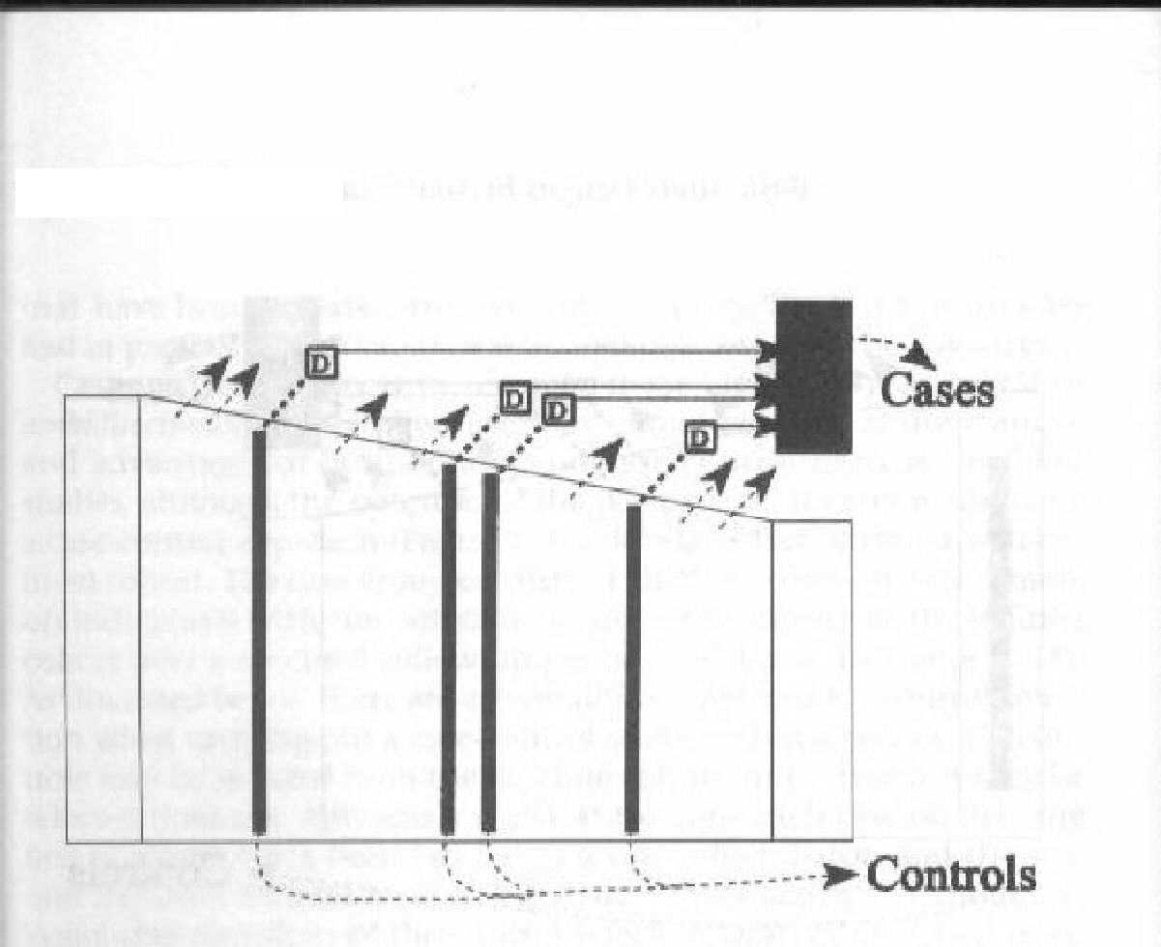
Mechanisms of Unequal Selection Probabilities in Case-Control Studies
  1. Violation of the study base principle (choosing the wrong controls)
  PLUS, since exposure and disease present at the outset, all the same mechanisms seen in cross-sectional study:
CE
controls
Controls
Non-participation amongst eligibles whom you have approached
  “Non-response” (eligible subjects in accessible population decline participation according to exposure & outcome). This can be among cases and/or controls.
Some people never become available to select
  Drop out and/or competing events influenced by/associated with both exposure and disease
Notes:
Let’s turn now to case-control studies. Here is an incidence density sampling design – an ideal way to choose controls – within a fixed cohort. What are the mechanisms of unequal selection probability in case-controls studies? The diagram helps us to enumerate them. The biggest problem, the most common mechanism, one we have already covered in the course, is choosing the wrong group of controls in the first place because you did not follow the study base principle. We therefore call this a violation of the study base principle. However, this is not the only mechanism of generating unequal selection probabilities because you still have all of the mechanisms that were present in cross-sectional studies. That these two other mechanisms can and do occur in case-control studies is because exposure and disease are already present at the outset of case-control studies, just like in cross-sectional studies. A case-control study can suffer bias from non-response even when the proper control group is identified (i.e. study base principle is followed); this is mechanism #2. Or, in mechanism #3, bias will occur when drop out and/or competing events are influenced by/associated with both exposure and disease.

Slide 69
Selection Bias in Case-Control Studies: Presence of Exposure & Disease at Outset Also Invites Selection Bias
Coffee and cancer of the pancreas. MacMahon et al. NEJM 1981
Cases: patients with histologic diagnosis of pancreatic cancer in any of 11 large hospitals in Boston and Rhode Island between October 1974 and August 1979
What type of study base is this?
Notes:
69
One of the most famous case-control studies evaluated the association between coffee consumption and pancreatic cancer.
In this study, the cases were defined as all patients with histologically confirmed pancreatic cancer in any of 11 hospitals in Boston (a city in the U.S.) or Rhode Island (a small state in the U.S.).
What is the study base that gave rise to the cases? Is it primary or secondary? Answer: secondary. This is because there is no tangible defined underlying cohort that gave rise to the cases. Our might be tempted to say all of the people of Boston or Rhode Island, but persons outside of Boston and Rhode Island will use these hospitals if they had developed pancreatic cancer. Furthermore, not all new cases of pancreatic cancer in these geographic regions would necessarily use these specific hospitals. Some cases may have gone to smaller hospitals in Boston or traveled to other medical meccas seeking better therapy.

Slide 70
Selection Bias in Case-Control Studies: Presence of Exposure & Disease at Outset Also Invites Selection Bias
Cases: patients with histologic diagnosis of pancreatic cancer in any of 11 large hospitals in Boston and Rhode Island between October 1974 and August 1979
How should controls be chosen?
Random digit dialing in area - A
Neighbors of the cases - B
Appendicitis admissions to hospitals - C
Hopeless; choose another project - D
Notes:
70
Given these cases, what is the best way of selecting the controls?
Is it:
-- random digit dialing in the Boston and Rhode Island communities
-- neighbors of the cases
-- admissions for appendicitis
-- don’t bother at all

Slide 71
Selection Bias in Case-Control Studies: Presence of Exposure & Disease at Outset Also Invites Selection Bias
None are quite right. Choosing controls in face of a secondary study base not easy.
Random digit dialing probably best of available answers, although Hopeless is also acceptable.
Cases: patients with histologic diagnosis of pancreatic cancer in any of 11 large hospitals in Boston and Rhode Island between October 1974 and August 1979
How should controls be chosen?
Random digit dialing in area - A
Neighbors of the cases - B
Appendicitis admissions to hospitals - C
Hopeless; choose another project - D
Notes:
71
Answer: None of these are quite right. Choosing controls in the face of a secondary study base is not easy. Random digit dialing is probably the best answer, although it is not clear what population boundary to use. Hopeless is also acceptable.

Slide 72
Selection Bias in a Case-Control Study
Coffee and cancer of the pancreas
MacMahon et al. NEJM 1981
Controls:
Other patients without pancreatic cancer under the care of the same physician of the cases with pancreatic cancer
Patients with diseases known to be associated with smoking or alcohol consumption were excluded
Notes:
So, what did the authors do? For controls, they choose patients under the care of the same physician of a case patient at the same time the case patient was diagnosed.
They also excluded patients with diseases known to be associated with smoking or alcohol consumption.

Slide 73
Coffee and cancer of the pancreas
MacMahon et al., NEJM 1981
Case Control
Coffee:
> 1 cup day
No coffee
207 | 275
9 | 32
216 307
OR= (207/9) / (275/32) = 2.7 (95% CI: 1.2-6.5)
Biased or Unbiased?
Notes:
Here is what they found. In both the cases and controls, they determined the prevalence of drinking at least one cup of coffee per day.
How was the odds ratio calculated? In other words, why are the numbers in the position they are in? Answer: the odds ratio is the exposure odds in the cases (207/9) divided by the exposure odds in the controls (275/32).
What does the odds ratio mean?
(Answer: what was measured was the exposure odds: cases had a 2.7 fold greater odds of being coffee drinkers than non-cases. Because the exposure odds ratio is equal to the disease odds ratio, we have: coffee drinkers have a 2.7 fold greater odds of getting pancreatic cancer than non-coffee drinkers.)
Do you believe this is a valid point estimate – a valid inference -- for the association between coffee use and pancreatic cancer? Is it biased or unbiased?

Slide 74
Relative to the hypothetical study base that gave rise to the cases, the selected controls were depleted of coffee users
Selected controls were:
Other patients under the care of the same physician at the time of an interview with a patient with pancreatic cancer
  Most of the MDs were gastroenterologists whose other patients were likely advised to stop using coffee
Patients with diseases known to be associated with smoking or alcohol consumption were excluded
  Smoking and alcohol use are correlated with coffee use; therefore, sample is relatively depleted of coffee users
  Conclusion: Controls vastly depleted of coffee users compared to true study base
Notes:
There are many reasons to believe that this odds ratio is biased.
When we think about the hypothetical study base that gave rise to the cases, we have a strong sense that the control group that was selected was relatively depleted of coffee users.
Let’s look at the controls that were used:
-other patients of the same physicians of the cases: most of these MDs were gastroenterologists whose other patients were enriched for having gastrointestinal diseases who were likely advised to stop using coffee because, at the time, excess coffee use was felt to cause a variety of gastrointestinal complaints. Hence, these individuals are not representative of the study base.
-equally important: what about excluding patients with diseases known to be associated with smoking or alcohol consumption? The authors probably knew that smoking and alcohol use were correlated with coffee use and the reason they made this exclusion was because they felt that using other hospital patients would be too enriched for persons with smoking or alcohol use - their reaction to this possibility was to exclude them outright. But relative to the actual study base, the study sample is now relatively depleted of coffee users with this exclusion.
What is the result of this in terms of biasing the odds ratio? [Answer: bias away from the null; an overestimate of the odds ratio]
The mechanism of this bias is violation of the study base principle.

Slide 75
Mechanisms of Unequal Selection Probabilities in Case-Control Studies
  1. Violation of the study base principle (choosing the wrong controls)
  PLUS, since exposure and disease present at the outset, all the same mechanisms seen in cross-sectional study:
CE
Non-participation amongst eligibles whom you have approached
  “Non-response” (eligible subjects in accessible population decline participation according to exposure & outcome). This can be among cases and/or controls.
Some people never become available to select
  Drop out, competing events, and/or death from disease influenced by/associated with both exposure and disease
Notes:
What mechanism is this? It is violation of the study base principle. They simply chose an inappropriate control group. This was commonplace in that era, in which researchers practiced largely without theory. This is less common today, but it still occurs in case-control studies.

Slide 76
Case-control Study of Coffee and Pancreatic Cancer:
Depiction of Selection Bias
Cancer No cancer
coffee
no coffee
Bias: overestimate effect of coffee in causing cancer
SOURCE POPULATION
Other GI condition
Selection into study
Coffee use
Pancreatic cancer
STUDY SAMPLE
Notes:
Here is what this selection bias looks like schematically. Coffee users in the control group are being undersampled. The result of this is to overestimate the effect of coffee in pancreatic cancer.

Slide 77
Coffee and cancer of the pancreas:
Use of population-based controls
Gold et al. Cancer 1985
Case Control
Coffee:
> 1 cup day
No coffee
84
82
10
14
OR = (84/10) / (82/14) = 1.4 (95% CI, 0.55 - 3.8)
It wasn’t until 2016 that coffee was removed from WHO carcinogen list
Notes:
What happened when the correct control group was used? Another set of investigators instead used population-based controls as obtained from random digit-dialing in the community. When doing so, the odds ratio was now roughly half what the first study showed and it was also compatible with a chance occurrence. Several other subsequent studies also failed to show an association. The link between coffee use and pancreatic is now officially discredited.
Interestingly, studies like the McMahon case-control work all contributed to coffee being classified as a carcinogen by the WHO. It was not until 2016 that coffee was removed for that carcinogen list. How many other mistakes are on that carcinogen list?
Coffee no longer viewed as a carcinogen. Loomis et al. Lancet Oncology 2016. http://www.thelancet.com/journals/lanonc/article/PIIS1470-2045(16)30239-X/fulltext

Slide 78
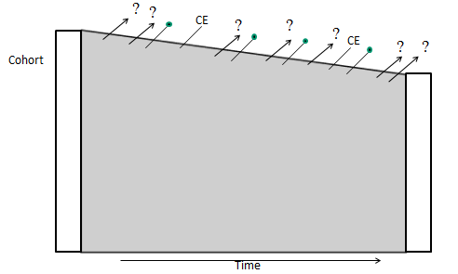
Mechanisms of Unequal Selection Probabilities in Cohort Studies: Mechanism #1: Selection at the Front End
  At the beginning of a cohort (time zero), outcome has not yet occurred.
  Hence, outcome per se cannot be direct driving force in selection probability
  However, other pre-existing causes of outcome (“other factors”), can serve as a driving force of selection probability.
    These “other factors” are what link outcome to selection probability
Notes:
Let’s now turn our attention to cohort studies. At the beginning of a cohort (i.e., time zero), the outcome has not yet occurred. Hence, outcome per se cannot be the direct driving force in anyone’s selection probability at the beginning (i.e., starting in the cohort). Yet, selection bias can still occur at the outset of cohort studies, what we call the “front end”, and this is via the existence of other factors, namely other causes of outcome, that are themselves also causally related to being selected into the study. It is these “other factors” that link outcome (that has not yet occurred) to unequal selection probability.

Slide 79
For Selection Bias to Occur at Cohort Front End
Need: A person’s selection must be influenced by/related to/ associated with BOTH his/her exposure and outcome
Selection
Exposure
Disease
Other factors
Other factors
Selection
Selection
Exposure
Disease
Exposure
Disease
Other factors
Other factors
Selection
Exposure
Disease
Notes:
Recall that we schematically showed this before when we said that not only could exposure and disease directly influence selection in order to result in selection bias, but we also said that “other factors” – specifically causes of exposure and causes of disease – could also result in selection bias if these factors were responsible for influencing either selection or retention in the study. These other factors are known as “common causes” of selection/retention and exposure; or as common causes of selection/retention and disease. This is what we meant by “associated with” exposure and disease in the definition of the criteria for selection bias to occur.
In the slide, we only show selection because we are focused on the front end of the cohort at this time – enrollment of the cohort.

Slide 80
Cohort Study of Sleeping Duration and Heart Disease:
Depiction of Selection Bias
Will tend to select persons with:
-- organized lifestyles (they have time to volunteer and time to sleep)
-- family history of heart disease (they have motivation for this research and are at risk for heart disease)
Heart Dis No Heart Dis
Sleep >8 hrs
Sleep <8 hrs
Bias: overestimation of effect
SOURCE POPULATION
Recruitment:
Volunteers from community
STUDY SAMPLE
Notes:
Here is an example of this. Let’s say we are interested in studying whether sleep duration causes heart disease. There is much interest in the effects of sleep duration on health, and this is one context. To do this, we recruit volunteers from the community to form a cohort. This method of recruitment will tend to select persons with organized lifestyles who have time to volunteer, but these persons also tend to have time to sleep. The recruitment method will also select persons who have a family history of heart disease because they have a motivation to assist with this type of research. These individuals will also tend to have a higher risk of heart disease. The result is that persons who sleep over 8 hrs and have a high risk for future heart disease will have a higher selection probability, resulting in an overestimation of the effect.

Slide 81
For Selection Bias to Occur at the Cohort Front End
Need: A person’s selection must be influenced by/associated with BOTH his/her exposure and outcome
Family history of heart disease
Organized lifestyle
Self-selection into study
Sleep duration
Heart disease
This might have been called confounding in the past but greater clarity between selection bias and confounding has recently emerged.
Notes:
And here is the schematic to remind us why this qualifies as selection bias. Neither the exposure (sleep duration) nor the outcome (heart disease) are directly influencing selection into the study but exposure and outcome are associated with selection by these other factors (organized lifestyle and family history of heart disease).
Note that in the past this scenario would have probably been called confounding, but more recently there is greater clarity between selection bias and confounding. We will come back to this in great detail in a few weeks.

Slide 82
Mechanisms of Unequal Selection Probabilities in Cohort Studies: Mechanism #2: Retention During Follow-up
  Forces that determine length of participation (i.e., who ultimately stays in the analysis) are a cause of selection bias in cohorts
  Failure to complete participation comes in one of two ways:
    Drop-outs (loss to follow-up)
    Competing events (if relevant)
Notes:
The other major mechanism of selection bias in cohort studies comes in the form of retention during follow-up. We have already spoken a lot about this in the course. This is a common mechanism of selection bias; it can create substantial bias and it may be very hard, if not impossible, to remedy. The mechanisms for this are the forces that determine length of participation (i.e., who ultimately stays in the analysis). The failure to complete participation comes in 1 or 2 ways, either drop-outs (also known as losses to follow-up) or competing events (which may or may not be relevant depending upon the outcome).
In this mechanism of selection bias, it is not whom you start with; it is whom you end up with.

Slide 83
When do Losses to Follow-up (Drop outs) Cause
Selection Bias in Cohort Studies?
When dropping out is
  Directly related to or associated with exposure; and
  Directly related to or associated with outcome
Basis of popular adage: “selection bias will occur when losses are related to exposure and outcome”
Another way of thinking about it:
When losses, in at least one exposure group, have different incidence of outcome than those who remain (i.e., informative censoring)
  AND
Magnitude of informative censoring differs across exposure groups
Notes:
When do losses to follow-up (drop outs) cause selection bias in cohort studies? The answer follows our standard rules. Selection bias will occur when dropping out is directly related to or associated with exposure, and when dropping out is directly related to or associated with outcome.
This is the basis of the popular adage that selection bias will occur when losses are related to exposure and outcome.
Another way of thinking about this is that selection bias occurs when two things happen:
First, when those persons lost to follow-up have a different incidence of the outcome than those persons who remain in the analysis - remember we called this informative censoring - in at least one of the exposure groups. You can heuristically think of this as how the problem starts. (If the losses, in each exposure group, have the same incidence of outcome as those who remain, then selection bias cannot occur.)
AND
Second, when the magnitude of informative censoring differs across the exposure groups.
In other words, for selection bias to occur, we must have informative censoring in the first place, and the magnitude of informative censoring must differ across exposure groups. Note that this all starts with those who are lost having a different incidence of the outcome than those who remain. If losses to follow up are simply by random chance and those persons who are lost have the exact same outcome experience as those who stay, then all you lose is statistical power.
One caveat: we cannot use our available data in our study to prove or disprove whether the conditions for selection bias due to loss to follow-up are present. For example, you might wonder if we can evaluate whether exposed persons have a higher incidence of drop out than unexposed persons. You might believe that if exposed and unexposed have the same incidence of drop out, then drop out is not associated with exposure and thus selection bias cannot occur. Unfortunately, this logic does not hold because our available data is also subject to chance occurrences. For example, exposed individuals might cause a higher rate of drop out to occur by affecting susceptible persons (who are destined to have a different rate of outcome than those who stay) but, then, by chance alone, the unexposed persons may high an equally high rate of drop out of persons via a random mechanism (non-informative censoring). Selection bias will nonetheless ensue here because the nature of those who drop out in the exposed are different than in the unexposed. The relationship between exposure and outcome among the lost will be different than those who remain. Thus, one cannot simply look at the incidence of drop out in exposed vs unexposed to rule in or rule out presence of selection bias. An absence of an association between exposure and drop out is somewhat reassuring but it does not preclude selection bias from occurring. This is because the nature of the losses in the two exposure groups may be quite different.

Slide 84
For Selection Bias to Occur During Cohort Follow-up
Need: A person’s retention must be directly related to / associated with BOTH his/her exposure and outcome
Retention
Exposure
Disease
Other factors
Other factors
Retention
Retention
Exposure
Disease
Exposure
Disease
Other factors
Other factors
Retention
Exposure
Disease
Notes:
Here is the schematic that we showed a few slides ago, when talking about selection bias at cohort initiation. Here, we just replace selection with retention. Again, for selection bias to occur during cohort follow-up, retention must be directly related to (i.e., influenced by) or associated with (via another factor) both exposure and disease. One of these four structures must be present for selection bias to occur.

Slide 85
Selection Bias Due to Losses to Follow-up
e.g., Cohort study of progression to cirrhosis (liver dysfunction) in hepatitis C virus carriers. Exposure = IDU vs transfusion recipients
All the ingredients are present for selection bias:
Informative censoring is likely (outcome directly influences drop out)
  becoming sick with undiagnosed cirrhosis is a reason for loss to follow-up
  persons who are lost to follow-up have greater cirrhosis incidence than those who remain (i.e., informative censoring)
Exposure directly influences drop out
  IDU more likely to become lost to follow-up - at any level of feeling sick – because of more life distractions and less social support
Result: selection bias – IDU group differentially depleted of sickest subjects; underestimates the incidence of cirrhosis in IDU relative to transfusion recipients
Notes:
As an example, consider a cohort study looking at progression to cirrhosis (which is dysfunction of the liver) among hepatitis C virus (HCV)-infected individuals, comparing two major risk groups for HCV acquisition: injection drug users (IDU) and transfusion recipients. These are the exposures under study. This is pertinent because there has been interest in whether the way you acquired HCV influences your initial inoculum of virus (and host immune response) and ultimately your liver disease course.
In a study like this, all the ingredients are present for selection bias; it is the perfect storm.
This is because it is easy to see that informative censoring is likely present. Specifically, getting sick from not yet officially diagnosed cirrhosis is a reason for becoming lost to follow-up; you just don’t feel well enough to come back for study visits. Therefore, you can see how it is likely that persons who are lost to follow up have a different cirrhosis incidence than those that remain. This is informative censoring.
Assume also -and this is not a great stretch- that injection drug users are more likely to become lost to follow up at any given level of feeling sick because of less social support and more chaotic lives. Therefore, this means that the frequency of losses differs across the exposure groups (IDU vs transfusion recipients), and it is more common in the IDU group.
The result of all of this is selection bias. The IDU group becomes more depleted of its sickest subjects. This results in an underestimation of the incidence of cirrhosis in IDU relative to transfusion recipients.

Slide 86
Effect of Selection Bias in a Cohort Study:
Assume no true difference in cirrhosis incidence between IDU and transfusion recipients
Effect of informative censoring in transfusion recipients
Assuming no informative censoring and no difference in cirrhosis incidence between IDU and transfusion recipients (superimposed lines)
Probability of developing cirrhosis
Selection bias
Effect of informative censoring in IDU group
Time
Assume no competing events
Notes:
This is what a Kaplan-Meier curve would look like. Or, more specifically 1-KM. The dark curve is what we would see if there was no informative censoring going on AND there was no difference between IDU and transfusion recipients in the incidence of cirrhosis. In other words, there would be superimposable curves.
However, now enter reality: there is loss to follow-up, and it is informative. The effect of this informative censoring is to underestimate cirrhosis incidence. Here is the effect in the transfusion recipients. Now, remember, we said that the informative censoring was even more common in the IDU group and that is depicted here.
The end result is the appearance that the IDU group has a slower progression to cirrhosis - all because of selection bias. See Greenland AJE 106:184, 1977 for further examples.

Slide 87
Cohort Study of Risk Group and Cirrhosis Progression:
Depiction of Selection Bias
Selection bias will lead to spurious underestimation of cirrhosis incidence in both exposure groups, more so in IDU group; end result: underestimate of IDU effect
Cirrhosis No Cirrhosis
IDU
Transfusion recipients
Mechanism: Sick subjects stopped coming (more so in IDU group)
SOURCE POPULATION
Ability to attend study visits
STUDY SAMPLE
IDU
Cirrhosis
Notes:
Here is the effect of selection bias schematically. Because of selective drop out of the IDU group with cirrhosis, this upper right hand cell is underrepresented in the study sample. The end result is spurious underestimation of cirrhosis incidence in the IDU group relative to the transfusion recipients group. [See other literature examples.]

Slide 88
Competing Events and Selection Bias
All of the prior comments regarding losses to follow-up also apply to competing events
Rationale
  Losses to follow-up and competing events are the ways that people fall out of observation
  When either losses and / or competing events are influenced by/associated with both exposure & disease, selection bias ensues
Generic structure
Specific example
Retention
Retention
Pathophysiologic state
Competing event
Genetic background
CHD death
Cancer death
Exposure
Disease
Smoking
Alzheimer’s
Notes:
Everything we just said about losses to follow-up (drop-out) as a mechanism for altered probabilities of retention also apply to competing events. The rationale is that losses to follow-up and competing events are the two ways that people fall out of observation. When drop-out or competing events are influenced by both exposure and disease, selection bias will ensue.
Here is the generic schematic. During follow-up, some pathophysiologic state is the “other factor” we defined earlier. This state is associated with our disease of interest and also the competing event. Having the competing event then affects whether a participant will continue to come back to study visits.
An example of this is the association between smoking and dementia, in which in older populations who are prone to the development of competing event (such as cardiovascular heart disease and cancer-related deaths), the data shows show that smoking is associated with a decreased incidence of dementia. This is not seen in younger populations, and hence the finding in the older populations is felt to be because of selection bias. This is explained in Hernan et al. Epidemiology 2008.

Slide 89
Selection Bias in a Randomized Trial
Randomization prevents selection bias at the outset
  This is because “exposure (an intervention)” is:
    randomly assigned
    comes after decision to participate
  Therefore, exposure cannot be related to study participation
Instead, factors related to retention (i.e., the back end) are the major potential cause of selection bias in RCTs
See Extra Slides for examples
Other Factor
Selection
Disease
Exposure (Intervention)
Notes:
Finally, how about selection bias in a randomized experiment? At the outset of a randomized experiment, selection bias cannot occur because exposure (which is an intervention) is randomly assigned after the decision of a participate to be in the trial. Hence, exposure status cannot directly influence selection into the study. Because exposure status is randomly assigned, no other factor causes it or is associated with it. So, both mechanisms of how exposure might influence selection are precluded. We show this with the red X’s on the diagram.
Instead of problems at the front end, where randomized trials can be threatened by selection bias is during follow-up (i.e., the back end). These are the same issues that occur during follow-up in cohorts studies, namely drop out and competing events. The Extra Slides have examples.

Slide 90
Summary: Selection Bias
Definition: When study sample does not represent/reflect source population
In a Descriptive Study
  Bias caused when persons in source population have different (unequal) probabilities of being selected for/retained in study sample
In an Analytic Study
  Bias caused when persons in source population have different (unequal) probabilities of being selected for/retained in study sample
    And these differing (unequal) probabilities are influenced by (or associated with) both exposure and outcome of interest
Disease
+ -
+
-
Selection/ Retention
Other factors
Exposure
Other factors
SOURCE POPULATION
Exposure
Disease
STUDY SAMPLE
Notes:
In summary, we recall that the definition of selection bias is when the study sample does not represent (i.e., reflect the source population). In a descriptive study, this is the bias caused by when persons in the source population have different probabilities for being selected in the first place or being retained. In an analytic study, this is the bias caused when persons in the source population have different probabilities of being selected in the study or being retained and these probabilities are influenced by directly (or are associated with) both exposure and outcome under study.
We also showed the requirements for selection bias diagrammatically. We showed this both with “box and stick” diagrams and with figures that emphasized how exposure and outcome must be directly related to or associated with either selection or retention in order for selection bias to occur.

Slide 91
Summary: Managing Selection Bias
Prevention in design stage is critical
  Fixes in the analysis stage may not be possible
  General advice: Strive for study samples that are representative of target populations; high participation %’s; and low rates of losses to follow-up
In cross-sectional studies:
  Presence of exposure and outcome at outset: potential for selection bias
In case-control studies:
  Follow the study base principle
In longitudinal studies (cohorts/experimental studies):
  Be mindful of occult selection forces at cohort outset (cohort only; not RCT)
  Remember competing events
  Consider approaches to tracking down the lost (or at least a sample)
    See Extra Slides for what to collect at study entry
Notes:
And, finally, a summary about how to manage selection bias.
The first message is that prevention and avoidance, through proper decisions in the design stage, are critical. Although there are sometimes fixes (or cures) in the analysis phase, they depend upon having some detailed measurements. In other words, don’t think a statistician is going to get you out of a mess created by poor design choices. Prevention and avoidance of selection bias are key. In this regard, there are three main general messages: strive for representative study populations (all designs); high participation %’s (all designs), and low rates of loss to follow-up (longitudinal studies).
And, we did discuss a few special tips by study design.
In cross-sectional studies, remember that the presence of both exposure and outcome at outset is a recipe for selection bias. Also, remember that you are also looking at determinants of outcome survival when you look at associations between exposure and outcome.
For case-control studies, it is critical to follow the study base principle when selecting controls.
In longitudinal studies, be mindful of occult selection forces at cohort outset that are related to both exposure and outcome. Of course, this applies only to cohort studies and not to randomized trials (RCTs) where randomization essentially guarantees no selection bias at the outset. In both observational studies and RCTs, the critical advice is to prevent losses to follow-up. When the study is over you can also consider performing worst case scenario sensitivity analyses regarding persons who were lost and if your finding is robust to even to the most extreme cases, then your qualitative inference is on pretty safe ground. Consider also approaches where you track down the lost or a sample of them. To prepare for this, make sure to learn as much about your participants when they enter the cohort and keep this information updated. Finally, be aware of and measure competing events. They cannot be prevented (they are part of nature) but you do need to account for them in your analysis. And, if you can understand the common causes of the competing event and your outcome of interest, you can actually begin to do a few things in your analysis that would allow you to conduct the analysis with an eye towards elimination of the competing event.
As mentioned, there are few remedies in the analysis stage. One possible fix is via adjustment of certain factors. We will learn about this in the weeks to come as we begin to discuss directed acyclic graphs.

Slide 92
Extra Slides

Slide 93
Slide Files for Rest of Course
Two versions of the Lecture slide files
  Initial Post (e.g., Selection Bias 2016 Initial Post.ppt)
    Posted before the lecture
and
  Final Post (e.g., Selection Bias 2016 Final Post.ppt)
    Posted after the lecture
Only difference: answers to i<Clicker questions omitted from Initial post and included in Final
Notes:
Before we get too far, one administrative note:

Slide 94
? INTERNAL VALIDITY
OTHER POPULATIONS
REFERENCE/
TARGET/
SOURCE POPULATION
Diseased
ACCESSIBLE
POPULATION
+ -
+
-
Exposed
? EXTERNAL
VALIDITY
(generalizability; transportability)
STUDY SAMPLE
Notes:
This is a slightly more elaborate schematic of the populations used in research. Sometimes our study sample comes directly from the target population as shown in the earlier slides. The NHANES study is an example of this, being directly sampled from the U.S. general population (which is a common target population). Other times, we are sampling from accessible populations. The Physicians Health Study or Nurses Health Study are examples of this. Or, even a study of teachers (e.g., the California Teachers study) -- when we seek to make inferences of the general adult population -- is an example of how we sometimes sample an accessible population, which itself is a sample of a more general target population. This more elaborate schematic is worth keeping in mind in that sometimes everything can be done correctly with regard to how one samples the accessible population to form the study sample but the choice of the accessible population is where the problems can reside that lead to bias. The firefighter example in the Hernan 2004 Selection Bias paper (Optional Reading) gives a nice example of this.
There is considerable variability in what the three most rightward populations are called (and defined) by different investigators, textbooks, and normative bodies. There is also a lack of clarity in terms of which of these three rightward populations is considered the gold standard in terms of the right answer. When we speak of bias, this is always in reference to the truth in some population. To be able to judge whether bias is present in a given study, it stands to reason that observers need to be clear what the gold standard population is. Thus, careful researchers are very clear to define what they consider the population to which study results are intended to be true – what is most often called the target population. This is explained well in Schwartz et al. Toward a clarification of the taxonomy of ‘bias’ in epidemiology textbooks. Epidemiology 26:216, 2015.

Slide 95
selection bias
measurement bias
confounding bias
vs.
bias
Notes:
The kind of classification scheme which we are promoting, with just four things to remember (selection bias, measurement bias, confounding, and chance), is much easier to remember than what some others have propagated. For example, Sackett, the author of one your textbooks in our Clinical Epidemiology (EPI 204) course, has cataloged, in a famous paper in 1979, a lengthy list of biases, some of which have interesting names, such as “apprehension” bias or “obsequiousness” bias. I find all of these impossible to remember and indeed because they all fall under one of our 3 biases (selection, measurement, and confounding), I simply just remember these three.

Slide 96
Leukemia Among Observers of a Nuclear Bomb Test
Caldwell et al. JAMA 1980
Smoky Atomic Test in Nevada
Outcome of 76% of observing troops at site was later found; occurrence of leukemia determined
82% contacted by the investigators
18% contacted the investigators on their own
4.4-fold greater prevalence of leukemia than those contacted by the investigators
Explanation: Human nature (affected humans like to come forward)
Notes:
Here’s a biomedical example of a study with a descriptive objective.
There has been a lot of interest over how much risk there was for cancer in the military observers of the various nuclear bomb tests that have been performed over the years. In one such study, there was an attempt to find all observers of the Smoky Atomic test in Nevada. In this study, 76% of the total troops were later identified and the occurrence of leukemia was determined.
On the surface, 76% seems pretty good. After all, the pre-election poll we just examined for the recall election that sampled just 1 in 10,000 voters got the right answer. But how representative were these 76%? The authors were clever enough to empirically look at this. They did so by separating the troops into those who were contacted by the investigators - 82% of the participants - and those who contacted the investigators on their own - 18% of the participants. And, as you might have predicted, those who contacted the investigators on their own, i.e. self-selection - had a much higher leukemia prevalence, over 4 times higher. Hence, at the end of the day we really don’t know how representative these 76% were and we have to be concerned that they are enriched - by self selection - by those who developed leukemia. The only way you could know the truth is if you contacted all 100% or if you got close to 100% and did sensitivity analyses on the remainder.
What is the explanation or mechanism for this? The study design looks fine. They had a list of troops and they set out to find them all. It is really just human nature that is the problem here. Affected humans like to come forward and it appears they did in this case.
[Would the investigators have done better by just using those who they contacted? Hard to know. This group may have been depleted of very sick persons (but not yet dead and not in any death registry) or perhaps those who already died of cancer.]

Slide 97
Mechanisms of Unequal Selection Probabilities in Cross-Sectional Studies
Assuming that the goal is to identify determinants of disease development (etiologic research)
CE
Unwise choice of a study sample as representative of target.
  Study sample influenced by both exposure and outcome (e.g., Harvard study)
Non-participation amongst eligibles whom you have approached
  “Non-response” (eligible subjects in accessible population decline participation according to exposure & outcome)
Some people whom you would like to sample never become available to ask
  Drop out, competing events, and/or death from disease influenced by/associated with both exposure and disease
Notes:
Let’s show an example of mechanism #3 of unequal selection probabilities in a cross-sectional study.

Slide 98
Selection Bias in a Cross-Sectional Study
Is glutathione S-transferase class μ deletion (GSTM1-null) polymorphism associated with increased risk of breast cancer?
With prevalent breast cancer in cross-sectional study, an association with GSTM1-null is seen depending upon the no. of years since diagnosis
But not with brand new incident diagnoses (via a case-control study)
GSTM1 (exposure) is associated with survival after breast cancer, but not with cancer development per se
Kelsey et al. Canc Epi Bio Prev 1997
Notes:
And, here is an example of mechanism #3.
Based on evidence from other cancers, there has been interest in whether a particular polymorphism of glutathione S-transferase class mu - a deletion- known as GSTM1-null is associated with increased risk of breast cancer.
These investigators evaluated this using both prevalent breast cancer cases (i.e., in a cross-sectional study) and with incident breast cancer cases (via a case-control study). In the cross-sectional study, using prevalent breast cancer cases, the magnitude of the association depended upon the number of years since diagnosis of the breast cancer cases. On the left, when limiting the analysis to breast cancer cases who had been diagnosed in the past 4 years, the odds ratio was 0.97, which is essentially 1. In other words, no evidence of an association. When using breast cancer cases who had been diagnosed between 4 and 8 years ago, there was a hint of an association with an OR of 1.3. Interestingly, when using prevalent breast cancer cases who had been diagnosed 8 or more years ago, this really brought out an association with an odds ratio of 2.0.
Similar to what was seen with the prevalent cases who were diagnosed less than 4 years ago, when the researchers used true incident cases (i.e., very recently diagnosed) they also saw no evidence of an association, odds ratio 1.08.
One explanation for this is that there is something about having this polymorphism that is associated with longer survival after a breast cancer diagnosis, but not with getting breast cancer per se. The authors speculated that it may be something to do with metabolism of the chemotherapy used to treat cancer. In any case, this illustrates the very different conclusions you would draw in a cross-sectional study with prevalent breast cancer versus a study using incident diagnoses, and this is all because of selection bias.

Slide 99
Cross-sectional study of GSTM1 polymorphism and breast cancer
Breast Cancer
+ -
null
Bias: overestimate effect of GSTM-1 null polymorphism in causing breast cancer
GSTM1
pos.
SOURCE POPULATION
Death from Breast Ca
GSTM1
Breast Ca
STUDY SAMPLE
Selection into Study
Notes:
Here is what this looks like schematically. You perform a cross sectional study with prevalent breast cancer and you end up preferentially sampling those with the null mutation because of their survival advantage. The result is an overestimate of the association between the null mutation and breast cancer.

Slide 100
“Causal Inference”
Goal: Identify causal relationships
6 ways a statistical association can occur
  Chance
  Selection bias
  Measurement bias
  Confounding
  Reverse causation
  True causal relationship
Process of causal inference: rule out the first 5
Notes:
Causal inference refers to the process undertaken to identify causal relationships. This is one of the central goals of epidemiology and clinical research. What we do initially do in any of our studies is to determine a statistical association between a given exposure and disease. We know that there are 6 different ways that a statistical association can occur. If we can find evidence that 1 through 5 can explain the statistical association, then we cannot accept #6. If we try to find alternative explanations 1 through 5 but cannot, eventually we can conclude that 6 is true. In other words, if we can refute all of the alternative explanations, then we feel comfortable accepting the causal explanation as being true. This is acceptance of causality by means of refutation.

Slide 101
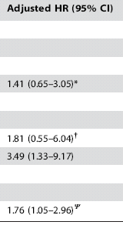
Effect of losses to follow-up in a cohort study
Determinants of mortality after initiation of antiretroviral therapy in Africa
Naively Ignoring Losses
Tracking Down Vital Status on Losses
1.0
1.0
1.0
1.0
1.0
1.0
Bisson PLoS One 2008
Selection bias
Notes:
Because we rarely know happens to those subjects who become lost in a longitudinal, we rarely have anything but theoretical examples of this bias. One group of investigators, however, went the extra mile and tracked down subjects who had become lost to follow-up. This is a study of the determinants of mortality after the initiation of antiretroviral therapy among adults in Africa. As in the earlier studies, we talked about there was substantial loss to follow-up after baseline. When the authors simply assumed that the losses were non-informative, i.e. they naively ignored the losses by censoring, this is what they found. These are hazard ratios, which as you know, are a type of rate ratio. Then, the authors went the extra mile and tracked down the vital status on patients who were lost to follow-up. They found who was dead and alive long after they left the study. When they incorporated this new information about the lost into the overall analysis, this column shows what they found. The differences compared to the middle column are notable. Sex, which was not significant in the naïve analysis, became significant. So did CD4 count. However, the effect of hemoglobin lost its statistical significance. The differences between ignoring losses and tracking them down is selection bias.

Slide 102
Selection Bias in a Randomized Trial
Losses to follow-up are the big unknown in clinical trials and the major potential cause of selection bias
e.g., Assume a randomized trial of a drug vs a placebo, and:
  a symptom-causing side effect of a drug is more common in persons “sick” from the disease under study
  occurrence of the side effect is associated with more losses to follow-up
Then:
  Compared to placebo, drug group would be selectively depleted of the sickest persons (i.e., informative censoring)
  Would make drug treatment group appear better
Notes:
As is the case with cohort studies, the main cause of selection bias in randomized trials is from losses-to-follow-up.
How could this happen? Consider this example of a randomized trial of a drug vs a placebo. What if a symptomatic side effect of a drug occurs more commonly in persons who are sickest and more prone to have the ultimate study outcome and that the occurrence of this side effect is associated with more losses to follow up. In other words, the patients with this side effect drop out of the study. This would mean that the drug treatment group would be selectively depleted of the sickest patients. This would make the drug look spuriously better than it really is.

Slide 103
Effect of Selection Bias in an RCT
Effect of informative censoring in drug group
Selection bias
Probability of survival
Survival assuming no informative censoring and no difference between drug and placebo (superimposed curves)
Time
Retention
Disease severity
Side effect
Drug
Death
Notes:
This is what a Kaplan-Meier curve would look like. Let’s say the outcome is death. The dark curve is what we would see if there was no informative censoring going on AND there was no difference between the treatment group and the placebo group. In other words, there would be superimposable curves. Then, consider what would happen if there was selective drop out (i.e., informative censoring) in the drug treatment group where the sickest persons were developing symptomatic side effects from the drugs and were dropping out of the study. This would leave the drug treatment group selectively enriched for those persons who are less sick and in the end you would see a spurious survival benefit from the drug.

Slide 104
Competing Events in Randomized Trials
Competing events are typically explicitly accounted for and reported on in RCTs
  They are often part of adverse event monitoring/reporting
  This allows for a balanced view of the outcomes of interventions
Competing events are typically swept under the carpet (i.e., ignored) in cohort studies
  This is unfortunate
  Fuller disclosure of competing events is more complicated but will give us a more comprehensive accounting of the effects of exposures

Slide 105
Preventing and Managing Losses to Follow-up
Prevention
Obtain comprehensive contact information
  SSN (critical for death index searches), DOB, legal name
  State of birth
  Middle initial, father’s surname
  Address and many phone numbers
  Friends and family members
Engage participants while in follow-up (frequent communication; incentives)
Management
When losses occur, contact:
  postal service for change of address
  DMV
  National death index
Search for a sample of those lost

