Slide 1
Sex Ratios,
Residential Segregation and
Life Tables 2

Slide 2
Outline
Sex ratios
Residential segregation
Life tables part 2

Slide 3
Sex Ratio
Most of the world (including China), over 1 or over 100 favors boys
India: under 1000 favors boys

Slide 4
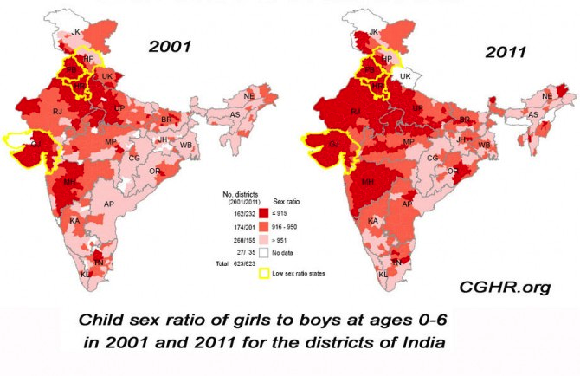
Child sex ratios in India have become increasingly imbalanced
Child sex ratios (girls per boys 5 and under)
  945/1000 in 1991
  927/1000 in 2001
  914/1000 in 2011
Geographic heterogeneity in the extent of imbalance in the child sex ratio
Notes:
SW: LARGER FONT. WOULD MAKE HEADING AND BODY FONT SAME. CONSIDER SOME NICE FORMATTING TO MAKE IT MORE INTERESTING

Slide 5
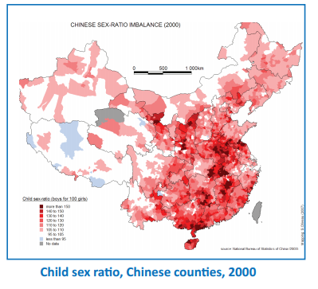
Uneven sex ratios elsewhere
China: 118 boys: 100 girls
  25% of women with no sons
  resort to sex selective abortion
Vietnam 111; Pakistan 110; Azerbaijan 116, Armenia 115, Georgia 114, Albania 112
Study in the UK (2011 Census) found sex ratios as high as 110-120 for second children born to families where the mother was born in India, Nepal, Pakistan, Afghanistan, or Bangladesh
  Similar findings in US and other western countries among immigrants

Slide 6
Why should we care about uneven child sex ratios in India?
Human rights
Marriage patterns: 40 million men remaining single (Guilmoto, 2012)
  Can increase use of prostitution and spread of STDs and HIV (evidence from China, Tucker et al., 2006)
Relationship found between sex ratios, violence and homicide rates and the perception of women being harassed more (Hudson et al., 2002; South et al., 2014)
Increased sex trafficking (Hesketh et al., 2006)
Possible increase in men joining terrorist / paramilitary/ criminal groups and subsequent increase in regional violence (Hesketh et al., 2006)
Notes:
SW: LARGER FONT. WOULD MAKE HEADING AND BODY FONT SAME. CONSIDER SOME NICE FORMATTING TO MAKE IT MORE INTERESTING

Slide 7
How does the child sex ratio become imbalanced? Two components
1. Pre-birth events
  Measured by the sex ratio at birth (Natural sex ratio at birth is about 105 males for every 100 females)
  Sex-selective abortion
  Anomalies in imbalanced conception and fetal survival
2. Excess mortality for girls compared to boys
  Child mortality for girls exceeds child mortality for boys in India; in other countries males have higher mortality (especially in neonatal/infancy)
  Breastfed for shorter duration, provided less food, fewer vaccinations, taken to health facility less frequently or not as quickly, etc.
  Infanticide
Notes:
SW: LARGER FONT. WOULD MAKE HEADING AND BODY FONT SAME. CONSIDER SOME NICE FORMATTING TO MAKE IT MORE INTERESTING

Slide 8
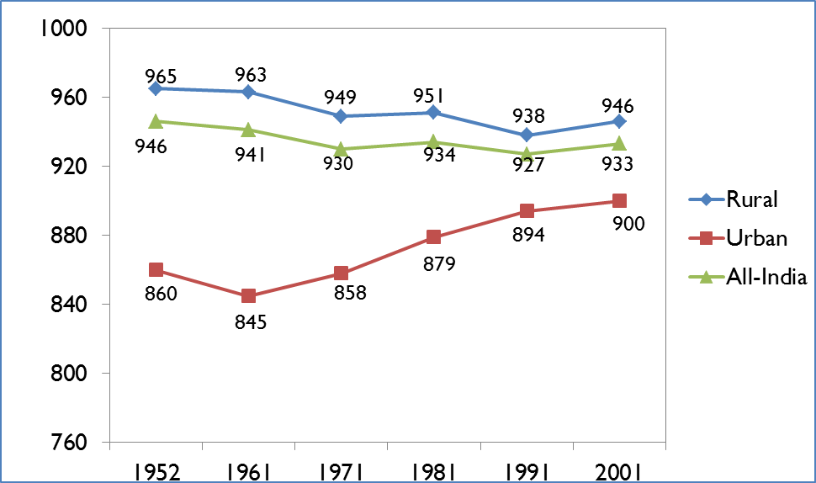
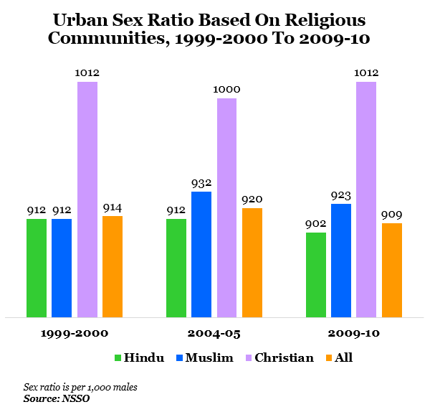
Why has the child sex ratio in India declined so dramatically recently?
Son preference
Fertility decline
Access to sex selective technology
and abortion
Sex ratios are more imbalanced among: urban, rich, highly educated, higher caste
  Doctors in India have extremely skewed child sex ratios (Patel, 2013)
Notes:
SW: LARGER FONT. WOULD MAKE HEADING AND BODY FONT SAME. CONSIDER SOME NICE FORMATTING TO MAKE IT MORE INTERESTING

Slide 9
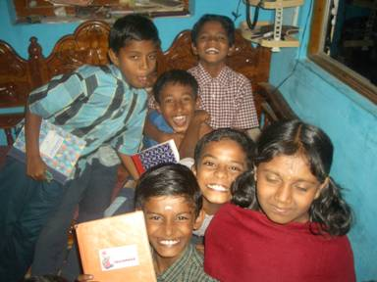
1. Why is there son preference in India?
Benefits of boys
  Patrilineal and Agrarian society
  Religious and cultural
Costs of girls
  Dowry
“500 rupees today to save 50,000 rupees tomorrow”
Advertisement on ultrasound clinic
  Investing in a daughter who will be married and live in another household
“Bringing up a daughter is like watering a neighbor’s plant” (Old Indian expression)
Notes:
SW: LARGER FONT. WOULD MAKE HEADING AND BODY FONT SAME. CONSIDER SOME NICE FORMATTING TO MAKE IT MORE INTERESTING

Slide 10
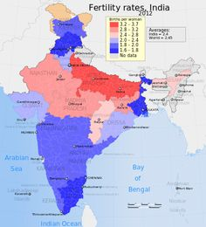
2. Fertility Decline in India

Slide 11
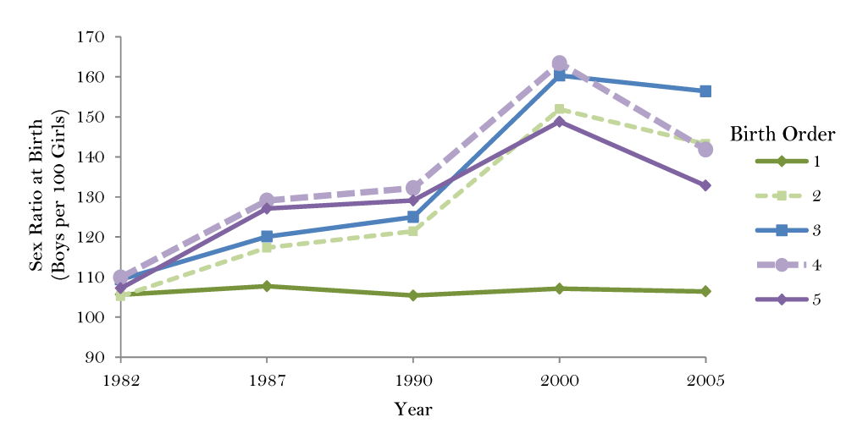
Sex Ratios differ by birth order

Slide 12
3. Abortion and sex selective abortion in India
Abortion is legal in cases of health (physical or mental) of mother, contraceptive failure or rape, or if fetus is physically or mentally disabled (since 1972)
  Prenatal sex determination is illegal (since 1994)
Very hard to enforce the law to not discriminate against female fetuses
  Place where determination of sex and actual abortion can be separated
Ban on sex selection should not lead to bans on abortion itself, but these have at times been conflated
  Some evidence that women think that abortion is illegal
Evidence that providers are afraid of providing abortions because might be accused of providing sex selective abortion
  Claim that clients pressure them

Slide 13
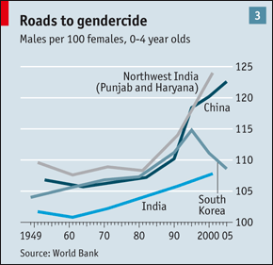
But, sex ratios have become more normal in some countries over time
South Korea: Why?
Not well understood

Slide 14

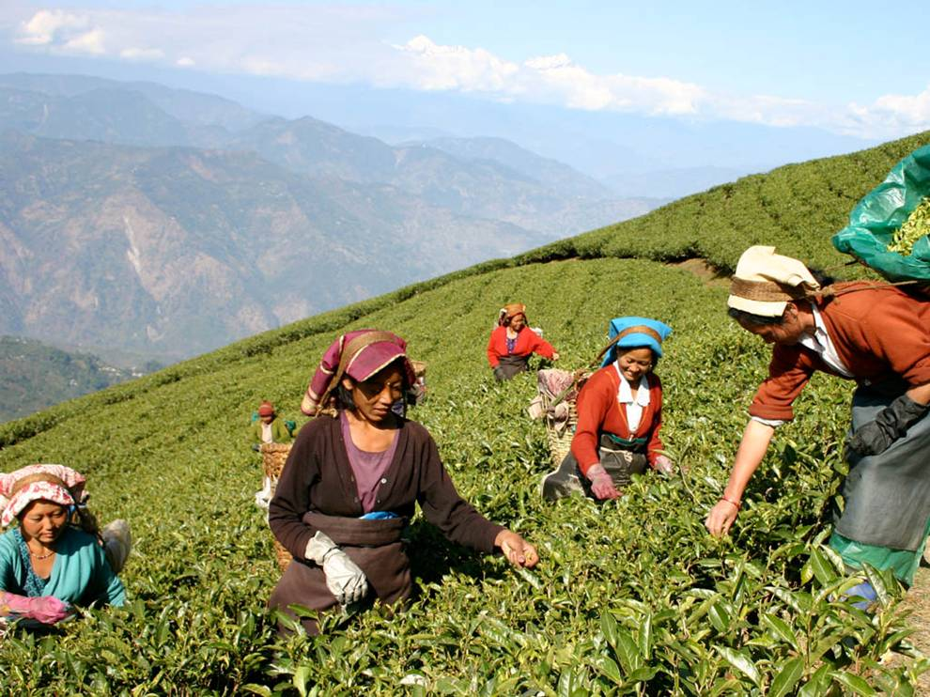
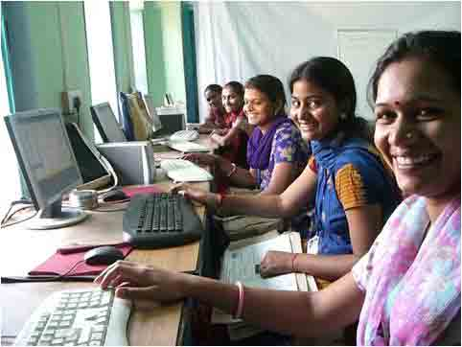
What might change the demand for girls compared to boys?
  Shortage of women in the marriage market
  Shortage of women to fill women-dominated jobs, leading to increased wages
  Changing role of woman: westernization, policies/programs, media
Notes:
SW: LARGER FONT. WOULD MAKE HEADING AND BODY FONT SAME. CONSIDER SOME NICE FORMATTING TO MAKE IT MORE INTERESTING

Slide 15

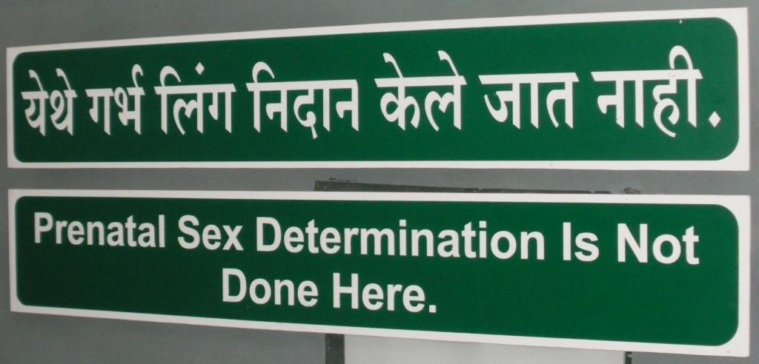
What might change the supply of girls or boys?
Improved health care access
Reduced access to sex-selective technology
  Laws and policies
Notes:
SW: LARGER FONT. WOULD MAKE HEADING AND BODY FONT SAME. CONSIDER SOME NICE FORMATTING TO MAKE IT MORE INTERESTING

Slide 16
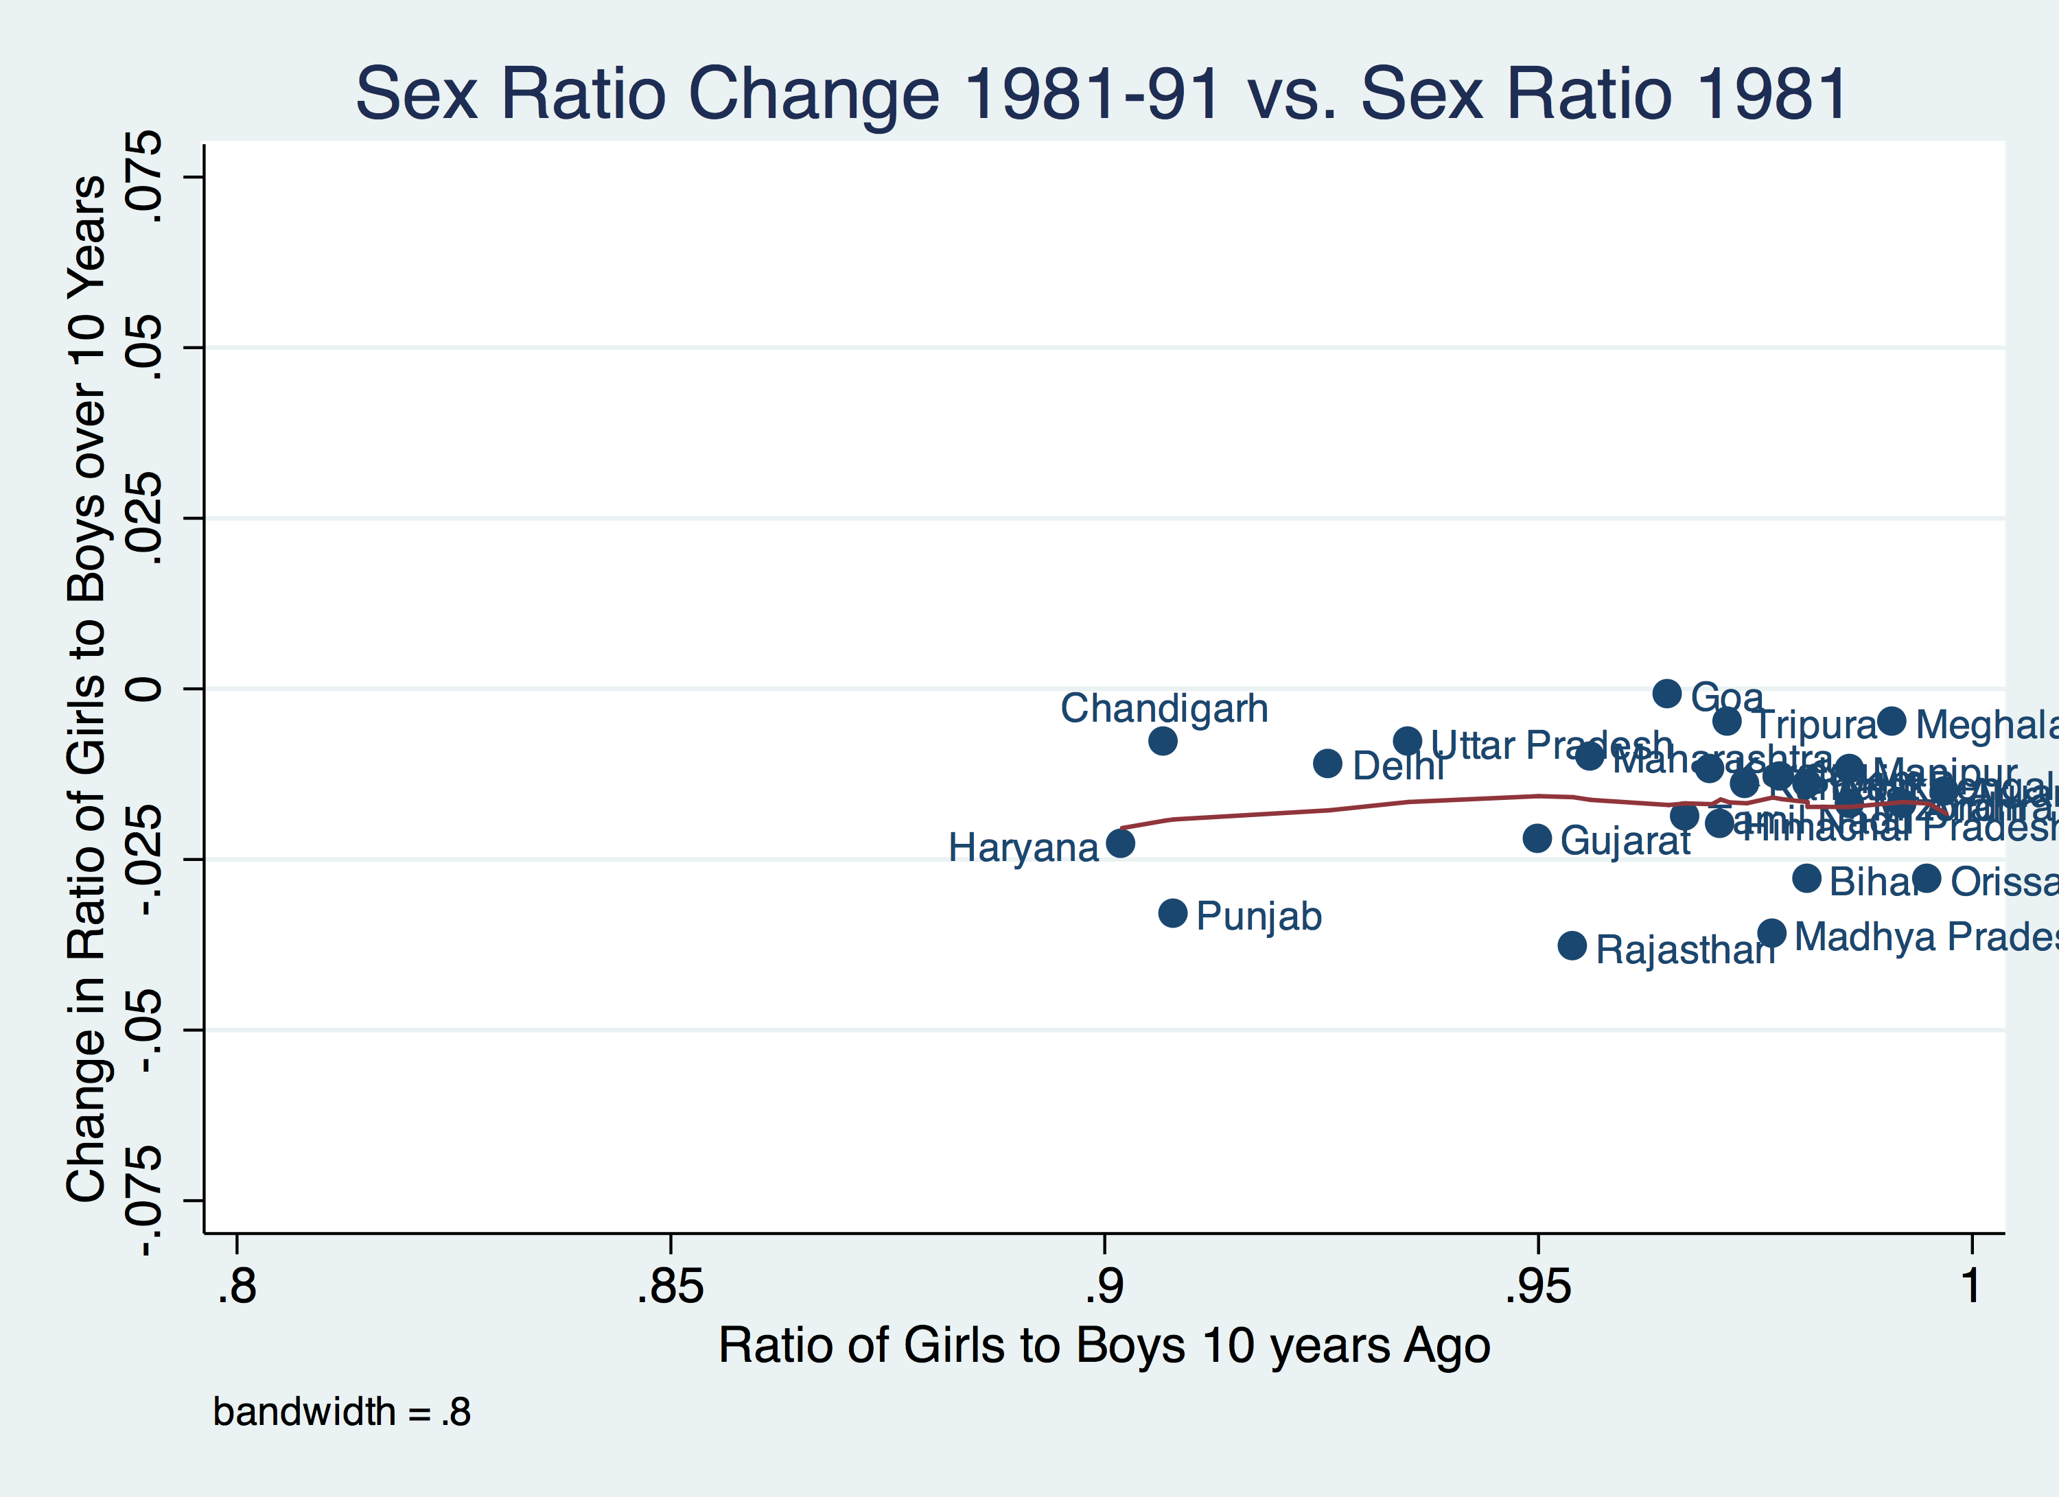
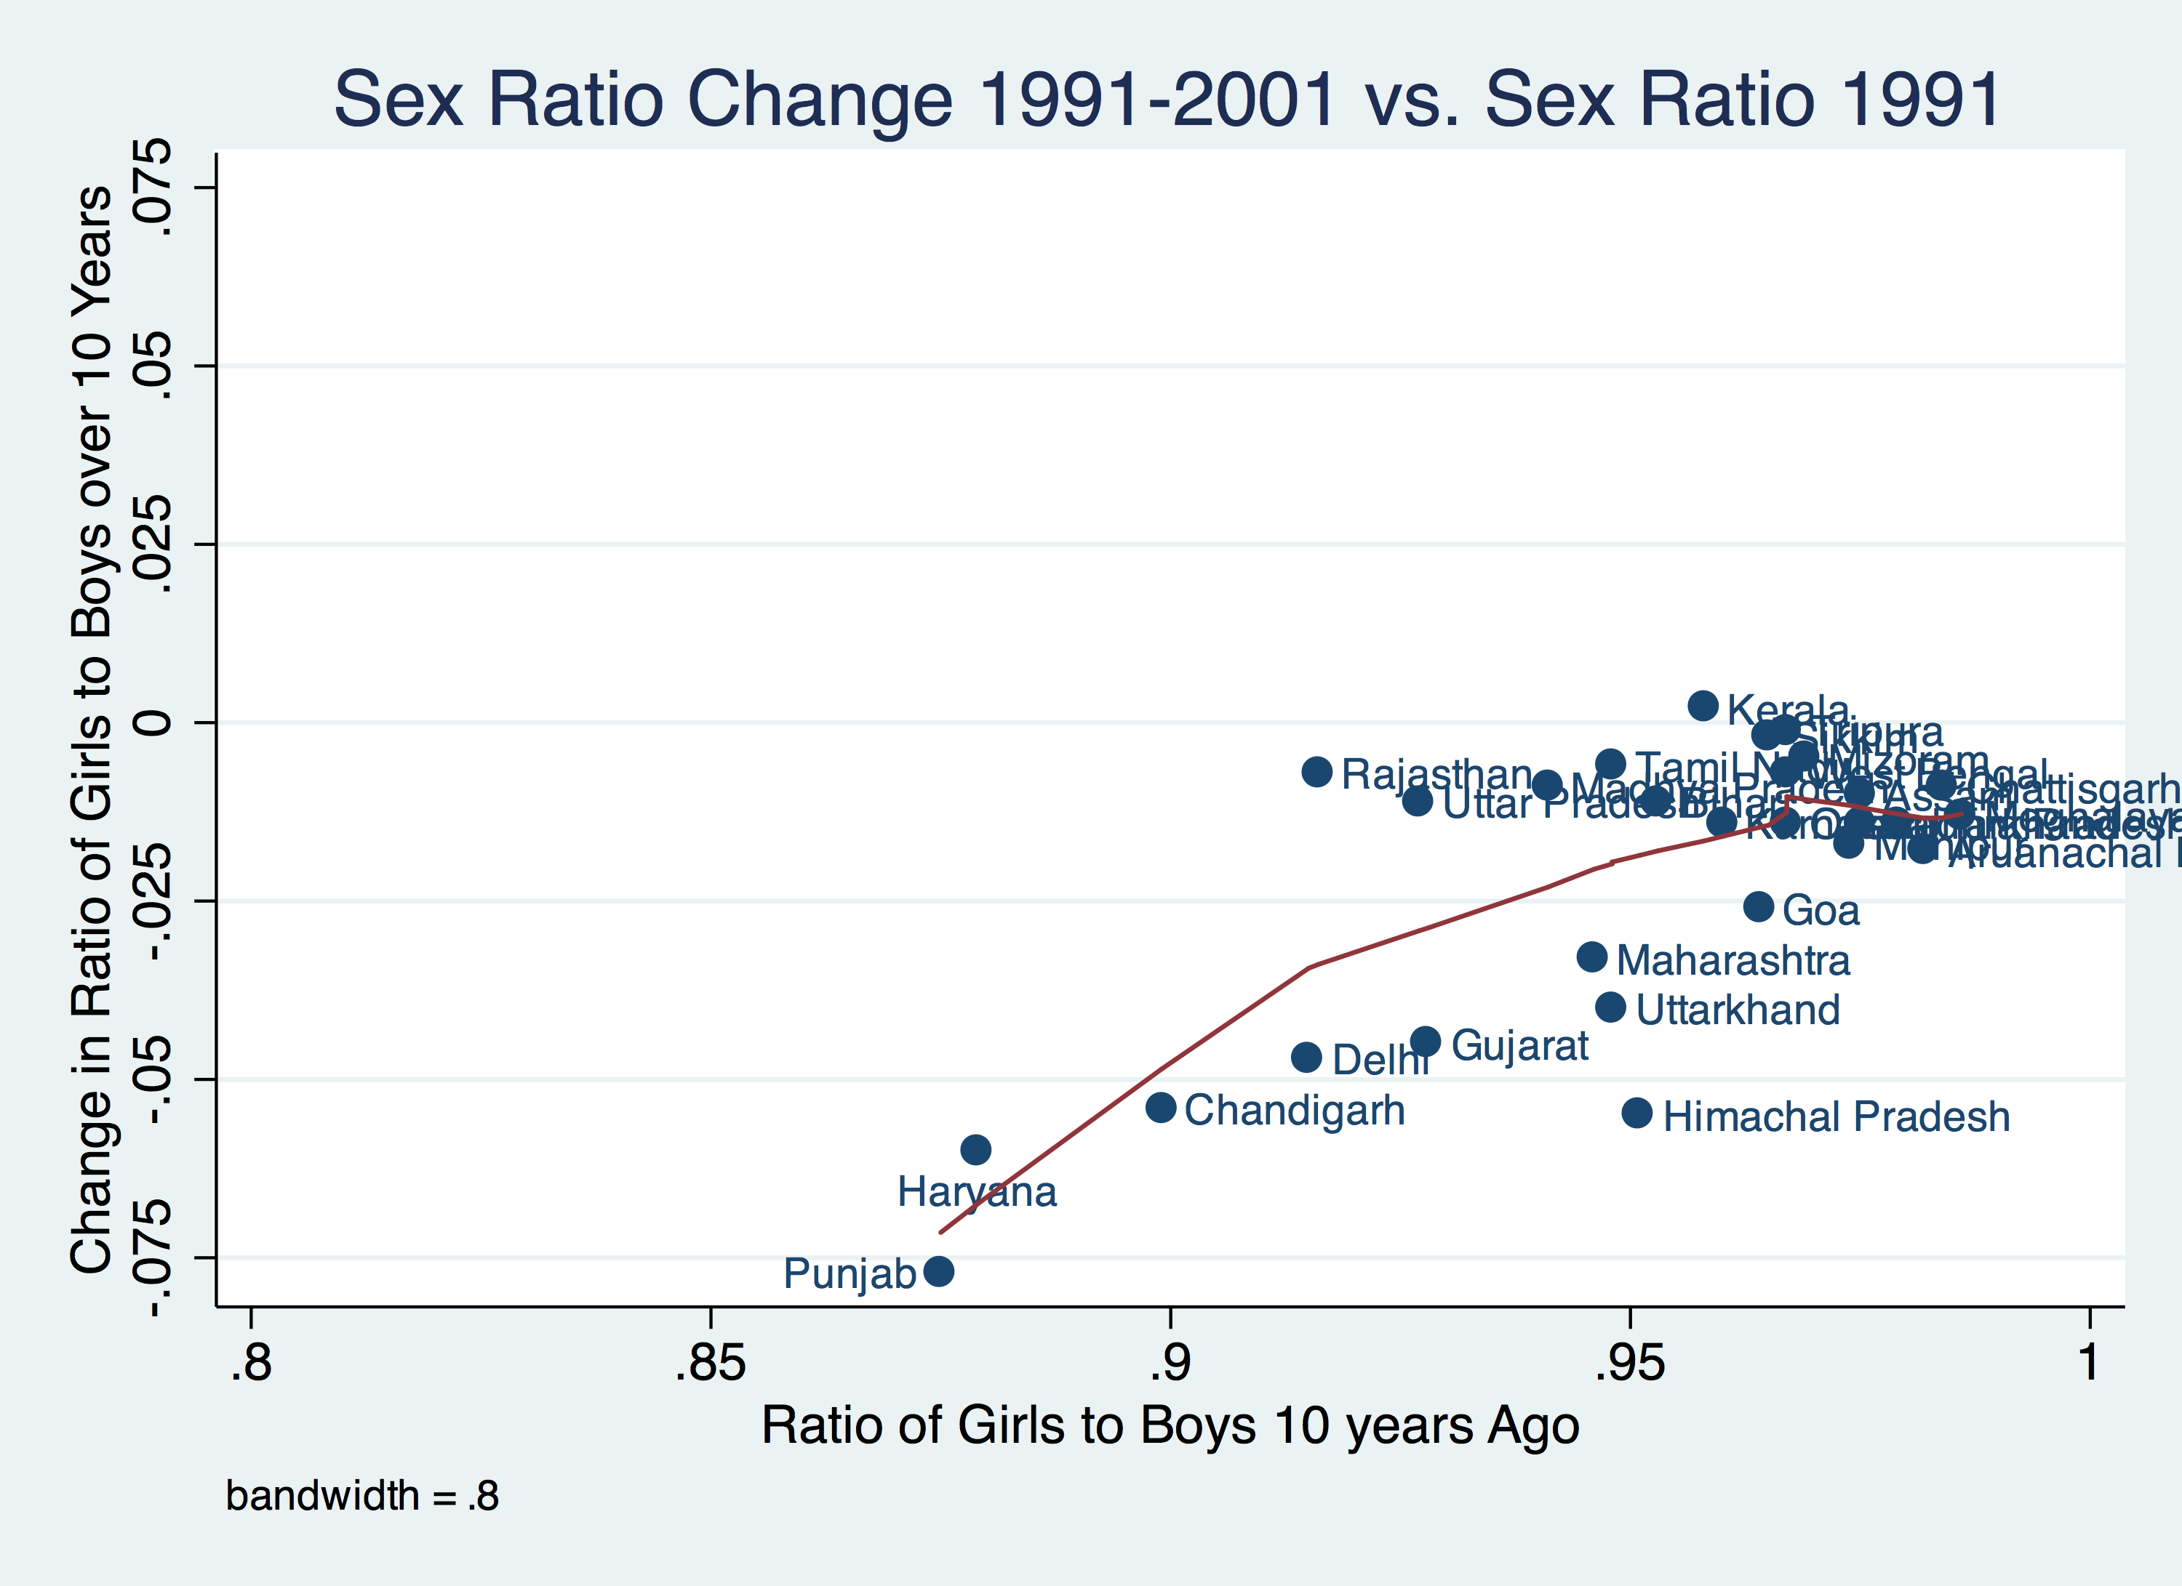
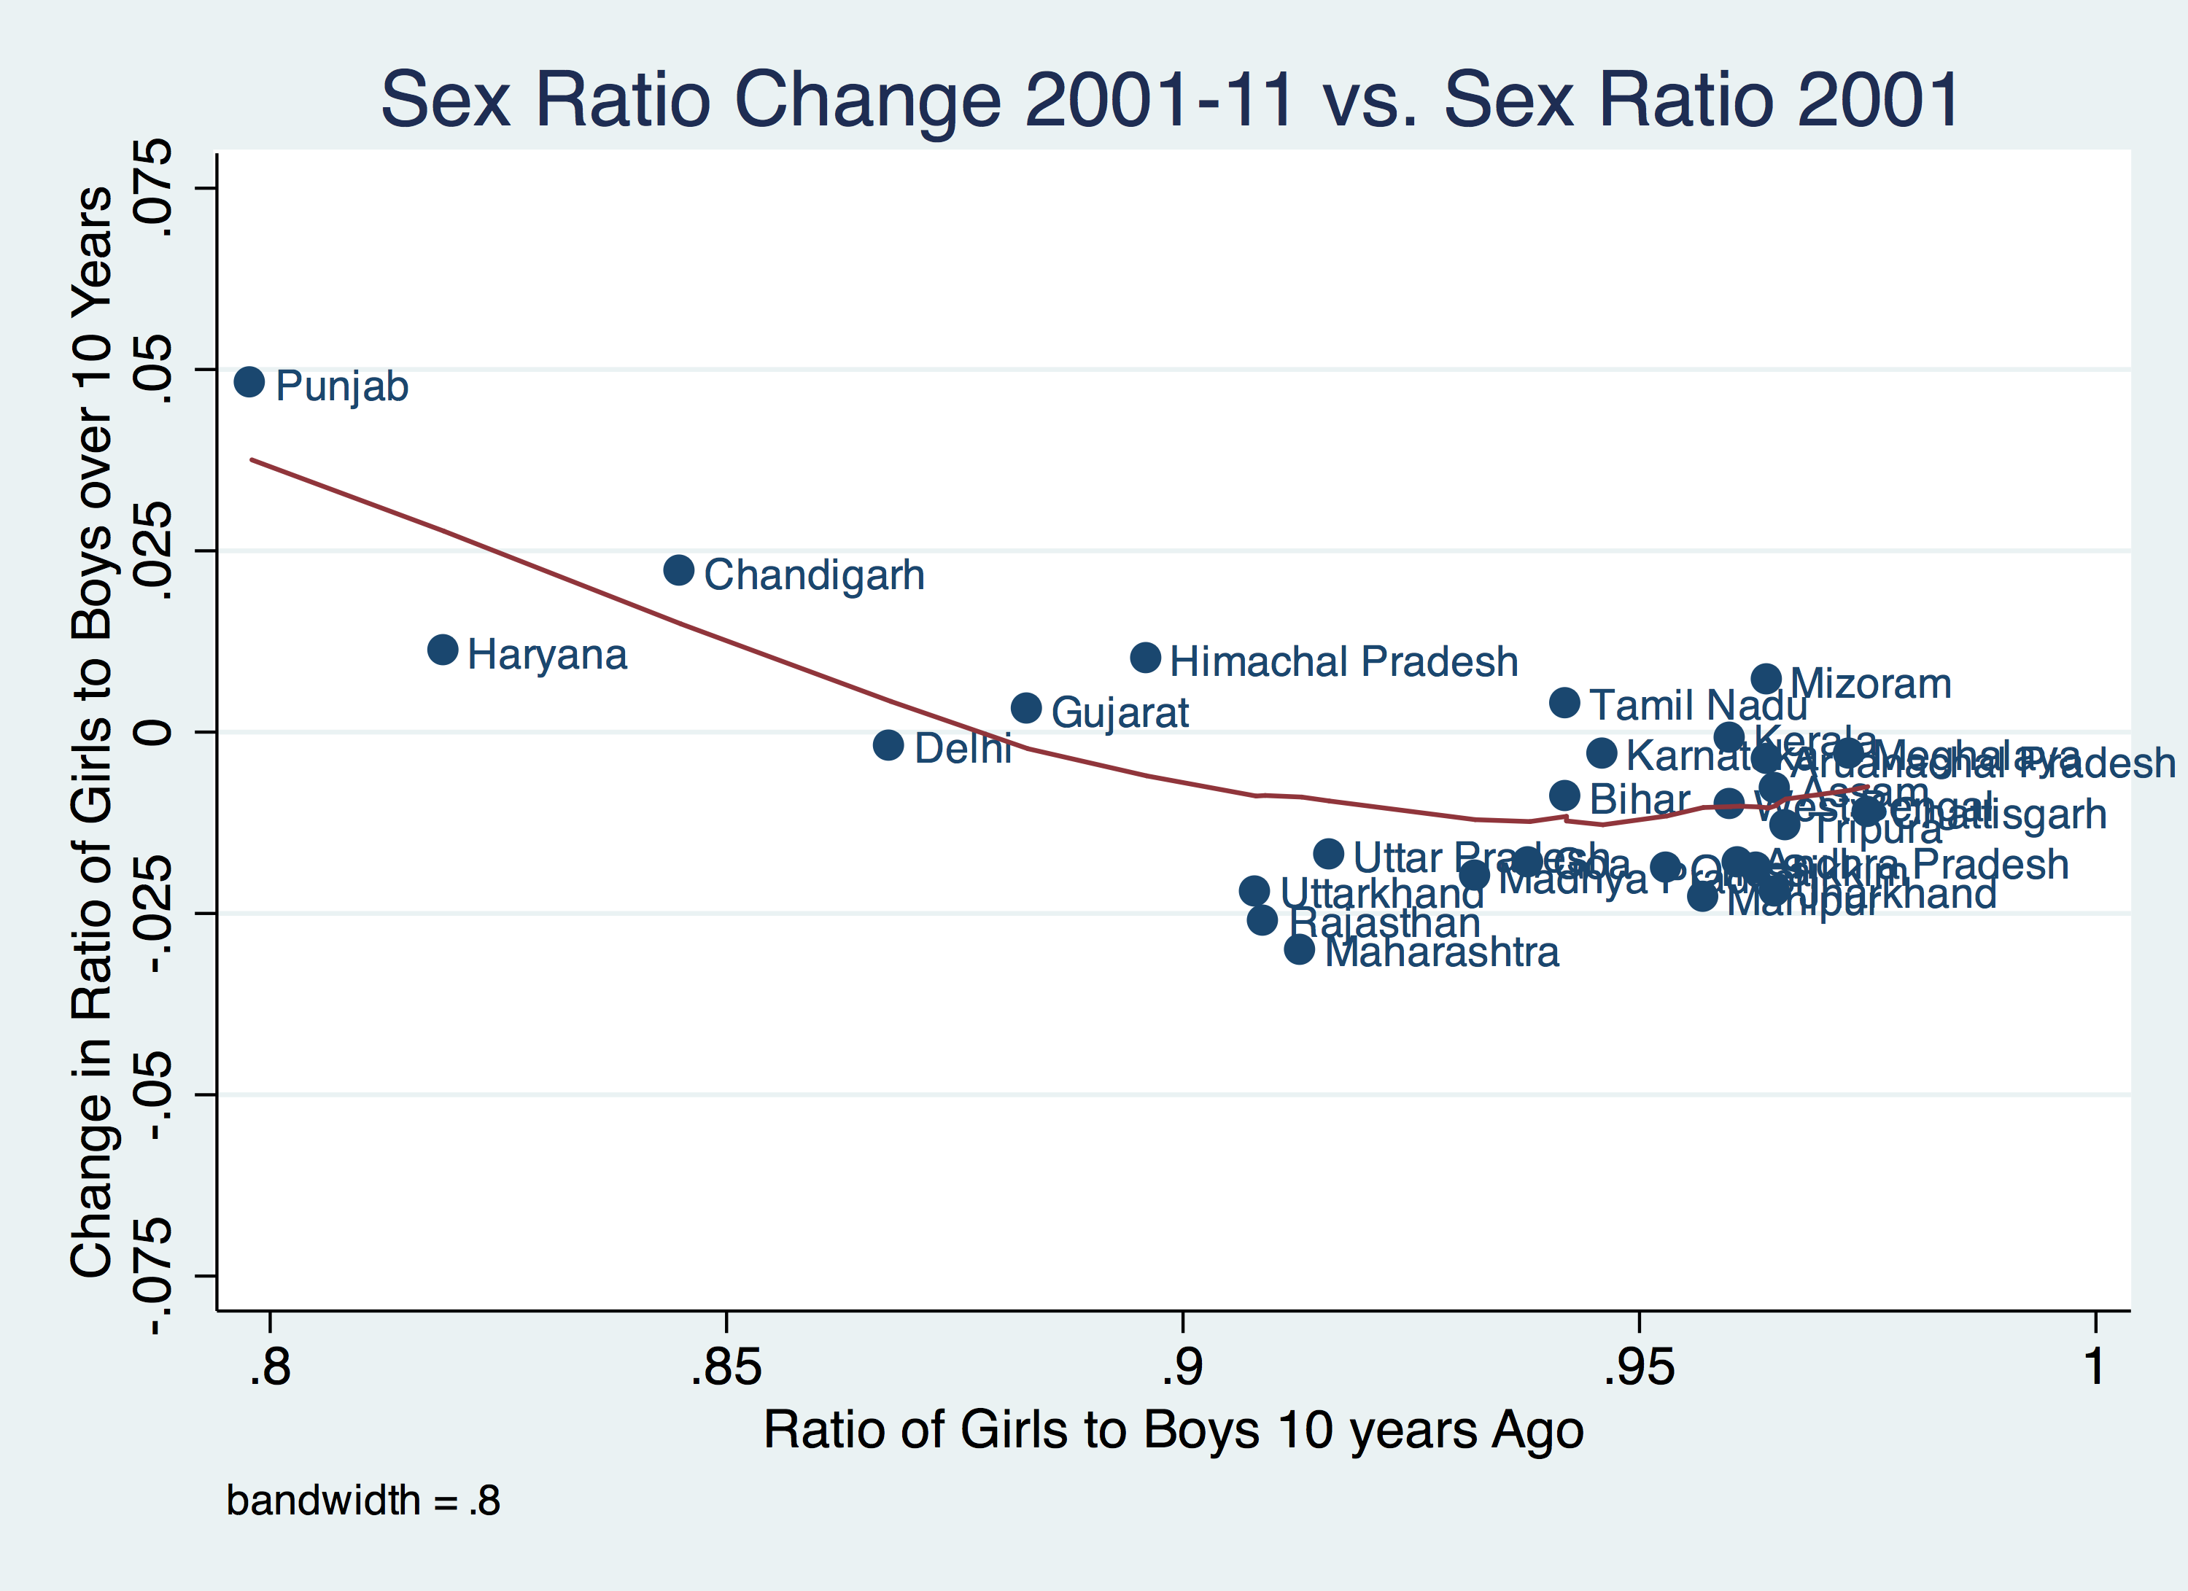
My research: is this happening in India?
Notes:
SW: LARGER FONT. WOULD MAKE HEADING AND BODY FONT SAME. CONSIDER SOME NICE FORMATTING TO MAKE IT MORE INTERESTING

Slide 17
Exploring the slowdown and improvement in imbalanced sex ratios in detail:
1. Is equalization occurring at a district-level?
2. Decompose the equalization into:
    Equalization due to less sex-selective abortion vs. improved girl child mortality compared to boy child mortality
    Look at geographic and urban/rural differences
3. What are the drivers of equalization?
    Marriage and labor market, norms, access to sex-selective technology
Notes:
SW: LARGER FONT. WOULD MAKE HEADING AND BODY FONT SAME. CONSIDER SOME NICE FORMATTING TO MAKE IT MORE INTERESTING

Slide 18

Is equalization occurring at a district level?
Indian census data, collected every 10 years
  1981-2011
Sample Registration System (SRS) 2010
  Some data not yet available for 2011 Census, so use data from 2010 SRS
Notes:
SW: LARGER FONT. WOULD MAKE HEADING AND BODY FONT SAME. CONSIDER SOME NICE FORMATTING TO MAKE IT MORE INTERESTING

Slide 19
Findings
Despite overall increasingly imbalanced sex ratios, the districts that have been the most imbalanced are starting to become less imbalanced
% of literate adults, % Scheduled tribe, Total fertility rate associated with increasingly imbalanced sex ratio
% literate females associated with equalizing sex ratio
Provides hope that sex ratios will not continue to become imbalanced forever
  But, if all districts had to become very imbalanced before they equalized this would mean many decades of discrimination against girls
Do not know if trend of improvement will be sustained
Notes:
SW: LARGER FONT. WOULD MAKE HEADING AND BODY FONT SAME. CONSIDER SOME NICE FORMATTING TO MAKE IT MORE INTERESTING

Slide 20
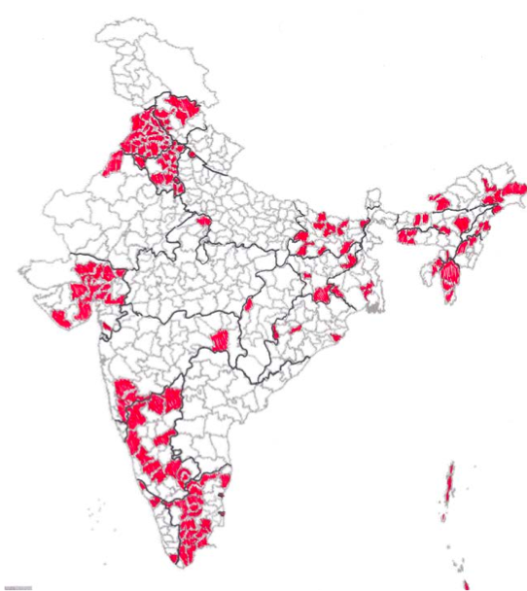
Results: Geographic distribution of increased equalization
Geographic Clusters:
North: Very imbalanced child sex ratios, dense pocket of change, include major urban centers
West: Gujarat: Very imbalanced child sex ratios, include the capital and 3rd largest city in Gujarat
South: Not as imbalanced sex ratios, stretch along the western Ghats from Tamil Nadu up through Karnataka
North eastern region: Scattered, not as imbalanced sex ratios, areas of social unrest, some matrilineal societies
Notes:
SW: LARGER FONT. WOULD MAKE HEADING AND BODY FONT SAME. CONSIDER SOME NICE FORMATTING TO MAKE IT MORE INTERESTING

Slide 21
Less sex selective abortion or improved mortality for girls compared to boys?
Decompose the improving child sex ratio into 2 components:
  Missing girls due to excess girl child mortality
  Missing girls due to sex-selective abortion
Do this for all districts that showed improvement between 2001 and 2011
  Rural and urban populations within districts
Explore geographic patterns in the improving child sex ratio
Test if there is a trade-off between declines in post birth female mortality and increases in pre-birth female mortality (sex-selective abortion)
Notes:
SW: LARGER FONT. WOULD MAKE HEADING AND BODY FONT SAME. CONSIDER SOME NICE FORMATTING TO MAKE IT MORE INTERESTING

Slide 22
Results: Abortion component larger than mortality component
Notes:
SW: LARGER FONT. WOULD MAKE HEADING AND BODY FONT SAME. CONSIDER SOME NICE FORMATTING TO MAKE IT MORE INTERESTING

Slide 23
Results: Worsening condition for female child mortality in urban areas
Notes:
SW: LARGER FONT. WOULD MAKE HEADING AND BODY FONT SAME. CONSIDER SOME NICE FORMATTING TO MAKE IT MORE INTERESTING

Slide 24
Does access to abortion improve the situation for those girls that are born?
Some authors have argued that access to pre-natal sex determination and abortion should allow those girls that are born to be more “wanted”
  Therefore excess girl-child mortality would decrease with increasing sex-selective abortion.
Evidence of this effect has been found by Sudha and Rajan, 2003
Others have argued that sex-selective abortion and girl-child neglect are additive, or even re-enforce and strengthen each other, and that additivity has lead to further imbalanced sex ratios in parts of Asia in recent years (Goodkind, 1996).
Tested this in my dataset: No relationship

Slide 25
Decomposition: Conclusions
Most of the cause of imbalanced child sex ratios is from sex-selective abortion
  Most of the improvement is from less sex-selective abortion
In those districts that are equalizing, it is happening in both rural and urban areas
  Slightly more in urban areas
Evidence that female children in urban areas are doing worse, compared to males, in 2011 compared to 2001
Distinct clusters of equalization: north, west, south
  Seems that equalization is grouped around urban centers
  Perhaps evidence of social contagion?
Notes:
SW: LARGER FONT. WOULD MAKE HEADING AND BODY FONT SAME. CONSIDER SOME NICE FORMATTING TO MAKE IT MORE INTERESTING

Slide 26
Why are sex ratios beginning to even out in India?
A test of supply- and demand-side factors influencing son preference
Notes:
SW: LARGER FONT. WOULD MAKE HEADING AND BODY FONT SAME. CONSIDER SOME NICE FORMATTING TO MAKE IT MORE INTERESTING

Slide 27
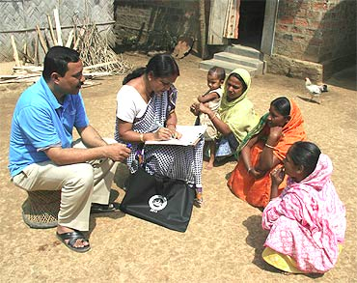
Data
National Family Health Survey 2005-06 data
  Household survey, individual-level data
Variables:
  Dependent:
    Probability of having a boy (Model 1, individual level)
    Community level child sex ratio (Model 2, community level)
  Independent (at both individual and community level):
    Marriage: marriage age gap
    Labor: % of women in the labor force and in professional occupations
    Social norms: % watch TV frequently, acceptability of wife beating
    Access to sex-selective technology: access to a doctor/nurse at delivery or antenatal care
    Demographic (age, education, religion, etc.)
Notes:
SW: LARGER FONT. WOULD MAKE HEADING AND BODY FONT SAME. CONSIDER SOME NICE FORMATTING TO MAKE IT MORE INTERESTING

Slide 28
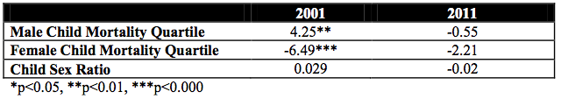
An individual woman’s odds of having a boy
Increased the odds of having a boy:
A more even sex ratio in children under 10, 2003* (OR=1.33)
Higher percent of women in the community who saw a doctor or nurse for delivery*** (2.77)
Decreased the odds of having a boy:
Higher percent of women in the community who saw a doctor or nurse for ANC*** (0.49)
Higher percent of women in the community in advanced labor force occupations*** (0.23)
Controlling for women’s education, any labor market participation (individual and community %), advanced labor market participation (individual and community %), wealth index, Hindu/other (individual and community %), State dummy, age gap between husband and wife (individual and community %, watches TV frequently (individual and community %), wife beating score (individual and community %), mean ideal number of boys/girls, percent watch TV frequently, (individual and community %), percent delivery with doctor/nurse (individual and community %), percent see doctor/nurse for ANC (individual and community %)
Notes:
SW: LARGER FONT. WOULD MAKE HEADING AND BODY FONT SAME. CONSIDER SOME NICE FORMATTING TO MAKE IT MORE INTERESTING

Slide 29
Factors associated with the stratum-level sex ratio in children under 10 in 2006
Increased the stratum-level child sex ratio
Higher percent of women in the community in advanced labor force occupations*** (0.92)
Controlling for community-level: age gap between husbands and wives, wealth index, wife beating score, mean ideal number of boys/girls, percent watch TV frequently, percent delivery with doctor/nurse, percent see doctor/nurse for ANC
Notes:
SW: LARGER FONT. WOULD MAKE HEADING AND BODY FONT SAME. CONSIDER SOME NICE FORMATTING TO MAKE IT MORE INTERESTING

Slide 30
Conclusions
Some weak evidence that lagged community-level child sex ratio is associated with an individual’s probability of having a boy
Women’s labor force opportunities in high level professions seems to be associated with both an individual’s probability of having a boy (reduces the odds) and community level child sex ratio
Community level access to providers seems to be important, not sure of direction
  Other ways of measuring marriage, labor, norms and access to technology should also be explored
Notes:
SW: LARGER FONT. WOULD MAKE HEADING AND BODY FONT SAME. CONSIDER SOME NICE FORMATTING TO MAKE IT MORE INTERESTING

Slide 31

Further research
Don’t know yet if the equalizing districts will continue to equalize in the future
Other potential drivers could be associated with changes in son preference
Should not interpret findings to suggest that imbalanced child sex ratios will “fix themselves”
Notes:
SW: LARGER FONT. WOULD MAKE HEADING AND BODY FONT SAME. CONSIDER SOME NICE FORMATTING TO MAKE IT MORE INTERESTING

Slide 32
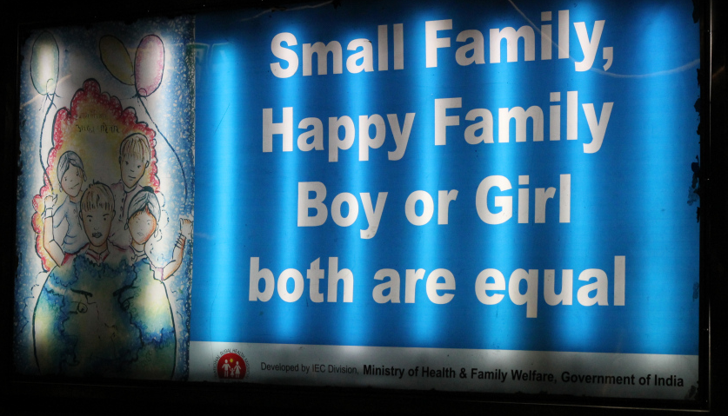
Programs and Policies
Many programs, interventions,
social media campaigns, and policies have been implemented in India but need evidence base
EXAMPLES:
The government will put money in a bank account for families who have a girl, which she gets to pay for her marriage (dowry)
Other schemes give an incentive at various stages of life: birth registration of a girl, completion of vaccinations, completion of various levels of education, marriage post age 18 or 21
Breaking news: Supreme Court of India LAST WEEK ordered Google and Yahoo to stop advertising for sex determination technologies on their websites

Slide 33
Outline
Sex ratios
Residential segregation
Life tables part 2

Slide 34
Measures of Residential Segregation
Five dimensions
  Evenness/dissimilarity
  Exposure
  Clustering
  Concentration
  Centralization

Slide 35

Evenness/index of dissimilarity
The degree to which groups (e.g., ethnic groups) are evenly spread across the city
“How many people would have to move in order to make each census tract have the same distribution as the city as a whole?”
Suppose:
b_{i} = the black population of the i^{th} areal unit, e.g. census tract
B = the total black population of the large geographic entity w_{i} = the white population of the i^{th} area unit, e. g. census tract
W = the total white population of the large geographic entity
The index of dissimilarity measuring the segregation of whites from blacks:

Slide 36
Evenness

Slide 37
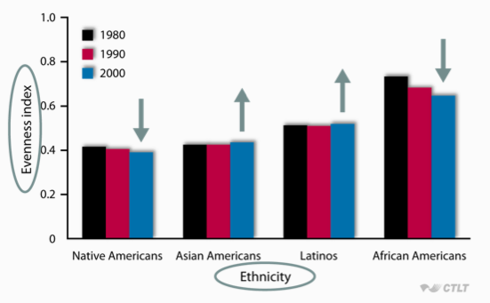
Evenness in US cities over time

Slide 38

Isolation/Exposure
Inverse of the probability that a person of one ethnic group shares a census tract with a person of a particular other ethnic group
Assume:
w_{i} = the white population of a component part (like a census tracts) of the larger geographic entity
t_{i}= the total population of a component part of the larger geographic entity
W_{i} = the total white population of the larger geographic entity
Then the isolation index for whites equals:
You are summing all the components of the area

Slide 39
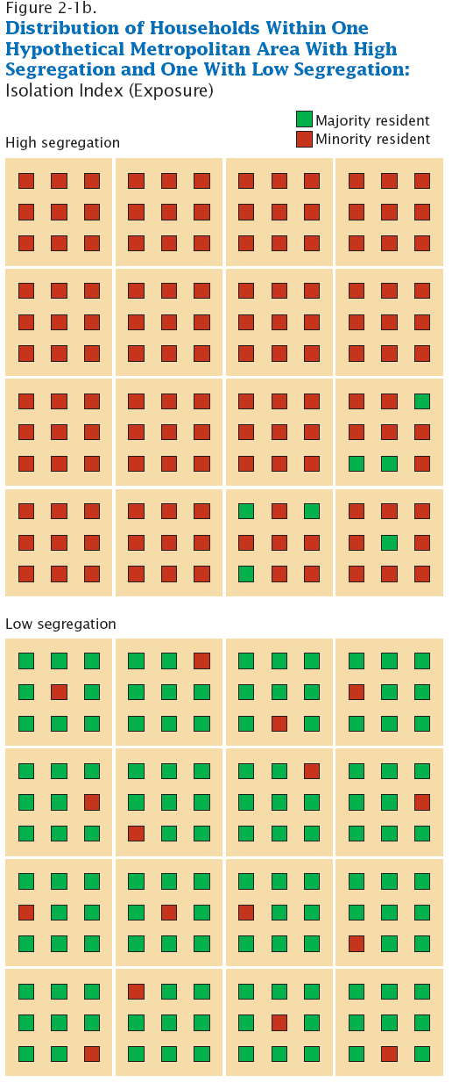
Isolation/Exposure

Slide 40
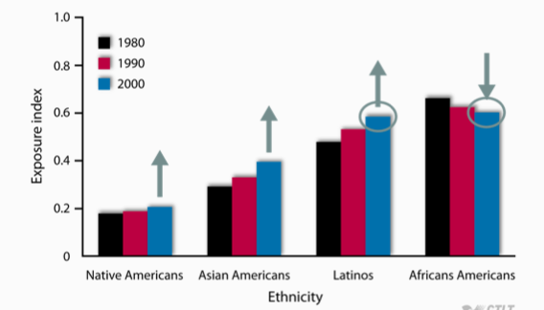
Exposure, compared to European Americans

Slide 41

Delta Index/Concentration
The proportion of geographic space occupied by census tracts with a large percentage of a particular ethnic group

Slide 42
Delta Index/Concentration

Slide 43
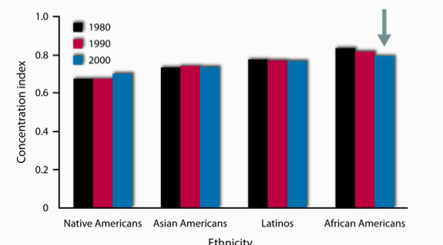
Concentration, compared to European American

Slide 44

Absolute Centralization Index
Closeness of the census tracts with a large percentage of a particular ethnic group to the central business district of the city
Ai= the land area of area i
Xi= the minority population

Slide 45
Absolute Centralization Index

Slide 46
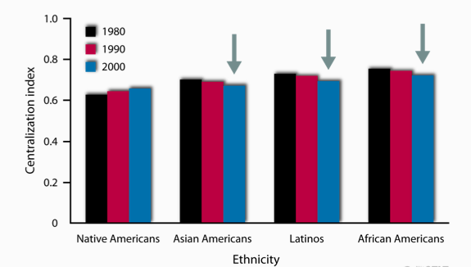
Centralization, European American comparison

Slide 47
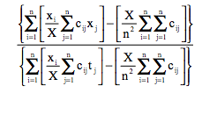
Spatial Proximity Index/clustering
The degree to which census tracts with a large percentage of a particular ethnic group are contiguous

Slide 48
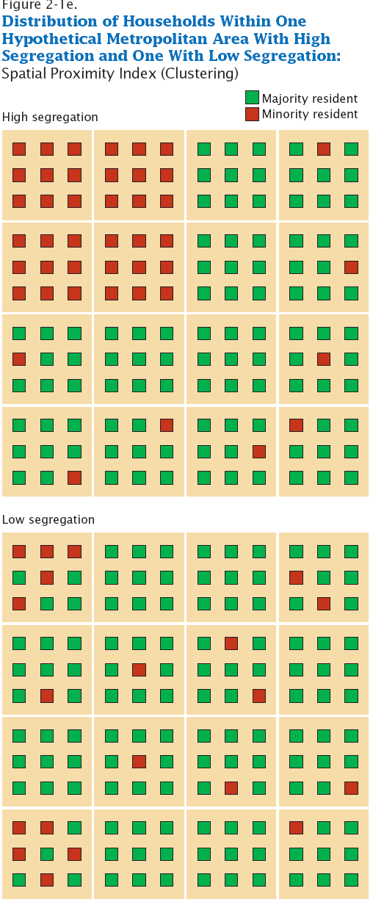
Spatial Proximity Index/clustering

Slide 49
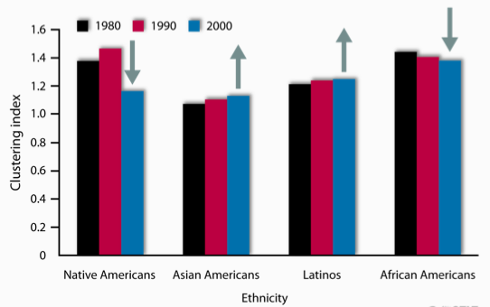
Clustering, compared to European Americans

Slide 50
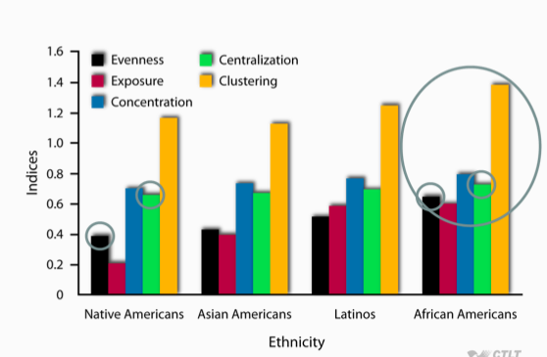
Today

Slide 51
Can measure Social Class or Income
Relatively little research on this, compared to ethnicity
  What studies there are show that social class segregation has increased a little over the last part of the 20th century
  In particular, has increased among ethnic minorities
Spatial concentration of poverty
  Combination of unrelenting ethnic segregation and slightly increasing social class segregation

Slide 52
Residential Segregation in public health research
Most models only use evenness

Slide 53
Outline
Sex ratios
Residential segregation
Life tables part 2

Slide 54
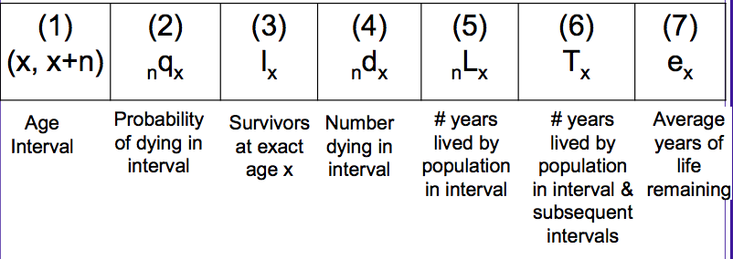
Life table

Slide 55
Back to life tables!
0-1 | 0.0582 | 100,000 | 582
1-2 |  | 99,418

Slide 56
L_{x}
L_{x} = The total number of person-years lived in each interval, or # in age group of stationary population
It is the sum of:
Persons who survived the interval, equivalent to the number alive at the beginning of the next interval or l_{x}+1
  They each contribute the number of years in the interval.
b. Persons who died during the interval (d_{x}) who contribute a part of the interval, depending on when they died. For most purposes, we simply assume they contributed 1⁄2 a year.

Slide 57
Lx calculations
Generally we assume linearity:
  unabridged: Lx = 0.5*(lx + lx+n)
    Every year from birth to death
  abridged: Lx = (n*0.5)*(lx + lx+n)
    Can have age groups

Slide 58
Infant/early childhood and oldest age
Because infant and early childhood deaths are closer to birth, we use:
  L₀ = 0.3*l₀ + 0.7*l₁
For the terminal category, we do not have length of interval, so we use :
∞L_{x} =l_{x}/ ∞m_{x}
for example
L₁₀₀₊ = l₁₀₀₊ / M₁₀₀₊
where ∞M_{x} substitutes for ∞m_{x} in abridged tables

Slide 59
  L₀ = 0.3*l₀ + 0.7*l₁
What is L₀ ?
0.3*100,000 + 0.7*99418
L₀=99592.6
Age group | _{n}q_{x} | l_{x} | _{n}d_{x} | L_{x} | T_{x} | e_{x}
0-1 | 0.0582 | 100,000 | 582
1-2 |  | 99,418

Slide 60
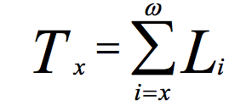
T_{x}
T_{x} is the total number of years of life lived by all members of the cohort. It is obtained by summing up all values of Lx from that age forward

Slide 61
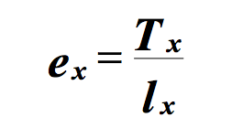
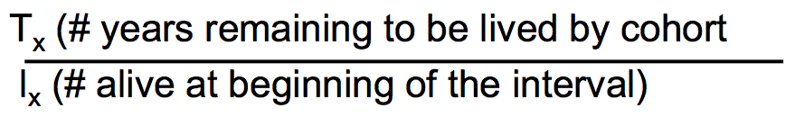
Life expectancy e_{x}
Whereas Tx provides the number of years remaining to be lived by the entire cohort, ex represents the number of years lived on average by any individual in the cohort.
Remember:

Slide 62
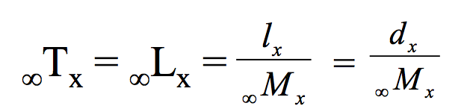
Different life expectancies
Life expectancy at birth (e₀) is the number of years that a baby born now will live if that baby experiences all the age-specific mortality rates currently operating in the population
Terminal Age Category= Because the final age category in the life table is an open ended interval, and all individuals in our cohort must die, we have variations on the usual formulas for this interval
where ∞M_{x} is the observed ASDR for the terminal age group, assumed to be equivalent to ∞m_{x}
Because everybody dies: ∞qx = 1.0

Slide 63
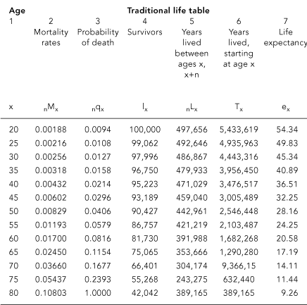

Slide 64
Thank you!
Questions?
Notes:
Final boiler plate language: 2 versions
Through its singular focus on health, UCSF is leading revolutions in health.
UCSF is driven by the idea that great breakthroughs are achieved when the best research, the best education and the best patient care converge.

