Slide 1
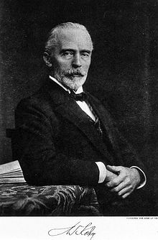
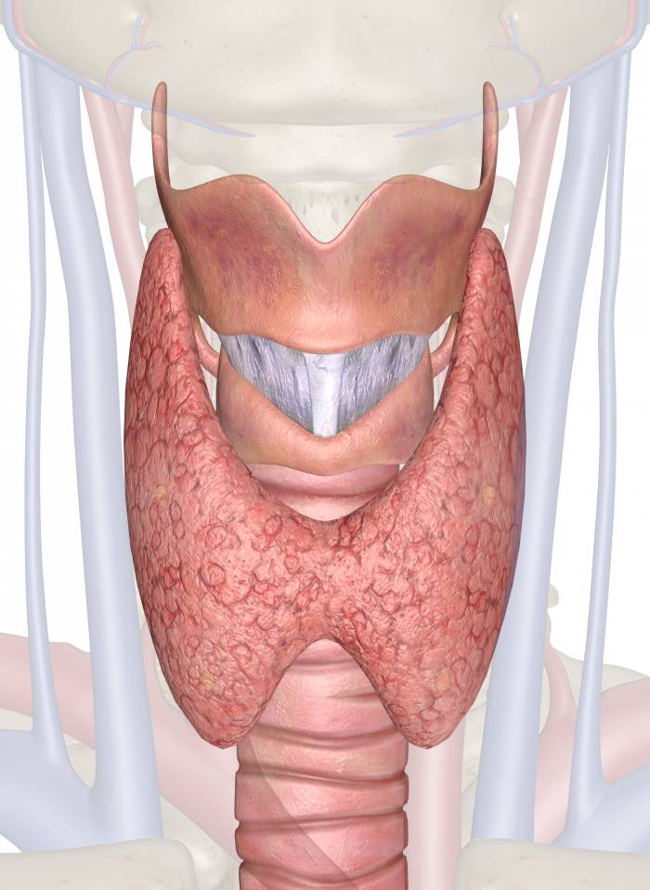
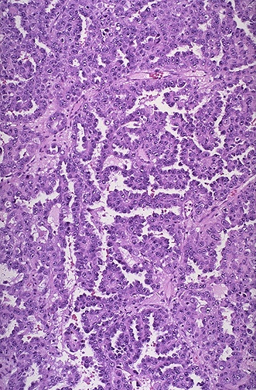
The Thyroid
Basic Overview, Thyroid Nodules and Cancer
Andrew Wisneski and Dr. Wen T. Shen
November 2nd, 2016
University of California San Francisco, CA, USA

Slide 2
Introduction
Thyroid nodules
  4-7% in general population
  Up to 50% in elderly with US criteria
  5% of all nodules ultimately found to be malignant.
Thyroid Cancer
  2% of all cancers
  Increasing at a high rate within the US
  SEER database: 2.4 fold increase in thyroid cancer between 1972 and 2002.

Slide 3
Thyroid Gland
Thyroid – Greek description of shield shaped gland ‘thyroides’
Kocher and Billroth key surgeons that advanced thyroid surgery and understanding of physiology.
  Kocher received Nobel Prize in 1909
Gland
  10-20g in normal adult
  Produces two families of hormones
    Thyroid: T3 and T4
    Calcitonin
  Follicular unit- produces T3, T5, stores thyroglobulin
  Stores 90% of total body iodine

Slide 4
Thyroid Hormones
Iodine transported into follicular cells, and bound to thyroglobulin
Thyroglobulin – role in formation of iodotyrosines
  Mono-iodotyrosine (MIT), Diiodotyrosine (DIT)
  MIT and DIT coupled together to form T3 and T4
T3 and T4 only biologically active thyroid hormones
Bound to TG and stored in follicles.
Calcitonin
  Made by parafollicular or C-cells
  Inhibit calcium absorption by osteoclasts, lower Ca

Slide 5
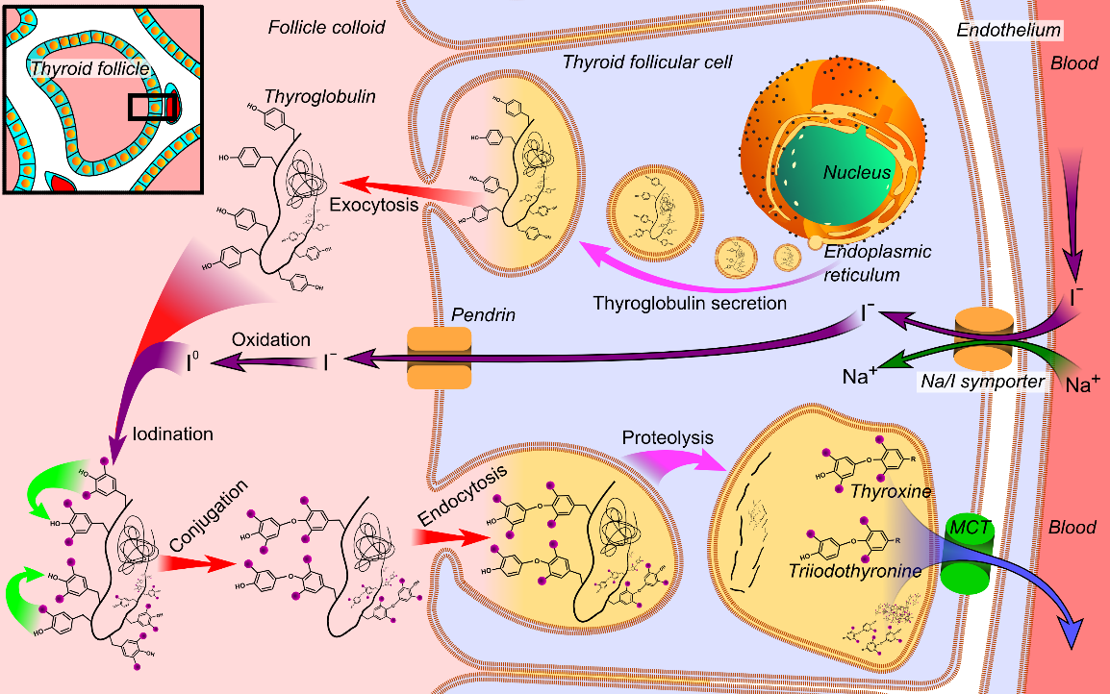
Thyroid Hormone
Peripheral Action
  T3 more potent that T4
  Most T4 converted to T3
    Sepsis, malnutrition, beta-blockers, PTU, steroids, amiodarone impair this conversion.

Slide 6
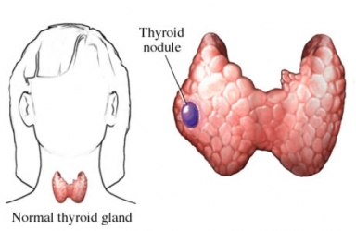
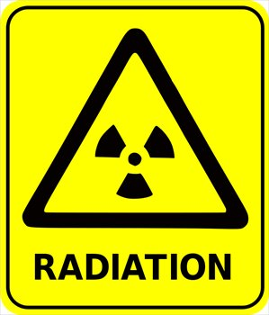
Thyroid Nodules
4-6.5% of all nodules harbor malignancy
Cancer higher in these groups:
  Children
  Adults <30 or >60yo
  h/o head/neck radiation
  Family history of thyroid cancer.

Slide 7
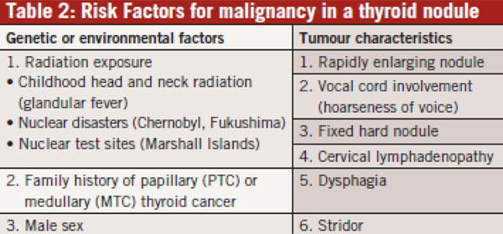
Thyroid Nodule Evaluation
History and Physical
  Rapid growth
  Childhood head/neck radiation
  Total body radiation (bone marrow transplantation)
  Family history

Slide 8
Thyroid Nodule Evaluation
TSH
  Subnormal – overt/subclinical hypothyroidism
    Hyperfucntioning nodule -> perform scintigraphy
  Normal or elevated
    If nodule meets criteria for FNA -> perform FNA
    Higher TSH associated with greater likelihood of malignancy

Slide 9
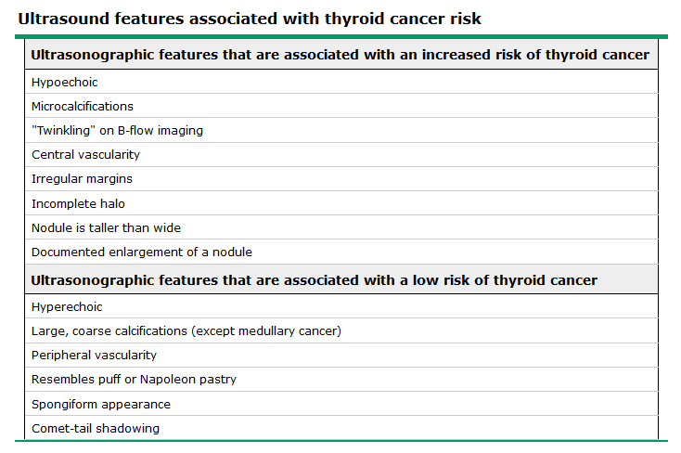
Thyroid Ultrasound
Perform on all patients with nodule.
Not to be relied on for diagnosing thyroid cancer.
Findings help guide decision to perform FNA

Slide 10
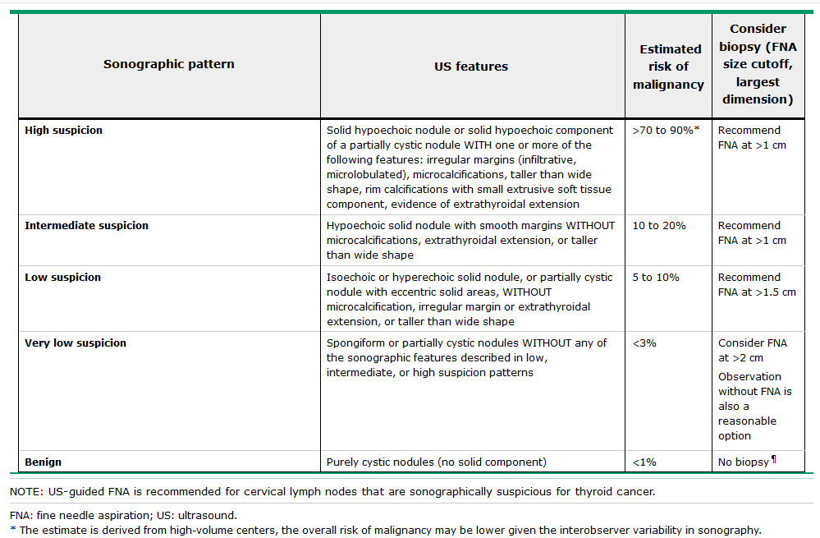
Sonographic Criteria for FNA
S

Slide 11
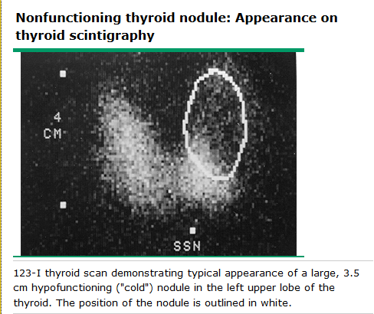
Thyroid Scintigraphy
Determine functional status of a nodule.
Hyperfunctioning nodules are rarely cancer.
  No FNA needed for hot nodule.
Useful for patients with multiple nodules.
  Select ones that are cold for FNA
Uses 123-Iodine or Technetium-99m
  Isotopes less concentrated in follicular cells
  Iodine preferred – 5% of thyroid cancers concentrate pertechetate but not iodine.
    Causes nodule to appear hot or indeterminate.
OUTDATED
Not routinely used

Slide 12
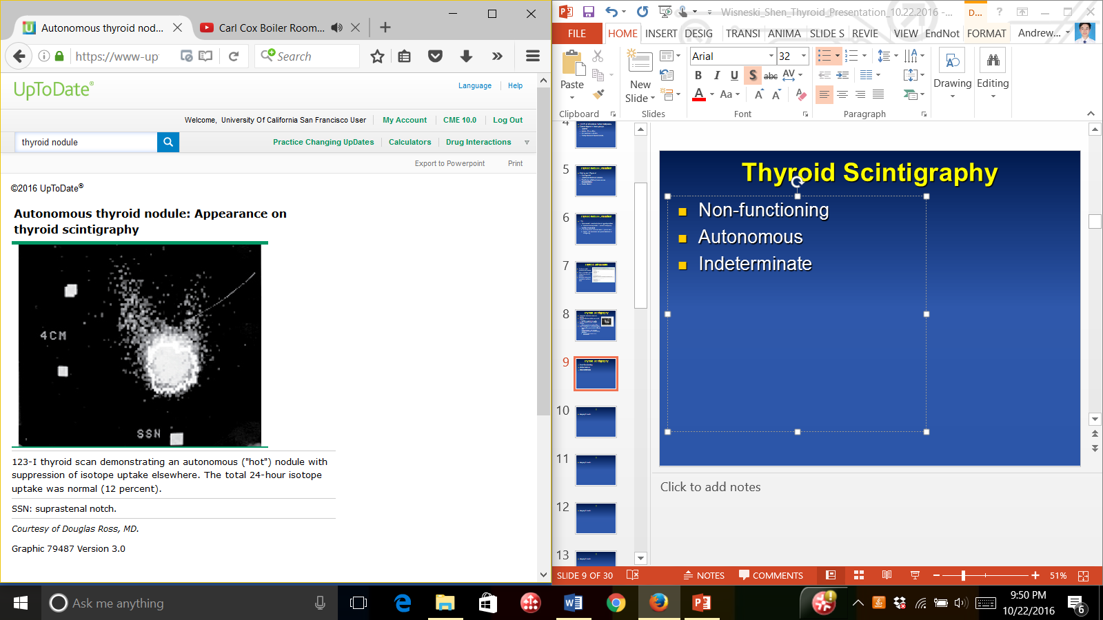
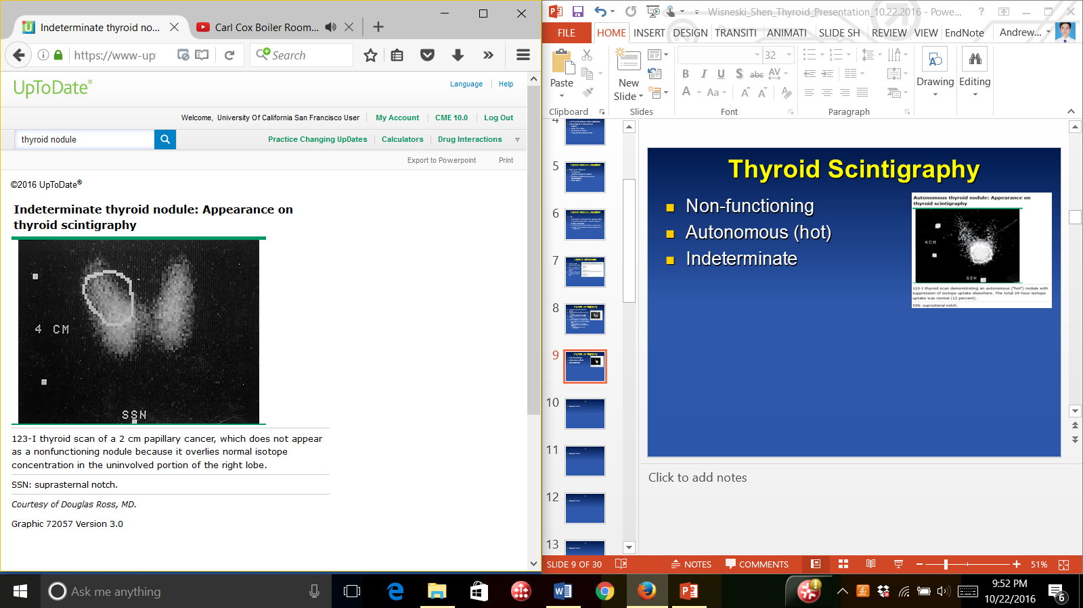
Thyroid Scintigraphy
Non-functioning
Autonomous (hot)
Indeterminate
  2 dimensional image, nodule superimposed over normal tissue
  Most are non-functioning
  Consider suppression test if FNA w/ follicular neoplasm of undetermined significance
    Give T4, repeat imaging.
OUTDATED
Not routinely used
Notes:
Cytologic findings of Follicular neoplasm (microfollicular) may be associated with autonomous nodules.
Suppression test- give T4, suppress all normal tissue. If nodule remains active and corresponds to nodule’s location on exam, presume it is an autonomous nodule.

Slide 13
Monitoring Nodules Not Meeting Criteria for FNA
6 to 12 months for subcentimeter nodules with suspicious characteristics
12 to 24 months for nodules with low to intermediate suspicion on ultrasound
>24 months for very-low-risk nodules

Slide 14
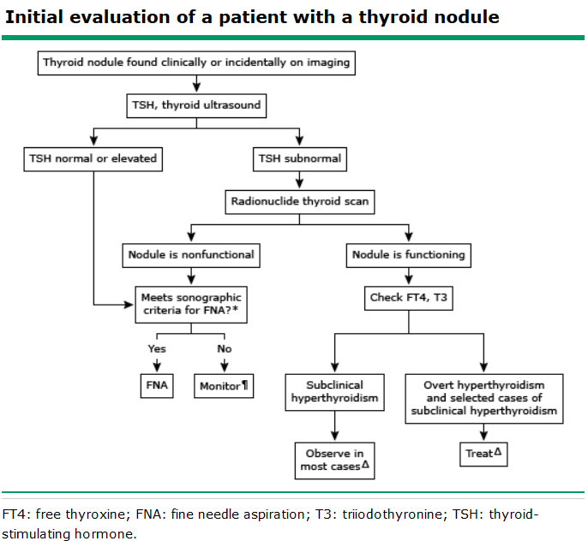
Algorithm
A

Slide 15
Genetic Analysis
For FNA with FLUS/AUS or follicular neoplasm -> ‘indeterminate’
Mutational analysis
  BRAF, RET/PTC, PAX8/PPARgamma, TERT
  PPV 96%, NPV 83%
mRNA gene expression classifier
  PPV 38%, NPV 95%

Slide 16
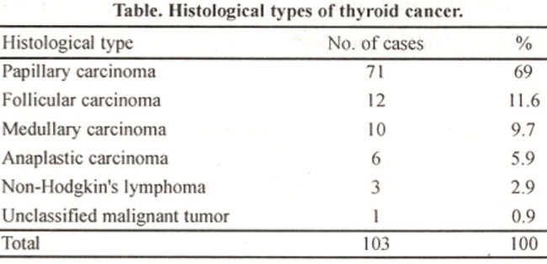
Thyroid Cancers
Classified into Follicular vs Non-follicular cell derived.
Follicular Cell Derived
  Papillary Thyroid Cancer
  Follicular cancer
  Hurthle cell cancer
  Anaplastic cancer.
Non-follicular cell derived
  Medullary thyroid cancer
  Lymphoma

Slide 17
Papillary Thyroid Cancer
Most common – 80% of all thyroid cancer
Associated with hereditary syndromes
  Familial adenomatous polyposis, Gardner’s syndrome, Cowden disease, Werner’s syndrome, Carney’s complex
Notes:
FAP – polyps in colon, APC mutation.
Gardner’s syndrome- subtype of FAP with adenomatous colon polyps and sebaceous cysts, which are closed sacs filled with liquid found under the skin, epidermoid cysts, which are lumps in or under the skin often filled with liquid, fibromas, which are fibrous tumors
desmoid tumors, which are fibrous tumors that can develop anywhere in the body, osteomas, which are bony growths, usually found on the jaw.
Cowden Syndrome: PTEN hamartoma tumor syndrome. Hamartomas are benign, meaning noncancerous, tumor-like growths. Other clinical syndromes that are part of the PTEN hamartoma tumor syndrome are Bannayan-Riley-Ruvalcaba syndrome (BRR; diagnosed in children), Proteus syndrome, and Proteus-like syndrome. CS is characterized by a high risk of both benign and cancerous tumors of the breast, thyroid, endometrium (uterus), colorectal, kidney, and skin (melanoma).
Werner’s Syndrome: erner syndrome, also called progeria, is a hereditary condition associated with premature aging and an increased risk of cancer and other diseases. Signs of Werner syndrome usually develop in the teenage years. A person with Werner syndrome does not have the usual growth spurt typical of a teenager and tends to be shorter than others. Signs of aging, including wrinkles, gray hair and hair loss, may appear in their 20s. In their 30’s, cataracts or clouding of the eye’s lens, type 2 diabetes, skin ulcers, a beaked nose, cancers, and osteoporosis, meaning decrease in bone mineral density, may develop. One of the most significant health problems faced by people with Werner syndrome is the early development of atherosclerosis, commonly known as hardening of the arteries, which can lead to a heart attack.
Carney Complex: Carney complex is a hereditary condition associated with: spotty skin pigmentation; myxomas, which are benign (noncancerous) connective tissue tumors; and benign or cancerous tumors, meaning it can spread to other parts of the body, of the endocrine (hormone producing) glands. Tumors can be benign or cancerous. A benign tumor means the tumor can grow but will not spread. A cancerous tumor is malignant, meaning it can grow and spread to other parts of the body.
Symptoms of Carney complex typically develop when a person is in his or her early 20s. Skin pigmentation and heart myxomas or other heart problems are usually the first signs of the condition. The spotty skin pigmentation is found on lips, inner and outer corners of the eyes, the conjunctiva (membrane lining) of the eye, and around the genital area. Other common features of Carney complex are Cushing’s syndrome and multiple thyroid nodules (tumors).

Slide 18
Well Differentiated Thyroid Cancer
PTC, FC, HCC
  Relatively indolent course
  High 10 year survival rates
  Account for 95% of all thyroid cancer
Staging
  Under age 45, max is Stage II

Slide 19
Non Well Differentiated
MTC, AC, Lymphoma
  More aggressive, poorer prognoses.
MTC associated with
  MEN 2A and 2B
Notes:
MEN 2A: Patients with this form of MEN 2 may have:
Medullary thyroid cancer
Pheochromocytoma (generally benign tumor in the adrenal glands)
Parathyroid adenoma (generally benign tumor of the parathyroid)
MEN 2B: Patients with this form of MEN 2 may have:
Medullary thyroid cancer
Pheochromocytoma (generally benign tumor in the adrenal glands)
Mucosal neuroma (benign tumor of nerve tissue on the tongue and lips)

Slide 20
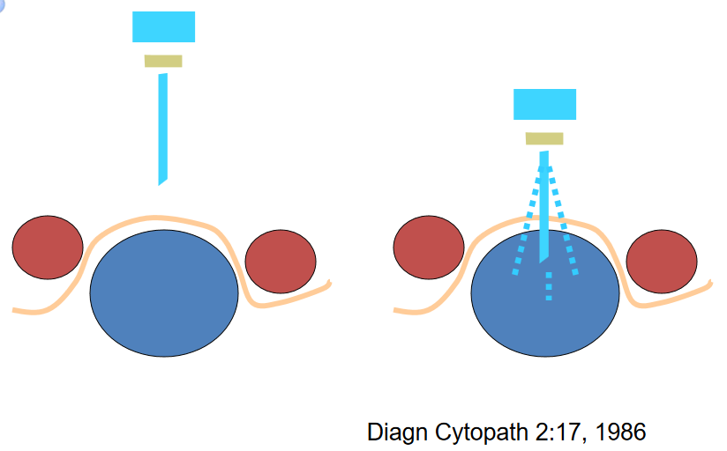
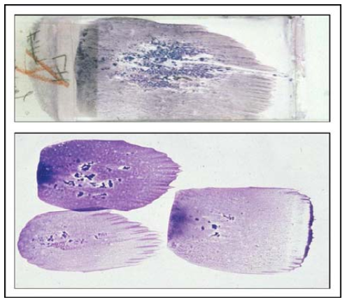
Diagnostic Workup
Fine Needle Aspiration
  Safe, cost-effective.
  High diagnostic accuracy 90-100%
  Low false positives <1%
  False negatives 1-11%

Slide 21
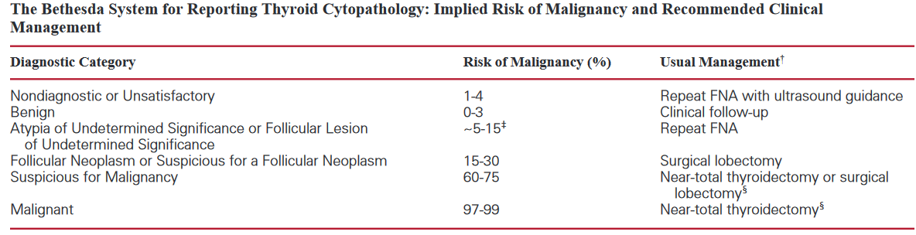
Diagnostic Workup
Bethesda Criteria – 2007
  Interpretation of FNA results and management

Slide 22
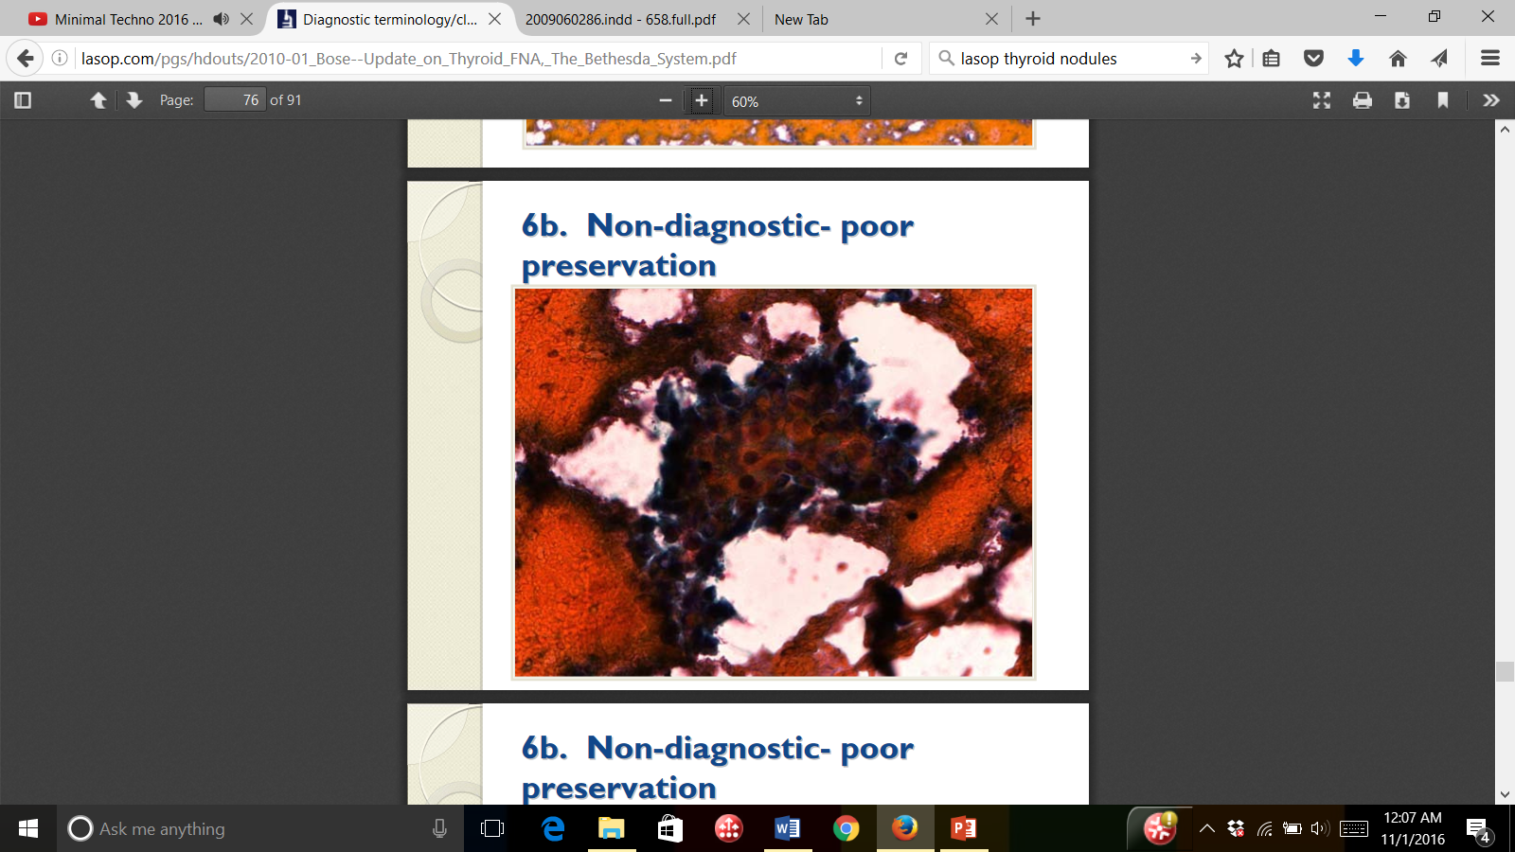
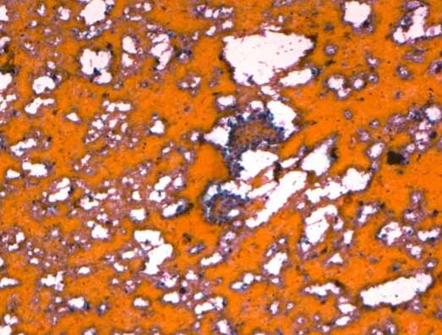
1. Nondiagnostic (ND)
Poor sample
  Inadequate cell number, obscuring blood, cyst fluid only.
  Risk of malignancy 1-4%
  Action: repeat FNA
    Repeat FNA diagnostic 50-88% of time.
    If persistent ND -> excise (10% malignancy rate)

Slide 23
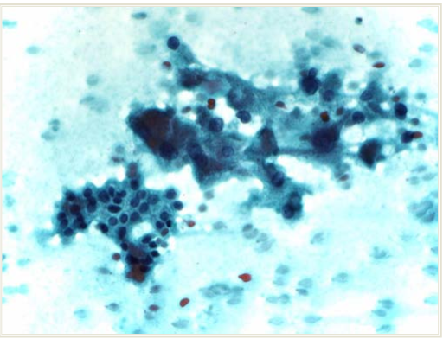
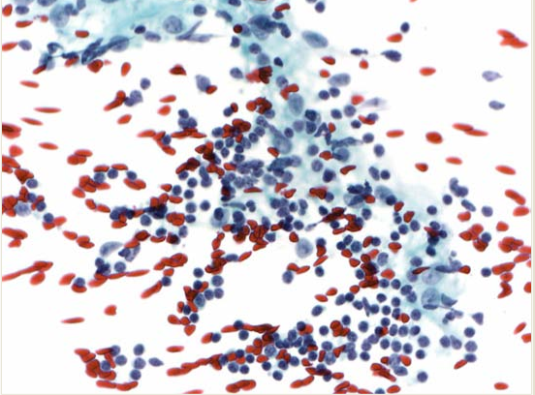
2. Benign
60-70% of FNAs
  Nodular goiter, chronic lymphocytic thyroiditis, colloid nodule.
False negative rate 0-3%
Clinical follow up at 6-18 month intervals
If growth or suspicious changes, consider repeat FNA.

Slide 24
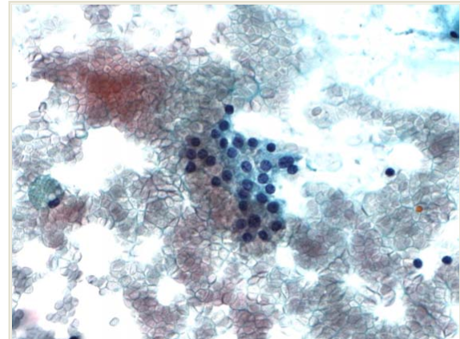
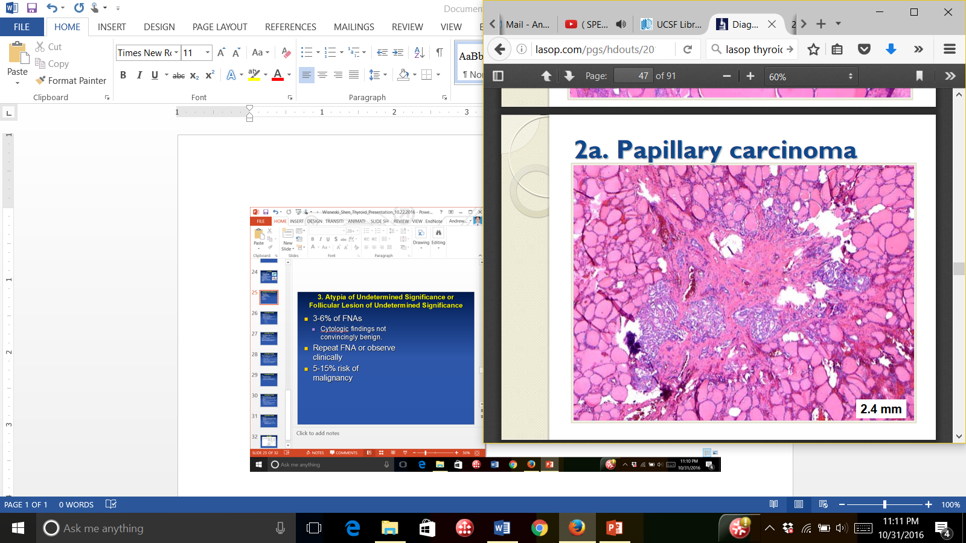
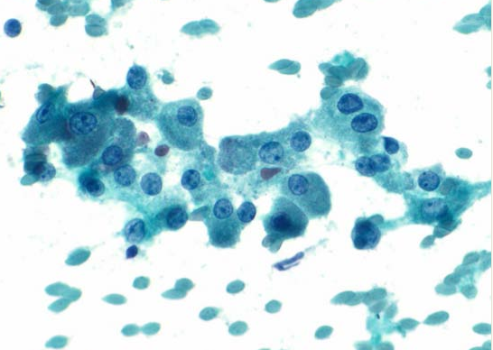
3. Atypia of Undetermined Significance or Follicular Lesion of Undetermined Significance
3-6% of FNAs
  Cytologic findings not convincingly benign.
Repeat FNA or observe clinically
5-15% risk of malignancy
Action: Repeat FNA

Slide 25
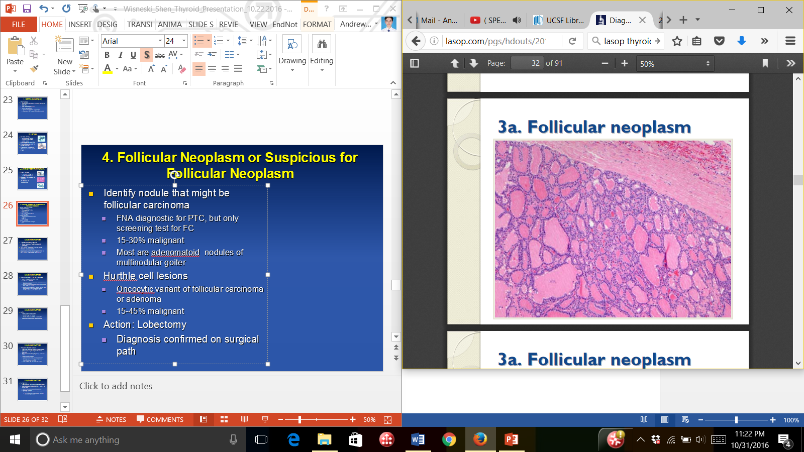
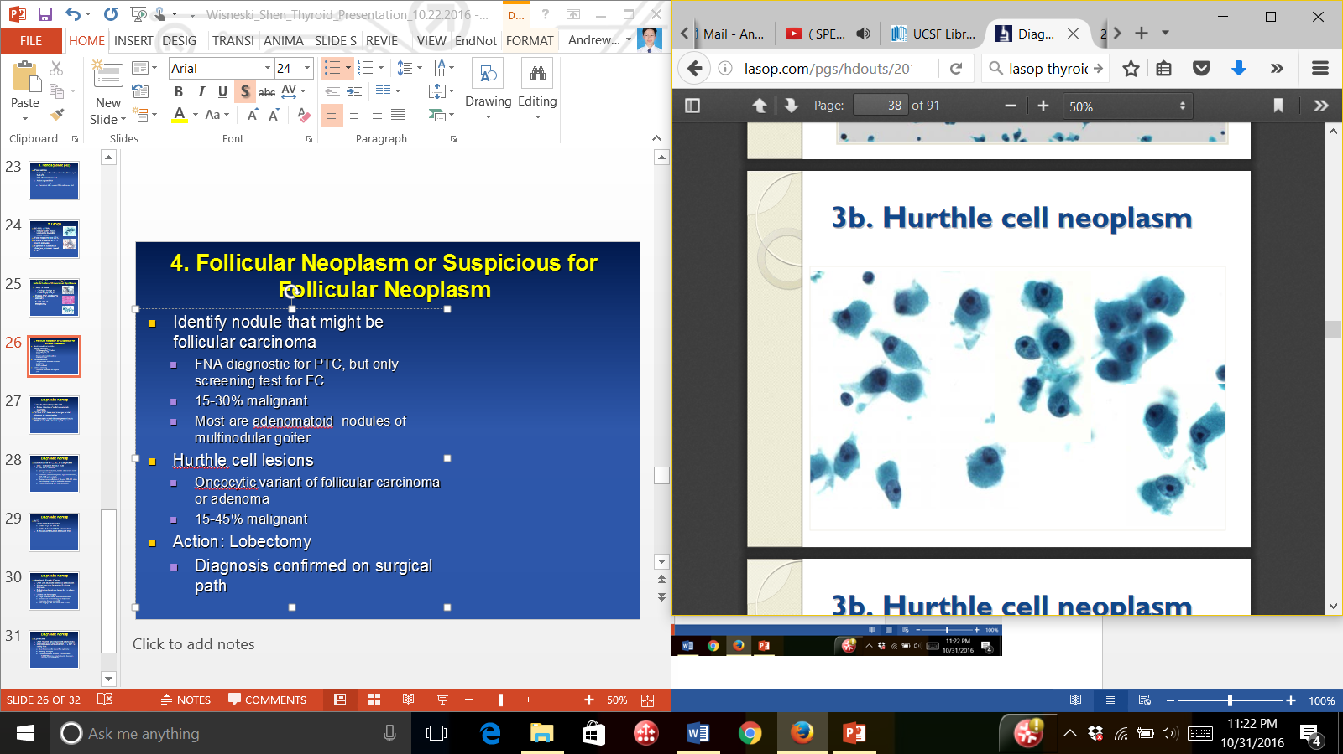
4. Follicular Neoplasm or Suspicious for Follicular Neoplasm
Identify nodule that might be follicular carcinoma
  FNA diagnostic for PTC, but only screening test for FC
  15-30% malignant
  Most are adenomatoid nodules of multinodular goiter
Hurthle cell lesions
  Oncocytic variant of follicular carcinoma or adenoma
  15-45% malignant
Action: Lobectomy
  Diagnosis confirmed on surgical path

Slide 26
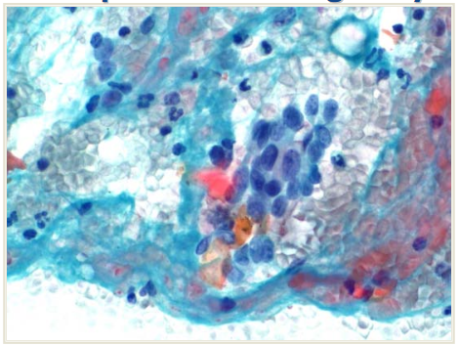
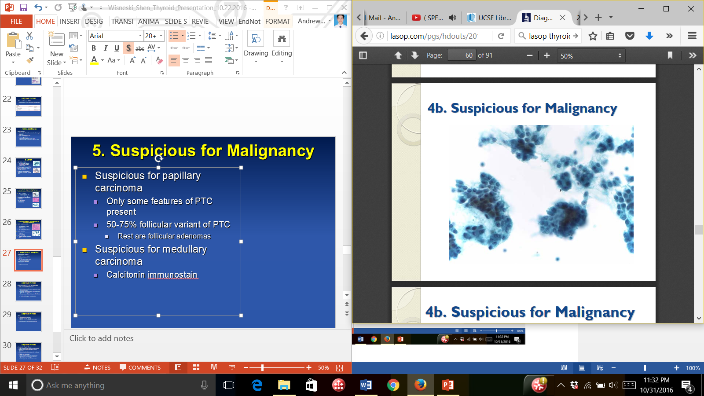
5. Suspicious for Malignancy
Suspicious for papillary carcinoma
  Only some features of PTC present
  50-75% follicular variant of PTC
    Rest are follicular adenomas
Suspicious for medullary carcinoma
  Calcitonin immunostain
Action: Lobectomy or thyroidectomy

Slide 27
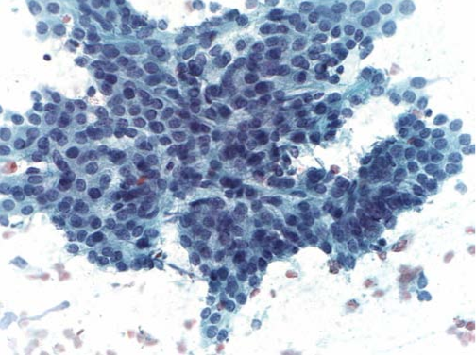
6. Malignant
Conclusive for malignancy
3-7% of FNAs
  Most are Papillary Thyroid Carcinoma
  PPV 97-99%
Action: Lobectomy or Total Thyroidectomy

Slide 28
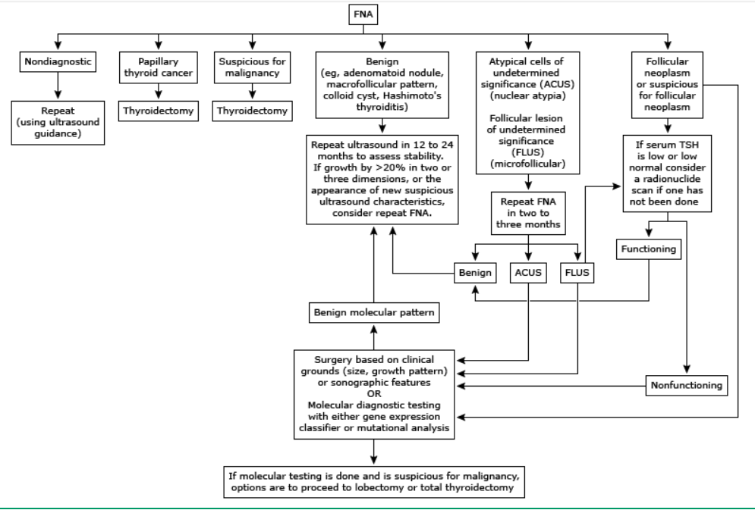
Algorithm
A

Slide 29
Conclusions
Thyroid Nodules
  High risk: head/neck radiation, family hx
  Obtain TSH
  Ultrasound – high risk features
  FNA
Bethesda Criteria
  6 categories
    Nondiagnostic, Benign (0-3%) -> Malignant (99%)

Slide 30
6. Malignant
Conclusive for malignancy
3-7% of FNAs
  Most are Papillary Thyroid Carcinoma
  PPV 97-99%
Action: Lobectomy or Total Thyroidectomy

