Slide 1
Biostat 200
Lecture 8

Slide 2
Where are we
Types of variables
Descriptive statistics and graphs
Probability
Confidence intervals for means and proportions
Hypothesis testing for means and medians and proportions (alone or grouped by a categorical variable)
Today: Testing for categorical variables grouped by another categorical variable
Lectures 9+10: Correlations and linear regression
Lecture 11: Logistic regression

Slide 3
Schedule
Final exam is take home, open book
Very much like assignments, but somewhat longer and covering the entire course
Posted Dec. 1, due Dec 8

Slide 4
Assumptions of hypothesis tests
For t-test and ANOVA, the underlying distribution of the random variable being measured (X) should be approximately normal
  In reality the t-test is rather robust, so with large enough sample size and without very large outliers, it is ok to use the t-test
For the ANOVA, the variance of the subgroups should be approximately equal
For the Wilcoxon Rank Sum Test and the Kruskal-Wallis Test the underlying distributions must have the same basic shape
  These tests are based on the ranks of the values
  More powerful when you have very skewed distributions

Slide 5
Categorical outcomes
With the exception of the proportion test, all the previous tests were for comparing numerical outcomes and categorical variables (e.g. predictors)
  E.g., CD4 count by alcohol consumption
We often have dichotomous outcomes and variates
  E.g. Having any children by sex

Slide 6
We can make tables of the number of observations falling into each category
These are called contingency tables
E.g. Currently having any children by sex
. tab children_any gender
children_a |
ny - Do |
you have | gender - What is your
any | gender?
children? | Male Female | Total
-----------+----------------------+----------
0 | 24 23 | 47
1 | 2 6 | 8
-----------+----------------------+----------
Total | 26 29 | 55

Slide 7
Contingency tables
Often summaries of counts of disease versus no disease and exposed versus not exposed
Frequently 2x2 but can generalize to n x k
  n rows, k columns
Note that Stata sorts on the numeric value, so for 0-1 variables the disease state will be the 2nd row
 |  | Exposure
 |  | + | - | Total
Disease | + | a | b | a+b
 | - | c | d | c+d
Total |  | a+c | b+d | n=a+b+c+d

Slide 8
Contingency tables
Contingency tables are usually summaries of data that originally looked like this.
Example of data set
Obs. | Exposure (1=yes; 0=no) | Disease (1=yes; 0=no)
1 | 1 | 1
2 | 1 | 0
3 | 1 | 1
4 | 0 | 0
5 | 1 | 1
6 | 1 | 0
7 | 0 | 0
… | … | …
n | 0 | 0

Slide 9
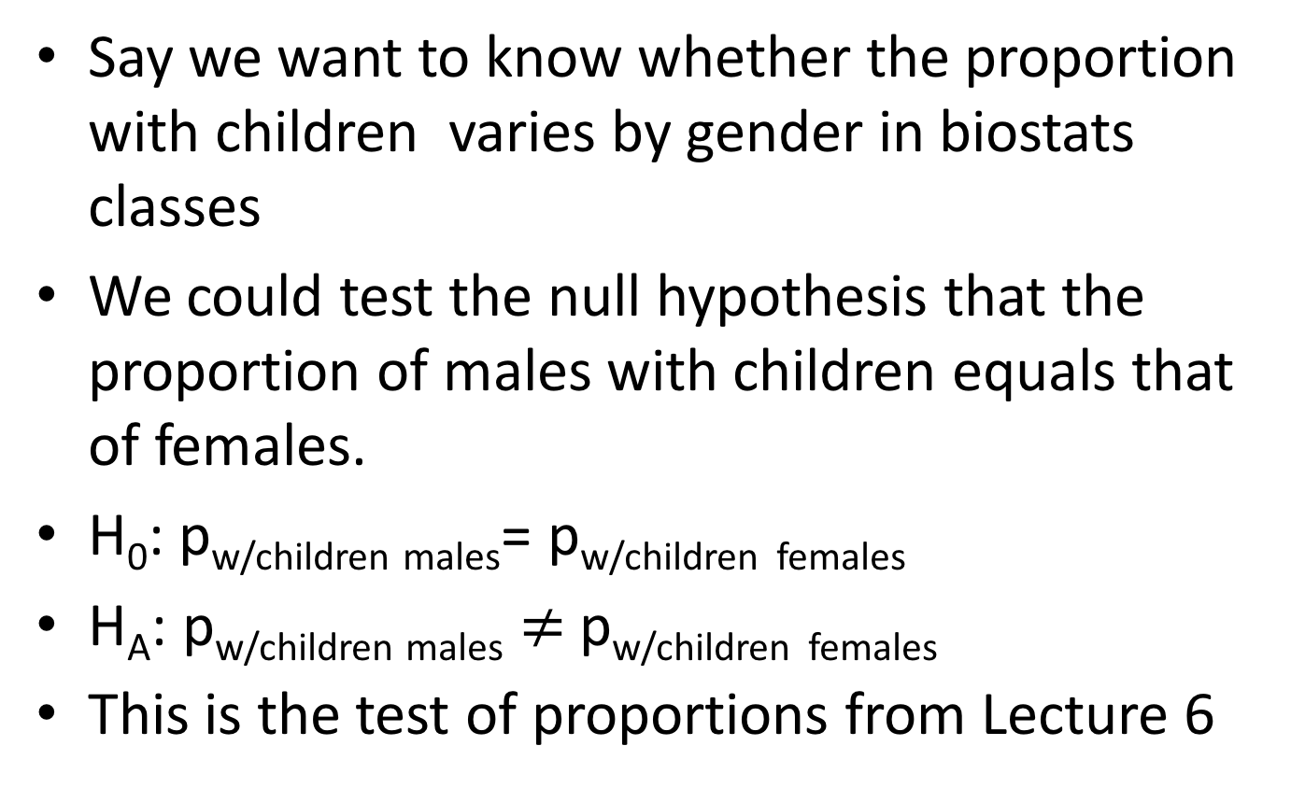
Say we want to know whether the proportion with children varies by gender in biostats classes
We could test the null hypothesis that the proportion of males with children equals that of females.
H₀: p_{w/children males}= p_{w/children} _{females}
H_{A}: p_{w/children males} $≠$p_{w/children} _{females}
This is the test of proportions from Lecture 6

Slide 10
The Proportion test
. . prtest children_any, by(gender)
Two-sample test of proportions Male: Number of obs = 26
Female: Number of obs = 29
------------------------------------------------------------------------------
Variable | Mean Std. Err. z P>|z| [95% Conf. Interval]
-------------+----------------------------------------------------------------
Male | .0769231 .0522589 -.0255026 .1793487
Female | .2068966 .0752216 .0594649 .3543282
-------------+----------------------------------------------------------------
diff | -.1299735 .091593 -.3094925 .0495456
| under Ho: .0952197 -1.36 0.172
------------------------------------------------------------------------------
diff = prop(Male) - prop(Female) z = -1.3650
Ho: diff = 0
Ha: diff < 0 Ha: diff != 0 Ha: diff > 0
Pr(Z < z) = 0.0861 Pr(|Z| > |z|) = 0.1723 Pr(Z > z) = 0.9139

Slide 11
There are other methods to do this (chi-square test)
Why?
  These methods are more general – can be used when you have more than 2 levels in either variable
We will start with the 2x2 example however

Slide 12
Overall, the probability of having any children overall in this sample is 8/55=0.1455 This is the marginal probability of having children (in this class)
There were 26 males and 29 females
Under the null hypothesis, the expected proportion in each group is the overall proportion
So the expected number of students who have children:
Males 26*.1455=3.8
Females: 29*.1455=4.2

Slide 13
We can also calculate the expected number without children under the null hypothesis of no difference
  Males: 26*(1-.1455) = 22.2
  Females: 29*(1-.1455) = 24.8
We can make a table of the expected counts
EXPECTED COUNTS UNDER THE NULL HYPOTHESIS
.tab children_any gender, expected nof
children_a |
ny - Do |
you have | gender - What is your
any | gender?
children? | Male Female | Total
-----------+----------------------+----------
0 | 22.2 24.8 | 47.0
1 | 3.8 4.2 | 8.0
-----------+----------------------+----------
Total | 26.0 29.0 | 55.0
Observed data
. tab children_any gender
children_a |
ny - Do |
you have | gender - What is your
any | gender?
children? | Male Female | Total
-----------+----------------------+----------
0 | 24 23 | 47
1 | 2 6 | 8
-----------+----------------------+----------
Total | 26 29 | 55

Slide 14
Generically
Expected counts |  | Exposure
 |  | + | - | Total
Disease | + | (a+b)(a+c)/n | (a+b)(b+d)/n | a+b
 | - | (c+d)(a+c)/n | (c+d)(b+d)/n | c+d
Total |  | a+c | b+d | n=a+b+c+d

Slide 15
The Chi-square test compares the observed frequency (O) in each cell with the expected frequency (E) under the null hypothesis of no difference
The differences O-E are squared, divided by E, and added up over all the cells
The sum of this is the test statistic and follows a chi-square distribution

Slide 16
Chi-square test of independence
The chi-square test statistic (for the test of independence in contingency tables) for a 2x2 table (dichotomous outcome, dichotomous exposure)
i is the index for the cells in the table – there are 4 cells
This test statistic is compared to the chi-square distribution with 1 degree of freedom

Slide 17
Chi-square test of independence
The chi-square test statistic for the test of independence in an nxk contingency table is
This test statistic is compared to the chi-square distribution
The degrees of freedom for the this test are (n-1)*(k-1), so for a 2x2 there is 1 degree of freedom
  n=the number of rows; k=the number of columns in the nxk table
  The chi-square distribution with 1 degree of freedom is actually the square of a standard normal distribution
Expected cell sizes should all be >1 and fewer than 20% should be <5
The Chi-square test is for two sided hypotheses

Slide 18
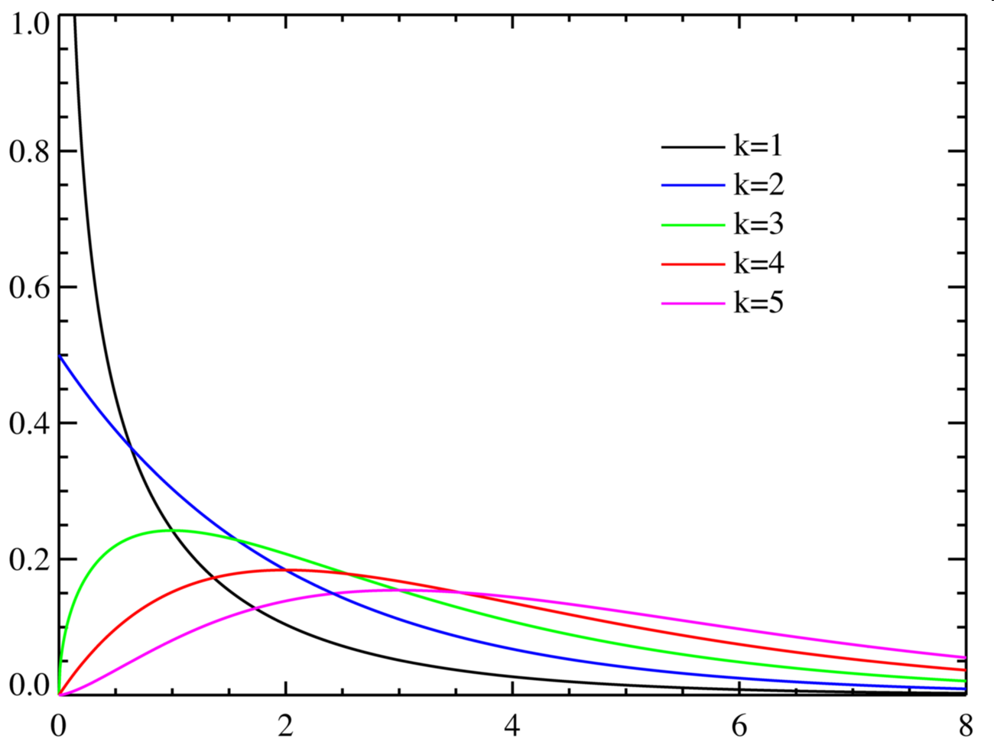
Chi-square distribution

Slide 19
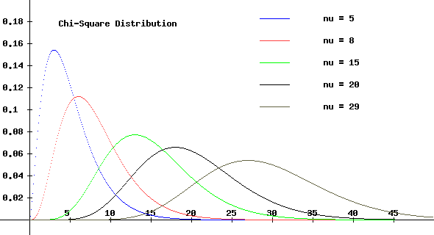
Chi-square distribution
Mean = degrees of freedom
Variance = 2*degrees of freedom

Slide 20
Chi-square test of independence
For the example, the chi-square statistic for our 2x2 is
di (24-22.2)^2/22.2 + (23-24.8)^2/24.8 + (2-3.8)^2/3.8 + (6-4.2)^2/4.2
1.9006513
There is 1 degree of freedom
Probability of observing a chi-square value of 0.0309 with 1 degree of freedom
      . di chi2tail(1,1.901)
      . .16796643
      Fail to reject the null hypothesis of independence
Notes:
Not rounding off:

Slide 21
. . tab children_any gender, chi
children_a |
ny - Do |
you have | gender - What is your
any | gender?
children? | Male Female | Total
-----------+----------------------+----------
0 | 24 23 | 47
1 | 2 6 | 8
-----------+----------------------+----------
Total | 26 29 | 55
Pearson chi2(1) = 1.8632 Pr = 0.172
p-value
Test statistic (df)

Slide 22
If you want to see the row or column percentages, use row or col options
tab children_any gender, row col chi expected
+--------------------+
| Key |
|--------------------|
| frequency |
| expected frequency |
| row percentage |
| column percentage |
+--------------------+
children_a |
ny - Do |
you have | gender - What is your
any | gender?
children? | Male Female | Total
-----------+----------------------+----------
0 | 24 23 | 47
| 22.2 24.8 | 47.0
| 51.06 48.94 | 100.00
| 92.31 79.31 | 85.45
-----------+----------------------+----------
1 | 2 6 | 8
| 3.8 4.2 | 8.0
| 25.00 75.00 | 100.00
| 7.69 20.69 | 14.55
-----------+----------------------+----------
Total | 26 29 | 55
| 26.0 29.0 | 55.0
| 47.27 52.73 | 100.00
| 100.00 100.00 | 100.00
Pearson chi2(1) = 1.8632 Pr = 0.172
.

Slide 23
Because we are using discrete cell counts to approximate a chi-squared distribution, for 2x2 tables some use the Yates correction
Not computed in Stata

Slide 24
Lexicon
When we talk about the chi-square test, we are saying it is a test of independence of two variables, usually exposure and disease.
We also say we are testing the “association” between the two variables.
If the test is statistically significant (p<0.05 if α=0.05), we often say that the two variables are “not independent” or they are “associated”.

Slide 25
Test of independence
For small cell sizes in 2x2 tables, use the Fisher exact test
It is based on a discrete distribution called the hypergeometric distribution
For 2x2 tables, you can choose a one-sided (results as or more extreme only in one direction) or a two-sided test
. . tab children_any gender, chi exact
children_a |
ny - Do |
you have | gender - What is your
any | gender?
children? | Male Female | Total
-----------+----------------------+----------
0 | 24 23 | 47
1 | 2 6 | 8
-----------+----------------------+----------
Total | 26 29 | 55
Pearson chi2(1) = 1.8632 Pr = 0.172
Fisher's exact = 0.257
1-sided Fisher's exact = 0.164
Notes:
https://en.wikipedia.org/wiki/Hypergeometric_distribution

Slide 26
Comparison to test of two proportions
prtest children_any, by(gender)
Two-sample test of proportions Male: Number of obs = 26
Female: Number of obs = 29
------------------------------------------------------------------------------
Variable | Mean Std. Err. z P>|z| [95% Conf. Interval]
-------------+----------------------------------------------------------------
Male | .0769231 .0522589 -.0255026 .1793487
Female | .2068966 .0752216 .0594649 .3543282
-------------+----------------------------------------------------------------
diff | -.1299735 .091593 -.3094925 .0495456
| under Ho: .0952197 -1.36 0.172
------------------------------------------------------------------------------
diff = prop(Male) - prop(Female) z = -1.3650
Ho: diff = 0
Ha: diff < 0 Ha: diff != 0 Ha: diff > 0
Pr(Z < z) = 0.0861 Pr(|Z| > |z|) = 0.1723 Pr(Z > z) = 0.9139
---
For 2x2 tables the chi-square statistic is equal to the z statistic squared
. di (-1.365)^2
1.863

Slide 27
Chi-square test of independence
The chi-square test can be used for more than 2 levels of exposure (with a dichotomous outcome)
  The null hypothesis is p₁ = p₂ = ... = p_{k}
  The alternative hypothesis is that not all the proportions are the same
Note that, like ANOVA, a statistically significant result does not tell you which level differed from the others
Also when you have more than 2 groups, all tests are 2-sided
The degrees of freedom for the test are k-1

Slide 28
Chi-square test of independence
. tab sex lastalc_3 if hiv==1, row col chi exact
+-------------------+
| Key |
|-------------------|
| frequency |
| row percentage |
| column percentage |
+-------------------+
| RECODE of lastalc (E1. Last time
| took alcohol)
A1. Sex | Never >1 year a Within th | Total
-----------+---------------------------------+----------
male | 110 64 203 | 377
| 29.18 16.98 53.85 | 100.00
| 29.49 35.36 45.72 | 37.78
-----------+---------------------------------+----------
female | 263 117 241 | 621
| 42.35 18.84 38.81 | 100.00
| 70.51 64.64 54.28 | 62.22
-----------+---------------------------------+----------
Total | 373 181 444 | 998
| 37.37 18.14 44.49 | 100.00
| 100.00 100.00 100.00 | 100.00
Pearson chi2(2) = 23.2657 Pr = 0.000
Fisher's exact = 0.000
.
Note that this is a 2x3 table, so the chi-square test has 1x2=2 degrees of freedom
Notes:
Using vct_baseline_biostat200_v1.dta data

Slide 29
Another way to state the null hypothesis for the chi-square test:
  Factor A is not associated with Factor B
The alternative is
  Factor A is associated with Factor B
For more than 2 levels of the outcome variable this would make the most sense
The degrees of freedom are (r-1)*(c-1) (r=rows, c=columns)

Slide 30
If you run a chi-square test and fail to reject the null, can you say Factor A is not associated with Factor B?

Slide 31
Paired dichotomous data
Matched pairs
  Matched case-control study
  Before and after data
You cannot just put each individual into an exposure and disease box, because then you would lose the benefits of pairing (and the observations would not be independent!)
Instead you have a table that tabulates each of the 4 possible states for each pair
Notes:
What type of data did we have for the paired t-test?
Here both variables are dichotomous.

Slide 32
Paired dichotomous data
For a 1:1 matched case/control study, in all pairs, one has the disease (case) and the other does not (control). The table then counts the number of pairs in which
  1. Both were exposed
  2. Neither were exposed
  3. The case was exposed, the control was not
  4. The case was not exposed, the control was exposed

Slide 33
Case-control study
HIV positives on ART in Uganda
The study question was: Is alcohol consumption in the past 3 months associated with treatment failure?
  The null hypothesis is that alcohol consumption is not associated with treatment failure
Cases:
  Treatment failure: HIV viral load after 6 months of ART >400 copies
Controls:
No treatment failure: HIV viral load <400
Matched on sex, duration on treatment, and treatment regimen class
Notes:
This is another study we did in the past…
At the time we did it, the cutoff for detectable viral load was 400.

Slide 34
. list matched_pair lastalc_case lastalc_control
+--------------------------------+
| matche~r lastal~e lastal~l |
|--------------------------------|
1. | 1 Yes No |
2. | 2 Yes Yes |
3. | 3 No No |
4. | 4 Yes No |
5. | 5 No No |
|--------------------------------|
6. | 6 No Yes |
7. | 7 Yes Yes |
8. | 8 Yes No |
9. | 9 No No |
10. | 10 No No |
|--------------------------------|
11. | 12 Yes Yes |
12. | 13 No Yes |
13. | 14 Yes No |
14. | 15 Yes No |
15. | 16 Yes No |
|--------------------------------|
16. | 17 No No |
17. | 18 No No |
18. | 19 No No |
19. | 20 Yes No |
20. | 21 No No |
|--------------------------------|
21. | 22 Yes No |
22. | 23 No No |
23. | 24 Yes Yes |
24. | 25 No No |
25. | 26 Yes No |
|--------------------------------|
26. | 27 No Yes |
27. | 28 No No |
+--------------------------------+
.
.
. tab lastalc_case lastalc_control
lastalc_ca | lastalc_control
se | No Yes | Total
-----------+----------------------+----------
No | 11 3 | 14
Yes | 9 4 | 13
-----------+----------------------+----------
Total | 20 7 | 27
Data are in “treatment outcomes case control.dta”
Notes:
The data are listed by pair, not by individual.

Slide 35
The test statistic is
r and s are the number of discordant pairs
  Concordant pairs provide no information
Under the null hypothesis, r and s would be equal
This statistic has an approximate Chi-square distribution with 1 degree of freedom
The test is called McNemar’s test
  The -1 is a continuity correction, not all versions of the test use this, some use .5

Slide 36
r=9, s=3
Test statistic = (9-3-1)^2/12 = 2.083
    . di chi2tail(1,2.083)
    .14894719
Test statistic = (6)^2/12 = 3 (Not using the continuity correction)
    di chi2tail(1,3)
    .08326452

Slide 37
In Stata, use mcc for Matched Case Control
mcc case_exposed control_exposed
. . mcc lastalc_case lastalc_control
| Controls |
Cases | Exposed Unexposed | Total
-----------------+------------------------+------------
Exposed | 4 9 | 13
Unexposed | 3 11 | 14
-----------------+------------------------+------------
Total | 7 20 | 27
McNemar's chi2(1) = 3.00 Prob > chi2 = 0.0833
Exact McNemar significance probability = 0.1460
Proportion with factor
Cases .4814815
Controls .2592593 [95% Conf. Interval]
--------- --------------------
difference .2222222 -.0518969 .4963413
ratio 1.857143 .9114712 3.78397
rel. diff. .3 .0159742 .5840258
odds ratio 3 .7486845 17.228 (exact)
Notes:
The data have two columns – one for the alcohol status (exposure) of the case, and one for the alcohol status (exposure) of the control. From this the 2x2 is made.

Slide 38
Use mcci if you only have the table, not the raw data
mcci #both_exposed #case_exposed_only #control_exposed_only #neither_exposed
. mcci 4 9 3 11
| Controls |
Cases | Exposed Unexposed | Total
-----------------+------------------------+------------
Exposed | 4 9 | 13
Unexposed | 3 11 | 14
-----------------+------------------------+------------
Total | 7 20 | 27
McNemar's chi2(1) = 3.00 Prob > chi2 = 0.0833
Exact McNemar significance probability = 0.1460
Proportion with factor
Cases .4814815
Controls .2592593 [95% Conf. Interval]
--------- --------------------
difference .2222222 -.0518969 .4963413
ratio 1.857143 .9114712 3.78397
rel. diff. .3 .0159742 .5840258
odds ratio 3 .7486845 17.228 (exact)

Slide 39
Note that the McNemar test is only for MATCHED data
It is quite possible to collect unmatched case control data. Then you analyze using the chi-square methods presented earlier.

Slide 40
Paired dichotomous data
For before and after data, the pairs are the individual participant, and the four outcomes might be:
    1. “Yes” before + “Yes” after (no change)
    2. “No” before + “No” after (no change)
    3. “Yes” before + “No” after
    4. “No” before + “Yes” after
E.g. Positive biomarker test at baseline and 3 months follow up

Slide 41
Self-reported alcohol consumption in Uganda
McNemar’s test for paired data
Null hypothesis: No change in the proportion PEth+ (≥50 ng/ml) from baseline to 3 months in persons entering HIV care in Uganda
. tab peth0_50 peth3_50
| peth3_50
peth0_50 | 0 1 | Total
-----------+----------------------+----------
0 | 78 7 | 85
1 | 23 69 | 92
-----------+----------------------+----------
Total | 101 76 | 177
using BREATH wide data.dta

Slide 42
Matched case-control study command
mcc peth0_50 peth3_50
| Controls |
Cases | Exposed Unexposed | Total
-----------------+------------------------+------------
Exposed | 69 23 | 92
Unexposed | 7 78 | 85
-----------------+------------------------+------------
Total | 76 101 | 177
McNemar's chi2(1) = 8.53 Prob > chi2 = 0.0035
Exact McNemar significance probability = 0.0052
Proportion with factor
Cases .519774
Controls .4293785 [95% Conf. Interval]
--------- --------------------
difference .0903955 .0255752 .1552158
ratio 1.210526 1.064678 1.376355
rel. diff. .1584158 .0609088 .2559229
odds ratio 3.285714 1.36498 9.066655 (exact)
Notes:
note that this calls the rows cases and the columns controls, but this can be used for situations other than case/control studies

Slide 43
Statistical hypothesis tests
Data and comparison type | Alternative hypotheses | Parametric test Stata command | Non-parametric test Stata command
Numerical; One mean | H_{a}: μ≠ μ_{a} (two-sided) H_{a}: μ>μ_{a} or μ<μ_{a} (one-sided) | Z or t-test ttest var1=hypoth val.*
Numerical; Two means, paired data | H_{a}: μ₁ ≠ μ₂ (two-sided) H_{a}: μ₁ >μ₂ or μ<μ_{a} (one-sided) | Paired t-test ttest var1=var2* | Sign test signtest var1=var2 Wilcoxon Signed-Rank signrank var1=var2)
Numerical; Two means, independent data | H_{a}: μ₁ ≠ μ₂ (two-sided) H_{a}: μ₁ >μ₂ or μ<μ_{a} (one-sided) | T-test (equal or unequal variance) ttest var1, by(byvar) unequal | Wilcoxon rank-sum test ranksum var1, by(byvar)
Numerical, Two or more means, independent data | H_{a}: μ₁ ≠ μ₂ or μ₁ ≠ μ₃ or μ₂ ≠ μ₃ etc. | ANOVA oneway var1 byvar | Kruskal Wallis test kwallis var1, by(byvar)
Dichotomous; One proportion | H_{a}: p≠ p_{a} (two-sided) H_{a}: p>p_{a} or p<p_{a} (one-sided) | Proportion test prtest var1=hypoth value* bitest var1=hypoth value
Dichotomous; two proportions | H_{a}: p₁≠ p₂ (two-sided) H_{a}: p₁ >p₂ (one-sided) | Proportion test (z-test) prtest var1, by(byvar) | Chi-square test tab var1 var2, chi exact McNemar’s for paired data: mcc var1 var2
Categorical by categorical (nxk) | H_{a} : The rows not independent of the columns |  | Chi-square test tab var1 var2, chi exact
Notes:
*Can be written ==

Slide 44
Comparison of disease frequencies across groups
The chi-square test and McNemar’s test are tests of independence
They do not give us an estimate of how much the two groups differ, i.e. how much the disease outcome varies by the exposure variable
We use odds ratios (OR) and relative risks (RR) as measures of ratios of disease outcome (given exposure or lack of exposure)
The odds ratio and the relative risk are just two examples of “measures of association”

Slide 45
Comparison of disease frequencies – relative risk
 | Exposure
Disease | + | - | Total
+ | a | b | a+b
- | c | d | c+d
Total | a+c | b+d | n=a+b+c+d
Risk ratio (or relative risk or relative rate)
= P (disease | exposed) / P(disease | unexposed)
= R_{e} / R_{u} = a/(a+c) / b/(b+d)

Slide 46
Comparison of disease frequencies – relative risk
 | Exposure
Disease | + | - | Total
+ | a | b | a+b
- | c | d | c+d
Total | a+c | b+d | n=a+b+c+d
Note that you cannot calculate this entity when you have chosen your sample based on disease status
  I.e. Case-control study – you have fixed the probability of disease a priori (i.e. usually 50%)! Relative risk is a NO GO!
  You can calculate it but it won’t have any meaning…

Slide 47
Odds
If an event occurs with probability p, the odds of the event are p/(1-p) to 1
If an event has probability .5, the odds are 1:1
Conversely, if the odds of an event are a:b, the probability of a occurring is a/(a+b)
  The odds of horse A winning over horse B winning are 2:1 → the probability of horse A winning is .667.

Slide 48
Odds ratio in a cohort study
 | Exposure
Disease | + | - | Total
+ | a | b | a+b
- | c | d | c+d
Total | a+c | b+d | n=a+b+c+d
Odds of disease among the exposed persons
= P(disease | exposed) / (1-P(disease | exposed))
= [ a / (a + c) ] / [ c / (a + c) ] = a/c
Odds of disease among the unexposed persons
= P(disease | unexposed) / (1-P(disease | unexposed))
= [ b / (b + d) ] / [ d / (b + d) ] = b/d
Odds ratio = a/c / b/d = ad/bc
Notes:
In cohort studies, participants are entered based on their exposure status and followed to determine if they develop disease.

Slide 49
Odds ratio note
Note that the odds ratio is also equal to
[ P(exposed | disease)/(1-P(exposed |disease) ] /
[ P(exposed | no disease)/(1-P(exposed | no disease) ]
This what we calculate for case-control studies because the proportion with disease is fixed (so you can’t calculate the probability of disease or the odds of disease)

Slide 50
Interpretation of ORs and RRs
If the OR or RR equal 1, then there is no effect of exposure on disease.
If the OR or RR >1 then disease is increased in the presence of exposure. (Risk factor)
If the OR or RR <1 then disease is decreased in the presence of exposure. (Protective factor)

Slide 51
Comparison of measures of association
When a disease is rare, i.e. the risk is <10%, the odds ratio approximates the risk ratio
The odds ratio overestimates the risk ratio
Why use it? – statistical properties, usefulness in case-control studies

Slide 52
The association of having any children with gender
tab children_any gender
children_a |
ny - Do |
you have | gender - What is your
any | gender?
children? | Male Female | Total
-----------+----------------------+----------
0 | 24 23 | 47
1 | 2 6 | 8
-----------+----------------------+----------
Total | 26 29 | 55
  What is the (estimated) odds ratio (where sex=female is the exposure)?
  . di (6*24)/(2*23)
  3.1304348

Slide 53
95% Confidence interval for an odds ratio
Remember the 95% confidence interval for a mean µ
Lower Confidence Limit: Upper Confidence Limit:
The odds ratio is not normally distributed (it ranges from 0 to infinity)
  But the natural log (ln) of the odds ratio is approximately normal
  The estimate of the standard error of the estimated ln OR is

Slide 54
95% Confidence interval for an odds ratio
We calculate the 95% confidence interval for the log odds
Then exponentiate back to obtain the 95% confidence interval for the OR
Notes:
Note that the OR is calculated from the sample data, so like the sample mean it is an estimate of the underlying population odds ratio.

Slide 55
Calculating an odds ratio and 95% confidence interval in Stata using tabodds command
Tabodds outcomevar exposurevar , or
. tabodds children_any gender, or
---------------------------------------------------------------------------
gender | Odds Ratio chi2 P>chi2 [95% Conf. Interval]
-------------+-------------------------------------------------------------
Male | 1.000000 . . . .
Female | 3.130435 1.83 0.1762 0.546769 17.922776
---------------------------------------------------------------------------
Test of homogeneity (equal odds): chi2(1) = 1.83
Pr>chi2 = 0.1762
Score test for trend of odds: chi2(1) = 1.83
Pr>chi2 = 0.1762

Slide 56
Calculating an odds ratio and 95% confidence interval in Stata using cc command
. gen gender_01=gender-1
.
. cc children_any gender_01
Proportion
| Exposed Unexposed | Total Exposed
-----------------+------------------------+------------------------
Cases | 6 2 | 8 0.7500
Controls | 23 24 | 47 0.4894
-----------------+------------------------+------------------------
Total | 29 26 | 55 0.5273
| |
| Point estimate | [95% Conf. Interval]
|------------------------+------------------------
Odds ratio | 3.130435 | .4837995 34.13049 (exact)
Attr. frac. ex. | .6805556 | -1.066972 .9707007 (exact)
Attr. frac. pop | .5104167 |
+-------------------------------------------------
chi2(1) = 1.86 Pr>chi2 = 0.1723
Exact confidence intervals use the hypergeometric distribution
Notes:
Gender was a 1-2 variable (1=male, 2=female). When I ran the cc command it looked like all 55 were “exposed”. So I subtracted off 1 to make it back into a 0-1 variable, and then it worked.

Slide 57
Chi-square test when the exposure has several levels (outcome dichotomous)
E.g. Is low CD4 count (<250) at HIV testing associated with alcohol consumption category?
tab cd4_low lastalc_3, col chi
| RECODE of lastalc (E1. Last time
| took alcohol)
cd4_low | Never >1 year a Within th | Total
-----------+---------------------------------+----------
0 | 203 89 246 | 538
| 54.42 49.44 55.78 | 54.12
-----------+---------------------------------+----------
1 | 170 91 195 | 456
| 45.58 50.56 44.22 | 45.88
-----------+---------------------------------+----------
Total | 373 180 441 | 994
| 100.00 100.00 100.00 | 100.00
Pearson chi2(2) = 2.0894 Pr = 0.352
Notes:
From VCT data. I dichotomized the cd4_cat variable.
gen cd4_low=1 if cd4_cat<=1
replace cd4_low=0 if cd4_cat>1 & cd4_cat !=.

Slide 58
Odds ratio when the exposure has several levels
One level is the “unexposed” or reference level
. tabodds cd4_low lastalc_3, or
---------------------------------------------------------------------------
lastalc_3 | Odds Ratio chi2 P>chi2 [95% Conf. Interval]
-------------+-------------------------------------------------------------
Never | 1.000000 . . . .
>1 year~o | 1.220952 1.21 0.2722 0.854441 1.744676
Within ~r | 0.946557 0.15 0.6979 0.717263 1.249151
---------------------------------------------------------------------------
Test of homogeneity (equal odds): chi2(2) = 2.09
Pr>chi2 = 0.3522
Score test for trend of odds: chi2(1) = 0.19
Pr>chi2 = 0.6623
This is as if you partitioned your data off and did a chi-square test comparing cd4<250 in the past drinker versus lifetime abstainer categories
Notes:
Note that the test for trend treats the data as numerical evenly spaced data and tests for a trend in the log odds. Note the 1 degree of freedom. The p-value is very close to what you’d get if you ran a logistic regression with the lastalc_3 variable included as a numerical variable (we’ll get to this in a few weeks).

Slide 59
Stata lets you choose the reference level
. tabodds cd4_low lastalc_3, or base(2)
---------------------------------------------------------------------------
lastalc_3 | Odds Ratio chi2 P>chi2 [95% Conf. Interval]
-------------+-------------------------------------------------------------
Never | 0.819033 1.21 0.2722 0.573172 1.170355
>1 year~o | 1.000000 . . . .
Within ~r | 0.775261 2.06 0.1509 0.547265 1.098244
---------------------------------------------------------------------------
Test of homogeneity (equal odds): chi2(2) = 2.09
Pr>chi2 = 0.3522
Score test for trend of odds: chi2(1) = 0.19
Pr>chi2 = 0.6623
Notes:
Note that the chi2 and p-values of the individual chi-square tests are now different, because there is a different comparison group.

Slide 60
Odds ratio for matched pairs
The odds ratio is r/s
The standard error of ln(OR) is
So the 95% confidence interval for the estimated OR is

Slide 61
For alcohol vs. case/control status:
OR= 9/3=3
SE (lnOR) = sqrt((9+3)/27) = .667
95% CI: exp(ln(3)-1.96*.667), exp(ln(3)+1.96*.667)
  (0.81 – 11.1)
  Data are in: treatment outcomes case control.dta

Slide 62
In Stata
mcc case_exposed control_exposed
. . mcc lastalc_case lastalc_control
| Controls |
Cases | Exposed Unexposed | Total
-----------------+------------------------+------------
Exposed | 4 9 | 13
Unexposed | 3 11 | 14
-----------------+------------------------+------------
Total | 7 20 | 27
McNemar's chi2(1) = 3.00 Prob > chi2 = 0.0833
Exact McNemar significance probability = 0.1460
Proportion with factor
Cases .4814815
Controls .2592593 [95% Conf. Interval]
--------- --------------------
difference .2222222 -.0518969 .4963413
ratio 1.857143 .9114712 3.78397
rel. diff. .3 .0159742 .5840258
odds ratio 3 .7486845 17.228 (exact)
Notes:
The data have two columns – one for the alcohol status (exposure) of the case, and one for the alcohol status (exposure) of the control. From this the 2x2 is made.

Slide 63
For next time
Read Pagano and Gauvreau
  Pagano and Gauvreau Chapter 15 (review)
  Pagano and Gauvreau Chapters 17 and 18

