Slide 1
Analyses with Clustered Data

Slide 2
Outline
Sources of clustering: place, time, people, sampling
Conceptual questions about clustered data
Consequences of ignoring clustering
Basic mixed model for clustered data without ordering
Growth curves with mixed models
GEE vs mixed
Nonlinear outcomes

Slide 3
Sources of clustering
Similar issues in many settings:
  Sampling places or contexts (neighborhoods, schools, hospitals, clinics, families, siblings)
  Repeatedly measuring the same person over time
  Two eyes of the same person
  Multiple measures of related constructs on the same person (math scores and verbal scores).
Clusters may have equal numbers of observations (balanced) or unequal
Items within a cluster may be ordered with respect to one another (e.g., time creates an ordering)
Assume that conditional on cluster, observations are independent

Slide 4
Represent the hierarchy of the data
Convenient to represent the measurements with an index to distinguish when you are referring to characteristics of the place versus the person.
Y_{ij}= Value of the variable “Y” for person i in place j
Could also talk about X_{ij} or X_{j,} a feature of place j that has the same value for every person i in place j.

Slide 5
Represent the hierarchy of the data

Slide 6
Represent the hierarchy of the data

Slide 7
Sources of clustering
Three level hierarchy:
  Diabetic people nested within clinics
  Each patient measured repeatedly
Cross-classified hierarchy:
  Diabetics within a clinic
  Same diabetics live in neighborhoods
Multivariate response
  Two outcome measures of the same latent variable
  Two measures, you think some of the effects of independent variables are the same.

Slide 8
Three level hierarchy
Y_{ijk}= Value of the variable “Y” for person i in household j in place k

Slide 9
Hierarchy not always obvious: contrast repeated cross sectional design
Repeated cross-sectional design is drawing a random sample of a target population repeatedly, with the selection probability of each individual at one wave unrelated to his/her selection in the previous wave, e.g, NHANES, BRFSS
Time is level 2 because People are sampled within Waves in each Place
Y_{itk}= Value of the variable “Y” for person i at time t in place k

Slide 10
With a repeated measures design
Repeated measures design: select a representative sample of individuals and measure them repeatedly.
Time is level 1 because annual observations are sampled within People in each Place
Y_{tik}= Value of the variable “Y” for at time t for person i in place k
Ask: Is there any characteristic of level 2 units that would apply to all level 1 units nested within it?

Slide 11
Multivariate responses
e.g., Y1=walking speed, Y2=balance measure, Y3=grip strength and Y4=lung function
Y_{ijk}= Value of the measurement i for person j in place k

Slide 12
Cross-classified models
People are nested within neighborhoods and also within worksites.
Some people who live in the same neighborhood work at the same place, others do not.

Slide 13
Sampling design creates clustering

Slide 14
Types of Random Sampling
Simple Random Sampling
Systematic Random Sampling
Stratified Random Sampling
Multi-stage Sampling
  Simple Multi-stage Sampling
  Multi-stage sampling proportionate to size

Slide 15
Types of Random Sampling
Simple Random Sampling:
  Each person in sampling frame has equal probability of selection
  Must start with a list of every element in the target population
Systematic Random Sampling:
  Decide how many people you want to be in your sample
  Calculate sampling fraction: sample size/size of whole popln, 1/x
  Take every x^{th} person from the list of the target population
Stratified Random Sampling
  Stratify into groups homogeneous on some characteristic
  Sample with pre-specified probability from each group
Multi-stage Sampling
  Organize everyone into mutually exclusive groups/clusters
  Sample clusters, then within selected clusters, sample people

Slide 16
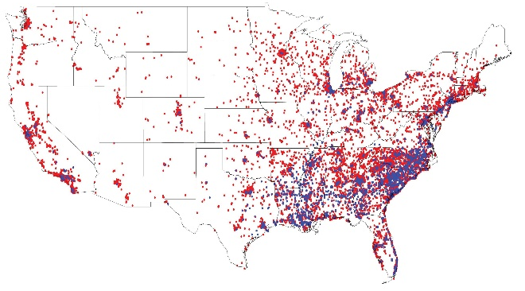
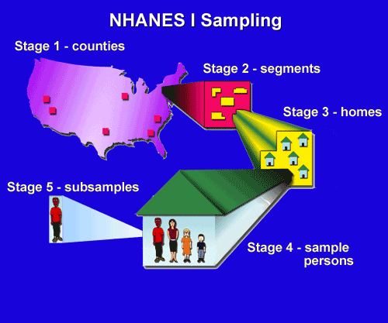
Why use clustered sampling?
Multi-stage Sampling
  Organize everyone into mutually exclusive groups/clusters
  Sample clusters, then within selected clusters, sample people
Stratified sampling essential
to be able to study small(er)
subgroups, e.g., old men.
Cluster sampling less expensive
if all of your participants live near
each other= reduced survey time
Cluster sample implies no need for
census of the sampling frame: just
need a census of the clusters

Slide 17
Outline
Sources of clustering
Conceptual questions about clustered data
Consequences of ignoring clustering
Basic mixed model for clustered data without ordering
Growth curves with mixed models
GEE vs mixed
Nonlinear outcomes

Slide 18
Clusters can be a statistical nuisance or a scientific feature
Statistical nuisance because the classic formulas to generate confidence intervals, p-values, or other measures of uncertainty assume all observations are independent.
If the observations are correlated, generally you can extract less information than with independent observations.
Clusters may also represent interesting substantive questions about the determinants of disease.
Useful to think about this when choosing an analysis plan.

Slide 19
Questions potentially of interest: measures of people in a place
Individual level exposure→ individual outcome
  Do men have higher systolic blood pressure than women?
Place level exposure → individual outcome
  Do people who live in places with sufficient greenspace have higher systolic blood pressure than women?
Cross-level interaction between individual and place level variables
  Does greenspace have greater benefits for men than women?
Variance partition/intraclass correlation
  How much of the variance in SBP is between places vs between people within a place?

Slide 20
Why is variance partition of interest?
NHANES data: people in census tracts in counties.
Initial model estimated variance partition controlling for individual variables
ICC for CT=17%
17%=1.99/(9.63+1.99+.09)
ICC for county much lower
Dubowitz, et al Am J Clin nutr

Slide 21
Why is variance partition of interest?
NHANES data: people in census tracts in counties.
Next model added a neighborhood characteristic
A 1 SD increase in neighborhood SES predicted 0.24 additional daily servings of F & V.
Neighborhood SES did not explain the remaining variance in dietary intake across census tracts
Dubowitz, et al Am J Clin nutr

Slide 22
Intraclass correlation suggests causation of higher level variables.
Clustering at a place or contextual level implies that there is something about the context that influences the outcome
If all the diabetics at clinic A have Hb_{A1c}<6.5 and all the diabetics at clinic B have Hb_{A1c} >8, it makes you think that clinic A is doing something right.
Common to start with a null model: just describe percent of variance in the outcome clustered at each level
Then a model accounting only for individual characteristics, and estimate intraclass correlation coefficients
Then add contextual variables to try to eliminate
Multilevel/random effects models can be used to rule out compositional explanations for place level differences, but:
  Cannot rule out selection differences (sick people go to good hospitals)
  Controversy regarding what is “downstream” of contextual exposures.

Slide 23
Intraclass correlation suggests causation of higher level variables.
Clustering at a place or contextual level implies that there is something about the context that influences the outcome
If all the diabetics at clinic A have Hb_{A1c}<6.5 and all the diabetics at clinic B have Hb_{A1c} >8, it makes you think that clinic A is doing something right.
We’ll go into the stats more, but conceptually this is a mixed model that partitions variance based on understanding of the sources of clustering
Common to start with a “null” model: just describe percent of variance in the outcome clustered at each level
Then a model accounting only for individual (level 1) characteristics, and estimate intraclass correlation coefficients
Then add contextual variables to try to account for variance at level 2.

Slide 24
Questions potentially of interest: repeated measures of a person
Time specific exposure→ time specific outcome
  Is SBP higher on days when CESD is higher?
Person level exposure → time-specific outcome
  Do men have higher SBP than women?
Cross-level interaction between individual and place level variables
  Does CESD have a greater effect on SBP for men than women? have greater benefits for men than women?
Variance partition/intraclass correlation
  How much of the variance in MMSE is between person vs between successive observations on the same person?

Slide 25
Questions potentially of interest: repeated measures of a person
Person level exposure → time-specific outcome
  Very important category of questions represented by cross-level interactions
  Does SBP change more quickly for men than for women: measure sex at person level and time at the occasion level.
  Addresses whether sex of the person modifies the rate of change over time.
  Major challenge is choosing the time dimension: age vs time from enrollment vs time from some other milestone (e.g., death, diagnosis)

Slide 26
Things we hardly ever ask in epidemiology
Individual level exposure→ place level outcome
  Does presence of men affect prevalence of greenspace in a neighborhood?
Place level exposure → place level outcome
  Do places with greenspace tend to have better air quality?
  Beware ecological fallacy: drawing inferences about individual level variables based on ecological associations, e.g., places with high prevalence of bathtubs also have prevalence of heart diseasse
Side note: distinguish compositional from structural characteristics of places
  Compositional: average income of people in the place
  Structural: presence of a park in the place

Slide 27
Outline
Sources of clustering
Conceptual questions about clustered data
Consequences of ignoring clustering
Basic mixed model for clustered data without ordering
Growth curves with mixed models
GEE vs mixed
Nonlinear outcomes

Slide 28
Consequences of ignoring clustering
Missed scientific questions
  Individualistic fallacy: assuming that individual-level outcomes can be explained exclusively in terms of individual-level characteristics
Incorrect standard errors
  Most variance estimates assume independent observations
Inefficient estimators
Sometimes helps handle missing data/loss to follow-up

Slide 29
Incorrect SEs and Loss of efficiency
  Ignoring clustered data generally leads to SEs for individual level exposures that are too small
    Variance of estimate of mean value of Y=variance of Y/N
    But in clustered data effective N<actual N
  Same problem if you draw a clustered sample, people within a cluster are not independent and you do not learn as much new information from each person.
    You must correct your standard errors for this phenomenon.
    You must anticipate this correction in study design and inflate the sample you need.
    The ratio of the clustered sample size needed to the simple random sample size is the design effect.
  How does clustering affect the sample size you must draw, compared to a simple random sample?
  Conversely, how much does ignoring clustering affect your SEs?

Slide 30
Variance “cost” of clustering a function of rho/ICC and # of obsvns/cluster
Rho = a measure of homogeneity that behaves like a correlation coefficient. It is the correlation between all possible pairs of elements within a cluster on a particular characteristic (Sudman, 1976)
ICC=rho= σ²_{between-cluster}/(σ²_{between-cluster} + σ²_{within-cluster})
Rho of 1 indicates extreme homogeneity (e.g., household income of all of 6 children in one household).
Rho of -1 indicates extreme heterogeneity (e.g., gender w/in a 2 person heterosexual household cluster).
Small Rho of 0.05 or less common for many characteristics in neighborhoods and schools
If you cluster randomize, everyone in the cluster has the same value of the random assignment variable, so rho for that variable is 1.

Slide 31
Calculation of rho/ICC
Denominator=total variance
Numerator=variance of mean at the cluster level
Can ask about unconditional (didn’t control for anything yet) or conditional ICC
Dubowitz, et al Am J Clin nutr

Slide 32
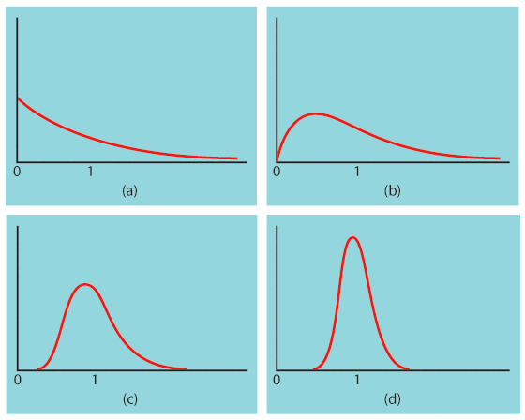
The central limit theorem
When randomly sampling from any population with mean μ and standard deviation σ, when n is large enough, the sampling distribution of x bar is approximately normal: ~ N(μ, σ/√n).
Population with strongly skewed distribution
Sampling distribution of for n = 2 observations
Sampling distribution of for n = 10 observations
Sampling distribution of
for n = 25
observations

Slide 33
Approximate design effect formula for estimation of the mean
DEff = σ²_{cluster}/σ²_{SRS} = 1 + rho_{X}(m_{avg}- 1)
DEff = the ratio of the variance from a clustered sample
design to the variance of a SRS of the same size
m_{avg} = average number of units drawn from a cluster
σ² = V= sample variance of the parameter estimate
  Works if clusters are about the same size.
  Assumes a small proportion of all possible clusters have been sampled.
Bigger DEff implies you need more data
DEff increases if rho goes up.
DEff increases if m goes up.
What if m=1? (i.e., 1 person in a cluster)
What if rho=1? (i.e., everyone in cluster identical)
Notes:
This is the design effect for estimating the population mean

Slide 34
Approximate design effect formula
DEff = the ratio of the variance from a clustered sample design to the variance of a SRS of the same size
So, if you estimate the population mean of some variable X, and X has variance σ² in the population with a SRS, the variance of your estimated mean in a SRS = σ² /n
But the variance of your estimated mean in a clustered sample=DE* σ² /n
Keep in mind: these are approximate formulas.
The relationship between the sample size and the variance of the estimate depends on what you are estimating (e.g. the mean of the population or some other characteristics, perhaps the 25th percentile).

Slide 35
Approximate design effect formula
Keep in mind: these are approximate formulas for the design effect.
The relationship between the sample size and the variance of the estimate depends on what you are estimating (e.g. the mean of the population or some other characteristics, perhaps the 25th percentile).
The design effect also depends on what you are estimating, mean of the population, linear regression coefficient, etc.
For bivariate linear regression, with equal size clusters with exchangeable within cluster correlation
DEff approximately= 1 + rho_{X}rho_{Y} (m_{avg}- 1)
So if either rho_{X} or rho_{Y} is 0, DEff is zero.

Slide 36
Examples, DEFF for the mean of X
DE=1+(m-1)*rho
  m=30, rho=.5
DE=1+29*.5=~16
  m=30, rho=.05
DE=1+29*.05=~1.15
  m=300, rho=.05
DE=1+299*.05=~16
  m=1, rho=.9
DE=1+0*.9=1
  m=500, rho=0
DE=1+499*0=1

Slide 37
Cluster Size
As the number of people in the cluster increases, the rho tends to decrease (this is not a law of nature… just generally true)
However, you do not need to enroll everyone in a cluster, even if you “treat” everyone in the cluster.
If you randomize cities of 1,000,000 to treatment or non-treatment and then you interviewed all million, the deff would be large even if the ICC for the city was tiny (1+999,999*.01)=1+9,999.99=~10,001.

Slide 38
Cluster Size
If your clusters are two cities of a million with rho=.01, your effective n would be 2x10⁶/1x10⁴=200.
But you probably won’t interview everyone in each city. Perhaps you interview only 100 per city.
The DE=1+(m-1)*rho=1+99*.01=2.
Effective n=200/2=100
Probably more efficient to interview only 100 instead of all million inhabitants and spend the money you saved trying to sample a third city.

Slide 39
Examples?
Rho for ???
Reflection examples

Slide 40
Outline
Sources of clustering
Conceptual questions about clustered data
Consequences of ignoring clustering
Basic mixed model for clustered data without ordering
Growth curves with mixed models
GEE vs mixed
Nonlinear outcomes

Slide 41
Clustering of people within places
Y_{ij}= Value of the variable “Y” for person i in place j
Could also talk about X_{ij} or X_{j,} a feature of place j that has the same value for every person i in place j.

Slide 42
Basic mixed model for clustered data without ordering
We assume places differ by some little bit (which we will call the mu for that place, or μ_{0j}) and everyone in the same place has this same little bit of offset, plus their own personal differences.
When predicting each person’s outcome value, we add this place-specific little bit to the intercept, along with differences predicted by any other factor.

Slide 43
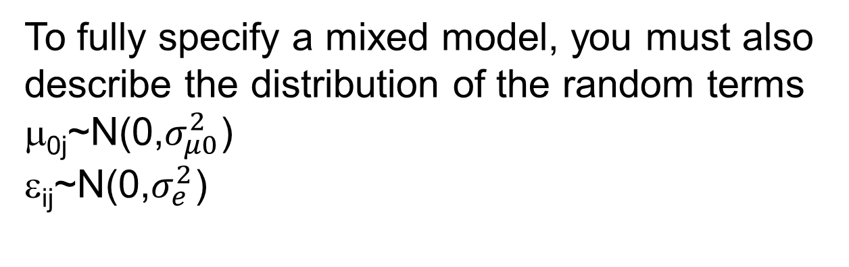
Basic mixed model for clustered data without ordering
Two level random intercepts model:
To fully specify a mixed model, you must also describe the distribution of the random terms
μ_{0j}~N(0,$σ_{μ0}^{2}$)
ε_{ij}~N(0,$σ_{e}^{2}$)

Slide 44

The “intercepts” are just place level deviations
Two level random intercepts model:
To fully specify a mixed model, you must also describe the distribution of the random terms
μ_{0j}~N(0,$σ_{μ0}^{2}$)
ε_{ij}~N(0,$σ_{e}^{2}$)
You can plot the
μ_{0j}s to get a sense
of the distribution

Slide 45
Random slopes model
Random slopes model (implicitly, assume you have a random intercept as well):
Not only do places differ by a little bit (the μ_{0j} random intercept) to the same extent for everyone in the place, but the effect of exposure differs depending on the place (μ_{1j}), so the “slope”, or coefficient is different.

Slide 46
Random slopes model
Two level random slopes model (implicitly, assume you have a random intercept as well):

Slide 47
Potential covariance of random intercept and slope
For a random slope model, you must describe the variance and covariance of the random intercept and slope

Slide 48
Substantive questions from the intercept-slope covariance
For a random slope model, you must describe the variance and covariance of the random intercept and slope
In places that average poor health outcomes for whites, are racial disparities especially large?
In hospitals that have poor functional outcomes for mild stroke patients, does stroke severity have a smaller or larger impact on functional outcomes? In other words, do hospitals “specialize” in optimizing outcomes for severe strokes (negative covariance) or are hospitals that are bad for mild strokes terrible for severe strokes (positive covariance)

Slide 49
Outline
Sources of clustering
Conceptual questions about clustered data
Consequences of ignoring clustering
Basic mixed model for clustered data without ordering
Growth curves with mixed models
GEE vs mixed
Nonlinear outcomes

