Slide 1
Epi 265: Epi Methods 3/ Research Methods in Chronic Disease Epi

Slide 2
Considering Alternative Data Sources Longitudinal data: design tradeoffs

Slide 3
Data source tradeoffs
Who is in the sample?
  Lack of selection bias (predictors of outcome do not predict participation)
  Diversity/representativeness of population of interest
How many people are in the sample?
What do they measure on those people?
  Substantive relevance of measures
  Quality of measures
  Number of measures
How does the sample limit or support the identification strategy?
  Usually most important: longitudinal data

Slide 4
  Design tradeoffs
These qualities are usually in direct opposition
Larger sample size, more diversity, less selection entails lower quality of measures (assuming a limited budget)

Slide 5
Data source tradeoffs
Who is in the sample?
  Lack of selection bias (predictors of outcome do not predict participation)
  Diversity/representativeness of population of interest
How many people are in the sample?
What do they measure on those people?
  Substantive relevance of measures
  Quality of measures
  Number of measures
How does the sample limit or support the identification strategy?
  Usually most important: longitudinal data

Slide 6
Why do we prefer longitudinal data?
Substantive question entails longitudinal data
  Long etiologic period between exposure and outcome
  Disease incidence or disease recovery processes are substantive outcomes
To strengthen causal inference
  Establish temporal order
  Help to avoid adjusting for mediating variables or variables downstream of outcome
  Address time-constant confounders (even ones that you did not measure)
  None of these is a slam dunk

Slide 7
Does longitudinal data establish temporal order?
Often assumed that if exposure is measured prior to when the outcome is measured, temporal order is established and you have ruled out Y→X
Sometimes yes:
  Household income measured in 2000 and incident stroke measured from 2000-2008.
Sometimes unclear:
    Depressive symptoms measured in 2000 and incident stroke measured from 2000-2008.
Sometimes, probably not:
  Memory loss measured in 2000 and incident stroke measured from 2000-2008
Sometimes obviously not:
  Memory loss measured in 2000 and APOE allele status measured in 2008

Slide 8
Does longitudinal data establish temporal order?
Often assumed that if exposure is measured prior to when the outcome is measured, temporal order is established and you have ruled out Y→X
This assumption should be considered on case by case basis
For many outcomes, including conditions we consider “acute onset”, there is a long preceding period of developing pathophysiology that may influence exposure status
Especially confusing is when exposure itself is defined as a long term experience

Slide 9
Does longitudinal data establish temporal order?
Often assumed that if exposure is measured prior to when the outcome is measured, temporal order is established and you have ruled out Y→X
This assumption should be considered on case by case basis
For many outcomes, including conditions we consider “acute onset”, there is a long preceding period of developing pathophysiology that may influence exposure status
Especially confusing is when exposure itself is defined as a long term experience

Slide 10
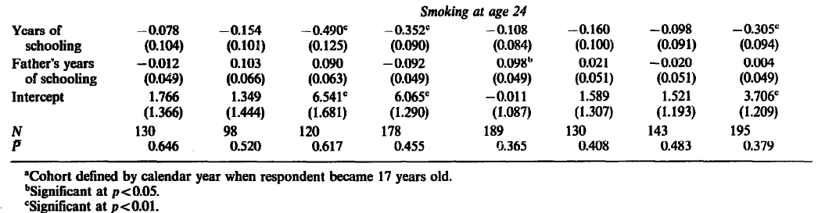
Does longitudinal data establish temporal order? Education and smoking
Farrell and Fuchs: Stanford Heart Disease Prevention Program, interviews in 1979 people aged 24+ (born 1947-1955), restricted to NH with 12-18 years of schooling
Assumption is that all were still in school at age 17, and all had equivalent amounts of schooling as of age 17
Retrospective question on lifetime history of smoking
Smoking at age 24
More years of schooling predicts lower odds of smoking at age 24
Men Women
Farrell and Fuchs, J Health Econ 1982

Slide 11
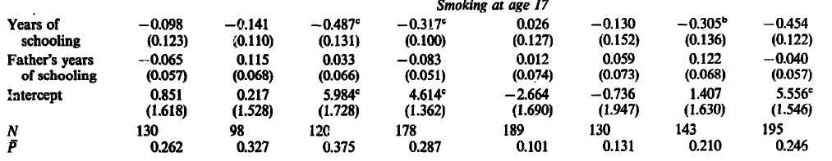
Does longitudinal data establish temporal order? Education and smoking
Farrell and Fuchs: Stanford Heart Disease Prevention Program, interviews in 1979 people aged 24+ (born 1947-1955), restricted to NH with 12-18 years of schooling
Assumption is that all were still in school at age 17, and all had equivalent amounts of schooling as of age 17
Retrospective question on lifetime history of smoking
Smoking at age 24
Smoking at age 17
More years of schooling predicts lower odds of smoking at age 24
But the same pattern was apparent when all had the same years of schooling
Men Women
Men Women
Farrell and Fuchs, J Health Econ 1982

Slide 12
Does longitudinal data establish temporal order? Education and smoking
Despite these caveats, longitudinal data is obviously superior to cross-sectional data to establish temporal order.
Key to ask whether the variables are truly “point in time” exposures and outcomes, or may have persisted across time in their current or some incipient form.

Slide 13
  Longitudinal data helps to avoid adjusting for mediators or variables affected by the outcome
Major conceptual error that turns out to be fairly common:
  If you are interested in estimating the effect of X on Y, do not adjust for any variable potentially influenced by X or potentially influenced by Y.
  The conceptual concern should be obvious, but consider how this relates to analyses of an RCT: never adjust for post-randomization variables, because they might be a consequence of randomization
  In observational studies: conceptualize the RCT and do not adjust for post-randomization variables
To estimate the effect of X on Y, do not adjust for A. Do not adjust for W. Do adjust for C.
X
A
Y
W
C₁

Slide 14
  Longitudinal data helps to avoid adjusting for mediators or variables affected by the outcome
To estimate the effect of X on Y, do not adjust for A. Do not adjust for W.
But in cross-sectional data, they are often measured all at the same time.
You must impose the temporal order by assumption: might be possible for some variables (genetics, education, “ever smoked”)
If self-reported, potential for recall bias
Regardless, consider possible selection/survival bias
W
X
A
Y
W
Y
X
C₁
C

Slide 15
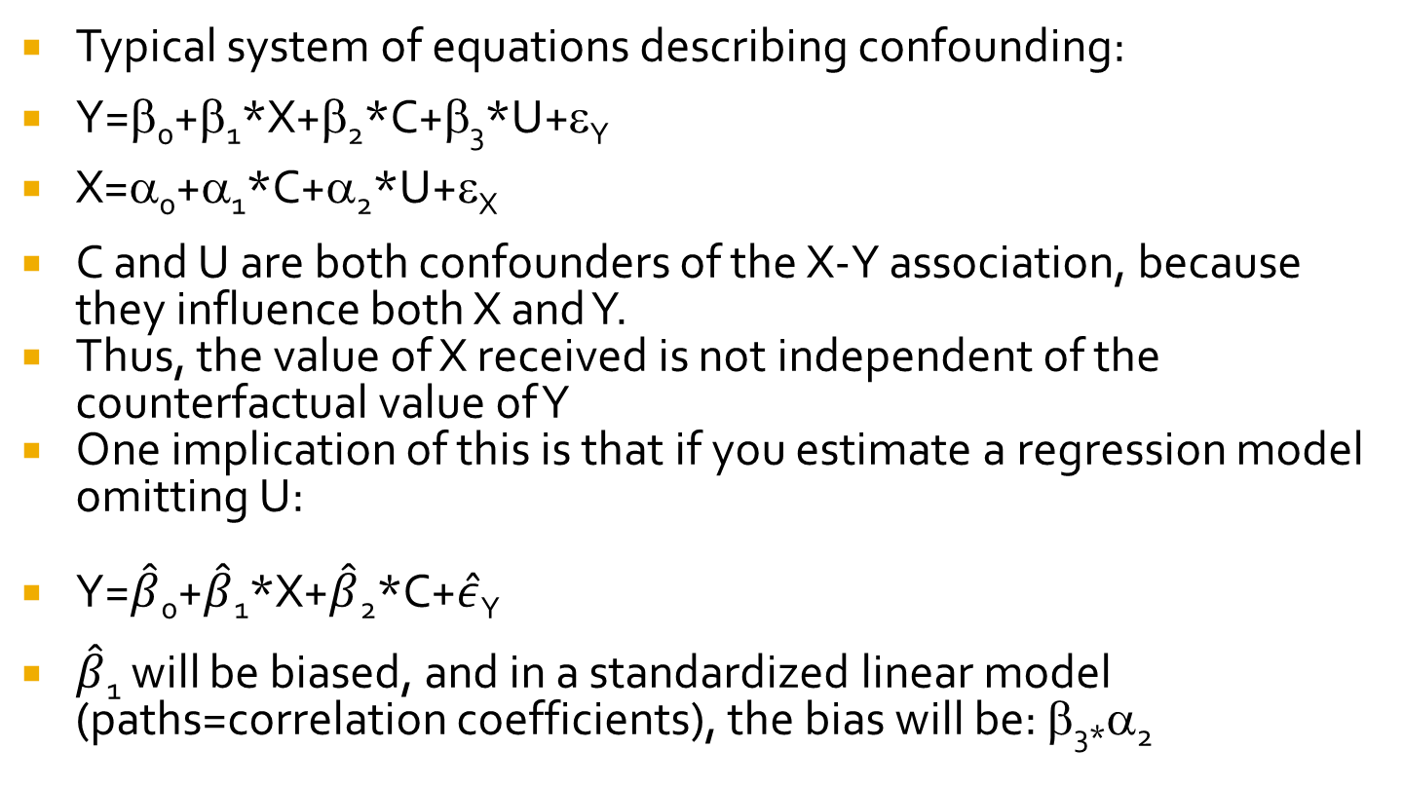
  Longitudinal data help address time-constant confounders (even ones that you did not measure)
Typical system of equations describing confounding:
Y=β₀+β₁*X+β₂*C+β₃*U+ε_{Y}
X=α₀+α₁*C+α₂*U+ε_{X}
C and U are both confounders of the X-Y association, because they influence both X and Y.
Thus, the value of X received is not independent of the counterfactual value of Y
One implication of this is that if you estimate a regression model omitting U:
Y=$\hat{β}$₀+$\hat{β}$₁*X+$\hat{β}$₂*C+$\hat{ε}$_{Y}
$\hat{β}$₁ will be biased, and in a standardized linear model (paths=correlation coefficients), the bias will be: β_{3*}α₂

Slide 16
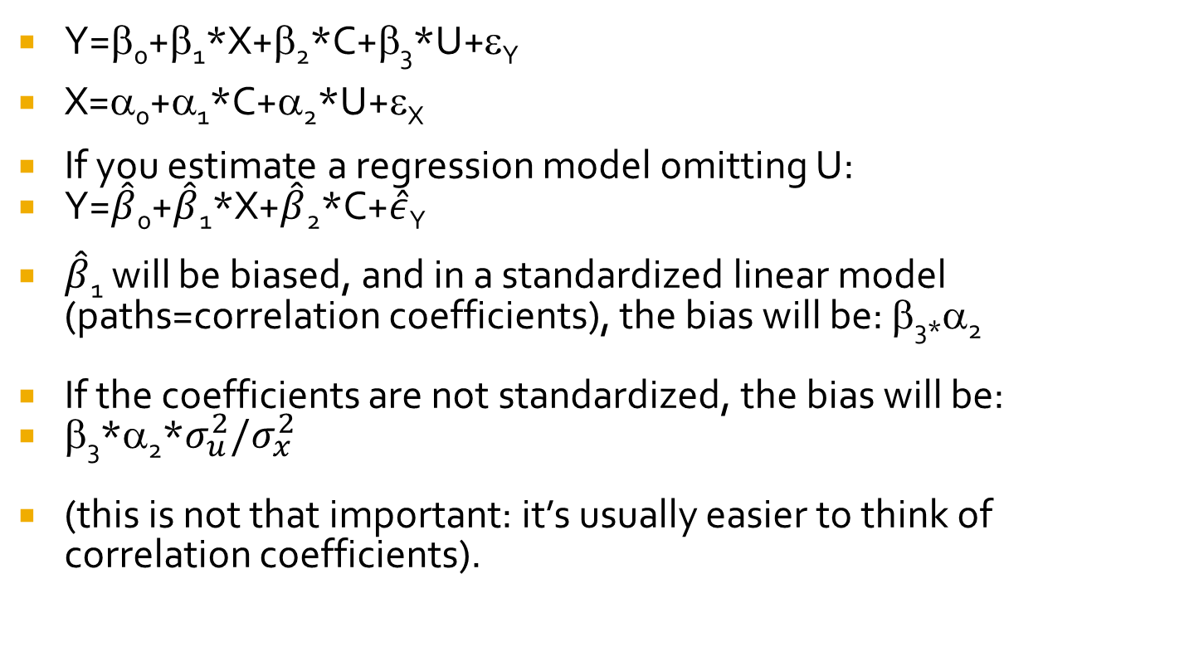
  Longitudinal data help address time-constant confounders (even ones that you did not measure)
Y=β₀+β₁*X+β₂*C+β₃*U+ε_{Y}
X=α₀+α₁*C+α₂*U+ε_{X}
If you estimate a regression model omitting U:
Y=$\hat{β}$₀+$\hat{β}$₁*X+$\hat{β}$₂*C+$\hat{ε}$_{Y}
$\hat{β}$₁ will be biased, and in a standardized linear model (paths=correlation coefficients), the bias will be: β_{3*}α₂
If the coefficients are not standardized, the bias will be:
β₃*α₂*$σ_{u}^{2}{/σ}_{x}^{2}$
(this is not that important: it’s usually easier to think of correlation coefficients).

Slide 17
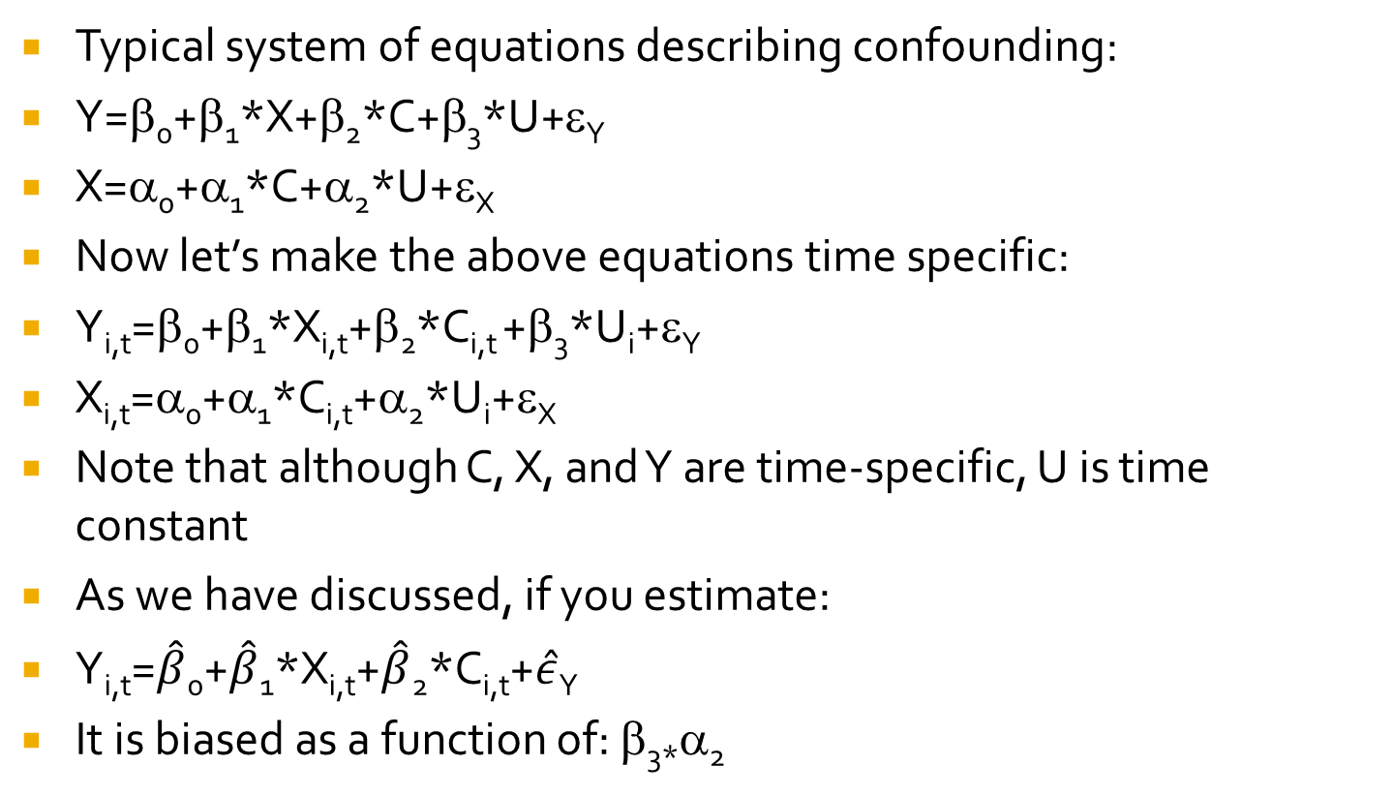
  Longitudinal data help address time-constant confounders (even ones that you did not measure)
Typical system of equations describing confounding:
Y=β₀+β₁*X+β₂*C+β₃*U+ε_{Y}
X=α₀+α₁*C+α₂*U+ε_{X}
Now let’s make the above equations time specific:
Y_{i,t}=β₀+β₁*X_{i,t}+β₂*C_{i,t} +β₃*U_{i}+ε_{Y}
X_{i,t}=α₀+α₁*C_{i,t}+α₂*U_{i}+ε_{X}
Note that although C, X, and Y are time-specific, U is time constant
As we have discussed, if you estimate:
Y_{i,t}=$\hat{β}$₀+$\hat{β}$₁*X_{i,t}+$\hat{β}$₂*C_{i,t}+$\hat{ε}$_{Y}
It is biased as a function of: β_{3*}α₂

Slide 18
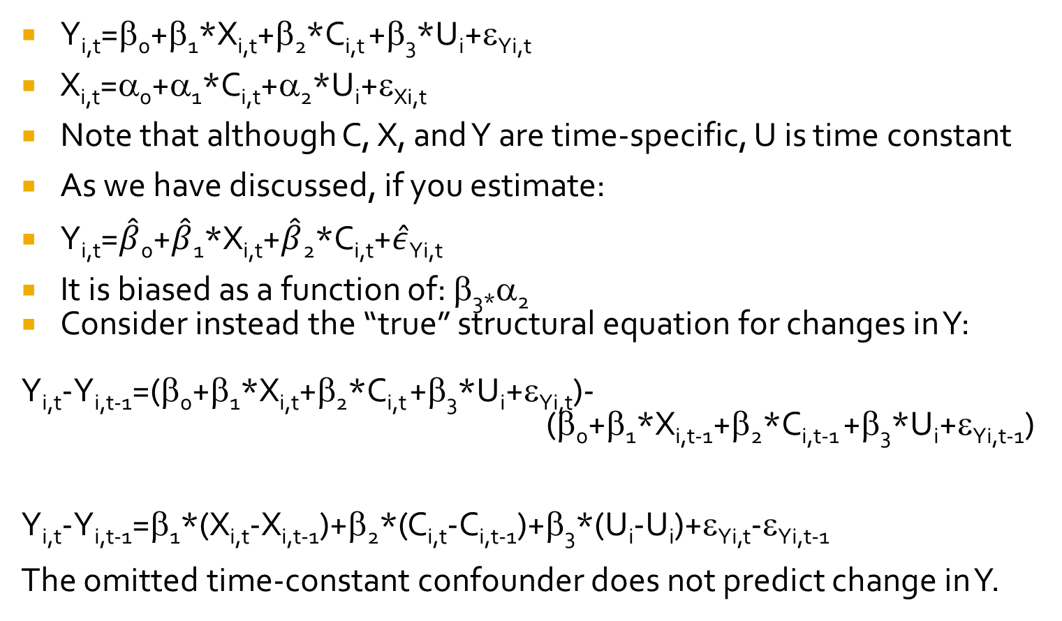
  Longitudinal data help address time-constant confounders (even ones that you did not measure)
Y_{i,t}=β₀+β₁*X_{i,t}+β₂*C_{i,t} +β₃*U_{i}+ε_{Yi,t}
X_{i,t}=α₀+α₁*C_{i,t}+α₂*U_{i}+ε_{Xi,t}
Note that although C, X, and Y are time-specific, U is time constant
As we have discussed, if you estimate:
Y_{i,t}=$\hat{β}$₀+$\hat{β}$₁*X_{i,t}+$\hat{β}$₂*C_{i,t}+$\hat{ε}$_{Yi,t}
It is biased as a function of: β_{3*}α₂
Consider instead the “true” structural equation for changes in Y:
Y_{i,t}-Y_{i,t-1}=(β₀+β₁*X_{i,t}+β₂*C_{i,t} +β₃*U_{i}+ε_{Yi,t})-
(β₀+β₁*X_{i,t-1}+β₂*C_{i,t-1} +β₃*U_{i}+ε_{Yi,t-1})
Y_{i,t}-Y_{i,t-1}=β₁*(X_{i,t}-X_{i,t-1})+β₂*(C_{i,t}-C_{i,t-1})+β₃*(U_{i}-U_{i})+ε_{Yi,t}-ε_{Yi,t-1}
The omitted time-constant confounder does not predict change in Y.

Slide 19
  Longitudinal data help address time-constant confounders (even ones that you did not measure)
Consider instead the “true” structural equation for changes in Y:
Y_{i,t}-Y_{i,t-1}=(β₀+β₁*X_{i,t}+β₂*C_{i,t} +β₃*U_{i}+ε_{Yi,t})-
(β₀+β₁*X_{i,t-1}+β₂*C_{i,t-1} +β₃*U_{i}+ε_{Yi,t-1})
Y_{i,t}-Y_{i,t-1}=β₁*(X_{i,t}-X_{i,t-1})+β₂*(C_{i,t}-C_{i,t-1})+β₃*(U_{i}-U_{i})+ε_{Yi,t}-ε_{Yi,t-1}
The omitted time-constant confounder does not predict change in Y.
Key assumptions:
The confounder does not change over time
The effect of the counfounder (β₃) does not change over time
(Equivalent): the confounder does not influence change in Y
Given these assumptions, you can use longitudinal data to eliminate bias from confounders you did not even measure.

Slide 20
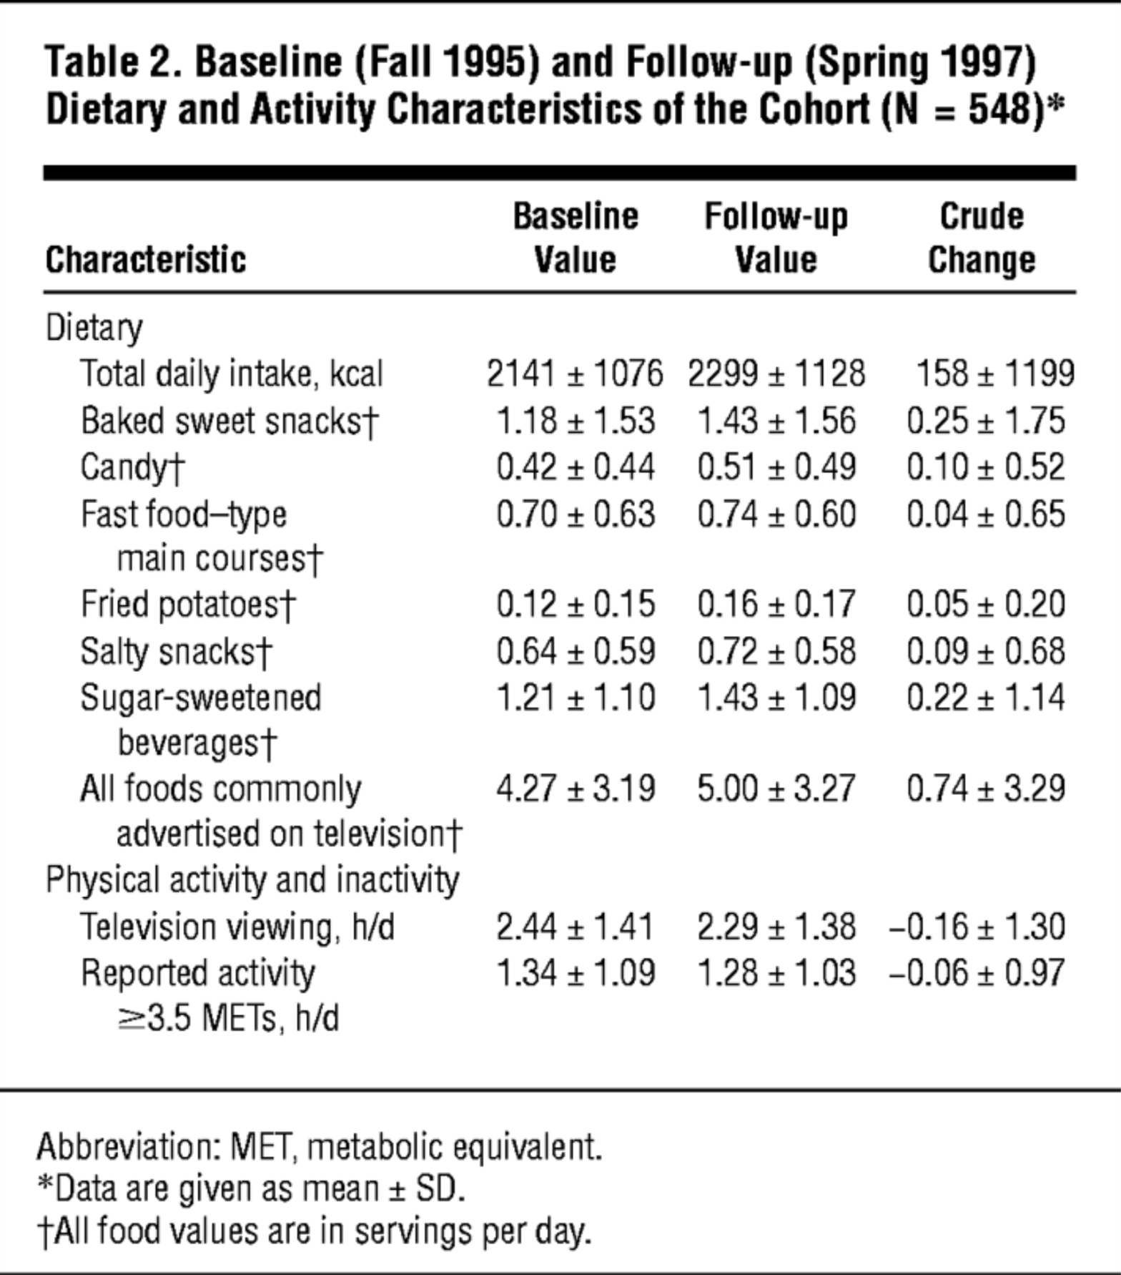
  Example: Effect of TV viewing on caloric intake
Two assessments of children in Boston (n=548)
Many plausible confounders: some measured many unmeasured.
From: Wiecha et al., When Children Eat What They Watch: Impact of Television Viewing on Dietary Intake in Youth Arch Pediatr Adolesc Med. 2006

Slide 21
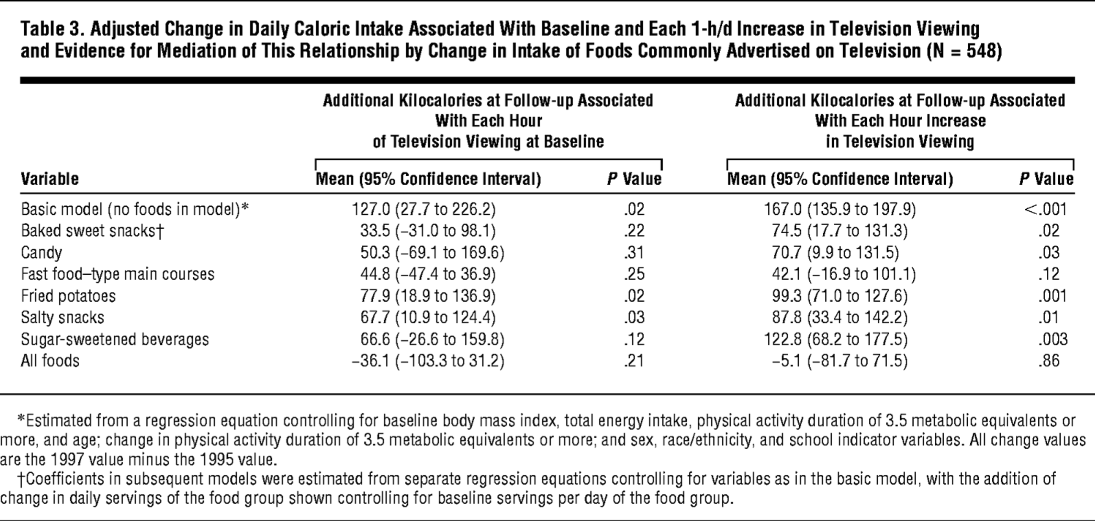
  Example: Effect of TV viewing on caloric intake
From: Wiecha et al., When Children Eat What They Watch: Impact of Television Viewing on Dietary Intake in Youth Arch Pediatr Adolesc Med. 2006

Slide 22
  Example: Effect of TV viewing on caloric intake
From: Wiecha et al., When Children Eat What They Watch: Impact of Television Viewing on Dietary Intake in Youth Arch Pediatr Adolesc Med. 2006
What is the usefulness of regressing change in calories on baseline versus changes in TV viewing?
In other words, should you use X₁ or ΔX?

Slide 23
  Using baseline exposure versus changes in exposure as independent variables
What is the usefulness of regressing change in calories on baseline versus changes in TV viewing?
We’ve already shown the power of using ΔX
Baseline X is appropriate if X is time-constant or highly correlated across time
But note you are assuming time-constant X influences changes in Y but time-constant U does not. Is this credible?
You may also hypothesize there is a delay from exposure to consequences, e.g., an etiologic period, so baseline X is most relevant
This highlights a huge limitation with using ΔX: it is a disaster if X at time (t) does not influence Y at time (t).
For example if X at time (t-1) influences Y at time (t) and you misspecify this, you can get the absolutely wrong answer.

Slide 24
Data source tradeoffs
How does the sample limit or support the identification strategy?
  Usually most important: longitudinal data
Longitudinal data allows you to establish temporal order
In some settings allows you to use a change in change model that rules out the effects of time-constant confounders, even if unobserved

Slide 25
Data source tradeoffs
Who is in the sample?
  Lack of selection bias (predictors of outcome do not predict participation)
  Diversity/representativeness of population of interest
How many people are in the sample?
What do they measure on those people?
  Substantive relevance of measures
  Quality of measures
  Number of measures
How does the sample limit or support the identification strategy?
  Usually most important: longitudinal data

Slide 26
  Design tradeoffs: surveillance versus etiologic research
Diversity/representativeness much more important if your task is surveillance or descriptive
  Prevalence of disease in a population
  Trends across time
  Magnitude of inequalities between groups
If your goal is to estimate the effect of an exposure on an outcome, you may be willing to compromise on representativeness or even diversity of sample
This is controversial

Slide 27
  The importance (or not) of representative samples
“statistical inference, the process of inferring from a sample to the source from which it was drawn, is …aided by…a representative sample. The mistake is to think that statistical inference is the same as scientific inference … representativeness can be counterproductive … the main road to general statements on nature is through studies that control skillfully for confounding variables and thereby advance our understanding of causal mechanisms. Representative sampling does not take us down that road.” - Rothman IJE 2013 “Why representativeness should be avoided”
Why counterproductive? Introduces extraneous variance in the outcome and may reduce measurement quality.
NHS argues: nurses are really reliable reporters! And there’s no confounding by SES. (note: this is not actually true)

Slide 28
  The importance (or not) of representative samples
Why counterproductive? Introduces extraneous variance in the outcome and may reduce measurement quality.
NHS argues: nurses are really reliable reporters! And there’s no confounding by SES. (note: this is not actually true)

Slide 29
  The importance (or not) of representative samples
“the selection of the subjects can influence both internal validity and external validity; and further, can modify the hypothesis being tested… External validity … is clearly a secondary issue; if the study has very low internal validity, the conclusions are likely to be wrong, and so its generalizability is irrelevant..”
Elwood IJE 2013 “On representativeness”
“representativeness should neither be avoided nor uncritically embraced, but adopted (or not) according to the particular questions that are being addressed. …many factors that are associated with the outcome of interest are also likely to be linked to self-selection into a study.

Slide 30
  The importance (or not) of representative samples
“representativeness should neither be avoided nor uncritically embraced, but adopted (or not) according to the particular questions that are being addressed. …[re the ACS volunteer cohort] many factors that are associated with the outcome of interest are also likely to be linked to self-selection into a study…. In the pre-modern epidemiology world the focus was often on triangulating evidence from across as many sources as possible. Such evidence comes from a variety of sources, of which some are deliberately non-representative (for example the considerable value of twin studies for identifying potentially causal epigenetic influences on disease, or the follow-up of natural experiments) and some of which (including essentially 100% coverage population linkage studies) will be representative.” Ebrahim and Davey Smith

Slide 31
  The importance (or not) of representative samples
Not controversial: the use of complex sample designs
  Cluster sampling: Separate the target population into non-overlapping clusters (neighborhoods, schools, states, any group such that everyone is included in one and only one such group). Choose a simple random sample of these clusters. Take a designated proportion of individuals from each of the selected clusters
  Stratified sampling: take a different proportion of individuals with different characteristics, e.g., 1/100 80 year old women but 1/50 80 year old men.
Generally need to correct for such design decisions in the analysis, but if sampling rules are known, you can reconstruct the original population.

Slide 32
  The importance (or not) of representative samples
Possibly more critical: how does the sample constrain the research questions?
Example of stroke
Two important questions in stroke
  Why such large geographic differences?
  Why racial disparities?

Slide 33
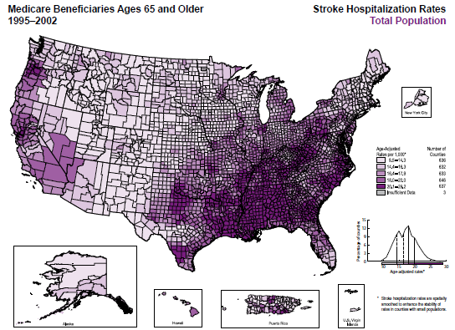
Stroke Hospitalizations in the US: 1995-2002

Slide 34
Competing Goals
High quality stroke measures
  Hospital based surveillance, with neuroimaging confirmation
High quality exposure measures
  Geographic variability
  Measures prior to onset of stroke
Long term follow-up

Slide 35
Single site sampling conflates race and migration
The overlap of race and place for older Americans
2000 Census 5% sample, age 65+, race black or white, southern= census region.

Slide 36
Major data sources for stroke surveillance (probably not comprehensive)
Incidence:
  Framingham Heart Study (one place, mostly white)
  Rochester registry (one place, mostly white)
  Brain attack surveillance in Corpus Christi (registry)
  Atherosclerosis Risk in Communities Study (4 sites: NC, MS [only blacks], MN, MD)
  Cardiovascular Health Study (4 sites: NC, CA, PA, MD)
  Greater Cincinnati/Northern Kentucky Stroke Study (registry)
  National Hospital Ambulatory Medical Care Survey (medical records)
  National Hospital Discharge Survey
  Northern Manhattan Stroke Study (one place)
  Washington Heights/Inwood Community Aging Project (one place)
  NHS: Nurses in 10 states
  REGARDS (nationally representative)
  HRS (nationally representative)
Prevalence: add NHANES, BRFSS, NHIS

Slide 37

Recognize Competing Goals and Assess Impact on Research Field
Study feasibility
Variation in exposure

Slide 38
Data source tradeoffs
Who is in the sample?
  Lack of selection bias (predictors of outcome do not predict participation)
  Diversity/representativeness of population of interest
How many people are in the sample?
What do they measure on those people?
  Substantive relevance of measures
  Quality of measures
  Number of measures
How does the sample limit or support the identification strategy?
  Usually most important: longitudinal data

Slide 39
Assessments
Health and Retirement Study
“Has a doctor ever told you you had a stroke
Reasons for Geographic and Racial Disparities in Stroke (REGARDS)
Self reported hospitalization
Medical record or death certificate review or proxy interview
Central adjudication
WHICAP
Self report
Medical records
MRI: lesions 3mm or larger

Slide 40
Self Report vs CMS Medical Records
Sensitivity (probability someone with a stroke will test positive) 74%
Specificity (probability someone without a stroke will test negative) 93%
Blacks:
Sensitivity: 75%
Specificity: 90%
Whites:
Sensitivity: 75%
Specificity: 93%
- Osypuk 2017, Circulation Outcomes, from HRS-CMS linkage

Slide 41
Self Report vs Neuroimaging
“In stroke research, sensitive neuroimaging techniques, rather than stroke self-report should be used to determine stroke history.”
-Reitz, Arch Neur, 2009
Sensitivity: 32%
Specificity: 79%
Blacks:
Sensitivity: 37%
Specificity: 77%
Whites:
Sensitivity: 27%
Specificity: 84%
Reitz, Arch Neur, 2009

Slide 42
Why do Glymour & Reitz disagree?
Many (most?) cerebral ischemic events are not diagnosed
Up to 5 times more silent infarcts than clinical strokes
CHS:
  Silent infarcts defined as focal lesions greater than 3 mm that were hyperintense on T2 images and, if subcortical, hypointense on T1 images
  28% of CHS participants (age 65+) had silent infarcts

Slide 43
Recognize Competing Goals and Assess Impact on Research Field
Measurement quality
Variation in exposure

Slide 44
Implications
Existing data sources very limited
Drive research orientation away from social or contextual factors or even preventive factors
Focus on clinical stroke characteristics, stable personal characteristics, things that can be evaluated retrospectively from hospital based samples
Need better validation built into ongoing cohort studies with self-report
Because diagnosed stroke is only tip of the iceberg, need more than just medical record verification.
Data availability fundamentally shapes the questions asked.

Slide 45
Data source tradeoffs
Who is in the sample?
  Lack of selection bias (predictors of outcome do not predict participation)
  Diversity/representativeness of population of interest
What do they measure on those people?
  Substantive relevance of measures
  Quality of measures
  Number of measures
How many people are in the sample?
How does the sample limit or support the identification strategy?
  Usually most important: longitudinal data

Slide 46

Goal is to estimate a characteristic of the population: how many people do we need?
Mean squared error of an estimator:
MSE=E[($\hat{β}$-$β)2]=Var\left(\hat{β}\right)+{(bias)}^{2}$
An estimator with a small bias and small variance might be closer to the truth (on average) than an unbiased estimator with a large variance
True beta is zero, but beta_hat_1 has some variance around zero.

Slide 47
Sample size tradeoffs
Mean squared error of an estimator:
MSE=E[($\hat{β}$-$β)2]=Var\left(\hat{β}\right)+{(bias)}^{2}$
An estimator with a small bias and small variance might be closer to the truth (on average) than an unbiased estimator with a large variance
Beta_hat_2 is biased mean(=.5) but has less variance.

Slide 48
Sample size tradeoffs
Mean squared error of an estimator:
MSE=E[($\hat{β}$-$β)2]=Var\left(\hat{β}\right)+{(bias)}^{2}$
An estimator with a small bias and small variance might be closer to the truth (on average) than an unbiased estimator with a large variance
Difference in absolute values (beta_hat_2 minus beta_hat_1) is negative

Slide 49
Sample size tradeoffs
Mean squared error of an estimator:
MSE=E[($\hat{β}$-$β)2]=Var\left(\hat{β}\right)+{(bias)}^{2}$
An estimator with a small bias and small variance might be closer to the truth (on average) than an unbiased estimator with a large variance.
Suppose true b=3, and you have two estimators
Estimator 1
3.3
3.5
3.1
2.9
Estimator 2
-4
10
5.5
0.5

Slide 50
Sample size tradeoffs
Mean squared error of an estimator:
MSE=E[($\hat{β}$-$β)2]=Var\left(\hat{β}\right)+{(bias)}^{2}$
An estimator with a small bias and small variance might be closer to the truth (on average) than an unbiased estimator with a large variance.
Suppose true b=3, and you have two estimators
Estimator 1
3.3
3.5
3.1
2.9
Bias=.2
Variance=.07
Estimator 2
-4
10
5.5
0.5
Bias=0
Variance=37

Slide 51
Data source tradeoffs
Many options
  Event registries/surveillance data (death records)
  Outcome registries (cancer cases, ALS registries)
  Administrative data (electronic health records)
  Population based cross-sectional or longitudinal (cohort) studies with a defined sampling frame
  Cross-sectional or longitudinal studies with convenience samples (including secondary analyses of RCT data)
  Clinic based cross-sectional or longitudinal studies
  Case control studies: conceptualize the parent cohort
  Linkages of above
Who and how many people are in the sample?
What did they measure and how well did they measure it??
Does this sample allow an identification strategy?

Slide 52
End Lecture 3

Slide 53
Stroke Mortality in the US:
1991-1998
From CDC Atlas of Stroke Mortality (pg27)
ftp://ftp.cdc.gov/pub/Publications/stroke_atlas/05a-intro-totalpop.pdf

Slide 54
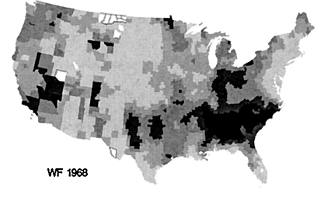
Geographic Pattern of US Stroke Deaths: 1968 vs 1996
From Howard et al, Stroke (2001).

Slide 55
Excess Stroke in Blacks vs Whites
“Risk factors for increased stroke mortality in blacks heretofore examined, primarily a higher prevalence of hypertension and diabetes and a lower socioeconomic status, explain only a fraction of this excess….
…It is possible that elevated blood pressure and insulin resistance/diabetes impact blacks more strongly, which perhaps suggests a genetic influence or susceptibility. …
… A more complete understanding of the mechanisms underlying the race/ethnic differences in stroke subtype will likely depend on advances in genomics. ” – Wolf and Kannell, Circulation 2007

Slide 56
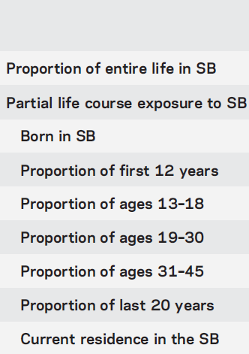
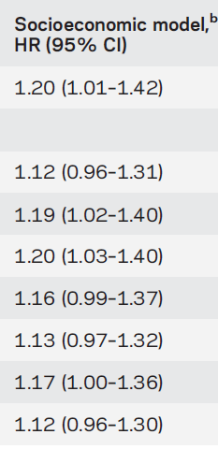
Place of birth predicts stroke risk, independently of race
n=24,544
141,736 P-Y
615 strokes
Howard et al., Neurology, 2013

Slide 57
Place of birth substantially confounds race effects on stroke

