Slide 1
Parathyroid
Wen Shen, MD
Michael Zobel, MD
November 9, 2016

Slide 2
Overview
Case
Parathyroid pathologies
Presentation
Diagnostic work-up
Management

Slide 3
Case
55 y.o. woman with hypercalcemia diagnosed on bloodwork which was done in follow up after contracting malaria overseas. Her calcium has risen from 11.1 mg/dl in 2013 to 11.4 mg/dl in 2016. She is referred for surgical evaluation.

Slide 4
A Moment to Reflect
What question(s) would you ask next?
Why?
What information do you think the attending will want to know?
What does the attending actually want to know?
What is on your differential? What are you most concerned about?

Slide 5
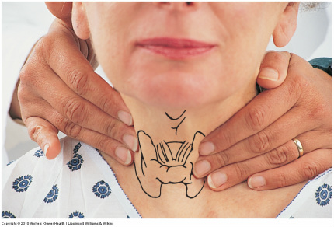
Case
PMHx: None
PSHx: C-section
Meds: None/ All: None
Exam: Fullness of L neck with palpable nodule, otherwise normal

Slide 6
A Moment to Reflect
What labs do you want?
Why?
How would these narrow your differential?
Do you want any imaging?
If so, which first?
Why?

Slide 7
Labs
PTH = 141 pg/ml
Alb = 4.8
Vit D = 20.7
24hr urine calcium= 228.8mg/24hr

Slide 8
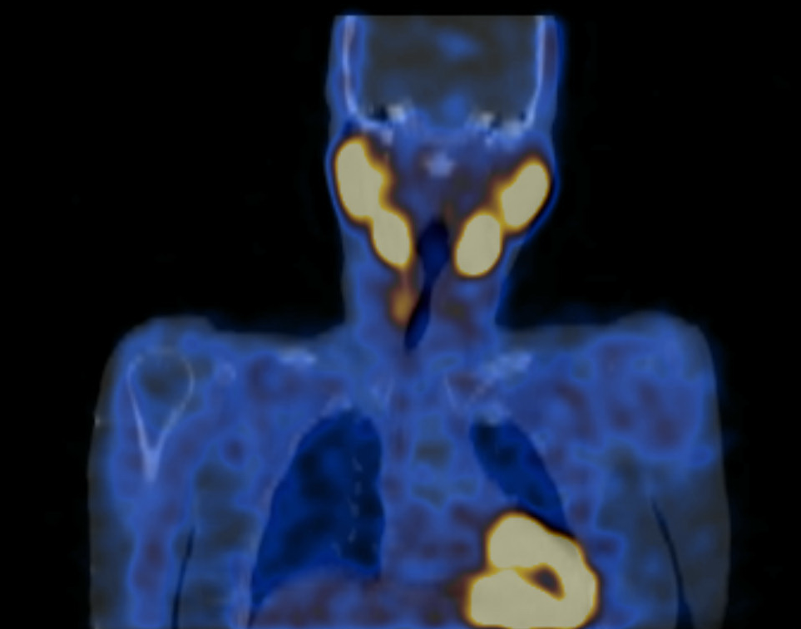
Imaging
Notes:
58818992

Slide 9
Parathyroid Glands
4 glands – 2 superior, 2 inferior
Embryologic origin
  Superior glands – 4th pharyngeal pouch
  Inferior glands – 3rd pharyngeal pouch
Anatomical location
  Differs based on variable migration
Arterial supply
  Inferior thyroid a. (most commonly)
Venous drainage
  Inferior, middle, superior thyroid v.
Notes:
Blood supply can vary. Occasionally the superior thyroid a. or thyroidea ima a.

Slide 10
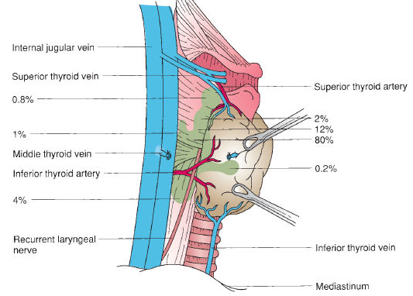
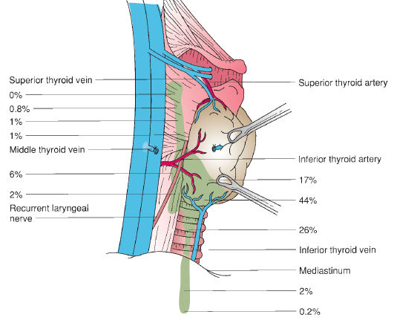
Inferior, anterior
Posterior, superior

Slide 11
Parathyroid Physiology
Chief cells produce parathyroid hormone
  Most important regulator of Ca, PO4
Stimulate bone resorption via osteoclasts
Stimulates reabsorption in the distal tubules
  Inhibits reabsorption of PO4
Indirectly stimulates GI reabsoprtion by increasing VitD levels
Notes:
In kidney, stimulates 1-alpha hydroxylase which creates active form of VitD

Slide 12
Hyperparathyroidism
Primary
  Autonomous production of PTH
Secondary
  Low Ca levels→ increase in PTH fxn
  Commonly with CKD patients (low VitD, high PO4)
Tertiary
  After renal transplant
  Occurs in patient previously with 2ndary hyperpara
Notes:
In kidney, stimulates 1-alpha hydroxylase which creates active form of VitD

Slide 13
Question
An asymptomatic patient presents with a serum Ca of 10.2, incidentally during routine lab testing. PTH is normal. What “benign” condition aside from primary hyperparathyroidism should be considered?
  Familial hypercalcemic hypocalcemia
Notes:
Inherited, affects Ca sensing receptor in kidney altering urinary Ca excretion. Mimics primary hyperparathyroid

Slide 14
Primary Hyperparathyroidism
Causes of primary hyperparathyroidism
  Adenoma 80%
  Multiple adenomas 5%
  Hyperplasia 15%
Associated with MEN I and MEN IIA
  MEN I: Parathyroid, pituitary, pancreas
  MEN IIA: Parathyroid, pheo, medullary thyroid CA
Notes:
PRAD1 oncogene associated with large adenomas

Slide 15
Presentation
Asymptomatic hypercalcemia
  80% of cases in western countries
Symptomatic hyperparathyroidism
  “Bones, stones, groans, psychiatric overtones”
Parathyroid crisis
  Rare (1-2% of patients with PHPT)
  Severe hyperCa (>15) with marked symptoms
Normocalcemic PHPT
  Elevated PTH, normal Ca
  Atypical

Slide 16
Diagnostic Work-up
Rarely palpated on exam
  Palpable mass is more likely parathyroid CA
Lab work-up
  Repeat serum Ca (consider iCa)
  Serum PTH (sensitivity 80-90%)
  24hr urinary Ca
Imaging
  Sestamibi scintigraphy (50-60% sensitivity)
  High resolution ultrasound (equivalent)
Notes:
PTH can be either elevated, normal, or low
If normal, can be “inappropriately” elevated
Elevated PTH alone is not diagnostic, but in setting of elevated Ca its practically is
24hr urinary Ca, may be normal with HPT

Slide 17
Management of Asymptomatic PHPT
Who do you think needs an intervention? Does everyone?

Slide 18
Management of Asymptomatic PHPT
Some suggested criteria for surgery:
  Ca concentration of 1.0 mg/dL or more above ULN
  eGFR < 60 ml/min
  DEXA T-score < -2.5
  24hr urine Ca > 400mg/day (no data)
  Nephrolithiasis, nephrocalcinosis
  Age < 50
MEN syndrome?
Fourth International Workshop on Asymptomatic Primary Hyperparathyroidism, 2013

Slide 19
Question
A 26-year-old male with primary HPT was sent for genetic testing and was found to have MEN I. He has a left inferior parathyroid adenoma localized on ultrasound and sestamibi. What procedure should be done?
Minimally invasive parathyroidectomy with removal of the localized parathyroid
Minimally invasive parathyroidectomy with removal of the localized parathyroid and intraoperative PTH monitoring
Bilateral cervical exploration with resection of 3 ½ glands and bilateral thymectomy
Bilateral cervical exploration with resection of 3.5 glands
Notes:
Patients with MEN 1 have a genetic mutation in all of their cells; therefore, all four glands have a propensity for hyperplasia. The primary surgery in these patients is therefore a 3.5 gland (subtotal) resection. The goal is to achieve normocalcemia for as long as possible while avoiding hypoparathyroidism. These patients also have a greater incidence of supernumerary and ectopic glands, as well as having thymic carcinoids; therefore bilateral thymectomy is also indicated in these patients.

Slide 20
Operative Planning
Goals of operation?
Major pitfalls to avoid?
https://www.youtube.com/watch?v=CTQsfeSBJXk
http://accesssurgery.mhmedical.com/MultimediaPlayer.aspx?MultimediaID=5481727
Notes:
Intraoperative PTH?

Slide 21
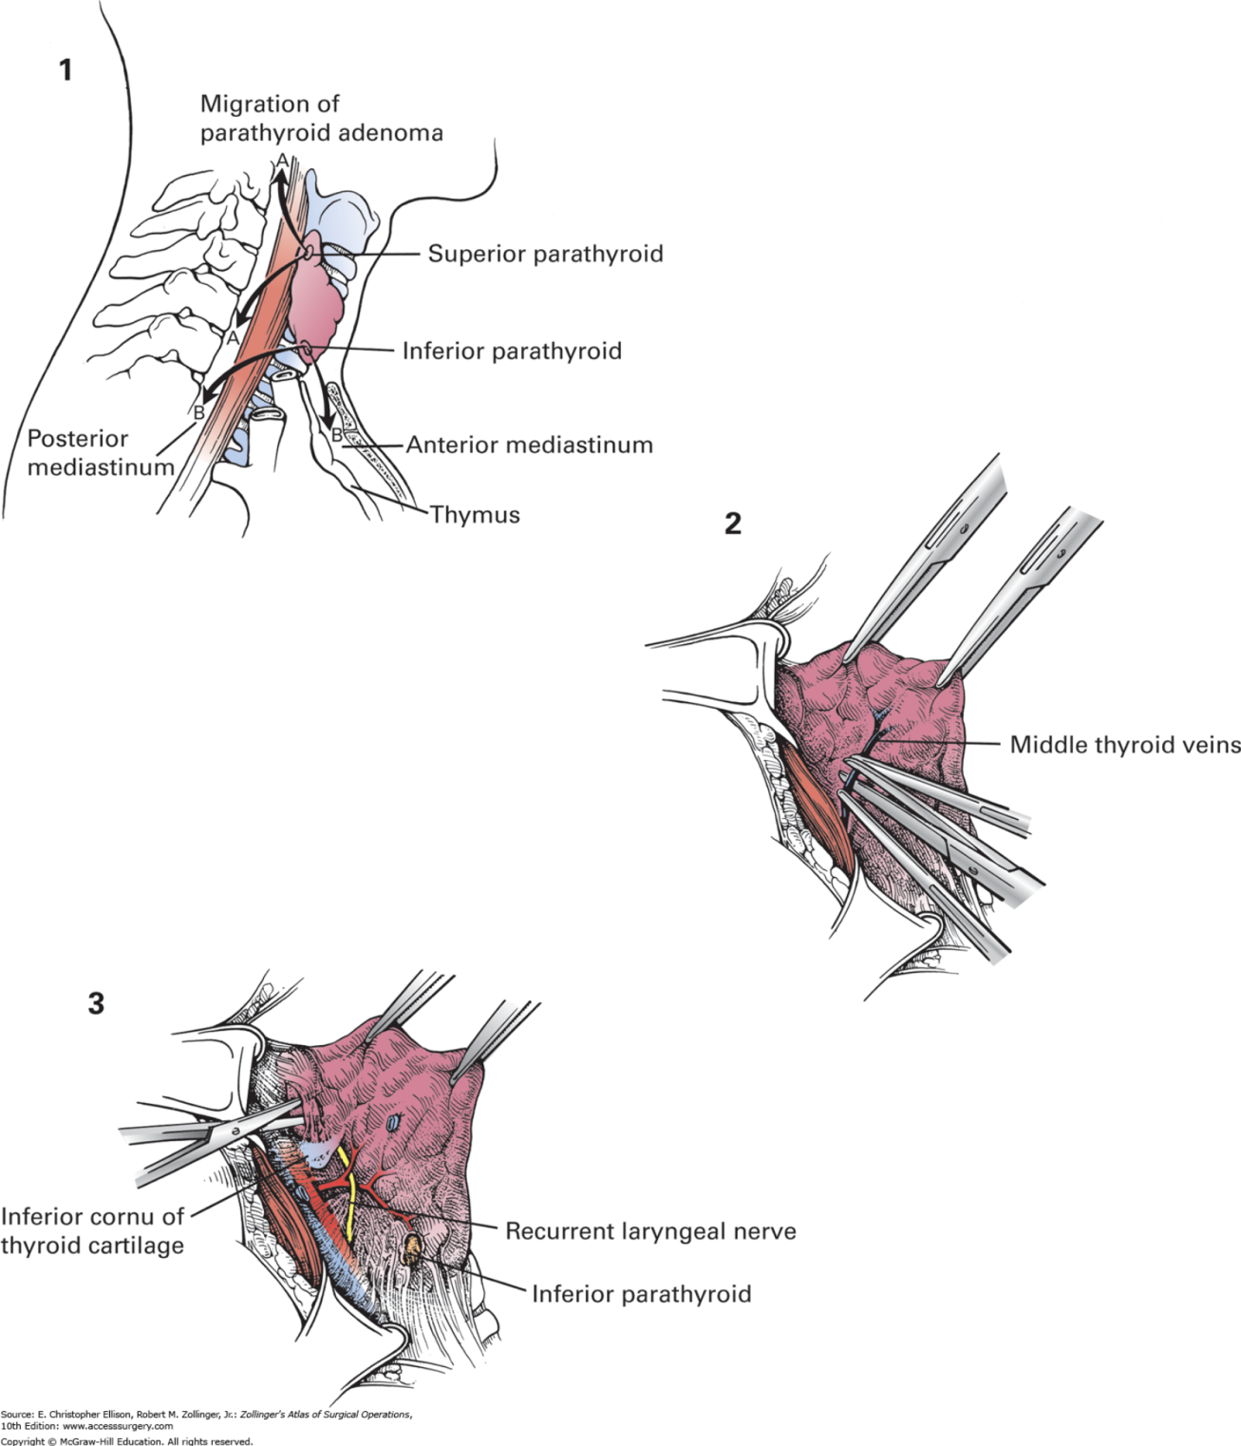
Notes:
Nonrecurrent laryngeal nerve? 1% of cases. Mistaken for inferior thyroid artery
What if you are unable to identify all the glands?
% of supranumerary glands?
Reimplantnation?

Slide 22
Question
In a 55-year-old male with primary HPT, which of the following would be an indication for bilateral exploration as the primary surgery?
  A. Intraoperative PTH drops from a baseline of 110 to 32 at 10 mins
  B. Lithium-induced HPT
  C. History of radiation exposure
  D. Amiodarone-induced HPT
  E. Nephrolithiasis
Notes:
If the intraoperative PTH levels fall appropriately after the removal of a single adenoma in a patient with a history of lithium use, a minimally invasive surgery can be considered. However, patients with lithium-induced HPT are more likely to warrant a four-gland exploration since all four glands are exposed to the effects of lithium. Lithium has a higher tendency to cause four-gland hyperplasia than in the normal population, making visualization of all four glands essential.

Slide 23
Postoperative Complications
Following a parathyroidectomy, a woman endorses hoarseness.
What are you concerned for?
How common is this outcome?
Is this permanent?
What is the worst case scenario? What would you do in that scenario?
Notes:
Recurrent laryngeal nerve injury
5-10%
No, only permanent in 1% of cases
Bilateral paralysis. Tracheostomy

Slide 24
Postoperative Complications
Post-operatively from a parathyroidectomy, a man endorses tingling around his mouth.
What are you concerned for?
What post-op labs are ordered to screen?
How is this managed?
Is it permanent?
Notes:
Post-op labs

