Slide 1
Session 7. Spatial regression analysis and disease mapping

Slide 2
Today’s session
Brief review goals of regression analysis
Why spatial autocorrelation important
Review how to test for in a regression framework
What to do if found- how to incorporate
Frequentist vs Bayesian approaches to inference and prediction
Conditional autoregressive models (CAR)
Intro to Winbugs and INLA

Slide 3
Basic review of regression analysis
Model
  Y_{i} = beta₁ * X_{1i} + … + beta_{p} * X_{p} + e_{i} , e_{i}~(iid) N(0,theta-sqr)
  Linear: ordinary least squares, choose beta₁, beta₂ by minimizing sum of squares (y_{i}-(beta₁ …))sqr
  Estimator beta is the best linear unbiased predictor (blue) – with the smallest variance

Slide 4
Spatial autocorrelation
Errors are NOT independent
Observations more closely related based upon space
If not accounted for, variation is UNDERestimated
Standard errors are too small, and too often we would reject null hypotheses (so claim ‘significance’)

Slide 5
What do we do if we find it?
Test covariates- do they explain it?
How do we incorporate correlated errors?
We need to account for spatial autocorrelation if it exists
We can potentially use spatial autocorrelation for disease mapping – filling in gaps in data (smoothing)

Slide 6
Disease mapping
Provide visual summary of spatial information and allow the identification of patterns. D
Disease maps are crucial for
  Describing spatial variation of disease
  Identifying areas of unusually high risk
  Formulating etiological hypotheses
  Allowing better resource allocation

Slide 7
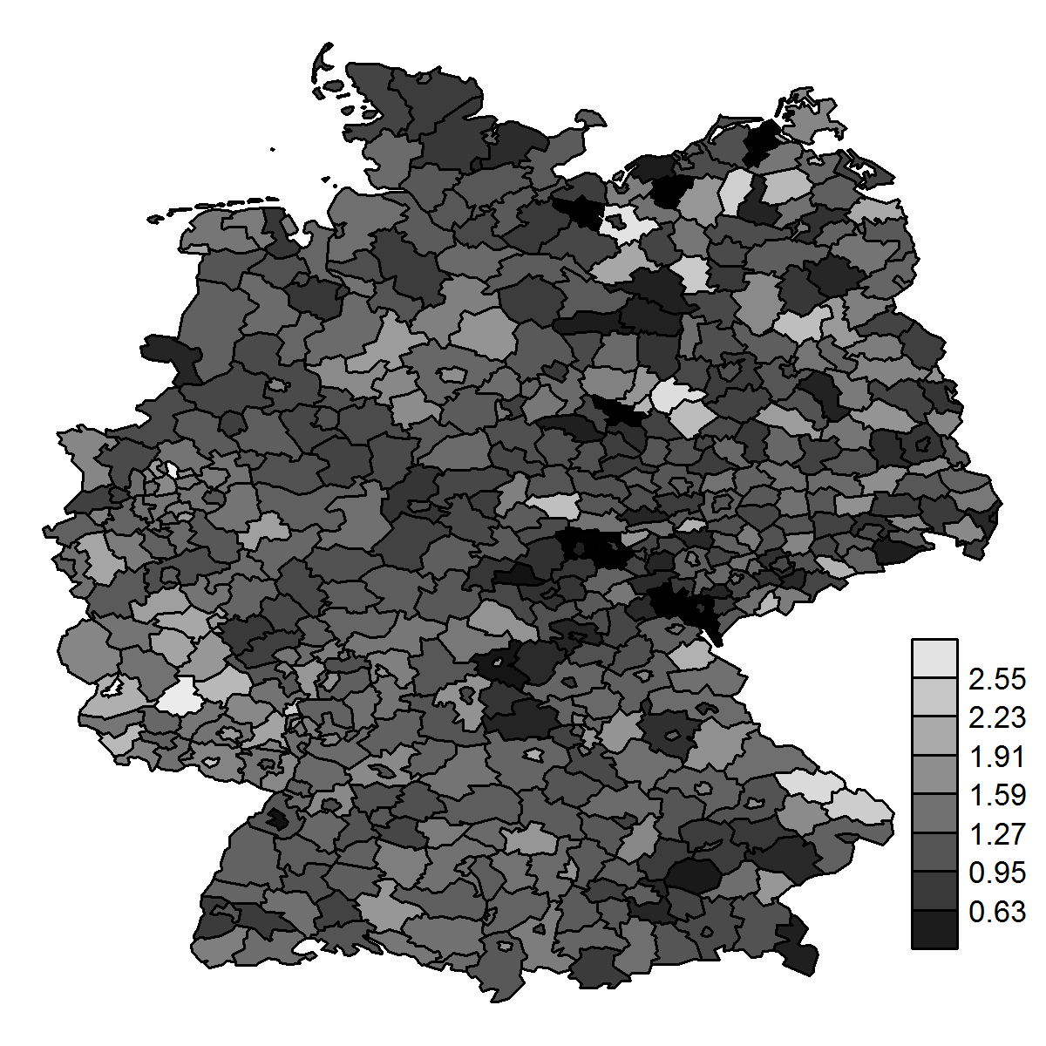
Areal data
SMR
Areal or lattice data arise when the region of interest is partitioned into a finite number of subregions at which outcomes are aggregated
Example: number of larynx cancer cases in the districts of Germany
We want to obtain the disease risk within the geographic units

Slide 8
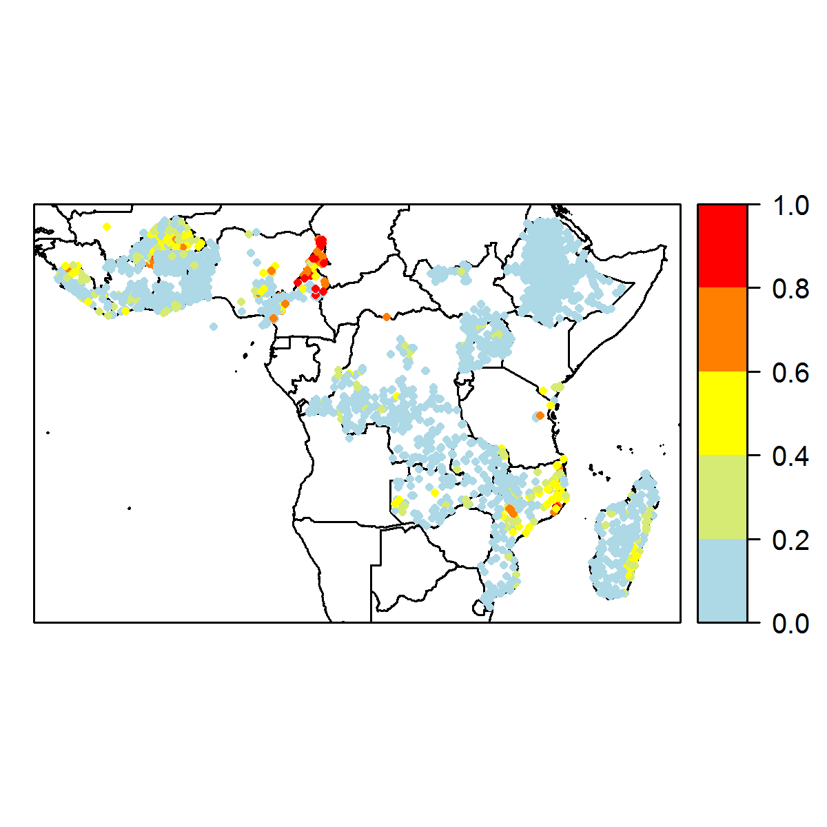
Geostatistical data
The disease risk is a spatially continuous phenomenon but it is measured only at particular sites
Example: lymphatic filariasis prevalence obtained from surveys conducted at several villages
We want to predict the disease risk at unobserved locations and construct a spatially continuous risk surface

Slide 9
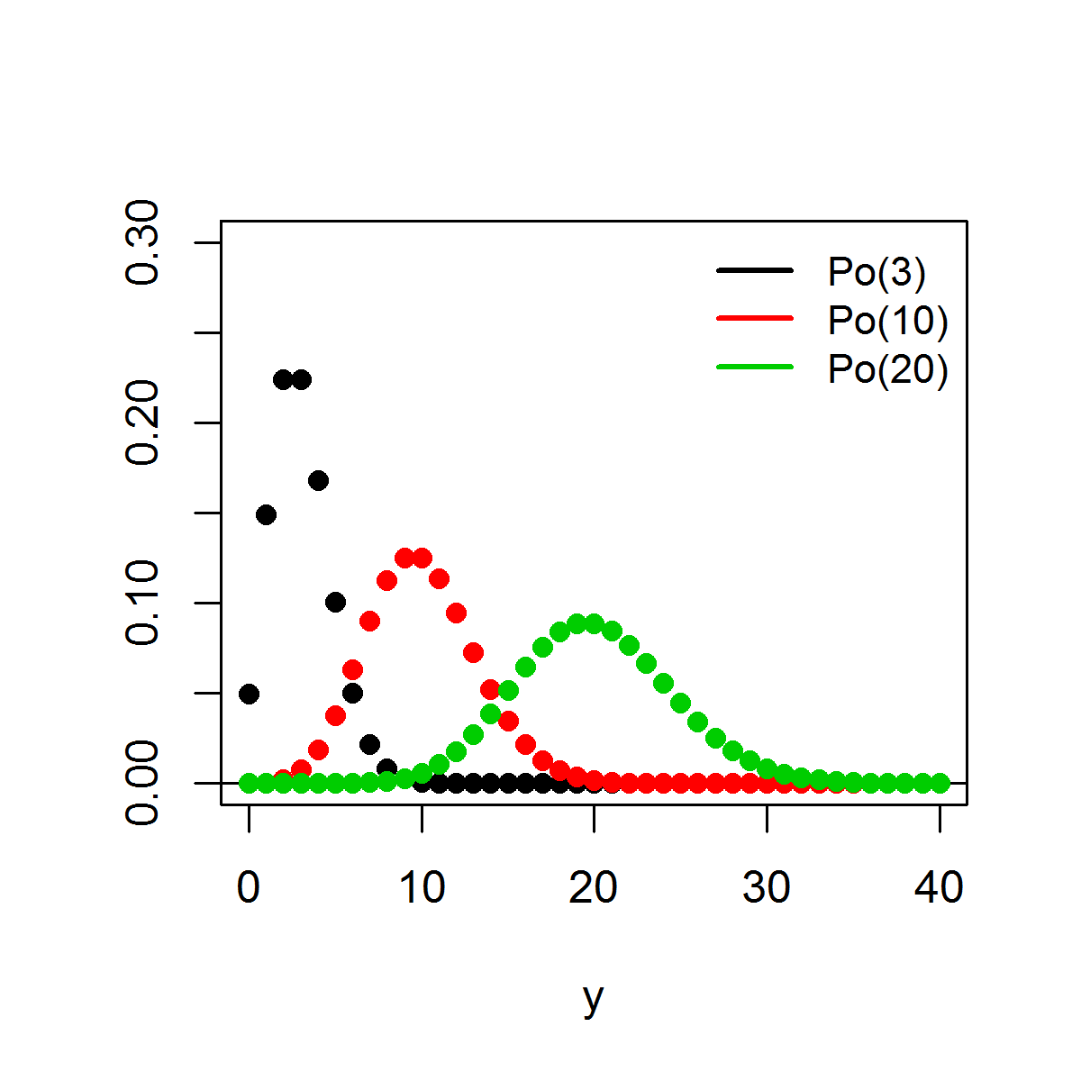
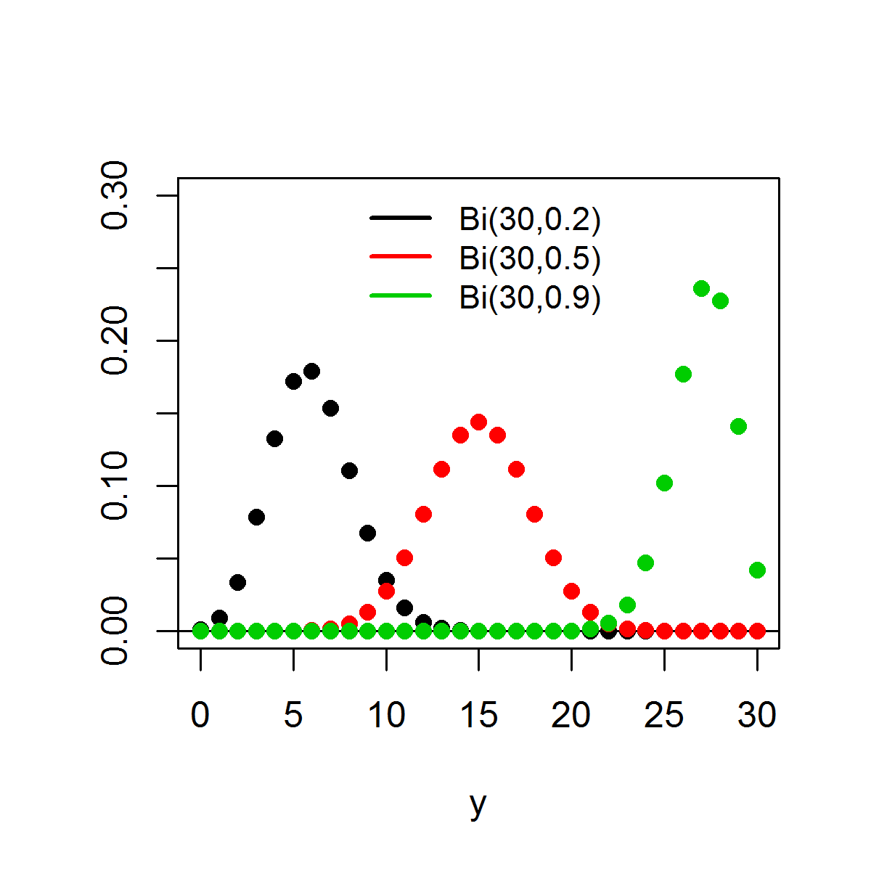
Distributions
Poisson distribution
Y ∼ Poisson(µ) y = 0, 1, 2, . . .
expected number of occurrences µ > 0
Binomial distribution Y ∼ Binomial (n, π) y = 0, 1, . . . , n
number of trials n ∈ {1, 2, . . .}, probability of success π ∈ [0, 1]
p(y|µ) =
e
−µ_{µ}y
n y (n−y )
y !
p(y|n, π) = π (1 − π)
y
E (Y ) = µ, Var (Y ) = µ
E (Y ) = nπ, Var (Y ) = nπ(1 − π)

Slide 10









Regression models
Log-linear model
Logistic model
Y_{i} ∼ Po(µ_{i} ), i = 1, . . . , n
log(µ_{i} ) = α + βx_{i}
For a one unit increase in x , the mean increases by a factor of exp(β) (holding all other covariates constant)
Y_{i} ∼ Binomial (n_{i} , π_{i} ), i = 1, . . . , n
logit(π_{i} ) = α + βx_{i}
log-odds: logit(π_{i} ) = log ^{( πi \}
1−π_{i}
π_{i} = logit⁻¹(α + βx_{i} ) =
exp(α+βx_{i} )
1+exp(α+βx_{i} )
β is the change in the log-odds associated with one-unit increase in the x covariate (holding all other covariates constant)
exp(β) is the odds ratio
π
OR =
1−π
|x =1
π
_{1−π} |x =0
For a one unit increase in x , the odds increase by a factor of exp(β) (holding all other covariates constant)

Slide 11






Standardized Mortality Ratio
Disease risk is often estimated by the standardized mortality ratio:
Y E
SMR =
Y number of observed cases
E number of expected cases if the study population has the same disease rate as the standard population (indirect standardization)
E = ^{},m}
_{r} (s)
n_{i}
i =1 i
_{r} (s)
rate in strata (age group) i in the standard population (usually
i
the national population)
_{r} (s)
number of events divided by number of individuals at risk
i
n_{i} population in stratum i of the observed population
SMR > 1 indicates more cases observed than expected from the standard population

Slide 12
Disease mapping
SMRs are often misleading and insufficiently reliable for reporting in areas with small populations
In contrast, model-based approaches enable to incorporate covariates and borrow information from neighboring areas to improve local estimates, resulting in the smoothing of extreme rates based on small sample sizes
Such approaches are often expressed as hierarchical Bayesian disease mapping models

Slide 13
Disease mapping models
Bayesian disease mapping models treat the disease risks θ_{i} , in small areas indexed by i , as random variables and specify a distribution for them
Y_{i} ∼ Po(E_{i} × θ_{i} ), i = 1, . . . , n
log (θ_{i} ) ∼ p(·|φ)
φ ∼ π(·)
Y_{i} and E_{i} are respectively the observed and expected number of cases of disease in area i
θ_{i} is the relative risk in area i
p(·|φ) is an appropriate prior distribution for the {θ_{i} }
φ are hyperparameters with hyperprior distributions π(·)

Slide 14
Disease mapping regression models
log(θ_{i} ) = α + CH + UH
CH is the correlated heterogeneity. It accounts for the spatial dependence between the relative risks
UH is an unstructured exchangeable component included to increase flexibility. It models uncorrelated noise
These hierarchical models allow straightforward extensions to estimate covariate effects, predict missing data and handle spatio-temporal data and multiple diseases

Slide 15
Spatial regression in practice- incorporating spatial relationships
Steps in determining the extent of spatial autocorrelation in your data and running a spatial regression:
Choose a neighborhood criterion
    Which areas are linked?
Assign weights to the areas that are linked
    Create a spatial weights matrix
Run statistical test to examine spatial autocorrelation
Run a OLS regression
    Determine what type of spatial regression to run
Run a spatial regression
    Apply weights matrix

Slide 16
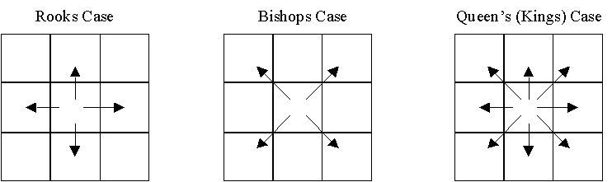
Spatial weights matrices
Neighborhoods can be defined in a number of ways
  Contiguity (common boundary)
    What is a “shared” boundary?
  Distance (distance band, K-nearest neighbors)
    How many “neighbors” to include, what distance do we use?
  General weights (social distance, distance decay)

Slide 17
Contiguity based neighbors
Areas sharing any boundary point (QUEEN) are taken as neighbors, using the poly2nb function, which accepts a SpatialPolygonsDataFrame
> library(spdep)
> sids_nbq<-poly2nb(sids)
If contiguity is defined as areas sharing more than one boundary point (ROOK), the queen= argument is set to FALSE
> sids_nbr<-poly2nb(sids, queen=FALSE)
> coords<-coordinates(sids)
> plot(sids)
> plot(sids_nbq, coords, add=T)

Slide 18
Distance based neighbors k nearest neighbors
Can also choose the k nearest points as neighbors
> coords<-coordinates(sids_SP)
> IDs<-row.names(as(sids_SP, "data.frame"))
> sids_kn1<-knn2nb(knearneigh(coords, k=1), row.names=IDs)
> sids_kn2<-knn2nb(knearneigh(coords, k=2), row.names=IDs)
> sids_kn4<-knn2nb(knearneigh(coords, k=4), row.names=IDs)
> plot(sids_SP)
> plot(sids_kn2, coords, add=T)
k=2
k=1
k=3

Slide 19
Distance based neighbors
Specified distance
Can also assign neighbors based on a specified distance
> dist<-unlist(nbdists(sids_kn1, coords))
> summary(dist)
Min. 1st Qu. Median Mean 3rd Qu. Max.
40100 89770 97640 96290 107200 134600
> max_k1<-max(dist)
> sids_kd1<-dnearneigh(coords, d1=0, d2=0.75*max_k1, row.names=IDs)
> sids_kd2<-dnearneigh(coords, d1=0, d2=1*max_k1, row.names=IDs)
> sids_kd3<-dnearneigh(coords, d1=0, d2=1.5*max_k1, row.names=IDs)
OR by raw distance
> sids_ran1<-dnearneigh(coords, d1=0, d2=134600, row.names=IDs)

Slide 20
Spatial weights matrices
Once our list of neighbors has been created, we assign spatial weights to each relationship
  Can be binary or variable
Even when the values are binary 0/1, the issue of what to do with no-neighbor observations arises
Binary weighting will, for a target feature, assign a value of 1 to neighboring features and 0 to all other features
  Used with fixed distance, k nearest neighbors, and contiguity

Slide 21
Row-standardized weights matrix
> sids_nbq_w<- nb2listw(sids_nbq)
> sids_nbq_w
Characteristics of weights list:
Neighbour list object:
Number of regions: 100
Number of nonzero links: 490
Percentage nonzero weights: 4.9
Average number of links: 4.9
Weights style: W
Weights constants summary:
n nn S0 S1 S2
W 100 10000 100 44.65023 410.4746
Row standardization is used to create proportional weights in cases where features have an unequal number of neighbors
  Divide each neighbor weight for a feature by the sum of all neighbor weights
    Obs i has 3 neighbors, each has a weight of 1/3
    Obs j has 2 neighbors, each has a weight of 1/2
Use is you want comparable spatial parameters across different data sets with different connectivity structures

Slide 22
Binary weights
> sids_nbq_wb<-nb2listw(sids_nbq, style="B")
> sids_nbq_wb
Characteristics of weights list:
Neighbour list object:
Number of regions: 100
Number of nonzero links: 490
Percentage nonzero weights: 4.9
Average number of links: 4.9
Weights style: B
Weights constants summary:
n nn S0 S1 S2
B 100 10000 490 980 10696
Row-standardised weights increase the influence of links from observations with few neighbours
Binary weights vary the influence of observations
  Those with many neighbours are up-weighted compared to those with few

Slide 23
Binary vs. row-standardized
A binary weights matrix looks like:
A row-standardized matrix it looks like:
0 | 1 | 0 | 0
0 | 0 | 1 | 1
1 | 1 | 0 | 0
0 | 1 | 1 | 1
0 | 1 | 0 | 0
0 | 0 | .5 | .5
.5 | .5 | 0 | 0
0 | .33 | .33 | .33

Slide 24
Regions with no neighbors
If you ever get the following error:
Error in nb2listw(filename): Empty neighbor sets found
You have some regions that have NO neighbors
  This is most likely an artifact of your GIS data (digitizing errors, slivers, etc), which you should fix in a GIS
  Also could have “true” islands (e.g., Hawaii, San Juans in WA)
    May want to use k nearest neighbors
    Or add zero.policy=T to the nb2listw call
> sids_nbq_w<-nb2listw(sids_nbq, zero.policy=T)

Slide 25
Spatial autocorrelation
Test for the presence of spatial autocorrelation
  Global
    Moran’s I
    Geary’s C
  Local (LISA – Local Indicators of Spatial Autocorrelation)
    Local Moran’s I and Getis G_{i}*
We’ll just focus on the “industry standard” – Moran’s I

Slide 26
Moran’s I in R
> moran.test(sids_NAD$SIDR79, listw=sids_nbq_w, alternative=“two.sided”)
Moran's I test under randomisation
data: sids_NAD$SIDR79
weights: sids_nbq_w
Moran I statistic standard deviate = 2.3625, p-value = 0.009075
alternative hypothesis: greater
sample estimates:
Moran I statistic Expectation Variance
0.142750392 -0.010101010 0.004185853
“two.sided” → H_{A}: I ≠ I₀
“greater” → H_{A}: I > I₀
Notes:
results reported here are actually for the default = “greater”

Slide 27
Moran’s I in R
> moran.test(sids_NAD$SIDR79, listw=sids_nbq_wb)
Moran's I test under randomisation
data: sids_NAD$SIDR79
weights: sids_nbq_wb
Moran I statistic standard deviate = 1.9633, p-value = 0.02480
alternative hypothesis: greater
sample estimates:
Moran I statistic Expectation Variance
0.110520684 -0.010101010 0.003774597

Slide 28
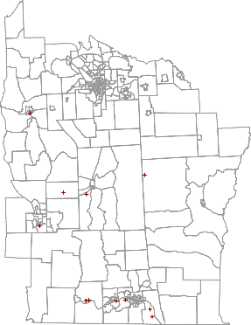
New York leukemia data
4800000
Syracuse
Oneida
4750000
Aub●uGrnE Auburn
The data set includes adjusted counts of leukemia 1978–1982, and observations on a number of other factors including distance to hazardous waste sites
Cortland
Smith Corona
Solvent Savers
Groton ●
4700000
Ithaca
Morse Chain
Hadco
4650000
Victory Plaza ●● B● in●gMhaomnaprtcohnChemicals
^{IBM Endicott} ● Singer
●
Nesco
350000
400000 450000

Slide 29
Reading the NY data
The 281 census tract data set for 8 central New York State counties featured prominently in Waller & Gotway (2004) will be used in the examples, supplemented with tract boundaries derived from TIGER 1992 and distributed by SEDAC/CIESIN; the boundaries have been projected from geographical coordinates to UTM zone 18
> NY8<-readOGR("NY_data","NY8_utm18")
OGR data source with driver: ESRI Shapefile
Source: "NY_data", layer: "NY8_utm18"
with 281 features
It has 17 fields
> TCE<-readOGR("NY_data","TCE")
OGR data source with driver: ESRI Shapefile
Source: "NY_data", layer: "TCE"
with 11 features
It has 5 fields
> cities<-readOGR("NY_data","NY8cities")
OGR data source with driver: ESRI Shapefile
Source: "NY_data", layer: "NY8cities"
with 6 features
It has 1 fields

Slide 30
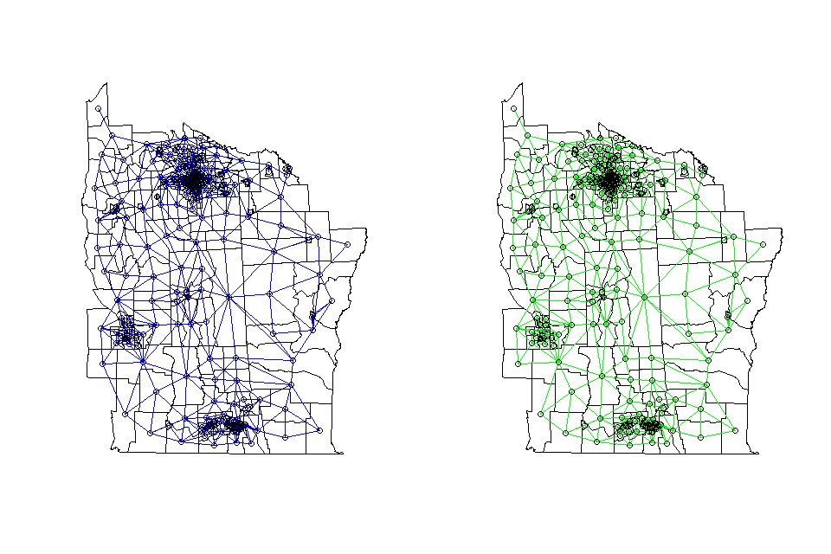
Queen vs. Rook neighbors
Queen
Rook
●
● ●
●
●
●
●
●●
●
●
● ●
●
NY8_1 <- poly2nb(NY8)
NY8_2 <- poly2nb(NY8,queen=F)
●
●
●
●
●
●
●
●
●
●
●
●
●
●
●
●
●

Slide 31
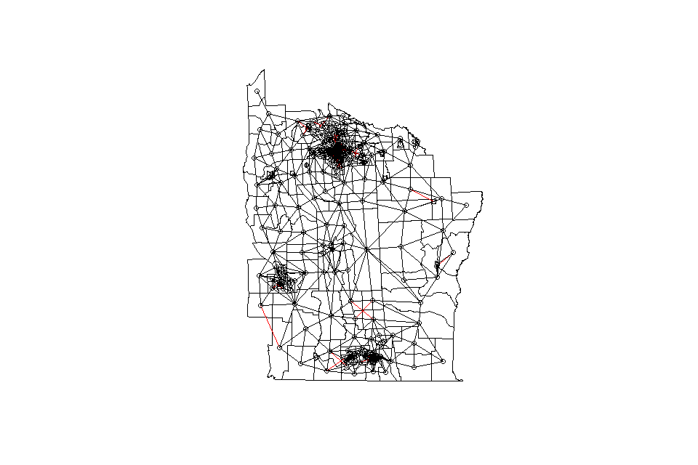

Slide 32
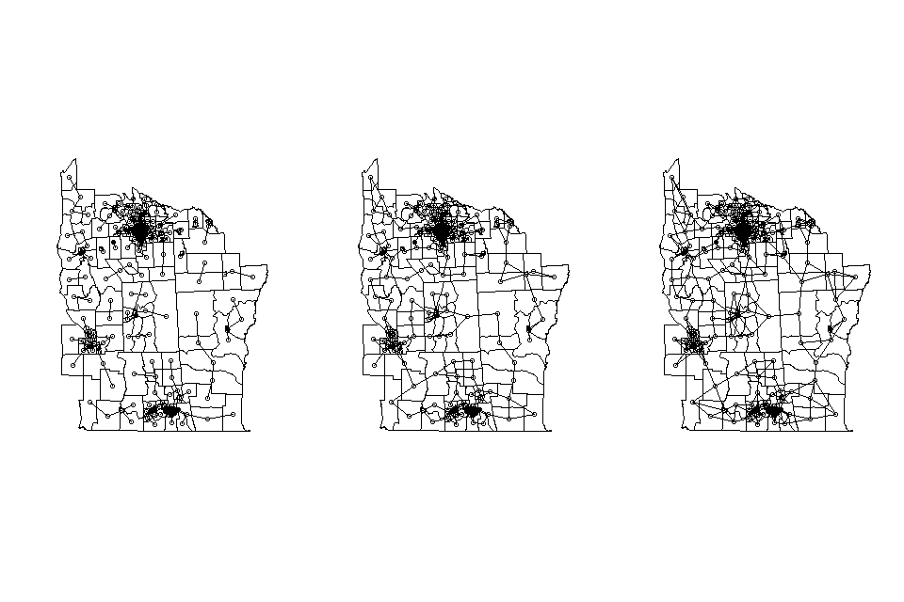
K nearest neighbors
k=1
k=2
k=3

Slide 33
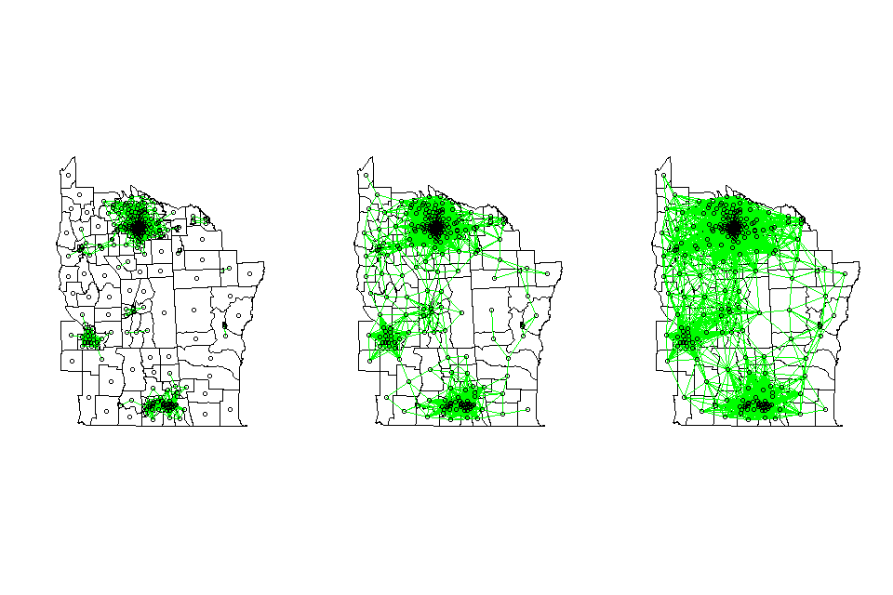
Distance based neighbors

Slide 34
In the spdep package, neighbour relationships between n
observations are represented by an object of class nb
This is a list of length n with the index numbers of neighbours of each component recorded as an integer vector
.If any observation has no neighbours, the component contains an integer zero
It also contains attributes, typically a vector of character region indentifiers, and a logical value indicating whether the relationships are symmetric

Slide 35
Testing for spatial autocorrelation
contiguity
distance

Slide 36
Moran’s test on regression residuals
NY8$r<-NY8$Cases/NY8$POP8
NY8$Zi<-log((1000*(NY8$Cases+1))/NY8$POP8)

Slide 37
Weighting for population variation

Slide 38
Adding a covariate

Slide 39
Residual spatial autocorrelation?

Slide 40
After adjusting for population variation…

Slide 41
Simultaneous autoregressive model (SAR)
Uses a regression on values from other areas to account for spatial dependence
Linear models (Gaussian) can be estimated by maximum likelihood
Observed values= linear trend (covariates) + spatial signal + independent residuals
Observed value is an average of neighboring observations – covariance is modeled directly based upon weights matrix
We can examine covariate effects while controlling for spatial dependence

Slide 42
SAR model in R (spdep)
Notes:
AIC=2k-2ln(L)

Slide 43
SAR model – distance neighbors

Slide 44
SAR model – weighted by population

Slide 45
Conditional autoregressive model (CAR)
Similar to SAR but more suited to inclusion of random effects
Each observation is conditional on the values of all other observations
More commonly used (more flexible) and widely used in Bayesian hierarchical modeling
Gaussian models can be done using maximum likelihood

Slide 46
Disease mapping regression models
log(θ_{i} ) = α + CH + UH
CH is the correlated heterogeneity. It accounts for the spatial dependence between the relative risks
UH is an unstructured exchangeable component included to increase flexibility. It models uncorrelated noise
These hierarchical models allow straightforward extensions to estimate covariate effects, predict missing data and handle spatio-temporal data and multiple diseases

Slide 47






Conditional autoregressive (CAR) model
To model CH, a Gaussian Markov random field prior distribution is most commonly used in disease mapping
These models are usually specified by a set of area-specific spatially correlated Gaussian random effects u_{i} , i = 1, . . . , n where n is the number of areas in the study region
v
u_{i} |u_{−i} ∼ N(u¯_{δi} , _{n} )
δ_{i}
_{j∈δi} u_{j} , and δ_{i} denotes the set of labels of the neighbours
u =
₁ },
δ
n
i
δ
i
of area i
u_{i} has a normal distribution with conditional mean given the average of the neighbouring u_{j} ’s, and conditional variance inversely proportional to the number of neighbours

Slide 48
Frequentist vs. Bayesian
Classical (frequentist)
  Sample is the only source of information
Bayesian (subjectivist)
  All available information is useful and must be taken into account (including prior knowledge)

Slide 49
Classical statistical inference
Classical inference draw conclusions about unknown parameters using confidence intervals and test hypotheses on the basis of p-value
Calculation of confidence interval is based on the idea of repeated sampling from a population
Distribution of sample proportions approximate a normal distribution
The unobserved population proportion/value is treated as a constant
“Frequentist”: probability of an event is defined as the limiting frequency of occurrence in an infinite number of trials
Frequentist-based interpretation of probability requires repeated trials- can be meaningless for events that cannot be repeated

Slide 50
Bayesian statistical inference
Bayesian approach draws inference about unobservable parameters (e.g. mortality risk) or hypotheses by combining two sources of information:
  Our (prior) beliefs about these parameters formed from past evidence (eg pilot studies, similar studies, subjective judgment, etc)
  Sample data that our study generates

Slide 51






Frequentist vs. Bayesian paradigms
Frequentist
Objective view of probability
Limit of the relative frequency of an outcome of an experiment over repeated runs of the experiment
Data y are random
Model parameters θ are fixed There is a fixed, true value of θ
Inference performed via maximum likelihood L(θ|y ) = p(y|θ)
Find θ such that likelihood p(y|θ) is maximized
Bayesian
Subjective view of probability
Quantity describing the individual’s degree of belief in the event
Current data y are fixed
Model parameters θ are random
We assign θ a probability distribution
Inference performed via the posterior distribution of θ, p(θ|y )
We have a prior belief about θ, p(θ). We combine this with the information provided by the observed data y , p(y|θ), to obtain the posterior distribution of θ, p(θ|y )

Slide 52




Frequentist vs. Bayesian paradigms
Frequentist
We estimate θ and make assumptions to generate measures of uncertainty about the estimate (standard errors, confidence intervals)
We cannot make probability statements about parameters (fixed) P(θ ∈ 95% CI ), P(θ > 3) are 0 or 1
We can only make statements about performance of estimators over repeated sampling
95% confidence interval:
95% of the time, θ is in the 95% interval that is estimated each time
Bayesian
All statistical inferences (point and interval estimates, hypothesis tests) follow from the posterior distribution
Posterior means yield point estimates of θ, quantiles yield credible intervals
We can make probability statements about parameters (random)
95% credible interval:
P(θ ∈ 95% CI ) = 0.95
Can handle complex models that are difficult to fit using classical methods (e.g. repeated measures, missing data, multivariate data)

Slide 53




Bayesian inference
Bayes’ Theorem
p(y |θ)p(θ) p(y )
p(θ|y ) =
p(θ|y ) posterior distribution of the parameter of interest θ
p(y|θ) likelihood function
p(θ) prior distribution. Reflects prior knowledge about θ. If there is not prior knowledge, use uninformative priors
Inference usually performed ignoring the normalizing constant p(y )
p(θ|y ) ∝ p(y|θ)p(θ)

Slide 54
Bayesian Inference
Bayesian Inference is based on estimating the probability density of the parameters θ in the model after observing the data, i.e., their posterior distributions: p(θ|y )
p(θ|y ) is usually difficult to derive:
Likelihood
Prior distribution
Posterior distribution
p(y | θ)p(θ)
p(θ|y ) = [
∝ p(y|θ)p(θ)
_{θ} p(y|θ)p(θ)
p(y|θ) is the likelihood of the model, which reflects the relationship between the data and the parameters
p(θ) is the prior distribution of the parameters, which reflects the initial information on the parameters

Slide 55
Estimation of the posterior distribution
Usually, p(θ|y ) is computed by simulation using Markov Chain Monte Carlo techniques
WinBUGS is a generic software to fit a wide range of models.
It uses the Gibbs sampler for that.

Slide 56






Model selection
Bayesian models may be assessed via the Deviance Information Criterion (DIC)
DIC is based on a trade-off between the fit of the data to the model, and the complexity of the model
DIC = D¯ + p_{D}
Deviance D(θ) = −2 log(p(y|θ)), p(y|θ) likelihood function
D¯ = E [D(θ)] is a measure of how well the model fits the data.
The larger this is the worse the fit
p_{D} = D¯ − D(θ¯) is the effective number of parameters.
The larger p_{D} is, the easier it is for the model to fit the data and so the deviance needs to be penalised
Models with smaller DIC are preferred to models with larger DIC

Slide 57





Bayesian inference
One principal difficulty in applying Bayesian methods is the calculation of the posterior p(θ|y ), which usually involves high-dimensional integration that is generally not tractable in closed form
Thus, even when the likelihood and the prior distribution have closed-form expressions, the posterior distribution may not
Methods for solving this problem:
Markov chain Monte Carlo methods (MCMC)
Approximate Bayesian inference for latent Gaussian models by using Integrated Nested Laplace approximations (INLA)

Slide 58
Markov Chain Monte Carlo/Gibbs sampler
MCMC aims at simulating a series of values for the parameters in the model, so that, in the end, these values will be draws from the posterior distribution.
Assign initial values to every parameter in the model (and missing values)
At every step, Gibbs sampler simulates from the full conditional distribution:
After a burn in period, the simulated values are draws from the posterior p(θ|y )
Convergence of the simulated values should be assessed

Slide 59





Markov chain Monte Carlo (MCMC)
A Markov chain is a stochastic process (θ⁽⁰⁾, θ⁽¹⁾, θ⁽²⁾, . . .) that satisfies the Markov property:
_{p(θ}(t+1)_{|θ}(t)_{, θ}(t−1)_{, . . . , θ}(1)_{) = p(θ}(t+1)_{|θ}(t)₎
Consider a draw of θ^{(t)} at iteration t. The next draw θ^{(t+1)} at iteration t + 1 is dependent only on the current draw θ^{(t)}, and not on any past draws
The objective is to build a Markov chain that converges to the desired target distribution p(θ|y )
Then we can run this chain to get draws that are approximately from
p(θ|y ) once the chain has converged
MCMC algorithms: Gibbs sampling, Metropolis-Hastings algorithm,... Software: WinBUGS, OpenBUGS, JAGS,...

Slide 60
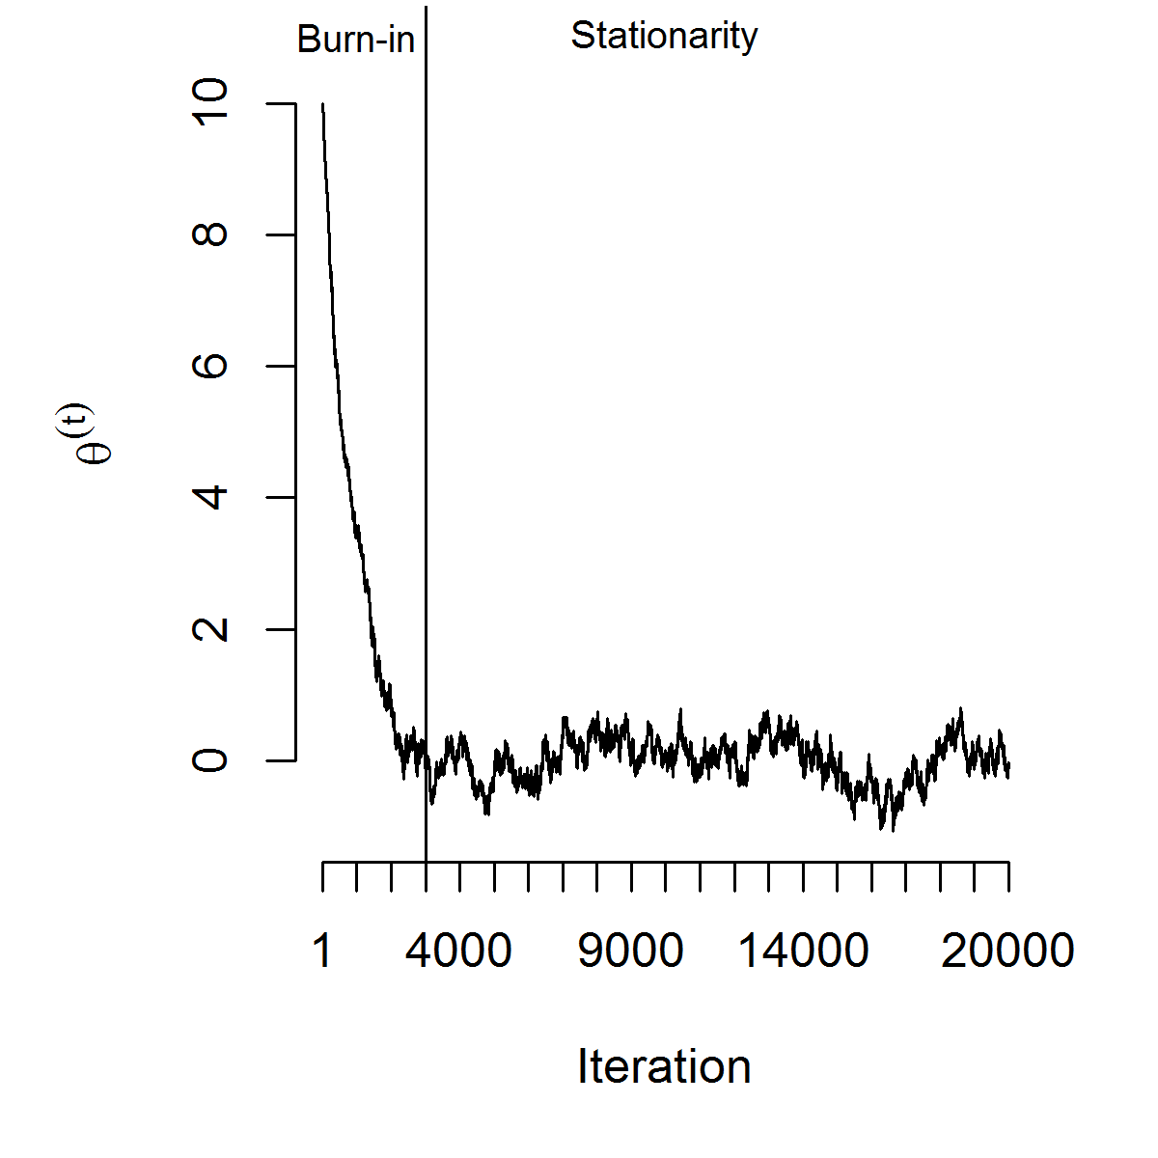
Burn-in
The chain will reach the stationary distribution eventually. The number of iterations it takes to converge varies depending on the starting point. We remove the first values, the burn-in

Slide 61
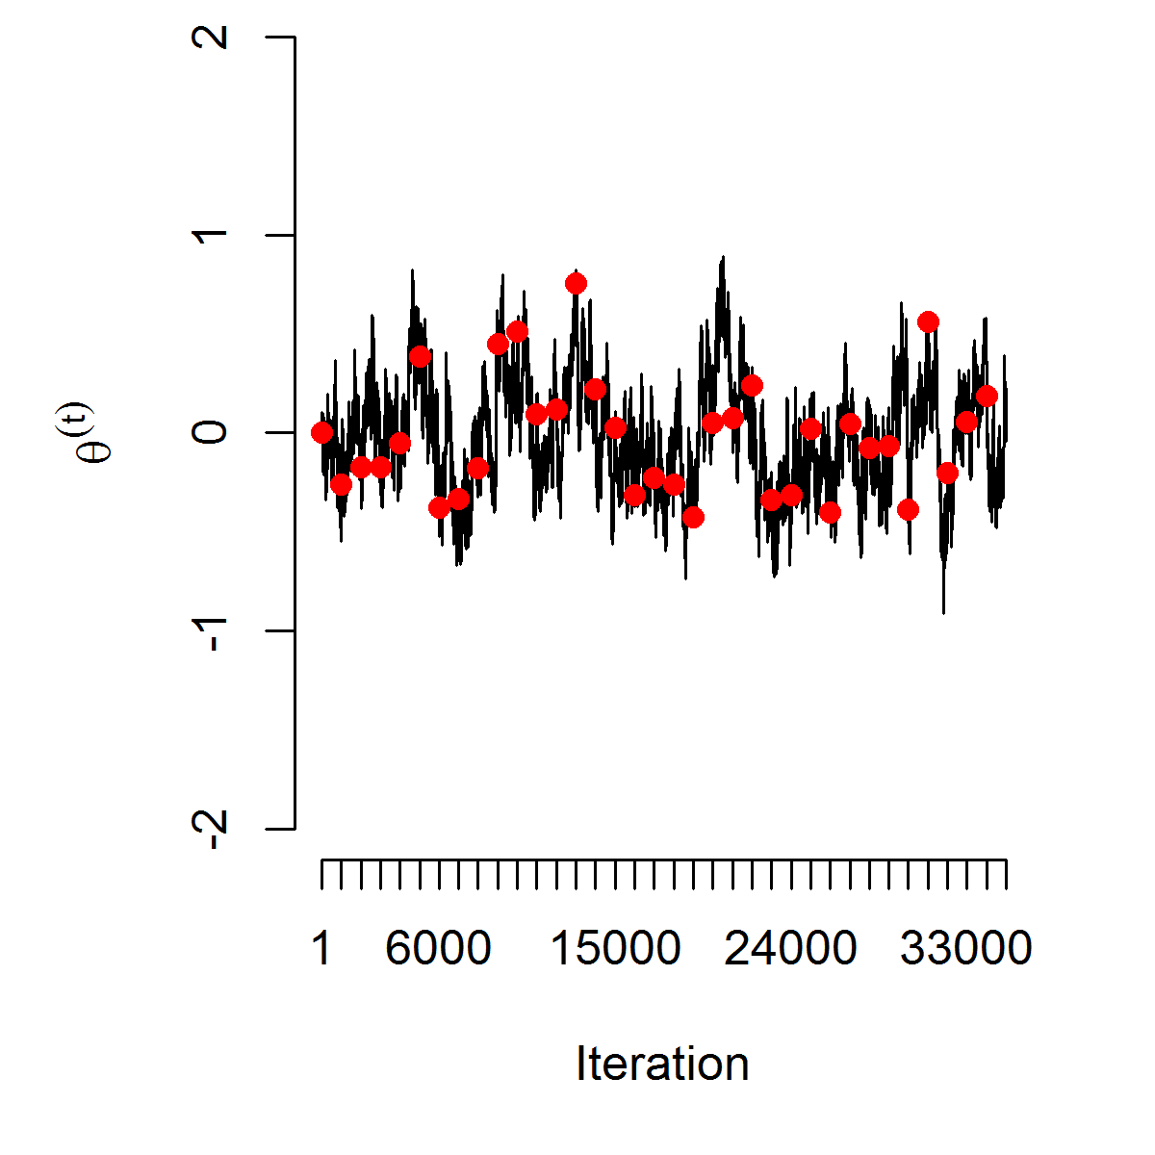
Thinning the chain
To reach converge the chain is run for a long time. We thin the chain by taking draws at every d th iteration. This saves memory and reduces the autocorrelation between draws

Slide 62




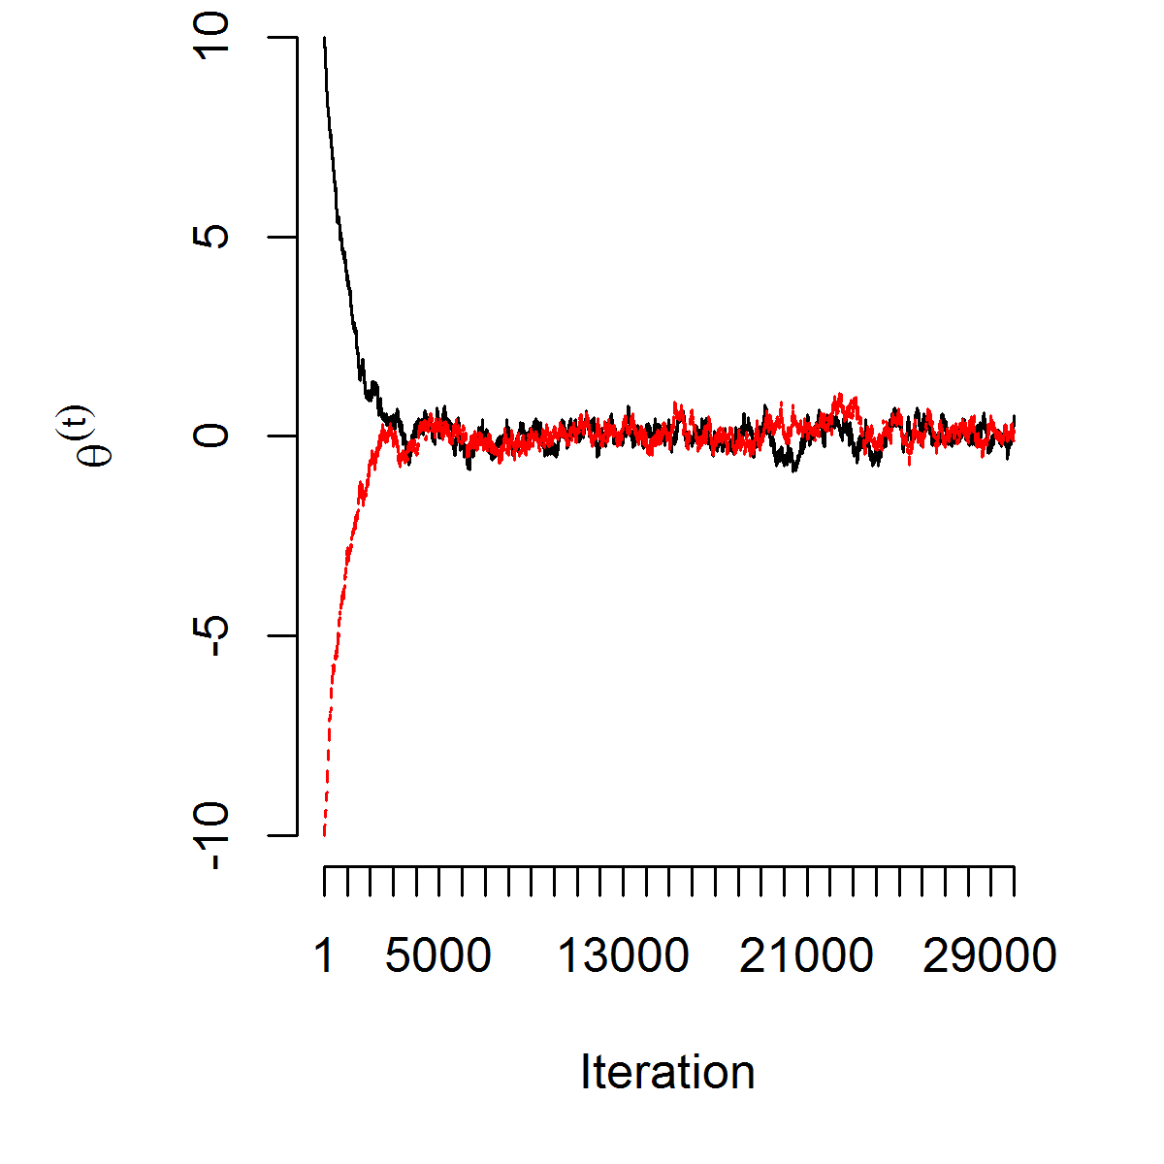
Convergence diagnostics
Traceplot of the chain should show good mixing
Auto-correlation function (ACF) measures the correlation of values h lags apart ρ(h) = cor (θ^{(t)}, θ^{(t+h)}). Slow decay of ACF indicates slow convergence and bad mixing
Run multiple chains
Gelman-Rubin-Brooks test. Run multiple chains. Once convergence is reached, variation within the chains and variation between the chains should coincide

Slide 63
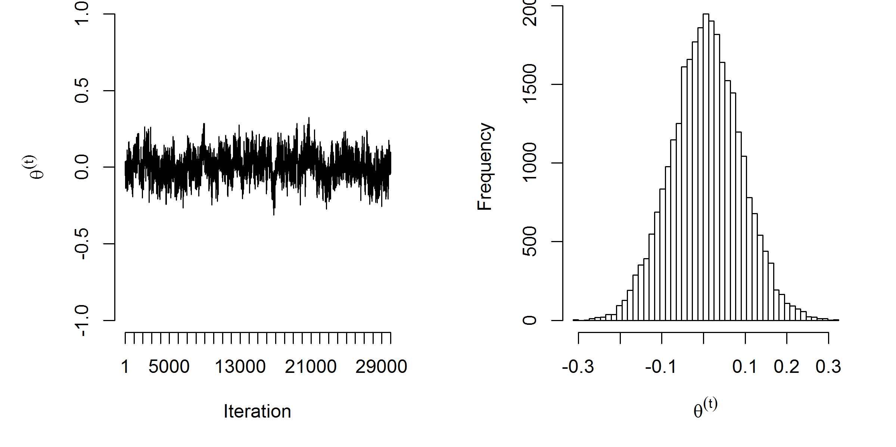
Monte Carlo Integration on the Markov chain
Once the Markov chain has converged to the stationary distribution, the draws in the chain are approximately draws from the posterior p(θ|y ).
Monte Carlo Integration methods can be used on those draws to get quantities of interest

Slide 64
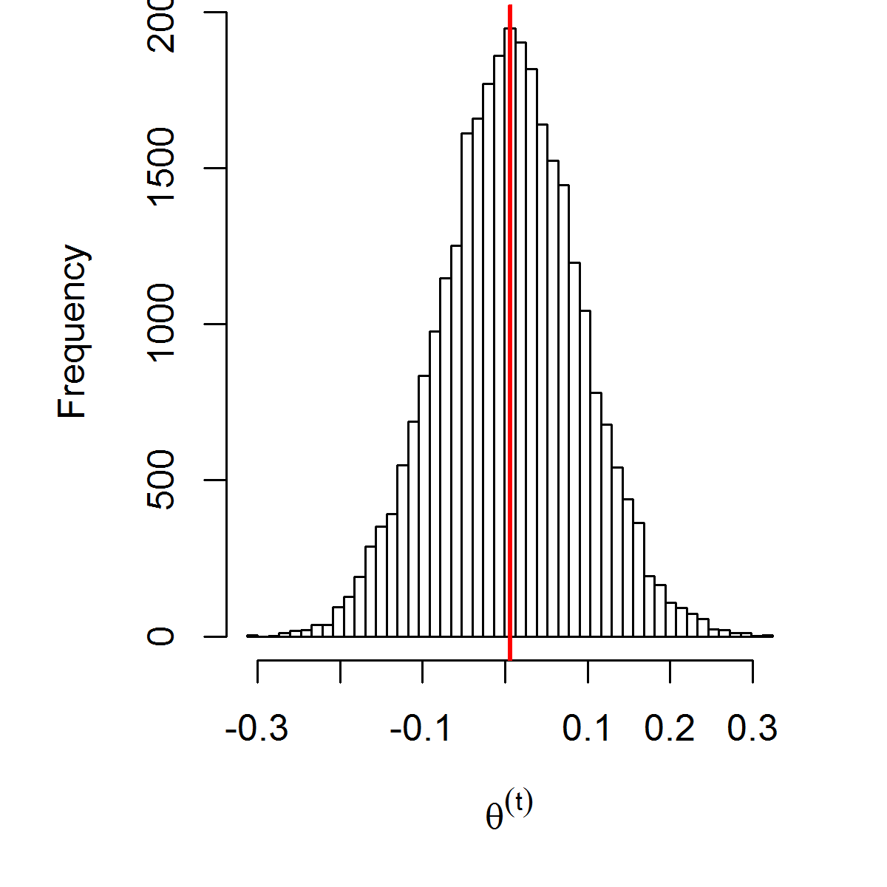
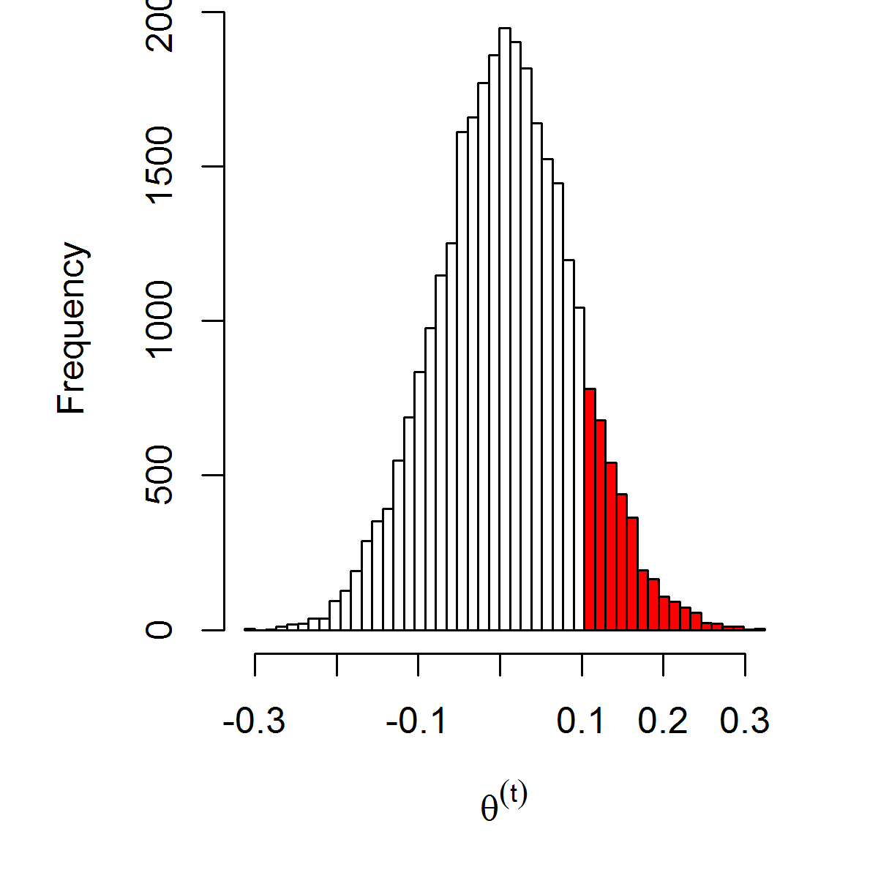
Monte Carlo Integration on the Markov chain
Given a sample (θ⁽¹⁾, . . . , θ^{(M)}) from p(θ|y ):
E (θ|y ) ≈
1
M
},
M
i =1
θ^{(i )} = 0.006
P(θ > 0.1
|y ) ≈
1
M
},
M
i =1
I (θ^{(i )} > 0.1) = 0.13

Slide 65





Approximate Bayesian inference for latent Gaussian models by using integrated nested Laplace approximations (INLA)
Integrated nested Laplace approximations (INLA) are an alternative to inference via MCMC in latent Gaussian models
The main advantage of INLA is the huge improvement of speed compared to MCMC alternatives
Laplace approximations to obtain posterior marginals Numerical algorithms for sparse matrices
Parallel computing
INLA can be easily applied thanks to the R package R-INLA

Slide 66
Benefits of Bayesian Inference
Suitable framework to deal with a large number of problems
Priors can be used to account for initial information (for example, spatial dependence)
If no prior information is available, vague (or non-informative) priors can be used so that the posterior distribution will only depend on the data and the model.
Multilevel models can be used: Bayesian Hierarchical Models
Complex effects, such as spatial and/or temporal dependence, can be modeled easily
Missing values are treated similarly as the parameters in the model
Bayesian Estimation in Disease Mapping has been one of the leading topics in spatial statistics in the last 20 years

Slide 67
WinBUGS
BUGS stands for Bayesian inference Using Gibbs Sampler
Developed at the MRC and Imperial College London
Provides a generic language to Bayesian Hierarchical models
Models can be specified graphically as well
Several utilities to assess the convergence of the chain and display results
GeoBUGS is an extension to deal with spatial models and maps
A developer interface has been included so that the user can extend the range of functions available
OpenBUGS is the open source version of WinBUGS
JAGS and STAN are a more recent tool

Slide 68
Calling WinBUGS from R
Packages R2WinBUGS, BRUGS, and R2OpenBUGS can call WinBUGS and OpenBUGS from R
R2WinBUGS calls WinBUGS using the scripting language and then reads the output log file
BRUGS is an interface to the actual OpenBUGS (NOT WinBUGS) routines
R2WinBUGS/R2OpenBUGS can run on several platforms (Windows, Linux/Unix, Mac)

Slide 69
Leukemia Cancer Data revisited
We need...
Model specification (using the BUGS language)
Mortality Data (in a list)
Spatial data describing the neighbourhood structure, in a specific format
Initial values of the parameters
.Optionally, we may want to export the map information to be used within WinBUGS

Slide 70
Model specification using the BUGS language
model
{
for(i in 1:N)
{
O[i] ~ dpois(mu[i])
mu[i]<-theta[i]*E[i]
log(theta[i]) <- alpha + beta[1]*PCTAGE65P[i] +
beta[2]*PCTOWNHOME[i] + beta[3]*AVGIDIST[i] + u[i] + v[i]
u[i] ~ dnorm(0, precu)
SMR[i]<-O[i]/E[i]
prob[i]<-step(theta[i]-1)
}
v[1:N] ~ car.normal(adj[], weights[], num[], precv)
alpha ~ dflat()
for(i in 1:3) {beta[i] ~ dnorm(0,1.0E-5)}
precu ~ dgamma(0.001, 0.001)
precv ~ dgamma(0.1, 0.1)
sigmau<-1/precu
sigmav<-1/precv
}

Slide 71
A brief intro to specifying distributions and priors
Normal ~dnorm(mean,precision)
Precision=1/variance
So ~dnorm(0,.0001) is the same as a Normal distribution with mean of 0 and variance of 100²
Essentially noninformative priors:
  ~dflat()
  ~unif(-100,100)
  ~dnorm(0,.00001)
Priors for random effect variance:
  ~dgamma(0.001,0.001)

Slide 72
Preparing data...
1.- Read maps
2.- Create list of observed, expected
> NY8$EXP<-NY8$POP8*(sum(NY8$Cases)/sum(NY8$POP8))
3.- Create adjacency matrix and weights
NY_nb<-poly2nb(NY8)
NY_nb_wb<-nb2WB(NY_nb)
4.- Create data list
d<-c(list(O=NY8$Cases,E=NY8$EXP),N=281,list(PCTAGE65P=NY8$PCTAGE65P,PCTOWNHOME=NY8$PCTOWNHOME, AVGIDIST=NY8$AVGIDIST))

Slide 73
Calling WinBUGS using R2WinBUGS
5.- Call WinBUGS
BUGSDir<-"C:\\Users\\BennettA2\\Documents\\Teaching\\Spatial Epi\\winbugs14\\WinBUGS14"
mfile<-paste(getwd(),"/NY_BYM.txt",sep="",collapse="")
tdir<-paste(getwd(),"/NYoutput",sep="",collapse="")
dir.create(tdir)
inits1<-list(alpha=1,beta=c(0,0,0),u=rep(0,281),
v=rep(0,281),precu=1,precv=1)
inits2<-list(alpha=10,beta=c(1,1,1),u=rep(1,281),
v=rep(1,281),precu=0.1,precv=0.1)
res<-bugs(data=c(d,NY_nb_wb),inits=list(inits1,inits2),
parameters.to.save=c("sigmau","sigmav","beta"),
model.file=mfile,working.directory=tdir,n.thin=3,n.chains=2,
bugs.directory=BUGSDir,n.iter=6000,n.burnin=3000,debug=T)
)

Slide 74
Running WinBUGS directly
Open all needed files in WinBUGS
Check the model syntax
Load data (health and spatial)
Compile the model
Load inital values
Run the model (burn in period)
Monitor parameters of interest and DIC
Rerun the model
Assess convergence of the simulations
Show summary statistics of the parameters of the model

Slide 75

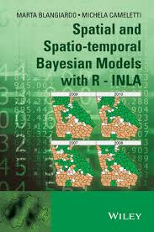
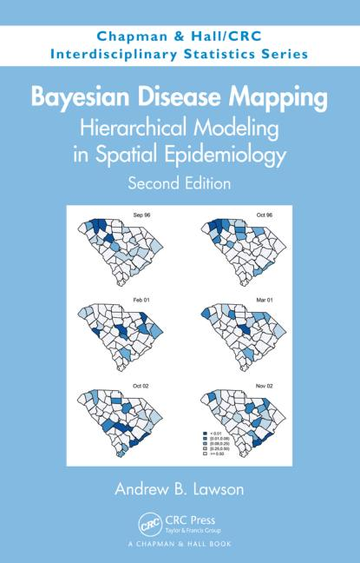
Further references
S. Banerjee, B.P. Carlin and A.E. Gelfand (2003). Hierarchical Modeling and Analysis for Spatial Data. Chapman & Hall.
OpenBUGS: http://mathstat.helsinki.fi/openbugs/
D.J. Spiegelhalter, N.G. Best, B.P. Carlin and A. Van der Linde (2002). Bayesian Measures of Model Complexity and Fit (with Discussion), Journal of the Royal Statistical Society, Series B 64(4), 583-616.
L.A. Waller and C.A. Gotway (2004). Applied Spatial Statistics for Public Health Data. Wiley & Sons.

Slide 76
Scottish lip cancer
Observed vs. Expected

