Slide 1
Demographic Methods for Public Health: Mortality Disparities
Margarete C. Kulik
Epidemiology 263, UCSF
November 14, 2016

Slide 2
In general…
…Mortality has been declining over time due to
Improved preventive and therapeutic medical interventions
Increased living standards, nutrition, hygiene
Spread of knowledge to public concerning disease prevention

Slide 3
Some history I
Regardless of how health (mortality) and socioeconomic position are measured, the general pattern of better health among individuals with higher socioeconomic position is consistently found in all populations and in all time-periods for which systematic data are available

Slide 4

Some history II
First scientific evidence on
social variations in morbidity
and mortality dates from the
17th century
By John Graunt, based on
mortality from plague in London

Slide 5
Some history III
Due to the lack of data, socioeconomic inequalities in health were not a public policy issue until the 19th century
Villermé and Virchow: death is not only biologically determined but closely related to social circumstances (social class, work conditions crucial determinants of health and disease)
Chadwick contributed to the solution of the high death rates in disadvantaged sections of the population by proposing a sanitary reform in Great Britain
Public awareness of socioeconomic inequalities in health led to improved housing, water supply, sanitation, nutrition, access to immunization and work conditions in Europe

Slide 6
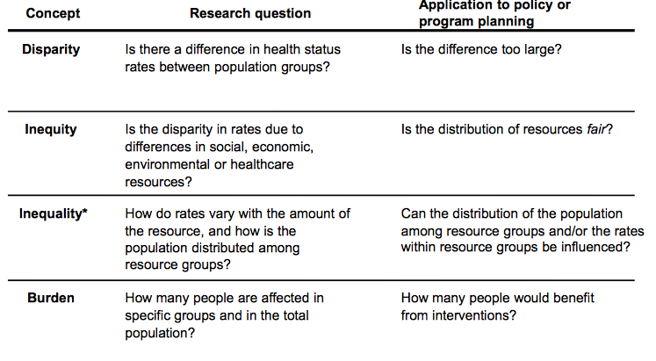
Some concepts and definitions

Slide 7

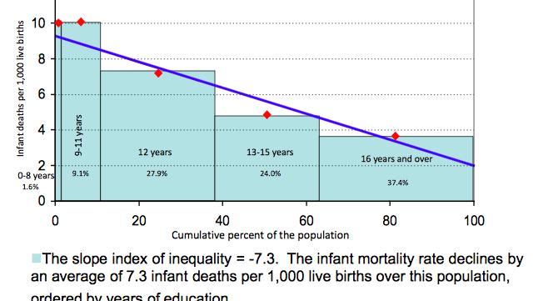

Slide 8

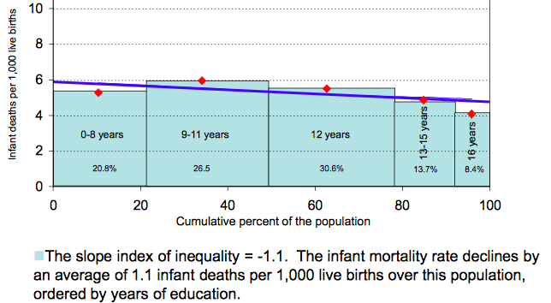

Slide 9
A little on my work in tobacco control

Slide 10
Smoking and Inequalities in Health Outcomes and Mortality
Smoking is the largest avoidable health risk in Europe and most of the world
Smoking prevalence varies by country, between men and women and by socioeconomic position, e.g. educational level
This ultimately translates into a higher health and death burden among those with a lower socioeconomic position

Slide 11

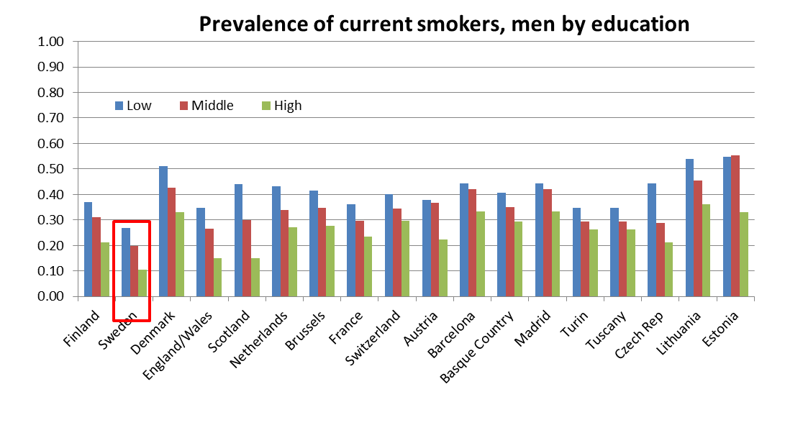

Slide 12
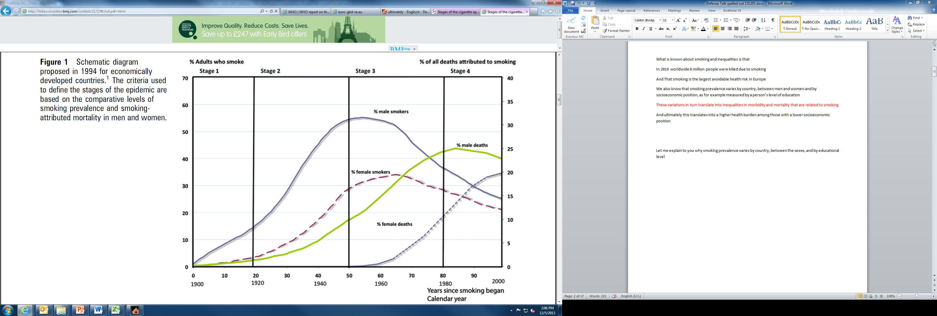
Stages of the Smoking Epidemic
(Lopez et al, 1994; Thun et al, 2012)

Slide 13
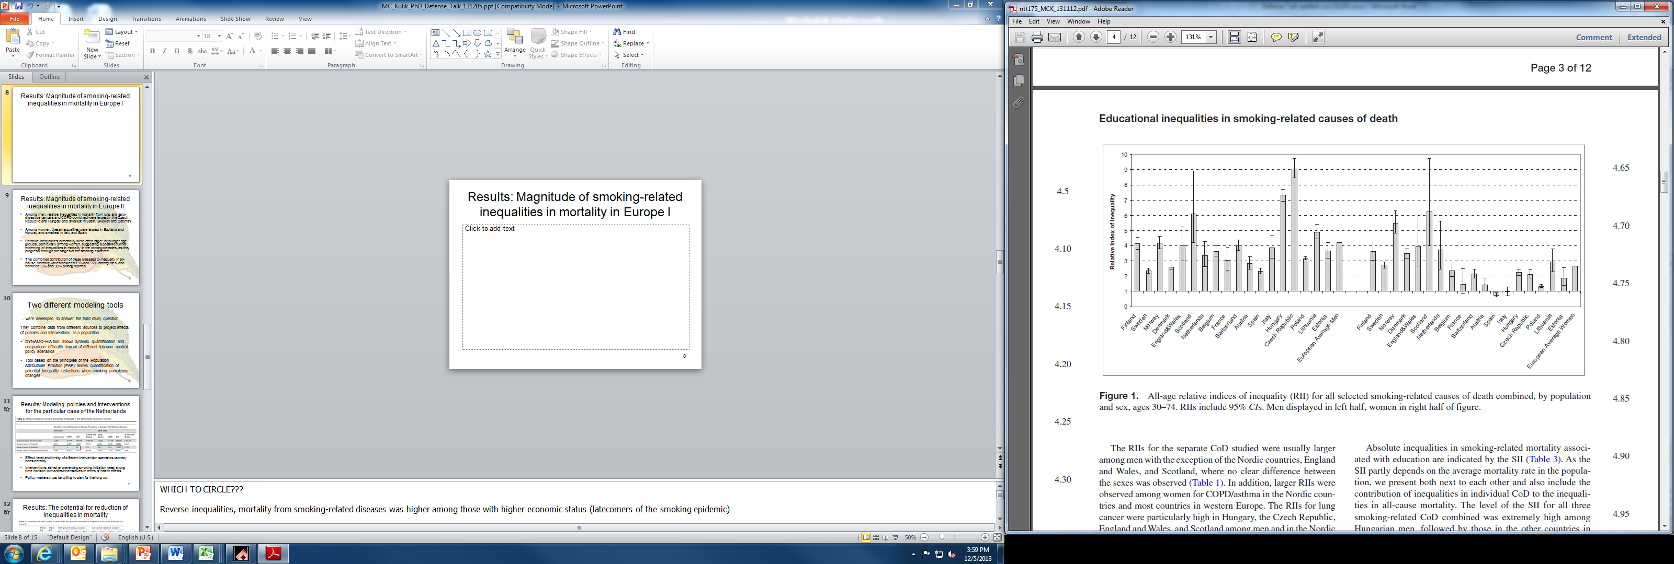
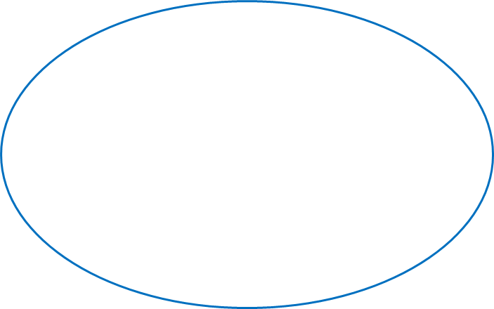
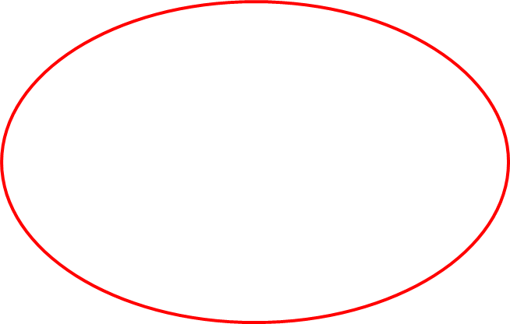
Magnitude of smoking-related inequalities in mortality in Europe

Slide 14
Death rates
Age distributions of populations differ (population pyramid)
Hence: cannot compare crude numbers (death rates)
For international comparisons: need to remove effects of different distributions

Slide 15
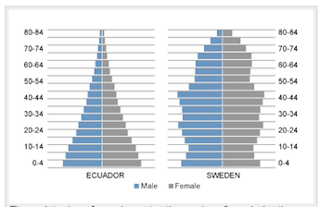
Ecuador vs. Sweden
Crude death rate
Ecuador: 5.6/1000
Sweden 10.5/1000
Why?
Age Structure:
More old people in Sweden

Slide 16
Direct Standardization
Apply age specific death rates of both countries to a standard population age distribution
Problem: what population to choose?
  Can get very different results depending on the population
  Some options
    Middle between the two populations
    Region specific fake populations (Africa, European, etc.)
    WHO in 2001 made a “world” population

Slide 17
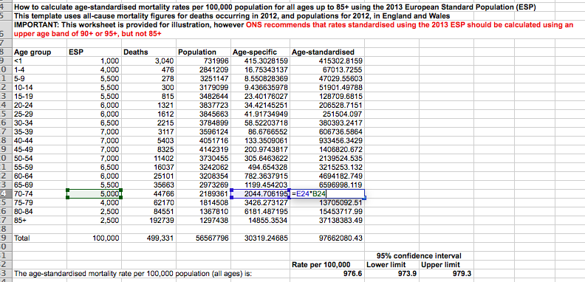
Notes:
http://webarchive.nationalarchives.gov.uk/20160105160709/http://www.ons.gov.uk/ons/guide-method/user-guidance/health-and-life-events/revised-european-standard-population-2013--2013-esp-/index.html

Slide 18
Indirect Standardization
Assume standard set of death rates, instead of a standard population
Usually calculate a Standardized Mortality Ratio (SMR)
Can use one country's death rates and apply to the other country

Slide 19
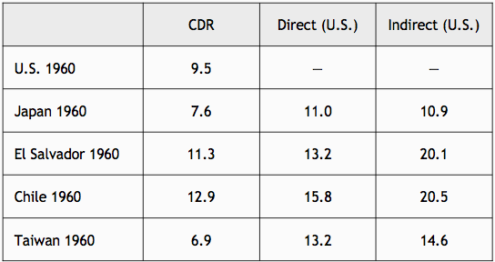
Comparison

Slide 20
Absolute vs. Relative differences in health and mortality
Absolute: how many fewer cases in one group compared to another (subtract)
Difference
Relative: ratio of cases in two groups (divide)
Ratio, Relative Risk

Slide 21
Calculation example
Diabetes:
Relative effects approach: black men have 13.5/7.7=1.75 times the prevalence of diabetes as white men
Absolute effects approach: black men have 13.5-7.7=5.8 percentage point higher prevalence of diabetes than white men

Slide 22
What do health inequalities translate to:
Higher morbidity in some population groups than in others
Lower life expectancy in some population groups compared to others
Can we do something about it?

Slide 23
Link and Phelan’s theory of Fundamental Causes
SES is a fundamental cause of inequalities in mortality
SES/inequality is more strongly associated with mortality from preventable causes
Over time one preventable cause can be replaced by another, and so health/mortality disparities persist (e.g. tobacco -> obesity)

Slide 24
Topics for discussion
How to reduce/eliminate disparities/inequalities?
More equal distribution of resources in general?
Universal health insurance?
Individual prevention (elimination of risk factors)?

