Slide 1
Biostat 200
Lecture 10

Slide 2
Announcements
Today – more on linear regression
Lectures
  Last lecture 11/29 (logistic regression)
Labs
  Last lab 12/1. Will review logistic regression
Assignment 9 – due Tuesday 11/22
Final
  Will be posted by 12/1
  Will be due Thursday 12/8 10:30 a.m.
  Take home format – no collaboration
  It is worth 30% of your course grade
  About 2x the length of most of the previous assignments
  Material through linear regression

Slide 3
Simple linear regression
Population regression equation μ_{y|x} = α + β x
α and β are constants and are called the coefficients of the equation
α is the y-intercept and is the mean value of Y when x=0 μ_{y|0} = α + β *0
The slope β is the change in the mean value of Y that corresponds to a one-unit increase in X
E.g. x=3 vs. x=2
μ_{y|3} - μ_{y|2} = (α + β*3 ) – (α + β*2) = β

Slide 4
Simple linear regression
There is variability in populations, so the linear regression equation is y = α + βx + ε
The error, ε, is the distance a value y has from the population regression line
y = α + βx + ε
μ_{y|x} = α + β x
so y- μ_{y|x} = ε

Slide 5
Simple linear regression
Assumptions of linear regression
  X’s are measured without error
  For each value of X, the Y’s are normally distributed with mean μ_{y|x} and standard deviation σ_{y|x}
  μ_{y|x} = α + β x
  Homoscedasticity
  All the y_{i} ‘s are independent

Slide 6
Simple linear regression
The regression line equation is
The “best” line is the one that finds the α and β that minimize the sum of the squared residuals Σe_{i}² (hence the name “least squares”)
We are minimizing the sum of the squares of the residuals

Slide 7
Simple linear regression example: Regression of FEV on age
FEV= α̂ + β̂ age
regress yvar xvar
. regress fev age
Source | SS df MS Number of obs = 654
-------------+------------------------------ F( 1, 652) = 872.18
Model | 280.919154 1 280.919154 Prob > F = 0.0000
Residual | 210.000679 652 .322086931 R-squared = 0.5722
-------------+------------------------------ Adj R-squared = 0.5716
Total | 490.919833 653 .751791475 Root MSE = .56753
------------------------------------------------------------------------------
fev | Coef. Std. Err. t P>|t| [95% Conf. Interval]
-------------+----------------------------------------------------------------
age | .222041 .0075185 29.53 0.000 .2072777 .2368043
_cons | .4316481 .0778954 5.54 0.000 .278692 .5846042
------------------------------------------------------------------------------
β̂ ̂ = Coef for age
α̂ = _cons (short for constant)

Slide 8
regress fev age
Source | SS df MS Number of obs = 654
-------------+------------------------------ F( 1, 652) = 872.18
Model | 280.919154 1 280.919154 Prob > F = 0.0000
Residual | 210.000679 652 .322086931 R-squared = 0.5722
-------------+------------------------------ Adj R-squared = 0.5716
Total | 490.919833 653 .751791475 Root MSE = .56753
------------------------------------------------------------------------------
fev | Coef. Std. Err. t P>|t| [95% Conf. Interval]
-------------+----------------------------------------------------------------
age | .222041 .0075185 29.53 0.000 .2072777 .2368043
_cons | .4316481 .0778954 5.54 0.000 .278692 .5846042
------------------------------------------------------------------------------
=.7565²
Notes:
0.5675 is the root MSE. It is like a standard deviation for what is left in the data after the regression has removed the relationship between y and x. A smaller number is a better fit, and it can range from 0 to infinity. See http://www.theanalysisfactor.com/assessing-the-fit-of-regression-models/ for a nice summary of these different statistics.

Slide 9
s²_{y|x}
regress fev age
Source | SS df MS Number of obs = 654
-------------+------------------------------ F( 1, 652) = 872.18
Model | 280.919154 1 280.919154 Prob > F = 0.0000
Residual | 210.000679 652 .322086931 R-squared = 0.5722
-------------+------------------------------ Adj R-squared = 0.5716
Total | 490.919833 653 .751791475 Root MSE = .56753
------------------------------------------------------------------------------
fev | Coef. Std. Err. t P>|t| [95% Conf. Interval]
-------------+----------------------------------------------------------------
age | .222041 .0075185 29.53 0.000 .2072777 .2368043
_cons | .4316481 .0778954 5.54 0.000 .278692 .5846042
------------------------------------------------------------------------------
=.7565²
s_{y|x}
s²_{y}

Slide 10
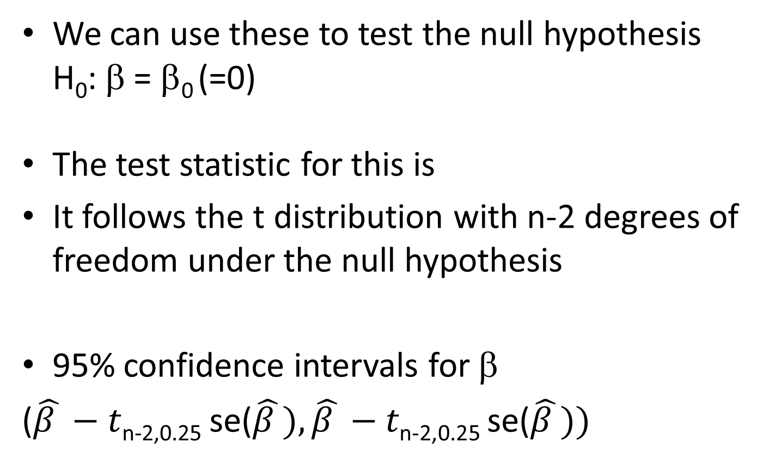
Inference for regression coefficients

Slide 11
Inference for predicted values
We might want to estimate the mean value of y at a particular value of x
E.g. what is the mean FEV for children who are 10 years old?
  ŷ = .432 + .222*x = .432 + .222*10 = 2.643 liters

Slide 12
Inference for predicted values
We can construct a 95% confidence interval for the estimated mean
( ŷ - t_{n-2,.025}se(ŷ) , ŷ + t_{n-2,.025}se(ŷ) )
where

Slide 13
Stata will calculate the fitted regression values and the standard errors
  regress fev age
  predict fev_pred, xb -> predicted mean values (ŷ)
  predict fev_predse, stdp -> se of ŷ values
You don’t have to calculate these to get a plot with the 95% CI:
twoway (lfitci fev age)
New variable names that I made up
Stands for linear fit for the line, CI for the confidence interval

Slide 14
. list fev age fev_pred fev_predse
+-----------------------------------+
| fev age fev_pred fev_pr~e |
|-----------------------------------|
1. | 1.708 9 2.430017 .0232702 |
2. | 1.724 8 2.207976 .0265199 |
3. | 1.72 7 1.985935 .0312756 |
4. | 1.558 9 2.430017 .0232702 |
5. | 1.895 9 2.430017 .0232702 |
|-----------------------------------|
6. | 2.336 8 2.207976 .0265199 |
7. | 1.919 6 1.763894 .0369605 |
8. | 1.415 6 1.763894 .0369605 |
9. | 1.987 8 2.207976 .0265199 |
10. | 1.942 9 2.430017 .0232702 |
|-----------------------------------|
11. | 1.602 6 1.763894 .0369605 |
12. | 1.735 8 2.207976 .0265199 |
13. | 2.193 8 2.207976 .0265199 |
14. | 2.118 8 2.207976 .0265199 |
15. | 2.258 8 2.207976 .0265199 |
336. | 3.147 13 3.318181 .0320131 |
337. | 2.52 10 2.652058 .0221981 |
338. | 2.292 10 2.652058 .0221981 |

Slide 15
Note that the Cis get wider as you get farther from x̅ ;
but here n is large so the CI is still very narrow
twoway (scatter fev age) (lfitci fev age, ciplot(rline) blcolor(black)), legend(off) title(95% CI for the predicted means for each age )

Slide 16
Prediction intervals
The intervals we just made were for means of y at particular values of x
What if we want to predict the FEV value for an individual child at age 10?
Same thing – plug into the regression equation: ỹ =.432 + .222*10 = 2.643 liters
But the standard error of ỹ is not the same as the standard error of ŷ

Slide 17
Prediction intervals
This differs from the se(ŷ) only by the extra variance of y in the formula
But it makes a big difference
There is much more uncertainty in predicting a future value versus predicting a mean
Stata will calculate these using
predict fev_predse_ind, stdf
f is for forecast

Slide 18
. list fev age fev_pred fev_predse fev_pred_ind
+----------------------------------------------+
| fev age fev_pred fev~edse fev~ndse |
|----------------------------------------------|
1. | 1.708 9 2.430017 .0232702 .5680039 |
2. | 1.724 8 2.207976 .0265199 .5681463 |
3. | 1.72 7 1.985935 .0312756 .5683882 |
4. | 1.558 9 2.430017 .0232702 .5680039 |
5. | 1.895 9 2.430017 .0232702 .5680039 |
|----------------------------------------------|
6. | 2.336 8 2.207976 .0265199 .5681463 |
7. | 1.919 6 1.763894 .0369605 .5687293 |
8. | 1.415 6 1.763894 .0369605 .5687293 |
9. | 1.987 8 2.207976 .0265199 .5681463 |
10. | 1.942 9 2.430017 .0232702 .5680039 |
|----------------------------------------------|
11. | 1.602 6 1.763894 .0369605 .5687293 |
12. | 1.735 8 2.207976 .0265199 .5681463 |
13. | 2.193 8 2.207976 .0265199 .5681463 |
14. | 2.118 8 2.207976 .0265199 .5681463 |
15. | 2.258 8 2.207976 .0265199 .5681463 |
336. | 3.147 13 3.318181 .0320131 .5684292 |
337. | 2.52 10 2.652058 .0221981 .567961 |
338. | 2.292 10 2.652058 .0221981 .567961 |

Slide 19
Note the width of the confidence intervals for the means at each x versus the width of the prediction intervals
twoway (scatter fev age) (lfitci fev age, ciplot(rline) blcolor(black) ) (lfitci fev age, stdf ciplot(rline) blcolor(red) ), legend(off) title(95% prediction interval and CI )
Notes:
The stdf option in the lfitci tells stata that you are predicting an individual value

Slide 20
Model fit
A summary of the model fit is the coefficient of determination, R²
R² represents the portion of the variability that is removed by performing the regression on X
R² is calculated from the regression with MSS/TSS

Slide 21
regress fev age
Source | SS df MS Number of obs = 654
-------------+------------------------------ F( 1, 652) = 872.18
Model | 280.919154 1 280.919154 Prob > F = 0.0000
Residual | 210.000679 652 .322086931 R-squared = 0.5722
-------------+------------------------------ Adj R-squared = 0.5716
Total | 490.919833 653 .751791475 Root MSE = .56753
------------------------------------------------------------------------------
fev | Coef. Std. Err. t P>|t| [95% Conf. Interval]
-------------+----------------------------------------------------------------
age | .222041 .0075185 29.53 0.000 .2072777 .2368043
_cons | .4316481 .0778954 5.54 0.000 .278692 .5846042
------------------------------------------------------------------------------
=.7565²

Slide 22
Model fit
The F statistic compares the model to a model with just y̅ (the null model)
The statistic is

Slide 23
Model fit
When there is only one independent variable in the model, these are equivalent tests
  F test that compares the model fit to the null model
  The test that β=0
  The test that r=0 (Pearson correlation)

Slide 24
Model fit -- Residuals
Residuals are the difference between the observed y values and the regression line for each value of x
y_{i}-ŷ_{i}
If all the points lie along a straight line, the residuals are all 0
If there is a lot of variability at each level of x, the residuals are large
The sum of the squared residuals is what was minimized in the least squares method of fitting the line

Slide 26
Residuals
We examine the residuals using scatter plots
We plot the fitted values ŷ_{i} on the x-axis and the residuals y_{i}-ŷ_{i} on the y-axis
We use the fitted values because they have the effect of the independent variable removed
To calculate the residuals and the fitted values Stata:
  regress fev age
  rvfplot
RVF = residuals versus fitted

Slide 27
rvfplot, title(Fitted values versus residuals for regression of FEV on age)

Slide 28
This plot shows that as the fitted value of FEV increases, the spread of the residuals increase – this suggests heteroscedasticity
We would get a similar plot if we plotted age on the x-axis
rvpplot age, name(res_v_age)
RVP=residuals versus predictor
We had a hint of this when looking at the box plots of FEV by age groups in the previous lecture

Slide 30
graph box fev, over(age) title(FEV by age)

Slide 31
Note that heteroscedasticity does not bias the estimates of the parameters, but it does reduce the precision of the estimates (and therefore reduces power)

Slide 32
Transformations
One way to deal with this is to transform either x or y or both
A common transformation is the log transformation
Log transformations bring large values closer to the rest of the data
There are methods to correct the standard errors for heteroscedasticity other than transformations

Slide 33
Log function refresher
Log₁₀
  Log₁₀(x) = y means that x=10^{y}
  So if x=100 log₁₀(x) = 2 because 100=10²
  Log₁₀(103) = 2.01 because 103=10^{2.01}
  Log₁₀(1)=0 because 10⁰ =1
  Log₁₀(0)=-∞ because 10^{-∞} =0

Slide 34
Log function refresher
Log_{e} or ln
  e is a constant approximately equal to 2.718281828
  ln(1) = 0 because e⁰ =1
  ln(e) = 1 because e¹ =e
  ln(100) = 4.61 because 100=2.71828^{4.61} =e^{4.61}
  ln(103) = 4.63 because 103=e^{4.63}
  Ln(0)=-∞ because e^{-∞} =0

Slide 35
Log transformations
Value | Ln | Log₁₀
0 | -∞ | -∞
0.001 | -6.91 | -3.00
0.05 | -3.00 | -1.30
1 | 0.00 | 0.00
5 | 1.61 | 0.70
10 | 2.30 | 1.00
50 | 3.91 | 1.70
103 | 4.63 | 2.01
Be careful of log(0) or ln(0)
Be sure you know which log base your computer program is using
  In Stata log() will give you ln()
  If you want log10 use log10()

Slide 37
Let’s try transforming FEV to ln(FEV)
. gen fev_ln=log(fev)
. summ fev fev_ln
Variable | Obs Mean Std. Dev. Min Max
-------------+--------------------------------------------------------
fev | 654 2.63678 .8670591 .791 5.793
fev_ln | 654 .915437 .3332652 -.2344573 1.75665
Examine the histograms
Run the regression of ln(FEV) on age and examine the residuals
regress fev_ln age
rvfplot, title(Fitted values versus residuals for regression of lnFEV on age)

Slide 40
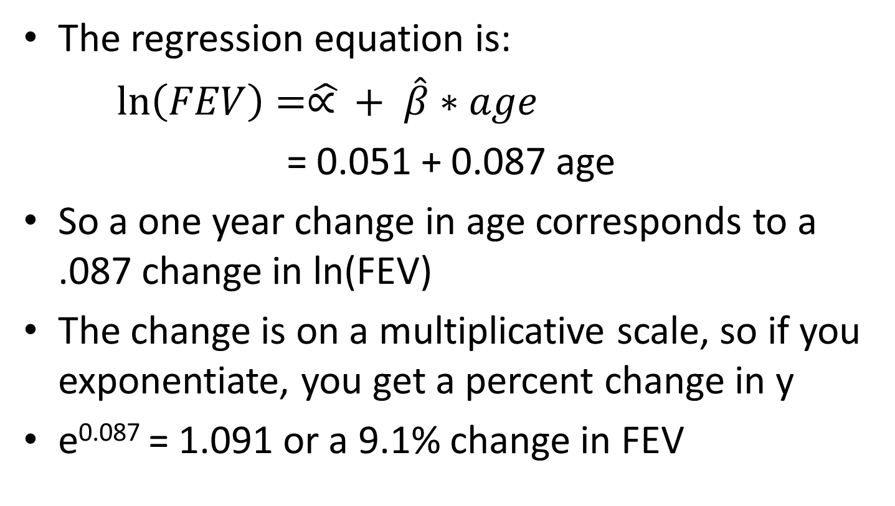
Interpretation of regression coefficients for transformed y value

Slide 41
For example…
Ln(FEV) = 0.051 + 0.087 age
Ln(FEV_{age21}) = 0.051 + 0.087*21
Ln(FEV_{age20}) = 0.051 + 0.087*20
Ln(FEV_{age21})-ln(FEV_{age20}) = 0.087
Remember ln(a)-ln(b) = ln(a/b)
Ln(FEV_{age21} /FEV_{age20})= 0.087
FEV_{age21}/FEV_{age20} = e^{0.087} = 1.09

Slide 42
Now using height as the independent variable
Make a scatter plot of FEV by height
Run a regression of FEV on height and examine the output
Construct a plot of the residuals vs. the fitted values

Slide 44
Now using height as the independent variable
4. Consider transformation that might be a better fit
-You can transform either x or y (or both)
-The interpretation easier (still additive) if you transform x
  Run the regression and examine the output
  Examine the residuals

Slide 47
Categorical independent variables
We previously noted that the independent variable (the X variable) does not need to be normally distributed
In fact, this variable can be categorical

Slide 48
Categorical independent variables
Coding: Dichotomous variables in regression models
  1 to represent the level of interest
  0 to represent the comparison or reference group.
  These 0-1 variables are called indicator or dummy variables.
The regression model is the same
The interpretation is slightly different
  β̂ is the change in y that corresponds to being in the group of interest vs. the reference category

Slide 49
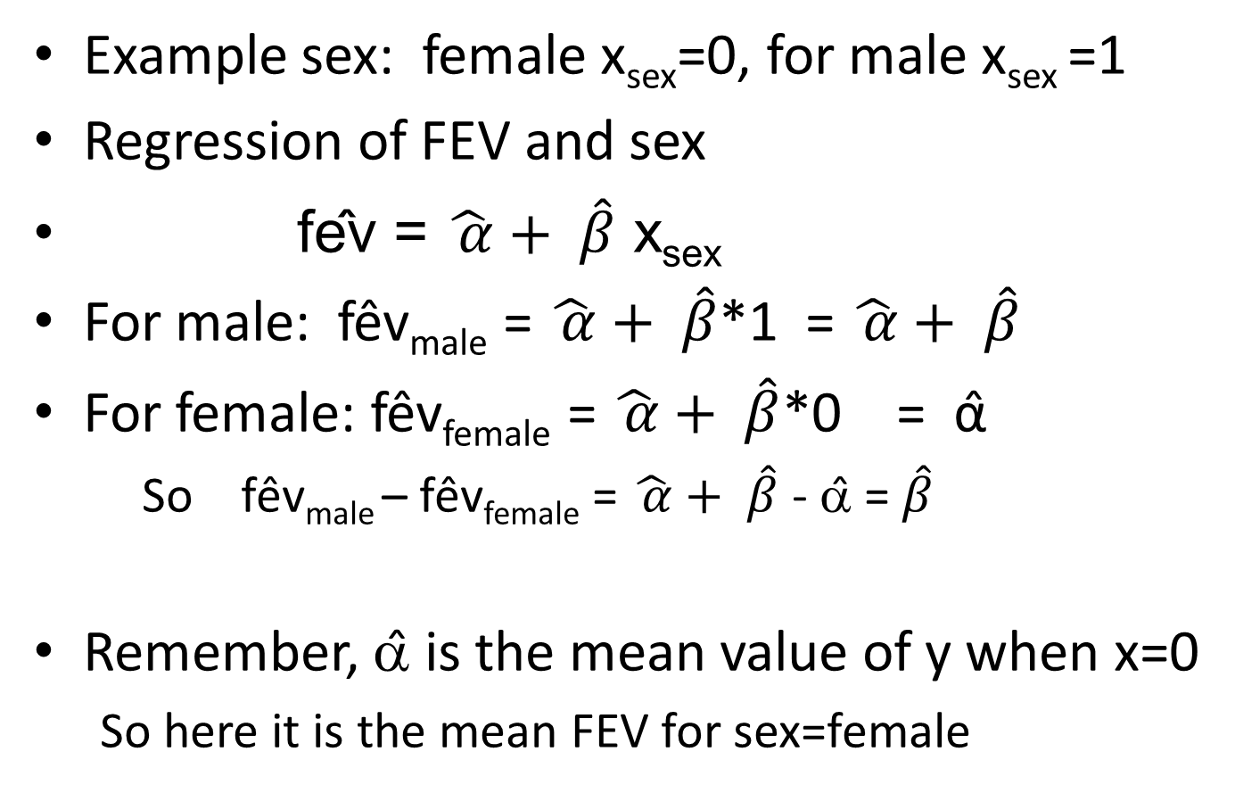
Categorical independent variables

Slide 50
Using the FEV data, run the regression with FEV as the dependent variable and sex as the independent variable
What is the estimate for beta? How is it interpreted?
What is the estimate for alpha? How is it interpreted?
What hypothesis is tested where it says P>|t|?
What is the result of this test?
How much of the variance in FEV is explained by sex?
Plot the fitted values against the residuals

Slide 52
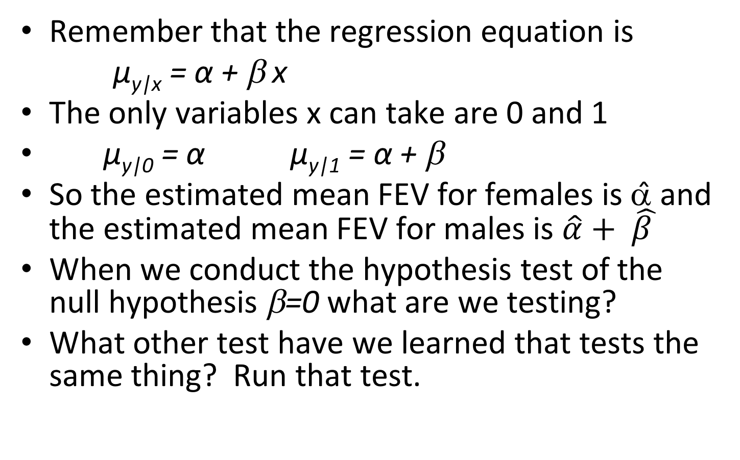
Categorical independent variable
Remember that the regression equation is
μ_{y|x} = α + β x
The only variables x can take are 0 and 1
μ_{y|0} = α μ_{y|1} = α + β
So the estimated mean FEV for females is α̂ and the estimated mean FEV for males is $\hat{α}+ \hat{β }$
When we conduct the hypothesis test of the null hypothesis β=0 what are we testing?
What other test have we learned that tests the same thing? Run that test.

Slide 54
Categorical independent variables
In general, you need k-1 dummy or indicator variables (0-1) for a categorical variable with k levels
One level is chosen as the reference value
Indicator variables are set to one for each category for only one of the dummy variables, they are set to 0 otherwise

Slide 55
Categorical independent variables
E.g. Race group = White, Asian/PI, Other
If Race=White is set as reference category, dummy variables look like:
 | x_{Asian/PI} | x_{Other}
White | 0 | 0
Asian/PI | 1 | 0
Other | 0 | 1

Slide 56
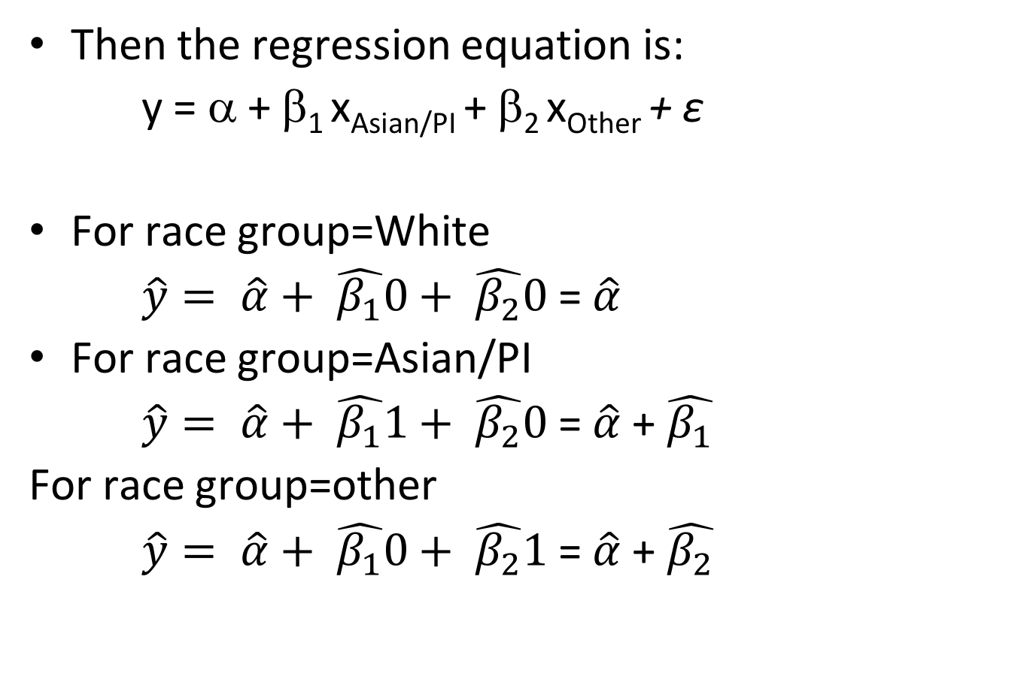
Categorical independent variables
Then the regression equation is:
y = α + β₁ x_{Asian/PI} + β₂ x_{Other} + ε
For race group=White
$\hat{y}= \hat{α}+ \hat{β_{1}}0+ \hat{β_{2}}0$ = $\hat{α}$
For race group=Asian/PI
$\hat{y}= \hat{α}+ \hat{β_{1}}1+ \hat{β_{2}}0$ = $\hat{α}$ + $\hat{β_{1}}$
For race group=other
$\hat{y}= \hat{α}+ \hat{β_{1}}0+ \hat{β_{2}}1$= $\hat{α}$ + $\hat{β_{2}}$

Slide 57
You actually don’t have to make the dummy variables yourself
All you have to do is tell Stata that a variable is categorical using i. before a variable name
Run the regression equation for the regression of FEV regressed on age group
regress fev i.agecat

Slide 59
What is the estimated mean FEV for age group = 3-6?
What is the estimated mean FEV for age group = 6-9?
What is the estimated mean FEV for age group = 15-19?
What other test looks at the same thing? Run that test.

Slide 61
A Stata trick allows you to specify the reference group with the prefix b# where # is the number value of the group that you want to be the reference group.
Try out regress fev b3.agecat
Now the reference category is age group= 9-12
2. Interpret that parameter estimates
3. Note if other output is changed

Slide 63
Multiple regression
Additional explanatory variables might add to our understanding of a dependent variable
We can posit the population equation
μ_{y|x1,x2,...,xq} = α + β₁x₁ + β₂x₂ + ... + β_{q}x_{q}
α is the mean of y when all the explanatory variables are 0
β_{i} is the change in the mean value of y the corresponds to a 1 unit change in x_{i} when all the other explanatory variables are held constant

Slide 64
Because there is natural variation in the response variable, the model we fit is
y = α + β₁x₁ + β₂x₂ + ... + β_{q}x_{q} + ε
Assumptions
  x₁,x₂,...,x_{q} are measured without error
  The distribution of y is normal with mean μ_{y|x1,x2,...,xq} and standard deviation σ_{y|x1,x2,...,xq}
  The population regression model holds
  For any set of values of the explanatory variables, x₁,x₂,...,x_{q} , σ_{y|x1,x2,...,xq} is constant – homoscedasticity
  The y outcomes are independent

Slide 65

Multiple regression – Least Squares
We estimate the regression line
$\hat{y}= \hat{α}+ \hat{β_{1}}$ $x_{1}+ \hat{β_{2}}$ $x_{2}+ …\hat{β_{q}} x_{q}$
using the method of least squares to minimize

Slide 66
Multiple regression
For one explanatory variable – the regression model represents a straight line through a cloud of points -- in 2 dimensions
With 2 explanatory variables, the model is a plane in 3 dimensional space (one for each variable)
etc.
In Stata we just add explanatory variables to the regress statement
Try regress fev age ht

Slide 68
We can test hypotheses about individual slopes
The null hypothesis is H₀: β_{i} = β_{i0} (=0) assuming that the values of the other explanatory variables are held constant
The test statistic
follows a t distribution with n-q-1 degrees of freedom (q explanatory variables)

Slide 69
. regress fev age ht
Source | SS df MS Number of obs = 654
-------------+------------------------------ F( 2, 651) = 1067.96
Model | 376.244941 2 188.122471 Prob > F = 0.0000
Residual | 114.674892 651 .176151908 R-squared = 0.7664
-------------+------------------------------ Adj R-squared = 0.7657
Total | 490.919833 653 .751791475 Root MSE = .4197
------------------------------------------------------------------------------
fev | Coef. Std. Err. t P>|t| [95% Conf. Interval]
-------------+----------------------------------------------------------------
age | .0542807 .0091061 5.96 0.000 .0363998 .0721616
ht | .1097118 .0047162 23.26 0.000 .100451 .1189726
_cons | -4.610466 .2242706 -20.56 0.000 -5.050847 -4.170085
------------------------------------------------------------------------------
Now the F-test has 2 degrees of freedom in the numerator because there are 2 explanatory variables
R² will always increase as you add more variables into the model
The Adj R-squared accounts for the addition of variables and is comparable across models with different numbers of parameters
Note that the beta for age decreased

Slide 70
Examine the residuals…
rvfplot, title(Residuals versus fitted for regression of age and height on FEV)

Slide 72
For next time
Read Pagano and Gauvreau
  Pagano and Gauvreau Chapters 18-19 (review)
  Pagano and Gauvreau Chapter 20

