Slide 1
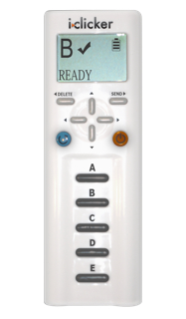
Please take an i>clicker

Slide 2
Reading and Working with DAGs
C
Two Basics
Two Nuances
1. Confounding
E
D
C
Selection Bias
aka “collider-stratification” bias
E
D
L
C
Conditioning on descendant of a collider
E
D
- also results in collider-stratification bias (induces spurious relationship between E & D)
E
D
4. Conditioning on descendant of outcome
Y
- also results in collider-stratification bias (induces spurious relationship between E & D)
Notes:
Some course participants were looking for a simplified guide to DAGs.
Reading and working with DAGs comes down to understanding two basic patterns and two more nuanced patterns. The first basic pattern is confounding. By now, hopefully everyone has this iconic pattern firmly emblazoned in their brains. Confounding occurs when exposure is influenced by factor – a common cause -- which also influences outcome. The second basic pattern is selection bias. It is also known as collider-stratification bias because it occurs when we evaluate the relationship between two factors (E and D) at fixed levels of another factor (C), called a common effect, which is caused by both of the factors. Selection bias induces a spurious relationship between E and D.
What is a bit less intuitive are what we are these two more nuanced patterns. The first is conditioning upon a descendant (L) of a collider (C). It also results in collider-stratification bias; it also induces a spurious relationship between E and D. The second more nuanced pattern is also a form of selection bias (collider-stratification bias). It occurs when we condition upon a descendant on an outcome variable. It will also induce a spurious relationship between E and D. A trick to remember this is that we know that there are other causal influences on D. We just do not usually need to show them on a DAG. For example, think of a factor, L, that has an edge coming into D. This means that Y is actually a descendant of a collider (D). When we condition upon Y, we are conditioning upon a descendant of a collider. This is yet another reason to avoid indiscriminate adjustment out of the spirit of “controlling for everything”.

Slide 3
Confounding and Interaction: DAGs
C
DAGs pristinely demonstrate confounding
D
E
C
DAGs are sensitive at pointing out where interaction is but not specific
E
D
– There is interaction between E and C on the occurrence of D on at least one scale (additive, multiplicative), if not both
Notes:
Some other course participants were wondering about how confounding and interaction are depicted and differ on DAGs.
DAGs do a great and unequivocal job of demonstrating confounding. We have been through the iconic structure. On the other hand, DAGs are sensitive at pointing out where interaction is but not specific. Whenever two factors are causally related to another factor, there will be interaction on at least one scale (additive or multiplicative) if not both. In other words, DAGs never miss pointing out interaction, but they are not specific and they are not able to point out scale dependence.

Slide 4
Confounding and Interaction: Part III
Methods to reduce confounding
  during study design:
    Randomization
    Restriction
    Matching
    Instrumental variables
  during study analysis:
    Stratification
    ------ INTERLUDE ON INTERACTION---------
      Forming “Adjusted” Summary Estimates
      Concept of weighted average
        Woolf’s Method
        Mantel-Haenszel Method
Handling more than one confounder
  Minimal sufficient adjustment set (MSAS)
Managing uncertainty in your DAGs
  Role of an analysis plan
Limitations of stratification to manage confounding
  Motivation for multivariable regression approaches
Limitations of conventional “conditioning” approaches
  Motivation for “non-conditioning” techniques
If time:
  Residual confounding; importance of overlap; quantitative bias analysis (in Extra Slides)
Notes:
Here is our roadmap for today. Two sessions ago, we motivated and defined confounding. Last session, we discussed strategies to reduce confounding in the design phase and analysis phase, and on our way to discussing management of confounding in the analysis phase via stratification, we came across the concept of statistical interaction. As a reminder, we also refer to statistical interaction as effect-measure modification, and we spent much of last week distinguishing it from confounding. One other reminder is that statistical interaction is just one of the four different concepts of interaction.
After this journey/interlude into interaction, we will now return to management of confounding during the analysis phase (by “analysis phase” we mean the analysis of the collected data), and we will spend the majority of today talking about stratification. We will talk about how to form adjusted summary estimates through the process of forming a weighted average. In particular, we will describe two specific methods, Woolf’s Method and the Mantel-Haenszel Method.
We will then talk about strategies of how to handle more than one confounder. Specifically, we will describe the concept of the minimal sufficient adjustment set, abbreviated as MSAS. As we discuss MSASs, we will confront the inevitable limitation of DAGs, which is that we are sometimes uncertain about whether or not they are correct. This means whether or not we have put in all of the relevant relationships (edges) and whether the relationships we have listed are correct. This will get us into the topic of an analysis plan and why having one is important.
As we end the topic of confounding, we will discuss the limitations of stratification and how this is a motivation for other techniques one can use in the analysis phase, such as multivariable mathematical regression. Lastly, we will discuss how all of the conventional conditioning approaches, including both stratification and regression, have limitations, which has motivated the development of newer non-conditioning techniques, which are sometimes called “causal” approaches. They are called “causal” approaches because it is their goal to derive causal estimates, but, of course, seeking to derive casual estimates is nothing new. One suspects in time that these techniques which we call “causal” today will be replaced by even newer techniques which themselves will be called “causal” thus supplanting the old causal techniques as being cutting edge. In other words, there are a variety of techniques that can produce estimates of causal relationships, not just the newest techniques.
If we have time, we will discuss three important topics: Residual confounding, the importance of overlap, and quantitative bias analysis. If we don’t have time, then we will ask you to read about these on your own in the Extra Slides section.

Slide 5
Effect-Measure Modification
Crude
PR _{crude} = 1.7
Heavy Caffeine Use
No Caffeine Use
Stratified
PR_{caffeine use} = 0.7
PR_{no} _{caffeine use} = 2.4
. cs delayed smoking, by(caffeine)
caffeine | RR [95% Conf. Interval] M-H Weight
-----------------+-------------------------------------------------
no caffeine | 2.414614 1.42165 4.10112 5.486943
heavy caffeine | .70163 .3493615 1.409099 8.156069
-----------------+-------------------------------------------------
Crude | 1.699096 1.114485 2.590369
M-H combined | 1.390557 .9246598 2.091201
-----------------+-------------------------------------------------
Test of homogeneity (M-H) chi2(1) = 7.866 Pr>chi2 = 0.0050
Report interaction. Managing confounding by summarizing the 2 stratum-specific estimates into 1 number is not appropriate & would hide an important inference. Instead, show 2 stratum-specific estimates.
Remember: reporting the 2 stratum-specific estimates IS still managing any confounding by caffeine use
Notes:
Remember this example from our last session of a study of the effects of smoking and caffeine use on the occurrence of delayed pregnancies among women hoping to conceive. The principal exposure of interest is smoking. We were interested in how the effects of a third variable, caffeine use, may be influencing this relationship.
We stratified by caffeine use and remember that we saw qualitative statistical interaction, both on the multiplicative (i.e., the risk ratio) and additive (i.e., the risk difference) scales. Qualitative statistical interaction on one scale always implies qualitative interaction on the other scale. When we performed a test of homogeneity in Stata for the multiplicative scale, and we saw the following. The test statistic is 7.8 and it follows a chi square distribution with 1 degree of freedom. This corresponds to a p value of 0.005. The null hypothesis is that the two stratum-specific estimates are the same. The interpretation of the p value is that finding this test statistic or larger would occur 5 times out of 1000 by chance alone if there was indeed no true difference between stratum. Here, we reject the null in favor of the alternative hypothesis. On the additive scale, the p value for the test of interaction was 0.018.
We decided that this is too rich of a story to sweep under the carpet and hence it would not be appropriate to try to summarize these two effects, 2.4 and 0.7, into one overall number. It would be wrong to lump this story together into one number. Instead, we should report the two stratum-specific estimates separately. In the presence of effect-measure modification of this magnitude, effect-measure modification trumps any further consideration of summarizing the stratum-specific estimates into one number. Stop here. End of story; don’t try to form one single summary adjusted measure of association. Note, however, any confounding that might be present has been managed if we decide to report two stratum-specific estimates in that the two stratum-specific estimates are unconfounded with respect to caffeine use. The point is that with interaction present, one should not go on to summarize stratum-specific estimates into one number.

Slide 6
Presenting Interaction
 | No Smoking |  | Smoking
 | Probability of delayed conception | Prevalence ratio (95% CI) | Probability of delayed conception | Prevalence ratio (95% CI) | Prevalence ratio (95% CI) for smoking within strata of caffeine use
No caffeine use | 0.082 | 1.0 (reference) | 0.20 | 2.4 (1.4 to 4.1) p = 0.001 | 2.4 (1.4 to 4.1) p = 0.001
Heavy caffeine use | 0.19 | 2.3 (1.4 to 3.8) p = 0.001 | 0.13 | 1.6 (0.88 to 3.0) p = 0.13 | 0.70 (0.35 to 1.4) p = 0.31
Measure of effect modification on additive scale = -0.17; p = 0.018
Measure of effect modification on multiplicative scale = 0.29; p = 0.005
Notes:
This table is an example of how we should display the final findings when we desire to report interaction. Remember the goal is to present enough information such that readers can evaluate both scales (additive and multiplicative) even if you, as author, are interested in just one of the two.

Slide 7
Report vs. Ignore
Effect-Measure Modification?
Some Guidelines
Is an art form: requires consideration of substantive, statistical and practical considerations
P value threshold for reporting might be higher than other contexts, but interpretation is no different
Notes:
Here are the rough guidelines that we presented at the end of class last time when we concluded that whether to report or ignore interaction requires substantive, statistical, and practical considerations. There are no absolute rules to use for all analyses, although as we will see later, it is important to set forth your criteria for reporting in your analysis plan.
Let’s say we are looking at the association between a given exposure and a given disease, and we are interested in evaluating the effect of a third variable that has two levels: present and absent. We are evaluating the effect of this third variable because we depicted it as a cause of the outcome in our DAG or something that is related to a cause of the outcome. In these two columns you see the stratum-specific measures of association; in this example, we are using risk ratios such that we are concerned about statistical interaction on the multiplicative scale. In this column is the p value for the test of homogeneity (or heterogeneity), and here is our suggestion or recommendation in terms of whether to report or ignore interaction.
If the two strata give results of 2.3 and 2.6 and a p-value for the test of heterogeneity of 0.45, what should we do with it? We should ignore this difference and not report the presence of interaction. What if the p value is 0.001? This is an example of where we should still ignore it because this difference really is pretty small from a substantive perspective -- not substantively meaningful. What if we got 2.0 in one stratum and 20 in another and a p value of 0.001. This is worth reporting. However, if we saw a difference of 2 and 20 and a p value of 0.1, we still might want to report or show this interaction rather than ignoring it. As the p value gets higher, I would be less and less interested in reporting and more and more interested in just lumping the stratum together. How about a difference between 3 and 4.5? This is not that big a difference in clinical or biological terms. Hence I would probably ignore it if the p value was 0.3 and be on the fence about it even if the p value was very small. Finally, how about in the presence of what appears to be qualitative interaction. I would have a lower threshold to report it, perhaps even up to a p value of 0.15. Again, the p value does not have any different meaning here than in other contexts, and I am not saying that a p of 0.15 is statistically significant. I am just stating that it is reasonable to report stratum-specific differences of large magnitude, even if the p value is up to 0.15. Such a report still requires dedicated confirmation in other future studies, hopefully with adequate statistical power.

Slide 8
Does AZT after needlesticks prevent HIV?
Crude
OR_{crude} = 0.61
Stratified
Minor Severity
Major Severity
OR = 0.0
OR = 0.35
Report or ignore interaction?
Notes:
Let’s recall another example from two sessions ago. This was a case-control study looking at the effectiveness of AZT in preventing HIV acquisition after a needlestick from an HIV-infected patient among health care workers. The context is that needlesticks among health care workers from patients with HIV disease are unfortunately all too common. The question is whether taking the drug called AZT right after a needlestick can prevent the healthcare worker from becoming infected with HIV. Attempts to address this question with a RCT did not work because few doctors or nurses wanted to be randomized to the placebo group. Therefore, this had to be sorted out observationally, and luckily there were at least some doctors and nurses who did not elect to use AZT such that we have some variability in exposure to work with.
Thus, the exposure in question is the use of AZT and the outcome is the occurrence of HIV. Cases were health care workers who had acquired HIV after a needlestick and controls were health care workers who did not acquire HIV after a needlestick. In the crude analysis, the OR was 0.61, which, by the way, was not statistically significant, i.e. no strong evidence of a benefit from AZT. However, remember that the authors were aware of confounding by severity of exposure and hence they stratified by the severity of the needlestick. When they did this, the stratum-specific estimates are now much greater in magnitude (farther away from 1). Not only are they much lower, but the stratum-specific estimates look different from each other. Hence, the first thing to decide is whether interaction is present.

Slide 9
Does AZT after needlesticks prevent HIV?
Report or ignore interaction?
Ignore Interaction - B
Report Interaction - A
Need more information - C
Notes:
What do you think?

Slide 10
Does AZT after needlesticks prevent HIV?
Report or ignore interaction?
Ignore Interaction - B
Report Interaction - A
Need more information - C
Notes:
Well, this is a big substantive difference in magnitude between the two strata (0 and 0.35), but note how few cases there are in the minor needlestick severity group. Accordingly, when we look at a statistical test of heterogeneity, we see a p value of 0.44 showing that chance could have easily caused this difference between strata even when there is truly no interaction. So, the authors did not decide to declare that there was any important interaction. We agree with the decision not to report interaction. Also, remember, although it is more interesting, it is also a bit more complicated to report interaction. Hence, you would not want to report if it is unwarranted.

Slide 11
If No Interaction, What Next?
Crude
OR_{crude} = 0.61
Stratified
Minor Severity
Major Severity
OR = 0.0
OR = 0.35
How would you summarize these strata into one number?
Notes:
Back to our example, we have decided not to report or declare interaction. This means that we are assuming that the two strata are both estimating the same thing. How do we estimate the quantity that both strata are estimating? In other words, how do we now complete the analysis and get a single unconfounded estimate of the effect of AZT on HIV acquisition?

Slide 12
Assuming Interaction is Not Present, Form a Summary of the Unconfounded Stratum-Specific Estimates
Construct a weighted average of the strata
  Assign weights to the individual strata
  Summary Adjusted Estimate = Weighted Average of the stratum-specific estimates
  a simple mean is a weighted average where the weights are equal to 1
  which weights to use depends on type of effect estimate desired (OR, RR, RD), characteristics of the data, and goal of research
  e.g.,
    Woolf’s method
    Mantel-Haenszel method (most common)
Notes:
Assuming interaction is not present, the process of forming a summary adjusted estimate is based on the concept of forming a weighted average.
To do this, we will form a weighted average of the individual stratum-specific estimates. In other words, we will assign weights to the various strata and then take an average of the strata using these weights. Mathematically, it looks like this (see formula). We take the measure of association in each stratum and multiply by the weight and then add all of this up. Then, we divide by the total sum of the weights. A simple mean is an example of a weighted average where all the weights are 1. For example, the average of 2, 4, 6, and 8 equals 1(2) + 1(4) + 1(6) + 1(8) / (4*1) which equals 5.
Which weight we should use in our goal of forming a single summary adjusted measuer of association depends upon a lot of factors, like the measure of association you are calculating, the nature of the data, and the purpose of the analysis. These weighting structures have been developed by statisticians in the last century. Two methods that we will discuss today are called Woolf’s method and the method of Mantel and Haenszel. The method of Mantel and Haenszel has over the years become the method of choice in most stratification contexts.

Slide 13
Forming a Summary Adjusted Estimate for Stratified Data
Crude
Stratified
OR_{crude} = 0.61
Minor Severity
Major Severity
OR = 0.0
OR = 0.35
How would you weight these strata? (the w_{i})
By number of cases - B
By inverse of the stratum-specific variance - E
By sample size - A
Evenly (weight of 1) - D
By degree of balance among cases/ controls - C
Notes:
Back to our example, we know that the weighted average is going to be somewhere between 0.0 and 0.35, but where exactly is it going to be? In other words, how are we going to weight these two strata? How do we get the w_{i}s? Would you weight them by sample size, number of cases, degree of balance among cases and controls (remember when we talked about matching how we focused on the degree of balance between cases and controls)? Or, would you just weight them evenly, meaning they all get a weight of 1, or perhaps by the inverse of their variance?

Slide 14
Forming a Summary Adjusted Estimate for Stratified Data
Crude
Stratified
OR_{crude} = 0.61
Minor Severity
Major Severity
OR = 0.0
OR = 0.35
How would you weight these strata?
By sample size - A
By number of cases - B
By inverse of the stratum-specific variance - E
Evenly - D
By degree of balance among cases/ controls - C
Notes:
It is interesting to see everyone’s initial intuition on this. Indeed, an argument could be made for either total sample size or inverse of variance. Total sample size has appeal but do you really want to give this much weight to a stratum with just 3 cases? Probably not. Instead, we will focus on what has gained the most theoretical support by weighting according to the precision of the estimate, i.e., how confident we are in our estimate. To do this, we will use the so-called variance or precision estimators, which weight by the inverse of the stratum-specific variance.

Slide 15
Summary Estimators:
Woolf’s Method
aka Directly pooled or precision estimator
Woolf’s estimate for adjusted odds ratio (OR_{Woolf})
  where w_{i}
  w_{i} is the inverse of the variance of the stratum-specific log(odds ratio)
  Smaller variance gets greater weight
Each of i number of strata has this form
OR_{i} =
(a_{i} /c_{i})/(b_{i} /d_{i})
Notes:
To understand the reason for choosing inverse of the variance, remember that in all of our studies we are just taking a sample of the population, and we know there is always the threat of sampling error. The potential for sampling error is best depicted in the variance of the measure of association for each stratum. Hence, one intuitive approach is to weight each stratum according to its sampling error - give the most weight to those strata that have the smallest variance. In fact, this is the basis of the one of the first techniques developed called Woolf’s method. In this method, when we estimate an adjusted odds ratio, we actually initially work with log of the odds ratio and the formula follows the general formula we showed before for a weighted average. The weighted average of the different strata is the weighted average of log odds ratio for each of the strata. In other words, this is the sum of the products of each stratum-specific log odds ratio times its weight, all divided by the sum of the weights. After you have taken the weighted average on the log scale, at the end you exponentiate this to get back to the native scale.
The weight is not the variance per se of the log odds ratio per se, but it is the inverse of the variance. So, what you see in the denominator of the weight is the variance of the log odds ratios. This makes sense because the bigger the variance, the inverse of the variance is small and thus a smaller weight. The smaller the variance, i.e. the more confident that you have nailed down the estimate, the inverse is larger - i.e. more weight.
Original reference: Woolf B. On estimating the relation between blood group disease. Annals of Human Genetics 19: 251–253, 1955.

Slide 16
Calculating a Summary Effect Using the Woolf Estimator
e.g., AZT use, severity of needlestick, and HIV
Crude
OR_{crude} =0.61
Stratified
Minor Severity
Major Severity
OR = 0.0
OR = 0.35
Problem: cannot take log of 0; cannot divide by zero
Notes:
When we work through the calculations, assign each stratum a weight based on the inverse of its variance and take a weighted average, we uncover a problem with Woolf’s method. It cannot handle cells that have zeros in them because a) you cannot take a log of zero; and b) you cannot divide by zero.

Slide 17
Summary Adjusted Estimator:
Woolf’s Method
Conceptually straightforward
Best when:
  number of strata is small
Cannot be calculated when any cell in any stratum is zero because log(0) is undefined
  “1/2” cell corrections have been suggested but are slightly biased
Formulae for Woolf’s summary estimates for other measures (e.g., risk ratio, RD) available in texts and software documentation
Rarely used in practice any longer but most clearly illustrates most intuitive weighting
Notes:
So, Woolf’s methods is conceptually very straightforward and has its uses, especially when the number of strata are small and the sample size within each stratum is large, but it formally does not work when there are zeros in cells. You can substitute 0.5 in these cells to get answers as a work-around, but this is an imperfect solution.
You can also find formulae for the Woolf’s approach for other measures of association, like a risk ratio, risk difference in textbooks and software documentation. In practice, Woolf’s method is rarely used these days, but we describe it first because it most clearly illustrates weighting.

Slide 18
Summary Adjusted Estimators: Mantel-Haenszel
Mantel-Haenszel estimate for odds ratios
  OR_{MH} =
  w_{i} =
  w_{i} is inverse of the variance of the stratum-specific odds ratio under the null hypothesis (OR_{i} =1)
Notes:
Given this problem with cells of zero, a second method, the Mantel-Haenszel method, is more widely used. Its formula is shown here. Here, we are not working on the log odds scale; instead, we are working with the native odds scale. The weight is bc/N which happens to be the inverse of the variance of each stratum under the conditions when the OR=1. This is one of those things you are going to have to accept without proof in this course because we do not have time to derive the proof. In other words, the weight is again related to the variance, but a special form of the variance, that is, when there is no association. Now, you might wonder why we are using a variance associated with an odds ratio of no effect if indeed there is an effect in the stratum. It turns out that despite this apparent illogic, this weight works quite well compared to what is considered the real gold standard approach of using a technique called maximum likelihood estimation to find the adjusted measure. Maximum likelihood estimation (MLE) is used in some of the techniques in multivariable regression you will learn about in the Winter and Spring Biostatistics courses, but MLE does require a computer to calculate and is not entirely transparent to the observer. Because Mantel-Haenszel estimation works about as well as maximum likelihood estimation in many situations, it has become a stalwart technique for stratification.
Note: another intuitive approach to understanding the MH formula is to note that ad/n is a pretty good approximation of the numerator ad in an odds ratio and bc/N is a pretty good approximation of the denominator of the odds ratio.
Original reference: Mantel N and Haenszel W. Statistical aspects of the analysis of data from retrospective studies of disease. Journal of the National Cancer Institute 22: 719–748, 1959.

Slide 19
Summary Adjusted Estimator:
Mantel-Haenszel
More resistant to the effects of large numbers of strata with few observations
Resistant to cells with a value of “0”
Computationally easy
Bottomline:
  The “workhorse” estimator for stratification
  Most commonly available technique in commercial software (typically the default)
Notes:
The Mantel-Haenszel technique, although not as straightforward conceptually as the Woolf technique — which directly uses stratum-specific variances — has many advantages. It is more resistant to large numbers of strata and can handle cells with zeros. It also is computationally very easy, although this is not an issue in these days of computers. For all these reasons, it is the most common approach to forming adjusted summary estimates in the context of stratification. It is the workhorse. It is the technique most commonly available in commercial software, and it is typically the default (such as in Stata).
Note: need to point out that the M-H technique is only relatively resistant to strata with few observations. If you start to get a lot of strata with just 1 observation (or just exposed persons and no unexposed), it can be seen how this will completely waste that observation since there will be nothing to which compare this observation.

Slide 20
Calculating a Summary Adjusted Effect Using the Mantel-Haenszel Estimator
Crude
OR_{MH} =
OR_{MH} =
OR_{crude} = 0.61
Stratified
Major Severity
Minor Severity
OR = 0.0
OR = 0.35
Notes:
Let’s work through our AZT and healthcare worker example and obtain an adjusted summary estimate for the association between AZT use and HIV acquisition, using the Mantel-Haenszel technique, after adjusting for severity of needlestick.
What do we end up with? The summary adjusted estimate is 0.3. Note that it is much closer to the point estimate in the major severity stratum than to the other stratum. This is despite the minor severity stratum having a larger sample size. Whether or not this is entirely desirable is an advanced topic and has to do with the limitations of the interpretation of conditional measures of association.
Recall that this is an example of negative confounding. The crude estimate was 0.6 and not even statistically significant. After adjustment for severity of needlestick the OR is now an impressive small 0.3. There is a 70% reduction in odds of HIV seroconversion associated with using AZT. Without this adjustment, the interpretation of the crude estimate would have been that there is no strong reason to use AZT after a needlestick. This would have been very unfortunate for many health care workers.

Slide 21

Calculating a Summary Effect in Stata
epitab command - Tables for epidemiologists
A good place to learn epidemiology
To stratify by a third variable:
  cs var_{case} var_{exposed}, by(var_{third variable})
  cc var_{case} var_{exposed}, by(var_{third variable})
Default summary estimator is Mantel-Haenszel
  “ , pool” will also produce Woolf’s method
To stratify by several variables:
  mhodds var_{case} var_{exposed} vars_{adjust}, by(var_list_{stratify})
  Problem Set this week
Notes:
How do we do this in Stata? You know the commands already. It is found in the ‘epitab’ command, which is short hand for “Tables for Epidemiologists”, which also happens to be a very good place to learn about epidemiology. Remember, for a cross-sectional or cohort study, to get the crude measure of association it is “cs followed by the outcome variable, followed by the exposure variable”. For a case-control study, it is “cc followed by outcome variable followed by exposure variable”.
To stratify by a third variable, you add a comma and a “by(name of third variable)” option. The default summary estimator is Mantel-Haenszel, but if you add a “, pool” you will also get the summary estimate using the Woolf method.
If you want to stratify by more than one variable, then use the mhodds command. You will get a chance to do this in the Problem Set this week.

Slide 22
Calculating a Summary Effect Using the Mantel-Haenszel Estimator
e.g., AZT use, severity of needlestick, and HIV
. cc HIV AZTuse, by(severity) pool
severity | OR [95% Conf. Interval] M-H Weight
-----------------+-------------------------------------------------
minor | 0 0 2.302373 1.070588
major | .35 .1344565 .9144599 6.956522
-----------------+-------------------------------------------------
Crude | .6074729 .2638181 1.401432
Pooled (direct) | . . .
M-H combined | .30332 .1158571 .7941072
-----------------+-------------------------------------------------
Test of homogeneity (B-D) chi2(1) = 0.60 Pr>chi2 = 0.4400
Crude
OR_{crude} =0.61
Stratified
Minor Severity
Major Severity
OR = 0.0
OR = 0.35
Notes:
Let’s see what Stata does with our problem.
On the bottom is the Stata command. “cc outcome predictor, by(third variable)” and then we added the “pool” option.
Here is the crude estimate again of 0.6.
Here are the stratum-specific estimates: 0 and 0.35.
Here are the Mantel-Haenszel weights.
Here is the Woolf estimate, that Stata calls Pooled or Direct: Note it is undefined because Stata had the same problem we had when dividing by zero. Stata cannot produce a Woolf’s method estimate.
Finally, here is the Mantel-Haenszel adjusted measure: 0.30 just like we got by hand on the prior slide.

Slide 23
After the Point Estimate:
Confidence Interval Estimation and Hypothesis Testing for the Mantel-Haenszel Estimator
e.g., AZT use, severity of needlestick, and HIV
. cc HIV AZTuse,by(severity) pool
severity | OR [95% Conf. Interval] M-H Weight
-----------------+-------------------------------------------------
minor | 0 0 2.302373 1.070588
major | .35 .1344565 .9144599 6.956522
-----------------+-------------------------------------------------
Crude | .6074729 .2638181 1.401432
Pooled (direct) | . . .
M-H combined | .30332 .1158571 .7941072
-----------------+-------------------------------------------------
Test of homogeneity (B-D) chi2(1) = 0.60 Pr>chi2 = 0.4400
Test that combined OR = 1:
Mantel-Haenszel chi2(1) = 6.06
Pr>chi2 = 0.0138
?
Notes:
Now that we have derived the Mantel-Haenszel summary estimate (i.e, the adjusted point estimate), what’s left to do? Now we know that the adjusted summary estimate is our best single answer (the “point estimate”) but what about the precision of this estimate? In addition to calculating the M-H summary point estimate (shown here), Stata also calculates the 95% confidence interval (shown here in red). The MH-adjusted odds ratio confidence interval is 0.12 to 0.79; it does not cross 1. There is also a null hypothesis being tested in addition to the display of the MH-adjusted OR and its 95% confidence interval. The null hypothesis is that the adjusted OR is equal to 1. This follows a chi-square distribution of 1, regardless of the number of strata. This is known as the Mantel-Haenszel chi square statistic, and here it is 6.06 with the corresponding p value of 0.0138

Slide 24
After Confounding is Managed: Confidence Interval Estimation and Hypothesis Testing for the Mantel-Haenszel Estimator
e.g. AZT use, severity of needlestick, and HIV
. cc HIV AZTuse,by(severity) pool
severity | OR [95% Conf. Interval] M-H Weight
-----------------+-------------------------------------------------
minor | 0 0 2.302373 1.070588
major | .35 .1344565 .9144599 6.956522
-----------------+-------------------------------------------------
Crude | .6074729 .2638181 1.401432
Pooled (direct) | . . .
M-H combined | .30332 .1158571 .7941072
-----------------+-------------------------------------------------
Test of homogeneity (B-D) chi2(1) = 0.60 Pr>chi2 = 0.4400
Test that combined OR = 1:
Mantel-Haenszel chi2(1) = 6.06
Pr>chi2 = 0.0138
What does the p value = 0.0138 mean?
1.38% probability that the adjusted OR = 0.30 is due to chance - A
If there truly is no association between AZT and HIV acquisition after adjustment for severity of exposure, there is a 1.38% probability of obtaining an OR of 0.30 or more extreme by chance alone. - C
1.38% probability that the difference between crude and adjusted OR is due to chance - B
Some better answer - D
Notes:
What does the p value mean?

Slide 25
After Confounding is Managed: Confidence Interval Estimation and Hypothesis Testing for the Mantel-Haenszel Estimator
e.g. AZT use, severity of needlestick, and HIV
. cc HIV AZTuse, by(severity) pool
severity | OR [95% Conf. Interval] M-H Weight
-----------------+-------------------------------------------------
minor | 0 0 2.302373 1.070588
major | .35 .1344565 .9144599 6.956522
-----------------+-------------------------------------------------
Crude | .6074729 .2638181 1.401432
Pooled (direct) | . . .
M-H combined | .30332 .1158571 .7941072
-----------------+-------------------------------------------------
Test of homogeneity (B-D) chi2(1) = 0.60 Pr>chi2 = 0.4400
Test that combined OR = 1:
Mantel-Haenszel chi2(1) = 6.06
Pr>chi2 = 0.0138
What does the p value = 0.0138 mean?
1.38% probability that the adjusted OR = 0.30 is due to chance - A
If there truly is no association between AZT and HIV acquisition after adjustment for severity of exposure, there is a 1.38% probability of obtaining an OR of 0.30 or more extreme by chance alone. - C
1.38% probability that the difference between crude and adjusted OR is due to chance - B
Some better answer - D
Pause for Reflection
Notes:
The answer is C. Like all other contexts, the p value is a conditional probability. Here it is conditioned upon the null hypothesis, which is that after adjustment for severity of exposure, there is no association between AZT use and HIV acquisition. Remember, also, that the probability referred to is of observing the effect seen in the study or a larger effect.
It is worth pausing here to note how far we have come in the course, from study design, measurement, measure of disease occurrence, and, now, measure of disease association with attention to statistical interaction, and, finally to adjustment for confounding (and also attention to selection bias and measurement bias). We have now discussed each of these topics. This covers the most fundamental aspect of clinical research, figuring out how we relate one construct (e.g., an exposure) to another (e.g., a disease state). Although things can and do get more complex when we have to contend with multiple “covariates”, what we have just discussed nonetheless represents the foundation for epidemiologic design and analysis.

Slide 26
“Conditional” vs “Marginal”
Measures of Association
Analyses which use conditioning techniques (e.g., stratification, conventional mathematical regression) to adjust for confounding natively produce:
  “conditional” measures of association
  e.g., OR_{Woolf} RR_{MH}
  Best used to depict “subject-specific” effect associated with various exposures
  Not exactly interpretable at the group level (although it is often “close” and, in practice, often used as such)
Analyses which use techniques other than conditioning (e.g., randomization or inverse probability weighting) to manage confounding natively produce:
  “marginal” measures of association
  Can be interpreted at level of the entire population
    Average effect of the exposure when applied to the study population as compared to when not
Distinction between “conditional” and “marginal” is gaining traction in the literature
More in EPI II and BIOSTAT 215 courses
Notes:
Now that we have taken these adjusted measures of association to their completion, we should spend a moment discussing a bit more on how we describe them.
Analyses which use the conditioning techniques we have been discussing to adjust for confounding (e.g. stratification) as well as techniques we won’t discuss in the course (e.g., conventional mathematical regression, such as logistic regression) natively produce what are known as “conditional” measures of association. The terminology is fortunate (conditioning – conditional). The adjusted measures of association by the method of Woolf or Mantel-Haenszel that we just discussed are examples of conditional measures of association. These conditional measures of association are best used to depict “subject-specific” risk associated with various exposures. In other words, they can be used to calculate exact risk based on individual profiles of particular individuals. It turns out that they are not technically exactly interpretable at the group or population level. However, these measures of association are often very close to the group-level measures, and, in practice, they are often used as if they were interpretable as group-level measures.
In contrast, analyses which use techniques other than conditioning to manage confounding natively produce “marginal” measures of association. Randomization is the prototype for this. Remember, with randomization the groups being compared (exposed and unexposed) are balanced from the beginning in terms of confounding. You really don’t have to do anything more other than compare outcome in everyone in the exposed and everyone in the unexposed. “Everyone” is another term for the “margins” in a 2 x 2 table (recall how we defined the margins of all exposed persons and all unexposed persons?). This is one way to remember what a “marginal” measure of association means because the term “marginal” is not exactly rememberable. As such, because we are comparing everyone in the exposed group to everyone in the unexposed group, these measures of association CAN be interpreted as the group or population level. Specifically, they can be interpreted as the average effect of the exposure when it is applied to the study population as compared to when it is not.
There are other approaches to manage confounding which yield marginal measures of association. These include the so-called marginal structural models (MSM), most prominently inverse probability weighting, which is among the most popular techniques. We won’t be discussing these in our course.
The importance of the distinction between conditional and marginal measures is gaining traction in the literature. We cover this distinction in more depth in our advanced courses.

Slide 27
Confounding and Interaction: Part III
Methods to reduce confounding
  during study design:
    Randomization
    Restriction
    Matching
    Instrumental variables
  during study analysis:
    Stratification
    ------ INTERACTION---------
      Forming “Adjusted” Summary Estimates
      Concept of weighted average
        Woolf’s Method
        Mantel-Haenszel Method
Handling more than one confounder
  Minimal sufficient adjustment set (MSAS)
Managing uncertainty in your DAGs
  Role of an analysis plan
If time:
  Residual confounding; importance of overlap; quantitative bias analysis
Limitations of stratification
  Motivation for multivariable regression
Limitations of conventional conditioning approaches
  Motivation for other “non-conditioning” techniques
Notes:
We’ve talked about how to handle one confounding variable. What if there is more than one?

Slide 28
More than One Confounder
RQ: Does Chlamydia pneumoniae infection cause coronary artery disease (CAD)?
Smoking
Age
Chlamydia pneumoniae infection
CAD
?
Notes:
How about if we have more than one confounder to contend with? Here, the research question, which this DAG depicts, is whether Chlamydia pneumoniae infection causes coronary artery disease. When we draw the DAG for this system it becomes apparent to us there are two confounders to contend with, age and smoking. Our goal is to adjust for smoking and age and therefore block the backdoor paths, but how should we do this?
(Note: there may be more than two common causes operative here; we just show two for illustrative purposes.)

Slide 29
Stratifying by Multiple Confounders
Confounders: Age and Smoking
Because the confounders are occurring together in nature, we seek to control for them simultaneously
To control for multiple confounders simultaneously, must construct mutually exclusive and exhaustive strata:
Notes:
Because the confounders operate together in nature, we seek to manage them by stratifying for the joint effects of these confounders, age and smoking. In other words, we should look at the factors working together by forming mutually exclusive and exhaustive strata. There are a variety of ways that we could specify age and smoking, but let’s assume, for this example, that we break up smoking into smokers and non-smokers. Then, for age, let’s assume we break this up into those less than 40, between 40 and 60, and greater than 60.
We then form six strata where we could put each participant only once by crossing smoking by age. To do this, we form strata that we call mutually exclusive and exhaustive. This would result in strata of the following: < 40 year old smokers, < 40 year old non-smokers, 40-60 year old smokers, 40-60 year old non-smokers, > 60 year old smokers, and > 60 year old non-smokers.

Slide 30
Because Confounders Operate Together in Nature, Joint Stratification is Needed
Crude
Stratified
<40 smokers
40-60 smokers
>60 smokers
<40 non-smokers
40-60 non-smokers
>60 non-smokers
Next steps:
Assess for interaction
-- If present, describe stratum-specific estimates
-- If absent, evaluate for one-way interaction; eventually, calculate the M-H summary estimator
Notes:
This is what the joint stratification looks like. The next steps would be to assess for interaction by the joint effect of these two factors and decide whether to report interaction. If yes, we would stop by reporting the stratum-specific estimates. If not, we would go on to look for interaction between Chlamydia infection and either of the two factors individually, while adjusting for the other factor. For example, we could control for age look for interaction between Chlamydia infection and smoking status. This would be done by forming a measure of association in the smokers that is a weighted average of the age strata and then doing the same for the non-smokers; in other words, you would have two age-adjusted smoking-specific measures of association. These two measures of interaction would then be examined for interaction. The reverse (controlling for smoking and looking for interaction between age and Chlamydia infection) can also be done; this would involve evaluating the differences between 3 smoking-adjusted age-specific measures of association. Depending upon what you find, you might report 6 stratum-specific estimates, 3 stratum-specific estimates, 2 stratum-specific estimates or one number with a Mantel-Haenszel adjusted summary estimator.

Slide 31
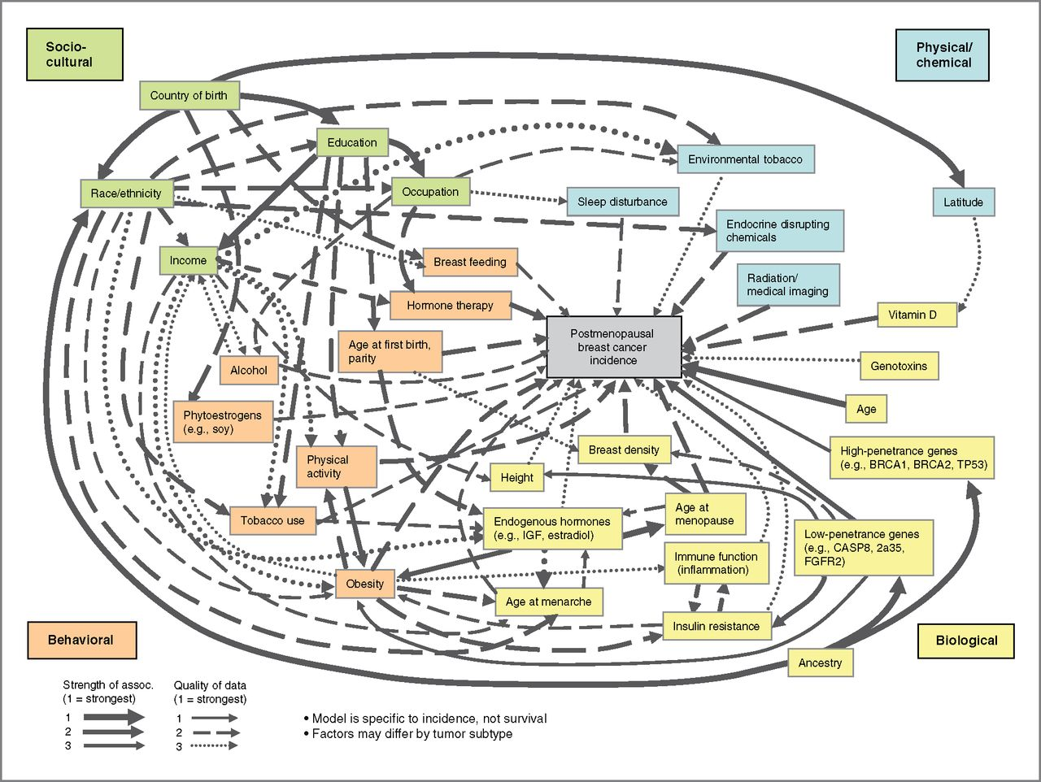
Multi-Level Model of Breast Cancer Incidence
e.g., What if we wanted to study the causal effect of physical activity on breast cancer?
How do we handle this complexity?
Do we adjust for everything?
Hiatt et al. Cancer Epidemiol Biomarkers Prev 2014
Notes:
In real life, the complexity is often much more than two confounders. For example, here is a causal diagram for the occurrence of breast cancer in post-menopausal women. How can you handle this much complexity? Should we just adjust for everything? We already know that one problem with adjusting for everything is that if we happened to adjust for a collider we will spuriously induce a relationship between the two parents of the common effect.

Slide 32
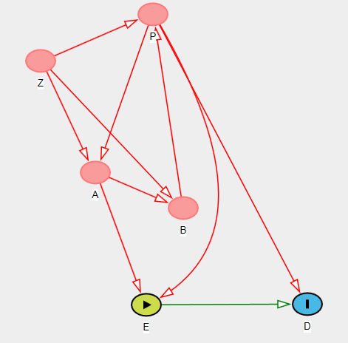
Simplifying the Complexity
Sometimes evaluating the causal association between an exposure (E) and outcome (D) is simpler than it appears
Which variable(s) do we need to control for ?
?
Notes:
Sometimes, there is a simpler solution to this complexity than is initially apparent on the DAG. Here is a somewhat complicated looking DAG. Which variable(s) do we need to control for to determine the causal effect of E on D? The answer is…

Slide 33
Simplifying the Complexity
Sometimes evaluating the causal association between an exposure (E) and outcome (D) is simpler than it appears
Which variable(s) do we need to control for ?
P only
?
Notes:
Sometimes, there is a simpler solution to this complexity than is initially apparent on the DAG. Here is a somewhat complicated looking DAG. Which variable(s) do we need to control for to determine the causal effect of E on D? The answer is P only

Slide 34
Minimal Sufficient Adjustment Sets (MSAS)
Sometimes evaluating the causal association between an exposure (E) and outcome (D) is simpler than it appears
DAGs allow us to identify the minimal set of variables, which if controlled for, will allow for estimation of causal effect of E on D
i.e., An MSAS is the minimal set of factors you need to control for that will:
  - keep direct (+/- indirect) causal paths between E and D open
  and
  - close all non-causal paths between E & D
For any DAG, there may be several minimal sufficient adjustment sets (MSAS’s) that allow us to evaluate causal effect of E on D.
Notes:
Sometimes, there is a simpler solution to this complexity than is initially apparent on the DAG. DAGs allow us to identify the minimal set of variables, which, if controlled for, will allow for estimation of the causal effect. This set of variables is called a minimal sufficient adjustment set or MSAS. This is defined as the minimal set of variables, which, if controlled for, will keep all direct causal paths open (and indirect causal paths if desired) between E and D, close all the non-causal paths between E and D, and thus allow for estimation of the total (or direct) causal effect of E on D.
In other words, an MSAS is the minimal set of factors you need to control for that will keep all causal paths open and close all non-causal paths in the context of evaluating the causal relationship between E and D.
Remember, the general statistical term for one means of “controlling for” is condition. To condition means to hold constant. The techniques we have described thus far (restriction, matching (followed by stratification), and stratification alone) are all called conditioning techniques. Multivariable regression is also a conditioning technique. Later today, we will describe some non-conditioning techniques, but for now we are focused on conditioning techniques. When we speak of conditioning on a set of variables, it does not mean that we have to use the same technique on each variable. For some variables, we might use restriction and for others we might use stratification.
Importantly, for any DAG, there may be several MSASs.

Slide 35
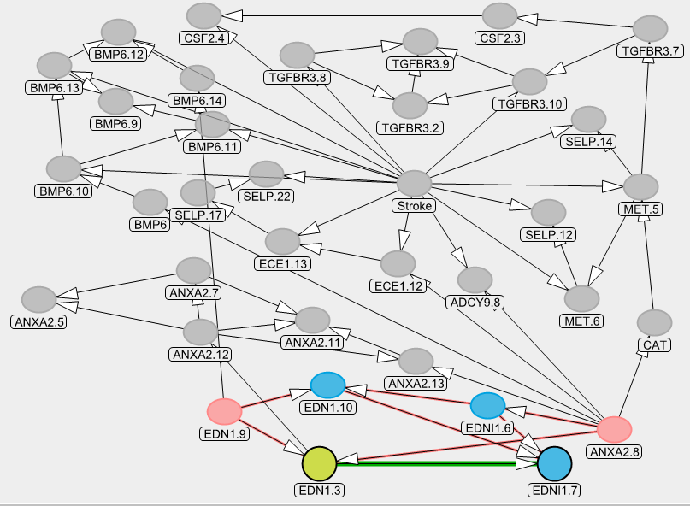
Real life DAGs make it very difficult for the human eye to manually determine the MSAS’s
  Although there are manual ways (see Shrier & Platt), humans got worn out trying & they make mistakes
  Has, in part, led to DAGs being underused
DAGitty.net now makes it simple to find the MSAS’s
Notes:
Here is a real life DAG. It is complicated. Although there are some formal approaches (see optional reading Shrier and Platt BMC Med Res Methodology 2008), it is hard for the human eye to manually determine the MSAS’s. Up until now, this was one of the biggest limitation of DAGs. People got worn out trying to solve them, and this has, in part, led to DAGs being underused. Humans also make mistakes when they try to identify all MSASs.
Thankfully, in the past few years, software has been developed — free software — to determine the MSAS’s. Dagitty.net is one such software.

Slide 36
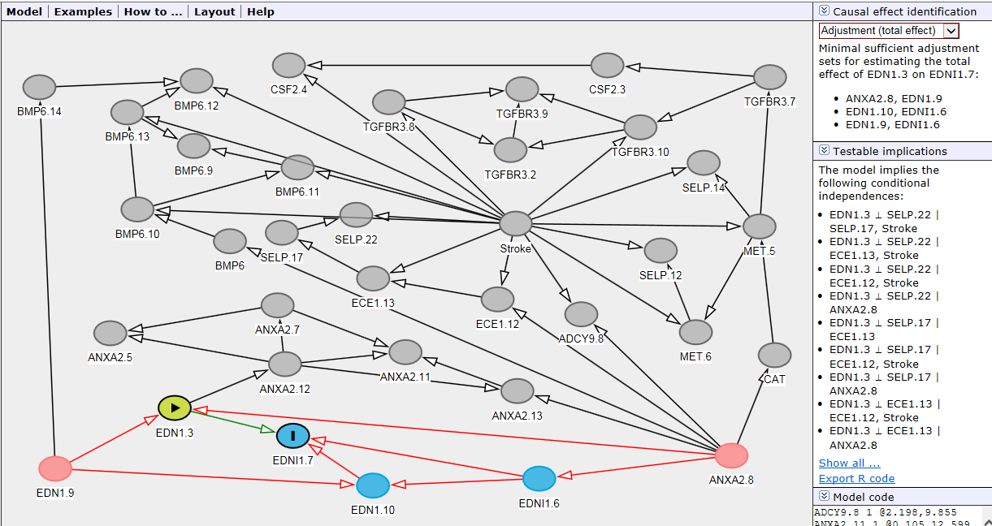
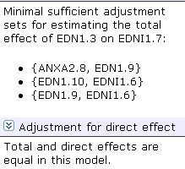
This is the major innovation of this software
Notes:
Specifically, most of you have already noted that in the upper right hand corner of the DAGitty.net screen, the program provides the minimal sufficient adjustment sets for unbiased estimation of the total causal effect of E on D and the direct causal effect (if there indirect paths noted). Recall earlier how we distinguished total effect from direct effect. In this case, this seemingly very complicated DAG boils down to 3 MSAS’s, listed here. In fact, DAGitty.net figures this all out on the fly. Those of you who are interested in the background for this can look at the Shrier and Platt article which explains the so-called moral graph approach.
The drop-down menu in the upper right hand corner allows to list the MSAS’s to estimate the direct effect of E on D apart from any of the other shown indirect causal paths. In this DAG, there is only one causal path in question so the program tells us that the total and direct effects are equal in this model.
I suspect that many of you have realized this, but this is the major technical innovation of this software. Heretofore, many DAGs were just too tedious to solve. Dagitty.net makes it trivial to solve them in terms of finding the MSASs (or telling you that no MSAS exists). Of course, it is also true that ease by which Dagitty.net allows to draw and edit the DAGs is also very nice.

Slide 37
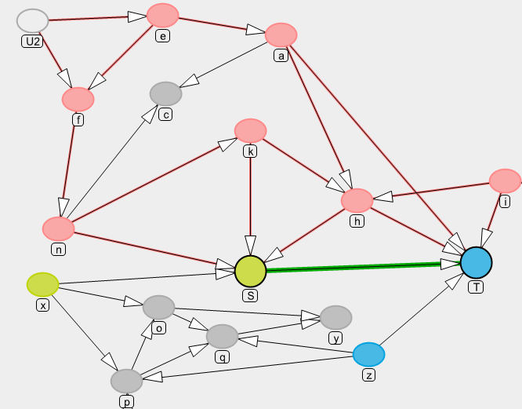
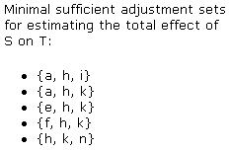
What are the MSAS’s for effect of S on T?
Which MSAS to choose?
Notes:
Here is another pretty complicated DAG. We just put letters in the nodes for simplicity. Who has this solved in terms of the MSASs? Too late. Dagitty.net has you beat. It has come up with 5 different MSAS’s.
Controlling for the factors in any of the MSASs will close the biasing paths (the red will go away) and decrease the count of biasing paths to zero. <This can be shown live if time >.
Which one would you choose?

Slide 38
Why might we decide to adjust for one MSAS over another?
Not all variables are created equal
  i.e., not all variables are equally easy to control for
Some variables:
  Have lots of missing data
  Are poorly measured
    Either reproducibility or validity
  Difficult to quantity
    e.g., injection drug use, or hypertension
  Difficult to specify shape of relationship with outcome
    e.g., continuous variables
  Expensive to measure
  Involve ethical issues if measured
    e.g., illegal behavior (drug use; commercial sex)
Advice
  Choose MSAS which has variables that are most feasible, reproducible, accurate, and manageable
Notes:
It turns out that often there is more than one MSAS to choose from. If this is the case, why might we decide to adjust for one MSAS over another? The answer is that when it comes to measurement and adjustment, not all variables are created equal. In other words, not all variables are equally easy or wise to control for.
Some variables may have lots of missing data. Attempting to adjust for variables with lots of missing data creates a number of problems, which are beyond the scope of this course, but suffice it to say that variables with missing data are often inferior to variables with complete data. Some variables are poorly measured, a concept we talked a lot about several weeks ago. By this, I mean problems with either reproducibility or validity. Remember a few weeks how we discussed how a poorly measured confounding variable does not allow us to fully adjust for that variable.
A related concept are variables that are difficult to quantify, such as injection drug use or hypertension. How do you really fully control for history of hypertension? It is hard to know, but you likely would have to know the daily blood pressure over a person’s lifetime and control for some area under the curve. Nearly impossible.
Even if you had accurate measurement of a confounder, actually adjusting for it — in a technical sense — can be a challenge. Although we won’t be discussing this in our course, finding the correct functional “specification” of a variable in terms of how it relates to the outcome, particularly continuous variables, can be a challenge. This refers to the mathematical relationship between the variable and the outcome in question. This issue gets into things like whether adding quadratic or cubic terms is useful or whether a spline may be important.
Finally, there are issues of feasibility. Some variables are more expensive than others to measure. Biological variables, in particular, are expensive, and some are more expensive than others. Then, there are issues of ethics. Measuring illegal behavior such as drug use or commercial sex brings with it several ethical issues.
In the face of these issues, the advice becomes clear: choose the MSAS which contains variables that are, collectively, the most feasible, reproducible, accurate, and technically manageable. This is a human decision and nothing that a computer can do for you.

Slide 39
Need h in all scenarios
If k is a problem to measure, go for {a, h, i}
Notes:
Back to our DAG, the program tells us that we are going to need variable h in our adjustment set no matter what. So, we know that we will really have to focus on measuring h well. Let’s say that variable k is difficult to measure, for whatever reason. If this is true, then we will plan to measure a and i in addition to h for our MSAS.

Slide 40
Confounding and Interaction: Part III
Methods to reduce confounding
  during study design:
    Randomization
    Restriction
    Matching
    Instrumental variables
  during study analysis:
    Stratified analysis
    ------ INTERACTION---------
      Forming “Adjusted” Summary Estimates
      Concept of weighted average
        Woolf’s Method
        Mantel-Haenszel Method
Handling more than one confounder
  Minimal sufficient adjustment set (MSAS)
Managing uncertainty in your DAGs
  Role of an analysis plan
If time:
  Residual confounding; importance of overlap; quantitative bias analysis
Limitations of stratification
  Motivation for multivariable regression
Limitations of conventional conditioning approaches
  Motivation for other “non-conditioning” techniques
Notes:
Let’s regroup for a moment and switch to the next topic, uncertainty in your DAGs.

Slide 41
The Ideal Process
You are confident about the DAG
Find all the MSASs
Choose the most practical MSAS
Adjust for the chosen MSAS
  Via restriction, matching, stratification, or regression
Report the final adjusted measure of association (or stratum-specific estimates, if interaction present)
The Often More Realistic Situation
You are often NOT confident about the DAG
Why not just take the most conservative route and adjust for everything that is conceivable?
B
?
A
?
D
E
?
Notes:
Let’s pause for a moment to review where we are. In the ideal situation, we are confident about our DAG. If we are, the process is that we simply find all of the MSAS’s and choose the “best” (i.e., most practical) MSAS using the tips we just discussed. We do the adjustment for the variables in the MSAS by restriction, matching, stratification, or regression or some combination of them. We then go ahead and report the final adjusted measure of association or the stratum-specific estimates if statistical interaction is present.
That is the ideal, but here is the often more realistic situation: It is often the case that you are NOT fully confident about the DAG. For example, you might be sure that A causes D, but you are and the literature are not so sure that A causes E. Or, perhaps you know that B causes E, but you are not so sure that B causes D. What should you do? Perhaps you figure you should take the conservative route and adjust for all confounding that is conceivable? Is there any downside to this?

Slide 42
Crude
OR _{crude} = 21.0
(95% CI: 16.4 - 26.9)
Matches Present
Matches Absent
Stratified
OR_{matches} = 21.0
OR _{no} _{matches} = 21.0
OR _{adj MH} = 21.0 (95% CI: 14.2 - 31.1)
Which will you report as your final answer?
Adjusted (95% CI) - B
Crude (95% CI) - A
Need more information- C
Notes:
To address this, let’s go back to our original motivating example of smoking, carrying matches, and lung cancer. Here, in the crude table, we are looking at the effect of smoking on lung cancer. The crude association shoes a strong effect; the odds ratio is 21. What if we now stratified on carrying matches? The two stratum-specific measures of association are both 21. What would we report as the final answer, the crude and its associated 95% CI or the adjusted estimate and its 95% CI?

Slide 43
What adverse effect occurred when we adjusted for matches?
Crude
OR _{crude} = 21.0
(95% CI: 16.4 - 26.9)
Matches Present
Matches Absent
Stratified
OR_{matches} = 21.0
OR _{no} _{matches} = 21.0
OR _{adj MH} = 21.0 (95% CI: 14.2 - 31.1)
Which will you report as your final answer?
We have suffered a precision penalty by adjustment
Crude (95% CI) - A
Adjusted (95% CI) - B
Need more information- C
Notes:
The answer is that we suffered a penalty in terms of statistical precision when we stratified. We should choose the crude. Look at the width of the crude and adjusted odds ratios. As you can see, the 95% confidence interval for the crude estimate is 16.4 to 26.9 compared to 14.2 to 31.1 for the adjusted.

Slide 44
No indication from the DAG that Matches should be controlled for
Don’t adjust for things you don’t need to (because it can sometimes cause you trouble)
Matches
Lung Cancer
Smoking
?
Notes:
Of course, you might say that you would have never adjusted for matches in the first place because it would have never been indicated by your DAG. If you did say this, you would be right. There is no evidence that matches cause lung cancer such that we should have never stratified on it.
Hence, this example illustrates why you don’t want to adjust for things that you don’t need to, things that are not indicated by your DAG. This is because they can sometimes decrease precision.

Slide 45
Effect of Adjustment on Precision (Variance)
Adjustment (e.g., stratification) is not always “all good”
Adjustment can increase or decrease standard errors (and CI’s) depending upon:
  Nature of outcome (interval scale vs. binary)
  Method of adjustment (stratification vs. regression)
  Strength of association between “potential” confounding factor and exposure/disease
    “potential” because as last slide illustrates, the uninitiated may decide to adjust for non-confounders
Not always straightforward to predict effect on precision
Good news:
  adjustment for strong confounders removes bias and often improves precision
  adjustment for strong determinants of outcome often improves precision
Bad news:
  adjustment for non-confounders, weak determinants of outcome, or less-than-strong confounders often (not always) worsens precision
Notes:
So, this is the first adverse manifestation of stratification that we have observed. Heretofore, it was always all good. Stratification was useful to assess for effect-measure modification and also useful to get rid of the bias from confounding. Now, we see that adjustment can be accompanied by a decrease in precision, and a decrease in precision from stratification is indeed a shortcoming for many analyses with limited sample size. Indeed, we can say that a decrease in precision is never a good thing, but, in practice, if you are working with a very large sample size then a decline in precision will have no practical importance.
Whether or not adjustment will decrease precision is a complicated story because adjustment can increase or decrease standard errors (and hence confidence intervals) depending upon a number of factors including:
The nature of the outcome: binary vs. interval scale. In this class, we have only been talking about binary outcomes, but some of the effects of adjustment are different in the case of interval scale. In general, adjustment for factors which are strong determinants of the outcome will increase precision when outcomes are on the interval scale.
the method used for adjustment, in other words, Woolf vs. Mantel-Haenszel (stratification-based) vs. a maximum likelihood estimation-based regression technique, for example, logistic regression
and, finally, the strength of association between the “potential” confounding factor and the exposure and disease, respectively. We note that this “potential” because as the last slide illustrates, the uninitiated may ill-advisedly decide to adjust for such a non-confounding factor.
This is complex and nothing most people can easily predict or commit to memory. However, the good news is that adjustment for strong confounders removes bias and typically often improves precision as well. This is a win-win situation. It is also the case that adjustment for strong determinants of outcome, even if they are not confounders, will also often (but not always) improve precision.
The bad news is that adjustment for non-confounders, weak determinants of outcomes, or less-than-strong confounders can often (but not always) worsen precision. This is the source of a lot of consternation.

Slide 46
Spermicides, Maternal Age & Down Syndrome
Crude
OR = 3.5
Stratified
Age < 35
Age > 35
OR = 3.4
OR = 5.7
Which answer should you report as “final”?
Adjusted (95% CI) - B
Crude (95% CI) - A
Need more information- C
Notes:
Let’s look at another example. Remember our earlier question looking at the effect of spermicide use and the development of Down Syndrome in a case-control study. Let’s assume that our interest is in the multiplicative scale. Remember after we stratified by maternal age, we saw these two stratum-specific estimates of the odds ratio: 3.4 and 5.7, which are substantively different. We were suspicious because of the small numbers in some of the cells that the stratum-specific estimates differed only because of sampling error. When we go ahead and performed a test of homogeneity on the multiplicative scale, we find it is 0.71 and so we are willing to pass on interaction (i.e., not report it), and now we need to finish our work.
Here, the crude estimate is 3.5. The adjusted OR by Woolf method is 3.82 and adjusted OR by M-H is 3.78; both are essentially 3.8. What should we report as our final answer, the crude (95% CI) or the adjusted (95% CI) estimate? Or, do we need more information?

Slide 47
Spermicides, maternal age & Down Syndrome
Crude
OR = 3.5
Stratified
Age < 35
Age > 35
OR = 3.4
OR = 5.7
Which answer should you report as “final”?
Adjusted is different than crude
Adjusted CI is also wider
Adjusted (95% CI)- B
Crude (95% CI) - A
Need more information- C
Notes:
All 3 answers are defensible. Notice that adjustment does change the point estimate a bit from 3.5 to 3.8. Those of you who chose B are probably happy about that because you believe it changed because you have accounted for confounding. However, again, adjustment results in loss of precision. Those of you who chose A are probably very conscious about this. You did not choose to control for age because you did not think it was a confounder and because you were concerned about worsening precision if you controlled for it. Or, if this substantive field is unfamiliar to you, then you might have rightfully said that you needed more external information about age.

Slide 48
If the red edge exists in your view, you will want to control for maternal age.
It all comes down to the red edge
Maternal Age
?
Down Syndrome
Spermicide use
?
If the red edge does not exist in your view, you do not have to control
What if you don’t know if the red edge exists? (i.e., existing literature is inconclusive)
Notes:
I am sure that many of you have already quickly drawn your DAG for this system. Most people realize that maternal age is a causal determinant of Down Syndrome, but for most observers it all comes down to this edge, in red. If you believe the red edge exists, you will control for age and accept whatever final adjusted answer you get. If you don’t believe it exists, then you don’t have to adjust for age. However, what if you simply don’t know the answer, i.e., the available literature is inconclusive or at least it is in your population?

Slide 49
If there are inconclusive edges:
Whether or not to use the “adjusted” summary estimate instead of the crude?
No one correct answer
  “Bias-variance tradeoff”
Scientifically rigorous approach is to:
  Create DAG with all “potential” confounders
  Prior to adjustment, classify the potential confounders as either being:
    “A” List: Those factors for which you will accept the adjusted result no matter how small or large the difference from the crude.
      Factors believed to be confounders
    “B” List: Those factors for which you will accept the adjusted result only if it meaningfully differs from the crude (with some pre-specified difference, e.g., at least 5 to 10%).
      Factors you are less sure about
      Termed: “Change-in-estimate” approach
For some analyses, may have no factors on B list. For other analyses, some factors on B list.
Always putting all factors on A list may seem “conservative”, but not necessarily the right thing to do in light of penalty of statistical imprecision
Bias control paramount
Need for tradeoffs: trade a bit of bias to protect variance
Notes:
It turns out that there is not one correct answer, and that the methodologic literature is inconsistent about what to do. The inconsistency in the literature is a manifestation of what is called the bias-variance tradeoff, something that you will see again in the next 3 quarters in our Biostatistics course sequence. The tension is between trying to get the most valid answer (least biased), or at least not a very biased answer, but without having to take unnecessary penalties in precision. This tension comes up all of the time in study design and data analysis. The tension is just how close is close enough when looking for an unbiased answer and how much increased variance are you willing to take to get a nearly unbiased answer?
In our view, a scientifically rigorous approach to this is to first create a DAG with all of the “potential” confounders. In other words, include all variables which you strongly believe to be common causes of E and D as well as those you are unsure about. Include all of the “inconclusive” edges we spoke of earlier. Prior to adjustment, create two lists: On one list, the “A” list, would be those factors for which you will accept the adjusted result no matter how small (or large) the difference from the crude. You will accept the adjusted results because these are factors you believe strongly to be confounders based on your subject matter knowledge (i.e., review of the scientific knowledge). They are either common causes themselves or any factor on a confounding pathway which, if blocked, can close that confounding pathway. An example might be age when looking at the association between hypertension and coronary artery disease. Age is definitely a confounder in the hypertension and coronary artery disease relationship and must be controlled for.
On another list, the “B” list, would be those factors which you are not sure about. They might be confounders but you honestly don’t know because you are not sure about one or both of the causal relationships between the originating common cause in question and exposure and/or the common cause and outcome. Note that this “B” list factor does not have to be the common cause per se but can be any factor on the confounding pathway that if adjusted for could block the pathway. For example, you might be sure that this confounding path has a solid causal relationship with outcome but not sure they are associated with exposure. For these, the advice is that you accept the adjusted result only if it meaningfully differs from the crude (with some pre-specified difference, e.g., at least 5 to 10%). For these factors, if they are not causing a large bias (i.e., the adjusted is no more than, say, 5 or 10% from crude) you would be willing to accept a bit of bias to protect against the loss of precision if you had adjusted (trade a bit of bias to protect against loss of variance). This approach in deciding whether to control for a variable or not is called the “change-in-estimate” or “change-in-coefficient” approach.
These kind of bias-variance tradeoff decisions are actually being made all of the time in statistical analyses. They come up when we need to decide whether certain types of statistical models which we know may not be 100% accurate (i.e., could be slightly biased) but do offer the promise of more precise estimates.
For some analyses, you may have no factors on the B list. For other analyses, you would have some factors on B list. Putting all factors on the A list may seem conservative, but it is not necessarily the right thing to do in that there may be a penalty to take in statistical imprecision when you adjust for these variables.

Slide 50
Adjusting for Maternal Age?
Age is on “A” List
Adjust for Age; Accept OR_{MH} = 3.8 as final estimate
Maternal Age
Spermicide use
Down Syndrome
?
Age is on “B” List
Accept/report age-adjusted result only if exceeds pre-specified change-in- estimate threshold (e.g., 5%) c/w crude (here, it is ~8%)
Whether age is on “A” or “B” list (and your threshold) should be pre-specified in your analysis plan
Maternal Age
?
Spermicide use
Down Syndrome
?
Notes:
So, back to the spermicide use, maternal age, and Down syndrome problem. If we had placed maternal age on our A list, meaning that we were sure that it is a confounder (i.e., part of a confounding path) and that this is the best DAG, then we need to adjust for age and accept the adjusted estimate no matter what it is. In this case, we would accept OR_{MH} = 3.8 as the final estimate.
On the other hand, you might be unsure after your review of the literature if age is truly related to spermicide use and hence unsure if age is truly is a confounder in your DAG. In this case, you will place age on your “B” list. In this case, you should adjust for age in your final estimate only if doing so exceeds your pre-specified change-in-estimate (e.g., 5%) when comparing crude to adjusted estimates. In other words, you will adjust for age only if makes some difference in the result. Another way of thinking about this is that you will use your own data (the data that you have collected) to help you decide if the inconclusive edge truly exists or not.
Which of these to choose is up to you, based upon your conclusion about the edge from age to spermicide use, but whether age is on your “A” or “B” list should be pre-specified in your analysis plan. You cannot, for example, adjust for age, see that it changes the crude by 6% but also moves it from a p value of 0.03 to 0.15 and decide that you don’t like it based on what you found. You need a pre-specified principled approach.

Slide 51
Choosing the crude or adjusted estimate?
Assume no multiplicative statistical interaction
Pre-specified analysis plan: Factors on B list have 10% change-in-estimate rule in place
Notes:
Let’s go through a few numerical examples. First, let’s assume there is no strong evidence in any of these examples for multiplicative statistical interaction and that our interest is in the multiplicative scale. Also, let us say that our pre-specified rule in our analysis plan is that any factors that we place on the “B” list must have a 10% change-in-estimate compared to the crude result in order for us to accept the adjusted estimate. In other words, we will adjust for the factor only if the adjusted differs from the crude by equal to or greater than 10%. Let us go through these examples.

Slide 52
“Change in Estimate” Approach
– A Historical Perspective
Historically, confounding was often defined by whether the adjusted estimate differed from the crude
  “if there is a change after adjustment, there has to be confounding present”
i.e., in the past, the available data defined confounding
  “data-based definition of confounding”
Today, theoretical philosophy is very different
  We primarily don’t use data from the current study to define presence or absence confounding or what to control for
    We put more weight into the collective body of prior evidence/literature than our single study
    e.g., if we adjust for something and it changes the estimate, we don’t accept this as confounding unless there was some a priori belief (e.g., gum chewing in melanoma)
  Exception: if the prior literature is uncertain about a part of a DAG (B list), reasonable to use data from current study to inform decision to adjust
    This is how we use “change in estimate” approach today
However, not all practice this, leading to non-uniformity
Notes:
There has been a change over the past decade in the theoretical understanding of how to define and manage confounding. For many years, confounding was often defined by the data at hand in the current study. If adjustment for a factor changed the estimate, confounding was deemed to be present.
Today, the philosophy is quite different. We do not primarily use the data from the current study to decide what to control for. Instead, we put more weight into the collective body of prior evidence, which we encode in our DAG. The exception is that sometimes we are unsure about one or more edges and one or more confounding paths. In these situations, it is reasonable to use the data at hand to inform the decision – to break the tie. This is how we selectively use the “change in estimate” approach today.
Unfortunately, this new understanding of confounding is not known by most researchers, who are instead practicing the older techniques. This leads to a lot of confusion in the literature and explains some fraction of the diversity of answers for any given research question.

Slide 53
No Role for
Statistical Testing for Confounding
Testing for statistically significant differences between crude and adjusted measures is inappropriate
e.g., examining an association for which there is a factor (from literature) which is a known confounder (e.g., age in association between hypertension & CAD)
  if the study has a small sample size, even large differences between crude and adjusted measures may not be statistically different
    yet, we know confounding by age is present
    therefore, the difference between crude and adjusted measures cannot be ignored as merely chance.
    bias must be prevented and hence adjusted estimate should be used/reported
    we must live with whatever effects we see after adjustment for a factor for which there is a strong a priori belief about confounding
If study has large sample size, even small differences between crude & adjusted will be statistically significant
  Will you accept all these adjustments — which could begin to add up to a large difference — to be necessary even if no a priori evidence of confounding?
Notes:
Many of you are perhaps saying why don’t we just apply a statistical test to see if the difference between the crude and adjusted is significant? After all, we used a statistical test when helping to decide whether statistical interaction is present. If there is anything we want you to leave you with today is that statistical testing for confounding is a bad idea. Luckily, even if you wanted to perform such a statistical test, they are actually not readily available in software packages.
Why is statistical testing for confounding inappropriate? Let’s say you are working with a variable that you know is a confounder from every bit of prior literature, like age in the evaluation of the relationship between hypertension and coronary artery disease. What if you happened to have a small sample size in your study? Then even large differences between the crude and adjusted measures of association might not be statistically significant. What are you going to do? Throw out age and just go with crude estimate of the relationship between hypertension and CAD? Of course, you won’t do this because you know that confounding is present! You cannot ignore differences between crude and adjusted measures just because they are not statistically significant. In other words, when protecting against bias with a known confounder, you have to do whatever you can regardless of statistical significance. If we believe that a factor is a confounder, then we have to live with (i.e., accept) what we see as differences between crude and adjusted regardless of the statistics.
Similarly, with a large sample size, even small differences between crude and adjusted estimates will be statistically significant. These small differences could add up to be a substantial difference once you starting adding up the effects from many variables. Yet, if you have no substantive conviction that a factor is a confounder (e.g., gum chewing and melanoma), why would you adjust for it?

Slide 54
The Ideal Process
You are confident about the DAG
Find all the MSASs
Choose the most practical MSAS
Adjust for the chosen MSAS
  Via restriction, matching, stratification, or regression
Report the final adjusted measure of association
The Often More Realistic Situation
You are often NOT confident about the DAG
Why not just take the most conservative route and adjust for everything that is conceivable?
Problems with this approach:
  1. Precision (increase variance)
  2. Bias (if inadvertent adjustment on a collider)
  — e.g., folate, birth defects, and stillbirths
  3. Chance may bite you and cause the adjusted point estimate to be different even if no confounding
  — e.g., gum chewing and melanoma
  Non-collapsibility
    — ORs, rate ratios, & high incidence outcomes
Notes:
Let’s pause for a moment to review where we are. In the ideal situation, we are confident about our DAG. If we are, we simply find all of the MSAS’s and choose the best, or most practical MSAS. We do this by restriction, matching, stratification, or regression or some combination of them. We then go ahead and report the final adjusted measure of association.
That is the ideal, but here is the often more realistic situation: It is often the case that you are NOT fully confident about the DAG. Earlier, we asked, why not just take the most conservative route and adjust for everything that is conceivable to adjust for? We just illustrated one problem with this approach which is that it can increase variance.
There are, however, other problems. The second issue is that adjustment for everything may result in inadvertent adjustment on a collider with resultant bias. Remember our initial example of collider bias with folate intake (exposure), birth defects (outcome), and stillbirths (collider)?
The third problem is that chance may bite you in ways more than just by increasing variance. Just by chance alone when you adjust for a factor in a sample of a population you can see differences between crude and adjusted even if there is no confounding. This is just because of chance relationships in the data. Remember the gum chewing and melanoma example. Why would you want to accept these chance findings?
The final reason is the phenomenon we called non-collapsibility earlier in the course. This is when adjustment for a factor which is not a confounder can result in a summary adjusted estimator being different than the crude. Recall how we discussed this with odds ratios, rate ratios, and high incidence/prevalence outcomes. Adjusting for “everything” is going to facilitate the occurrence of non-collapsibility.

Slide 55
In Addition to Presence, Direction of an Edge Can Make a Big Difference
Controlling for M gives a desirable result
U₁
U₂
M
E
D
?
Controlling for M induces collider bias
U₁
U₂
M
E
D
?
Solution: If crude & adjusted estimates differ by > 5% to 10%, report both analyses and discuss the influence of this unknown direction
  Pre-specify % in your analysis plan
Notes:
55
In addition to wondering about the presence of an edge, the direction of an edge can also make a big difference when you are considering adjustment. Let’s say that you were uncertain about the direction of the relationship between M and U2. In one DAG, we might draw it like we see in the above figure. However, in another DAG, we might draw the DAG in the opposite direction, as in the below DAG. It may be very hard to know which is correct.
Unfortunately, the consequences of controlling for M are very dependent upon the direction of the edge. In the top DAG, controlling for M gives a desirable result; it closes a confounding path. In the below DAG, you have just the opposite. Here, controlling for M induces collider bias.
This issue is not whether the edge exists, as it was in our A list vs B list scenario, but rather it is an issue of the direction of the edge. This situation can also be handled with a similar strategy as before, i.e., if the decision makes a difference in the analysis (changes the measure of association by more than 5% to 10%), then we need to worry about it, report both answers, and tell your readers how the direction of the edge is influential and that we need to understand the direction if we hope to get the right answer for the causal effect of E on D. If it does not make much a differences (less than 5 to 10%), then we can ignore it and report one answer.

Slide 56
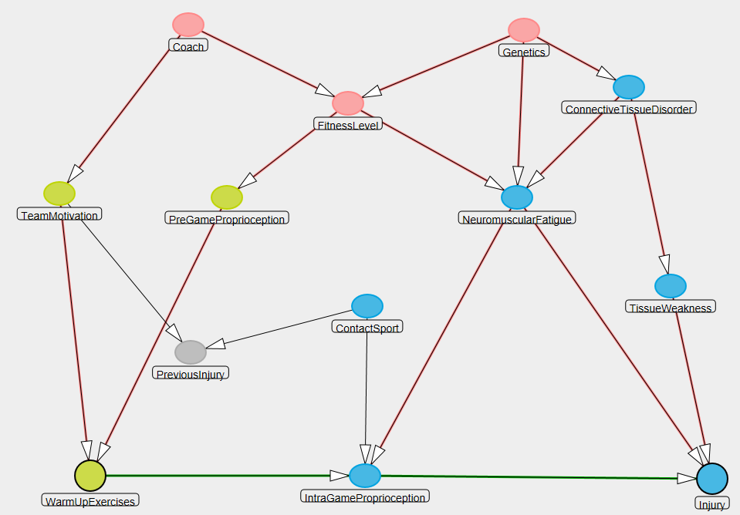
What About Multiple Areas of Uncertainty?
?
?
?
No one best/accepted approach
  Frontier of methodologic research
  See Extra Slides for our advice and algorithms
  More in BIOSTAT 208 and 209
Notes:
This is simple enough in the presence of just one non-causal path, but what happens when you have multiple areas of uncertainty in a complex DAG?
Unfortunately, there is no one single best or accepted approach. How to best handle this is on the frontier of methodologic research. Please see the Extra Slides for an example of an algorithm that we endorse.

Slide 57
An Analysis Plan
How to select variables to control for (“final model”) is one of the least standardized processes in research
Available methods often arbitrary and can give different answers for the “final estimate”
  Invites fishing for desired answers
Solution: Analysis plan
Written before the data are analyzed
Content
  Detailed description of the techniques to be used to analyze data, step by step
  Forms the basis of “Statistical Analysis” section in manuscripts
  Parameters/rules/logic to guide key decisions:
    which variables will be assessed for interaction and for adjustment?
    what p value and magnitude/scale of heterogeneity will be used to guide reporting of interaction?
    what is a meaningful change-in-estimate threshold between two estimates (e.g., 5% or 10%) to determine variable selection and model reporting?
Utility: A plan helps to keep the analysis:
  Focused
  Transparent
  Reproducible (“reproducible research”)
  Honest (avoids p value shopping)
Not legitimate to try various analyses until you find a statistically significant result
Notes:
All of the different approaches and decisions I have described may cause your head to spin. If the process seems arbitrary to you, it should because many of the different approaches out there don’t have any particular justification. Indeed, how to select final variable to control for (the final set) is one of the least standardized processes in observational human subjects research. In particular, with all these approaches, there appear to be many avenues to take and often they will give different answers. Hence, it is possible to try many different approaches until you get the result you want to see. This is a big problem in observational research. There is no one single best approach to handle confounding, and, hence, there is too much of an invitation to shape one’s final results.
The only solution to this, in our view, is an analysis plan that is written before the data are analyzed. The content of the plan is a description of the various techniques you will use to analyze the data, step by step. This plan will form the basis of the Statistical Analysis section in your manuscript. It contains all of the parameters and logic you will use to guide your decisions about interaction and confounding. For example, it will state which p value thresholds you will use to decide whether to report interaction or not. It will also state the logic you will use to deal with uncertainty in your DAG. Finally, it will list the change-in-estimate threshold (e.g., 5% to 10%) you will use to handle the bias-variance tradeoff of determining what to control for (when you have B list variables or when the direction of an edge is unknown).
There are many advantages to having such a plan. For one, it helps keep you focused in your own work and avoids your wasting a lot of time making things up as you go. A well written plan provides transparency to your work and is useful in that it is reproducible by others. As we mentioned earlier in the course, the world (and particularly funders) is beginning to demand reproducible research. Finally, as I mentioned above, a plan helps keep you honest by avoiding p value shopping, by which I mean trying a number of different approaches until you get the answer you like. To be clear, it is not legitimate to try various analyses until you find a statistically significant result that favors the hypothesis that you are promoting.

Slide 58
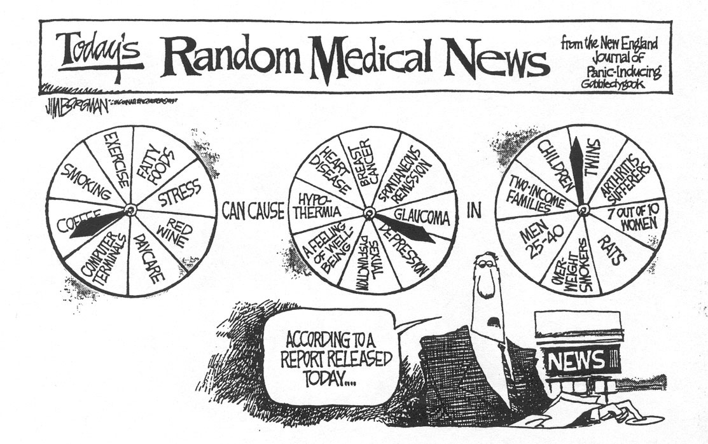
Transparency of Analytic Plans
Poor Quality of Reporting Confounding Bias in Observational Studies: A Systematic Review. Groenwold et al. Ann Epid 2008
Review of 174 observational studies, 2004 - 2007
Lack of transparency contributes to…
Notes:
How well do scientists do with reporting a transparent analytic plan? There was an interesting article that looked at this not too long ago. These authors looked at 174 consecutive observational studies in selected journals for a variety of characteristics related to the reporting and conduct of analyses related to confounding. They looked at a variety of things, but two stood out. The first was the percentage of articles where the authors reported why they were choosing the factors they did for controlling for bias. Only 10% did so. The other was the percentage of articles where the authors reported the reasons for the factors they ultimately included in the final analysis. Only about 50% of articles did this. It is hard to know what authors are doing, or if it is correct, if they don’t tell you. This lack of transparency likely contributes to the cartoon we showed earlier.

Slide 59
Stratification to Manage Confounding
Advantages
  straightforward to implement and comprehend
  transparent; some reviewers phobic of regression
  easy way to evaluate for presence of interaction
Limitations
  Requires continuous variables to be discretized
    loses information; possibly results in “residual confounding”
    discretizing often brings less precision
  Deteriorates with multiple confounders
    e.g., suppose 4 confounders with 3 levels
      3x3x3x3=81 strata needed
      unless huge sample, many cells have “0”’s and strata have undefined effect measures, which wastes data (“sparse data problem”)
Conventional conditioning solution to these limitations
  Mathematical modeling (aka, multivariable regression)
    e.g.,
      linear regression
      logistic regression
      log-binominal regression
      proportional hazards regression
See BIOSTAT 208 & 209
Notes:
Let’s end our discussion of stratification by summarizing its advantages and disadvantages. The primary advantage is that it is a very straightforward and easy to comprehend approach. Some reviewers are phobic of regression models and, hence, stratification, if you can do it, is very easily understood; everything is very easy to see in stratification -- it is entirely transparent. You can see the strata directly. Stratification is also a very easy way to evaluate for the presence of interaction. In contrast, multivariable regression makes interaction harder to identify.
There are, however, limitations.
The first limitation is what do we do if we have continuous variables as our exposure or confounders, something like age, for example? To use stratification, we have to break these continuous variables into categories in order to get them into our contingency tables. This unfortunately is not the richest use of continuous data. This can also result in residual confounding if our categories are not narrow enough.
Second, probably the biggest limitation of stratification, that we have already touched upon, is that it deteriorates with multiple potential confounders. Suppose there are 4 confounders present each with 3 levels. If you wanted to look for the presence of joint confounding by these 4 confounders you would have to form 81 strata, and, unless you had an enormous sample size, many of these strata would have unusable data (no ability to make comparisons), which effectively results in throwing away data and imprecise estimates.
The conventional solution to all of these limitations lies in the use of mathematical regression models also known as multivariable regression. These regression models are also a form of conditioning. You will learn will learn the detailed aspects of how to do these in the Biostatistics courses starting in January.

Slide 60
Limitation of Conventional Regression (as well as Stratification)
Scenario: Time-varying exposures in the presence of time-varying confounders which are also mediators of relevant causal paths
  e.g., Cohort study of effect of antiretroviral therapy (ART) on AIDS incidence
See Extra Slides for another scenario
CD4 time₁
CD4 time₂
AIDS
ART time₁
ART time ₂
?
?
CD4 here = time-dependent confounder/mediator
At any given time:
there are some patients for whom you wish to control for CD4 (to manage confounding); and
some patients for whom you do NOT wish to control for CD4 (because it is a mediator of one of the relevant direct causal paths)
Notes:
It turns out that even regression methods themselves are not fool proof. Therefore, before we end our discussion of confounding, it is useful to describe some scenarios where none of the conditioning methods we have discussed for observational data, be it stratification or regression, will give you an unbiased answer.
One scenario is when you are studying time-varying exposures (for example, treatment) in the face of a factor we refer to as a time-dependent confounder/mediator. As an example, let’s say we are performing a cohort study of the effect of antiretroviral therapy, ART, on the incidence of AIDS. Because the exposure, here ART, varies with time in this cohort, we depict it with two nodes, one for time 1 and another for time 2. In reality, you could have an infinite number of nodes for each period in time. At time 1, the CD4 count of a patient will affect whether he/she is administered ART. The CD4 count also affects whether or not he will develop clinical AIDS. Yet, we also know that ART affects/causes CD4 count at time 2 which influences the occurrence of AIDS.
Therefore, at given time, we simultaneously desire to, in some patients, control for CD4 count to block this backdoor pathway, the one where CD4 is confounding, but in other patients we also want to leave it alone because it is a mediator of one of the relevant indirect causal paths we are studying. Let us assume we are studying the total effect of ART on AIDS. In other words, we are in trouble if we control for it (we will block one of the indirect paths) and in trouble if we don’t (we will not control for confounding effect). If stratification or regression are the only tools we have for this, we cannot both control and not control simultaneously in a group of participants; you need to do one or the other (control or not control). We are stuck, and thus we need another technique.
The Extra Slides show an additional scenario in which conventional conditioning techniques lead to bias.

Slide 61
Time-varying exposures in the presence of time-varying confounders which are also mediators of relevant indirect causal paths
“Weighted” refers to inverse probability weighting (a type of marginal structural model)
Cole et al, AJE 2003
Notes:
What actually happens if you have such a dilemma? These are data from a large cohort of HIV-infected women, known as the WIHS. The research question is whether highly active antiretroviral therapy has an effect on the occurrence of AIDS or death. In the first 3 lines, we see the unadjusted or crude analysis. Women who were not treated with highly active antiretroviral therapy, abbreviated as HAART, formed the reference category. The comparator group was women who received HAART. Compared to this reference category, women who received HAART had 0.98 times the hazard of developing AIDS or death. As you know, a hazard ratio is a form of a rate ratio. This means essentially no effect of HAART.
In the fourth line, the adjusted analysis is presented, where CD4 count and a variety of other factors are controlled for in a conventional multivariable regression model. Here, the hazard ratio has changed, 0.81, compared to crude, but its confidence interval still crosses 1. The interpretation would still have to be that there is no strong evidence of an effect of HAART on the occurrence (prevention) of death or AIDS.
It was only when the investigators performed a technique called inverse probability weighting (a form of what is called marginal structural modeling) did they arrive at an estimate of the hazard ratio of 0.54, which was statistically significant. We happen to know that this estimate is the correct one because well-performed randomized clinical trials have shown that HAART drastically reduces AIDS and mortality to a similar extent as the HR of 0.54.
We won’t have time in this course to describe how these marginal structural models work other than to say they re-weight the study populations for the confounders instead of directly performing conditioning. The reweighting is similar to what two arms of randomized trial would look like; the arms have the same distribution of different confounding variables.

Slide 62
Conditioning vs Non-Conditioning Approaches to Manage Confounding
Conditioning approaches:
  e.g., Restriction, matching (with subsequent stratification), stratification, mathematical regression
  Compare exposed to unexposed at fixed levels of the confounders
In contrast, non-conditioning approaches:
  Several different techniques:
    G-estimation
    Structural nested models
    Marginal structural models (e.g., inverse probability weighting)
      Currently enjoying most popularity
    (& others, e.g., nested new user cohort analysis)
    See BIOSTAT 215
  Theme: balance exposed and unexposed groups for the confounder
    then compare exposed to unexposed to achieve “marginal” measure of association
    This is what randomization does, but non-conditioning techniques for observational analysis are much more complicated!
Goal for you
    Recognize when these techniques are needed
Notes:
Again, what we have talked about thus far are called conditioning techniques to manage confounding. Restriction, matching (with subsequent stratification), stratification, and mathematical regression are examples. What they do is to compare exposed to unexposed persons at a fixed level of a confounding variable.
In contrast, non-conditioning approaches (whose names are listed here) do something other than fixing the confounder at a set level to manage confounding. They first balance exposed and unexposed groups for the presence of confounders. If you think back, you will recall that this is what randomization did. By randomly distributing people to exposure groups, the exposure groups were balanced. Randomization is pretty simple to do in experimental designs, but performing these non-conditioning techniques on observational data is much more complicated.
At this point in time, the implementation of these non-conditioning approaches are largely in the hands of expert biostatisticians. They typically should not be done by non-experts unless they have a lot of help.
What is relevant, however, for you is to recognize when these non-conditioning techniques need to be used. The data won’t be screaming out for these approaches, and most people are unaware of these situations. The goal for you is to be able to spot the scenarios where conventional conditioning techniques do not work, and we have described the two big ones (one in the prior slides regarding time-dependent confounding/mediators and in the Extra Slides).

Slide 63
Summary
Stratification useful: evaluate interaction, control for confounding, & block indirect causal paths
Adjusted summary estimators are formed via weighted averaging of stratum-specific estimates
  Mantel-Haenszel technique most common
  a “conditional” measure of association.
While adjustment can reduce bias, it can worsen precision (& create bias if adjust on a collider)
DAGs (plus software, if needed) tell us the MSAS’s
  Investigators must choose the best MSAS based on a variety of considerations
Yet, we are not always certain about our DAGS
Use a principled and transparent analysis plan to guide your work
Stratification falls apart with multiple confounders
  Regression is the typical conventional solution
DAGs help us recognize when conventional conditioning methods (stratification/regression) fail
  And hence non-conditioning technique needed
Notes:
Here is a summary of our discussion today.
Stratification is useful for….
When performing stratification, adjusted summary estimates are formed via the process of a weighted average of the stratum-specific estimates. The Mantel-Haenszel technique is the most commonly used. Stratification produces what is called a “conditional” measure of association.
We learned that stratification is not all good..
To solve complex DAGs, we need to identify the MSASs.
The dirty little secret, however, about DAGs is that you might be uncertain about them.
If this is the case, an analysis plan is the principled approach to guide. Sometimes there is not just one final model or one final measure of association.
We talked about the limitations of stratification and how these were a motivation for conventional mathematical regression.
And we discussed when all conditioning techniques fail, for example, in the face of time-dependent confounders/mediators.

Slide 64
Next Tuesday (Next Week)
8:45 to 10:15: Journal Club
  Meet here. We are all together.
1:30 to 3:00 pm: Last Section
  Web-based course evaluation
  Bring laptop
Distribute Final Exam (on website)
  Exam due following week by 4 pm Tuesday (Dec. 13) (for in-person students) or 9 pm Wednesday (Dec. 14) (for online section)
  Upload your file on the CLE (Moodle) website (the syllabus site)
    Use a .pdf to preserve all of your formatting
  Contact Olivia (olivia@epi.ucsf.edu) if problems

Slide 65
Extra Slides

Slide 66
Terminology to use when describing adjusted relationships
e.g. AZT use, severity of needlestick, and HIV
. cc HIV AZTuse, by(severity) pool
severity | OR [95% Conf. Interval] M-H Weight
-----------------+-------------------------------------------------
minor | 0 0 2.302373 1.070588
major | .35 .1344565 .9144599 6.956522
-----------------+-------------------------------------------------
Crude | .6074729 .2638181 1.401432
Pooled (direct) | . . .
M-H combined | .30332 .1158571 .7941072
-----------------+-------------------------------------------------
Test of homogeneity (B-D) chi2(1) = 0.60 Pr>chi2 = 0.4400
Test that combined OR = 1:
Mantel-Haenszel chi2(1) = 6.06
Pr>chi2 = 0.0138
“Use of AZT is associated with decreased odds of HIV acquisition, independent of needlestick severity”
“Use of AZT is associated with decreased odds of HIV acquisition, adjusted for needlestick severity”
“Use of AZT is associated with decreased odds of HIV acquisition, controlling for needlestick severity”
“Use of AZT is associated with decreased odds of HIV acquisition, conditioned on needlestick severity”
Notes:
This is the terminology to use when describing, in general, an adjusted relationship. There are several acceptable sentences.

Slide 67
“Independent of”
“Use of AZT is associated with decreased odds of HIV acquisition, independent of needlestick severity”
“independent of” simply refers to adjustment/control for specific factors
  Does not refer to whether or not adjusted estimate is different from crude
  Just means that something has been done to contend with confounding by the factor in question (e.g., via stratification)
  Does not necessarily mean the association is causal
Notes:
Let’s look at this term independent a bit more because in the past some students have been confused by it. “Independent of” simply refers to something having been done to contend with confounding. This something could have been restriction, matching, an instrumental variable, stratification, regression, or some other form of adjustment. It does not refer to whether or not the adjusted estimate differs from the crude. It just means that some form of adjustment has been performed (for example, via stratification).

Slide 68
Mantel-Haenszel Confidence Interval and Hypothesis Testing
Notes:
Consider again the AZT use, needlestick severity, and HIV acquisition example. It is worth pointing that Stata is working hard for you behind the scenes in the Mantel-Haenszel-adjusted confidence interval formation and hypothesis testing. Whereas the point estimate for the adjusted measure of association point estimate is easy to calculate, the standard error, shown here, is not. But luckily Stata calculates all of this for you. And, remember, the standard formula for a 95% confidence interval is the point estimate plus or minus 1.96 times the standard error.
For the hypothesis test of adjusted measure of association equal to one, this is the formula for the chi-square statistic which has 1 degree of freedom. There is no need for remember these formulae, but you do need to know how to interpret them.

Slide 69
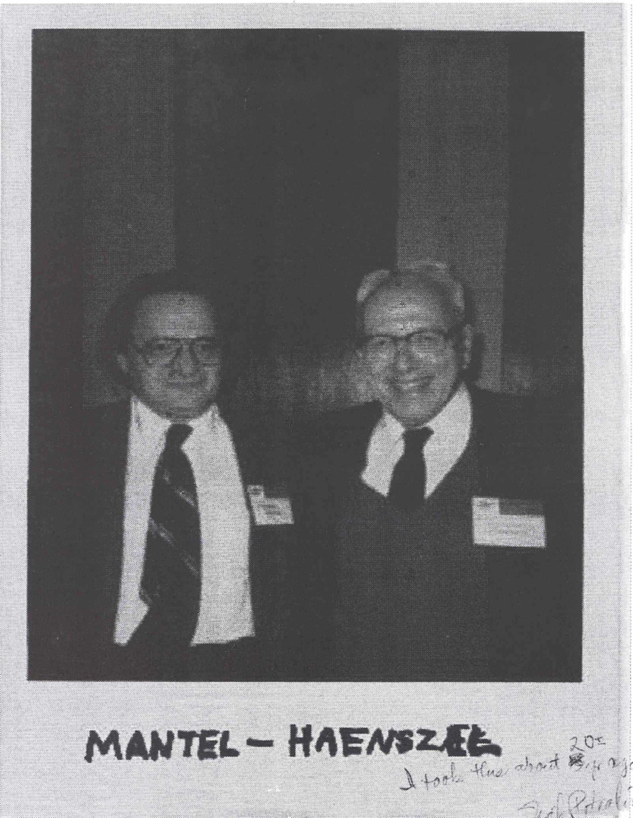
Some Mantel-Haenszel Techniques
Mantel-Haenszel estimators
Mantel-Haenszel chi-square statistic
Mantel’s test for trend (dose-response)
Notes:
It is also worth pointing that in addition to the Mantel-Haenszel estimators we are discussing, you’ll see other techniques named after Mantel and/or Haenszel, and it is worth keeping it straight which is which. We actually described the M-H chi-square statistic in the last slide, and there is also something known as the Mantel test for trend, for which there’s a nice discussion in the Appendix of our S & N textbook.

Slide 70
How about this conclusion?
“Use of AZT is causally related to reduced HIV acquisition.”
Formally, our analyses produce statistical associations, which could result from:
  Causal relationship (Truth)
  Or bias due to:
  Selection bias
  Measurement bias
  Confounding bias
  Or
  Reverse causality (but not here since we know AZT use came first)
  Or
  Chance
Single observational study rarely suffices as argument for causality
Data themselves do not establish causality
  - Scientists do, by consensus, by excluding other 5 explanations (“causal inference”)
Notes:
How about this conclusion? Use of AZT is causally related to reduced HIV acquisition (or as short hand: AZT prevents HIV acquisition). Can we say this? Probably not, at least not with just the information at hand and without more discussion. This is because formally our analyses can only produce statistical associations, which could have resulted from one of 6 possibilities shown.
We can never formally prove causality. The best we can do is to make arguments why the other 5 explanations (selection bias, measurement bias, confounding, reverse causality, or chance) are not present. We are not going to take any time in this course to discuss the various other criteria or guidelines for establishing causation because they are becoming outdated. The most famous are the Austin Bradford Hill criteria. We won’t take the time to discuss these because you have now learned the more important aspects of the process, which is to exclude the 3 main threats to validity, reverse causation, and chance. This is a process that is only done by consensus among methodologically astute and substantively grounded scientists. This process is known as causal inference. This is what we mean when we say that data themselves do not establish causality. Instead, scientists do in a process of consensus, by excluding the 5 other explanations.
Because of the uncertainties involved in causal inference using observational data, it is rare that a single observational suffices as a sole argument for causality. It is not impossible, but it is rare.

Slide 71
How to handle multiple areas of uncertainty in complex DAGs?
No one best approach
  Frontier of methodologic research
Our advice features transparency & reproducibility
Draw the different possible DAGs & find the MSAS’s
No common MSAS’s across the DAGs
Common MSAS’s present across the DAGs
Does any uncertainty involve colliders?
Adjust for the common MSAS
No
Yes
Next slide
Done
Determine adjusted estimate that includes all of the uncertain relationships (all of the B list variables). Consider this “maximally adjusted”.
One by one, recalculate adjusted estimate without one of the B list variables. Drop the B list variable if its exclusion results in an estimate no more than some threshold (e.g., 5% to 10%) away from maximally adjusted estimate. Stop when no more B list variables can be dropped.
Notes:
Earlier we posed a question about how to handle multiple areas of uncertainty in complex DAGs. The answer is that there is no one best approach that is universally agreed upon, and this is an active area of methodologic research. In this sense, epidemiology and biostatistics are relatively young scientific fields.
Our advice features transparency, scientific honesty, and a goal of reproducibility. It starts by drawing the different possible DAGs based on the various uncertainties and finding the MSASs. If there are common MSASs across the DAGs, then you are in good shape. If this is the case, this means there are identical actionable approaches. If so, then adjust for that common MSAS (or, if there are many common MSAS, then choose the most feasible given the prior advice). This produces the “final” answer.
If there are not common MSASs across the DAGs, then we have to ask if any of the uncertainty involves colliders? If yes, see the next slide. If no, then determine the adjusted estimate that includes all of the uncertain relationships, in other words, all of the “B” list variables. Consider this the maximally adjusted estimate. Then, one by one, recalculate the adjusted estimate without one of the B list variables, but keep all of the A list variables fixed. Drop the B list variables, using a change-in-estimate approach, if excluding the variable does not change the estimate by more than some threshold (of say, 5% to 10%). Stop the process when no more B list variables can be dropped.

Slide 72
How to handle multiple areas of uncertainty in complex DAGs?
Draw the different possible DAGs & find the MSAS’s
No common MSASs across the DAGs
Common MSAS’s present across the DAGs
Does any uncertainty involve colliders?
Adjust for the common MSAS
No
Yes
Done
Prior slide
If necessary, reduce # of DAGs to some reasonable #
Determine adjusted estimate for the different DAGs
They are all close (within 5% or 10%)
They are NOT close (> 5% or 10%)
Done
Report adjusted estimates for the different DAGs
Discuss which uncertain relationships are most influential & highlight them for future research
Additional approaches in BIOSTAT 208 and 209
Notes:
Continuing the algorithm, if the uncertainty does involve colliders, then we need to determine how many different DAGs are there after considering the different directions that key edges may have. If the number of DAG permutations is unmanageable, then you as the investigator will need to make some decisions to get this down to a reasonable number. This might mean fixing the direction of some of the edges for which you have uncertainty. After this is done, determine the adjusted estimate for each of the different DAGs. If they are close, say within 5% to 10%, then you are done. If they are not close (e.g., they differ by more than some threshold of 5% or 10%), then you should report the different results and discuss which of the uncertain peripheral relationships are most influential. These uncertain peripheral relationships should be highlighted for future research.
This is just one approach, and you will learn of others in our BIOSTAT 208 and 208 courses.

Slide 73
Remember the Research Purpose When Performing Adjustment
We have focused on adjustment for causal hypothesis testing of a single exposure variable
However, there are other purposes why we adjust
  Evaluating multiple exposure variables for causation
  Prediction of outcome by a set of variables (even if non-causal variables)
  Mediation analysis
These other research purposes require different approaches to decide what variables to adjust for
Notes:
You need to remember the research purpose when you are performing adjustment. In other words, why are you conducting the work in the first place? We have focused thus far on adjustment for causal hypothesis testing of a single (primary) exposure variable. Yet, there are other purposes to performing adjustment. Three other main categories are, one, evaluating multiple exposure variables for causation; two, prediction of outcome by a set of variables even if non-causal; and, three, for mediation analyses.
These other research purposes for adjustment require different approaches to decide which variables to adjust for. This is beyond the scope of this course but will be covered in our Biostatistics sequence, including BIOSTAT 215.

Slide 74
Importance of Overlap of the Confounder
From Last Week
2. Matching also provides a way to ensure overlap between comparator groups (e.g., cases/controls) in the distribution of confounders other than complex nominal variables
e.g., Case-control study of prostate cancer -- confounding by age
  Cases will have many old individuals
  Random sampling of controls, especially in smaller studies, apt not to contain oldest individuals
  Matching age distribution of controls to age distribution of cases ensures complete overlap in age between cases and controls
controls
cases
Age
Age
Notes:
Recall this slide from the discussion of matching from last week. Recall how we discussed how matching ensures overlap between the comparison groups in the distribution of confounders. We spoke of how this applies to both categorical variables and interval scale categorical variables. We considered a case-control study of prostate cancer, where there is concern for confounding by age. Certainly, the case group will contain many older individuals. If one just randomly sampled a control group from the general population, it is likely, especially in a small study, not to contain men as old as some of the cases, and it may contain many younger men. This is shown here in the two distributions of age in cases and controls. In a situation like this, there is no way to adjust for age in the analysis phase without some strong assumptions. Both stratification and regression techniques need there to be overlap in the distribution of the confounder between comparator groups. Without overlap, there are no controls to use to compare against these older cases. Matching provides a solution for this because it ensures that the distribution of age in the controls will completely overlap the age distribution in the cases. Now, in the analysis phase, you can adjust for age completely and without strong assumptions.

Slide 75
Importance of Overlap of the Confounder
Overlap is guaranteed in restriction, and matching; overlap theoretically guaranteed in randomization
But not guaranteed in stratification or regression
In stratification, lack of overlap will result in unused strata and wasted data
In regression, certain assumptions are made about the non-overlap zones (based on behavior of the data in overlap zones)
  Typically without the investigator being aware
  Can lead to bias
Advice
  Look for presence of overlap of confounder distributions between comparator groups
  Propensity scores are easiest approach
    Lack of overlap also called:
      Positivity violation
      Experimental treatment allocation (ETA) violation
Notes:
In general, overlap is guaranteed in restriction and matching. It is also theoretically guaranteed in randomization (assuming that chance imbalance does not get in your way). It is not, however, guaranteed in stratification or regression. In stratification, lack of overlap will result in some strata where a comparison between exposed and unexposed (or case and control) cannot be made. This wastes data. In regression, certain assumptions are made about the non-overlap zones based on the behavior of the data in the overlap zones. If these assumptions are incorrect, the resulting inferences from the regression are biased. Unlike stratification where the investigator might typically see the non-overlap, the problem is more insidious in regression because the analyst can easily just push the buttons on Stata without even knowing there is non-overlap.
The advice is that one needs to look for the presence of overlap of confounder distribution between comparator groups. This takes a bit of extra effort. Creating propensity scores are the easiest approach. This lack of overlap is given some esoteric names such as “positivity violation” or “experimental treatment allocation violation”.

Slide 76
Residual Confounding
(i.e. confounding still present after adjustment)
Four Mechanisms
Categorization of confounder too broad
  e.g., Association between natural menopause and prevalent CHD
  Szklo and Nieto
Misclassification of confounders
  Can be differential or non-differential with respect to exposure and disease
  If independent non-differential, will lead to adjusted estimates somewhere in between crude and true adjusted
  If differential, can lead to a variety of not easily predictable directions of bias
Notes:
One topic to review is residual confounding, which we have touched upon a few times in the past few weeks. Let’s review the four different mechanisms of residual confounding. Residual confounding means confounding is still present even after some attempt at adjustment.
To my count, there are 4 mechanisms for this.
The first is when the categorization of confounder is too broad. Let’s look at a telling example from the textbook in which age adjustment is performed. The results are very different as we move from too broad (just dichotomous) to a continuous variable depiction of age. There are many other examples, such as when investigators dichotomize variables such as smoking and hypertension.
The second mechanism for residual confounding is when the measurement of the confounders is misclassified. Note that the misclassification can be differential or non-differential with respect to exposure and disease. If the misclassification is all independent and non-differential, this will lead to adjusted estimates that rest somewhere between the crude and true adjusted estimate.
If the misclassification is differential, this can lead to a variety of difficult to predict directions of bias.

Slide 77
Residual Confounding
CAD
Mechanisms – cont’d
Variable used for adjustment is imperfect proxy/surrogate for true confounder
Periodontal disease
?
Inflammatory Predisposition
CRP level
Unmeasured confounders
Unmeasured C
Age
D
E
?
Notes:
The third mechanism for residual confounding is when the variable used for adjustment is an imperfect proxy or surrogate for the true confounder. We actually encountered this system in our problem sets with the CRP, inflammation, and coronary artery disease example.
The fourth mechanism is simple, caused by when you have unmeasured confounders and unblocked backdoor paths. This is shown in the DAG with the construct “Unmeasured C”.

Slide 78
Two Reasons to Adjust
Close a backdoor path generated by a non-collider which is a “common cause” (a confounder)
Close an indirect path which is a nuisance
  estimating “direct effect” of E, apart from its effect on X (e.g., poor diet)
Parental myopia
Nightlights
Child’s myopia
?
Poor Diet
Poverty
Mortality
?
First 3 “residual” mechanisms noted in the two prior slides also pertain to this reason for adjustment -- results in “incomplete adjustment for indirect causal pathways”
Notes:
78
Remember that two weeks ago we talked about two reasons to adjust, the first being to control for confounding and the second being to block indirect causal pathways. We mention this now because the first 3 mechanisms we just mentioned (categorization too broad; misclassification; and use of proxy) that lead to residual confounding also pertain to when adjustment to block indirect causal pathways is the objective. If this occurs, it results in what we call incomplete adjustment for indirect causal pathways.

Slide 79
Quantitative Analysis of Unmeasured Confounding
Can back calculate to determine how a confounder would need to act in order to spuriously cause any apparent measure of association; e.g.: observed OR= 2.0
Prevalence of “high” level of unmeasured confounder
Association between unmeasured confounder and exposure (prevalence ratio)
Association between unmeasured confounder and disease (risk ratio)
A (low prevalence scenario) = 7 B (high prevalence scenario) = 3.4
Winkelstein et al., AJE 1984
Notes:
Remember when we were discussing measurement bias that we described ways how the investigator could go from the observed results to the truth if he/she knew something about the specifications of the measurement? This is known as a form of quantitative bias analysis. Another form of quantitative bias analysis can be done with unmeasured confounders. The idea is that the investigator can back calculate to determine what characteristics a confounder would have to have in order to spuriously cause any apparent measure of association. In other words, what would the association need to be between the unmeasured confounder and the exposure and between the unmeasured confounder and the outcome in order to cause the observed measure of association, assuming that there was truly no association between exposure and disease. In this graph, let’s assume we have an observed odds ratio of 2.0. The y axis shows magnitude of association between the unmeasured confounder and exposure, as described in a prevalence ratio. In the x axis, we show the magnitude of association between the unmeasured confounder and the outcome, as described with a risk ratio. In addition to the magnitude of association between the unmeasured confounder and exposure/disease, the other relevant parameter is the prevalence of the confounder, shown by these contour lines.
For example, let’s assume that the unmeasured confounder is dichotomous and it has high level and a low level. Let’s look situations where the prevalence of the ‘high’ level of the unmeasured confounder is 0.1 (10%), in other words, uncommon. The curved line marked “A” shows the combination of associations between the unmeasured confounder and the exposure and disease, respectively, in order for us to spuriously see an odds ratio of 2 between the exposure and disease. At the point where the line crosses the hatched diagonal line is telling us is that there would need to be a prevalence ratio of 7 between the unmeasured confounder and the exposure and a risk ratio of 7 between the unmeasured confounder and outcome to cause positive confounding of an odds ratio of 2.0 Or, if the prevalence of the ‘high’ level of the unmeasured confounder was higher, say 52% (as depicted in the curve labeled “B”), then the associations would need to be 3.4 in the two arms. These two scenarios make sense to us: for a low prevalence confounder to be operative it would have to have very strong relationships with exposure and disease (measures of association ~7). A more common confounder would not need to have such strong relationships with exposure and disease.
With this in mind, investigators can then try to convince readers that it is unlikely that such unknown confounders and relationships exist. We can examine the two scenarios in this example. In the first, for a low prevalence confounder to be operative it would have to have very strong relationships with exposure and disease (measures of association ~7). As authors, we would try to argue that if such strong relationships (“7’s”) existed, we would surely know about them already. In the second scenario, that of a more common confounder (50% prevalence), one would not need to have such strong relationships with exposure and disease (3.4). In this scenario, we, as authors, would argue that we would surely know such a moderately strong confounder if it existed in 52% of the population. The logic of these arguments is compelling in certain systems (those that are well studied) more so than in others (new systems).
Perhaps the first example of this quantitative bias analysis for confounding, and perhaps also the most famous, came during the scientific discussions regarding the association between smoking and lung cancer. R.A. Fisher, who was a famous statistician and also a smoker, argued that some "underlying constitution" existed that both caused lung cancer and a propensity to smoke. He thought that this underlying constitution was an unmeasured confounder that was spuriously causing smoking to look like it was associated with lung cancer. However, other scientists (most notably Jerome Cornfield) countered this by saying that if such an underlying constitution existed, its strength of association with both smoking (exposure) and disease (outcome) would have to be very very large -- large enough to explain the odds ratio of 10 that was observed for smoking and lung cancer. The argument was that if such a strong factor existed the scientific community would surely know about it already and could measure it. If Fisher could no know better than simply saying an "underlying constitution" existed, this is not convincing enough. With an important public health decision on smoking needed to be made, the Cornfield-led scientists argued that without being to specify this notion of an underlying constitution it had to be rejected in favor of believing and acting upon the nominal association between smoking and lung cancer. This was a critical nail in the coffin for smoking.
One other aspect of this is that you could have multiple confounders of smaller magnitude that could in combination add up to these effects. Convincing readers that these smaller magnitude confounders are absent is more difficult.

Slide 80
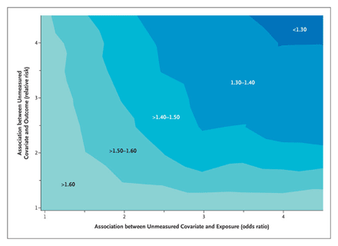
Quantitative assessment of unmeasured confounders
Exposure was deferral of anti-HIV therapy and outcome was death. Observed risk ratio was 1.94.
“The contour plot shows that a confounding factor with a relative risk for death of 4.0 and an odds ratio for deferral of therapy of 4.0 after adjustment for all included variables would reduce the estimated relative risk for deferred therapy to approximately 1.30.”
  Kitahata et al. NEJM 2009
Notes:
Here is more recent example that the Course Directors was involved with in the NEJM where the research group showed a contour plot looking at various scenarios for unmeasured confounding and how much this might influence our findings. In this approach, we showed how adjustment for different combinations of would-be confounder/exposure and would-be confounder/outcome relationships would alter the observed relationship. In other words, if the confounder did exist and we controlled for it, how would our answer change.

Slide 81
Quantitative Bias Analysis
Our teaching of selection, measurement, and confounding bias has mainly been qualitative
Frontier of epidemiologic methods is quantitative bias analysis
  Selection bias: use estimates of selection probabilities to back-calculate to truth
  Measurement bias: use estimates of misclassification to back-calculate to truth
  Confounding: How would results change in presence of certain confounding factors of a given prevalence and strength of association with exposure and outcome?
See Stata “episens” user created ado file
Notes:
In this course, our discussion of selection bias, measurement bias, and confounding bias has mainly been qualitative. We have attempted to state the direction of the bias in the face of certain biases but not the magnitude. The one exception has been a few items on the problem sets where we gave you the opportunity to back calculate to the truth in the face of measurement bias – the cell phone problme and the regression dilution bias problem.
Qualitative bias analysis is the current standard approach, but we do want everyone to know that quantitative bias analysis is what is on the frontier of methodologic research. Specifically, for selection bias one can use estimates of the differential selection probabilities to back calculate to the truth. For measurement bias, one can use estimates of the measurement parameters (or ranges) and back-calculate to the truth. And for confounding bias, one can determine how much the results would change if we controlled for a confounder of a given prevalence and strength of association with exposure and disease.
Within the next 10 years, these techniques will become more commonly used as the software to implement them improves. One such early software program is the user created ado file called “episens”, which we used in the Measurement Bias Problem Set.

Slide 82
Methods to Manage Confounding
During study design:
  Conditioning techniques
    Restriction
    Matching -- with stratification
  Non-Conditioning techniques
    Randomization
    Instrumental variables
During study analysis:
  Conditioning techniques
    Stratification
    (Mathematical regression)
    (Propensity scores)
  Non-conditioning techniques
    (Inverse probability weighting)
    (G-estimation)
    (Structural nested models)
    (Nested new user cohort)
(not explained in this course)
Notes:
Here is a summary of all of the techniques we have mentioned to manage confonding. The techniques in the parentheses were not explained in this course.

Slide 83
Limitation of Conventional Regression (as well as Stratification)
Scenario: Mediation Analysis
  e.g., Estimating effect of E on D apart from effect on M
C
M
E
D
?
Our instinct is to condition on M to get direct effect of E on D apart from M
Yet, M is a collider.
Simultaneous desire to control for C to block non-causal collider bias; and NOT to control for C because it is part of the effect apart from M
Instead, a non-conditioning method needed
Notes:
Here is another scenario where the conditioning approaches of stratification or mathematical regression will fail to give unbiased answers. It is a scenario in which we wish to perform a mediation analysis. Let’s say we want to determine the effect of E on D apart from its effects via the mediator M. An example would be a where we are interested in the causal effect of smoking (E) on the occurrence of heart attack (D) apart from its effect on atherosclerosis (M). Perhaps smoking causes heart attack by some of type of vasospasm or altering of platelet function. Let’s also say that blood pressure (C) is a cause of atherosclerosis and heart attack, and let us say that smoking causally influences blood pressure. When we go about this analysis and condition on M to block that indirect path mediated by M, we note that M is also a collider. Conditioning on a collider produces selection bias (also known as collider-stratification bias). While we might be tempted to control for C to undue this collider bias, we also recognize that C is part of another path to D that is apart from M. Conditioning on C will block that path and underestimate the effect of E on D apart from M.
So, there is a simultaneous desire to condition on C (to block the non-causal path) and not condition on C (to keep the causal path open). Again, as we saw for the situation of time-dependent confounding/mediation, some other technique, something other than the conditioning techniques we have discussed, is needed. We need a non-conditioning technique such as inverse probability weighting or “g-estimation”.
Hence, we have described two scenarios where both stratification and regression won’t work and other “newer” methods needed. The recognition that the older conventional techniques don’t work in this situation is part of the genesis of the so-called “causal inference” era or “causal” methods.

Slide 84
Regression is ahead but don’t forget about the simple techniques …..
“Because of the increased ease and availability of computer software, the last few years have seen a flourishing of the use of multivariate analysis in the biomedical literature. These highly sophisticated mathematic models, however, rarely eliminate the need to examine carefully the raw data by means of scatter diagrams, simple n x k table, and stratified analyses.” Szklo and Nieto 2007
“The widespread availability and user-friendly nature of computer software make the method accessible to some data analysts who may not have had adequate instruction in its appropriate applications. When they are misapplied, multivariate techniques have the potential to contribute to incorrect model development, misleading results, and inappropriate interpretation of the effect of hypothesized confounders.” Friis and Sellers, 2009
Notes:
Let me end with the following plea. Although we are building towards a crescendo which is calling for sophisticated regression techniques, don’t forget about the simple techniques, like stratification, when exploring your data.
Here are a few diplomatic quotes echoing this.

