Slide 1
Spatial Regression part 2

Slide 2
INLA
Fairly recent alternative to MCMC proposed for certain Bayesian models
Integrated Nested Laplace Approximation (INLA)
Uses an approximation to the posterior distribution
Computationally far quicker than MCMC!
Useful for simpler models and large data sets

Slide 3

Website http://www.r-inla.org/

Slide 4
Installation of R-INLA
The INLA package for R
All the procedures needed to perform INLA are implemented in the
R-INLA package
To install the package, type the following command line in R
source("http://www.math.ntnu.no/inla/givemeINLA.R")
To load the package in R library(INLA)

Slide 5
INLA for areal models
To use maps in INLA you must have mapfile set up by INLA in correct format
Get polygons into R using readShapePoly
Use spdep library to create adjacency map file
Scot_nb<-poly2nb(scot_LL)
nb_scot<-nb2INLA(file="Scot_nb.adj",Scot_nb)

Slide 6
INLA code
library (INLA)
“BYM” model stands for “Besag, York and Mollie”
Uncorrelated (UH) + Correlated (CH) heterogeneity
formula.bym<-Observed ~ 1 + PcAFF + f(ID,model="bym",graph="Scot_nb.adj")
model.inla<-inla(formula.bym,family="poisson",data=data,control.compute=list(dic=T,graph=T),
E=Expected)

Slide 7
Formula call
formula.bym<-Observed ~ 1 + PcAFF + f(ID,model="bym",graph="Scot_nb.adj")
This call sets up model formula (like glm)
Dependent variable “Observed” is related to “ID” through a model with UH and CH components (‘iid’ and ‘Besag’)
Uses the Scot_nd.adj adjacency matrix
f(…) function can be very general…including linear functions of covariates, temporal autoregressive parameters, splines, etc

Slide 8
Other functions
UH only
  f(ID, model =‘iid”)
CH only
  f(ID,model=“besag”,graph=“Scot_nb.adj”)

Slide 9
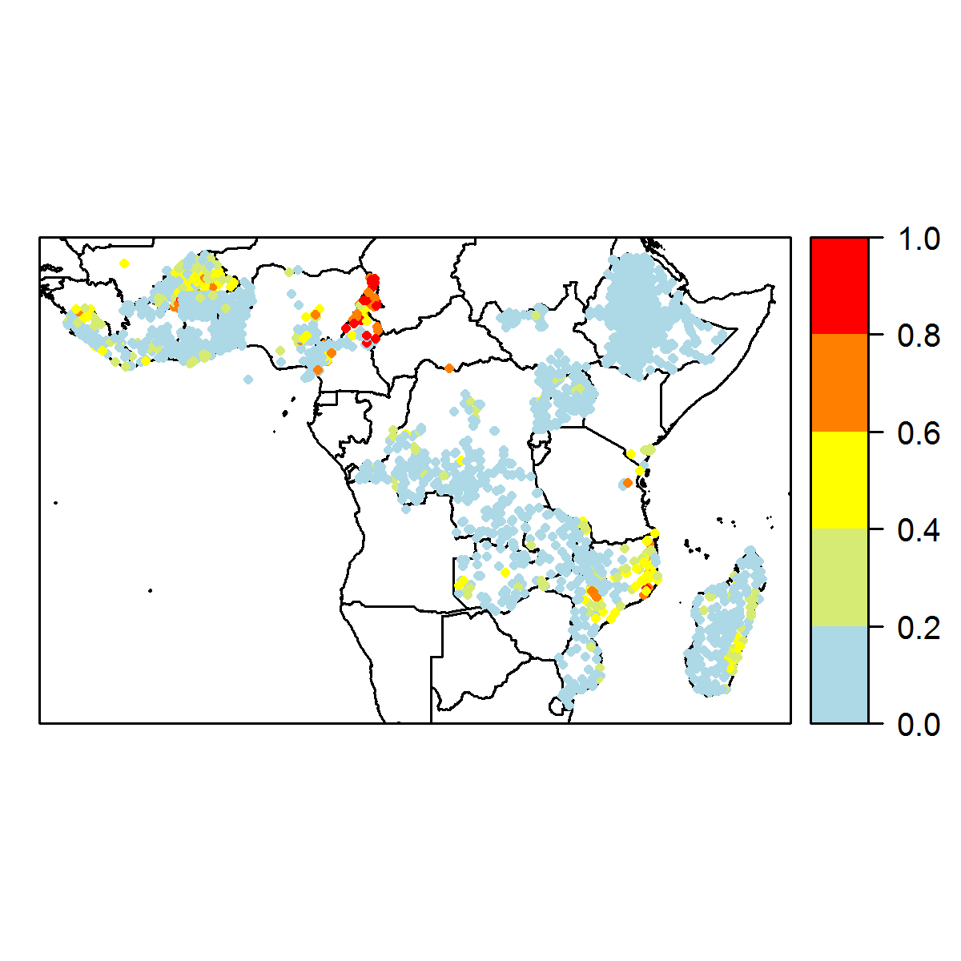
Geostatistical data
The disease risk is a spatially continuous phenomenon but it is measured only at particular sites
Example: lymphatic filariasis prevalence obtained from surveys conducted at several villages
We want to predict the disease risk at unobserved locations and construct a spatially continuous risk surface

Slide 10
Risk mapping
http://www.map.ox.ac.uk/

Slide 11
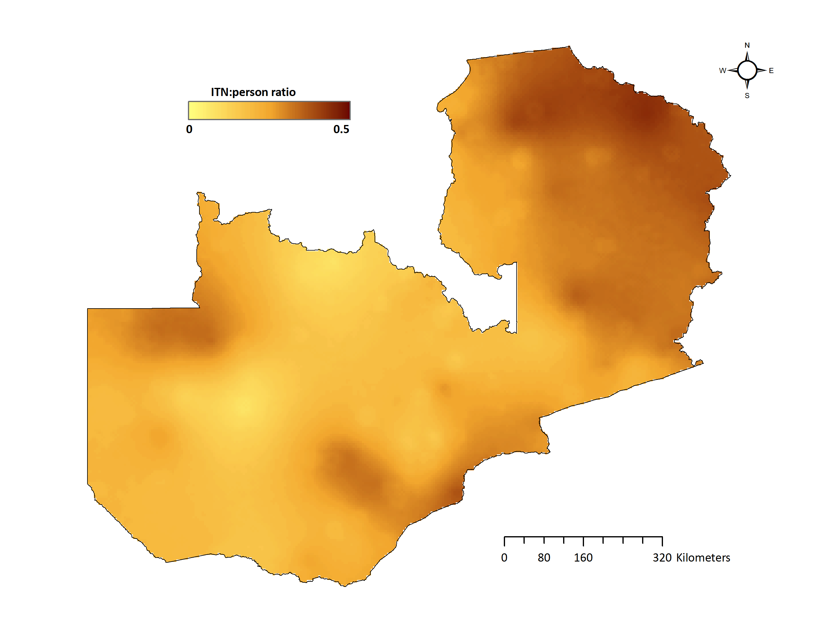
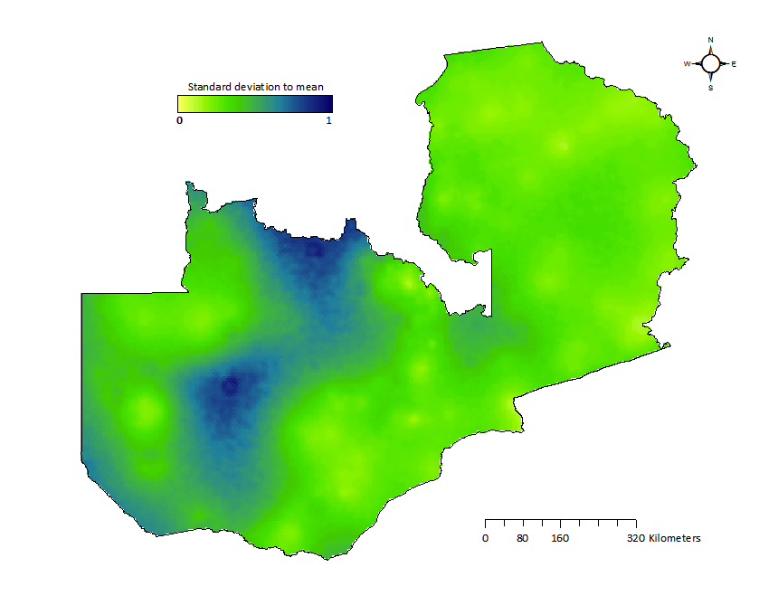
Mapping uncertainty

Slide 12
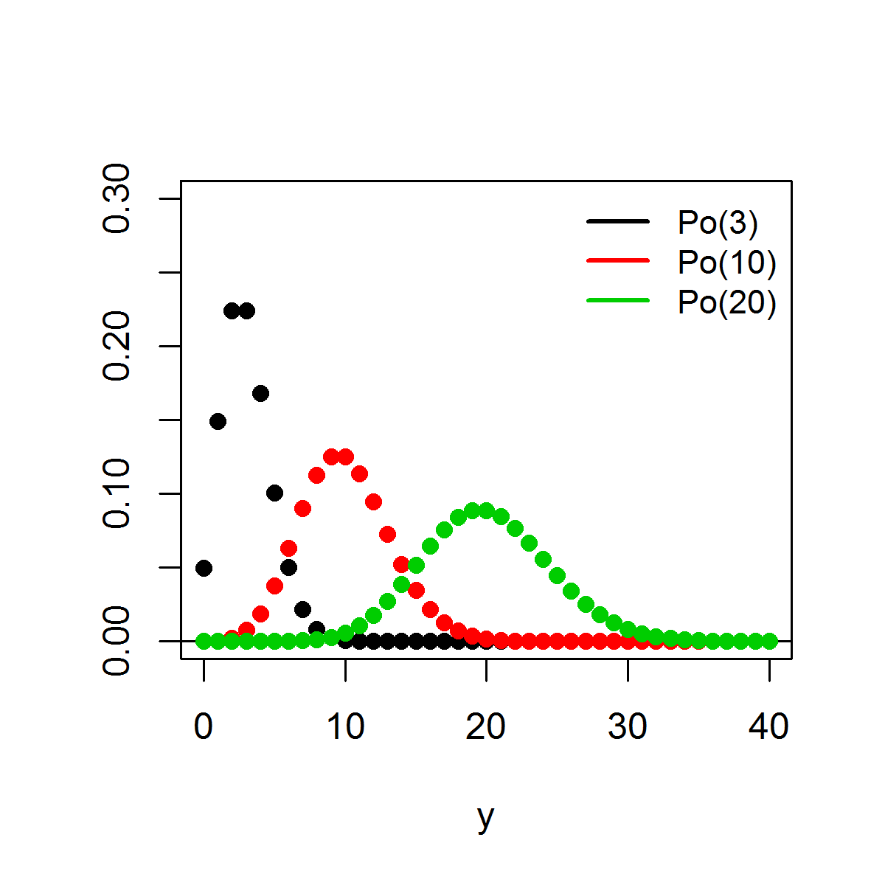
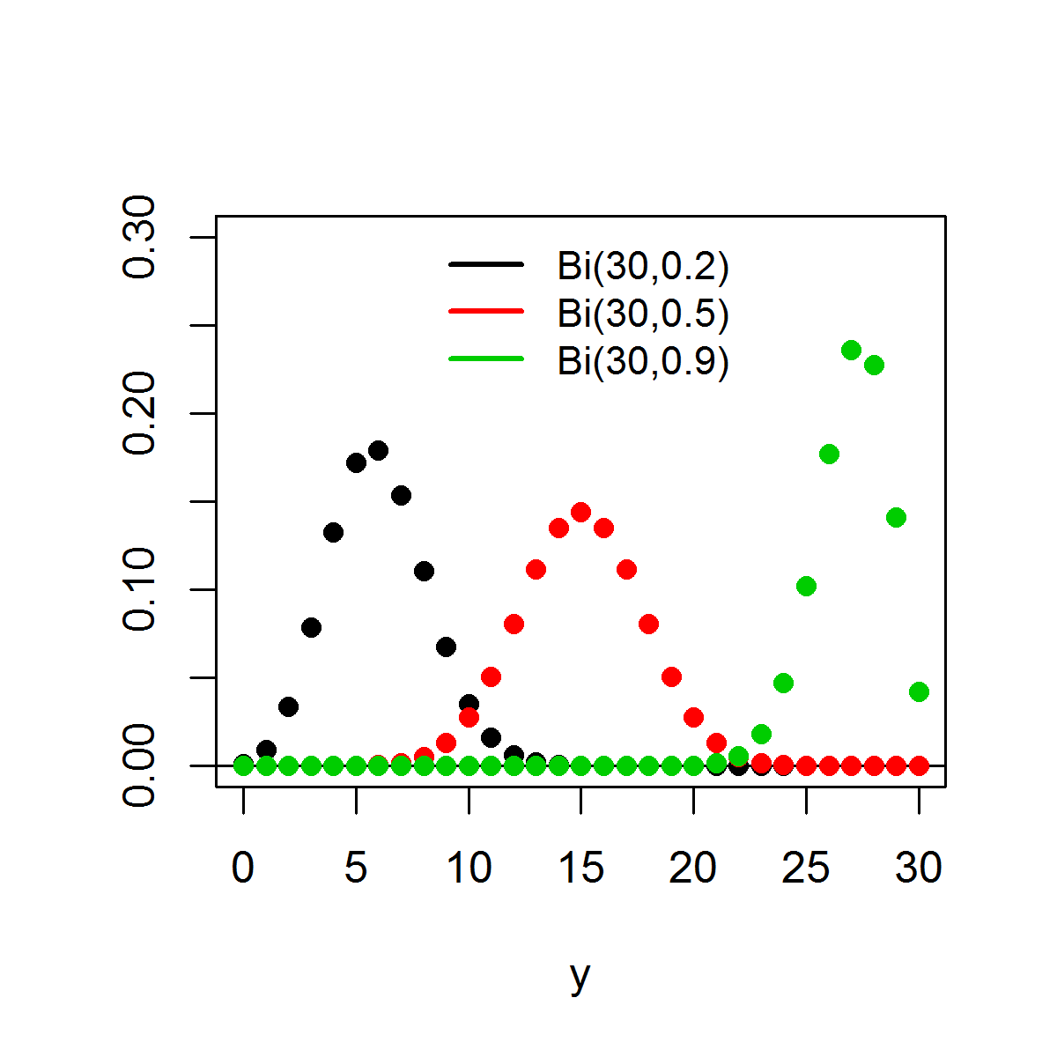
Distributions
Poisson distribution
Y ∼ Poisson(µ) y = 0, 1, 2, . . .
expected number of occurrences µ > 0
Binomial distribution Y ∼ Binomial (n, π) y = 0, 1, . . . , n
number of trials n ∈ {1, 2, . . .}, probability of success π ∈ [0, 1]
p(y|µ) =
e
−µ_{µ}y
n y (n−y )
y !
p(y|n, π) = π (1 − π)
y
E (Y ) = µ, Var (Y ) = µ
E (Y ) = nπ, Var (Y ) = nπ(1 − π)

Slide 13









Regression models
Log-linear model
Logistic model
Y_{i} ∼ Po(µ_{i} ), i = 1, . . . , n
log(µ_{i} ) = α + βx_{i}
For a one unit increase in x , the mean increases by a factor of exp(β) (holding all other covariates constant)
Y_{i} ∼ Binomial (n_{i} , π_{i} ), i = 1, . . . , n
logit(π_{i} ) = α + βx_{i}
log-odds: logit(π_{i} ) = log ^{( πi \}
1−π_{i}
π_{i} = logit⁻¹(α + βx_{i} ) =
exp(α+βx_{i} )
1+exp(α+βx_{i} )
β is the change in the log-odds associated with one-unit increase in the x covariate (holding all other covariates constant)
exp(β) is the odds ratio
π
OR =
1−π
|x =1
π
_{1−π} |x =0
For a one unit increase in x , the odds increase by a factor of exp(β) (holding all other covariates constant)

Slide 14




Model-based geostatistics
Geostatistics is that part of spatial statistics which deals with data obtained by spatially discrete sampling of a spatially continuous process S (·) = {S (x ) : x ∈ A ⊂ R²}
Data consist of measurements Y₁, . . . , Y_{n} taken at locations
x₁, . . . , x_{n} sampled within A, and Y_{i} is a noisy version of S (x_{i} )
Model-based geostatistics is the application of general principles of statistical modelling and inference to geostatistical problems
Prediction problems are based on explicitly declared statistical models for the data. Likelihood-based methods of inference are applied to fit the model and the fitted model is used to make predictions

Slide 15




Prediction problem
Survey data
Sample of individuals in each of a number of villages Test results for a given disease
Explanatory variables
environmental and socio-economic data (elevation, vegetation, temperature, age,...) Objective
Predict local disease prevalence throughout the study region Compute local exceedance probabilities P(prevalence > cutoff)
Formulate a model describing the variability in the response variable as a function of the explanatory variables and a spatial effect to account for the residual spatial autocorrelation that enables spatial prediction in unsampled locations

Slide 16



Model
Distribution for the number of positive results Y_{i} out of N_{i} people sampled conditional on the true prevalence P(x_{i} ) at locations x_{i} ,
Y_{i} |P(x_{i} ) ∼ Binomial(N_{i} , P(x_{i} )),
logit(P(x_{i} )) = z_{i} β + S (x_{i} )
z_{i} = (1, z_{i 1}, . . . , z_{ip} ) vector of the intercept and covariates
β = (β₀, β₁, . . . , β_{p} )^{t} coefficient vector
Fixed effects quantify the effects of the covariates on the disease
S (·) is a zero-mean Gaussian process with
Var [S (x )] = σ² and ρ(u) = Corr [S (x_{i} ), S (x_{j} )], u = ||x_{i} − x_{j} ||
Correlation functions: Mat´ern, Powered exponential, Spherical families
Random effects represent residual spatial variation which is not
explained by the available covariates

Slide 17
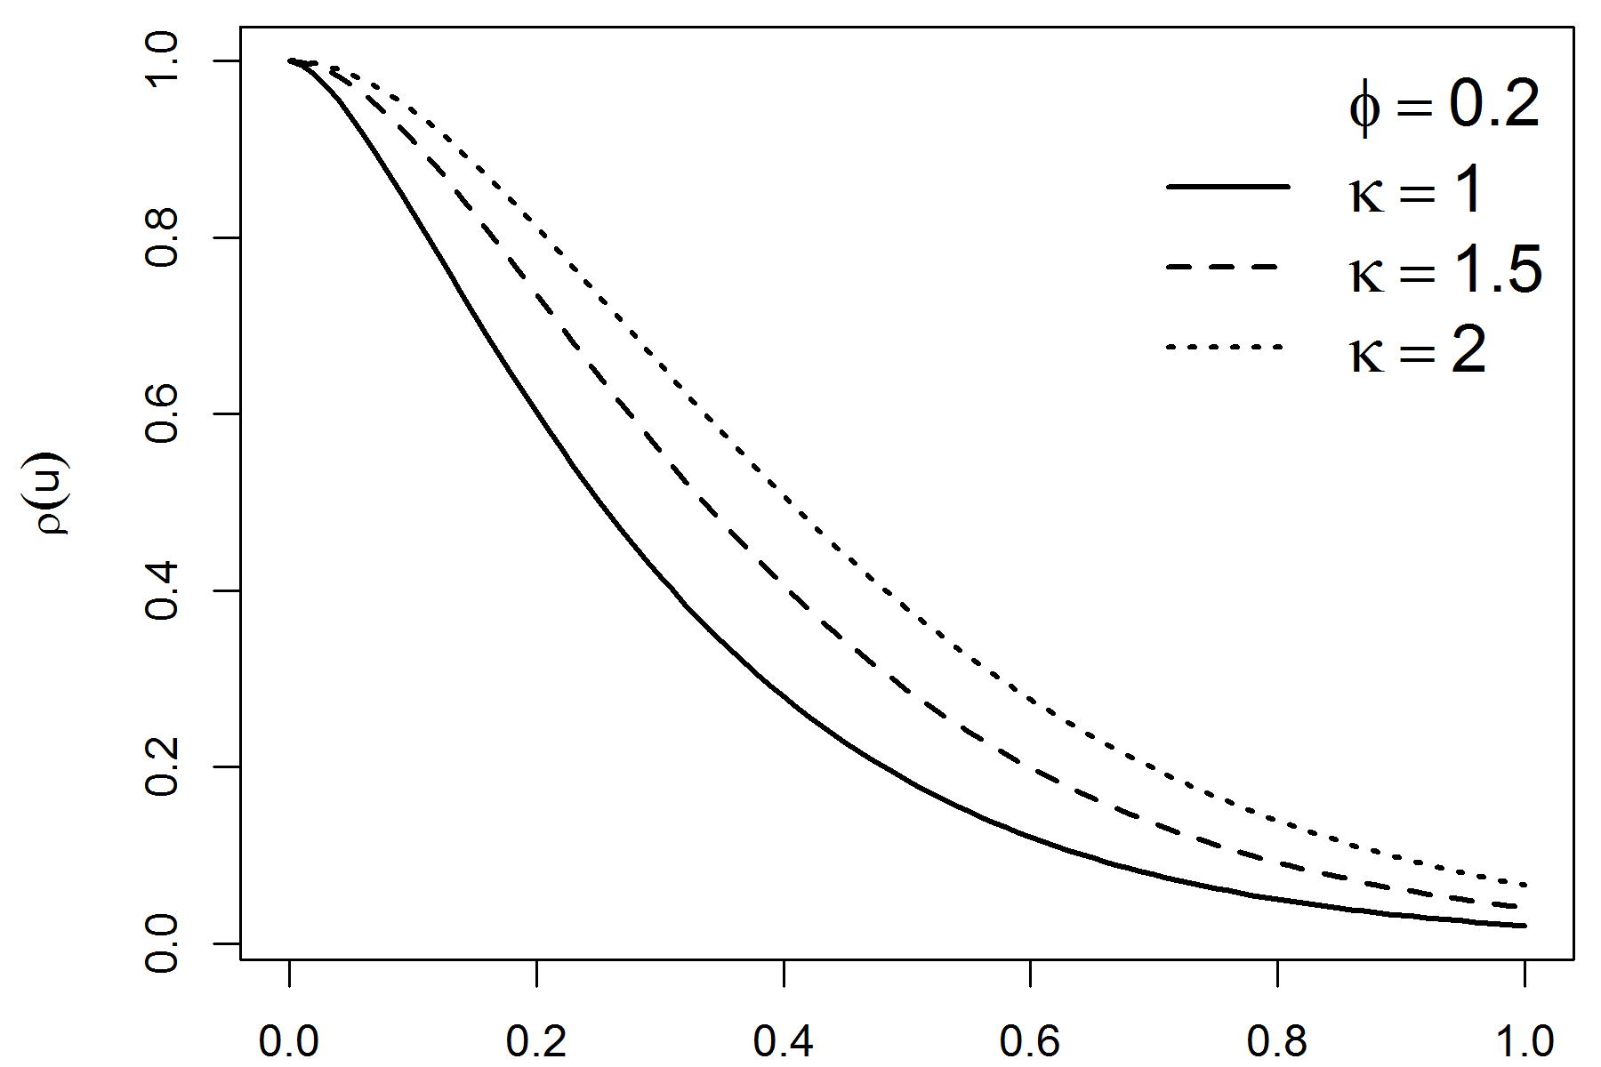
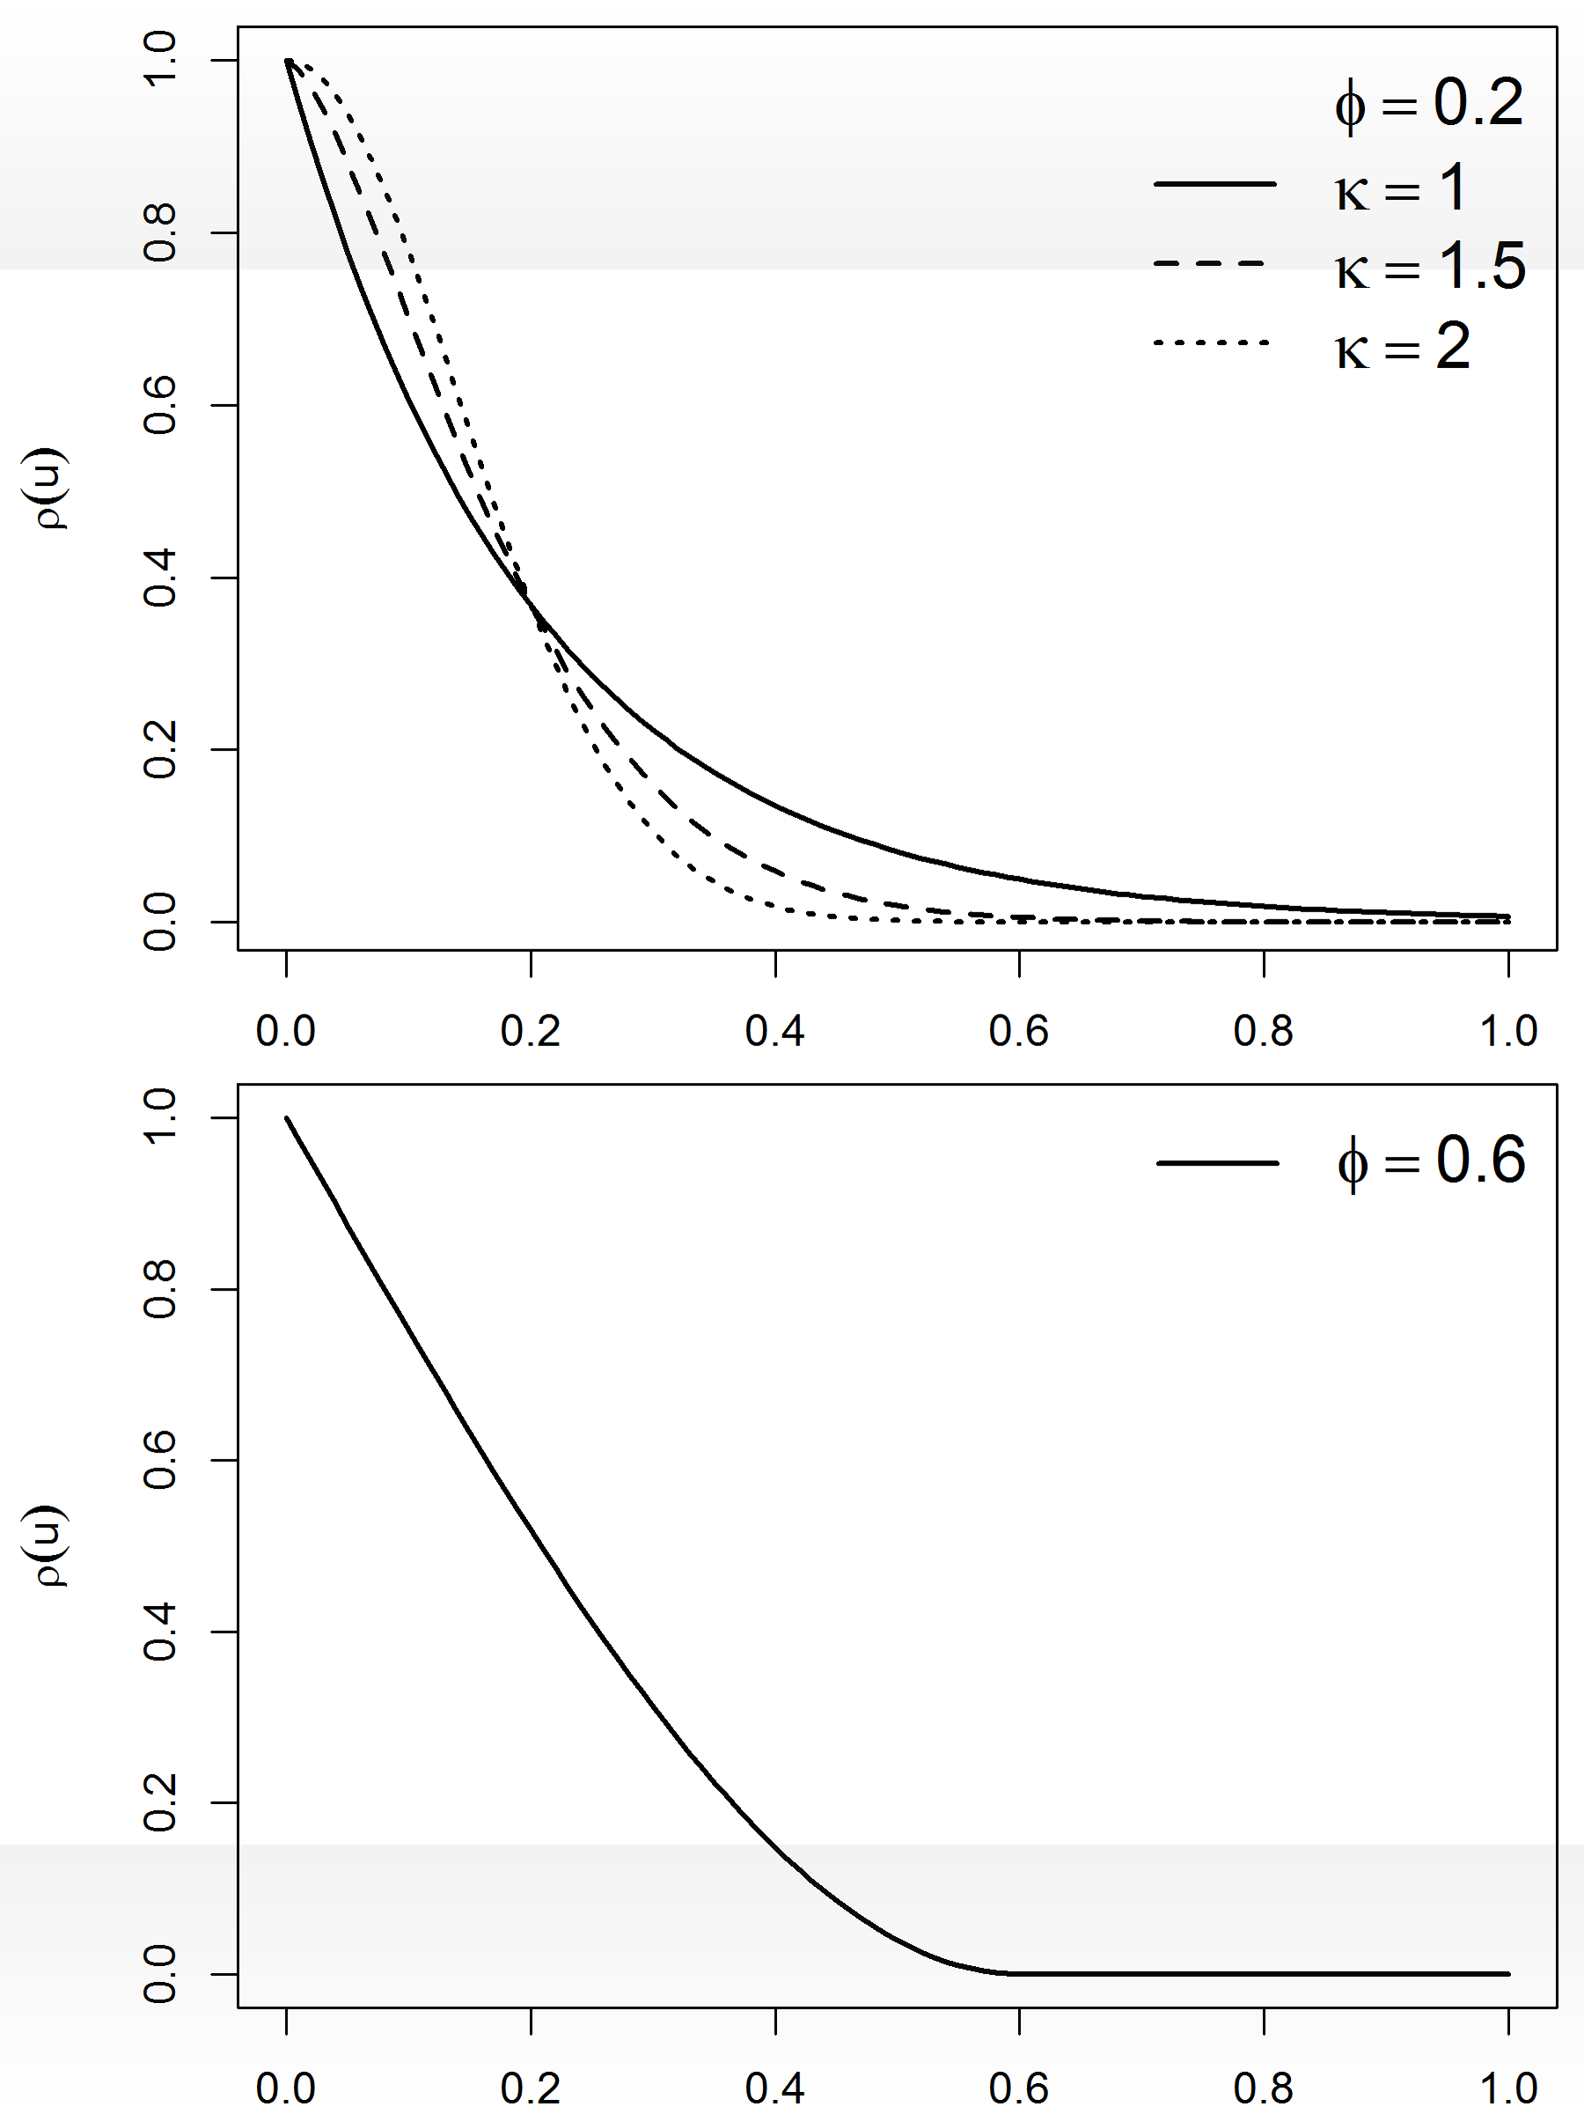

Correlation functions
Mat´ern family
1
ρ(u) = (u/φ)^{κ} Kκ (u/φ)
2^{κ−1} Γ(κ)
φ > 0 scale, κ > 0 order, Kκ (·) modified Bessel function of order κ
Exponential: ρ(u) = exp(−u/φ) (κ = 0.5)
Gaussian: ρ(u) = exp (−(u/φ)² ) (κ → ∞)
S (·) is Iκ − 1 times mean-square differentiable
Powered exponential family
ρ(u) = exp ⁽− (u/φ)^{κ )}
φ > 0 scale, 0 < κ ≤ 2 shape
if κ < 2, S (·) mean-square continuous but not mean-square differentiable if κ = 2, S (·) infinitely mean-square differentiable
Spherical family
⁽ 1 − ³ (u/φ) + ¹ (u/φ)³ : 0 ≤ u ≤ φ
ρ(u) =
2 2
0 : u > φ
φ > 0 single parameter
It has finite range, i.e. ρ(u) = 0 for sufficiently large u, namely u > φ ρ(u) is only once differentiable at u = φ

Slide 18



Example: Model
Conditional on the true prevalence P(x_{i} ) at location x_{i} , i = 1, . . . , n, the number of positive results Y_{i} out of N_{i} people sampled at x_{i} follows a binomial distribution,
Y_{i} |P(x_{i} ) ∼ Binomial(N_{i} , P(x_{i} )) logit(P(x_{i} )) = z_{i} β + S (x_{i} )
z_{i} = (1, z_{i 1}, . . . , z_{ip} ) vector of the intercept and the p covariates
β = (β₀, β₁, . . . , β_{p} )^{t} coefficient vector
S (x_{i} ) spatially structured random effect
S (x_{i} ) zero-mean Gaussian process with covariance function

Slide 19



Example: The Beta-Binomial model
Let Y be the number of successes in n independent trials
Y ∼ Binomial (n, π)
We wish to estimate π
Prior distribution for π:
p(π) = Beta(α, β) Posterior distribution for π:
p(π|y ) ∝ p(y|π)p(π)
= Binomial (n, π) × Beta(α, β)
= Beta(α + y, β + n − y )

Slide 20
WinBUGS modeling of point prevalence data
Can be modeled as binomial or bernoulli
positives[i]~dbin(p[i], examined[i])
positive[i]~dbern(p[i])
logit(p[i])<-alpha + beta + …..

Slide 21
WinBUGs modeling of point prevalence data
Uses spatial.exp argument to model spatial random effects
#spatial effects
w[1:N]~spatial.exp(mu1[],longitude[],latitude[],tau.sp,phi,1)
Need latitude and longitude at each survey location
tau.sp is spatial ‘precision’ (inverse of variance)
phi is modeled estimate of spatial decay
“range” of spatial decay is roughly 3/phi

Slide 22
Validation
Mean absolute error (MAE)
  Mean of (predicted-actual)
Mean percentage error (MPE)
  Mean of (predicted-actual/actual)
Mean absolute percentage error (MAPE)
  Mean of (abs(predicted-actual)/actual))
Root mean square error (RMSE)
  Square root of mean of squared (predicted-actual)

Slide 23
Data
Malaria prevalence data from Burkina Faso
109 villages sampled
Altitude, rainfall, temperature, normalized difference vegetation index (NDVI) potential predictors

Slide 24
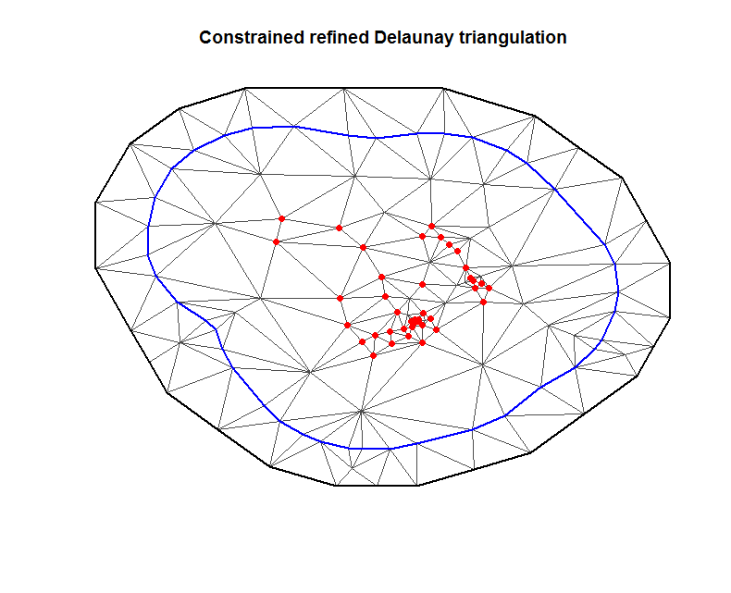
Model fitting using R-INLA
Triangulation to do the random field discretization
bound2 <- inla.nonconvex.hull(as.matrix(cross.data.dfloc[,1:2]), convex=0.5, concave=-0.15)
mesh=inla.mesh.create.helper(as.matrix(cross.data.dfloc[,1:2]),boundary=bound2,offset=c(.1,.2),min.angle=c(15,15),max.edge=c(1,1))
Projector matrix to project the process at the mesh nodes to locations
A.est =inla.spde.make.A(mesh,loc=coords)
A.pred =inla.spde.make.A(mesh,loc=pred_points)
Build the SPDE model on the mesh
spde<-inla.spde2.matern(mesh,alpha=2)

Slide 25
Model fitting using R-INLA
Stack the data
st.b<-inla.stack(data=list(y=cross.data.dfull$positives,n=cross.data.dfull$examined),A=list(A.est,1),
effects=list(i=1:spde$n.spde,data.frame(b0=1,cross.data.dfull)),tag='est')

Slide 26
Call model
res.b<-inla(y ~ 0 + (b0) + distriver + evimay + f(i,model=spde),family="binomial", control.predictor=list(A=inla.stack.A(st.b)),Ntrials=examined,control.compute=list(dic=T),control.fixed=list(expand.factor.strategy="inla"),data=inla.stack.data(st.b))

Slide 27
Summary
exp(res.b$summary.fix)
res.b$dic$dic

Slide 28
Predictions
igr<-inla.stack.index(stk.full,'pred')$data
mean<-res.p$summary.fitted.values[igr,"mean"]
low<-res.p$summary.fitted.values[igr,"0.025quant"]
high<-res.p$summary.fitted.values[igr,"0.975quant"]

