Slide 1

Announcements
Notes:
Friday – 11 am – Laurel Hts

Slide 2


Social Justice Epidemiology

Slide 3
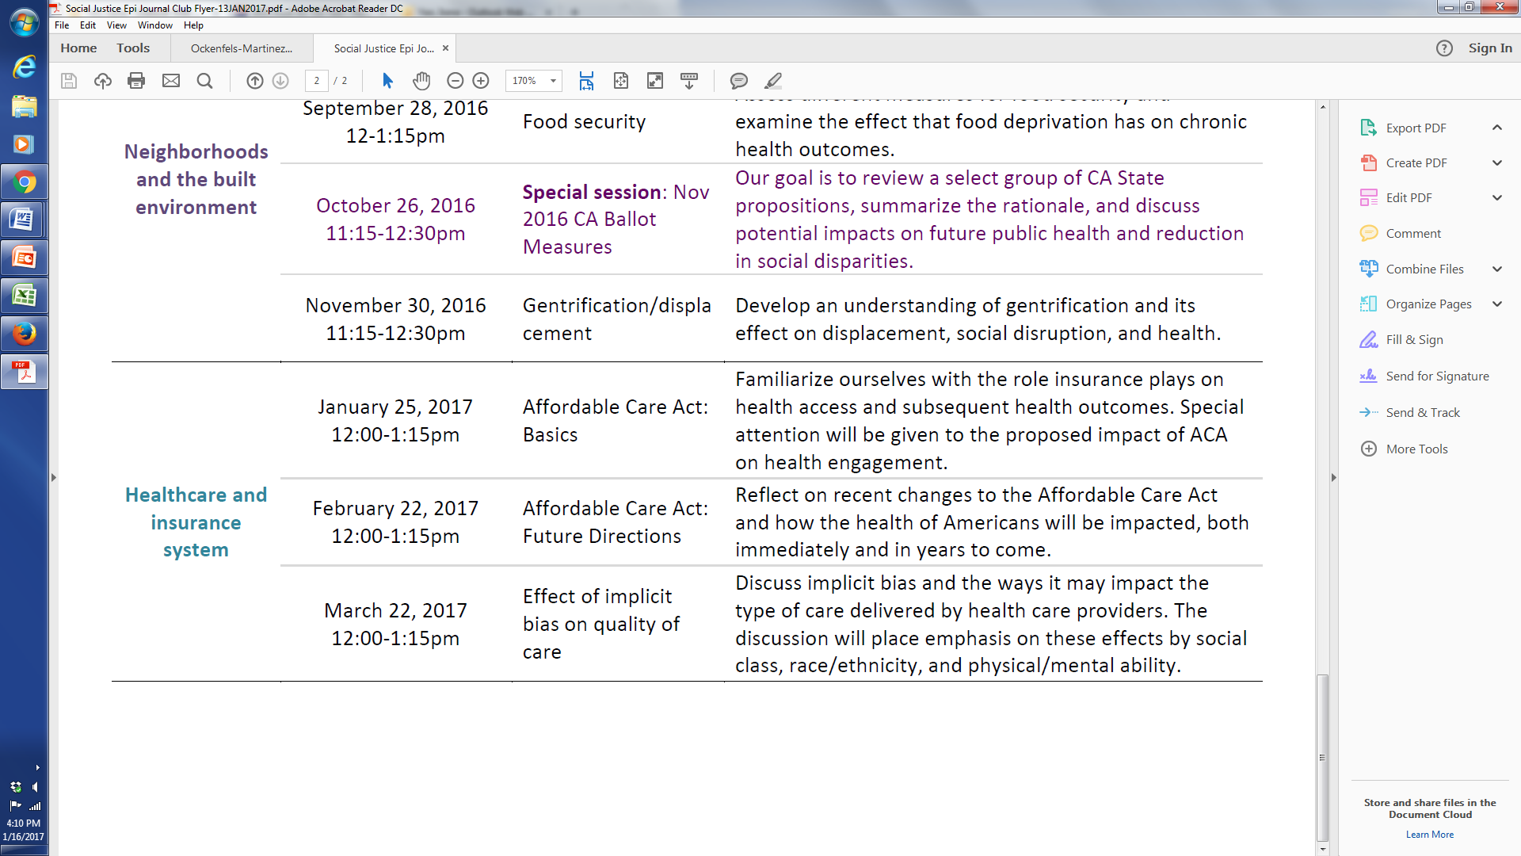

Slide 4
Multi-level Etiologies of Health Disparities:
Pt 1. social determinants
Irene Yen, PhD, MPH
Associate Professor

Slide 5
Housekeeping - units
1 or 2 units:
students to decide how many units will be completed before the 3rd week of term.
If the decision gets made later, a Study List Change petition needs to be submitted ($5 fee).
change period ends in the 7th week of the term.
Notes:
People can switch from 1 unit to 2 unit – by 3rd week of course
What are we struggling with in the field? Challenges that we don’t know a lot of things are causal
Job strain is controversial – mixed whether it’s causal or not – quasi experimental – plant changes and how they organize the plant
This is where the science is
These are the challenges and we take them seriously.
How do we move from associational studies to causal studies
We are at different places with research on these different factors. We are regularly challenged when we can’t do RCT’s with these.
MPO example

Slide 6
Questions?

Slide 7

Importance of social factors
in any research
Notes:
FRAME - Why should we care if we’re not doing health disparities research?
Having the big picture matters.
Make methodological pts – if you’re collecting your own data or working on data collected by someone else vs setting out to collect your own

Slide 8
Objectives
Review multi-level conceptual approach
Social determinants – multiple examples
  Socioeconomic status, socioeconomic position
  Race / ethnicity, racism
  Neighborhood and place
How to study

Slide 9
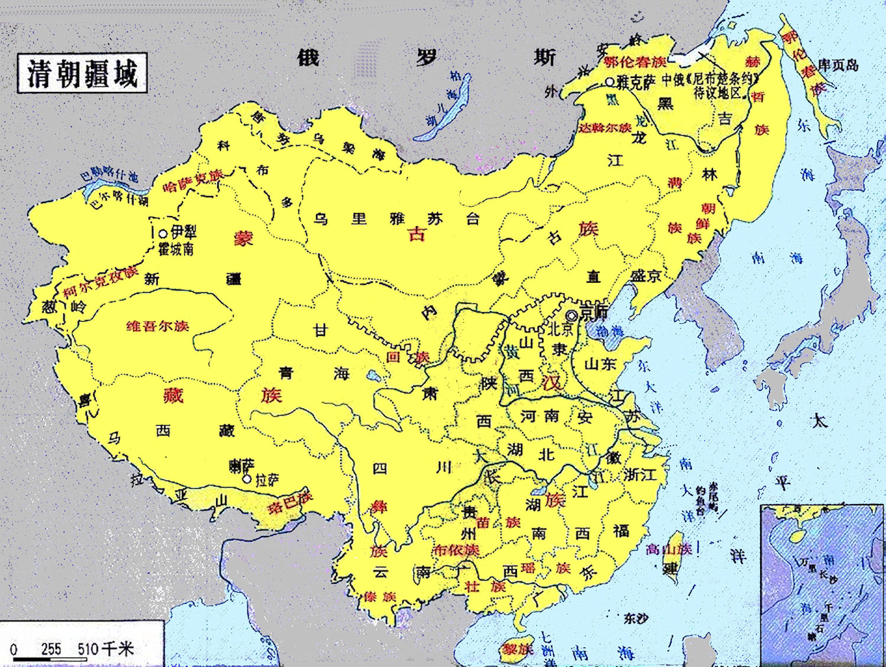

Slide 10
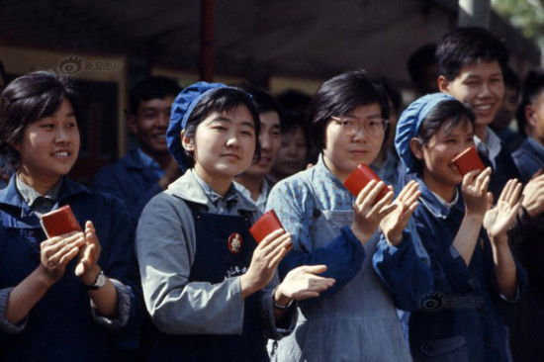

Slide 11
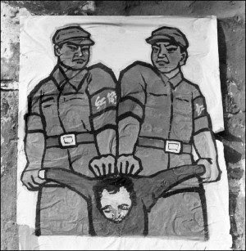

Slide 12
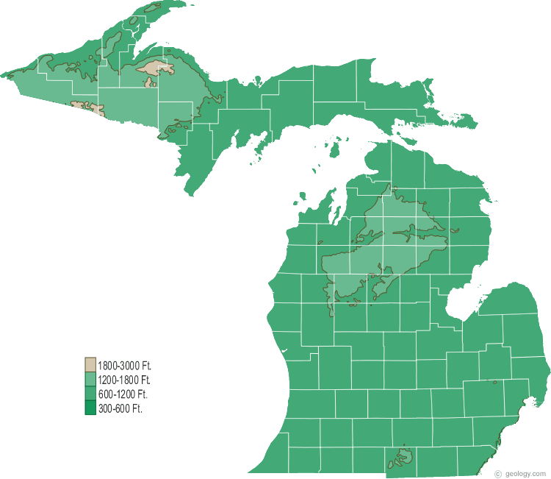

Slide 13
Fundamental Cause
Influences multiple disease outcomes;
Affects disease thru multiple risk factors;
Involves access to resources that can assist in minimizing risk once the disease occurs;
Reproduced over time

Slide 14
Improving health & reducing disparities by addressing the role of social factors
Economic & Social
Opportunities and Resources
Living & Working Conditions
in Homes and Communities
Behaviors
Medical Care
Interaction with genetic/other biological factors
HEALTH
Adapted from Braveman et al., for Robert Wood Johnson Foundation Commission to Build a Healthier America | www.commissiononhealth.org
Notes:
Paradigm – positivism, dialectism – how we think about and study truth
Methodology – ways of thinking about methods
Methods – procedures – data collection

Slide 15
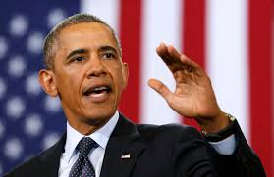


Social status
“the relative rank that an individual holds, with attendant rights, duties, and lifestyle, in a social hierarchy based upon honor or prestige.”
www.brittannica.com
“relations of ownership or control over productive resources (i.e. physical, financial and organizational).”
WHO Social Determinants of Health

Slide 16
Socioeconomic position
“… the social and economic factors that influence what positions individuals or groups hold within the structure of a society”
Galobardes et al 2006

Slide 17
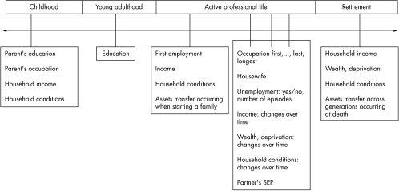
Galobardes et al 2006

Slide 18
SES Across The Lifecourse:
Adult income
Latency/critical period model:
Exposure during sensitive window puts one at risk for development of disease later in life. Exposures encountered after the critical window closes do not influence risk. Focus on early life experiences that do not have a cumulative effect.
Older Age Health
Education
Cognitive
experiences
Knowledge
Credential
Social ties
Adult occupation
Notes:
so then we ask is every episode of poverty adding to the harm done to the child, or is it really poverty ages 3-5? In other words, is it important to make really special efforts to protect children at particular ages from adversity? Conversely, if the child lives in poverty ages 3-5 can it still be "undone" by good contexts in later life? Probably cognitive development is the place where the evidence is strongest, and the Romanian Orphan study has nice examples, showing distinct sensitive periods for cognitive and socioemotional development.

Slide 19
SES Across The Lifecourse:
Trajectory
Stability
Wealth
Adult income
Social trajectory model:
Social disadvantage increases risk of future disadvantage later in life. The initial insult does not necessarily have a harmful effect on the outcome – but the first exposure leads to subsequent exposures that then directly cause the outcome.
Old Age Health
Education
Adult occupation
Class
Prestige
Job content

Slide 20
Childhood SES is associated with adult health
Nurses Health Study:
Parental education is associated with the self-rated health of their adult children, after taking into consideration current SES (highest year of schooling, total household income, total net worth)
[Moody-Ayers, et al. 2007]
Health and Retirement Survey:
Parental occupation is associated with cardiovascular disease in middle age, after taking into consideration current SES (highest year of schooling)
[Gliksman et al. 1995]

Slide 21
Childhood SES is associated with adult health
Regression models – physical functioning
Beta coefficients
Model 1 | + father’s SES | + adult SES | + father’s SES, adult SES
Two parents 6.48*
Age started working -4.89* | * | *** | *
Perception importance educ 6.48*** | ** | ** | **
Extracurr Activities HS
Adult discourage -1.06* | * | * | *
* P <0.05; ** p < 0.01; *** p <0.0001
Yen et al 2013

Slide 22
Results - summary
Raised by two parents, perception of importance of education are positively associated with perceived health and physical functioning
Age began working is negatively associated with perceived health and physical functioning
Discouragement by adults is negatively associated with physical functioning
Associations remain after adjustment for parental and adult SES (except for two parents)
Yen et al 2013

Slide 23

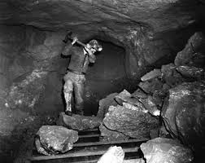
Employment and working conditions
Occupational classification
  Current
  Longest lasting
Employed vs. not

Slide 24
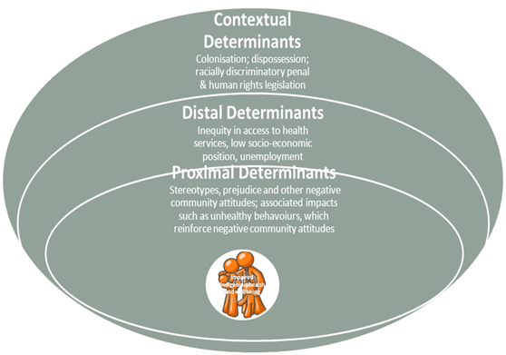

Slide 25
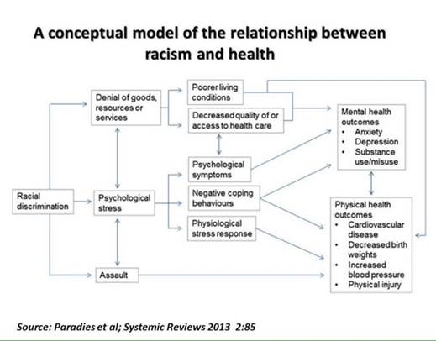

Slide 26
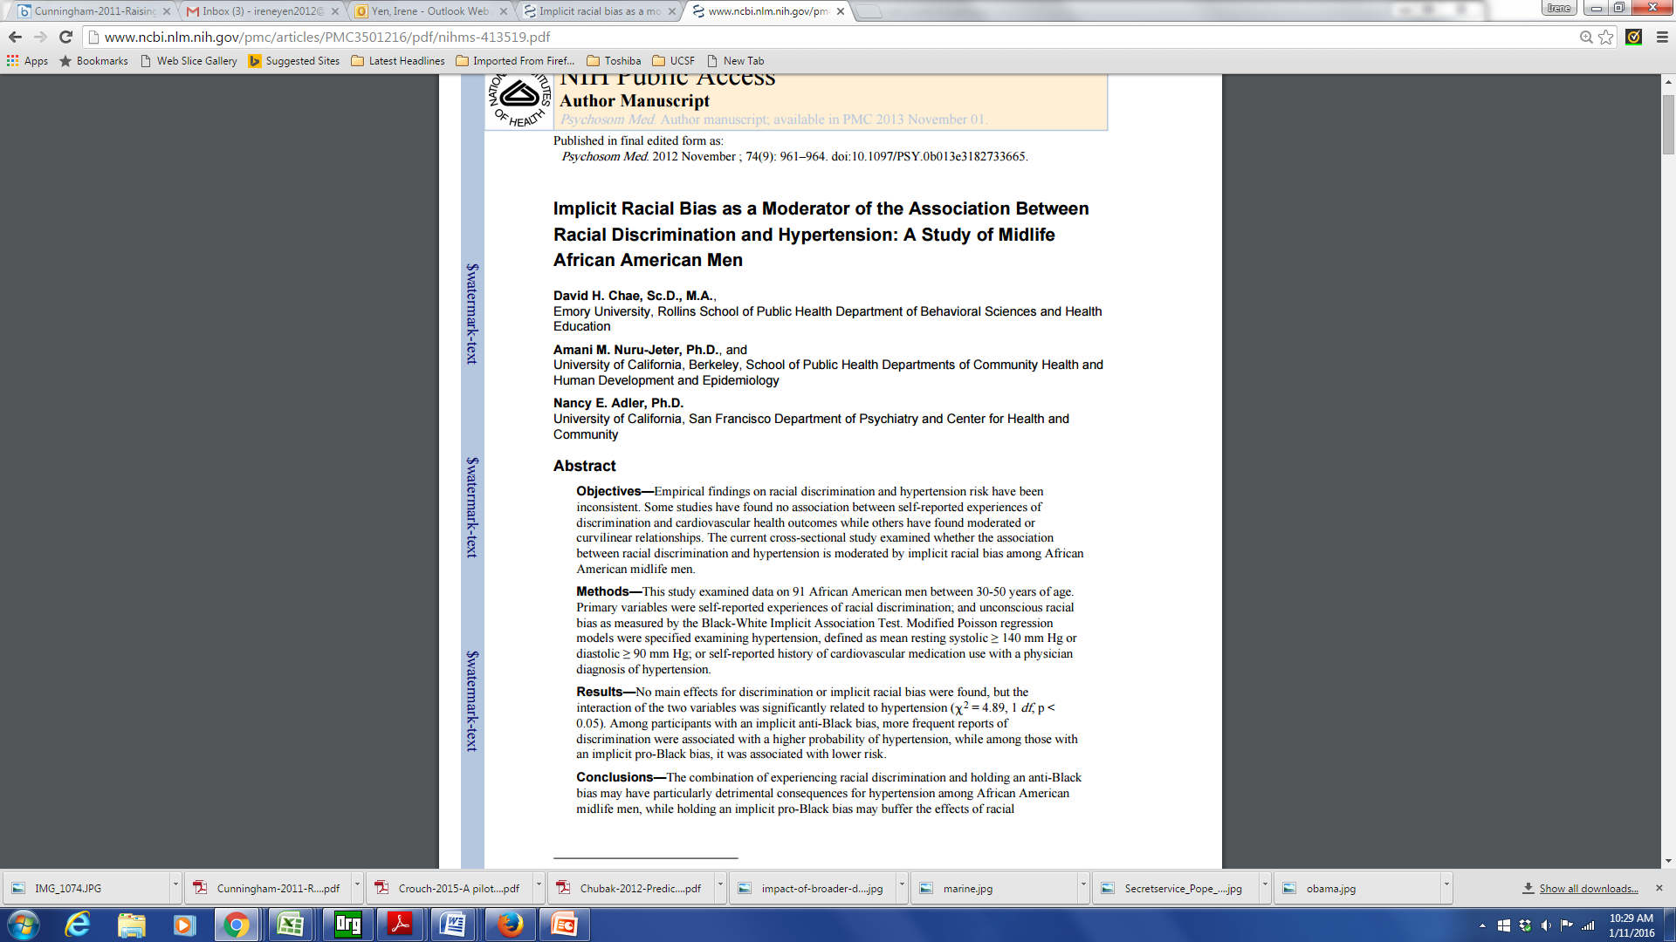
Internalized Racism

Slide 27
Internalized Racism
Implicit association test used to measure implicit (unconscious) racial bias
Among black men with anti-black bias, experiences of discrimination associated with hypertension
  Those with a pro-black bias had lower dx of hypertension

Slide 28
Race / Ethnicity
Unfair treatment
Discrimination
In your day-to-day life, how often do any of the following things happen to you?
1. You are treated with less courtesy than other people are.
You are treated with less respect than other people are.
You receive poorer service than other people at restaurants or stores.
People act as if they think you are not smart.
People act as if they are afraid of you.
Have you ever been unfairly treated in the following six domains (Yes/No):
fired or denied a promotion
not hired for a job
treated unfairly by the police
discouraged by a teacher from continuing education
prevented from moving into a neighborhood
neighbors have made their life difficult.

Slide 29
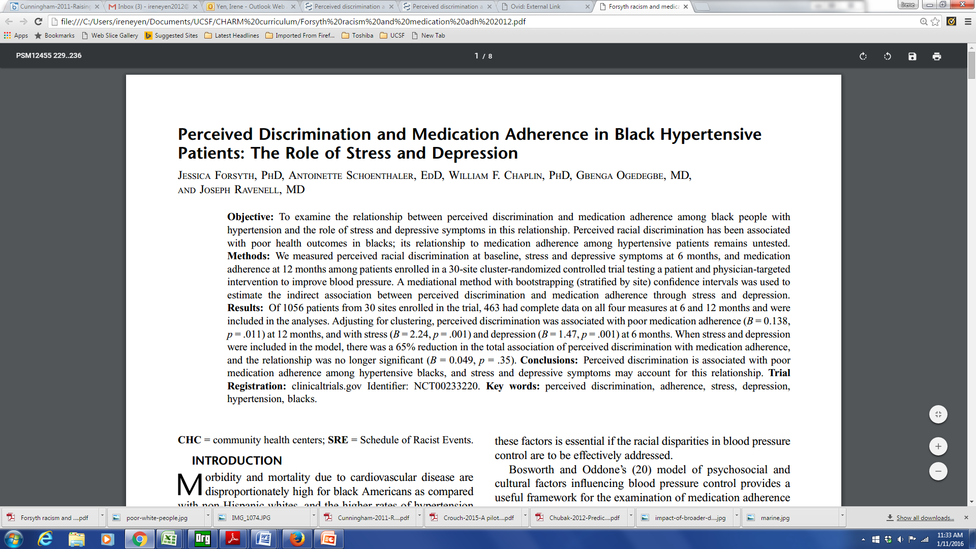
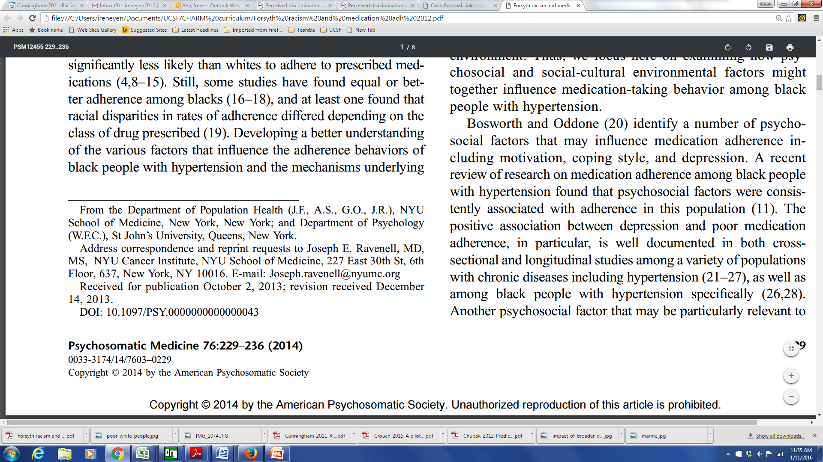

Slide 30
Racism and Medication Adherence
Perceived racial discrimination measured among patients enrolled in a 30-site cluster-randomized controlled trial
A mediational method was used to estimate the indirect association between perceived discrimination and medication adherence through stress and depression
Perceived discrimination was associated with poor medication adherence, and was mediated by stress and depression
Notes:
Racism
Pt’s experience racism
Medical mistrust
Research on the outcomes / prognosis of people with a condition – as contrasted with the incidence

Slide 31
Hypersegregation
Segregation highest for African Americans
Characterized by not only by racial segregation, but also socioeconomic segregation
Socioeconomic segregation does not account for racial/ethnic segregation
Related to discrimination in housing/ mortgage markets

Slide 32
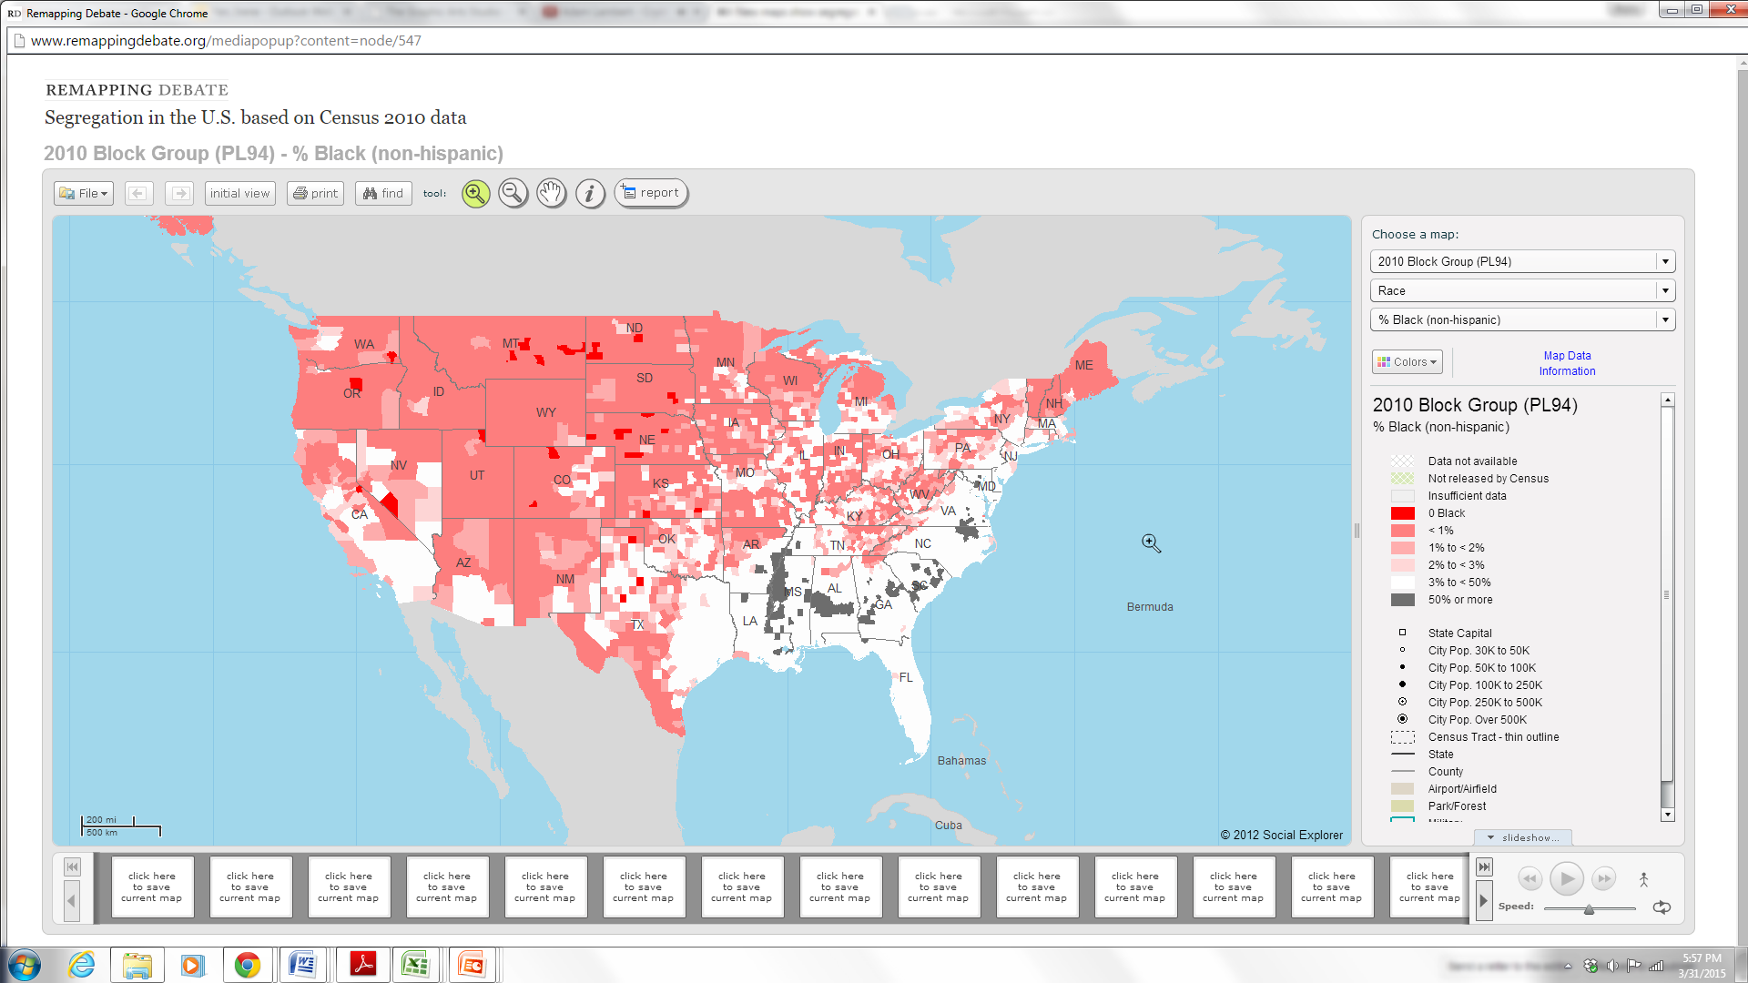

Slide 33
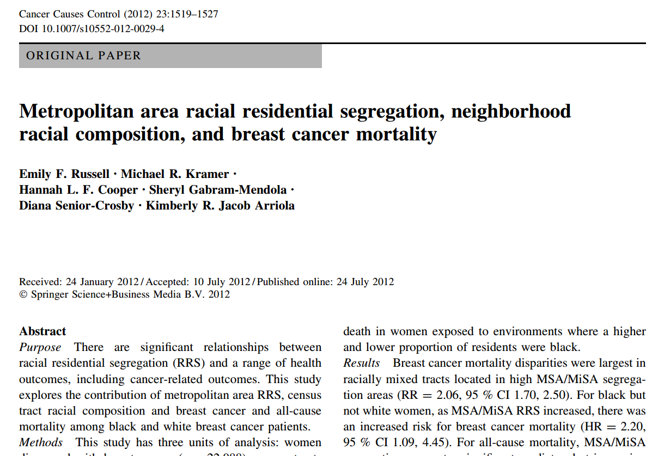

Slide 34
Social Determinants of Health II
Stressors / Stress
Housing
Neighborhood
Transportation
Incarceration
Notes:
Map to the socioecologic model

Slide 35
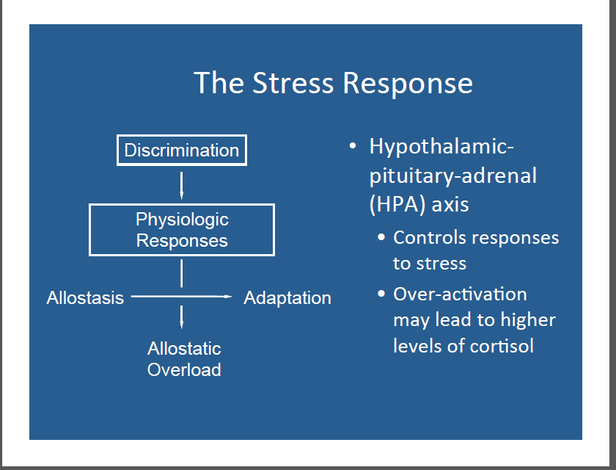

Slide 36
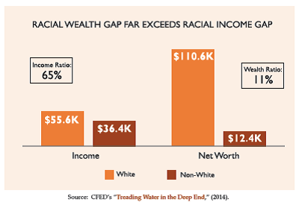
Notes:
African-Americans are twice as likely to be liquid asset poor as white households. This lack of savings corresponds with overall lower wealth and assets. Corporation for Enterprise Development (CFED) found that households of color have approximately one-tenth the median net worth (assets minus debt) of white households ($12,377 and $110,637, respectively).
The racial wealth gap is growing. According to research by the Urban Institute, the wealth gap has doubled in the past few decades. In 1983, the average wealth of white families was $230,000 higher than the average wealth of African-American and Hispanic families; in 2010, it has increased to over $500,000.

Slide 37
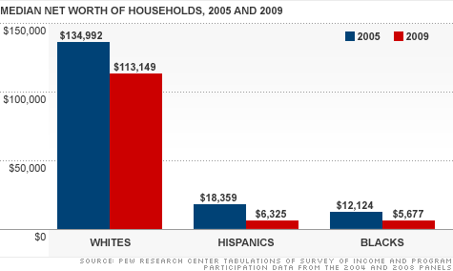

Slide 38
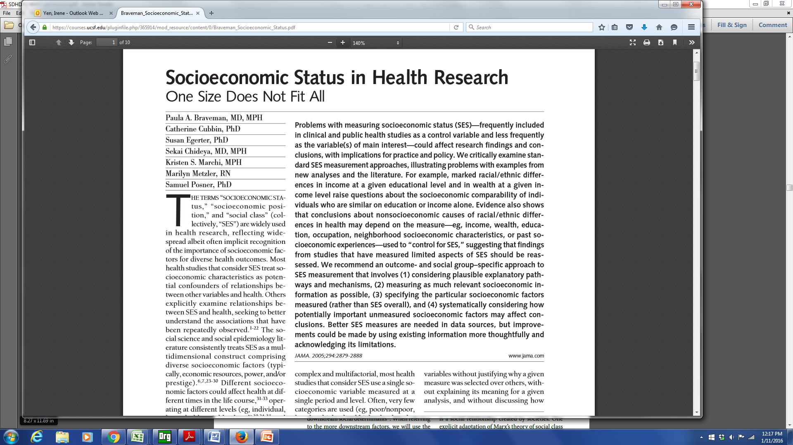

Slide 39
Braveman et al article –
a few of the take home points
Education and income not interchangeable – earnings can vary at similar educ levels.
income not a proxy for wealth
Importance of past socioeconomic experiences

Slide 40
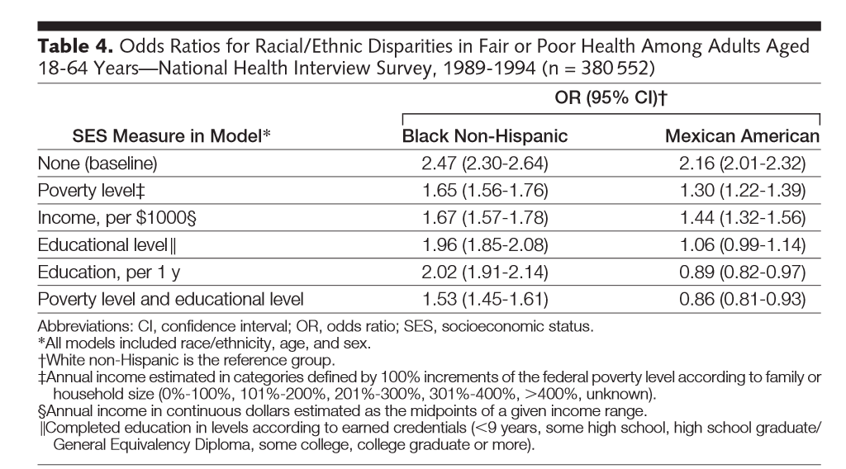
Notes:
Models differed by whether and how income and education were included.
When income was used to adjust for SES, Mexicans had increased risk for fair/poor health compared to Whites
If use education, risk appear similar

Slide 41
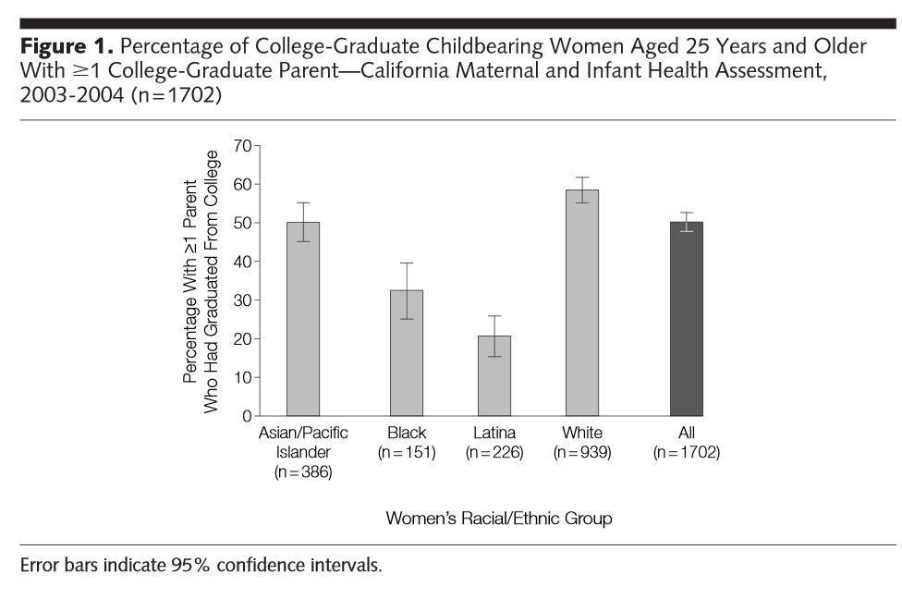

Slide 42
Social Determinants of Health II
Stressors / Stress
Housing
Neighborhood
Transportation
Incarceration

Slide 43
Stressors
Food insecurity
Job insecurity
High demands / Low control
Notes:
Can go even further and talk about food policy, corn syrup etc.
http://www.ncbi.nlm.nih.gov/pubmed/24392603
http://www.ncbi.nlm.nih.gov/pubmed/15622689
http://www.ncbi.nlm.nih.gov/pubmed/18366535/
Perceived discrimination/racism has been shown to play a role in unhealthy behaviors such cigarette smoking, alcohol/substance use, improper nutrition, and refusal to seek medical services (Lee, Ayers, & Kronenfeld, 2009; Peek et al, 2011).

Slide 44
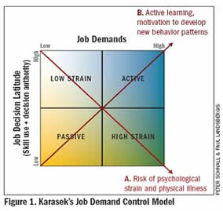
High Demands / Low control = job strain
Notes:
Note that this started in norway, began to notice childhood effects

Slide 45
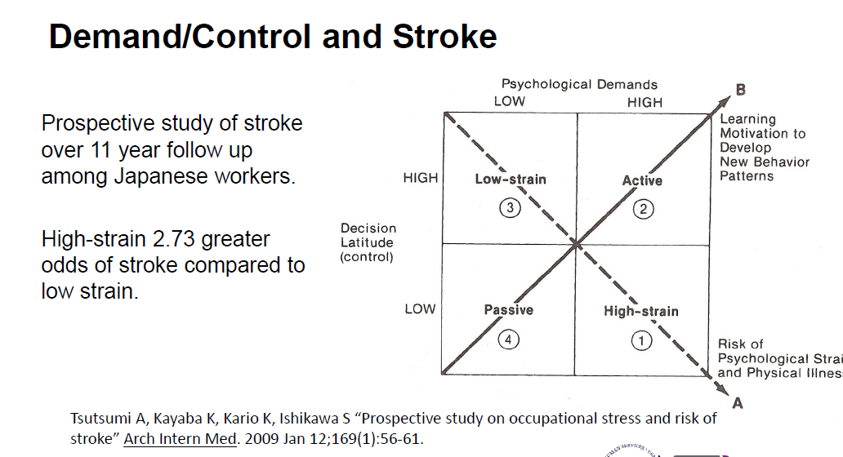

Slide 46
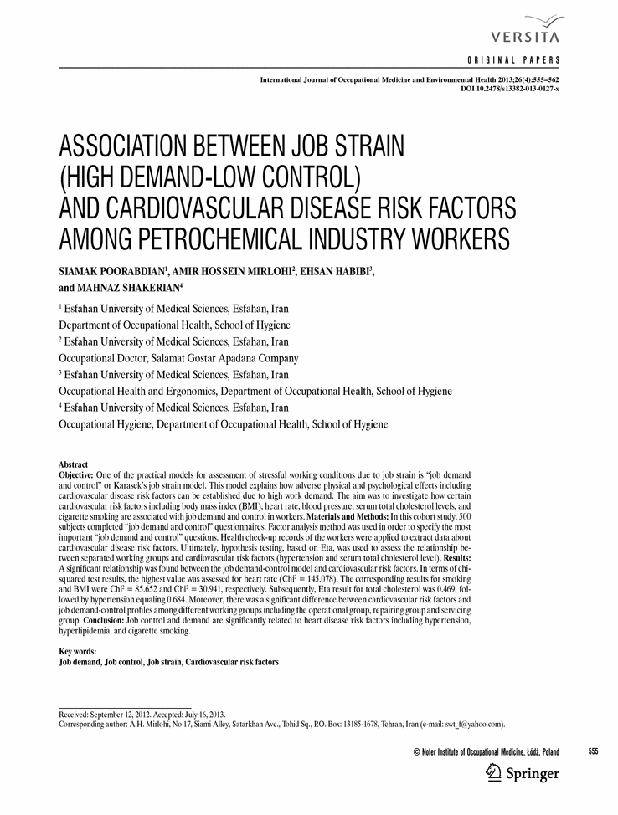

Slide 47
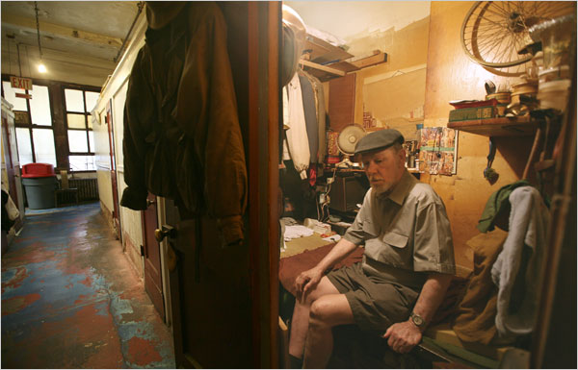
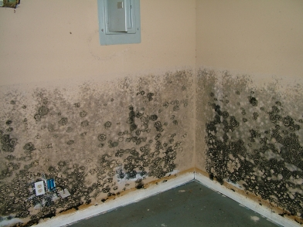
Housing
Own vs. rent
Cost / income proportion

Slide 48
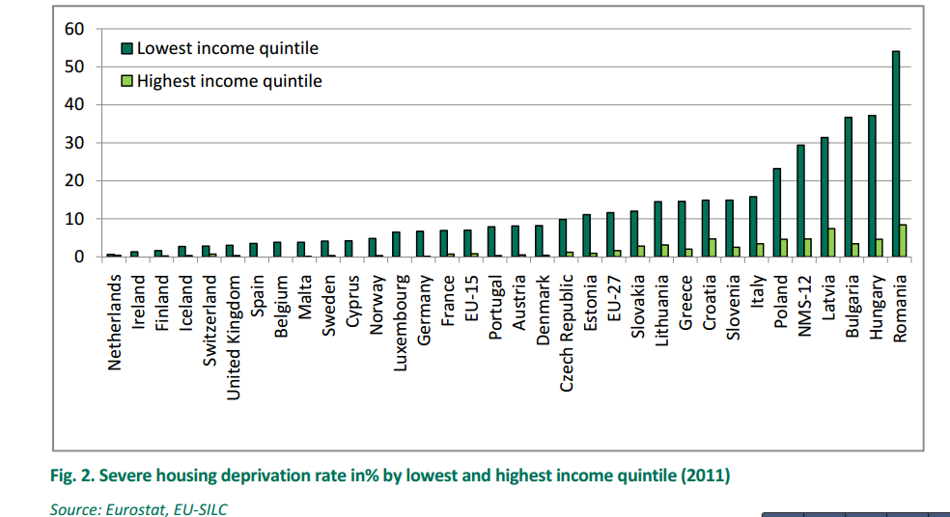
Housing Deprivation
Notes:
In 2011, 5.5% of the EU population suffered from severe housing deprivation, defined as an overcrowded dwelling in combination with one or more of the above‐mentioned housing deprivation measures. In five EU Member States, more than a tenth of the population faced severe housing deprivation, with the share rising to 17.9% in Latvia, and 25.9% in Romania. Across all EU countries, low income is associated with increased exposure levels to housing deprivation

Slide 49
Neighborhood
Pubmed Articles “Neighborhood” in title: 1970 - 2012
49

Slide 50
Neighborhood / Place research concepts and methods
definitions of neighborhood / geographic unit (scale)
  census block group
  census tract
  zip code
  buffers
measure to characterize the place
  composition
  context
types of measures
  census data
  counts
  density
  distance to
  time / space

Slide 51
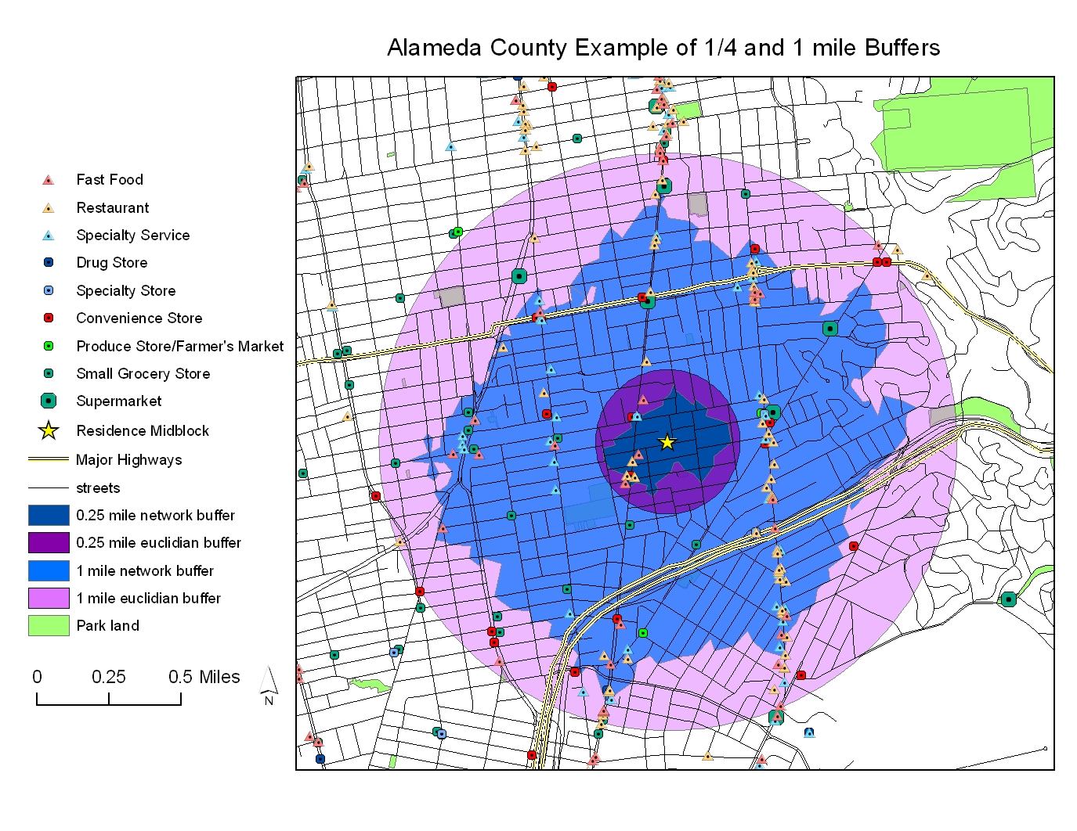

Slide 52
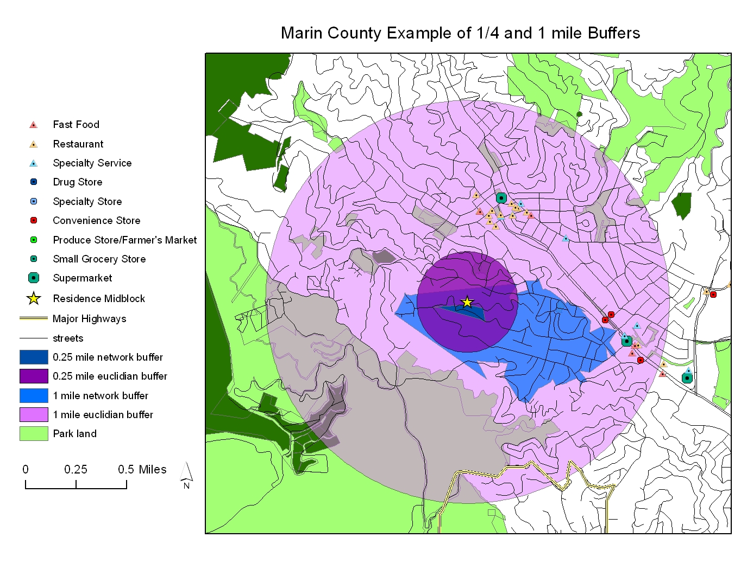

Slide 53
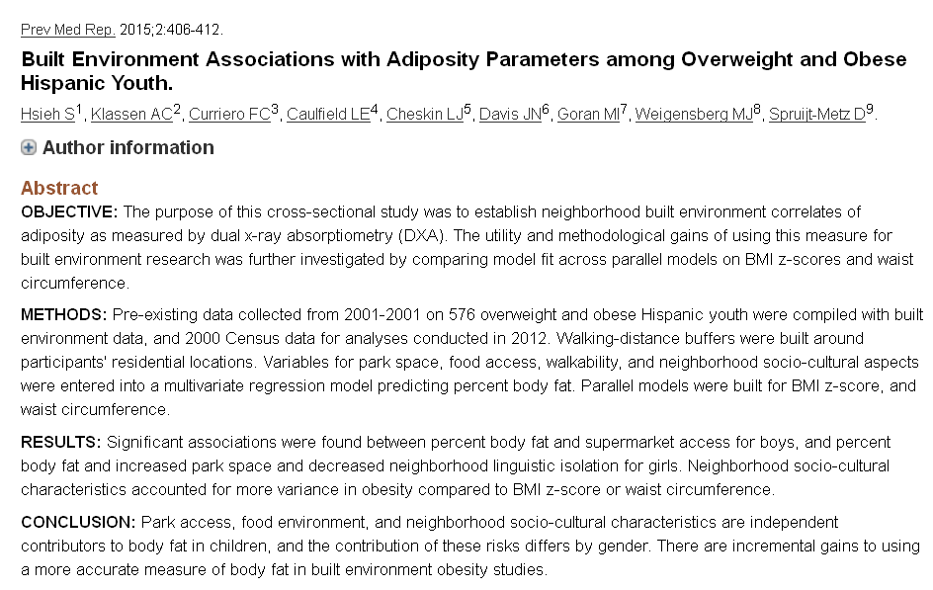

Slide 54
Moving to Opportunity
1994 – 4600 families with children living in public housing – RCT to move to lower poverty neigh
  Vouchers
  Section 8
  control
2008-2010 – evaluation studies

Slide 55
Moving to Opportunity
adults offered housing vouchers have a lower prevalence of severe obesity and diabetes compared to controls
Adults offered housing vouchers report fewer physical limitations
self-reported health status and rates of hypertension and health-related risk behaviors are similar across groups.
improved mental health in areas such as depression and psychological distress

Slide 56
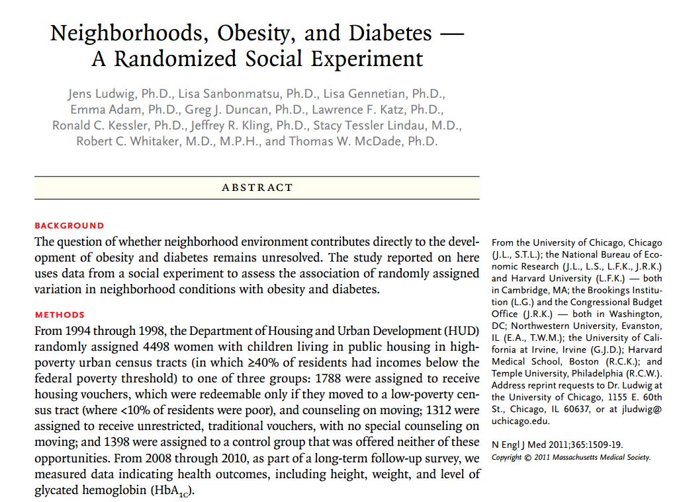

Slide 57
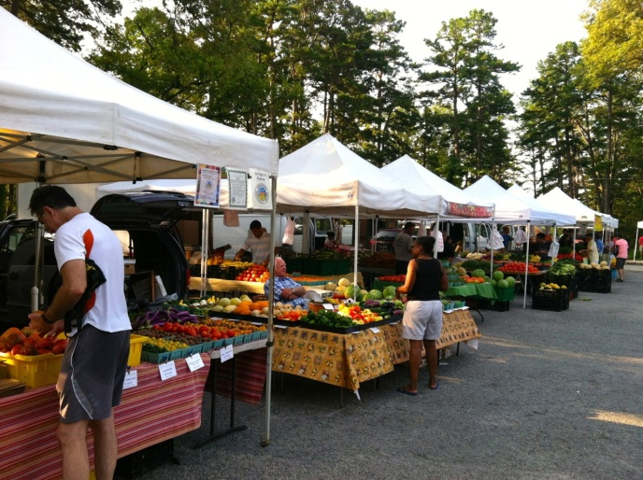


Food
Healthy People 2020

Slide 58
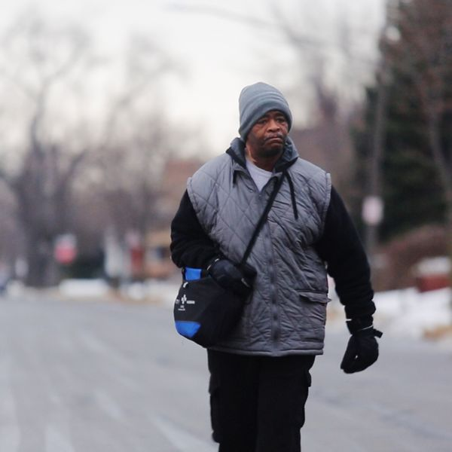
Transportation
Notes:
walks 21 miles each day round trip just to get to his job. No matter what the weather, Robertson has been hiking it to work ever since his car broke down 10 years ago
His job at a factory pays $10.55 so he says he can't afford a car and the bus only takes him so far to work. The rest he has to walk, consuming large amounts of Coca-Cola and Mountain Dew just to stay awake
Low-income, inner-city residents suffer from a “modal” mismatch, a drastic divergence in the relative advantage between those who have access to automobiles and those who do not (Blumenberg and Hess 2003; Blumenberg and Ong 2001; Grengs 2010; Kawabata 2003; Ong and Miller 2005; Shen 1998; Taylor and Ong 1995; Wyly 1998). In almost all metropolitan areas, individuals without reliable access to automobiles can reach far fewer opportunities within a reasonable travel time compared with those who travel by automobile (Benenson et al. 2010; Blumenberg and Ong 2001; Grengs 2010; Kawabata 2009; Kawabata and Shen 2006, 2007; Ong and Miller 2005; Shen 2001, 1998).

Slide 59
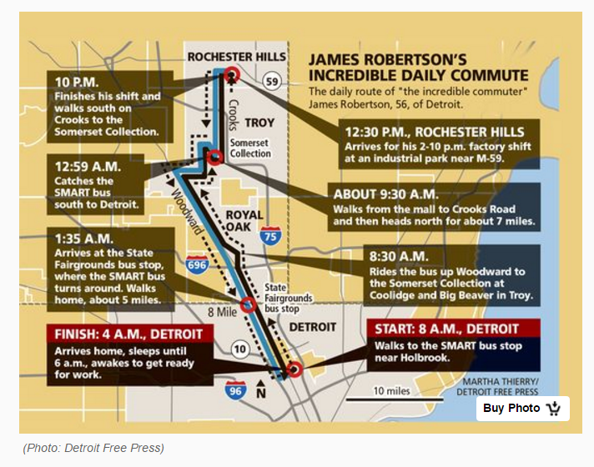

Slide 60
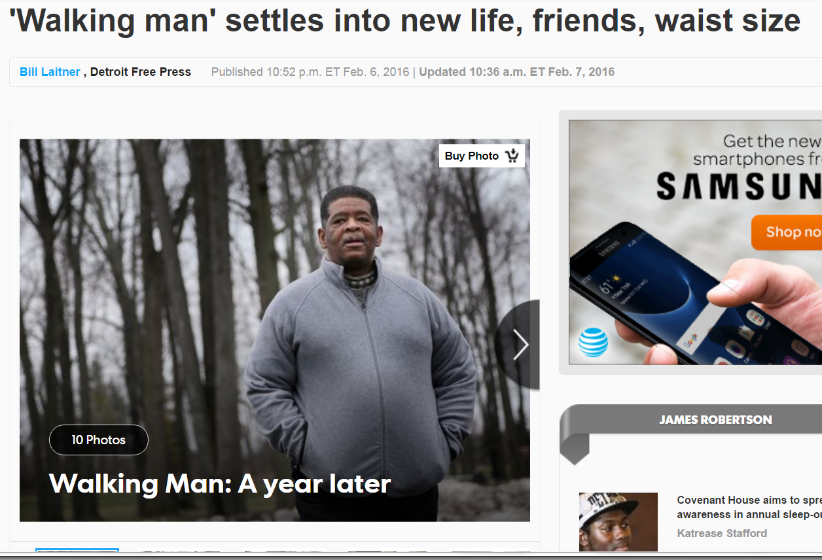

Slide 61
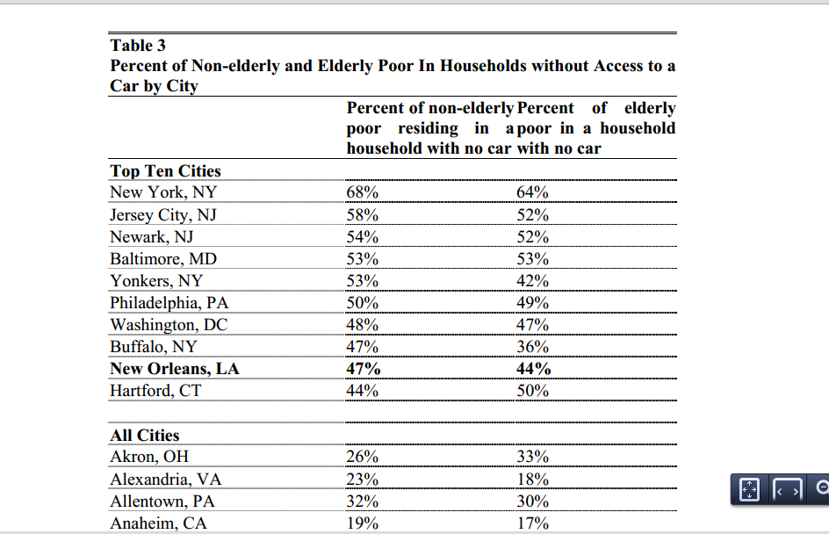

Slide 62
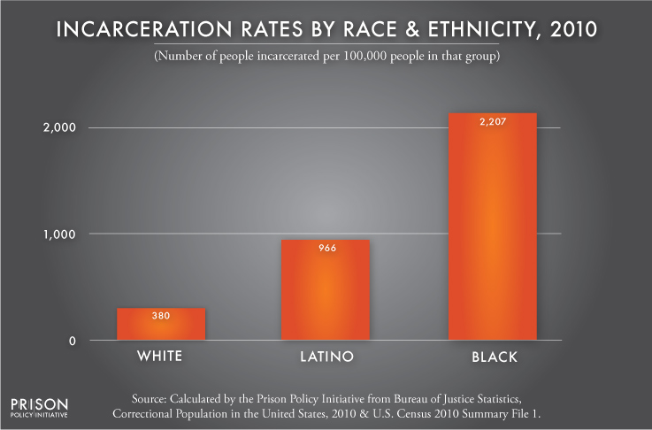
Incarceration

Slide 63
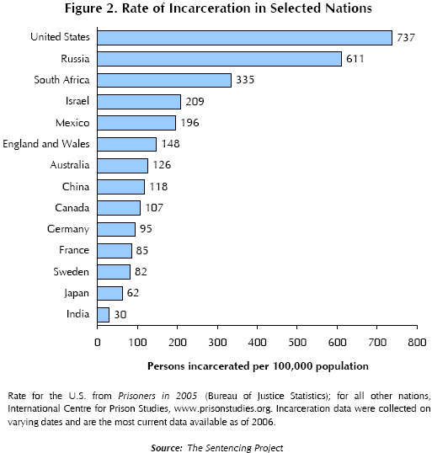
Incarceration

Slide 64
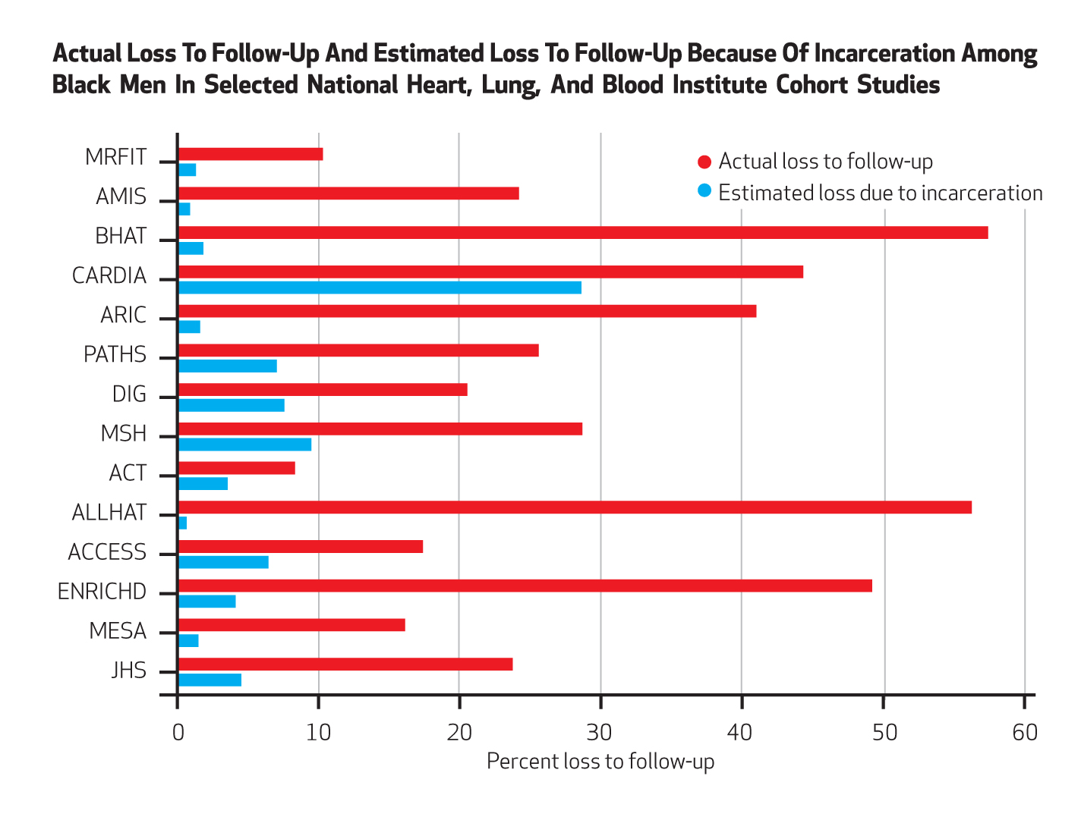
Incarceration
Notes:
Health Affairs 2014

Slide 65
Incarceration
As of 2004, there were approximately six times more inmates and ex-inmates than in the mid-1970s.
Presently, there are more than 16 million felons and ex-felons in the United States (Uggen et al. 2006)

Slide 66
Incarceration
The lifetime cumulative risk (measured to age 34) of imprisonment for all African American males > 20 % (Pettit & Western 2004).
African American males without a high school diploma, the lifetime risk of incarceration is 59 % (5x the rates of comparable whites.)
correctional policies have caused the emergence of a new ‘‘felon class’’ in society.
  8 % of the adult population,
  22% of the black adult population
  33% percent of the black adult male population

Slide 67
Questions?

Slide 68
What produces health disparities across the life course and across generations?
SOCIETY
Reducing social
inequality
INDIVIDUAL
Social position, e.g. by race & class
Social
Context
1. Social inequality
2. Differential exposure
Reducing harmful exposures
Specific exposure
3. Differential vulnerability
Reducing vulnerability
Disease
4. Differential consequences
Preventing unequal
consequences
Policy
Context
5. More social inequality
Social consequences
of ill health
Adapted from Diderichsen, U. Copenhagen

Slide 69
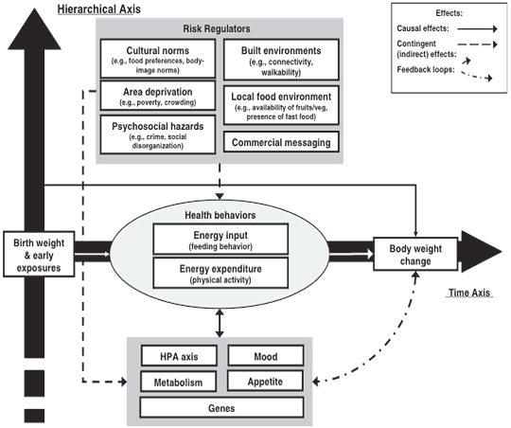
CDC Multilevel Model for Obesity
Notes:
http://www.cdc.gov/pcd/issues/2009/jul/09_0013.htm

Slide 70
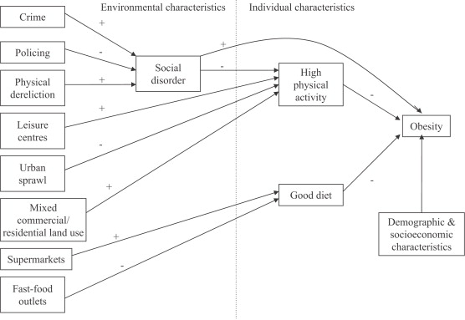
Theoretical model linking social and physical environmental characteristics to obesity
Pathways to obesity: Identifying local, modifiable determinants of physical activity and diet
Mai Stafford , Steven Cummins , Anne Ellaway , Amanda Sacker , Richard D. Wiggins , Sally Macintyre
Social Science &amp; Medicine, Volume 65, Issue 9, 2007, 1882 - 1897

