Slide 1
EPI222:
Lecture 3 Biological Determinants, Mediators and Mechanisms

Slide 2
Where are we in the class?
Economic & Social
Opportunities and Resources
Policies to promote child
and youth development
and education, infancy
through college
Policies to promote economic development, reduce poverty,
and reduce racial segregation
Living & Working Conditions
in Homes and Communities
Policies to promote healthier
homes, neighborhoods,
schools and workplaces
Behaviors
Medical Care
Biology and interactions between biology & experiences
HEALTH
Adapted from Robert Wood Johnson Foundation Commission to Build a Healthier America | www.commissiononhealth.org

Slide 3
Biological Mechanisms
Preliminaries
Behaviors, including use of medical care
Direct toxic exposures
Stress mediated pathways
Major controversies or uncertainties
  Lifecourse/sensitive periods
  Qualitative interactions/dandelion vs orchid
  Role of genetics

Slide 4
Biological Mechanisms
Preliminaries
  What this lecture is not about
  Why care about the biology?
  Embodiment
  Pathways
  Sensitive/critical periods
  Where do genetics fit in?

Slide 5
Preliminaries
Many health disparities fall along lines that appear to be arbitrary social boundaries, e.g., high versus low education.
Yet these lines correspond with huge differences in physical health.
The mechanisms by which social experiences, things outside the body, get “under the skin” and become “embodied” is a controversial and rapidly developing field.
This is not just about the biological correlates of differences in health and illness, but rather about the mechanisms.
Similar mechanisms are assumed to apply to multiple dimensions of inequality: SES, race, sexual orientation, geography, but some mechanisms will be unique or especially relevant.
Notes:
How is Eliseo introducing race/ethnicity? Link back to his definition.

Slide 6
Why worry about the biological mechanism?
Designing effective interventions to interrupt the pathway (not always necessary to understand biological mechanisms for this, but it’s helpful)
Evidence that associations are “causal” (because if not causal, there is no hope of effective interventions on this exposure)
Motivating action: biologically grounded explanations often move decision makers more than statistical associations.

Slide 7
Embodiment
“how we literally incorporate, biologically, the material and social world in which we live, from in utero to death…” Krieger 2005, JECH
Many biological phenomena have social origins, so finding a biological basis for a health disparity does not imply that the root cause of that disparity is not social or could not be eliminated by a social or behavioral intervention.
  Cultural norms regarding diet can lead to differences in average body fat, hypertension, and effectiveness of hypertension medications.
Many social phenomena have biological origins, so a finding of a social pattern may have root causes in biological differences.
  Birthweight→ cognitive scores, educational attainment→ earnings
Notes:
How is Eliseo introducing race/ethnicity? Link back to his definition.

Slide 8
Social Factors and Health:
What pathways explain the link?
Education
Disease
Onset, Progression, and Consequences
?
?
Race/
Ethnicity

Slide 9
Social Factors and Health: Many socioeconomic, cognitive, and network resources
Employment/ Occupation
Education
Income
Wealth
Disease
Onset, Progression, and Consequences
Social Networks
Knowledge
Cognitive Skills (literacy, numeracy)
Race/
Ethnicity
Self efficacy

Slide 10
…which in turn influence material, behavioral, and psychological risk
Employment/ Occupation
Toxic/Dangerous Environments (Housing, work, infections, lead)
Education
Income
Wealth
Behaviors (diet, exercise, medical care, sex, violence)
Disease
Onset, Progression, and Consequences
Social Networks
Knowledge
Cognitive Skills (literacy, numeracy)
Psychological Experiences
(stress, shame, stigma)
Race/
Ethnicity
Self efficacy

Slide 11
Not a law of physics: These pathways can be weakened or broken.
Employment/ Occupation
Toxic/Dangerous Environments (Housing, work, infections, lead)
Education
Income
Wealth
Behaviors (diet, exercise, medical care, sex, violence)
Disease
Onset, Progression, and Consequences
Policies
Policies
Social Networks
Knowledge
Cognitive Skills (literacy, numeracy)
Psychological Experiences
(stress, shame, stigma)
Race/
Ethnicity
Self efficacy

Slide 12
What I Want You to Leave Knowing
There are physiologic mechanisms for embodiment of social experiences and adversity
Examples of some promising areas of research on mechanisms
Intersection of human development and social stratification→ lifecourse determinants
Know (some) key research approaches & challenges
Know (some) major points of controversy

Slide 13
Biological Mechanisms
Preliminaries
  What this lecture is not about
  Why care about the biology?
  Embodiment
  Pathways
  Sensitive/critical periods
  Where do genetics fit in?

Slide 14
Key Idea in Biological Embedding: Sensitive Periods
Arguments for special sensitivity in early life because this is a period of very rapid physical development
Sensitive period: an age when the influence of the stimulus is disproportionate
Critical period: an age when the influence of the stimulus is essential for normal development
However, there is clearly a persistence of plasticity (capacity to change) throughout life and into old age
Sensitive periods can be defined with respect to physical or social experiences.
Notes:
This leads us into the ideas of alternative models, discussed last week in the lifecourse framework.

Slide 15
Physical Pathways for Special Sensitivity to Early Context
15
Periods of rapid growth; “catch-up” is hard
Critical periods for certain skills (e.g., language)
Enduring changes to gene expression patterns
Exposures at specific developmental periods set in place behavioral patterns/addictions (e.g. smoking, education→ soft skills)
Hierarchy of skill development

Slide 16
Feedback Occurs Across the Lifecourse
Social patterns create biological & physiological patterns.
Physiological patterns create social patterns.
Feedback occurs across the lifecourse, in ways that depend on both the biology and the social context.
  Community norms influence whether an adolescent starts smoking.
  Cigarette use is initiated in adolescence and is highly addictive,
  Smoking reflects place of residence in adolescence
Because smoking is such a powerful influence on health, this manifests in other outcomes, such as LBW
Teitler et al., International Migration Review
18 AUG 2015 DOI: 10.1111/imre.12207
http://onlinelibrary.wiley.com/doi/10.1111/imre.12207/full#imre12207-fig-0005
Notes:
Estimated Effects of Duration of US Residence on Low Birthweight among Mothers Who Arrived at Ages <18 Years, Controlling for Year of Arrival and Maternal Age at Time of Birth (N = 8,000) Note: Derived from estimates in column (d) of Table .

Slide 17
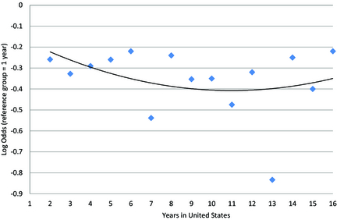
Feedback Occurs Across the Lifecourse
Duration of US Residence on Low Birthweight among Mothers Who Arrived at Ages 18+ Years
Teitler et al., International Migration Review
18 AUG 2015 DOI: 10.1111/imre.12207
http://onlinelibrary.wiley.com/doi/10.1111/imre.12207/full#imre12207-fig-0005
Notes:
Estimated Effects of Duration of US Residence on Low Birthweight among Mothers Who Arrived at Ages 18+ Years, Controlling for Year of Arrival and Maternal Age at Time of Birth (N = 12,350) Note: Derived from estimates in column (e) of Table .
Estimated Effects of Duration of US Residence on Low Birthweight among Mothers Who Arrived at Ages <18 Years, Controlling for Year of Arrival and Maternal Age at Time of Birth (N = 8,000) Note: Derived from estimates in column (d) of Table .

Slide 18
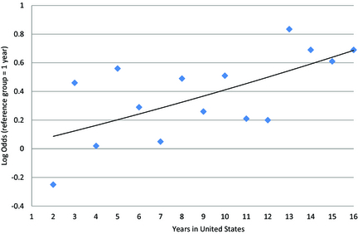
Feedback Occurs Across the Lifecourse
Duration of US Residence on Low Birthweight among Mothers Who Arrived at Ages 18+ Years
Duration of US Residence on Low Birthweight among Mothers Who Arrived at Ages <18 Years
Teitler et al., International Migration Review
18 AUG 2015 DOI: 10.1111/imre.12207
http://onlinelibrary.wiley.com/doi/10.1111/imre.12207/full#imre12207-fig-0005
Notes:
Estimated Effects of Duration of US Residence on Low Birthweight among Mothers Who Arrived at Ages <18 Years, Controlling for Year of Arrival and Maternal Age at Time of Birth (N = 8,000) Note: Derived from estimates in column (d) of Table .

Slide 19
Dendritic growth
The major outgrowth of dendrites starts after birth and continues during the first 2-3 years. This phase of the fastest dendritic outgrowth parallels the phase of fast cerebral cortex expansion, which also lasts until about 4 years of age.
After 5 years of age, a large interindividual variation in dendritic tree size becomes apparent.
Uylings, H.B.M. (2006) Development of the Human Cortex and the Concept of “Critical” or “Sensitive” Periods. Language Learning, 56, 59-90.
Notes:
19
Neurogenesis – 225,000 cortical neurons per minute are produced between 6-18 weeks gestation. No new neurons appear to produced after birth. Transmitter maturation goes on into adulthood dopamine, noradrenaline and serotonin a mature pattern might be expected by early adulthood… very difficult to change after age 4

Slide 20
Human cortical development
Uylings, H.B.M. (2006) Development of the Human Cortex and the Concept of “Critical” or “Sensitive” Periods. Language Learning, 56, 59-90.
Critical periods…exist for those functions for which axonal rewiring across a long distance in the brain is necessary. This is virtually impossible after completion of the developmental competition between different axonal systems.
Under dramatic circumstances, environmental factors during the first years of life can be quite decisive for the development of language social or other intellectual functions
Notes:
20
Neurogenesis – 225,000 cortical neurons per minute are produced between 6-18 weeks gestation. No new neurons appear to produced after birth. Transmitter maturation goes on into adulthood dopamine, noradrenaline and serotonin a mature pattern might be expected by early adulthood… very difficult to change after age 4

Slide 21
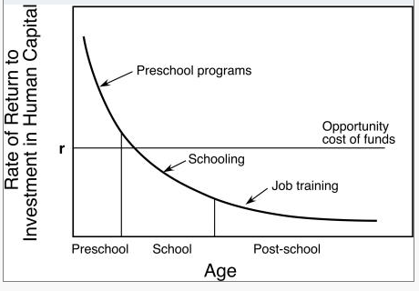
Giving up on grown-ups: Is there any “return” to investing in adults?
Rates of return to investment in human capital as function of age when the investment was initiated. Data from a life cycle model of dynamic human capital accumulation with multiple periods and credit constraints.
Investments were initially set to be equal across all ages. r represents the cost of the funds. Reproduced from Knudson, data are from Cunha et al.

Slide 22
(Possible) Socially Defined Sensitive Periods
22
  Age when you meet and woo your spouse (who will influence your diet, behaviors, material conditions for decades to come)
  Departure from school/ Entry into the labor force.
  Departure of children from the household or from dependence
  Retirement
  Bereavement

Slide 23
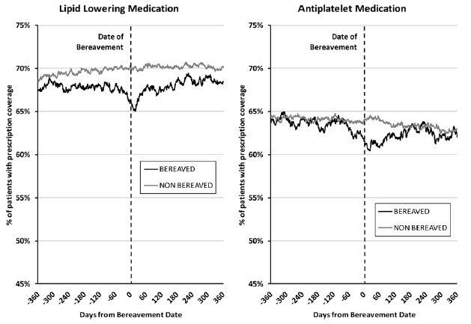
Bereavement as a Sensitive Period
  In a large UK cohort of older adults with preexisting CVD, there was lower uptake of cardiovascular care and reduced medication coverage in the year leading up to bereavement.
  Shah et al Circulation 2013
23

Slide 24
Biological Mechanisms
Preliminaries
  What this lecture is not about
  Why care about the biology?
  Embodiment
  Pathways
  Sensitive/critical periods
  Where do genetics fit in?

Slide 25
Where do genetics fit in?
Gene expression probably central to explanations of disparities
Genetic code cannot mediate health disparities, because this would imply that race/SES/place influences genetic code (draw the DAG to see what an unlikely claim this is).
Usually when people say genetics “mediate” health disparities, they mean “confound”: they hypothesize genes that cause people to be low SES also cause worse health, or that racial/ethnic groups have different frequencies of genetic polymorphisms linked to disease.
Evidence for this is, for most complex disorders, largely speculative. Few identified genes have large effects. Rarely major MAF differences that could account for disease differences.

Slide 26
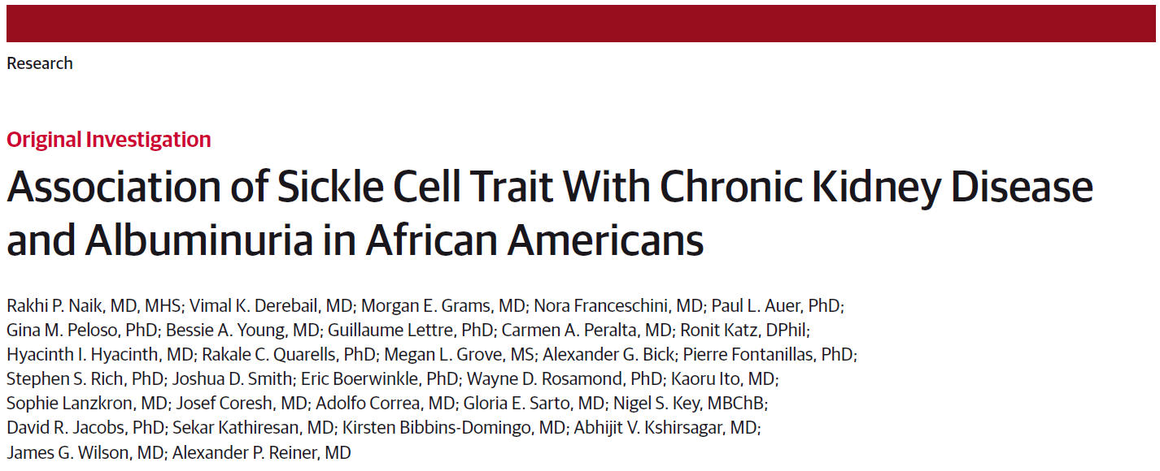
APOL-1 and risk of albuminuria in
African Americans

Slide 27
Apolipoprotein L1
Apolipoprotein L1 (APOL1 ) is a minor apoprotein component of HDL cholesterol, found in vascular endothelium, liver, heart, lung, placenta, podocytes, proximal tubules, and arterial cells.
Although its intracellular function has not been elucidated, APOL1 circulating in plasma has the ability to kill the trypanosome that causes sleeping sickness.
Two coding sequence variants in APOL1 were identified by looking at variation in genetic ancestry in African Americans with kidney disease.
People who have at least one copy of either the G1 or G2 variant are resistant to infection by trypanosomes, but people who have two copies of either variant are at an increased risk of developing a non-diabetic kidney disease.

Slide 28
Research question
  To investigate the role of genetic variants in APOL1, traditional risk factors and socioeconomic position (SEP) in explaining race differences in albuminuria and kidney function decline in young adults.
  PAF=Fraction of cases in the population that would not have occurred if the exposure had been eliminated
USRDS - 2007
Peralta, Bibbins-Domingo et al. under review

Slide 29
Results- Incident albuminuria
Peralta CA , Bibbins-Domingo, K et al. Under review
Incidence
N
Rate per
Age Adjusted
Risk Factor
Adjusted
SEP
1000 PY
Adjusted
Comparison
Within Blacks
In Blacks, population attributable fraction for
APOL1 was 9.4%
HTN and DM was 27.6%
Black
no APOL1
1058
7.3
(72
)
ref
ref
ref
2.34*
2.80*
2.81*
APOL1 Black
143
14.8
(20)
(1.38 to 3.98)
(1.61 to 4.87)
(1.59 to 4.98)
Comparison
between Whites and
Blacks
White
1617
3.9 (
62
)
ref
ref
ref
Black
no APOL1
2.06*
1.11
1.09
1058
7.3
(72
)
(1.45 to 2.93)
(0.75 to 1.65)
(0.73 to 1.65)
APOL1 Black
4.83*
3.12*
3.07*
143
14.8
(20)
(2.81 to 8.31)
(1.76 to 5.51)
(1.69 to 5.60)

Slide 30
Example of Genetics: APOL1
Example of use of ancestry differences clearly useful for insights into disease
Large beta effect estimate (RR~2), large MAF difference, but still does not explain that much of the disparity
Here’s the math to keep in mind (it’s friendly math!): PAF=Fraction of cases in the population that would not have occurred if the exposure had been eliminated
PAF=p*(RR-1)/(p*(RR-1)+1)
If p (prevalence of exposure) =.5 and RR=1.5, PAF=.5*.5/(.5*.5+1)=0.2
If p=.5 and RR=4, PAF=.5*3/(.5*3+1)=0.60
Notes:
Not so simple that I don’t have to look it up every single time.

Slide 31
Biological Mechanisms
Preliminaries
Behaviors, including use of medical care
Direct toxic exposures
Stress mediated pathways
Major controversies or uncertainties
  Lifecourse/sensitive periods
  Qualitative interactions/dandelion vs orchid
  Role of genetics

Slide 32
Biological mechanisms for categories of mechanisms
Employment/ Occupation
Toxic/Dangerous Environments (Housing, work, infections, lead)
Education
Income
Wealth
Behaviors (diet, exercise, medical care, sex, violence)
Disease
Onset, Progression, and Consequences
Social Networks
Knowledge
Cognitive Skills (literacy, numeracy)
Psychological Experiences
(stress, shame, stigma)
Race/
Ethnicity
Self efficacy

Slide 33
Behaviors are shaped and constrained by social context
Behaviors are the focus of an upcoming lecture. Key messages in this lecture:
  Behavioral patterns are shaped by social context
  Influence of social context on behavior can be mediated by physiologic changes that occur in response to environmental stimuli (epigenetic regulation, neurological development)
  The biological embedding implies that environmental causes may be relevant at developmentally specific ages

Slide 34
Example Mechanism: Epigenetics
Epigenetic modifications provide a possible physiologic mechanism linking parental behaviors to individual behaviors and health outcomes

Slide 35
Epigenetic Modifications: Regulate Gene Expression
Methylation: Attach a methyl (CH3) group to CpG dinucleotides in “islands”
    Catalyzed by DNA methyltransferase, which connects the methyl to a cytosine
    Changes the shape of the double helix, reducing binding or access of some proteins
    Reduces access of polymerase and silences expression
    Often on a “promoter” region that controls extent of expression or tissue specificity
Histone acetylation enhances transcription while histone deacetylation represses transcription.
Epigenetic patterns change rapidly at a small number of developmentally specific ages
Methylation patterns can be maintained if the DNA is copied, and potentially persist throughout life and across generations.
Notes:
35
Neurogenesis – 225,000 cortical neurons per minute are produced between 6-18 weeks gestation. No new neurons appear to produced after birth. Transmitter maturation goes on into adulthood dopamine, noradrenaline and serotonin a mature pattern might be expected by early adulthood… very difficult to change after age 4

Slide 36
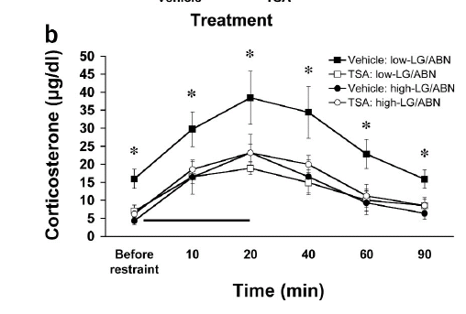
Meaney & Szyf: Parent-offspring interactions shape epigenetic patterns
Basic observation: rat pups handled postnatal days 1-5 have lower stress responses for the rest of their lives.
Notes:
36
Neurogenesis – 225,000 cortical neurons per minute are produced between 6-18 weeks gestation. No new neurons appear to produced after birth. Transmitter maturation goes on into adulthood dopamine, noradrenaline and serotonin a mature pattern might be expected by early adulthood… very difficult to change after age 4

Slide 37
“Handled” rats – with more engaged maternal care - had better cognitive aging
At 24 months, significant differences in neuron density in hippocampal regions.
-Meaney, Neurobio of Aging 1991

Slide 38
“Handled” rats – with more engaged maternal care - had better cognitive aging
Better stress recovery (per cortisol) and better memory (faster swim to landing).
-Meaney, Neurobio of Aging 1991

Slide 39
“Handled” rats – with more engaged maternal care - had better cognitive aging
Better stress recovery (per cortisol) and better memory (faster swim to landing).
-Meaney, Neurobio of Aging 1991

Slide 40
Epigenetic changes are a mechanism for enduring behavioral differences
First finding: mediated by maternal behavior (arch-backed nursing, licking and grooming)
  Directly observed changes in maternal behavior after handling
  After handling, such changes in maternal behavior predict outcomes
  Showed that natural variations in maternal behavior predicted same outcomes
  Cross-fostering of pups to high or low LG mothers produced same patterns
Notes:
40
Neurogenesis – 225,000 cortical neurons per minute are produced between 6-18 weeks gestation. No new neurons appear to produced after birth. Transmitter maturation goes on into adulthood dopamine, noradrenaline and serotonin a mature pattern might be expected by early adulthood… very difficult to change after age 4

Slide 41
Epigenetic changes are a mechanism for enduring behavioral differences
Mediated by hippocampal glucocorticoid receptor expression and negative feedback
  The adult offspring of high- compared with low-LG-ABN mothers show increased hippocampal GR expression and enhanced glucocorticoid feedback sensitivity
  Eliminating the difference in hippocampal GR levels abolishes the effects of early experience on HPA responses to stress in adulthood
Notes:
41
Neurogenesis – 225,000 cortical neurons per minute are produced between 6-18 weeks gestation. No new neurons appear to produced after birth. Transmitter maturation goes on into adulthood dopamine, noradrenaline and serotonin a mature pattern might be expected by early adulthood… very difficult to change after age 4

Slide 42
Epigenetic changes are a mechanism for enduring behavioral differences
How does maternal care influence GR expression for offspring’s whole life?
  Maternal care → serotonin in pup
  Serotonin → NGFI-A expression
  NGFI-A binds to promoter for GR gene (I₇)
  Post-natal day 1, methylated regardless of maternal care
  Post-natal day 6, I₇ demethylated in licked/groomed pups
  NGFI-A binding at critical period of demethylation creates access for the demethylase?
Notes:
42
Neurogenesis – 225,000 cortical neurons per minute are produced between 6-18 weeks gestation. No new neurons appear to produced after birth. Transmitter maturation goes on into adulthood dopamine, noradrenaline and serotonin a mature pattern might be expected by early adulthood… very difficult to change after age 4

Slide 43
Why this is extremely powerful, if it’s true
Epigenetic patterns are quite stable across the lifecourse
Formerly thought almost no changes in methylation patterns after birth; not strictly true (studies in twins show greater divergence in methylation patterns in older twins)
Epigenetic changes are a mechanism by which an organism can respond to early life environment, and make changes to gene expression patterns that endure for a lifetime
Changing fundamental feature of (rat-)behavior
Notes:
43
Neurogenesis – 225,000 cortical neurons per minute are produced between 6-18 weeks gestation. No new neurons appear to produced after birth. Transmitter maturation goes on into adulthood dopamine, noradrenaline and serotonin a mature pattern might be expected by early adulthood… very difficult to change after age 4

Slide 44
Does it translate to humans?
What is the human parallel for postnatal day 1-5 licking and grooming?
Is this just a specific case of a general model, i.e. other exposures may induce epigenetic modifications of other genes and lead to fundamental behavioral changes?
Notes:
44
Neurogenesis – 225,000 cortical neurons per minute are produced between 6-18 weeks gestation. No new neurons appear to produced after birth. Transmitter maturation goes on into adulthood dopamine, noradrenaline and serotonin a mature pattern might be expected by early adulthood… very difficult to change after age 4

Slide 45
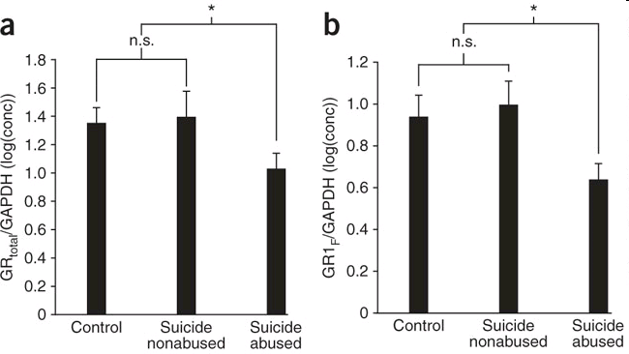
Does it translate to humans?
Mean /s.e.m. expression levels of glucocorticoid receptor (GR) mRNA (a) and glucocorticoid receptor 1_{F} (GR1_{F}) in 12 suicide victims with a history of childhood abuse, 12 nonabused suicide victims and 12 control subjects (b).
* indicates P < 0.05; n.s. indicates not statistically significant.
McGowan, Nature Neuroscience, 2009
Notes:
45
Neurogenesis – 225,000 cortical neurons per minute are produced between 6-18 weeks gestation. No new neurons appear to produced after birth. Transmitter maturation goes on into adulthood dopamine, noradrenaline and serotonin a mature pattern might be expected by early adulthood… very difficult to change after age 4

Slide 46
Does it translate to humans? Bucharest Early Intervention Study
In the glucocorticoid receptor
Serotonin transporter gene
Relationship between proportion of time in institutional care and methylation level -- among children who had ever spent
time in the institution -- for CpG sites with significant associations in SLC6A4 and FKBP5. Longer institutionalization, less methylation.
Non et al., Am J Phys Anthro, 2016
Notes:
46
Objectives: Differences in DNA methylation have been associated with early life adversity, suggesting that alterations
in methylation function as one pathway through which adverse early environments are biologically embedded.
This study examined associations between exposure to institutional care, quantified as the proportion of time in
institutional care at specified follow-up assessment ages, and DNA methylation status in two stress-related genes:
FKBP5 and SLC6A4.
Materials and Methods: We analyzed data from the Bucharest Early Intervention Project, which is a prospective
study in which children reared in institutional settings were randomly assigned (mean age 22 months) to either
newly created foster care or care as usual (to remain in their current placement) and prospectively followed. A group
of children from the same geographic area, with no history of institutionalized caregiving, were also recruited. DNA
methylation status was determined in DNA extracted from buccal epithelial cells of children at age 12.
Results: An inverse association was identified such that more time spent in institutional care was associated with
lower DNA methylation at specific CpG sites within both genes.
Discussion: These results suggest a lasting impact of early severe social deprivation on methylation patterns in
these genes, and contribute to a growing literature linking early adversity and epigenetic variation in children. Am
J Phys Anthropol 161:84–93, 2016. VC 2016 Wiley Periodicals, Inc.
SLC6A4, the gene that encodes the
serotonin transporter (5-HTT). Serotonin (5-HT) is
involved in the development of the central nervous system,
including multiple pathways that have been implicated
in neuropsychiatric disorders (Jans et al., 2007).
The 5HTT is a key regulator of 5HT levels and a substantial
body of literature has examined genetic and
stress-related alterations in SLC6A4 in association with
early life adversity and long-term health outcomes
(Dayer, 2014).
FK506 Binding protein 5 (FKBP5) is a member of the
glucocorticoid receptor complex, which facilitates termination
of the cortisol stress response by altering the sensitivity
to glucocorticoid receptor negative feedback
(Binder, 2009). Specifically, elevated FKBP5 gene expression
reduces the ability of the GR complex to translocate
to the nucleus, decreasing transcriptional activation,
and subsequently down regulating expression changes
initially triggered by elevated glucocorticoids

Slide 47
Example Mechanism:
Neural development
Early deprivation or trauma changes brain development and subsequent behavioral and health trajectories

Slide 48
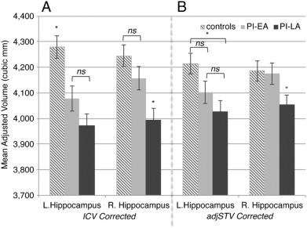
Early adversity changes brain development (volume, WMV, GMV)
N=110 post-institutionalization children (internationally adopted: 3.5 to 60 months of institutional care, dichotomized at adoption before 12 months) compared to 62 children raised with biological families.
Duration of early adversity predicts hippocampal volume reduction (age and sex adjusted). Panel A: ICV corrected (± SEM). Panel B: adjSTV corrected (± SEM).
Amanda, NeuroImage 2015 Duration of early adversity and structural brain development in post-institutionalized adolescents
Notes:
adjusted supratentorial volume.
Similar patterns in PFC.
Primarily changes in surface area rather than thickness.

Slide 49
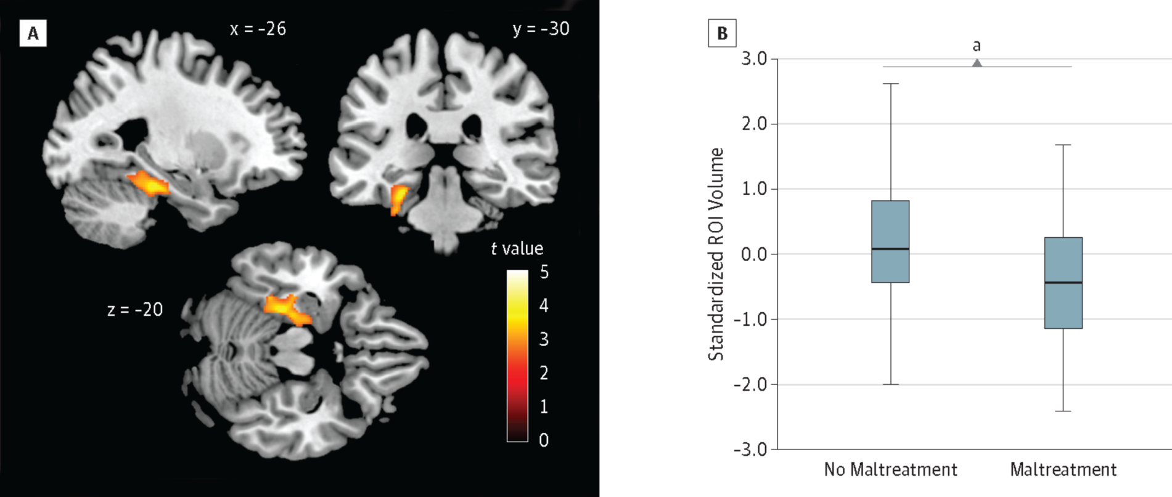
Child maltreatment influences Gray Matter Volume and substance use disorder
From: Childhood Maltreatment, Altered Limbic Neurobiology, and Substance Use Relapse Severity via Trauma-Specific Reductions in Limbic Gray Matter Volume JAMA Psychiatry. 2014.
GMV Differences Related to Childhood Maltreatment: Using whole-brain voxel-based morphometry, CM was associated with lower mean GMV, controlling for substance use disorder, psychiatric history, age, sex, total intracranial volume, and substance dependence by age, in the left medial temporal lobe. A, The GMV cluster predominantly includes regions of the hippocampus and parahippocampal and fusiform gyri. B, Box-and-whisker plot of estimated, standardized region-of-interest (ROI) cluster volumes by group (no trauma vs trauma). The shaded boxes indicate the 75th (top) and 25th (bottom) percentiles; horizontal lines in the middle of the boxes, the median (50th percentile); and whiskers, the minimum and maximum volumes.ªA t test revealed significant differences in the estimated volumes for the ROI between the 2 groups at P < .001.

Slide 50
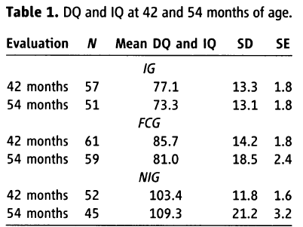
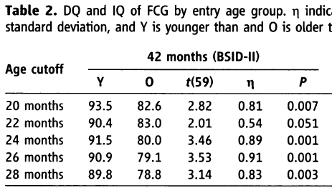
Bucharest Early Intervention Project: High Quality Foster Care Offsets Cognitive Harm
Mean score in kids randomized younger than that age
Mean score in kids randomized older than that age
Children in the institutional group had significantly worse IQ than children randomized to high quality foster care or a never-institutionalized group.
Earlier age at randomization associated with better outcomes
Thresholds for some cognitive and behavioral outcomes, age-thresholds differed across outcomes.
-Nelson Science 2007

Slide 51
Biological mechanisms for categories of mechanisms
Employment/ Occupation
Toxic/Dangerous Environments (Housing, work, infections, lead)
Education
Income
Wealth
Behaviors (diet, exercise, medical care, sex, violence)
Disease
Onset, Progression, and Consequences
Social Networks
Knowledge
Cognitive Skills (literacy, numeracy)
Psychological Experiences
(stress, shame, stigma)
Race/
Ethnicity
Self efficacy

Slide 52
Biological Mechanisms
Preliminaries
Where do genetics fit in?
Behaviors, including use of medical care
Direct toxic exposures
Stress mediated pathways
Major controversies or uncertainties
  Lifecourse/sensitive periods
  Qualitative interactions/dandelion vs orchid
  Role of genetics

Slide 53
Direct Toxic Exposures
Environmental toxins, e.g., lead, passive tobacco exposure, air pollution strongly socially patterned
Affect both disease incidence & outcomes/severity
Categories may interact so lead exposure has worse consequences if combined with social stressors
Violence
Food environments and nutritional deprivation

Slide 54
Nutritional Deprivation
54
How to research long term effects of nutritional deprivation?
  Use anthropometric measures because growth sensitive to both genetic and environmental conditions (distinguish from phrenology deterministic perspective)
  Use administrative records, e.g., birthweight, as a proxy for a set of more diverse exposures
  Use natural experiments (Dutch Famine study)
Research in this area is extremely constrained by data availability

Slide 55
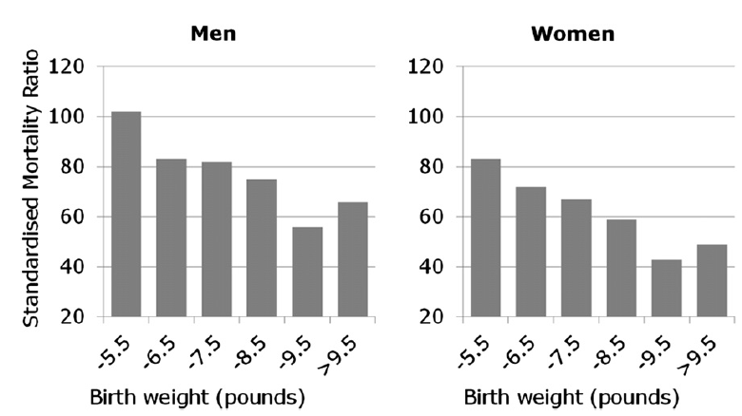
Barker Hypothesis: Birthweight and later CVD risk
Mortality from CHD in n=15,726 Hertfordshire
Barker, annual review of public health, 2012
55

Slide 56
Birthweight and later CVD risk
Birthweight is an indicator of adverse exposure in utero (first 1000 days)
Reduced function in organs such as kidney
Modified “settings” in metabolism and hormonal feedback
More vulnerable to adverse later environmental conditions
Developing organism prioritizes resources for brain growth, low priority for kidney and lungs
Compensatory growth costs other developmental activities.
56

Slide 57
Nutritional Deprivation
Several studies report associations between brain or head size and late life cognitive function.
  Women with neuropathological changes characteristic of AD but no clinical impairment had larger brain volume than women with similar neuropathological changes exhibiting clinical impairments. – Katzman, Ann Neurol 1988
  Larger head circumference predicts higher cognitive function scores in Japanese Americans in Washington State - Graves, 1996
  Women with head circumference in the lowest quintile were 2.9 times more likely to have AD (adjusting for age, education, and ethnicity); men were 2.3 times more likely to have AD – sample from Northern Manhattan- Schofield, 1997
57

Slide 58
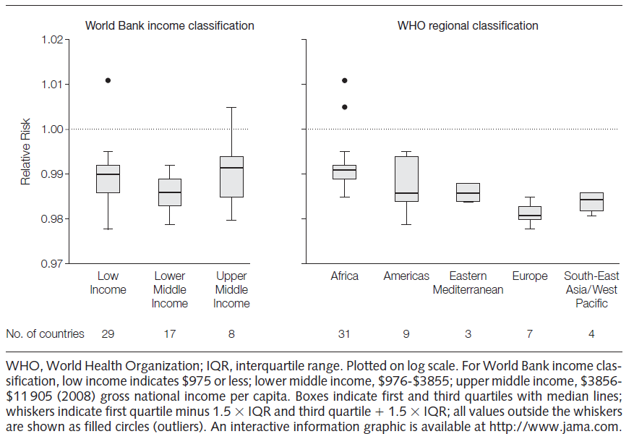
Maternal Height (in cm) and Infant Mortality
Short stature indicates mother’s nutritional status in childhood
Each taller cm of mom’s height associated with 1.4/1000 fewer deaths in children under 5.
Ozaltin, JAMA, 2009
58

Slide 59
Nutritional Deprivation: other measures
59
Key questions:
  Other SES measures or entirely confounding?
  Timing of exposures that matter?
  Does the sources of stress matter?
    (Nutrition? Infection? Emotional?)
  Which outcomes are affected?

Slide 60
Biological mechanisms for categories of mechanisms
Employment/ Occupation
Toxic/Dangerous Environments (Housing, work, infections, lead)
Education
Income
Wealth
Behaviors (diet, exercise, medical care, sex, violence)
Disease
Onset, Progression, and Consequences
Social Networks
Knowledge
Cognitive Skills (literacy, numeracy)
Psychological Experiences
(stress, shame, stigma)
Race/
Ethnicity
Self efficacy

Slide 61
Biological Mechanisms
Preliminaries
Where do genetics fit in?
Behaviors, including use of medical care
Direct toxic exposures
Stress mediated pathways
Major controversies or uncertainties
  Lifecourse/sensitive periods
  Qualitative interactions/dandelion vs orchid
  Role of genetics

Slide 62
Stress Response
Stressors: external demands encountered by the organism
  Source:
    Physical (cold, infection)
    Psychological (fear, shame, anxiety)
  Duration:
    Acute (trauma)
    Chronic (daily hassles)
Stress occurs when demand is perceived to exceed capacity to respond

Slide 63
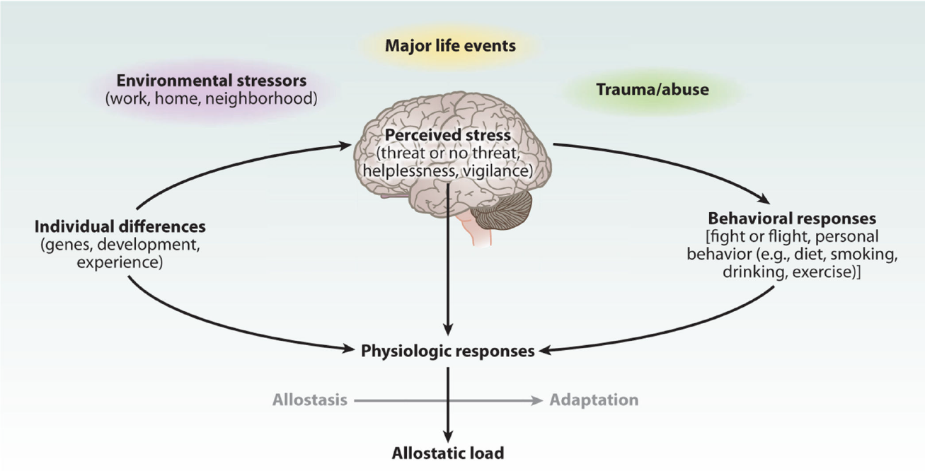
Stress triggers HPA and SNS Response to improve behavioral response
McEwen and Gianaros, annu rev med, 2011

Slide 64
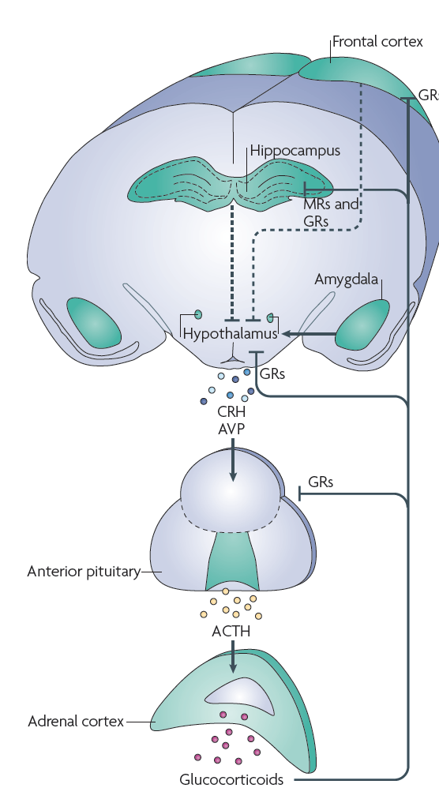
HPA axis response
Threat/stress triggers autonomic, neuroendocrine, metabolic and immune responses.
Hypothalamus-pituitary-adrenal axis: hypothalamus releases corticotropin releasing hormone triggering adrenocorticotropic hormone from pituitary → glucocorticoid production by adrenal → adrenaline and noradrenaline.
Glucocorticoids feed back and bind corticosteroid receptors to return to base state.

Slide 65
Allostatic Load
Homeostasis: capacity of a biological system to maintain state through marked environmental changes
Allostasis (robustness): capacity of a biological system to maintain functioning through marked environmental changes
  Allostasis may require changes in state in order to maintain function
  Biological regulatory systems alter functioning in order to adapt to changing conditions/demands
Allostatic load: “wear and tear” accumulating as a result of chronic need to adapt to adverse environmental conditions, especially stress
Although effects may have thresholds, concept emphasizes accumulation of harm.
Measurements of allostatic load emphasize multi-system breakdown

Slide 66
Allostatic Load: Multi-system dysregulation by cumulative lifetime SES
Biomarker substudy of MIDUS, n=1008.
Gruenewald, 2012 Soc Sci Med
Notes:
Disadvantage included parent education, welfare, financial situation Plus own education, household income, difficulty paying bill,s availability of money to meet basic needs, current financial situation
Sympathetic nervous system: epinephrine norepinephrine
Parasympathetic, HRT,
HPA: cortisol, DHEAS,
Inflammation: Il6, CRP, fibrinogen, sEselectin and sICAM
Cardiovascular: pulse, SBP, DBP.
Metabolic glucose risk: Hba1c, fasting glucose, fasting insulin HOMA-IR, WHR, BMI
Metabolic lipids riskcholesterol, HDL, LDL

Slide 67
Allostatic Load: Multi-system dysregulation by cumulative lifetime SES
Biomarker substudy of MIDUS, n=1008.
Gruenewald, 2012 Soc Sci Med
Child and adult SES disadvantage quintile:
Notes:
Disadvantage included parent education, welfare, financial situation Plus own education, household income, difficulty paying bill,s availability of money to meet basic needs, current financial situation
Sympathetic nervous system: epinephrine norepinephrine
Parasympathetic, HRT,
HPA: cortisol, DHEAS,
Inflammation: Il6, CRP, fibrinogen, sEselectin and sICAM
Cardiovascular: pulse, SBP, DBP.
Metabolic glucose risk: Hba1c, fasting glucose, fasting insulin HOMA-IR, WHR, BMI
Metabolic lipids riskcholesterol, HDL, LDL

Slide 68
Bucharest Early Intervention Study and Stress Response Differences
Significant changes in all ANS measures were observed during the social tasks: HR, SBP, and DBP increased, and RSA and PEP decreased (indicating significant PNS withdrawal and SNS activation, respectively). ..evidence for causal effects of the caregiving environment on ANS reactivity to social stress. … CAUG exhibited significantly blunted ANS responses compared with children randomized to FCG during the prep, speech, and math portions of the TSST
pre-ejection period
Respiratory sinus arrhythmia
Care as usual in institution
Foster care
Never institutionalized

Slide 69
Stress Response
Chronic stress predicts dysregulation of cortisol levels, but can be either up or down (diurnal fluctuation of cortisol is normal)
Science on when upregulated versus downregulated not established
  Serious methodological challenges because “healthy”=fluctuating

Slide 70
Stress Response: Active Research Areas
Cell structure and tissue remodeling (e.g., apoptosis, dendritic shape and synapse formation, cellular developmental trajectories)
SNS stimulation → increased pro-inflammatory profile of immune cells
Telomere length and telomerase activity (chronic stress predicts shorter telomeres; racial patterns inconsistent)
Metabolome: stress→ HPA → gut microbiota
Dynamic relationships between physical dysregulation and stress, e.g., PTSD
Other mechanisms to regulate gene expression, based on mRNA profiles: “conserved transcriptional response to adversity” → inflammation

Slide 71
Biological Mechanisms
Preliminaries
Where do genetics fit in?
Behaviors, including use of medical care
Direct toxic exposures
Stress mediated pathways
Major controversies or uncertainties
  Lifecourse/sensitive periods
  Qualitative interactions/dandelion vs orchid
  Role of genetics

Slide 72
Uncertainties and Controversies
Physiologic mechanisms still controversial, many hypothesized mechanisms have limited empirical evidence – piecing together evidence from animals, experimental human studies in labs, and observational epidemiologic evidence. Research is very limited by the tools.
How common are qualitative reversals of effects (i.e., the same exposure that is good for some people is bad for others)?
  Boyce: dandelion children versus orchid children
  GxE?
Adaptive plasticity: adaptations optimize to environment that prevailed during critical developmental period, and illness is due to a mismatch with new environments?
Mechanisms of intergenerational transmission
Reversibility: can advantageous environments undo harm?
The role of genetics

Slide 73
Controversy regarding stress mechanisms
“Cortisol has received extensive attention as a potential mediator in the SES–health relationship. This review documented that more studies to date have found no association of cortisol with SES than have found the hypothesized association between lower SES and higher levels of cortisol, with several studies identifying ‘reverse’ associations for the whole sample or subgroups. These results may point to genuine inconsistencies in the nature of these relationships, or current inconsistencies in the measurement and analysis cortisol and SES”
Dowd, IJE 2009

Slide 74
(Semi-)Competing Theoretical Perspectives
Developmental origins and health and disease (DOHAD): insults in early development periods have enduring consequences, possibly because the organism makes developmental choices optimized for a different environment (“fetal programming”).
Weathering/cumulative allostatic load: Large and small insults each have small physiologic consequences which accumulate and accelerate aging. Eventually the body’s ability to compensate for these accumulating injuries is overwhelmed.
Although these seem very distinct theoretically, many people believe both or believe it depends on the outcome. Open empirical question.

Slide 75
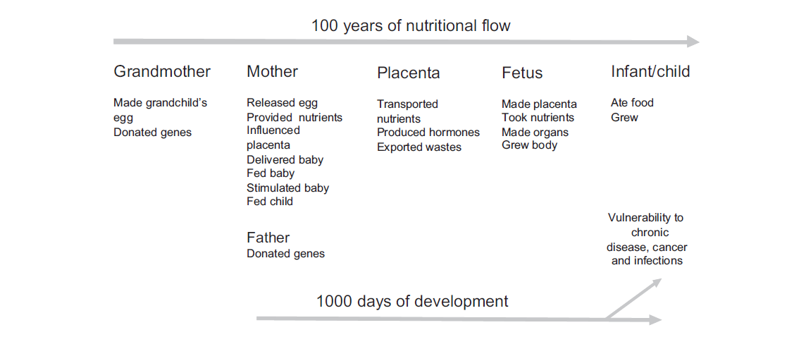
Hypothesized transgenerational flow of risk for chronic disease
Barker, Public Health, 2012 Sir Richard Doll Lecture
75

Slide 76
How special are early developmental periods?
76
Example of Extreme Induced Neuroplasticity in Adults:
  18-30 year olds randomized to 5 days of complete visual deprivation
  All receive intensive Braille training, plus two hours of other tactile games.
  Both improved Braille skills
  Blindfolded group performed better on Braille discrimination.

Slide 77

Quick, reversible plasticity
Sighted recruited occipital cortex for Braille
Day 6 (unblindfolded)
Day 1
Day 3
Day 5
77
Notes:
77
Differential tactile activation maps contrasting the blindfolded and non-blindfolded. Silencing this area with TMS on day 5 impaired Braille performance of the blindfolded group but did not affect performance of the non-blindfolded group.

Slide 78
Merabet et al., 2008
“…sudden and complete visual deprivation in normally sighted individuals can lead to profound, but rapidly reversible, neuroplastic changes by which the occipital cortex becomes engaged in processing of non-visual information. The speed and dynamic nature of the observed changes suggests that normally inhibited or masked functions in the sighted are revealed by visual loss.”
78
Notes:
78
Sile

Slide 79
How much of racial disparities can be explained by genetic factors?
So far, rarely major MAF differences that could account for disease differences: “Despite the rapid increase in the number of genomic studies over the past decade that covered many outcomes, the accumulated evidence for a genetic contribution to CVD disparities in blacks versus whites has been essentially nil.” – Kaufman et al AJE 2015
Genetic ancestry strongly tied to SES
  highest to lowest quartile of African ancestry (among blacks)
  OR for mother completed 8th grade=0.44
  $12,000 less household wealth (Marden)- wealth marks family SES
Adjustment for measured social factors leaves much residual – interpret at “unobserved genetics” or “unobserved social”?
Small samples of non-Europeans → more frequent fluke findings and non-significant results

Slide 80
In groups/ Homework
Choose an aspect of environmental context that could have a profound effect on lifelong health
Hypothesize a mediating pathway
Outline studies you would like to conduct to test this pathway.
  Outline one observational epi study and the major assumptions you would need to make to draw causal inferences about your exposure from that study
  Outline how a lab or animal study might help address those assumptions

Slide 81
end

Slide 82
Example 3
Depletion of self-regulation by repeated exertions of self-control

Slide 83
Self-regulatory depletion- blood glucose influences self-regulation
Self-regulation conceptualized as a “resource” depleted by making difficult decisions or resisting temptation
  Famous examples: Judges make more lenient parole decisions early in the morning and right after lunch (moral: bring your dissertation committee snacks)
  Exposing people to radishes and cookies and asking them to only eat the radishes led to reductions in amount of time spent in a subsequent problem solving task
  Giving people food (glucose) restores self-control (Gailliott)
  Meta-analysis shows persistence across task demands and subsequent displays of self-control
Notes:
Baumeister

Slide 84
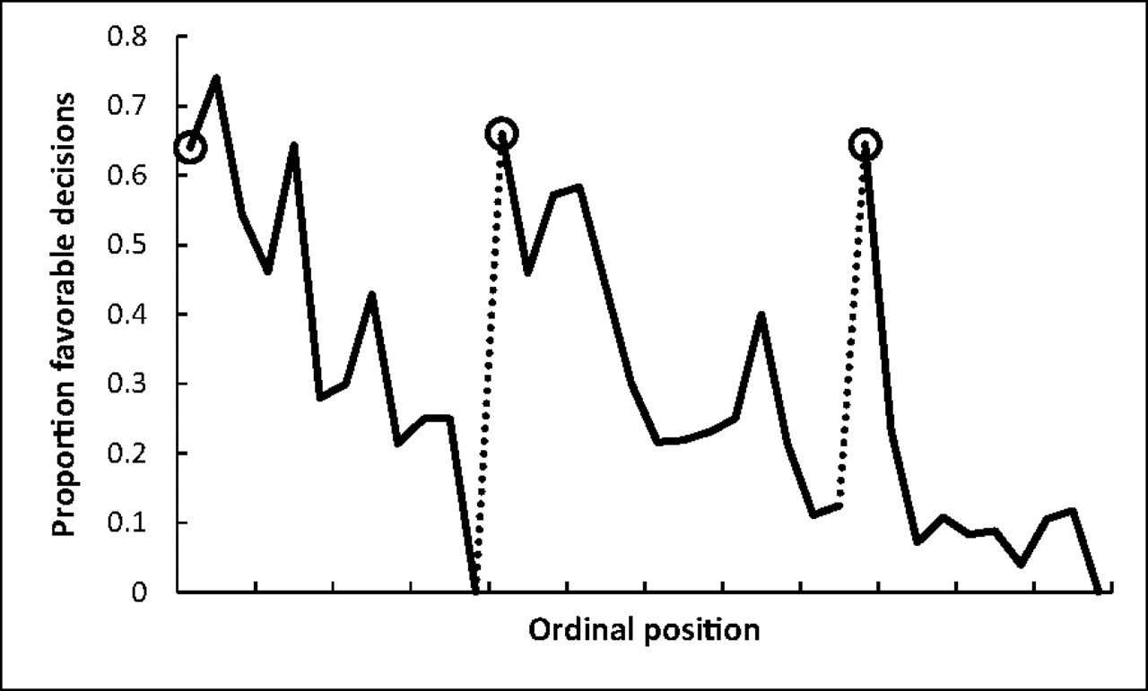
Proportion of rulings in favor of the prisoners by order of decisions faced by the judge that day
Shai Danziger et al. PNAS 2011;108:6889-6892
©2011 by National Academy of Sciences
Notes:
Proportion of rulings in favor of the prisoners by ordinal position. Circled points indicate the first decision in each of the three decision sessions; tick marks on x axis denote every third case; dotted line denotes food break. Because unequal session lengths resulted in a low number of cases for some of the later ordinal positions, the graph is based on the first 95% of the data from each session.
From 1,112 judicial rulings collected over 50 days over 10 months by 8 judges on parole boards in Israel

Slide 85
Recent efforts seek to identify differential neural activity after depletion of self-regulation
Increased reactivity in ventral striatum and differential functional connectivity between orbitofrontal cortex, inferior frontal gyrus. Research preliminary.
Wagner et al 2015

