Slide 1
EPI 262:
Basic Epidemiologic Study Design and Analysis
Course Director: Michael A. Kelsh, MPH, PhD
Center for Observational Research, Amgen, Inc.
Department of Epidemiology and Biostatistics, UCSF

Slide 2
EPI 262 Course Schedule - 2017
Date | Instructor | Topic
01/12 | M. Kelsh | Class logistics, Intro, History of Pharmacoepidemiology, Public health impacts
01/19 | M. Kelsh | Study Design in Pharmacoepidemiology
01/26 | M. Sprafka | Pharmacoepidemiology and Drug Safety
02/02 | V. Chia | Pharmacoepidemiology: Data sources
02/09 | F. Callaghan | Advanced Methods: Quantitative Bias Analyses, MetaAnalysis, FDA – a Brief Overview
02/16 | F. Xue | Advanced Methods/Analytical Approaches
02/23 | D. Cher | Medical Devices, Study Design and Regulatory Considerations
03/02 | M. Woolley | Health Economics I – Basic Principles
03/09 | Beaubrum A Liede | Ethics in Pharmacoepidemiologic Research Case Studies
03/16 | A. Liede M. Kelsh | Ethics/Genetic Research in pharma Class Summary

Slide 3
Take Home Midterm/Final Schedule
Date
Topic
Thursday February 16
Monday February 20
Thursday March 16
Tuesday March 21
Midterm take-home
Turn in Midterm
Final take-home
Turn in Final

Slide 4
Administrative Announcements
General Course Website: ticr.ucsf.edu/courses/schedule/pharmacoepi.html
Website still needs to be updated with 2017 Schedule
  Dr. Kelsh on business trip Feb 9th – There will still be class (Dr. Callaghan) :
  Overview of FDA
  Advanced Methods – Quantitative Bias Analysis, MetaAnalysis

Slide 5
Outline
Epidemiology and special considerations of pharmacoepidemiology
Selecting the appropriate study design
Major sources of error in epidemiology and control of error in pharmacoepidemiology studies

Slide 6
What is epidemiology?
Considered the core science of public health
A scientific discipline with roots in biology, logic, statistical methods and the philosophy of science
Definitions:
  “The study of the distribution and determinants of disease frequency”
  “The study of the occurrence of illness”
  “The study of how often diseases occur in different groups of people and why”

Slide 7
Uses of epidemiology
Population/community health assessment
  Setting policy, planning programs
  Available, accessible, effective, efficient health services?
  Who is the population at risk?
  Unmet needs – estimating ”treatable” population
  Mostly “descriptive epidemiology” – yet critical to public health

Slide 8
Uses of epidemiology
Population/community health assessment
Individual decisions
  Influenced by epidemiologists’ assessment of risk (smoking, dietary fat)
  Who might be at higher risk when taking a certain medication/treatment
  Treatment decisions
  More reliance on analytical epidemiology

Slide 9
Uses of epidemiology
Population/community health assessment
Individual decisions
Completing the clinical picture
  Contributions to understanding the natural history of disease
  Understanding differential risk in subgroups
  Both descriptive and analytical epidemiology

Slide 10
Uses of epidemiology
Population/community health assessment
Individual decisions
Completing the clinical picture
Search for causes
  Factors that influence a population’s risk of disease
  Analytical epidemiology

Slide 11
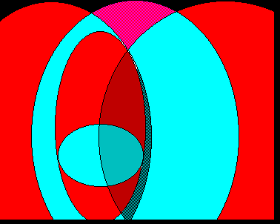
Health services
research
Economics
Epidemiology
Health
economics
Outcomes
research
Clinical epidemiology
Pharmaco-
Epidemiology
Conceptualization by Harry Guess

Slide 12
How might a Pharmacoepidemiology (PE) study differ from “Standard” epidemiology?
Although utilizing a traditional epi framework, PE studies require specific considerations:
  Exposure assessment
  Outcome assessment
  Study Bias
Understanding the disease area and sources of bias are important to design selection
There are a number of sources of bias in PE studies and some confounding can be difficult to control
  Sometimes, less traditional designs and methods are needed to control for bias in these cases

Slide 13
Specifying drug exposures
Exposures often vary over time (time dependent)
Orders and prescriptions may not reflect actual exposure (e.g. adherence)
Drug exposures have multiple dimensions including duration, dose, and bioavailability
  Exposure defined as “ever” is unsatisfactory
Drug exposure immediately or shortly before diagnosis more likely to be part of causal pathway
Common data sources (e.g. claims) are not designed to answer PE questions and may fail to completely capture exposure and diagnostic information

Slide 14
Identifying the clinical outcome
Included cases should be adequately validated
Timing of outcome must be well-defined
  Drug exposure must precede the onset
  Duration of exposure compatible with drug action (latency)
Need to understand the clinical history and how that might affect the probability of: 1) being exposed to the drug, and 2) development of the outcome
Need to understand/evaluate potential sources of bias arising from the data source and population
Improving study design can help to minimize and control bias

Slide 15
Epidemiologic Study Design and Effect Measures

Slide 16
Disease Rates, Measures of Risk
Counts of events
Disease rate: Number of events per population at risk
Incidence vs. prevalence
Risk Difference/Attributable Risk – Comparing the difference of disease/event rates of “exposed group” versus “unexposed group”
Relative risk: Comparing the ratio of disease/event rates of “exposed group”) to disease injury rate in “unexposed group”
95% confidence intervals to represent statistical variability

Slide 17
Risk Measures
Ratio of observed events to expected events
Ratio of disease rate in exposed group compared to disease rate in unexposed group
Many names:
  Odds ratio
  Rate ratio
  Risk ratio
  SMR, SIR
  PMR, PIR
  Prevalence ratio, incidence ratio
Difference measures:
  Absolute risk
  Risk difference
  Attributable risk

Slide 19
Preclinical studies
Phase 1
Phase 2
Premarketing
Phase 3
Drug approval
Phase 4
Postmarketing

Slide 20
Phase 1 clinical studies
Subjects:
  small numbers
  generally healthy volunteers
Purpose:
  Pharmacokinetic parameters
  Common toxic reactions
  Safe dosage range

Slide 21
Phase 2 clinical studies
Subjects:
  Relatively small numbers
  Patients with target disease
  Narrow eligibility criteria
  Can have “single” arm or comparator arm as well
Purpose:
  Dose ranging studies, optimal dose
  Pharmacokinetic parameters in patients with target disease
  Common adverse events in patients with disease
  Preliminary evidence of efficacy

Slide 22
Phase 3 clinical studies
Subjects:
  Usually large studies (n=500-8,000)
  Patients with target disease
  Random allocation, may involve multiple study groups
Purpose:
  Efficacy
  Safety
Pivotal studies
  Used for getting new drugs approved, expand label
  Extensive data collection
Include control or comparator groups

Slide 23
Phase 4 Studies
Post-Market setting
Subjects:
  generally large study population
  those taking the medication vs other/no medication
Purpose:
  Effectiveness of the drug in “real world”, as prescribed
  Additional safety information (e.g. rare events, drug interactions, specific subgroups)
  Long-term safety/efficacy
Sometimes required by FDA
Often observational, although can include allocation component – making it interventional

Slide 24
Population: definition
A group of individuals
  Application of probability to epidemiology: one can rarely predict the specific persons who develop disease
  But in groups, statistical methods can often predict the percentage of individuals who will develop the disease
  Why risk is a population-level concept!
Statistics and its methods do not offer, nor do they aspire to provide, a scientific explanation for the development of disease or the occurrence of death for any particular person

Slide 25
Population: definition
Target population
Population to which results are extrapolated

Slide 26
Population: definition
Target population
Population to which results are extrapolated
Source population (or base population)
the population from which contrast arises

Slide 27
Population: definition
Target population
Population to which results are extrapolated
Source population
the population from which contrast arises
Sample
who is actually in our study
Always ask yourself whether your sample from the source population represents the target population

Slide 28
Mimicking the counterfactual in pharmacoepidemiology
Ideally we would evaluate the causal effect of a drug on an outcome by:
Administering the drug to a person and comparing this person’s experience with the counterfactual experience of what would have happened to the same person at the same time had the drug not been taken
Study designs seek to mimic this causal experiment

Slide 29
The counterfactual model:
The counterfactual ideal
Disease experience, given exposed
Hypothetical disease experience, if unexposed
From: Lash, Modern Epidemiology Lecture Notes, 2008

Slide 30
The counterfactual model:
The counterfactual ideal
Disease experience, given exposed
Substitute disease experience of truly unexposed

Slide 31
Study Designs Used in Pharmacoepidemiology
Case reports
Case series
Cross-sectional
Ecologic
Case-control
  Nested case-control
  Case-crossover
Cohort
  Prospective vs. retrospective

Slide 32
Different comparisons are used to make inferences in PE study designs
Ecologic Study:
  Compares frequency/rate of outcome and drug exposure across populations or time periods
Case-Control Study:
  Compares odds of drug exposure between those who have the outcome and those who do not
Case-Crossover (case only) Study:
  Compares odds of drug exposure before outcome to odds at a different time-point in same individual
Cohort Study:
  Estimates and/or compares rates/risks of outcomes between those exposed and unexposed to a drug

Slide 33
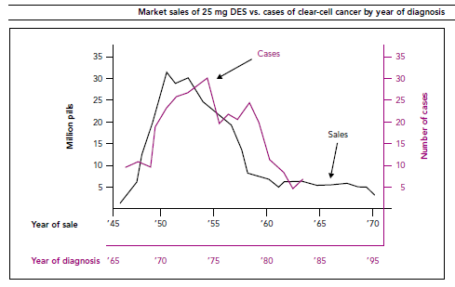
Ecologic data suggest a clear association between the sale of DES and diagnosis of CCC 20 years later
From: Melnick et al, NEJM, 1987

Slide 34
Ecologic Studies:
Breast Cancer Incidence by National Fat Intake
USA
Switzerland
Italy
UK
Israel
Sweden
N Zealand
France
Yugoslavia
Spain
Romania
Poland
Hong Kong
Hungary
Japan

Slide 35
Low-fat study leaves little to chew on
Low-Fat Diet Does Not Cut Health Risks, Study Finds
Study of older women shows little effect on disease rates
CNN.com
Associated Press
By GINA KOLATA
Published: February 8, 2006
The largest study ever to ask whether a low-fat diet reduces the risk of getting cancer or heart disease has found that the diet has no effect.
Low-fat study unlikely to reduce offerings at grocery store
By Bruce Horovitz, USA TODAY
Sorry, potato chip lovers. And ice cream worshipers. And cheeseburger chompers.
Low-fat foods are not on their death bed — despite an eight-year, federal study of 49,000 women announced Wednesday that determined there's no beneficial link between low-fat diets and lower incidence of cancer or heart disease.
Low fat diet's disease prevention benefits overstated
Asian News International
Washington, February 9, 2006
A new study has revealed that merely switching on to a low fat diet does not reduce the risk of breast cancer, colorectal cancer or heart disease, in women, instead they should cut back on saturated and trans fats.

Slide 36
Should we abandon low fat diets?
Only one study, although largest and is a clinical trial, need to consider all of the evidence
In fact epidemiologic evidence has not been that strong in showing benefits of low fat diet
Limited time of follow-up (8.1 years)
Diet change at an older age (post menopausal women)
Modest dietary differences
Actually observed some modest effects

Slide 37
Cohort Studies - Defining a cohort
Cohort: “any designated group of individuals who are followed or traced over a period of time”
  Nurses Health Study, Framingham, ARIC, WHI
Cohort study: “study based on random samples of populations with differing exposure characteristics:
Closed vs. open cohorts
Can estimate ratio and difference measures

Slide 38
Cohort study basic design
Disease
Exposed
No disease
Must account for differences in distributions of patient characteristics that could predict outcome
Disease
Unexposed
No disease
Time

Slide 39
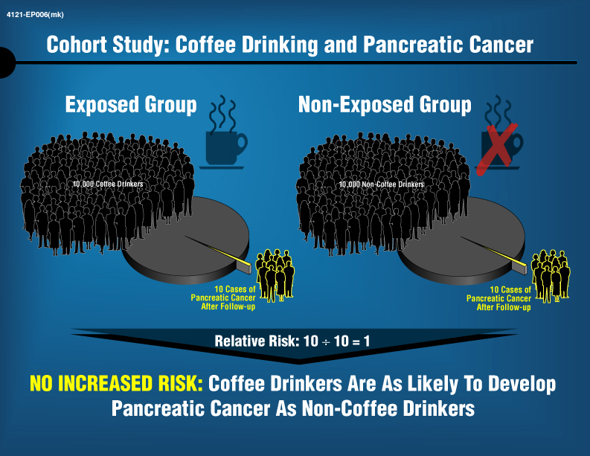

Slide 40
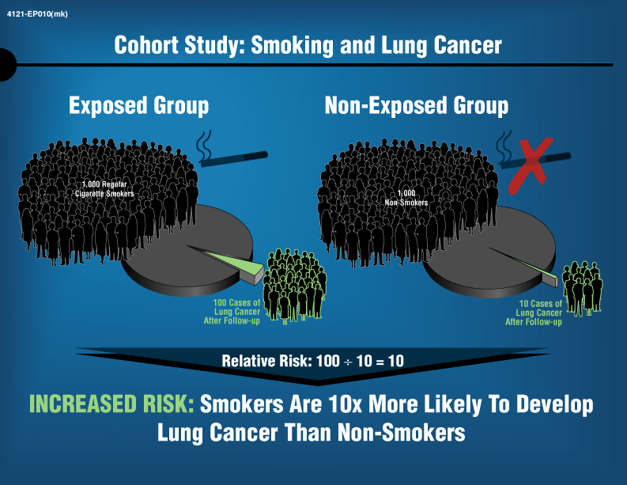

Slide 41
Cohort studies are used to answer various PE questions
Understanding disease states
  “Healthy” cohorts (e.g. Framingham, NHS)
  Patient registries and prospective/retrospective cohorts
Safety and pharmacovigilence
  Disease/Drug registries
  Prospective/Retrospective cohort studies
Drug effectiveness (comparative effectiveness)
    Prospective/Retrospective cohort studies
Very useful when studying multiple outcomes from a single exposure (e.g. effects from a newly marketed drug)

Slide 42
Case-control study
Studies that compare cases with a disease to controls without the disease, looking for differences in antecedent exposures
Yields estimates of ratio effect measures (i.e. odds ratio, OR)
  When well-designed (cases/controls selected irrespective of exposure status; exposure distribution of controls represents source population), odds ratio estimates of the incidence rate ratio
Most efficient for rare diseases, diseases with a long latency period
Can evaluate multiple exposures with study design
Outcome measure often more precise

Slide 43
Case-control basic design
Study begins by selecting subjects based on case status
Exposed
Look-back
CASE
Unexposed
Then, match controls to cases in an n:1 ratio
Exposed
Look-back
CONTROL
Unexposed

Slide 44
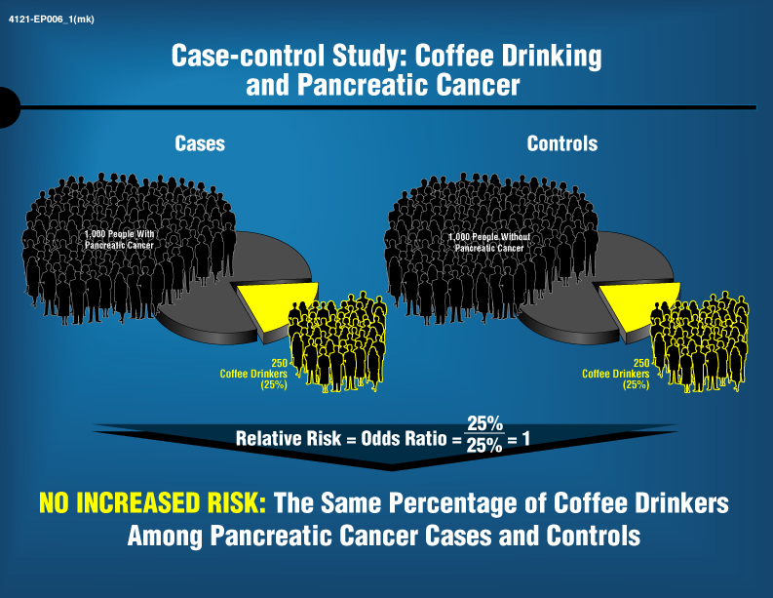

Slide 45
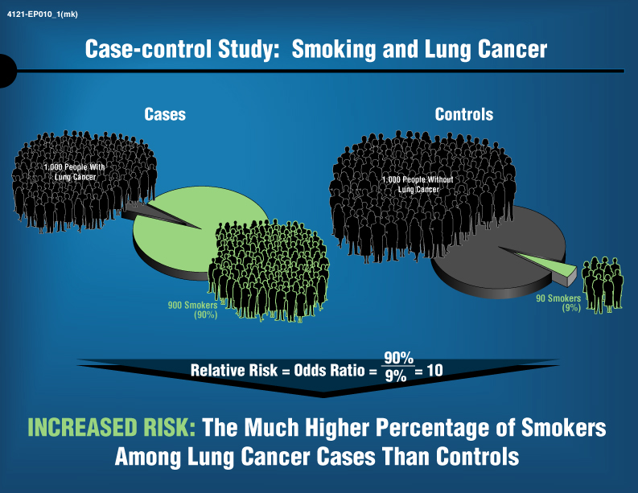

Slide 46
A classic case: The DES story: long-term consequences of prenatal exposure
In 1971, Herbst et al published a report of a rare vaginal cancer (vaginal clear-cell adenocarcinoma, CCC) in 8 young women diagnosed in a Boston hospital
  Cancer had never before been seen in this age group in this hospital (generally diagnosed in women >50 years)
Findings linked CCC with prenatal exposure to synthetic oestrogen diethylstilboestrol (DES)
DES had been prescribed since 1947 in the widespread belief that it prevented spontaneous abortion (miscarriage)

Slide 47
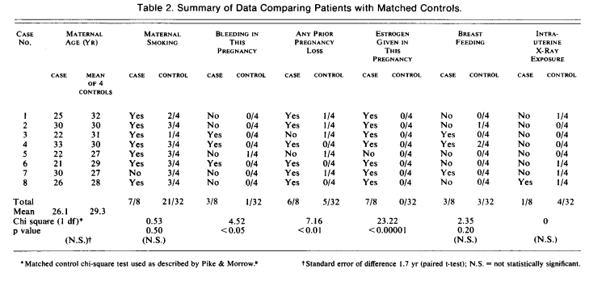
Matched case-control study very effective in showing association
Study required only 8 cases and 32 matched controls
From: Herbst et al, NEJM, 1971

Slide 48
Case-control Example:
Silicon Breast Implants and Chronic Disease
Background: Concerns various disease outcomes
  Neurological disease
  Connective Tissue Disorders
  Cancer
Two ongoing prospective cohort studies being conducted
  Large studies 10,000 + patients enrolled
  10 years+ follow-up required to observe disease events
  Expensive, challenges with loss to follow-up, burdensome
Case-control studies in Brazil
  Prevalence of exposure – higher than most regions
  Can provide answers about risk in a more timely manner – i.e. more readily addresses long latency period
  Cost efficiencies
  Challenges in measuring exposure

Slide 49
Proper selection of controls can be challenging
If the controls are well selected, their exposure distribution represents the exposure distribution of the source population for the cases
  i.e. controls should represent the source population, not the most fit, healthy, and productive members of society (unless the source population only contained such people)
Usually, the source population is an open cohort, so the controls are intended to represent the exposure distribution in the person-time at risk

Slide 50
Consider the case-crossover design in Pharmacoepidemiology
Study begins by selecting subjects based on case status
Uses a case as his/her own control by considering person-time before the case event
Exp
3 days
Case
date
Not Exp
Exp
3 days
Control
date
2 months
Not Exp
Exp
3 days
Control
date
4 months
Not Exp

Slide 51
Strengths of the case-crossover design
By using a patient as his/her own control all time-invariant factors are adjusted including those difficult to measure
  Genetic polymorphisms, lifestyle, and socioeconomic factors (given the time horizon is not too long)
Reductions in effect measures are expected from a case-control to case-crossover
  Crossover design better controls for patient frailty
Design works best when exposure varies with time and the outcome has an acute onset

Slide 52
Examples Where Case-Crossover Might be used
Mobile phone use and motor vehicle accident:
  Researchers were able to combine phone records and insurance claims data
Viagra use and CV events
Asthma inhaler use and XX event
XX Medication/event and migraine headaches
Key to conducting an unbiased study will be the ability to precisely measure the time of exposure and time of outcome events

Slide 53
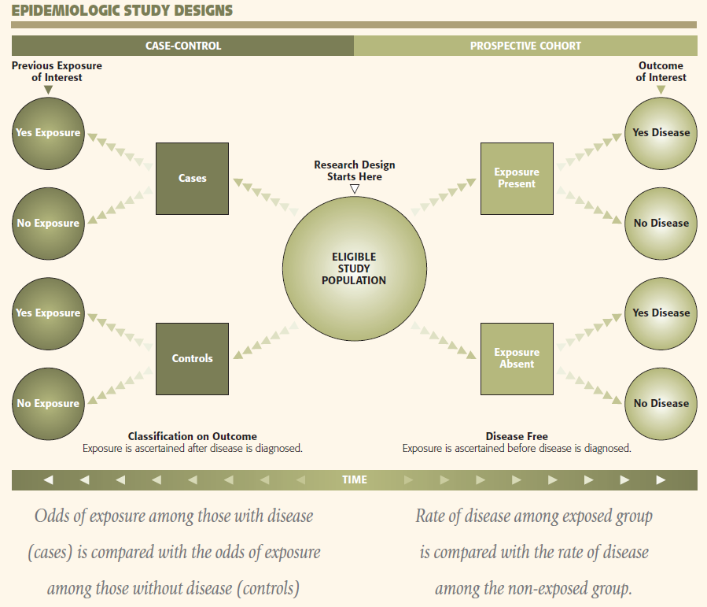

Slide 54
Summary: Limitations of different study designs
Some limitations of observational cohorts
  Often have low power and precision for rare diseases
  Do have the potential for selection bias, with regard to unknown or unmeasured confounders
  Outcome information is often inferior
Some limitations of case-control studies
  Control-selection bias is often a major concern
  Exposure information is sometimes inferior
  Matching limits analytic options
  Some say we "generate hypotheses" with case-control studies and "test" them with cohort studies

Slide 55
Appropriate design depends on the question, exposure/outcome relationship, and logistics

Slide 56
Proposed Hierarchy of Evidence
Systematic reviews of randomized trials
Single randomized trial
Systematic review of observational studies
Single observational study
Physiologic studies
Unsystematic clinical observations
Guyatt et al. JAMA 2000; 284:1290-1296

Slide 57
Rothman – Six Research Misconceptions
Hierarchy of research study designs
Representative Sample of target population
Product terms in regression model and biological interactions
Continuous variables and percentile categories
Multiple Comparison Adjustment
Significance testing data interpretation

Slide 58
Final words
Remember, all designs have limitations. Thoughtfully select the most appropriate design.
Carefully interpret your results
  Understand the definition and measurement of drug exposure
  Understand the validity and relevance of the case definition
  Carefully interpret the effect estimate along with its associated measure of precision
  Understand areas of residual bias that might impact the validity of your results
  Avoid the pitfall of extending your conclusions past where the results meaningfully can take you

Slide 59
Systematic Error and confounding

Slide 60
Multiple sources of systematic error (bias) in pharmacoepi studies
Selection Bias
  Referral Bias
  Self-Selection Bias
  Prevalence Bias
  Protopathic Bias
Misclassification
  Recall bias
  Detection bias
  Immortal time bias
Confounding
  By indication
  By co-medication

Slide 61
Error in epidemiology studies
Two types of error in an epidemiology study:
  Random error (measured by precision)
  Systematic error (bias)
Random error approaches 0 as N increases→ Systematic error does not!
Systematic error typically minimized through study design and analytic approaches
Unique challenges to consider in pharmacoepi studies

Slide 62
Confounding is a mixing of effects
The effect of the exposure is mixed together with the effect of another variable, leading to a bias.
Arises when the target population and a substitute population have different distributions of variables

Slide 63
Birth order & Down’s syndrome: classic example
From: Rothman, Epidemiology: An Introduction, 2002

Slide 64
Three criteria of a confounder
Must be a cause or a proxy for a cause of the disease
Must be a cause of the exposure
Must not be an intermediate in the causal pathway
Confounding
Factor(s)
C
X
Y
Exposure
Outcome

Slide 65
Example of confounding – Alcohol use and cardiovascular disease (CVD) risk
Does alcohol use increase the risk of CVD?
 | Exposed | Unexposed
Cases | 200 | 100
Non-cases | 800 | 900
Total | 1000 | 1000
Risk | 0.2 | 0.1
RR | 2.0
Relative Risk (RR)
Risk in Exposed
Risk in Unexposed

Slide 66
Removing the imbalance of smoking status reveals much lower risk related to exposure
 | Smoker |  | Non-smoker |  | Total
 | Exposed | Unexposed | Exposed | Unexposed | Exposed | Unexposed
Cases | 195 | 73 | 5 | 27 | 200 | 100
Non-cases | 705 | 320 | 95 | 580 | 800 | 900
Total | 900 | 393 | 100 | 607 | 1000 | 1000
Risk | 0.216 | 0.186 | 0.05 | 0.044 | 0.2 | 0.1
RR | 1.16 |  | 1.14 |  | 2.0
MH RR^ | 1.15 |  |  |  | 2.0
^Mantel Haenszel Relative Risk (MH RR) – summarizes across strata

Slide 67
Confounding-by-indication is a significant source of bias in pharmacoepidemiology
Patients who take a drug generally differ from those who do not take the drug
Example 1: A therapeutic, or higher dose of the drug, may be prescribed to sicker patients
  Drug can appear harmful because exposed patients are at a higher baseline risk
Example 2: Conversely, a therapeutic may be prescribed to healthier patients
  Drug may appear more beneficial than it really is because exposed patients are at a lower baseline risk

Slide 68
Confounding by Indication is common in studies of real-world use of drugs
Patient Level Prognostic Factors
Use/Dose of Drug X
Clinical/Economic Outcomes

Slide 69
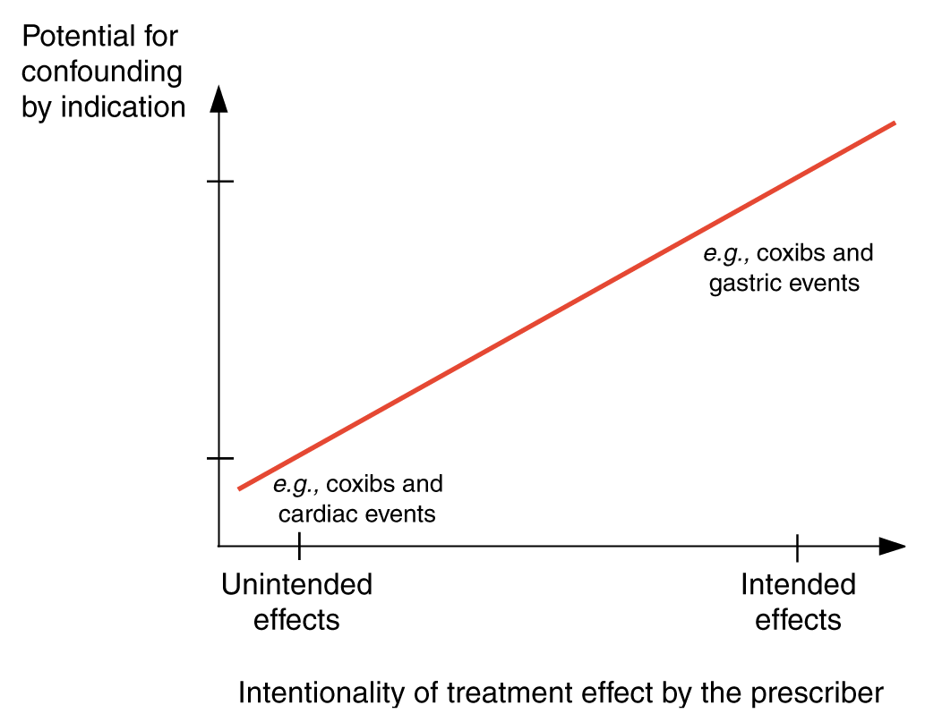
Confounding by indication: A particular challenge for PE
From: Schneeweiss, Clin Pharmacol Ther, 2007

Slide 70
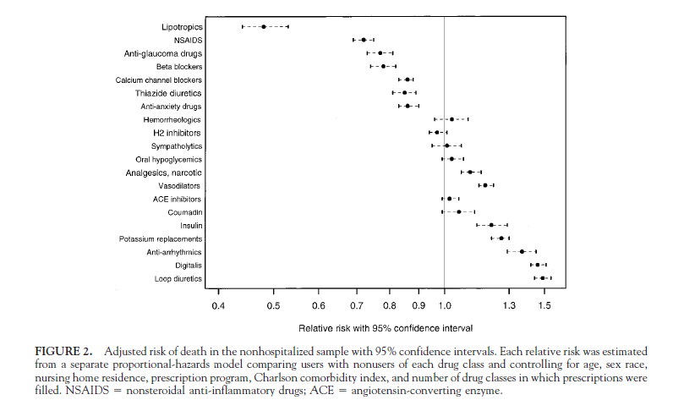
Paradoxical relation of drugs with death
From: Glynn et al., Epidemiology, 2001

Slide 71
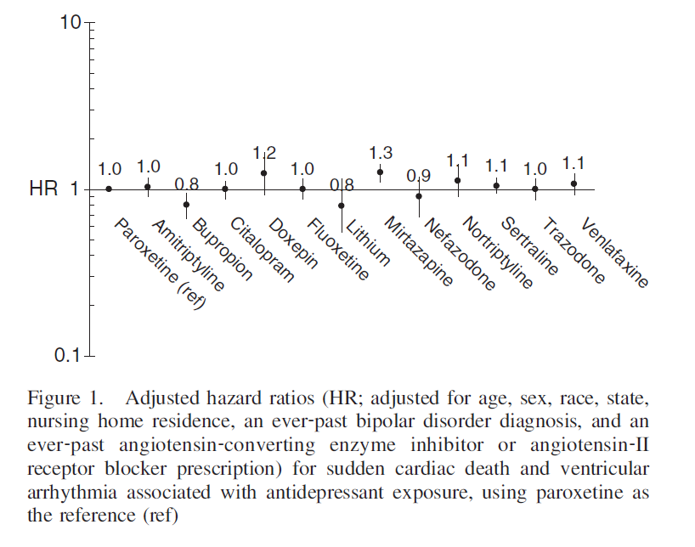
Retrospective cohort study evaluated comparative safety of anti-depressents
From: Leonard et al, Pharmacoepidemiology & Drug Safety, 2011

Slide 72
Example of CBI: Thiazolidinidiones (TZDs)
TZDs are a class of oral hypoglycemic agents used to treat Type II diabetes; introduced to market in 2000
Includes rosiglitazone and pioglitazone
Has been shown to be more effective in reducing glucose levels than other drugs, but concerns about adverse events
Therefore, possibility of preferential prescription to patients with more severe diabetes

Slide 73
Two outcomes of interest
Microvascular disease (retinopathy, nephropathy, neuropathy)
  Risk increases with increasing glucose levels
Myocardial infarction
  Relationship with glucose levels not as straightforward
  However, patients with more severe diabetes tend to have other risk factors for MI (i.e., overweight, high blood pressure, etc.)
Confounding by indication is more likely in studies of intended vs. unintended effects
Rosiglitazone was withdrawn from market in Europe; severely restricted use allowed in US

Slide 74
CBI in NSAIDS and COX-2 inhibitors
NSAIDS are known to cause GI bleeding.
Those with history of GI bleed/risk factors would therefore be more likely to receive COX-2 inhibitors.
This leads to appearance of COX-2/GI bleed association due to confounding by indication.

Slide 75
Design and analytic approaches are used in to address confounding in PE studies
Design Stage:
  Randomization
  Restriction
Analytic Stage:
  Stratification
  Regression modeling
  Propensity scores
  Marginal structural modeling (MSM)
  Instrumental variable analysis (IV)

Slide 76
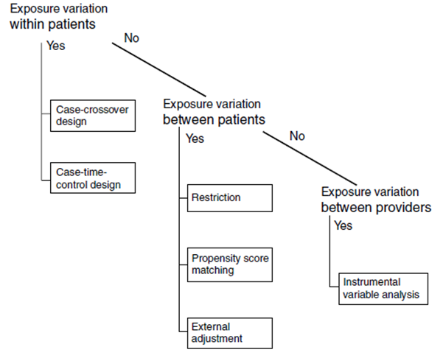
Pattern of drug utilization can guide choice approach to control confounders

Slide 77
Restriction in study design can prevent confounding but limit ability to generalize findings.
Limiting the study to only certain levels of a confounder (e.g. age strata, gender, etc)
“A variable cannot produce confounding if it is prohibited from varying.”¹
*
*
Age
Age > 65
Ischemic Heart Disease
Ischemic Heart Disease
Diabetes
Diabetes
Rothman, Greenland, Lash, Modern Epidemiology 3rd ed.
*Jager, KI, 2008

Slide 78
Regression analysis can more efficiently handle multiple confounders though “modeling” assumptions are required
Demographics Age, Diabetes, Gender
Malnutrition
Inflammation
(MICS)
Dietary Protein
Mortality
*From: Shinaberger, et. al. 2006

Slide 79
misclassification

Slide 80
Misclassification
  “Of equal or greater importance [as confounding] to validity are problems of measurement error, which in most cases (and contrary to popular lore) cannot be validly handled by simple approaches, such as stratification on indicators of ‘information quality.’” — Greenland, Pearl & Robins, 1999
Arises when information collected about or from study subjects is erroneous:
  Exposure misclassification
  Disease misclassification
  Misclassification of covariates
  Common problem when using claims databases for pharmacoepidemiology studies

Slide 81
Exposure Misclassification
Occurs in virtually every study
Hope that it is non-differential
  assess direction of bias and impact
Non-differential exposure misclassification:
  generally biases towards null
  larger impact when “true” relative risk is higher
  more concern with negative studies

Slide 82
Definitions: Sensitivity & Specificity (E=truth; T=test)
Classification values (truth in the denominator)
  Sensitivity = the probability of being correctly classified as exposed. Pr(T+|E+)
  False negative rate = the probability of being incorrectly classified as unexposed. 1-sensitivity
  Specificity = the probability of being correctly classified as unexposed Pr(T-|E-)
  False positive rate = the probability of being incorrectly classified as exposed. 1-specificity

Slide 83
Definitions: PPV & NPV
Classification values (truth in the numerator)
  Different than sensitivity & specificity – relies on underlying prevalence in population
  Positive predictive value = the probability of truly being exposed, given classification of exposure Pr(T+|E+)
  Negative predictive value = the probability of truly being unexposed, given classification of non-exposed Pr(T-|E-)

Slide 84
Relation between predictive and classification measures

Slide 85
Example of misclassification
Exposure: Smoking during pregnancy
Outcome: Breast cancer risk
RR_{obs} = 0.95 (95% CI 0.81 – 1.1)
Smoking was collected based on self-report on child’s birth certificate, so concern about exposure misclassification
 | E = 1 | E = 0
Breast cancer | 215 | 1,449
No breast cancer | 668 | 4,296
Example from: Lash TL, Fox MP, Fink AK. Applying Quantitative Bias Analysis to Epidemiologic Data. Springer. 2009.

Slide 86
Example of misclassification (con’d)
Assuming a sensitivity of 78% and specificity of 99% from a validation study:
RR_{adj} = 0.949 vs. RR_{obs} = 0.954 → Misclassification not a strong bias
 | Smokers | Nonsmokers
Cases | 257.6 | 1406.4
Controls | 803.1 | 4160.9

Slide 87
Exposure Misclassification – General Example

Slide 88
Validity Studies of Exposure Assessment Instrument
Exposure assessment – “the 600 pound” gorilla in epidemiology
Validity and uncertainty more important than correlation and p values
Better off to invest resources in smaller exposure assessment validation study

Slide 89
Latency Analyses
Definitions of latency period:
  Time from first exposure to disease on set
Exposure windows
Methods for identifying appropriate exposure windows
  Biological, epidemiologic rationale
  Statistical methods

Slide 90
Strategies for addressing misclassification
Study Design
  Consideration of the quality of the data source (e.g. objective records vs. self-report)
  Prospective collection of exposure data (advantages of claims data sources; even in case control studies)
Quantitative bias analysis
  Need to define bias parameters from validation sub-studies

Slide 91
Immortal Time Bias

Slide 92
Important Bias in PE Studies:
Immortal Person Time Bias
“Span of cohort follow-up or observation time, which because of exposure definition, the study outcome or death cannot occur” – (Suissa 2008)
“Immortal time” – a period of follow-up during which by design, death or study outcome cannot occur (Levesque 2010)
In pharmacoepidemiology – happens when individual’s treatment status involves a delay or wait period (e.g. waiting for prescription after discharge)
Can be quite common in cohort studies of drug effects (Suissa, 2008)

Slide 93
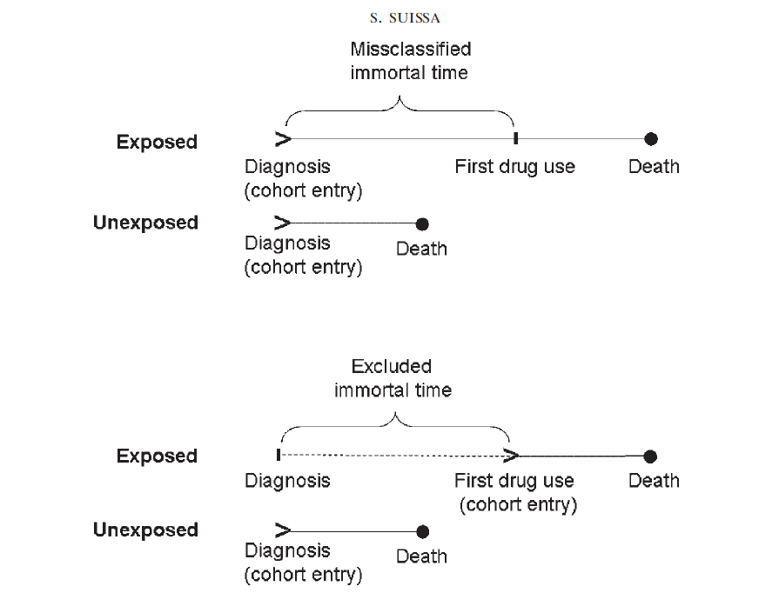

Slide 94
Immortal Person Time Bias
A misclassification bias when classifying the immortal time as treatment follow-up time – inflates the denominator – biases risk estimate towards the null
A selection bias when excluded immortal time leads to excluding individuals who do not receive treatment – bias could go in either direction
The amount of bias on the effect measures (e.g. HR) – will be dependent on the amount of immortal time misclassified
  Less impact on acute events

Slide 95
Identifying Immortal Time Bias (Levesque 2010)
Was treatment status determined after the start of follow-up, or defined using follow-up time?
Was the start of follow-up different for treated and untreated (comparator) groups?
Were treatment groups identified hierarchically (one group before the other)?
Were subjects excluded on the bases of treatement identified during follow-up
Was a fixed time analysis used?
  Fixed time refers to classifying exposed and unexposed time only in one group, cannot change over time

Slide 96
Immortal Time Bias – Examples
Statin use and reduction of the risk of diabetes progression (Levesque, 2010)
  Looked at time between statin use and initiation of insulin treatment
Use of corticosteriods to prevent mortality due to COPD compared with use of bronchodilators
  More time between diagnosis of COPD and corticosteriod use than diagnosis of COPD and bronchodilator use.
  Also – hierarchal example - corticosteriod use often followed bronchodilator use, from time of diagnosis, there is immortal time for corticosteriod use
Survival of heart transplant patients vs non-transplant patients
  similarly hematopoietic stem cell transplant patients

Slide 97
Analytical and Design Methods to Deal with Immortal Time Bias
Time Dependent analyses:
  Classify treatment time accurately
  Cox regression
  Other statistical techniques – Mantel Byar
Time-matched nested case-control studies within a cohort

Slide 98
Selection Bias

Slide 99
Selection bias — definition
Distortions of the estimate of effect arising from procedures used to select subjects and from factors that influence study participation
Common element is that the exposure-disease relation is different among participants than among those theoretically eligible
Observed estimate of effect reflects a mixture of forces affecting participation and forces affecting disease occurrence

Slide 100
Summary
Multiple sources of bias in PE studies can obscure the risks and benefits of therapies.
Confounding by indication is one common source of bias in PE studies.
A number of approaches can be used to address this and other sources of bias although complex forms of bias persist.
Given the need to use OR in this context, causal inference in PE is a very active area of study.

Slide 101
