Slide 1
Databases for Pharmacoepidemiology Studies: Attributes and Implications
Vicky Chia

Slide 2
Outline
Data needs for pharmacoepidemiology studies
Sources of data and types of databases
Working with a database
Some examples

Slide 3
Large databases can be useful in characterizing diseases
Phase 1
Phase 2
Phase 3
Launch
Post-Approval
Understand the Disease
Understanding:
Incidence, prevalence, survival & mortality
Risk factors of disease
Disease pathophysiology
Natural history of disease
Burden of disease: disability, life years lost
Understanding:
Disease pathophysiology
Predictors of patient outcomes
Disease burden and outcomes
Informs public health and decision-making:
Patient risk stratification
Clinical trial design
Pharmacoepidemiology modeling
Post-marketing drug safety research
Informs public health and decision-making:
Identify diseases with unmet medical need
Size patient populations
Inform clinical trial design
Pricing & reimbursement
Also informs:
Health economics
Health policy

Slide 4
Large databases are essential for conducting pharmacoepidemiologic studies
Phase 1
Phase 2
Phase 3
Launch
Post-Approval
Pharmacoepidemiology
Evaluating:
Utilization of existing therapeutics
  Clinical practice patterns
  Treatment guidelines
  Coverage policies
Patient outcomes with current therapies
Evaluating:
Real world utilization
Post-marketing effectiveness
Pharmacovigilance
Predictors of patient outcomes
Informs public health and decision-making:
Identify patients with unmet medical need
Size patient populations
Inform clinical trial design
Pricing & reimbursement/patient access
Informs public health and decision-making:
Are therapies used appropriately?
What is the population-level impact?
What is the benefit/risk profile?
Patient stratification
Treatment guidelines
Health policy

Slide 5
What kind of data are needed?
Significant gaps in disease state knowledge
  Incidence, prevalence, survival & mortality
  Disease pathophysiology, risk factors, natural history
  Predictors of patient outcomes course
  Burden of disease – disability, potential life years lost
RCTs provide limited information
  Real-world utilization
    Access, treatment guidelines, medication adherence
  Post-marketing effectiveness and safety
  Population sub-groups of particular interest
    Older adults, patients with greater comorbidity/frailty

Slide 6
Outline
Data needs for pharmacoepidemiology studies
Sources of data and types of databases
Working with a database
Some examples

Slide 7
Databases
Variety of data sources available
  Registries, cohorts, claims, health records, surveys...
Not all databases are created equal
  Different strengths and weaknesses
  Most were not created specifically for pharmacoepidemiologic or health services research
Appropriate selection of a database often depends on the research question
  Occasionally research questions must be adapted

Slide 8
Understanding the data is critical
Original intent for collecting the data
  Reimbursement
  Record of service
  Surveillance – disease, costs of care, care utilization
  Specific research/scientific question
Method for data collection
  Automated (medical claims, dispensing records)
  Clinical based (electronic medical records)
  Medical record abstraction
  Surveys
Organization and presentation of data
  Standardized coding system vs. Free text
  Quantitative vs. Qualitative

Slide 9
Other important data considerations
Characteristics of the population within the database
  Population-based? Clinic-based? Pharmacy-based?
  Sampling method – random, stratified, convenience
  Age, sex, geography, employment status, socioeconomic status
Time period over which the data was collected
  Historical data can be advantageous
  Absence of more recent data is often a limitation
Inclusion criteria
  Insurance coverage necessary?
  Geographic area of residence influential?
Adjudication of information
  Verification of diagnosis made?
  Medication administration confirmed?

Slide 10
Types of databases
Administrative claims
  US: Medicare, Medicaid, United HealthCare, MarketScan
Pharmacy databases
  US: IMS LRx, Retail pharmacy chain data
Surveillance – surveys, registries
  National Health and Nutrition Examination Survey (NHANES)
  Surveillance Epidemiology and End Results (SEER)
  Nordic national databases and registries
Electronic medical/health records databases
  US: Kaiser Permanente, Group Health Cooperative, Geisinger, OSCER
  UK: Clinical Practice Research Datalink (CPRD, formerly GPRD)
Cohort studies
Notes:
Spontaneous reporting of ADR (adverse drug reaction) may generate hypotheses

Slide 11
Administrative Claims Data

Slide 12
Administrative claims data
Provider: Physician
Provider: Facility
Data User
Payer
Provider: Pharmacy
Enrollment
Records of billable services rendered to insured patients by providers within the health care system
Data collected for the primary purpose of reimbursement
  Payers may also have incentive to use data for program/policy evaluation
Databases are usually large (millions of individuals/claims)
Usually contains multiple files organized by service type and linked by a patient identifier

Slide 13
Administrative claims data
Common Data Elements
  Provider
    Date of provider claim
    Provider specialty
    Place of service
    Diagnosis codes (ICD-9)
    Procedural codes (HCPCS, CPT)
    Cost of professional services
  Facility
    Dates of admission & discharge
    Length of stay
    Diagnosis and procedural codes
    Cost of facility services
    Pharmacy
    Date of prescription claim
    National Drug Code
    Quantity dispensed
    Days supply
    Cost of prescription fill
    Enrollment
    Dates of enrollment
    Sex
    Year of birth
    Insurance plan type
    Geographic region

Slide 14
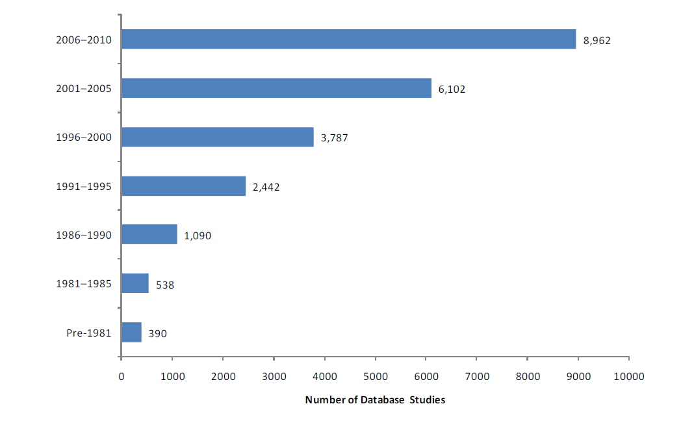
Studies using administrative claims databases are becoming more common

Slide 15
Considerations in using an administrative claims database
Availability of other data of interest
  Laboratory values or results of diagnostic tests
  Linkage to mortality data or medical charts
Data on potentially important confounders is often lacking
  Patient lifestyle behaviors – smoking, diet, exercise
  Other patient demographics – race, ethnicity, SES
Diagnosis and procedure codes have limitations
  Rule-out diagnosis vs. true diagnosis
  Inclusion of ‘most important’ / exclusion of less important diagnoses
  Sensitivity and specificity
Non-covered services and medications are typically excluded
  Over-the-counter (OTC) medications, CAM
  Cosmetic, lifestyle, weight-loss medications and services
Supplemental insurance/other payer data may not be included

Slide 16
Examples of large administrative claims databases
 | Medicare | MarketScan
Purpose | Reimbursement for medical services rendered | Reimbursement for medical services rendered
Patient population | Medicare beneficiaries: Most 65+ years old; nationally representative; not transient | Data from employer groups (working and insured); tends to be younger (<65 years old); more transient
Data available | Inpatient stays Outpatient/physician visits Prescriptions – Part D All deaths | Inpatient stays Outpatient/physician visits Prescriptions Some laboratory data Only inpatient deaths
Time lag | ~2 years | ~ 3-6 months

Slide 17
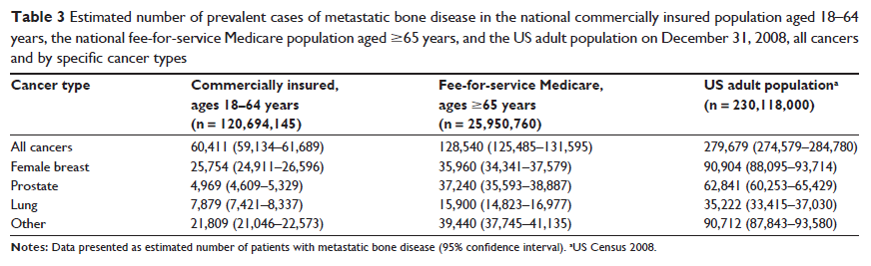
Using MarketScan and Medicare data to understand prevalence of disease
Li S et al. Clinical Epidemiology 2012;4:87-93

Slide 18
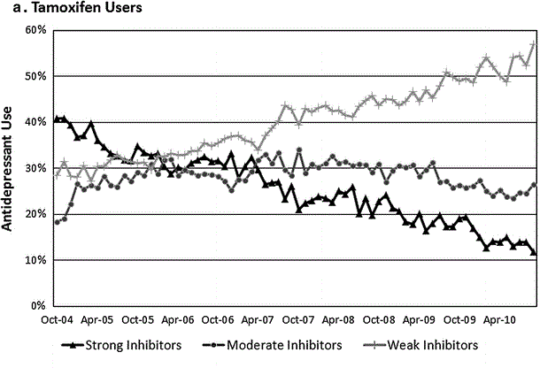
MarketScan data to describe prescribing patterns
Tamoxifen and anti-depressant co-prescribing by CYP2D6 status
Dusetzina SB et al. Breast Cancer Res Treat. 2013;137:285-96

Slide 19
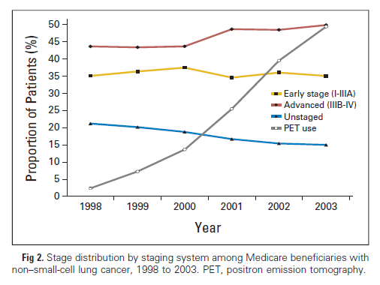
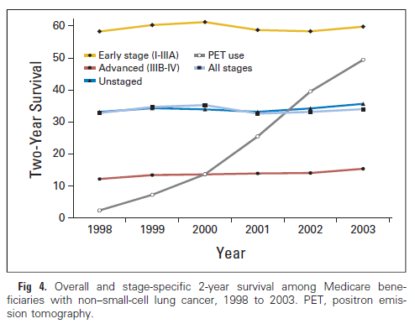
Medicare data provides useful surveillance information on use of therapies/diagnostic tests

Slide 20
Claims data: strengths & limitations
Strengths
Population-based (Medicare) → improved generalizability
Large sample size → less random error
Longitudinal data
Can generate population-level statistics → incidence, prevalence
Limitations
Minimal information on potential confounders
  smoking status, alcohol consumption, BMI, laboratory values
Potential for confounding by indication
Data only collected when provider submits claim to payer
  No information on services paid for100% out-of-pocket
  No information on individuals not seeking care
No information on prescription directions or OTC drug use
Notes:
Population based – defined as those in which the cases are a representative sample of all cases in a precisely defined population and the controls are directly sampled randomly from the population.

Slide 21
Pharmacy Databases

Slide 22
Pharmacy databases
Data from community pharmacies
Databases maintained by:
  Large retail chain pharmacies
  Grocery chain pharmacies
  IMS LRx
May be linked to prescription claims data
  CVS - CVS/Caremark
  Walgreens – Walgreens Health Initiative, Medicaid
Outside US: databases may include pharmacy dispensing records linked to other data sources (e.g., hospital admissions, physician visits, etc.)

Slide 23
Pharmacy databases
Possible Data Elements
  Prescriber characteristics
    Provider specialty
    Sex
  Patient characteristics
    Age
    Sex
    Insurance type
      Employer-sponsored
      Medicare
      Medicaid
      Cash/discount card
    Prescription specifics
    Date of prescription fill
    National Drug Code
    Dose
    Directions for use
    Quantity dispensed
    Days supply
    Cost of prescription fill
      Co-payment/co-insurance
      Dispensing fee
      Charge for medication
    Date prescription picked up

Slide 24
Pharmacy databases
  Potential uses in research
Medication use/adherence/persistence
  Adherence to diabetes treatment among cash paying individuals
Evaluate pharmacist-based interventions
  Effect of counseling on medication adherence
‘Doctor shopping’/controlled substance diversion
  Descriptive analysis of ADHD doctor shopping
Abandoned prescriptions
  Proportion of prescriptions never filled, not picked up

Slide 25
Pharmacy data: strengths & limitations
Strengths
Information on drug dose and directions for use
Captures information for patients w/o prescription drug coverage
Captures information on non-covered prescription drugs
Potentially large sample size → less random error
Longitudinal data possible
Limitations
Data on prescriptions filled at other pharmacies may be missing
Diagnosis information usually not available
No information on health outcomes unless data is linked to claims data or electronic medical/health records
Minimal information on other health variables of interest
  smoking status, alcohol consumption, BMI, laboratory values
Generally no information on OTC drug use

Slide 26
Surveillance Data

Slide 27
Surveillance data
Incidence and prevalence of disease
Health status, health care access, and progress toward national health objectives
Provision and use of health care services
Medical expenditures and cost of care
Disease survival and mortality statistics

Slide 28
Surveillance databases: examples
Database | Information includes
National Center for Health Statistics
Health Interview Survey (NHIS) | Health status and health care access
Health & Nutrition Examination Survey (NHANES) | Disease states, labs, tests, medications
Health Care Surveys | Provider characteristics – technology diffusion, care quality, disparities
Vital Statistics System (NVSS) | Birth and death events
Cancer Registries
Surveillance, Epidemiology, & End Results (SEER) | Incidence, prevalence, survival, mortality
Intl Agency for Research on Cancer (IARC) | Incidence, prevalence, mortality
Agency for Healthcare Research & Quality
Medical Expenditure Panel Survey (MEPS) | Cost/use of care; insurance coverage
Healthcare Cost and Utilization Project (HCUP) Nationwide Inpatient Sample | Diagnoses, procedures, total charges, comorbidity, insured/un-insured

Slide 29
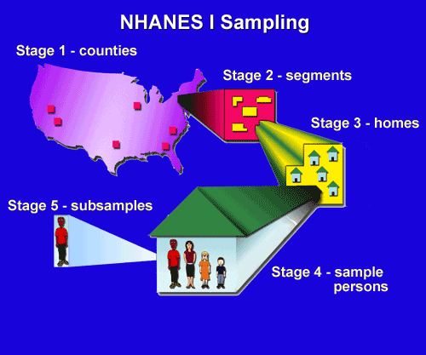

NHANES
Combination of interviews and physical examinations
  Collection of demographic, socioeconomic, dietary, medical, and dental information, physiological measurements, and lab tests
Data elements include diagnosed/undiagnosed chronic conditions, lifestyle behaviors, and medication use

Slide 30
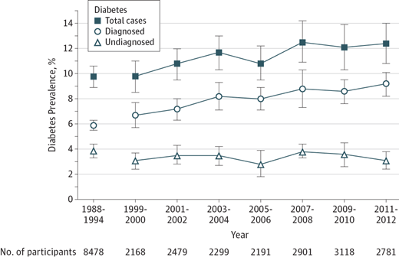
US trends in diabetes prevalence in adults aged 20 years and older
Menke A et al. JAMA 2015;314:1021-1029

Slide 31
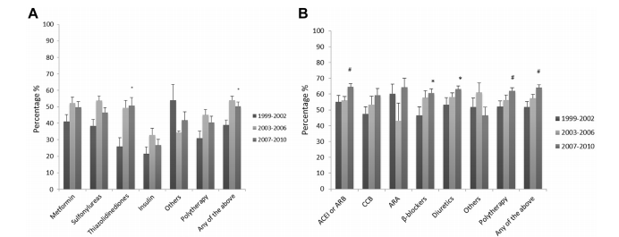
Glucose and blood pressure medication use among people with type ii diabetes
MenWong HK et al. Annals of Epidmiol 2014;24:516-521

Slide 32
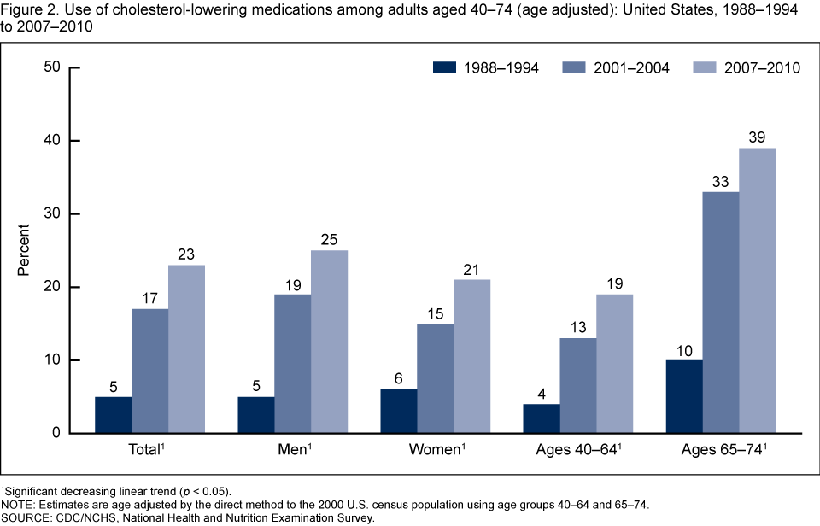
Use of cholesterol-lowering medication among US adults

Slide 33
National Cancer Institute's (NCI) Surveillance Epidemiology and End Results (SEER) Program
Authoritative source of cancer statistics in the US
  Routinely collect data on patient demographics, primary tumor site, tumor morphology and stage at diagnosis, first course of treatment, and vital status
  Only comprehensive source of population-based information in the US that includes stage of cancer at the time of diagnosis and patient survival
  Includes mortality data provided by the National Center for Health Statistics
Updated annually since1973 (current data through 2011)
Statistics provided as a public service in print and electronic format (Cancer Statistics Review, SEER*Stat online analysis tool)
Linked with other databases (Medicare claims, Medicare Health Outcomes Survey, National Longitudinal Mortality Study)

Slide 34
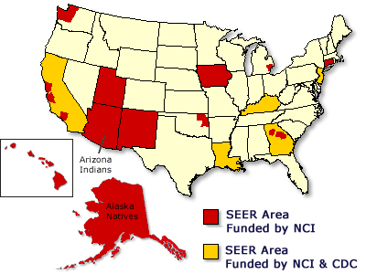
SEER cancer registries cover 28% of US population (http://www.seer.cancer.gov)
Strategically located
Coverage:
26% of African Americans
38% of Hispanics
31% of AI/AN
  50% of Asians
  67% of Hawaiian/PIs
SEER population comparable to general US population in regard to measures of poverty and education
SEER population tends to have a higher proportion of foreign-born persons

Slide 35
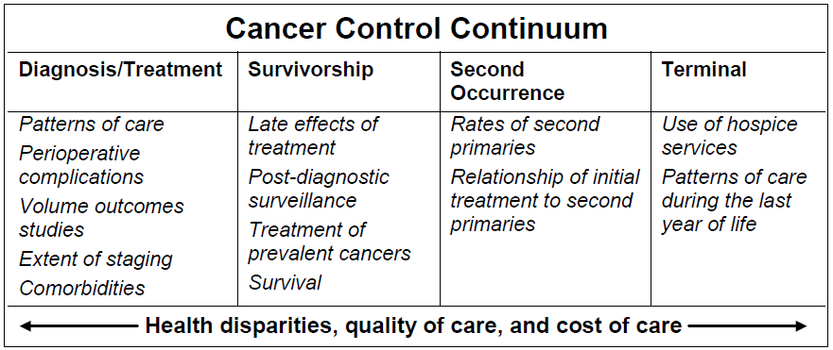
SEER-Medicare linked database can provide data for questions throughout the continuum of cancer care

Slide 36
SEER-Medicare: Receipt of chemotherapy in beneficiaries with acute lymphoblastic leukemia
Danese et al. ASH Annual Meeting Abstracts, 2013

Slide 37
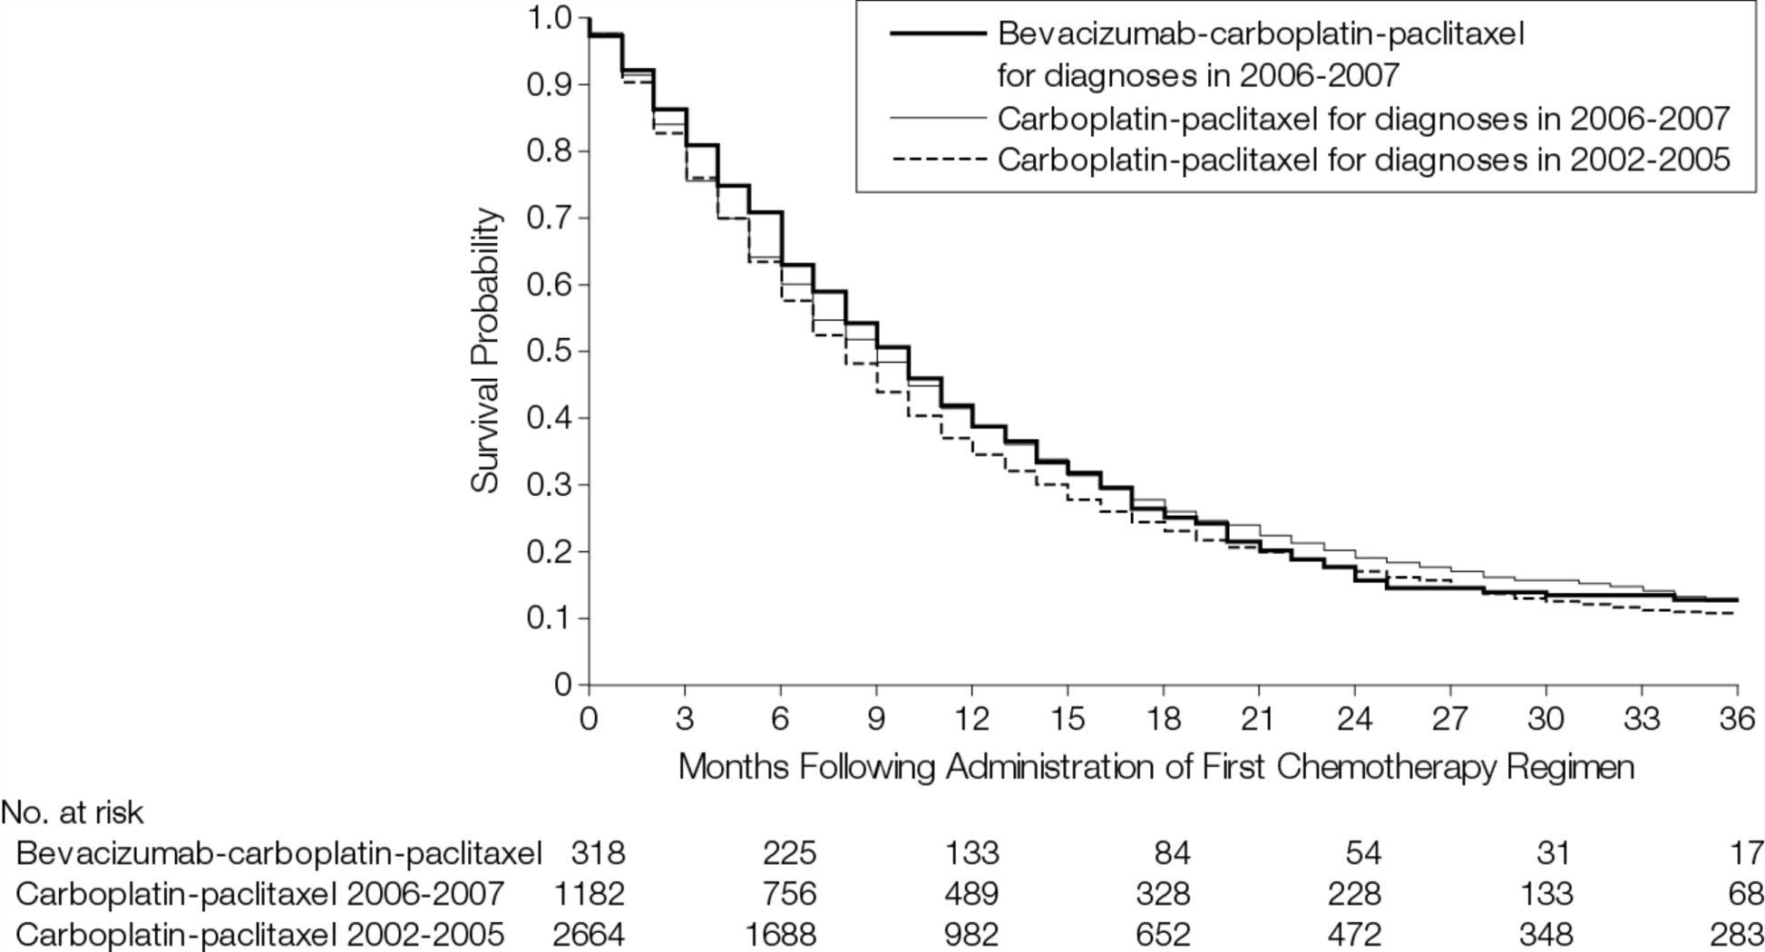
SEER-Medicare: Comparative effectiveness of treatments in older adults with advanced non-small cell lung cancer
Zhu J et al. JAMA 2012;307:1593-1601

Slide 38
International Agency for Research on Cancer (IARC)
Databases
GLOBOCAN - most recent estimates (for 2012) of the cancer incidence, mortality and prevalence for 28 cancers worldwide
CI5 (Cancer Incidence in Five Continents) - detailed information on the incidence of cancer recorded by cancer registries (regional or national) worldwide
WHO - long time series of selected cancer mortality recorded in selected countries of the world

Slide 39
Cancer Incidence in Five Continents (IARC): Acute lymphoblastic leukemia incidence by age and country
Katz AJ et al. 2014.

Slide 40
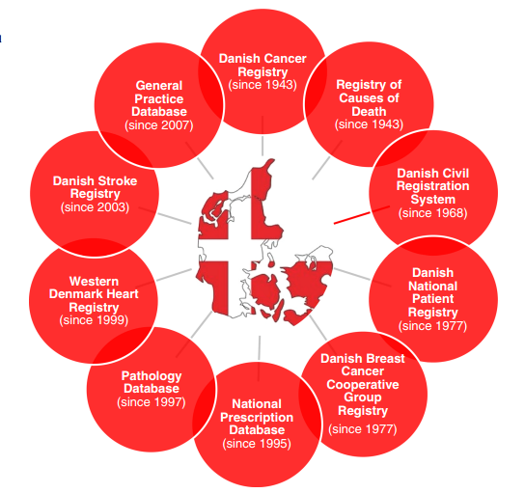
Danish National Databases

Slide 41
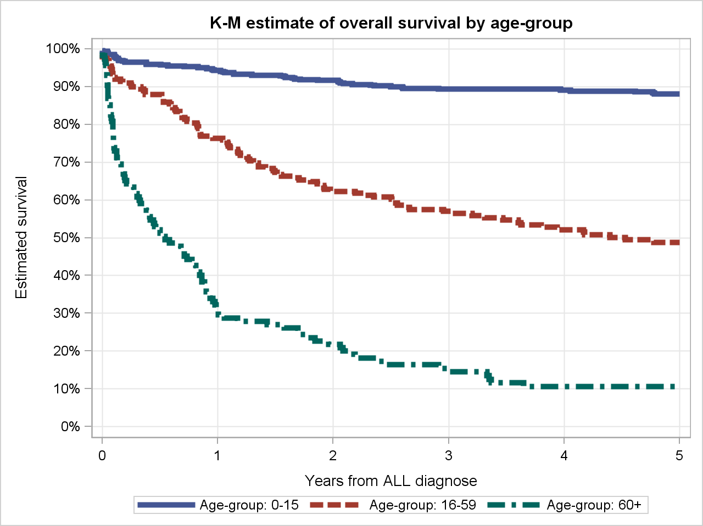
Survival by age group in patients with acute lymphoblastic leukemia
Rasmussen TB et al. 2015 ICPE abstract.

Slide 42
Surveillance data: strengths & limitations
Strengths
Population-based (generalizable)
Estimations of disease incidence, prevalence, survival and mortality, treatment use, health outcomes, and/or the costs of health care services (depending on data source)
SEER database: level of granularity; linkage to Medicare data; etiologic studies feasible with IRB approval
Limitations
Some sources are cross-sectional (no follow-up data)
Lack of information on disease recurrence or progression
Sources may not provide the level of granularity desired
Information on confounders (smoking, diet) often limited

Slide 43
Electronic Medical / Health Records Data

Slide 44
Electronic medical/health records databases
Data from health care systems
Sometimes paperless, digital versions of patient charts
Often used for billing and administrative purposes, but increasingly used for patient care and/or research
May have more detailed patient, diagnosis, and treatment data than administrative claims data
Concerns about other sources of care, generalizability

Slide 45
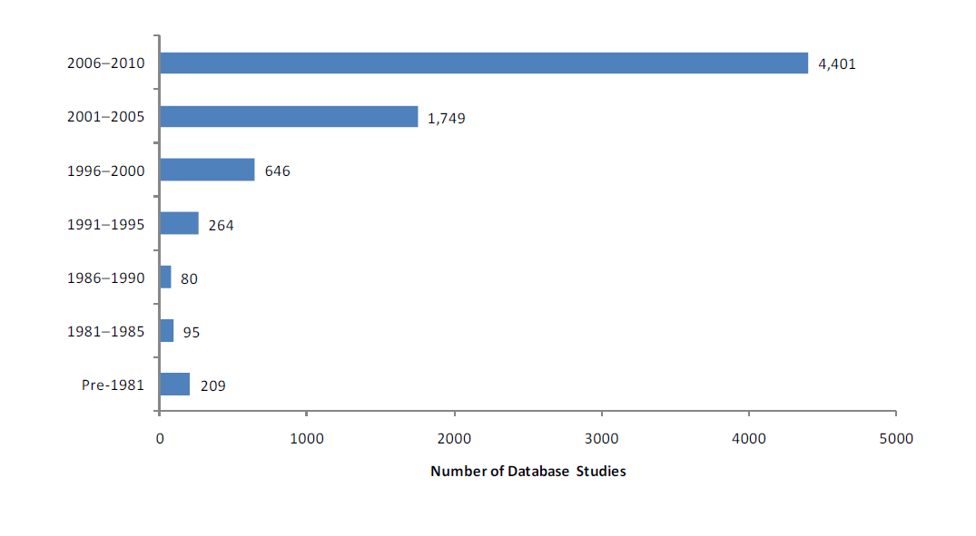
The number of EMR-based studies has more than doubled in the past 5 years

Slide 46
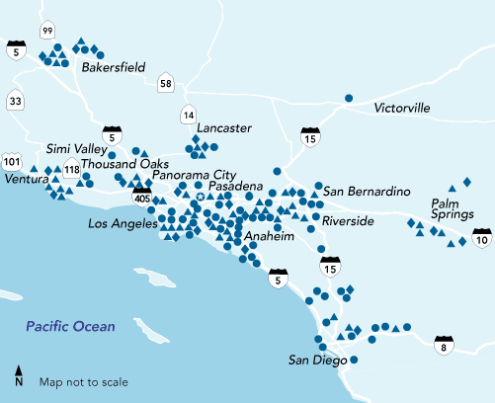
Kaiser Permanente (HMO)
Generally population-based (though
specific to certain regions [e.g., Northern California, Southern California, Portland])
Captures all health care provided within the network
  Medication use, procedures, hospitalizations, laboratory tests
  Patient data (may include smoking history, SES, BMI), medical history
  Specialty data: e.g. cancer registry, HIV registry

Slide 47
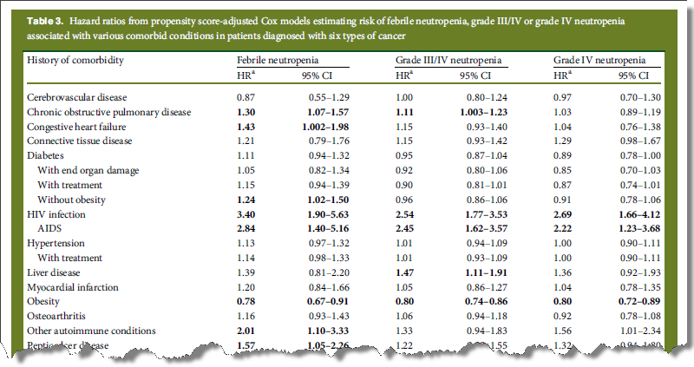
Chronic comorbidities and risk of febrile neutropenia in cancer patients
Chao et al. Annals Oncol 2014;25:1821-9

Slide 48

Clinical Practice Research Datalink (CPRD) – formerly GPRD
  A longitudinal real-world database of anonymised electronic healthcare records for medical research
28 years of data collection
Total 18 million lives
Current data collection
>500 GP practices
>5 million patients
5%
11%
Northern Ireland 3%
Wales 6.5%
GPRD
March 2012
CPRD
May 2015
Scotland
10%
England 80.5%

Slide 49
CPRD
Primary care database in the United Kingdom with links to other data resources such as cancer and death registries and hospital event statistics (1994-present)
Data from ~650 primary-care practices in the UK, covering ~8% of the UK population (>5 million active patient records)
Information collected as part of routine medical care (not for reimbursement)
Comprehensive capture of contact with health care setting
  Demographics, medical symptoms, diagnoses
  Therapy (medications, vaccines, devices), labs, procedures
  Lifestyle factors
  Referrals to specialists, hospitalizations
http://www.cprd.com/home/

Slide 50
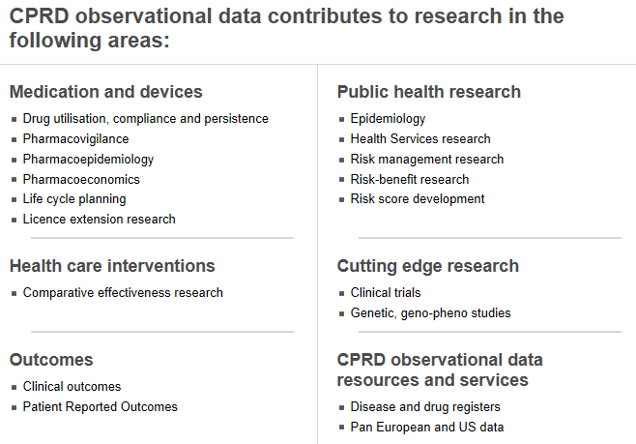
CPRD (cont.)

Slide 51
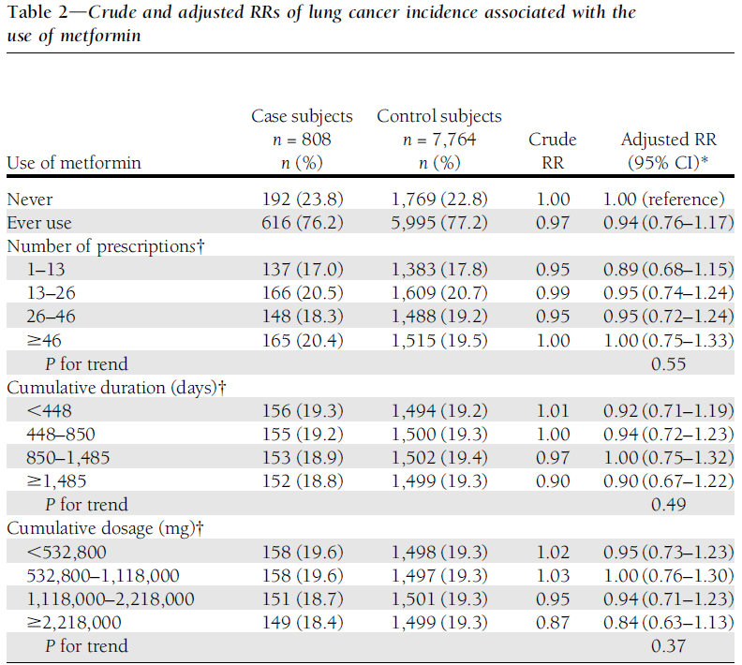
Metformin use and the risk of lung cancer among patients with diabetes
Schmiechowski et al. Diabetes Care 2013;36:124-9

Slide 52

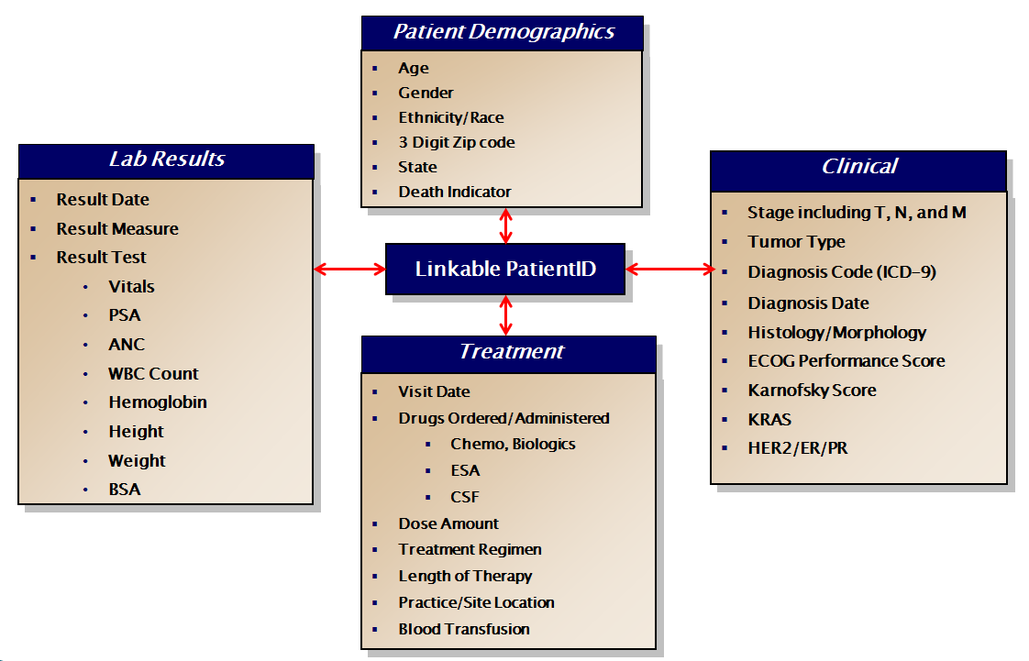
Oncology Services Comprehensive Electronic Records (OSCER)
Amgen’s proprietary oncology EMR
Data on >500,000 cancer patients in the US from 2004+, representing 64 oncology practices at 442 clinical sites

Slide 53
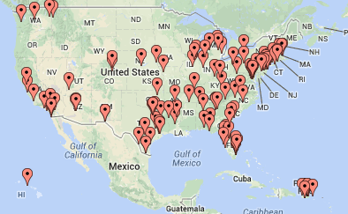
Flatiron Cancer Center Network: Regional Distribution
220
1,700
750,000+
Cancer Centers
Clinicians
Active Cancer Patients

Slide 54
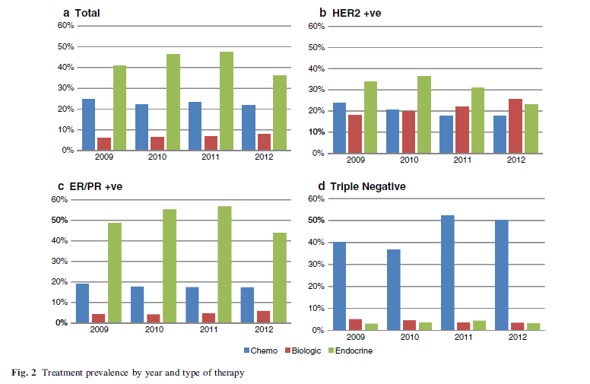
Prevalence of women with early-stage breast cancer receiving therapy
Hernandez RK et al. Breast Cancer Res Treat 2014;146:637-46.

Slide 55
EMR/EHR data: strengths & limitations
Strengths
Population-based (generalizability); often large samples
Can be useful for estimating incidence and prevalence
Good for conducting etiologic research, drug safety studies
More detailed information on treatment (e.g. drug dosage) than administrative claims
Limitations
Information on covariates may be limited (e.g. depends on whether the institution collects them)
Limited to the individuals in that system; may be geographically specific (not national)
Formularies can be specific to the network

Slide 56
Summary: administrative claims data vs. electronic medical records
Need to be aware of what is missing
  Claims: lack detail on inpatient care, labs, disease assessments
    Have pharmacy data but drugs given in the hospital are generally not billed separately
  EMRs: lack information from outside the system network, may not have drug dispensing data
    Prescriptions recorded but do not know if filled
    Many medical conditions can be treated by a number of different providers
Linked claims and EMR databases

Slide 57
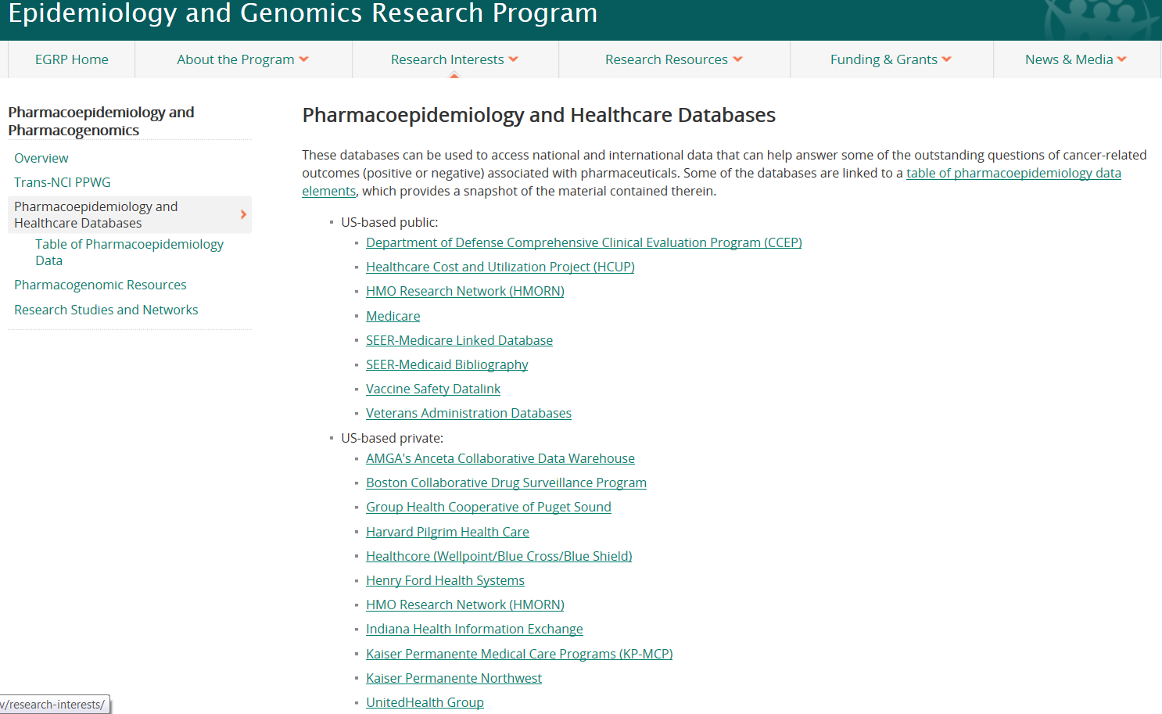
Database resources
  http://epi.grants.cancer.gov/pharm/pharmacoepi_db/

Slide 58
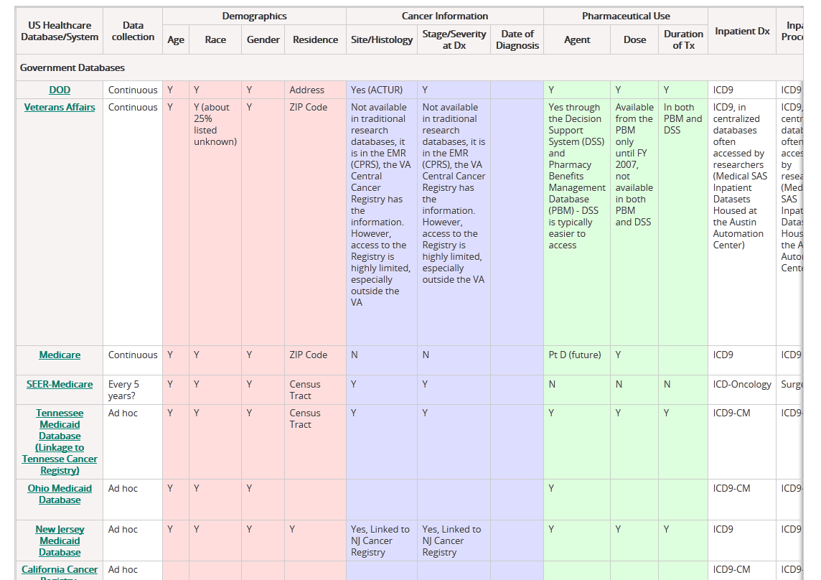
Database resources – data elements
  http://epi.grants.cancer.gov/pharm/pharmacoepi_db/elements.html

Slide 59
Outline
Data needs for pharmacoepidemiology studies
Sources of data and types of databases
Working with a database
Some examples

Slide 60
Some general thoughts about working with databases
All databases are “messy”
Develop a solid understanding of the data collection process
Spend lots of time looking at data; although time consuming, it is enormously useful
  Look at patient profiles
  Conduct lots of descriptive data analyses
  Look for indicators of internal validity (e.g., rates increase with age)
Understand the limitations of the data, and what that means for your study

Slide 61
Value of examining the data
Do you have all of the information?
  Defining your outcome often requires an algorithm
    Diagnosis + procedure codes – increases specificity
Is information being used to rule out a diagnosis?
  Laboratory values, diagnostic procedures and codes

Slide 62
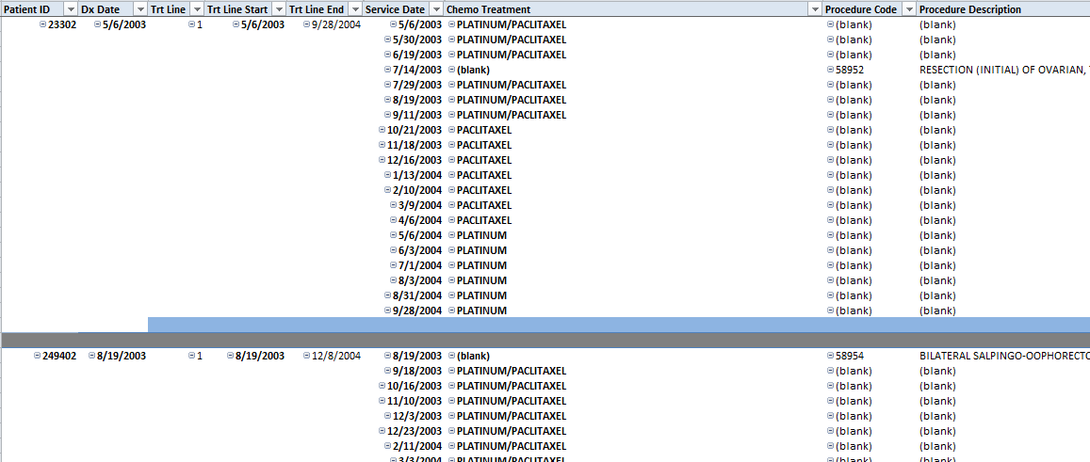
Patient profiles: what does the practice of medicine look like in the data?

Slide 63
Practical considerations when selecting a database
Who is the population to which you want to infer? Age, gender, race, geography?
What type of exposure are you evaluating? Drug exposure? Inpatient vs. outpatient?
Do you have the requisite confounder information? If not, can you do a valid study?
It is critical to understand the strengths and limitations of the database

Slide 64
Outline
Data needs for pharmacoepidemiology studies
Types and sources of data
Working with a database
Some examples

Slide 65
Example # 1
Study Objective:
  Evaluate whether a new oral contraceptive formulation increases the risk of venous thromboembolism
What critical information does the database need to contain?
  Population (person, place, time)?
  Exposure?
  Covariates?
  Outcome?
Which database would you choose? Limitations?

Slide 66
Example # 2
Study Objective:
  Evaluate whether use of a new antineoplastic agent in combination with myelosuppressive chemotherapy increases the risk of venous thromboembolism in patients with stage III/IV breast cancer
What critical information does the database need to contain?
  Population (person, place, time)?
  Exposure?
  Covariates?
  Outcome?
Which database would you choose? Limitations?

Slide 67
Example # 3
Study Objective:
  Evaluate whether high doses of a newly marketed anti- diabetic drug increases the risk of sudden cardiac failure relative to previously available anti-diabetic medications
What critical information does the database need to contain?
  Population (person, place, time)?
  Exposure?
  Covariates?
  Outcome?
Which database would you choose? Limitations?

Slide 68
Database resources
National Cancer Institute list of pharmacoepidemiology and health care databases:
  http://epi.grants.cancer.gov/pharm/pharmacoepi_db/
CDC National Center for Health Statistics
  http://www.cdc.gov/nchs/
Agency for Healthcare Research and Quality (AHRQ)
  https://www.ahrq.gov/research/data/index.html

