Slide 1
EPI 262:
Introduction to Pharmacoepidemiology
Course Director: Michael A. Kelsh, MPH, PhD
Center for Observational Research, Amgen, Inc.
Department of Epidemiology and Biostatistics, UCSF
Guest Lecturers:
Michael Sprafka, PhD
Vicky Chia, PhD
Fiona Callaghan, PhD
Fei Xue, PhD
Daniel Cher, MD
Michael Wooley, PhD
Alex Liede, PhD
Anne Breaubaun, PhD

Slide 2
Outline
Introductions
Course overview & logistics
  Texts and readings
  Course requirements
  Seminar Review
Pharmacoepidemiology: Definition and selected history, role in drug safety
The expanding role of pharmacoepidemiology

Slide 3
Introduction – Kelsh
Current Position: Director, Center for Observational Research – Therapeutic Oncology at Amgen
Former Adjunct Professor: UCLA Department of Epidemiology:
  Environment Exposure Assessment
  Occupational Health
Previous Position: Consultant – Occupational, Environmental Health, Pharmacoepidemiology
Disclosure: Opinions/statements in this course reflect my personal opinions, not policy or opinions of Amgen, Inc.

Slide 4
Kelsh – Contact Information
Email: mkelsh@amgen.com
michaelakelsh@gmail.com
Phone: Office - (805) 447-7891
Mobile – (805) 625-4529
Office Hours: Immediately after class or by
appointment

Slide 5
Course Website
Website:
http://ticr.ucsf.edu/courses/schedule/pharmacoepi.html.
Will post lecture slides, readings on website

Slide 6
Acknowledgements
Guest lecturers
Mary Haan, Vice Chair, UCSF Department of Epidemiology and Biostatistics
Robert Hiatt, Chair, UCSF Department of Epidemiology and Biostatistics
Administrative support from UCSF Department of Epidemiology and Biostatistics
Brain Bradbury, Executive Director, Amgen; Adjunct Professor, UCLA Department of Epidemiology
Cathy Critchlow, Executive Director, Amgen

Slide 7
Student Introductions
Department
Academic goals, degree objectives
Previous experience, coursework
What you hope to get out of this course

Slide 8
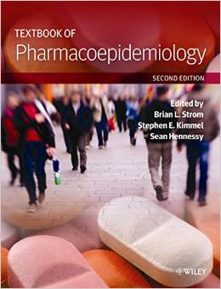
Recommended Text and Readings
Recommended Text:

Slide 9

Recommended Text and Readings
Another useful Textbook:

Slide 10


Recommended Text and Readings
Useful General Epidemiology Textbooks:

Slide 11

The field of pharmacoepidemiology continues to mature
ISPE’s Education Committee recently sought to define the core content of the field and identified the following competencies as essential:
  Pharmacovigilance
  Analysis of exposure data
  Epidemiologic methods
  Communication skills
The discipline will continue to respond to rapidly evolving challenges and opportunities
Jones JK, et al. Pharmacoepidemiol Drug Saf 2012;21:677-689.
Notes:
Pharmacovigilance
Example: definition of adverse events vs adverse drug reactions
Analysis of exposure data
Example: knowledge of types of data on drug use
Epidemiologic methods
Example: basic study designs and their usual hierarchy
Communication skills
Example: conveying results to non-epidemiology scientists

Slide 12
Course Objectives
To provide students with an introduction to:
  The field of pharmacoepidemiology, role in drug development and drug safety
  Basic study design principles and analysis in pharmacoepidemiology research
  Advanced methods specific to pharmacoepidemiology
  Awareness of available data sources, strengths/ limitations for pharmacoepidemiologic research
  Post-marketing pharmacovigilance/drug safety research
  Health economics and pharmacoepidemiology
  Issues of bias and conflict of interest

Slide 13
EPI 262 Course Schedule - 2017
Date | Instructor | Topic
01/12 | M. Kelsh | Class logistics, Intro, History of Pharmacoepidemiology,
01/19 | M. Kelsh | Study Design in Pharmacoepidemiology
01/26 | M. Sprafka | Pharmacoepidemiology and Drug Safety
02/02 | V. Chia | Pharmacoepidemiology: Data sources
02/09 | F. Callaghan | Advanced Methods: Quantitative Bias Analyses, MetaAnalysis, FDA – a Brief Overview
02/16 | F. Xue | Advanced Methods/Analytical Approaches
02/23 | D. Cher | Medical Devices, Study Design and Regulatory Considerations
03/02 | M. Woolley | Health Economics I – Basic Principles
03/09 | Beaubrum A Liede | Ethics in Pharmacoepidemiologic Research Case Studies
03/16 | A. Liede M. Kelsh | Ethics/Genetic Research in pharma Class Summary

Slide 14
Take Home Midterm/Final Schedule
Date
Topic
Thursday February 16
Monday February 20
Thursday March 16
Tuesday March 21
Midterm take-home
Turn in Midterm
Final take-home
Turn in Final

Slide 15
Course Grading
Each lecture has pre-read materials
Classes are intended to be interactive
  Students should feel free to ask questions and engage in class discussion
Student assessments will be made based on:
  Mid-Term Quizes (50%)
    Take-home short answer quizes based on reading and lectures
  Final Assessment (50%)
    Similar to Take-Home quizes – short answer questions based on reading and lectures
Class can be P/NP or Grade

Slide 16
Study Design and Analysis Seminar
Basic epidemiologic study designs used in pharmacoepidemiology
  Comparative advantages/disadvantages
Epidemiology measures of effect
Study Bias and methods to address bias
Case Studies

Slide 17
Pharmacology and Drug Safety
Drug safety monitoring (pharamacovigilance) – review of regulatory data systems:
  FAERS/Spontaneous Reports
  FDA Sentinel
  Clinical trial safety data
Safety signals – evaluation across pre-clincial to post-market settings
Definitions
International Perspective (EMA – PASS studies)
Case Study – Vioxx and cardiovascular disease

Slide 18
Data Sources for Pharmacoepidemiology
Data needs in pharmacoepidemiology
“Real World Data” – what is the hype?
Data sources:
  Administrative claims data
  EMRs
  Other (e.g. registries, existing cohorts, surveys)
Practical aspects in working with databases
Limitations/strengths of each type of database
Examples

Slide 19
Quantitative Bias Assessment
When quantitative bias assessment is appropriate/useful
Why important? Why don’t we see more often?
Tools/approaches used
Which biases to address? Defining bias models
Case Studies

Slide 20
Meta-Analysis and Systematic Review
Review of evidence-based medicine: Mission and methods
Meta-Analysis
  How to conduct, when is it appropriate to combine results across studies?
  Analytical approaches – e.g. “fixed effects”, “random effects”
  Strengths and limitations
Case Studies

Slide 21
Advanced Methods in Pharmacoepi
Goal - to provide “exposure” and familiarity with more complex analytical tools
Review of confounding by indication
Methods to address confounding by indication:
  Propensity Score analyses
  Instrumental variables
  Marginal Structural models
Changing exposure over time
Directed acyclic graphs (DAGs)
Validity studies

Slide 22
Medical Devices
Unique aspects of medical device safety research, impacts on pharmacoepidemiologic studies
Expanding use and complexity of medical devices in health care
Regulatory considerations
Case Studies

Slide 23
Health Economics, Health Outcomes
Economic evaluation in Health Care: overview of basic definitions and concepts
Uniqueness of health care in the context of economic evaluation
Cost Benefits/Cost Effectiveness Analyses
Health Technology Assessment

Slide 24
Ethics in Pharmacoepi Research
Ethical Issues:
  Equipoise
  Authorship
  Conflicts of Interest
Conflicts of interest
  Is financial/funding the only source? – discussion of financial, social political/idealogical, and professional conflicts
  Approaches on how to deal with conflicts of interest

Slide 25
Definition and Need for Pharmacepidemiology

Slide 26
What is Pharmacoepidemiology?
“Pharmacoepidemiology is the study of the use of and the effects of drugs in large numbers of people.”
The application of epidemiologic methods to clinical pharmacology
A branch of general epidemiology
Strom BL. Pharmacoepidemiology 3rd edition. 2000

Slide 27
Epidemiology’s role across all stages of drug development
Basic descriptive epidemiology – magnitude of disease
Natural history and burden of target disease
Evaluation of Co-morbidities, Other Events
Pharmacovigilance
Post-Market safety evaluation
Post-Market effectiveness assessment
“Real-World” data evaluation
Regulatory interactions
Value Assessment (OCM example)

Slide 28
Example of Performance-Based Payments (PBP) Calculation
Target Amount
vs.
Actual 6-month Expenditure
Determine Performance Multiplier
Apply Performance Multiplier & Calculate Final PBP

Slide 29
List of Quality Measures to Determine Performance Payment (1 of 3)
Purpose | Quality Domain | Quality Measure | OCM Measure # | Source
Performance-based payment | Communication and Care Coordination | Risk-adjusted proportion of patients with all-cause hospital admissions within the 6-month episode | OCM-1 | Claims
Performance-based payment | Communication and Care Coordination | Risk-adjusted proportion of patients with all-cause ED visits that did not result in a hospital admission within the 6-month episode | OCM-2 | Claims
Performance-based payment | Communication and Care Coordination | Proportion of patients who died who were admitted to hospice for 3 days or more | OCM-3 | Claims
Performance-based payment | Person- and Caregiver-Centered Experience and Outcomes | Pain assessment and management (NQF 0383 and 0384, PQRS 143 and 144) | OCM-4 | Registry (practice-reported)

Slide 30
Magnitude of Drug-Induced Diseases, Drug Related Adverse Events
Significant public health impact
  2.3 million AE reports on 6000 drugs (1969-2002)
  19,000+ reports of Vaccine AEs in US Vaccine reporting system
Adverse events significantly under-reported
75 Drugs removed from market due to safety – represents less than 1% of drugs on market
Label changes – much more common
  New side effects
  Contraindications in certain patient groups
  Drug-drug interactions

Slide 31
Historical Perspective
Thanks to Sean Hennessy, University of Pennsylvania, for Select History graphics

Slide 32
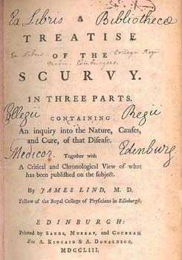
Early Examples of Interventional Studies
1742: James Lind conducted a controlled trial examining different interventions for treating scurvy
Observed that those given oranges and lemons experienced remarkable recovery
Notes:
In 1747, while serving as surgeon on HMS Salisbury, he carried out experiments to discover the cause of scurvy, the symptoms of which included loose teeth, bleeding gums and haemorrhages.
Lind selected 12 men from the ship, all suffering from scurvy, and divided them into six pairs, giving each group different additions to their basic diet. Some were given cider, others seawater, others a mixture of garlic, mustard and horseradish. Another group of two were given spoonfuls of vinegar, and the last two oranges and lemons. Those fed citrus fruits experienced a remarkable recovery. While there was nothing new about his discovery - the benefits of lime juice had been known for centuries - Lind had definitively established the superiority of citrus fruits above all other 'remedies'.

Slide 33
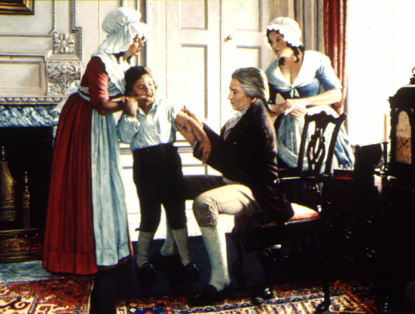
Early Examples of Interventional Studies (2)
1796: Edward Jenner investigated the usefulness of vaccinations
Inoculated a child with cowpox material and challenged him with smallpox
This paved the way for successful eradication of smallpox in 1980
Willis NJ. Edward Jenner and the eradication of smallpox. Scott Med J 1997;42:118-211.
Notes:
Edward Jenner's careful investigations into the usefulness of cowpox vaccination for the prevention of smallpox during the late 1790s, and his enthusiastic and continued advocation of vaccination despite the scepticism of critics, laid the foundations for the growth of understanding about the nature of infectious disease and the development of immunity during the 19th century. He began the long process which resulted in the successful eradication of the smallpox virus in 1980. His life story remains an inspiration to physicians facing an uncertain future as viruses and bacteria not yet eradicated adapt to the antibiotic age.

Slide 34
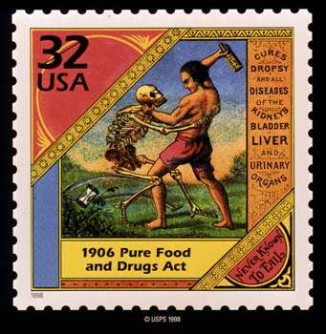
US Pure Food and Drug Act was passed in 1906
In response to adulterated and misbranded products
Government given power to remove products that were adulterated or misbranded
No requirements for efficacy or safety
FDA created

Slide 35
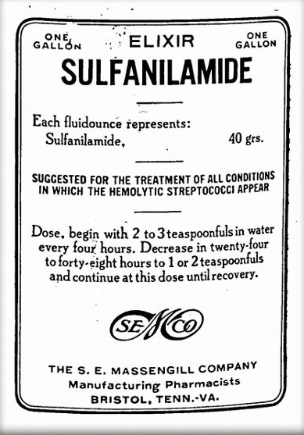
Food, Drug and Cosmetic Act was passed in 1938
1937: over 100 people died from renal failure after taking elixer of sulfanilimide dissolved in diethylene glycol
Preclinical toxicity testing was required for the first time
Manufacturers required to gather drug safety data and submit to FDA before drug marketing
No requirement for efficacy data
Notes:
Sulfonamide drugs were the first antimicrobial drugs, and paved the way for the antibiotic revolution in medicine. The first sulfonamide was trade named Prontosil and was the first medicine ever discovered that could effectively treat a range of bacterial infections inside the body. It had a strong protective action against infections caused by streptococci, including blood infections, childbed fever, and erysipelas, and a lesser effect on infections caused by other cocci. However, it had no effect at all in the test tube, exerting its antibacterial action only in live animals. Later it was discovered by a French research team, led by Ernest Fourneau (French), at the Pasteur Institute that the drug was metabolized into two pieces inside the body, releasing from the inactive dye portion a smaller, colorless, active compound called sulfanilamide. The discovery helped establish the concept of "bioactivation" and dashed the German corporation's dreams of enormous profit; the active molecule sulfanilamide (or sulfa) had first been synthesized in 1906 and was widely used in the dye-making industry; its patent had since expired and the drug was available to anyone.^{[3]}
The result was a sulfa craze.^{[4]} For several years in the late 1930s, hundreds of manufacturers produced tens of thousands of tons of myriad forms of sulfa. This and nonexistent testing requirements led to the Elixir Sulfanilamide disaster in the fall of 1937, during which at least 100 people were poisoned with diethylene glycol. This led to the passage of the Federal Food, Drug, and Cosmetic Act in 1938. As the first and only effective antibiotic available in the years before penicillin, sulfa drugs continued to thrive through the early years of World War II.^{[5]} They are credited with saving the lives of tens of thousands of patients.

Slide 36
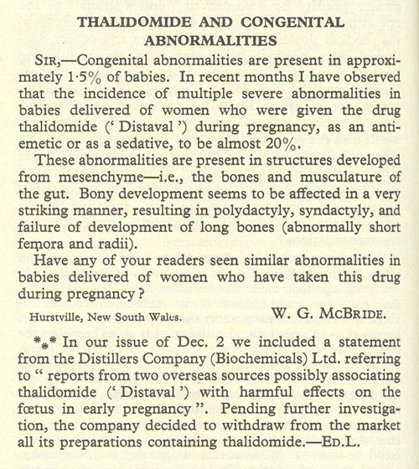
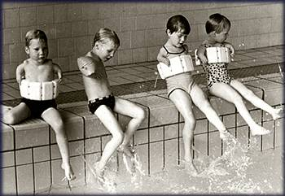
Thalidomide Disaster
McBride WG. Lancet 1961;2:1358
Notes:
Over the counter medicine used to treat morning sickness in pregnant women.

Slide 37
Kefauver-Harris Amendments Passed in 1962
Required extensive preclinical pharmacological and toxicological testing
Submission of Investigational New Drug Application (IND) prior to use in humans
Defined three phases of clinical trials
Required evidence of efficacy
Dr. Francis Kelsey – key to preventing thalidomide use in the US

Slide 38
Drug Development is Now Highly Regulated
Drug regulation has evolved as governments have become more involved in the drug development process
Successful drug development now requires substantial evidence demonstrating:
  Safety
  Efficacy
  Quality (manufacturing)
There is also greater attention focused on appropriate marketing practices
  Fair balance when discussing benefits and risks
    Direct-to-consumer advertising

Slide 39
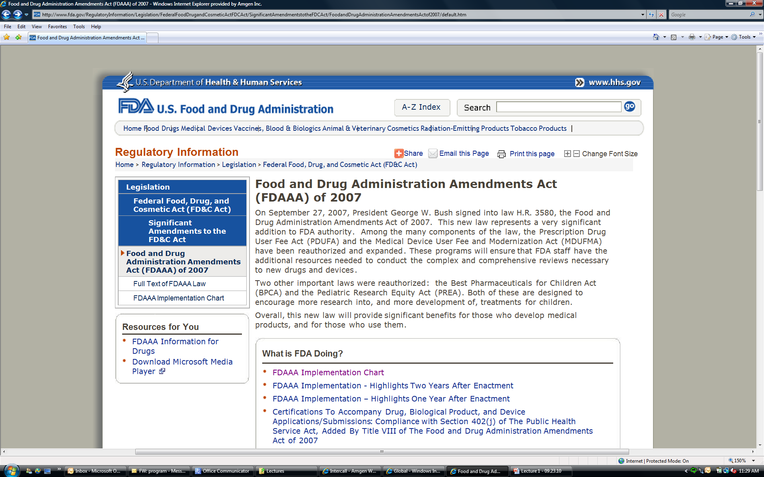
FDAAA

Slide 40
Food & Drug Administration
Amendment Act (FDAAA)
In 2007, President Bush signed into law H.R. 3580, the Food and Drug Administration Amendments Act of 2007. This new law represents a very significant addition to FDA authority.
  Prescription Drug User Fee Act (PDUFA) , Medical Device User Fee and Modernization Act (MDUFMA)
  Best Pharmaceuticals for Children Act (BPCA) , Pediatric Research Equity Act (PREA)
The FDA was granted enhanced authority regarding post-marketing safety of drugs
  FDA can mandate a drug manufacturer conduct a post market study
  Granted authority to require a Risk Evaluation and Mitigation Strategy (REMS)
  Mandated to develop an active surveillance system for monitoring drugs,
Notes:
PDUFA/MDUFMA have been reauthorized and expanded.
These programs will ensure that FDA staff have the additional resources needed to conduct the complex and comprehensive reviews necessary to new drugs and devices.
BPCA / PREA
Both of these are designed to encourage more research into, and more development of, treatments for children.

Slide 41
The Regulatory Process for Drug Development
Pre-marketing phase (Required)
  Preclinical studies
    Dose ranging
    Pharmacokinetics (PK) / pharmacodynamics (PD))
  Phase I-III
    Identifying optimal doses
    Identifying potential toxicities
    Establishing efficacy; ensuring safety
Post-marketing phase (Required?)
  Adverse event reporting
  Post-marketing studies, Phase IV
This is referred to as “drug development lifecyle”
Notes:
Medication Guide
Medication Guides are paper handouts that come with many prescription medicines. The guides address issues that are specific to particular drugs and drug classes, and they contain FDA-approved information that can help patients avoid serious adverse events.
FDA requires that Medication Guides be issued with certain prescribed drugs and biological products when the Agency determines that:
certain information is necessary to prevent serious adverse effects
patient decision-making should be informed by information about a known serious side effect with a product, or
patient adherence to directions for the use of a product are essential to its effectiveness
Phase 4 studies
The intent of Phase 4, or post-marketing studies, is to learn more about the drug after it has been approved by government authorities. In Phase 4 studies, researchers gather information about an approved drug's risks, benefits, and best uses in ‘real-life’ conditions. These studies can also include trials of different doses or schedules of administration, other stages of disease or other disease and age groups, cost studies, quality-of-life studies, or use of the drug over a longer period of time.

Slide 42
Preclinical studies
Phase 1
Phase 2
Premarketing
Phase 3
Drug approval
Phase 4
Postmarketing

Slide 43
Phase 1 clinical studies
Subjects:
  small numbers
  generally healthy volunteers
Purpose:
  Pharmacokinetic parameters
  Common toxic reactions
  Safe dosage range

Slide 44
Phase 2 clinical studies
Subjects:
  Relatively small numbers
  Patients with target disease
  Narrow eligibility criteria
  Can have “single” arm or comparator arm as well
Purpose:
  Dose ranging studies, optimal dose
  Pharmacokinetic parameters in patients with target disease
  Common adverse events in patients with disease
  Preliminary evidence of efficacy

Slide 45
Phase 3 clinical studies
Subjects:
  Usually large studies (n=500-8,000)
  Patients with target disease
  Random allocation, may involve multiple study groups
Purpose:
  Efficacy
  Safety
Pivotal studies
  Used for getting new drugs approved, expand label
  Extensive data collection
Include control or comparator groups

Slide 46
Phase 4 Studies
Post-Market setting
Subjects:
  generally large study population
  those taking the medication vs other/no medication
Purpose:
  Effectiveness of the drug in “real world”, as prescribed
  Additional safety information (e.g. rare events, drug interactions, specific subgroups)
  Long-term safety/efficacy
Sometimes required by FDA
Often observational, although can include allocation component – making it interventional

Slide 47
Post-marketing Pharmacovigilance is Intensifying
Companies are being required to establish REMS for their products
  Medication guide: contain FDA-approved information that can help avoid serious adverse events
  Ensure that the benefits of the drug outweigh the risks
Companies may be required to establish a registry for all patients receiving a new drug
  Minimize off-label use
  Help to monitor the clinical outcomes, side-effects, etc.
Notes:
Medication Guide
Medication Guides are paper handouts that come with many prescription medicines. The guides address issues that are specific to particular drugs and drug classes, and they contain FDA-approved information that can help patients avoid serious adverse events.
FDA requires that Medication Guides be issued with certain prescribed drugs and biological products when the Agency determines that:
certain information is necessary to prevent serious adverse effects
patient decision-making should be informed by information about a known serious side effect with a product, or
patient adherence to directions for the use of a product are essential to its effectiveness

Slide 48
FDA Sentinel System
A new active surveillance system that will eventually be used to monitor all FDA-regulated products
  Linked, automated and sustainable system
  Leverages existing electronic data records (e.g., automated healthcare data from multiple sources)
    Claims database (e.g., Blue Cross, Medicare)
    Electronic medical records (e.g., Kaiser, Veteran’s Administration)
  Designed to enable rapid signal detection and verification across multiple data sources
It will change the field of post-marketing drug surveillance significantly
  Reliance on core pharmacoepidemiologic methods
  Development of new surveillance methods for signal detection and validation
  Increase the demand for well-trained pharmacoepidemiologists

Slide 49
The Field of Pharmacoepidemiology
Continues to Evolve
Increased need to understand the safety profile of drugs prior to their approval
Increased need to understand the safety of drugs once they have been approved (post-marketing drug surveillance research)
Desire to identify sub-populations in whom therapies should be targeted
Identification of potential beneficial effects beyond labeled indication
Label changes – provide data on new safety issues, subpopulations, drug interactions

Slide 50
Understanding the Safety Profile of Drugs Prior to their Approval
Ideally, safety information is obtained prior to drug approval (Phase I-III)
Pre-marketing studies have limitations:
    Sample size
      Study size often limits the ability to detect rare events (e.g., an event has a background rate of 1 in 5,000 - this is not generally detectable in study of 2,000 patients)
      Study size also limits ability to make inference about less frequent events (e.g., 3 in one arm and 5 in another)
    Strict inclusion/exclusion criteria
      Select healthier patients to maximize efficacy
    Study duration
      Studies are often not long enough to observe events

Slide 51
Understanding the Safety Profile of Drugs Prior to their Approval (2)
Understanding the safety profile of drugs also requires in-depth understanding of the disease
  Clinical profile of patients with the disease
  Natural history of the disease
  Common/uncommon clinical outcomes in patients with the disease (i.e., background rates)
  Understanding the risks associated with other, similar therapies used to treat the same condition
  Helps to define the right population for study and treatment

Slide 52
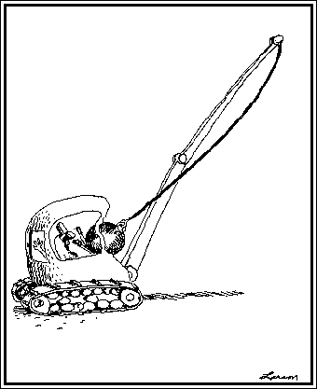
Weight of the available evidence suggests…
So what went wrong???
Elevated MI risk associated with rofecoxib
  RR from RCTs: 2.24 (95% CI: 1.24-4.02)
The small cardioprotective effect of naproxen in observational studies (RR: 0.86 (95% CI: 0.75-0.99) does not explain the VIGOR findings
Jüni et al, the Lancet 2004

Slide 53
Why do we need post-marketing safety assessment?
Study Population in RCT
Smaller sample size
Strict selection criteria
Patient Population in Clinical Practice
Variety of patients
High medication adherence
Close monitoring of patients
Highly experienced practitioners
Limited outcomes, shorter duration
Often used after a series of treatment failures, or in combination with other treatments
Sub-optimal adherence
Patients seen infrequently

Slide 54
Post-marketing Drug Surveillance Research
There is a critical need to understand the safety of drugs once they have been approved
  Identification of safety signals
    Phase IV studies or non-experimental research
  Characterization of treatment patterns
    Who is receiving the therapy?
    Are there regional differences in practices?
    Are sicker patients being referred to newer therapies (confounding)?
  Identification of uncommon side effects of therapy
  Evaluation of potential drug-drug interactions
    Typically, RCTs enroll healthier patients so interactions with other medications may not have been studied previously

Slide 55
Identification of Sub-populations in Whom Therapies should be Targeted
Identify patients for whom there is substantial efficacy
  Not all patients will respond to a given therapy
    Some may have minimal or blunted response, others none at all
  For those who do respond, the benefit may be even greater
In those patients in whom the drug is not efficacious, does treatment increase the risk of adverse events
  May provide valuable information about disease pathways
  Off-target drug effects
Notes:
Panitumumab - fully human antibody against epidermal growth factor receptor

Slide 56
Identification of Sub-populations in Whom Therapies should be Targeted (2)
One path to identifying these sub-populations is genetics (pharmacogenetics research)
Do different genotypes modify the effects of drugs?
  The wild-type KRAS gene (on tumors) is required for anti-EGFR therapies efficacy in patients with metastatic colorectal cancer.
  Differential effects on progression free survival
    Wild type: HR=0.45, 95% CI:0.34-0.59
    Mutant: HR=0.99, 95% CI:0.73-1.36
Amado et al., J Clin Oncol 2008:26:1626-34.
Notes:
Panitumumab - fully human antibody against epidermal growth factor receptor

Slide 57
Identification of Potential Off-Label Uses
Identification of potential beneficial effects beyond labeled indication
  Statins (HMG-CoA reductase inhibitors) are labeled to lower cholesterol levels
  Statins are used to treat or prevent atherosclerosis and subsequent clinical sequelae (e.g. heart attacks)
  Can statins reduce the risk of incident diabetes mellitus?
    Statins do not appear to lower the risk of incident Diabetes Mellitus (results from meta-analyses)^{1,2}
¹Sattar et al., Lancet 2010; ²Rajpathak et al., Diabetes Care 2009

Slide 58
Other Focus Areas in Pharmacoepidemiology
Randomized controlled trials
  Design and conduct
  Identifying/describing target population
Comparative effectiveness research
  Which drug is the better (best) alternative? Effectiveness? Safety? Cost?
Cost-effectiveness research
  How much are we willing to spend to gain benefit?

Slide 59
Many different entities are now conducting pharmacoepidemiologic research
Academic research centers
FDA, EMA regulatory agencies
Industry (Major biotechnology & pharmaceutical companies)
  Departments of Pharmacoepidemiology or Epidemiology
Contract Research Organizations (CRO’s)

Slide 60
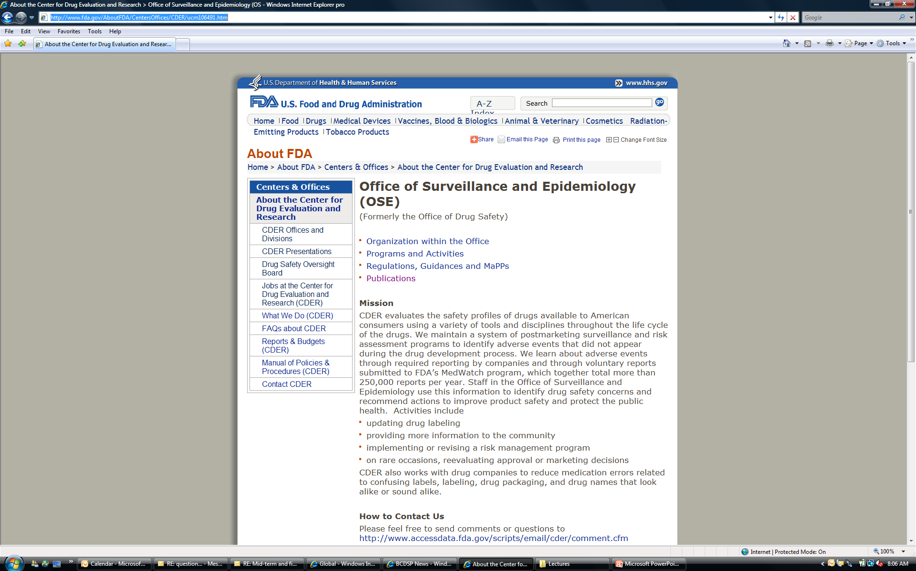
Drug Safety at the FDA
Notes:
CDER evaluates the safety profiles of drugs available to consusmers throughout the lifecycle of drugs.

Slide 61
In What Areas Do Epidemiologists Work in the Pharmaceutical Industry?
Drug development
  From pre-clinical through approval
Safety during drug development
  Understand background rates of adverse events
Health economics – understand the “value” of a new medication
Pharmacovigilence – post-approval

Slide 62
Phase 1
Phase 2
Phase 3
Discovery to Pre-clinical
Filing
Launch
Post-Launch
Contribute to disease target selection
Incidence and prevalence of disease
Natural history of disease
Background rates of safety events of interest
Treatment patterns for diseases
Characterize unmet needs with current therapies
Studies to understand potential confounding (including CBI)
Benefit/risk in patients
Academia or Industry led
Benefit/risk in subpopulations
Industry led
Comparative effectiveness studies

Slide 63
Epidemiologic Contributions to Early Stage Drug Development (Pre-clinical, Phase I, IIa):
Descriptive Epidemiology Studies
Inform disease target selection
  Incidence/prevalence
  Disease natural history
Inform clinical trial development
  Characteristics of target population
  Clinical and surrogate measures
Contribute to decision of further development
  Side effects associated with disease or concomitant treatments
  Unmet needs of current therapies

Slide 64
Contributions to Trial Design
Case definitions and ascertainment methods
Identify, develop, and/or validate outcome measures
Inclusion/exclusion criteria
Covariate data to collect
Key safety endpoints

Slide 65
Summary
Pharmacoepidemiology is a rapidly growing field
Greater attention to drug safety and costs
There are many different dimensions to practicing epidemiology in this setting
Many different sectors are looking for well-trained pharmacoepidemiologists
  Academia, consulting, government, industry

Slide 66
