Slide 1
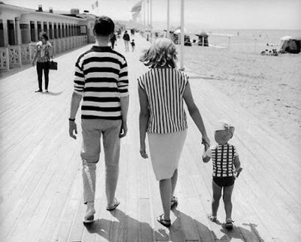
Family-Based Studies
https://belkazan.files.wordpress.com/2012/04/stripe-shirts-mother-father-child-at-the-beach-boardwalk.png?w=620

Slide 2
Outline
  Background/Review
Family studies [PTC example]
Linkage analysis [PTC example]
Family-based association tests
  Trios/TDT
  Discordant sibships

Slide 3
Review: Process of Genetic Epidemiology
Defining the Phenotype
Migrant Studies
Familial Aggregation
Segregation
Linkage Analysis
Association Studies
Fine Mapping
Cloning
Characterization
Notes:
Hand out cards for them to complete
3

Slide 4
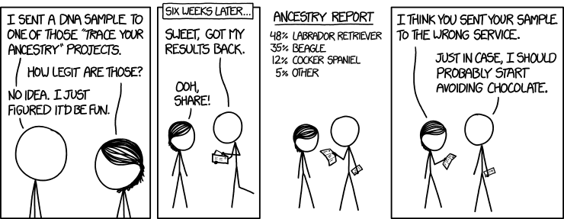
Review: Population stratification
https://xkcd.com/1706/
Notes:
4
Most of you have come here for two reasons - you have a candidate gene and want to find out more information about or the genomic region where it resides. Or you have a gene and am saying I want to genotype this with a population I have how do I extract SNPs from the databases. So we would like to spend about an hour going over some of the genomic resources that are out there. Many of you have likely used these before, but now is the time to have some time to ask questions about hard to get at data and have us help you or learn something from scratch. I will have to admit right off that I am not the expert,but the way I have learned about these online databases is have sit down with them and clicked on every link I could find and played a lot. This isn’t meant to be comprehensive but rather an overview. So I will just go over a few of the basic here and then take you through a “live” browsing session. Later this afternoon you will have an hour or so to go over these sites on your own, and then we can also work with you to get specific information you would like.

Slide 5
Review: Population stratification
- Population stratification is a form of confounding in genetic studies where a gene under study shows marked variation in allele frequency across subgroups of a population and these subgroups differ in their baseline risk of disease
- Previous e.g. of Pima & Papago Indians: Significant allele frequency difference because of ancestry, not disease status
Family-based tests today tend to be robust to this issue (not require any special adjustment)
  Not based on allele frequency directly…
Notes:
5
Most of you have come here for two reasons - you have a candidate gene and want to find out more information about or the genomic region where it resides. Or you have a gene and am saying I want to genotype this with a population I have how do I extract SNPs from the databases. So we would like to spend about an hour going over some of the genomic resources that are out there. Many of you have likely used these before, but now is the time to have some time to ask questions about hard to get at data and have us help you or learn something from scratch. I will have to admit right off that I am not the expert,but the way I have learned about these online databases is have sit down with them and clicked on every link I could find and played a lot. This isn’t meant to be comprehensive but rather an overview. So I will just go over a few of the basic here and then take you through a “live” browsing session. Later this afternoon you will have an hour or so to go over these sites on your own, and then we can also work with you to get specific information you would like.

Slide 6
Outline
  Background/Review
Family studies [PTC example]
Linkage analysis [PTC example]
Family-based association tests
  Trios/TDT
  Discordant sibships

Slide 7
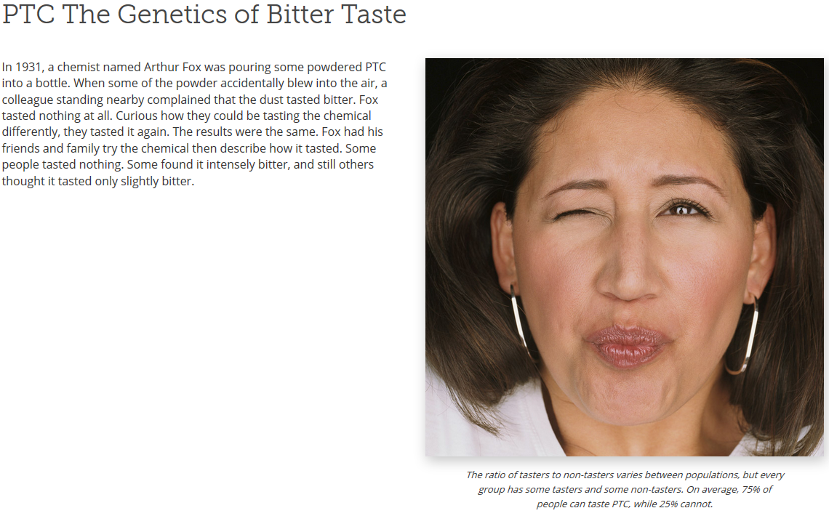
PTC: Bitter Taste Receptor
http://learn.genetics.utah.edu/content/basics/ptc/

Slide 8
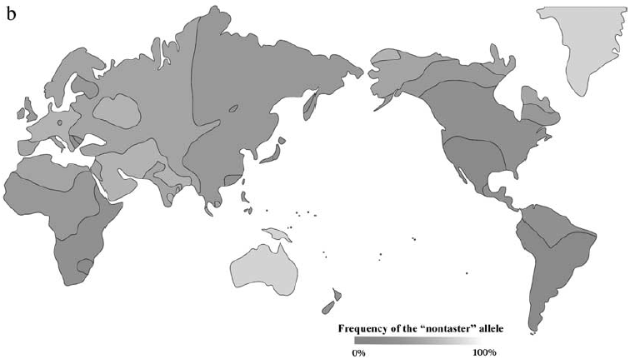
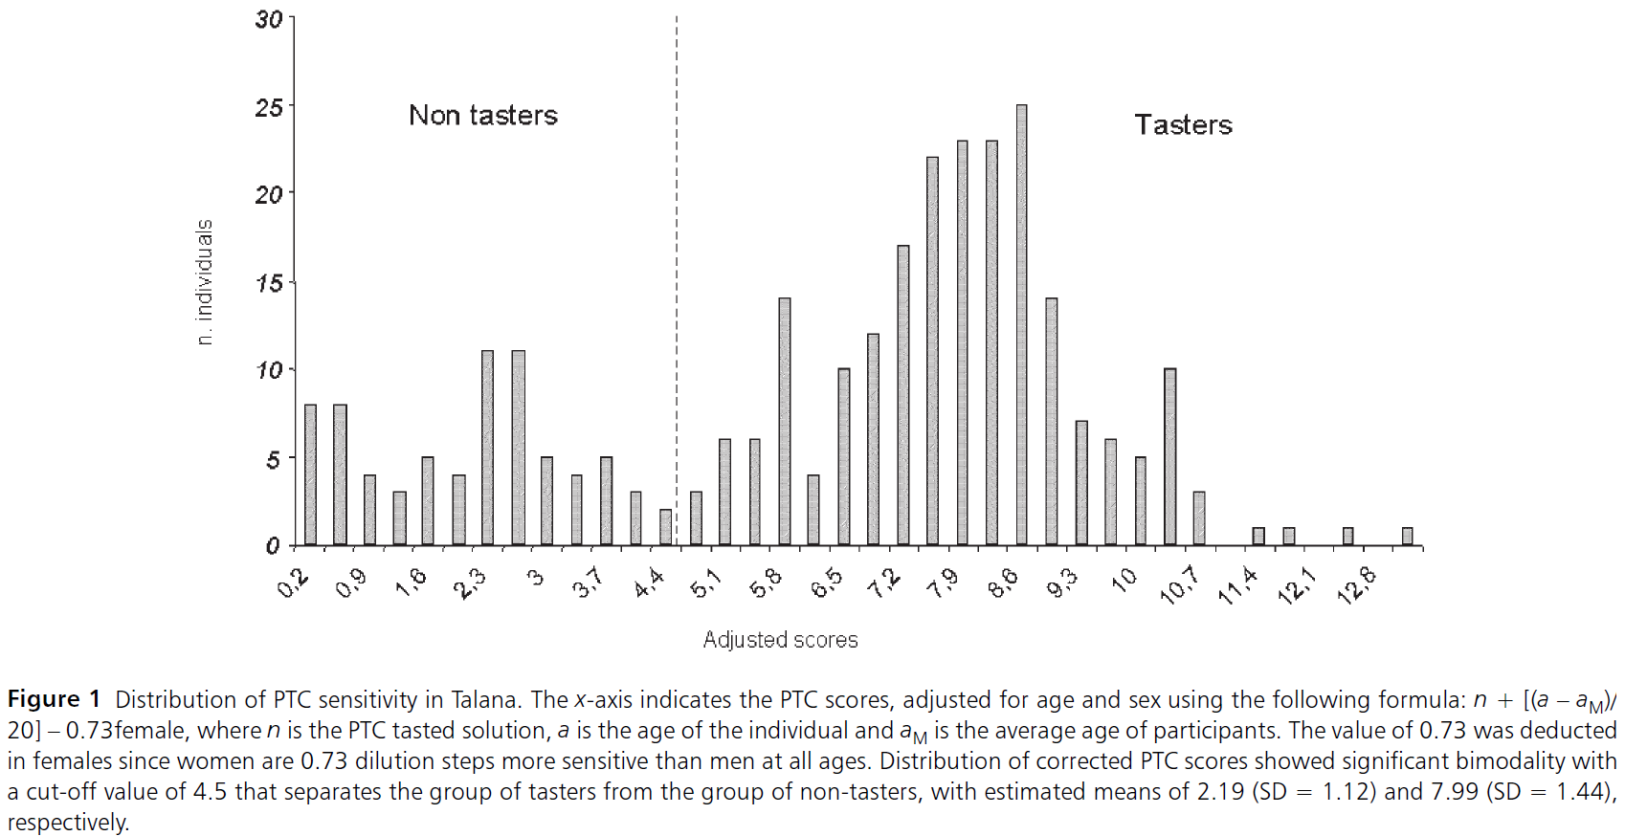
Geographic Distribution of PTC Phenotype
Wooding Genetics 2006, adapted from Cavalli-Sforza 1994
Prodi, Chem. Senses, 2004

Slide 9
Types of Genetic Studies
Family Studies
  Compare trait values across family members
Linkage Analysis
  Compare trait values with inheritance patterns
Association
  Compare trait values against genetic variants
(next page for PTC…)
Notes:
9

Slide 10
First PTC Family Study
L. H. Snyder Science 1931
Notes:
10
Both: 15%
One: 32%
Neither: 100%

Slide 11
Family Studies
Familial Relationships
  - Twins
  - Siblings
  - Parents/offspring
Phenotype information
  - Affected/Unaffected (Prostate Cancer)
  - Quantitative measure (Blood Pressure)
No Genotype information required for some things (e.g., lecture 2)
Notes:
11

Slide 12
Why do Family Studies?
Is the trait genetic?
What is the mode
of transmission?
  - Dominant
  - Recessive
  - Additive
  - Polygenic (Multiple genes involved)
https://belkazan.files.wordpress.com/2012/04/stripe-shirts-mother-father-child-at-the-beach-boardwalk.png?w=620
Notes:
12

Slide 13
Outline
  Background/Review
Family studies [PTC example]
Linkage analysis [PTC example]
Family-based association tests
  Trios/TDT
  Discordant sibships

Slide 14
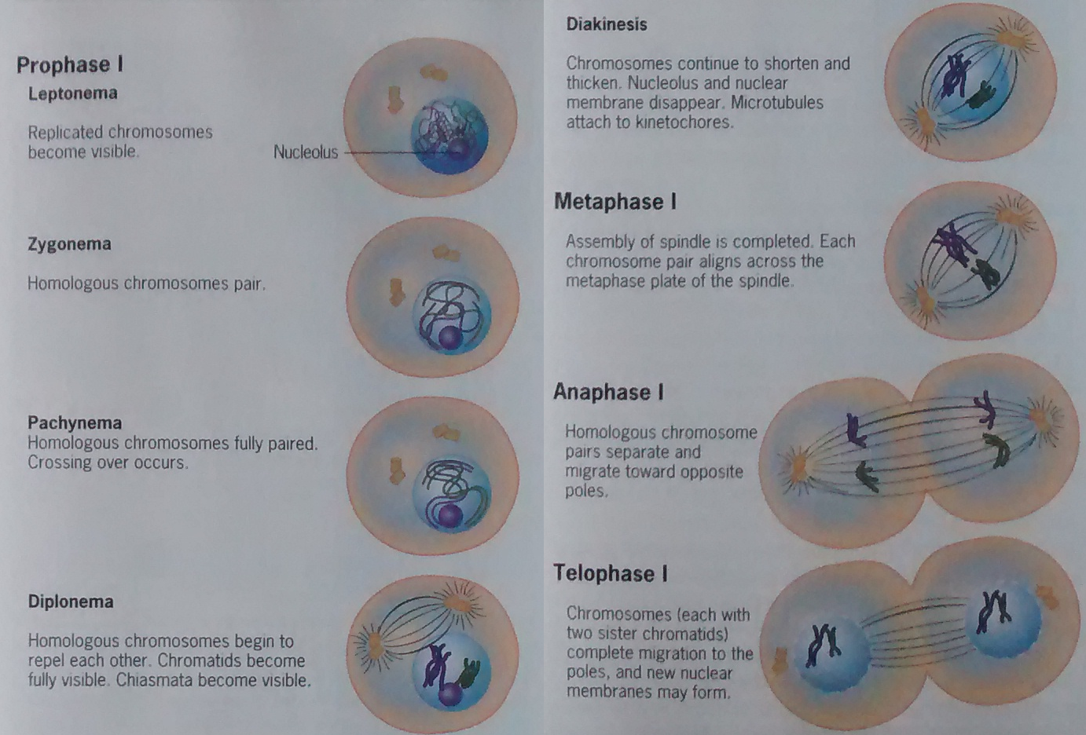
Meiosis – Crossing over
Snustad & Simmons, Principals of Genetics

Slide 15
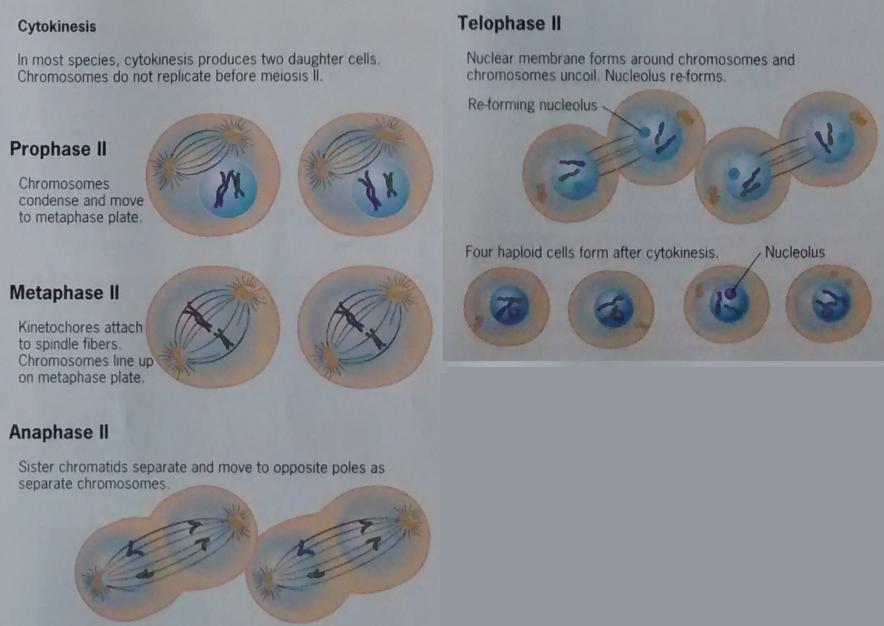
Meiosis – Crossing over
Snustad & Simmons, Principals of Genetics

Slide 16
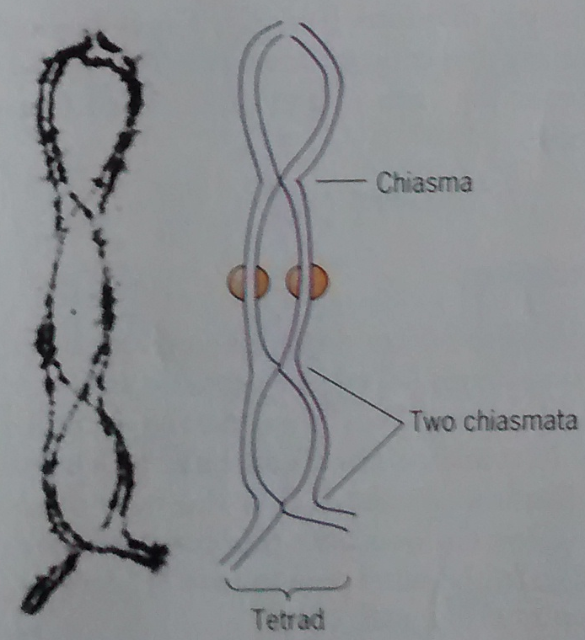
Crossing over – Chiasmata
Snustad & Simmons, Principals of Genetics

Slide 17
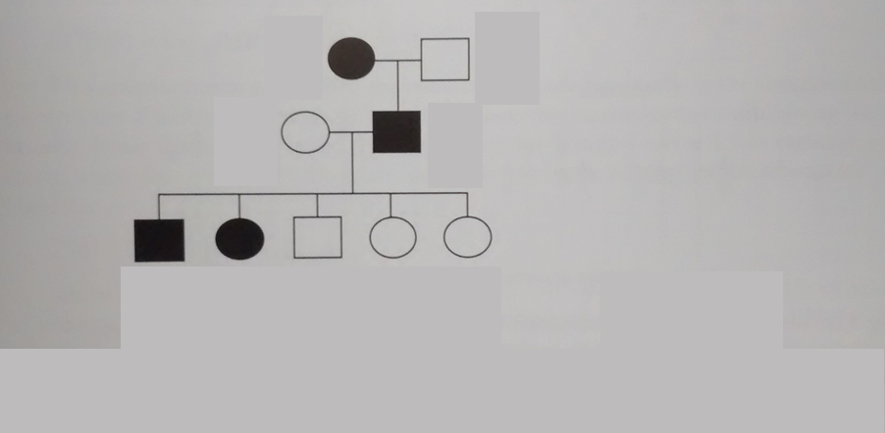
Idea behind linkage – crossing over
PAUSE: Think then take a poll!
What kind of disease is this, assuming full penetrance?
Dominant? Recessive? Neither? Both?
Austin, Genetic Epidemiology

Slide 18
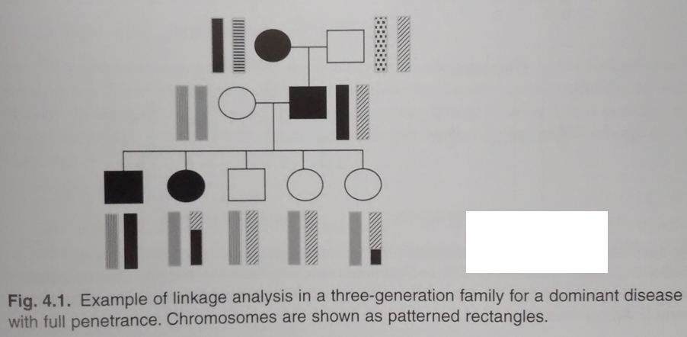
Idea behind linkage
Like the shuffling of new cards (difficult to shuffle, more in blocks).
PAUSE:
Can you narrow the genetic region responsible?
Austin, Genetic Epidemiology

Slide 19
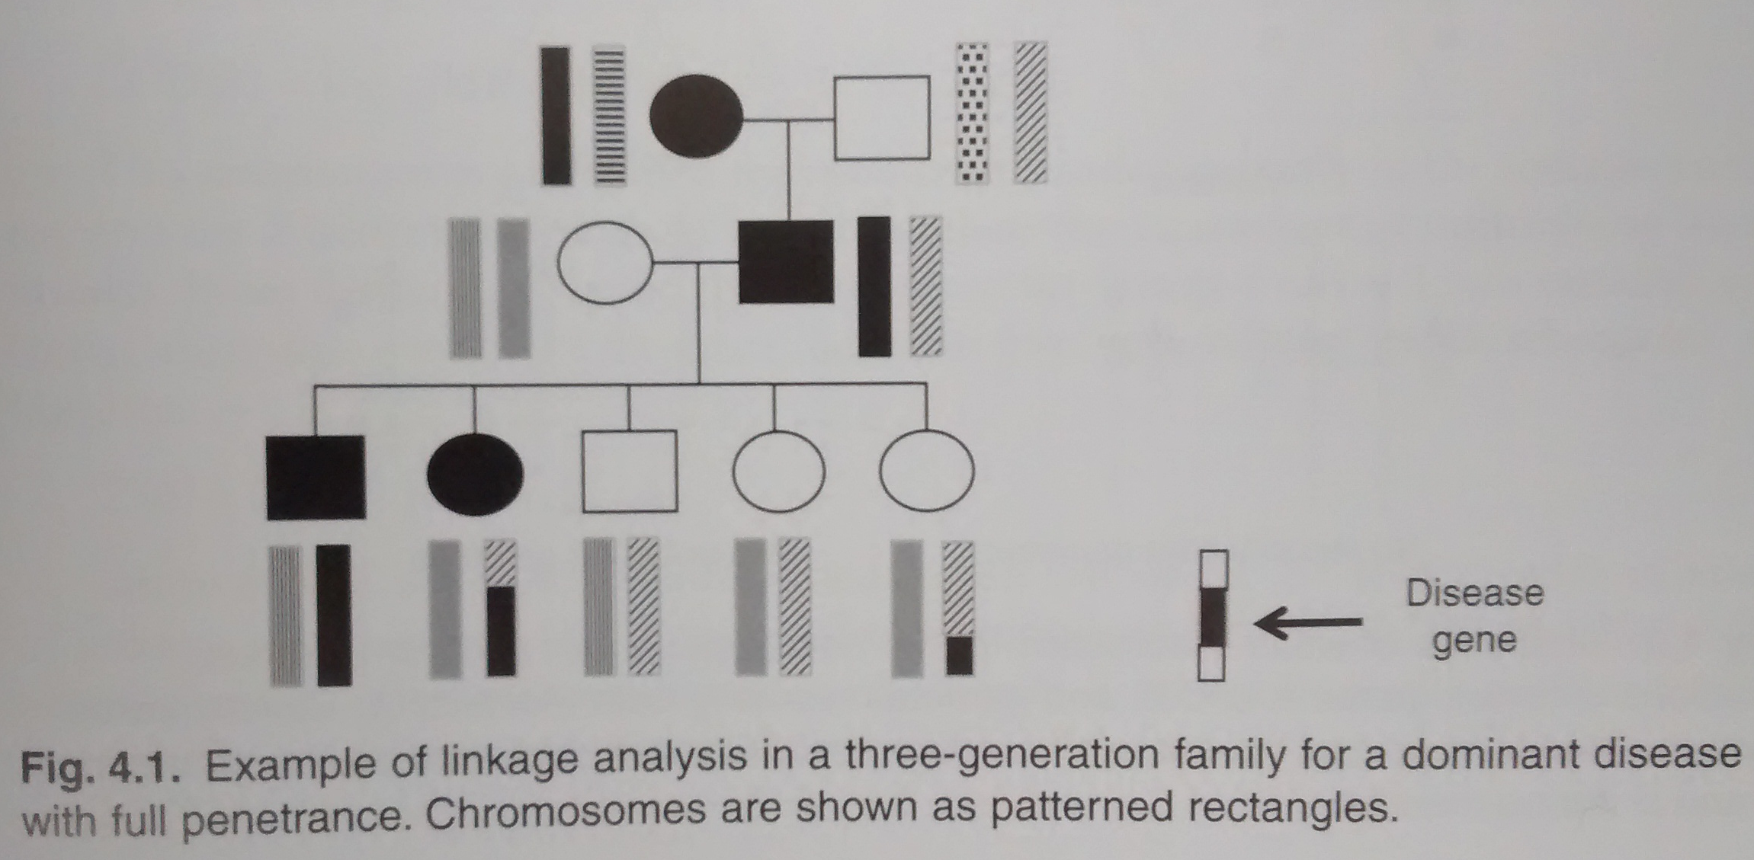
Idea behind linkage
Like the shuffling of new cards (difficult to shuffle, more in blocks).
Austin, Genetic Epidemiology

Slide 20
Linkage Analysis
- Narrow down position of disease gene
- No biological knowledge needed
- Genetic markers (not disease gene)
- It’s all about the recombination

Slide 21
PTC, dominant(-ish…, more later)
T
A
?
a
t
a
t
a
Phase known…
T
A
t
a
t
a
t
a
Which ones are recombinant?
NR = non-recombinant
R = recombinant
T
A
t
a
T
a
t
a
t
A
t
a
t
a
t
a

Slide 22
PTC, dominant(-ish…, more later)
T
A
?
a
t
a
t
a
Phase known…
T
A
t
a
t
a
t
a
NR = non-recombinant
R = recombinant
T
A
t
a
T
a
t
a
t
A
t
a
t
a
t
a
NR
R
R
NR

Slide 23
Linkage Analysis
LOD score based on recombination
LOD (θ) = log (θ)^{R} (1 - θ)^{NR}
        ____________________
        (θ_{null}= 1/2) ^{R + NR}
θ_{null}= ½, completely unlinked have 50% chance of recombining
The LOD score is the maximum of this function. You could maximize it easily here (take derivative, etc.), but this is difficult in more complicated examples (e.g., phase unknown, multi-generational pedigrees). So do a grid search over some possible values.
Effectively a likelihood ratio test.
<-2 evidence of lack of linkage
>3 evidence of linkage
Not definitive in -2 to 3

Slide 24
PTC, dominant(-ish…, more later)
θ | LOD(θ)
0 | -infinity
0.1 | -0.89
0.2 | -0.39
0.3 | -0.15
0.4 | -0.04
0.5 | 0
T
A
?
a
t
a
t
a
Phase known…
T
A
t
a
t
a
t
a
NR = non-recombinant
R = recombinant
T
A
t
a
T
a
t
a
t
A
t
a
t
a
t
a
NR
R
R
NR
LOD(0.1) = log₁₀[(0.1)²(1-0.1)²/0.5⁴] = -0.89

Slide 25
PTC, dominant(-ish…, more later)
LOD score=0
Not definitive
What now???

Slide 26
Get more families!!!
Assume phase known still…
T
A
t
a
t
a
t
a
NR = non-recombinant
R = recombinant
T
A
t
a
T
A
t
a
t
a
t
a
T
A
t
a
t
a
t
a
t
a
t
a

Slide 27
Get more families!!!
Assume phase known still…
T
A
t
a
t
a
t
a
NR = non-recombinant
R = recombinant
T
A
t
a
T
A
t
a
t
a
t
a
T
A
t
a
t
a
t
a
t
a
t
a
NR
NR
NR
NR
NR
NR

Slide 28
Get more families!!!
θ | LOD(θ)
0 | 1.81
0.1 | 1.53
0.2 | 1.22
0.3 | 0.88
0.4 | 0.48
0.5 | 0
Assume phase known still…
T
A
t
a
t
a
t
a
NR = non-recombinant
R = recombinant
T
A
t
a
T
A
t
a
t
a
t
a
T
A
t
a
t
a
t
a
t
a
t
a
NR
NR
NR
NR
NR
NR
LOD(0.1) = log₁₀[(0.1)⁰(1-0.1)⁶/0.5⁴] = 1.53

Slide 29
Add lod scores of families together…
θ | LOD(θ)
0 | -infinity
0.1 | -0.89
0.2 | -0.39
0.3 | -0.15
0.4 | -0.04
0.5 | 0
θ | LOD(θ)
0 | 1.81
0.1 | 1.53
0.2 | 1.22
0.3 | 0.88
0.4 | 0.48
0.5 | 0
θ | LOD(θ)
0 | -infinity
0.1 | 0.64
0.2 | 0.83
0.3 | 0.73
0.4 | 0.44
0.5 | 0
LOD(θ)
LOD(θ)
+
=

Slide 30
Now what?
LOD score of 0.83, not definitive
Suppose we had more families, LOD score of -4 (i.e., not that locus)?
Test more loci?

Slide 31
Genome-wide linkage analysis
Genetic Markers
Genes
(Markers can be much less dense than genome-wide association studies later on…)

Slide 32
Human Linkage Analysis
  RFLP Markers for Linkage (1980)
  Huntington’s Disease Linkage (1983)
  Cystic Fibrosis Linkage (1985)
  Cystic Fibrosis Gene (1989)
  Huntington’s Disease Gene (1993)

Slide 33
PTC Linkage Analysis
LOD Score
of 3 or higher
is significant
Notes:
33
Utah Genetic Reference Project
27 large families
269 subjects

Slide 34
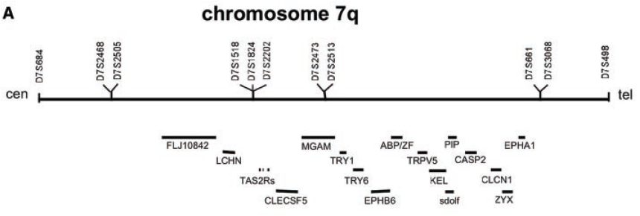
After you have found a linkage peak: Fine Mapping (more details later)
Linkage markers
Genes
Kim et al. Science 2003
Notes:
34

Slide 35
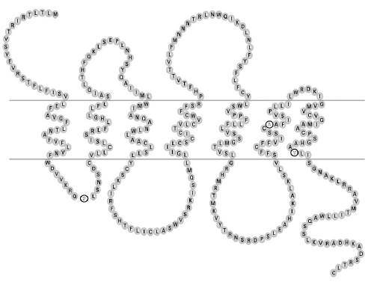
TAS2R38 Receptor Structure
rs1726866
rs10246939
rs713598
Kim et al. J Dent Res 2004

Slide 36
3 SNPs form 3 Haplotypes
Taster
P A V
Non-taster
A V I
Rare
A A V
Notes:
3rd haplotype is the result of recombination.
A of non-taster
AV of taster
Allows us to compare the effect of the 1st SNP vs. the 2nd and 3rd.
Rare-not in all combinations

Slide 37
Predicted Effect of the 3 SNPs
Notes:
3 a.a. substitution matrices
Sequence alignment
Scale
Chemical change
Scale
1st and 2nd most severe.

Slide 39
Exome sequencing and examples in Austin book following up on linkage peaks:
BRCA2 Breast cancer
HOXB13 G84E
  Took so long to find because they were initially looking in the wrong place!

Slide 40
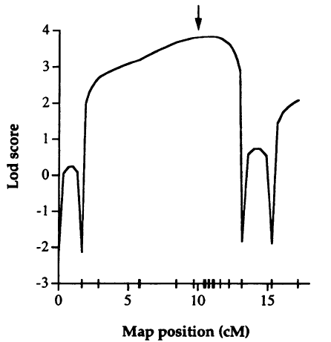
Multipoint Linkage Analysis
- Can base LOD score on multiple surrounding markers, same basic idea
- Austin refers to other articles
- Khoury et al. (1993)
- Ott (1999)

Slide 41
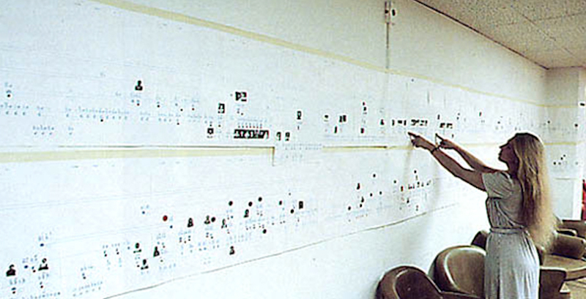
Non-parametric linkage analysis
Large multi-generational families most powerful for parametric linkage analysis
  Difficult to ascertain!!!
Nancy Wexler examining a family tree with nearly 10,000 people, on a figure over 100 feet (30 meters) long!

Slide 42
Non-parametric linkage analysis
Large multi-generational families most powerful for parametric linkage analysis
  Difficult to ascertain!!!
Non-parametric tests available for >= 2 affected siblings
Instead of testing θ directly, test excessive sharing identity by descent (IBD)
  Always share exactly one allele IBD with parent, and so on

Slide 43
Outline
  Background/Review
Family studies [PTC example]
Linkage analysis [PTC example]
Family-based association tests
  Trios/TDT
  Discordant sibships

Slide 44
Moving from linkage to association...
Linkage: Estimating & Testing recombination rates θ
Association:
  Difference in genotype frequencies (next lecture)
  Difference in genotype transmission frequency (discuss next)
Family based tests next based on composite hypothesis: No linkage, no association
LD block much smaller than linkage, so much finer resolution (next slide...)
Much smaller family structures than for linkage!

Slide 45
Key Idea: Linkage and Linkage Disequilibrium
Association: Linkage Disequilibrium blocks (LD) are much finer resolution than just linkage (basically the effect of linkage over time, over many more generations) [Shuffle cards more and more...]
A
a
A
a
A
a
B
b
b
b
b
b
Time

Slide 46
Mendel’s laws
Recall the playing cards example...
One allele from each parent for each gene
  Many family based tests based on this, rather than estimating allele frequencies (case-control)

Slide 47
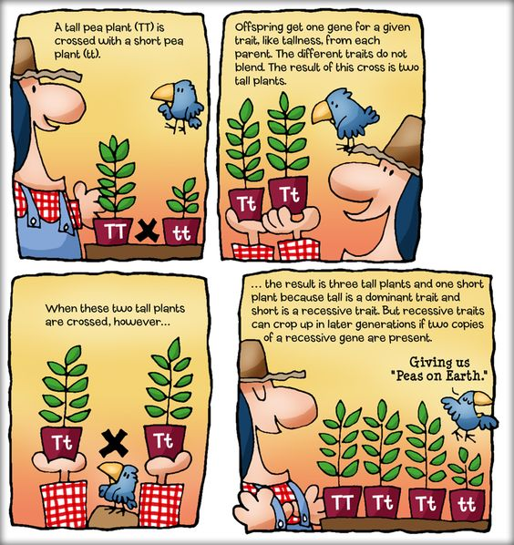
Mendel’s laws

Slide 48
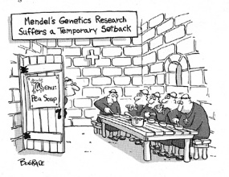
Mendel’s laws

Slide 49
Mendelian transmission: Ex
E.g., parents are Aa, Aa:
  P(offspring=AA | Mother=Aa,Father=Aa)=?
  P(offspring=Aa | Mother=Aa,Father=Aa)=?
  P(offpsring=aa | Mother=Aa, Father=Aa)=?

Slide 50
Mendelian transmission: Ex
E.g., parents are Aa, Aa:
  P(offspring=AA | Mother=Aa,Father=Aa)=1/4
  P(offspring=Aa | Mother=Aa,Father=Aa)=1/2
  P(offpsring=aa | Mother=Aa, Father=Aa)=1/4
Conditioning on parents...

Slide 51
Mendelian transmission: Ex
E.g., parents are AA, Aa:
  P(offspring=AA | Mother=AA,Father=Aa)=?
  P(offspring=Aa | Mother=AA,Father=Aa)=?
  P(offpsring=aa | Mother=AA, Father=Aa)=?

Slide 52
Mendelian transmission: Ex
E.g., parents are AA, Aa:
  P(offspring=AA | Mother=AA,Father=Aa)=1/2
  P(offspring=Aa | Mother=AA,Father=Aa)=1/2
  P(offpsring=aa | Mother=AA, Father=Aa)=0

Slide 53
Mendelian transmission: Ex
E.g., parents are AA, AA:
  P(offspring=AA | Mother=AA,Father=AA)=?
  P(offspring=Aa | Mother=AA,Father=AA)=?
  P(offpsring=aa | Mother=AA, Father=AA)=?

Slide 54
Mendelian transmission: Ex
E.g., parents are AA, AA:
  P(offspring=AA | Mother=AA,Father=AA)=1
  P(offspring=Aa | Mother=AA,Father=AA)=0
  P(offpsring=aa | Mother=AA, Father=AA)=0
Homozygote parents are “non-informative” (no variation in offspring’s conditional genotype distribution)

Slide 55
Trios: Transmission Disequilibrium Test (TDT)
Test based on transmissions from parents to offspring
Assumptions:
  Parents' and offspring genotypes are known
  Dichotomous phenotype (thought Q-TDT), only affected offspring
Count transmissions from heterozygote parents, and compare to expected transmissions
  Mendel's laws of seqregation (previous slides) not control group
  Test for over/under-transmission of alleles in cases (intuition)
Conditional test
  Offspring affection status
  Parental genotypes (conditions out allele frequencies, which is what case-control is based on testing)
Composite null hypothesis: No linkage, no association
Spielmen et al., AJHG 1993

Slide 56
Trios: Transmission Disequilibrium Test (TDT)
Non-transmitted parental allele
Transmitted parental allele
w AA parents (transmit one A, do not transmit other A)
z aa parents (transmit one a, do not transmit other a)
x Aa parents that transmit A, do not transmit a
y Aa parents that transmit a, do not transmit A

Slide 57
Trios: Transmission Disequilibrium Test (TDT)
Non-transmitted parental allele
Transmitted parental allele
w AA parents (transmit one A, do not transmit other A)
z aa parents (transmit one a, do not transmit other a)
x Aa parents that transmit A, do not transmit a
y Aa parents that transmit a, do not transmit A
PAUSE: Talk to your neighbor and construct a rough test! Try starting with (1) what cells are important? (hint, not all of them) (2)Think about whether you might want to add or subtract the two remaining values. (3) Is this like a test with matched pairs of subjects? EDUCATIONAL RESEARCH: Making you think/struggle about it will make you remember more!

Slide 58
Possible Parental Configurations
AA-AA, AA-Aa, AA-aa, Aa-AA, Aa-Aa, Aa-aa, aa-AA, aa-Aa, aa-aa
  (Ones not bolded are symmetric for what we will do next, e.g., AA-Aa == Aa-AA
  Six possible configurations

Slide 59
Both parents homozygous
Non-transmitted parental allele
AA-AA
|
AA
Transmitted parental allele
Offspring genotype is deterministic, no variation, not informative!

Slide 60
Both parents homozygous
Non-transmitted parental allele
aa-aa
|
aa
Transmitted parental allele
Offspring genotype is deterministic, no variation, not informative!

Slide 61
Both parents homozygous
Non-transmitted parental allele
AA-aa
|
Aa
Transmitted parental allele
Offspring genotype is deterministic, no variation, not informative!

Slide 62
One parent heterozygous
Non-transmitted parental allele
AA-Aa
|
AA,Aa
.5 .5 ← Pr
Transmitted parental allele
Non-transmitted parental allele
Transmitted parental allele
Variation from one parent

Slide 63
One parent heterozygous
Non-transmitted parental allele
Aa-aa
|
Aa,aa
.5 .5 ← Pr
Transmitted parental allele
Non-transmitted parental allele
Transmitted parental allele
Variation from one parent

Slide 64
Both parents heterozygous
Non-transmitted parental allele
Aa-Aa
|
AA,Aa,aa
.25,.5,.25 ← Pr
Transmitted parental allele
Non-transmitted parental allele
Non-transmitted parental allele
Transmitted parental allele
Transmitted parental allele
Variation from both parents

Slide 65
Trios: Transmission Disequilibrium Test (TDT)
Non-transmitted parental allele
Transmitted parental allele
w AA parents (transmit one A, do not transmit other A)
z aa parents (transmit one a, do not transmit other a)
x Aa parents that transmit A, do not transmit a
y Aa parents that transmit a, do not transmit A

Slide 66
Transmission Disequilibrium Test (TDT)
Non-transmitted parental allele
Transmitted parental allele
No variation in w or z (recall homozygous parents non informative)
(x-y)²/(x+y) ~ χ₁²; it’s just special case of McNemar’s test
Think of it as testing are there an excess of the A allele in the affected offspring than would happen by Mendel's laws?

Slide 67
Transmission Disequilibrium Test (TDT)
Non-transmitted parental allele
Insulin Dependent Diabetes Mellitus (IDDM)
Transmitted parental allele
Example from the text: 94 families, 78 parents transmit allele A, 46 transmit allele a
(78-46)²/(78+46)=8.26, p-value=0.004
Spielman et al., 1993

Slide 68
Limitations of TDT
Limitations
  Only affected offspring
  Only dichotomous phenotypes
  Bi-allelic markers
  Additive genetic model
  No missing parents
  Can’t do multiple markers, multiple phenotypes
Extensions exist for most everything you'd want to do, e.g., FBAT, ...(next slide)...
  “If you cannot get rid of the family skeleton, you may as well make it dance” (G.B. Shaw) → Nan Laird’s favorite quote on this… (big proponent of FBAT)

Slide 69
Discordant sibships
Conditional logistic regression
  P(Y₁=1|Y₁+Y₂=1,g₁,g₂,…)
  Matching each sib together, conditions on the fact that they have discordant phenotypes
  Standard model for disease as in logistic regression, just matching based on family strata
    Interpret coefficients, etc., in the same way (i.e., as odds ratios)
You will go through an example in the homework

Slide 70
Summary
- Family-based studies can be inherently robust to population substructure (based on Mendelian transmissions, not population allele frequencies)
- Robust to HWE failure
- Powerful for very rare, highly penetrant traits

