Slide 1
Fixed Dental Prosthesis:
An Introduction to Treatment Planning
Sara Hahn, DMD
Assistant Clinical Professor

Slide 2
Overview
Lytle and Skurow (L&S) Classification
Phasing
Diagnosis
Treatment Plan Evaluation
Notes:
We will cover: (read slide)

Slide 3
Intake Interview: History, Clinical Exam, Radiographs, Casts, Photos, etc.
Diagnosis
Treatment Planning
Notes:
In order to prepare for fixed dental prosthesis (FDP) treatment planning, you need to have completed the following:
Complete History, Examination, Radiographs, mounted casts and the gathering of any other information you may need (eg. Endo testing). For an anterior case, photos are very important so you have documentation of the esthetics the patient had before you start irreversible treatment. After gathering all the relevant information, you will be in a position to make a diagnosis of the different conditions, prior to selecting treatment planning options.

Slide 4
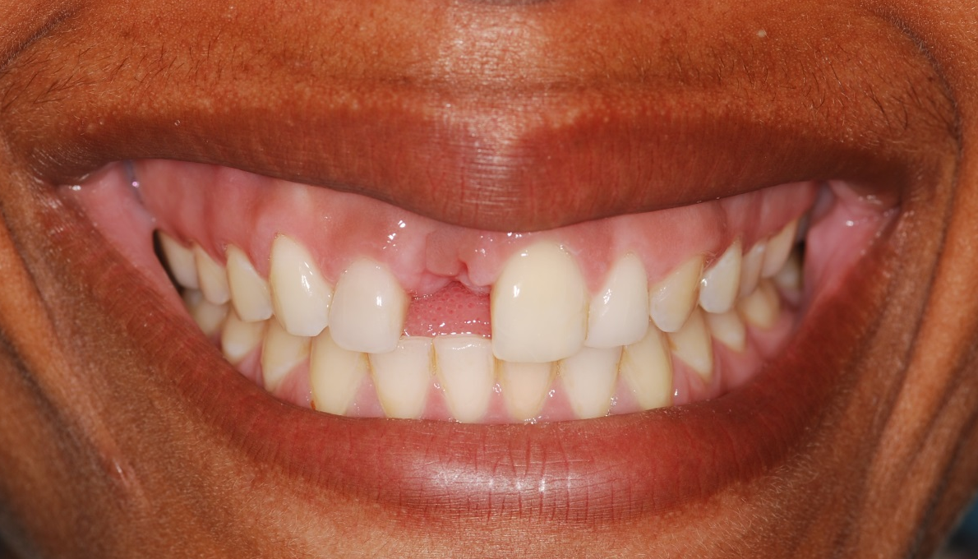
Chief Concern: “I want a bridge”
4 options for an edentulous space
  Implant
  FDP
  RPD
  Do nothing
Do not discuss treatment options before
your faculty checks your findings
Notes:
There are four options for an edentulous space. Implants, FDP, RPD or do nothing. Patients need to be aware of all the options before proceeding with one.
However, it is very important to write down the patient’s chief concern, take a full history of present illness (HPI), and DO NOT discuss any treatment options prior to gathering your data. If a patient keeps asking if you can do a bridge for them, kindly tell them that you need to complete the examination, and do the proper diagnosis before presenting a treatment plan. It is important during a COE not to discuss treatment options before your faculty has checked your findings.

Slide 5
Complexity for Predoc:
Lytle and Skurow Classification
Type I: Intracoronal restorations
Type II: Extracoronal restorations
Type III: Full mouth rehabilitation or complete dentures
Type IV Periodontal Prosthesis (splint)
Students can treat types I, II and III (if CD)
Lytle JD and Skurow H, An interdisciplinary classification of restorative dentistry.
Notes:
This simple classification system assists in the determination of the complexity of the case. There are three factors evaluated for their acceptability: hard tissue, perio and occlusion. Type I and II are simple, meaning there is a problem with the teeth (caries), but perio and occlusion are satisfactory, so you can proceed with intra- and extra-coronal restorations. You do not alter perio or occlusal plane in a L&S I or II. L&S I and II patients are treated to MIP.

Slide 6
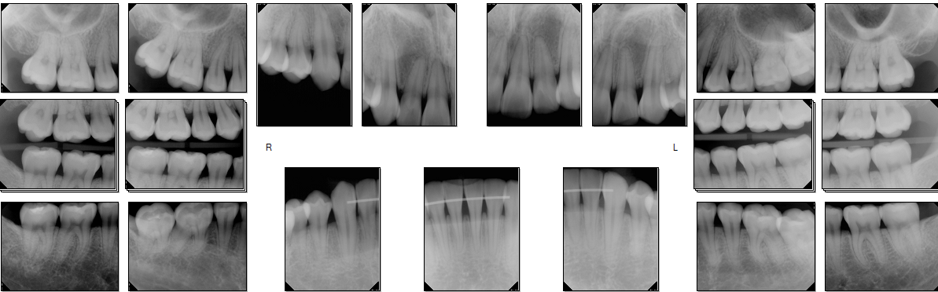
L&S Type I
Intracoronal restorations and prophy

Slide 7
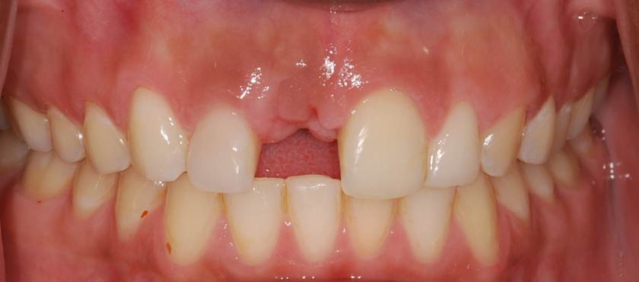
L&S Type II
Extracoronal restorations
(quadrant dentistry)
Occlusion and Periodontium acceptable

Slide 8
L&S Type III
Significant attrition/erosion
Uneven Occlusal Plane
Lack of inter-arch space for tooth replacement
Sometimes increased occlusal loading on teeth with normal periodontium
Notes:
Type III patients often require a full mouth rehabilitation and interdisciplinary care in order to treat them. The occlusion is unacceptable. In order to treat a L&S III, you have to change at least one entire arch (either with fixed or a complete denture). You must treat the patient to CR in a L&S III. They have significant occlusal problems and often heavy loading (primary occlusal trauma). The only L&S III patients that pre-doc students can treat are complete denture patients.

Slide 9
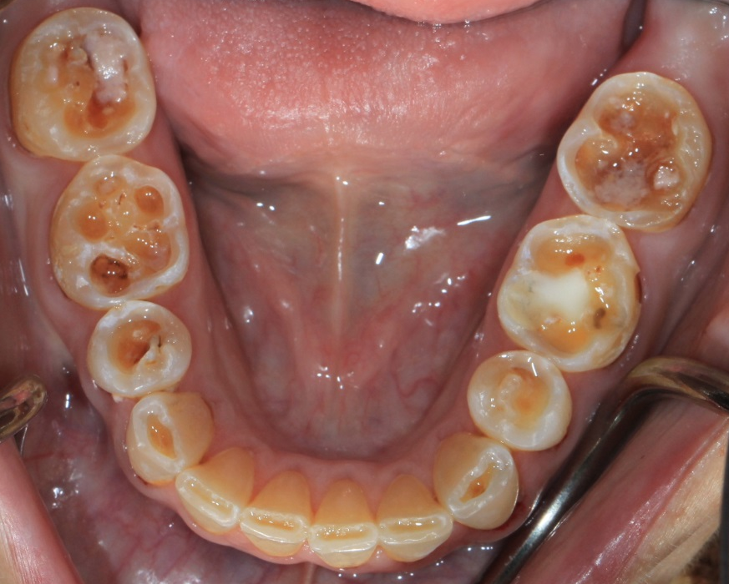
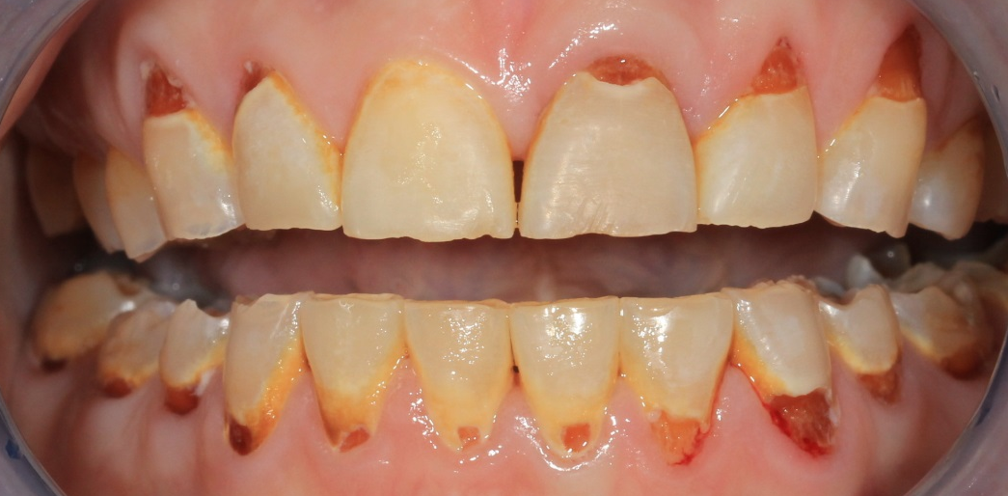
L&S Type III
Notes:
This is an example of a Type III Lytle and Skurow. At the NPV sessions, care is taken to either refer these patients to an appropriate provider (usually a Prosthodontist) or to explain to the patient that only limited care can be provided in the student clinic: Phase 1 holding care- take care of caries with sedative fillings and a cleaning, but no single crowns, no complex perio procedures. We can provide night guard, fluoride, medical referral for possible gastric reflux with the aim of maintaining the remaining tooth structure. The other option is to do a complete denture.

Slide 10
L&S Type IV
Unacceptable periodontium
Mobile teeth
Increasing diastemas
Secondary Occlusal Trauma (Normal occlusal loading on reduced periodontium)
Notes:
Type IV Lytle and Skurow patients often present with a “collapsed bite”. The teeth are mobile and moving under normal loading (secondary occlusal trauma). Opening diastemas in the maxilla is a common sign of this underlying condition. If the patient is to have full mouth extractions and complete dentures provided, treatment is simplified and patients can be treated in the predoctoral clinics. If the patient wishes to save their teeth, interdisciplinary perio-pros-ortho treatment is indicated.

Slide 11
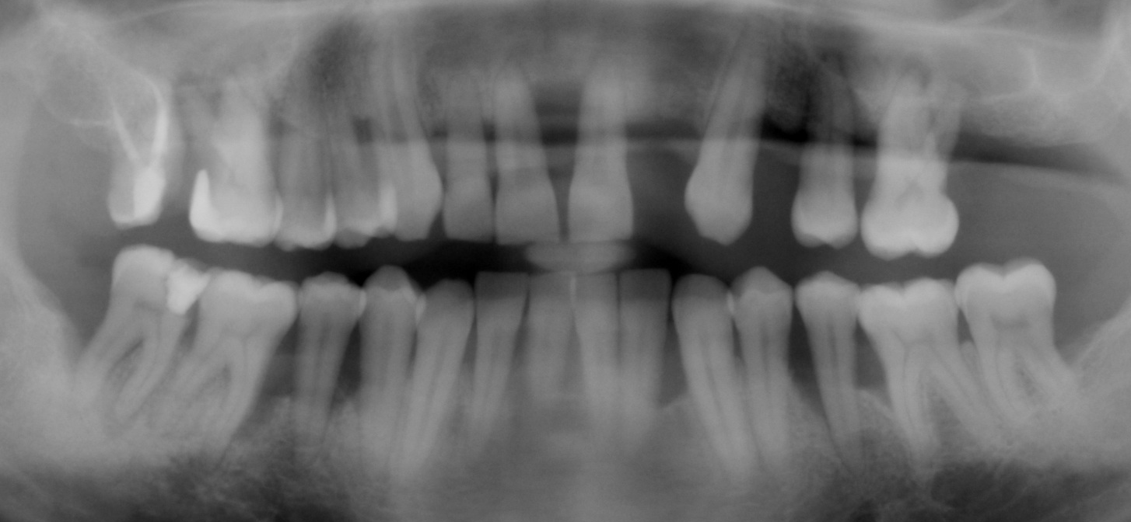
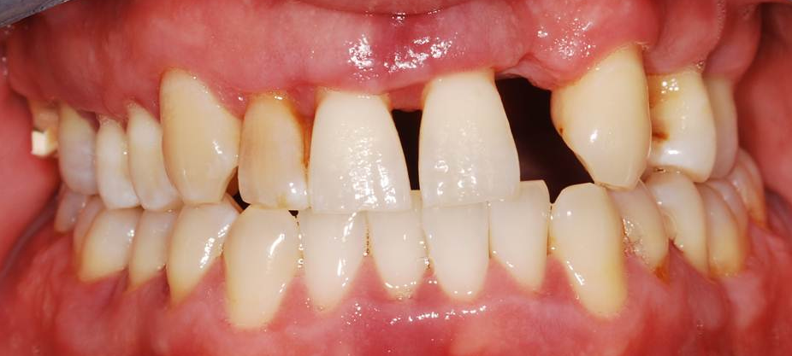
L&S Type IV
Notes:
This is an example of a Lytle and Skurow type IV case. The periodontium is unacceptable, even though from the clinical photo, his attachment level looks okay. This patient must be referred to PG Perio and PG Prosth for cross-arch splinting using long span FDPs or remove all of teeth and make complete dentures.

Slide 12
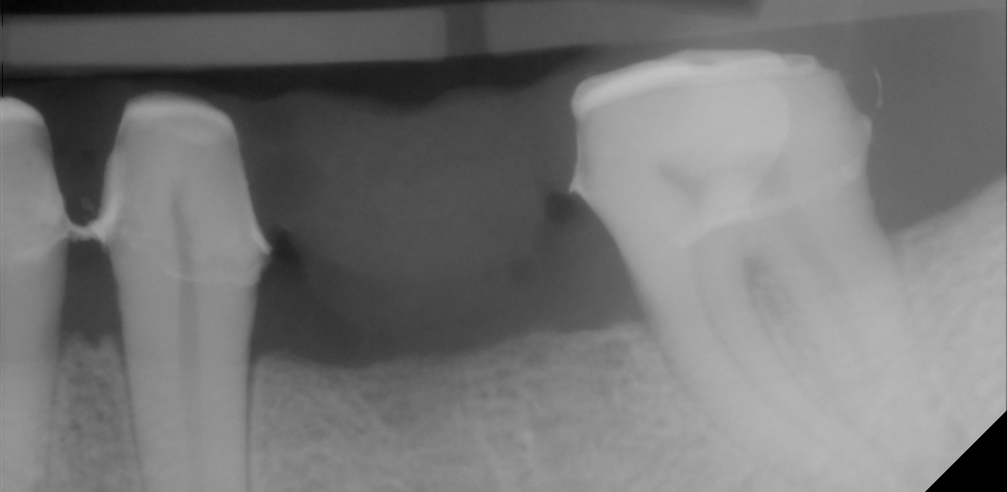
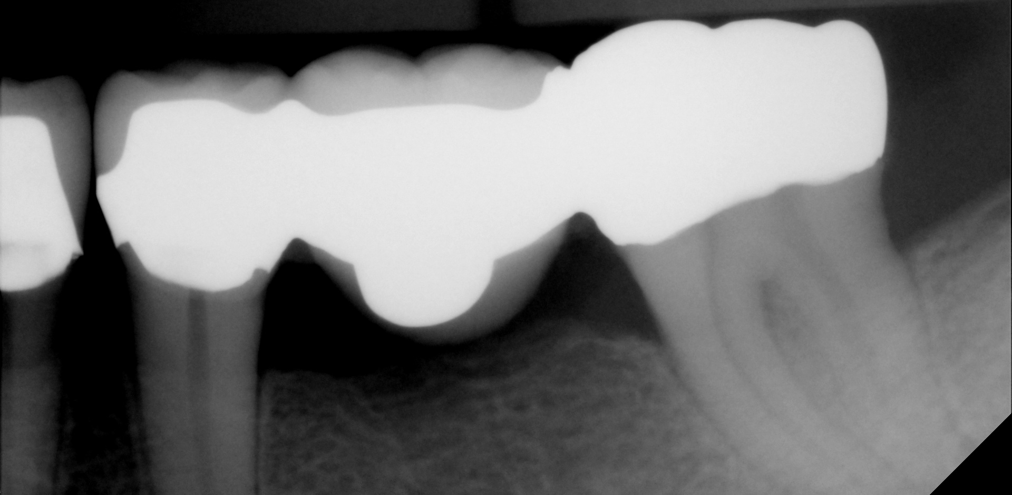
Successful FDPs
Depends on case selection
  Select L&S II (extra-coronal restorations)
    Periodontium must be healthy
    Occlusion must be healthy
    Hard tissue (teeth) need to be replaced
Notes:
If Perio and occlusion are not healthy, your FDP will fail. To ensure perio is healthy, you must first complete Phase 1: Management of active disease.

Slide 13
Phasing of Care
Tooth replacement is PLANNED at the beginning or end of Phase I
Tooth replacement is EXECUTED at Phase II/III
Notes:
Fitting this treatment planning into Phasing of dental treatment, the missing tooth replacement is planned at Phase I but is executed at Phase II/III

Slide 14
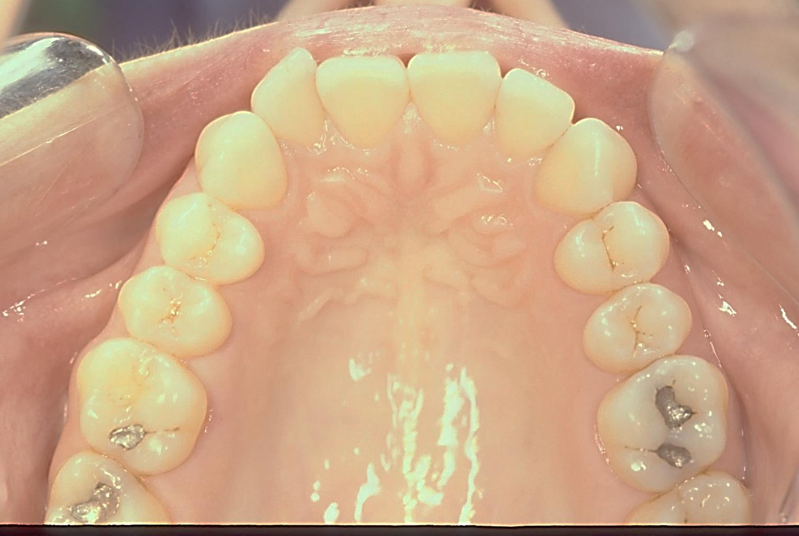
Short Phase I Care
Notes:
This patient has no active dental disease.

Slide 15
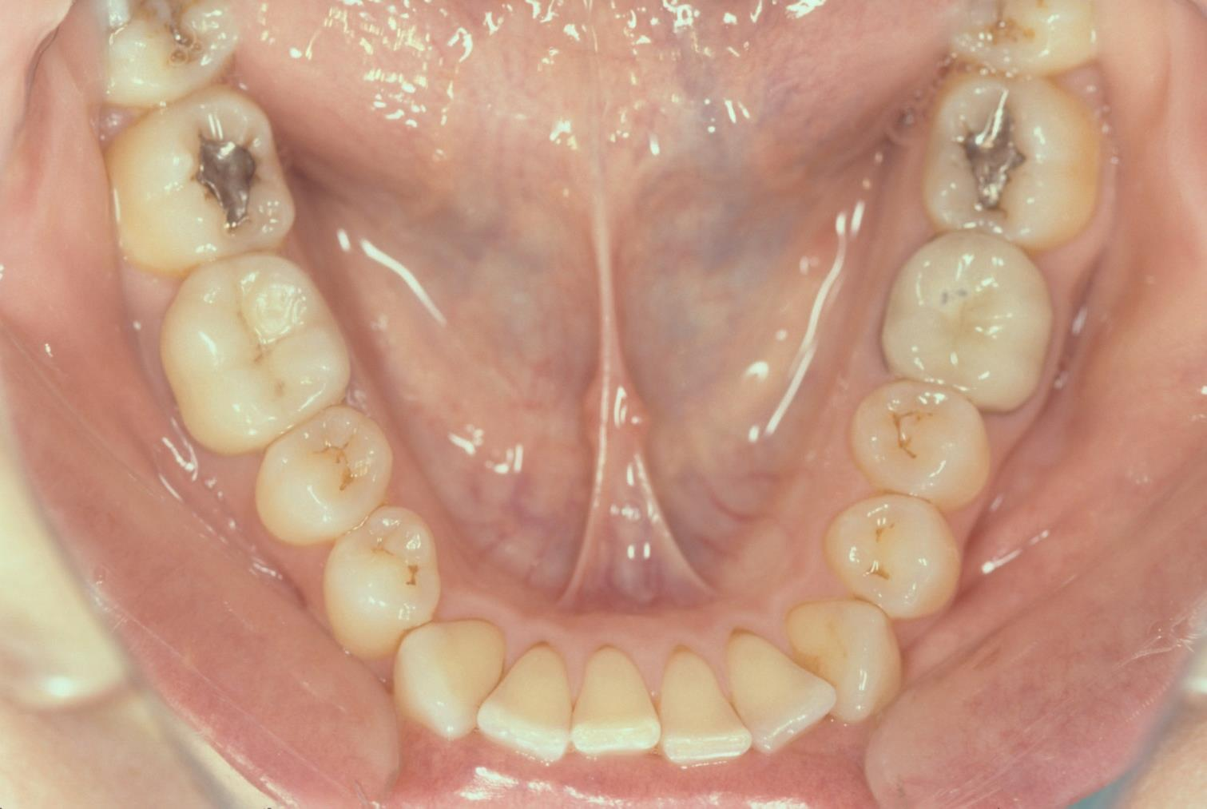
Short Phase I Care
Notes:
#19 tooth has a vertical fracture due to injury and will need to be extracted. Phase I is very short, since the prognosis of all teeth is known and there is no disease to manage.

Slide 16
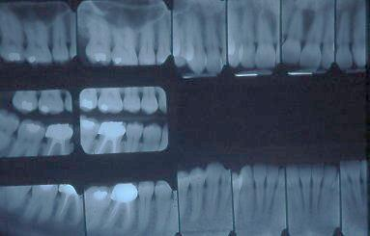
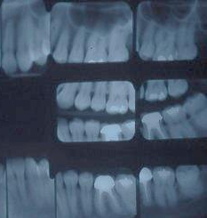
Short Phase I Care
Notes:
The tooth replacement can be planned at the first visit.

Slide 17
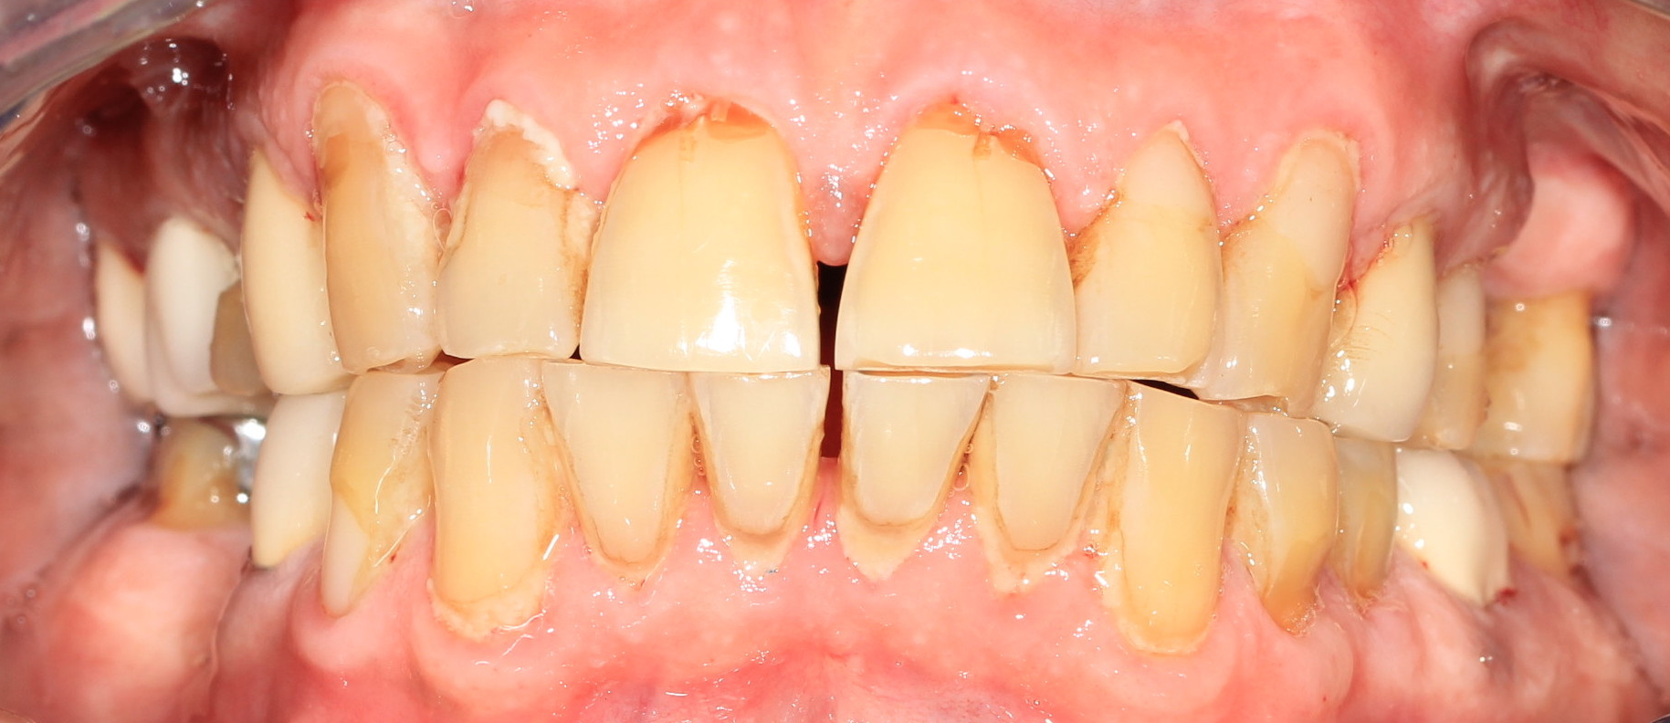
Long Phase I Care
Notes:
This patient has extensive caries and some of the teeth have an unpredictable prognosis at the beginning of Phase I

Slide 18
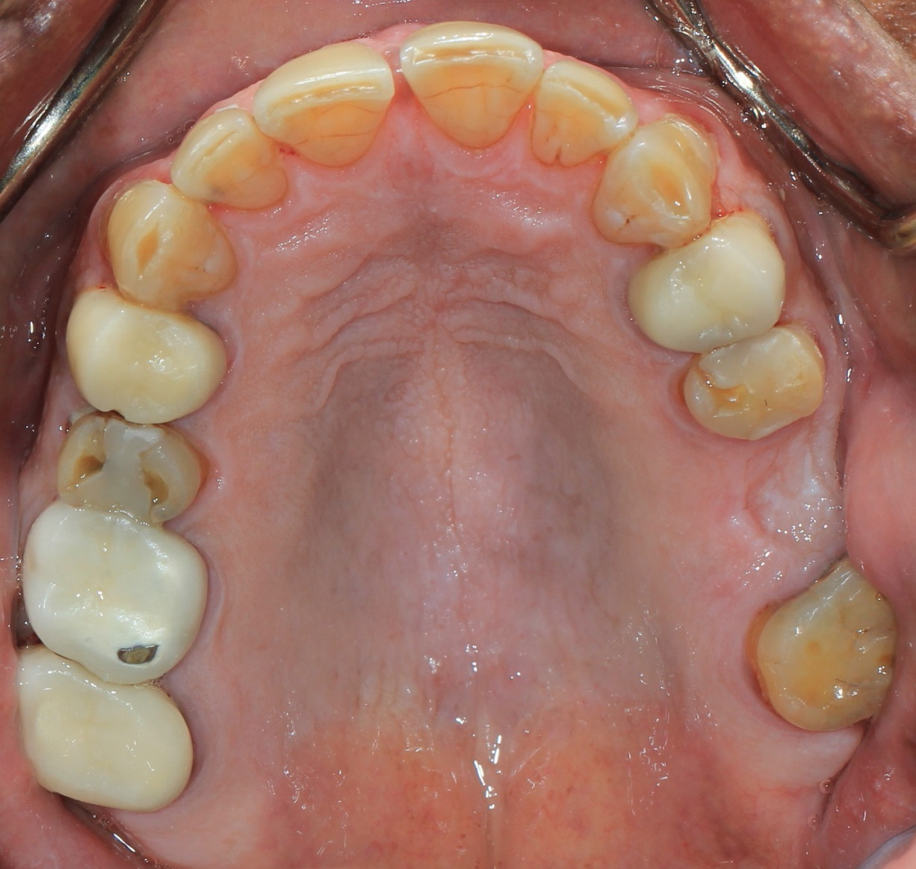
Long Phase I Care
Notes:
In Phase I, you will provide the most important care: prevention: The patient will need a CAMBRA protocol for extreme caries risk due to a dry mouth. In addition to the immediate evaluation and management, they will need to be recalled for continued long term management.
Since we do not know which teeth will be maintained, Phase I is used to evaluate this. The teeth with uncertain prognosis are treated for ‘caries management’, meaning that the caries is removed and the tooth is evaluated for long term restorability.

Slide 19
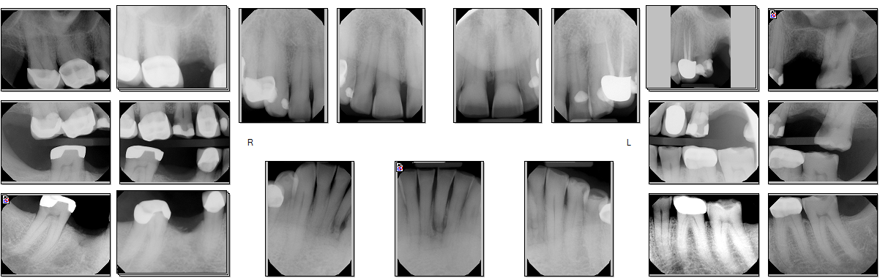
Long Phase I Care
Some patients remain permanently in Phase I due to lack of compliance and continued dental disease.
Notes:
At the end of Phase I you will know which teeth can be maintained long term (see restorability lecture for more information), and you will have knowledge of the patient’s compliance with preventive measures. You can then plan the tooth replacement options, you will need mounted casts and a Prosthodontic consultation. in some cases you will fabricate a stayplate and THEN refer to Oral Surgery for extractions of all hopeless teeth. For some patients, Phase I is very long and further radiographs are required during or at the end of this Phase. Some patients remain permanently in Phase I due to lack of compliance and continued dental disease.

Slide 20
Diagnosis
What is the etiology of disease?
Caries
Erosion
Attrition
Fracture
Old restoration fell out
Goal: prevent this condition from re-occurring.
Notes:
The fixed partial denture is the surgical procedure to correct the condition of a missing tooth. This is only one small part of the patient treatment or management. The tooth may be missing for a number of different reasons and it is essential to the care of your patient that you have a good understanding of the reasons for tooth loss so that, when applicable, you can provide long term management that will prevent this condition from re-occurring.

Slide 21
Treatment Planning Evaluation
Patient expectations
Smile Line
Gingival Biotype
Gingival Architecture
Occlusion
Abutment health
Notes:
A crucial part of the intake interview is to understand the patient’s expectations. Do they expect the FDP to look exactly like the missing tooth? This is a challenging task that requires joint treatment with periodontists who may need to add soft tissue. Do they have an existing FDP? Why did that one fail? Can I ensure that the next one will last longer? How much do they show when they smile? How healthy are the potential abutments? All of these are questions that you need to address.

Slide 22
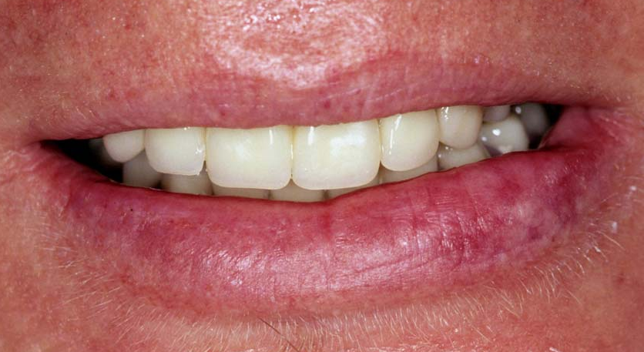
Smile Line: Low
Fewer esthetic challenges
Notes:
A patient who requires replacement of the anterior teeth and who has a low smile line will have fewer esthetic challenges than the patient with a high smile line.

Slide 23
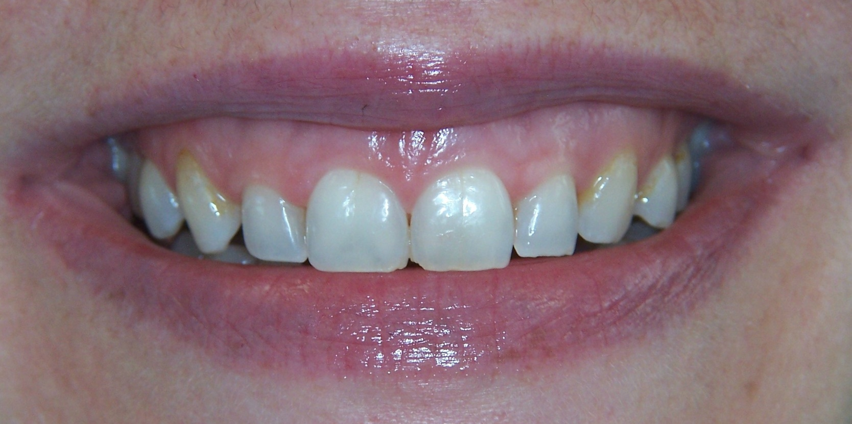
Smile Line: High
Thin Gingival Biotype
Extremely challenging with a high smile line
Notes:
This patient has a high smile line and very thin tissue. (Use a perio probe to evaluate the tissue thickness; if you can see the black color of the tip, the tissue is thin). Margins of the restorations may become visible. Any recession or discrepancies in the gingival contours will be very apparent. Tooth replacement is a very challenging process in this patient and needs to be very carefully planned.

Slide 24
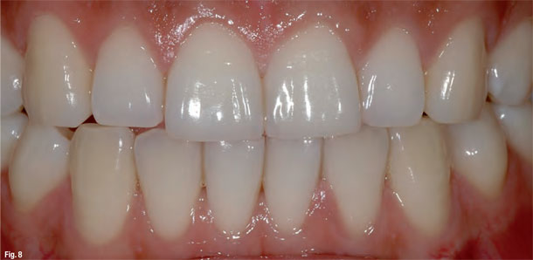
Gingival Architecture
Notes:
Notice the architecture of the gingival tissues. Asymmetry is very apparent to even the untrained eye. The height of the gingival tissue is pleasing if the cuspid and central incisor gingival margins are even and the gingival margin of the laterals are positioned more coronally, and if there is symmetry.

Slide 25
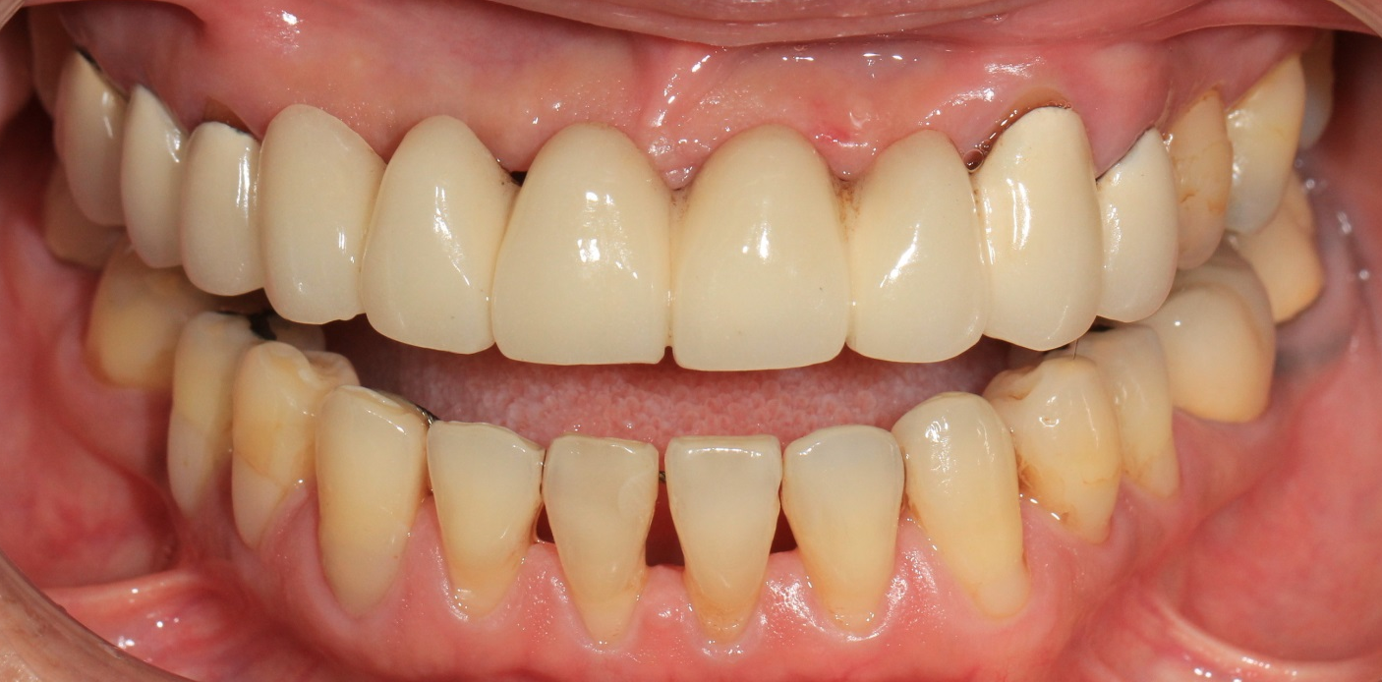
Gingival Architecture
After extraction, the bone and gingiva recede, creating a longer pontic
Notes:
Where extraction has taken place and there is gingival recession, if the patient has a high smile line, the esthetics can often not be reconstructed by tooth replacement only. This might be a patient that you would consider referring to a specialist for care.

Slide 26
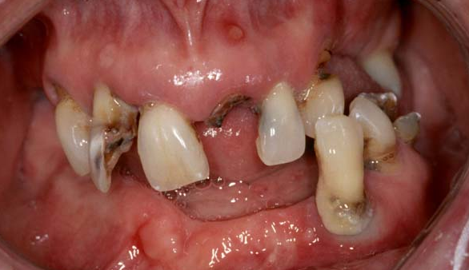
Caries Risk, Periodontal Status,
Oral Hygiene
The patient must be free of dental disease before proceeding
Caries management by risk assessment: implementation guidelines. Young DA, Featherstone JD, Roth JR, Anderson M, Autio-Gold J, Christensen GJ, Fontana M, Kutsch VK, Peters MC, Simonsen RJ, Wolff MS.. J Calif Dent Assoc. 2007 Nov;35(11):799-805.
Notes:
The patient needs to be disease free and well maintained prior to treatment planning for a fixed partial denture. It would be ill-advised to proceed with FDP 8-X-10 while ignoring the rest of the mouth. Do not do this.

Slide 27
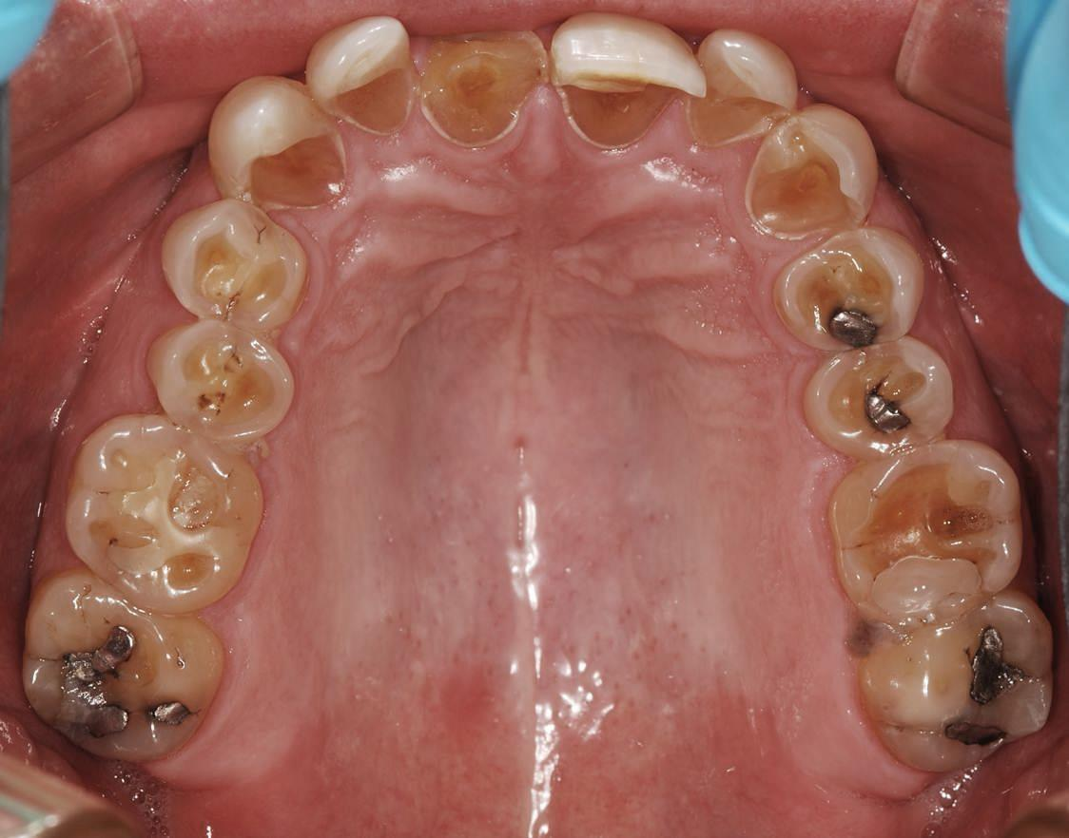
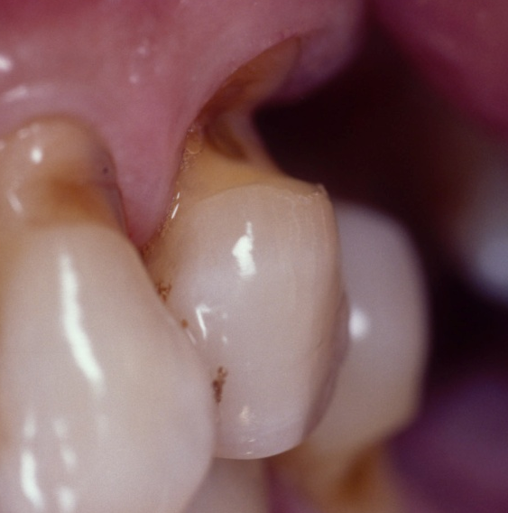
Erosion, Attrition, Abfraction, Abrasion
Is the wear chemical, mechanical or both?
Notes:
If you suspect erosion, refer the patient to his MD to evaluate the etiology of the acid erosion, and evaluation for possible Barrett’s esophagus.
Attrition and abfraction may be indications of high occlusal loading, and counseling and a night guard may be indicated.
Abrasion may be diagnosed and advice given to the patient.
All of these processes can ultimately become extremely destructive (especially if there is erosion plus on of the other conditions). Tooth restorability needs to be evaluated.

Slide 28
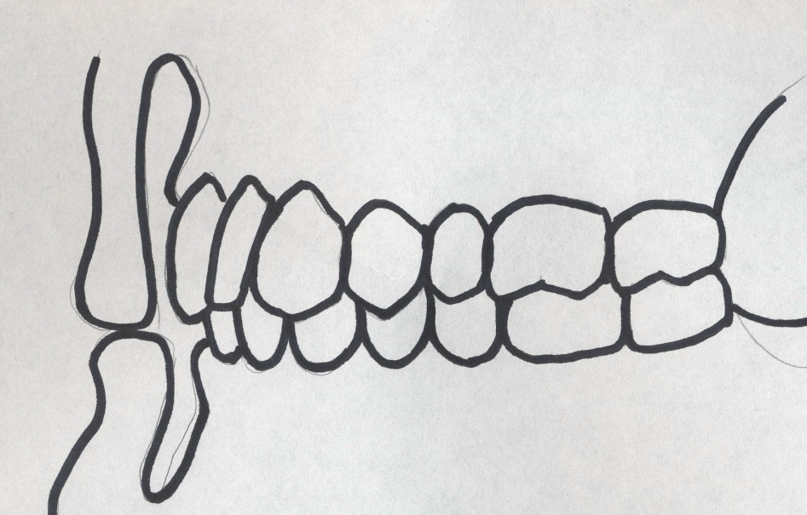
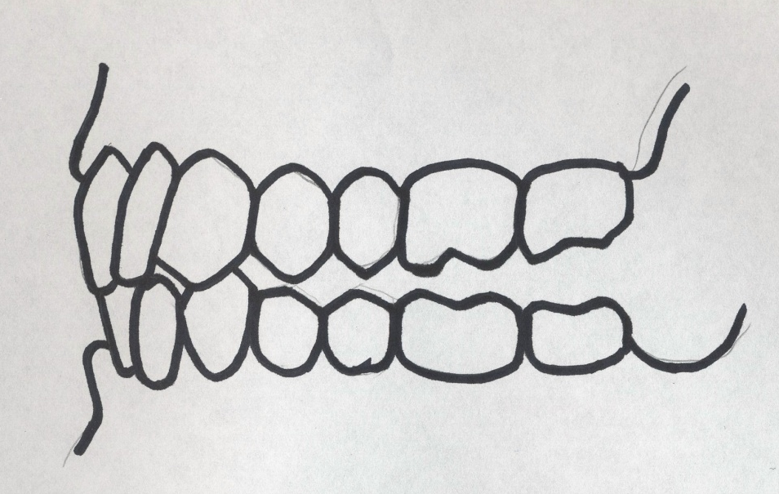
Anterior Guidance
In MIP, the posterior teeth protect the anterior teeth
In protrusion, the anterior teeth protect the posterior teeth
In laterotrusion, the canines protect the posterior teeth
Peter Dawson, Evaluation, Diagnosis and Treatment of Occlusal Problems, 2nd Edition, Mosby, ISBN: 0-8016-2788-5Chapter 16: Anterior Guidance
Notes:
Not all occlusal factors will be covered here, but do make a note of the patients guidance. If you are replacing a tooth you need to ensure that you do not introduce occlusal factors that will be detrimental to the patient. Patients are selected for the predoctoral program based on the lack of necessity to alter the occlusion. It is critical that any prosthesis delivered to the patient conforms to their existing occlusion. In protrusion and lateral excursion, only the anterior teeth should contact and healthy cuspids can provide a significant protection for the posterior teeth. Further reading is essential to an understanding of this.

Slide 29
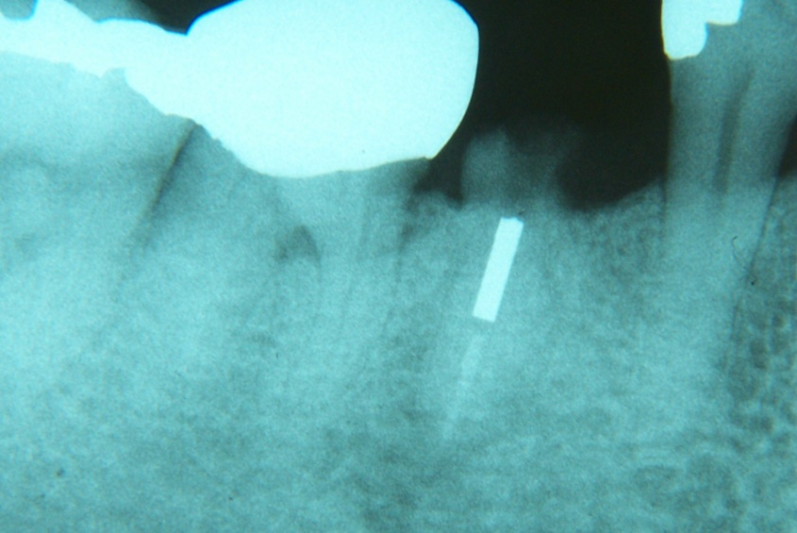
Crown:Root
Minimum proposed 1:1 (Ante’s “Law”)
Ante's (1926) law revisited: a systematic review on survival rates and complications of fixed dental prostheses (FDPs) on severely reduced periodontal tissue support. Lulic M, Clin Oral Implants Res. 2007 June
Notes:
Ante’s “Law” was written in 1926. It was not scientifically derived and it is a guide, not a law. There are situations where teeth are restored with the crown being much longer than the root (ie. The crown to root ratio is large, or a “poor” ratio)
So, the further the treatment moves away from this principle, the less predictable the treatment.
In the predoctoral program, it is likely that you will follow this guide most of the time.

Slide 30
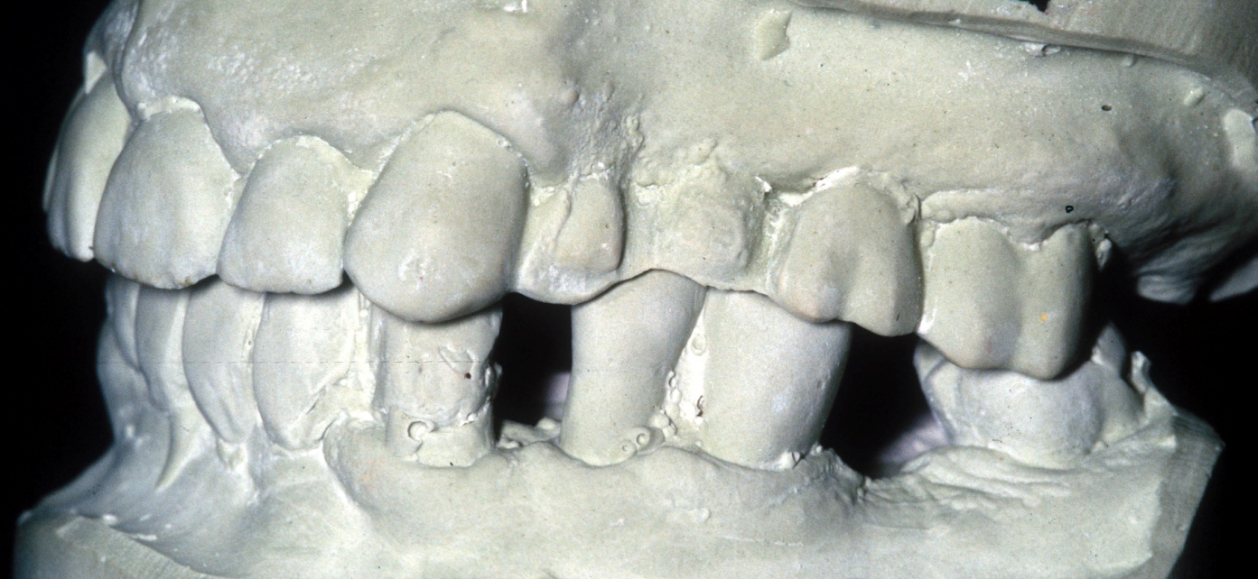
Inter-arch Space
Inadequate inter-arch space for restoration creates short connectors may lead to fracture of the FDP
Uneven occlusal plane leads to non-working side contacts instead of anterior guidance.
Notes:
Inadequate inter-arch space for restoration creates short connectors may lead to fracture of the FDP
Uneven occlusal plane leads to non-working side contacts instead of anterior guidance.
If tooth structure is not replaced as it is lost, the opposing teeth supra-erupt into the available space and lead to more complex treatment planning. It is critical that casts are mounted for these patients to help with treatment planning.

Slide 31
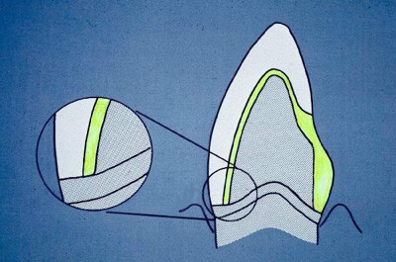
Abutment Design
Margins: depth, shape, material
Gold, PFM or all-ceramic
Framework Design Chapter 19, Rosenstiel, Contemporary Prosthodontics
Notes:
For simple fixed partial denture patients, it is important that you plan out the design of the final prosthesis at the time of treatment planning, ie. at Phase I (or the end of phase I). For margins that are not visible, the unnecessary destruction of tooth structure can be avoided by placing metal margins. Chapter 19 of Contemporary Prosthodontics by Rosenstiel is essential reading.

Slide 32
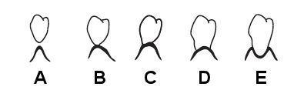
Pontic Design
Notes:
Pontic design is essential and this should also be planned at Phase I. Surgical procedures to either build out the pontic site, or reduce redundant tissue may be necessary, followed by a phase of healing. Proper planning will allow you to quote your patient appropriately and save healing time.

Slide 33
Risks, Benefits and Alternatives to FDP
Nothing
Implant
RPD
Notes:
Consider the alternatives to fixed dental prosthesis treatment and the advantages of disadvantages of each. This information needs to be provided to the patient prior to making restorative decisions. These are covered in the lecture called “Decision Making on Restorability”

Slide 34
Review
Data Gathering, Diagnosis, Treatment Planning, Phasing.
Tooth replacement planned at phase I, executed at phase II/III
Long term management of dental disease
Use of Fixed Dental Prosthesis Treatment Planning Check List
Alternatives to Fixed Dental Prosthesis
Notes:
A brief review: accurate data gathering prior to diagnosis and treatment planning, including appropriate radiographs and mounted casts. Plan out the treatment including the design of the prosthesis at phase I (or the end of phase I). This is BEFORE any permanent restorations have been placed. Use the check list to help you to avoid unanticipated conditions that may lead to failure. Long term management of the patient is essential and needs to be appropriate for that patient. Make sure that you understand the risks, benefits and alternatives to the different treatment options and that these are presented to and documented with the patient.

