Slide 1
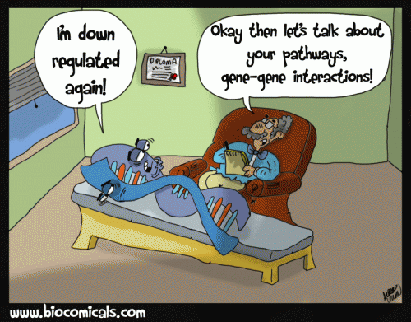
Association Studies
Notes:
1

Slide 2
Overview
Association Studies
  Design
  Analysis
Candidate Gene Studies
  Resources
  Selecting ‘tag’SNPs
Pathways

Slide 3
Process of Genetic Epidemiology
Defining the Phenotype
Migrant Studies
Familial Aggregation
Segregation
Linkage Analysis
Association Studies
Discussed some family-based ones last lecture; here, population-based
Fine Mapping
Cloning
Characterization
Notes:
Hand out cards for them to complete
3

Slide 4
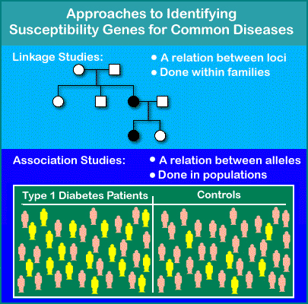
Association Studies
ROCHE Genetic Education (www)
Notes:
4
4
Compare alleles between individuals with extreme levels of a phenotype (i.e., cases and controls).
Association exists when cases are more (or less) likely than the controls to carry particular alleles (E.g., G).

Slide 5
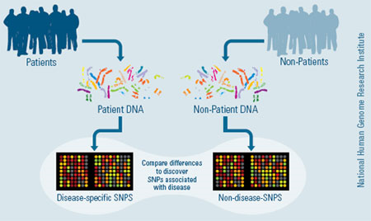
Association Studies

Slide 6
Association Studies
Use of (population-based) association studies is rapidly expanding, reflecting a number of good properties, including:
  Ease, since one need not collect large pedigrees
  Potential for being more powerful than conventional linkage-based approaches
Common disease / common variant hypothesis

Slide 7
Linkage vs. Association
Risch & Merikangas, Science 1996
Notes:
7

Slide 8
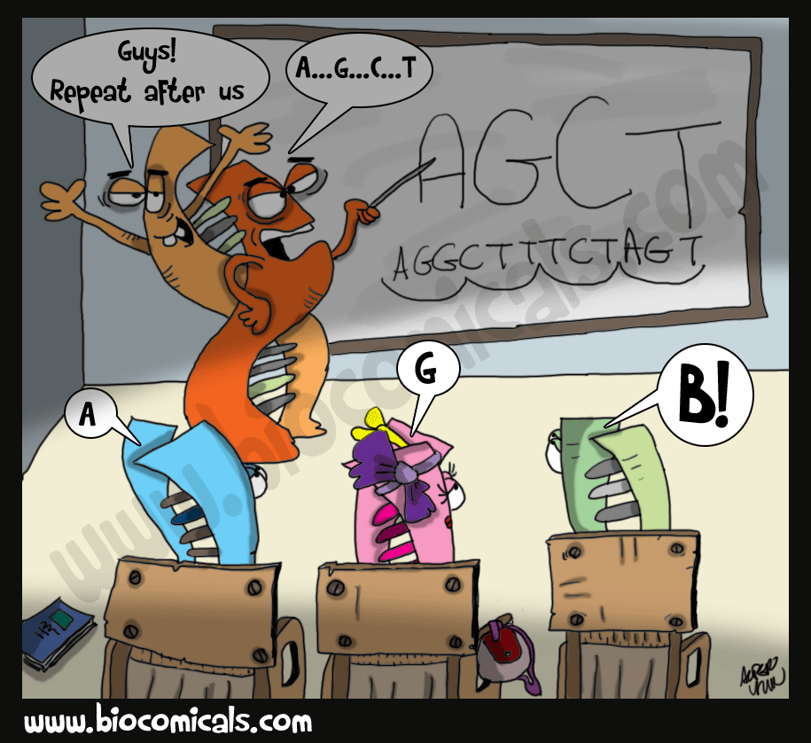
Association Studies – Educational Group Exercise!
Come up with important aspects and determine the design AND how to analyse your genotype association study…
  What aspects might influence where you draw your cases/controls?
  How would you choose where in the genome?
    Do you need all of that? Is there a way you could genotype less?
  How might you conduct a test of if the allele frequencies differ in cases and controls at a specific SNP?
Not about getting things perfectly right, the exercise is to get you to think about the problem, as studies show that you will remember things better that way.

Slide 9

Association Studies
Hirschhorn & Daly, Nat Rev Genet 2005
Candidate Gene or GWAS
Implications on design?
Implications on analysis?
Key concept: Linkage Disequilibrium
Notes:
9
Card Trick: Phenomenon of recombination.
genotype variants in LD with the variant of interest

Slide 10
Association Study Approaches
Direct vs Indirect (tagSNPs, later in lecture)
Candidate genes:
  Functional
  All common variants
  Exome Arrays
All common variants in genome (GWAS)
All variants in genes/genome (sequencing)
  Expensive

Slide 11
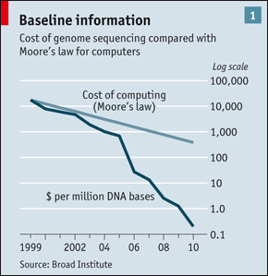
Genomics Revolution
Human Genome Project:
13 years, $3B for 1 sequence
Now: <1 week, ~$1.5K
> 500 times faster
< one million^{th} the cost!
Still not quite there:
1 hour, $1K
(#1 Innovation, 2010)
The Economist, 2010
Notes:
Computing has, famously, increased in potency according to Moore’s law. This says that computers double in power roughly every two years—an increase of more than 30 times over the course of a decade, with concomitant reductions in cost.
calculates that the cost of DNA sequencing at the institute has fallen to a hundred-thousandth of what it was a decade ago (see chart 1). The genome sequenced by the International Human Genome Sequencing Consortium (actually a composite from several individuals) took 13 years and cost $3 billion. Now, using the latest sequencers from Illumina, of San Diego, California, a human genome can be read in eight days at a cost of about $10,000. Nor is that the end of the story. Another Californian firm, Pacific Biosciences, of Menlo Park, has a technology that can read genomes from single DNA molecules. It thinks that in three years’ time this will be able to map a human genome in 15 minutes for less than $1,000.
11

Slide 12
Study Design: Control Selection
A critical aspect of association studies is that controls should be selected from the cases’ source population.
That is, controls should be those individuals who, if they were diseased, would become cases.

Slide 13
Family-Based Association Studies
(Covered in last lecture)
Siblings
Parents
G
G
G
G
G
Cousins
G
G
G
Termed “pseudo”-controls (the hypothetical other mendelian transmissions)

Slide 14
Continuum of Assoc Study Designs
Population-based
“Ethnicity” Matched
Structured Assoc
Family-based
Population Stratification
Overmatching
(Bias (maybe)……………versus…............. less efficient)
Subpopulation
↑ Sharing of genes & envt.
Efficiency
Also, recruitment issues
Gene
Disease

Slide 15
Association Analysis
Genotype | Cases | Controls | OR
TT | A | D | 1
CT | B | E | BD/AE
CC | C | F | CD/AF
Simple chi-square test comparing genotype frequencies (2 d.f.)
Called a co-dominant analysis

Slide 16
Simple chi-squared test
Observed: Expected
Geno Case Control Total Case Control
TT A D A+D=nCC nTT*nCase/n nTT*nCont/n
CT B E B+E=nCT nCT*nCase/n nCT*nCont/n
CC C F C+F=nTT nCC*nCase/n nCC*nCont/n
Total A+B+C D+E+F A+B+C+D+E+F
=nCase =nCont =n
Sum (Observed – Expected)^2/Expected as before. Chi squared with 2 degrees of freedom.
Hint: Expected cell count = row_total * column_total / total

Slide 17
Simple chi-squared test example
Observed: Expected
Geno Case Control Total Case Control OR (to TT genotype)
TT 5 15 20 20*35/65=10.8 20*30/65=9.2 1
CT 10 10 20 20*35/65=10.8 20*30/65=9.2 (10x15)/(5x10) = 3
CC 20 5 25 25*35/65=13.5 25*30/65=11.5 (20x15)/(5x5) = 12
Total 35 30 65
=nCase =nCont =n
Sum (Observed – Expected)^2/Expected
= (5-10.8)^2/10.8 + (10-10.8)^2/10.8 + (20-13.5)^2/13.5
+ (15-9.2)^2/9.2 + (10-9.2)^2/9.2 + (5-11.5)^2/11.5
= 13.7
P-value = 0.0011

Slide 18
Genetic Model
ORs depend on genetic model
R = r = 1 not risk allele
R > r = 1 recessive
R = r > 1 dominant
R = r² > 1 log additive
(Assuming positive association)
Genotype OR
TT 1
CT r
CC R

Slide 19
Tests of association
If genetic model known:
  Collapse genotypes into 2x2 table, 1 d.f. test
  Trend test for log additive
  Use logistic regression: coding; covariates
Rarely know genetic model
Use all three models (dom, rec, log additive)
Compare fit with the co-dominant (2d.f.) model (LR test) / it’s two estimated coefficients
Cannot use LR test to compare models with each other as not nested
Model with best fit and smallest P is best?

Slide 20
Tests of Association
2 df Genotype Recessive (G) Dominant (G)
Genotype Case Control Case Control Case Control
GG A D GG A D GG or GT A+B D+E
GT B E GT or TT B+C E+F TT C F
TT C F
~chi_sq(2df) ~chi_sq(1df) ~chi_sq(1df)
Genotype Case Control Case Control Case Control
TT 5 15 TT 5 15 TT or TG 15 25
GG 20 5 GG or GT 30 15 GG 20 5
GT 10 10
P=0.0011 P=0.0045 P=0.0020

Slide 21
Tests of Association – OR use logistic regression, covariates…
  . * Load in the dataset, and describe it
  .
  . cd c:\ttemp
  c:\ttemp
  .
  . insheet using geno_ex.csv, clear
  (2 vars, 65 obs)
  .
  . table geno_logadditive case
  ----------------------
  geno_loga | case
  dditive | 0 1
  ----------+-----------
  0 | 15 5
  1 | 10 10
  2 | 5 20
  ----------------------

Slide 22
Tests of Association – OR use logistic regression, covariates…
  . * handle a model fitting both coefficients
  . generate geno1 = (geno_logadditive==1)
  . generate geno2 = (geno_logadditive==2)
  . logit case geno1 geno2
  Iteration 0: log likelihood = -44.862069
  Iteration 1: log likelihood = -37.630625
  Iteration 2: log likelihood = -37.619709
  Iteration 3: log likelihood = -37.619707
  Logistic regression Number of obs = 65
  LR chi2(2) = 14.48
  Prob > chi2 = 0.0007
  Log likelihood = -37.619707 Pseudo R2 = 0.1614
  ------------------------------------------------------------------------------
  case | Coef. Std. Err. z P>|z| [95% Conf. Interval]
  -------------+----------------------------------------------------------------
  geno1 | 1.098612 .68313 1.61 0.108 -.2402981 2.437522
  geno2 | 2.484906 .7187953 3.46 0.001 1.076094 3.893719
  _cons | -1.098612 .5163978 -2.13 0.033 -2.110733 -.0864911
  ------------------------------------------------------------------------------

Slide 23
Tests of Association – OR use logistic regression, covariates…
  . * handle a model fitting both coefficients
  . generate geno1 = (geno_logadditive==1)
  . generate geno2 = (geno_logadditive==2)
  . logit case geno1 geno2
  Iteration 0: log likelihood = -44.862069
  Iteration 1: log likelihood = -37.630625
  Iteration 2: log likelihood = -37.619709
  Iteration 3: log likelihood = -37.619707
  Logistic regression Number of obs = 65
  LR chi2(2) = 14.48
  Prob > chi2 = 0.0007
  Log likelihood = -37.619707 Pseudo R2 = 0.1614
  ------------------------------------------------------------------------------
  case | Coef. Std. Err. z P>|z| [95% Conf. Interval]
  -------------+----------------------------------------------------------------
  geno1 | 1.098612 .68313 1.61 0.108 -.2402981 2.437522
  geno2 | 2.484906 .7187953 3.46 0.001 1.076094 3.893719
  _cons | -1.098612 .5163978 -2.13 0.033 -2.110733 -.0864911
  ------------------------------------------------------------------------------
OR=exp(1.0986)
=3
OR=exp(2.4849)
=12
What model does this resemble?

Slide 24
Tests of Association – OR use logistic regression, covariates…
  . * recessive test for T / dominant test for G
  . generate geno0 = (geno_logadditive==0)
  . logit case geno0
  Iteration 0: log likelihood = -44.862069
  Iteration 1: log likelihood = -39.903582
  Iteration 2: log likelihood = -39.889842
  Iteration 3: log likelihood = -39.88984
  Logistic regression Number of obs = 65
  LR chi2(1) = 9.94
  Prob > chi2 = 0.0016
  Log likelihood = -39.88984 Pseudo R2 = 0.1108
  ------------------------------------------------------------------------------
  case | Coef. Std. Err. z P>|z| [95% Conf. Interval]
  -------------+----------------------------------------------------------------
  geno0 | -1.791759 .6055301 -2.96 0.003 -2.978576 -.6049422
  _cons | .6931472 .3162278 2.19 0.028 .0733521 1.312942
  ------------------------------------------------------------------------------

Slide 25
Tests of Association – OR use logistic regression, covariates…
  . * dominant test for G / recessive test for T
  . logit case geno2
  Iteration 0: log likelihood = -44.862069
  Iteration 1: log likelihood = -39.003467
  Iteration 2: log likelihood = -38.972594
  Iteration 3: log likelihood = -38.97259
  Logistic regression Number of obs = 65
  LR chi2(1) = 11.78
  Prob > chi2 = 0.0006
  Log likelihood = -38.97259 Pseudo R2 = 0.1313
  ------------------------------------------------------------------------------
  case | Coef. Std. Err. z P>|z| [95% Conf. Interval]
  -------------+----------------------------------------------------------------
  geno2 | 1.89712 .5972157 3.18 0.001 .7265984 3.067641
  _cons | -.5108255 .3265986 -1.56 0.118 -1.150947 .129296
  ------------------------------------------------------------------------------

Slide 26
Tests of Association – OR use logistic regression, covariates…
  . * log additive
  . logit case geno
  Logistic regression Number of obs = 65
  LR chi2(1) = 14.42
  Prob > chi2 = 0.00014
  ------------------------------------------------------------------------------
  case | Coef. Std. Err. z P>|z| [95% Conf. Interval]
  -------------+----------------------------------------------------------------
  geno | 1.2451 .3592 3.47 0.0005 .5360 1.9440
  _cons | -1.1577 .4664 -2.48 0.0131 -2.0461 -0.2359
  ------------------------------------------------------------------------------

Slide 27
Review: Population stratification
Population stratification is a form of confounding in genetic studies where a gene under study shows marked variation in allele frequency across subgroups of a population and these subgroups differ in their baseline risk of disease
(Pima and Papago example, significance indicates what population from, not association with trait.)
Notes:
27
Most of you have come here for two reasons - you have a candidate gene and want to find out more information about or the genomic region where it resides. Or you have a gene and am saying I want to genotype this with a population I have how do I extract SNPs from the databases. So we would like to spend about an hour going over some of the genomic resources that are out there. Many of you have likely used these before, but now is the time to have some time to ask questions about hard to get at data and have us help you or learn something from scratch. I will have to admit right off that I am not the expert,but the way I have learned about these online databases is have sit down with them and clicked on every link I could find and played a lot. This isn’t meant to be comprehensive but rather an overview. So I will just go over a few of the basic here and then take you through a “live” browsing session. Later this afternoon you will have an hour or so to go over these sites on your own, and then we can also work with you to get specific information you would like.

Slide 28
Correcting for population stratification
“Homogeneous” group (and ignore)
Genomic control (PMID: 11315092) [see next slide]
  Non-central chi-square λ = median of all χ² tests in the sample
  Adjust all test statistics for inflation due to empirical chi-square distribution (χ²_{new} = χ²_{old}/λ)
  Critiques: An average across the genome, and may over or under correct for individual tests
    For large samples, e.g. 100,000, polygenetic traits, should NOT equal 1!
Ancestry Principal Components (more in GWAS lecture)
  Eigenstrat (PMID: 16862161)
  Adjust regression model for principal component values which serve as a proxy for ancestry
Mixed model – more in GWAS lecture (PMID 20562875) [idea is to condition on the rest of the genome]

Slide 29
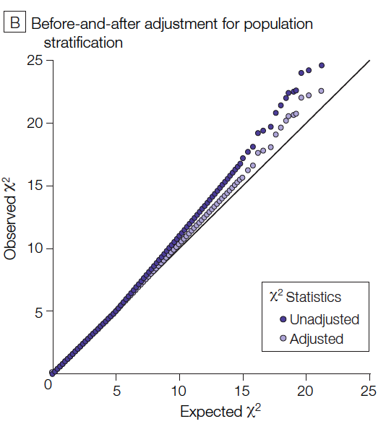
Quantile-Quantile (QQ) Plots

Slide 30
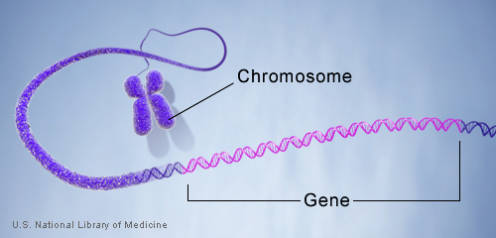
3. Candidate Gene Studies
Selection of candidates
Linkage regions?
Biological support?
“I am interested in a candidate gene and have samples ready to study. What SNPs do I genotype?”
Notes:
30

Slide 31
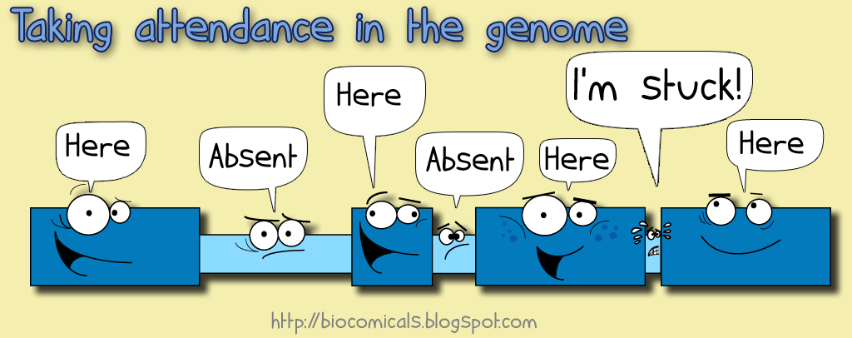
Candidate Gene: Where do I Start?
Location:
What chromosome? What position on the chr?
Exons/UTR:
How many exons? UTR regions?
Size:
How large is the gene?
Use UCSC genome browser.
Notes:
31

Slide 32
SNP Picking: Things to Consider
Validation: What is the quality of the SNPs?
Informativity: Are these SNPs informative in my population? How common are they? Location?
Potentially Functional: Do these SNPs have a potential biological impact? Missense variants?
Previously Associated: Have previous studies found SNPs in the candidate gene associated with the outcome?
Notes:
32

Slide 33
Learning activity! Try these websites with these terms
Links:
  UCSC Genome browser / 1000 Genomes Browser
  dbSNP
  Pubmed
Example terms: mthfr (a gene), mthfr cancer
Things to find out: Chromosome? # Exons? # Introns? Size of gene? Functional variants? Previously associated variants? SNP validation status?

Slide 34
UCSC Genome Browser

Slide 35
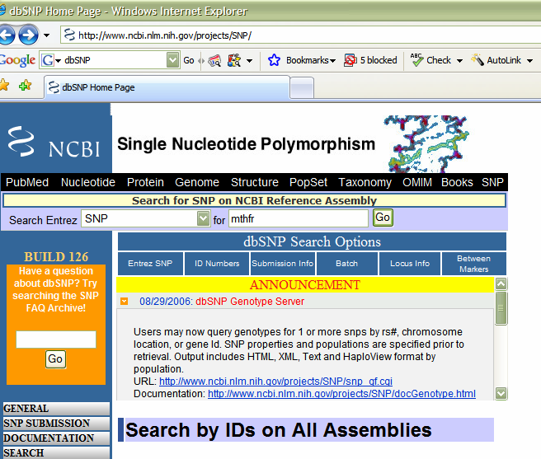
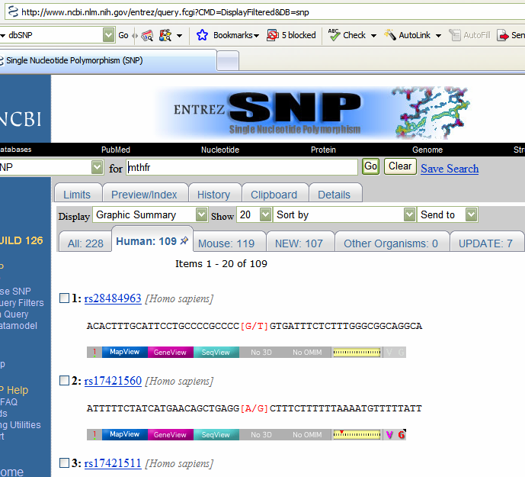
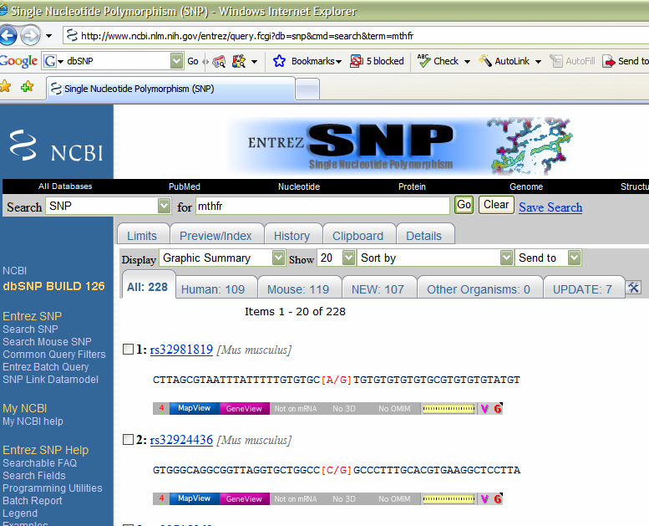
SNP Picking: Validation
Notes:
35

Slide 36
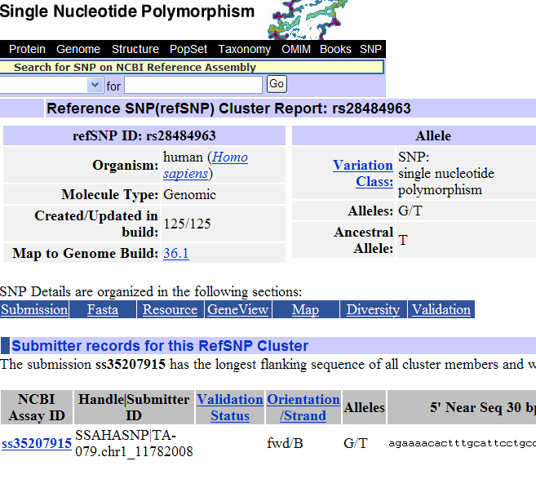
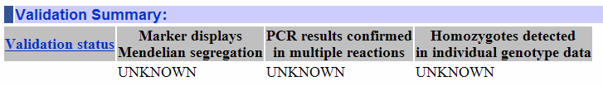
SNP Picking: Validation
Notes:
36

Slide 37
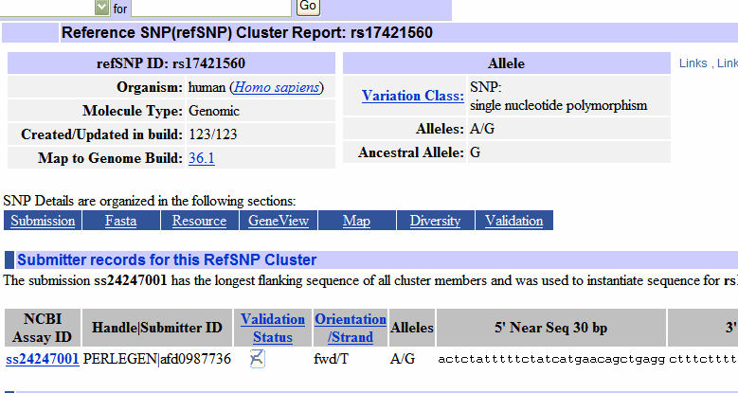
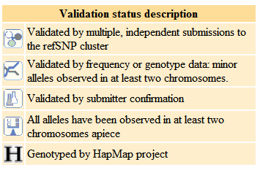
SNP Picking: Validation
Notes:
37

Slide 38
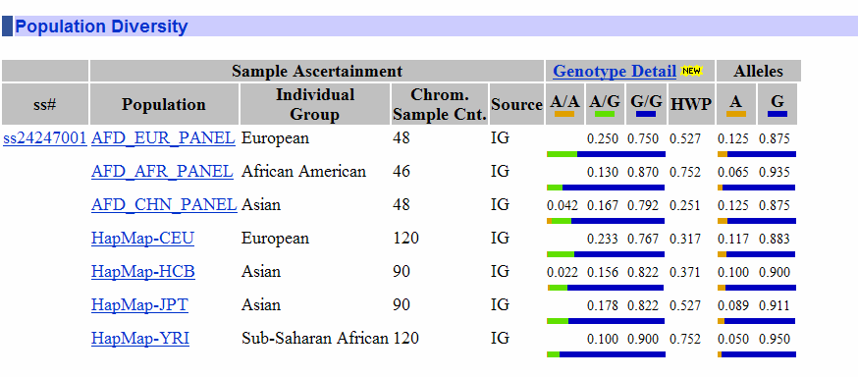
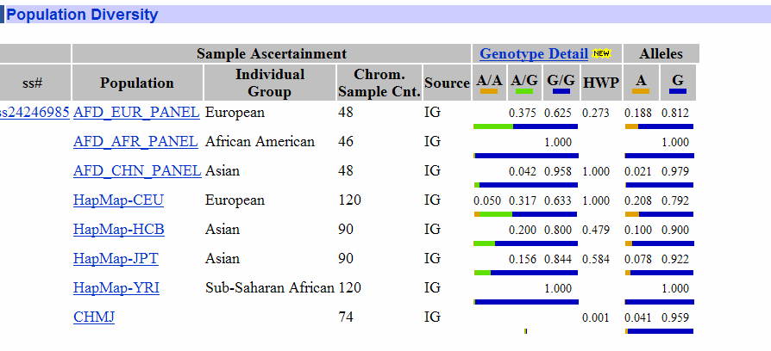
SNP Picking: Informative
(rs17421511)
Notes:
38

Slide 39
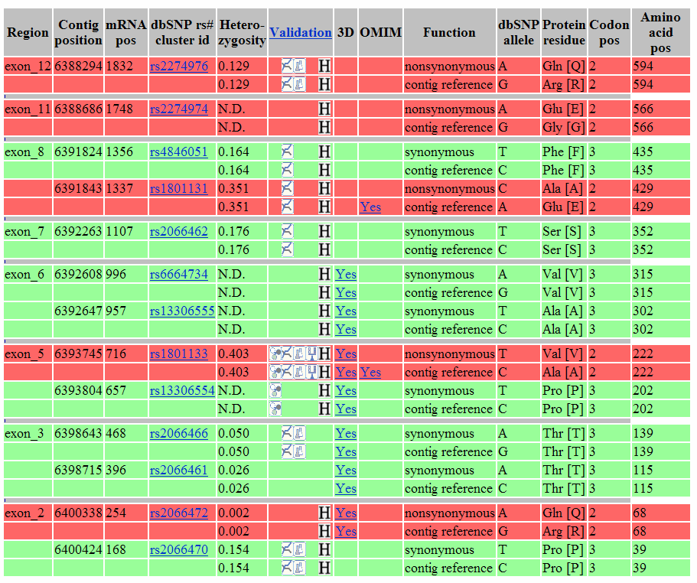
SNP Picking: Potentially Functional
C677T
Notes:
39

Slide 40
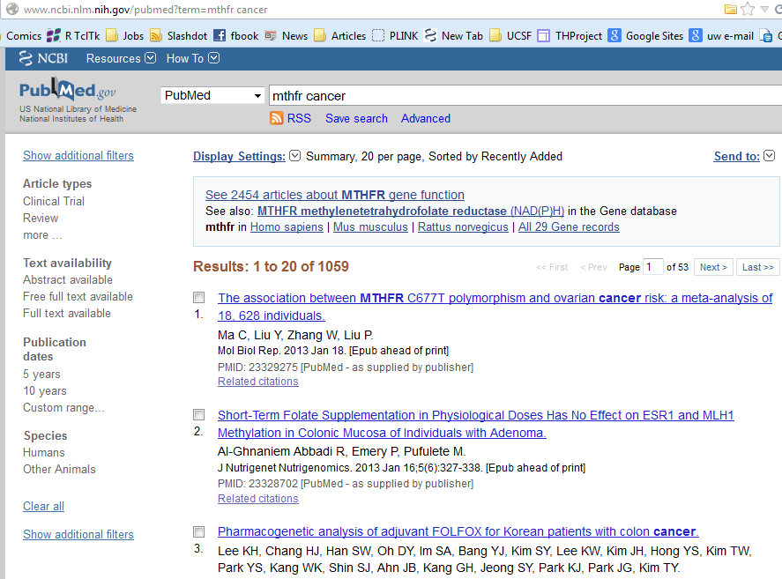
SNP Picking: Previously Associated
Notes:
40

Slide 41
MTHFR Summary
chr1
Size: 20,329 bp
Exons: 12
Potentially Functional:
5 missense of which 3 MAF >5%
Previously Associated:
3 (C677T, A1298C, A2756G)
Notes:
41

Slide 42
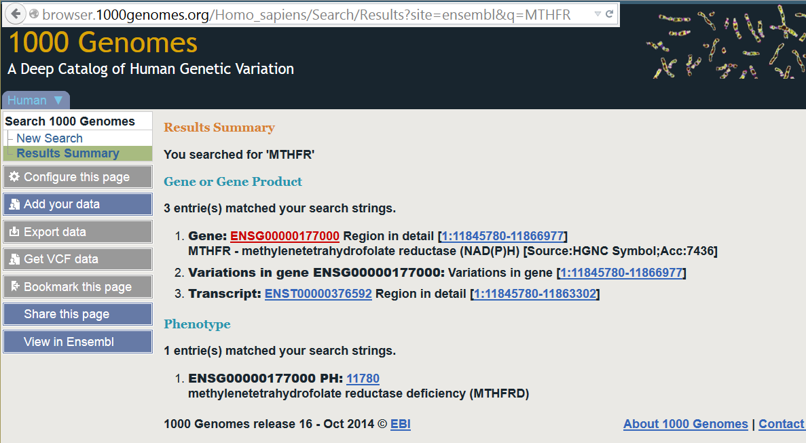
MTHFR Example

Slide 43
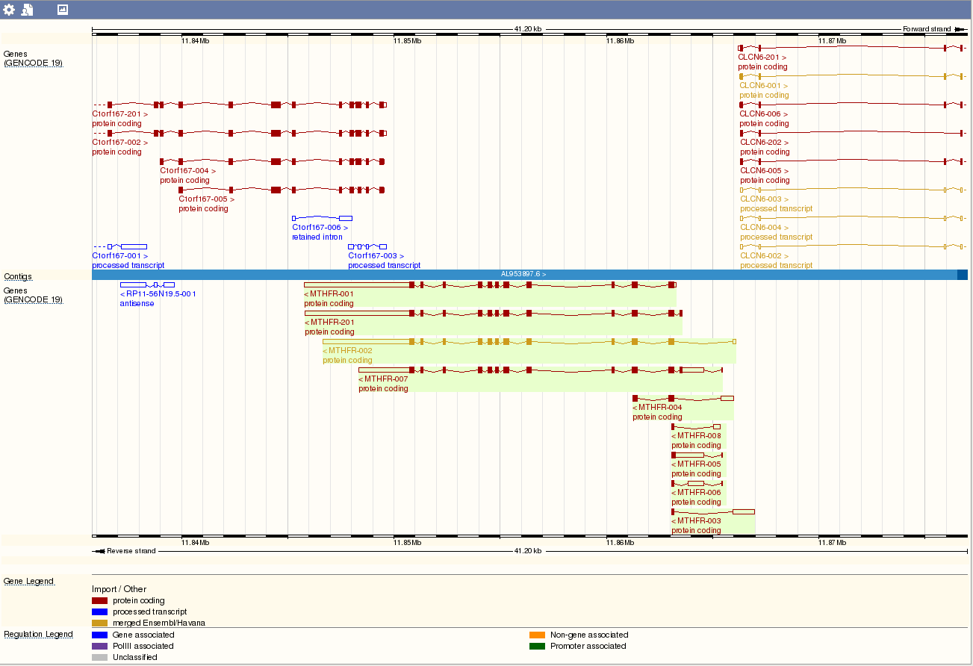
MTHFR Example

Slide 44

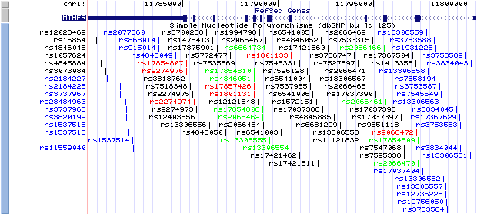
MTHFR SNPs
http://genome.ucsc.edu/cgi-bin/hgGateway
102 SNPs across MTHFR
Too Many SNPs to Genotype!
Notes:
44

Slide 45
Too many MTHFR SNPs
Solution: Tag SNP Selection
SNPs are correlated (aka Linkage Disequilibrium)
A/T
1
G/A
2
G/C
3
T/C
4
G/C
5
A/C
6
Pairwise Tagging:
SNP 1
SNP 3
SNP 6
3 tags in total
Test for association:
SNP 1
SNP 3
SNP 6
A
A
G
G
G
T
G
A
C
C
C
C
C
C
C
C
T
T
A
A
G
G
C
C
high r²
high r²
high r²
Carlson et al. (2004) AJHG 74:106
Notes:
45

Slide 46
Coverage: Measurement Error in TagSNPs
Want to compute coverage of all SNPs in the area, we start with this one, and look at pairwise correlation with each of the genotyped SNPs.
Genotyped SNPs
Notes:
46
Complete set
Subset of these make up the genotyping set
For a given SNP
Get r2 between that SNP and SNPs in the genotyping set
Take the highest r2 value
Called maximum r2

Slide 47
Common Measures of Coverage
Threshold Measures
  e.g., 73% of SNPs in the complete set are in LD with at least one SNP in the genotyping set at r² > 0.8
Average Measures
  e.g., Average maximum r² = 0.84
Notes:
47

Slide 48
Coverage and Sample Size
Sample size required for Direct Association, n
Sample size for Indirect Association
n* = n/ r²
For r² = 0.8, increase is 25%
For r² = 0.5, increase is 100%
Notes:
48

Slide 49

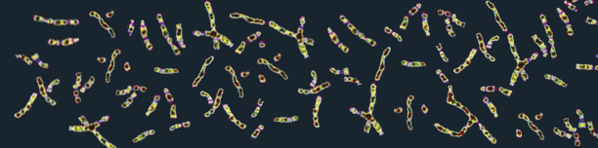

Tag SNPs Database Resources
http://www.hapmap.org
http://browser.1000genomes.org/index.html
1000 Genomes
A Deep Catalog of Human Genetic Variation
Notes:
49

Slide 50
HapMap
Re-sequencing to discover millions of additional SNPs; deposited to dbSNP.
SNPs from dbSNP were genotyped
Looked for 1 SNP every 5kb
SNP Validation
  Polymorphic
  Frequency
Haplotype and Linkage Disequilibrium Estimation
  LD tagging SNPs
HapMap was taken offline due to security issues & laziness (newer database)
Notes:
50

Slide 51
HapMap Phase III Populations
ASW African ancestry in Southwest USA
CEU Utah residents with Northern and Western European ancestry from the CEPH collection
CHB Han Chinese in Beijing, China
CHD Chinese in Metropolitan Denver, Colorado
GIH Gujarati Indians in Houston, Texas
JPT Japanese in Tokyo, Japan
LWK Luhya in Webuye, Kenya
MEX Mexican ancestry in Los Angeles, California
MKK Maasai in Kinyawa, Kenya
TSI Toscani in Italia
YRI Yoruba in Ibadan, Nigeria
Notes:
51

Slide 52
1000 Genomes Project
http://www.internationalgenome.org/about
~2-5x whole-genome sequencing coverage, some whole exome
2,504 individuals diverse genetic ancestries:

Slide 53
1000 Genomes Project Populations
Supergroup
AFR AMR EAS EUR SAS
ACB 96 0 0 0 0
ASW 61 0 0 0 0
BEB 0 0 0 0 86
CDX 0 0 93 0 0
CEU 0 0 0 99 0
CHB 0 0 103 0 0
CHS 0 0 105 0 0
CLM 0 94 0 0 0
ESN 99 0 0 0 0
FIN 0 0 0 99 0
GBR 0 0 0 91 0
GIH 0 0 0 0 103
GWD 113 0 0 0 0
AFR AMR EAS EUR SAS
IBS 0 0 0 107 0
ITU 0 0 0 0 102
JPT 0 0 104 0 0
KHV 0 0 99 0 0
LWK 99 0 0 0 0
MSL 85 0 0 0 0
MXL 0 64 0 0 0
PEL 0 85 0 0 0
PJL 0 0 0 0 96
PUR 0 104 0 0 0
STU 0 0 0 0 102
TSI 0 0 0 107 0
YRI 108 0 0 0 0
Subgroup

Slide 54
Haploview using 1000 Genomes Project data
(or just type in the name of the gene)
Go to the 1000 Genomes project website, and go to the 1000 Genomes Project Browser.
Enter gene name (e.g., MTHFR), to get the genomic coordinates (b37) of interest (e.g., 1:11845780-11866977) and view the region in the browser.
Click “Get VCF data” on LHS. Since you already searched for the gene (MTHFR), it will have the relevant coordinates already filled in for you.
We don’t want VCF format. Click the VCF to PED converter link on the window that pops up.
Click Next (the “Region” should have gene:coordinatesBEGIN-coordinatesEND)
Choose populations of interest – match what you are trying to target. So, for European ancestry (EUR), select CEU + FIN + GBR + IBS + TSI.
Click next, then right click on “Marker Information File” and “Linkage Pedigree File” to save the data set.
Finally, open Haploview, choose linkage format, and navigate to the pedigree information file (.ped), and then the marker information file (.info) should be auto-filled in. Click OK, and you can use Haploview!!!

Slide 55
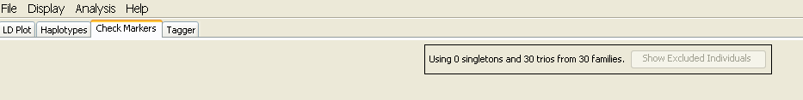
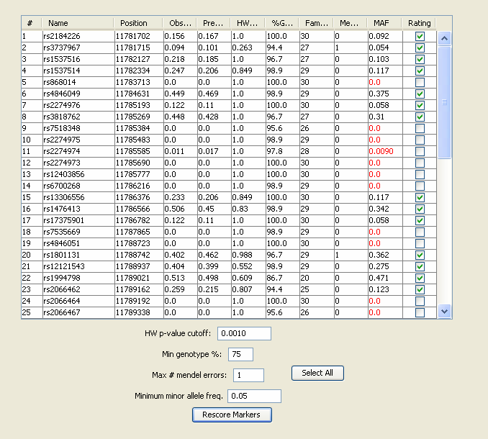
Tag SNPs: HapMap & Haploview
This Column only happens because of old HapMap data (which is why I am leaving it in!) – also missing genotype rate
Notes:
55

Slide 56
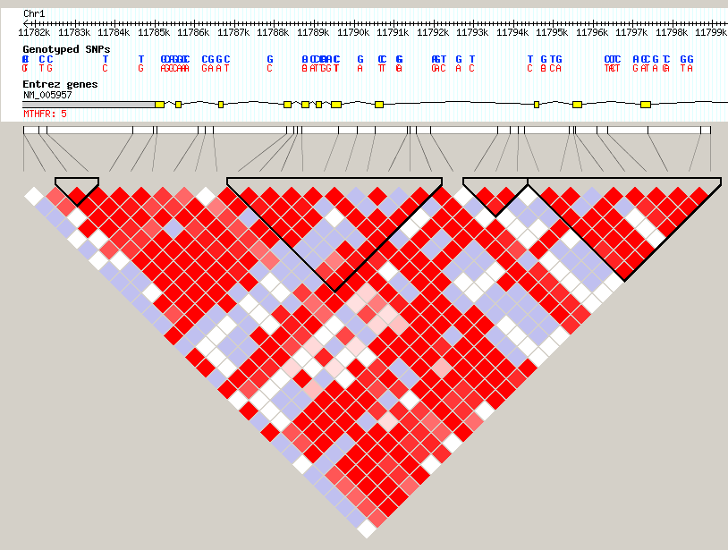
Tag SNPs: HapMap & Haploview
Can’t get anymore ☹
Notes:
56

Slide 57
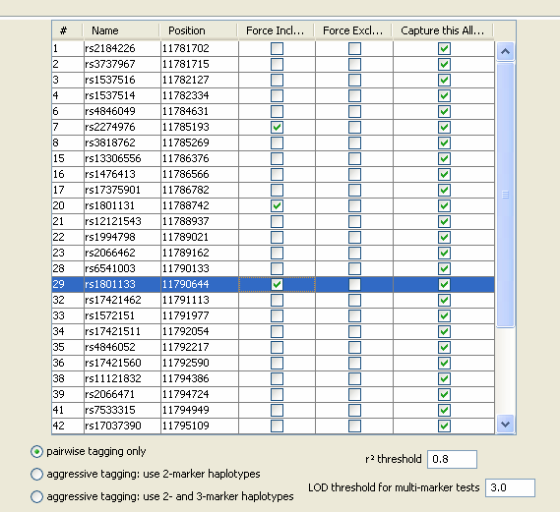

Tag SNPs: HapMap & Haploview
Notes:
57

Slide 58

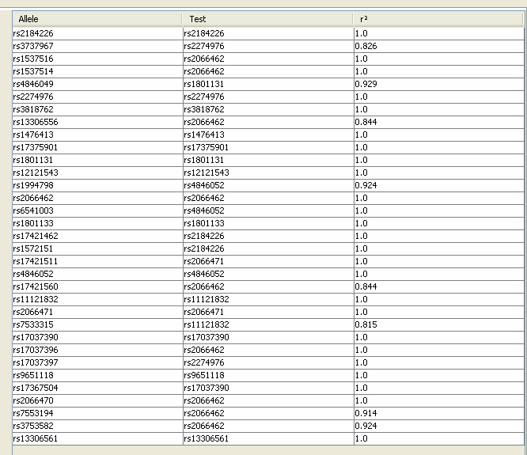
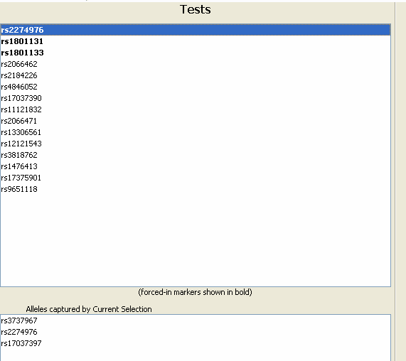

Tag SNPs: HapMap & Haploview
Notes:
58

Slide 59
Tag SNPs: HapMap Summary
How many tag SNPs did we need, to tag all SNPs with r²>0.8?
In practice forced in potentially functional/previously associated SNPs
Identified tag based on pairwise tagging
Note: number of SNPs required varies from gene to gene and from population to population
  Why?
Notes:
59

Slide 60
Extra Slides
(if time)

Slide 61
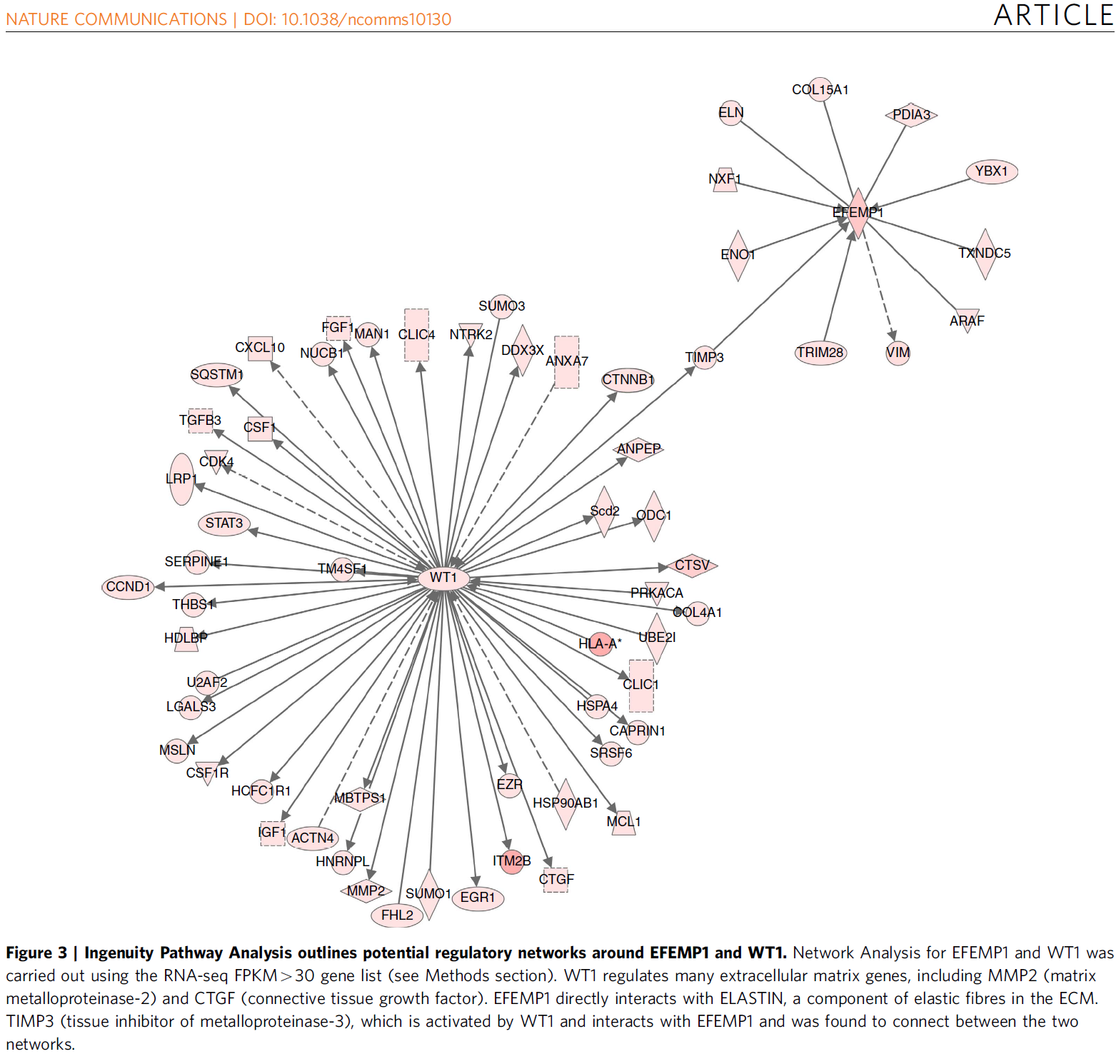
Pathways

Slide 62
Pathways
May be interested in potential joint and/or interaction effects of multiple genes in one pathway
Many sites provide models of molecular and biochemical pathways.
Example: BioCarta: http://www.biocarta.com/

Slide 63
Polygenic Models
Many weak associations combine to risk?
Score model:
where
  ln(ORi ) = ‘score’ for SNPi from ‘discovery’ sample
  SNPij = # of alleles (0,1,2) for SNPi, person j in ‘validation’ sample.
  Large number of SNPs (m)
xj associated with disease?
ISC / Purcell et al. Nature 2009

Slide 64
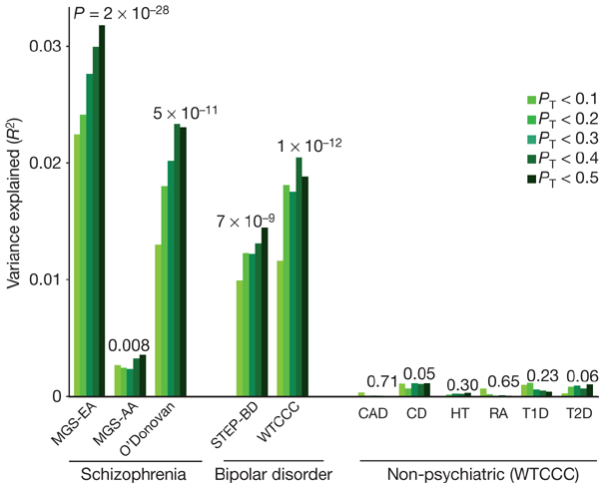
Application of Model
Purcell / ISC et al. Nature 2009

