Slide 1
Research in Mobile/Internet-enabled Learning Health(care) Systems Part 1
Ida Sim, MD, PhD
February 21, 2017
Division of General Internal Medicine, and
Center for Clinical and Translational Informatics
UCSF
Copyright Ida Sim, 2017. All federal and state rights reserved for all original material presented in this course through any medium, including lecture or print.
Notes:
http://www.isrii.org/
http://www.innovations.ahrq.gov/ for PHRs
http://www.ageinplacetech.com/blog/mobile-devices-and-data-everywhere-not-drop-information-drink
increasing therapeutic precision/info of tradeoffs between alternatives (eg justifying prior authorization)
http://www.k4health.org/toolkits/mhealth/country-specific-global-database-mobile-projects

Slide 2
Learning Health (Care) System
“that is designed to generate and apply the best evidence for the collaborative health care choices of each patient and provider; to drive the process of discovery as a natural outgrowth of patient care” (IOM Evidence-Based Medicine Roundtable)
  aka learning from every patient
Friedman, et al. Achieving a Nationwide Learning Health System. Sci Transl Med 2010; 2(57):57cm29
Notes:
LHC not as popular as PMI

Slide 3
Last Class
Cohort ID
  extensive APEX programming needed
Recruitment
  digital divide exists in older, rural, poorer populations; internet access is tenous in some with only smartphones
Consent and Enrollment
  waiver of informed consent enables point-of-care QI RCTs
  several platforms available for recruiting digital cohorts, but diversity and engagement are challenging
Outcomes Assessment
Interventions and interventional design
Notes:
Companies now have all the data. Used to be academics

Slide 4
Outline
Cohort ID
Recruitment
Consent and Enrollment
Outcomes Assessment
Interventions and Interventional Design
Class Summary
Notes:
Talked about basic networking, how machines connect to one another, and how we can run computation across data stored in distributed databases. This is all happening on the backdrop of the Web.

Slide 5
Outcomes Assessment
Traditional assessments: patient comes in for directed observations of function, anatomy, or physiology for care or research
  physical exam by study staff, labs, imaging
Moving outcomes assessment beyond walls of clinic and hospital
  active self-reports and sensing
    patient fills out a survey or instrument (e.g., PHQ-9)
    patient uses wearable sensor to collect data (e.g., BP cuff)
    patient completes an activity that is sensed by some technology (e.g., 6 minute walk test via smartphone)
  passive sensing
    a wearable or IoT thing senses the outcome without the patient’s active involvement, besides wearing the wearable or agreeing to being sensed (e.g., step count)
Notes:
What is state-of-the-field? How do outcomes data get back into the clinical workflow?

Slide 6
Common Data Elements (CDEs)
Common data elements / study variables would make research more comparable, reproducible, and meta-analyzable
  should measure same elements in care process to enable learning health system
CDEs may be variable definitions or surveys (PROs)
  NIH Common Data Elements repository (>20,000 items)
  PhenX (520 measures)
  ICHOM measures covering 47% of global disease burden
Notes:
International Consortium for Health Outcomes Measurement

Slide 7
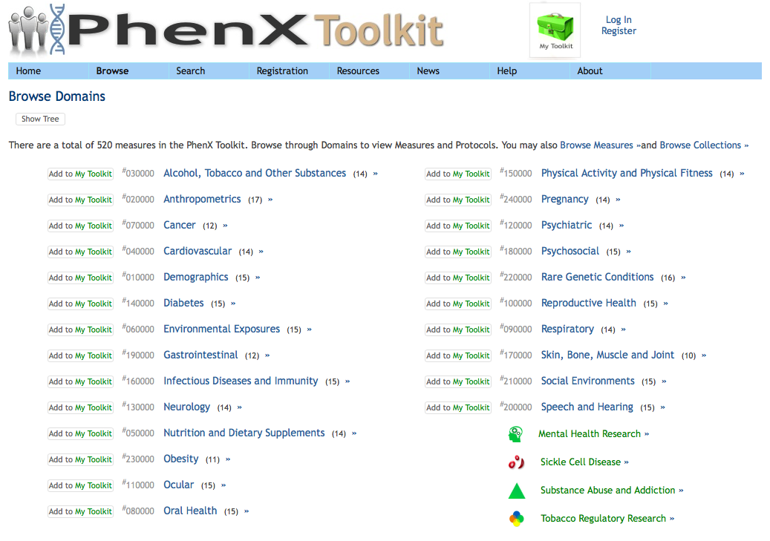
Outcomes Assessment Beyond Walls
Notes:
What is state-of-the-field? How do outcomes data get back into the clinical workflow?

Slide 8
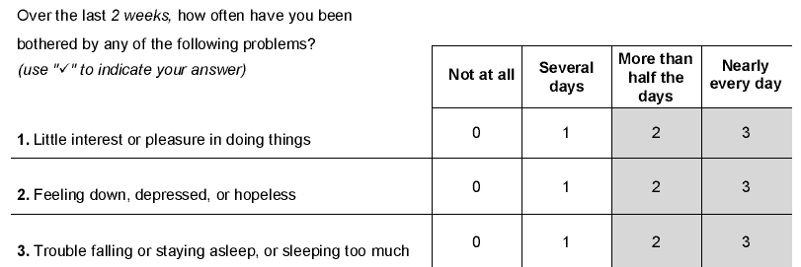
Patient-Reported Outcomes (PROs)
Paper-based
  e.g., PHQ-9, Beck, AUA BPH, SF-12, NeuroQOL, etc.
ePROs, via telephone or smartphone/computer
  guidelines for validating e-versions of paper forms
  computer adaptive testing (CAT) can build in branching logic to minimize number of questions patients have to answer, e.g., PROMIS
Notes:
Talked about basic networking, how machines connect to one another, and how we can run computation across data stored in distributed databases. This is all happening on the backdrop of the Web.

Slide 9

Patient Reported Outcomes Measurement Information System®
  PROMIS®: brief, precise, valid, reliable fixed or tailored measures of patient-reported health status in physical, mental, and social well-being for adult & pediatric populations
  Advantages: Disease-agnostic, Flexible, Adaptable, Low burden, Comparable, Accessible
  Development: Item Response Theory (IRT) for measure construction
  Standardized: One metric (T-score, Mean=50, SD=10; ref US pop)
  slides from Ashley Wilder Smith, PhD, MPH

Slide 10
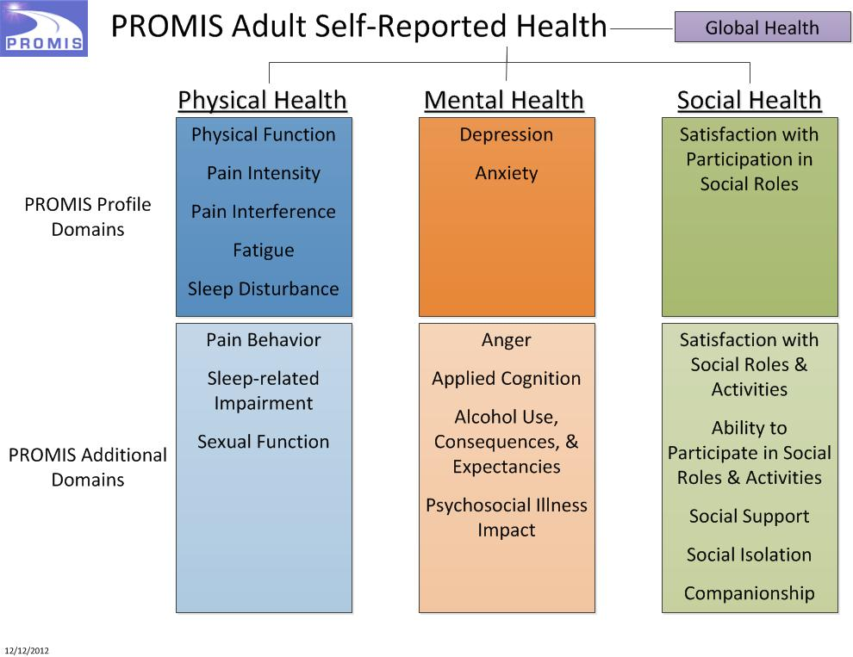

Slide 11
Adaptability: Addresses need for high precision, broad range
high
physical
function
3
2
2
Questionnaire
with high precision
but small range
1
1
Questionnaire
with a wide range
but low precision
0
- 1
low
physical
function
- 2
- 3

Slide 12
Computerized Adaptive Tests (CAT)
high
physical
function
3
Question #2
Question #3
2
2
2
1
1
1
Question #1
0
0
- 1
Questionnaire
with high precision
AND a wide range
- 2
low
physical
function
- 3

Slide 13
Flexibility:
PROMIS® Short forms and Profiles (v1)
8
6
4
Anxiety
29
Mental
Depression
28
Fatigue
95
Pain Interference
41
Physical
Sleep Disturbance
27
Physical Function
124
Social
Satisfaction with Roles
14

Slide 14
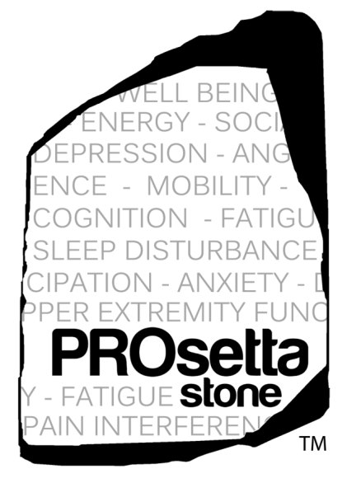
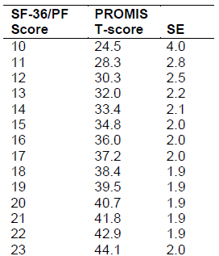
Comparability: Instrument Linking
A common problem when using a variety of PRO measures is comparability of scales
Linking establishes relationships between scores on two different measures
PROsetta Stone® developed and applied methods to link the PROMIS with other instruments (e.g., SF-36, Brief Pain Inventory, CES-D, MASQ, FACIT-Fatigue)
http://www.prosettastone.org/

Slide 15
PROs into the EHR
Standard PROs like PHQ-9
  can be built into Epic/MyChart as a form, but still uncommon
Example: GI PROMIS at the VA
  patients complete GI PROMIS 1 week before visit
  computer generates heatmap and HPI
  doc and patient see this on “e-portal” or tablet
Important component of the Learning Health System
Almario, et al. Am J Gastroenterol 2 August 2016; doi: 10.1038/ajg.2016.305

Slide 16
Weakneses of Current PROs
Standard measures
New approach
  infrequent assessments
  hard to answer “average” over period of report, e.g., 3 months, patient may report their current state instead
  may forget how they felt
  interviewer bias
  assessments are often in clinic
assessments as frequent as necessary and appropriate
patient reports in real-time
less recall bias
direct self-report
assessments in native environment

Slide 17
Ecological Momentary Assessments
  A collection of methods often used in behavioral medicine research by which a research participant repeatedly reports on symptoms, affect, behavior, and cognitions close in time to experience and in the participants' natural environment (Stone Shiffman, 1994)

Slide 18
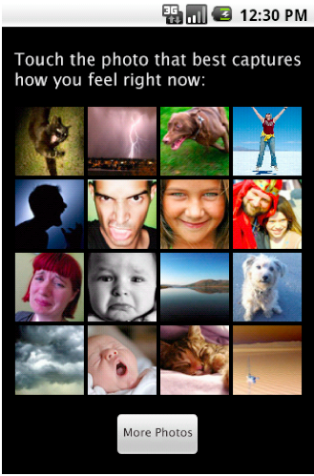
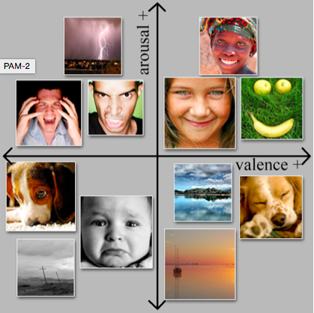
Photographic Affect Meter (PAM)
http://idl.cornell.edu/files/2013/09/PAM-1gnjegn.pdf

Slide 19
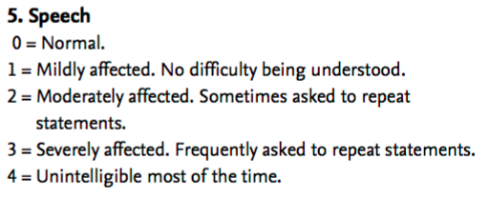
“Active Tasks”
activities under semi-controlled conditions, using sensors to collect data
can be used for outcomes assessment or disease detection
Unified Parkinsons Disease Rating Scale
mPower ResearchKit study
Notes:
Talked about basic networking, how machines connect to one another, and how we can run computation across data stored in distributed databases. This is all happening on the backdrop of the Web.

Slide 20
Validation Challenges
What is the gold standard?
  is PHQ-9 administered weekly the same as “mood” assessed daily?
  need new measurement science for e-measures
Can we measure more directly what we’re interested in? passively instead of actively?
  instead of pain: mobility, and individualized models of mobility vs pain level
  instead of UPDRS: voice, ability to trace on iPhone
  instead of self-reported loneliness: social network topology
  instead of frailty: home mobility patterns, gait, balance
  instead of PHQ-9…

Slide 21
Passive Sensing of Depression
40 people used Purple Robot app for 2 weeks (only 28 resulted in usable data)
collected q 5 minute GPS readings and phone usage data
derived bio markers correlated with PHQ-9 scores
  circadian movement (regularity in 24-hour rhythm; r =-.63, P =.005)
  normalized entropy (mobility between favorite locations; r =-.58, P =.012)
  location variance (GPS mobility independent of location; r =-.58, P =.012)
  phone usage features, usage duration, and usage frequency were also correlated (r =.54, P =.011, and r =.52, P =.015, respectively)
Accuracy – 86.5% for predicting PHQ-9 score of 5 or greater
PERCEPT study will use both PAM and GPS to assess and correlate mental health status
Saeb S, et al. J Med Internet Res 2015;17(7):e175
Notes:
logistic regression classifier

Slide 22
Passive Sensing Using
Commercial Sensors
http://www.yole.fr/WearableElectronics_Overview.aspx#.WKeZyhi-JE4
Notes:
logistic regression classifier

Slide 23
Obtaining the Data: APIs
API = Applications Programming Interface
  a piece of software that sets of requirements on how one application can talk to another
Data repositories can expose their data via APIs
  some EHRs are just starting to offer APIs
Modern Internet APIs are usually RESTful and use JSON (but not always)
  no, Meaningful Use CCD is not a modern API
Many companies offer APIs for other systems to access their data
  e.g., 23&Me, Jawbone, FitBit, GoogleFit, Apple HealthKit

Slide 24
Example API: GoogleFit
Your machine has to connect to the GoogleFit cloud
You have to let it know who you are (identification), prove that you are who you are (authentication) and be given appropriate access (authorization)
  this is usually done using OAuth 2.0
https://developers.google.com/fit/rest/v1/reference/parameters lists a bunch of commands you can now issue to get at data, e.g.,
  GET https://www.googleapis.com/fitness/v1/users/userId/dataSources/dataSourceId

Slide 25
Obtaining the Data: Schemas
  e.g., https://www.googleapis.com/fitness/v1/users/"me"/dataSources/dataSourceId
You can get data about instantaneous or aggregated readings using their schemas (or data models)
  e.g., com.google.heart_rate.bpm
    bpm (float—bpm)
  com.google.heart_rate.summary
    average (float—bpm)
    max (float—bpm)
    min (float—bpm)

Slide 26
AHA Physical Activity Recommendation
"At least 30 minutes of moderate-intensity aerobic activity at least 5 days per week for a total of 150"
http://www.heart.org/HEARTORG/GettingHealthy/PhysicalActivity/FitnessBasics/American-Heart-Association-Recommendations-for-Physical-Activity-in-Adults_UCM_307976_Article.jsp

Slide 27
GoogleFit Activity Data
com.google.activity.summary
  activity (int—enum)
  duration (int—ms)
  num_segments (int—count)
Notes:
Enumerated list of types of activity.

Slide 28
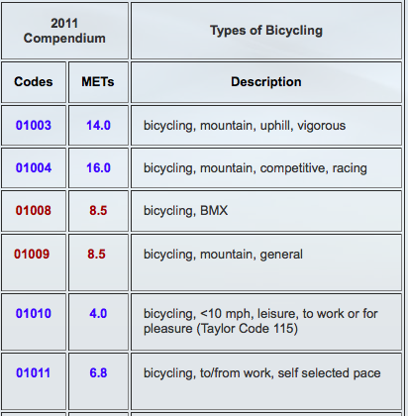
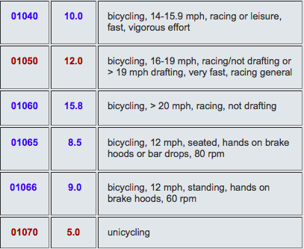
Minutes of Moderate Activity
Device | Data Element Name | Data Type/Value List
FitBit | Fairly active minutes | Number
GoogleFit | Activity | Aerobics, badminton, baseball, jogging, running, road biking, etc
 | Duration | Integer (milliseconds)
infer METS by type of activity, add up minutes at 3-6 METS
2011 Compendium of Physical Activities
Notes:
What about Google? Google Fit provides activity type and duration, so we could infer the METS by looking up the type of activity in for example the 2011 Compendium of Physical Activities. But road biking is anywhere from 4 METS if you're cycling leisurely at under 10 mph to over 15 METS if you're racing over 20 mph, and not drafting, or it's 5 METS if you're unicycling at any speed. So just knowing you're road biking isn't enough.
~~~~~~~~~~~~
Android FIT has Distance delta, Distance covered since the last reading, in meters

Slide 29
Minutes of Moderate Activity
Device | Data Element Name | Data Type/Value List
FitBit | Fairly active minutes | Number
GoogleFit | Activity | Aerobics, badminton, baseball, jogging, running, road biking, etc
 | Duration | Integer (milliseconds)
Health Kit | Workout Activity Type | Elliptical, running, hiking, walking, cycling, etc.
 | startDate | Number (a time value relative to an absolute reference date—the first instant of 1 January 2001, GMT)
 | endDate | Number (a time value relative to an absolute reference date—the first instant of 1 January 2001, GMT)
 | Total Distance (m, in, ft, or mi) | Number
Can convert duration and distance to METS (ml/kg/min) and add up minutes at 3-6 METS
Notes:
And HealthKit from Apple? We can calculate the duration of a workout using their definitions of start and endDate, and use known equations to calculate METS and add up the minutes at 3-6 METS. I've presented here a simplified story to make the point that something seemingly easy like getting at minutes of moderate activity isn't at all, and we're haven't gotten into more challenging data blood glucose (is it random, fasting or after a meal), or complicated variables to self-report and standardize like mood, or stress.
Birth of the Apple Universe

Slide 30
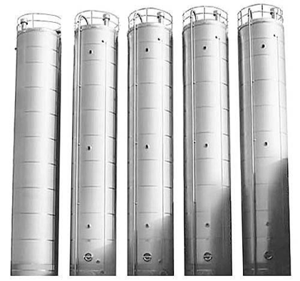
Déjà Vu
SNOMED
RxNORM
CPT
ICD-10
LOINC
ICD-9
Notes:
This is looking like déjà vu all over again. Silos, standards, headache!

Slide 31
Why Can't Health Data Work Like an ATM?
Banking
ISO 8583 standard has 128 data items, <80 used
No ambiguities in meaning (e.g., a dollar)
Only about 10 standard tasks (e.g., deposit)
20 years for ATMs to interoperate widely
Health care
ICD10 has 68,000 codes
Concepts (e.g., diseases) not well understood
Many complex, varying tasks
Each “customer” is different, many “tellers”

Slide 32

Need mHealth Data Standards
1
Open source data schemas: a common way to express e.g., minutes of moderate activity (IEEE 1752 assignment pending)
2
Open source tools (e.g., Shimmer) to integrate data for a BYOD (bring your own device) approach
3
Evolving and adapting to new fields and new methods in mobile health
Open mHealth*
a non-profit technology start-up
*disclosure: Sim co-founded Open mHealth
Estrin D, Sim I. Science 2010; 330:759-760
Notes:
Need data standards for mHealth. 3 years ago cofounded OmH, read about it in our Science paper.
Working with industry on open source schemas…

Slide 33
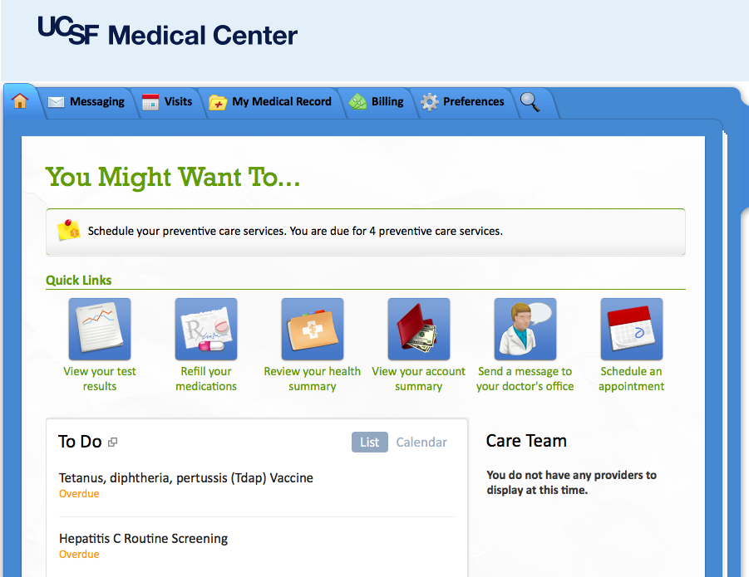
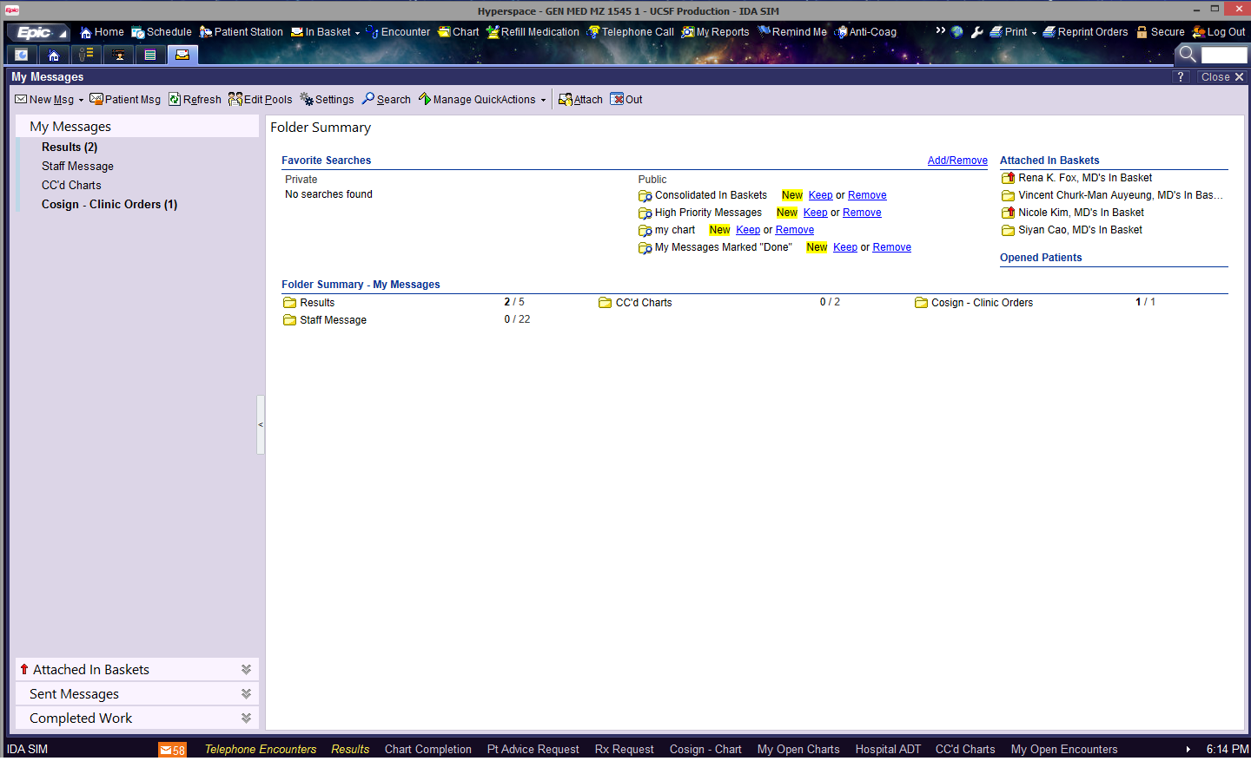
iOutcomes Assessment for LHS
PROs
Epic Chronicles DB
Omron BP
CCD
MyChart
completely dependent on Apple and Epic
FitBit doesn’t talk to HealthKit
External EHR
Epic interface
Notes:
No FitBit, no Android

Slide 34
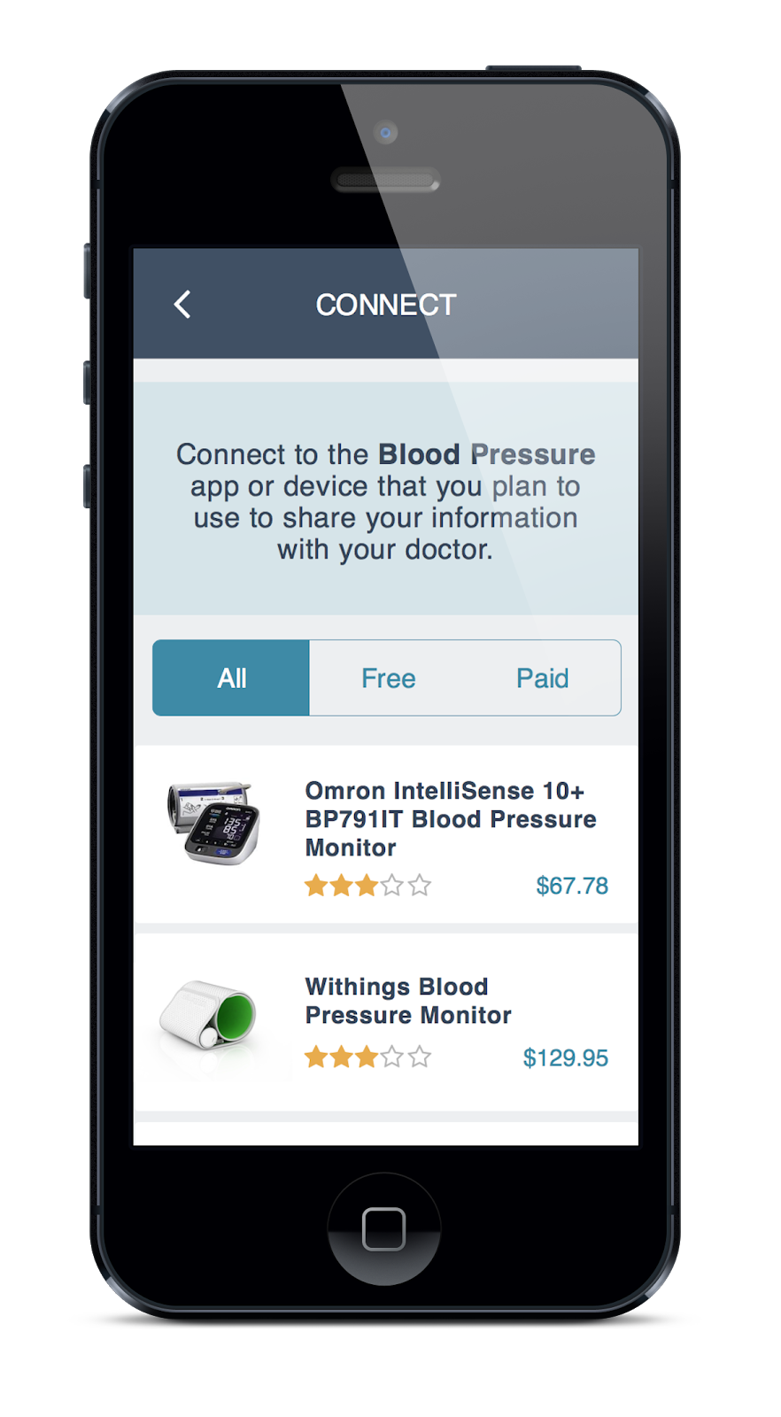
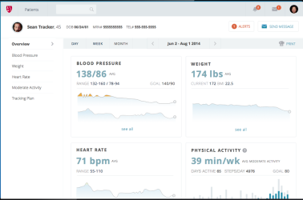
Overlap* Outcomes Assessment for LHS
iOS or Android
PROs/EMAs
Active Tasks
BYOD
Omron cloud
Feedback and viz to patient
Shimmer
FitBit cloud
OmH
FHIR/OmH
PGHD data
FitBit
Displays in window within Epic workflow
*disclosure: Overlap is a spin-off from Open mHealth, co-founded by Sim

Slide 35
Outcomes Assessment Summary
Common variables and data elements would promote more harmonized science and learning health systems, but adoption has been slow
Assessment can be active, passive, or hybrid
Active assessments can involve ePROs, computer-adaptive testing, ecological momentary assessments, and active tasks
Passive BYOD assessments facilitated by open mHealth data standards
Various approaches possible and in play for getting outcome data and actionable recommendations back to patients and into the clinical workflow
  patient-generated health data do not necessarily have to go into the EHR database
  should avoid vendor trap
Notes:
Talked about basic networking, how machines connect to one another, and how we can run computation across data stored in distributed databases. This is all happening on the backdrop of the Web.

Slide 36
Outline
Cohort ID
Recruitment
Consent and Enrollment
Outcomes Assessment
Interventions and Interventional Design
Class Summary
Notes:
Talked about basic networking, how machines connect to one another, and how we can run computation across data stored in distributed databases. This is all happening on the backdrop of the Web.

Slide 37
Technology-enabled Interventions
Education (e.g., post-natal self-care)
Reminders (e.g., med adherence, sit less!)
Tracking (e.g., diet)
Feedback (e.g., activity, BP at goal?)
Reflection (e.g., gratitude)
Goal setting (e.g., physical activity)
Incentives and rewards (e.g., points, leaderboard)
Social network (e.g., peer counselling)
Cognitive exercises (e.g., urge surfing, mindfulness)
Active tasks (e.g., practicing eye contact)
…
Notes:
Talked about basic networking, how machines connect to one another, and how we can run computation across data stored in distributed databases. This is all happening on the backdrop of the Web.

Slide 38
Therapeutic Precision
Genomics will help make biological therapies more precise
  but there will still be heterogeneity of treatment response
“Behavioral medicine is the blockbuster ‘drug’ of the 21st century”
  different mix of app/tech functions are needed for each person and each context

Slide 39
Mismatched "Metabolic Rate" of Technology and Evaluation
Riley et al. Clinical and Translational Medicine 2013, 2:10

Slide 40
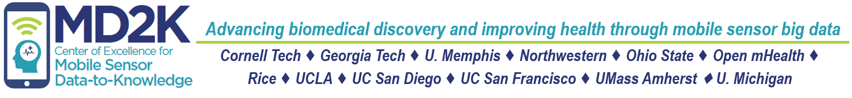
Staying Quit – A JITAI Study
Just-in-time Adaptive Intervention
P: smokers who have just quit
I: just-in-time stress reduction
C: usual care
O: time to first lapse, rate of relapse
Notes:
I'm part of an NIH center on mobile health called Mobile Data to Knowledge. One of our studies is a sensor-powered JITAI or just in time adaptive intervention study.
This study aims to help smokers who have just quit to stay quit, which is pretty hard actually. 60% of quitters will relapse, or smoke again, in the first week. The hypothesis is that stress leads to relapse, so detecting and treating stress "just-in-time" should increase the time to first lapse, and reduce the rate of relapse.

Slide 41
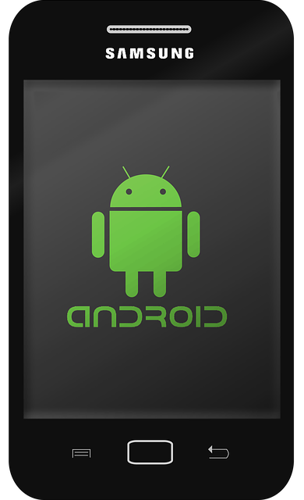

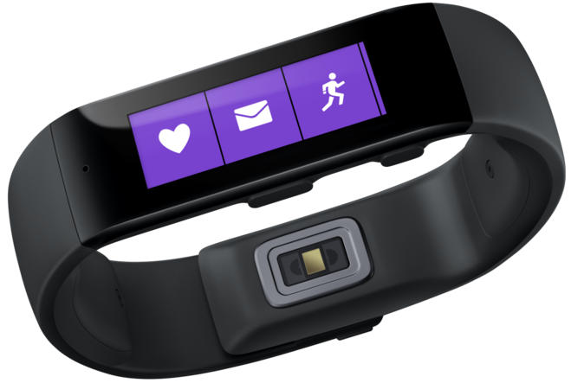

Staying Quit – A JITAI Study
Detect stress
adaptive microrandomization
Detect smoking
geolocation
stress
activity
individualized smoking urge model
individualized efficacy model
MD2K Spark cloud platform
Notes:
To do this study, we must be able to detect stress in real time. We're doing that using a chest band that infers stress from HR, HRV, and respiratory rate and pattern. If stress is detected, the person gets a buzz on their MS Band wristband, and they go to their phone and are microrandomized to a stress reduction exercise – could be music, guided imagery, or meditation. They are then monitored for whether they smoke again, through a wrist sensor to monitor arm and wrist movement correlated with a deep inhalation.
Our real-time computational platform crunches all this real-time data to build individualized models of smoking urge and to drive adaptive randomization through an individualized efficacy model. Remember just 10 hours of this monitoring is 3 Shakespeare's worth of data.
https://methodology.psu.edu/media/techreports/14-126.pdf

Slide 42
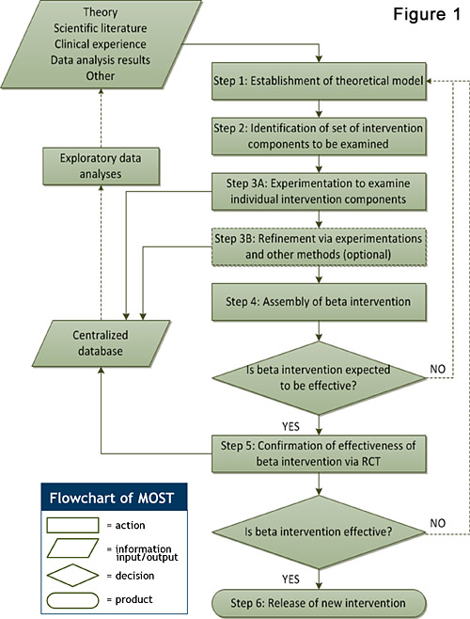
Multiphase Optimization Strategy (MOST)
JITAI studies can be combined with MOST studies
http://methodology.psu.edu/ra/most/research
Notes:
http://methodology.psu.edu/ra/most/research

Slide 43
MD2K’s mCerebrum JITAI Platform
Android-only mobile sensor data platform
  collects high-rate sensor data from phone and sensors (via ANT and bluetooth)
  can run real-time analytics on that data to detect digital biomarkers (e.g., stress, smoking event, eating, drinking (liquid), teeth brushing, conversation)
  can trigger EMAs or interventions based on data
    if stress high, EMA “what is your smoking urge level?”
    if stress high, administer stress reduction exercise
Can be used for just-in-time adaptive interventions (JITAI)
Now available – email Consortium Core lead Sim

Slide 44
LHS Interventional Designs: Does it Work?
Observational studies
  traditional and Big Data
Experimental
  JITAI
  MOST
  embedded RCTs (e.g., COPD order sets)
  PORT
  Stepped wedge
  N-of-1
Notes:
Observational studies, embed RCTs in care like CTSI COPD order sets and

Slide 45
Prompted Optional Randomized Trial
venlafaxine
sertraline
venlafaxine
sertraline
venlafaxine
venlafaxine
venlafaxine
sertraline
sertraline
sertraline
If enough docs switch when prompted, known and unknown confounders are washed out
  i.e., lower precision can be overcome with larger sample size
Prompt is an instrumental variable
  quite strongly associated with treatment assignment
  not directly associated with outcome of interest
  not associated with potential confounding variables
Flory, Karlawish. Am J Public Health 2012;102:e8–e10. doi:10.

Slide 46
Stepped Wedge
Technology, behavioral and QI interventions often have to be rolled out in stages
  e.g., EHR roll out, limited $ for online chat staffing, have only one team of anti-smoking counsellors, limited number of sensors available
You may suspect large temporal confounding
  e.g., change in reimbursement policies, changes in background technology
Using only single historical or parallel-group control may not be enough

Slide 47
Stepped Wedge Design
parallel controls
historical controls
http://www.biomedcentral.com/1471-2288/6/54
Notes:
randomly assigned to row
- esp good for more good than harm (e.g., EHR) where everyone gets the intervention in the end (unethical not to let them use it)

Slide 48
rephrasing ‘does it work?’
(Complexes of) Exposures
Outcome
strength of association?
anti-depressant
mood
me
population
Notes:
Statistically, this is asking about the strength of association between being "exposed" to oxycodone or percocet, say, and some outcome we care about, like pain relief.
We can ask whether oxycodone works at the population level or whether it works for an individual (does it work for me).

Slide 49
which works better: venlafaxine or sertraline?
sertraline
Mood, social activity
100 people
50 people
venlafaxine
Mood, social activity
50 people
population
tells us on average whether sertraline or venlafaxine is better at improving mood, depression
Notes:
49
The standard thing to do would be to run an RCT, and we will see on average if oxycodone works better than say Percocet.
The problem though is that none of us are average.

Slide 50
none of us are average
sertraline better
venlafaxine better
Notes:
50
The standard thing to do would be to run an RCT, and we will see on average if oxycodone works better than say Percocet.
The problem though is that none of us are average.

Slide 51
Consider…
8-week remission rate¹
e.g., for the last 200 patients "like you" in APEX
  60 velafaxine patients, 30 remitted (50%)
  140 sertraline patients, 88 remitted (63%)
Which should you take?
 | Effexor | Zoloft | p value
Mehtonen, et al. 2000 | 68 | 45 | 0.008
Sir, et al. 2005 | 54.4 | 59.5 | 0.47
 | Effexor | Zoloft | p value
Mehtonen, et al. 2000 | 68 | 45 | 0.008
Sir, et al. 2005 | 54.4 | 59.5 | 0.47
¹http://www.effectivehealthcare.ahrq.gov/repFiles/Antidepressants_Final_Report.pdf

Slide 52

which works better for you?
N-of-1 study design: testing both in you for the outcomes that matter to you
sertraline
venlafaxine
sertraline
You
venlafaxine
Mood
sertraline
Mood
venlafaxine
individual
http://effectivehealthcare.ahrq.gov/index.cfm/search-for-guides-reviews-and-reports/?productid=1844&pageaction=displayproduct
Notes:
52
The only formal method for answering "does it work for me" is the N-of-1 study design.
In which there's only 1 person, 1 "n" in the study. So I would be randomized first to PTSD Coach, then usual care, and back and forth a few cycles, assessing my depression symptoms along the way.
This method is not widely known and is statistically complicated, but offers the kind of personal evidence we need to drive systematic but personalized learning across mHealth

Slide 53
there you are!
sertraline better
venlafaxine better
Notes:
53
The standard thing to do would be to run an RCT, and we will see on average if oxycodone works better than say Percocet.
The problem though is that none of us are average.

Slide 54
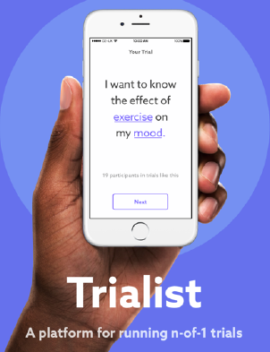
Trialist App
Generalizable platform for n-of-1 studies
v 1.0 being used for chronic pain med use (PREEMPT), n = 200+
v 2.0 from Overlap Health
  for WNYC, n = up to 6000

Slide 55
n = 1
Notes:
Ιν σελφ−εξπεριμεντατιον, ν, τηε νυμβερ οφ παρτιχιπαντσ, ισ 1. Τηε εξπεριμεντ μαψ βε θυιτε χασυαλ, ορ λιτ μαψ βε μορε σοπηιστιχατεδ ιν μετηοδολογψ λικε Ιαν ανδ Μιχηαελ ηαϖε δεσχριβεδ,

Slide 56
(n = 1).^{N}
Notes:
Scaling self-experimentation means having more people do it, to the power of a much much bigger n, still with strong methoology so we can learn more and advance health more broadly.

Slide 57
(n = 1).^{N}
Σ
Notes:
But even better, we should sum the experiences of all of those experiments to achieve real scale. The question of course, is how.

Slide 58
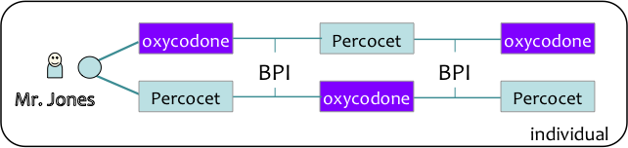
flip direction of research inference
population
Notes:
58
Once we get individual evidence, can aggregate to population level evidence – VA/DoD should help build the evidence base for better care.

Slide 59
“the ultimate study design for precision medicine”
(n ≥ 1).^{N}
Σ
Kravitz, et al. Design and Implementation of N-of-1: A User’s Guide. AHRQ, February 2014.
Notes:
The real excitement is aggregating findings from many self-experiments. For that, we must first make the findings comparable. We are building libraries of standard measures, and working on way to index variables and results to standard vocabularies.

Slide 60
Interventions Design Summary
Technology promises “21st century” primarily behavioral interventions
Enables and requires novel interventional designs
  adaptive, just-in-time, and individualized
  embedded into care processes via EHR and self-care processes via personal technologies
  includes observational and more expensive/complicated experimental designs depending on the strength of evidence needed
Notes:
Talked about basic networking, how machines connect to one another, and how we can run computation across data stored in distributed databases. This is all happening on the backdrop of the Web.

Slide 61
Learning Health(care) System
WELLNESS
PATIENT CARE
RESEARCH
. .
. .
Virtual Patient
Transactions
Raw data
Medical knowledge
Clinical research transactions
Raw research data
. .
. .
Doctor
. .
Decision support
. .
. .
Medical logic
. .
. .
. .
. .
. .
Citizen
Scientists
Patient
Big (Open) Data
Interaction design, workflow modeling and support, cognitive support, policies and mechanisms for sharing, privacy

Slide 62
Class Summary
Informatics necessary for making sense of data into information and knowledge
Today's health IT focuses very heavily on supporting doctor-driven transactions (bottom left quarter of Big Picture)
Need brand new technologies for other 3/4 of Big Picture
  systems to support learning health care system, deep decision support, patient and community self-care
Key informatics points to keep in mind
  data representation and standards vital(?) for ensuring meaning
  it's about more than the data…. to get to information and knowledge, need blend of EBM and big data methods
  technology must be designed for humans to use and engage with, and to enhance human connection
  some of the hardest challenges are sociotechnical: privacy, organizational change, digital divide

Slide 63
Take Home Message
At the cusp of something transformative
  be open to partnering with computer scientists, patients, companies, etc.
To guard against hype and to maximize value
  stay grounded in what is clinically useful and important
  know as much as possible of the underlying informatics
  don't forget to apply epi/biostats
  help develop new tech, digital biomarkers, methods for evaluation -- bring clinical research science to the digital age
Course evaluation
  please fill out when you get it!

