Slide 1
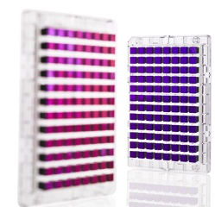

Genome-wide association studies (GWAS)

Slide 2
Further reading (not required)
Nature reviews genetics: http://www.nature.com/nrg/series/gwas/index.html
  McCarthy et al. Genome-wide association studies for complex traits: consensus, uncertainty and challenges
  Marchini and Howie. Genotype imputation for genome-wide association studies
  Ott. Family-based designs for genome-wide association studies.
  Gibson. Rare and common variants: twenty arguments.

Slide 3
Outline for GWAS
Review / Overview
Design
Analysis
  QC
  Prostate cancer example
  Imputation
  Replication & Meta-analysis
Advanced analysis
  Limitations & “missing heritability”
  Gene/pathway tests
  Polygenic models

Slide 4
Outline for GWAS
Review / Overview
Design
Analysis
  QC
  Prostate cancer example
  Imputation
  Replication & Meta-analysis
Advanced analysis
  Limitations & “missing heritability”
  Gene/pathway tests
  Polygenic models

Slide 5
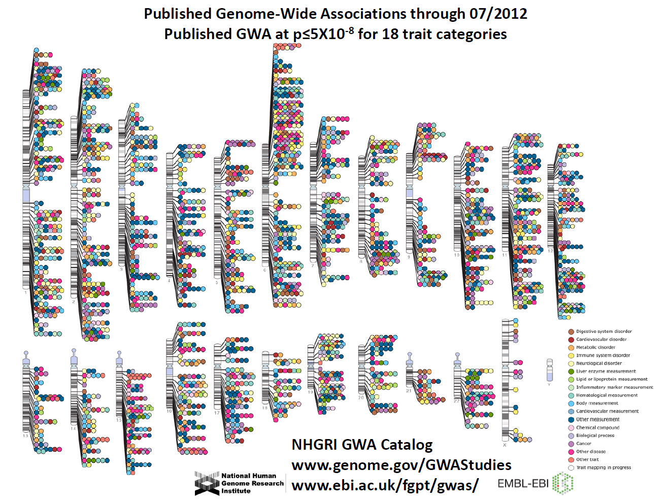
Manolio et al., Clin Invest 2008
Notes:
5

Slide 6
Outline for GWAS
Review / Overview
Design
Analysis
  QC
  Prostate cancer example
  Imputation
  Replication & Meta-analysis
Advanced analysis
  Limitations & “missing heritability”
  Gene/pathway tests
  Polygenic models

Slide 7

Design 1: Microarray – Genotype a subset of markers available
(guilt by association)
Disease locus directly typed
Marker correlated with typed disease locus
Previously we talked about using this to “tag” candidate genes (only Genotype a subset of the SNPs).
Same principal applies to tagging the whole genome.
Hirschhorn & Daly, Nat Rev Genet 2005
Notes:
7

Slide 8
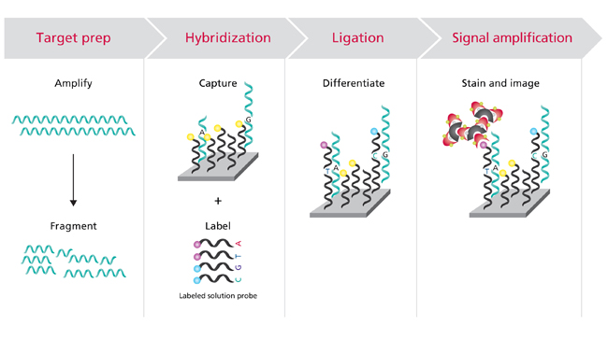
Technology behind a GWAS Microarray
Labeled probes bind to sample, differentiating between the two alleles
Make it bright enough then measure intensity of array
Sample binds to array
Assay ~ 0.7 - 5M SNPs (keeps increasing)
Affymetrix, http://www.affymetrix.com

Slide 9
Raw microarray data: Genotype calls
Good calls!
Bad calls!

Slide 10
Class Exercise!: How would you design a general GWAS microarray?
It will be linked to an EHR, all diseases of interest
Do you have to genotype everything?
Regions/SNPs to prioritize?
Hoffmann et al., Next generation genome-wide association tool. Design and coverage of a high-throughput European-optimized SNP array. Genomics, 2012.
Hoffmann et al., Design and coverage of high throughput genotyping arrays optimized for individuals of East Asian, African American, and Latino race/ethnicity using imputation and a novel hybrid SNP selection algorithm. Genomics, 2012.

Slide 11
Class Exercise!: How would you design a general GWAS microarray?
It will be linked to an EHR, all diseases of interest
Do you have to genotype everything? [tag SNPs (population?), minor allele frequency limit, old multistage design]
Regions/SNPs to prioritize? [genes?, prev hits, functional significance?; some SNPs cost more; some SNPs work better]
[Similar to candidate genes before, but grander scale]
Hoffmann et al., Next generation genome-wide association tool. Design and coverage of a high-throughput European-optimized SNP array. Genomics, 2012.
Hoffmann et al., Design and coverage of high throughput genotyping arrays optimized for individuals of East Asian, African American, and Latino race/ethnicity using imputation and a novel hybrid SNP selection algorithm. Genomics, 2012.

Slide 12
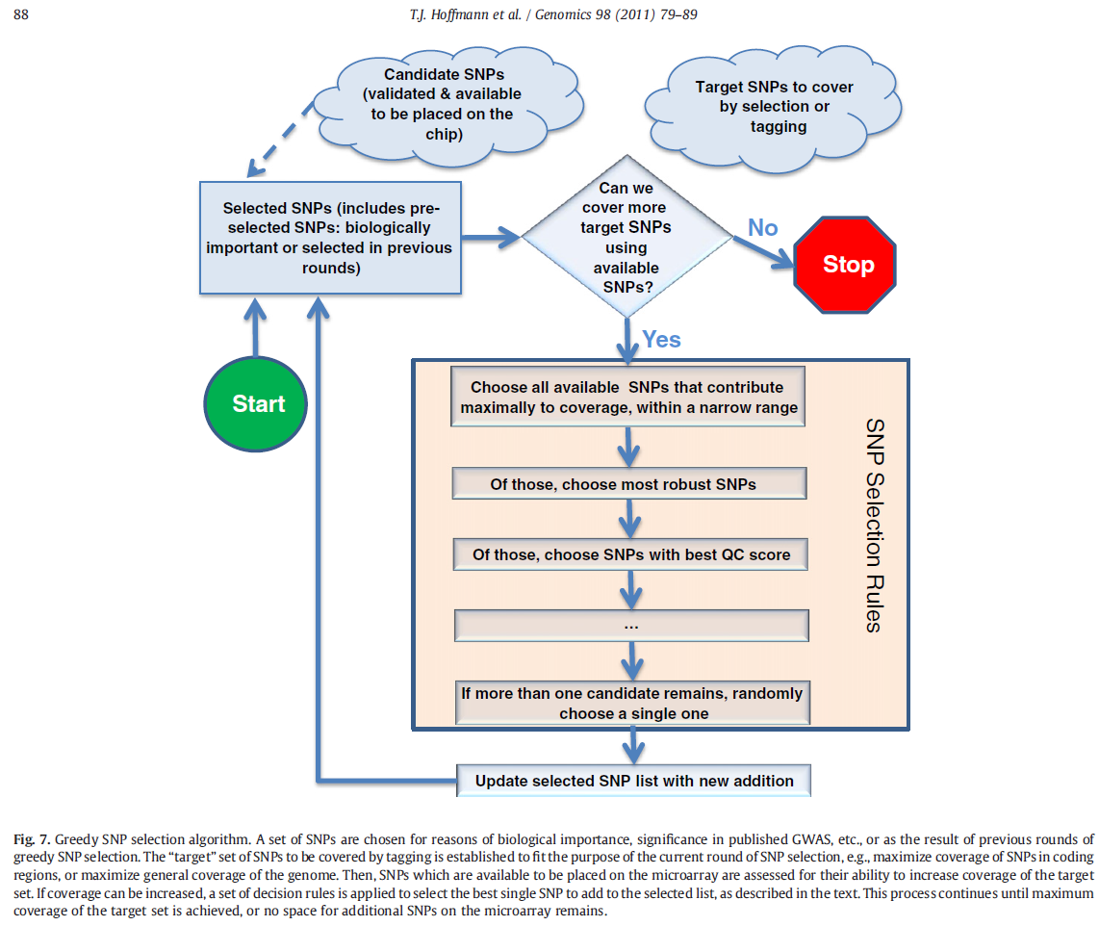
Class Exercise!: How would you design a general GWAS microarray?
Hoffmann et al., Next generation genome-wide association tool. Design and coverage of a high-throughput European-optimized SNP array. Genomics, 2012.
Hoffmann et al., Design and coverage of high throughput genotyping arrays optimized for individuals of East Asian, African American, and Latino race/ethnicity using imputation and a novel hybrid SNP selection algorithm. Genomics, 2012.

Slide 13
Genome-wide Assocation Studies (GWAS)

Slide 14
Genome-wide Assocation Studies (GWAS)
Just this first step is done these days.
Cost previously

Slide 15
Design 2: Next generation sequencing
Genotype essentially “all” SNPs in genome
  A bunch of random reads all over the genome are assembled to produce the genome
  Some regions of the genome have more reads than others; can choose how much you want to sequence (5x coverage 1000 Genomes, 60-80x Complete Genomics, …)
More expensive
Extreme phenotypes, since can't do everyone?
More in “Next Generation Sequencing” lecture

Slide 16
Design choices
GWAS Microarray
  Only assay SNPs designed into array (0.7-5 million)
  Cheaper (so more subjects tradeoff)
GWAS Sequencing
  “De novo” discovery (particularly good for rare variants)
  More expensive (but costs are falling) (many less subjects)
  Need much more expansive IT support
  Lots of interesting interpretation problems (field rapidly evolving)
Can also do a hybrid design, more later in the lecture.

Slide 17
Design choices
Exome Microarray
  Only assay SNPs designed into array (~300K+custom); in exons only and that could affect protein coding function
  Cheapest (so many more subjects)
Exome Sequencing
  “De novo” discovery (particularly good for rare variants); %age of exons only (first step is a pull down that does not capture all exons)
  More expensive than microarrays, less expensive than gwas sequencing
  Need more expansive IT support, but not as much as whole genome

Slide 18
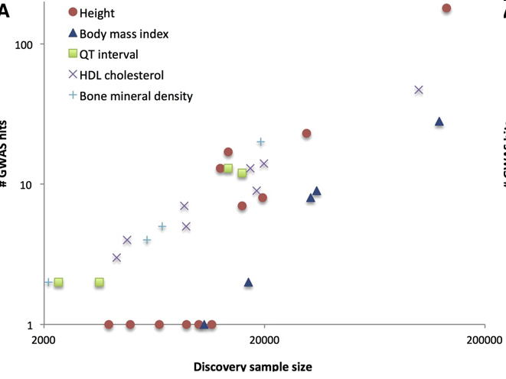
Size matters
Large # SNPs tested – multiple comparisons
Very small effect sizes
Tag SNP, rather than actual SNP
Consortiums
Visscher, AJHG 2012

Slide 19
Biggest studies...
GWAS Microarray:
  US: 100K people in the Kaiser RPGEH (Hoffmann et al., Genomics, 2011a&b)
  UK: 500K people in process (150K current)
  MVP: 1M people in process (400K soon)
Sequencing: 1000 Genomes Project, UK10K
Exome Sequencing: GO ESP (12,031 subjects, for exome microarray design)

Slide 20
Outline for GWAS
Review / Overview
Design
Analysis
  QC
  Prostate cancer example
  Imputation
  Replication & Meta-analysis
Advanced analysis
  Limitations & “missing heritability”
  Gene/pathway tests
  Polygenic models

Slide 21
QC Steps: Class exercise!
Can you think about potential QC steps you might take at an individual and SNP level basis? Which one first?
What tests have we talked about in this course?
Special chromosomes?
(Could families be problematic? useful?)

Slide 22
QC Steps
“garbage rises to the top”
Filter SNPs and Individuals
  MAF (e.g., 1%, but very sample size dependent!)
  Low call rates (means genotype probably didn't work correctly)
Test for HWE among controls & within ethnic groups. Use conservative alpha-level (10⁻⁶, e.g., but opinions vary) (again, to remove artifacts)
Check for relatedness.
  MZ twins, or accidentally genotyped same sample twice?
  Remove first degree, or account for.
Check genotype gender (mislabeled samples)
Filter Mendelian inhertance (family-based, or potentially cryptics, if large enough sample)
plink sofware: pngu.mgh.harvard.edu/~purcell/plink/reference.shtml

Slide 23
Filter for Mendelian inheritance
A|A-----A|A
|
A|T

Slide 24
Filter for Mendelian inheritance
A|A-----A|A
|
A|T ← Offspring Genotype not
Possible!
(De novo mutation, but
more likely genotyping
error.)

Slide 25
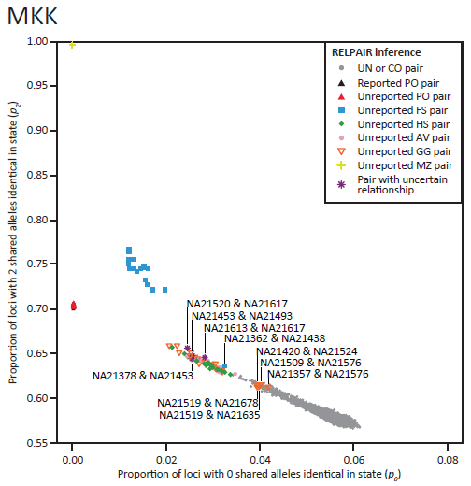
Check for relatedness, e.g., HapMap
Take overall average of all SNPs of how many alleles are shared.
E.g., parent-offspring never shares zero alleles.
HapMap was supposed to be unrelateds (this was a bit of a surprise!)
Pemberton et al., AJHG 2010

Slide 26
GWAS analysis
Most common approach: Model each SNP separately
Additive coding of SNP most common, just a covariate in a regression framework
Dichotomous phenotype: logistic regression
Continuous phenotype: linear regression
Correct for multiple comparisons
  e.g., Bonferroni, 1 million gives α=5x10⁻⁸
  [Often use 5x10⁻⁸ for larger GWAS arrays (or imputed SNPs, more later) also, SNPs are correlated, so Bonferroni is a little too conservative…]
Adjust for potential population stratification (details next slides…)
  principal components (PC’s), on best performing SNPs
  software usually does LD filter (e.g., Eigensoft)

Slide 27
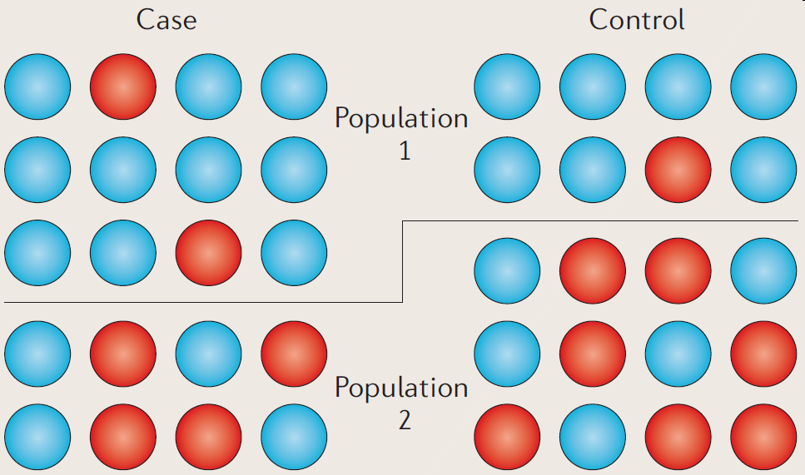
Recap of population substructure
Two populations have different disease frequency, and different allele frequency (Recall Pima & Papago example).
Association picks up they are different populations!
Balding, Nature Reviews Genetics 2010

Slide 28
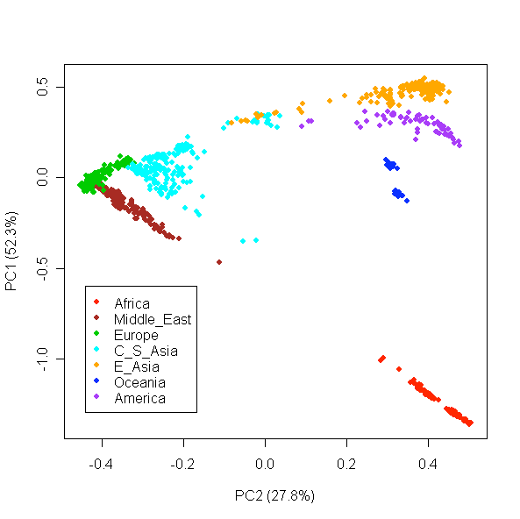
Control for race/ethnicity/ancestry: Principal Components (PCs) as covariates in regression model
Li et al., Science 2008

Slide 29
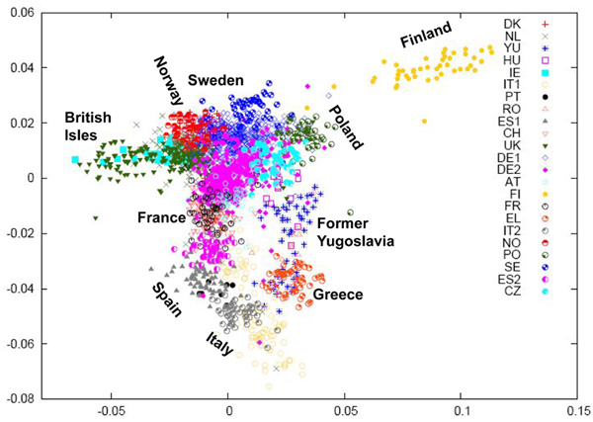
PCs pick up fine population structure
Razib, Current Biology 2008

Slide 30
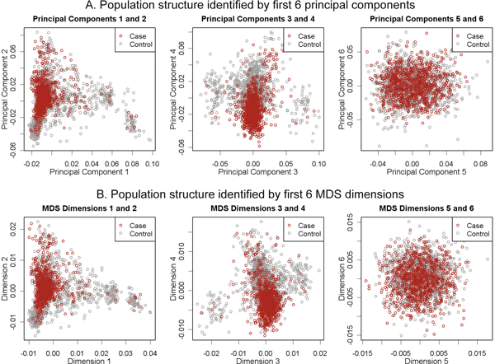
Adjusting for PC's
Do not want separate cluster for cases as controls! – Why want individuals from similar population for controls (and randomization). [These look reasonable, but if see a separation…]
Wang, BMC Proc 2009

Slide 31
After run analysis
Assess the fit with QQ-plot (saw last lecture)
Look at results in Manhattan plots
Replication of hits in a separate cohort

Slide 32
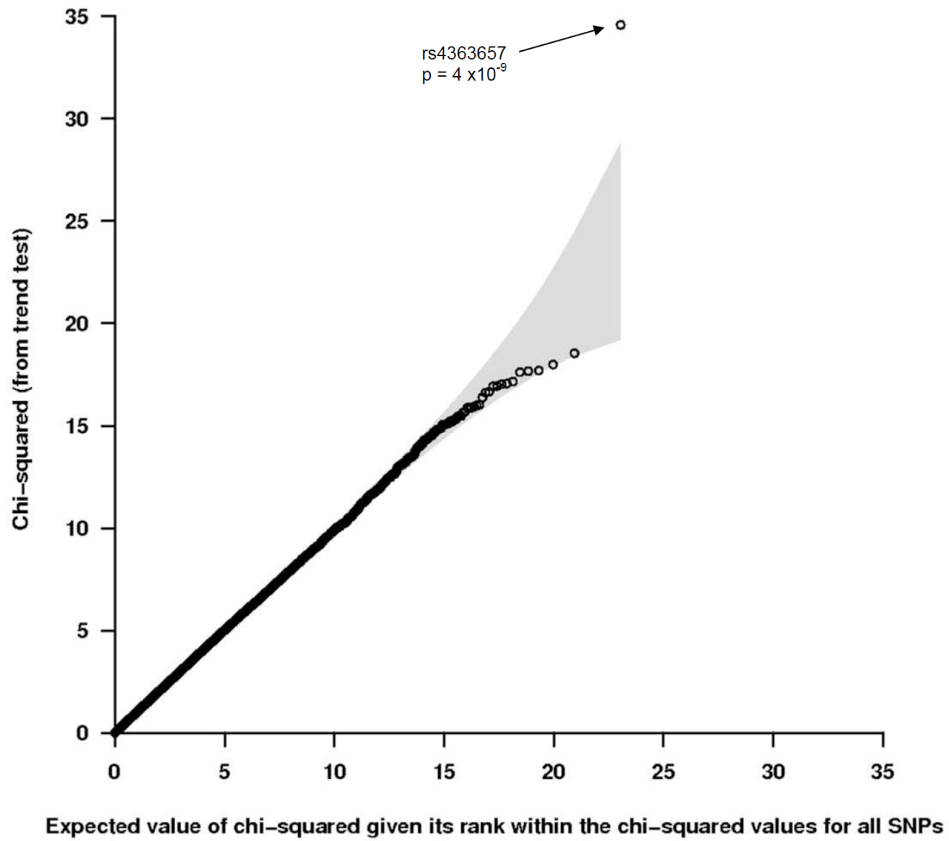
Quantile-quantile (QQ) plot review
Most SNPs are on the line, but want a few hits off the line (true significant associations!)

Slide 33
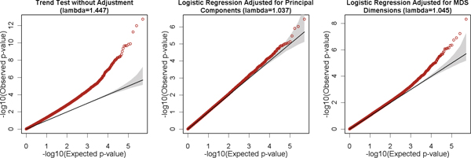
QQ-plots and PC adjustment recap
Exactly on line if no signal at all.
If don't adjust for PC's, then p-values are all inflated artificially.
Adjusting for PC's fixes the problem.
Wang, BMC Proc 2009

Slide 34
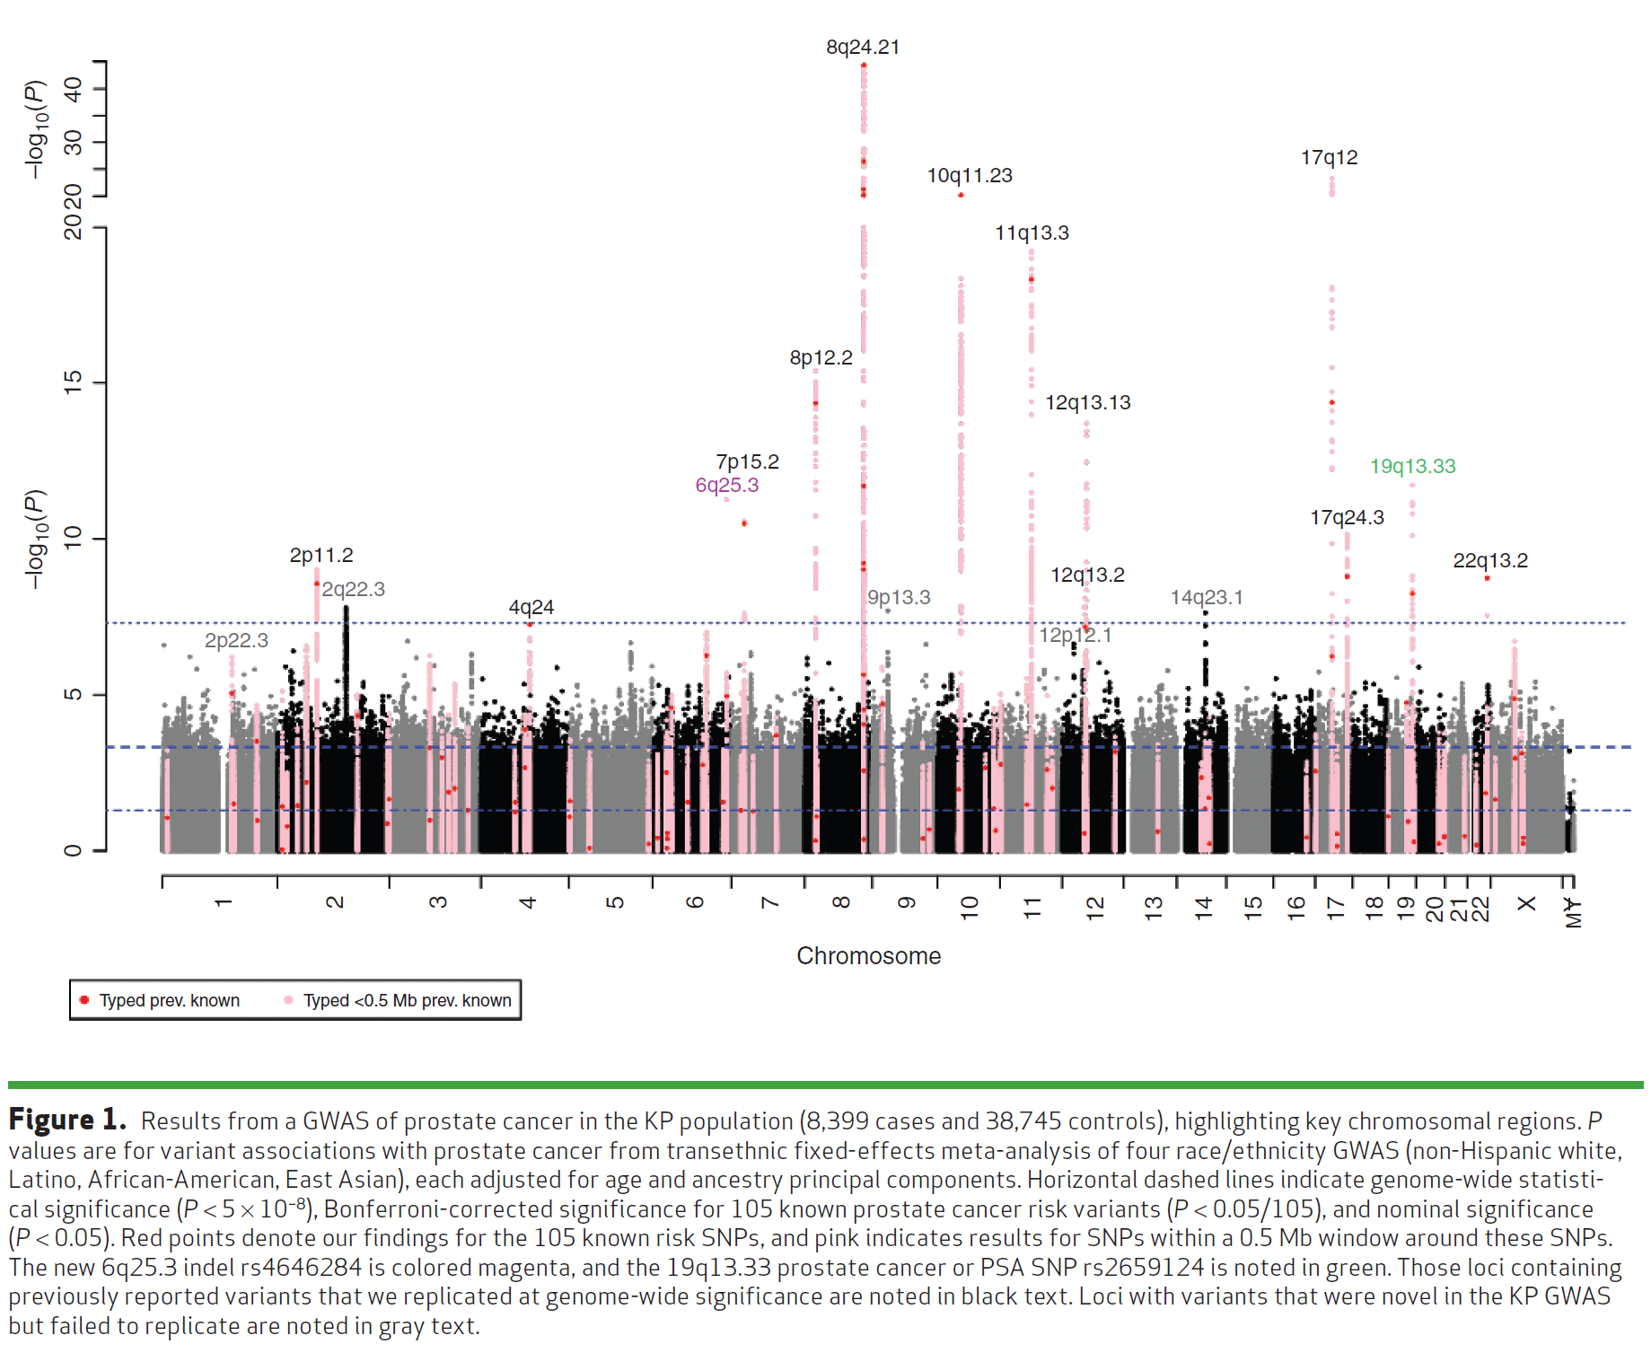
Manhattan plot example:
Kaiser GWAS of Prostate Cancer
Hoffmann et. Al, Cancer Discovery 2015

Slide 35
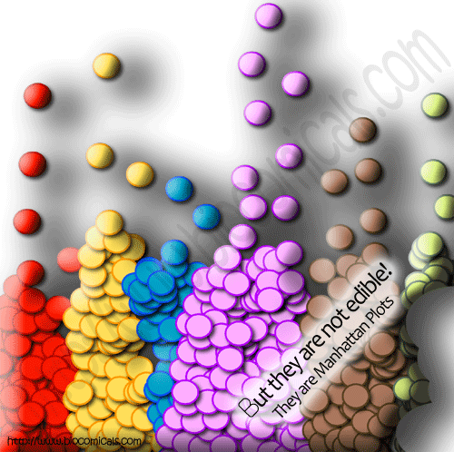

Slide 36
Replication, Replication, Replication
To replicate:
  Association test for replication sample significant at 0.05/{Number of SNPs replicating} alpha level
  Same genetic model (e.g. additive, dominant)
  Same direction
  Sufficient sample size for replication!
    [e.g., do a power calculation]
Non-replications not necessarily a false positive
  LD structures, different populations (e.g., flip-flop)
  covariates, phenotype definition, underpowered
  Winner’s curse

Slide 37
Meta-analysis
Combine multiple studies to increase power
Either combine p-values (Fisher’s test),
or coefficient estimates + standard error (better)

Slide 38
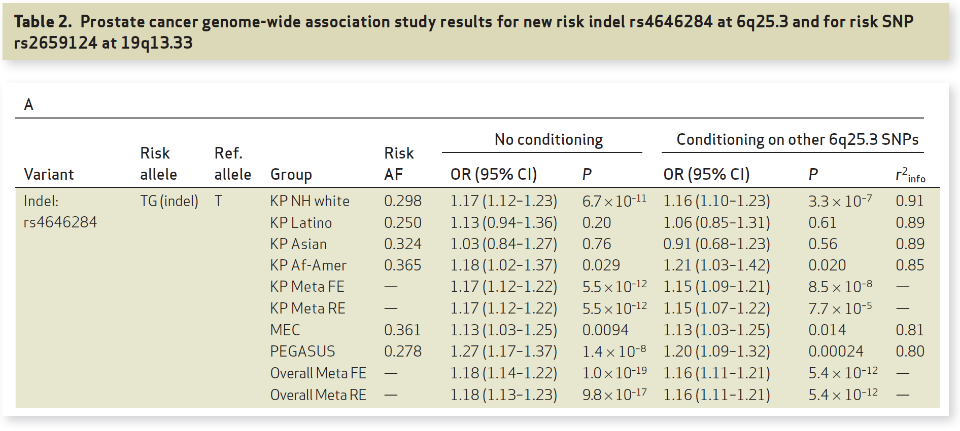
Replication & Meta-analysis
Hoffmann et. Al, Cancer Discovery 2015`

Slide 39
Beyond Genotyped SNPs:
Imputation of SNP Genotypes
Combine data from different platforms (e.g., Affy & Illumina) (for replication / meta-analysis).
Estimate unmeasured or missing genotypes.
Based on measured SNPs and external info (e.g., haplotype structure of HapMap).
Increase GWAS power (impute and analyze all), e.g. Sick sinus syndrome, most significant was 1000 Genomes imputed SNP (Holm et al., Nature Genetics, 2011)
HapMap as reference, now 1000 Genomes Project; UK10K, Haplotype reference consortium?
Hybrid sequencing/genotyping approaches

Slide 40
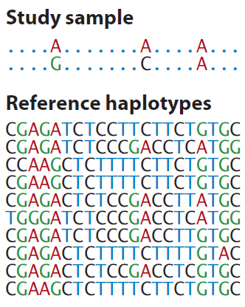
Generalization of Tag SNPs: Imputed SNPs using a Reference Panel
Generalization of pairwise r² of tagSNPs to multi-marker correlation
Class Exercise!
How would you fill in the remaining genotypes of this study sample individual, given the reference haplotypes?
http://www.shapeit.fr/, http://mathgen.stats.ox.ac.uk/impute/impute_v2.html
http://faculty.washington.edu/browning/beagle/beagle.html
http://www.sph.umich.edu/csg/abecasis/MACH/download/
Li et al., Ann Rev Human Genet, 2009

Slide 41

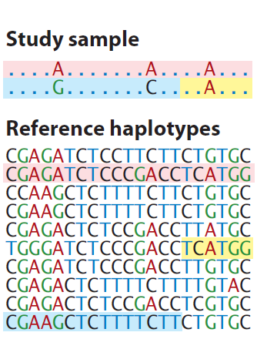
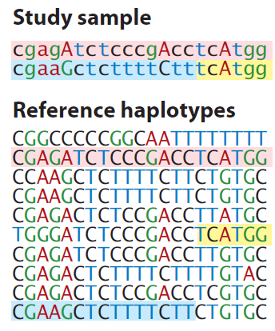
Generalization of Tag SNPs: Imputed SNPs using a Reference Panel
Generalization of pairwise r² of tagSNPs to multi-marker correlation
http://www.shapeit.fr/, http://mathgen.stats.ox.ac.uk/impute/impute_v2.html
http://faculty.washington.edu/browning/beagle/beagle.html
http://www.sph.umich.edu/csg/abecasis/MACH/download/
Li et al., Ann Rev Human Genet, 2009

Slide 42
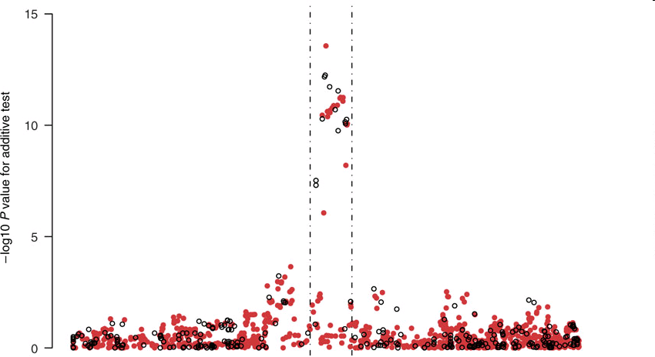
Imputation Application
TCF7L2 gene region & T2D from the WTCCC data
Observed genotypes black
Imputed genotypes red.
Imputed SNP more significant than typed SNP!
Chromosomal Position
Marchini Nature Genetics2007
http://www.stats.ox.ac.uk/~marchini/#software
Notes:
42

Slide 43
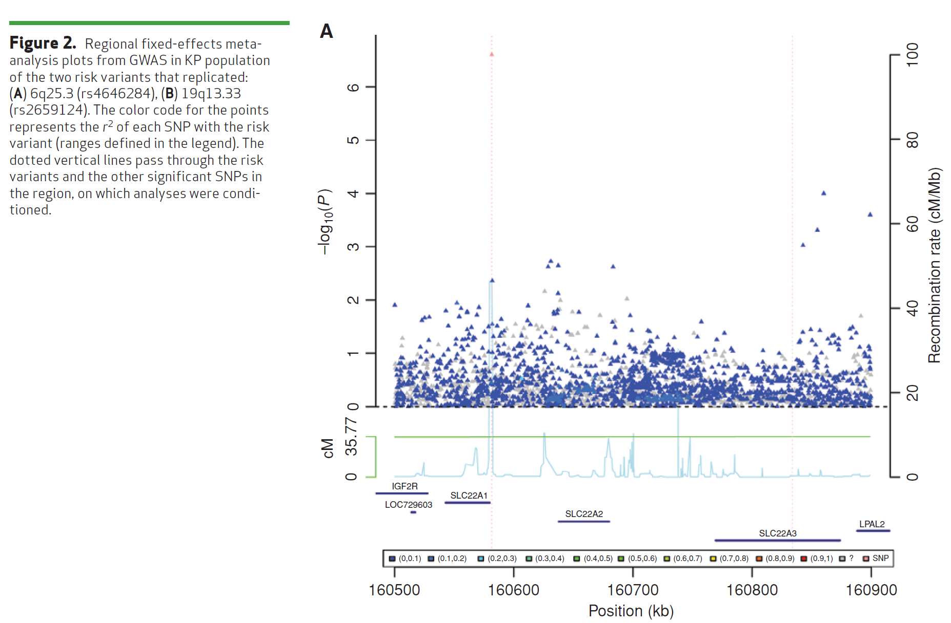
Imputation Application #2 – Do not always see a jet of points, even for common SNP…
(Same SNP as 4 slides ago)
Hoffmann et. Al, Cancer Discovery 2015`

Slide 44
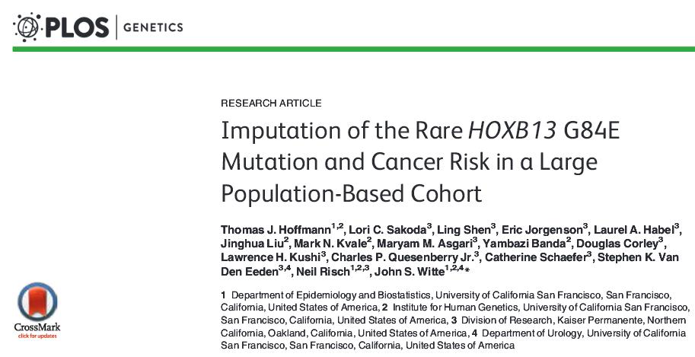
Imputation example: How rare can you go?
G84E example talked about in Austin pg. 62
MAF 0.0034 in European ancestry. r²=0.57.
In general, a moving target, still unknown how rare is possible

Slide 45
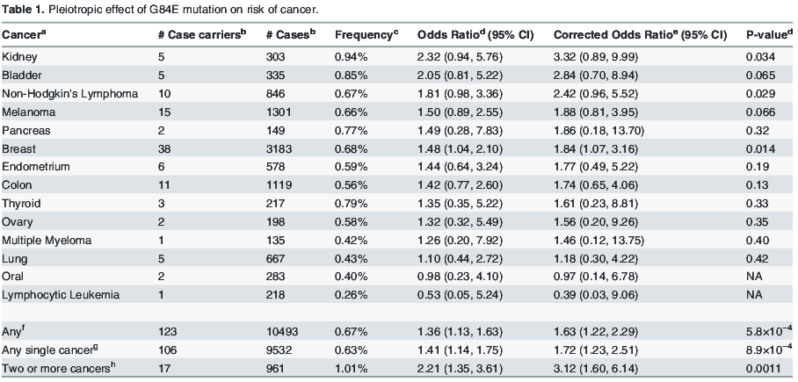
HOXB13 G84E (continued)

Slide 46
Outline for GWAS
Review / Overview
Design
Analysis
  QC
  Prostate cancer example
  Imputation
  Replication & Meta-analysis
Advanced analysis
  Limitations & “missing heritability”
  Gene/pathway tests
  Polygenic models

Slide 47
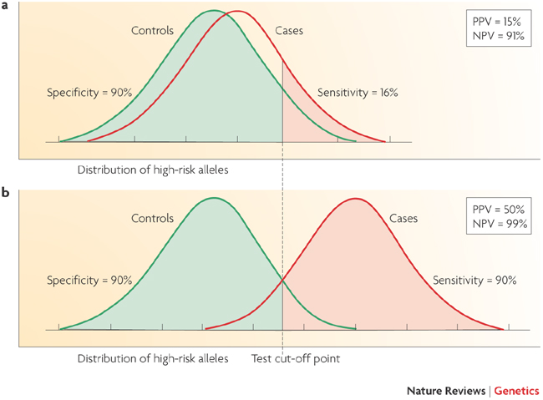
Limitations of GWAS
Example:
AUC for Breast Cancer Risk
58%: Gail model (# first degree relatives w bc, age menarche, age first live birth, number of previous biopsies) + age, study, entry year
58.9%: SNPs
61.8%: Combined
Wacholder et al., NEJM 2010
Not very predictive
Witte, Nat Rev Genet 2009
Notes:
47

Slide 48
Limitations of GWAS
Not very predictive
Explain little heritability
Focus on common variation
Many associated variants are not causal

Slide 49
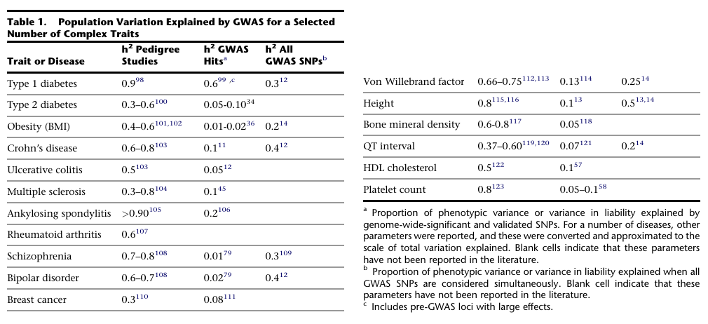
Where's the heritability?
Visccher, AJHG 2011

Slide 50
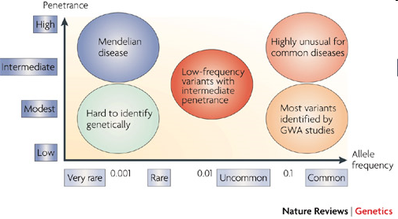
Where’s the heritability?
Common disease rare variant (CDRV) hypothesis: diseases due to
multiple rare variants with intermediate penetrances (allelic heterogeneity)
Many more
of these?
See: NEJM, April 30, 2009
McCarthy et al., 2008

Slide 51
Will GWAS results explain
more heritability?
Possibly, if…
Causal SNPs not yet detected due to power issues – weak effects
  Previous GWAS designed/powered for MAF>0.05/0.10; lower MAFs for newer arrays and larger reference panels
More complicated modeling necessary, e.g. gene-gene interaction, gene-environment interaction, etc.
Notes:
51

Slide 52
“Array” heritability
Compute heritability using all SNPs
  Be careful with QC, esp. case-control
If you adjust for the known hits, how much remains yet to be found?
Restricted to narrow sense heritability
E.g.,
http://www.complextraitgenomics.com/software/gcta/

Slide 53
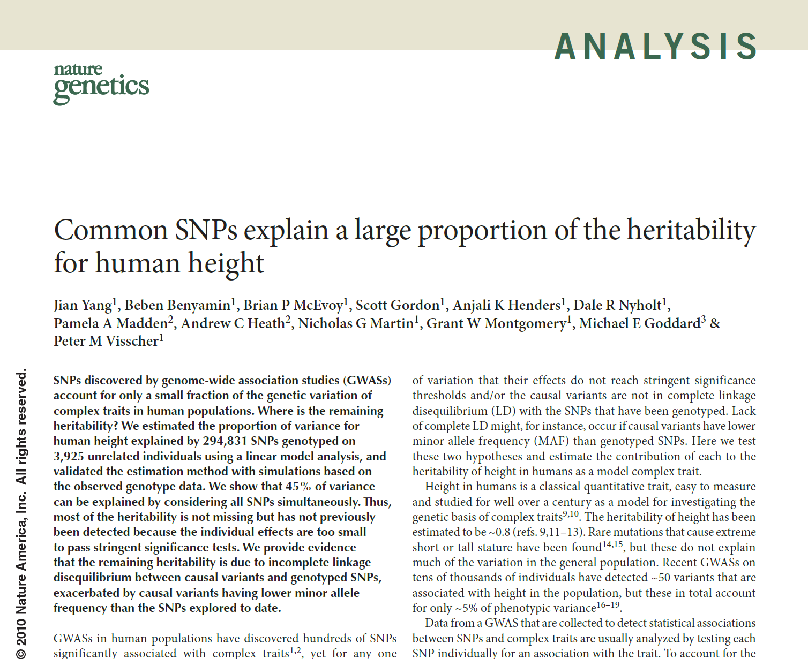

Slide 54
Gene/pathway-based tests
Various ways of collapsing the genotype information in multiple genes
  Less multiple comparison adjustment
logit (Prob(y=1| x, c)) = α + βx + γc
e.g.=α+β₁x₁+…+β₁₂x₁₂+{PC’s, other covariates}
  y: disease status)
  x is a vector of genotypes (e.g., a gene, or a pathway)
  c is a vector of covariates
H₀: β=0
Rare variant “burden” tests are along these lines

Slide 55
Pathways - how to define?
Many websites / companies provide ‘dynamic’ graphic models of molecular and biochemical pathways.
Examples: GO (Gene Ontology), KEGG, BioCarta, Reactome
May be interested in potential joint and/or interaction effects of multiple genes in one pathway.

Slide 56
Other Extreme: Polygenic Models
Many weak associations combine to risk?
Score model (use all GWAS SNPs):
where
  ln(ORi ) = ‘score’ for SNPi from ‘discovery’ sample
  SNPij = # of alleles (0,1,2) for SNPi, person j in ‘validation’ sample.
  Large number of SNPs (m)
xj associated with disease?
ASIDE: Genetic risk score this idea, but only on known hits
ISC / Purcell et al. Nature 2009

Slide 57
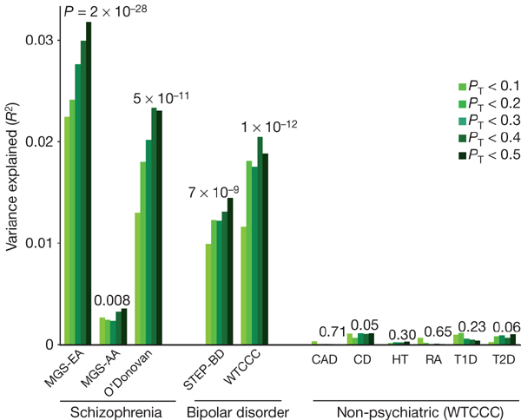
Application of Model
Purcell / ISC et al. Nature 2009

Slide 58
Other things than SNPs
Copy number variants (CNVs)
Epigenetics, e.g., methylation, histone modification
Gene expression (RNA levels)
Proteomics (measures of proteins in cells)
...

