Slide 1
Medical Devices in the US: History and Regulatory Process
Daniel Cher, MD
Vice President of Clinical Affairs, SI-BONE, Inc.
Vice President of Regulatory Affairs, PROCEPT Biorobotics, Inc.

Slide 2
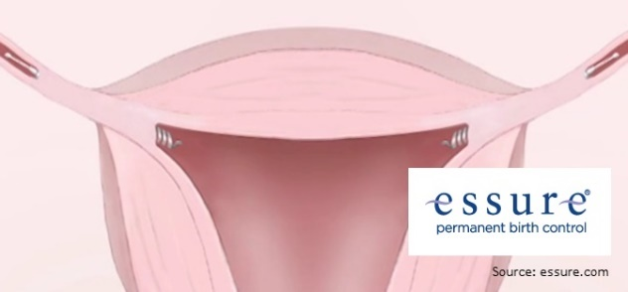
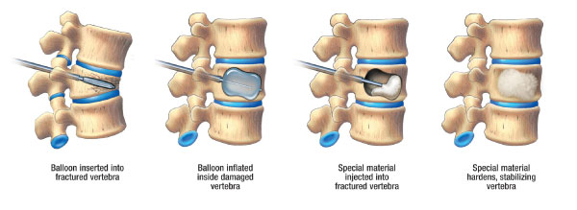
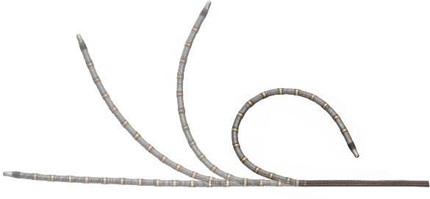
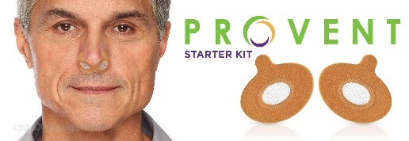
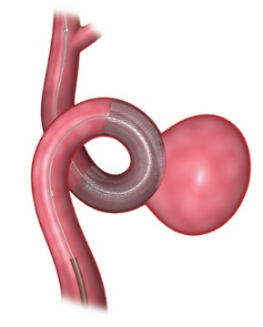
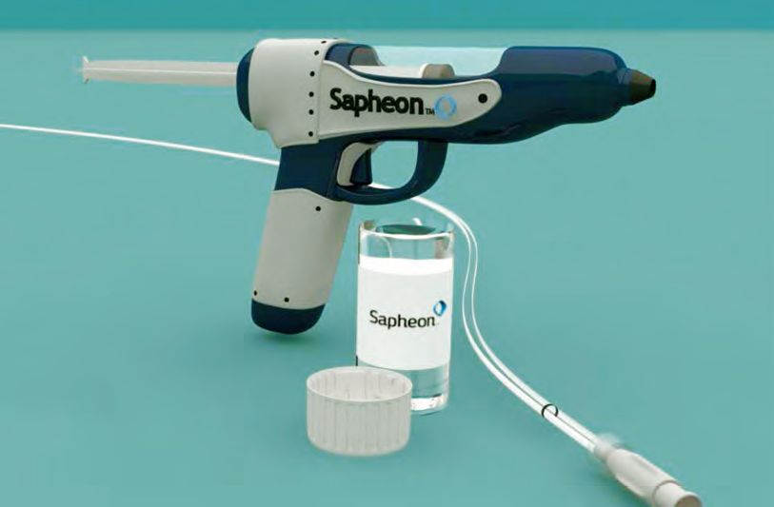
About Me / Disclosures
Stanford Biology 1986
Yale MD 1990
Medicine residence (Univ Wisconsin, California-Pacific Medical Center)
Stanford/Palo Alto VA Hospital fellowship general medicine
Medical device industry since 1997
Multiple clinical trials/devices
Head of clinical or regulatory affairs at 2 local companies

Slide 3
Outline
Epidemiology of medical devices
Medical device regulations and approval process
Medical device premarket studies
Premarket studies vs. studies for market acceptance
US market approval vs. EU and other countries
Health economics in med devices
Postmarket surveillance and device epidemiology

Slide 4
History of Medical Devices

Slide 5
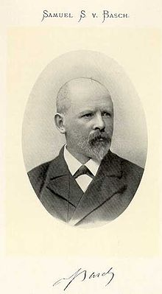
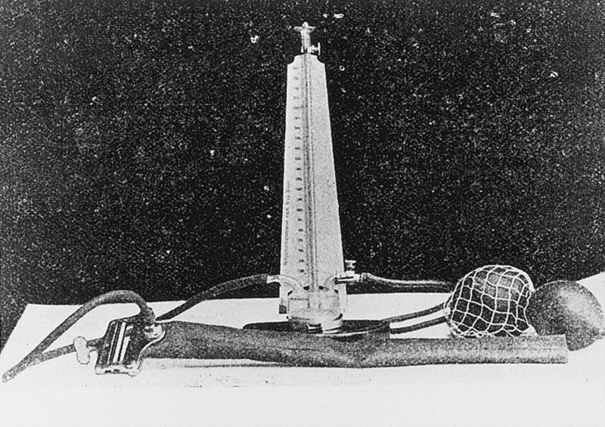
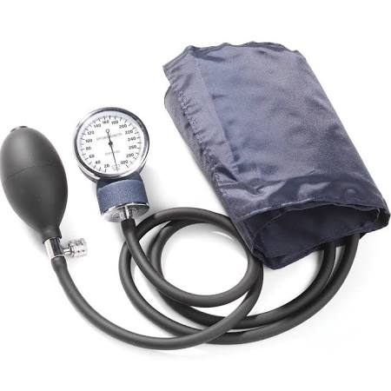
First Medical Device
Sphygmomanometer 1881?
  Samuel Siegfried Karl Ritter von Basch

Slide 6
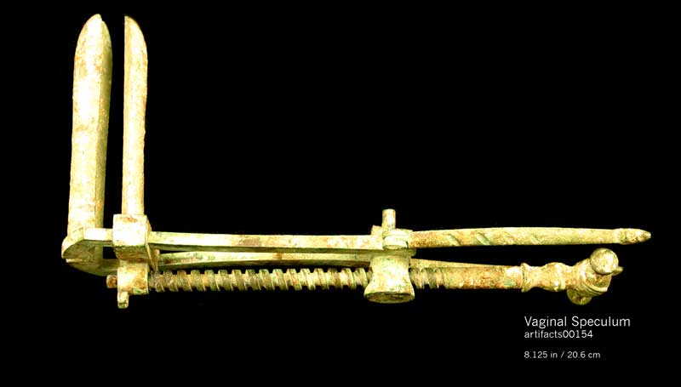
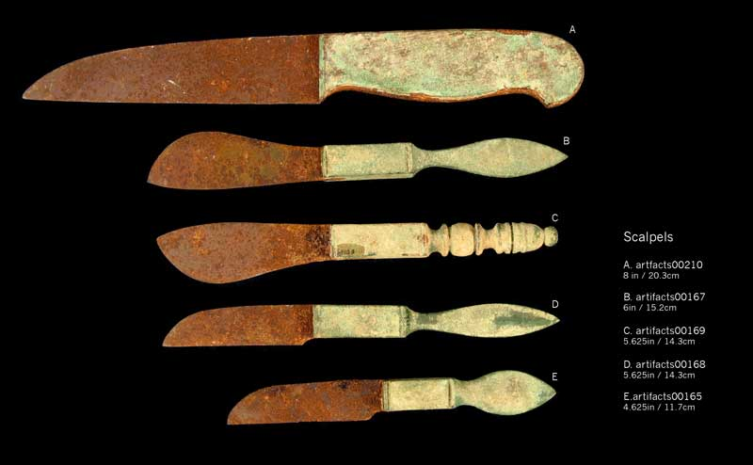
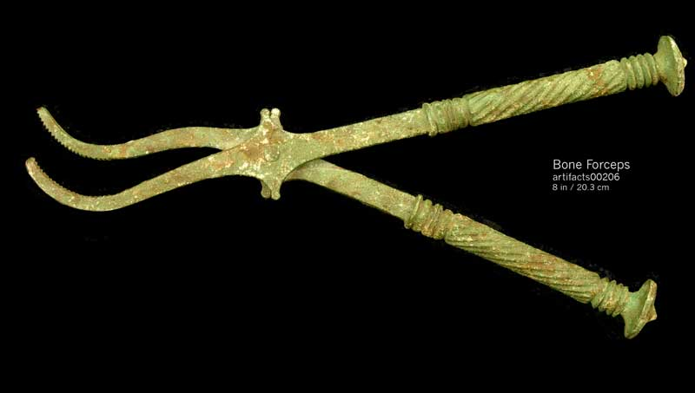
First Medical Device
1714: first mercury thermometer, Daniel Gabriel Fahrenheit
1881: sphygmomanometer, Samuel Ritter von Basch
1858: Stethoscope, René Laënnec, a French physician
Ancient Greeks and Romans:

Slide 7
Timeline
Year | Device
1881 | Sphygmomanometer
1885 | X-ray image
1885 | Electrocardiograph
1899 | Radiation therapy (yes, radiation is a type of medical device)
1939 | Mammogram
1927 | Respirator
1933 | Defibrillator
1945 | Dialysis machine
1948 | Contact lens
1951 | Artificial heart valve
1952 | Pacemaker

Slide 8
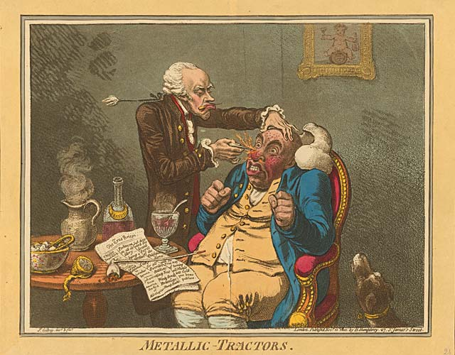
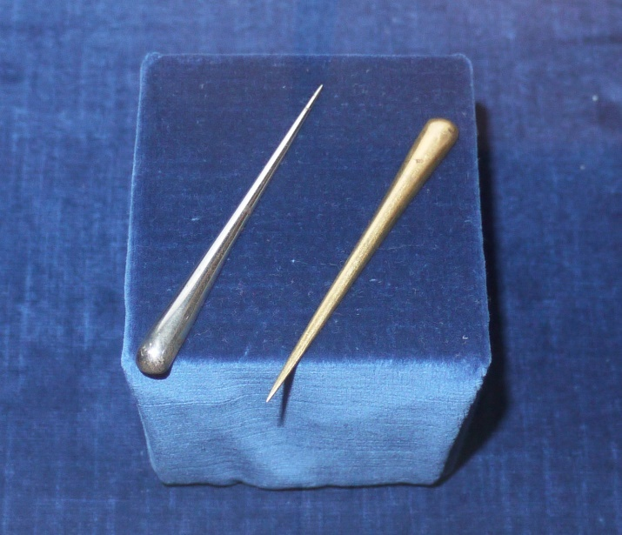
First fraudulent medical device marketed in the US
“Tractors”, Dr. Elisha Perkins (Connecticut, late 1700s)
Two brass/iron rods, 3 inches long
  Use: apply the points on the aching body part for about 20 minutes.
  Claim: unusual alloys with special properties that could cure inflammation, rheumatism and pain in the head and the face.
  "draw off the noxious electrical fluid that lay at the root of suffering"
George Washington bought a set!
Exposed as a fraud 1799

Slide 9
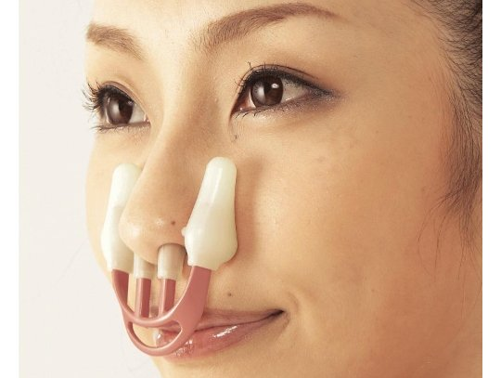
Medical Device Regulation in US
Pure Food and Drugs Act, 1906
  Purpose: ban foreign and interstate traffic of adulterated or mislabeled food and drug products
  Took 27 years to pass
  Did not address medical devices!
  In early 1900s, devices simple, hazards readily apparent – little overall risk
By 1917, fraudulent med devices appearing:
  Nose straighteners
  Height-stretching machines
  Heated rubber applicators as a cure for prostate gland disorders
  Radiation health hazards of radium (Curie, 1898), radium belt to prevent appendicitis!
1938 update to Food and Drug Act, multiple subsequent updates (1976, 1990)
Citation: http://www.fda.gov/aboutfda/whatwedo/history/productregulation/medicaldeviceandradiologicalhealthregulationscomeofage/default.htm

Slide 10
Medical Device Definition
Section 201(h) of the Federal Food Drug & Cosmetic (FD&C) Act
"an instrument, apparatus, implement, machine, contrivance, implant, in vitro reagent, or other similar or related article, including a component part, or accessory which is:
  recognized in the official National Formulary, or the United States Pharmacopoeia, or any supplement to them,
  intended for use in the diagnosis of disease or other conditions, or in the cure, mitigation, treatment, or prevention of disease, in man or other animals, or
  intended to affect the structure or any function of the body of man or other animals, and which does not achieve its primary intended purposes through chemical action within or on the body of man or other animals and which is not dependent upon being metabolized for the achievement of any of its primary intended purposes."
Defined by “what it’s not”

Slide 11
US Medical Device Approval

Slide 12
Classify Your Device
Class I – Lowest Risk
Class II – Moderate Risk
Class III – Highest Risk
Examples: manual toothbrush, sutures, many simple surgical instruments.
General controls
Examples: male condoms, non-invasive blood pressure monitors, catheters, screws
General controls and special controls
Examples: heart valve, most permanent implants
General controls and premarket approval

Slide 13
Combination Products
Definition
  Two or more regulated products (drug/device, biologic/device, drug/biologic, or drug/device/biologic) that are physically, chemically, or otherwise combined or mixed and produced as a single entity
  Two or more separate products packaged together comprised of drug and device products, etc.
  Drug, device, or biological product packaged separately but used together for a specific reason
Examples
  Device coated or impregnated with a drug or biologic
  Drug-eluting stent; pacing lead with steroid-coated tip; catheter with antimicrobial coating; condom with spermicide
  Skin substitutes with cellular components; orthopedic implant with growth factors
  Prefilled syringes, insulin injector pens, metered dose inhalers, transdermal patches
Not address today

Slide 14
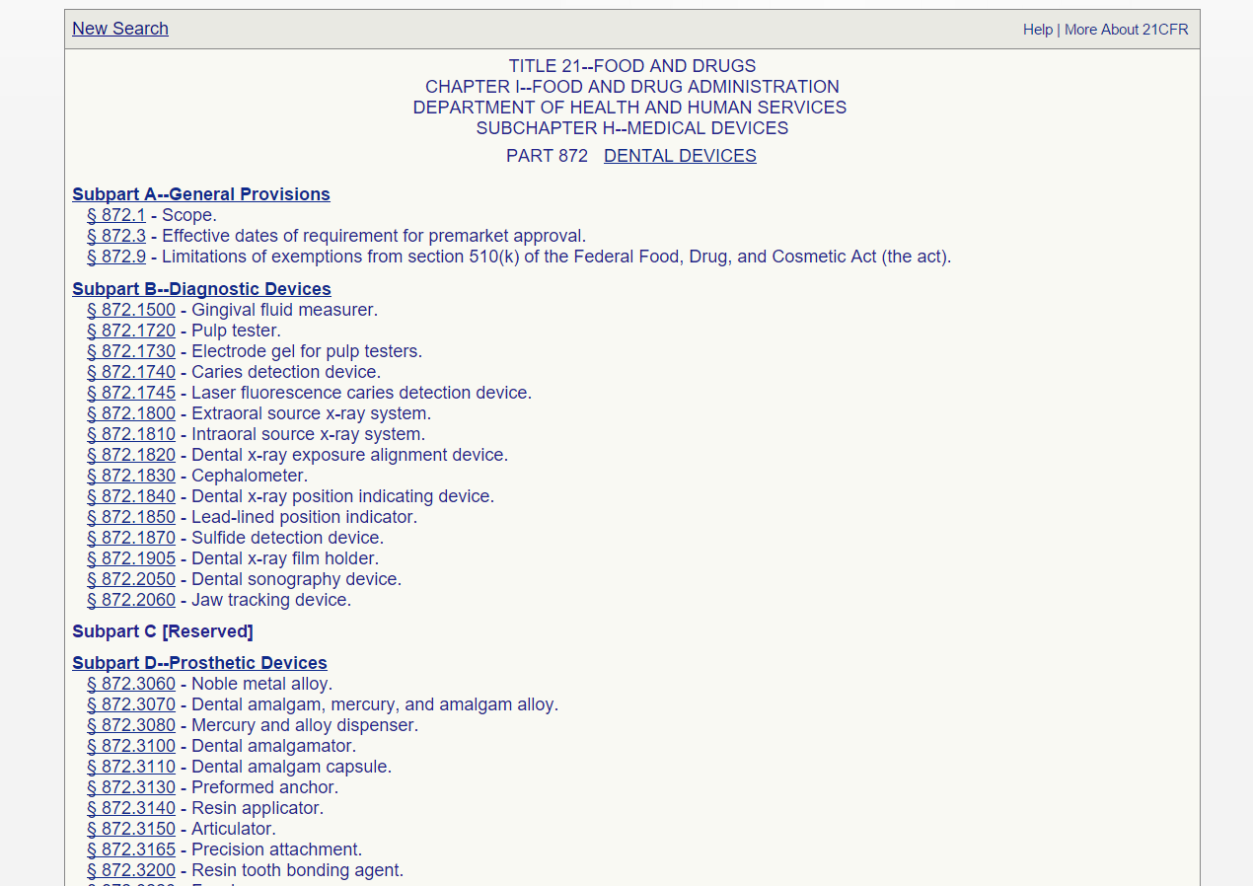
Classify Your Device
CFR Title 21 - Food and Drugs: Parts 1 to 1499
FDA regulations for most device types
http://www.accessdata.fda.gov/scripts/cdrh/cfdocs/cfcfr/cfrsearch.cfm
Examples:
  (862) Clinical chemistry and clinical toxicology devices
  (864) Hematology and pathology devices
  (866) Immunology and microbiology devices
  (868) Anesthesiology devices
  (870) Cardiovascular devices
  (872) Dental devices
  (874) Ear, nose, and throat devices
  (876) Gastroenterology-urology devices
  (878) General and plastic surgery devices
  (880) General hospital and personal use devices
  (882) Neurological devices

Slide 15
Premarket Submission Pathway
510(k) Premarket Notification
PMA Premarket Approval
De Novo: Evaluation of Automatic Class III Designation
HDE Humanitarian Device Exemption

Slide 16
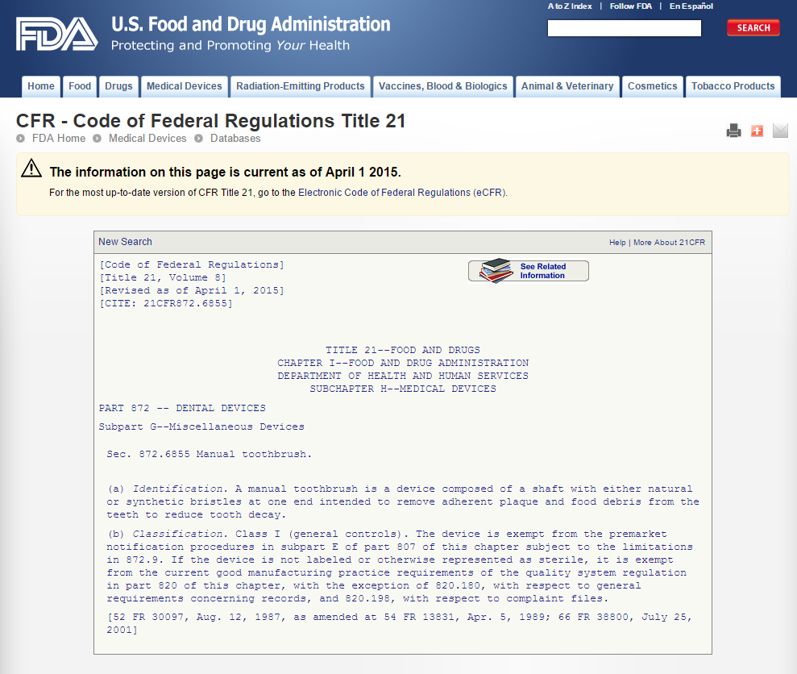
Class I (Lowest Risk) Devices
Register establishment with FDA
General controls
  Regulatory requirements
  Part of FD&C Act, sections 501, 502, 510, 516, 518, 519, and 520
  Apply to all medical devices
Comply and manufacture: you’re in business
You are subject to periodic FDA inspections and all aspects of medical device recalls

Slide 17
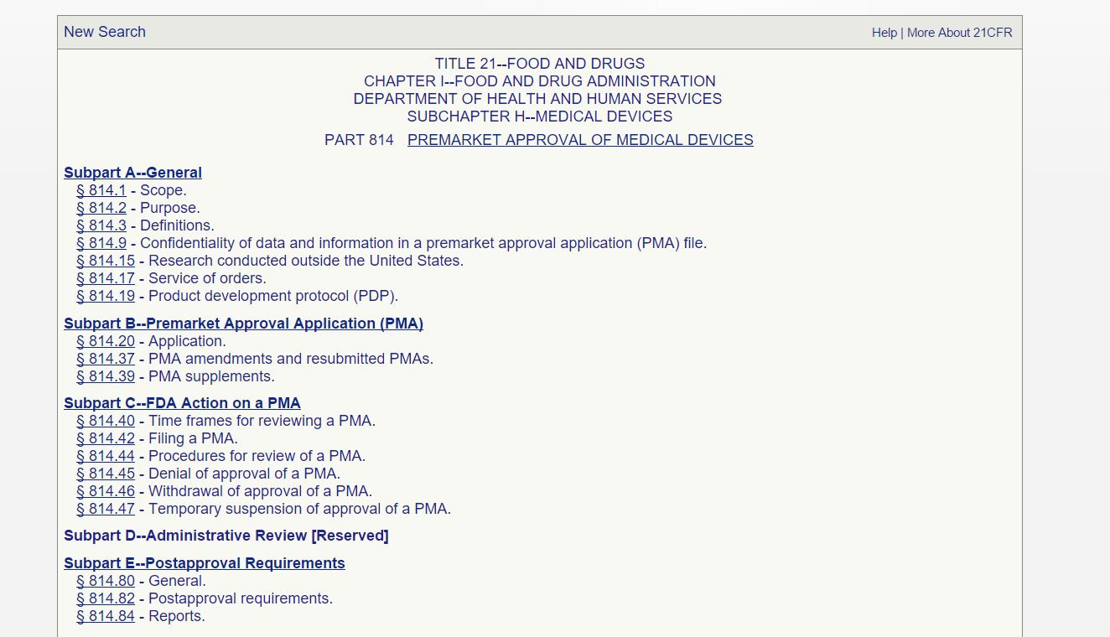
Class III (Highest Risk)
Premarket Approval
Broad definition:
  Any device supporting or sustaining human life or preventing impairment of human health, or that may present a potential unreasonable risk of illness or injury for which general controls and special controls are insufficient to provide reasonable assurance of the safety and effectiveness of a device, or for which there is insufficient information to make such a determination.
21 CFR 814
Examples: most permanent implants or complex devices
  Heart valves, orthopedic devices, coronary stents, etc.
Substantially difficult regulatory pathway

Slide 18
Class II (Moderate Risk)
Special controls, as general controls are insufficient
Specific FDA requirements related to device category to assure safety and effectiveness
“510k” pathway
Special Controls
  Performance standards
  Postmarket surveillance
  Patient registries
  Special labeling requirements
  Premarket data requirements
  Guidelines

Slide 19
Market a Device without Clinical Testing – is that right?
Low risk devices do not need clinical trials
  Needle, appropriately manufactured, is low risk and likely effective for its intended use
High risk devices need clinical trials for safety/effectiveness
Intermediate risk devices may be marketed provided that:
  Manufacturer establishes and proves that device can be made reliably under a quality system
  Device itself meets FDA requirements for testing
  They are substantially equivalent to previously marketed devices

Slide 20
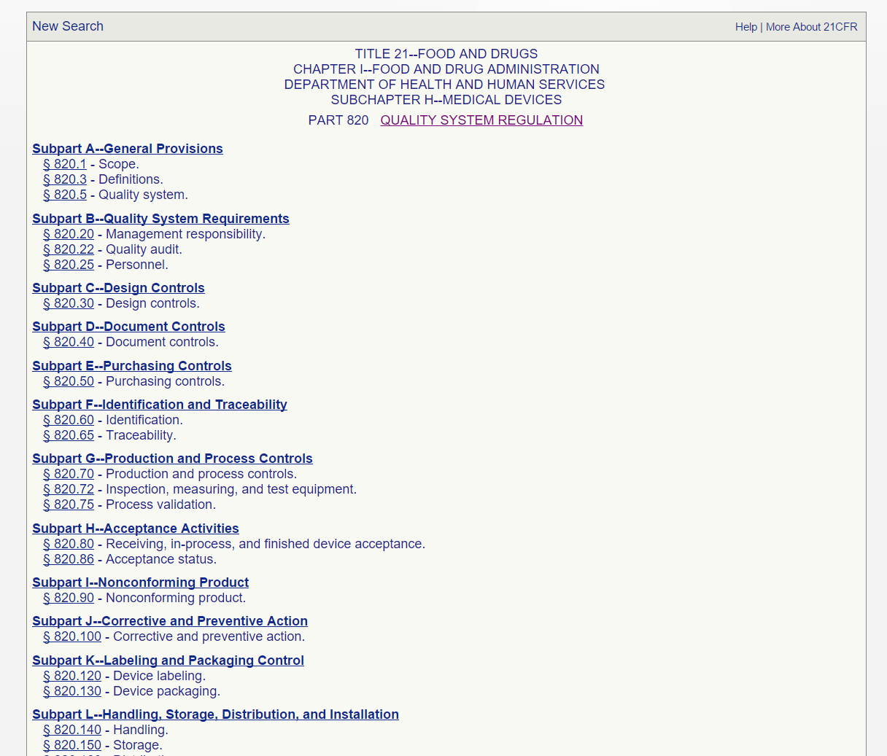
Quality System Regulations
21 CFR 820
Purpose
Responsibility
Burden
FDA regulation applying to all devices
Systems to ensure safety, effectiveness and quality of medical devices
Manufacturers responsible for determining which parts of QSR apply to their device
Appropriately high

Slide 21
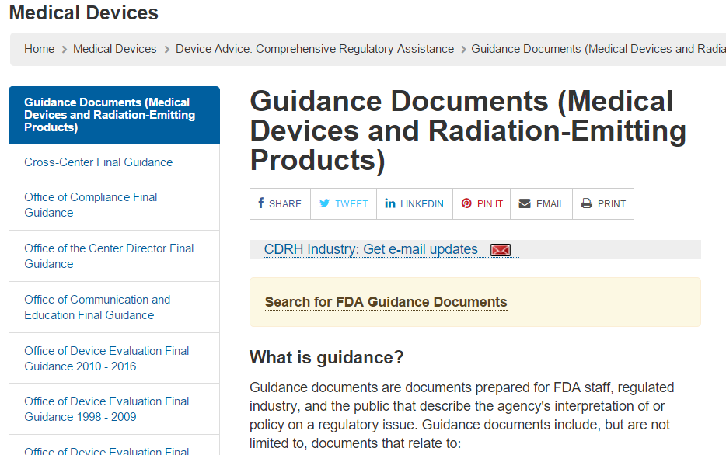
Class II Guidance Documents
Guidance documents for particular device types
Must read / follow / provide proof that your class II device meets FDA’s needs

Slide 22
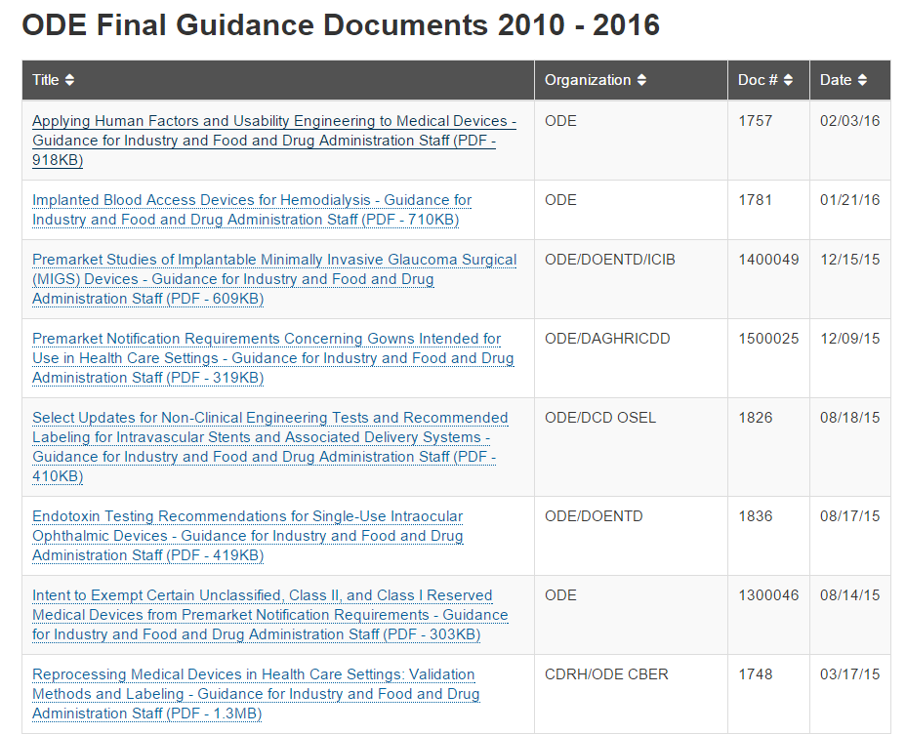
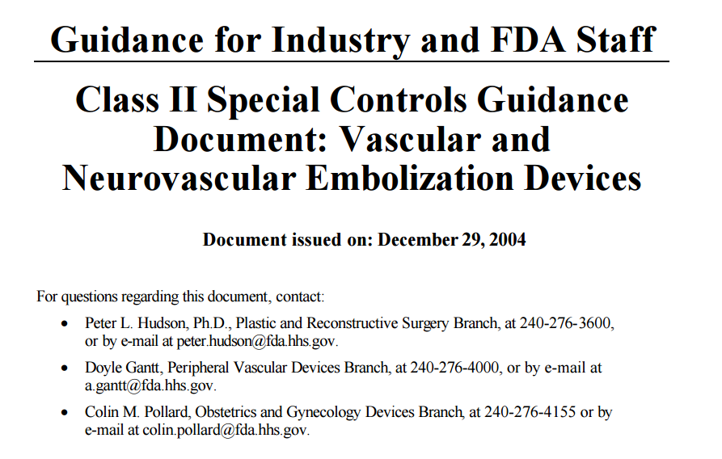
FDA Guidance Documents
http://www.fda.gov/MedicalDevices/DeviceRegulationandGuidance/GuidanceDocuments/ucm198577.htm

Slide 23
Guidance Documents Scope
Preclinical tests:
  Benchtop tests to verify device design and validate (confirm) that device works as intended
  Biocompatibility testing (ISO 10993)
Sterility testing:
  Substantial work to ensure reliable sterility
  Can be challenging when device very complex
Animal testing
  Confirm that device works as intended in suitable animal model
Clinical testing
  Very specific guidance on trial design
Labeling
  What you can and cannot claim

Slide 24
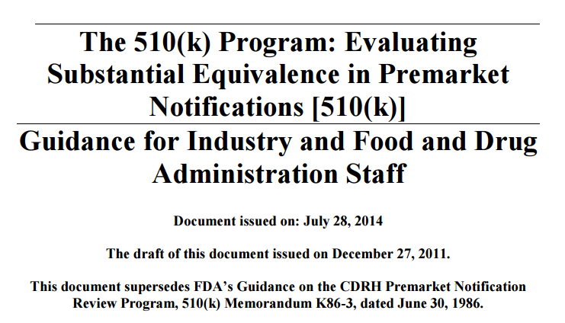
Class II Pathway – Substantial Equivalence: 510k regulation
A new (i.e., post-amendments) device is automatically in Class III and must undergo premarket approval or reclassification before it can be marketed, unless it is a type of device that was in commercial distribution prior to May 28, 1976, and is substantially equivalent to another such device;
Not “approval” but rather “clearance under 510(k)”
http://www.fda.gov/downloads/MedicalDevices/.../UCM284443.pdf

Slide 25
Definition of Substantial Equivalence
Device has the same intended use as the predicate [i.e., already cleared] device and device
  (i) has the same technological characteristics as the predicate device, or
  (ii)(I) has different technological characteristics and the information submitted that the device is substantially equivalent to the predicate device contains information, including appropriate clinical or scientific data if deemed necessary by the Secretary or a person accredited under section 523, that demonstrates that the device is as safe and effective as a legally marketed device, and (II) does not raise different questions of safety and effectiveness than the predicate device.
“different technological characteristics” means significant change in the materials, design, energy source, or other features compared to the predicate

Slide 26
Substantial Equivalence Issues
Same technological characteristics as the predicate
“Me, too” device – your catheter is identical in most respects to a catheter on the market
Challenging if your device
Made from different materials
Put in different place in body
Manufactured very differently
Impossible if your device:
Different mech of action
Different energy source
Different application
Different technological characteristics but “as safe and effective” as a legally marketed device
“As S/E” highly debatable
You may not want to do a large non-inferiority clinical trial
But FDA may require it

Slide 27
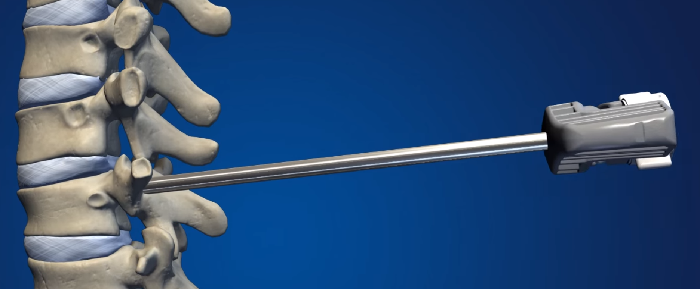
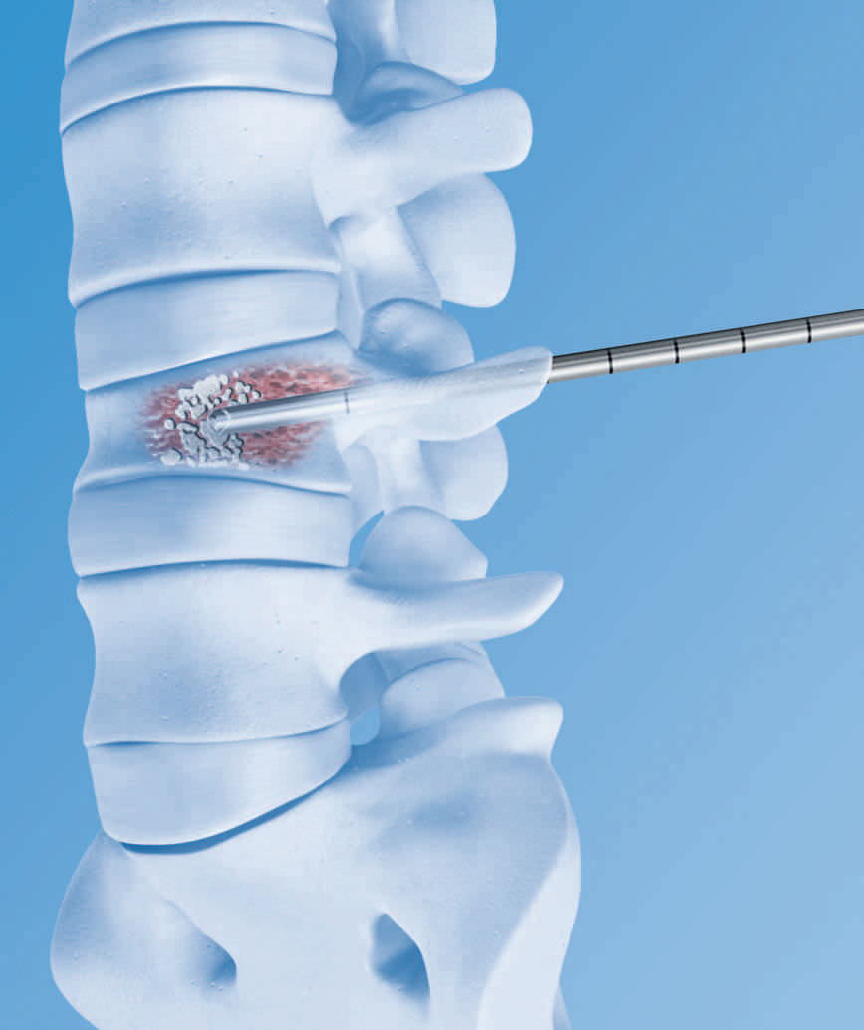
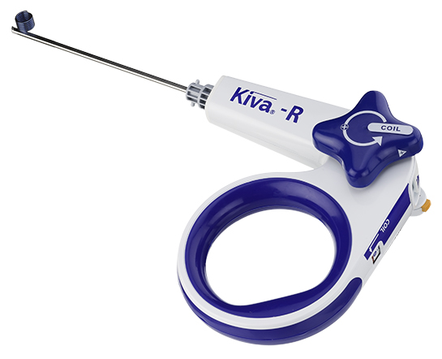
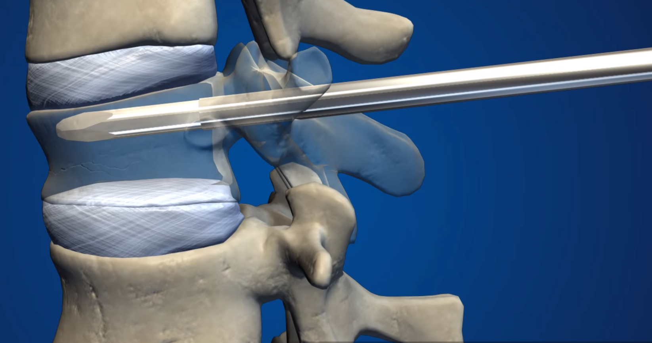
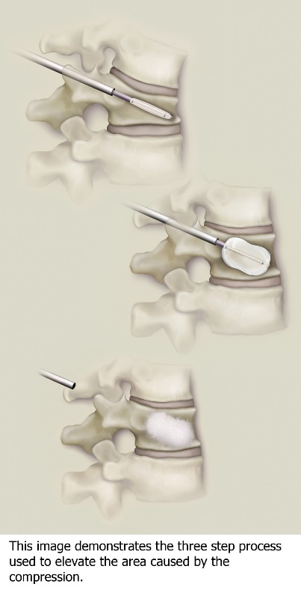
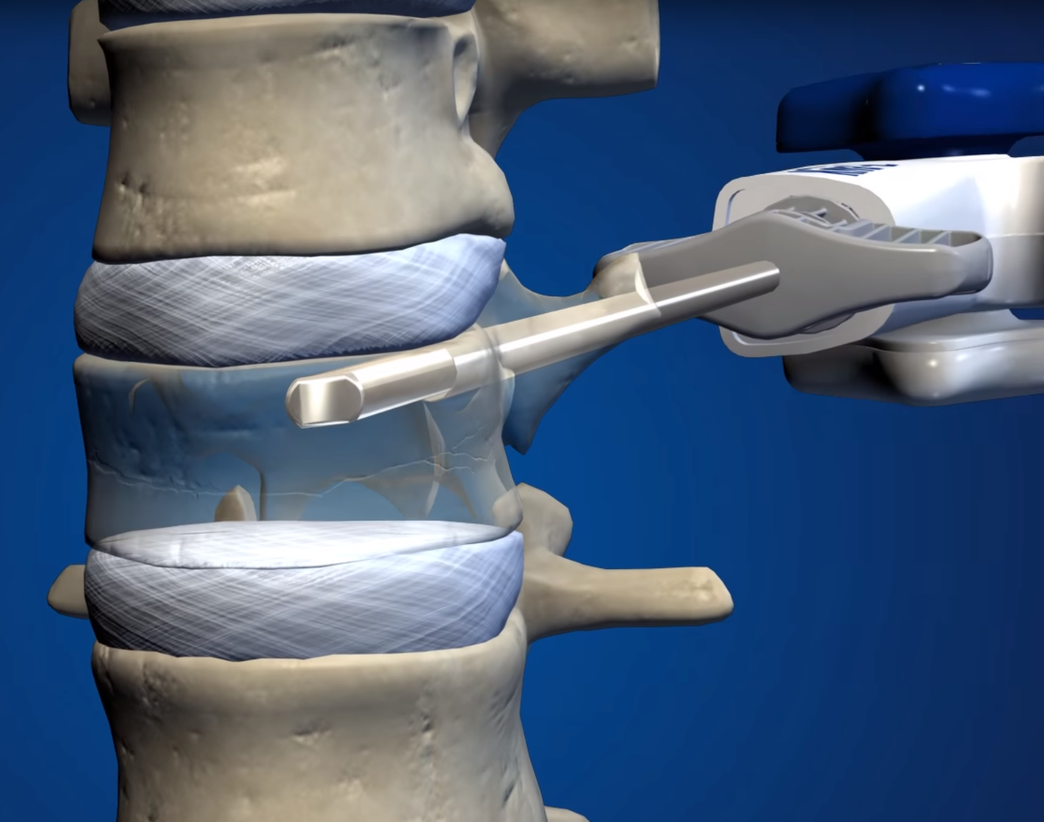
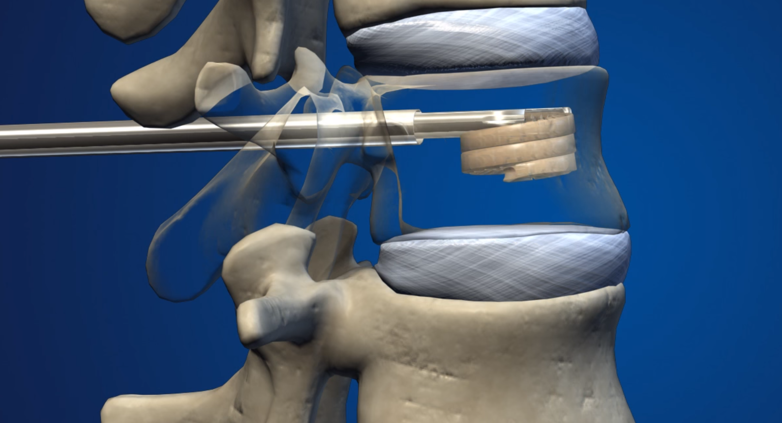
Vertebroplasty / Kyphoplasty

Slide 28
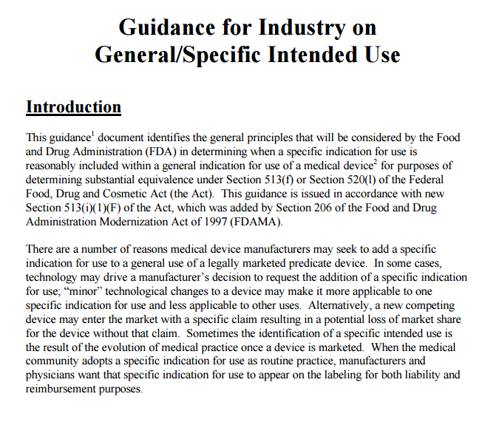
General → Specific Use
Risk - Does a specific use introduce new risks not associated with general use of the device?
Public Health Impact - Does specific use impact public health to a significantly greater degree than the general use of the device?
  Example: diagnosis vs. screening, cutting soft tissue vs. treating breast cancer
Knowledge base - Is there evidence that distinguishes more specific use from a new intended use?
Endpoints – Can performance information on general use speak to specific use? E.g., your device ablates tissue, but does it cure heart arrhythmia?
Tool or treatment?- A tool is used by a physician to perform a task (e.g., scalpel to cut tissue) vs. device to treat particular disease (e.g., extra corporeal shock wave lithotripter)
Adjunctive therapy- does a separate device need to be used to achieve the proposed therapeutic goal?
Design changes- how modified is the design to facilitate the specific use compared to the general use?
Can trigger PMA pathway instead of 510k pathway
Can trigger

Slide 29
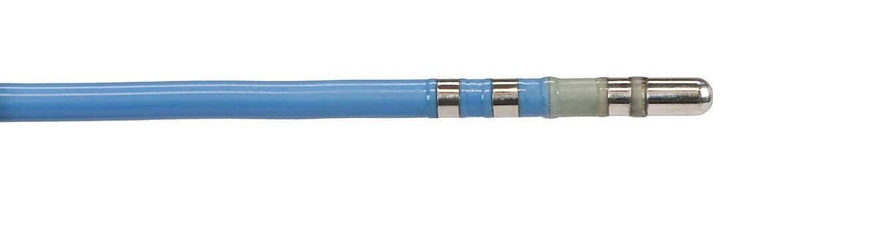
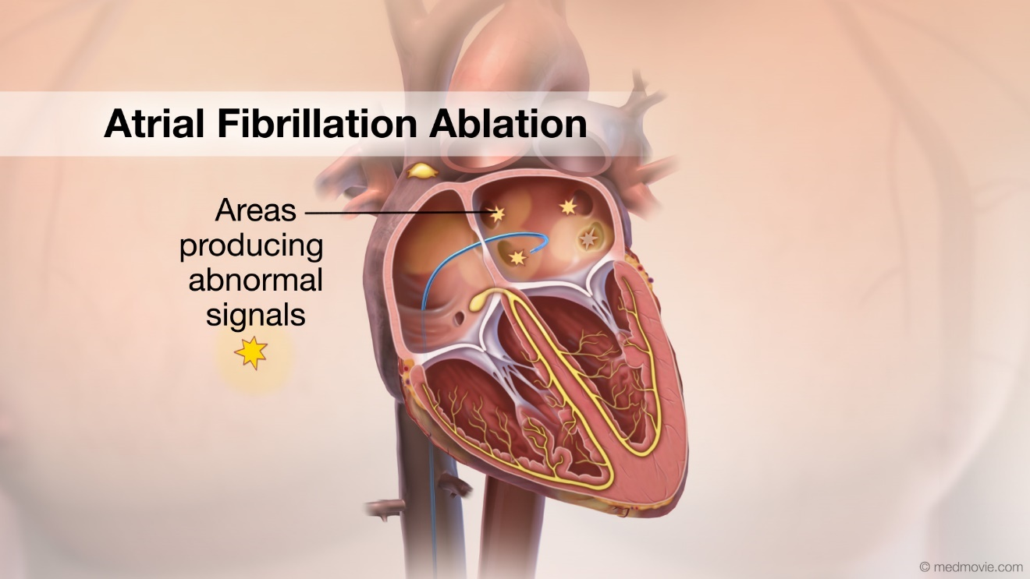
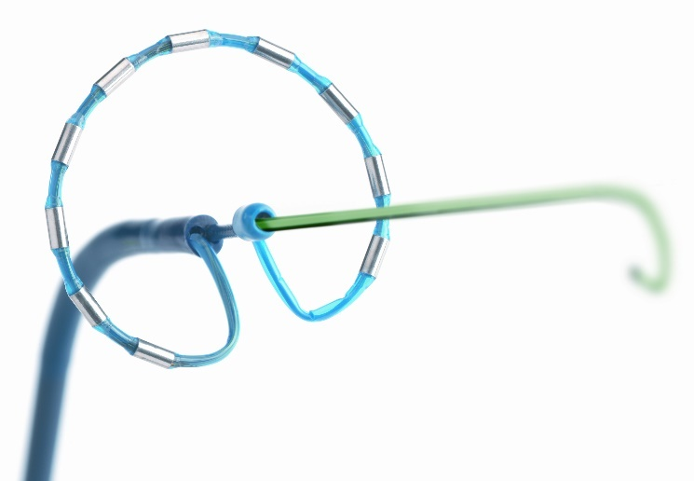
General → Specific Can Trigger PMA
PMA may also be required for
  Devices with new concepts
  Simpler (class II) devices applied to specific diseases

Slide 30
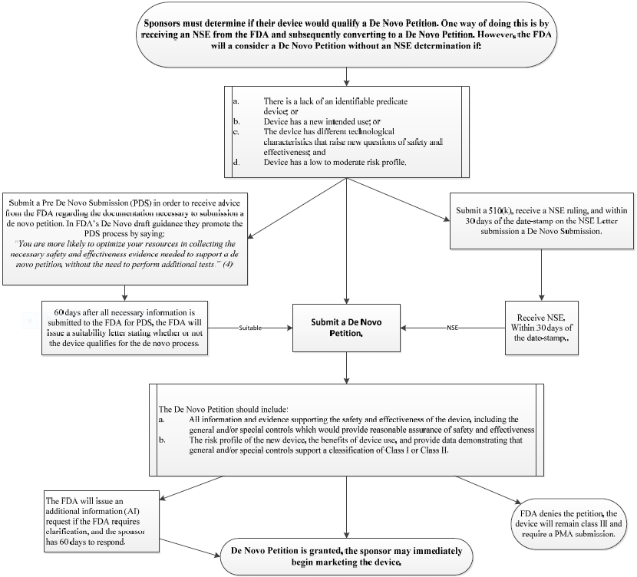
What if there is no clear pathway?
Class II may not apply
  Your device is moderate risk but there is no predicate
  “De novo process” as a Class I or Class II device
  Section 513(f)(2)

Slide 31
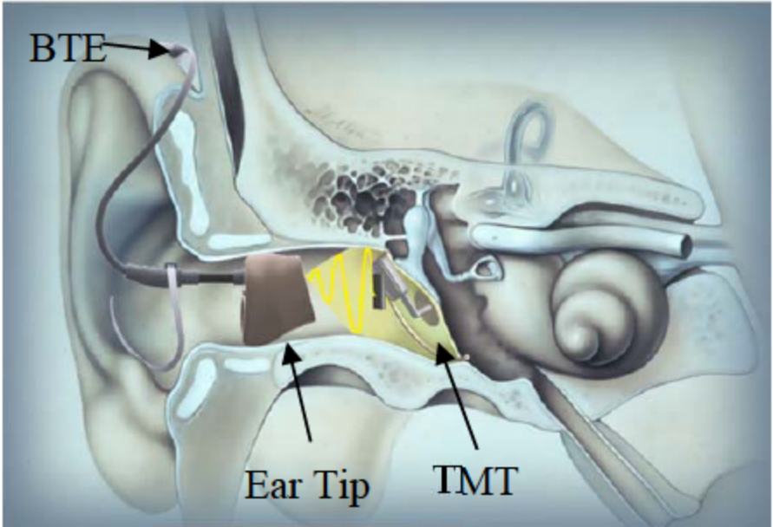
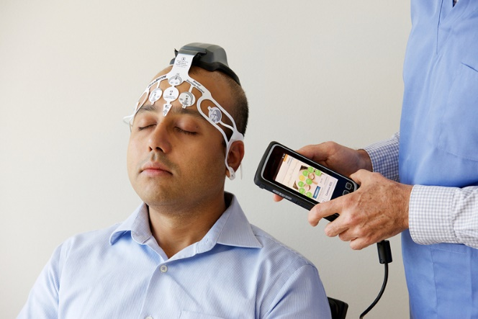
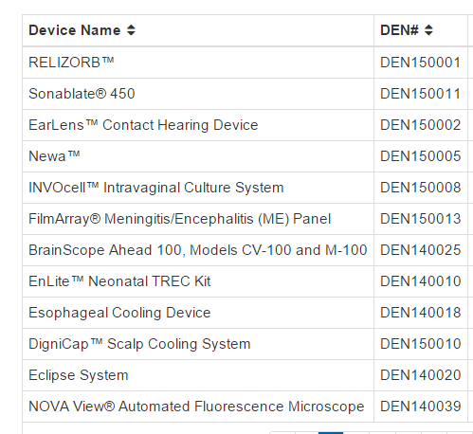
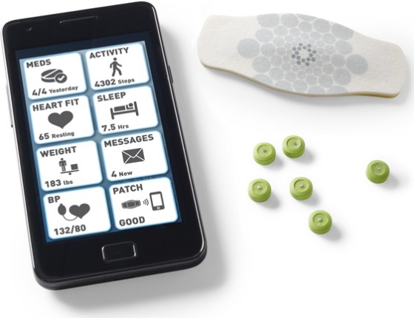
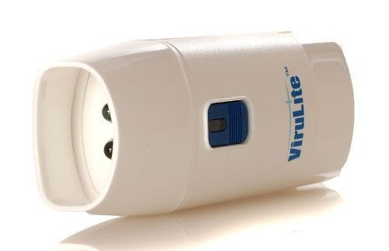
Devices cleared through de novo
http://www.fda.gov/AboutFDA/CentersOffices/OfficeofMedicalProductsandTobacco/CDRH/CDRHTransparency/ucm232269.htm

Slide 32
Class III (Highest Risk)
Premarket Approval
Broad definition:
  Any device supporting or sustaining human life or preventing impairment of human health, or that may present a potential unreasonable risk of illness or injury for which general controls and special controls are insufficient to provide reasonable assurance of the safety and effectiveness of a device, or for which there is insufficient information to make such a determination.
21 CFR 814
Examples: most permanent implants or complex devices
  Heart valves, orthopedic devices, coronary stents, etc.

Slide 33
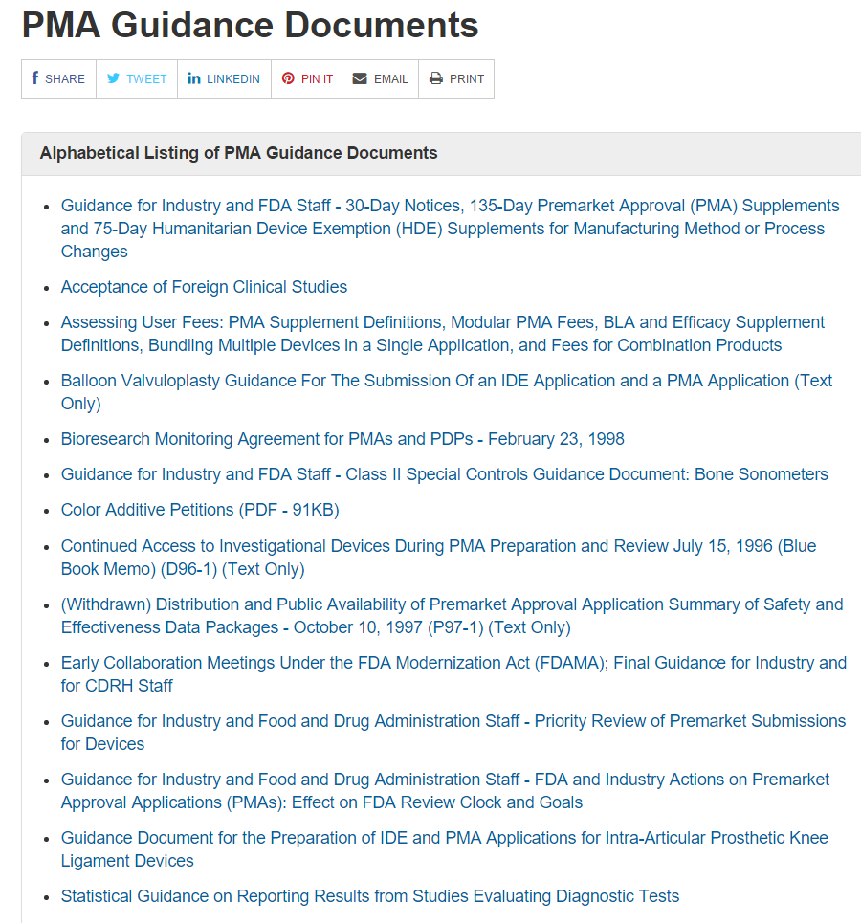
Class III Pathway - Clinical Trials Required
Premarket approval (PMA)
Long list of requirements in 21 CFR 860.7
Implies at least 1clinical trial

Slide 34
21 CFR 860.7 Definitions
agency relies upon only valid scientific evidence to determine whether there is reasonable assurance that the device is safe and effective.
Valid scientific evidence is evidence from well-controlled investigations, partially controlled studies, studies and objective trials without matched controls, well-documented case histories conducted by qualified experts… from which it can fairly and responsibly be concluded by qualified experts that there is reasonable assurance of the safety and effectiveness of a device under its conditions of use.
reasonable assurance that …benefits to health from use of the device for its intended uses and conditions of use, when accompanied by adequate directions and warnings against unsafe use, outweigh any probable risks… absence of unreasonable risk of illness or injury associated with the use of the device for its intended uses
valid scientific evidence… significant portion of the target population, the use of the device for its intended uses and conditions of use, when accompanied by adequate directions for use and warnings against unsafe use, will provide clinically significant results.

Slide 35
Subjective Interpretation vs. FDA Needs
FDA wants to approve new medical devices
FDA needs to preserve patient safety
FDA therefore requires high-quality evidence of safety and effectiveness
At least 1 “pivotal” clinical trial
Design, sample size, assessments, etc. are negotiated

Slide 36
Typical Requirements for Premarket Medical Device Studies
Usually control group
  Compare experience of new device with experience of “old” device or standard treatment or non-surgical treatment
No control group in unusual circumstances

Slide 37
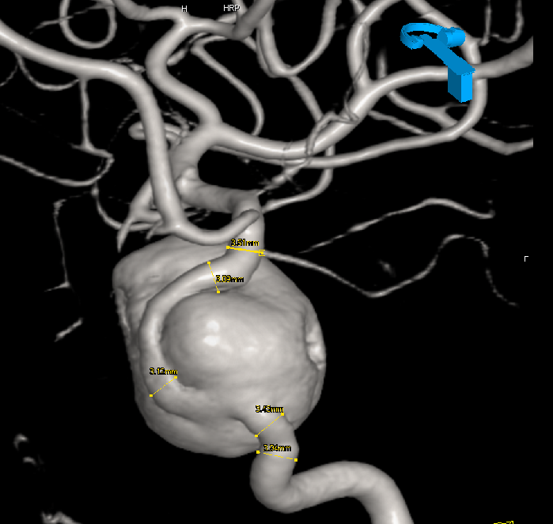
Pipeline Embolization Device
Giant intracranial aneurysms
Anatomic abnormality of blood vessels in brain
Can be highly symptomatic
High rate of spontaneous rupture → immediate death or grave disability
Five year cumulative risk of rupture by size and location
Location | 13-24mm | >25mm
Cavernous | 3.0% | 6.4%
ICA | 14.5% | 40%
Lancet 2003;362:103 ISUIA

Slide 38
Treatments for Giant Aneurysms
Surgery
  Challenging
  High risk
Endovascular
  Guglielmi detachable coils didn’t work well due to adverse geometry
  Stents available but not designed for this very abnormal anatomy
Available literature in 2008 showed success rates of 15-30%

Slide 39
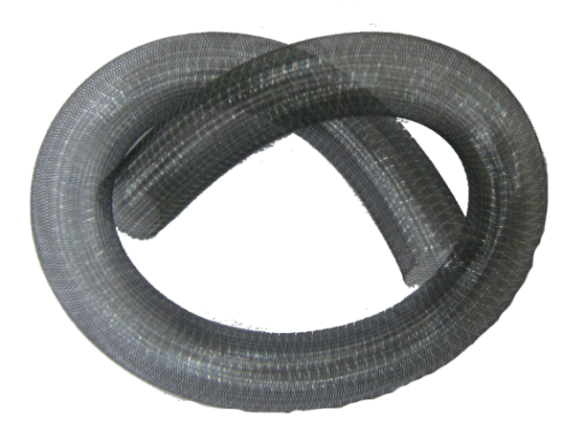

Pipeline Embolization Device
Metal stent with high-density mesh
Reconstruct artery from inside

Slide 40
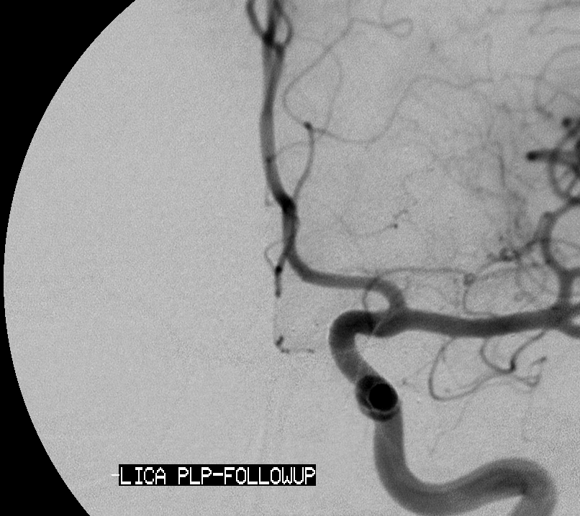
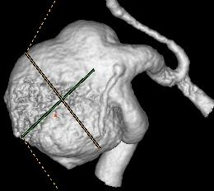
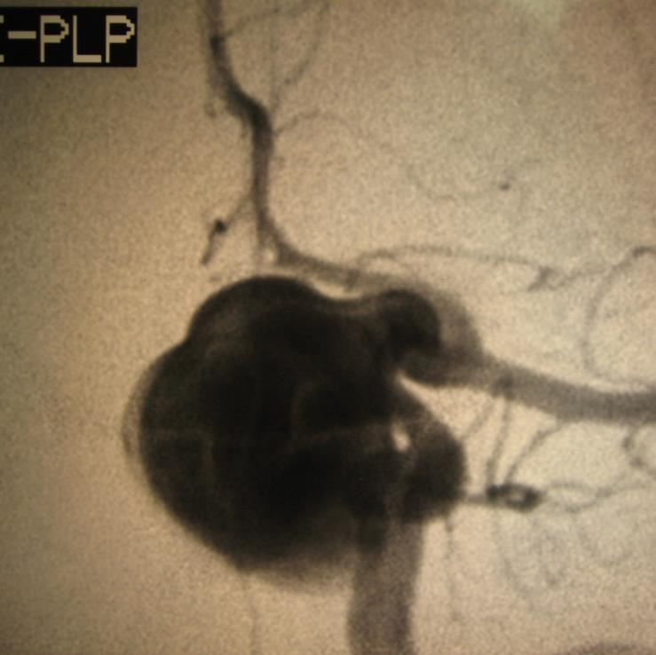
LICA PRE TREATMENT
Notes:
40
This is an AP view of paraopthalmic aneurysm from the PITA study. On the the 3D reconstruction in the upper left of the screen, you can see that the parent vessel is blown out at the level of the aneurysm. This was treated by reconstructing the vessel with PED. At follow up angiography at 6 months (Click) the aneurysm is no longer seen and the vessel looks normal.

Slide 41
FDA OK with single arm
FDA agreed that
  Available treatments not very effective
  If we showed success rate statistically exceeded 50%, “breakthrough treatment” and approvable
  Success rate could be judged with 6 month cerebral angiogram
  Final success rate 74% (p<.0001 vs. 50%)

Slide 42
Other Aspects of Med Device Trials
Sham trials very difficult
In comparison, placebo-controlled drug trial is “easy”
Surgery vs. non-surgery trials challenging
Patients with severe problem “ready” for surgery and have exhausted medical options
Especially when treatment is surgical
Unblinding bias
Intervention significant
Compared to “little white pill” surgical intervention usually very impactful
Patients often very sick, at high risk for death

Slide 43
Other Aspects of Med Device Trials
Intervention complex
Often, company members present to help surgeon use device
Bias introduced?
Not just “pill”
Often many complex devices – shipping/manufacturing issues
Support staff

Slide 44
Sample Sizes
Multicenter common (10-50 sites)
“Hundreds” – typically not “thousands”
Enrollment challenging
  Especially when other devices/treatments available commercially

Slide 45
Study Endpoints
In many cases different from drug studies
Often radiographic endpoints
  Confirm “device accomplishes its technical goal”
    Blocked something (embolization device in an aneurysm)
    Kept something open (stent in heart artery)
    Promoted fusion of a body part (spine implant)
Endpoints less often just death

Slide 46
Physician Investigators
Typically, busy surgeons
Often no clinical trial infrastructure
Often wide variation in practice
Lack of data doesn’t prevent strong opinions
Surgeons are good at surgery
  Typically not good at research
  (Internists are better researchers but they don’t use devices)

Slide 47
In-House Team
In pharma, teams can be large
Many device companies are small
Clinical affairs teams can be very small
Often no in-house technical expertise
  No statistician
  No IT support
  Seat of the pants

Slide 48
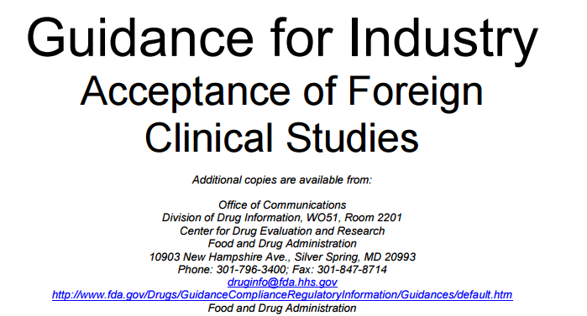
International Data
FDA prefers med device trials in US citizens
Reluctantly accepted data from outside US
Best to limit proportion of data not from US
Concern that patient responses and surgical practices are “different” in Europe

Slide 49
Statistical Rigor
<1980s: Wild West
  Loose power calculations
  Single-arm studies
  Poorly defined endpoints
1990s: increasing rigor
2000s-present: highly rigorous
Great concern regarding
  Statistical techniques
  Impact of missing data
  Define EVERYTHING up front
    Do what you said you were going to do
    No posthockery allowed

Slide 50
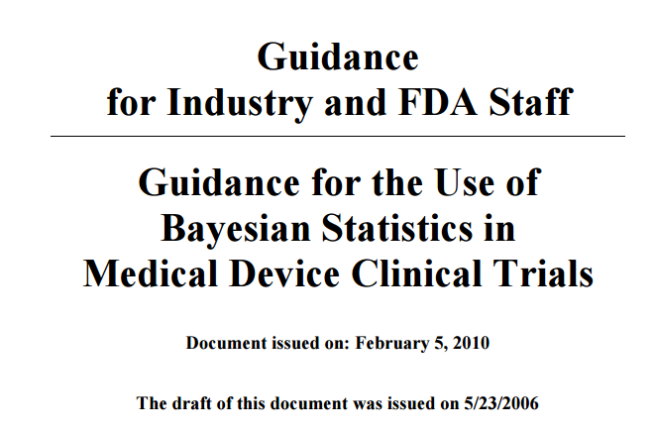
Increasing Acceptance of Flexible (Adaptive) Trial Designs
Bayesian statistics first explored in late 1990s
Bayesian paradigm uniquely suited to devices

Slide 51
Bayesian Paradigm
Bayesian stats: degrees of belief
Pathobiology of disease often quite clear
Mech of action of a device is very clear
  Holds open
  Closes off
  Holds together
  Zapping and frying
Strong prior beliefs based on “surgical knowledge”
Trials are therefore “confirmatory” as opposed to “establishing knowledge”
Allows flexibility

Slide 52
Adaptive Design
Planned changes to trial conduct while the trial is happening
“Play the winner”
Interim sample size calculations
“Based on what I know now, wow many more will I need?”
Predictive calculations
“Based on what I know now, how likely will trial be a success?”
Longitudinal modeling
“Based on how patients have done up until now, how will remaining patients do?”
Dose response
“Based on accumulating data, is the likelihood that dose A is ineffective high? If so, terminate that arm”
“For the last few patients, treatment A was better”
“You get treatment A”

Slide 53
Adaptive Designs Promote Efficiency
Enroll only right amount
Select only treatments (or doses) that are most promising
Gain insight into your trial as it’s happening
FDA OK with this provided you
  Confirm test performance characteristics before study starts
  Follow the rules
  Preserve Type 1 error

Slide 54
Bayesian Interim Analyses to Stop Enrollment
Advantages
Disadvantages
When effect size not known but suspect large
Early cessation of enrollment = save $ and time
Depends on enrollment
Sometimes cannot take advantage of
Always carefully explore Type 1 error rate before implementing
Adjust for Type 1 error (e.g., prob = 0.98XX not 0.975)

Slide 55
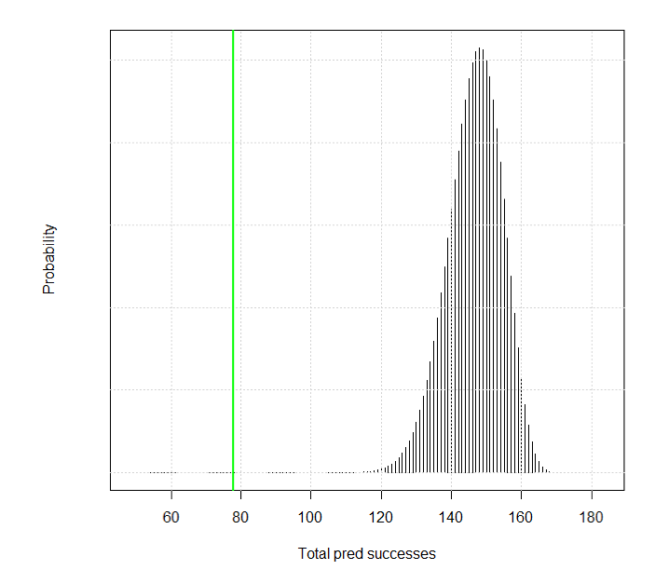
Prospective Single-Arm Study
Stop enrollment?
Dec 2013
184 enrolled
48/60 (80%) success rate
Predicted success rate high
Stop enrolling
Follow all to primary endpoint
Single calculation
No statistical penalty
Predictive distribution for # of successes at trial end

Slide 56
Plan Device Study Carefully
Design may work for FDA approval
But market may find the study too small or wrong design
Customers (surgeons) may find the study great… but insurance companies want better
Insurance companies often apply “drug approach” to devices
  Want gold Cadillac studies, which could be impossible
US trials may not work for EU
EU trials may not work for US

Slide 57
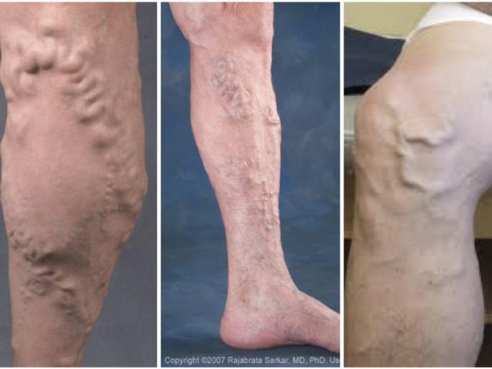


Sapheon VenaSeal

Slide 58


Cyanoacrylate Embolization (CAE)

Slide 59
Proposed Trial
Initially: single-arm
Prior evidence
  Several trials of prior devices
  2 trials of prior use of glue
  We “knew” that success rates would be high
Randomized trial
  Glue vs. standard treatment (radiofrequency ablation)
  10% non-inferiority delta
FDA ok with 3-month closure rate as primary endpoint
  Not all agreed
But…FDA wanted to see 12 mo
Not necessarily trial that insurers would want

Slide 60
Interim Analysis
Predictive analysis of 12-month success rates when
  All had 3-month (primary endpoint) AND
  About ¼ of all subjects had 12-mo data

Slide 61
Interim Analysis
As of June 2014
  All had 3-month data
  3-month success rates were 99% glue and 95% RFA
    Probability of non-inferiority >0.9999
    Probability of superiority = .08
  60 had 12-month data
  Predictive distribution based on:
    Likelihood closed at Mo 12 | closed at mo 3
    Likelihood closed at Mo 12 | open at mo 3

Slide 62

Predicted >99% chance that 12-mo data show non-inferiority
Company decided not to submit
However, FDA aware of calculation
Glue successes

Slide 63

One design doesn’t fit all…

Slide 64
Trial Design May Not Work For Everyone
Insurers may want longer follow-up
May challenge control group
Technology changes
  By the time your study done, control treatment might be different
Not “real world” – maybe your trial used world’s experts
Design trial for all audiences, even if it’s beyond what FDA would want

Slide 65
Regulatory approval studies:
US vs. EU vs. Elsewhere

Slide 66
Health Economics in Medical Devices

Slide 67
Similar Question: Health Value for $
QALYs often used
Incremental cost for QALY
  Incremental cost effectiveness ratio
  How much does it cost to improve quality of life by about 1 year of full health?
Difference: med device interventions can be very expensive
Many questions about how to do this:
  Compare with no treatment? Best available treatment? Non-surgical treatment?

Slide 68
Insurers demand value
Health benefits
Cost benefits

Slide 69
Embed Cost Analysis in Clinical Trials
At each study visit assess:
  Quality of life → health state utility
  Healthcare costs
  Perhaps even indirect cost measures (work status, days out of work)
Standard calculation of
  Difference in QALY
  Difference in cost
  Incremental cos effectiveness ratio with measure of uncertainty

Slide 70
Postmarket surveillance and device epidemiology

Slide 71



Your iPhone can be a Medical Device
FDA wants to regulate important mobile health-related apps

Slide 72

FDA Guidance
“Mobile medical app” is a mobile app that meets the definition of device in section 201(h) of the Federal Food, Drug, and Cosmetic Act (FD&C Act) - 7 - 4 ; and either is intended:
  to be used as an accessory to a regulated medical device
  to transform a mobile platform into a regulated medical device
http://www.fda.gov/downloads/MedicalDevices/.../UCM263366.pdf

Slide 73
Perspective
It’s a device if it is designed to perform a medical device function
Responsible party is software company, not Apple

Slide 74

FDA wants to regulate high risk devices only
Low risk High risk
Control inflation of a medical balloon
Retrieve/display patient-specific CT scan
Patient-specific calculations or diagnosis
General information about health
General information about managing health condition
Tools to organize health information
Tools to automate simple tasks for HCP

Slide 75
Mobile Apps FDA Wants to Regulate
Sensor connected to a mobile platform to measure and display EKG
Microphone to amplify heart sounds (electronic stethoscope)
Accelerometer to measure physiologic parameters during CPR
Sensor to measure eye movements to diagnose balance disorders

Slide 76
Regulatory pathway can be unclear for mobile apps
Many in vitro diagnostic tests are class III devices
  Require trial proving test characteristics are adequate
Same for mobile apps – sleep apnea

Slide 77
Mandatory Post-Market Studies
After device approval, FDA will often request further studies
Done in post-market setting
Answer residual questions about use outside of clinical trials
Controversial
  Less motivation (sponsor and physician)
  Harder to enroll as device may be available commercially

Slide 78
Post-Market Surveillance
System for reporting of adverse events related to device problems
  Medical Device Reporting
  MAUDE
Denominator data only
How to measure impact of new med tech use in community

Slide 79

Systems in Development
US market approval vs. EU and other countries

Slide 80
What We Talked About
History of medical devices
Medical device regulations and approval process
Medical device premarket studies
Premarket studies vs. studies for market acceptance
Health economics in med devices
Mobile medical devices
Postmarket surveillance and device epidemiology

Slide 81

Thanks for listening!
Questions?

