Slide 1
Gene-Environment Interactions, Rare Variants, Pleiotropy
John Witte

Slide 2
I. GxE Interactions
Conventional approaches
Case-only GxE
Empirical-Bayes case-only / case-control
Two-step approaches
Gauderman et al., submitted 2016

Slide 3
Gene-Environment Interactions
Difference in the magnitude or direction of effect of an environmental exposure on disease risk in people with different genotypes (or vice-versa).
Effect modification
Important because it may:
  Identify populations with environmental exposures at increased risk.
  Increase power and/or statistical accuracy.
  Clarify biological mechanisms of disease risk.
  Explain some of the missing heritability.

Slide 4
1. Conventional Analysis
Assume case-control data.
Logit(Pr(D=1|G,C) = α₀ + β_{G}G + β_{C}C
  D = binary trait or disease outcome
  G = genetic variant (e.g., SNP coded 0, 1, 2)
  C = set of potential confounders
exp(β_{G}) = ‘marginal effect’ of G on D
  averaging (or marginalizing) over the environmental (E) exposure-specific effects of G.
E may or may not be included in C

Slide 5
Conventional GxE Model
Logit(P(D=1|G,E,C))=α₀+ β_{G}G+ β_{E}E+ β_{GxE}GxE+β_{C}C
exp(β_{G}) = main effect of G on D (G=1, E=0)
exp(β_{E}) = main effect of E on D (G=0, E=1)
exp(β_{GxE}) exp(β_{G}) exp(β_{E}) = overall effect (G=1, E=1)

Slide 6
Interaction Scale
  Multiplicative
  Departure from multiplicative effects implies odds-ratios associated with one risk-factor varies by the level of the other risk-factor and vice-versa.
  GxE_{Multp} = exp(β_{GxE}) exp(β_{G}) exp(β_{E}) / (exp(β_{G}) exp(β_{E}))
    = exp(β_{GxE}) = interaction effect
Additive
Departure from additivity implies that absolute risk-reduction associated with removal of one risk-factor depends on the levels of another and vice-versa.
GxE_{ADD} = exp(β_{GxE}) exp(β_{G}) exp(β_{E}) - exp(β_{G}) - exp(β_{E}) +1

Slide 7
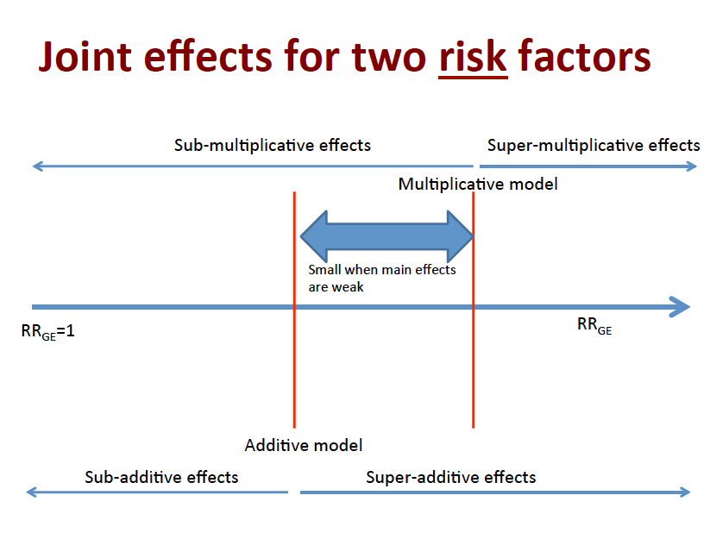
Notes:
If RR_{G+E-}≠1 and RR_{G-E+}≠1, then no interaction on one scale implies interaction on the other!
So different conclusions depending on the scale assumed (multiplicative vs. additive).

Slide 8
Factor V Leiden Mutations, Oral Contraceptive Use, and Venous Thrombosis
Strata
Cases
Controls
OR
G+E+: 34.7
G+E-: 6.9
G-E+: 3.7
G-E-: Reference
G+E+
25
2
OR _{Interaction (mult)}
= OR_{G+E+} / OR_{G+E-} OR_{G-E+}
= 34.7 / 6.9 x 3.7
= 1.4
OR _{Interaction (add)}
= OR_{G+E+} - OR_{G+E-} - OR_{G-E+} +1
= 34.7 - 6.9 - 3.7 +1
= 25.1
G+E-
10
4
G-E+
84
63
G-E-
36
100
Total 155 169
Vandenbroucke et al., The Lancet 1994

Slide 9
Testing for Multiplicative GxE Interactions
Logit(P(D=1|G,E,C))=α₀+ β_{G}G+ β_{E}E+ β_{GxE}GxE+β_{C}C
1 df test. H₀: β_{GxE} = 0.
2 df test. Joint null H₀: β_{G}= β_{GxE} = 0.
2 df often more powerful than 1 df test.

Slide 10
Why so few GxE Interactions detected?
Limited power.
Challenges measuring E (both for discovery and replication).
Model misspecification.
A number of approaches can increase power.
Notes:
Finally, the models that appear most powerful for detecting GxE interactions in simulation studies may not necessarily find the most interactions in real data. For example, the conventional case-control GxE design appears the least powerful in simulation studies; but in a recent study of colorectal cancer, this approach detected more of the GxE interactions than other putatively more powerful models. This counterintuitive observation may reflect limitations of the simulation studies’ applicability, or false positives in the colorectal study. Understanding what is underlying this conflicting result might help clarify the strengths and weaknesses of different methods for detecting GxE interactions.

Slide 11
2. G-E Interaction: Case-Only
Strata
Cases
Controls
Odds Ratio (OR)
ah / bg
ch / dg
eh / fg
1
G+E+
a
b
G+E-
c
d
G-E+
e
f
G-E-
g
h
OR _{Interaction} = OR_{G+E+} / OR_{G+E-} OR_{G-E+}
= ah/bg / (ch/dg) (eh/fg)
= (ag/ce) / (bh/df)
= ag/ce if no G-E assoc in controls (bh/df = 1).
Piegorsch et al., 1994
Notes:
Assume independence of G-E in source population.
Can’t look at main effects.
Can only look at multiplicative departures.

Slide 12
Case-Only Model
Logit(P(G=g|E,D=1)) = γ₀+ γ_{GxE}E
exp(γ_{GxE}) = GxE interaction effect
H₀: γ_{GxE} = 0.
Wald test asymptotically equivalent to H₀: β_{GxE} = 0 (assuming log-additive coding for g, 0,1,2).
If G-E are associated in source population, then can give high false positive rate.

Slide 13
Overview
Conventional approaches
Case-only GxE
Empirical-Bayes case-only / case-control
Two-step approaches

Slide 14
3. Empirical-Bayes GxE Test
Case-only more efficient than case-control, but can give biased results (e.g., if G-E assumption violated).
Use EB hybrid model to combine case-control and case-only approaches (bias versus efficiency trade-off).
β_{EB} = K(β_{GxE}) + (1-K)γ_{GxE}
where K=θ_{GE}²/(σ_{GxE}²+θ_{GE}²)
θ_{GE} = G-E association
If θ_{GE} ≠ 0 or if σ_{GxE}² is small, larger weight assigned to β_{GxE}.
If θ_{GE} = 0 (G-E independence), γ_{GxE} ≅ β_{GxE}, use γ_{GxE} (more efficient).
H₀: β_{EB} = 0. More power than case-control, helps control type I error from case-only.
Mukherjee and Chatterjee, 2008
Notes:
f there is G-E independence in the population (i.e. θgE=0), g_{gE} and b_{GxE} will be approximately equal, and one should favor the case-only estimate γgE for its increased efficiency. On the other hand, if the data provide evidence of gene-environment association via a value of θgE that is further from zero or if the variance of the standard case-control estimate is already very small (σGxE2→0), larger weight is assigned to βGxE.
The EB-Wald test provides power gain compared to standard case-control test and provides superior (although not perfect) control of Type 1 error compared to a case-only type test in the presence of population G-E association.

Slide 15
4. Two-Step GxE Tests
Step 1 screen: For each SNP, compute screening test statistic T₁ and corresponding p-value p₁.
Step 2 test: Prioritize SNPs based on p₁, and conduct GxE interaction test T₂ with corresponding p-value p₂.
Key requirement: T₁ and T₂ are independent.
Kooperberg and LeBlanc, 2008; Murcray et al., 2009; 2011; Hsu et al., 2012

Slide 16
Two Step GxE: Case-Control Data
Step 1:
Test for marginal D-G association
Logit(Pr(D=1 | G) = l₀ + l_{G}G, and/or
Test for E-G association
Logit(Pr(G | E) = d₀ + d_{E}E
Step 2:
Test for GxE interaction, only using SNPs passing Step 1 threshold (fewer comparisons).
Can use an E Bayes procedure here.
Additional info from Step 1 increases power by up to 50% over conventional approach.
Notes:
Three additional 2-step methods have been proposed, including H2 (22), Cocktail (20), and EDGE (19)

Slide 17
Hybrid 2-Step Approach
Step 1: test DG and EG.
Retain SNPs that pass at least one of these tests.
Step 2: Apply case-control analysis and test GxE, correcting for the number of SNPs retained from step 1.
Murcray et al., 2011;

Slide 18
Cocktail Method
Step 1: If p<threshold for EG, assign SNP that p.
Else, assign SNP from DG (marginal) analysis.
Step 2:
  If p from DG, then test for GxE using case-only model.
  If p from EG, then test GxE using case-control analysis.
  Use weighted hypothesis testing.
Hsu et al., 2012

Slide 19
EDGxE Approach
Step 1: combines the DG and EG tests into single 2 df test.
Step 2: weighted hypothesis testing of case-control analysis.
Gauderman et al., 2013

Slide 20
Power Gains for Two-step
Assume G has MAF = 0.3, and for E 30% exposed
exp(b_{G}) = exp(b_{E}) = 1.0, exp(b_{GxE}) = 1.5.
For a GWAS, 80% power (alpha = 0.05)
For conventional GxE model, N=10,060.
Two-step approaches:
  D-G screening, N=6,630
  E-G screening, N=4,472
  EDGE screening, N=3,994.

Slide 21
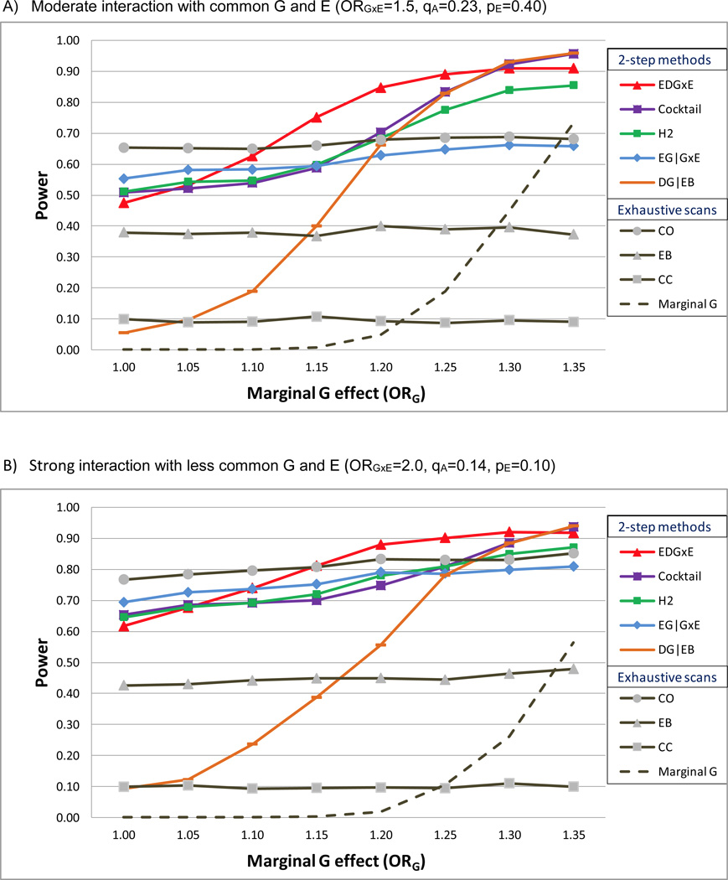
Comparison of GxE Tests
Gauderman et al., 2013

Slide 22
Gauderman et al., 2013

Slide 23
Step 2: Weighted hypothesis testing
Partition SNPs into groups, where higher ranked SNPs have less stringent alpha level.
B most significant SNPs in step 1 tested in step 2 at significance level (α/2)/B, next 2B at (α/4)/2B, next 4B at (α/8)/4B, etc.
Maintains overall GWAS alpha level, but uses larger alpha level for most promising interactions.
Ionita-Laza et al. 2007

Slide 24
GxE Software
Program | GxE | Case-only | EB | 2-Step | Additive models
PLINK | X
GxEScan | X | X |  | X
CGEN | X | X | X |  | X
Notes:
Combine with summary approaches.

Slide 25
II. Rare Variants
Previous GWAS focused on chips designed for MAF > 0.05 (most powered for MAF > 0.10)
Exome arrays
Sequencing (de novo)

Slide 26
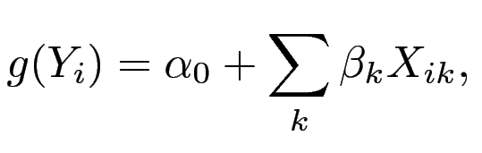
Analysis of Rare Variants
Focus on a set of k variants
Difficult to model due to sparsity.
Limited power.

Slide 27
Rare Variant Tests
‘Up-weight’ analyses for most likely causal variants.
Burden tests (CAST, Collapsing, WSS).
Variance component (dispersion) tests (SKAT, SKAT-O, C-alpha).
Burden tests more powerful when a large percentage of rare variants are causal and have the same sign (direction of association).
Variance component more powerful when there is a mixture of risk and protective variants, and most rare variants are not causal.

Slide 28
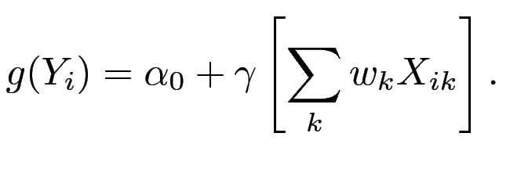
Burden Tests for Rare Variants
Where w_{k} defines similarities among the variants for their aggregation / modeling
Estimate the effect of a weighted summary ‘score’
across each individuals’ rare variants on outcome.

Slide 29
Key Aspect: Specifying w_{k}
where
  a_{k} inverse variance weighting, controls’ MAF
  s_{k} direction of association; positive / negative
  i_{k} Indicators for whether to aggregate
    Overall MAF
      Hard cutpoint (e.g., MAF < 0.01)
    Functional information
      Non-synonymous
      Deleterious (SIFT)

Slide 30
Example: Cohort Allelic Sums Test (CAST)
Aggregate rare variants within three genes
  a_{k} = 1
  s_{k} = 1
  i_{k} = 1 if rare, nonsynonymous
ABCa1, APOA1, or LCAT | >95% HDL | <5% HDL | OR (p-value)
No ns variants | 125 | 107 | 1.0
ns variants | 3 | 21 | 8.1 (1x10⁻⁴)
Cohen et al., Science 2004;305:869.
Morgenthaler Mut Res 2007;615:28.

Slide 31
Variance Components Approach
SNP-set (Sequence) Kernel Association Test (SKAT) (Wu et al., AJHG 2011).
Uses flexible weight kernels, which reflect different assumptions underlying the rare variant tests.
For example, that rarer variants have larger effect sizes.

Slide 32
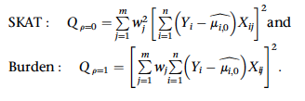
Test Stats for SKAT vs. Burden

Slide 33
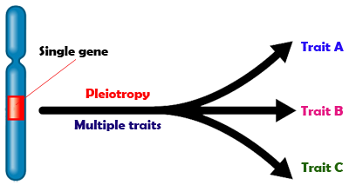
III. Pleiotropy
From Greek: Pleio (many) and tropic (affecting).
One gene, multiple traits.

Slide 34
Assessing Pleiotropy
1. Pleiotropy ‘look-ups’
2. Meta-analysis (ASSET)
3. Multiphenotype
4. Multilevel pleiotropy

Slide 35
1. Pleiotropy “Look-ups”
Prostate
Breast
Testicular
Melanoma
Colon
Bladder
Lung
Rectum
NHL
Ovary
Cancers
1 | 2 | ... | 100 | 101 | … | 1K | ... | 1M | …
Variants / SNPs

Slide 36
Pleiotropy “Look-ups”
Prostate
Breast
Testicular
Melanoma
Colon
Bladder
Lung
Rectum
NHL
Ovary
Cancers
1 | 2 | ... | 100 | 101 | … | 1K | ... | 1M | …
Variants / SNPs

Slide 37
Pleiotropy “Look-ups”
Prostate
Breast
Testicular
Melanoma
Colon
Bladder
Lung
Rectum
NHL
Ovary
Cancers
1 | 2 | ... | 100 | 101 | … | 1K | ... | 1M | …
Variants / SNPs

Slide 38
Pleiotropy “Look-ups”
Prostate
Breast
Testicular
Melanoma
Colon
Bladder
Lung
Rectum
NHL
Ovary
Cancers
1 | 2 | ... | 100 | 101 | … | 1K | ... | 1M | …
Variants / SNPs

Slide 39
Pleiotropy “Look-ups”
Prostate
Breast
Testicular
Melanoma
Colon
Bladder
Lung
Rectum
NHL
Ovary
Univariate analyses:
logit (Pr(Y=1|G, C)) = α + Gβ + Cγ
One-at-a-time for each SNP / cancer
β, P-values, FDR
Cancers
1 | 2 | ... | 100 | 101 | … | 1K | ... | 1M | …
Variants / SNPs

Slide 40
2. Meta-Analysis Approach
Prostate
Breast
Testicular
Melanoma
Colon
Bladder
Lung
Rectum
NHL
Ovary
Cancers
Single estimate of effect
1 | 2 | ... | 100 | 101 | … | 1K | ... | 1M | …
Variants / SNPs

Slide 41
ASSET
Cycle through different combinations of traits
and maximize meta-analysis test statistic.
Standard fixed-effects
Subset-based
where
where
Bhattacharjee et al. AJHG, 2012
Notes:
standard fixed-effects model: a powerful tool for combining distinct GWAS on a single trait
based on summary level data
weighted combination of the Z statistics
Cycle through different combinations of traits and maximizes meta-analysis test statistic.

Slide 42
3. Multiphenotype Approach
Prostate
Breast
Testicular
Melanoma
Colon
Bladder
Lung
Rectum
NHL
Ovary
Model all traits simultaneously.
Can be more:
  consistent with underlying biology;
  powerful than univariate.
Power gain due to:
  genetic correlations among traits;
  fewer tests.
Cancers
1 | 2 | ... | 100 | 101 | … | 1K | ... | 1M | …
Variants / SNPs

Slide 43
Multinomial Regression
logit (Pr(Y_{i}=1|G, C)) = α_{i} + G_{i}β_{i} + Cγ_{i}
Y is multivariate with dimension = # traits
Test different pleiotropic models by specifying assumptions about the β_{i}.

Slide 44
Null Model
Prostate
Breast
Testicular
Melanoma
Colon
Bladder
Lung
Rectum
NHL
Ovary
H₀: β₁=β₂=...=β_{k}=0
Cancers
1 | 2 | ... | 100 | 101 | … | 1K | ... | 1M | …
Variants / SNPs

Slide 45
Alternative Hypotheses
Prostate
Breast
Testicular
Melanoma
Colon
Bladder
Lung
Rectum
NHL
Ovary
At least one β_{i}≠0
Cancers
1 | 2 | ... | 100 | 101 | … | 1K | ... | 1M | …
Variants / SNPs

Slide 46
Alternative Hypotheses
Prostate
Breast
Testicular
Melanoma
Colon
Bladder
Lung
Rectum
NHL
Ovary
  All β_{I} are equal and non-zero
Cancers
1 | 2 | ... | 100 | 101 | … | 1K | ... | 1M | …
Variants / SNPs

Slide 47
Alternative Hypotheses
Prostate
Breast
Testicular
Melanoma
Colon
Bladder
Lung
Rectum
NHL
Ovary
  A pre-specified subset of β_{I} are non-zero.
Cancers
1 | 2 | ... | 100 | 101 | … | 1K | ... | 1M | …
Variants / SNPs
Notes:
What if we have different types of traits: binary, discrete, or continuous?

Slide 48
Alternative Hypotheses
Prostate
Breast
Testicular
Melanoma
Colon
Bladder
Lung
Rectum
NHL
Ovary
  All traits have different effects
Cancers
  What if we have different types of traits: binary, discrete, or continuous?
1 | 2 | ... | 100 | 101 | … | 1K | ... | 1M | …
Variants / SNPs

Slide 49
MultiPhen: ‘Inverse Regression’
…
1M
…
1K
…
101
100
…
2
1
Proportional odds logistic regression of genotype on cancers:
log (Pr(G>m|Y)/Pr(G≤m|Y)) = α_{m}+Y’β+Cγ
m = 0,1
Variants / SNPs
Prostate | Breast | Testicular | Melanoma | Colon | Bladder | Lung | Rectum | NHL | Ovary
Cancers
O'Reilly et al.,PLoS One 2012

