Slide 1
Ethics and Conflict of Interest in the Pharmaceutical Industry
Alexander Liede, MSc, PhD &
Anne Beaubrun, PhD
EPI 262 Course
UCSF Department of Epidemiology and Biostatistics
March 09, 2017
Notes:
Both

Slide 2
Opening Questions
What is ethics?
What does it mean to be ethical?
Notes:
AL
Ethics = a set of moral principles that govern a person's or group's behavior.
It is a shared, reflective examination of ethical issues
"Ethics has to do with what my feelings tell me is right or wrong.“ - A person following his or her feelings may recoil from doing what is right. In fact, feelings frequently deviate from what is ethical.
"Ethics has to do with my religious beliefs.“ - Religion can set high ethical standards and can provide intense motivations for ethical behavior. Ethics, however, cannot be confined to religion nor is it the same as religion.
"Being ethical is doing what the law requires.“ - Being ethical is also not the same as following the law.
"Ethics consists of the standards of behavior our society accepts.“ - standards of behavior in society can deviate from what is ethical. An entire society can become ethically corrupt. Nazi Germany is a good example of a morally corrupt society.
"I don't know what the word means."
These replies might be typical of our own. The meaning of "ethics" is hard to pin down, and the views many people have about ethics are shaky.
Ethics is two things.
First, ethics refers to well-founded standards of right and wrong that prescribe what humans ought to do, usually in terms of rights, obligations, benefits to society, fairness, or specific virtues. Ethics, for example, refers to those standards that impose the reasonable obligations to refrain from rape, stealing, murder, assault, slander, and fraud. Ethical standards also include those that enjoin virtues of honesty, compassion, and loyalty. And, ethical standards include standards relating to rights, such as the right to life, the right to freedom from injury, and the right to privacy. Such standards are adequate standards of ethics because they are supported by consistent and well-founded reasons.
Secondly, ethics refers to the study and development of one's ethical standards.

Slide 3
What’s wrong with these definitions?
“Ethics has to do with what my feelings tell me is right or wrong.”
“Ethics has to do with my religious beliefs.”
“Being ethical is doing what the law requires.”
“Ethics consists of the standards of behavior our society accepts.”
Notes:
AL

Slide 4
What is ethics?
A set of moral principles that govern a person's or group's behavior
Ethics is the systematic study of moral choices
It is a shared, reflective examination of ethical issues
Notes:
AL

Slide 5
Ethics and Conflict of Interest in the Pharmaceutical Industry
Equipoise
Authorship
Conflict of interest
Notes:
AL

Slide 6
Equipoise
Equipoise is the state of being balanced or in equilibrium, meaning that there is genuine uncertainty in the expert medical community over whether a treatment will be beneficial
Relevant to randomized clinical trials, which should only be considered when there is genuine uncertainty about which treatment would benefit patients’ most
Many gray areas
  Definition of genuine uncertainty
  Research involving “standard of care”
  Research in lesser developed countries
Notes:
AL
Clinical equipoise, also known as the principle of equipoise, provides the ethical basis for medical research that involves assigning patients to different treatment arms of a clinical trial.
Equipoise means that there is genuine uncertainty in the expert medical community over whether a treatment will be beneficial

Slide 7
Ghostwriting
How I was asked to “author”
a ghostwritten research paper
By Adriane Fugh-Berman
Thursday April 21, 2005
The Guardian Newspaper
Recently, the House of Commons health select committee looked at the submission of ghostwritten articles to medical journals. Witnesses from two pharmaceutical groups, GlaxoSmithKline and AstraZeneca, "strongly denied that ghostwriting was practised in their respective companies". But such work can be hired out. Last summer, I was asked by RxComms, a British medical communication company, to author a review of interactions between herbs and warfarin (a generic anticoagulant prescribed to prevent strokes or blood clots). Well, not "author", exactly. The usual practice is for a complete article to be supplied; all I would have to do was review it and sign it off.
Notes:
AL

Slide 8
Author Shifting
Shifting is more problematic than ghostwriting
Solutions:
  Develop an explicit publication process that includes following ICMJE uniform guidelines
  Gain agreement on order of authorship early in project
  Work only with trusted academic colleagues who have a publication clause in their contracts
Notes:
AL

Slide 9
International Committee of Medical Journal Editors (ICMJE) Guidelines
Authorship credit should be based on 4 criteria:
  Substantial contributions to the conception or design of the work; or the acquisition, analysis, or interpretation of data for the work; AND
  Drafting the work or revising it critically for important intellectual content; AND
  Final approval of the version to be published; AND
  Agreement to be accountable for all aspects of the work in ensuring that questions related to the accuracy or integrity of any part of the work are appropriately investigated and resolved.
Acquisition of funding, collection of data, or general supervision of the research group alone does not constitute authorship
Ref: Defining the Role of Authors and Contributors – ICMJE
Notes:
AL

Slide 10
Case Study: Authorship Credit
Samuel, a 2nd year graduate student at “M” University was outraged when he discovered that his name had been left off the penultimate draft of a journal article which he had worked hard at for the last year
He helped design the experimental approach and even collected some of the initial data. “I was promised the 2nd author slot,” complained Samuel. “I don’t know what happened. Maybe Professor Honest forgot, or something, but I barely made it on as fourth author after I complained.”
Samuel knew of other grad students that were collaborating with Prof. Honest on the project, but two of the co-authors listed on the final draft were added at the last minute. One was a graduate student just finishing up her degree. She was given 2nd authorship. The other was a professor who Samuel suspects did nothing except provide reagents for the experiment.
Ref: http://155.97.32.9/~bbenham/Phil%207570%20Website/pdfs-Authorship/csAuthorship-Fall08.pdf
Notes:
AB

Slide 11
Case Study: Authorship Credit Discussion Questions
Is Samuel justified in being upset about his place in the list of authors? What legitimate reasons might Prof. Honest have for demoting Samuel from second to fourth author?
If Samuel’s suspicions about the graduate student and the professor added to the paper are true, is this an appropriate use of authorship? Whose responsibility is it to determine authorship on this paper?
Did Samuel do the right thing in complaining to Prof. Honest? How would you have handled it if you were in the same position as Samuel?
Notes:
AB

Slide 12
Conflict of Interest
Show me the money!
Thomas Kuhn on objectivity
Why focus on financial interests?
Does the focus on financial interests detract from scientific evaluation?
How best to deal with conflicts?
Notes:
AL

Slide 13
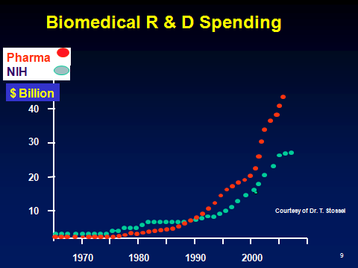
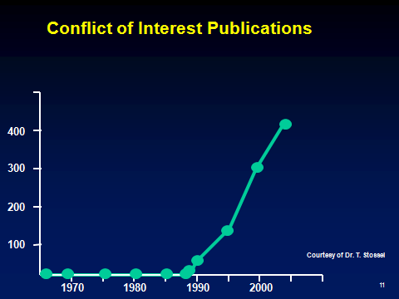
Show Me the Money!
Notes:
AL

Slide 14
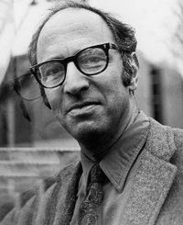
Thomas Kuhn: The Challenge of Scientific Objectivity
American physicist, historian and philosopher of science, proposed the notion that scientific truth, at any given moment, cannot be established solely upon “objectivity” but is defined by a consensus of a scientific community
A scientist’s worldview influences what he or she researches and how results are interpreted
Science must account for subjective perspectives, since all objective conclusions are ultimately founded upon the subjective conditioning and the worldview of its researchers and participants
This worldview may undergo periodic “paradigm shifts”, opening up new approaches to understanding what scientists would never have considered valid before
Thomas Kuhn (1922-1996)
Notes:
AL

Slide 15
Different types of interests may present conflict
Financial
  Personal reward
  Research funding
Sociopolitical & ideological
  Environmentalism
Professional
  Status
Ref: Horton R. Conflicts of interest in clinical research: opprobrium or obsession. Lancet 1997; 349:1112-3.
Notes:
AL

Slide 16
The Three Fallacies
Scientific writing can be free from biases
Financial conflicts cause the most concern
Disclosure heals the wound inflicted by a financial conflict
Ref: Horton R. Conflicts of interest in clinical research: opprobrium or obsession. Lancet 1997; 349:1112-3.
Notes:
AL

Slide 17
Why focus on financial conflicts of interest?
“Conflict-of-interest rules usually focus on financial gain, not because it is more pernicious than other secondary interests, but because it is more objective and more fungible.… Just because we cannot do much about other secondary interests, it does not follow that we should do little about financial gain”
Environmental and social activism are popular (acceptable?) special interests; financial interests are not
Since epidemiology is a science, shouldn’t all interests be treated as critically as possible?
Is it true that we can’t do much about other secondary interests?
Ref: Thompson DF. NEJM 1993;329:573-6
Notes:
AL

Slide 18
Preference: An expression of conflict of interest
Preference refers to the state of being preferred… the act, fact, or principle of giving advantages to some over others
Some of the criticism expressed over Erin Brockowich’s appearance as the keynote speaker at the American Public Health Association (APHA) 2004 conference stems from the preference she assigned to certain scientific evidence
Ref: Merriam-Webster Online Dictionary. www.m-w.com
Notes:
AL

Slide 19
Does the focus on financial conflicts hinder scientific evaluation?
“We, like many others, give most credence to papers published in reputable journals by academics working in ‘Institutes of Excellence’. The credibility rating goes down when a project is funded by a drug company that has an interest in its outcome.”
Ref: Raveendran R, Gitanjali B. Letter to the Editor. Lancet 1997:349:1173-4.
Notes:
AL

Slide 20
Are we developing a caste system in clinical epidemiology research?
“Under the new Policy, ASCO will not accept an abstract or paper describing company-funded original research if the first, last, or corresponding author has been the Company’s employee, investor, or paid speaker during the previous 2 years.”
ASCO 2013. American Society of Clinical Oncology Policy for Relationships with Companies: Background and Rationale. J Clin Oncol Published Ahead of Print on April 22, 2013 as 10.1200/JCO.2013.49.4997
Notes:
AL

Slide 21
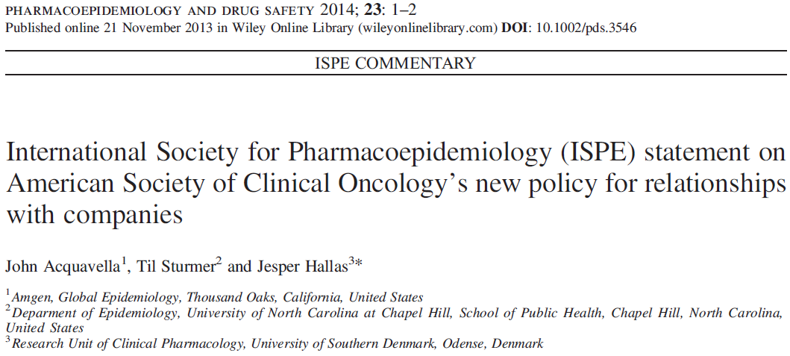
Response
Notes:
AL

Slide 22
ASCO Reconsiders its Policy
“ASCO leadership has carefully considered the concerns expressed by the biomedical community regarding the author restrictions in the 2013 COI policy and has decided to suspend enforcement of these restrictions for a period of at least 3 years.”
ASCO 2014. The Changing Landscape of Conflict of Interest Supports Further Study of American Society of Clinical Oncology Authorship Restrictions for Research Studies J Clin Oncol: Published Ahead of Print on February 10, 2014 as 10.1200/JCO.2014.55.4006
Notes:
AL

Slide 23
“Conflict of interest. The New McCarthyism in Science”
“The objectivity of the [scientific] process depends on each contribution receiving its due regard, whatever the motivations for bringing it. It depends on judging a work on its merits, rather than on the inferred state of mind of the author.”
Ken J. Rothman
Ref: Rothman KJ. JAMA 1993; 269:2782-4, p 2783
Notes:
AL

Slide 24
When You Are Looking for Jobs… Ask the Right Questions
How do you limit commercial influence on epidemiologic research? Specifically, does research get published regardless of outcome?
Do you have any examples of early career epidemiologists as first authors on published papers?
Notes:
AL

Slide 25
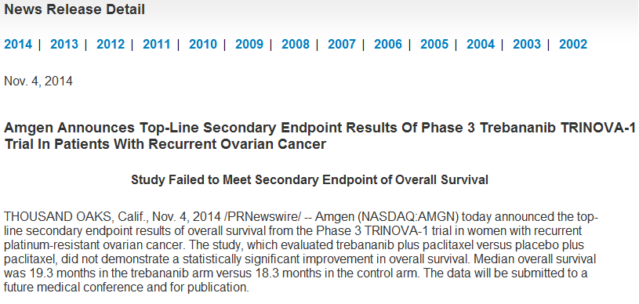
Sometimes Priorities Change
Ongoing epidemiology studies in ovarian cancer
Ethical commitment to complete work, often represent academic collaborations (publication)
Notes:
AL

Slide 26
Beware of your own biases, and lead by example
Judge on merit, not on presumed conflict of interest
Advocate a more balanced perspective on conflict of interest
Engage financial and other interests to live up to highest standards of our profession
Help clean up irregularities that exist (e.g., ghostwriting, author shifting)
Notes:
AL

Slide 27
Beware of Scientific vs Sponsor Interests
All sponsors have an interest in the outcome
Beware that you can be influenced
Only get involved in projects where the scientific issue is clear and can be pre-specified in a protocol. Consider sponsor input at protocol stage.
Be clear with the sponsor on the strengths and limitations of the proposed research
Insist on appropriate publication language in contracts
Consider sponsor suggestions and accept only those that make scientific sense
Notes:
AL

Slide 28
Top Ten Misbehaviors by Scientists
Falsifying or ‘cooking’ research data.
Ignoring major aspects of human-subject requirements.
Not properly disclosing involvement in firms whose products are based on one’s own research.
Relationships with students, research subjects or clients that may be interpreted as questionable.
Using another’s ideas without obtaining permission or giving due credit.
Unauthorized use of confidential information in connection with one’s own research.
Failing to present data that contradict one’s own previous research.
Circumventing certain minor aspects of human-subject requirements.
Overlooking others’ use of flawed data or questionable interpretation of data.
Changing the design, methodology or results of a study in response to pressure from a funding source.
Ref: Martinson, Anderson, & deVries, 2005, p. 737
Notes:
AL

Slide 29
Potential Causes of Scientist Misconduct
Pressure for professional advancement
  Pressure to gain promotion and tenure
Ease of intentionally reporting inaccurate, incomplete, or more positive results
Failure to engage in rigorous academic research
Rationalization that everyone else does it
Belief that no one will ever find out about it
Claim that an unintentional or careless error was made rather than misconduct
Ref: Lumpkin, A from the University of Kansas. Presentation entitled “Responsible Conduct in Research — Standards and Expectations for Ethical Conduct .”
Notes:
AB

Slide 30
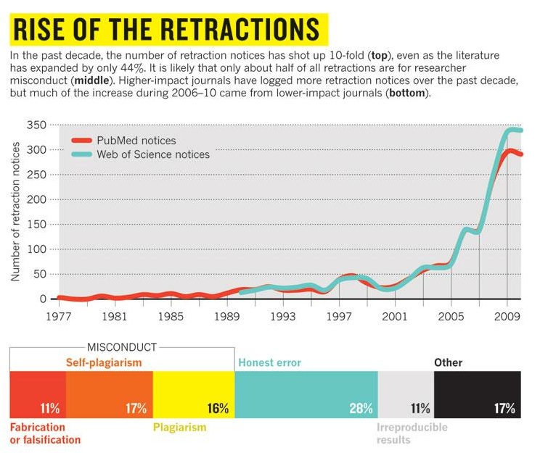
Ref: Van Noorden, R. (2011). Science publishing: The trouble with retractions. Nature, 478:26-8.
Notes:
AB

Slide 31
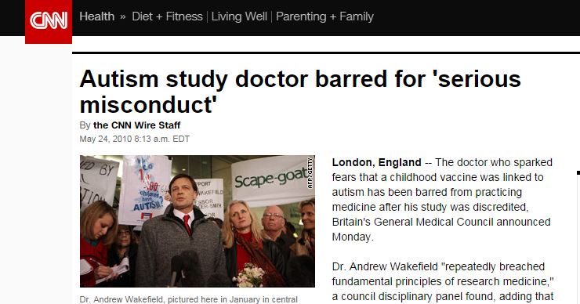
Wakefield: Vaccination & Autism
Andrew Wakefield Lancet’s paper (1998):
  Temporal relation between chronic gastro-intestinal disease and autism, and MMR vaccination.
Notes:
AB

Slide 32
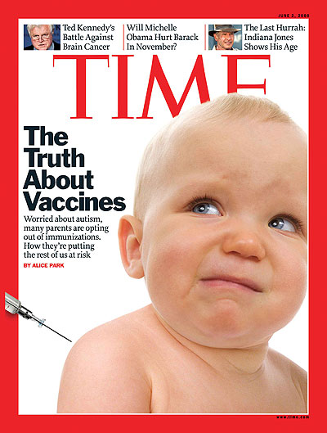
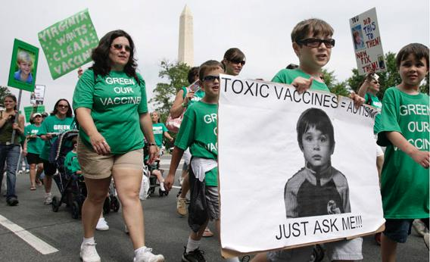
Wakefield: Media & Public Health Fall Out
Wakefield spawned large anti-vaccination movement
  MMR vaccination rates in UK drop from 80% to 62%
Notes:
AB

Slide 33
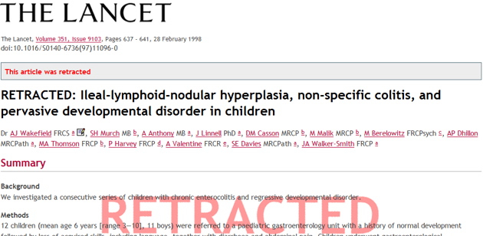
Wakefield: Ethical Issues
Study found to contain falsified data and tainted by conflicts of interest
Wakefield’s recruitment practices were called into question
Wakefield’s reported results have not been replicated by other investigators, despite several attempts
Notes:
AB
Although vaccination rates in the United Kingdom have recovered slightly from their 80% low in 2003-4,19 they are still below the 95% level recommended by the World Health Organization to ensure herd immunity. In 2008, for the first time in 14 years, measles was declared endemic in England and Wales.20 Hundreds of thousands of children in the UK are currently unprotected as a result of the scare, and the battle to restore parents’ trust in the vaccine is ongoing.
Further investigation with regard to the reasons for the consistent falsification of results evident in the Wakefield piece revealed that the principal investigator was involved in a lawsuit centering on the MMR vaccine, involvement for which he had received payment—a clear and undisclosed conflict of interest

Slide 34
Case Study: Wakefield Discussion Questions [1]
In what ways do news or advocacy groups or social networks communicate scientific results differently from the scientific literature?
To what extent are authors of research papers and other scientists responsible for the eventual public dissemination of messages derived from the primary studies and publications?
Do you think the scientific literature is self-correcting?
Notes:
AB

Slide 35
Case Study: Wakefield Discussion Questions [2]
Exercise: 3 volunteers defend 3 different positions
Approaches to encouraging vaccination:
  Education and Encouragement—Parents receive information about the importance of vaccination. It is left to parents to decide what is best for their children
  Make Vaccinations a Legal Requirement but Allow Parents to Opt Out—All 50 states allow exemption if an individual is medically unable to be vaccinated, 47 states allow exemptions for religious reasons, and 19 states for philosophical reasons
  Tighten Vaccine Requirements—Only allow vaccine exemptions for medical (or medical and religious) reasons
Notes:
AB

Slide 36
Retraction: Riken Center for Developmental Biology in Kobe, Japan
Researcher, Haruko Obokata, published 2 papers in Nature with colleagues both in Japan and in the U.S. claiming to describe a surprising new way to generate stem cells from already developed cells.
  The process, stimulus-triggered activation of pluripotency (STAP), proposed that either with an acidic solution or with physical force, mouse cells could turn back the clock on their development and revert back to an earlier stem-cell stage.
After other researchers could not replicate the results, there was a call for 2 papers to be retracted.
  Discrepancies and irregularities in the images of the stem cells published in the papers were observed, and the Riken committee concluded that some of the images were enhanced or falsified to improve the result
Not the first time that falsified data has plagued the stem-cell field.
  In 2006, South Korean veterinary scientist Hwang Woo-suk claimed to have successfully used the cloning technique on human cells to generate patient-specific stem cells, but it later emerged that the stem cells came from already existing embryos.
Notes:
AB/AL

Slide 37
Discussion
Any ethical dilemmas you (or someone you know – wink wink) are currently facing or have faced in the past?
Notes:
AB

Slide 38
Perspectives in Bioethics
Notes:
AB

Slide 39
Perspectives in Bioethics
Historical Context: Protection of human subjects
Case studies
Ethical Dilemmas in the Digital Age: New technologies posing new challenges
Notes:
AB

Slide 40
What is Bioethics?
The study of ethics or ethical implications of biological research and its applications, especially in medicine. It is a shared, reflective examination of ethical issues in healthcare, health science, and health policy.
For example, ethical debate often ensues with technological advances
Ethical decision-making requires respect for individual rights, neutrality, and concern for the consequences of intended actions
The moral basis for choices in biomedical research relies on the four guiding principles of bioethics:
  Autonomy
  Justice
  Beneficence
  Nonmaleficence
Notes:
AB

Slide 41
Laws to Protect Human Subjects: The Nuremberg Code
A Turning Point in Bioethics
1947 – Nuremberg Code established as part of the Nuremberg trials after World War II, specifically related to the violation of rights of human subjects as part of medical experiments during Nazi Germany
First document to specify ethical principles that should guide medical staff engaged in human research
Set the standard for the protection of human subjects in medical research
Did not have the strength of law, it was created post hoc, and it applied to only non-therapeutic human subjects research
Notes:
AB

Slide 42
The Declaration of Helsinki (1964)
Ethical principles re: human experimentation developed for the medical community by the World Medical Association (WMA).
  The Declaration more specifically addressed clinical research, and set the stage for the implementation of the Institutional Review Board (IRB) process
  “Biomedical research cannot be legitimately carried out unless the importance and objective is in proportion to the inherent risk to the subject.”
  Regarded as the cornerstone document of human research ethics, and continually revised (6th revision 2007-2008)
  FDA issued a final decision to replace the Declaration of Helsinki with Good Clinical Practice (GCP) effective October 2008
    GCP is an international quality standard that is provided by International Conference on Harmonisation (ICH), an international body that defines standards, which governments can transpose into regulations for clinical trials involving human subjects
  Each country may also have local regulations; Common Rule, Tri-Council Policy Statement in Canada, CIOMS, Nuffield Council (UK) and UNESCO
  There are a number of available tools which compare these--e.g., "Comparison of Common Rule with the Declaration of Helsinki and Good Clinical Practice". 2012.
Notes:
AB

Slide 43
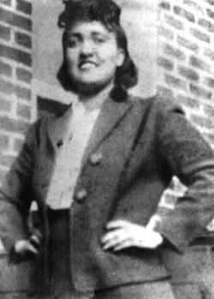
Lacks: Mother of Modern Medicine
Standard diagnostic test reveals cervical cancer (1951)
Cancer cells are removed for research purposes without consent
George Gey created the first immortal cell line, and they were widely shared
Creation of the cell line generated an increase in medical and biological research, including a vaccine for polio, cancer research, AIDS research, among others
The identity of Henrietta Lacks remained confidential until the 1970s
After her identity was known, the family found out for the first time that Henrietta Lack’s cells were still “alive.”
The family was approached to give blood for research
The Lacks family did not have access to health care
Henrietta Lacks 1920-1951
Ref: Ruiz J and Bell K. Presentation entitled “Research Ethics and Research Involving Humans”
Notes:
AB
How many people have seen these cells??
Has anyone used them in research or class labs etc.?
How many people know the story behind them?
Henrietta Lacks was born into a black working class family in 1920 in Virginia. She had 5 children.
Story recently popularized with the publication of The Immortal Life of Henrietta Lacks by Rebecca Skloot

Slide 44
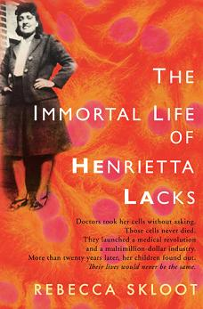

Lacks: Bioethics in Popular Science
http://ew.com/tv/2016/12/22/oprah-winfrey-hbo-henrietta-lacks-movie/
Notes:
AB

Slide 45
Case Study: HeLa Discussion Questions
What are the ethical issues?
Consent
Individual benefit versus societal benefit
Confidentiality
Commercialization
Notes:
AB
-Consent – common practice in the 1950s to take tissue samples for research without consent (still common but there is regulatory oversight that governs this)
-Do you think that it was “wrong” to take the cancer cells without consent. Would this same situation bother you.
-Individual rights versus Public benefit
-What benefits did society get - research and development, advances in healthcare (From R. Skloot without tissue research “we would have no tests for diseases like hepatitis and HIV; no vaccines for rabies, smallpox, measles; none of the promising new drugs for leukemia, breast cancer, colon cancer.” The list goes on….
-What benefits did Henrietta Lacks – What could have the benefits been: contributing to research
-Confidentiality: George Gey strongly believed in confidentiality so Henrietta Lack’s identity did not come out until after he died. Impact on the family once it did come out.
-Money – Henrietta Lack’s family cannot even access healthcare? Not sharing in the benefits of the research. Who should benefit?
Rebecca Skloot The Immortal Like of Henrietta Lacks

Slide 46
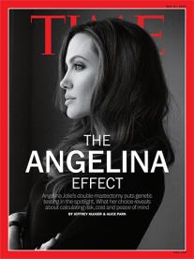
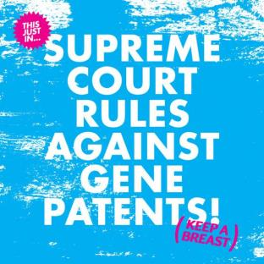
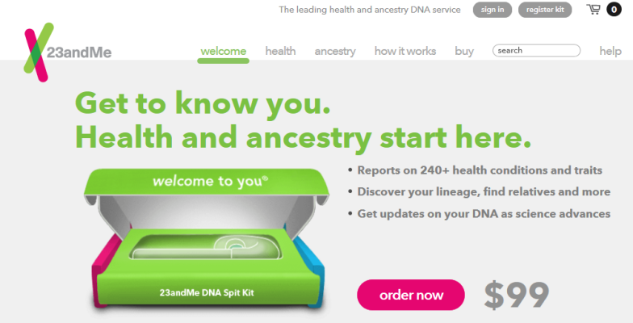
Some ethical debates related to patent laws and genetic testing have been reignited
May 2013: Increased referrals to genetics clinics
November 2013: FDA warning letter related to accuracy and standards Personal Genome Service
June 2013: “A naturally occurring DNA segment is a product of nature and not patent eligible merely because it has been isolated”
Notes:
AL

Slide 47
Cost of Genetic Sequencing Has Dramatically Declined and is Expected to Continue to Decline
Cost per whole genome
Forecast: full genome sequence
at $200 per test by 2020
$4,200¹
Next-generation sequencing technologies become available
$1,500
2005
2010
2015
2020
Note: Costs assume 30x coverage for NGS, 6x coverage for Sanger and includes the following 'production' costs are accounted for: 1) Labor, administration, management, utilities, reagents, and consumables 2) Sequencing instruments and other large equipment (amortized over three years) 3) Informatics activities directly related to sequence production (e.g., laboratory information management systems and initial data processing) 4) Submission of data to a public database
1. From genome.gov (http://www.genome.gov/sequencingcosts/), Dewey F E et al. Circulation 2012;125:931-944, American Heart Association, NHGRI Daily finance (2012), Life Tech investor announcements
Notes:
AL

Slide 48

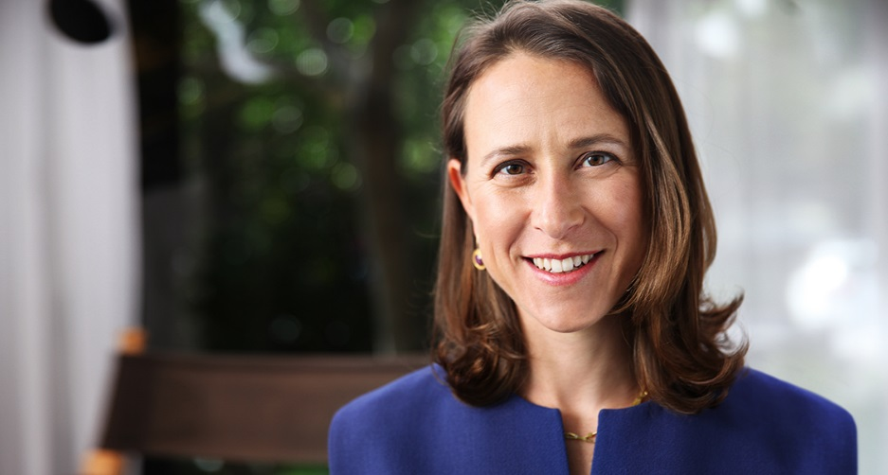
FDA versus 23andMe
November 25, 2013: Warning letter issued on the accuracy and standards of test results
  Of greatest concern was testing for mutations in genes linked to hereditary breast and ovarian cancer, stating that a false positive could lead to an unnecessary preventive mastectomy
    Genetic testing for breast cancer risk is one example where guidance from doctors and genetic counselors is warranted, and offering these results directly to consumers is of concern
Class-action suit followed
More controversies on privacy:
“1 step forward, 23 steps back”
Will my data be sold to Google?
  Expansion to UK sparks privacy concerns
Notes:
AL

Slide 49
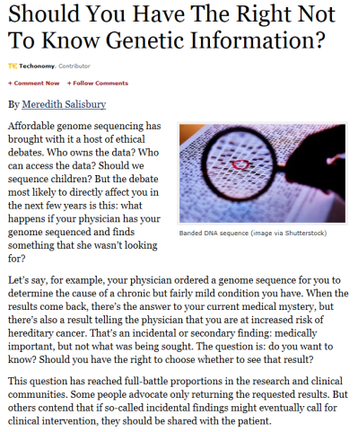
Patient Autonomy and the Right Not to Know
November 2013: American College of Medical Genetics and Genomics (ACMG) recommendation that 57 genes should be evaluated any time a physician orders a genetic test
  Genes related to diseases such as Alzheimer’s or Huntington’s, with no known medical treatment, are not on the list
  Genes linked to hereditary breast and ovarian cancer are among the selected 57
“Duty to hunt” caused heated debate at the American Society of Human Genetics (ASHG) 2013 meeting
Forbes.com 11/05/2013
Notes:
AL

Slide 50
Case Study: Genetic Counseling Issues (Family)
Family involvement
  For accurate risk assessment or testing
  Communicating results
Confirmation of a “cancer gene” in family
Insurance concerns
Expectations of family members
  Family members may or may not wish to have testing or share results
  Strategy to inform relatives
What about the right not to know?
Genetic guilt
Ethical concern: patient autonomy, right not to know
BRCA2 family from the Philippines in De Leon Matsuda et al. Intl J Cancer 2002 98:596-603
Notes:
AL

Slide 51
Women with a BRCA1 Mutation may opt for surgery, chemoprevention, or surveillance
Angelina Jolie underwent risk-reducing bilateral mastectomy at 37
Mother, Marcheline Bertrand, died of ovarian cancer age 56
In 2015, underwent prophylactic bilateral salpingo oophorectomy to reduce her risk of ovarian cancer
Women with a sister or mother with breast or ovarian cancer are significantly more likely to have prophylactic surgical procedures¹
Only 11% of Jewish women who underwent population genetic testing in Canada had bilateral mastectomy within 2 years, and 90% had oophorectomy³
Risk reducing options chosen by 2,677 BRCA1/2 mutation carriers (2,051 BRCA1)²
Option | Israel | Norway | Poland | Italy | Austria | Canada | France | Netherlands | US
Mastectomy* | 4% | 4% | 3% | 10% | 20% | 22% | 25% | 33% | 36%
Oophorectomy | 67% | 74% | 35% | 50% | 52% | 57% | 71% | 64% | 71%
Tamoxifen or raloxifene* | 11% | 0% | 6% | 0% | 5% | 10% | 0% | 0% | 12%
Any risk-reducing measure (above)* | 57% | 68% | 26% | 40% | 40% | 59% | 75% | 56% | 72%
Mammography | 96% | 93% | 66% | 100% | 100% | 97% | 100% | 100% | 98%
MRI | 2% | 14% | 7% | 72% | 65% | 48% | 67% | 95% | 24%
*among women without breast cancer
Metcalfe et al. Clin Genet. 2008;73(5):474-9.
Metcalfe et al. Int J Cancer. 2008; 122(9):2017–22.
Metcalfe et al. Breast Cancer Res Treat. 2012;133(2):735-40. n=19, mean age 46 yrs (28–67 yrs).
Notes:
AL
Relative to last year, the SRE market growth is flat or -1%. Another milestone was over 100,000 patients treated with XGEVA by 2013. However, the brand team plan anticipated about a 30% growth in SRE market and now CfOR and GHE are working to help provide a better understanding of the proportion of bone mets patients that remain untreated. To better understand the drivers and barriers of prescribing bone modifying agents to prevent skeletal complications.

Slide 52

Gilda Radner Ovarian Cancer Detection Program
Women at risk of ovarian cancer in Los Angeles (n>1,600); family history
Followed at Cedars-Sinai for 10 years (1991-2001)
  Free surveillance with CA125, TVS, color Doppler
8 incident ovarian cancers
Study cohort:
  Ashkenazi Jewish; 290 eligibile
  Informed consent obtained and genetic counseling; n=213 (73.4%) tested in 1998
Results: 16% BRCA-positive
  31 BRCA1
  2 BRCA2 mutation carriers
Gilda Radner (1946-1989)
Ref: Liede et al. J Clin Oncol 2002 20(6):1570-1577
Notes:
AL
From the follow-up of ten years available on this cohort of women, I was able to calculated the cumulative risk of cancer for BRCA1 mutation carriers versus non-carriers. You may recall that all these women were “healthy” at the start of the program. Women were censored if they were diagnosed with cancer, died, or at the date of their last appointment or date of oophorectomy for Kaplan-Meier survival analysis.
43 women had prophylactic oophorectomy.
Because we tested 100% of women who developed cancer and only 72% of women who did not develop cancer. We reduced or adjusted our estimates by 24%.

Slide 53
Ethical Debate: Decision to disband program
Bottom Line: Screening failed to detect early-stage ovarian cancers
All women who developed ovarian cancers were stage IIIc, and were BRCA1 185delAG mutation carriers
  One stage Ic ovarian cancer identified, in a non-carrier
  Risk of cancer in non-carriers <3% in ten years
Program redesigned to focus on BRCA1/2 mutation carriers 2002
BRCA1 carriers
Cumulative risk at 10 years:
28% ovarian cancer
21% (adjusted)
P < 10⁻⁶
Non-carriers
Time since entry to program (years)
Ref: Liede et al. J Clin Oncol 2002 20(6):1570-1577
Notes:
AL
The Gilda Radner Program allowed us to conduct the first prospective study on BRCA1 or BRCA2 mutation carriers.
We observed that….
Implications for surgical prevention of ovarian cancer - how do we reduce the risk of peritoneal cancer in carriers.

Slide 54
Perspectives in Big Data
Notes:
AL

Slide 55
Digital technologies to bring forward patient voice
“Digital Medicine was made for Learning Health Systems and Adaptive Studies” Ahmed Albaiti, CEO, Medullan
RCTs are changing, and rightly so
Conventional RCT costs not sustainable, populations under study are not representative
  Rise of adaptive, patient-centric clinical studies = new gold standard
  RWD, big data needed for analytics and for planning patient-centered research
  Current CRO model will be destroyed in 5-10 years
Patients → consumers
  Social media – e.g., Facebook community for rare disease recruiting 100+ per week… n=2900 (high capture, retention lower)
Patient retention → patient relationships
Notes:
AL

Slide 56
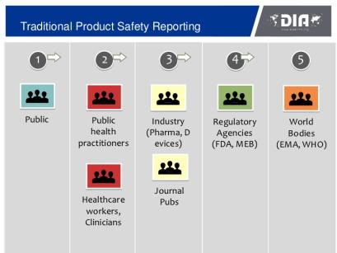
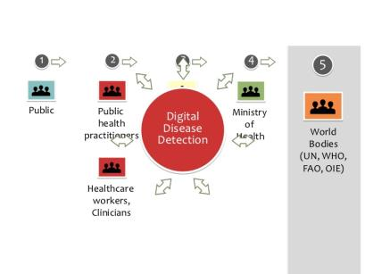
Where Social Media holds promise…
169M US adults (72% of all adults) went online to research a health question in 2010, compared with 63M in 2002
80% of serious AEs are reported by pharmaceutical companies
Notes:
AL

Slide 57
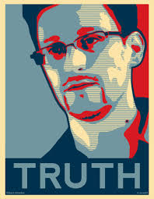
Big Data Poses New Challenges
Citizens with a conscience are not going to ignore wrong-doing simply because they'll be destroyed for it: the conscience forbids it.
From Wikipedia, accessed 8/22/14
Notes:
AL

Slide 58

Facebook T3 Study: “But the Data is Already Public”
In 2008, researchers publicly released data from Facebook accounts of college student cohort
Tastes, Ties, and Time (T3) research project sought to understand social network dynamics of large groups of students
“All the data is cleaned so you can’t connect anyone to an identity”
  While names, birthdates, and e-mails were removed…
  Various other potentially “identifying” information remained
    Ethnicity, home country/state, major, etc
Zimmer, Michael. "“But the data is already public”: on the ethics of research in Facebook." Ethics and information technology 12.4 (2010): 313-325.
Notes:
AB

Slide 59
Facebook T3 Study: Ethical Considerations [1]
Privacy
  Presumption that because subjects make information available on Facebook/Twitter, they don’t have an expectation of privacy
  Ignores contextual nature of sharing
  Ignores whether users really understand their privacy settings
Anonymity vs. Identifiability
  Presumption that stripping names & other obvious identifiers provides anonymity
  Ignores how anything can identifiable and become the “missing link” to re-identify an entire dataset
Zimmer, Michael. "“But the data is already public”: on the ethics of research in Facebook." Ethics and information technology 12.4 (2010): 313-325.
Notes:
AB

Slide 60
Facebook T3 Study: Ethical Considerations [2]
Consent
  Presumption that because something is made visible on Facebook/Twitter the subject is consenting to it being harvested for research
  Ignores how research method might allow un-anticipated access to data meant to be restricted
Harm
  Researchers imply “already public, what harm could happen”
  Ignores dignity & autonomy, let alone unanticipated consequences
Zimmer, Michael. "“But the data is already public”: on the ethics of research in Facebook." Ethics and information technology 12.4 (2010): 313-325.
Notes:
AB

Slide 61
Case Study: Facebook T3 Study Discussion Questions
Consent
  What do we mean by “consent” when it comes to using “publicly” available content
Harm
  Must a “wrong” occur for there to be damage to the subject?
  Do subjects deserve control over the use of their data streams?
Zimmer, Michael. "“But the data is already public”: on the ethics of research in Facebook." Ethics and information technology 12.4 (2010): 313-325.
Notes:
AB

Slide 62
Health Insurance Portability and Accountability Act (HIPAA) of 1996
Protects health insurance coverage for workers and their families when they change or lose their jobs.
Administrative Simplification (AS) provision requires the establishment of national standards for electronic health care transactions and national identifiers for providers, health insurance plans, and employers.
Right to privacy to individuals from age 12-18.
  The provider must have a signed disclosure from the affected before giving out any information on provided health care to anyone, including parents.
  Research can be exempt from HIPAA’s Privacy Rule; HIPAA’s Privacy Rule only applies to personal health information (PHI) gathered by or from covered entities
Notes:
AL

Slide 63
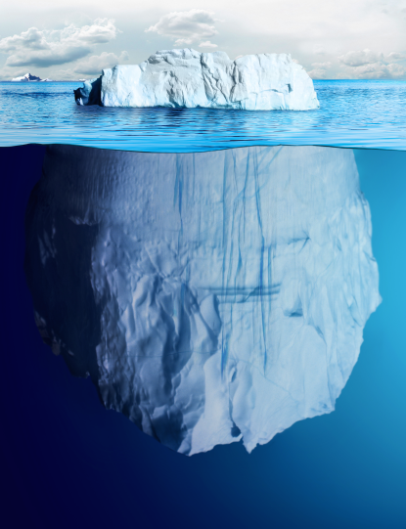
HIPAA and Privacy Challenge: Much of the EMR Data Remains Untapped
EMR research to date
Structured data
(e.g., demographics, stage, diagnosis)
There’s more to EMR
Unstructured data
(e.g., pathology, stage, biomarkers, physician notes)
Notes:
AL

Slide 64


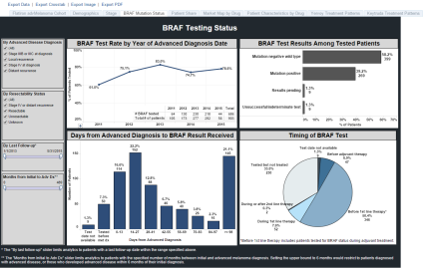
Is our Personal Health Information Protected?
How do we go from here?
(site of care)
To here?
(electronic data)
To here?
(research use)
Electronic Database
Notes:
AL

Slide 65

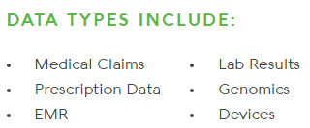


We can merge data systems
  GENOTYPE
  Exome sequencing
  PHENOTYPE (RWD)
Research data set
HIPAA-compliant data de-identification and encryption in storage and in transit
Notes:
AL

Slide 66
In Scandinavia, patient SSN can be used to link across National Databases
specimens
Access to patient data is governed by the Danish Data Protection Agency: http://www.datatilsynet.dk/english/
Notes:
AL
In Denmark, access to patient-level data is governed by the Danish Data Protection Agency:
http://www.datatilsynet.dk/english/
Getting approval from this agency is the first step for each study.
To access patient medical records (as opposed to registry records), one needs informed consent of patients.
Similar in other Nordic countries.
In Germany, data access governed by laws:
http://www.gesetze-im-internet.de/sgb_10/BJNR114690980.html
EU Data Protection Directive 95/46/EC
http://eur-lex.europa.eu/LexUriServ/LexUriServ.do?uri=CELEX:31995L0046:en:HTML

Slide 67
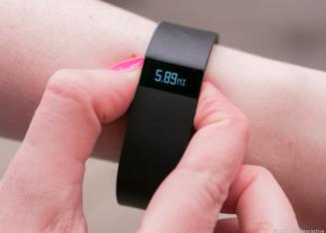
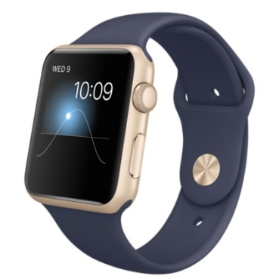
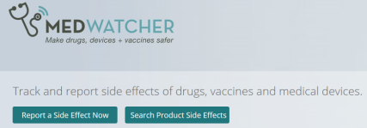
Ethical debate will follow Big Data and the integration of new sources of health data
Big Data refers to very large super-sets of data that include RWD and data from other sources
  social media (Twitter, Facebook)
  consumer data (purchasing habits)
  health technologies (Fitbit)
  non-health behaviors
Big Data is also a conceptualization in which all of these RWD sources may be integrated and used for healthcare decision-making
Technological advances are being made to help FDA monitor social media to identify safety signals/adverse events
MedWatcher.org and app allow individuals
to report adverse events
Notes:
AL

Slide 68


Ethics in Cognitive Computing
Cognitive computing is the simulation of human thought processes in a computerized model
Notes:
AB

Slide 69
Case Study: Cognitive Computing Discussion Questions
What are the ethical considerations that should guide the advancement and implementation of cognitive computing and artificial intelligence technologies?
If patient consults with Watson & receives a wrong diagnosis without being seen by a doctor, who is to blame?
What kind of decisions would you not handover to a machine?
Notes:
AB

Slide 70
Conclusions
Research integrity and ethics characterize responsible conduct of research
Responsible conduct applies to all aspects of research, and researchers must strictly conform to federal, institutional, and professional requirements
Every researcher must accept responsibility to call to the attention of appropriate individuals any concerns about possible research misconduct
Engaging in research misconduct has and should have serious consequences
Ethics is a shared, reflective examination of ethical issues—issues that are continuously changing and challenging our assumptions of what may be considered ethical
Ref: Lumpkin, A from the University of Kansas. Presentation entitled “Responsible Conduct in Research — Standards and Expectations for Ethical Conduct .”
Notes:
AL

Slide 71
Discussion
Any topics that resonated, require further discussion or deep dive?
Notes:
AL

Slide 72
Thank you

Slide 73
BACK-UP

Slide 74
Good Clinical Practice, an international standard
  2008 – FDA issued a final decision on April 28, 2008 to replace the Declaration of Helsinki with Good Clinical Practice (GCP) effective October 2008
  GCP is an international quality standard that is provided by International Conference on Harmonisation (ICH), an international body that defines standards, which governments can transpose into regulations for clinical trials involving human subjects
  Today, the GCP are used in clinical trials throughout the globe with the main aim of protecting and preserving human rights
Notes:
Anne to present

Slide 75
ISPE-Professional Certification Commission Code of Ethics
The International Society for Pharmacoepidemiology (ISPE) has a certification that defines a set of principles for the professional conduct expects from its certificants and candidates
The Code of Ethics works together with the Standards of Professional Conduct to provide guidance for certificants/candidates regarding ethical and fair professional practices
  Hold paramount the health, welfare and safety of the public, customers, colleagues and employers and protect the environment and property in the performance of the certificants professional duties.
  Act with objectivity, competence, and in an ethical manner with colleagues in the pharmaceutical and related industries, the public, employers, clients and prospective clients worldwide.
  Maintain all relationships with the highest standards of integrity and honesty.
  Take reasonable steps to ensure the privacy and safekeeping of confidential and proprietary information concerning the business affairs and technical processes of any former or present employer or client or public body for which they serve.
  Refrain from receiving or offering gratuities or inducements that may compromise professional standards or independent judgment.
Ref: http://www.ispe.org/certified-pharmaceutical-industry-professional/code-of-ethics
Notes:
Anne to present

Slide 76
  Physician As Research Participants
AB: BACK-UP
  Ensuring the rights of participants while encouraging research enrollment
  Law and regulations in place to prevent:
Coercion
  Incentives to participate
Undue Influences
  Payment
Pressures
  Manipulation and Persuasion
Exploitation
Conflict of interest
  Increases the likelihood of the other ethical concerns
Physician surveys as part of mandated PV to measure prescribers’ understanding of risks associated with drug
  Ethical concern: How to protect confidentiality with “test results” provided to regulatory agency
ICC/ESOMAR Code on Market and Social Research: http://www.esomar.org/knowledge-and-standards/codes-and-guidelines.php

