Slide 1


Slide 2
Q1. Consider the meta-analysis study by Petrelli et al (2012). Do you think these studies meet the first hurdle in a meta-analysis (combinable/common footing)? What are the rates of hypomagnesemia in the control arms of these studies? How might this influence the comparability of these studies? What are the risk differences for each study? How might that affect the interpretation of these data?

Slide 3
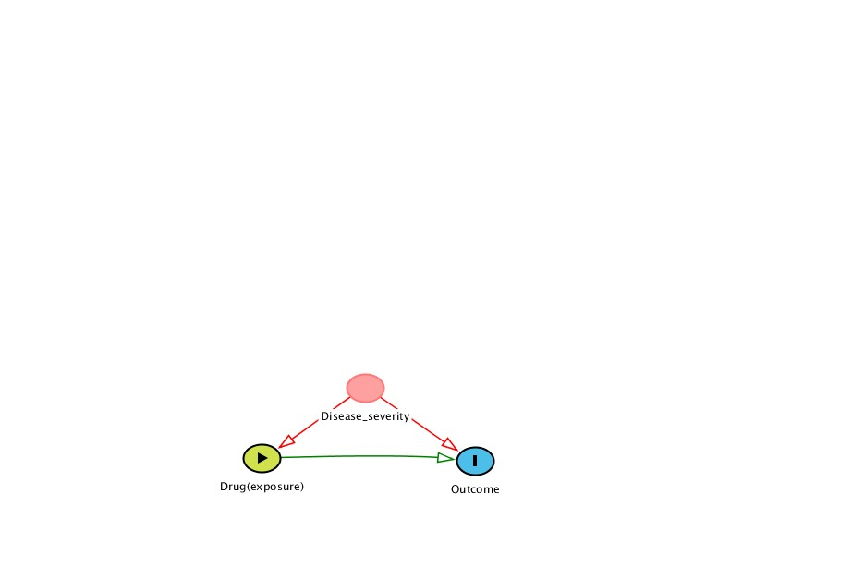
Q 2: Describe the concept of “confounding by indication”. Why is this a concern to pharmaocepidemiologic studies that evaluate drug safety and efficacy? Is confounding by indication a concern for randomized clinical trials?
In Real world physicians may prescribe certain drugs to patients with the same disease, but different risk profiles – so disease severity is associated with drug exposure as well as outcome (e.g. risk of AE, disease progression)- “Indication” for prescribing drug in a certain manner
Patients receiving drug of interest may be healthier or sicker – so bias can go in both directions
Consequence – inaccurate assessment of a drug’s benefit or safety profile. May create false associations attributed to drug that are basically due to patients’ disease severity, or miss a true benefit that is “masked” by disease severity
Propensity score analyses, marginal structural models – methods for addressing this bias
Examples: COX-2 Inhibitors and GI events,
Randomization protocols in clinical trials usually minimize he potential for confounding by indication

Slide 4
Q 3. Describe some the key differences between the SEER-Medicare database and commercial insurance claims databases (e.g. Marketscan, United Health Care). What are some of the key strengths and limitations of these two types of databases?
Commercial Insurance Claims databases
  Developed for administrative billing purposes – diagnoses, treatments/ procedures, dates of treatment/procedures
  Typically do not include lab test results, patient status, clinical notes and other confounder data (e.g. smoking, BMI)
  Insured populations, widespread coverage, reflects working populations
  Adjudicated data
  Patients drop coverage, move to different plans, lack full medical history
  Large sample sizes
SEER-Medicare Data
  Medicare - administrative claims data like commercial claims databases
  Linked file of SEER cancer registry to Medicare data – accuracy in cancer diagnosis, staging etc. Survival data
  Medicare primarily 65+ year olds
  More complete coverage in older population – accurate estimates of incidence, prevalence of cancer, surveillance data
  Reporting lag ~ 3 years

Slide 5
Q 4: In one of our seminars, data from several studies on the potential adverse effects of VIOXX were presented and discussed. Based on the clinical trial and epidemiologic data, do you think Merck should have taken VIOXX off the market? Why?
No correct answer to this question.
Arguments pointing to the need for withdrawal:
  Clinical studies with longer follow-up showed elevated risk – limitations of earlier studies – not enough follow-up
  Several post market studies – showed increased risk
  Marketing misbehavior on the part of Merck
Arguments favoring not taking off the market:
  FDA did not request
  Other similar COX inhibitors with similar risks – still on market
  Benefit risk considerations for certain patient subgroups
  Anecdotally – for certain patients drug offered pain relief when others did not work
  Could implement more restrictive risk management program, use in special circumstances

