Slide 1
Overview for Today
Discussion of Immortal Time Bias
Big Data: finishing from last week’s presentation
Course Summary
Distribution and Review of Final Quiz questions
Course Evaluations

Slide 2
Immortal Time Bias

Slide 3
Important Bias in PE Studies:
Immortal Person Time Bias
“Span of cohort follow-up or observation time, which because of exposure definition, the study outcome or death cannot occur” – (Suissa 2008)
“Immortal time” – a period of follow-up during which by design, death or study outcome cannot occur (Levesque 2010)
In pharmacoepidemiology – happens when individual’s treatment status involves a delay or wait period (e.g. waiting for prescription after discharge)
Can be quite common in cohort studies of drug effects (Suissa, 2008)

Slide 4
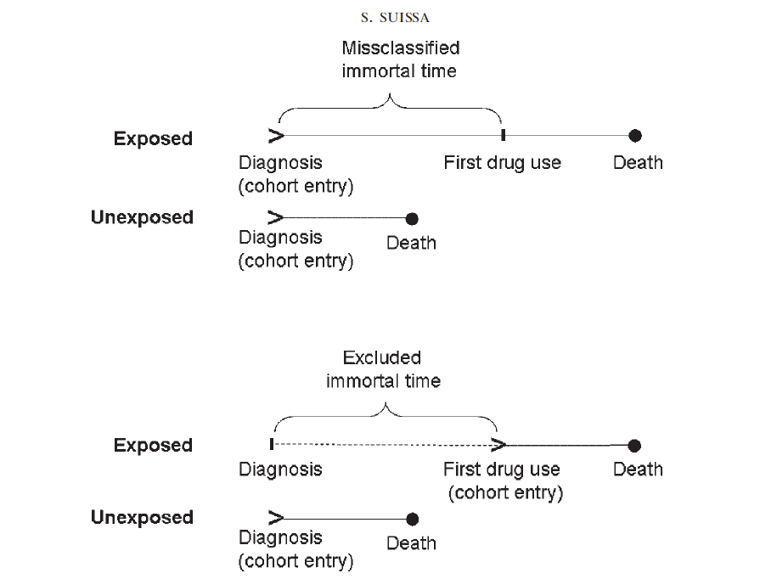

Slide 5
Immortal Person Time Bias
A misclassification bias when classifying the immortal time as treatment follow-up time – inflates the denominator – biases risk estimate towards the null
A selection bias when excluded immortal time leads to excluding individuals who do not receive treatment – bias could go in either direction
The amount of bias on the effect measures (e.g. HR) – will be dependent on the amount of immortal time misclassified
  Less impact on acute events

Slide 6
Identifying Immortal Time Bias (Levesque 2010)
Was treatment status determined after the start of follow-up, or defined using follow-up time?
Was the start of follow-up different for treated and untreated (comparator) groups?
Were treatment groups identified hierarchically (one group before the other)?
Were subjects excluded on the basis of treatment identified during follow-up
Was a fixed time analysis used?
  Fixed time refers to classifying exposed and unexposed time only in one group, cannot change over time

Slide 7
Immortal Time Bias – Examples
Statin use and reduction of the risk of diabetes progression (Levesque, 2010)
  Looked at time between statin use and initiation of insulin treatment
Use of corticosteriods to prevent mortality due to COPD compared with use of bronchodilators
  More time between diagnosis of COPD and corticosteriod use than diagnosis of COPD and bronchodilator use.
  Also – hierarchal example - corticosteriod use often followed bronchodilator use, from time of diagnosis, there is immortal time for corticosteriod use
Survival of heart transplant patients vs non-transplant patients
  similarly hematopoietic stem cell transplant patients

Slide 8
Analytical and Design Methods to Deal with Immortal Time Bias
Time Dependent analyses:
  Classify treatment time accurately
  Cox regression
  Other statistical techniques – Mantel Byar
Time-matched nested case-control studies within a cohort

Slide 9
Pharmacoepidemiology at UCSF
Courses Currently Available:
This course – Intro Pharmacoepidemiology (Epi 262)
Clinical Trials (Epi 205)
Development and Approval of Drugs & Devices (Epi 260)
Systematic Review (Epi 214)
Clinical Epidemiology (Epi 204)
Cancer Epidemiology (Epi 252)
Molecular & Genetic Epidemiology (Epi 217)
Other Potential courses:
  Special topics in Pharmacoepidemiology
  Advanced methods
  Database course

Slide 10
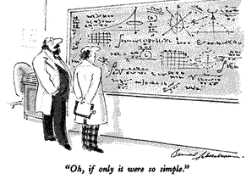

Slide 11
Perspectives in Big Data
Notes:
AL

Slide 12
Digital technologies to bring forward patient voice
“Digital Medicine was made for Learning Health Systems and Adaptive Studies” Ahmed Albaiti, CEO, Medullan
RCTs are changing, and rightly so
Conventional RCT costs not sustainable, populations under study are not representative
  Rise of adaptive, patient-centric clinical studies = new gold standard
  RWD, big data needed for analytics and for planning patient-centered research
  Current CRO model will be destroyed in 5-10 years
Patients → consumers
  Social media – e.g., Facebook community for rare disease recruiting 100+ per week… n=2900 (high capture, retention lower)
Patient retention → patient relationships
Notes:
AL

Slide 13
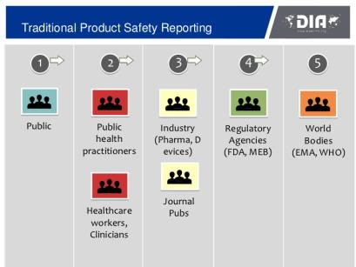
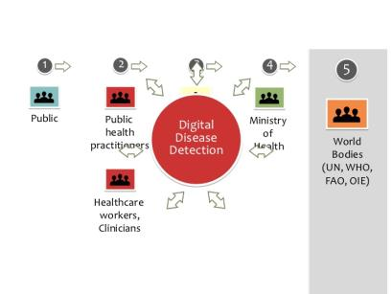
Where Social Media holds promise…
169M US adults (72% of all adults) went online to research a health question in 2010, compared with 63M in 2002
80% of serious AEs are reported by pharmaceutical companies
Notes:
AL

Slide 14

Big Data Poses New Challenges
Citizens with a conscience are not going to ignore wrong-doing simply because they'll be destroyed for it: the conscience forbids it.
From Wikipedia, accessed 8/22/14
Notes:
AL

Slide 15

Facebook T3 Study: “But the Data is Already Public”
In 2008, researchers publicly released data from Facebook accounts of college student cohort
Tastes, Ties, and Time (T3) research project sought to understand social network dynamics of large groups of students
“All the data is cleaned so you can’t connect anyone to an identity”
  While names, birthdates, and e-mails were removed…
  Various other potentially “identifying” information remained
    Ethnicity, home country/state, major, etc
Zimmer, Michael. "“But the data is already public”: on the ethics of research in Facebook." Ethics and information technology 12.4 (2010): 313-325.
Notes:
AB

Slide 16
Facebook T3 Study: Ethical Considerations [1]
Privacy
  Presumption that because subjects make information available on Facebook/Twitter, they don’t have an expectation of privacy
  Ignores contextual nature of sharing
  Ignores whether users really understand their privacy settings
Anonymity vs. Identifiability
  Presumption that stripping names & other obvious identifiers provides anonymity
  Ignores how anything can identifiable and become the “missing link” to re-identify an entire dataset
Zimmer, Michael. "“But the data is already public”: on the ethics of research in Facebook." Ethics and information technology 12.4 (2010): 313-325.
Notes:
AB

Slide 17
Facebook T3 Study: Ethical Considerations [2]
Consent
  Presumption that because something is made visible on Facebook/Twitter the subject is consenting to it being harvested for research
  Ignores how research method might allow un-anticipated access to data meant to be restricted
Harm
  Researchers imply “already public, what harm could happen”
  Ignores dignity & autonomy, let alone unanticipated consequences
Zimmer, Michael. "“But the data is already public”: on the ethics of research in Facebook." Ethics and information technology 12.4 (2010): 313-325.
Notes:
AB

Slide 18
Case Study: Facebook T3 Study Discussion Questions
Consent
  What do we mean by “consent” when it comes to using “publicly” available content
Harm
  Must a “wrong” occur for there to be damage to the subject?
  Do subjects deserve control over the use of their data streams?
Zimmer, Michael. "“But the data is already public”: on the ethics of research in Facebook." Ethics and information technology 12.4 (2010): 313-325.
Notes:
AB

Slide 19
Health Insurance Portability and Accountability Act (HIPAA) of 1996
Protects health insurance coverage for workers and their families when they change or lose their jobs.
Administrative Simplification (AS) provision requires the establishment of national standards for electronic health care transactions and national identifiers for providers, health insurance plans, and employers.
Right to privacy to individuals from age 12-18.
  The provider must have a signed disclosure from the affected before giving out any information on provided health care to anyone, including parents.
  Research can be exempt from HIPAA’s Privacy Rule; HIPAA’s Privacy Rule only applies to personal health information (PHI) gathered by or from covered entities
Notes:
AL

Slide 20

HIPAA and Privacy Challenge: Much of the EMR Data Remains Untapped
EMR research to date
Structured data
(e.g., demographics, stage, diagnosis)
There’s more to EMR
Unstructured data
(e.g., pathology, stage, biomarkers, physician notes)
Notes:
AL

Slide 21


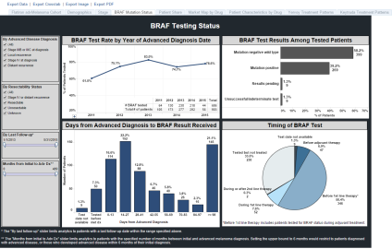
Is our Personal Health Information Protected?
How do we go from here?
(site of care)
To here?
(electronic data)
To here?
(research use)
Electronic Database
Notes:
AL

Slide 22

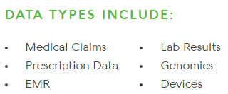


We can merge data systems
  GENOTYPE
  Exome sequencing
  PHENOTYPE (RWD)
Research data set
HIPAA-compliant data de-identification and encryption in storage and in transit
Notes:
AL

Slide 23
In Scandinavia, patient SSN can be used to link across National Databases
specimens
Access to patient data is governed by the Danish Data Protection Agency: http://www.datatilsynet.dk/english/
Notes:
AL
In Denmark, access to patient-level data is governed by the Danish Data Protection Agency:
http://www.datatilsynet.dk/english/
Getting approval from this agency is the first step for each study.
To access patient medical records (as opposed to registry records), one needs informed consent of patients.
Similar in other Nordic countries.
In Germany, data access governed by laws:
http://www.gesetze-im-internet.de/sgb_10/BJNR114690980.html
EU Data Protection Directive 95/46/EC
http://eur-lex.europa.eu/LexUriServ/LexUriServ.do?uri=CELEX:31995L0046:en:HTML

Slide 24
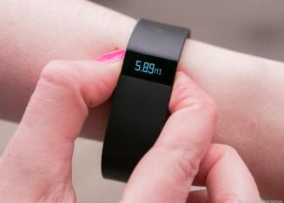
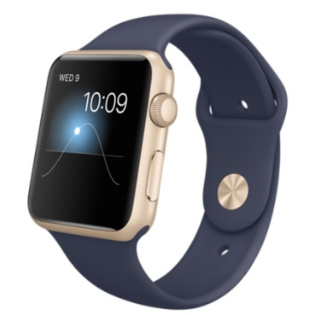
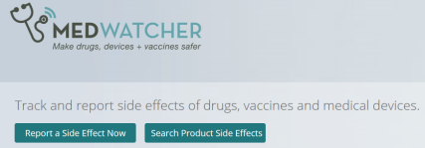
Ethical debate will follow Big Data and the integration of new sources of health data
Big Data refers to very large super-sets of data that include RWD and data from other sources
  social media (Twitter, Facebook)
  consumer data (purchasing habits)
  health technologies (Fitbit)
  non-health behaviors
Big Data is also a conceptualization in which all of these RWD sources may be integrated and used for healthcare decision-making
Technological advances are being made to help FDA monitor social media to identify safety signals/adverse events
MedWatcher.org and app allow individuals
to report adverse events
Notes:
AL

Slide 25


Ethics in Cognitive Computing
Cognitive computing is the simulation of human thought processes in a computerized model
Notes:
AB

Slide 26
Case Study: Cognitive Computing Discussion Questions
What are the ethical considerations that should guide the advancement and implementation of cognitive computing and artificial intelligence technologies?
If patient consults with Watson & receives a wrong diagnosis without being seen by a doctor, who is to blame?
What kind of decisions would you not handover to a machine?
Notes:
AB

Slide 27
Conclusions
Research integrity and ethics characterize responsible conduct of research
Responsible conduct applies to all aspects of research, and researchers must strictly conform to federal, institutional, and professional requirements
Every researcher must accept responsibility to call to the attention of appropriate individuals any concerns about possible research misconduct
Engaging in research misconduct has and should have serious consequences
Ethics is a shared, reflective examination of ethical issues—issues that are continuously changing and challenging our assumptions of what may be considered ethical
Ref: Lumpkin, A from the University of Kansas. Presentation entitled “Responsible Conduct in Research — Standards and Expectations for Ethical Conduct .”
Notes:
AL

Slide 28
Good Clinical Practice, an international standard
  2008 – FDA issued a final decision on April 28, 2008 to replace the Declaration of Helsinki with Good Clinical Practice (GCP) effective October 2008
  GCP is an international quality standard that is provided by International Conference on Harmonisation (ICH), an international body that defines standards, which governments can transpose into regulations for clinical trials involving human subjects
  Today, the GCP are used in clinical trials throughout the globe with the main aim of protecting and preserving human rights
Notes:
Anne to present

Slide 29
ISPE-Professional Certification Commission Code of Ethics
The International Society for Pharmacoepidemiology (ISPE) has a certification that defines a set of principles for the professional conduct expects from its certificants and candidates
The Code of Ethics works together with the Standards of Professional Conduct to provide guidance for certificants/candidates regarding ethical and fair professional practices
  Hold paramount the health, welfare and safety of the public, customers, colleagues and employers and protect the environment and property in the performance of the certificants professional duties.
  Act with objectivity, competence, and in an ethical manner with colleagues in the pharmaceutical and related industries, the public, employers, clients and prospective clients worldwide.
  Maintain all relationships with the highest standards of integrity and honesty.
  Take reasonable steps to ensure the privacy and safekeeping of confidential and proprietary information concerning the business affairs and technical processes of any former or present employer or client or public body for which they serve.
  Refrain from receiving or offering gratuities or inducements that may compromise professional standards or independent judgment.
Ref: http://www.ispe.org/certified-pharmaceutical-industry-professional/code-of-ethics
Notes:
Anne to present

Slide 30

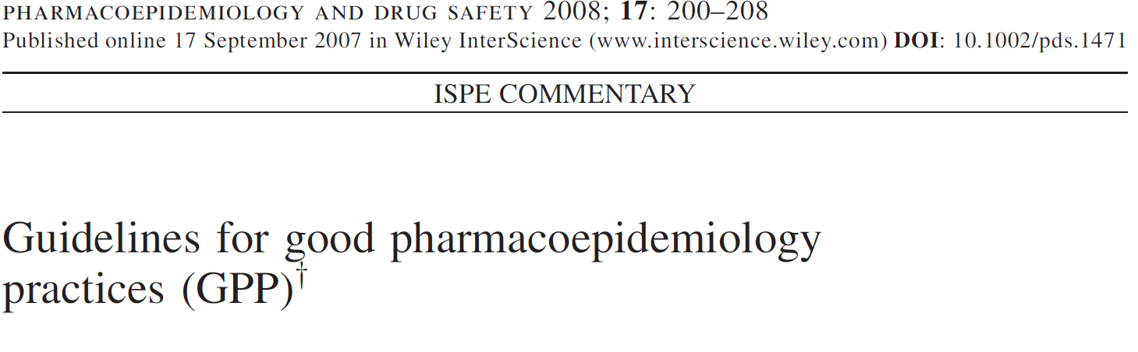

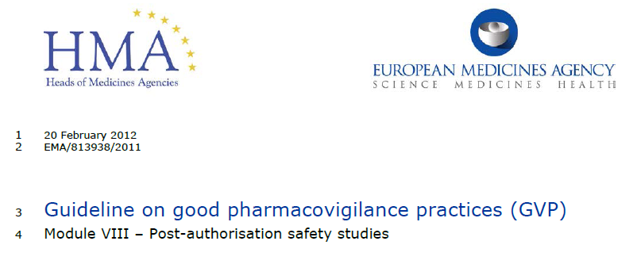

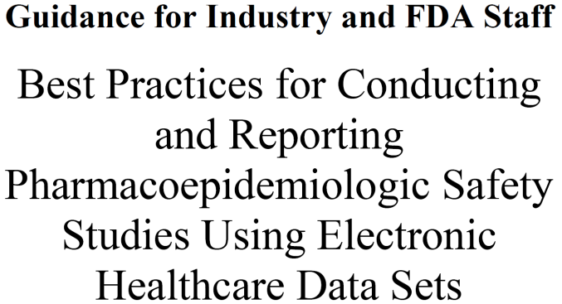


To Keep Up with the Consistently Evolving Environment
Registries for Evaluating Patient Outcomes: A User’s Guide
AHRQ Publication No. 07-EHC001-1 April 2007

Slide 31
Regulatory Bodies Providing Guidance
International Conference on Harmonization (ICH)
Council for International Organizations of Medical Sciences (CIOMS)
European Medicines Agency
Food and Drug Administration
World Health Organization

Slide 32
Summary review

Slide 33
EPI 262:Introduction to Pharmacoepidemiology
Guest Lecturers:
Michael Sprafka, PhD
Vicky Chia, PhD
Fiona Callaghan
Fei Xue, PhD
Michael Woolley, PhD
Daniel Cher, MD
Anne Beaubrun, PhD
Alex Liede, PhD

Slide 34
EPI 262 Course Schedule - 2017
Date | Instructor | Topic
01/12 | M. Kelsh | Class logistics, Intro, History of Pharmacoepidemiology, Public health impacts
01/19 | M. Kelsh | Study Design in Pharmacoepidemiology
01/26 | M. Sprafka | Pharmacoepidemiology and Drug Safety
02/02 | V. Chia | Pharmacoepidemiology: Data sources
02/09 | F. Callaghan | Advanced Methods: Quantitative Bias Analyses, MetaAnalysis, FDA – a Brief Overview
02/16 | F. Xue | Advanced Methods/Analytical Approaches
02/23 | D. Cher | Medical Devices, Study Design and Regulatory Considerations
03/02 | M. Woolley | Health Economics I – Basic Principles
03/09 | Beaubrun A Liede | Ethics in Pharmacoepidemiologic Research Case Studies
03/16 | A. Liede M. Kelsh | Big Data: Challenges and Opportunities Class Summary

Slide 35
Course Objectives
To provide students with an introduction to:
  The field of pharmacoepidemiology
  Basic study design principles and analysis in pharmacoepidemiology research
  Data sources and their strengths/ limitations for pharmacoepidemiologic research
  Post-marketing drug safety research
  Advanced analytical methods in pharmacoepidemiology
  Medical Devices
  Health economics and pharmacoepidemiology
  Issues of ethics, bias and conflict of interest

Slide 36
Epidemiology Role in the Drug Development and Life-Cycle Management Process
Phase 1
Phase 2
Phase 3
Launch
Post-Approval
Pharmacoepidemiology
Evaluating:
Utilization of existing therapeutics
  Clinical practice patterns
  Treatment guidelines
  Coverage policies
Patient outcomes with current therapies
Evaluating:
Real world utilization
Post-marketing effectiveness
Pharmacovigilance
Predictors of patient outcomes
Informs public health and decision-making:
Identify patients with unmet medical need
Size patient populations
Inform clinical trial design
Pricing & reimbursement/patient access
Informs public health and decision-making:
Are therapies used appropriately?
What is the population-level impact?
What is the benefit/risk profile?
Patient stratification
Treatment guidelines
Health policy

Slide 37
Disease Rates, Measures of Risk
Counts of events
Disease rate: Number of events per population at risk
Incidence vs. prevalence
Risk Difference/Attributable Risk – Comparing the difference of disease/event rates of “exposed group” versus “unexposed group”
Relative risk: Comparing the ratio of disease/event rates of “exposed group”) to disease injury rate in “unexposed group”
95% confidence intervals to represent statistical variability

Slide 38
Risk Measures
Ratio of observed events to expected events
Ratio of disease rate in exposed group compared to disease rate in unexposed group
Many names:
  Odds ratio
  Rate ratio
  Risk ratio
  SMR, SIR
  PMR, PIR
  Prevalence ratio, incidence ratio
Difference measures:
  Absolute risk
  Risk difference
  Attributable risk

Slide 39
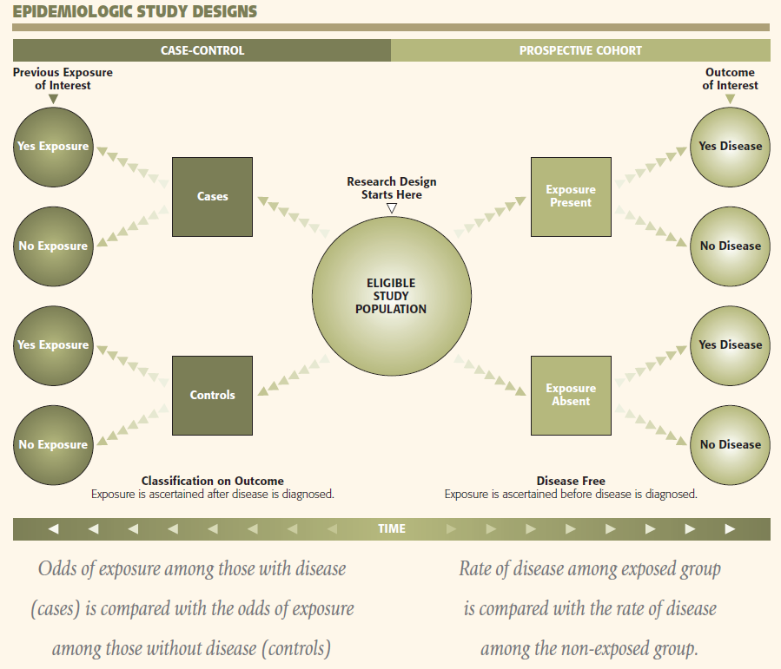

Slide 40
Pharmacoeconomic Checklist
Question
Perspective
Costs
Health effects
Timing
Sensitivity Analyses

Slide 41
Health Effects
What outcomes to consider?
  Survival
  Quality of Life
  Willingness to pay
  Responders
Quality-Adjusted Life Years (QALYs)
  Combine duration and quality of life
  Based on “utility”
    Range from 0 (death) to 1 (perfect health)
  Example: 3 years at 0.6 utility gives 1.8 QALYs
Questions:
  Do QALYs lead to discrimination (e.g. age)? Should they?

Slide 42
Health Resource Utilization Data
Hospitalization
Emergency room visits
Physician office visits
Outpatient surgical procedures
Therapist visits (physical, speech, occupational)
Caregiver time
Medications
Durable medical equipment
Ventilation

Slide 43
League Table (1997 dollars)

Slide 44
Cost Per Life Year Estimates

Slide 45
Medical Device Definition
Section 201(h) of the Federal Food Drug & Cosmetic (FD&C) Act
"an instrument, apparatus, implement, machine, contrivance, implant, in vitro reagent, or other similar or related article, including a component part, or accessory which is:
  recognized in the official National Formulary, or the United States Pharmacopoeia, or any supplement to them,
  intended for use in the diagnosis of disease or other conditions, or in the cure, mitigation, treatment, or prevention of disease, in man or other animals, or
  intended to affect the structure or any function of the body of man or other animals, and which does not achieve its primary intended purposes through chemical action within or on the body of man or other animals and which is not dependent upon being metabolized for the achievement of any of its primary intended purposes."
Defined by “what it’s not”

Slide 46
Classify Your Device
Class I – Lowest Risk
Class II – Moderate Risk
Class III – Highest Risk
Examples: manual toothbrush, sutures, many simple surgical instruments.
General controls
Examples: male condoms, non-invasive blood pressure monitors, catheters, screws
General controls and special controls
Examples: heart valve, most permanent implants
General controls and premarket approval

Slide 47
The Rules Governing Medicinal Products
A Hitchhikers Guide to Regulatory Enlightenment
J. Michael Sprafka MPH, PhD
Center for Observational Research
AMGEN

Slide 48
Adverse Event (or Adverse Experience)
An adverse event (AE) is any untoward medical occurrence in a patient administered a medicinal product and which does not necessarily have to have a causal relationship with this treatment.

Slide 49
Adverse Drug Reaction (ADR)
A reaction, in contrast to an event, is characterized by the fact that a causal relationship between the drug and the occurrence is suspected. If an event is spontaneously reported, even if the relationship is unknown or unstated, it meets the definition of an adverse drug reaction.

Slide 50
Unexpected Adverse Drug Reactions
An ADR whose nature, severity, specificity, or outcome is not consistent with the term or description used in the official product information should be considered unexpected.
Please note that the term “listedness” is not applicable for expedited reporting

Slide 51
Seriousness Criteria
results in death
is life-threatening
requires inpatient hospitalisation or results in prolongation of existing hospitalisation,
results in persistent or significant disability/incapacity,
is a congenital anomaly/birth defect,
is a medically important event or reaction.

Slide 52
Pharmacovigilance Methods
Passive Surveillance
  Spontaneous Reports (signal detection)
  Case Series
Stimulated Reporting
Active Surveillance
  Sentinel Sites
  Drug Event Monitoring
  Registries
  Comparative Observational Studies
    Cross-sectional Study
    Case-control Study
    Cohort Study
Targeted Clinical Investigations
Descriptive Studies
  Natural History of Disease
  Drug Utilization Study

Slide 53
Limitations
Chronic under-reporting
Episodic over-reporting (e.g., publicity, litigation)
Misreporting
Incomplete information
Changes over time in reporting and naming/coding practices
Data quality (e.g., dosage, duration of exposure)

Slide 54
Types of databases
Administrative claims
  US: Medicare, Medicaid, United HealthCare, MarketScan
Pharmacy databases
  US: IMS LRx, Retail pharmacy chain data
Surveillance – surveys, registries
  National Health and Nutrition Examination Survey (NHANES)
  Surveillance Epidemiology and End Results (SEER)
  Nordic national databases and registries
Electronic medical/health records databases
  US: Kaiser Permanente, Group Health Cooperative, Geisinger, OSCER
  UK: Clinical Practice Research Datalink (CPRD, formerly GPRD)
  FlatIron Oncology
Cohort studies
Notes:
Spontaneous reporting of ADR (adverse drug reaction) may generate hypotheses

Slide 55
Some Final Advice
Remember, all data sources and study designs have limitations. Thoughtfully select the most appropriate data source and design.
Carefully interpret your results
  Understand the definition and measurement of drug exposure
  Understand the validity and relevance of the case definition
  Carefully interpret the effect estimate along with its associated measure of precision
  Understand areas of residual bias that might impact the validity of your results
  Avoid the pitfall of extending your conclusions past where the results meaningfully can take you

Slide 56
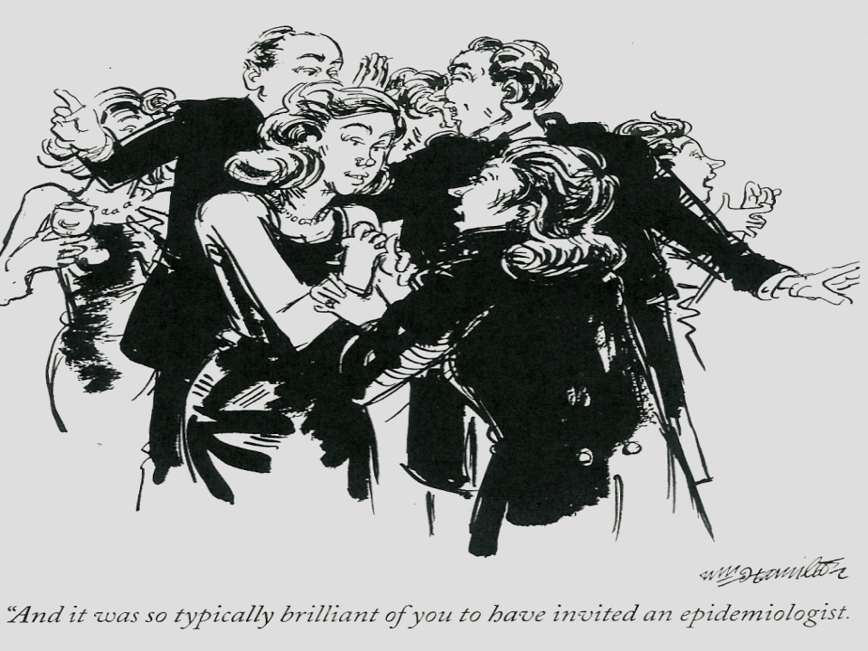

Thank you
Nov 26, 2001 – New Yorker Cartoon by William Hamilton

