Slide 1
Prework
Set up and configure MyNCBI account
Download and configure EndNote X8
  $78 OnTheHub UCSF
Notes:
Do you want them to use EndNote, vs others that are free to them?

Slide 2
EPI-214: Lecture 1
Designing a Systematic Review (Meta-analysis)
Dejana Braithwaite
Associate Professor in-Residence
Head, Screening and Early Detection Area of Concentration
Department of Epidemiology and Biostatistics
University of California, San Francisco
April 7, 2017

Slide 3
14 review types
Critical review
Literature review
Mapping review/systematic map
Meta-analysis
Mixed methods review
Overview
Qualitative systematic review/qualitative evidence synthesis
Rapid review
Scoping review
State-of-the-art review
Systematic review
Systematic search and review
Systematized review
Umbrella review
Grant et al. Health Info Libr J 2009

Slide 4
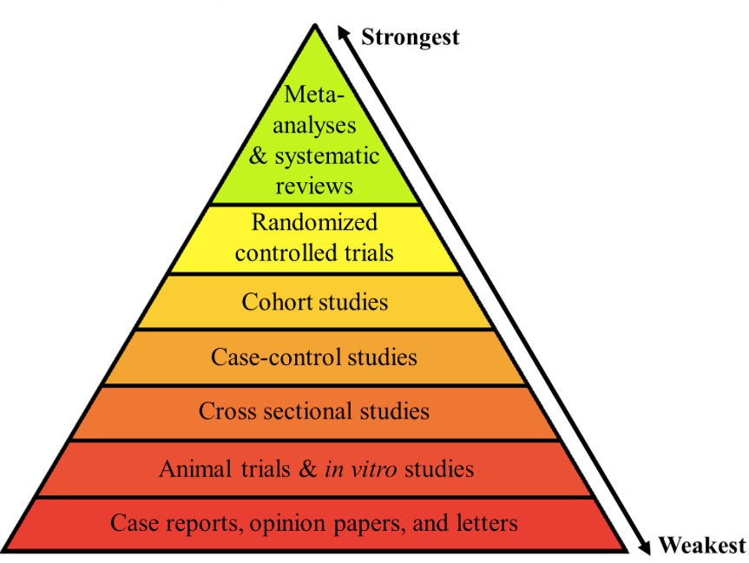
Evidence-based Pyramid

Slide 5
SYSTEMATIC REVIEW
A review of the evidence on a clearly formulated question that uses systematic and explicit methods to identify, select and critically appraise relevant primary research, and to extract and analyze data from the studies that are included in the review.”
META-ANALYSIS
Statistical combination of results from 2 or more separate studies
Cochrane Collaboration

Slide 6
Meta-analyses
IPD*
Systematic reviews
*IPD= individual participant data

Slide 7

Cochrane Collaboration
International systematic review initiative
Archie Cochrane’s vision led to the opening of the first Cochrane centre in Oxford, UK, in 1992
Cochrane Collaboration founded in 1993
Source: http://www.cochrane.org/cochrane/archieco.htm
Notes:
The Cochrane Collaboration is a group of over 27,000 volunteers in more than 90 countries who review the effects of health care interventions tested in biomedical randomized controlled trials.[3] A few more recent reviews have also studied the results of non-randomized, observational studies. The results of these systematic reviews are published as "Cochrane Reviews" in the Cochrane Library.

Slide 8
What are the advantages of a systematic review?
Facilitates evidence-based medicine
  Reduces bias
  Replicable
  Resolves controversy between conflicting findings
  Provides reliable basis for decision making

Slide 9
What are the pros and cons of
meta-analysis?
Potential advantages:
an increase in power
an improvement in precision
can answer questions not posed by individual studies
Potential weaknesses:
can mislead if specific study designs, within-study biases, variation across studies, and reporting biases are not carefully considered.
Notes:
NOTE: meta-analysis is simply the statistical combination of findings; it should not be considered as a type of review

Slide 10
What are the advantages of using meta-analysis as a prelude to clinical trials?
  Define pre-trial expected effect sizes
  Sample size estimation
  Determine effect estimates in key subgroups (e.g. based on gender, race/ethnicity or age)
  Identify sources of heterogeneity in prior studies
  Address these sources in design phase of new trial
Notes:
Determine effect estimates in key subgroups (e.g. based on gender, race/ethnicity or age)
Identify (through meta-regression) the sources of heterogeneity in prior studies

Slide 11
Can meta-analysis be used in study designs that are not clinical trials?
  Observational studies
  “IPD” = individual patient data studies
Notes:
Although meta-analysis is most widely known in biomedical settings for its application to clinical trials, the technique can also be used to synthesize/analyze other study designs:

Slide 12
Requirements for a systematic review
Topic
Time – Cochrane time line is one year with 2-3 months to develop question and perform searches.
Team
  Varied expertise (subject expert, search expert, statistics expert, writer, minimum team size is two, optimal size 5)
Reference manager (EndNote is one example)
Specialized software
  Statistical package
  Systematic review (Covidence, Distiller)

Slide 13
What are the steps of a systematic review?
1. Formulate research question
2. Protocol
3. Identifying relevant work
4. Apply inclusion /exclusion criteria
5. Assessing the quality of studies
6. Summarizing evidence
7. Analysis
8. Interpreting the findings

Slide 14
Protocol content guidelines
PRISMA-P
  http://www.prisma-statement.org/Extensions/Protocols.aspx
Cochrane Handbook – Part 1, Chapter 4
  http://handbook.cochrane.org/
Finding What Works in HealthCare
  https://www.nap.edu/download/13059

Slide 15
Components of a research question (PICOT)
Patient:
  Disease or condition
  Demographic characteristics
Intervention (or “Exposure”):
  Type of intervention
  Dose, duration, timing, etc.
Comparison:
  Absence of risk or treatment
  Placebo or alternative therapy
Outcome:
  Risk or protective
  Dichotomous or
  continuous
  Type: mortality, quality of life, etc.
Type of Study:
  RCTs
  Cohort
  Case-control
  Cross-sectional
  All
Notes:
A clearly defined, focused review begins with a well framed question. In Cochrane reviews, questions are stated broadly as review ‘Objectives’, and specified in detail as ‘Criteria for considering studies for this review’.The review question should specify the types of population (participants), types of interventions (and comparisons), and the types of outcomes that are of interest. The acronym PICO (Participants, Interventions, Comparisons and Outcomes) helps to serve as a reminder of these. These components of the question, with the additional specification of types of study that will be included, form the basis of the pre-specified eligibility criteria for the review. Cochrane reviews should include all outcomes that are likely to be meaningful, and not include trivial outcomes. Primary outcomes should be limited to a very small number and include adverse as well as beneficial outcomes. Cochrane reviews can focus on broad questions, or be more narrowly defined. There are advantages and disadvantages of each.

Slide 16
PICO, PECO, PICOS, PICOT, PICOTT, SPIDER
The variants on PICO are very similar and are a question formulation tool for EB Practice
  Exposure for Intervention
  S for study type
  T study type
  TT type of question, type of study)
  PICO works best with therapy/treatment OR exposure questions
  SPIDER is designed to help with systematic reviews of qualitative data
    S Sample; P,I Phenomenon of Interest; D Design; E Evaluation; R Research type

Slide 17
How do we formulate an etiology question?
What are the pros and cons of broad vs. narrow questions?
Risk factor/Exposure
Outcome
Is breast density a risk factor for breast cancer?
Patient
Exposure
Are women with dense breasts at greater cancer risk compared to those with fatty breasts?
+ cohort & case-control studies
Outcome
Comparison
Notes:
Discuss some advantages and disadvantages of broad versus narrow review questions
Discuss changing the review question

Slide 18
What should be included in the protocol?
Background
Objectives
Pre-determined selection criteria
Planned search strategy
Planned data abstraction
Proposed method of synthesis of findings
Notes:
Background
give rationale for systematic review as well as importance of research question

Slide 19
Steps of a systematic review
1. Formulate research question
2. Protocol
3. Identifying relevant work
4. Apply inclusion /exclusion criteria
5. Assessing the quality of studies
6. Summarizing evidence
7. Analysis
8. Interpreting the findings

Slide 20
How do we identify studies?
At least two of these:
Pubmed
Web of Science
EMBASE
Cochrane Central
Key points:
Authors should work closely from the start with a librarian to identify relevant studies
Searches should seek high sensitivity, which may result in relatively low precision

Slide 21
Pick Resources Depending on Your Topic and Available Resources
Biomedical question: PubMed, Embase, BiosisPreviews(?)
Psychosocial component: PsycINFO, Sociological Abstracts
Educational component: ERIC
Cost Analysis/Economic component: Business databases e.g., Business Source Complete
Nursing and allied health: CINAHL
Cited reference searching: Web of Science

Slide 22
Grey Literature
Probably goes beyond this assignment but good to be aware of…
Grey literature: that which falls outside standard publishing (usually not peer reviewed)
  Posters, conference proceedings
  Dissertations and theses
  Government or organizational reports
  Clinical trials repositories (CT.gov, ICTRP)
Helps overcome publication bias (negative results, small studies)
Material is more current than traditional literature

Slide 23
Identifying literature you will keep for your analysis
Inclusion and exclusion criteria as denoted in your protocol
Typically 2 independent reviewers look at titles and abstracts of articles found by searches
  This step may eliminate 90% or more of your search results
Typically 2 independent reviewers look at full text of articles left after title and abstract screening and re-evaluate
  Once again this may cut out a large percentage of the remaining articles
* - Teams will decide how to “break ties” between reviewers

Slide 24
How do we determine which studies are suitable for inclusion?
Inclusion/exclusion criteria
P - Population
I - Intervention
C - Comparison (if necessary)
O - Outcome
T - Type of study (if necessary)
Subject headings OR Textwords
To find studies using all of the PICO elements:
P and I and C and O (and T)
Notes:
Reviewers must determine which studies are relevant and suitable for inclusion in the systematic review. As noted before, it is crucial that the criteria for study selection be determined ahead of time to the extent possible, so investigators cannot, for example, decide to exclude certain types of studies that do not show a positive result. The specific inclusion criteria will depend on the study question.

Slide 25
Exclusion criteria
Keep log of excluded studies
Note reasons for exclusion
Have eligibility checked by more than one reviewer
Develop strategy to resolve disagreements

Slide 26
Record keeping
High on compulsive record keeping is necessary in systematic reviews
Create a document or lab notebook in which you keep everything, it will save effort and heartache!
Think of it as a diary or journal.
Date each entry
  Copy searches, search numbers, search wording
  Write down your ideas, copy email from team-mates
  Keep track of where any other files are stored.
    EndNote libraries
    Spreadsheets
    Material you have saved in databases.

Slide 27
PRISMA (Preferred Reporting Items for Systematic Reviews and Meta-Analyses) statement
Evidence-based minimum set of items for reporting in SRs and meta-analyses
The aim of the PRISMA Statement is to help authors improve the reporting of SRs and meta-analyses
Focused on randomized trials but can also be used as a basis for reporting SRs of other types of research
www.prisma-statement.org/
Notes:
Checklist and a flow diagram

Slide 28
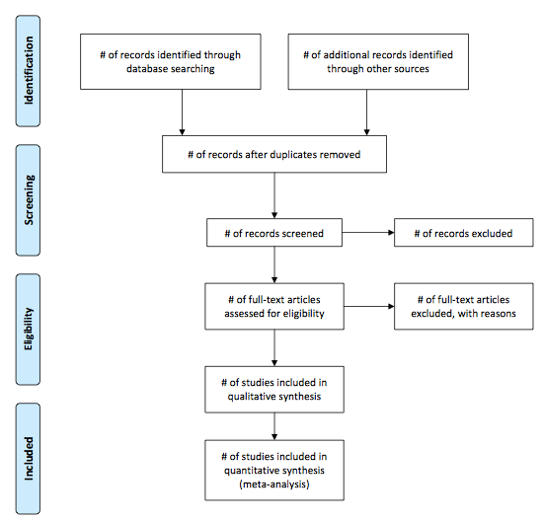
PRISMA CHECKLIST http://www.prisma-statement.org/2.1.4%20-%20PRISMA%20Flow%202009%20Diagram.pdf

Slide 29
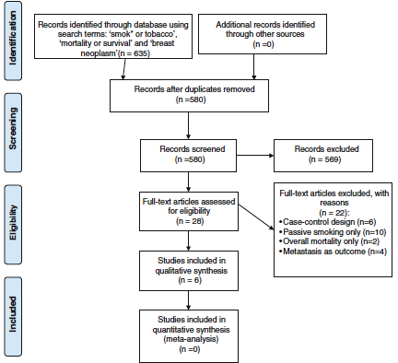
PRISMA-based search strategy flow-chart
Braithwaite et al Breast Ca Res Treatm 2012

Slide 30
EXAMPLE: SEARCH STRATEGY
You are interested in evaluating the benefits and harms associated with the use of screening mammography in women aged 70 and older. You need to determine what literature is available to conduct your review.

Slide 31
Quiz 1: You decide to conduct a systematic review (SR). What are two ways in which SRs differ from narrative reviews?
They are the same thing
Systematic reviews use comprehensive searches and explicit methods
Systematic reviews always employ quantitative synthesis (meta-analysis)

Slide 32
Quiz 1 answers: SRs versus narrative reviews?
They are the Same – Incorrect since narrative reviews do not employ explicit methods
Comprehensive Search and Explicit Methods – Correct!
Meta-analysis – Incorrect since SRs may or may not employ quantitative synthesis

Slide 33
Quiz 2: When conducting a comprehensive search, what do you need to assure?
You balanced precision and recall
You have employed every possible relevant citation regardless of the workload involved
That you limit the search so that only relevant citations are found

Slide 34
Quiz 2 answers: When conducting a comprehensive search, what do you need to assure?
Balancing precision and recall - This is correct!
  Precision - proportion of retrieved articles that are relevant.
  Recall - proportion of potentially relevant articles retrieved by the search.
You’ve Gotten it All– incorrect since this is unnecessarily onerous
Only Have Relevant Citations in your Search – incorrect since overly restrictive strategy may miss citations

Slide 35
Quiz 3: You try to decide whether to do one search or two searches (one for benefits and another for harms). Which of the following would cause you to perform two searches?
Performing two searches is redundant and should be avoided
You decide a priori to only allow RCT data when evaluating benefits but allowing RCTs and observational trials for harms
If the available literature base on the topic is extensive

Slide 36
Quiz 3 answers:
one versus multiple searches?
Never Do Multiple Searches - This is incorrect. Extensive literature may necessitate multiple searches.
Separate Benefits and Harms Search - This is correct! Benefits searches usually limited to RCTs due to greater internal validity. Harms searches usually broader.
When the available literature is extensive, two searches improves precision without appreciably impacting recall.
Notes:
Re option 1: If the size of the available literature is small, it may be appropriate to conduct one single broad search. However, if the literature is extensive and observational trials are allowed in the harms but not the benefits evaluations, a single broad search would reduce precision for studies reviewing efficacy endpoints without appreciably improving the recall.
Re option 2: harms searches usually broader and include observational trials. Searches usually include the harm (or subheadings for general harms) and the intervention. When the available literature is extensive, two searches improves precision without appreciably impacting recall.

Slide 37
Quiz 4: You decide to use hand searching of references from identified SRs, studies, and abstract booklets from prominent meetings within the field of interest. Why would you do this?
Hand searching can capture citations that are not indexed or are improperly indexed.
Limiting hand searching to these sources can target this time intensive activity to areas where the yield will be the greatest.

Slide 38
Quiz 4 answer: Value of hand searching
Both are Correct. Hand searching can yield up to 13-25% of citations that do not come up in database searches.
Since hand searching is the most time intensive search strategy, it should be targeted to maximize the yield.

Slide 39
Quiz 5: You decide to search the FDA website and ClinicalTrials.gov to identify studies that might be appropriate for your systematic review. These websites are an example of:
Grey literature
Informally published written material

Slide 40
Quiz 5 answers: Grey Literature
Grey Literature or informally published written material – both are correct!
  This can be important for identifying studies that were conducted but are, as of now, unpublished or incompletely published.
  Can minimize publication bias.

Slide 41
Search strategy
What will give readers confidence in your systematic review?
a comprehensive understanding of the topic
use of multiple searches
multiple databases
use of hand searching and grey literature
development of a transparent reporting structure

Slide 42
Systematic Reviews:
Strengths and Limitations
Findings of a review of 300 studies
  Not all systematic reviews equally reliable
  Reporting could be improved by a standard set of guidelines
Out of 100 systematic reviews monitored:
  7% needed updating at the time of publication
  Another 4% within a year
  Another 11% within 2 years
Extending searches beyond major databases, perhaps into grey literature, may increase the effectiveness of reviews
Ionnadis xxx; Moher et al. (2007); Shojania et al. (2007), Savoie, Isabelle et al. (2003).

Slide 43
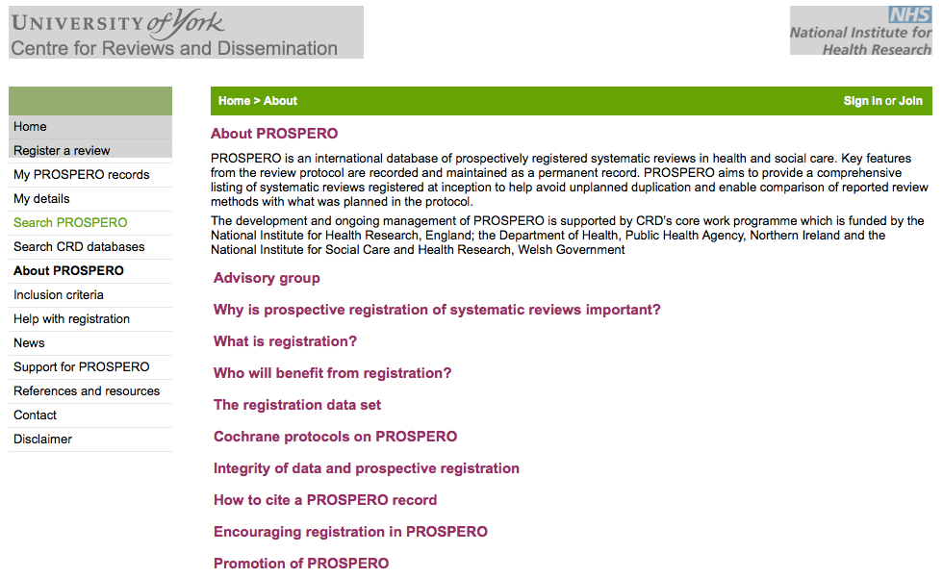
What is PROSPERO?
http://www.crd.york.ac.uk/prospero/about.asp

Slide 44
PROSPERO: Who may benefit from registration?
Researchers – comply with PRISMA & raise awareness of their review
Commissioners and funders – help avoid duplication
Peer reviewers – compare manuscript with protocol
Journal editors – safeguard against reporting biases
Guideline developers
The public

Slide 45
Your own systematic review
How could you use a systematic review to answer a specific clinical research question?
What are the challenges and risks?

Slide 46
Finalizing a question
Finding information
Reference manager
Keep close accounting of search terms, ideas, dates, numbers in your “diary”
Other purpose built software to assist with your systematic review
  For this class you might try Covidence

Slide 47
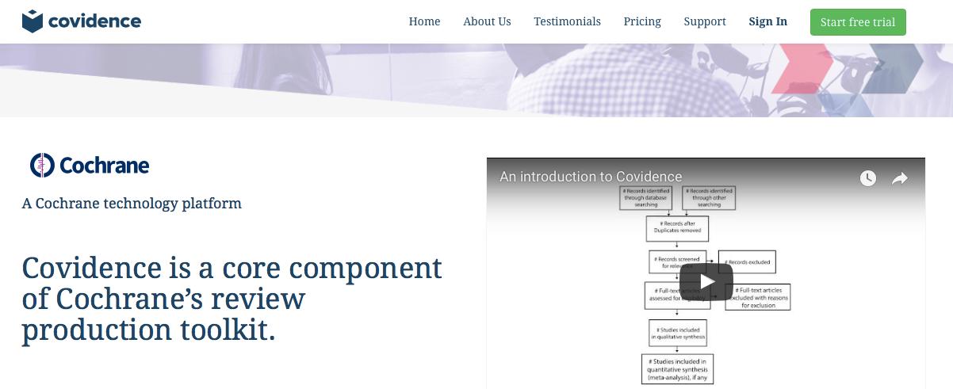
Why Use Covidence?
A not-for-profit service working in partnership with Cochrane to improve the production and use of systematic reviews.
https://www.covidence.org/

Slide 48
Organizing information
Reference manager
Keep close accounting of search terms, ideas, dates, numbers in your “diary”
Other purpose built software to assist with your systematic review
  For this class you might try Covidence

Slide 49
Screening the literature
Can use spreadsheet/database for this but Covidence makes this easier
Title and abstract screening
Full text screeening
Left with a set of keeper articles
Cited reference search
GoogleScholar search
PRISMA flow diagram…

Slide 50
Next steps
Data extraction
Analysis
Writing
These are the broad strokes…
But as always ”devil is in the details”
On to PubMed...

