Slide 1
Theories and Frameworks for Implementation Science: Approaches to Analysis of Gaps between Evidence and Practice
Epidemiology 245
Spring 2017

Slide 2
Week 1 – Framing the Gap (Redux)

Slide 3
Framing the Gap
Settle on an implementation problem
  To get the most out of this class
What is the role of warfarin in the era of direct thrombin inhibitors?
  Not an “implementation science” question (doesn’t mean it’s not a good question)
  Consider: strategies to enhance the use of anticoagulation now that there are multiple options…
What is the consequence of delay of colonoscopy after positive FIT
  Not an “implementation science” question
  Consider: Explaining delays between positive FIT and colonoscopy

Slide 4
Framing the Gap
Often there is an activity that we know we should do for good health outcomes
  What if there is an obvious thing we should do but it’s direct link to health outcomes is unclear
  Gap statement becomes tricky…
    Can’t state efficacy
    Can’t talk about consequences of lack of use
Contextualize this activity as one set in use of an efficacious intervention
  Bring the bigger picture into focus
  For anticoagulation…
Notes:
(move this to first lecture)

Slide 5
A “Cascade” Approach to Characterizing the Implementation Gap
gap?
Or is this the gap?
With condition
Diagnosed
Ever started
Offered treatment
Controlled
Retained or adherent
Notes:
Depends on how much of the gap is due to this step (is it the critical problem or a small one?)
Depends on whether there is data about this step’s contribution to non-treatment consequences

Slide 6
“Treatment of peri-partum depression reduces poor birth outcomes by 50%”
Strategy A – Focus on Screening
Strategy B –Screening Part of a Larger Story
Gap: Even though screening for depression during pregnancy has been shown to improve birth outcomes, only 12% of women screened. As a result, uncontrolled depression leads to X, Y and Z in maternal and child outcomes.
Analysis: Even though providers of antenatal care have opportunities to intervene and are motivated to address depression, they do not feel comfortable with discussing treatment options (e.g., CBT or anti-depressive medications) and therefore they are reluctant to raise the topic.
Intervention: We propose an opinion leader led training – led by a prominent OB GYN rather than a psychiatrist – on an automated screening and referral package
Gap: The CDC estimates that only 12% of women with peri-partum depression receive any treatment. As a result, uncontrolled depression leads to X, Y and Z in maternal and child outcomes.
Analysis: Existing data suggest only 12% of women who are pregnant are screened, even though virtually 100% of them visit health care providers during pregnancy. At the same time efficacious treatments exist: the bottleneck is underdiagnoses and therefore improving screening and referral represents a high-yield target for improving birth outcomes.
Intervention: We propose an opinion leader led training – led by a prominent OB GYN rather than a psychiatrist – on an automated screening and referral package
Notes:
Let’s say
Screening one step in the cascade of care, but making it a part of the analysis to motivation

Slide 7
Week 2 - Objectives
Understanding the Gap using Theory
  What is “theory” in implementation science?
Cover prominent theories
Understand how to use theory

Slide 8
Quantifying the Gap: Pre-exposure Prophylaxis for HIV Prevention
PrEP is highly efficacious
  95% if highly adherent, up to 50% with moderate adherence
PrEP is underused
  1,230,000 persons in US eligible for PrEP (MMWR 11/27/15)
  25,000 individuals ever on PrEP (Grant, CROI 2015)
PrEP uptake not optimal even in progressive municipalities
  SF: 16,089 PrEP eligible, 5,059 using - 31% (Grant 2015 CROI)
  Seattle: high risk “ever” use of PrEP - 31% (Hood AIDS 2016)

Slide 9
Why?

Slide 10
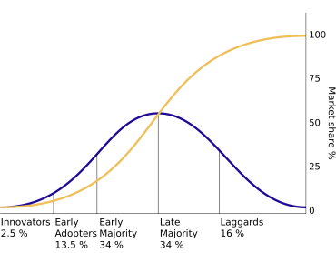
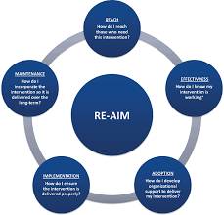
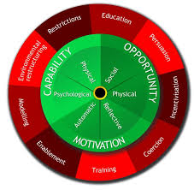
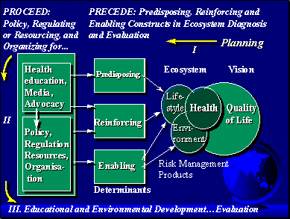
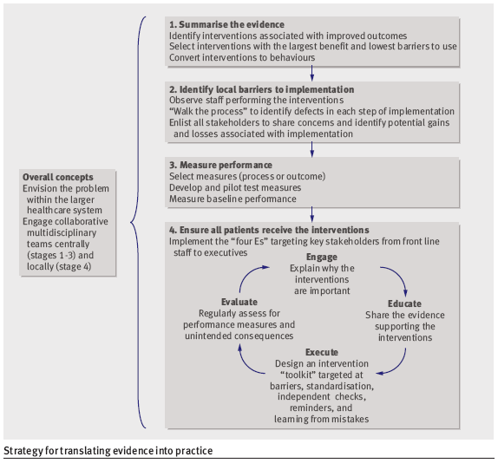
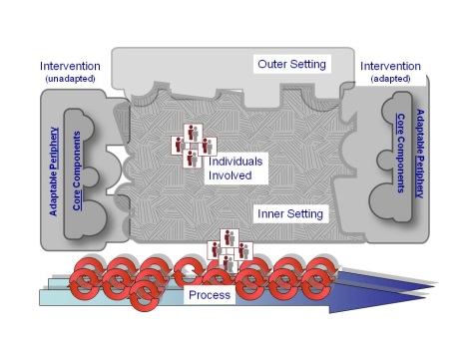
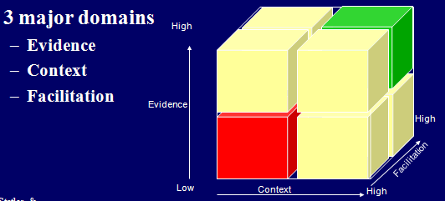
Framework, Models, Theories in Implementation Science
Notes:
On a practical level, how do you engage with framework, models or theories?
Theory seems obscure, esoteric or academic to many practioners…

Slide 11



What is Theory?
“An explanation of a phenomenon arrived at through examination and contemplation of the relevant facts” (Oxford English Dictionary)
Ideas about facts

Slide 12
Why does this Gap Exist? Call in Back-up
Links your problem (i.e., the gap) to a body of scholarship
  Implementation and behavioral theory
  Draw on a body of knowledge to understand why this problem exists
No different than what we do when we face clinical or statistical problems
  Why is this patient hypotensive?
    Medical school
  Is a causal relationship between the exposure and outcome
    TICR

Slide 13
Fact
Fact
Fact
Fact
Your observation or fact
Fact
Fact
Fact
Fact
Fact
Fact
Fact
Fact
Connect your observations with other thinking
Contribute to a discourse (don’t be an isolated node)

Slide 14
Clinical use of “Theory”?
58 year old woman who is a nurse, PMH of hypertension, a-fib, and rheumatoid arthritis, traveled to Africa the last year as a part of a missionary health team. Presents with 2 days of malaise and VS in ER 99.8, 90/60, 110, 30, 98%. Why is this patient hypotensive?
Shock Physiology
Cardiac output
Lactate
WBC count
Etc.
Cardiogenic? Vasodilatory?
She has a lobar pneumonia and also is on infliximab
Infectious diseases / immunological physiology
Infliximab is monoclonal antibody to an interferon TNF-alpha
TNF alpha plays a key role in host defense against mycobacterial infection
What antibiotics do I choose?
What else do I do in management?
Treat her with broad spectrum antibiotics
Isolate and rule out tuberculosis

Slide 15
“Why do these Gaps Exist?” Trial and Error Approach
“Why is there a gap between evidence and practice?”
Apply your personal experience
Propose formative research – some interviews
Call your friend who you think is smart (WWTBM approach)
Find that it has sub-optimal impact or score
Good case scenario: reviewers raise something you didn’t think of.
Worse case scenario: you finish the formative research and realize that there were factors you should have considered finding out more about
Try something – write a proposal or do a QI project in your clinic
Realize you need to systematically assess what others have said about how to approach the problem

Slide 16
“Why do these Gaps Exist?” Theory-Based Approach
Why is there a gap between evidence and practice?
Invest in a formulation of a diagnosis
Consult frameworks and theories in implementation science
Apply your own contextual knowledge, local network, consult stakeholders to further shape your diagnosis
Propose research which is embedded in existing discourse; builds on what is known; adds to body of knowledge
Consult relevant frameworks and theories in a particular area of social science or psychology
Peruse primary literature to sharpen your understanding of the problem

Slide 17
One Way to Look at Objectives of Theory in Implementation Science
CFIR
Behavior change wheel
Broad (mapping) – Have you thought of everything?
Health belief model
Characteristics of interventions (DOI)
Explanatory – Are there causal relationships for this type of thing that have been previously articulated (and does your problem fit?)
Adapted from Grol, Bosch et al., 2007

Slide 18
Many Ways to Organize Theory
Socio-ecologicial level
  Individual
  Organization
  Community
Tabak et al., reviewed literature - identified 61 models, frameworks or theories for D and I research (Am J Prev Med 2012;43(3):337–350)
Neilson identified five categories (Implementation Science (2015) 10:53)
  Process models
  Determinant frameworks
  Classic theories
  Implementation Theories
  Evaluation frameworks
Bartholomew suggested five functions of models and theories (JPHD 71 (2011) S20–S33)
  Identify determinants of behavior
  Explication of a causal model
  Selection of intervention methods
  Evaluation of the results
  Reporting of the active ingredients

Slide 19
Diffusion of Innovation
Diffusion is the process in which an innovation is communicated among members of a social system
Four main elements
  Innovation
  Communication
  Time
  Social system
You can identify these in every problem with diffusion
Rogers, Everett M. Diffusion of innovations. Simon and Schuster, 2010.

Slide 20
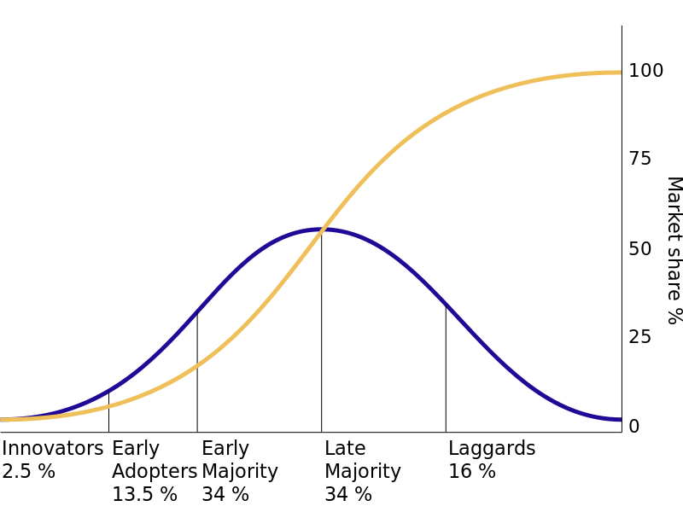
Quantifying the Gap: Rogers’ Diffusion of Innovations
Quantify the gap numerically
  50% of people doing X
Quantify the gap socio-behaviorally
  Innovators
  Early adopters
  Early majority
  Late majority
  Laggards
Rogers, Everett M. Diffusion of innovations. Simon and Schuster, 2010.
Notes:
Maybe you know that nothing has been done – how do you kick start? Target the innovators.
Adding a layer of information to the gap.
50% of the people are doing it, then you can try and hit the early majority…
START – rapid start was being practiced by some providers – the innovators and the early adopters – but not yet by the early majority – this tell you where a practice is al

Slide 21
Innovation Characteristics
Relative advantage
  Is it better than what you are doing?
Compatibility
  Does it fit with the processes and skills in place?
Complexity
  How hard is it to use?
Trialability
  Can you try it out before committing? (free trial)
Observability
  Can you (and others) see the benefits of adopting the new practice?
Rogers, Everett M. Diffusion of innovations. Simon and Schuster, 2010.

Slide 22
?
?
PrEP Use
?
?
?

Slide 23
Apply Diffusion of Innovations to the PrEP Problem
Relative advantage over condoms, abstinence and serosorting?
Compatibility with life in general (requirement to see doctors, get lab tests, etc.) as well as sexual practices (vs. on-demand PrEP?)
PrEP Use
Complexity (a pill with potential side effects) and monitoring
Observability - HIV acquisition rare and hidden?
Trialability: Can stop anytime? High start up costs?
Notes:
Gives you a way to analyze the problem…

Slide 24
Health Belief Model
Perceived susceptibility
  Do you think the disease will happen to you?
Perceived severity
  Do you think the outcome is bad?
Perceived benefits of a particular behavior
  If you do X to avoid it, will it work?
Perceived barriers
  What is getting in your way of it
Cues to action
Self efficacy

Slide 25
Health Belief Model
Perceived benefits and barriers
Perceived seriousness
Desired behavior
Perceived susceptibility
Self Efficacy
Cues to action

Slide 26
Apply Health Belief Model to the PrEP Problem
Perceived benefits – Do they know about? Believe in it? Do they think it’s a conspiracy?
Perceived susceptibility – What do patients think will happen to them in terms of HIV risk?
Desired behavior – Use PrEP
Self Efficacy – do they know where to go? How to pick it up? How to ask for it?
Cues to action – do they need a reminder? Are there competing priorities?
Notes:
What is missing?

Slide 27
CFIR: Have you captured the universe of considerations?
A “meta-theory” perhaps?
The CFIR comprises five major domains
  Intervention characteristics
  Outer setting: policy, economic, political and social context
  Inner setting: organizational characteristics
  Individuals: actors in the system
  Process: behavior change blueprint
(Damschroeder Imp Sci 2009)

Slide 28
Intervention Characteristics
Outer Setting
Inner Setting
Intervention source
Evidence strength perception
Relative advantage
Adaptability
Trialability
Complexity
Design quality and packaging
Patient needs and resources
Cosmopolitanism
Peer pressure
Policy environment
Structural characteristics of organization
Networks and communications
Culture
Implementation climate (tension for change)
Readiness of implementation
People
Processes
Knowledge and beliefs about the intervention
Self efficacy
Individual stages of change
Individual identification with the organization
Planning
Engaging
External change agents
Execution
Reflecting and evaluating

Slide 29
Apply CFIR to the PrEP Problem
Intervention characteristics (source? (CDC and experimentation), other characteristics from diffusion of innovations
Outer setting – insurance coverage, ”PrEP Stigma”
PrEP Use
Inner setting (are providers, culture, leadership in STI clinics ready to embrace PrEP?)
People – Knowledge and beleifs among target population about PrEP?
Processes: Is there a managed process for change and how it is managed, planned, executed?

Slide 30









Elucidate and Explain: COM-B
Michie et al (2011) Implementation Science
Notes:
Broad in the sense that it is comprehensive, but does not attempt to enumerate all subcategories
Also offers causal relationships between these constructs
Use it to map and to explain
Example of a behavioral problem: throwing garbage out the window in Qinghai – its not motivation – its opportunity

Slide 31

Physical skills
Knowledge
Cognitive and Interpersonal skills
Memory, Attention and Decision processes
Behavioural regulation
Environmental Context and Resources Social Influences
Professional/Social Role & Identity – my responsibility?
Beliefs about Capabilities
Optimism
Beliefs about Consequences
Intentions
Goals
Reinforcement
Michie Imp Sci 2011

Slide 32
Apply COM-B to the PrEP Problem
Capability (for providers: knowledge and interpersonal skills to assess)
PrEP Use
Opportunity (are there ways to screen to know who to offer it to? Are there insurance issues?)
Motivation– Beliefs about behavioral risk compensation?

Slide 33
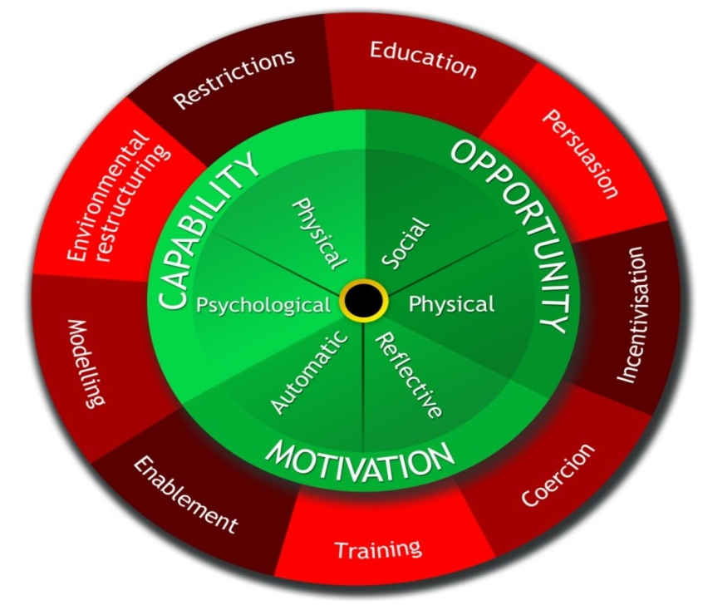
Using rules to reduce the opportunity to engage in the
behaviour (or to increase
behaviour by reducing
opportunity to engage
in competing
behaviours)
Increasing knowledge or understanding
Using communication to induce positive or negative feelings to stimulate action
Changing the physical or social context
Creating an expectation of reward
Provide an example for people to aspire to or emulate
Increasing means
or reducing barriers to
increase capability (beyond
education or training) or opportunity
(beyond environmental restructuring)
Creating an expectation of punishment or cost
Imparting skills
Michie Imp Sci 2011

Slide 34
Candidate intervention functions for PrEP
 | Education | Persuasion | Incentivization | Coercion | Training | Restriction | Environment | Modelling | Enablement
Capability | X |  |  |  | X
Opportunity |  |  |  |  |  |  | X |  | X
Motivation | X | X | X |  |  |  |  | X | X
Michie Imp Sci 2011

Slide 35
Theory of Change PRECEDE
Predisposing, Reinforcing and Enabling Constructs in Educational Diagnosis and Evaluation
Predisposing:
  Knowledge or information that inclines or influences a person to a particular behavior
Enabling:
  Materials or skills that facilitate the desired behavior
Reinforcing:
  Anticipated rewards to consequences of behavior
A “theory” in that PRECEDE makes a causal claim:
  interventions that make use of these three domains are more effective
    Davis, David A., et al. "Evidence for the effectiveness of CME: a review of 50 randomized controlled trials." Jama 268.9 (1992): 1111-1117
  A way of delivering a “sufficient cause”
.
Green, Lawrence W., and Marshall W. Kreuter. "Health program planning: An educational and ecological approach." (2005).

Slide 36
Apply PRECEDE to the PrEP Problem
Predisposing (for providers – how will you change what they want to do? Change knowledge, attitude, motivation?)
PrEP Use
Reinforcing (How can you create incentives to offer PrEP? Make PrEP perscription rates reported? Dashboards?)
Enabling – How can you make it easier for doctors to prescribe PrEP? Decision support? Order bundles? Through an app (rather than in person?)

Slide 37
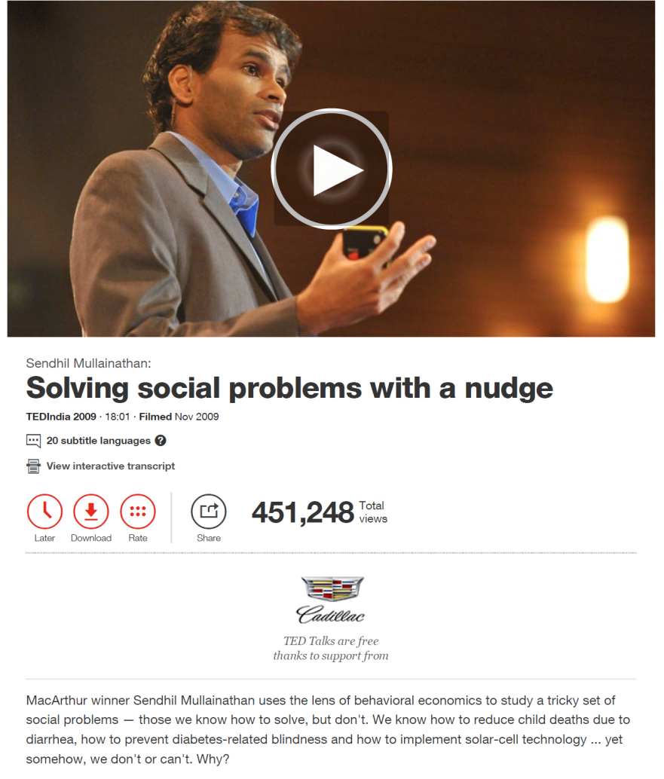
Behavioral Economics and Applied Psychology
Temporal discounting
Implementation Intentions
Commitment Devices
Defaults and choice architecture

Slide 38
Science of disparities: a scarcity hypothesis?
Having less makes you focus on immediate problems and neglect issues of long term benefit
Poverty is by definition a state of scarcity
High interest loans among poor
“If scarcity creates a focus on pressing expenses today, then attention will go to a loan’s benefits but not its costs. This suggests a clear prediction: Scarcity, of any kind, will create a tendency to borrow, with insufficient attention to future costs”
Bertrand, Mullainathan, Shafir. 2004. American Economic Review 94(1): 419-423.
Notes:
Scarce – distractions - cognitive function declines

Slide 39
Temporal discounting
100 tomorrow vs. 200 in six months
150 tomorrow vs. 200 in six months
190 tomorrow vs. 200 in six months
195 tomorrow vs. 200 in six months

Slide 40
Apply Temporal Discounting to the PrEP Problem
I want PrEP, but I’ll get it later because I have other stuff to do.
Micro-incentives? Get cash for filling first PrEP script (to address temporal discounting rather than price point)
Implementation intentions: Send people locations of PrEP providers and ask them to write down when they will go
PrEP Use
Commitment devices:

Slide 41
Stress and Temporal Discounting
Cornelisse 2013
Notes:
10 mg of hydrocoridsone
15 and 195 minutes before the text
Randomized 78 males to 1 of 3 groups

Slide 42
Caveats about Theory
Theory + Knowledge about your problem (including contextual knowledge) = Good Diagnosis
Theory without contextual knowledge about your problem give you a superficial diagnosis
Strong contextual knowledge without theory often gives you a very specific but local diagnosis

Slide 43
General and Specific
Generic
Implementation Science
Theory
A specific improvement activity, not scientific
Purile
Use of knowledge about your specific problem

Slide 44
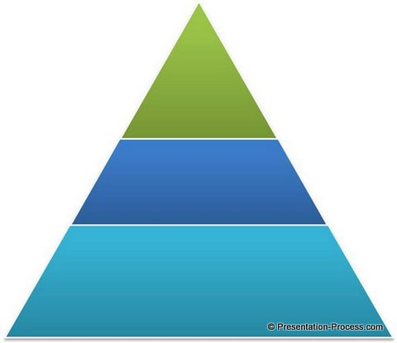
Ways of Solving Problems with Implementation
Science
  Generalizable inferences
  Public knowledge
  Use of theories and framework links to a larger and longer discourse
  Draw from and contribute to general, public knowledge
Organized strategies based on systematic assessments
  Quality improvement
  Incentivization
  McKinsey
Day to day managerial practices
  Business world
  “Leadership”

Slide 45
Frail, confused, sun-downing; tries to get out of bed to go bathroom and has a fall
Becomes combative and agitated; given haldol
MERT called; everyone is annoyed, sitter ordered; keeps trying to get out of bed
Hospital stay goes up; cost goes up; outcomes worsen
88 year old, community dwelling, admitted for pneumonia
“I know that nurse, he’s slow and lazy, didn’t respond on time. What a jerk.”
Restructure the environment (ACE unit); home based care; policy change
“Unit manager is too lenient, the nurses get away with anything”
Managerial
Review admission criteria; set up committee to do root cause analysis on all falls
Implementation
Science
Apply CFIR – consider policy, systems, environment; interventions, etc.
That intern is terrible – he’ll order haldol on anyone just so he can go back to bed
Quality
Improvement
Understand health worker psychology – look at TDF
Restrict use of restraints; require sign off for any sedating agents from chief resident
We need to start measuring the number of falls
Notes:
What’s the problem?

Slide 46
Conclusions
Use theory when you seek to understand the reasons for a gap between evidence and practice
Use your practiced based and contextual knowledge
Different theories are like different tools – what do you need to build?

Slide 47
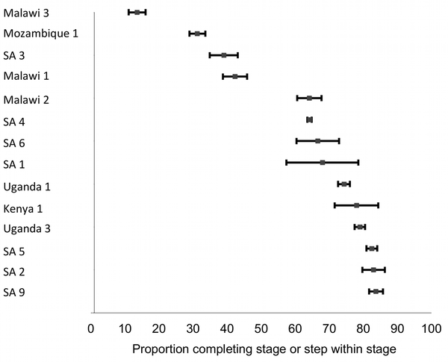
Delays in Antiretroviral Therapy Initiation among ART Eligible Patients
ART Initiation among Eligible Patients
Fox and Rosen PLoS Medicine 2011
Systems Barriers to ART Initiation
Providers
  Perception that “ART is not an emergency”
  Slow diffusion of new research (Zolopa PLoS One 2009, Havlir NEJM 2011)
  Unaware of loss to follow-up between eligibility and initiation
Structural
  Overnight CD4 processing - failure to return for second visit
Organizational
  Standard three pre-ART adherence and “treatment supporters”
Median 68%
(range 14%–84%)
Notes:
47

Slide 48
Intervention Based on PRECEDE Framework
BARRIERS
PRECEDE DIMENSIONS
THEORY – BASED INTERVENTIONS
Provider knowledge and beliefs
Predisposing
Opinion leader led teaching and coaching
Multiple pre-therapy counseling visits standard
Revised counseling protocol
Enabling
Multiple visits (overnight CD4 processing)
PIMA
Provider motivation
Reinforcing
Feedback to clinics

Slide 49
Example: Formal “Behavioral Diagnosis”
Gap analysis (qualitative interviews)
  Perceived susceptibility, severity was high, perceived benefits were high
  Barriers – health systems difficult to navigate
Formulation of action and action target
  Message as cue to action as well as information and encouragement for self efficacy
  “Everybody would wish to be loved”
  “A positive message and a personal touch”
  “Should not mention HIV”
Odeny AIDS 2014
Notes:
Consequences….
Implications for generalizability? Coming into more focus.

Slide 50
Frameworks and Theories– Improve Gap Analysis
Theory, Model, Framework
Map the gap, elucidate
Comprehensiveness; coherence
Have you considered all the factors of the implementation problem broadly and systematically?
Explain, relationships, causes
Offer putative relationships between constructs
Have you considered the possible explanations?
Is there a compelling general reasons which have explained similar problems before?
Deepen: REAIM
Broaden: CFIR
COM-B
Neilsen; Tabak (Am J Prev Med 2012;43(3):337–350); Bartholomew (JPHD 71 (2011) S20–S33)
PRECEDE
Notes:
Change – DOI – elucide a process / change
REAIM – one construct – really get into it
CFIR – try to grab as many constructs as possible
Maybe another way to look at this is with the pies
Help develop logic model or dag

Slide 51
Motivating Example
Patients testing HIV + often don’t come back to pick up CD4 results in Swaziland
Mobile phone penetration is high – 80%
SMS messages are inexpensive, but still cost money.
Free intervention: at time of blood draw for CD4 testing, the counselor puts a number with name “Go Back to Clinic”
Receive a “buzz” before appointment
No difference in follow-up before and after the intervention (80.1% versus 83.3%, p = 0.401)

