Slide 1
Week 4 – Study Designs in Implementation Science
Elvin Geng
Epidemiology 245
Spring

Slide 2
Announcements
David Evans will offer a guest lecture next week
Homework – conflict of interest…?

Slide 3
Scientific designs to understand “real world”
We have established that the behavior of “real world” systems and individuals drives use of evidence-based interventions for health
Understanding those behaviors are important
What kinds of designs allow us to understand implementation in the “real world” and what kinds of designs get in the way?

Slide 4
Strategy A (human subjects research): Conform reality to research needs
Research needs – what to do and when; what to measure and when
Traditional strategies “to understand” can be inimical to understanding when applied to implementation problems
Understand cause and effect through control
  Laboratory studies – Pearson’s correlation coefficient demonstrates causality
  Mimicked by “interval cohorts” and clinical trials – patient selection, intensive monitoring
Strengthens internal validity
  At the expense of external validity?
(I am agnostic regarding research on yeast)

Slide 5
Strategy B (Human subjects research): Conform design to reality
Do not seek control to understand effects (but still desire to understand effects)
Use analytic techniques to get at causal effects
Use opportunities that arise naturally (natural experiments)
Give up some control over measurements
Complicates analyses
  More difficult than a well conducted RCT

Slide 6


The Fisherman and the Hot Air Balloon
Attributed to Larry Green

Slide 7
Between a rock…
“GRADE”
Highest: Individual, double blinded, randomized trial
Downgraded: no blinding, cluster-randomized,
4. Rating the quality of evidence—risk of bias
5. Rating the quality of evidence—publication bias
6. Rating the quality of evidence—imprecision (random error)
7. Rating the quality of evidence—inconsistency
8. Rating the quality of evidence—indirectness
9. Rating up the quality of evidence
10. Rating the quality of evidence for resource use

Slide 8
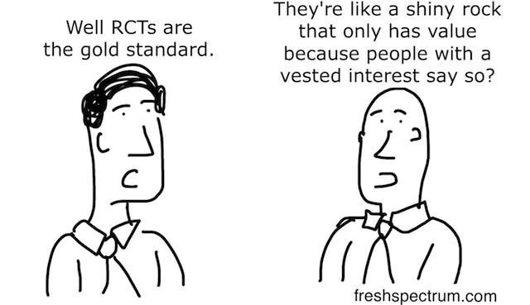
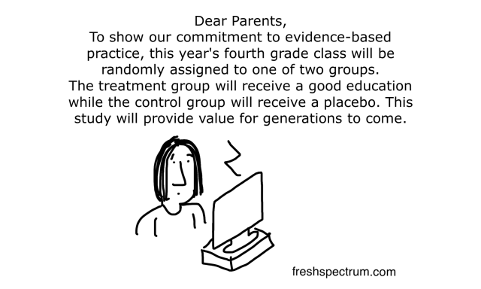
…and a Hard Place
http://www.ictworks.org/2016/06/24/randomized-control-trials-feed-our-fetish-for-single-focus-interventions/
Notes:
http://blogs.sciencemag.org/pipeline/archives/2016/06/15/the-nejm-and-clinical-trials-whats-going-on

Slide 9
Objectives Week 4
Designs that are correct and informative?
Observational
  Clinic or community based observational cohorts
  So called “impact evaluation”
    Regression discontinuity, difference in difference, and instruments
Experimental
  Implementation studies
  Hybrid studies
  Pragmatic randomized trials
  Stepped wedge trials
Qualitative work – another session

Slide 10
Observational Studies: Cohorts
“Interval cohort” vs. “clinic-based cohort” (Lau ARHR 2007)
Interval
  Researcher controls timing and nature of the measurements
  Patients “recruited” and assembled specifically for the purposes of research
Clinic based
  Uses a population enumerated by program or practice (EHR)
  Researcher does not control nature nor timing of measurements
    For example - loss to follow-up maybe common and more “informative”
  Missing or misclassified information is the common
  But… more “real world”

Slide 11
Interval cohort
http://aidscohortstudy.org/
“THE MACS STUDY IS CONDUCTED by sites located in Baltimore, Chicago, Pittsburgh and Los Angeles, and includes over 7000 men with and without HIV infection.”
“Study visits include detailed questions covering HIV-related symptoms and utilization of health services, demographic and psychosocial characteristics, a quality of life survey, a physical examination, a detailed form on medications used as prophylaxis and/or treatment, a neuropsychological screening and examination, blood samples to measure hematologic variables including enumeration of T-cell subsets and HIV viral load, and the allocation of samples to be sent to the National Repository. ”
Notes:
The only they they don’t have are biopsies!

Slide 12
Clinic-based cohort
http://www.iedea.org/
Pools data collected in routine HIV clinical care from sites all over the world
  Patients come for care (enumerated through care)
  Paper forms – data entered into open source database
  Minimal intrusion into clinical practice
  Seven regions globally
  NIAID funded
1,700,000 patients globally

Slide 13
A MACS – type publication
Molsberry, Samantha A., et al. "Mixed membership trajectory models of cognitive impairment in the multicenter AIDS cohort study." AIDS (London, England) 29.6 (2015): 713-721.

Slide 14
An IeDEA Type Publication
International Epidemiological Databases to Evaluate AIDS
Data come from “blue sheet” standardized clinical form
  Minimum data
Pools clinic-based cohorts regionally
  Seven regions
  East Africa
  Does not influence care delivery
  Install database and data entrants at the site
Want to understand barriers to care among HIV patients

Slide 15
Clinic-based cohort
Clinic based enumeration
Loss to follow-up = Achilles heal?
  Dead because of loss
Descriptive estimates biased
Associational estimates biased
Supplemental data but basically clinic based
Geng AJE 2012

Slide 16
18,081 Current Clinic Population
3,250 (18%) Lost to follow-up
579 (18%) Sampled
82 (14%) No outcome found
497 (86%) Outcome found
157 (32%) Dead
340 (69%) Alive
62 (18%) Updated Retention Status Not Possible
278 (82%)
Updated Retention Status Possible
90 (32%)
Not in care
188 (68%)
In care
Figure 1
Geng CID 2015
Notes:
215 and 149

Slide 17
Unweighted “naïve” analysis (N=18,081)
Weighted “corrected” analysis (N=18,081)
Proportion
Proportion
Days since ART initiation
Days since ART initiation

Slide 18
Implementation Science Cohorts?
Interval
  Internal validity stronger
Practice-based (or clinic based)
  Missing predictor data – imputation
  Missing outcomes – DAG suggests imputation will structurally fail
  Internal validity may not be as firm
Questions should match “structure”
  IeDEA
    “Is ethambutol needed in a four drug regimen in Africa?” (maybe not a good question)
    What fraction of patients are evaluated by sputum for pulmonary TB? (maybe better)

Slide 19
“Impact Evaluation”
A family of study designs that are not experimental but mimic experimental conditions
Putatively generates a valid counterfactual without randomly allocating the program or policy through “design”
Regression discontinuity, instrumental variables, difference in difference…
In general, embedded in “real world” conditions
  Design conforms to reality
  Investigator uses an opportunity rather than creates one

Slide 20
Difference-in-Difference
Compares before and after results in intervention group versus those in the control
Best with multiple pre-baseline measures
(to assess trends that might be evident even before the intervention begins)

Slide 21
Difference-in-Difference
(Y_{C}-Y_{A})-(Y_{D}-Y_{B})
Outcome
treatment effect
Intervention
C
Intervention
group
D
A
A’
B
B’
Control
group
0
1
Time
Martinez S. Perspectives on Impact Evaluation Conference, Cairo, Egypt; 2009.
Notes:
21

Slide 22
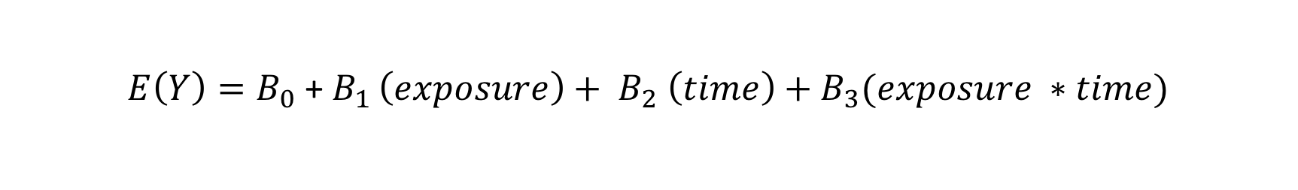
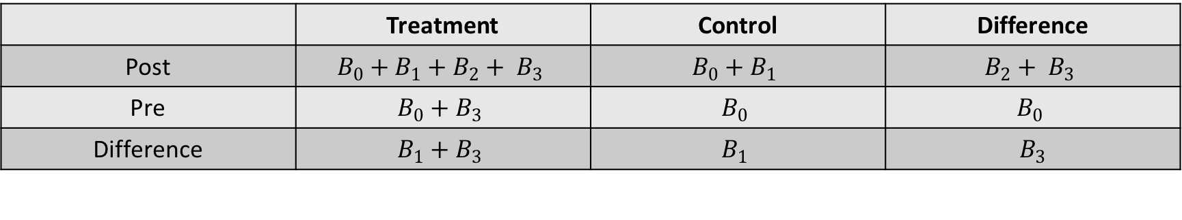
Difference-in-difference (lite)
$E\left(Y\right)=B_{0}$ + $B_{1 }\left(exposure\right)+ B_{2} \left(time\right)+B_{3}(exposure ∗time)$
 | Treatment | Control | Difference
Post | $$B_{0}+B_{1}+B_{2}+ B_{3}$$ | $$B_{0}+B_{1}$$ | $$B_{2}+ B_{3}$$
Pre | $$B_{0}+B_{3}$$ | $$B_{0}$$ | $$B_{0}$$
Difference | $$B_{1}+B_{3}$$ | $$B_{1}$$ | $$B_{3}$$
Difference in difference

Slide 23
Key assumptions
“Parallel Paths”
  Change in the comparison group represents the counterfactual change in the treatment group
“Common shocks”
  No treatment by time confounder
In implementation problems where outcome is bounded by 0 and 1, absolute change in control cannot be counterfactual change in treatment because P0 is not same
  50 to 75 != 0 to 25
Intervention in Time 1
C
Change in Outcome
at Time 2 (on absolute scale)
Notes:
I think the difference in difference faces a special problem when you are dealing with improvement things where the outcomes I bounded by 0 and 1
I think this is a variant fo felstein 1995 as in the wharton dif in dif slides
How does a diff in diff vary by
MAR on baseline – sort of like the CD4 missingness thing

Slide 24
Regression Discontinuity
Assignment to treatment is based on a clearly defined index or parameter with a known cutoff for eligibility (e.g., age)
Possible when eligibility criteria can be ordered along a quantifiable scale, which is systematically related to the assignment of treatment
The effect is measured at the discontinuity – the estimated impact around the cutoff

Slide 25
Regression Discontinuity - Baseline
Outcome
Program eligibility criteria
Martinez S. Perspectives on Impact Evaluation Conference, Cairo, Egypt; 2009.
Notes:
25
Difference in difference is one example of a quasi-experimental design.
Here, the outcome is measured at baseline in an intervention group and control group, represented by A and B on the graph.

Slide 26
Regression Discontinuity - Baseline
Outcome
Participation cut point
Not Eligible
Eligible
Program eligibility criteria
Martinez S. Perspectives on Impact Evaluation Conference, Cairo, Egypt; 2009.
Notes:
26
Difference in difference is one example of a quasi-experimental design.
Here, the outcome is measured at baseline in an intervention group and control group, represented by A and B on the graph.

Slide 27
Regression Discontinuity
Outcome
Participation cut point
Impact
Not Eligible
Eligible
Program eligibility criteria
Martinez S. Perspectives on Impact Evaluation Conference, Cairo, Egypt; 2009.
Notes:
27
Difference in difference is one example of a quasi-experimental design.
Here, the outcome is measured at baseline in an intervention group and control group, represented by A and B on the graph.

Slide 28
Example from HIV
Does eligibility for ART affect retention?
Exploit 350 /ul cuff off for ART eligibility
CD4 of 300 /ul not that different than 400 /ul at presentation
  Measurement error
  Diurnal variable
So whether you were above or below 350 /ul at presentation is pretty arbitrary
  Not a result of things that can also effect retention
People around that threshold “as if” randomized to eligibility
Is there a difference in retention?
Bor CROI 2015

Slide 29
Jacob Bor CROI 2015

Slide 30
Stepped Wedge Cluster Randomized Trial
Rationale
  Reconciles policy maker constraints with rigorous evaluation
  There is not equipoise scientifically or politically
  Or you can’t implement every where at once
  Finally when you have numerous potential comparators is when you want to match to obtain power

Slide 31
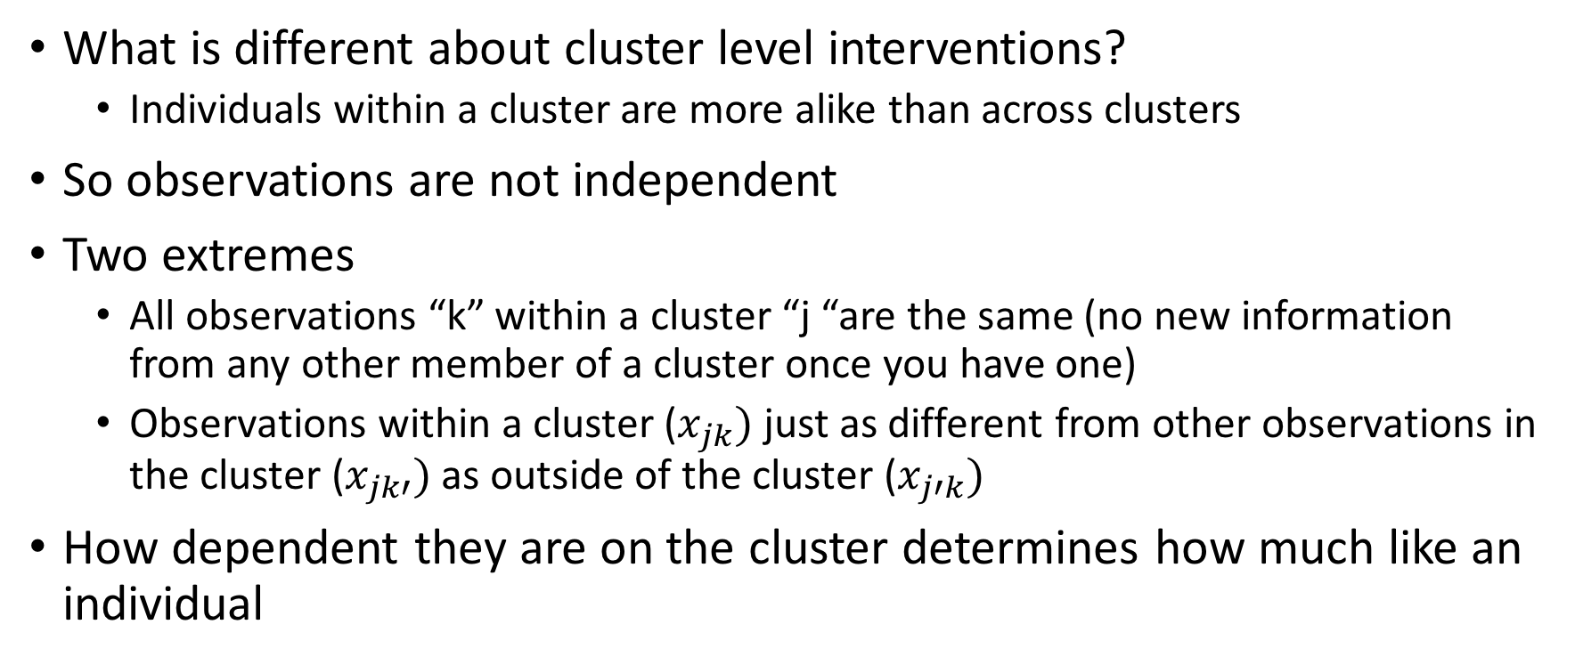
Primer on cluster level interventions
What is different about cluster level interventions?
  Individuals within a cluster are more alike than across clusters
So observations are not independent
Two extremes
  All observations “k” within a cluster “j “are the same (no new information from any other member of a cluster once you have one)
  Observations within a cluster ($x_{jk})$ just as different from other observations in the cluster ($x_{jk′})$as outside of the cluster ($x_{j′k})$
How dependent they are on the cluster determines how much like an individual
Notes:
Imagine if there was two clusters –
Between cluster variance is sigma (between) squared
Coefficient of variation is k
Coefficient of variation k=sigmaBetween / sample mean or mu
Say you want to give bed nets to villages to see effect on malaria
Malaria averages 30% but “could easily” vary between 15 and 45
If we say 95% of villages fall between 15 and 45
30 +/- 2x 7.5
K= .25 because sigma b / pi is .075/.3

Slide 32


Much variability between clusters (within correlation is high)
Within cluster variability
Cluster A mean
Cluster A
Between cluster variability
Grand mean
Cluster B
Cluster B mean
$$σ_{Between}^{2}$$
= Big
$$σ_{Total}^{2}$$

Slide 33
Less variability between clusters (more variability is within cluster)
Within cluster variance
Cluster A mean
Between cluster variance
Grand mean
Cluster B mean
$$σ_{Between}^{2}$$
= Smaller
$$σ_{Total}^{2}$$
Notes:
So even though cluster mean does nto change and grand mean does not change, and between is a smaller proportion of total

Slide 34


Very little variability is between: within cluster variability accounts for all variability
Within cluster variance = total variance
Between cluster variance is near zero
Grand mean is cluster mean
$$σ_{Between}^{2}$$
= Very small
Same as one single population
$$σ_{Total}^{2}$$
Notes:
So even though cluster mean does nto change and grand mean does not change, and between is a smaller proportion of total

Slide 35
Effective sample size and ICC
10 clusters
100 persons in each cluster
Closer to 1000
Power loss due to “design effect”
Effective sample size
Closer to 10
The proportion of total variability
that is between cluster

Slide 36
Phased implementation
6
5
Wave
4
3
2
1
90-day intervals
Notes:
Primary outcomes
Also provider attitudes
Specific provider behaviors

Slide 37
Decisions in a Stepped Wedge
Number of cluster in each group
Number of time between
Short term outcomes

Slide 38
Power diminished compared to individual trial because of within cluster correlation
Clusters before and after (one cluster goes into control and intervention experience) have small between cluster variability (they are the same)
  That helps power compared to a parallel CRT
But the the ICC is very large, then the between clusters variability trumps
  Power is diminished compared to a CRT

Slide 39
ICC=very big
ICC=very small

Slide 40
Example
 | Intra-cluster correlation 0.01 |  |  | intra-cluster correlation 0.1
 | Parallel | Parallell with baseline | Stepped wedge | Parallel | Parallell with baseline | Stepped wedge
Number of clusters | 20 | 20 | 20 | 20 | 20 | 20
Cluster size | 50 | 50 | 50 | 50 | 50 | 50
Total sample size | 1000 | 1000 | 1000 | 1000 | 1000 | 1000
Number of steps | 0 | 1 | 4 | 0 | 1 | 4
Number of clusters per step |  | 10 | 5 |  | 10 | 5
Power* | 0.97 | 0.87 | 0.88 | 0.5 | 0.77 | 0.82
Hemming BMJ 2014
Notes:
If no correlation why does adjustment for calendar time diminish power? Imbalance at any given time? Any given time interval is relatively less powered…

Slide 41
Phased implementation
Uncontrolled calendar time
Wave
4
3
2
1
Notes:
Primary outcomes
Also provider attitudes
Specific provider behaviors

Slide 42
Longer term outcomes in phased approach
Longer term outcomes without intervention
6
5
Wave
4
3
2
1
Longer term outcomes in intervention
Notes:
Retention, viral load and survival
Sampling based approach

Slide 43
Is a RCT a good way to study implementation problems….?
…it depends

Slide 44
Design of studies (vs. study designs) for implementation science
“Randomized trials are not good for ISR”
Within any particular design (such as randomized trials)
Decisions can influence what the trial tells us
  More nuanced decision within a larger “study design” typology

Slide 45
Emerging literature on how to do a trial
Clarify what you want to know
  Pragmatic – what does X do in the real world
  Explanatory – what can X do under idealized settings
Implementation science usually but not always is focuses on latter

Slide 46
Another way to look at the point of a trial
Effectiveness – understand the effect of some intervention on clinical outcomes (in real world)
Implementation – understand the effect of some intervention on implementation

Slide 48
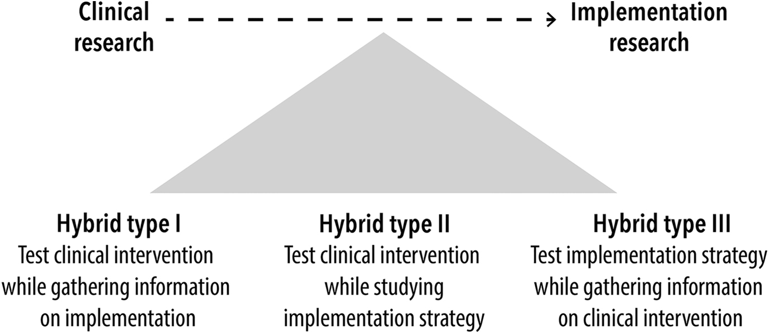
Implementation – Effectiveness Designs
Curran

Slide 49
Efficacy studies in implementation science?
Recall implementation strategy is…
Can you have “explanatory” ?
Yes...
  For these reasons
  If it can’t work in ideal settings it won’t work in any setting
  You don’t have money to do it in a real setting so if you are only going to do it in small setting you might as well make it idealized
But... You don’t want to test something that is so idealized that there isn’t anyway it could be taken into a real world setting

Slide 50
PRECIS -2
Eligibility—To what extent are the participants in the trial similar to those who would receive this intervention if it was part of usual care?
  TB trial includes all those with clinically suspected TB or those with culture or smear positive TB?
  Exclude people with mental illness form study of alcoholism intervention
Recruitment—How much extra effort is made to recruit participants over and above what would be used in the usual care setting to engage with patients?
  Pay people to participate
Setting—How different are the settings of the trial from the usual care setting?
  Predisone for ART IRIS carried out at university hospital in Africa
Follow-up—How different is the intensity of measurement and follow-up of participants in the trial from the typical follow-up in usual care?
  Incubators for pre term babies in India
Primary analysis—To what extent are all data included in the analysis of the primary outcome?

Slide 51
Precis - 2
Organization
  How different are the resources, provider expertise, and the organization of care delivery in the intervention arm of the trial from those available in usual care
Flexibility (delivery)
  How different is the flexibility in how the intervention is delivered and the flexibility anticipated in usual care?
  The most pragmatic design approach to delivery flexibility would leave the details of how to implement the intervention up to providers, in other words, what happens in usual care.
Flexibility (adherence)—How different is the flexibility in how participants are monitored and encouraged to adhere to the intervention from the flexibility anticipated in usual care?
  How dos this shake out when the intervention is meant to change how the end user interacts?
  Prep trials where a lot is undertaken to influence them
  I think this is ok if you study this rather than sweep it under the carpet
Primary outcome—To what extent is the trial’s primary outcome directly relevant to participants?

Slide 52
Wrap-up
Observational and interventional studies can be used for implementation science
Their utility, it the objective is for implementation science, depends on
  Clarifying the intention
  Nuances of design
Emerging thinking which is evolving

Slide 53
extras

