Slide 1
Uncertainty

Slide 2
Sources of uncertainty
Is your code doing what you think it is doing?
If you repeated this again with all exact same sampling procedure, but draw a new sample, and apply identical analysis procedures, what would be the distribution of this parameter?
If I repeated this again, with identical data but left it to a reasonable scientist to make analytic decisions s/he thought best?
If I repeated this again in a new setting with different populations, measurement instruments, scientists… would I find the same result?
If I tried to test the theory in a whole new way, would I find the same result?

Slide 3
Sources of uncertainty
Is your code doing what you think it is doing?
If you repeated this again with all exact same sampling procedure, but draw a new sample, and apply identical analysis procedures, what would be the distribution of this parameter?
If I repeated this again, with identical data but left it to a reasonable scientist to make analytic decisions s/he thought best?
If I repeated this again in a new setting with different populations, measurement instruments, scientists… would I find the same result?
If I tried to test the theory in a whole new way, would I find the same result?

Slide 4
Reproducibility
Segregate data for projects
  Raw
  Recoded
Separate from code
Write all code in a script that ideally you can run top to bottom
  Recode variables
  Select analytic sample
  Analyze data
Never recode variables without renaming variable
Document your code explaining what you are doing and why
Try to line up a code reviewer- someone who can read your code, see if it corresponds with what you said in your methods, see if it produces what you expected (consider inviting this person to co-author)

Slide 5
Tips for writing code to be checked
Provide an informative title to your code.
Annotate your code. Well annotated code makes it easier for the code checker to know what you are trying to accomplish during each data/proc step (and makes it easier for them to tell if you accomplished what you think you have accomplished).
Order your code. When submitting code to be checked, try to follow the order of the steps outlined in your methods and results section.
Make sure the checker can tell where you pulled variables from. This is usually easy to do if you have libname statements, but if you used a more unusual dataset, it might be worth pointing this out to the code-checker.
Clean your code. The code checking process will go faster if the coding of only relevant variables is included.
Assume your code includes some errors, this is the reality of life.

Slide 6
Tips for checking code
Look up variables you do not know. If the person is using a variable that you have not used before, it is worth looking it up in a codebook to determine if they pulled the correct variable and to find out the categories of the variable they are working with.
Run the code yourself. By changing the libname directories, you can run the person’s code and make sure that you get the same output they do.
Program it another way. If the person is performing some data cleaning and you are unsure of how they cleaned the code, try programming it in a way you feel more comfortable with and see if you get the same answer.
Check the paper against the code. Whatever the person says they did in the methods section should be in the code. Similarly, whatever is in the results needs to be in the code.
Check the output. Run the tables/models yourself and check them again the results presented in the paper.

Slide 7
Sources of uncertainty
Is your code doing what you think it is doing?
If you repeated this again with all exact same sampling procedure, but draw a new sample, and apply identical analysis procedures, what would be the distribution of this parameter?
If I repeated this again, with identical data but left it to a reasonable scientist to make analytic decisions s/he thought best?
If I repeated this again in a new setting with different populations, measurement instruments, scientists… would I find the same result?
If I tried to test the theory in a whole new way, would I find the same result?

Slide 8
Standard approaches to characterizing uncertainty
Most emphasis on assessing uncertainty is on the possibility that the associations you observe in the sample you drew represent the associations in the population from which it was drawn.
  Standard errors
  Confidence intervals
  Intuitions of bootstrapping
  P-values
  Evaluating subgroup effects

Slide 9
Uncertainty expressed as precision of estimates
Most of this class has focused on methods to avoid bias
But precision of effect estimates is also important
Intuition:
  An estimator is biased if the expected value (average) of the estimator does not equal the causal effect
    Small point of confusion: we can talk about the magnitude of bias or about the qualitative state of being a biased or unbiased estimator
    A biased but consistent estimator gets closer to the truth as you increase the sample size. Sometimes that’s good enough.
  An estimate is imprecise if the estimate would differ if you repeated the whole study – from sample to analysis – exactly the same but with a new set of observations.
An unbiased but very imprecise estimate may be no use, possibly worse than a precisely estimated estimate w/ a small bias.

Slide 10
Uncertainty
An estimate is imprecise if the estimate would differ if you repeated the whole study – from sample to analysis – exactly the same but with a new set of observations.
How can you know how much the estimate would differ if you repeated the whole study with different observations?
  Repeat the study with new observations (a bunch of times)
  Apply a formula for the sampling distribution of the estimator (if you are lucky enough to know such a formula)

Slide 11
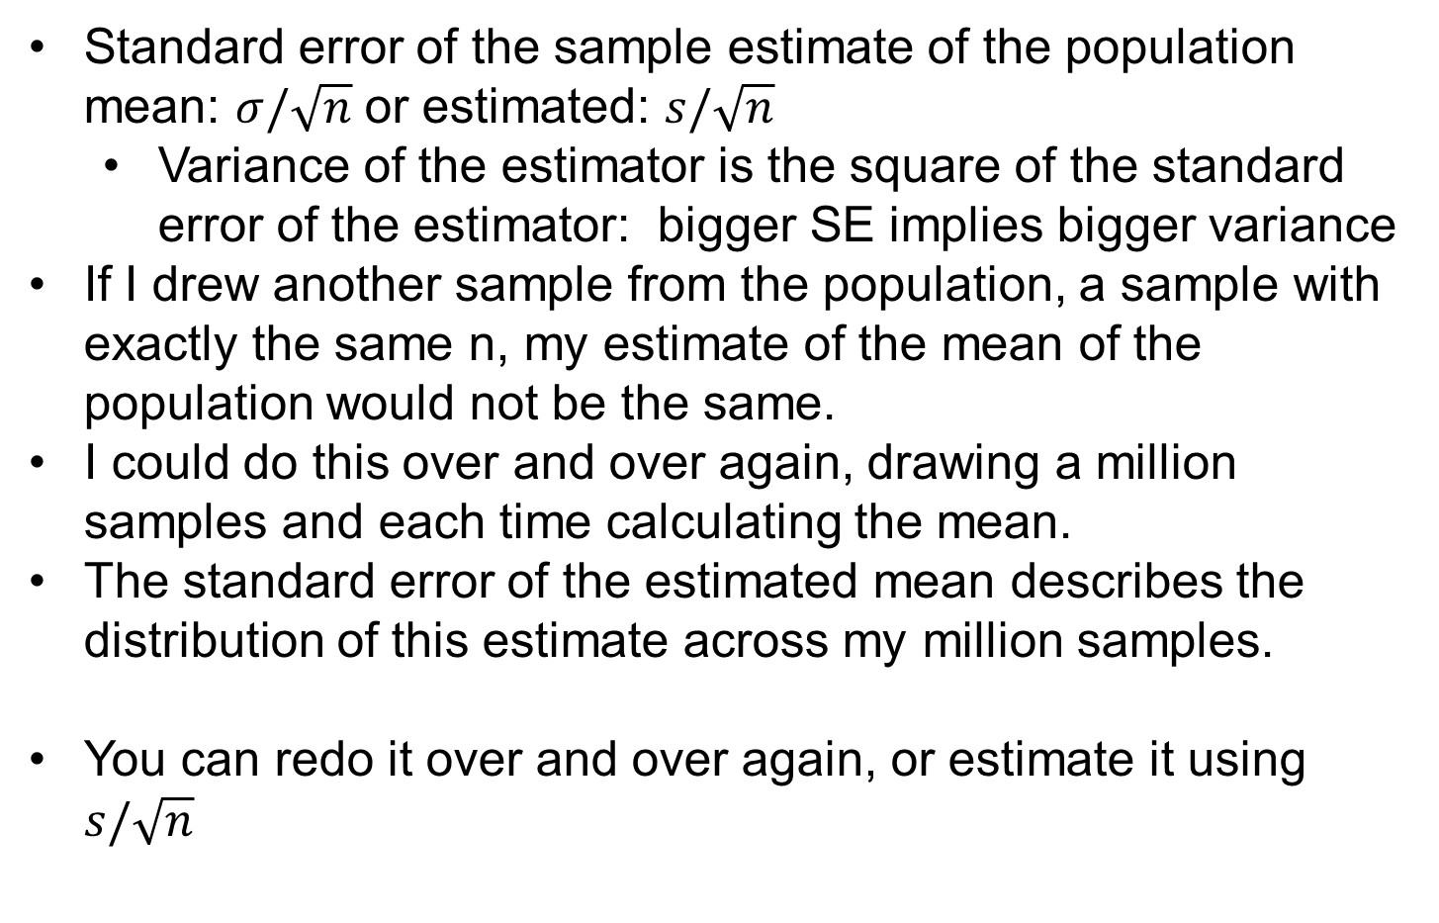
Standard Errors
Standard error of the sample estimate of the population mean: $σ/\sqrt{n}$ or estimated: $s/\sqrt{n}$
  Variance of the estimator is the square of the standard error of the estimator: bigger SE implies bigger variance
If I drew another sample from the population, a sample with exactly the same n, my estimate of the mean of the population would not be the same.
I could do this over and over again, drawing a million samples and each time calculating the mean.
The standard error of the estimated mean describes the distribution of this estimate across my million samples.
You can redo it over and over again, or estimate it using $s/\sqrt{n}$
Notes:
11

Slide 12
How to estimate the SE of the estimated mean of a variable?
Make up some data for a large sample N=10,000
X is a normally distributed random variable with a mean of 3.016 in the full sample

Slide 13
How to estimate the SE of the estimated mean of a variable?
Arbitrarily select 100 observations and estimate the mean
How confident am I in this estimate based on only 100 observations?

Slide 14
How to estimate the SE of the estimated mean of a variable?
Use the SD and N to estimate the standard error

Slide 15
How to estimate the SE of the estimated mean of a variable?
Repeat the sample numerous times and observe the distribution of the estimated mean across each sample
bootstrap r(mean) , si(100) sa(classse.dta, replace) r(500) :sum x
Std devn across repeated
samples approximates the
std error calculated in 1 sample

Slide 16
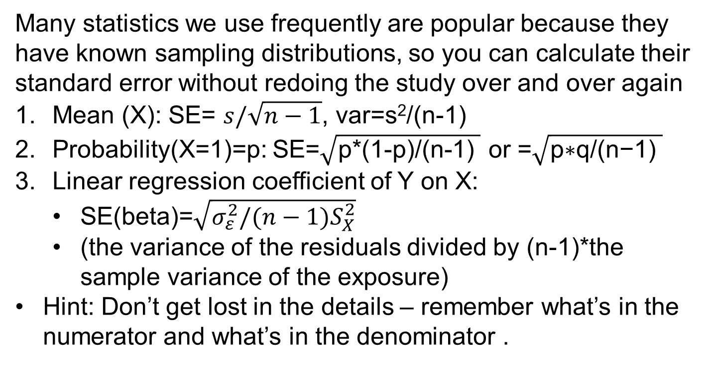
Standard Errors
Many statistics we use frequently are popular because they have known sampling distributions, so you can calculate their standard error without redoing the study over and over again
Mean (X): SE= $s/\sqrt{n−1}$, var=s²/(n-1)
Probability(X=1)=p: SE=$\sqrt{\text{p}\text{∗(1−}\text{p}\text{)/(}\text{n}\text{−1) }}$ or =$\sqrt{\text{p}\text{∗}\text{q}\text{/(}\text{n}\text{−1) }}$
Linear regression coefficient of Y on X:
  SE(beta)=$\sqrt{σ_{ε}^{2}/(n−1)S_{X}^{2}}$
  (the variance of the residuals divided by (n-1)*the sample variance of the exposure)
Hint: Don’t get lost in the details – remember what’s in the numerator and what’s in the denominator .
Notes:
16

Slide 17
The culture war around P-values
Informally, a p-value is the probability under a specified statistical model that a statistical summary of the data (e.g., the sample mean difference between two compared groups) would be equal to or more extreme than its observed value (ASA Statement, 2016)
Usually the statistical model we are assessing is a null model of independence between two variables
Notes:
17

Slide 18
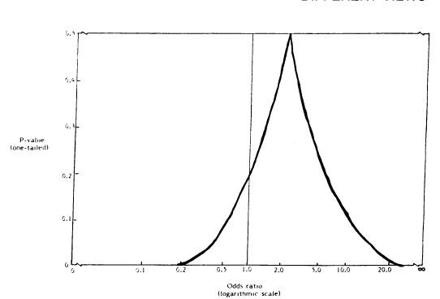
P-values: some common traps to avoid
The p-value > .05, therefore, β=0
The 95% CI may include the null, but does it also include values of substantive/clinical importance?
Large p-values might reflect a true effect that is null or close to null.
But p-values are also influenced by the sample size, and the other sources of variance in the outcome.
Look at the whole CI, and recognize that your data would be consistent with values across the range.
Do not simply use the CI as a more irritating way to test p>.05
From: Poole, Beyond CIs, 1987
Notes:
18

Slide 19
P-values: some common traps to avoid
The p-value > .05, therefore, β=0 NO NO NO This is so insidious and tempting…
The 95% CI may include the null, but does it also include values of substantive/clinical importance?
Large p-values might reflect a true effect that is null or close to null.
But p-values are also influenced by the sample size, and the other sources of variance in the outcome.
Look at the whole CI, and recognize that your data would be consistent with values across the range.
Do not simply use the CI as a more irritating way to test p>.05
From: Poole, Beyond CIs, 1987
Notes:
19

Slide 20
P-values: some common traps to avoid
Situations when this is tempting:
  E(BMI)=b₀+b₁*Mom_Ed
  b₁=-2 95% CI: (-.08, -3.92)
  E(BMI)=a₀+a₁*Mom_Ed+a₂*Own_Ed
  a₁=-1.8 95% CI: (0.20, -3.80)
  a₂=-4 95% CI: (-3, -5)
  Does mother’s education have an effect on BMI independent of own education?
Notes:
20

Slide 21
P-values: some common traps to avoid
Situations when this is tempting:
  E(BMI)=b₀+b₁*Mom_Ed among women
  b₁=-2 95% CI: (-.08, -3.92)
  E(BMI)=a₀+a₁*Mom_Ed among men
  a₁=-1.8 95% CI: (0.20, -3.80)
  Is the effect of mother’s education greater among men than among women?
Notes:
21

Slide 22
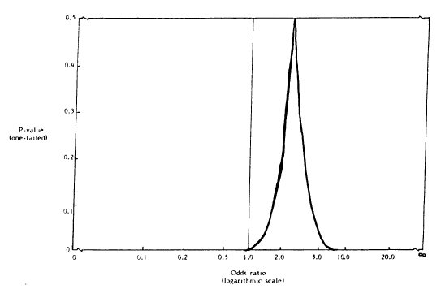
P-values: some common traps to avoid
The p-value > .05, therefore, β=0
Conceptually, can plot the p-value for tests of whether data arose from any in a range of coefficients
P-value=1 when testing against the exact point estimate you found in your data. That’s the coefficient most consistent with your data.
In the two situations above, the point estimate is the same, but there is more precision in the right hand panel than the left.
From: Poole, Beyond CIs, 1987
Notes:
22

Slide 23
Confidence Intervals
The set of parameter values for which the P-value exceeds some threshold, e.g., 0.05
Calculate the P-value comparing the observed data to a particular “truth” (e.g., beta=0, 0.1, 0.2, 0.3…4.0, 4.1)
Identify the range of possible betas for which the P-value is >0.05
That’s the 95% confidence interval for the beta
A 95% CI will over unlimited repetitions contain the true parameter at least 95% of the time (if statistical model is correct and there’s no bias)

Slide 24
Confidence Intervals
A 95% CI will over unlimited repetitions contain the true parameter at least 95% of the time (if statistical model is correct and there’s no bias)
CI gives you more information on how much you’ve learned from the study compared to just a p-value
  Very wide CI: not much info.
  i.e., large SE and large variance
  Sometimes show SE instead of CI
Often the CI is just used as significance tests: if the CI doesn’t include the null, P<.05 for test of the null. This is ignoring advantages of the CI.

Slide 25
P-value misuse rampant
ASA issued a statement
Many journals essentially ban p-values
The use of P-value thresholds (* indicates P<.05) is even worse.
  Encourages binary thinking: P<.05, so it’s true!!!
  Nobody can even back-calculate the SEs to use your results in future work

Slide 26
Standard Errors
But you may have an estimator for which the sampling distribution is not known, or at least not known by either you or Stata.
For example:
The 25th percentile minus the 75th percentile
The difference between two regression coefficients estimated from the same data in non-nested models.
  Eg immediate risk vs cumulative risk models
The mean predicted value for the top 20% of the distribution if you estimate among women only versus if you estimate among everyone.
Notes:
26

Slide 27
Standard Errors: Bootstrap
In these cases, the bootstrap is very useful.
Conceptually, estimate the parameter over and over again in new samples,
Except instead of actually drawing new samples just a resample of the original sample
If you resample without replacement, there’s no new information!
If you resample with replacement, some people are represented multiple times, and some people not at all
Notes:
27

Slide 28
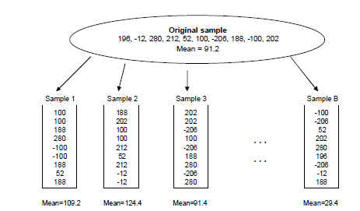
Bootstrapping
Useful if you can estimate the parameter, but you don’t know how to calculate the standard error for that parameter estimate.
Resample your original sample with replacement, to create a new population of the same size
In the new sample, estimate the parameter.
Repeat this a bunch of times (e.g. 1,000)
Look at the distribution of your parameter estimate in each of the new samples.
What is the variance of the estimate across samples?
From Barker, paper PK02
Notes:
28

Slide 29
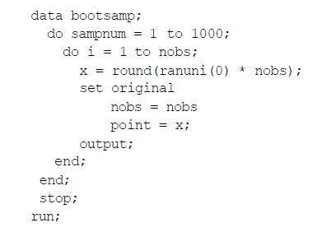
Bootstrapping
Resample the sample following the same structure used to draw the original sample
If the original sample was clustered, resample the clusters
In STATA, the command to bootstrap is really straightforward: “bootstrap” or now “bs …. : reg…” or “bs …: blah.do”.
In SAS, you need more code:
Then run your analysis with “by sampnum” and output the parameter estimate.
From Barker, paper PK02
Notes:
29

Slide 30
Bootstrapping: issues
The structure of the bootstrap resampling must match the structure of the original sample design. If the original sample design was clustered, the bootstrap must draw a clustered sample.
  Take a random sample of people, not of the observations on each person
  Take a random sample of neighborhoods, not of the observations within neighborhoods
  This means the resamples will not have the same number of observations as the original sample, but will have the same number of clustering unit
Notes:
30

Slide 31
Bootstrapping: issues
Sometimes the bootstrap doesn’t work. I don’t understand the rules, but ask a stats person before applying it for any specific estimator.
There is a large technical literature on “bias correction” in the bootstrap. In my experience, it doesn’t make a big difference.
  Take the 2.5th percentile and 97.5th percentile observations and use those as 95% CIs.
  Take the standard deviation of the effect estimates and use those to calculate the CI
    If you use this strategy, you have to decide if the center is the median of the bootstrapped estimates or the effect estimate in the primary sample
If you are calculating a familiar estimator (regression coefficients) with a straightforward standard error, you don’t need the bootstrap, but try it a few times to convince yourself that bootstrapping works.
Notes:
31

Slide 32
Note the parallel with multiple imputation
Estimate the missing value.
Estimate the parameter of interest (e.g your regression coefficient)
Add uncertainty to your parameter estimate to account for the uncertainty in the imputation of the missing value.
Notes:
32

Slide 33
Handling Missing Data: multiple imputation
Estimate the missing value.
  Use the observed values of that variable and all others to estimate the missing value.
  Estimate it as the predicted value conditional on the other covariates + a random error term, where the random term follows the overall distribution of the variable
  Repeat this several (e.g., 20) times: each time the “fixed” part is the same, but the random part differs.
  You now have several (e.g., 20) possible data sets
Notes:
33

Slide 34
Imputation: Multiple Copies of Dataset
From: CFDR, BGSU

Slide 35
Imputation: Iterative
Each imputation requires an assumed covariance matrix or regression model for the “fixed” part of the prediction, based on all the observed variables.
Once you have imputed, your best estimates of these coefficients will change.
So the computer iterates: estimate the covariance matrix, fill in the data, re-estimate the covariance matrix, fill in new data, re-estimate the covariance matrix… until it’s stable.
From: CFDR, BGSU

Slide 36
Handling Missing Data: multiple imputation
Estimate the missing value.
  You now have several (e.g., 20) possible data sets
Estimate the parameter of interest (e.g your regression coefficient)
  Derive one parameter estimate in each of the possible data sets.
  Now you have a distribution of estimates, some bigger, some smaller
  Within each data set, there are confidence bounds around the parameter estimate
Add uncertainty to your parameter estimate to account for the uncertainty in the imputation of the missing value.
Notes:
36

Slide 37
Handling Missing Data: multiple imputation
Estimate the missing value.
  You now have several (e.g., 20) possible data sets
Estimate the parameter of interest (e.g., your regression coefficient)
Add uncertainty to your parameter estimate to account for the uncertainty in the imputation of the missing value.
  Combine the two sources of uncertainty: within data set variance in your estimate + between data set variance in your estimate
Notes:
37

Slide 38
Multiple Imputation: a really nice picture
Rubin 1987
From: Von Hippel
Notes:
The fact that you get different results when you impute the data again
gives rise to the procedure of multiple imputation.
Let’s impute the data several times, look at how much our results vary, and incorporate that variation into our final estimates.
Multiple imputation has four steps.
First we replicate the incomplete data, making several copies.
Then we impute each copy separately.
Then we analyze each imputed copy separately.
Then we recombine the results of the separate analyses.

Slide 39
Handling Missing Data: multiple imputation
This is automated in SAS and Stata
Previously controversial because it is “making up data”, increasingly standard
Sometimes reviewers want to see it.
If there is only a small fraction of missing data, it probably won’t matter.
If there’s a lot of missing data, or highly scatter-shot missing data, it can be very helpful
Notes:
39

Slide 40
Sources of uncertainty
Is your code doing what you think it is doing?
If you repeated this again with all exact same sampling procedure, but draw a new sample, and apply identical analysis procedures, what would be the distribution of this parameter?
If I repeated this again, with identical data but left it to a reasonable scientist to make analytic decisions s/he thought best?
If I repeated this again in a new setting with different populations, measurement instruments, scientists… would I find the same result?
If I tried to test the theory in a whole new way, would I find the same result?

Slide 41
Scientific judgment: critical but often ignored source of uncertainty
Silberzahn and Uhlmann 2015

Slide 42
Sources of uncertainty
Is your code doing what you think it is doing?
If you repeated this again with all exact same sampling procedure, but draw a new sample, and apply identical analysis procedures, what would be the distribution of this parameter?
If I repeated this again, with identical data but left it to a reasonable scientist to make analytic decisions s/he thought best?
If I repeated this again in a new setting with different populations, measurement instruments, scientists… would I find the same result?
If I tried to test the theory in a whole new way, would I find the same result?

Slide 43
Meta-analyses
Meta-analyses can help with three categories of uncertainty
  Sampling variability because they effectively increase the sample size
  Researcher judgment uncertainty to extent that researchers are independent
  New setting uncertainty because often conducted with slight variations in population, measures, etc.

Slide 44
Meta-analysis of RCTs of vitamin D supplements and cancer mortality
Meta-analysis goal is to combine effect estimates usually weighting by the inverse of the variance (ie the information in the study).
No individual study convincing, but 3 studies, with nearly identical RRs, fairly convincing evidence

Slide 45
Bayesian approaches
Combine prior information with new evidence
You nearly always have a prior, either based on what is plausible or previous research
Technical tools to articulate that prior and incorporate into analyses
Informally: express priors as a small data set and combine with existing data before analyzing
Many settings where a version of Bayesianism is used
  Meta-analyses
  Multi-level models
  Positive predictive values
  Probability conclusions are false (Ioannidis “Why most published research findings are false”)

Slide 46
Sources of uncertainty
Is your code doing what you think it is doing?
If you repeated this again with all exact same sampling procedure, but draw a new sample, and apply identical analysis procedures, what would be the distribution of this parameter?
If I repeated this again, with identical data but left it to a reasonable scientist to make analytic decisions s/he thought best?
If I repeated this again in a new setting with different populations, measurement instruments, scientists… would I find the same result?
If I tried to test the theory in a whole new way, would I find the same result?

Slide 47
Triangulation
Strengthening causal inferences by integrating results from several different approaches, where each approach has different (ideally unrelated) key sources of potential bias – Lawlor (IJE 2016)
Key sources of bias in multivariable regression in observational data (dominant approach in epi)
  Unmeasured or poorly measured confounders
  Reverse causation
  Misclassification of exposure or outcome differential by the other
  Differential missing data

Slide 48
Triangulation: Alternative Approaches
Cross-context comparisons (new confounding structures)
  Breast feeding in high versus low income countries
Different control groups for case-control studies
Natural experiments (new confounding structures, biases likely to differ)
Within-person, within-family, within-twin studies
  controls many types of confounders, exacerbates other biases
IVs applied to RCTs
Negative controls defined by theory
  CSLs have no effect on health of college graduates

Slide 49
Conclusions: Uncertainty
You nearly always see only 1 iteration of your study, 1 sample, 1 set of sampling peculiarities, 1 version of the analyst making his or her innumerable arbitrary decisions, 1 study design with potential biases implicit to that design.
Seek replication and honest accounts of uncertainty
  Uncertainty within studies
  Uncertainty between studies
  Both contribute to uncertainty

Slide 50
end

Slide 51
Contextualizing Coefficients
Compare the magnitude to other variables, especially variables that are familiar to readers (e.g., age, sex, race). For example “Each additional year of education was associated with an increase of X points in performance on the cognitive test. The magnitude of this association was as large as the predicted difference between cognitive scores of a 75 vs 70 year old.”
Convert the outcome, the exposure, or both to z-scores.
  Usually not good to present everything this way, but it can be helpful to interpret one or two coefficients.
Dichotomize your exposure, or describe “The difference in predicted outcome for individuals at the 75th percentile of exposure compared to individuals at the 25th percentile of exposure was….”
Notes:
51

Slide 52
Choosing reference groups
Please make sure dichotomous variables are coded as 0/1.
Good reference groups:
  There are a lot of people in the group
  It represents some sort of standard comparison point
  It allows you to show the contrast you would like to show.
  For ex: If the coefficient for men is b=.2 (p=.2) and the coefficient for women is b=.5 (p=.01), then if you code *men* as the reference group, with an interaction between female*attachment, you could get a non-significant main effect for attachment and a non-significant interaction. Technically true, but maybe not the story you’d prefer to present.
Notes:
52

