Slide 1
Points of dispensing in rural Washoe County Elementary schools
Epidemiology 245 Final Project
Gap Analysis
Adrienne Lebsack, MPH

Slide 2
Gap
Lack of access to flu vaccinations in rural communities/zip codes in Washoe County Nevada.
Incidence of flu infection is much higher in these rural communities than in other communities in Washoe County.
Lack of medical access is present in these areas.

Slide 3
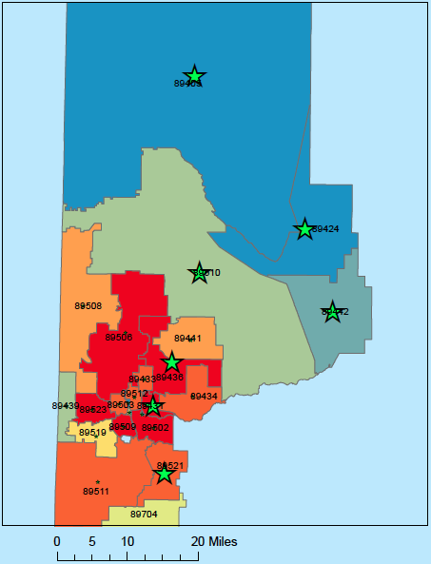
Seven Zip Codes for PODs:
89405, 89424, 89431, 89436, 89442, 89510, and 89521.

Slide 4
Seven Zip Codes in Washoe County
- 89521: level four income area, 84% White, 10% Hispanic, 6% Asian, semi-rural (Southeast Reno).
- 89436: level four income area, 82% White, 14% Hispanic, 4% Asian, semi-rural (Northern Sparks).
- 89510: level three income area, 78% White, 16% Native American, 6% Hispanic, rural location (Pyramid Lake area).
- 89405: level two income area, 80% White, 19% Hispanic, 1% Native American, rural location (Empire).
- 89431: level two income area, 60% White, 40% Hispanic, not rural (Sparks).
- 89442: level one income area, 64% Native American, 32% White, 4% Hispanic, rural location (Wadsworth).
- 89424: level one income area, 94% Native American, 3% Hispanic, 3% White, rural location (Nixon).

Slide 5
Impact of Vaccination
In October 2009, the United States employed a national influenza H1N1 vaccination campaign and it is estimated that roughly 41.2% and 43% of the U.S. population received the 2009–2010 and 2010–2011 influenza vaccines (CDC FluVaxView, 2011).
Following this campaign, the frequency of positive influenza cultures reported to the CDC quickly declined (Oshansky & Thomas, 2012).

Slide 6
Gap Analysis
Community level problem
Lack of knowledge and medical access
Immunize Nevada Program partnership
Washoe County Health District
Many stakeholders

Slide 7
Intervention
Actor: Elementary school personnel and nurses providing the vaccines
Action: provide influenza vaccinations and educate about the importance of vaccinations in a rural elementary school
Dose: flu vaccine with a nasal spray option
Temporality: prior to the beginning of flu season (September/October)
Targets: Parents of children in the elementary school to consent to at-school flu vaccination
Behavioral Targets: all eligible children in the rural elementary school vaccinated and family is educated to obtain vaccinations as well
Single component intervention.

Slide 8
Clinical Research Design
Pilot study: before and after: measure flu rates before intervention and after intervention in children in school and associated family members
Patient population: rural elementary school children in selected school
Measurements: Flu vaccine uptake, flu infection, family flu vaccination obtained, family flu infection
Confounders/Mediators: parents deny vaccination, parents forget to submit permission form, children absent from school on vaccination day, children already received flu vaccine.
Analytic Approach: send surveys and compare to school records to all children in the elementary school at the end of flu season

Slide 9
References
Broadbent, A. J. and K. Subbarao (2011). Influenza virus vaccines: lessons from the 2009 H1N1 pandemic. Current Opinion in Virology. 1(4): 254-262.
Centers for Disease Control and Prevention. (2014). Seasonal Influenza Vaccine Supply for the U.S. 2014-2015 Influenza Season. Retrieved from: http://www.cdc.gov/flu/about/qa/vaxsupply.htm
Heymann DL. (2015). Control of Communicable Diseases Manual. 20th Edition.
American Public Health Association. Influenza (Flu) Centers for Disease Control and Prevention. (2015, January 9). Retrieved from: http://www.cdc.gov/flu/
Oshansky CM, and Thomas PG. (2012). The human side of influenza. J Leukoc Biol. 2012 Jul; 92(1): 83–96. doi: 10.1189/jlb.1011506
The 2009 H1N1 Pandemic: Summary Highlights, April 2009-April 2010. Centers for Disease Control and Prevention. (2010). Retrieved from: http://www.cdc.gov/h1n1flu/cdcresponse.htm
U.S. Centers for Disease Control and Prevention (2011). FluVaxView: Influenza Vaccination Coverage. CDC, Atlanta, GA, USA
Washoe County 2009-10 Influenza Surveillance Summary. (2010). (1-13). Retrieved from: http://www.washoecounty.us/repository/files/4/Influenza-Summary-2009-2010.pdf
Washoe County 2012-13 Influenza Surveillance Summary. (2013). (1-13). Retrieved from: http://www.washoecounty.us/repository/files/4/Influenza-Summary-2012-2013.pdf

