Slide 1
Using Electronic Health Records for Research
Mark Pletcher
April 21, 2017

Slide 2
Course logistics
Final Project due on Monday (6 days)
  Submit to CLE
  Follow instructions carefully! Leave time!
  Grading considerations
    See News Post
  We will grade and return to you in 2 weeks
Course evaluations are IMPORTANT this year
  Please look for email with link
Any questions?

Slide 3
Lecture Outline
The Statin Duration Study
Opportunities and challenges to using EHR data for research
How EHR data flows at UCSF
  APeX→Clarity→Caboodle
  Different data models
  De-identified data – you can access it now!
Demonstration

Slide 4
The Statin Duration Study
Does longer duration of statin use help prevent MI?
  Statins work
  But how early in life should they be prescribed?
  Should we start during young adulthood?
The Statin Duration Study is a case-control study designed to examine the association between duration of statin use and incident MI among adults age 40-60 without prior MI prescribed a statin at least 2 years prior.

Slide 5
The Statin Duration Study
Can we use EHR data from UCSF patients to answer this question?

Slide 6
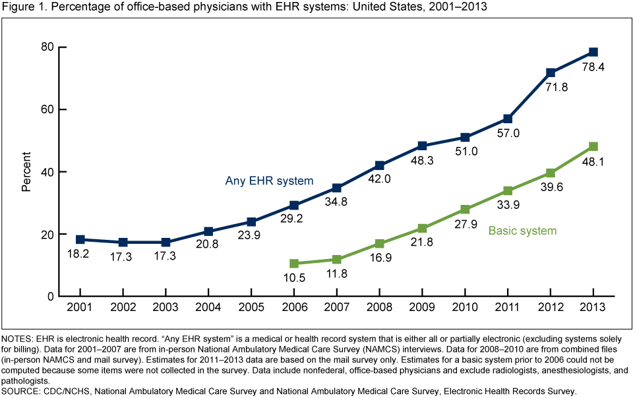
Opportunities
2017

Slide 7
Opportunities
For observational studies
Large repository of data ready for analysis
Real-world medical utilization patterns
For longitudinal research (including RCTs)
Follow up is “free”
For studies requiring participant contact
Recruitment easily targeted to specific types of patients
Extensive existing measurements → lower ppt burden (fewer surveys/forms)

Slide 8
Challenges
Collected for billing and clinical use, not research
  Example: diagnosis data (clinicians know how bad this is)
Data structure designed to facilitate user interface
Every system is different
  EPIC vs. Cerner vs. Others
  EPIC installations are all customized
Data collection (not just the measurement value) inherently depends on health status
  A recipe for selection bias
Confounding by indication
  Medical care is not provided at random
People get care at more than one location
  Follow up not complete
  Claims data more complete, but less rich (no lab values, etc)

Slide 9
Challenges
Diagnosis data
Medication data
Lab data
Other numeric data (blood pressure, ejection fraction)
Text data

Slide 10
Challenges
Diagnosis data
  Sources
    Event-based (every visit, every lab)
    On Problem List
  Categories are sometimes hard
    Garbage in vs. omitted (vs. time to get it right)
  ICD10 vs. ICD9
    Different codes
    Requires extreme detail

Slide 11
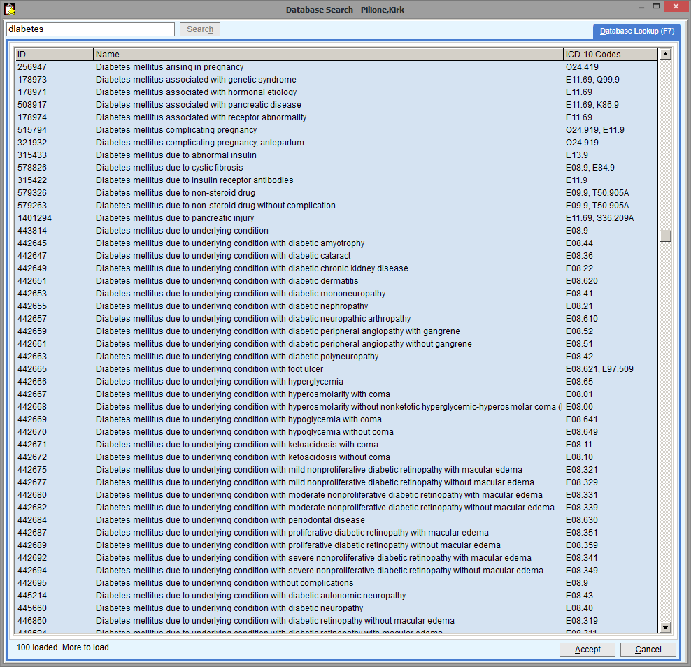

Slide 12
Challenges
Medications data
  Also coded, but it works better
  But many sources
    Prescribing event
    Dispensing in facility
    Dispensing at pharmacy
    Med List
  How do you define what a patient is actually taking?
    Med list (hard to find, not necessarily updated, single snapshot)
    Start date easier than end date?
    “Medication possession ratio”, etc
      Requires pharmacy claims!

Slide 13
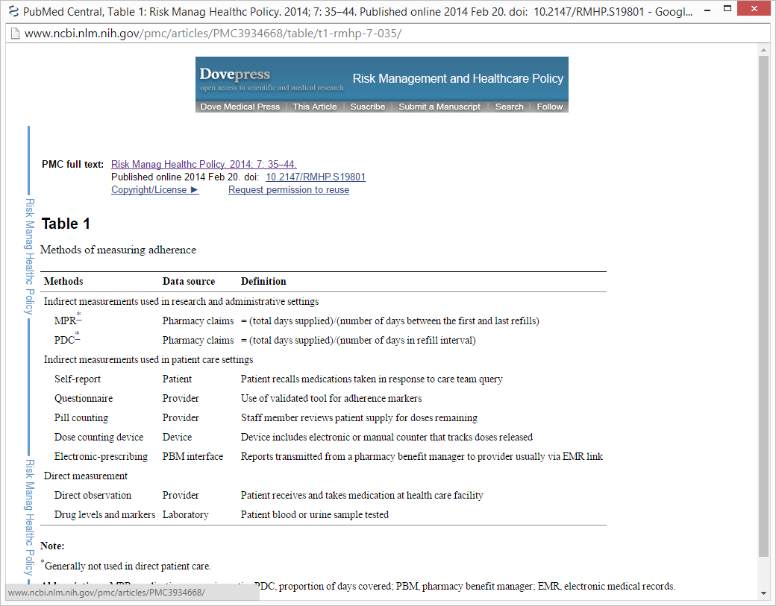
http://www.ncbi.nlm.nih.gov/pmc/articles/PMC3934668/

Slide 14
Challenges
Laboratory data
  Oldest and cleanest?
    STOR data going back decades...
  Units, normal ranges, comparability are often questionable

Slide 15
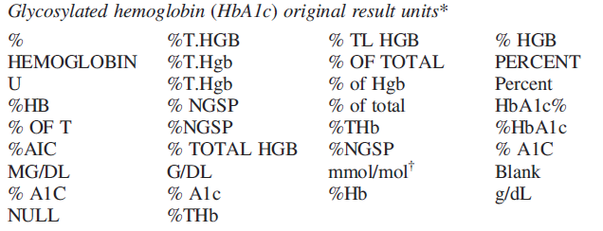
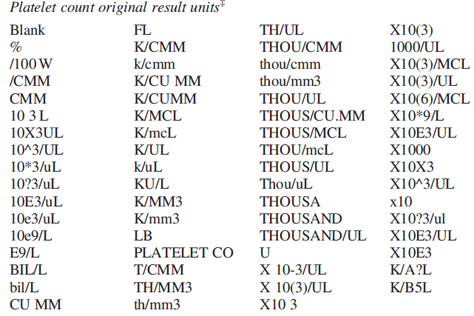
Slide from Mini-Sentinel and PCORnet
(courtesy of Lesley Curtis)
34 different result units for HbA1c
68 different result units for platelets
Source: Electronic clinical laboratory test results data tables : lessons from Mini Sentinel
MarshaA.Raebel1,,KevinHaynes,Tiffany S. Woodworth, Gwyn Saylor, Elizabeth Cavagnaro , Kara O. Coughlin, Lesley H. Curtis, Mark G. Weiner, Patrick Archdeacon and Jeffrey S. Brown

Slide 16
Challenges
Other numeric data...2 examples
  Blood pressure
    Context important?
    In Emergency Dept vs. clinic, clinician-reported vs. dinamap, which arm, etc
    Often need the “metadata”
  Ejection fraction
    Radiology/Cardiology reports – structured free text?
    Code at UCSF – extracts from ~100 sources!
    (thanks to Alvin Rajkomar)

Slide 17
Challenges
Text data from written notes
  Progress notes, discharge summary, nurses notes, etc
  Extremely important information...but hard to “mine”
  Whole science of natural language processing (“NLP”)
    Find concepts (e.g., heart attack, myocardial infarction, MI)
    Identify “negation” language (e.g., “No ___”, “rule out”, “r/o”)

Slide 18
Challenges
Other special data types
  EKG signals
  Imaging files
  Etc

Slide 19
UCSF Resources
IT (Information Technology)
  Responsible for maintaining the enterprise infrastructure (warehouse, assets, access)
  Rick Larsen and Academic Research Systems
ICHS (Institute for Computational Health Sciences)
  Responsible for cutting edge methods development and research
  Atul Butte and Sharat Israni
CTSI (Clinical and Translational Sciences Institute)
  Responsible for improving systems for researchers
  Informatics and Research Innovation (IRI) Program and Consultation Services (CS) Program
IT
ICHS
CTSI

Slide 20
UCSF Resources
IT
ICHS
CTSI
Electronic health record data

Slide 21
UCSF Resources
IT
ICHS
CTSI
Major new collaborative efforts
  “Colloquium” on May 10 2017
  Data.ucsf.edu
  Reorg of services
  Data enhancements
    Death data
    Location/geospatial data
    Next generation data warehouse
  New methods (e.g., NLP)

Slide 22
Data Models
Data exist in different “models” (relational tables with variable names and coding schemes)
Tradeoffs
  Simplicity/intuitive organization vs. completeness
  Commonality across institutions vs. information loss/integrity

Slide 23
Data Models
Real-time data needs (e.g., ED recruiting)
EPIC EHR System (“APeX”)
Hierarchical (“Chronicles”)
EPIC-designed ETL (once a day)
Clinical/Ops “dashboards”
Clarity
13,000 tables
EPIC-designed ETL
Caboodle
200+ tables
OMOP
18 tables
PCORnet
15 tables
i2b2
Research datasets
Counts (IDR, UCReX)
EPIC products
Common data models

Slide 24
Data Models
APeX Chronicles
Backend for clinical interfaces
Only for “point of care” real-time clinical needs
Real-time data needs (e.g., ED recruiting)
EPIC EHR System (“APeX”)
Hierarchical (“Chronicles”)
EPIC-designed ETL (once a day)
Clinical/Ops “dashboards”
Clarity
13,000 tables
EPIC-designed ETL
Caboodle
200+ tables
OMOP
18 tables
PCORnet
15 tables
i2b2
Research datasets
Counts (IDR, UCReX)
EPIC products
Common data models

Slide 25
Data Models
Clarity
You can find “everything” here
You can’t analyze it directly without training in Wisconsin...
Only “Honest Brokers” can access
Real-time data needs (e.g., ED recruiting)
EPIC EHR System (“APeX”)
Hierarchical (“Chronicles”)
EPIC-designed ETL (once a day)
Clinical/Ops “dashboards”
Clarity
13,000 tables
EPIC-designed ETL
Caboodle
200+ tables
OMOP
18 tables
PCORnet
15 tables
i2b2
Research datasets
Counts (IDR, UCReX)
EPIC products
Common data models

Slide 26
Data Models
Caboodle
Logical rearrangement of Clarity
Little information loss
De-identified tables available
  https://myresearch.ucsf.edu/research-data-browser-de-identified-export-and-flowsheet-files
Real-time data needs (e.g., ED recruiting)
EPIC EHR System (“APeX”)
Hierarchical (“Chronicles”)
EPIC-designed ETL (once a day)
Clinical/Ops “dashboards”
Clarity
13,000 tables
EPIC-designed ETL
Caboodle
200+ tables
OMOP
18 tables
PCORnet
15 tables
i2b2
Research datasets
Counts (IDR, UCReX)
EPIC products
Common data models

Slide 27
OMOP
Common data model
  http://www.ohdsi.org/web/wiki/doku.php?id=documentation:cdm
Community/tools
  https://www.ohdsi.org/
Cross-UC data warehouse coming
Data Models
Real-time data needs (e.g., ED recruiting)
EPIC EHR System (“APeX”)
Hierarchical (“Chronicles”)
EPIC-designed ETL (once a day)
Clinical/Ops “dashboards”
Clarity
13,000 tables
EPIC-designed ETL
Caboodle
200+ tables
OMOP
18 tables
PCORnet
15 tables
i2b2
Research datasets
Counts (IDR, UCReX)
EPIC products
Common data models

Slide 28
PCORnet
Common data model
  http://www.pcornet.org/wp-content/uploads/2014/07/2015-07-29-PCORnet-Common-Data-Model-v3dot0-RELEASE.pdf
Research network
  http://www.pcornet.org/
Good(?) for major multisite research projects
Data Models
Real-time data needs (e.g., ED recruiting)
EPIC EHR System (“APeX”)
Hierarchical (“Chronicles”)
EPIC-designed ETL (once a day)
Clinical/Ops “dashboards”
Clarity
13,000 tables
EPIC-designed ETL
Caboodle
200+ tables
OMOP
18 tables
PCORnet
15 tables
i2b2
Research datasets
Counts (IDR, UCReX)
EPIC products
Common data models

Slide 29
i2b2
Back end database for simple user interface and count querying
  Integrated data repository
    https://it.ucsf.edu/services/integrated-data-repository
  UCReX
    Access: https://myresearch.ucsf.edu/uc-rex
    About: https://www.ucrex.org/
Not currently recommended
Data Models
Real-time data needs (e.g., ED recruiting)
EPIC EHR System (“APeX”)
Hierarchical (“Chronicles”)
EPIC-designed ETL (once a day)
Clinical/Ops “dashboards”
Clarity
13,000 tables
EPIC-designed ETL
Caboodle
200+ tables
OMOP
18 tables
PCORnet
15 tables
i2b2
Research datasets
Counts (IDR, UCReX)
EPIC products
Common data models

Slide 30
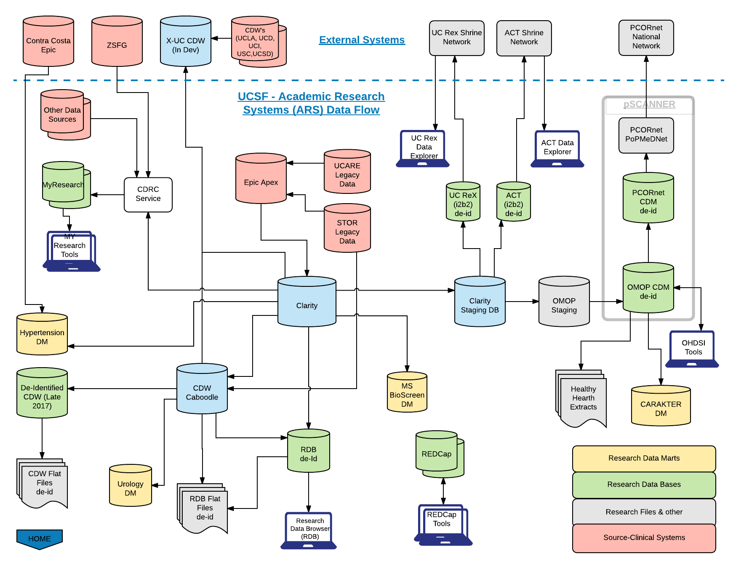
Data Flow at UCSF

Slide 31
Data Flow at UCSF

Slide 32
Who can help you get EHR data?
For quality improvement, administration
  Various APeX Reporting teams
For research
  CTSI Data Management and Extraction → IT/ARS
    CTSI – Clinical and Translational Sciences Institute
    ARS – Academic Research Systems
  Self-serve (de-identified “flat files”)
Start here: data.ucsf.edu

Slide 33
Statin Duration Study
Let’s get some data and try this out!

Slide 34
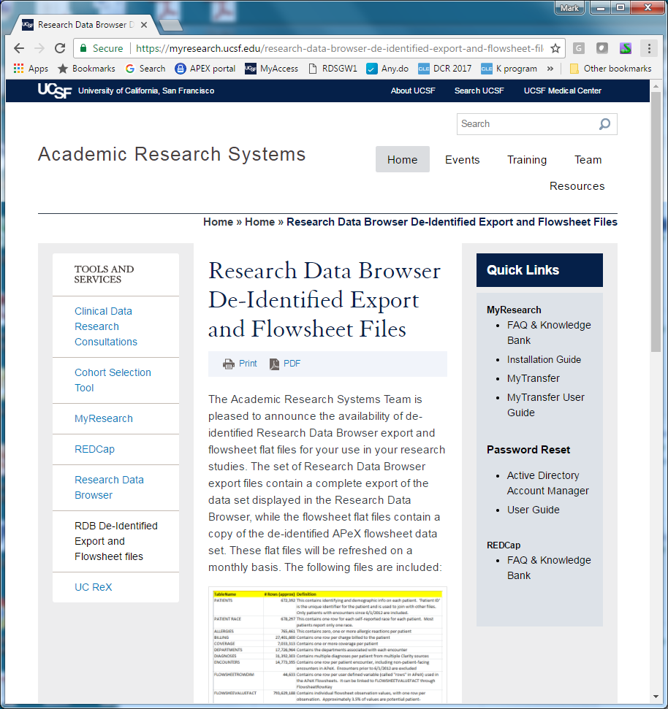
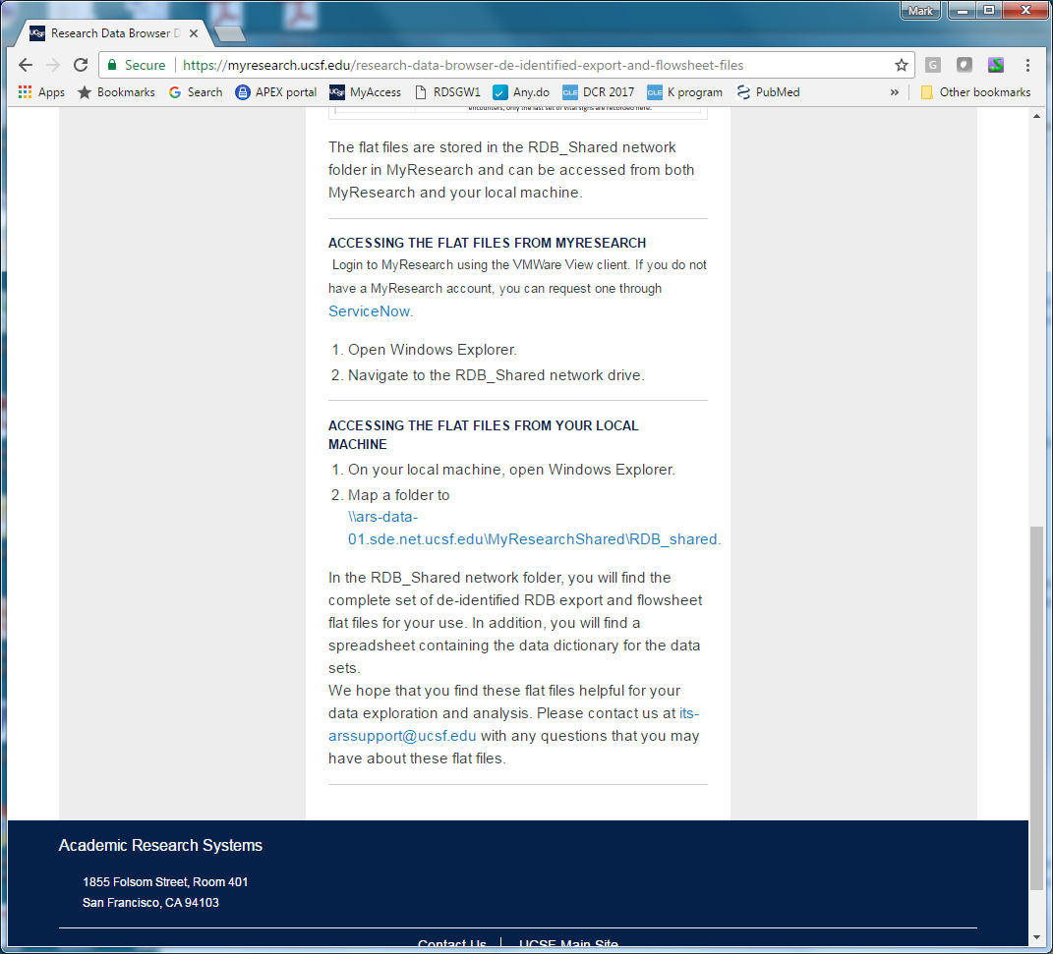
“De-identified flat files”
https://myresearch.ucsf.edu/research-data-browser-de-identified-export-and-flowsheet-files

Slide 35
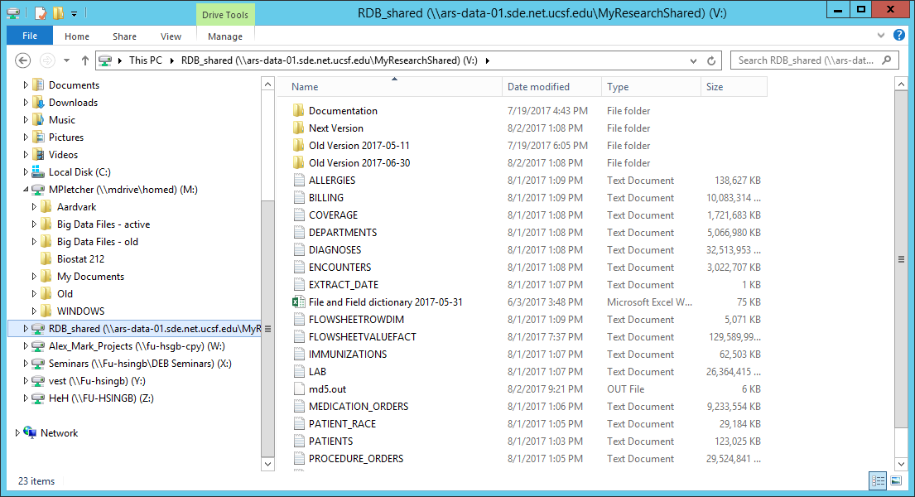
Mapped drive on my UCSF computer
  Direct access!

Slide 36
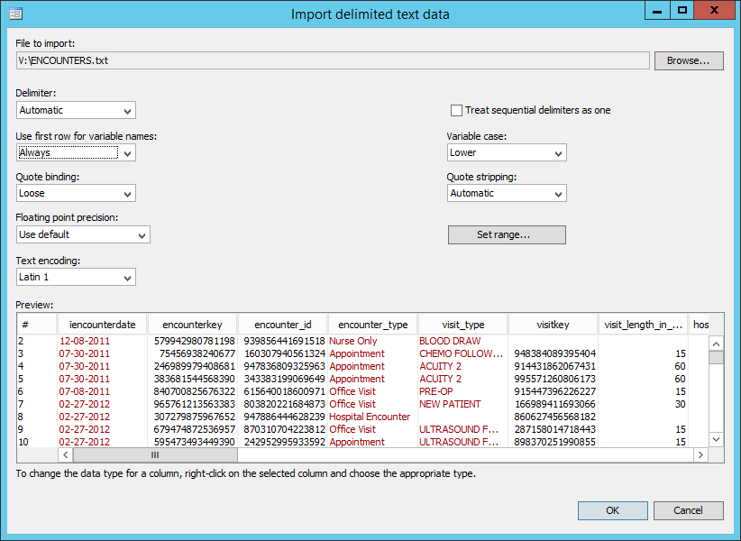
In Stata:
File: Import/text data (delimited…)

Slide 37
Size of UCSF data
904,380 patients
25,068,998 encounters
51,637,882 diagnoses
24,961,248 medication orders
79,028,248 lab test results

Slide 38
Importing large text file into Stata
How long do you think this took to run?
import delimited V:\LAB.txt, varnames(1)
save "lab.dta", replace
keep in 1/2000
save "lab_small.dta", replace
A - 8 seconds
B - 8 minutes
C - 80 minutes
D - 8 days

Slide 39
Importing large text file into Stata
How long do you think this took to run?
import delimited V:\LAB.txt, varnames(1)
save "lab.dta", replace
keep in 1/2000
save "lab_small.dta", replace
A - 8 seconds
B - 8 minutes
C - 80 minutes – 1 hour and 22 minutes
D - 8 days

Slide 40
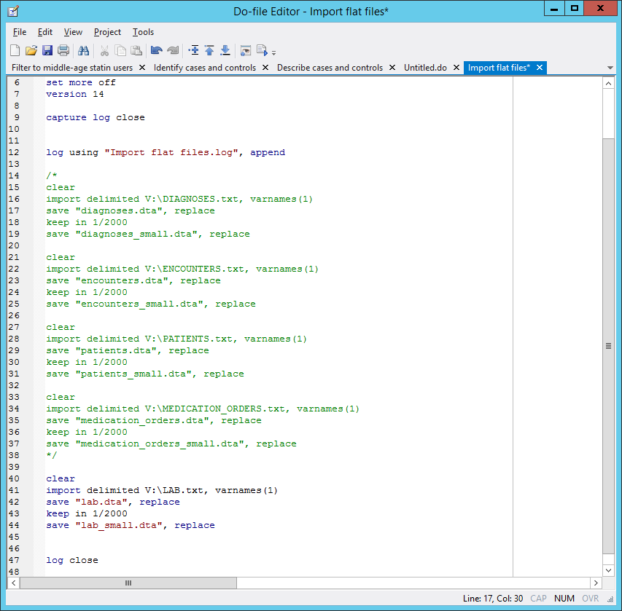

Slide 41
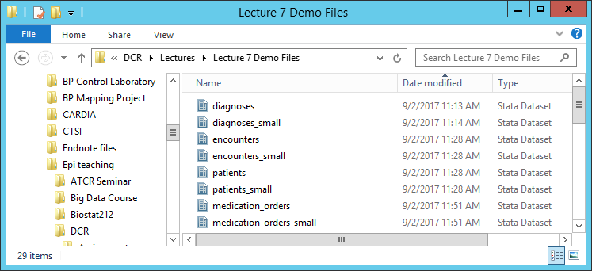

Slide 42
Lessons
One definition of Big Data is data that is inconvenient to analyze using standard methods…
I had to modify my Stata do file strategy…
  Import files in a batch, come back later
  Can’t rerun the whole input do file very easily
  Made “small” versions of each for iterating and debugging

Slide 43
Filter down quickly
Limit to age 40-60, and statin use for > 2 years

Slide 44
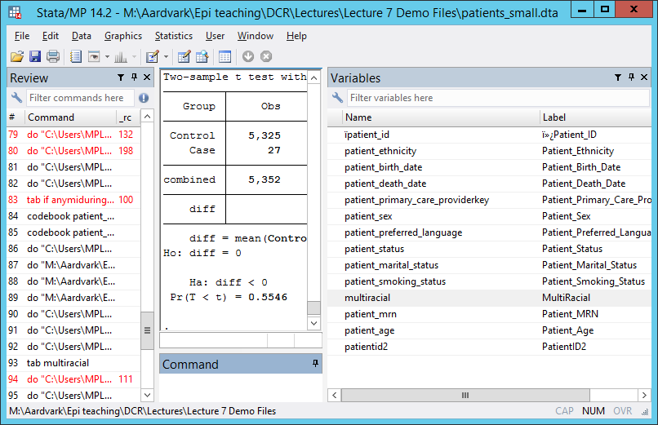
Is that age variable correct?
Limit to age 40-60, and statin use for > 2 years

Slide 45
Filter down quickly
Limit to age 40-60
gen dob = date(patient_birth_date, "MDY")
format dob %td
gen dayssincedob = d(1jan2017) - dob
gen age = trunc(dayssincedob/365)

Slide 46
Filter down quickly
Limit to statin use for > 2 years

Slide 47
Filter down quickly
Limit to statin use for > 2 years
gen statin = 0
replace statin = 1 if regexm(medname, "statin")

Slide 48
Results in “medication_orders_small.dta”
gen statin = 0
replace statin = 1 if regexm(medname, "statin")
Medication_Generic_Name | Freq. Percent Cum.
----------------------------------------+-----------------------------------
atorvastatin 10 mg tablet | 9 23.68 23.68
atorvastatin 20 mg tablet | 5 13.16 36.84
atorvastatin 40 mg tablet | 2 5.26 42.11
atorvastatin 80 mg tablet | 2 5.26 47.37
pravastatin 40 mg tablet | 2 5.26 52.63
rosuvastatin 5 mg tablet | 1 2.63 55.26
simvastatin 20 mg tablet | 14 36.84 92.11
simvastatin 40 mg tablet | 2 5.26 97.37
simvastatin 5 mg tablet | 1 2.63 100.00
----------------------------------------+-----------------------------------
Total | 38 100.00

Slide 49
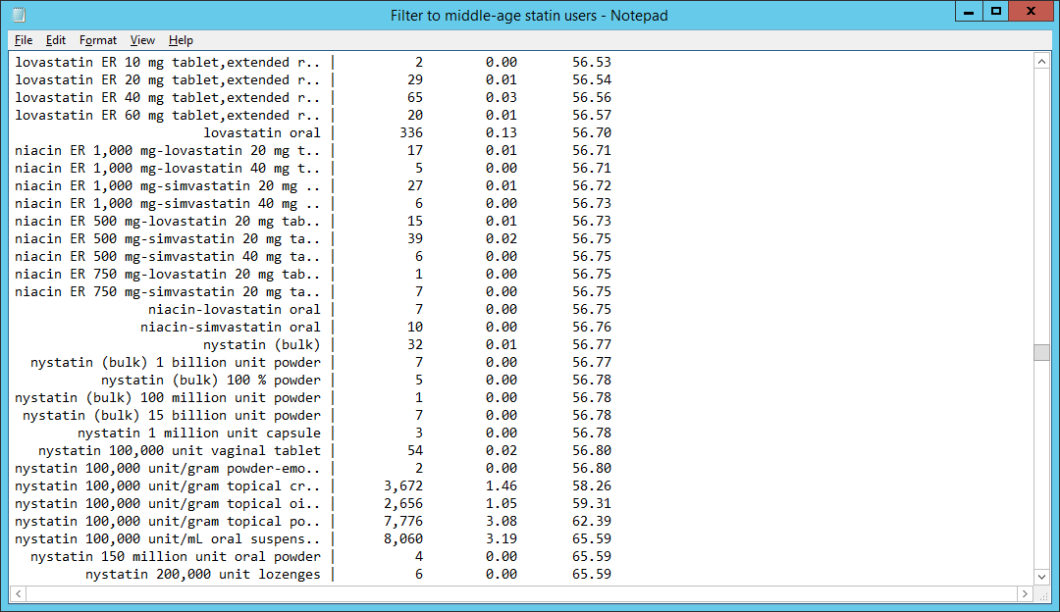
Results in “medication_orders.dta”
gen statin = 0
replace statin = 1 if regexm(medname, "statin")

Slide 50
This code seems to work
gen statin = 0
replace statin = 1 if regexm(medname, "statin")
replace statin = 0 if regexm(medname, “nystatin")
replace statin = 0 if regexm(medname, “cilastatin")

Slide 51
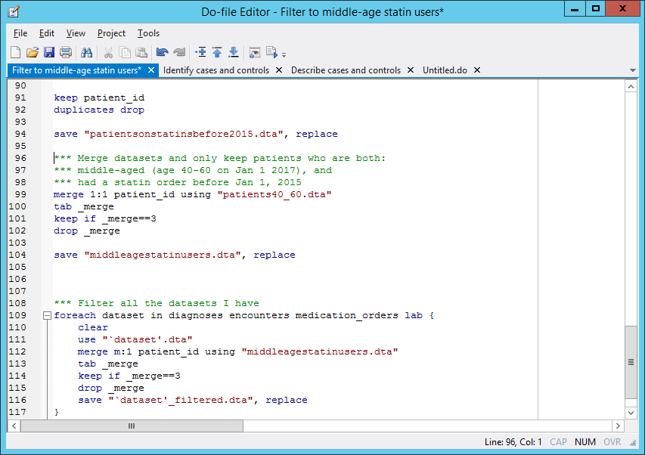

Slide 52
Filter down quickly
Limit to age 40-60, and statin use for > 2 years
904,380 → 12,884 patients
25,068,998 → 1,049,699 encounters
51,637,882 → 2,447,632 diagnoses
24,961,248 → 1,254,286 medication orders
79,028,248 → 3,993,158 lab test results

Slide 53
Filter down quickly
Limit to age 40-60, and statin use for > 2 years
904,380 → 12,884 patients
25,068,998 → 1,049,699 encounters
51,637,882 → 2,447,632 diagnoses
24,961,248 → 1,254,286 medication orders
79,028,248 → 3,993,158 lab test results
(1 hour and 8 minutes)

Slide 54
Lessons
Dates are inherently important
  Time series data with repeated observations over time
  Learn to handle dates in your analysis
  Think through “index dates” and date-related case definitions when you plan your study
LOTS of weird variability in the dataset
  Inspect, check, recheck; use full dataset

Slide 55
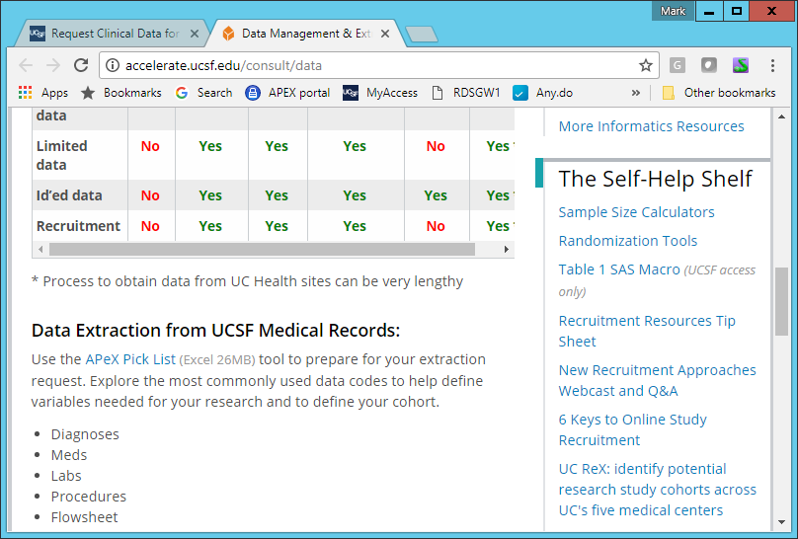
If you don’t use Stata…

Slide 56
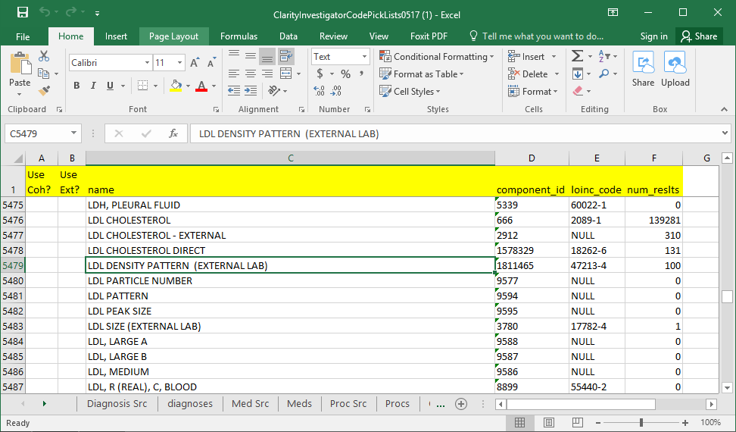
If you don’t use Stata…

Slide 57
If you don’t use Stata…

Slide 58
Lessons
Dates are inherently important
  Time series data with repeated observations over time
  Learn to handle dates in your analysis
  Think through “index dates” and date-related case definitions when you plan your study
LOTS of weird variability in the dataset
  Inspect, check, recheck; use full dataset
  …Or use the APeX Pick List
    Excel file with all values and frequencies in the database

Slide 59
Define cases and controls
Diagnosis of myocardial infarction (MI)

Slide 60
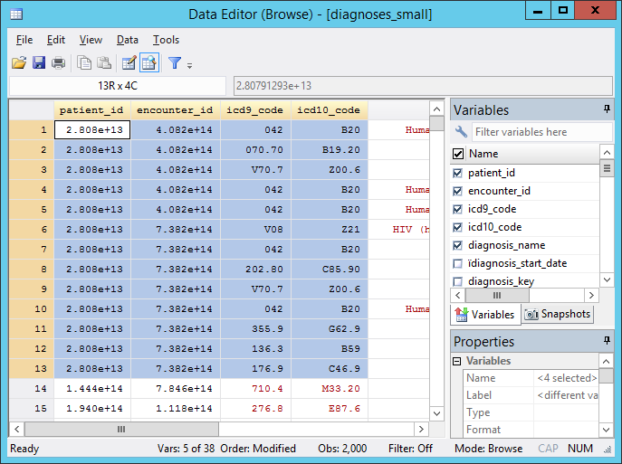
Multiple encounters per pt
Multiple diagnoses per encounter
Diagnosis of myocardial infarction (MI)

Slide 61
ICD9 and ICD10 codes for each diagnosis!
Diagnosis of myocardial infarction (MI)

Slide 62
ICD9 and ICD10 code lookup sites
http://www.icd10data.com/ICD10CM/Codes
http://icd9cm.chrisendres.com/

Slide 63
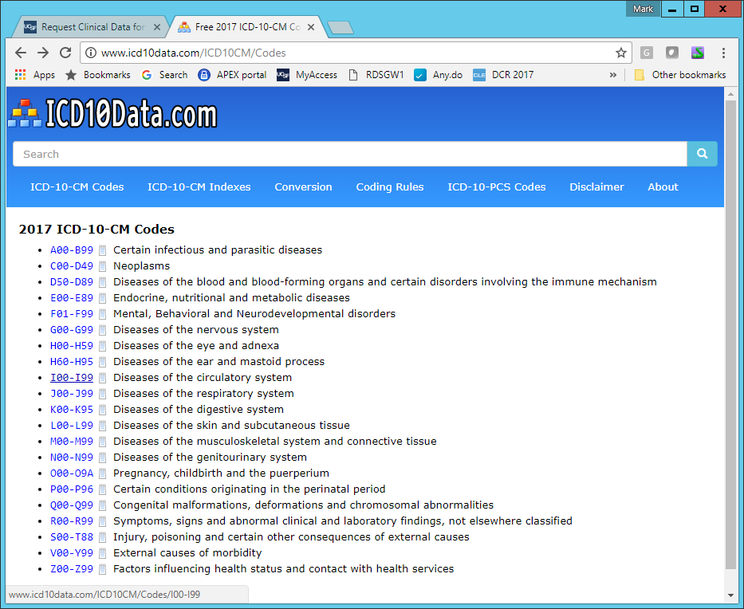

Slide 64
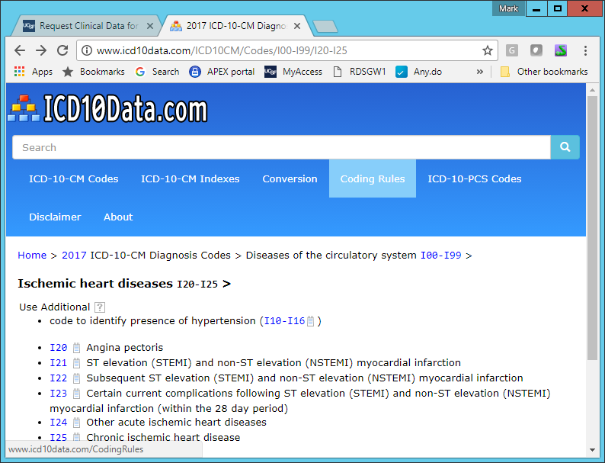

Slide 65
This code seems to work:
gen mi = 0
replace mi = 1 if regexm(icd10_code, "^I21")
replace mi = 1 if regexm(icd9_code, "^410")

Slide 66
Define cases and controls
Of 12,786 patients
  433 had an MI before 2015 - excluded
  5,566 had at least one diagnosis during 2016
5325 eligible
  27 had an MI in 2016 = CASES
  5325 did not = CONTROLS

Slide 67
Describe cases and controls
Cases Controls
Characteristic n=27 n=5325
Age 54.6 53.6
% male 52% 62%
% Hispanic 15% 13%

Slide 68
Describe cases and controls
Cases Controls
Characteristic n=27 n=5325
Age 54.6 53.6
% male 52% 62%
% Hispanic 15% 13%
Statin duration 3.7 +/-.19 3.8 +/- .013
p=.89

Slide 69
Lessons
Need more cases!
  Cross-UC data warehouse? PCORnet?

Slide 70
Lessons
Moderately complex structure
  1:m relationships
    Patients: Encounters
    Encounters: Diagnoses
    Encounters: Labs
    etc
  Learn how to merge, de-duplicate, “egen”, etc
Get familiar with icd9 and icd10 coding
  Learn how to search strings

Slide 71
Summary
EHR provides big source of cheap “real-world” data
  Still relatively new and underutilized
Access issues are getting solved
  Get your hands on it and start analyzing
  Valued skill
Challenges
  Data structure, cleaning, manipulation
  Interpretation issues

Slide 72
Questions?
Stata do files uploaded to syllabus:
  “Import flat files.do”
  “Filter to middle-age statin users.do”
  “Identify cases and controls.do”
  “Describe cases and controls.do”

Slide 73
Advanced topics not covered…
Learning Health System Projects
  Embedding randomization to learn from patient care
Pragmatic trials
  Using the EHR to find patients, measure outcomes
API-based methods of accessing health data
  Allowing patients to “donate” their data for research
  HL7, FHIR, other formats for server→server interactions

