Slide 1


REDCap
Demonstration
Lecture
Jennifer Creasman, MSPH
Director, Consultation Services, Data Managment Unit
Director, Patient Recruitment ServicesEmail: Jennifer.creasman@ucsf.edu

Slide 2

Consultation Services (CS)
Expert advice is provided in a wide range of subject areas, including:
  Bioinformatics Data Analysis
  Biostatistics
  Data Management
  Study Design & Implementation
  Recruitment Services
  All services are available on a fee-for-service basis, after the initial consultation, which is free.
For more information on any services offered by CTSI Consultation Services, visit http://accelerate.ucsf.edu/consult
or contact CTSI.Consulting@ucsf.edu

Slide 3
Outline
Practical Data Management Guidance
REDCap Background/Advantages/Disadvantages
REDCap Overview
Questions

Slide 4
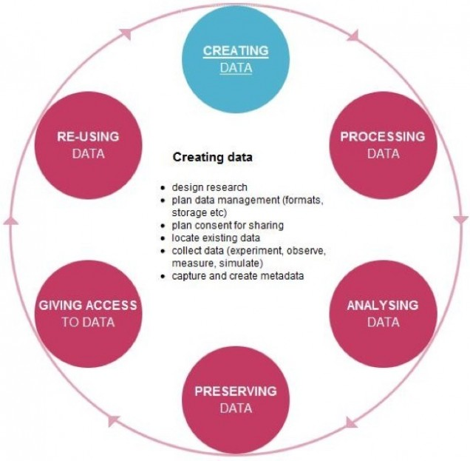
Data Life Cycle
http://www.bu.edu/datamanagement/background/data-life-cycle/

Slide 5





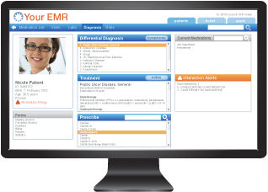


Data Life Cycle
Creating Data
Processing Data
Analyzing Data

Slide 6
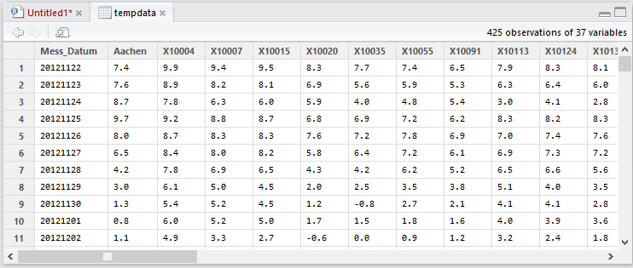
Data Life Cycle
Creating Data
Processing Data
Analyzing Data
Objective: Create an analyzable data frame

Slide 7




Data Life Cycle
Creating Data
Processing Data
Analyzing Data

Slide 8
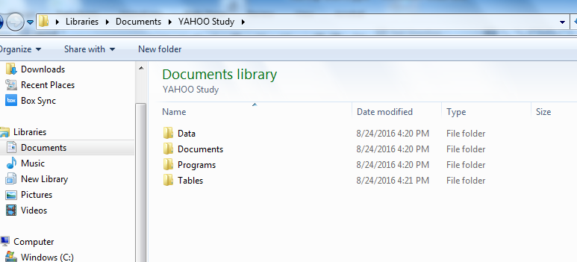
How to Deliver Data to Your Statistician
Data delivery check list
The raw data
A tidy data set
A code book describing each variable and its values
Explicit instructions on how to derive your variables
From the Leek Group Guide to Sharing (https://github.com/jtleek/datasharing)

Slide 9
How to Deliver Data to Your Statistician: Tidy Dataset
General Principles of a Tidy Dataset
Each variable should be in one column
Each observation should be in a different row
First row contains column names
If you have multiple tables, each table should include a column that allows the tables to be linked
From the Leek Group Guide to Sharing (https://github.com/jtleek/datasharing)

Slide 10
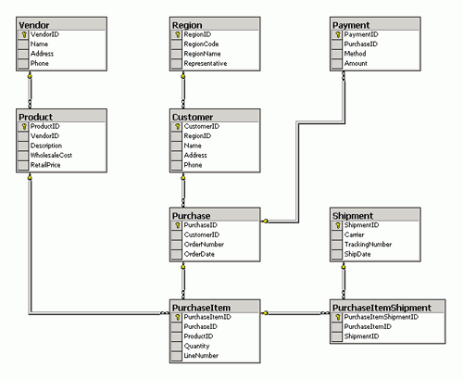
How to Deliver Data to Your Statistician: Tidy Dataset
Each table should include a column
that allows
the tables
to be linked

Slide 11
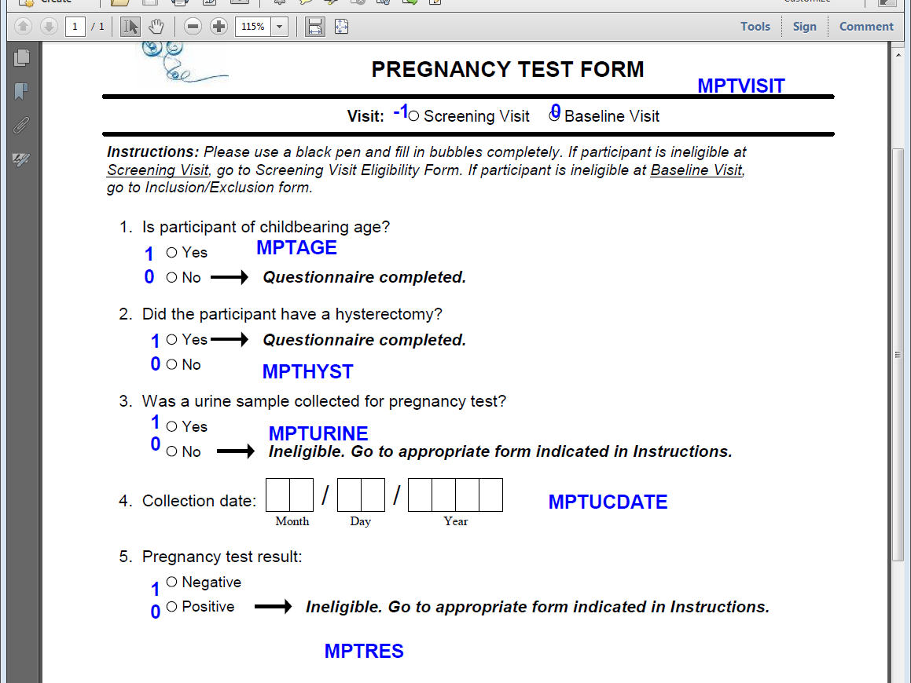
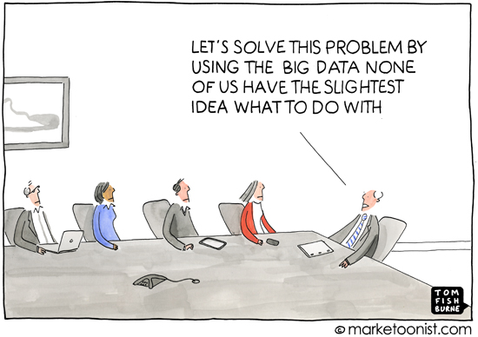
How to Deliver Data to Your Statistician: Code Book
What to include in your code book
Description of how the data was collected.
Information about the variables included in the tidy dataset (variable label, units, response definitions, data type)
Relationships between tables
If from a questionnaire,
From the Leek Group Guide to Sharing (https://github.com/jtleek/datasharing)

Slide 12
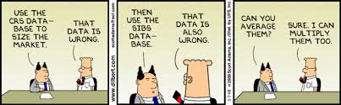
How to Deliver Data to Your Statistician: Instructions
Provide an explicit and exact recipe for new calculated variables
Instructions describing how to calculate a comprehensive score
Clear instructions on how to define calculated variables
  Primary outcome: percent change at week 12 from baseline
  ([baseline].[leak] - [week_12].[leak])/ [baseline].[leak]
Describe how data should be summarized
(i.e., take first lab chronologically before the visit)
Describe how missing values should be treated
From the Leek Group Guide to Sharing (https://github.com/jtleek/datasharing)

Slide 13
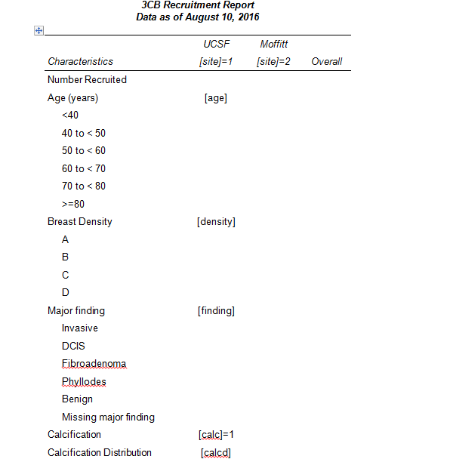
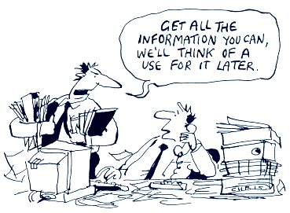
How to Deliver Data to Your Statistician: Tidy Dataset
Start with your primary aim.
Get the data you REALLY need!
Build your story from there.
Review the literature – what variables are expected to be there?
Create Mock tables/Empty tables shells

Slide 14
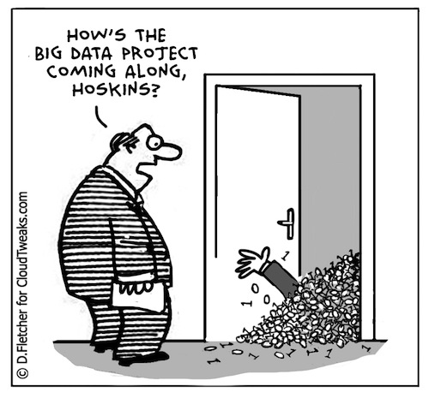
What to Expect from the Analyst
Careful inspection
  Your statistician should check your recipe, ask questions and try to confirm that they are obtaining the same answer that you are intending to get.
  Careful statisticians will perform spot checks to ensure the data are tidy.
Description of methods
The computer code used to run the analysis
Output and figures
From the Leek Group Guide to Sharing (https://github.com/jtleek/datasharing)

Slide 15
How to Deliver Data to Your Statistician
Provide a tidy dataset
Provide a codebook (or annotated forms)
Start with the data you need
Provide instructions
  Variable definitions
  Mock tables
It takes work!
From the Leek Group Guide to Sharing (https://github.com/jtleek/datasharing)

Slide 16
REDCap
Research Electronic Data Capture

Slide 17
Background of REDCap
Research Electronic Data Capture
Developed by an informatics core at Vanderbilt University in 2004 to address common problems for academic biomedical research
Available free to UCSF researchers through UCSF Academic Research Systems – https://it.ucsf.edu/services/redcap
Reference: Paul A. Harris et al. (2009). "Research electronic data capture (REDCap) – A metadata-driven methodology and workflow process for providing translational research informatics support". Journal of Biomedical Informatics 42 (2): 377–381. doi:10.1016/j.jbi.2008.08.010

Slide 18
Features of REDCap
Hosted on a secure server, maintained with nightly backups and security updates
Web-based (secure connection via internet) with several levels of permissions for users
Longitudinal Study capability
Survey capability (including automated email invitations)
Exports to common stat package formats
Audit trail for tracking data manipulation and export
Classroom and online training resources
Active user community (164,000 users)
Code book (data dictionary)
http://project-redcap.org/

Slide 19
Limitations of REDCap
Limited ways to set up relational data, flat file
Limited data management features
  - Very simple data viewing, querying capabilities
  - No data manipulation or analysis tools
Limited advanced programming features
Rigid navigation

Slide 20
Why use REDCap? …versus
Hosted on a secure server, maintained with nightly backups and security updates
Web-based (secure connection via internet) with several levels of permissions for users
Longitudinal Study capability
Survey capability (including automated email invitations)
Exports to common stat package formats
Code book (data dictionary)
Audit trail for tracking data manipulation and export
Classroom and online training resources
Active user community (164,000 users)
Data is accessible via Application Program Interface (API)
FREE
http://project-redcap.org/

Slide 21
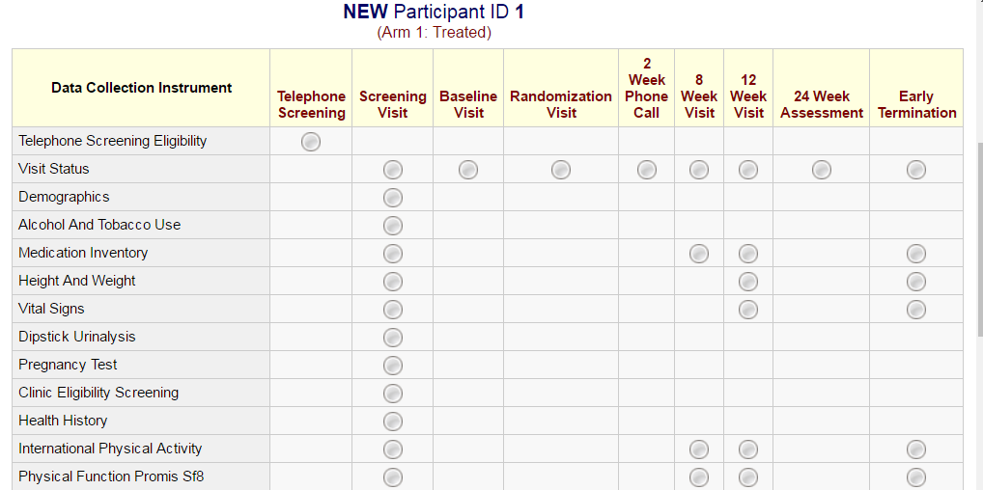
Longitudinal REDCap Project

Slide 22
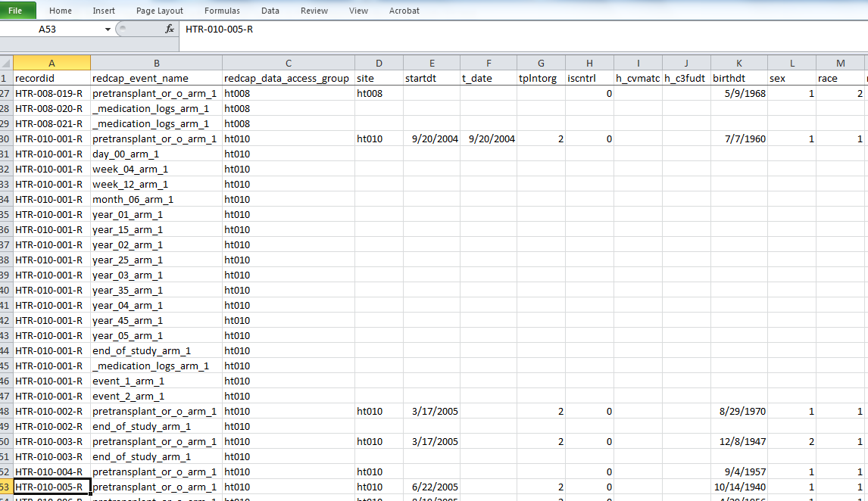
Data from REDCap

Slide 23
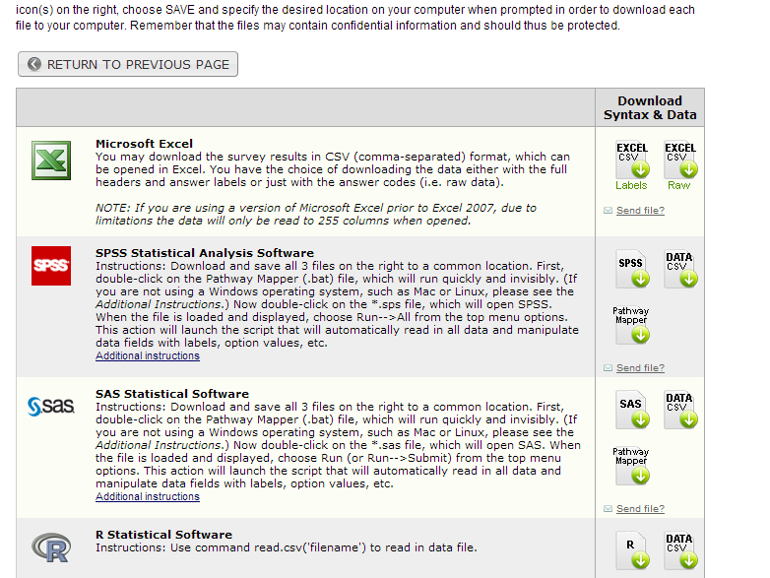
SAS Ready Datasets
Export
*.csv Raw vs Labels
SAS files include data labels and formats
Import
Recordid must be the first variable
All data must have the same format as indicated in the data forms (variable name and values)
REDCap will provide errors if variables names or values do not match
Include “arm”, “visit” and group information

Slide 24
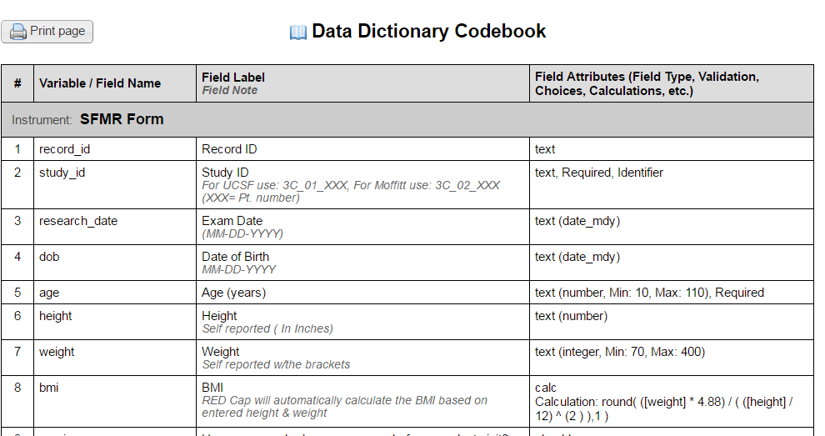
REDCap Codebook

Slide 25
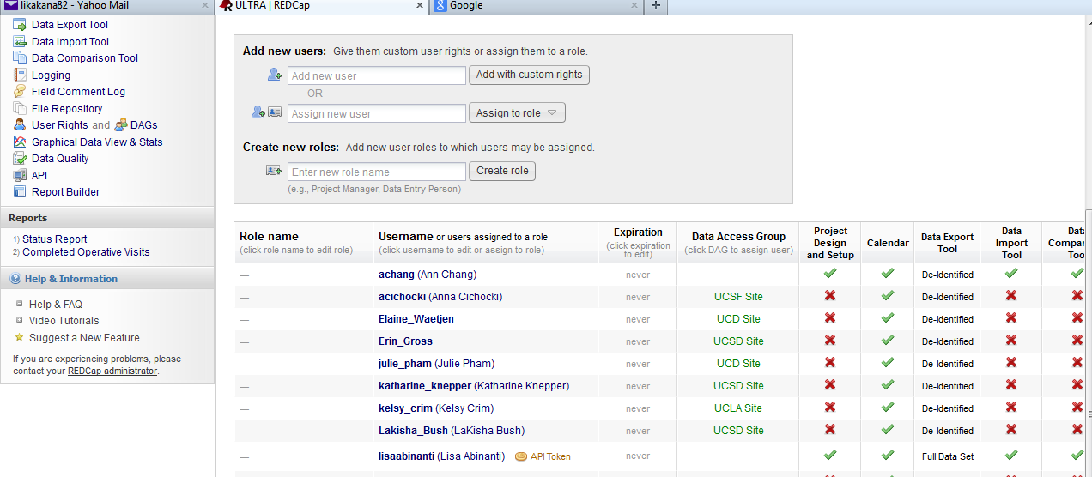
User Rights/Defining Groups

Slide 26
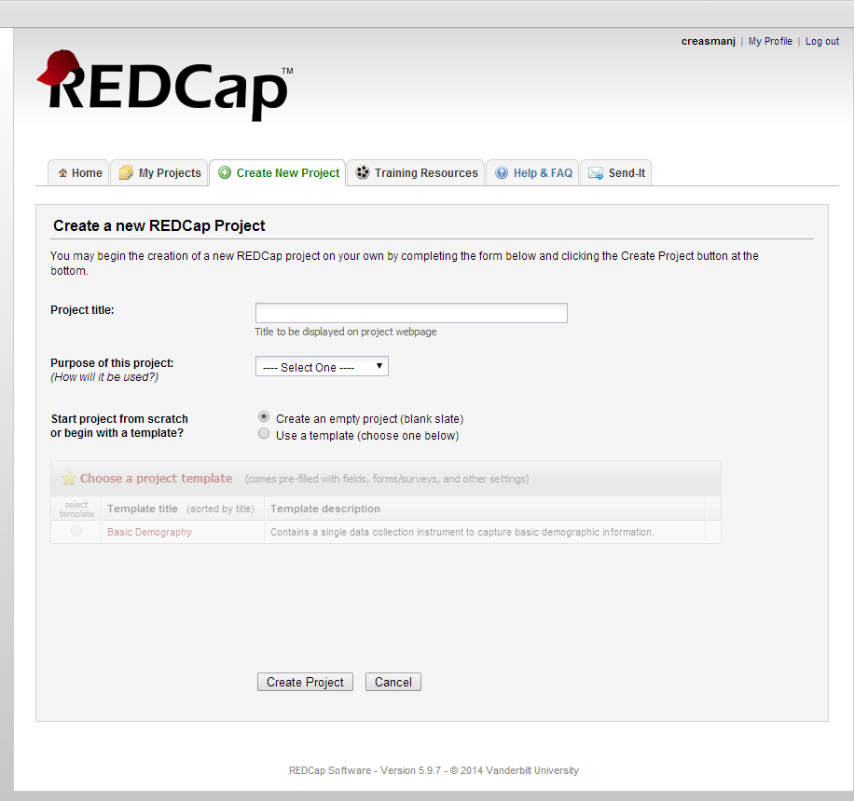
Create New Project
-> Login at https://redcap.ucsfopenresearch.org/index.php
-> Create New Project

Slide 27
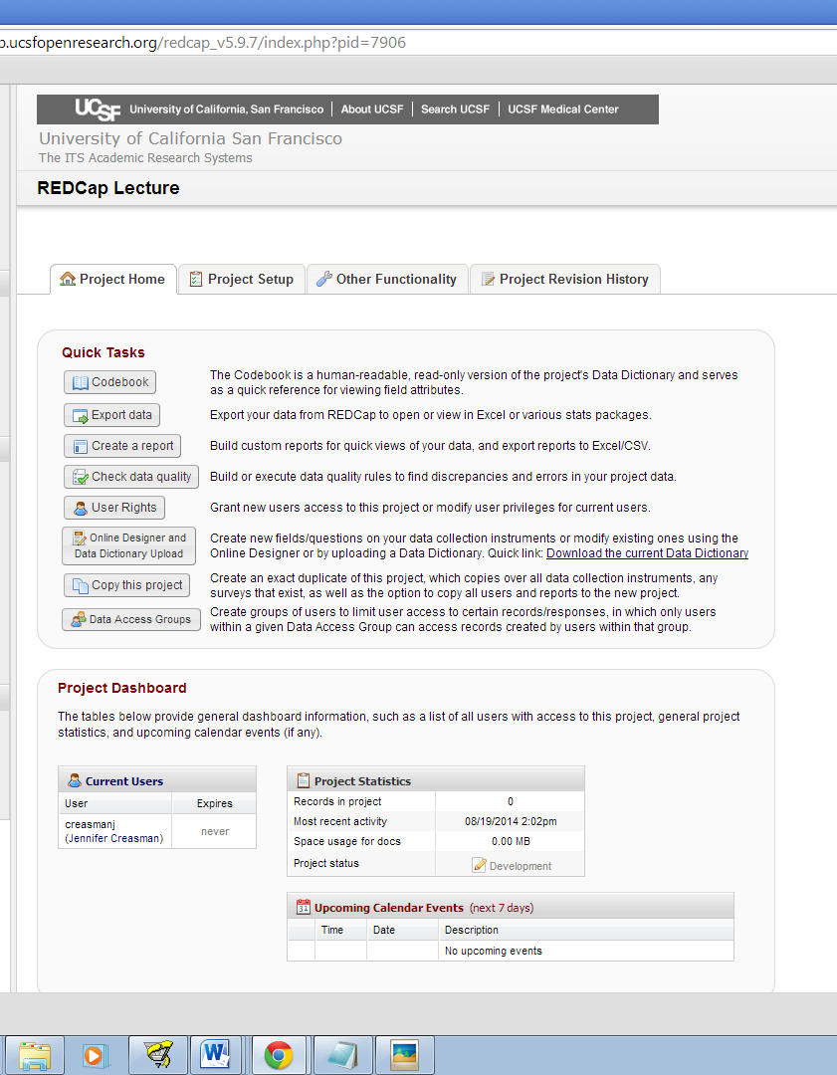
->Project Home
Quick Link Tabs
View Codebook
Export data into .csv, .sas7bdat, .dta or .sps
Create a “simple” report combining variable from multiple forms.
Assign User Rights – Read, Write, Export
Design your database
Create a copy of your project
Define Data Access Groups

Slide 28
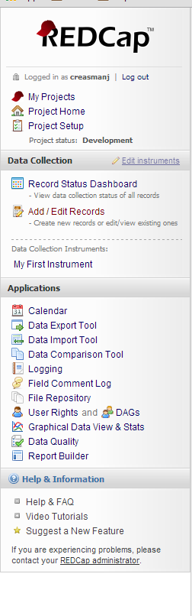
->Project Home
Quick Link Left Bar
My Projects Tab
Project Home Tab
Project Setup
~Manage Survey Participants
~Record Status Dashboard
~Add/Edit Records
~Data Collection Instruments
~Applications

Slide 29
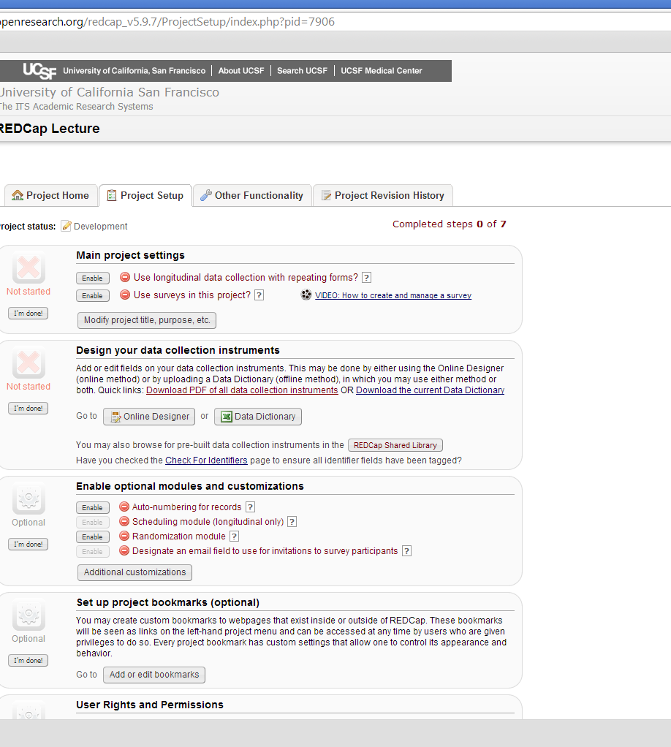
->Project Setup
Quick links
New~ Main Project Settings
Design your database
Assign User Rights
Define Data Access Groups
~ Set up project bookmarks
~ Test your project
~ Move to projection status

Slide 30
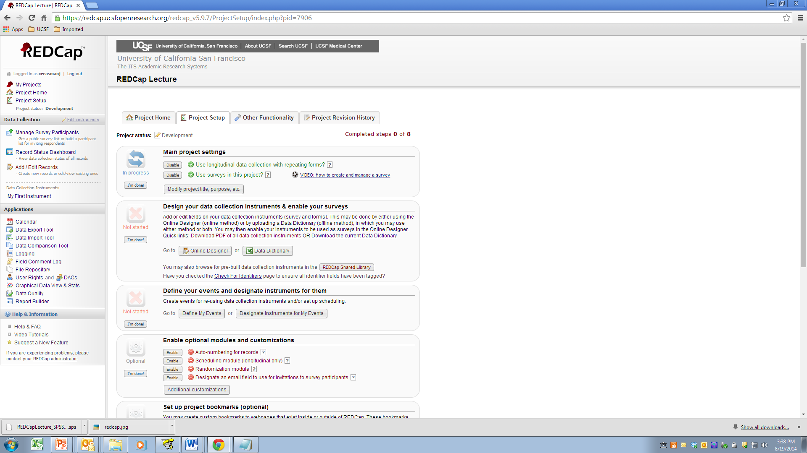
->Project Setup -> Main project Settings
REDCap has two “relational” features. Clicking [Enable] for “Use longitudinal data collection with repeating forms” activates one of them.
REDCap’s Surveys
  Allows you to email participants the data collection form, similar to SurveyMonkey
  Track who has viewed and completed your surveys
  Send multiple emails.

Slide 31
->Project Setup -> Design your data collection instruments & enable your surveys
Go to ‘Online Designer’ to create/modify forms
Go to ‘Data Dictionary” to download or upload your data dictionary
REDCap Shared Library takes a repository of REDCap forms
‘Define My Events’ is the longitudinal/relational feature
‘Designate Instruments for My Events’ is where you choose the forms to be completed at each “event” or, in some cases, visit

Slide 32
Create a Form
->Project Setup -> Online Designer
A well designed database starts with clearly marked annotated forms
Clearly label numeric values for each response
Print the variable name next to each question
Prefix your variable names to identify the form.
Include skip patterns or ‘warnings’

Slide 33
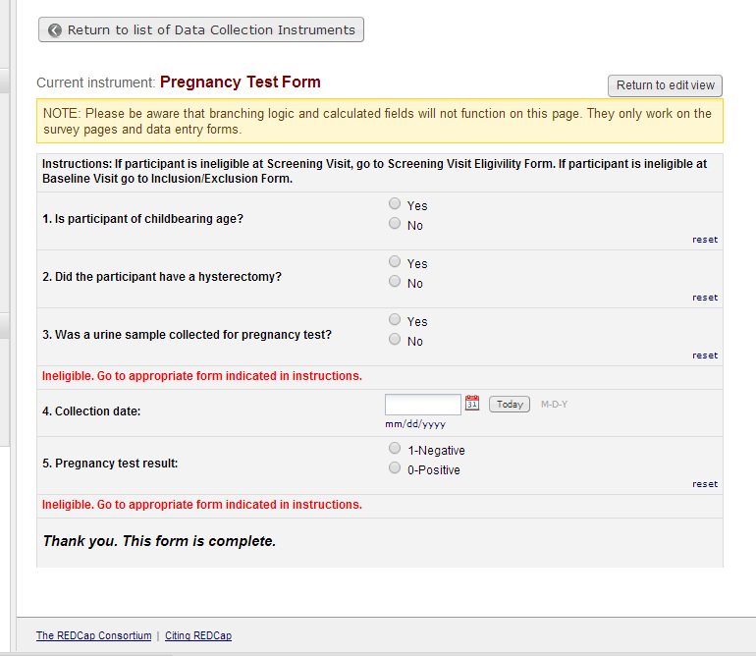
Customization with HTML coding
HTML coding examples
<FONT COLOR='#FF0000'>Ineligible. Go to appropriate form indicated in instructions.</FONT>
<p style="font-size: 125%;"><i>Thank you. This form is complete.</i></p>

Slide 34
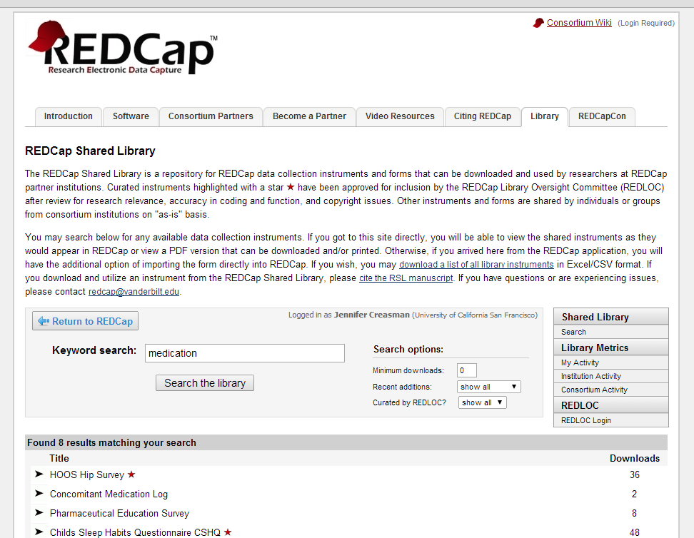
REDCap Shared Library
Demonstration: Adding forms from the REDCap Shared Library
Concomitant Medications
Adverse Events with Branching Logic
BRFSS 2009 Section 12: Demographics

Slide 35
Setting up ‘Visits’ or ‘Events’ and Multiple Arms
Create a “Visit” arm – Baseline, Week 4 and Week 12
Create a “Floating AE” arm with up to 5 AEs

Slide 36
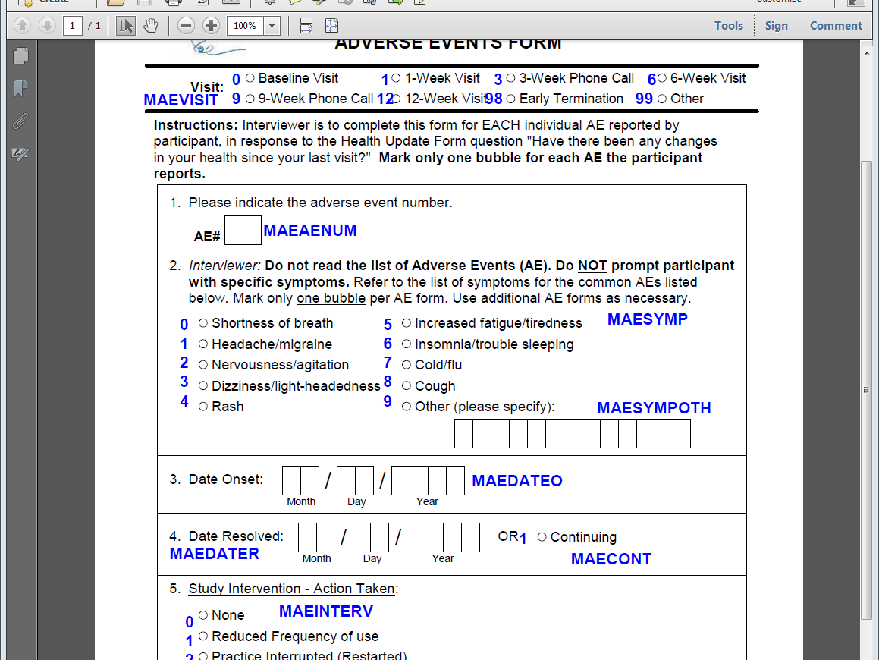
Floating forms
Create AE form
0, Shortness of breath
1, Headache/migraine
2, Nervousness/agitation
3, Dizziness/light-headedness
4, Rash
5, Increased fatigue/tiredness
6, Insomnia/trouble sleeping
7, Cold/flu
8, Cough
9, Other (please specify):

Slide 37
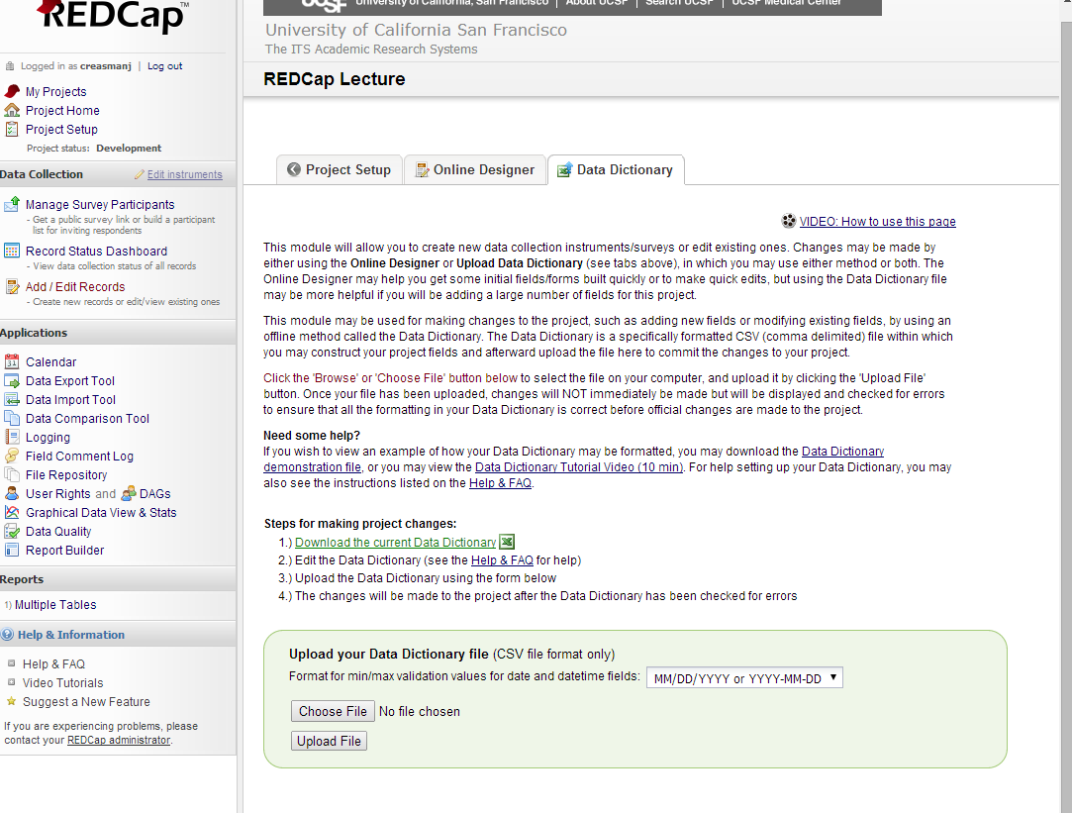
Export/Upload your Data Dictionary
Add Enrollment form from HCV study

Slide 38
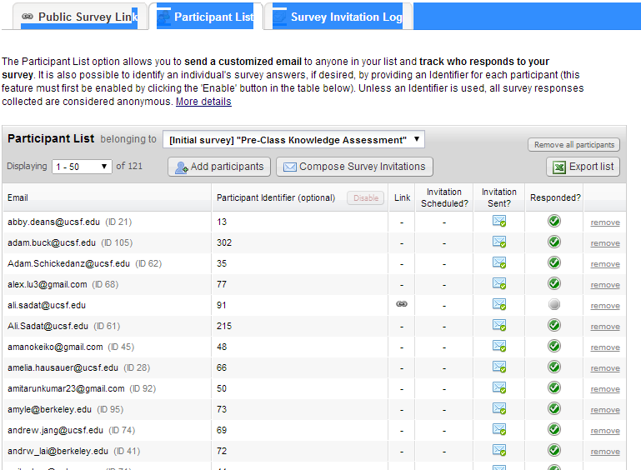
Survey feature:
Managing Participant Surveys
On-line Learning example
Invite participants
Track with a ID number (not the same as the Recordid)
Unique link for each participant
Track response (opened, started, completed)
Automated survey invitations (based on some criteria) send surveys

Slide 39
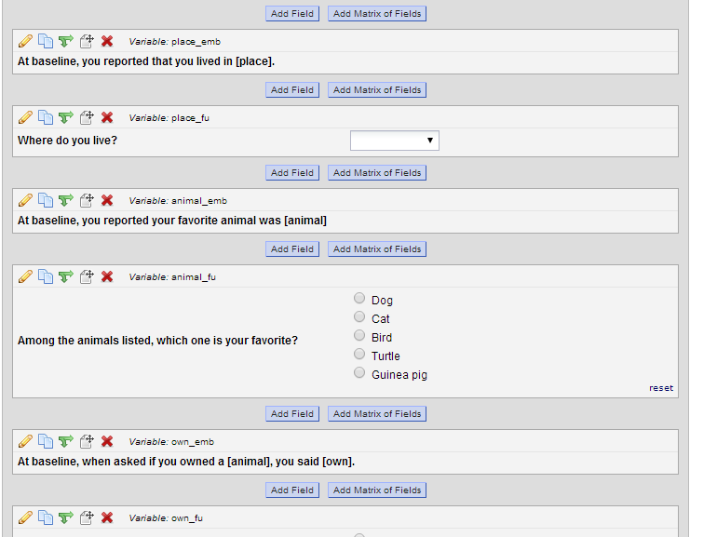
Piping Example
For database with multiple events you can specify the event [baseline][place].

Slide 40
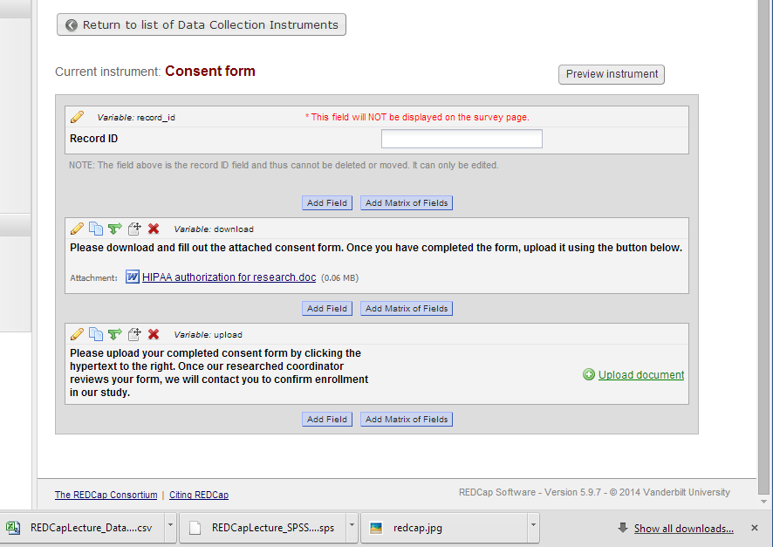
Uploading forms
Consent
Participants can upload a file to survey

Slide 41
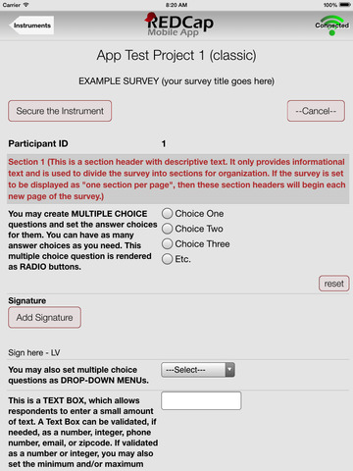
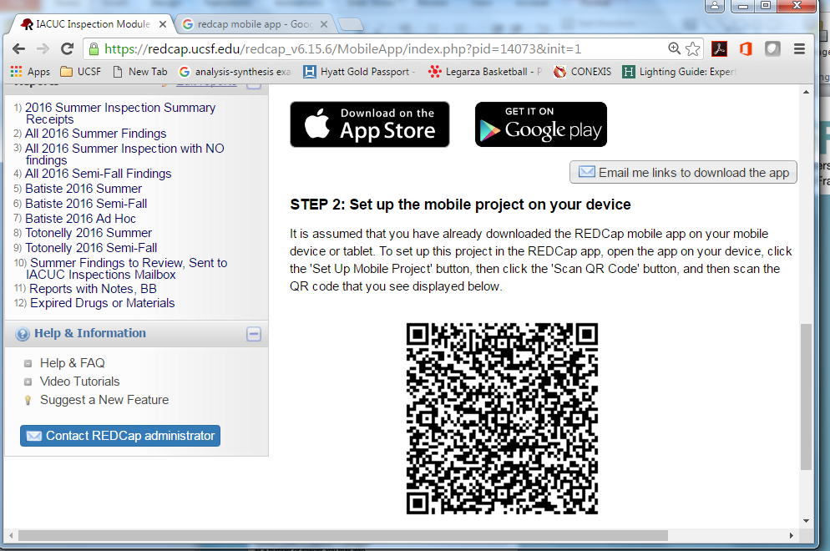
REDCap Mobile App

Slide 42
How to Deliver Data to Your Statistician
Provide a tidy dataset
Project Home -> Export
Provide a codebook (or annotated forms)
Project Home -> Code Book
Start with the data you need
Provide instructions
  Variable definitions
  Mock tables
It takes work!
From the Leek Group Guide to Sharing (https://github.com/jtleek/datasharing)

Slide 43
Questions?

