Slide 1
Selection Bias
Epi 265
Modified from:
Elizabeth Rose Mayeda, PhD, MPH

Slide 2
What Kinds of Questions Does Epidemiology Answer? Selection relevant to all.
Description
  How frequent/common are risk factors/exposures/conditions/diseases?
Prediction
  Do A, B, and C predict presence or occurrence of Y? e.g., diagnosis or prognosis
Causation
  Total effect
    What would changing some exposure – any biological, behavioral, environmental, social (etc.) factor – do to the incidence or prevalence of the health outcome in a population?
    Will intervening upon X change occurrence of Y?
  Public health importance of effect/ attribution
    What fraction or how many cases of disease Y can be eliminated if a causal exposure X is eliminated or reduced? This reflects both the effect of X and the prevalence of X.
  Mediation
    Understanding the mechanisms of causation
    How does X cause Y?
Interaction- which spans prediction and causation
  When and for whom does X cause Y? Are the effects different for different kinds of people or in different settings?
How often does Y occur?
Notes:
A few more specifics on what we cover. Just what does epidemiology do? What kinds of questions does epidemiology answer? The answer is many, and each of them is highly relevant.
First, is description….
Lastly, is prediction. Can we identify a factor or set of factors that predicts the occurrence of disease or some outcome in a diseased person. Doing this prediction concurrently is basically diagnosis. Using prediction to predict the future is prognosis.
I’m guessing that each of you is working at least one of these questions. If true, then this is course is for you.

Slide 3
Inferring Causation From Association
Statistical association between two variables X and Y may be due to:
Random fluctuation
X caused Y
Y caused X
X and Y share a common cause
The statistical association was induced by conditioning on a common effect of X and Y (as in selection bias).

Slide 4
What is selection bias?
Confounding: Bias arising from the existence of common causes of exposure and outcome.
Selection bias: Bias arising from conditioning on a common effect (collider) of exposure (or cause of exposure) and outcome (or cause of outcome).
C
A
Y
C
A
Y

Slide 5
What is selection bias?
Arises from differential:
  Selection into study (by design or self-selection by participants)
  Selective attrition (drop out/death) of enrolled participants
  Nonresponse, missing data
Selection can influence both internal and external validity, but usually selection bias refers to internal validity problems
Consequence: Association between exposure and outcome among the selected study participants differs from those eligible
Both observational and randomized studies are vulnerable to selection bias
Causal diagrams are helpful for depicting causal structures that give rise to selection bias

Slide 6
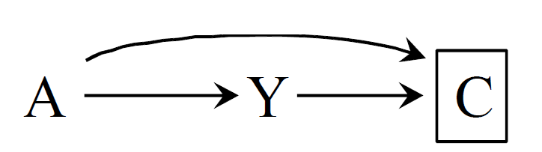
Causal structures of selection bias
Conditioning on a common effect of exposure and outcome results in two sources of association between exposure and outcome:
  Causal effect of A on Y: A→Y
  Spurious association between A and Y induced by conditioning on collider C: A→C ← Y
Because of selection bias, association ≠ causation:
  Pr[Y=1|A=1,C=0]/Pr[Y=1|A=0,C=0] ≠ Pr[Y^{a=1}=1]/Pr[Y^{a=0}=1]
Notes:
Figures 8.1 and 8.2 from Hernan and Robins

Slide 7
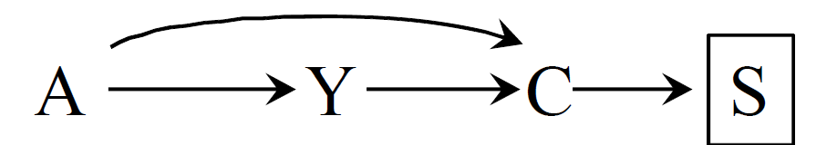
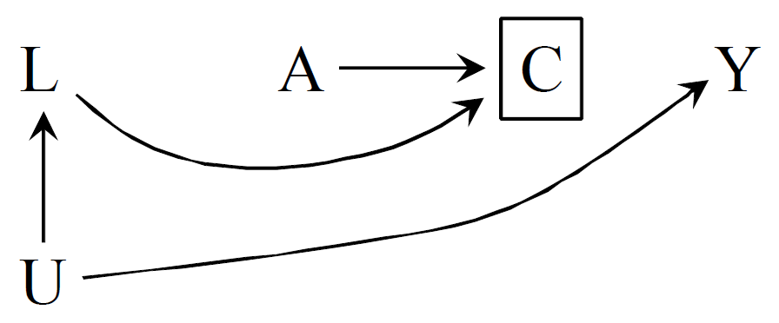
Causal structures of selection bias
Extension: Conditioning on a common effect of exposure (or cause of exposure) and outcome (or cause of outcome) induces selection bias
Notes:
Figures 8.1 and 8.2 from Hernan and Robins

Slide 8
Selection bias in cohort studies and RCTs

Slide 9
Selection bias in cohort studies: selection into cohort due to recruitment
Cohort study of cigarette smoking and coronary heart disease among middle-aged adults
  A: Cigarette smoking
  Y: Coronary heart disease
  C: Volunteered to participate
  U: Family history of coronary heart disease
  L: Heart healthy behaviors
A
C
Y
L
U

Slide 10
Selection bias in cohort studies: selection into cohort due to survival
Cohort study of cigarette smoking and cognitive decline among oldest-old (age 85+)
  A: Cigarette smoking
  Y: Cognitive decline
  C: Alive and healthy enough to participate in study at age 85
  U: Unmeasured common causes of survival to old age and cognitive decline
A
C
Y
U

Slide 11
Selection bias in cohort studies or RCTs: selective attrition
RCT of intensive glucose control treatment among adults with type 2 diabetes
  A: Intensive glucose control treatment
  Y: Cognitive decline
  C: Survival
  U: Unmeasured common causes of survival and cognitive decline
A
C
Y
U

Slide 12
Selection bias arising from conditioning on a disease in a cohort study
Obesity predicts excess morbidity and mortality in the general population, but among many chronic disease patients (stroke, heart failure, and cancer), obesity are associated with lower risk of mortality
  Should obese patients with these chronic conditions be counseled to lose weight?
  Should normal weight patients with these chronic conditions be counseled to gain weight?
Causal scenario
Selection bias scenario
Notes:
Background: Obesity predicts excess morbidity and mortality in the general population, but among stroke patients, overweight and obesity are associated with lower risk of post-stroke mortality,1-6 recurrent stroke, and major vascular events.5-7 This phenomenon is also seen for many other cardiovascular conditions and is often called the “obesity paradox.” Although observational evidence suggests that overweight and obesity reduce mortality in stroke patients, researchers and clinicians have been skeptical that this is causal, proposing instead that the association is due to “confounding” or “selection” bias.8-10 Based on this puzzling evidence, clinical care recommendations were successively weakened between 2006 and 2014, so stroke patients and their physicians are now given no recommendation regarding weight loss.11-13
Causal scenario: Some researchers hypothesize that higher body mass confers protection against a hypercatabolic state that may be triggered by stroke,3 and the elevated body mass thus protects against wasting of fat and lean mass.1, 21-23 This proposed pathophysiological mechanism would predict similar short-term outcomes but better long-term post-stroke survival in obese vs. normal weight patients.
Selection bias: A spurious inverse association between obesity and death among stroke patients is induced by selection bias. In the selection scenario, other stroke risk factors influence both stroke incidence and mortality risk via pathways unrelated to obesity. Normal weight individuals are less likely to have stroke, so among stroke patients the normal weight individuals likely have some other, unobserved, adverse stroke risk factor. If this stroke risk factor also independently increases mortality, this will spuriously make obesity appear to protect against mortality among stroke patients. In other words, stroke is a “common effect” of obesity and the unmeasured stroke risk factor, and restricting analyses to stroke patients induces an inverse association between obesity and death, even though obesity has no independent effect on death in this scenario.25, 26 This scenario is plausible given the substantial heterogeneity in stroke and stroke consequences based on differences in stroke mechanism, lesion location, neurovascular structure, and collateral circulation. For example, if the strokes resulting from obesity are more likely to be preceded by a period of gradual atherosclerotic thrombotic occlusion, allowing for development of collateral flow, whereas strokes in normal weight individuals are more likely to be embolic, with less collateral flow compensation, we would expect worse outcomes among normal weight stroke patients.27
Ask students about observational studies investigating causal effects of obesity

Slide 13
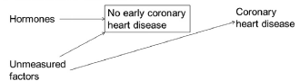
Selection bias arising from gap between time of start of exposure and follow up
Discrepancy between evidence on effect of HRT on CHD from observational studies and RCTs:
  Observational studies (HRT protective): Selected prevalent HRT users without prevalent CHD and followed them for incident CHD
  RCTs (HRT harmful): Randomized women without prevalent CHD to HRT or placebo and followed them for incident CHD
Observational studies effectively ignored the first years of follow up by comparing prevalent users to never users

Slide 14
Example: Socioeconomic health inequalities
Cohort members tend to be more affluent and healthier compared to the whole population, but this does not bias certain exposure-outcome associations.
Howe et al: How does selected participation influence estimates of effects of socioeconomic health inequalities?
Avon Longitudinal Study of Parents and Children
  Estimated effect of maternal education on outcomes in a) the whole cohort (n≈12,000) and b) restricted to subsamples participating at age 10 (n ≈ 7,000) and age 15 (n ≈ 5,000).
?

Slide 15
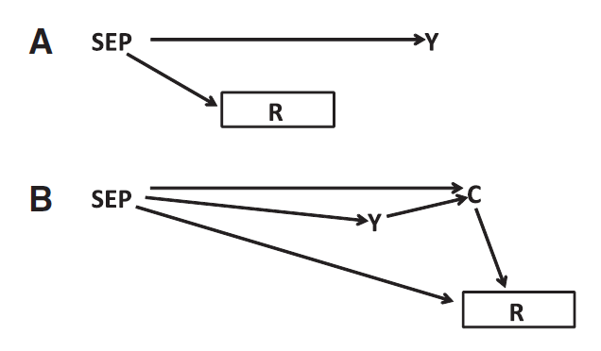
Example: Socioeconomic health inequalities
SEP=exposure of interest, Y=outcome of interest, R=response, C=conditions that influence participation (e.g. illness making participation more difficult or interest in health increasing participation).

Slide 16
Example: Socioeconomic health inequalities
Continued participation associated with both SEP and outcomes.
Loss to follow-up resulted in underestimation of inequalities, although qualitative conclusions held for most outcomes. For example, mean birth weight difference between highest and lowest SEP was:
  Full sample: 116 grams (95% CI: 78-153)
  Sample participating age 10: 93 grams (95% CI: 45-141)
  Sample participating age 15: 62 grams (95% CI: 5-119)
Notes:
Howe’s conclusions: “Considerable attrition from cohort studies may result in biased estimates of socioeconomic inequalities, and the degree of bias may worsen as participation rates decrease. However, even with considerable attrition (>50%), qualitative conclusions about the direction and approximate magnitude of inequalities did not change among most of our examples.”

Slide 17
Tools to address selection bias

Slide 18
Tools to address selection bias
Repeated measures Time to event
Study design
Adjustment
IPW
Joint longitudinal-survival models
Multiple imputation
Sensitivity analysis and bias correction (estimate what the bias would be from your model and then subtract it)
Study design
Adjustment
IPW
Fine-gray
Multistate models
Multiple imputation
Sensitivity analysis and bias correction (estimate what the bias would be from your model and then subtract it)

Slide 19
Study design to address selection bias
Selection of appropriate controls in a case-control study
Avoid gap between time of start of exposure and follow up (incident user design) in a longitudinal study
Measures to reduce missing data and attrition between exposure and outcome assessment in a longitudinal study

Slide 20
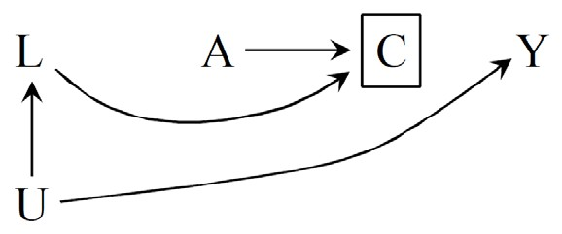
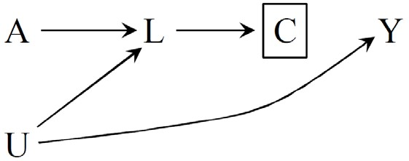


Adjustment to address selection bias
Depending on the causal structure, stratification/adjustment can
sometimes be used to control for selection bias
Idea is to block the path that was unblocked by conditioning on the collider (C)
Can fit model E[Y| Z,L,C=0]=b₀+b₁A+b₂L to estimate conditional (on L and C=0) association between A and Y

Slide 21
Inverse probability weighting (IPW) to address selection bias
Goal is to block the path that was unblocked by conditioning on the collider (C) (block path that confounds association between C and Y)
“Treatment” for IPW to address selection bias is C (unlike when you use IPW to address confounding, where A is the treatment)

Slide 22
IPW to address selection bias
We assign a weight, W, to each selected/noncensored (C=0) individual so that she represents not only herself but also individuals like her (i.e., same values of A and L) who were not selected (C=1); the weights create a pseudo-population
Assumes exchangeability of censored and uncensored, conditional on A, L (Y^{c} ∐ C|A=a,L=l)
A selected individual’s weight is the inverse of the probability of her selection given her values of A,L (P[C=0|A,L])
Nonselected (C=1) individuals have weight zero
For stabilized weights, numerator is the individual’s probability of having been selected given her A values
Nonstabilized weights: 𝑊 =
1
P[C=0|A,L]
P[C=0|A]
Stabilized weights: 𝑆𝑆 W=
P[C=0|A,L]

Slide 23
Specifying counterfactual contrast of interest guides analysis
An essential, but often overlooked, step in conducting meaningful research is to clearly define the estimand of interest
“No method is so sophisticated that it can relieve the investigator of the obligation to provide a well-formulated causal question in the first place” -Kaufman JS, Hernán MA. Commentary: Epidemiologic Methods Are Useless: They Can Only Give You Answers. Epidemiology. 2012;23(6):785-6
Counterfactual contrast (and appropriate statistical method) depends on the research question
With respect to selection bias, clearly defining the estimand of interest is particularly relevant for selective survival

Slide 24
Estimating effects in selected survivors: 2 estimands for effect of exposure on dementia
Effect of exposure on proportion of the initial (alive, dementia- free) population who developed dementia within a specified period of follow-up time after exposure (i.e., population burden of dementia estimated using Fine and Gray competing risk regression)
  Difference in cumulative incidence of dementia over a specified follow-up time after exposure: Pr(Y_{x=1}=1|S_{t=0}=1) - Pr(Y_{x=0}=1|S_{t=0}=1) during a specified time period
  The numerator is the number of people who developed dementia during the specified period of follow-up time after exposure and the denominator is the population that was alive and free of dementia at the time of exposure.

Slide 25
Estimating effects in selected survivors: 2 estimands for effect of exposure on dementia
Effect of exposure on dementia among people who would survive under either exposure status (survivor average causal effect (SACE) estimated using IPW)
  Risk difference among the survive under either treatment group: [Pr(Y_{A=1}) – Pr( Y_{A=0})] | [S_{A=1}=S_{A=0}=1]
  It is this contrast between the SACE and estimands calculated among survivors that leads to the label “survival bias,” in that there is an association between exposure and outcome (among survivors) even when exposure has no impact on an individual’s probability of developing dementia

Slide 26
Survivor average causal effect (SACE)
The SACE was developed to address the conundrum that for individuals who would die under one exposure status, the effect of exposure on the outcome is undefined
Drawing on a principal stratification framework, the population is conceptualized as including four types of individuals:
  Those who would survive up to time t under either exposure status (always survive)
  Those who would die by time t under either exposure status (never survive)
  Those would survive up to time t if exposed but die otherwise (survive only if X=1)
  Those who would die by time t if exposed but survive otherwise (survive only if X=0)
Tchetgen Tchetgen EJ, Phiri K, Shapiro R. A Simple Regression-based Approach to Account for Survival Bias in Birth Outcomes Research. Epidemiology. 2015;26(4):473-80.

Slide 27
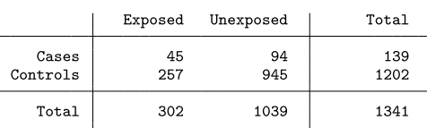
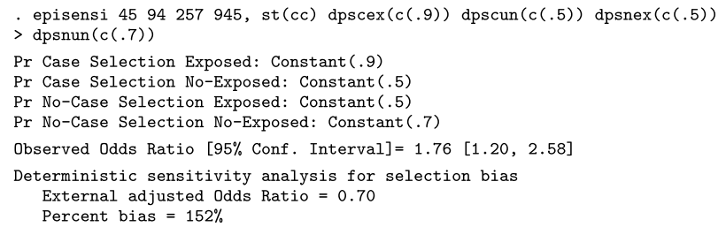
Sensitivity analysis using episensi macro
Hypothetical case-control study of occupational exposure to resins and lung-cancer death. Selection bias arises if selection probabilities among cases and non-cases differs by exposure status:
Selection bias factor: (0.9/0.5)/(0.5/0.7)=2.5
Selection bias adjusted OR: 1.76/2.5=0.70
Orsini N, Bellocco R, Bottai M, Wolk A, Greenland S. A tool for deterministic and probabilistic sensitivity analysis of epidemiologic studies. Stata Journal. 2008;8(1):29-48

Slide 28
A simulation platform to quantify survival bias: an application to research on determinants of cognitive decline

Slide 29
A simulation platform to quantify survival bias
Survival bias is a major concern for researchers studying determinants of cognitive decline because many exposures of interest for dementia researchers influence mortality and cognitive decline predicts mortality
Difficult to anticipate the degree of bias in empirical studies
Simulation studies provide a means to quantify expected degree of bias in studies of determinants of cognitive decline

Slide 30

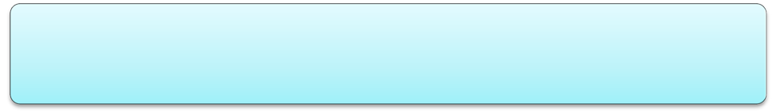
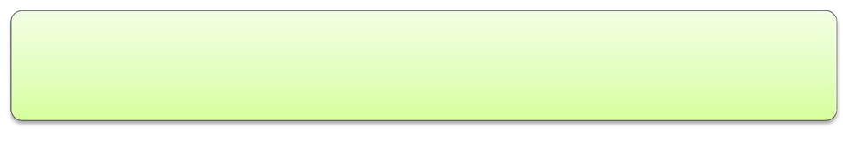

A simulation platform to quantify survival bias
Simulations provide a means to quantify degree of expected bias in research on determinants of cognitive decline under several causal scenarios
Generate data corresponding with assumptions of substantive researchers
Select causal scenarios for investigation
Run simulations under different causal scenarios
Estimate exposure-outcome association in each scenario
Quantify magnitude of bias for each scenario

Slide 31
A simulation platform to quantify survival bias
Scenario A (no anticipated bias)
Age
U
Exposure
Survival
Rate of Cognitive Decline
Scenario B1 exposure and U affect mortality
Scenario B2 exposure and U have more than multiplicative effects on mortality hazard
Age
U
Exposure
Survival
Rate of Cognitive Decline
Scenario C exposure and rate of cognitive change affect mortality
Age
U
Exposure
Survival
Rate of Cognitive Decline

Slide 32
A simulation platform to quantify survival bias
Difference in mean value of U between exposed and unexposed participants alive at each study wave
Low mortality (25%) High mortality (75%)
0.0
0.0
-0.2
-0.2
Mean Difference
Mean Difference
-0.4
-0.4
-0.6
-0.6
-0.8
-0.8
-1.0
-1.0
-1.2
-1.2
0
1
2
3
Wave
4
5
6
0
1
2
3
Wave
4
5
6
Scenario A B1 B2

Slide 33
A simulation platform to quantify survival bias
Results from B=1,000 simulations on n=1,500 people with up to 7 cognitive assessments over 9 years
𝛽𝛽 (true effect of exposure on rate of cognitive decline) = 0
Simulation results for estimated effect of exposure on rate of cognitive change per 10 yrs
 | Low mortality scenario (25%) |  |  | High mortality scenario (75%)
 | _{𝛽𝛽�}̅ | RMSE | Coverage | _{𝛽𝛽}� | RMSE | Coverage
Scenario A | 0.002 | 0.085 | 0.954 | -0.002 | 0.120 | 0.957
Scenario B1 | 0.048 | 0.098 | 0.914 | 0.094 | 0.155 | 0.883
Scenario B2 | 0.164 | 0.186 | 0.527 | 0.412 | 0.429 | 0.081
Scenario C | 0.094 | 0.126 | 0.809 | 0.316 | 0.335 | 0.229
𝛽𝛽̂̅ = mean of the estimate of interest over all simulations, RMSE = root mean square error (measure of accuracy), Coverage = proportion of times the 95% confidence interval for 𝛽𝛽̂ includes 𝛽𝛽

Slide 34
A simulation platform to quantify survival bias
Magnitude of bias is strongly influenced by mortality rate
In high mortality scenarios, substantial bias is easily induced when mortality is influenced by the exposure and cognitive decline
When mortality is influenced by the exposure and a determinant of cognitive decline, substantial bias only arises when a strong interaction on the hazard ratio scale between the exposure and the determinant of cognitive decline is present

Slide 35
Conclusions
Selection bias has many forms—can arise from different sources in different study designs
DAGs can help identify potential selection bias
Selection of appropriate tools to address selection bias depends on counterfactual contrast of interest
Sensitivity analyses and simulation studies can quantify potential magnitude of selection bias

Slide 37
Quiz
Consider a hypothetical trial of a new drug treatment (A) to reduce the probability of memory impairment (Y) assessed 1 year after randomization to the drug. Write the ITT estimate for the risk difference, assuming perfect adherence, everyone survives and continues to participate through the 1 year outcome assessment:
Write the counterfactual contrast estimated by the above ITT,.
Can you infer that the ITT estimates the Population Average Treatment Effect and do you need the assumptions of exchangeability, consistency, or positivity to draw this inference?
Now imagine that drug A reduces survival to 1 year follow-up.
Pr[S^{a=1}=1]<Pr[S^{a=0}=1]
Now write out the best ITT estimate of the risk difference, assuming you can only evaluate cognitive impairment on people who remain alive:
Write the counterfactual contrast estimated by the above.
Can you infer that the ITT estimates the Population Average Treatment Effect and do you need the assumptions of exchangeability, consistency, or positivity to draw this inference?
Notes:
Quiz: give them a counterfactual contrast for the ITT estimate this trial. Tell them to write what the counterfactual contrast of the ITT estimate if the exposure kills people.
Pr[Y=1|A=1]-Pr[Y=1|A=0]
Under consistency, this estimates Pr[Y^{a=1}=1|A=1]-Pr[Y^{a=0}=1|A=0] which under exchangeability estimates: Pr[Y^{a=1}=1]-Pr[Y^{a=0}=1]
Pr[Y=1|A=1,C=0]/Pr[Y=1|A=0,C=0]

Slide 38
Quiz
Consider a hypothetical trial of a new drug treatment (A) to promote memory function (Y), with the counterfactual contrast for the intention to treat (ITT) effect estimate from this trial is:
  Pr[Y=1|A=1]/Pr[Y=1|A=0]
  With no selection bias, association equals causation, and this ITT estimate equals the causal risk ratio: Pr[Y^{a=1}=1]/Pr[Y^{a=0}=1]
Now write out the counterfactual contrast of the ITT estimate if the treatment kills people:
  Pr[Y=1|A=1,C=0]/Pr[Y=1|A=0,C=0]
  Study is restricted to people who are alive (C=0)
Notes:
Quiz: give them a counterfactual contrast for the ITT estimate this trial. Tell them to write what the counterfactual contrast of the ITT estimate if the exposure kills people.

Slide 39
Causal Directed Acyclic Graphs
Show your assumptions about the causal relationships among X, Y, and possible covariates in a causal diagram:
If two variables shown in the graph have a common cause, you must show the cause in the graph.
Do not allow causal “loops”.
If you use SEM: draw an SEM, take out the shapes around your variables, and replace correlations with “some association” on the paths
X
A
Y
U
X
A
Y
B
A
X
Y
U
E

Slide 40
Terminology
Descendants
    The direct or indirect effects of a variable
Paths
    A sequence of lines (edges) between two variables, regardless of direction of arrows
    Not retracing any line segments
Colliders
    Common effect of two variables in a path: where the arrows ‘collide’.
    The two causes must both be “on the path”.
    Any variable on a path that is not a collider is a “non-collider”.
Conditioning
    Examining the distribution of one variable within levels of another
    Regression adjustment, stratification, restriction

Slide 41
Colliders vs Non-Colliders
Colliders: common effects
Non-Colliders:
common causes (=confounders)
Or mediators
A
A
B
B
C
C
A
B
C

Slide 42
D-separation
The assumptions shown in a causal diagram imply that a variable X will be independent of a variable Y, after conditioning on a set of variables {Z} if every path between X and Y is blocked by {Z}.
The set of covariates {Z} blocks a path if and only if either:
  The path contains a non-collider that is in {Z} , or
  The path contains a collider which is not in {Z} , and no descendant of the collider is in {Z} .
If there is an unblocked path linking X and Y, then X and Y will typically be statistically dependent (unless there is a perfectly offsetting balance between two paths).

Slide 43
D-separation: intuition
There may be many reasons that two variables are associated (some confounding, some mediated causation etc).
Adjusting for a confounder of the two variables blocks that source of association between two variables
Adjusting for a mediator between the two variables blocks that source of association between two variables
Adjusting for a common effect of the two variables creates an association between the two variables

