Slide 1
Epi 245 – Measurement Issues in Implementation Science
Elvin Geng
UCSF
2017

Slide 2
Outline
Research depends on data
Implementation science depends on real world data
Discuss “real world” data lifecycle
  Capturing reality (creating data)
  Storing data
  Extracting data
  Analyzing data from non-research sources
Challenges and opportunities
Use cohorts and or studies that I have worked in as case studies
Phronesis

Slide 3
Data lifecycle
Capture reality (create data)
Store data
Extract data
Analyze data
Use data to change reality

Slide 4
Data lifecycle – data creation
Capture reality (create data)
Store data
Extract data
Analyze data
Use data to change reality

Slide 5


Widespread capture of reality with data
Data used to be the domain of researchers
Today data capture is ubiquitous
  Clinical electronic medical records
  Administrative databases
  Uber / facebook
  The purpose is not expressly for research
  How much of your life is “data” (a lot)

Slide 6
Opportunities and challenges in use of health data from care settings
Advantageous
  Timely
  Cheap (low marginal cost)
    Drug trial – 1000$ a patient
  “Real world”
  Large
  Diverse
Disadvantages
  Does not map perfectly to concepts in research questions
  Big data = small biases effect inferences

Slide 7
How do you decide what to have for dinner on Thursday?
(Or should I have a BLT?)

Slide 8
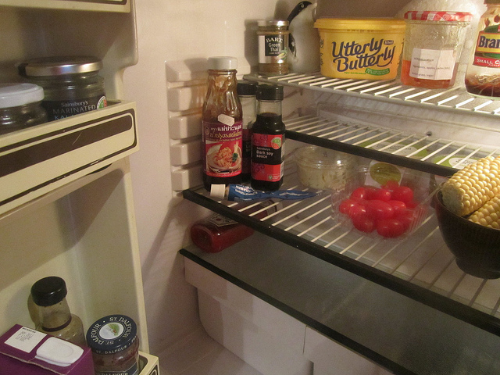
Choice A
Choice B
Decide what you want
Go get the ingredients
But what if Whole Foods is closed?

Slide 9

Asking the right question - case study

Slide 10
Clinic-based database
Network of integrated “clinical systems”
  “unique” electronic records of patient care experience
The effect of antiretroviral drug initiation on short term outcomes in those with advanced HIV.
Consortia minimum dataset
  Medication name, dose, frequency, start and stop dates
Consortia standards
  Medications records should be ”adjudicated for start date”

Slide 11
When is the start date?
Jul 2016
Jan 2015
July 2015
Jan 2016
Presented for care at W86; no symptoms; tested positive in VCT; Cd4 is 30 / ul
Patient returned after several missed visits, concedes to restarting methamphetamine use
Spotty visit adherence and viral load suppression inconsistent
Treatment discussed, patient agreed to start, medication prescribed and sent to pharmacy (Jan 5, 2015)
Stabilized and started HIV medications during hospitalization (July 5, 2016)
Patient picked up medication, but at next visit, says he hadn’t started
Admitted through ER – found to have pneumococcal sepsis

Slide 12
TabMedication
id | date | Medication active | Medication discontinuation
1 | 4354
1 | 4376 | EFV
1 | 4395 | EFV
1 | 4420 |  | EFV
1 | 4510
1 | 4554
1 | 4576 | EFV
1 | 4695 | EFV
1 | 4720 | EFV
1 | 4810 | EFV
1 | 4850 | EFV

Slide 13
“Adjudication…”
Medication start date manually changed from January 15, 2015 to July 5, 2016
Is that the right thing to do?
  What if they never come back?
  What if the provider doesn’t know or doesn’t document that delayed start?

Slide 14
Does the question match the reality you have captured (your data)
What is adherence for patients with advanced disease
  Bad question
When did someone start ART
  Better question if you want to do quite a bit of chart review
When was someone prescribed ART
  Perhaps even better question
  Aligned with nature of information collected

Slide 15
What is the problem?

Slide 16
Don’t promise a BLT if you don’t have bacon (and its 6 pm in Geneva)
Asking a question that can be answered with your data even if it is not exactly what you originally had in mind is better than asking a question that can’t be answered
But… the questions you can answer are more interestng (in my opinion)
In reality many times people go ahead and make the BLT and then are surprised when guests complain when it is served without bacon

Slide 17
The omnivore’s dilemma: where does your food come from and do you know what is in it?

Slide 18


Slide 19


Slide 20
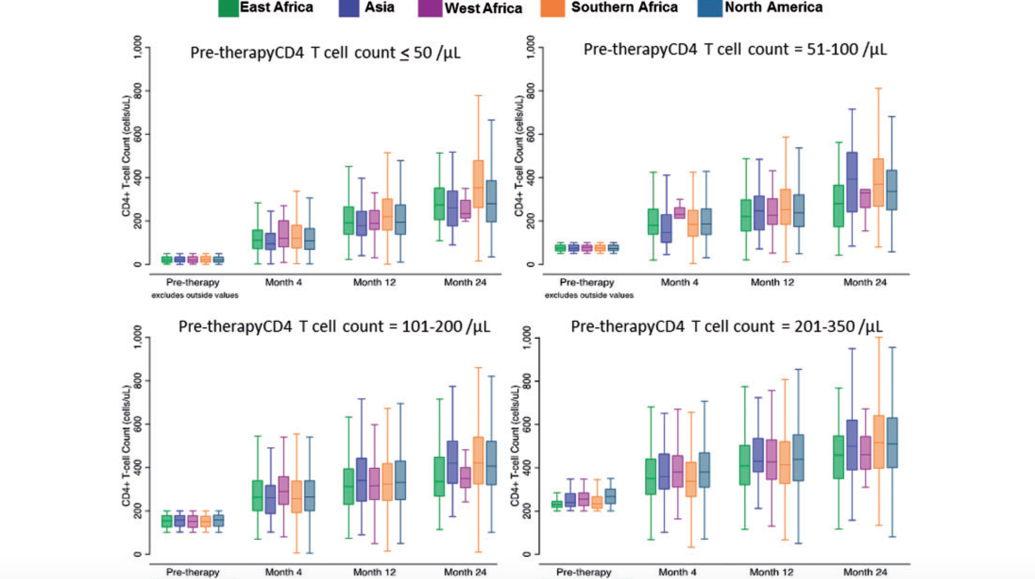

Slide 21
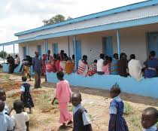


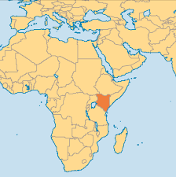
Data entry
Clinical care
Data pooling at national and subnational scale (possible derivation)
Data collected on a clinical encounter form
International pooling

Slide 23
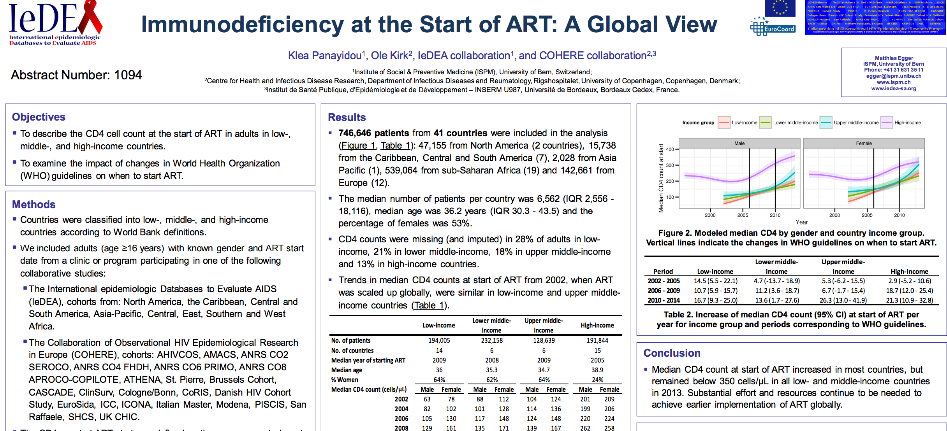

Slide 24
Missing second visit (ltfu) and therefore CD4 level
CD4 level at first visit
Early death

Slide 25
Know your ingredients (and keep them simple and unprocessed)

Slide 26
Data lifecycle
Capture reality
Store data
Extract data
Analyze data
Use data to change reality

Slide 27

Data extraction – harder than pulling teeth

Slide 28

The eye of the beholder (health care wokers)

Slide 29
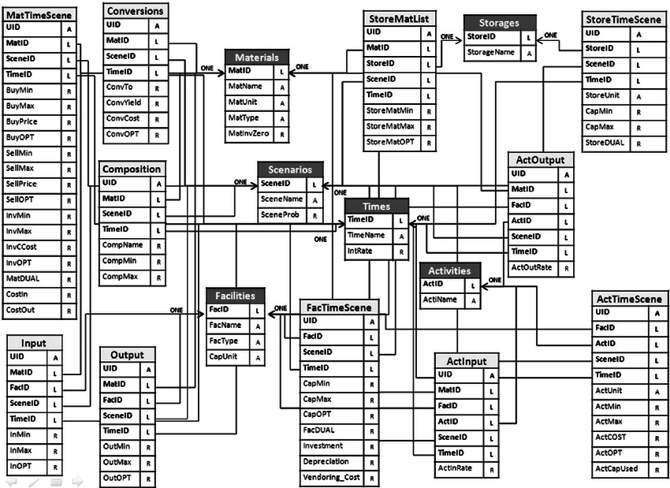

The eye of the beholder (data manager)

Slide 30
Communications: Clinical Investigators and Data Managers

Slide 31
Clinical investigators are from Venus and Data managers are from Mars
Investigator
  You understand what you want to do
  You understand what the measurements mean
  You must define the ingredients you want with precision
  You need to spell out the ingredients
Data manager
  Must extract data from a database
  But does not know exactly what you want
  Does not understand what a “viral load” is
  The concept is named 14334 in the database
  The data dictionary says
  “Plasma HIV RNA (Roche TM V12) = 14334”

Slide 32
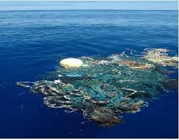
Consequences….

Slide 33
Garbage in, Garbage out (wait what came out?)

Slide 34


Slide 35
Step 1 for Investigator
Generally you have access to the front end
If you can, get a hold of a database schema or the tables
Surprisingly hard to get

Slide 36
Step 2 – Decide how you will define your cohort of interest
Do you obtain the variables to do so or give instructions for cohort definition?
CNICS cohort inclusion criteria: two primary care visits within a year after January 1, 2001
But ”primary care” is not a variable in the database
Logic of the visit type classification
  Resource code – one of any number of providers
  Location – Ward 86
  Date of visit
Prefer to derive yourself
Otherwise give very clear instructions

Slide 38
Codify decisions and formally communicate with data manager
Specify name (might be different than the “native” name of the variable
Specify format (date, numeric, text, coded with response categories)
Avoid highly derived variables – strive to get more granular (can’t go other way)
Ask for ”time invariant variables” in one table (e.g., sex, dob, etc.)
As for all ”repeated measures” in separate “long tables” (e.g., appointments, visits, CD4 values, hemoglobin levels, etc.
Make sure to obtain variables from individuals even if those preceed the cohort entry date

Slide 39
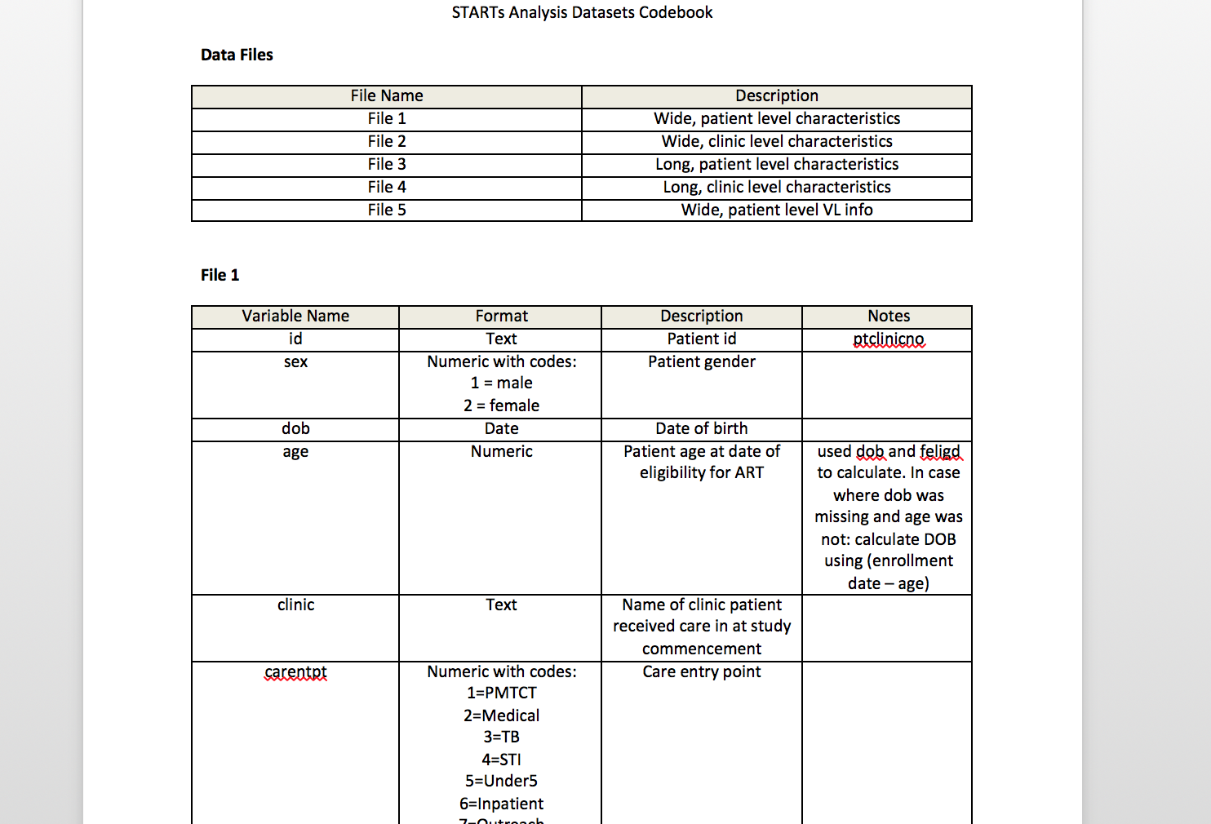

Slide 40
Other tips…
Meet data manager face-to-face
Codebook specification is iterative

Slide 41
Know what’s in your food (or data)

Slide 42
Wrap-up
Measurement issues in real world data are complicated
Phronesis of implementation science
No clear single source of definitive information
Experiential (kind of like being a resident)
Extremely valuable..

