Slide 1

Big Data
Notes:
Even in today’s popular culture.

Slide 2
Big Data
Jasper Sitwell: Zola's algorithm is a program...for choosing Insight's targets.
Steve Rogers: What targets?
Jasper Sitwell: You! The TV anchor in Cairo, the Undersecretary of Defense, a high school valedictorian in Iowa city. Bruce Banner, Stephen Strange, anyone who's a threat to HYDRA. Now, or in the future.
Steve Rogers The future? How can it know?
Jasper Sitwell: How could it not? The 21st century is a digital book. Zola taught HYDRA how to read it. Your bank records, medical histories, voting patterns, e-mails, phone calls, the damn SAT scores. Zola's algorithm evaluates peoples' past to predict their future.
Steve Rogers What then?
Jasper Sitwell: Then the Insight heli-carriers scratch people off the list.
Notes:
Obviously science fiction. But isn’t far from what is possible now. We can’t predict everyone’s exact future, but given that information we could predict a number of things.
Raises significant privacy issues.

Slide 3

Big Data
Nick Fury: We've been data-mining HYDRA's files. Looks like a lot of rats didn't go down with the ship.
Notes:
Later in the same movie, Nick Fury, the leader of a spy agency called SHIELD exclaims:

Slide 4
Thought #1
Big data and data mining can be used for good or evil.

Slide 5
Biostat 202: Opportunities and Challenges of “Big Data”
Charles E. McCulloch,
Division of Biostatistics,
Department of Epidemiology and Biostatistics
Biostat 202 - 2017

Slide 6
Course outline
Introduction
Getting data (large databases, electronic health records)
Managing data
Digital Health
Describing data with tables and figures
Algorithms (predictive, clustering)
Causal inference and big data
Case study

Slide 7
Course Grading
Homework (40%)
Lab assignment (0/1/2 grading – 15%)
  (0=not handed in on time, 1=substantial elements missing, 2=essentially complete)
Project
  3 “components” (0/1/2 grading – 15%)
  Final project write-up (30%)
See the CLE website for details on the class due dates and project guidelines. More coming on the course project datasets.

Slide 8
TICR Professional Conduct Statement
I will maintain the highest standards of academic honesty
I will neither give nor receive aid in examinations or assignments unless such cooperation is expressly permitted by the instructor (Our policy: mutual collaboration on labs and assignments is fine. The project should be your own work)
I will conduct research in an unbiased manner, report results truthfully, and credit ideas developed and work done by others
I will not use answer keys from prior years
I will write answers in my own words, and, when collaboration is permitted, acknowledge collaborators when answers are jointly formulated.

Slide 9
Course organization and dates
Lectures
  Mondays and Thursdays 1-2:30pm (7/27-8/31)
Labs
  Thursdays 2:45-4:15pm (7/27-8/24)
  Interactive and hands-on learning session
  Lab assignments due by midnight on Sunday
Homeworks due Thursdays starting 8/3.
Project components due Mondays from 8/14.
Final project due Tuesday 9/5.

Slide 10
Course software:
IBM SPSS Modeler
  Free license for a year through UCSF
  Regular price of $4,500 per person per year
A key aspect of the labs will be hands-on use of the software
Allows access to many of the features of big data analytics without the need to learn programming
  Allows more focus on concepts rather than technical programming details
Notes:
Clair Dunne will be emailing you to convert your trial license to a full year license.

Slide 11
Optional reading (posted on CLE):
Data Mining with SPSS Modeler. Theory, Exercises and Solutions. Free as an ebook from within the UCSF network via http://link.springer.com/book/10.1007%2F978-3-319-28709-6.
An Introduction to Statistical Learning. eBook free via www-bcf.usc.edu/~gareth/ISL/. Or within UCSF network from Springer directly.
Notes:
Data mining with SPSS modeler. Theory, Exercises and Solutions. Tilo Wendler and Sören Gröttrup. Springer, Switzerland, 2016. Available for free electronically within the UCSF network via http://link.springer.com/book/10.1007%2F978-3-319-28709-6. This book is focused on the IBM SPSS Data Modeler software, though is still useful for learning about methods. The book provides background on using IBM SPSS Data Modeler for data cleaning and manipulation and then onto the application of simple statistical methods and visualization, before going on to cover regression, data-reduction methods, clustering and classification. The book gives IBM SPSS Data Modeler examples and screenshots throughout.
An introduction to statistical learning. Gareth James, Daniela Witten, Trevor Hastie, and Robert Tibshirani. New York: Springer, 2013 and is available for free via www-bcf.usc.edu/~gareth/ISL/. Largely a machine learning book. The book is technical in places, but strives to explain things in text. The book provides accompanying code in R to illustrate concepts, but the R material is restricted to lab sections at the end of each chapter; understanding R is not necessary for following the general concepts in the book.

Slide 12
Outline for today
What is big data? And since computers are so fast these days, is it really any different than what we have been doing all along?
Data mining.
Causality versus prediction.
Overfitting and spurious associations.

Slide 13
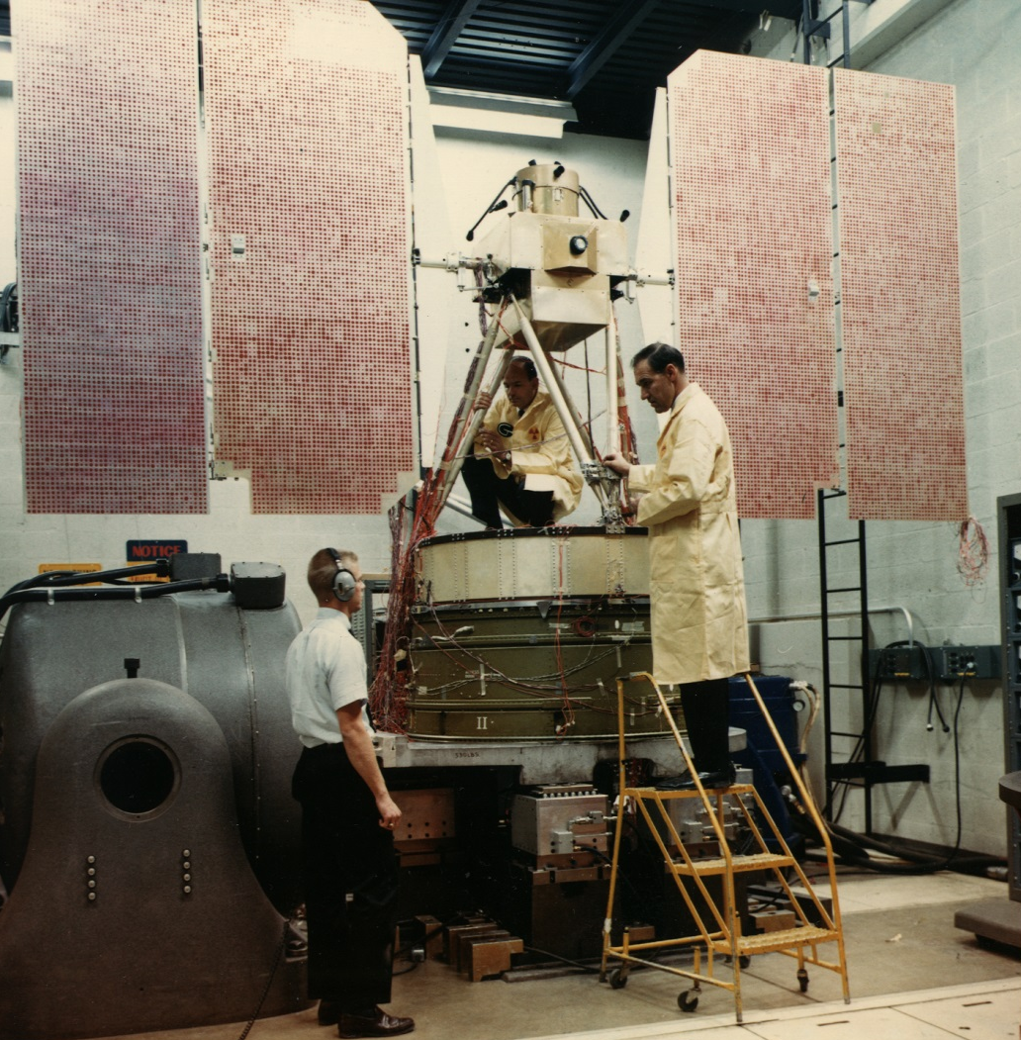
Is Big Data new?
My father actually was a rocket scientist.
Here is one of his
satellites being
tested: Nimbus
weather satellite.
Notes:
With it’s solar panels unfurled.
My father had a dry sense of humor. When something exasperating occurred at his work like a project not meeting its deadline he’d exclaim “Come on. That isn’t rocket science. Oh wait – it is rocket science. And after a pause. Well – it isn’t brain surgery.”

Slide 14
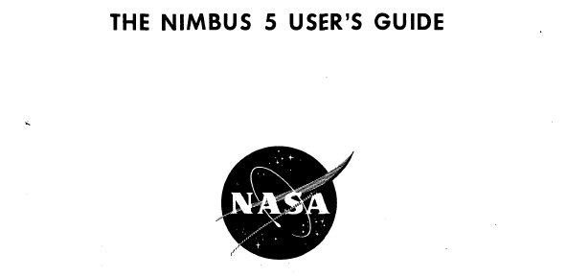
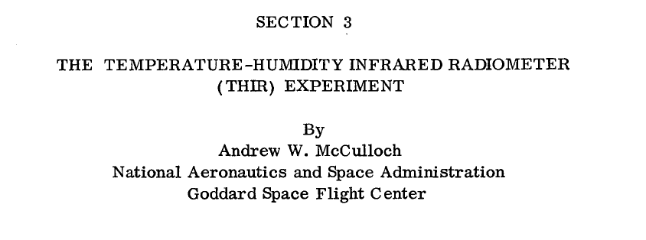
Notes:
Here is something he wrote about the Nimbus satellite.

Slide 15
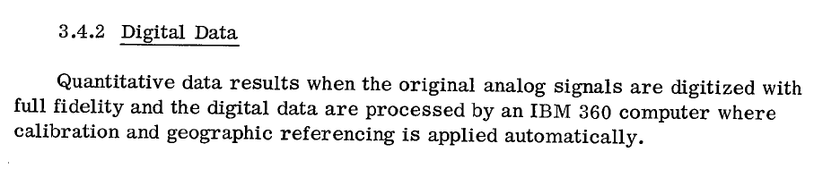
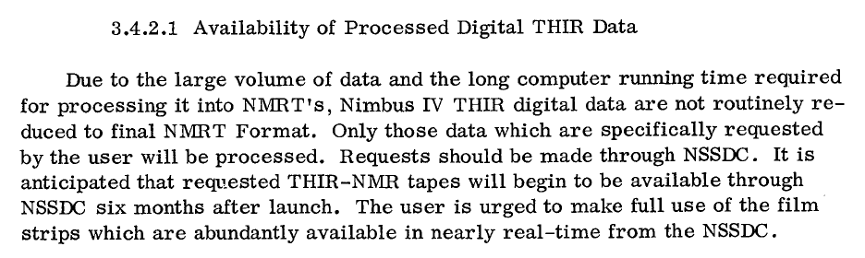
Nimbus Users Guide
Notes:
Let me just highlight a couple of the lines.
NMRT = NIMBUS meterological radiation tape, THIR = temperature, humidity infrared radiometer, NSSDC = national space science data center.

Slide 16
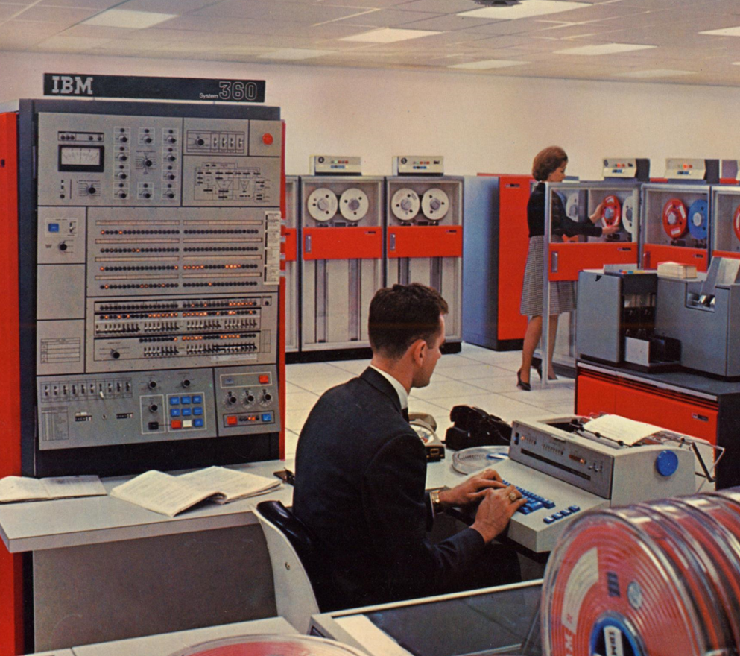
Is Big Data new?
So even in my father’s time, he had “big” data. And he needed the latest and greatest computing equipment (an IBM 360) to process it.
The weather files are archived and anyone can download them from the Nat’l Snow and Ice Data Center.
They are about 1 Mb per day.

Slide 17
Big Data – what is it?
Every era has had big data.
In 1936, the Literary Digest conducted a presidential poll (Landon v. Roosevelt). They mailed 10 million postcards and received 2.4 million back. (More in a bit).

Slide 18
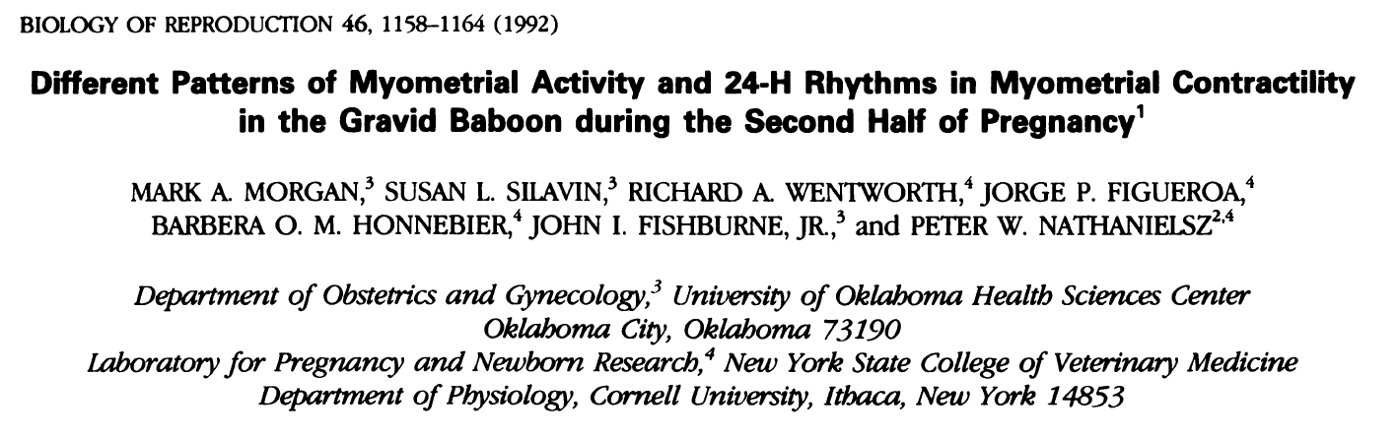
Big Data in the 1990s
Methods: Continuous EMG …were sampled at 32 Hz … Fast Fourier Transform and power spectrum analysis were performed …to quantify myometrial activity as contractures or contractions.
Notes:
In the 1980s and 1990s I worked with Peter Nathanielsz (MD, PhD, DVM) and his group studying determinants of premature birth. He would hook up electrical leads to monitor muscle movement and distinguish contractions from other movements.

Slide 19
Big Data in the 1990s
13 baboons studied.
At least two electrical leads per animal.
Up to 67 days of observation.
Record electrical activity of uterine muscles 32 times per second
About 4.8 billion data points (~4.5 GB)
Notes:
4 GB was well beyond the storage capacity of those days. Instead we summarized data as we went (using a Fast Fourier transform) and periodically saved those results.

Slide 20
Thought #2
Big data isn’t the same as big information.
In this example, 4.8 billion data points from only 13 animals.
So the usual name of “data mining” and not “information mining” is appropriate.
Notes:
Only 13 animals.

Slide 21
Data isn't information. ... Information, unlike data, is useful. While there’s a gulf between data and information, there’s a wide ocean between information and knowledge. What turns the gears in our brains isn't information, but ideas, inventions, and inspiration. Knowledge—not information—implies understanding. And beyond knowledge lies what we should be seeking: wisdom.
— Clifford Stoll, High-Tech Heretic: Reflections of a Computer Contrarian (2000), 185-186.

Slide 22
What is “Big Data” today?
Electronic health records.
Data collected electronically at a personal level (e.g., Fitbit monitors).
Web based surveillance (e.g., Google Flu Trends).
Imaging data (e.g., MRIs).
Digital Exhaust (noun). Unstructured information or data that is a by-product of the online activities of Internet users.
Omics data (e.g., genomic, proteomic, or exposome)

Slide 23
What is “Big Data” today?
Is “big data” really any different than what we have been doing for decades other than a steady increase in volume?
Yes
Handling poor quality and heterogeneous data.
Harder to practice reproducible research.
Dealing with data “velocity.”
Possibility of real time decision making.
Algorithmic association detection. “Data mining” and “machine learning.”
Notes:
Currently working on a project merging Medicare data with data collected in a cohort study. Took 2.5 years to refine the algorithms for doing things like deciding on short versus long term nursing home stays.
Can’t “look at your data”. Need sophisticated visualization techniques to try to understand it and deal with anomalous data points.

Slide 24
Why data mining?
Example: OA biomarkers project (one of the course datasets). In a cohort of individuals at risk for knee osteoarthritis, can we predict who will go on to develop painful knee arthritis? Predictors include many measurements of the knee based on Xray (width of the space between bones at many locations), MRI (degree of degeneration in various locations of the cartilage) and blood sample (numerous bone turnover markers). Full study has 1000s of predictors.
Notes:
Can’t manually build models in cases where there are a plethora of possible variables to include. Even with the simplest linear models and 40 predictors there are 2^40 = 1.1x10^12 possible models (2^40). If you could look at one model a second 24 hours a day it would take you about 35,000 years to consider them all. Many current projects have many more than 40 predictors and consider models that are much more complicated.

Slide 25
Why data mining?
Building a model to predict painful knee osteoarthritis with, say, 30 predictors. Since each predictor can be in or out of the model, there are 2³⁰ possible models. Suppose you could review 1 per second:
2³⁰ = 1.1 x 10⁷ seconds
= 18 million minutes
= 300,000 hours
= 12,500 days
= 34 years to check them all
Notes:
Can’t manually build models in cases where there are a plethora of possible variables to include. Even with the simplest linear models and 40 predictors there are 2^40 = 1.1x10^12 possible models (2^40). If you could look at one model a second 24 hours a day it would take you about 35,000 years to consider them all. Many current projects have many more than 40 predictors and consider models that are much more complicated.

Slide 26
Not just a fad
Patient Centered Outcomes Research Institute
Has funded 33 health data networks (PCORnet) to the tune of $140m that link together electronic health record systems in order (in part) to conduct:
“observational studies of multiple research questions, including prevention and treatment, at low marginal cost”
by leveraging
“data from real-world clinical experiences of patients within their system”
Notes:
Here is a lot of hype surrounding big data and data mining.
From the PCORI “National Priorities for Research and Research Agenda” downloaded from
http://www.pcori.org/assets/PCORI-National-Priorities-and-Research-Agenda-2012-05-21-FINAL.pdf
On 7/11/12

Slide 27
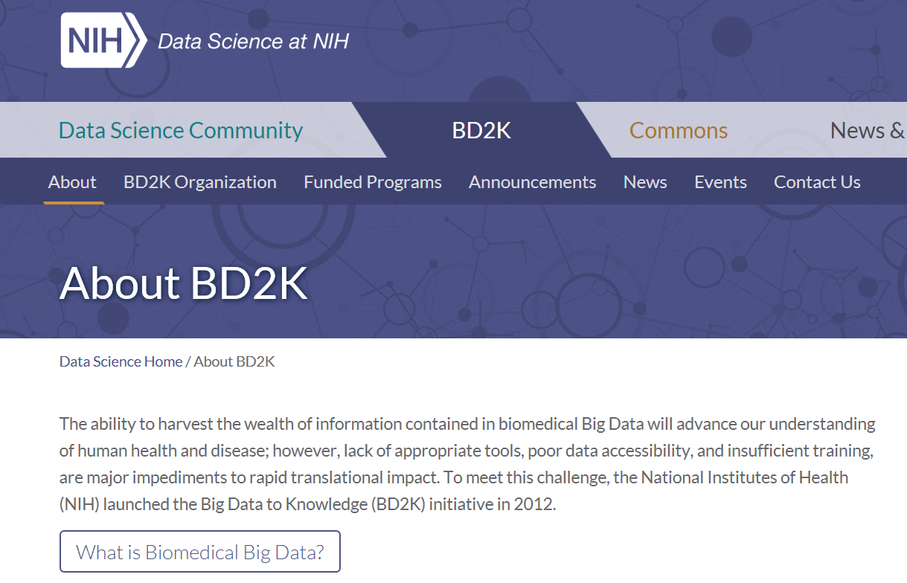
Not just a fad

Slide 28
Not just a fad
The advantages of large datasets are undeniable:
Ability to fit flexible models.
Ability to investigate heterogeneity and subgroups. “Precision medicine.”
Easy to validate predictive rules.
High precision.

Slide 29
Example: OA Biomarkers Project
Predict participants who go on lose full thickness of their cartilage in the medial compartment of the knee (FT_cart_loss). We’ll consider just 13 predictors, so there are 2¹³ = 8,192 possible models (assessing all 8,192 would take you 3.5 workweeks if you could do 1 per minute).
We will consider three methods for predicting the outcome, stepwise logistic regression, all subsets regression and a “tree” based method. But first some graphics.
Notes:
OAI is a longitudinal cohort study with about 5000 participants studied approximately yearly for 10 years.

Slide 30
Example: Predicting progression of osteoarthritis
SPSS Modeler demonstration
Read in a dataset
Simple descriptive statistics
Simple graphical description

Slide 31
Stata Illustration: Predicting progression of osteoarthritis
Demonstration:
Stepwise -
sw, pe(0.05) pr(0.1): logistic FT_cart_loss_medial BMI … min_medial_JSW
All possible subsets -
gvselect <term> BMI … min_medial_JSW, nmodels(2): logistic FT_cart_loss_medial <term>

Slide 32
Stata Illustration: Predicting progression of osteoarthritis
I also added in extra predictors to total 30 of them. Recall that a human would take 34 years to review all the models at 1 per second.
Stata took <8 hours on my laptop.
And that could easily be dropped by an order of magnitude by using more computing cores.

Slide 33
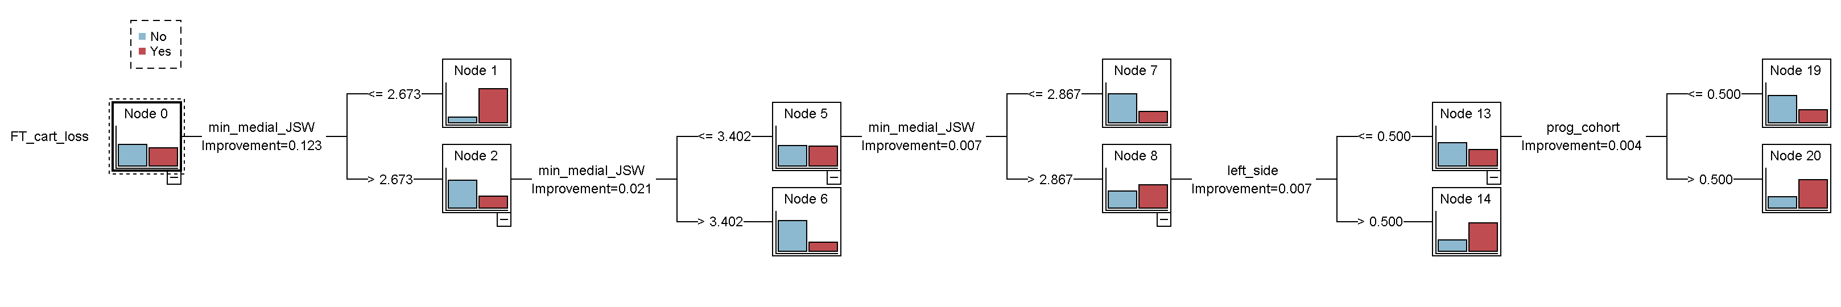
Example: Predicting progression of osteoarthritis: tree model
Colored bars show full thickness cartilage loss
Show results of a tree model.
classification tree continues from node 8

Slide 34
Example: Variables selected
Variable | Stepwise | All subsets | Tree
Female | ✓ | ✓
Kellgren Lawrence | ✓ | ✓
Left side | ✓ | ✓ | ✓
Progression cohort | ✓ | ✓ | ✓
Min Medial JSW | ✓ |  | ✓✓✓
Medial JS grade |  | ✓
Knee pain

Slide 35
Not just a fad
The advantages of large datasets are undeniable:
Ability to fit flexible models.
Ability to investigate heterogeneity and subgroups. “Precision medicine.”
Easy to validate predictive rules.
High precision.
But there are a number of caveats.
Notes:
Next slide: But they aren’t a cure-all

Slide 36
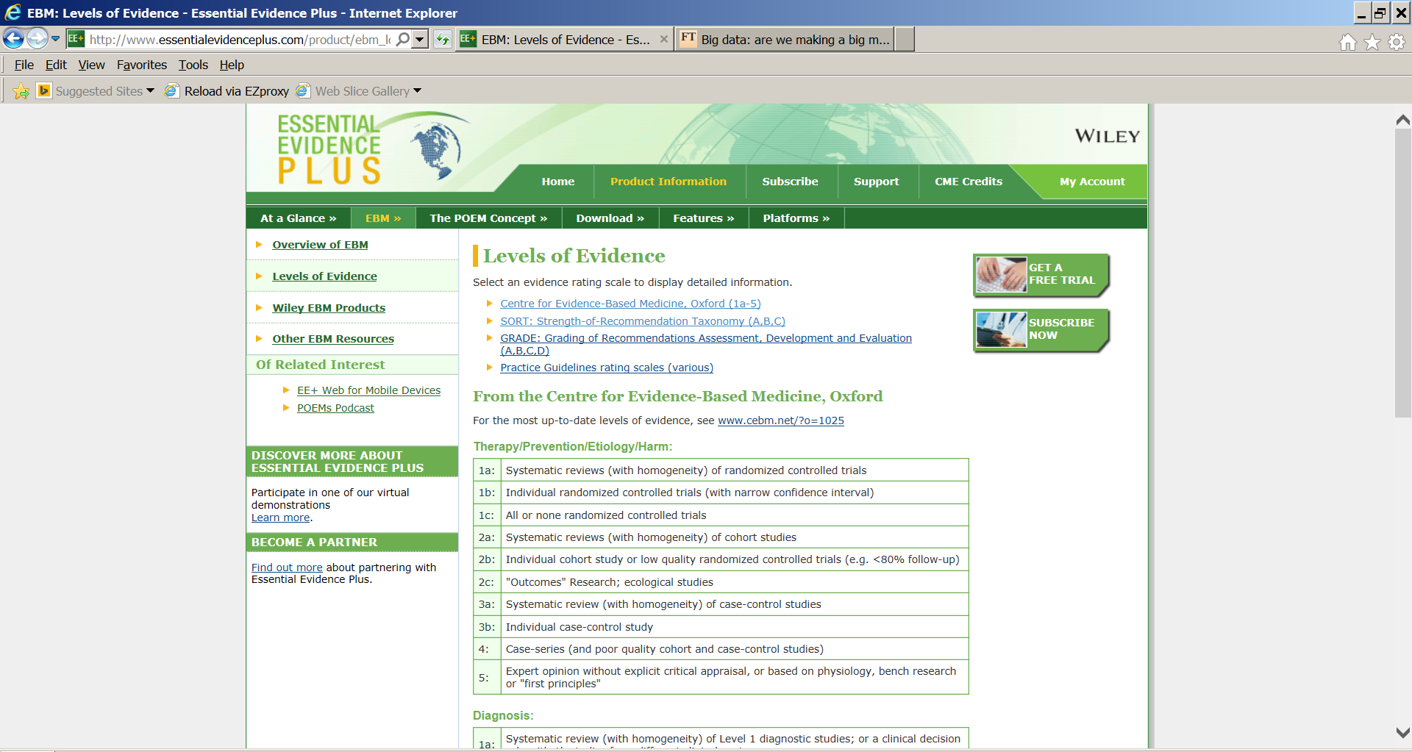
Osteoarthritis Initiative
Electronic health record based study
Notes:
Many venues of science rate the “quality” of evidence. Here is a typical classification of the type of study.
Most of the examples of big data are observational studies not designed for research purposes. That puts us way down on the list and suggests we need to take care.

Slide 37
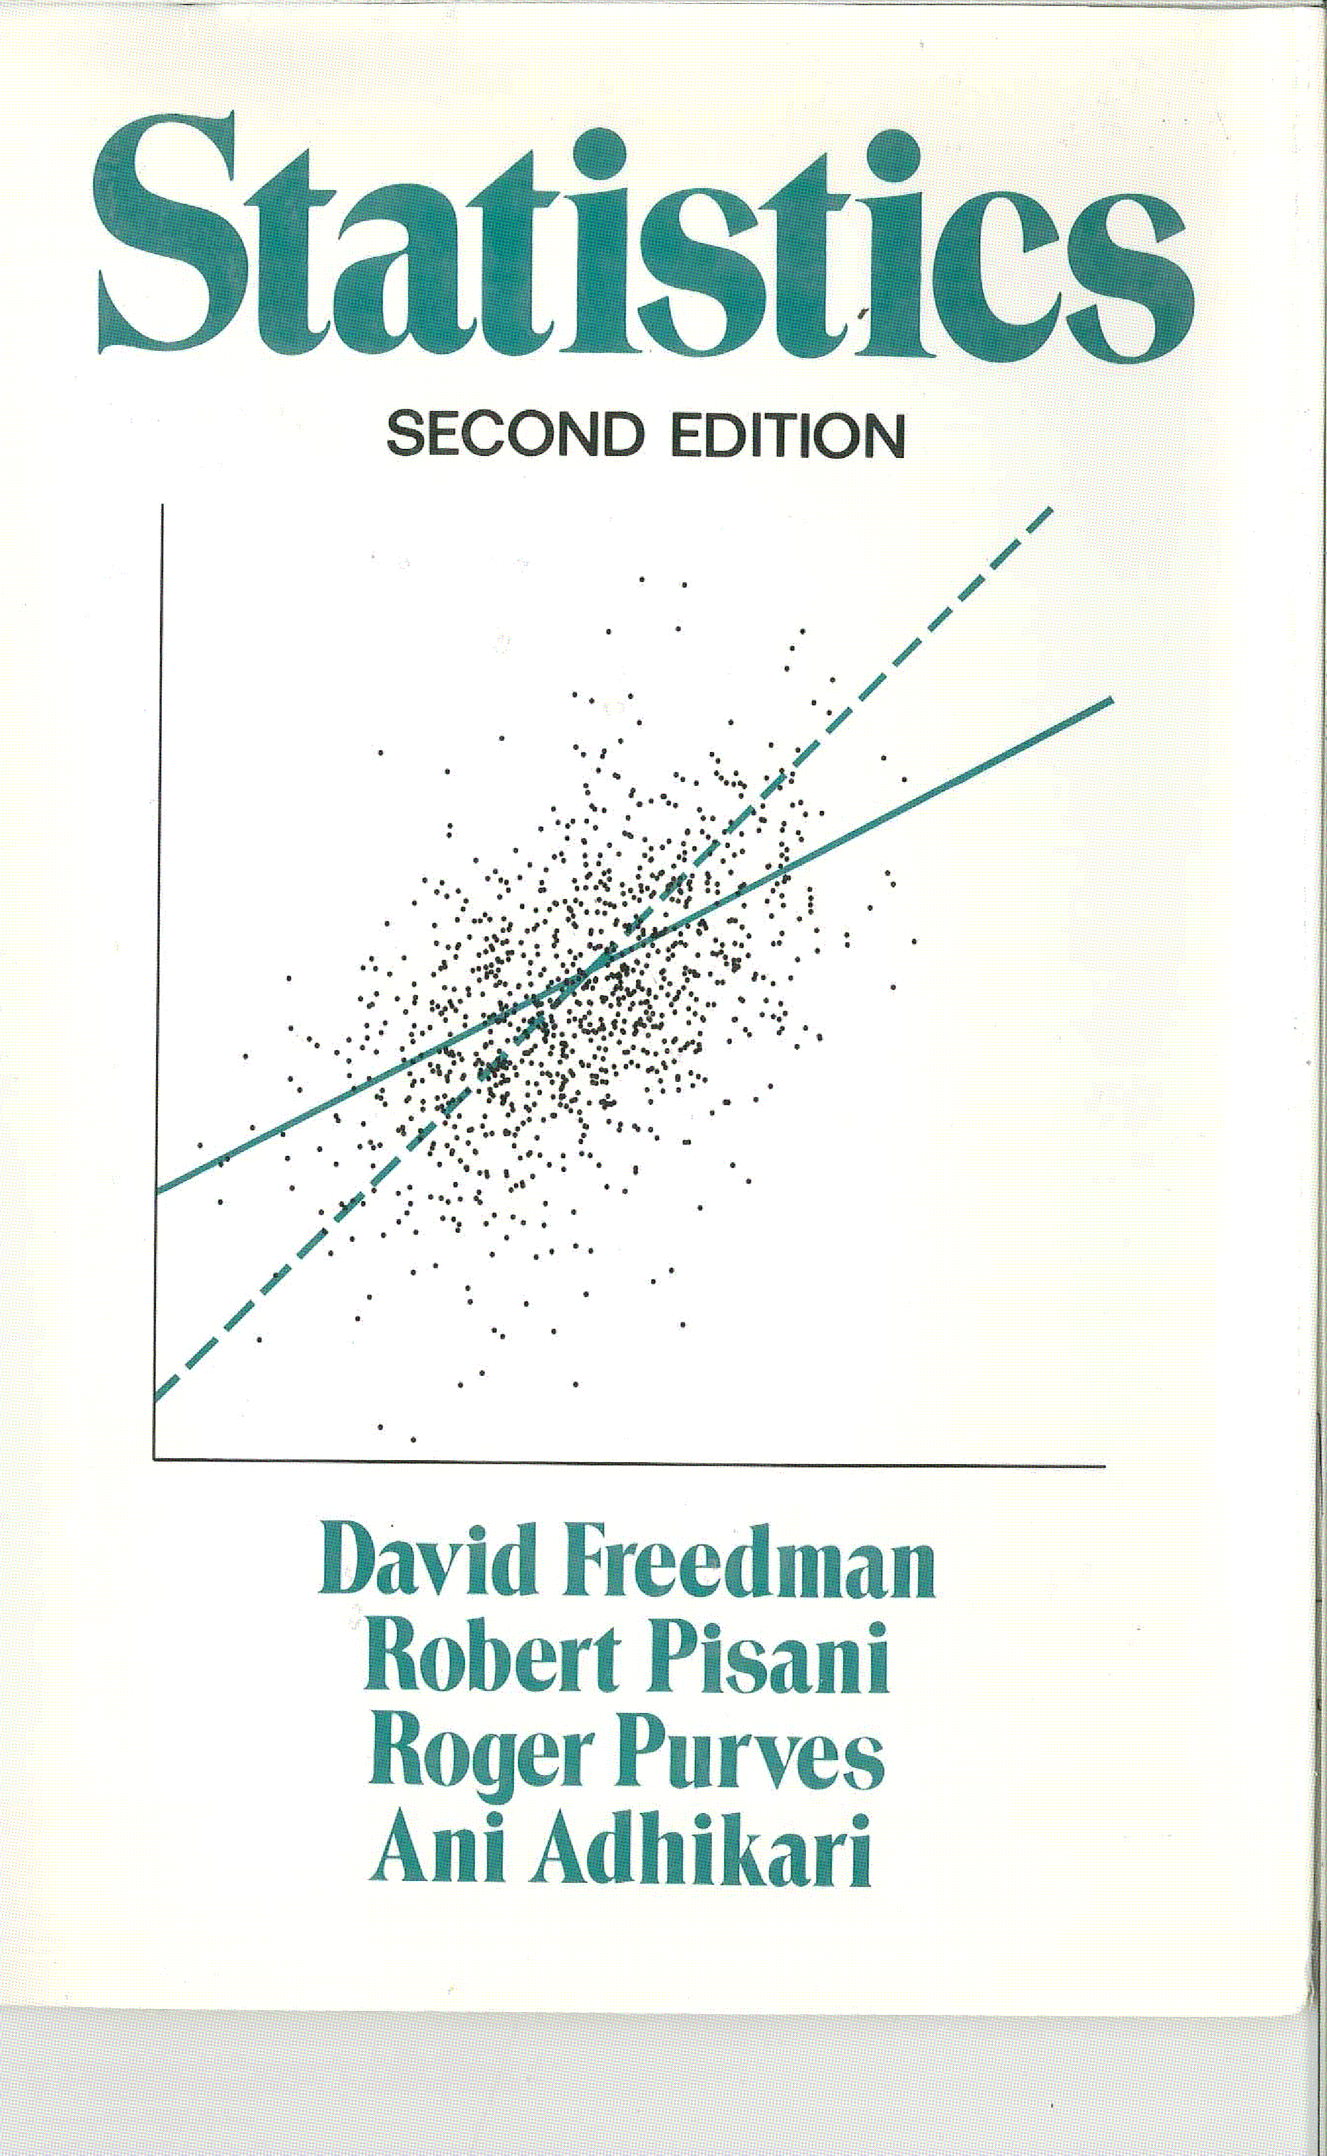
1991
Notes:
From 1991 (Second Edition). One of my favorite Stats 101 texts.

Slide 38
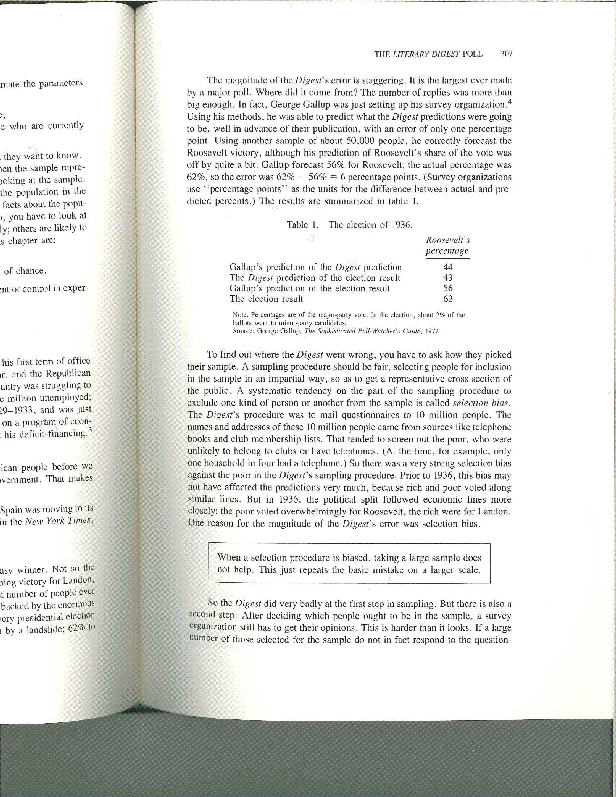
The Literary Digest Poll
Literary Digest collected 2.4 million responses and projected a solid victory for Alf Landon.
George Gallup surveyed 50,000 individuals and predicted a solid victory for Roosevelt

Slide 40

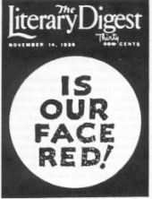
The Literary Digest Poll
After its prediction of the election of 1936, Literary Digest folded in 1938.

Slide 41
Thought #3
Having big data doesn’t help if was selected in a biased way.

Slide 42
Prediction versus causality
Everyone in the science community understands the difference between causation and correlation.
Data-mining and machine learning algorithms are only based on correlations.
In my work on 1000s of research projects, pure prediction problems make up only a small portion.
Usually interested in causation, i.e., understand the cause of illness or develop interventions that cause improvement.

Slide 43
Some bona fide prediction problems
Early detection of cancer.
Identifying high risk patients for closer monitoring. For example, patients likely to be readmitted to the hospital within 30 days.
Prediction of disease epidemics.
Key aspect: Not concerned with causal interpretation of the effect of variables included in the model or interpreting presence of absence of the variable in the model causally.

Slide 44
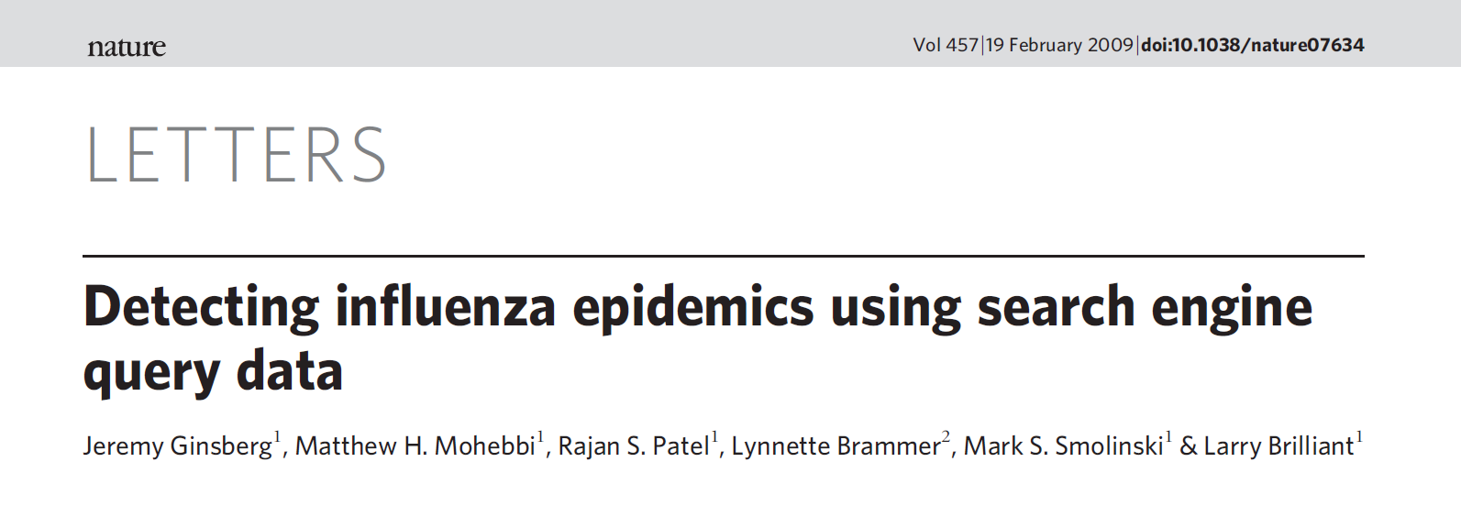
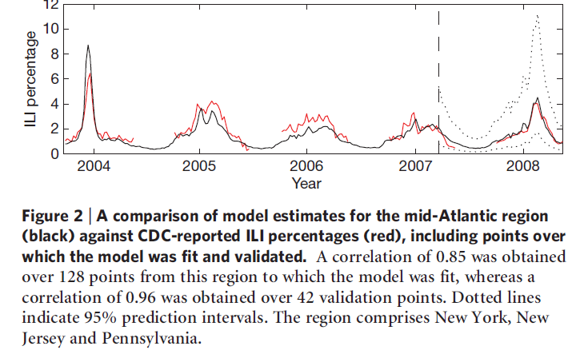
Big Data Prediction: Google Flu Trends
Notes:
Can we use the frequency of Google searches to predict the flu epidemic? For example, monitoring the frequency of a search such as “cold or flu remedy”.

Slide 45
Google Flu Trends
Used “hundreds of billions of searches” to build the model.
Reduced to weekly counts of 50 million common searches for each state for 6 years.
(50 million)*(50 states)*(52 weeks)*(6 years) or about 8x10^11 possible predictors.
Built a model based on 2003 to 2007 to predict the CDC reported percentages of ILI (influenza like visits) before they were released in 2008.

Slide 46
Big Data Prediction: Google Flu Trends
Notes:
Were able to accurately predict the CDC reported percentages of ILI (influenza like visits) before they were released in 2008 (correlation between actual and predicted of 0.96).

Slide 47
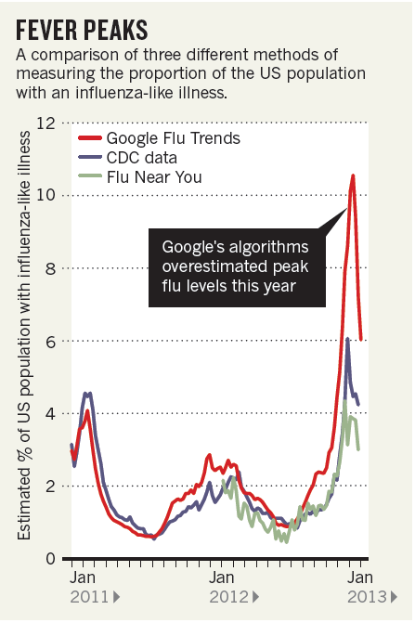
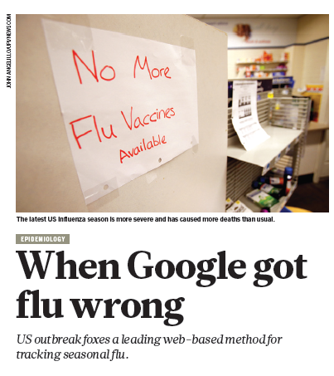
Big Data Prediction: Google Flu Trends
Butler: Nature vol. 949, p.155 Feb 14, 2013
Notes:
But it broke in 2009 and, after recalibration, again in 2012.

Slide 48
Why did it break?
The underlying conditions under which the model was developed changed.
The model wasn’t built with any biological insight. It was built (in a sophisticated way) on correlations.
It was built on weekly counts of the 50 million most common search queries but only 6 years of flu data.
See Thought #2
Notes:
So a massive amount of data but a small amount of information in terms of flu seasons.

Slide 49
Thought #4
Compared to causality, prediction is easy since you only have to understand associations and correlation.
Until it isn’t.

Slide 50
Correlation versus causation
Many big data “successes” are solely prediction.
Data mining methods can help you predict 30 day readmission rates but may not tell you how to improve them.

Slide 51
Correlation versus causation
There is the feeling that if we just take enough measurements we will understand causal effects:
“There is now a better way. Petabytes allow us to say: ‘Correlation is enough.’ We can stop looking for models. We can analyze the data without hypotheses about what it might show. We can throw the numbers into the biggest computing clusters the world has ever seen and let statistical algorithms find patterns where science cannot.” Wired Mag. 6/2008

Slide 52
Correlation versus causation
And it continues:
“The new availability of huge amounts of data, along with the statistical tools to crunch these numbers, offers a whole new way of understanding the world. Correlation supersedes causation, and science can advance even without coherent models, unified theories, or really any mechanistic explanation at all.
There's no reason to cling to our old ways. It's time to ask: What can science learn from Google?

Slide 53
Epidemiologists have long studied the pitfalls of using observational studies to infer causation.
A fundamental idea in causal inference is to compare the same person with and without an intervention or condition. Can’t usually measure the person under both conditions.
For example, observe the same person with and without a history of knee injury to understand its impact on later osteoarthritis.
Or recording the outcomes in a catchment area of an trauma center with and without its closure.
Notes:
Called potential outcomes or counterfactuals

Slide 54
Thought #5
If you are interested in causation you can’t measure it all.
You can, at most, measure half of it all and that half is subject to selection bias.

Slide 55
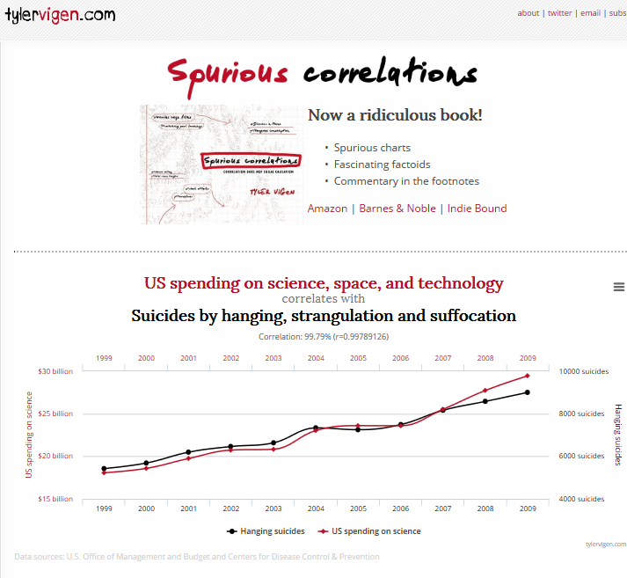
Notes:
“Spurious correlation” is a bit of a lazy phrase, but I will stick with it because it is evocative. Correlation between two variables that is not the result of any direct relationship. There is a whole web site devoted to it.

Slide 56
From the spurious correlation website
Notes:
Here is a dataset from his site.

Slide 57
From the Spurious Correlation website
Correlation of deaths caused by X-ray contrast media and the age of the Academy Award winning best actress is 0.74 (p=0.0076).
Stepwise regression shows a further association with annual precipitation in Nebraska (p=0.003) while age of actress remains statistically significant (p=0.032).
Fortunately, number of lawyers in Ohio is not independently associated (p>0.05).
Notes:
Stepwise regression – a simple form of data mining. The variables on the spurious correlation website are screened to be correlated, so I am cheating a bit. However, this isn’t too different than some researcher’s approach – to screen a large number of predictors to get a more manageable number.

Slide 58
Need to beware of overfitting
1. Stepwise with unrelated variables demonstration.
Revisited the OAI example and added in 3 spurious (randomly generated) variables. Were these selected by the automated methods?
    Stepwise: none
    All subsets: spurious1 and spurious3
    Tree: spurious1
Notes:
Not a general recommendation for stepwise.

Slide 59
Thought #6
Modern machine learning methods are just as good or even better than the more usual statistical methods at finding spurious correlations and make it harder to conduct reproducible research.
Usual solution: validation data set or subsets.

Slide 60
Having our cake and eating it too:
Big data and randomized trials
“Early Supported Discharge for Improving Functional Outcomes After Stroke”
PCORI funded project to compare a more comprehensive package of post-stroke services with usual care.
Randomize most stroke patients in North Carolina by randomizing hospitals to intervention or control.
Outcomes collected electronically: death, recurrent stroke, use of transition billing codes, proportion re-hospitalized.

Slide 61
Thought #7
We can have our cake and eat it too.

Slide 62
Thoughts on Big Data
Data mining can be used for good and evil.
Big data isn’t the same as big information.
Modern machine learning methods can search for associations quickly and flexibly.
Having big data doesn’t solve selection bias.
Distinguish prediction problems from causal investigation.
Machine learning methods are good at finding spurious associations and hard to use reproducibly. Need to wary of over-fitting.
Randomization can be used with big data.

