Slide 1
Biostat 202: Accessing Data and Large Datasets
Charles E. McCulloch,
Division of Biostatistics,
Department of Epidemiology and Biostatistics
Biostat 202 - 2017

Slide 2
Outline for today
File types
Data formats
Variable types and roles
Best practices in data
Availability of datasets
CELDAC
Research using APeX data

Slide 3
File types
Data are stored in many different file formats. You usually have to understand at least roughly how the data are stored to access them. In SPSS Modeler there are a number of nodes under the Sources tab and it can read data from a variety of different sources.

Slide 4
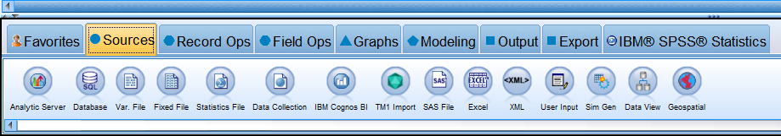
File types

Slide 5
File types supported by Modeler
Excel spreadsheet
.csv file. Text file with a structured format – data elements separated by commas (delimiter).
Text file with other delimiters.
Text file with structured columns.
SAS or SPSS statistics data file.
.xml file. Text file with mark-ups to designate fields and field names.

Slide 6
Files: What does a .csv file look like?
In homework we will use the data from the National Electronic Injury Surveillance System (NEISS).
Designed by the Consumer Product and Safety Commission to monitor consumer products that can cause injuries (think hoverboard).
Based on a national sample of U.S. hospitals. Records emergency department visits that involve injury related to a consumer product.
The data from 2015 alone consists of approximately 360,000 records.

Slide 7
Files: What does a .csv file look like?
Take a look at the NEISS dataset
CPSC Case #,trmt_date,psu,weight,stratum,age,sex,race,race_other,diag,diag_other,body_part,disposition,location,fmv,prod1,prod2,narr1,narr2¶
150324089,3/9/2015,21,15.0591,V,28,1,0,,57,,76,4,0,0,1894,,28YM EVADING BAIL BONDSMAN&JUMPED FROM 3RD STORY WINDOW LANDING ONTO FA,"CE, +LOC/SZ LIKE ACTIVITIES>>MULTI FACIAL BONE FXS” ¶
150734952,7/4/2015,57,15.7762,V,20,1,2,,59,,82,1,1,0,1894,,20 YOM DX HAND LACERATION - S/P PT PUNCHED A WINDOW., ¶
Notes:
What you would see if you opened the NEISS data as a text file. Paragraph marks, mark the ends of the line in the text file (wrapping on screen here). Computers read the file starting at the and move from left to right. So what does it need to do to make sense of the data?
It reads C then P then S then C then blank then C etc.

Slide 8
Files: What does a .csv file look like?
NEISS dataset from Homework
CPSC Case #,trmt_date,psu,weight,stratum,age,sex,race,race_other,diag,diag_other,body_part,disposition,location,fmv,prod1,prod2,narr1,narr2¶
150324089,3/9/2015,21,15.0591,V,28,1,0,,57,,76,4,0,0,1894,,28YM EVADING BAIL BONDSMAN&JUMPED FROM 3RD STORY WINDOW LANDING ONTO FA,"CE, +LOC/SZ LIKE ACTIVITIES>>MULTI FACIAL BONE FXS” ¶
Variable names
Notes:
How does it know that the first row contains variable names and not data?

Slide 9
Files: What does a .csv file look like?
NEISS dataset from Homework
CPSC Case #,trmt_date,psu,weight,stratum,age,sex,race,race_other,diag,diag_other,body_part,disposition,location,fmv,prod1,prod2,narr1,narr2¶
150324089,3/9/2015,21,15.0591,V,28,1,0,,57,,76,4,0,0,1894,,28YM EVADING BAIL BONDSMAN&JUMPED FROM 3RD STORY WINDOW LANDING ONTO FA,"CE, +LOC/SZ LIKE ACTIVITIES>>MULTI FACIAL BONE FXS” ¶
Data from an emergency room visit

Slide 10
Files: What does a .csv file look like?
NEISS dataset from Homework
CPSC Case #,trmt_date,psu,weight,stratum,age,sex,race,race_other,diag,diag_other,body_part,disposition,location,fmv,prod1,prod2,narr1,narr2¶
150324089,3/9/2015,21,15.0591,V,28,1,0,,57,,76,4,0,0,1894,,28YM EVADING BAIL BONDSMAN&JUMPED FROM 3RD STORY WINDOW LANDING ONTO FA,"CE, +LOC/SZ LIKE ACTIVITIES>>MULTI FACIAL BONE FXS” ¶
End of a record

Slide 11
Files: Data issues
NEISS dataset from Homework
CPSC Case #,trmt_date,psu,weight,stratum,age,sex,race,race_other,diag,diag_other,body_part,disposition,location,fmv,prod1,prod2,narr1,narr2¶
150324089,3/9/2015,21,15.0591,V,28,1,0,,57,,76,4,0,0,1894,,28YM EVADING BAIL BONDSMAN&JUMPED FROM 3RD STORY WINDOW LANDING ONTO FA,"CE, +LOC/SZ LIKE ACTIVITIES>>MULTI FACIAL BONE FXS” ¶
Issues?
Notes:
Issues: Narrative is split into two fields. Causes misspellings in each field. Quotes.

Slide 12
Files: Data issues
NEISS dataset from Homework
CPSC Case #,trmt_date,psu,weight,stratum,age,sex,race,race_other,diag,diag_other,body_part,disposition,location,fmv,prod1,prod2,narr1,narr2¶
150324089,3/9/2015,21,15.0591,V,28,1,0,,57,,76,4,0,0,1894,,28YM EVADING BAIL BONDSMAN&JUMPED FROM 3RD STORY WINDOW LANDING ONTO FA,"CE, +LOC/SZ LIKE ACTIVITIES>>MULTI FACIAL BONE FXS” ¶
,, Issue?

Slide 13
Files: Data issues
NEISS dataset from Homework
CPSC Case #,trmt_date,psu,weight,stratum,age,sex,race,race_other,diag,diag_other,body_part,disposition,location,fmv,prod1,prod2,narr1,narr2¶
150324089,3/9/2015,21,15.0591,V,28,1,0,,57,,76,4,0,0,1894,,28YM EVADING BAIL BONDSMAN&JUMPED FROM 3RD STORY WINDOW LANDING ONTO FA,"CE, +LOC/SZ LIKE ACTIVITIES>>MULTI FACIAL BONE FXS” ¶
Issue?

Slide 14
File types
Much data does not exist easily packaged into files. For example, suppose you wanted to develop a data mining algorithm to identify spam.
How would you go about summarizing the data?
Notes:
Leads us to consider variable types.

Slide 15
Variable types
Numeric (It is not usually necessary to distinguish continuous versus not).
Nominal/categorical
Ordinal/categorical
Text
Date
Time

Slide 16
Variable types: Why is it important to distinguish?
Most software will try to adapt the analysis depending on the variable type and read it correctly.
Example: hospitalized on 12/7/2015, readmitted on 1/6/2016. Was that within 30 days? Many programs allow subtraction of dates.
Example: Knee pain is coded as 1, 2, 3 and 4. Does is make sense to split it as 1 and 2 versus 3 and 4?
Maybe if ordinal (1=no, 2=slight, 3=moderate, 4=severe pain). Probably not if nominal (1=no, 2=left knee only, 3=right knee only, 4=both).

Slide 17
Variable types - roles
It is also important to designate the role of a variable in the analysis. Main ones are:
Target. Also called outcome, response, dependent variable.
Input. Also called predictor, covariate, independent variable.
Modeler also has variable roles of Record ID (identification variable like medical record number), split (for separate analyses of subgroups), partition (for assessing training/testing).
Notes:
Target and Input are the Modeler names.
Split is different from Partition. With Split the analyses are run separately for the values of the variable that is declared as Split. In Partition, the model is fit using the training and not refit with the test data. Also is done randomly.

Slide 18
Best practices in data
Most analysis programs want the data in “rectangles” with each row a record or observation and each column a field or variable. Exception: the first row usually contains variable names.
So a dataset with 10 variables and 300 people would have 10 columns and 301 rows (300 data rows and a variable names row).

Slide 19
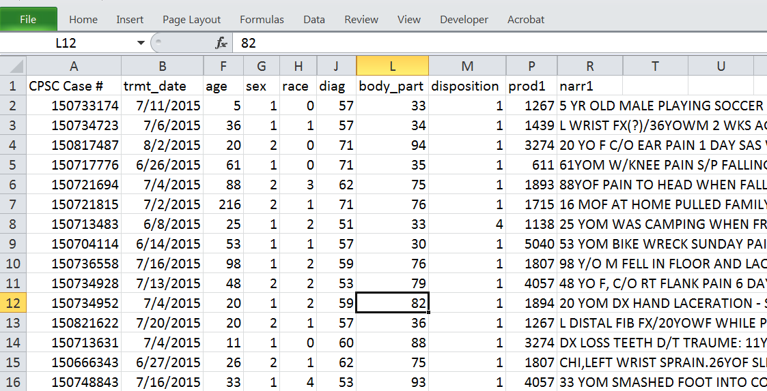
Best practices: rectangular data
Notes:
Here is what the NEISS data looks like in Excel.

Slide 20
Best practices in data
Each column should contain 1 variable, or one unique piece of information about the subject. More than one piece of information should not be put into a variable. For example, don’t enter blood pressure in one column as “130/90”. That would be two variables -- one variable for systolic and one for diastolic.
Another thing I have seen is the patient id variable coded such as “Fresno1133”, “Parnassus0002” without a site variable elsewhere in the dataset.

Slide 21
Best data practices checklist part 1
One row per subject, one column per variable.
Variable names in first row only.
Variables represent a single piece of information.
Generally good to avoid hyphens, or special characters in the variable names. Some programs don’t want variable names that start with numbers.
Modeler does but many other programs don’t distinguish lower and upper case in names.

Slide 22
Best data practices checklist part 2
Do not leave values blank when they are the same as the row above.
For the majority of analysis programs leave missing data as blank. For advanced users of sophisticated packages like SAS, different flavors of missing data can be coded.
Sometimes on questionnaires or surveys, "Unknown" or "Don't know" is a valid answer, different from missing data, and should have its own code.

Slide 23
Best data practices checklist part 3
Dates are often an important aspect of a dataset and sometimes you can designate that as the variable type. If not, entering it in the format of mm/dd/yyyy (e.g., 07/04/2016) can be read by just about any analysis package.
Times are often an important aspect of a dataset and sometimes you can designate that as a variable type. It is usually easier to use military time (e.g., 14:00 instead of 2:00pm) and many programs can read a time if it is entered in the format of hh:mm (and seconds if necessary).

Slide 24
Best data practices checklist part 4
Do not intersperse blank rows or columns, lines of labels, or summary statistics in with the data. The dataset should be a solid rectangle.
It is hard for analysis programs to directly handle fields that contain comments or extended text.

Slide 25
Best data practices: sad but true 1
When looking at the variable titled “patient ID” in the dataset:
Question: Is the patient with patient ID equal to 2 different from the one with patient ID equal to 2R?
Answer: No – the patient with patient ID equal to 2 is the left and 2R is the right leg of the same patient.

Slide 26
Best data practices: sad but true 2
When modeling a response to different dosages of a drug:
Question: Why didn’t you analyze the data using the actual concentrations of the dose?
Answer: We used the dose variable you sent us in the data which was coded as 0, 1, 2, …, 11.
Question: Why? Those weren’t the actual doses.
And this was after scraping the data out of the body of an email.

Slide 27
Best data practices: sad but true 3
When asked to compare the treatment and placebo groups in the dataset in which there was no treatment variable:
Question: How can we tell which patients are in the treatment group?
Answer: Those are the patient IDs that are in red in Excel.

Slide 28
Two common variations on the basic rectangular layout. 1. Longitudinal
It is quite common to collect data over time on the same “patient” (longitudinal data) across multiple “visits”.
There are two common ways to arrange the data: one row per patient (sometimes called “wide” format because the rectangle of data would have many columns and be wide) and one row per visit (sometimes called “long” format because the rectangle of data would have many rows and be long).

Slide 29
Data layouts for longitudinal data
“Wide format”
Notes:
Stata command: reshape

Slide 30
Data layouts for longitudinal data
For longitudinal analyses: “long format”
Not a very efficient data storage format
Notes:
Longitudinal analyses typically want data in the “long” format. One row per outcome.
Change analyses typically want data in the “wide” format. One row per subject.
“Long” is more flexible and missing data is then just a missing row.

Slide 31
Two common variations on the basic rectangular layout. 2. Relational
More efficient to store two files, one for patient level characteristics and one for visit level.

Slide 32
Two common variations on the basic rectangular layout. 2. Relational
If the data are originally in two files but Modeler (or just about any other analysis program) wants the data in rectangular format, how can we do that?
Need to merge the two datasets.

Slide 33
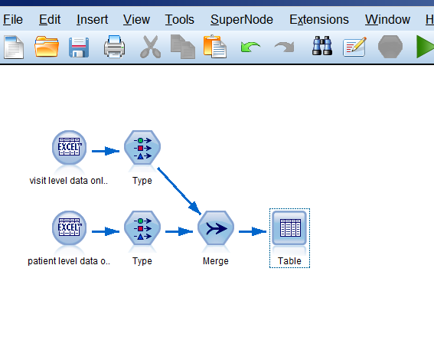
Relational database
Merging on records with the same ID

Slide 34
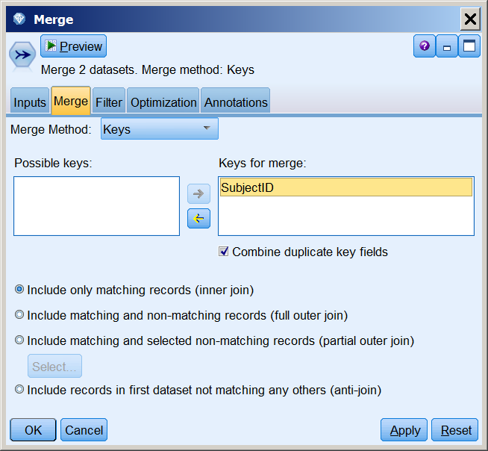
Relational database
Merging on records with the same ID
Merge on key variable
Match records with the same Subject ID

Slide 35
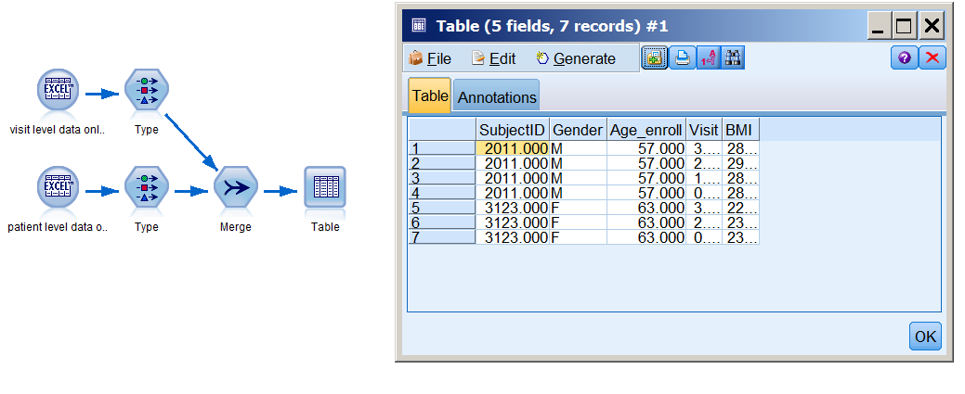
Relational database
Merging on records with the same ID
Notes:
Next transition to sources of data. Questions?

Slide 36
Healthcare datasets are rapidly becoming much more available
There are a number of datasets that are available for conducting research. The National Library of Medicine offers an entrée to many of them:
https://www.nlm.nih.gov/hsrinfo/datasites.html
I’ll briefly talk about three examples: NHANES, NIS, and OAI.

Slide 37
Datasets: NHANES
National Health and Nutrition Examination Survey.
Description: NHANES is a set of studies for assessing the health and nutritional status of adults and children in the United States, comprising both interviews and physical examinations. It began in the early 1960s and, since 1999, has surveyed about 5,000 persons each year.
Location: http://www.cdc.gov/nchs/nhanes/
Datafile type(s): SAS transport files (.xpt)

Slide 38
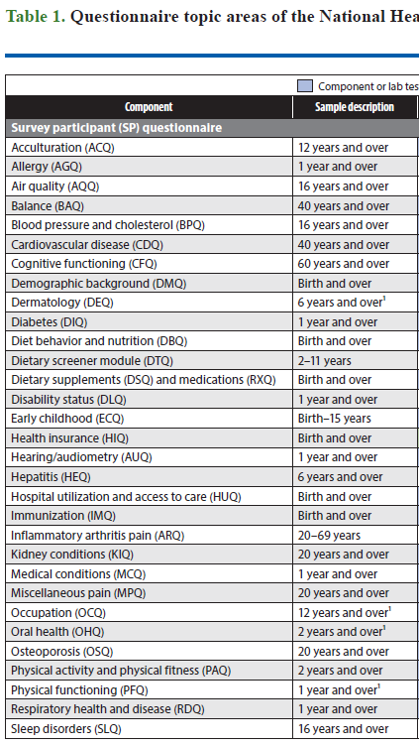
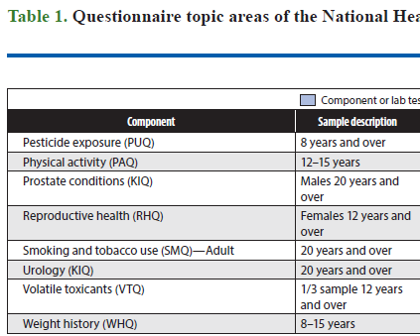
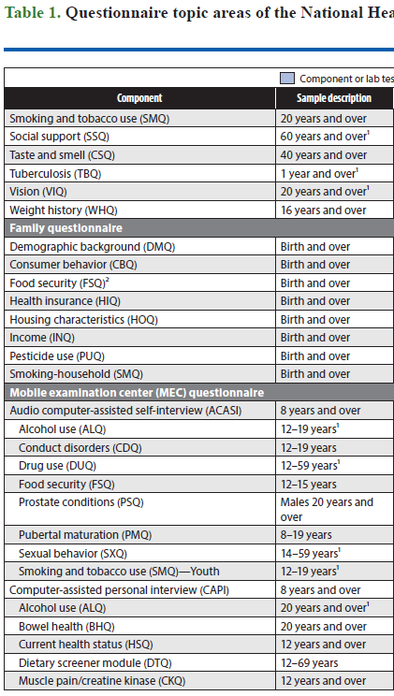
Datasets: NHANES

Slide 39
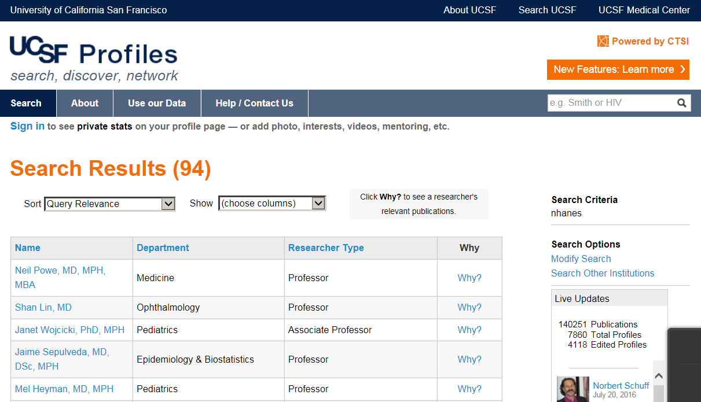
UCSF Profiles search on “NHANES”
94 entries, mostly faculty who have published using NHANES

Slide 40
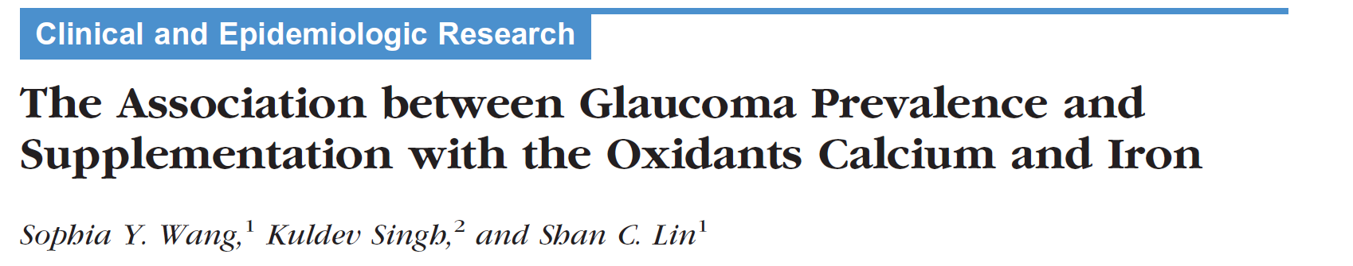
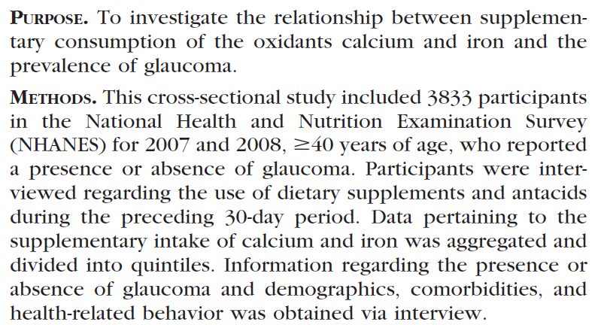
Datasets: NHANES examples

Slide 41
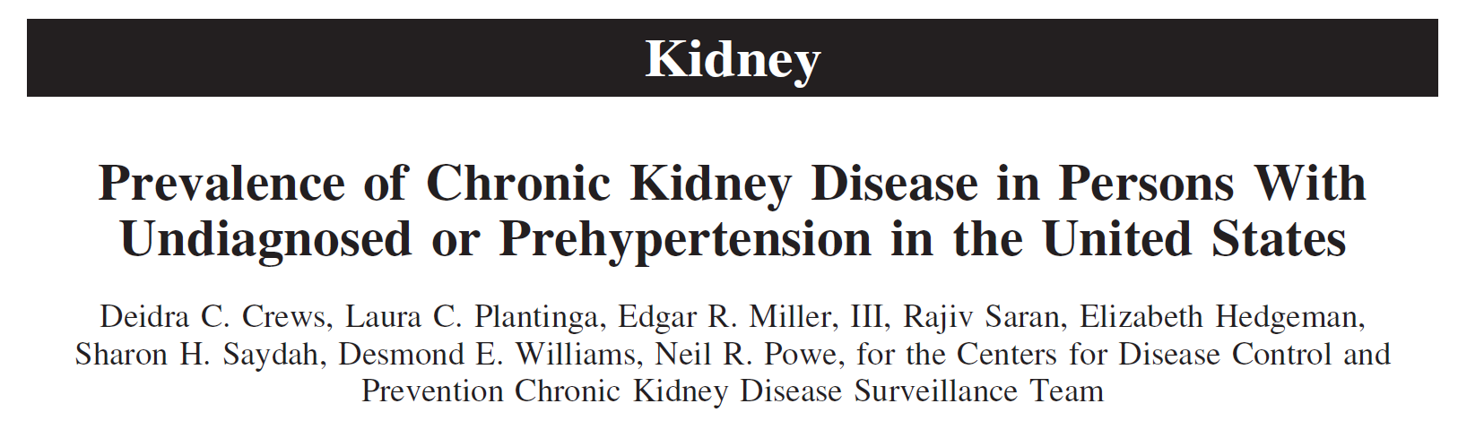
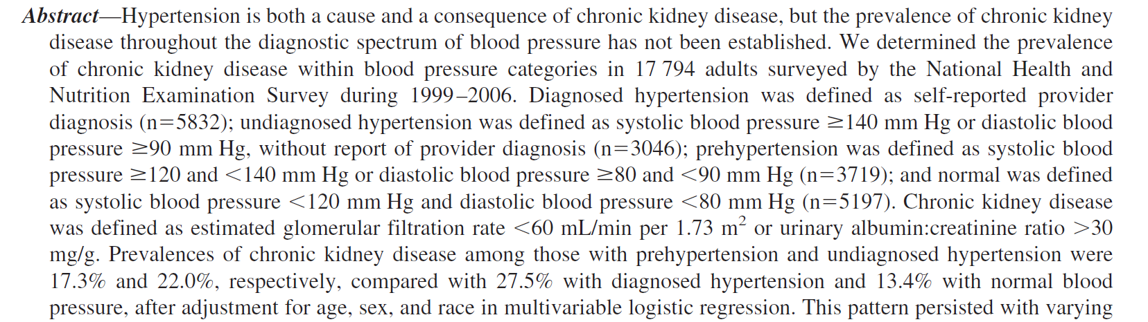
Datasets: NHANES examples

Slide 42
Datasets: NIS
National Inpatient Sample (NIS).
Description: NIS is the largest publicly available all-payer inpatient health care database in the United States, yielding national estimates of hospital inpatient stays. It contains data from more than 7 million hospital stays each year.
Location: https://www.hcup-us.ahrq.gov/nisoverview.jsp
Datafile type(s): text, fixed file format (website includes code to read the files into SPSS, SAS and Stata).

Slide 43
Datasets: NIS
The NIS contains clinical, nonclinical, and resource-use information that is included in a typical discharge abstract, including:
Primary/secondary diagnoses and procedures,
Patient demographics,
Hospital characteristics,
Payment source and total charges,
Discharge status and length of stay, and
Severity and comorbidity measures.

Slide 44
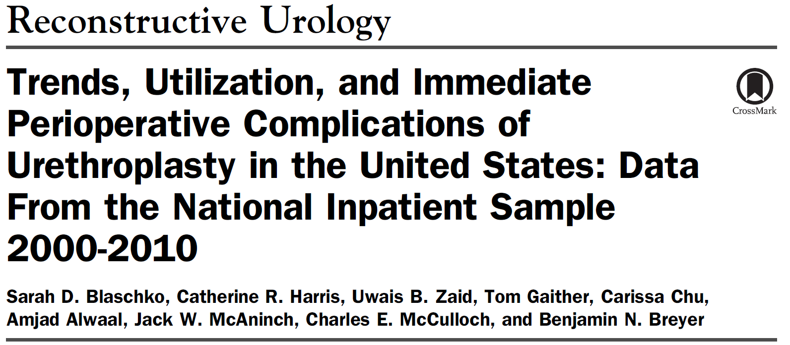
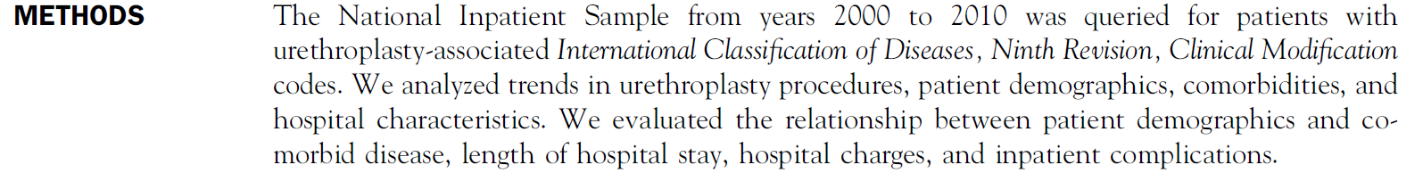
Datasets: NIS examples

Slide 45
Datasets: OAI
Osteoarthritis Initiative (OAI).
Description: The OAI is an ongoing multi-center, longitudinal, prospective observational study of knee osteoarthritis. The goal is the evaluation of biomarkers for disease onset and progression.
Location: www.oai.ucsf.edu
Datafile type(s): SAS file (.sas7bdt), SAS transport (.xpt), pipe-delimited (“|”) text file.
Notes:
So if you looked at one of the text data files what would it look like?

Slide 46
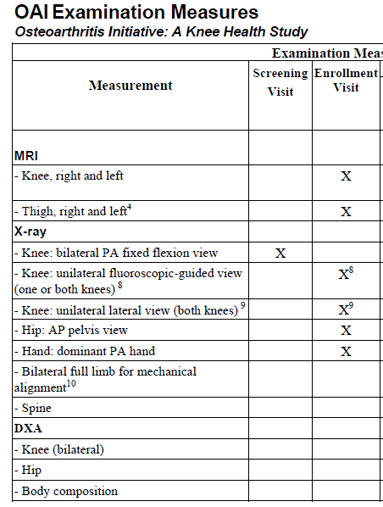
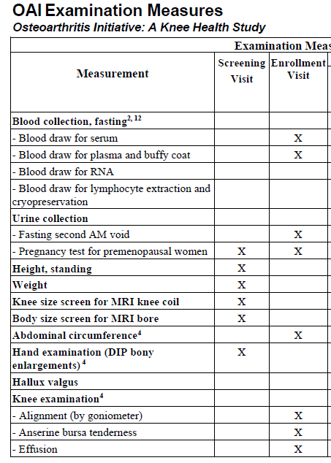
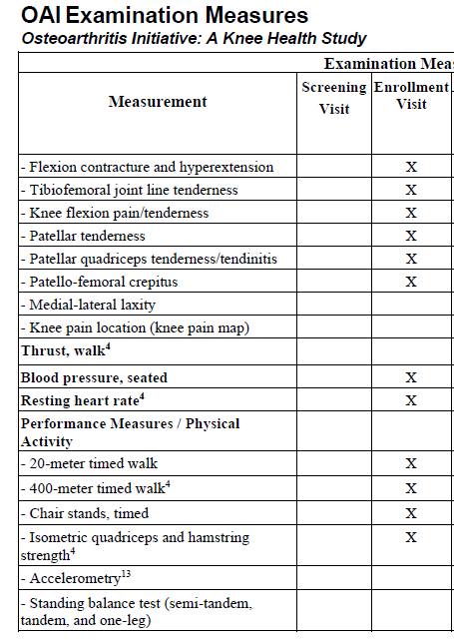
Datasets: OAI

Slide 47
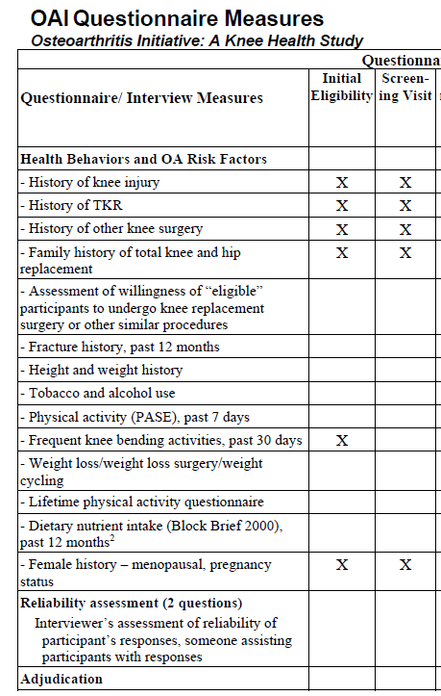
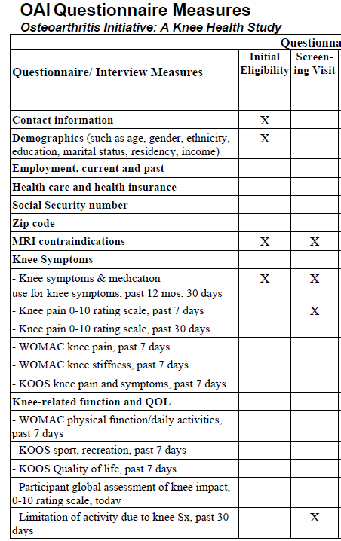
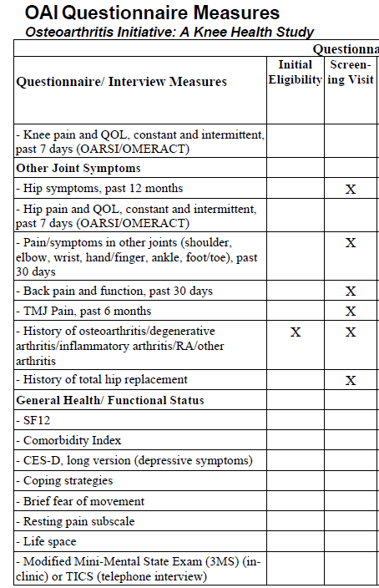
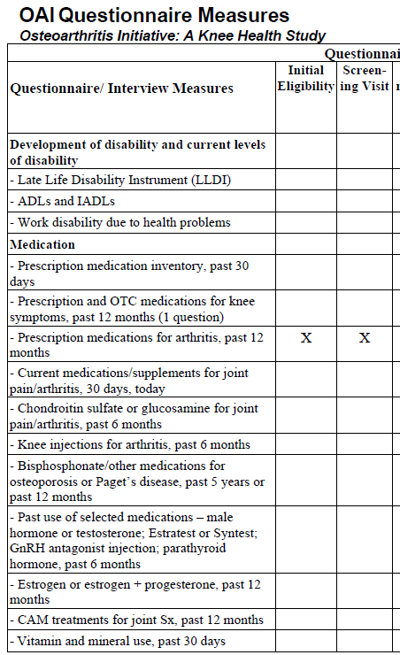
Datasets: OAI

Slide 48
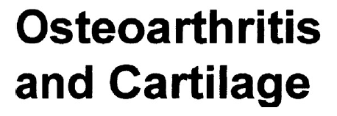
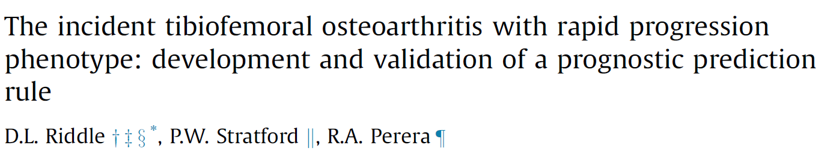
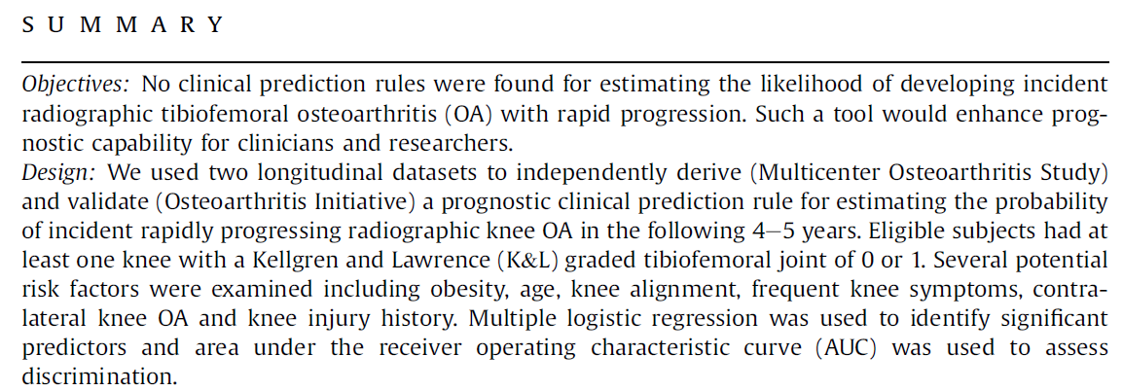
Datasets: OAI

Slide 49
Datasets: OAI
Getting around a large dataset.
The NHANES website has examples and a tutorial.
OAI Data Browser demonstration.

Slide 50
Finding your way around big datasets: CELDAC
CELDAC (Comparative Effectiveness Large Dataset Analysis Core) is a part of the Clinical and Translational Research Institute and its mission is to enhance UCSF's capacity for analysis of large local, state, and national health datasets to conduct research on health and health care.

Slide 51
CELDAC’S Main Components
Consultation to identify relevant datasets
Repository of select datasets available through MyResearch

Slide 52
Dataset Repository
CELDAC has created a repository of select large, public datasets that are available to UCSF researchers at no cost.
These data sets include
  National samples of hospital discharges and ED visits
  Universes of hospital discharges and ED visits for select states
  Data on characteristics of hospitals
  County level data on demographic, socio-economic, and health system characteristics
Notes:
For example the NIS

Slide 53
How to Access CELDAC Datasets
Obtain a MyResearch account
Obtain CHR approval or exemption
Request CELDAC help through CTSI at
https://accelerate.ucsf.edu/research/large-datasets-application

Slide 54
Using Electronic Health Records for Research
The Academic Research Systems group has recently made a de-identified extract of the APeX files available.
Details at: https://myresearch.ucsf.edu/research-data-browser

Slide 55
Using Electronic Health Records for Research
Before you can access the de-identified data you need to be granted access to the “Research Data Browser.”
You can apply for access by following the instructions under “Getting Access” at the link on the previous slide. (If interested, email me first and then list me as “Approver” on the form)

Slide 56
Using Electronic Health Records for Research
If you want access to data including identifiers, you can request an extract of APeX data at UCSF through Academic Research Systems.
First 8 hours of consultation are free.
Need CHR approved protocol.
Details available at:
https://myresearch.ucsf.edu/clinical-data-research-consultations
Notes:
Notes and lab fields contain PHI.

Slide 57
Using Electronic Health Records for Research
Navigating the process of specifying what you need from APeX to conduct research can be a daunting task.
CTSI’s Data Management Unit can help with both the specification and the data request to Academic Research Systems.
http://accelerate.ucsf.edu/research/data-consult
But note that these often require considerable work for which you would need to arrange funding.
Notes:
Notes and lab fields contain PHI.

Slide 58
Using Electronic Health Records for Research
Also
UCReX – University of California Research eXchange – a compendium of 14.5m data records from the five UC medical centers. See
http://www.ucrex.org/ or
https://myresearch.ucsf.edu/uc-rex
Limited data.
Notes:
Notes and lab fields contain PHI.

Slide 59
Summary
It helps to know the format and layout of a dataset you want to analyze.
Paying attention to data formatting issues can save LOTS of time later.
Defining variable roles is important in IBM SPSS Modeler.
Access to rich data is easy.
Finding your way around can be hard.
Look for tools (tutorials, browsers),
Or get professional help (ARS and CTSI).

