Slide 1

Introduction to clinical research and
The research question
Peter Chin-Hong, MD and
Miriam Kuppermann, PhD MPH
August 2, 2017

Slide 2
Outline
Philosophy
Anatomy and physiology of research
Research questions
Examples from our research

Slide 3
Outline
Philosophy
Anatomy and physiology of research
Research questions
Examples from our research

Slide 4

Philosophy
Research is the art of the possible
  Inherently opportunistic
  No study is perfect
  From theory → reality → theory
  Feasibility trumps all
  Can you add a brick in the wall?
    Understand what’s already there
    Find a gap
    Design something feasible to fill the gap
    Execute
    Interpret and publish

Slide 5
Outline
Philosophy
Anatomy and physiology of research
Research questions
Examples from our research

Slide 6
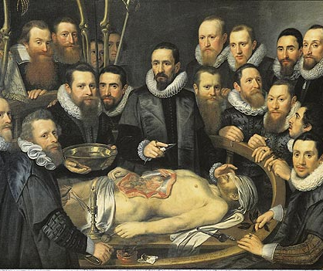
Anatomy and Physiology
Anatomy:
  What it’s made of
Physiology:
  How it works

Slide 7
Anatomy of Clinical Research
What is research made of?
Written products!
Including descriptions of:
  Research question(s)
  Background and significance
  Study design
  Study sample
  Measurements
  Statistical issues (including sample size justification)
  Implementation plans

Slide 8
Anatomy of Clinical Research
Formats:
  1-Sentence Summary
  1-Page Outline
  5-Page Protocol

Slide 9
Anatomy of Clinical Research
Formats:
  1-Sentence Summary
  1-Page Outline
  5-Page Protocol
  Examples
    Grant application*
    Methods section for a publication
    ClinicalTrials.gov submission*
    Manuscript proposal for analysis of existing study data*
    UCSF IRB’s Protocol for a Clinical Trial*
    Operations Manual
* - Example files on the CLE Syllabus

Slide 10
Anatomy of Clinical Research
1-sentence summary example:
  The Prevention of Premature Atherosclerosis in Young Adults (POPAYA) Trial is a randomized controlled trial designed to estimate the effect of 10 mg atorvastatin for 5 years versus placebo on coronary calcification in young adults age 30-40 with LDL 130-190 mg/dl

Slide 11
Anatomy of Clinical Research
NAME of the study
1-sentence summary example:
  The Prevention of Premature Atherosclerosis in Young Adults (POPAYA) Trial is a randomized controlled trial designed to estimate the effect of 10 mg atorvastatin for 5 years versus placebo on coronary calcification in young adults age 30-40 with LDL 130-190 mg/dl

Slide 12
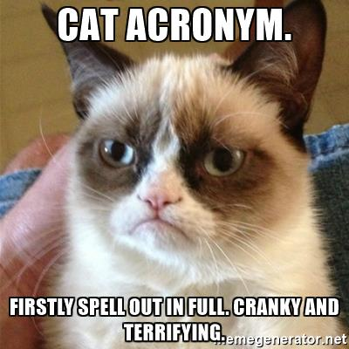
Digression
Importance of a good acronym
Fun initial way to engage collaborators
Gives your study credibility and life
Useful for naming files and directories
Worth the effort!

Slide 13
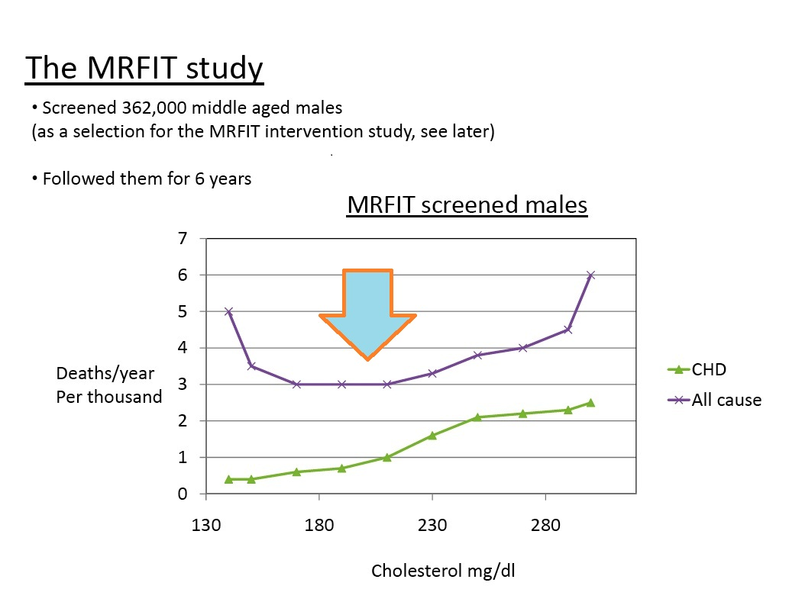
Examples
Multiple Risk Factor Intervention Trial
= MRFIT
Late Impact of Getting Hyperbilirubinemia or photoTherapy
= LIGHT
Diagnosis of Infection in Stem Cell Transplant Patients OVER Time
= DISCOVER

Slide 14
Examples
A study of the cost effectiveness of differerent protocols for treating gestational diabetes (James G. Kahn, MD, MPH)
Gestational Diabetes Formulas for Cost-Effectiveness
=

Slide 15

Examples
A study of the cost effectiveness of differerent protocols for treating gestational diabetes (James G. Kahn, MD, MPH)
Gestational Diabetes Formulas for Cost-Effectiveness
= GeDiFORCE

Slide 16
Anatomy of Clinical Research
NAME of the study
1-sentence summary example:
  The Prevention of Premature Atherosclerosis in Young Adults (POPAYA) Trial is a randomized controlled trial designed to estimate the effect of 10 mg atorvastatin for 5 years versus placebo on coronary calcification in young adults age 30-40 with LDL 130-190 mg/dl

Slide 17
Anatomy of Clinical Research
DESIGN of the study
1-sentence summary example:
  The Prevention of Premature Atherosclerosis in Young Adults (POPAYA) Trial is a randomized controlled trial designed to estimate the effect of 10 mg atorvastatin for 5 years versus placebo on coronary calcification in young adults age 30-40 with LDL 130-190 mg/dl

Slide 18
Anatomy of Clinical Research
Primary PREDICTOR variable
1-sentence summary example:
  The Prevention of Premature Atherosclerosis in Young Adults (POPAYA) Trial is a randomized controlled trial designed to estimate the effect of 10 mg atorvastatin for 5 years versus placebo on coronary calcification in young adults age 30-40 with LDL 130-190 mg/dl

Slide 19
Anatomy of Clinical Research
Primary OUTCOME variable
1-sentence summary example:
  The Prevention of Premature Atherosclerosis in Young Adults (POPAYA) Trial is a randomized controlled trial designed to estimate the effect of 10 mg atorvastatin for 5 years versus placebo on coronary calcification in young adults age 30-40 with LDL 130-190 mg/dl

Slide 20
Anatomy of Clinical Research
Study population
1-sentence summary example:
  The Prevention of Premature Atherosclerosis in Young Adults (POPAYA) Trial is a randomized controlled trial designed to estimate the effect of 10 mg atorvastatin for 5 years versus placebo on coronary calcification in young adults age 30-40 with LDL 130-190 mg/dl

Slide 21
Anatomy of Clinical Research
1-sentence summary “MADLIB”:
  The [study name] is a [study design] designed to estimate the effect of [intervention] versus [comparator] on [outcome] in [study sample]

Slide 22
Anatomy of Clinical Research
1-sentence summary “MADLIB”:
for trials:
  The [study name] is a [study design] designed to estimate the effect of [intervention] versus [comparator] on [outcome] in [study sample]
for observational studies:
  The [study name] is a [study design] designed to examine the association between [primary predictor] and [outcome] in [study sample]

Slide 23
Anatomy of Clinical Research
1-sentence summary “MADLIB”:
for trials:
  The [study name] is a [study design] designed to estimate the effect of [intervention] versus [comparator] on [outcome] in [study sample]
for observational studies:
  The [study name] is a [study design] designed to examine the association between [primary predictor] and [outcome] in [study sample]
There are extremely important advantages to fitting into this framework (e.g., power calculations)

Slide 24
Physiology of Clinical Research
How does research work?
We use measurements in a sample to draw inferences about phenomena in a population

Slide 25
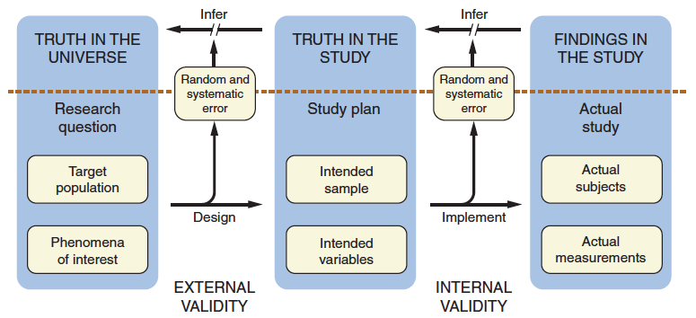
DCR-4 Figure 1.4
Goal: Use actual measurements in an actual sample to draw inferences about phenomena in a population

Slide 26
DCR-4 Figure 1.4
Step 1) What do you actually want to know?

Slide 27
DCR-4 Figure 1.4
Step 2) Can we theoretically access a relevant sample of participants and get required measurements?

Slide 28
DCR-4 Figure 1.4
Step 3) Can we actually recruit the intended study subjects and make the measurements without bias?

Slide 29
DCR-4 Figure 1.4
Good design reduces random and systematic error, and allows better inference

Slide 30
Outline
Philosophy
Anatomy and physiology of research
Research questions
Examples from our research

Slide 31
Choosing a research question
What “truth” do you want to know?
  Where are the real gaps and opportunities?
Tension between feasibility and importance

Slide 32
Choosing a research question
The FINER Criteria
Feasible
Interesting
Novel
Ethical
Relevant

Slide 33
Choosing a research question
The FINGER Criteria
Feasible
Interesting
Novel
Good for your career
Ethical
Relevant

Slide 34
Choosing a research question
Some FINER projects aren’t ideal choices for this course:
  Qualitative research
  Data synthesis like decision analysis, cost-effectiveness analysis, meta-analysis
  Animals/molecules without humans

Slide 35
Choosing a research question
Some FINER projects aren’t ideal choices for this course:
  Qualitative research
  Data synthesis like decision analysis, cost-effectiveness analysis, meta-analysis
  Animals/molecules without humans
Humans are a primary source of many feasibility issues

Slide 36
Example research questions
Does treatment with Coenzyme Q10 reduce clinic-based systolic blood pressure more than treatment with a placebo among patients with mild-to-moderate hypertension over a one-year period?
Does treatment with a 15-day tapering course of oral prednisone result in a greater change in physical functioning compared to treatment with an oral placebo after three weeks follow-up?
What are the clinical, demographic, psychosocial, and financial determinants that are independently associated with adherence to statin medication therapy over a two-year period in a managed-care population?

Slide 37
Choosing a research question for this course
Secondary data analyses are great for career-building
Pros:
  Feasible
  Often use high-quality/high-impact data sources and leverage $millions invested in study execution
  Can lead to quick, high-quality publications
Cons:
  Some already did the hard work of design and implementation
  You won’t learn as much from this course

Slide 38
Choosing a research question for this course
Bottom line:
  Design at least 1 study with primary data collection
  Design at least 1 study you definitely plan to do (near-term feasibility)
  Do at least a 1-page outline for both
  Your small group leader/colleagues can help you decide which to turn in as your final project

Slide 39
Choosing a study design
Choosing a research design is hard! And we haven’t told you anything about study design!
  Quick overview today
  More detail in upcoming lectures
  Also more information in the text book
  Modify, refine during the course

Slide 40
Observational designs
Cross-sectional study
  Take a look at a given population (sample) right now
Cohort study
  Choose a sample and follow over time
Case-control study
  Choose two samples (cases and controls) with and without the outcome, compare exposures

Slide 41
Experimental design
Randomized controlled trial
  INTERVENTION (with random assignment to control)

Slide 42
Simple rubric for choosing a study design
No
Do you want to compare groups?
Descriptive study
Is the outcome rare? (Sample based on outcome)
Yes
Case-control study
No
Cross-sectional study
Will you follow the subjects over time?
Is the exposure rare? (Sample based on exposure)
Yes
Double-cohort study
Will you TREAT the subjects?
No
Cohort study
Can you randomly assign treatment?
Yes
Randomized trial
Yes
Compare subjects only with themselves?
Before-after study
Compare subjects with others?
Yes
Nonrandomized trial (historical control)
Clinical Anecdote
From Warren Browner
42

Slide 43
Choosing a study design
Advice: “Try out” different study designs for your research question

Slide 44
Outline
Philosophy
Anatomy and physiology of research
Research questions
Examples from our research

Slide 45
A brief introduction
A question I asked my obstetrician:
  Why is [was] prenatal diagnostic testing offered only to women who would be 35 or older at the time of delivery?

Slide 46
A brief introduction, cont
The answer I received:
  That is the age at which the chance that the woman is carrying an affected fetus is similar to the chance that the procedure will cause a miscarriage.

Slide 47
Implicit Assumption in
Equal-Risk Threshold
Women (providers? policy makers?) value these two outcomes equally
Procedure-related
miscarriage
Down-syndrome
affected infant
Notes:
Although reasonable on first examination – it is understandable that an obstetrician would be reluctant to do a procedure if it is more likely to cause fetal loss than to identify the condition being sought, but this implicitly assumes –that these two outcomes – experiencing a procedure-related miscarriage and having a child with Down syndrome would be equally difficult for all women, or at least the average woman.

Slide 48
The truths I wanted to know
How do pregnant women feel about these two outcomes relative to one another?
What would happen if all pregnant women where given complete information about all prenatal testing options and allowed to make choices reflective of their preferences?

Slide 49
Research Question #1
How do women who are receiving prenatal care at UCSF or ZSFG compare experiencing a procedure-related miscarriage versus giving birth to an infant who has Down syndrome?

Slide 50
Do pregnant women weight these two outcomes equally?
1082 socioeconomically and age-diverse women
English-, Spanish- or Chinese-speaking
Interviewed <20 weeks pregnant
Measured preferences (utilities) for these outcomes
Notes:
Some of these papers were sounding board pieces and editorials, while others were reports on evidence that challenged the implicit assumption. Our group, for example, conducted a study of over 1000 sociodemographically diverse pregnant women, during which we used a technique called utility assessment to measure their preferences. We used this technique to generate scores for each potential outcome of decisions to undergo –or forego- testing on a scale of zero to 1. Using this method, we found that on average women did not equate these outcomes . .

Slide 51
On average, women do not equally weight the outcomes of procedure-related miscarriage and Down syndrome-affected birth …
Median value for
procedure-related
miscarriage
= 0.86
Median value for Down-syndrome
affected infant
= 0.73
P<0.001 by Wilcox sign rank test
Kuppermann, Nease, Learman, Gates, Blumberg, Washington. Procedure-related miscarriages and Down syndrome-affected births: implications for prenatal testing based on women's preferences. Obstet Gynecol 2000;96:511-6.

Slide 52
Conclusion
Pregnant women tend to find the prospect of a Down syndrome–affected birth more burdensome than a procedure-related miscarriage, calling into question the equal risk threshold for prenatal diagnosis.
Individual preferences for those outcomes varied profoundly.
Current guidelines do not appropriately consider individual preferences in lower-risk women, and the process for developing prenatal testing guidelines should be reconsidered to better reflect individual values.
Kuppermann, Nease, Learman, Gates, Blumberg, Washington. Procedure-related miscarriages and Down syndrome-affected births: implications for prenatal testing based on women's preferences. Obstet Gynecol 2000;96:511-6.
Notes:
Some of these papers were sounding board pieces and editorials, while others were reports on evidence that challenged the implicit assumption. Our group, for example, conducted a study of over 1000 sociodemographically diverse pregnant women, during which we used a technique called utility assessment to measure their preferences. We used this technique to generate scores for each potential outcome of decisions to undergo –or forego- testing on a scale of zero to 1. Using this method, we found that on average women did not equate these outcomes . .

Slide 53
ACOG Screening Guidelines, 2007
All women, regardless of age, should have the option of invasive testing.
A woman's decision to have an amniocentesis or CVS is based on many factors, including
    Risk of chromosomal abnormality,
    Risk of pregnancy loss
    Consequences of having an affected child.
Women weight these potential outcomes differently.
Maternal age of 35 years alone should no longer be used as a threshold to determine who is offered screening versus who is offered invasive testing.
Notes:
The first bulletin focused on screening. It emphasized that women of all ages should be offered screening, and that all women, regardless of age, should have the option of invasive testing. The bulletin stated that “a woman’s decision to have an amniocentesis or CVS is based on many factors, including the risk that the fetus will have a chromosomal abnormality, the risk of pregnancy loss from an invasive procedure, and the consequences of having an affected child if diagnostic testing is not done.” It also noted that “studies that have evaluated women’s preferences have shown that women weigh these potential outcomes differently.”
The bulletin went on to say that the decision to offer invasive testing should take into account these preferences and should not be solely age based, and that maternal age of 35 years alone should no longer be used as a cutoff to determine who is offered screening versus who is offered invasive testing.

Slide 54
The truths I wanted to know
How do pregnant women feel about these two outcomes relative to one another?
What would happen if all pregnant women were given complete information about all prenatal testing options and allowed to make choices reflective of their preferences?

Slide 55
Research Question #2
Which testing strategies will be selected by a racially/ethnically, socioeconomically, and age-diverse group of pregnant women who receive complete information on all testing options and have all options available to them compared to women receiving usual care?

Slide 56
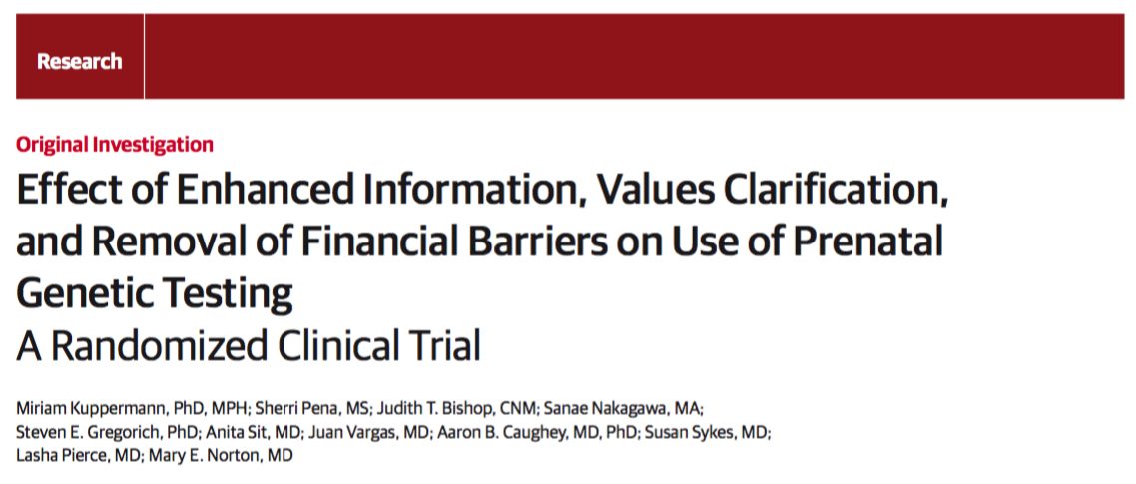
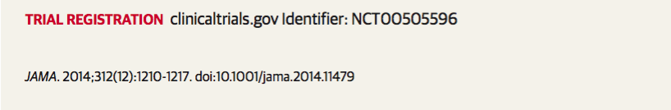

Slide 57
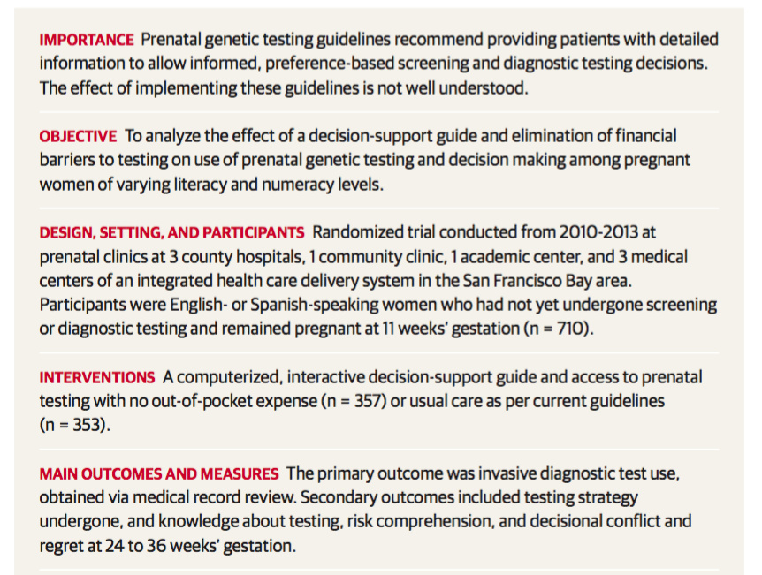

Slide 59
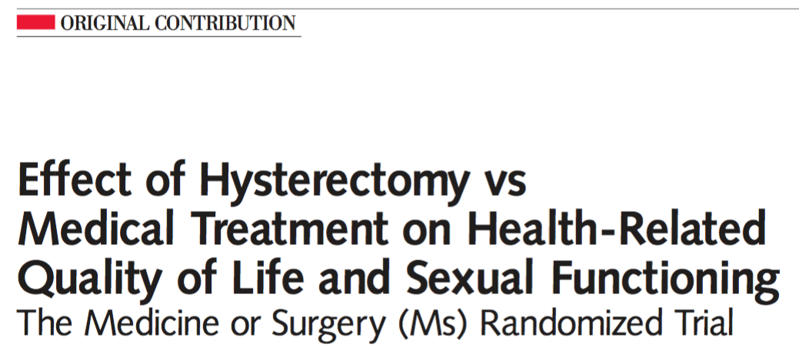
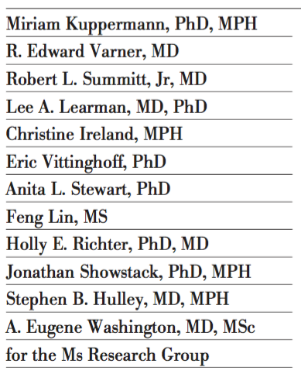
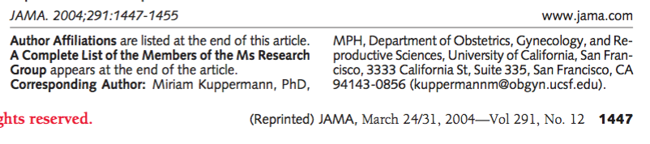

Slide 60
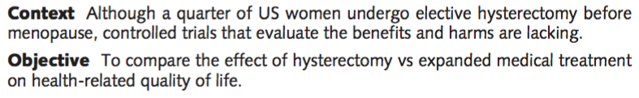

Slide 61
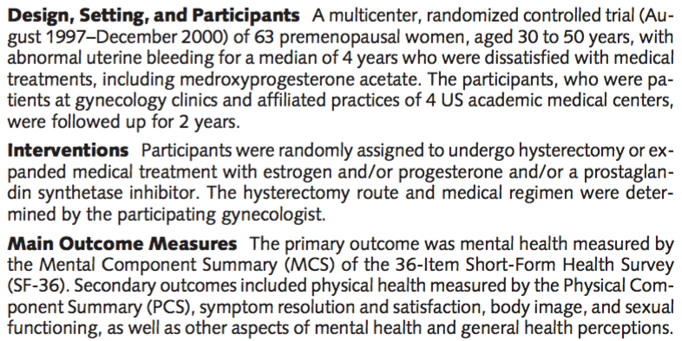

Slide 62
Pearls
You can’t contribute to science without a carefully crafted and specified research question
  A description of your Goal and What You Will Do, are not enough
  Primary objective of DCR is to help you specify your study design
Consider all of your study design options
  All research has flaws and limitations
  Design multiple studies
  Discard if completely infeasible or “fatally” flawed
  Role of opportunism and cleverness

Slide 63
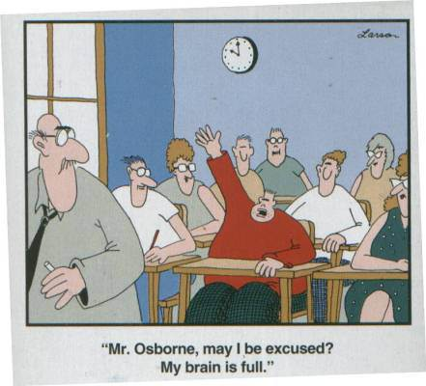
Have fun in section!
Questions →
Small Group Leaders

Slide 64

DCR sections 2017
Armin Afshar* (Opthalmology)
Beth Cohen (Medicine) – S-174
Ray Hsu (Medicine) – S-159
Kirsten Kangelaris (Medicine) – S-172
Chaz Langelier (Medicine) U-456
Ben Lee (Medicine) – S-178
Aoife O’Donovan (Psychiatry) – CL-213
Suzanne Sharpton (Medicine) – CL-214
Kala Mehta (Epidemiology) – S-180
Shan Ward (Pediatrics) - S-168
Dan West (Pediatrics) – U-460
CVP Mural, UCSF
*E-section

