Slide 1
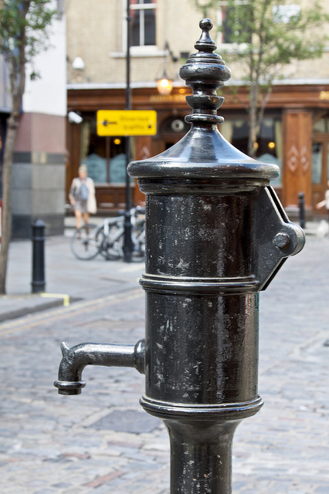
Data Visualization:
Telling Stories with
Data
I. Elaine Allen, PhD
Biostatistics & Epidemiology, UCSF
isabel.allen@ucsf.edu
…where am I?

Slide 2
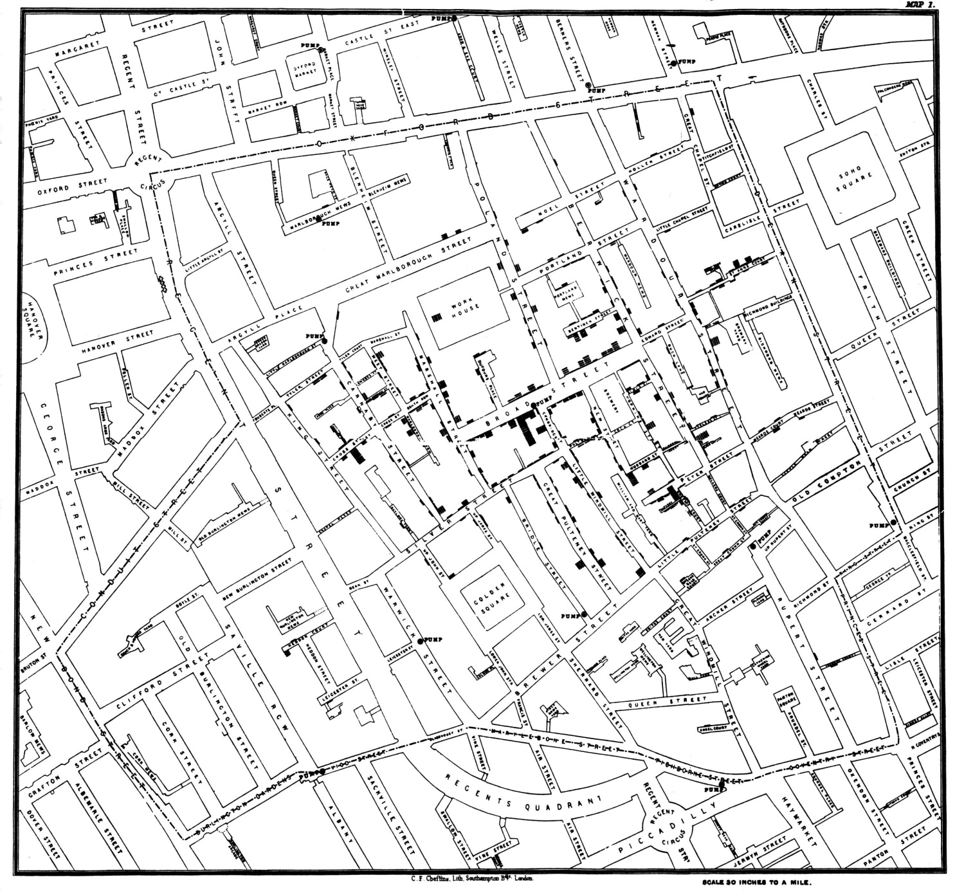
John Snow’s Cholera Map, 1854
*“Know There Are Unknowns: How suspected confounding variables influence models,” I. Elaine Allen & Julia E. Seaman, Journal of Quality Progress, February, 2011

Slide 3
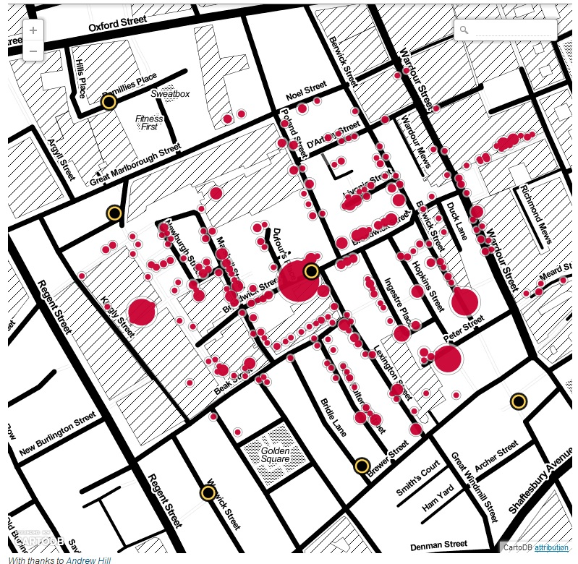
John Snow’s Cholera Map, 2013* from the London Daily Examiner

Slide 4
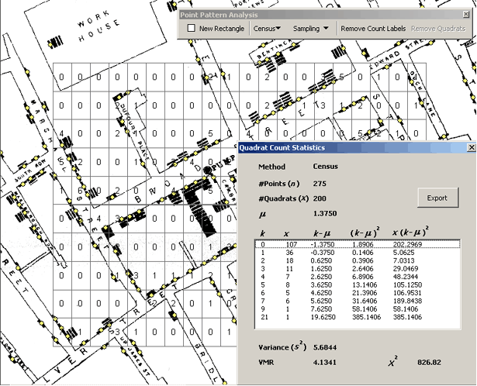
Creating the grid to digitize John Snow’s original map.

Slide 5
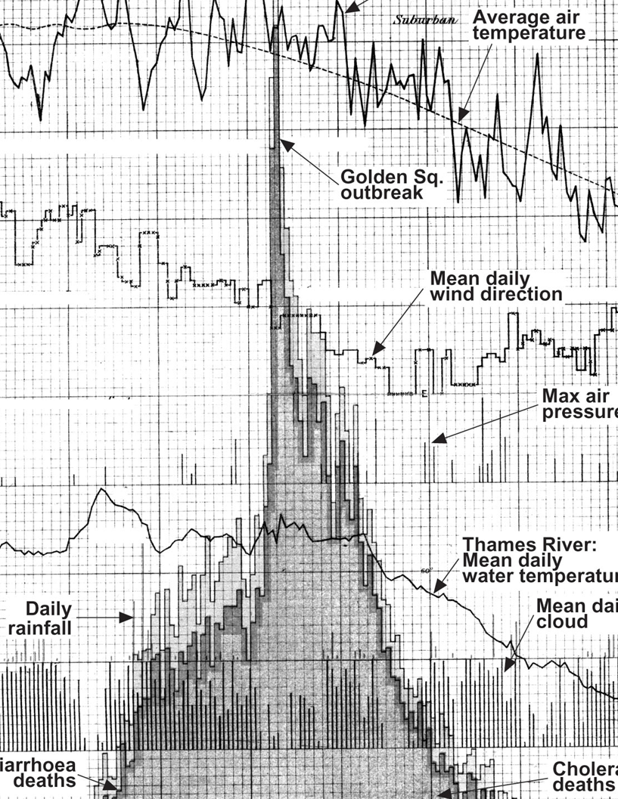
Adding additional confounders & variables

Slide 6
Graphs to uncover the message: Emergency Room visits*
Frequency groups | 1 | 2-4 | 5-14 | 15+ | Total
Number (Percent) of people | 26682 (84.8%) | 4075 (13.0%) | 605 (1.9%) | 100 (0.3%) | 31462 (100%)
Number (Percent) of Activations | 26682 (61.2%) | 9773 (22.4%) | 4436 (10.2%) | 2668 (6.1%) | 43559 (100%)
Number (Percent) of Transports | 23311 (59.6%) | 8998 (23.0%) | 4224 (10.8%) | 2574 (6.6%) | 39107 (100%)
 | 1 | 2-4 | 5-14 | 14+ | Total
Average Age (Mean, 95% CI) | 53 (+ 0.26) | 60 (+ 0.61) | 52 (+ 1.15) | 49 (+ 2.22) | 55 (+ 0.24)
This table of mean age seems to show little difference between age groups – can we refine this result?
*”EMS-STARS: Emergency Medical Services ‘Superuser’ Transport Associations, a Retrospective Study “M. Kennedy Hall MD*, Maria C. Raven MD MPH MSc FACEP*, Jane Yu, PhD**, Clement Yeh MD*⁺, Elaine Allen PhD⁺⁺, Robert M. Rodriguez MD FAAEM*, Niels L Tangherlini NREMTP BA⁺, Karl A. Sporer MD⁺⁺⁺, John F. Brown MD MPA FACEP* to appear in Annals of Emergency Medicine

Slide 7
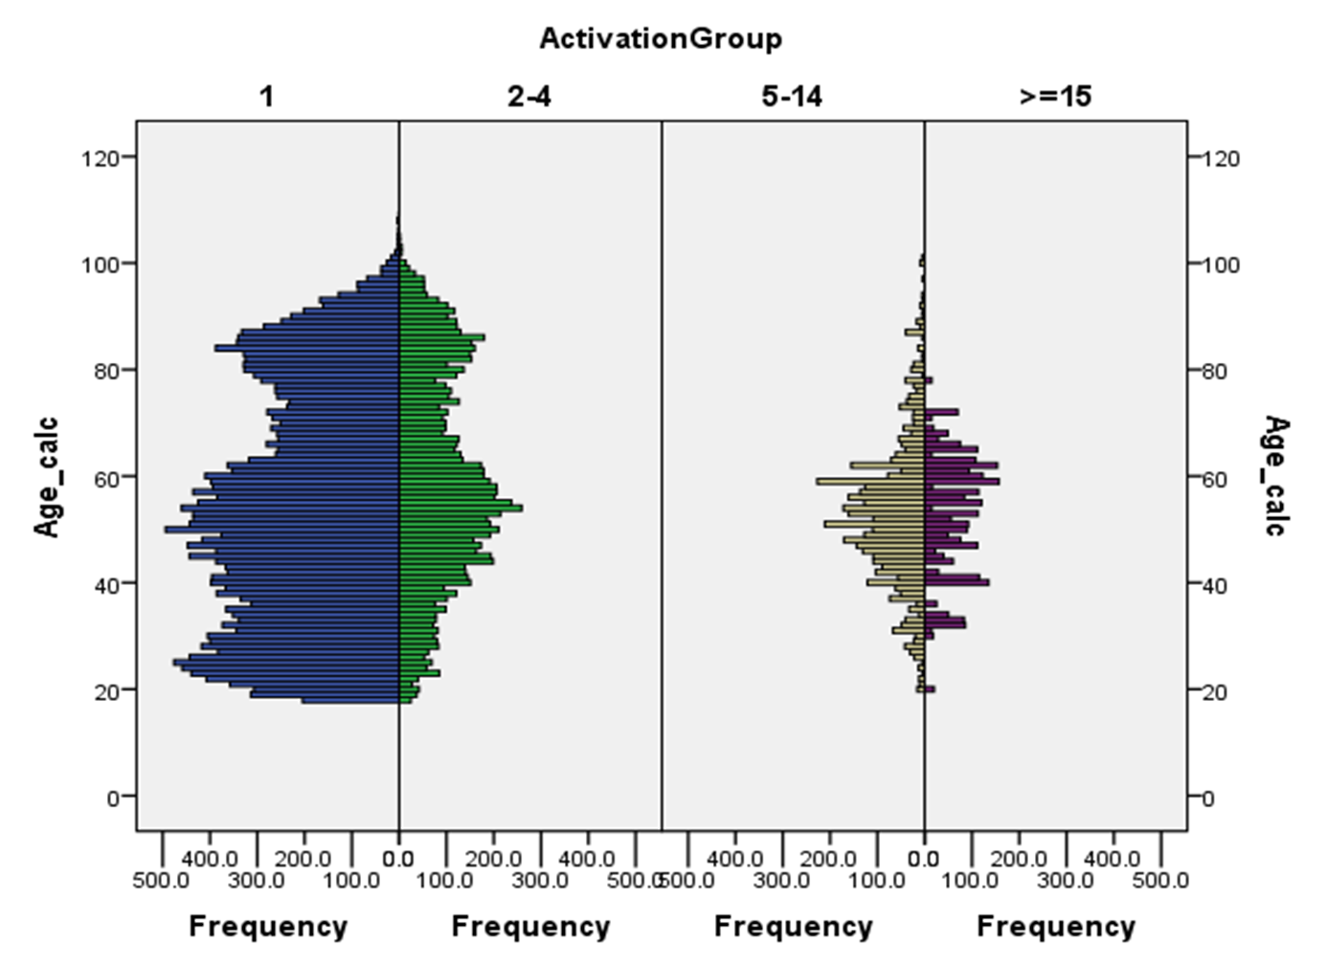
Examining the patterns of age was important*
*SPSS Graphics

Slide 8
Graphics to tell a story: Oakland A’s*
2004: Moneyball published by Michael Lewis
2011: The film ‘Moneyball’ released
  The film ends with the A’s winning their 20th consecutive game in 2002.
  It’s now 2013:
Did Moneyball work for the Oakland A’s?
Was Moneyball a sustainable practice?
*“Fair or Foul? The innovative Moneyball management approach can make a difference—up to a point,” Julia E. Seaman & I. Elaine Allen, Journal of Quality Progress, April, 2012.

Slide 9
Moneyball & the Oakland A’s: Background*
*Excel plot

Slide 10
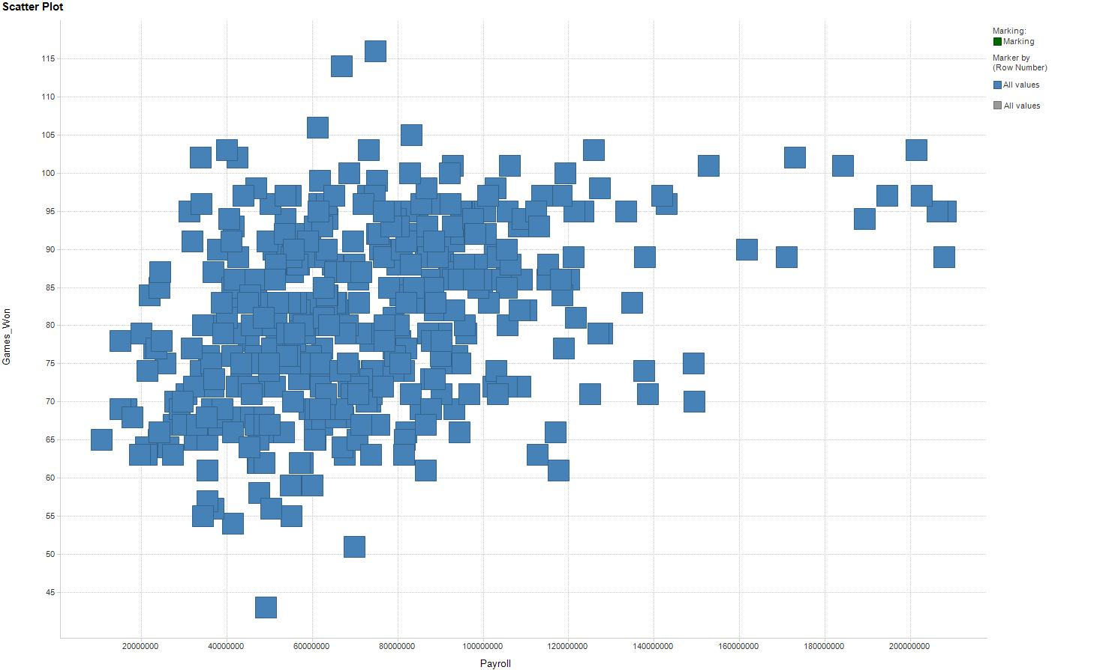
Payroll vs. Games Won

Slide 11
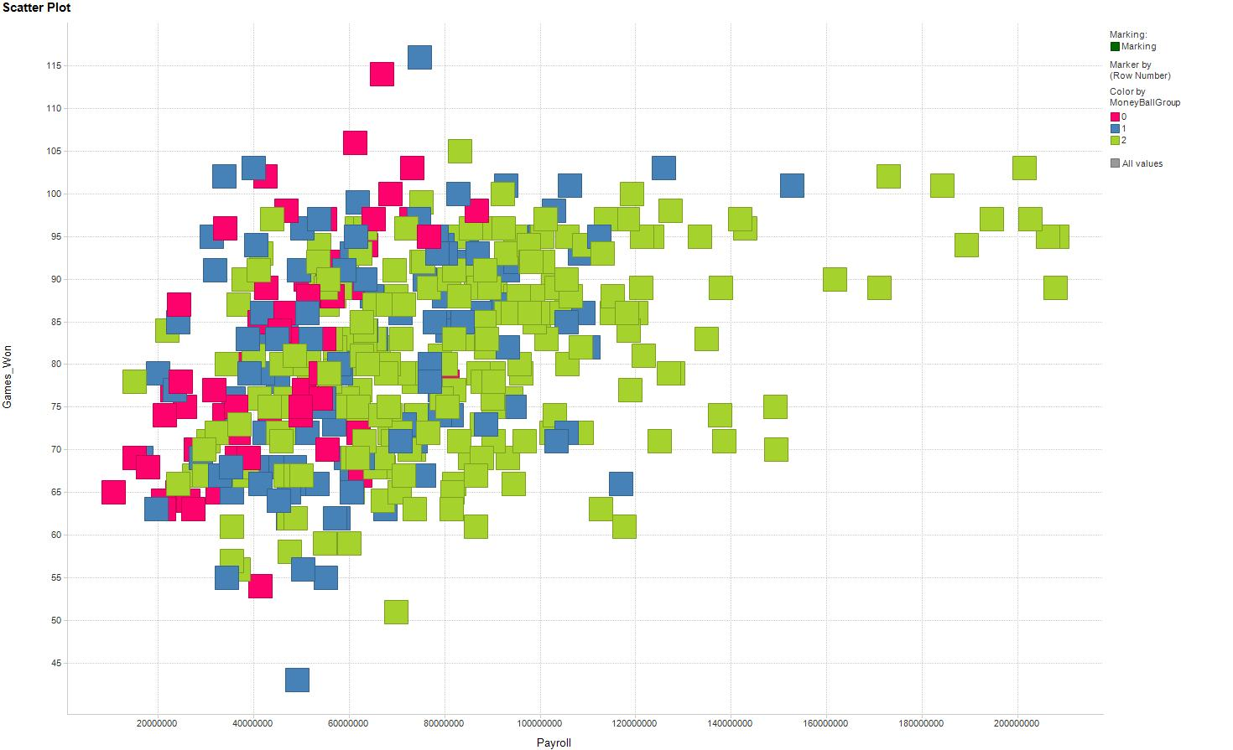
Overlay colors where Pink = PreMoneyball, Blue = MoneyBall, and Green is Post MoneyBall

Slide 12
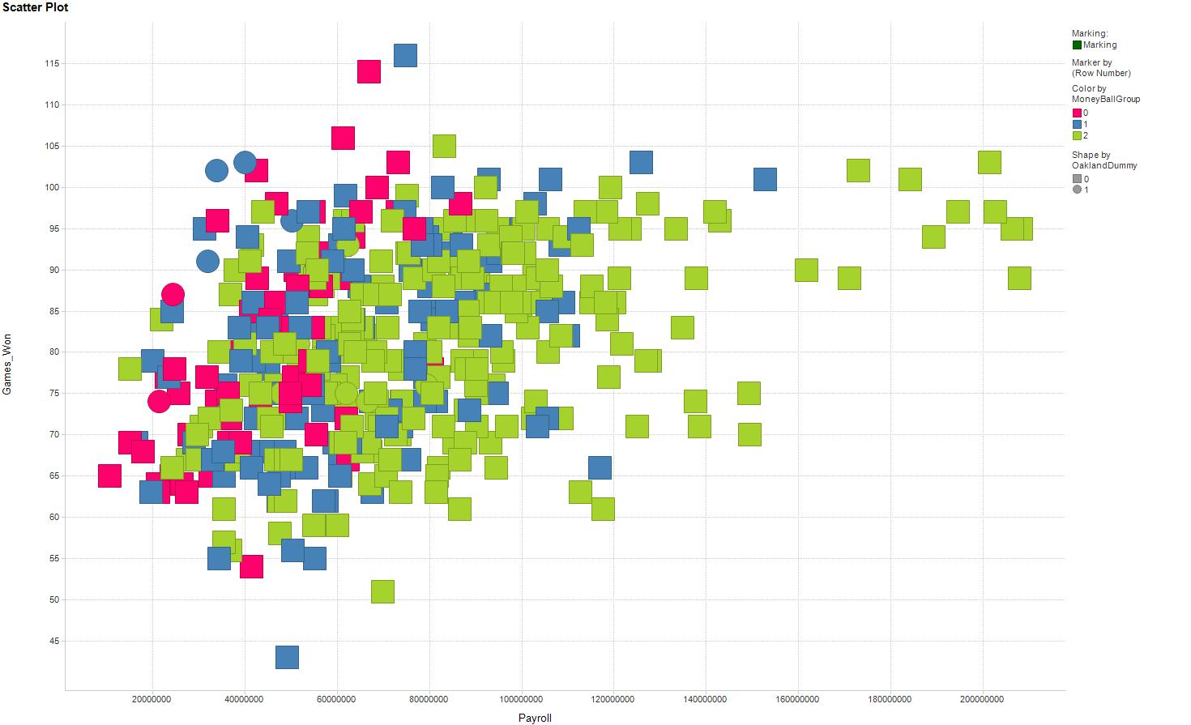
Add Circles for Oakland so BLUE Circles = Oakland & MoneyBall

Slide 13
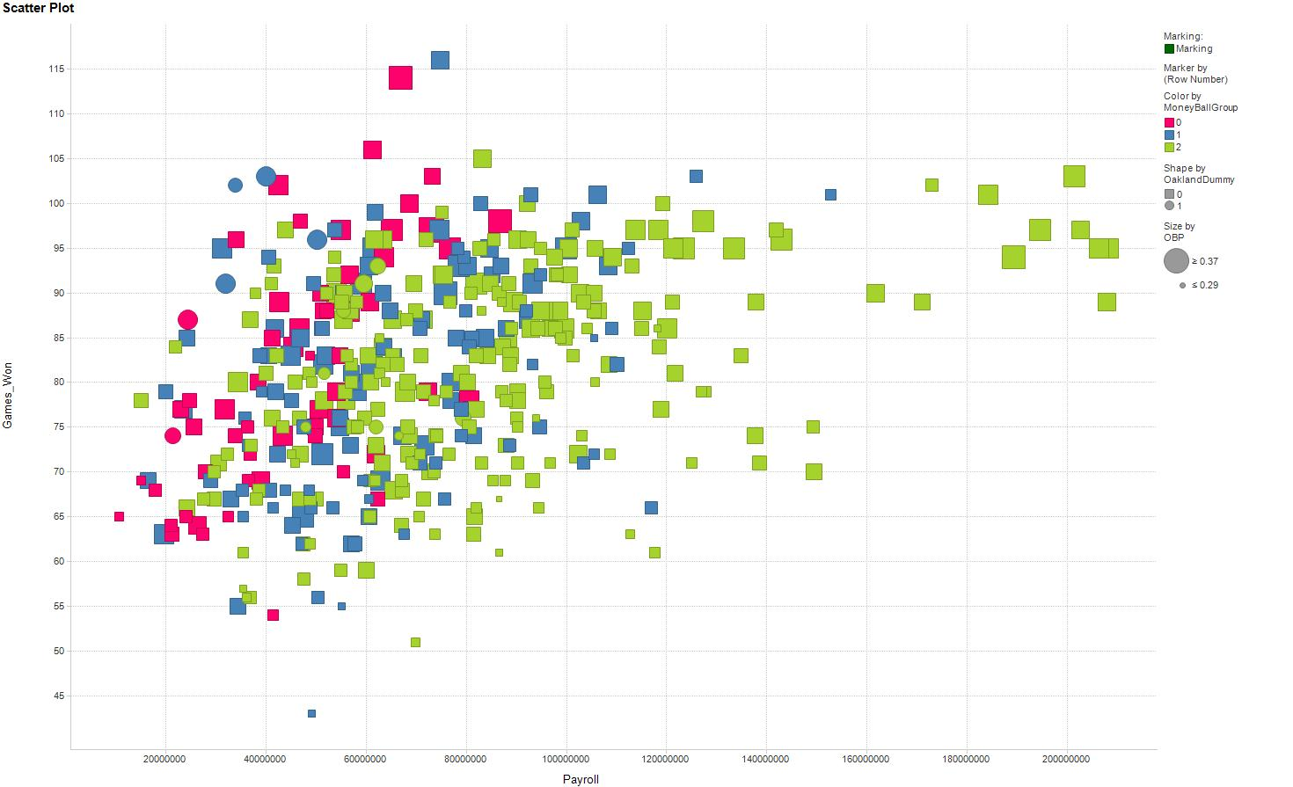
Add size to indicate the OBP for a team . . . Oakland looking good!
But did it help them get to the Post Season or the World Series?

Slide 14
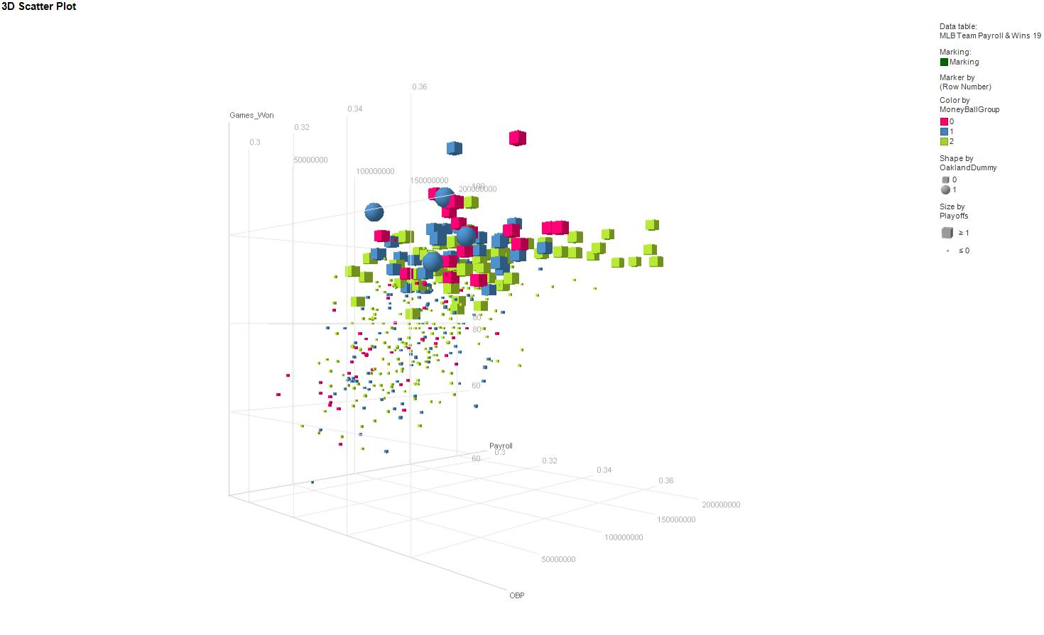
Now in 3D – Look at Oakland during the MoneyBall era getting into the playoffs…but does using only one metric = success?

Slide 15
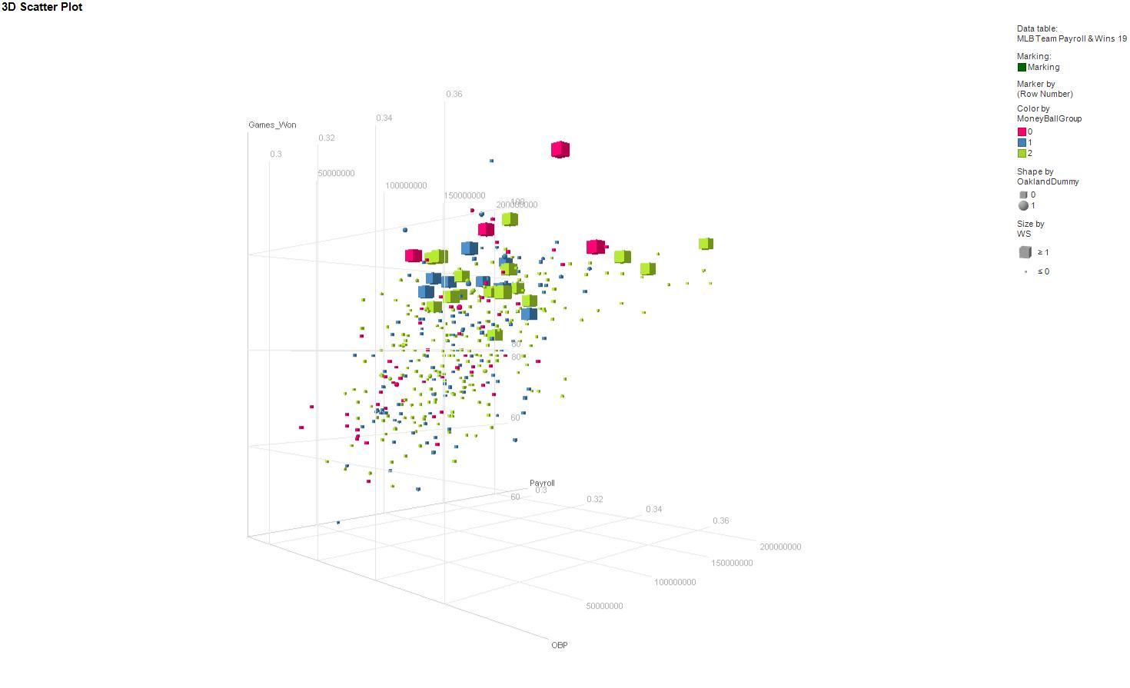
Sadly no, analytics can get you to the party but maximizing only one metric (offense) will not win you everything.

Slide 16
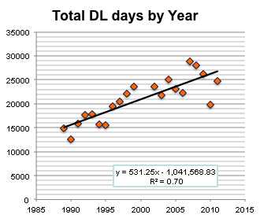
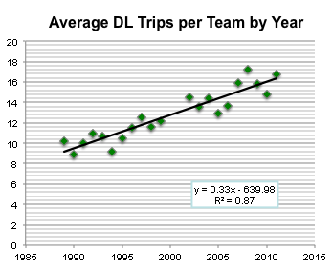
MLB & the LA Dodgers: The Injury Project
Increasing number of players injured per year
Increasing cost of injuries
Negative correlation to training

Slide 17
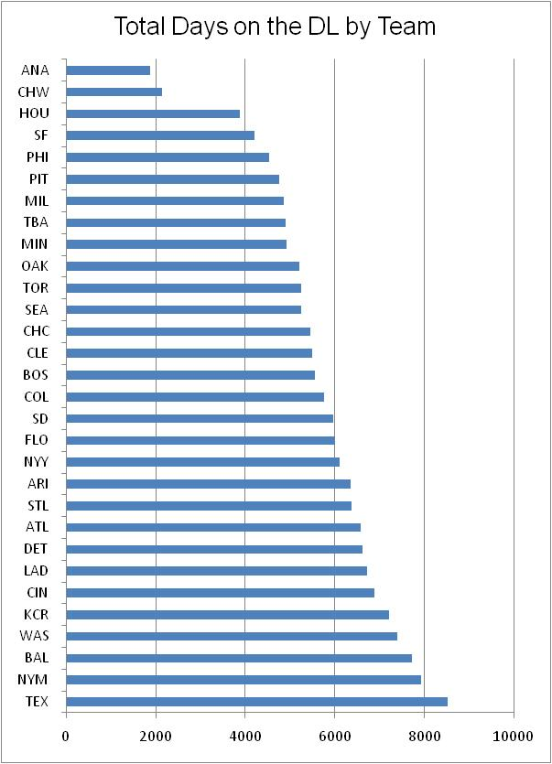
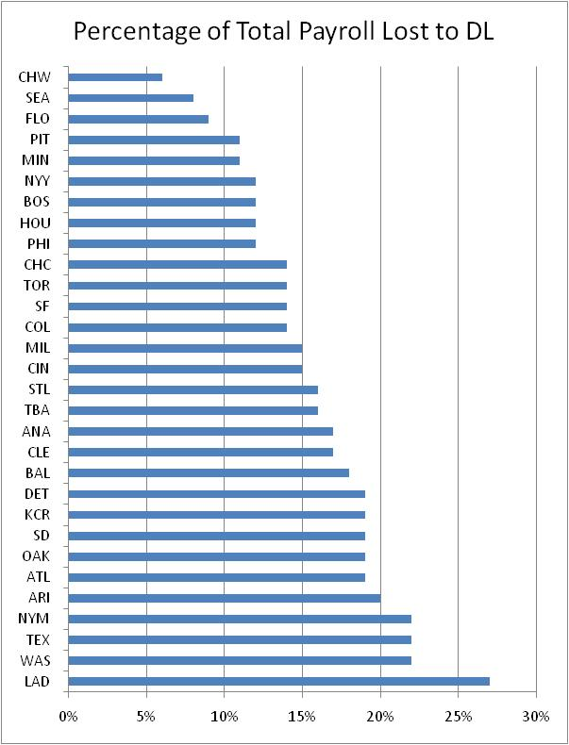
MLB & the LA Dodgers: The Injury Project

Slide 18
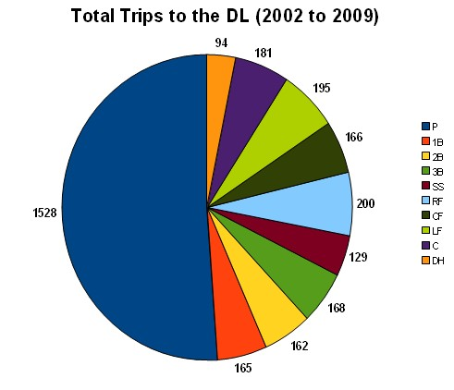
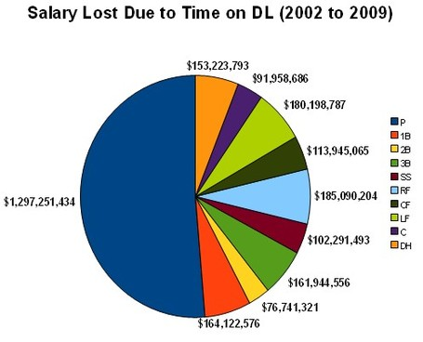
MLB & the LA Dodgers: The Injury Project
It’s all about the pitchers
Need more detailed information about injuries by position …

Slide 19
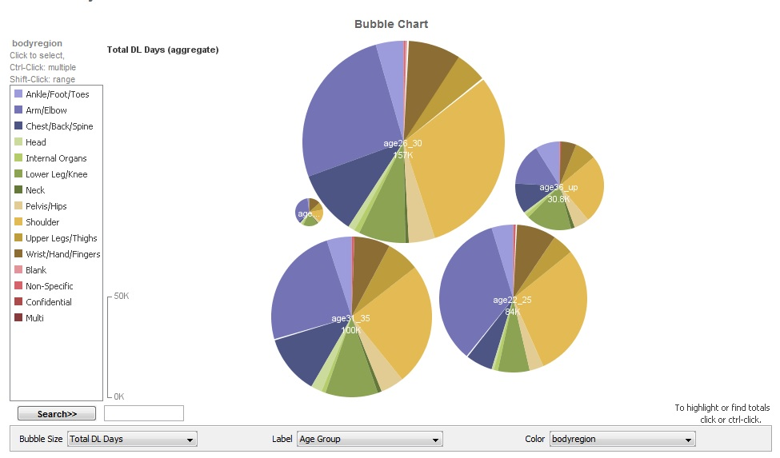
What about age & Position: Using manyeyes
http://www-958.ibm.com/software/analytics/labs/manyeyes/#home
http://www-958.ibm.com/software/analytics/labs/manyeyes/#vis=501453

Slide 20
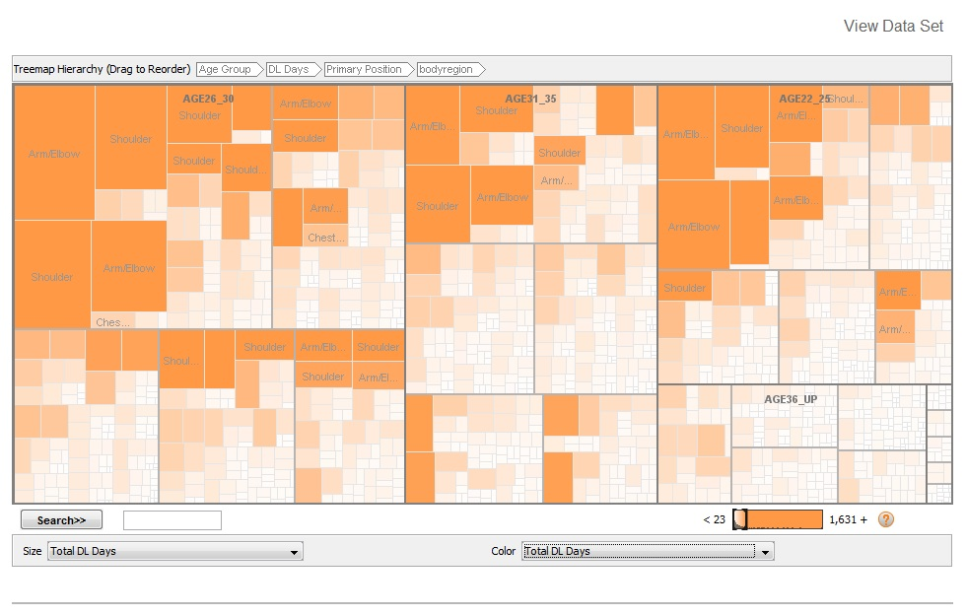
Creating your own Visualizations using free applications: many eyes
http://www-958.ibm.com/software/analytics/labs/manyeyes/#home
http://www-958.ibm.com/software/analytics/labs/manyeyes/#vis=501453

Slide 21
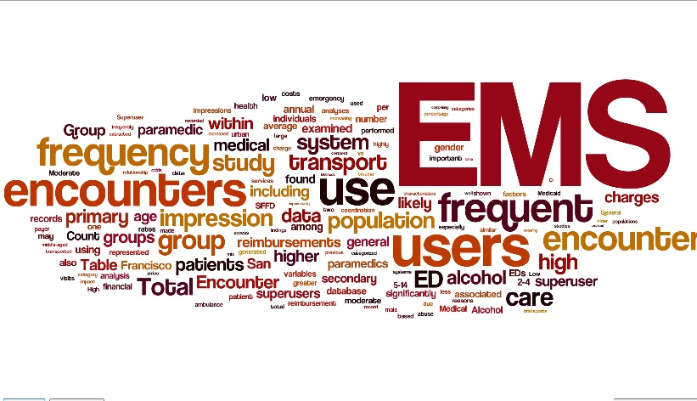
Simple Text Visualizations
www.wordle.net

Slide 22
Two different ways of examining the same dataset: suicide rates in veterans
http://backhome.news21.com/interactive/suicide-interactive/
https://my.infocaptor.com/dash/mt.php?pa=veteran_suicides_521b8c632d32b

Slide 23
Summary & Wrap-UP
Recommendations:
  Always look at your data – bar graph, histogram, scatterplot to start
  Don’t stop with just one visualization of the data
  Ask yourself – what are you trying to show with this data?
  Maybe go a level deeper than the analysis to validate your results
Software and websites for making ‘interesting’ visualizations
  Tibco Spotfire – e-mail me if you want to try it – academics a get free one-year license
  IBM’s Many Eyes - http://www-958.ibm.com/software/analytics/labs/manyeyes/#home
  Text clouds – www.wordle.net
  Contrasting histograms: www.spss.com
  Other good websites - http://www.bewitched.com/research.html, http://www.healthymagination.com/projects/data-visualizations/, http://www.tableausoftware.com/

