Slide 1
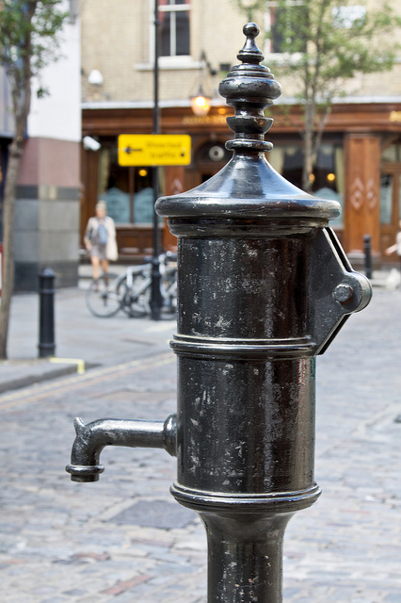
Biostat 202:Lecture 5
Analytics & Visualization: Telling Stories with Data
Isabel Elaine Allen, PhD
Professor, Epidemiology & Biostatistics
isabel.allen@ucsf.edu
…where am I and what is missing in this picture?

Slide 2
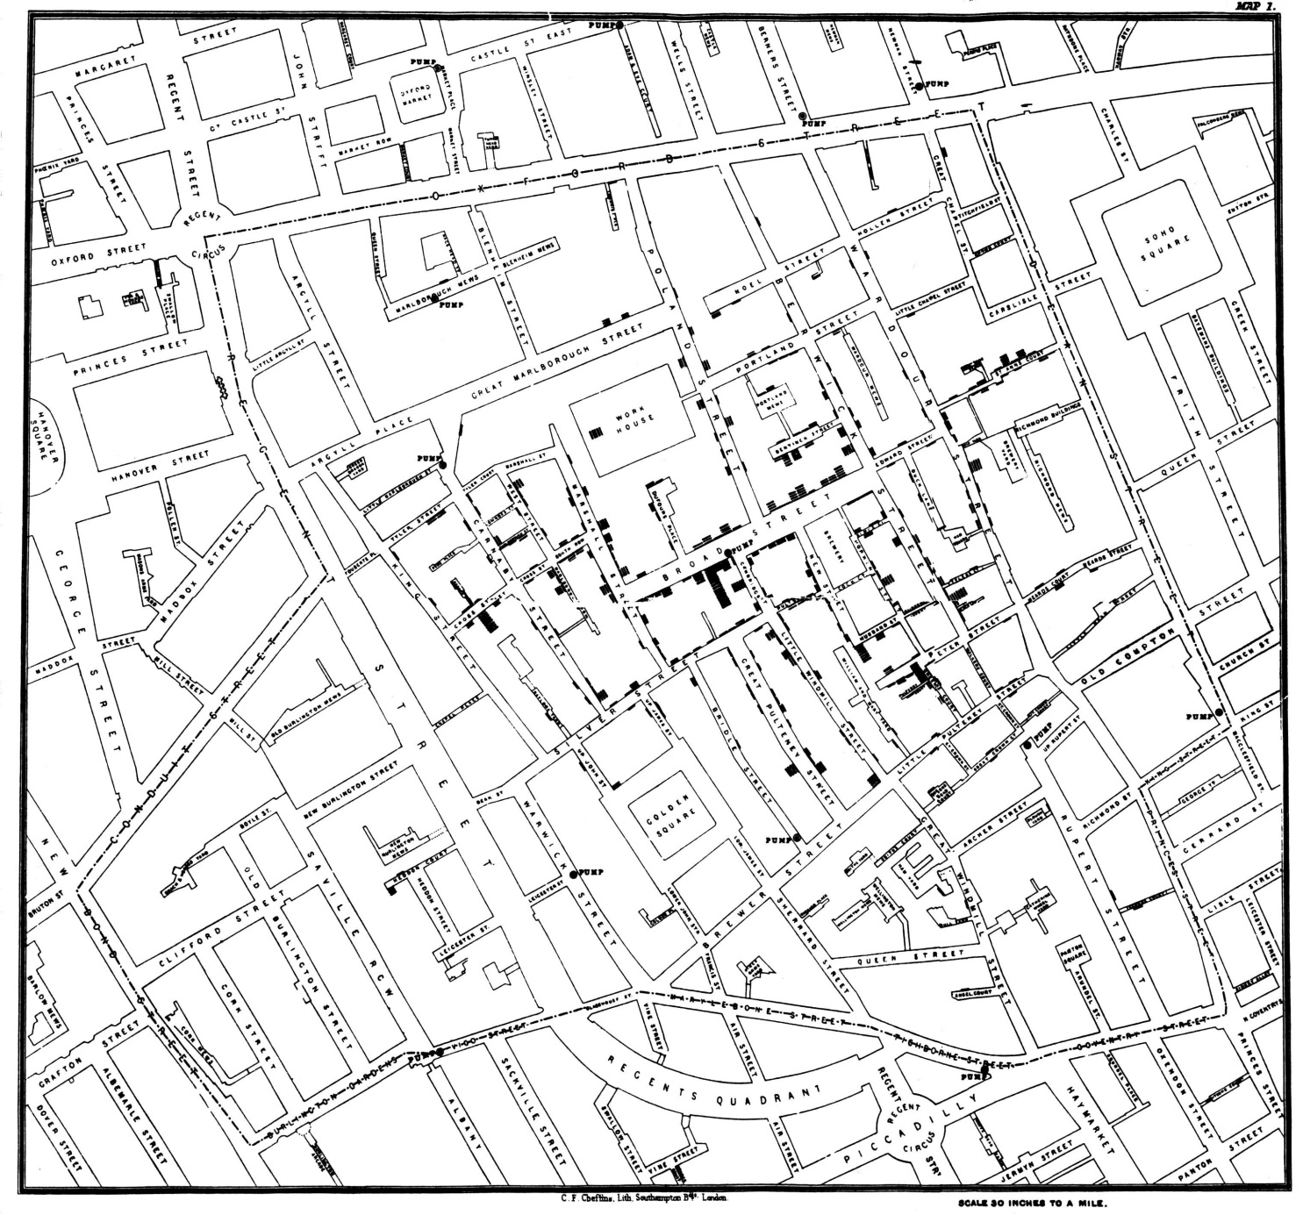
Decoding the Outliers: John Snow’s Cholera Map, 1854
*“Know There Are Unknowns: How suspected confounding variables influence models,” I. Elaine Allen & Julia E. Seaman, Journal of Quality Progress, February, 2011

Slide 3
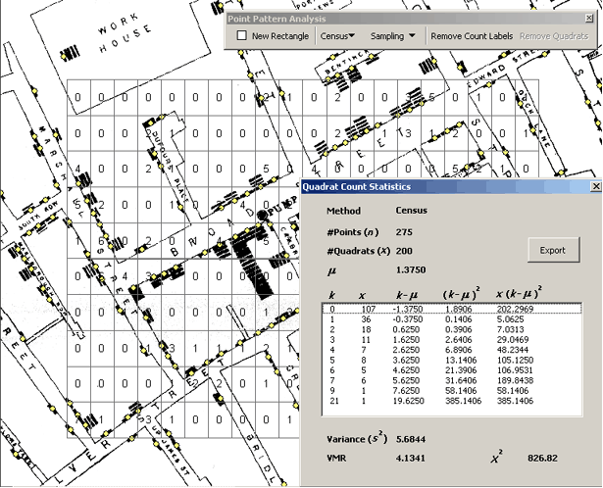
Creating the grid to digitize John Snow’s original map*.
*CartoDB & DigitizeIt software: https://docs.cartodb.com/tutorials/conditional_styling/

Slide 4
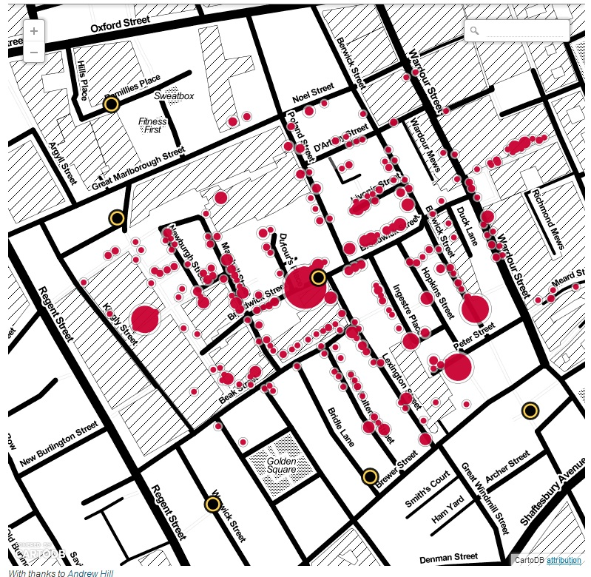
John Snow’s Cholera Map, recreated from data extracted by the London Daily Examiner, 2013
What is unusual about the pattern of Cholera cases?

Slide 5
John Snow’s Cholera Map, recreated from data extracted by the London Daily Examiner, 2013
What is unusual about the pattern of Cholera cases?

Slide 6
Uncovering the message: Emergency Room visits*
Frequency groups | 1 | 2-4 | 5-14 | 15+ | Total
Number (Percent) of people | 26682 (84.8%) | 4075 (13.0%) | 605 (1.9%) | 100 (0.3%) | 31462 (100%)
Number (Percent) of Activations | 26682 (61.2%) | 9773 (22.4%) | 4436 (10.2%) | 2668 (6.1%) | 43559 (100%)
Number (Percent) of Transports | 23311 (59.6%) | 8998 (23.0%) | 4224 (10.8%) | 2574 (6.6%) | 39107 (100%)
 | 1 | 2-4 | 5-14 | 15+ | Total
Average Age (Mean, 95% CI) | 53 (+ 0.26) | 60 (+ 0.61) | 52 (+ 1.15) | 49 (+ 2.22) | 55 (+ 0.24)
The table of mean age shows no significant difference between age groups – can we refine this result? Who are the frequent flyers?
Better ways to tell the story? What factors do you think we should examine?
*”EMS-STARS: Emergency Medical Services ‘Superuser’ Transport Associations, a Retrospective Study “M. Kennedy Hall MD*, Maria C. Raven MD MPH MSc FACEP*, Jane Yu, PhD**, Clement Yeh MD*⁺, Elaine Allen PhD⁺⁺, Robert M. Rodriguez MD FAAEM*, Niels L Tangherlini NREMTP BA⁺, Karl A. Sporer MD⁺⁺⁺, John F. Brown MD MPA FACEP* Annals of Emergency Medicine, 2013

Slide 7
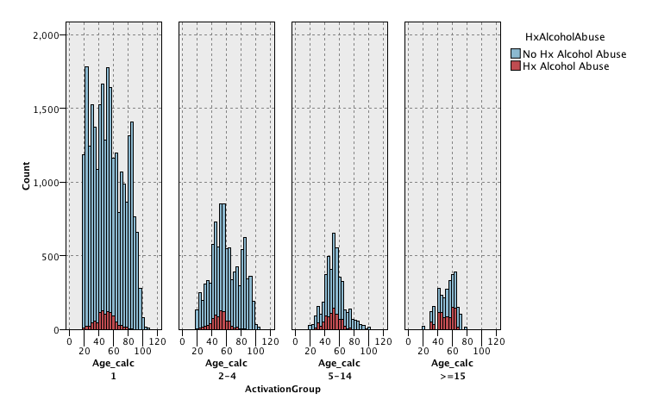
*SPSS Graphics

Slide 8
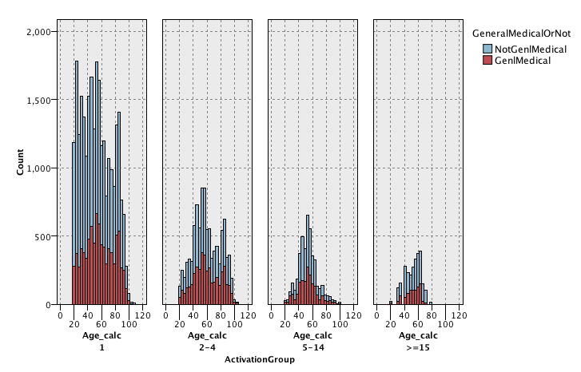
*SPSS Graphics

Slide 9
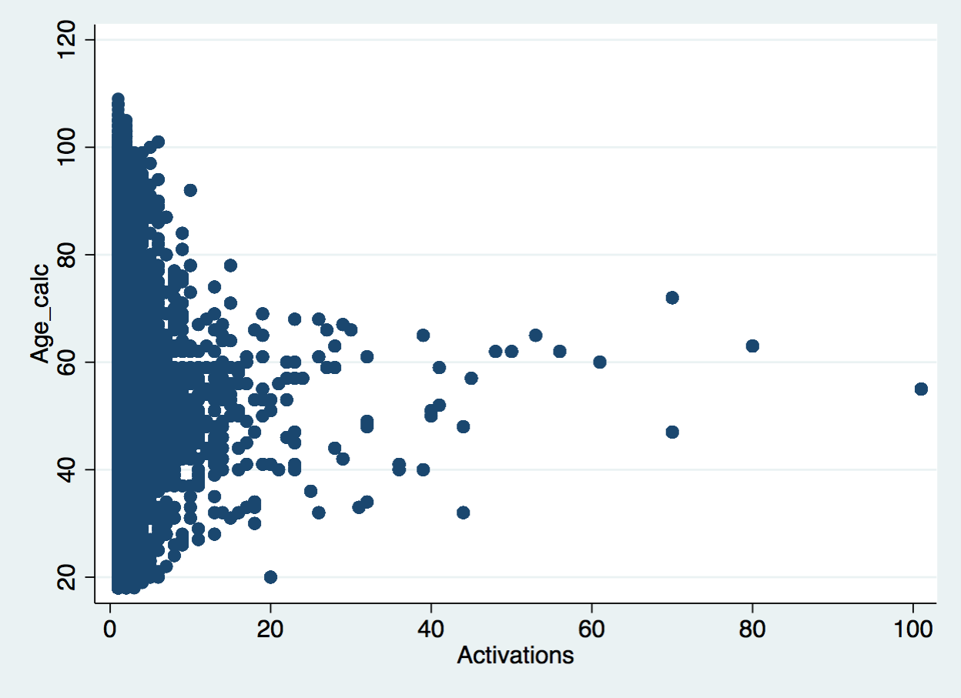
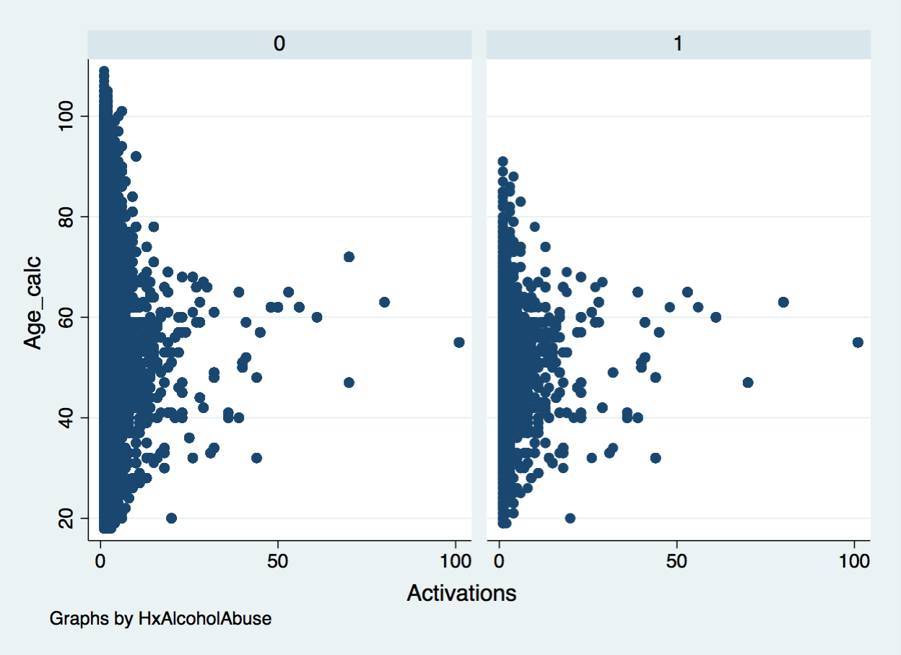
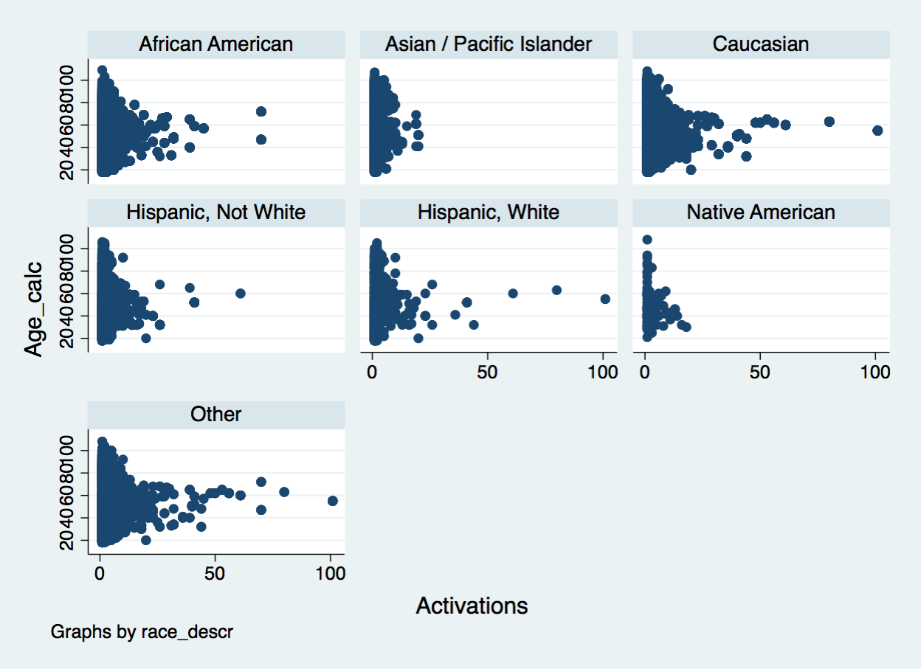
Stata Graphics – successive panels of scatter plots

Slide 10
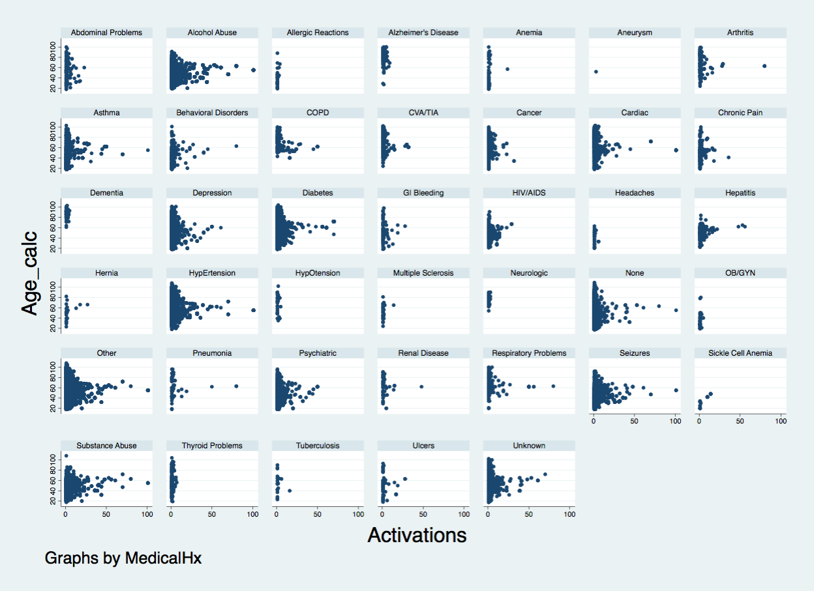

Slide 11
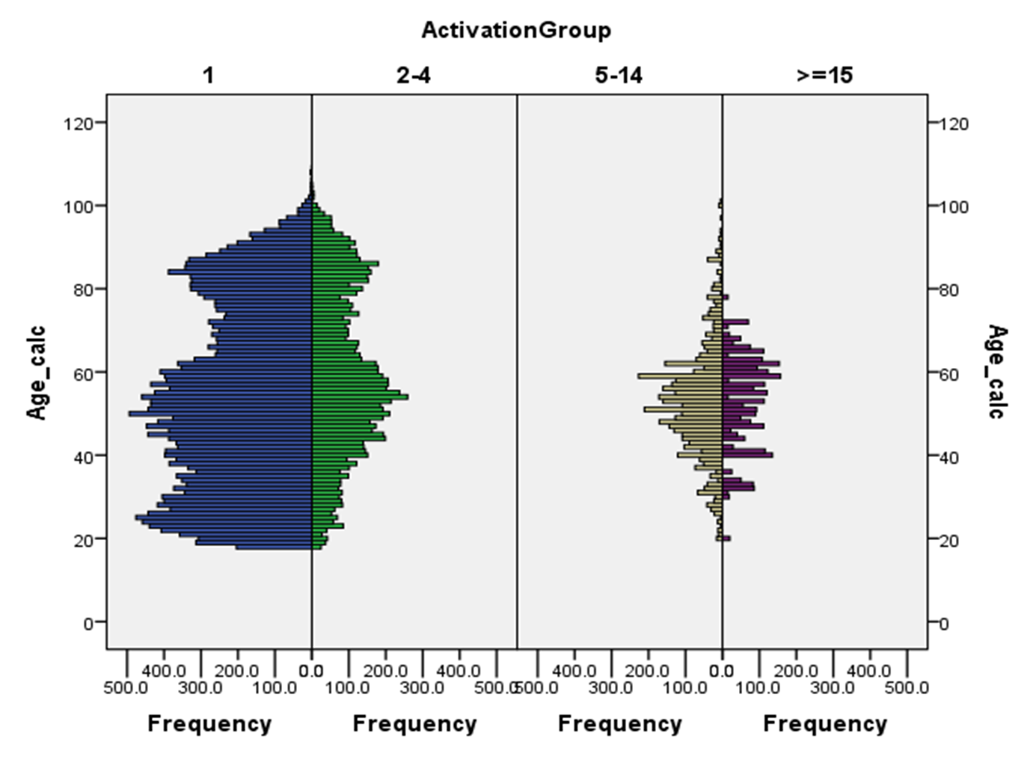
Examining the patterns of age was important*
*SPSS Graphics

Slide 12
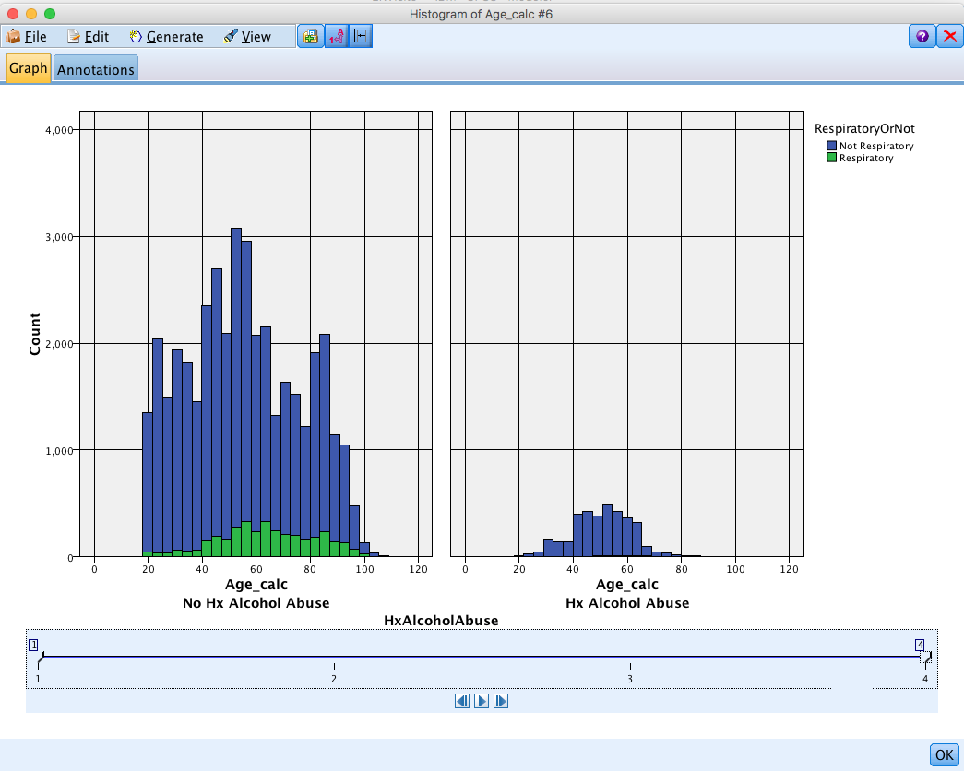
Animation Plot from Modeler – let’s look at more detail…

Slide 13
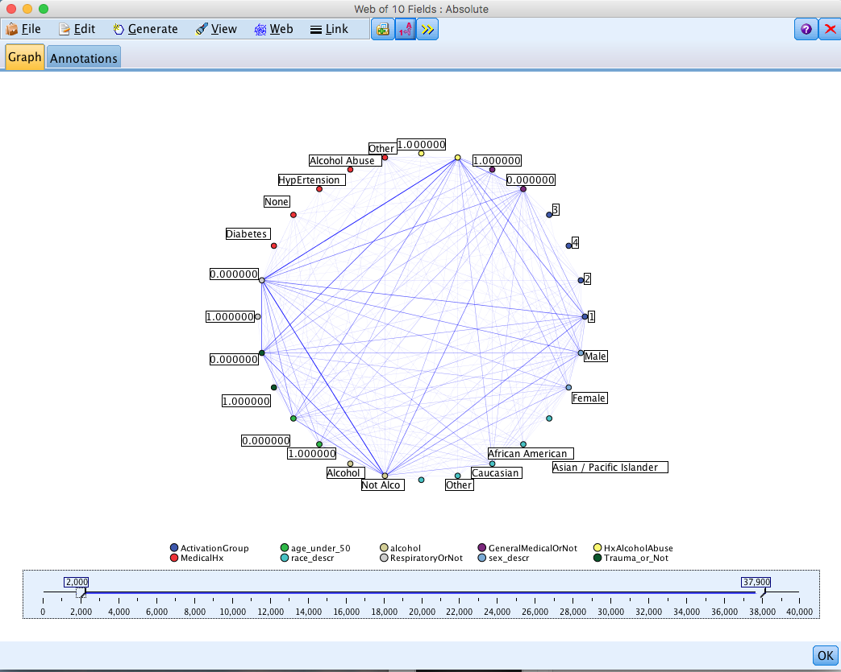
Web Plot from Modeler – let’s look at more detail…

Slide 14
Animating your figures: Kohonen Analysis
Osteoarthritis data
age | race | spurious1 | spurious2 | spurious3 | BMI | hispanic | hx_knee_inj | freq_knee_pain | KellgrenL | lateral_JS | medial_JS | min_medial_JSW | female | prog_cohort | white | Side | FT_cart_loss
61 | Black | 0.09 | 0.56 | 0.13 | 36.50 | Non-Hispanic | No | Both | Extreme | 0 | 3.0 | 1.6 | Male | 1 | Non-White | Left | Yes
73 | White | 0.90 | 0.21 | 0.53 | 25.60 | Non-Hispanic | No | Both | Extreme | 0 | 3.0 | 0.6 | Male | 0 | White | Left | Yes
66 | White | 0.91 | 0.18 | 0.97 | 30.70 | Non-Hispanic | No | Both | Extreme | 0 | 3.0 | 1.1 | Female | 0 | White | Left | Yes
59 | White | 0.73 | 0.95 | 0.40 | 26.80 | Non-Hispanic | No | Both | Extreme | 0 | 3.0 | 0.0 | Female | 1 | White | Right | Yes
57 | White | 0.11 | 0.24 | 0.25 | 26.30 | Non-Hispanic | No | Both | Extreme | 0 | 3.0 | 0.7 | Male | 0 | White | Left | Yes
77 | White | 0.94 | 0.29 | 0.30 | 30.10 | Non-Hispanic | No | Both | Extreme | 0 | 3.0 | 0.5 | Female | 1 | White | Right | Yes
53 | White | 0.28 | 0.13 | 0.32 | 34.50 | Non-Hispanic | No | Both | Extreme | 0 | 3.0 | 0.0 | Male | 1 | White | Right | Yes
79 | White | 0.89 | 0.24 | 0.32 | 23.60 | Non-Hispanic | No | Both | Extreme | 0 | 3.0 | 0.0 | Female | 0 | White | Right | Yes
58 | White | 0.82 | 0.92 | 0.61 | 27.00 | Non-Hispanic | No | Both | Extreme | 0 | 3.0 | 1.6 | Male | 1 | White | Left | Yes
58 | Black | 0.02 | 0.81 | 0.50 | 28.80 | Non-Hispanic | No | Both | Extreme | 0 | 3.0 | 0.0 | Female | 1 | Non-White | Right | Yes
60 | White | 0.78 | 0.85 | 0.96 | 27.90 | Non-Hispanic | No | Both | Extreme | 0 | 3.0 | 1.0 | Female | 1 | White | Left | Yes
Going to use SPSS Modeler to cluster the data using a Kohonen network: Self Organizing Map
Created by Teuvo Kohonen ~ 20 years ago
Great for visualisation of high dimensional data
The clustering is an extension of a neural net
Consists of neurons arranged in a grid
Unsupervised analyses, usually 2 or 3 dimensions
What’s a good example of a self organizing map?
http://joneisen.me/d3-tsp-demo/

Slide 15
Animating your figures: Kohonen Analysis
Opening the Modeler stream
Examining the data
Simple X / Y plot
Web plot
Kohonen analysis
Kohonen Plots

Slide 16
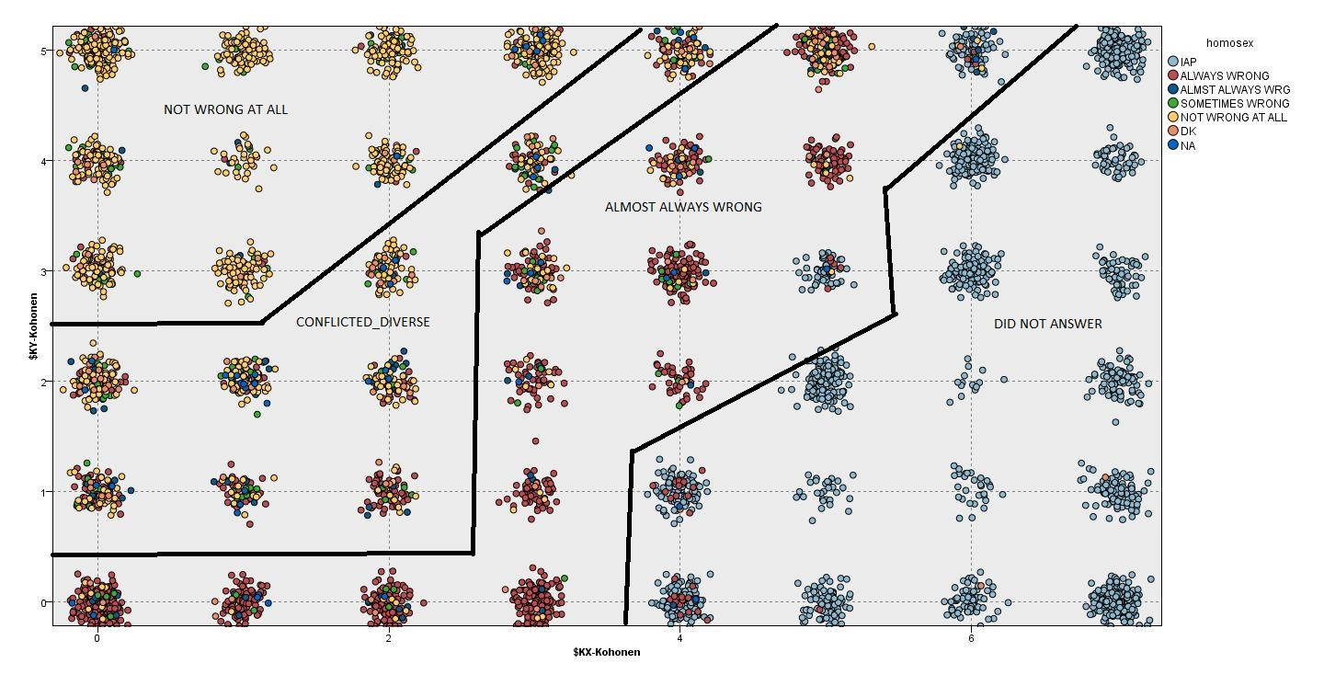
Kohonen classifying respondents on the General Social Survey on Attitudes towards Homosexuality
60 variables used for clustering including demographics & social & behavioral activities & habits –
The Kohonen network identified 48 groups and these groups are plotted using the attitude toward homosexuality variable.
The General Social Survey (GSS) is a sociological survey used to collect information and keep a historical record of the concerns, experiences, attitudes, and practices of residents of the United States. Started in 1972 with annual surveys.
-Zalatan, Diaz, & Uhrick, Joint Statistical Meetings, 2012

Slide 17
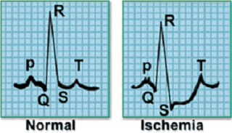
Time Series Data: What do we want to do with it?
Cluster
Classification
Motif Discovery
Rule Discovery
Visualization
10
⇒
s = 0.5
c = 0.3
Novelty Detection
Notes:
Clustering:
Lin, J., Vlachos, M., Keogh, E., & Gunopulos, D (2004). Iterative Incremental Clustering of Time Series. In proceedings of the IX Conference on Extending Database Technology. Crete, Greece. March 14-18, 2004
Keogh, E., Lonardi, S. and Ratanamahatana, C. (2004). Towards Parameter-Free Data Mining. In proceedings of the tenth ACM SIGKDD International Conference on Knowledge Discovery and Data Mining. Seattle, WA, Aug 22-25, 2004.
Classification:
Chotirat Ann Ratanamahatana and Eamonn Keogh. (2004). Making Time-series Classification More Accurate Using Learned Constraints. In proceedings of SIAM International Conference on Data Mining (SDM '04), Lake Buena Vista, Florida, April 22-24, 2004. pp. 11-22. Keogh, E., Lonardi, S. and Ratanamahatana, C. (2004). Towards Parameter-Free Data Mining. In proceedings of the tenth ACM SIGKDD International Conference on Knowledge Discovery and Data Mining. Seattle, WA, Aug 22-25, 2004.
Motif Discovery:
Chiu, B. Keogh, E., & Lonardi, S. (2003). Probabilistic Discovery of Time Series Motifs. In the 9th ACM SIGKDD International Conference on Knowledge Discovery and Data Mining. August 24 - 27, 2003. Washington, DC, USA. pp 493-498.
Rule Discovery:
E. Keogh, J. Lin, and W. Truppel. (2003). Clustering of Time Series Subsequences is Meaningless: Implications for Past and Future Research. In proceedings of the 3rd IEEE International Conference on Data Mining . Melbourne, FL. Nov 19-22. pp 115-122.
Query by Content:
Keogh, E., Palpanas, T., Zordan, V., Gunopulos, D. and Cardle, M. (2004) Indexing Large Human-Motion Databases. In proceedings of the 30th International Conference on Very Large Data Bases, Toronto, Canada.
Chotirat Ann Ratanamahatana and Eamonn Keogh. (2004). Making Time-series Classification More Accurate Using Learned Constraints. In proceedings of SIAM International Conference on Data Mining (SDM '04), Lake Buena Vista, Florida, April 22-24, 2004. pp. 11-22
Keogh, E. (2002). Exact indexing of dynamic time warping. In 28th International Conference on Very Large Data Bases. Hong Kong. pp 406-417.
Keogh, E., Hochheiser, H. and Shneiderman, B. (2002). An Augmented Visual Query Mechanism for Finding Patterns in Time Series Data. In the 5th International Conference on Flexible Query Answering Systems. October 27 - 29, 2002, Copenhagen, Denmark. Springer, LNAI 2522, Troels Andreasen, Amihai Motro, Henning Christiansen, and Henrik Legind Larsen (eds)., pp. 240-250.
Visualization
Lin, J., Keogh, E., Lonardi, S., Lankford, J. P. & Nystrom, D. M. (2004). Visually Mining and Monitoring Massive Time Series. In proceedings of the tenth ACM SIGKDD International Conference on Knowledge Discovery and Data Mining. Seattle, WA, Aug 22-25, 2004.
(This work also appears as a VLDB 2004 demo paper, under the title "VizTree: a Tool for Visually Mining and Monitoring Massive Time Series.")
Novelty Detection
Keogh, E., Lonardi, S and Chiu, W. (2002). Finding Surprising Patterns in a Time Series Database In Linear Time and Space. In the 8th ACM SIGKDD International Conference on Knowledge Discovery and Data Mining. July 23 - 26, 2002. Edmonton, Alberta, Canada. pp 550-556.

Slide 18
1. Time series data are large databases
2. All of these techniques require similarity matching
3. Most data require a degree of subjectivity
4. Data formats differ, sampling rates differ, there is often noise
5. Need algorithms that can search for patterns quickly
…How do we define similar???
Why is analyzing time series data hard?

Slide 19
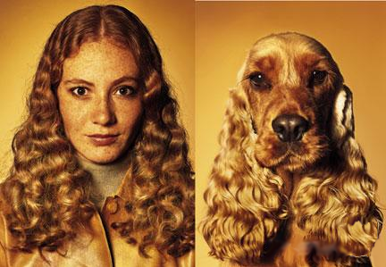
What is Similarity?
The quality or state of being similar; likeness; resemblance; as, a similarity of features*.
Similarity is hard to define, but…
“We know it when we see it”
The real meaning of similarity is a philosophical question.
We need a more objective approach.
*Webster's Dictionary

Slide 20
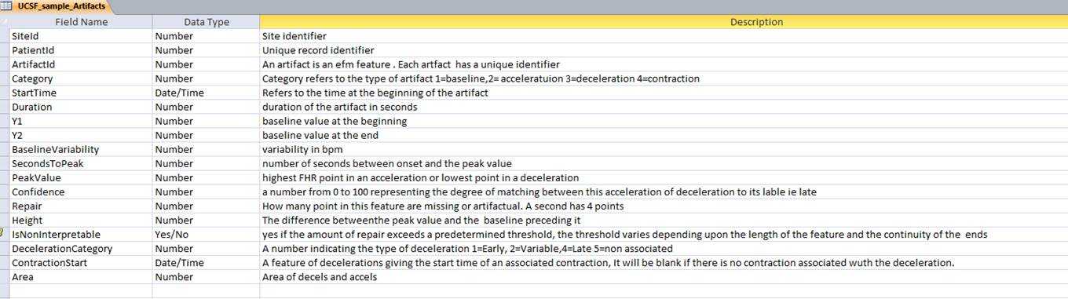
Preventing Birth-Related Injuries:
Maternal Antecedents of Encephalopathy in Singleton Term Infants (MAESTRA)
To study the relationship of neonatal encephalopathy to overly frequent uterine contractions and fetal heart rate abnormalities within a large birth cohort. The cohort will be delivered by Kaiser Permanente Northern California OB physicians.
Tracings of the last 4 hours before birth to identify artifacts in the
  Fetal heart rate
  Maternal heart rate
  Uterine contractions
  Match to birth and maternal health records

Slide 21
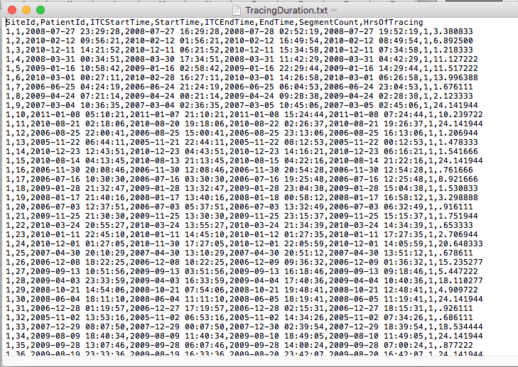

Slide 22
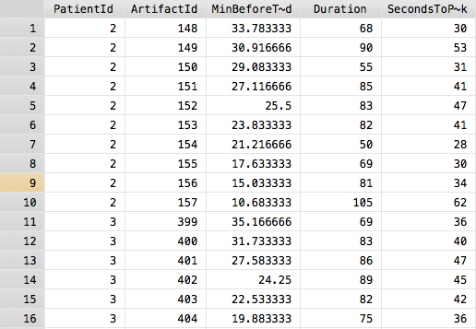
SiteId | PatientId | ArtifactId | Category | StartTime | MinBeforeTracingEnd | epoch | changebytime | Duration | Y1 | Y2 | BaselineVariability | SecondsToPeak | PeakValue | Confidence | Repair | Height | IsNonInterpretable | DecelerationCategory | NonReassuringFeatures | ContractionStart | DecelOnsetDelay | Area
1 | 1 | 13 | 1 | 36:50.5 | 195.483333 | 195 |  | 74.5 | 156 | 141 | 22 |  |  |  |  |  |  |  |  |  |  | 0
1 | 1 | 14 | 1 | 38:40.2 | 193.65 | 193 | 1.833333 | 151 | 142 | 150 | 14 |  |  |  |  |  |  |  |  |  |  | 0
1 | 1 | 15 | 1 | 41:11.5 | 191.133333 | 191 | 2.516667 | 153.75 | 150 | 151 | 18 |  |  |  |  |  |  |  |  |  |  | 0
1 | 1 | 16 | 2 | 43:45.5 | 188.566666 | 188 | 2.566667 | 39.25 |  |  |  | 17.5 | 169 | 93 | 0 | 20 | FALSE |  |  |  |  | 1812
1 | 1 | 17 | 1 | 7/27/08 16:44 | 187.9 | 187 | 0.666666 | 67 | 147 | 154 | 12 |  |  |  |  |  |  |  |  |  |  | 0
1 | 1 | 18 | 1 | 45:32.2 | 186.783333 | 186 | 1.116667 | 260.75 | 148 | 150 | 8 |  |  |  |  |  |  |  |  |  |  | 0
1 | 1 | 19 | 1 | 49:53.3 | 182.433333 | 182 | 4.35 | 260.25 | 152 | 163 | 17 |  |  |  |  |  |  |  |  |  |  | 0
1 | 1 | 20 | 1 | 54:13.7 | 178.1 | 178 | 4.333333 | 93.5 | 160 | 160 | 16 |  |  |  |  |  |  |  |  |  |  | 0
1 | 1 | 21 | 2 | 55:47.5 | 176.533333 | 176 | 1.566667 | 83.5 |  |  |  | 66.5 | 176 | 60 | 0 | 18 | FALSE |  |  |  |  | 2934.5
1 | 1 | 22 | 1 | 57:11.2 | 175.133333 | 175 | 1.4 | 252 | 159 | 152 | 17 |  |  |  |  |  |  |  |  |  |  | 0
1 | 1 | 23 | 1 | 01:23.5 | 170.933333 | 170 | 4.2 | 111.75 | 157 | 149 | 16 |  |  |  |  |  |  |  |  |  |  | 0
1 | 1 | 1 | 4 | 7/27/08 17:03 | 169.183333 | 169 | 1.75 | 123 |  |  |  | 67 |  |  |  |  |  |  |  |  |  | 0
1 | 1 | 24 | 2 | 03:15.5 | 169.066666 | 169 | 0.116667 | 47 |  |  |  | 17.25 | 173 | 79 | 0 | 20 | FALSE |  |  |  |  | 1877.5
1 | 1 | 25 | 1 | 04:02.7 | 168.283333 | 168 | 0.783333 | 37 | 155 | 149 | 11 |  |  |  |  |  |  |  |  |  |  | 0
1 | 1 | 26 | 2 | 7/27/08 17:04 | 167.65 | 167 | 0.633333 | 33.5 |  |  |  | 8.5 | 171 | 89 | 0 | 15 | FALSE |  |  |  |  | 1147
1 | 1 | 27 | 1 | 05:13.7 | 167.1 | 167 | 0.55 | 73.75 | 153 | 152 | 18 |  |  |  |  |  |  |  |  |  |  | 0
1 | 1 | 28 | 2 | 7/27/08 17:06 | 165.65 | 165 | 1.45 | 50.25 |  |  |  | 13.75 | 170 | 91 | 0 | 16 | FALSE |  |  |  |  | 1951
1 | 1 | 29 | 1 | 07:30.5 | 164.816666 | 164 | 0.833334 | 243 | 150 | 169 | 15 |  |  |  |  |  |  |  |  |  |  | 0
1 | 1 | 2 | 4 | 7/27/08 17:14 | 158.133333 | 158 | 6.683333 | 52 |  |  |  | 28 |  |  |  |  |  |  |  |  |  | 0
1 | 1 | 3 | 4 | 7/27/08 17:25 | 146.683333 | 146 | 11.45 | 64 |  |  |  | 32 |  |  |  |  |  |  |  |  |  | 0
1 | 1 | 4 | 4 | 7/27/08 17:31 | 140.566666 | 140 | 6.116667 | 70 |  |  |  | 28 |  |  |  |  |  |  |  |  |  | 0
1 | 1 | 5 | 4 | 7/27/08 18:09 | 102.733333 | 102 | 37.833333 | 157 |  |  |  | 65 |  |  |  |  |  |  |  |  |  | 0
1 | 1 | 6 | 4 | 7/27/08 18:14 | 97.433333 | 97 | 5.3 | 112 |  |  |  | 67 |  |  |  |  |  |  |  |  |  | 0
1 | 1 | 7 | 4 | 7/27/08 18:20 | 92.266666 | 92 | 5.166667 | 124 |  |  |  | 64 |  |  |  |  |  |  |  |  |  | 0
1 | 1 | 8 | 4 | 7/27/08 18:23 | 89.266666 | 89 | 3 | 95 |  |  |  | 42 |  |  |  |  |  |  |  |  |  | 0
1 | 1 | 9 | 4 | 7/27/08 18:26 | 86.2 | 86 | 3.066666 | 108 |  |  |  | 63 |  |  |  |  |  |  |  |  |  | 0
1 | 1 | 10 | 4 | 7/27/08 18:28 | 83.833333 | 83 | 2.366667 | 83 |  |  |  | 42 |  |  |  |  |  |  |  |  |  | 0
1 | 1 | 11 | 4 | 7/27/08 18:31 | 80.9 | 80 | 2.933333 | 67 |  |  |  | 28 |  |  |  |  |  |  |  |  |  | 0
1 | 1 | 12 | 4 | 7/27/08 18:54 | 57.65 | 57 | 23.25 | 85 |  |  |  | 61 |  |  |  |  |  |  |  |  |  | 0
1 | 1 | 30 | 1 | 55:01.7 | 57.3 | 57 | 0.35 | 174.75 | 151 | 151 | 18 |  |  |  |  |  |  |  |  |  |  | 0
1 | 1 | 31 | 2 | 57:56.7 | 54.383333 | 54 | 2.916667 | 49.75 |  |  |  | 24.75 | 168 | 93 | 0 | 18 | FALSE |  |  |  |  | 2341
1 | 1 | 32 | 1 | 58:47.7 | 53.533333 | 53 | 0.85 | 225.25 | 154 | 153 | 18 |  |  |  |  |  |  |  |  |  |  | 0
1 | 1 | 33 | 1 | 02:33.2 | 49.766666 | 49 | 3.766667 | 220.5 | 161 | 152 | 18 |  |  |  |  |  |  |  |  |  |  | 0
1 | 1 | 34 | 2 | 7/27/08 19:06 | 46.083333 | 46 | 3.683333 | 71.25 |  |  |  | 12 | 170 | 93 | 6 | 18 | FALSE |  |  |  |  | 3801.214286
1 | 1 | 35 | 1 | 07:25.5 | 44.9 | 44 | 1.183333 | 158.5 | 151 | 150 | 8 |  |  |  |  |  |  |  |  |  |  | 0
1 | 1 | 36 | 1 | 14:27.5 | 37.866666 | 37 | 7.033334 | 447.25 | 151 | 152 | 6 |  |  |  |  |  |  |  |  |  |  | 0
1 | 1 | 37 | 3 | 21:56.2 | 30.383333 | 30 | 7.483333 | 42 |  |  |  | 24.5 | 100 | 98 | 46 | 53 | TRUE | 2 | 0 |  |  | 5142.756098
1 | 1 | 38 | 1 | 22:38.5 | 29.683333 | 29 | 0.7 | 100.5 | 151 | 147 | 9 |  |  |  |  |  |  |  |  |  |  | 0

Slide 23
Interpretable Decelerations
Deceleration
Category | Freq. | Percent | Mean Area | Std. Dev. | Min | Max
Early | 429 | 9.33 | 2174.637 | 1388.192 | 419 | 9062.5
Late | 891 | 19.38 | 2650.345 | 1731.03 | 142 | 13053
Non-Associated | 395 | 8.59 | 3171.894 | 2008.815 | 179.5 | 11624
Variable | 2,883 | 62.7 | 4133.22 | 4348.57 | 10.5 | 77327.4
Decelerations | 4,605
Late Decelerations
>10 Decelerations | 34
1-9 Decelerations | 68
None | 50
Total Patients | 152
All Decelerations
Deceleration
Category | Freq. | Percent | Mean Area | Std. Dev. | Min | Max
Early | 517 | 7.38 | 2267.22 | 1428.58 | 231.42 | 9062.50
Late | 1,124 | 16.04 | 2850.94 | 1932.11 | -1001.50 | 14303.00
Non-Associated | 582 | 8.31 | 3202.28 | 2106.41 | 179.50 | 12152.77
Variable | 4,784 | 68.27 | 5467.93 | 6736.75 | -2953.50 | 158273.80
Total | 7,007 | 100
Late Decelerations
>20 Decelerations | 17
10-19 Decelerations | 24
1-9 Decelerations | 78
None | 52
Total Patients | 171

Slide 24
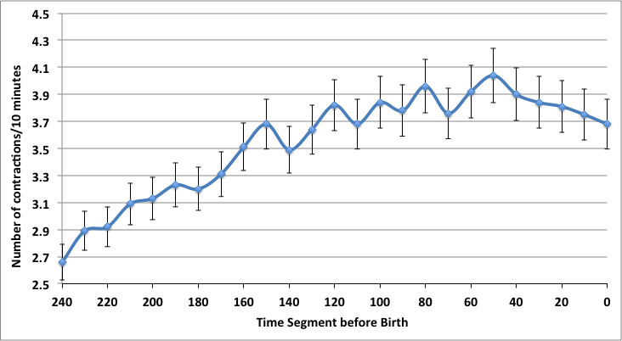

Slide 25
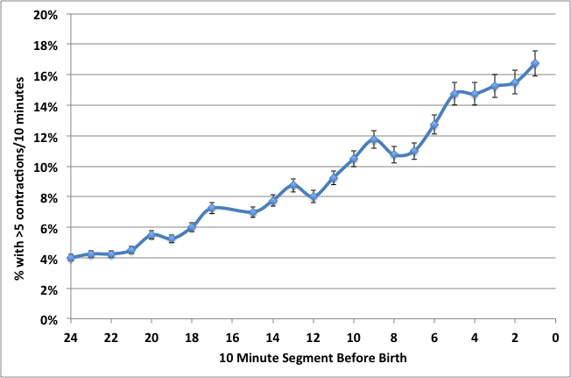

Slide 26
Other types of visualizations? When to use a graphic?
You should already know:
Scatter plots
Bar charts
Histograms
Box plots
Pie charts
Classification trees
Advice:
If the graphic makes it easier to understand, use it
Don’t use a table and a graphic showing the same thing

