Slide 1
NAME THAT CHART!!!

Slide 2
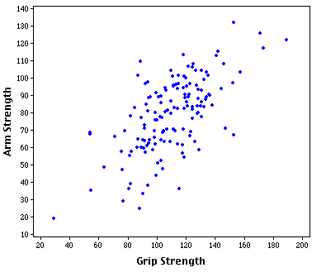

Slide 3
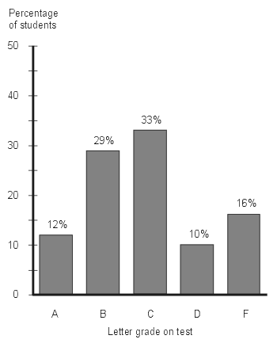

Slide 4
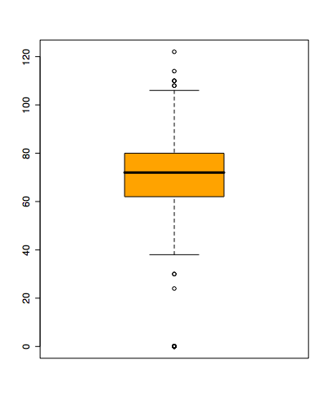

Slide 5
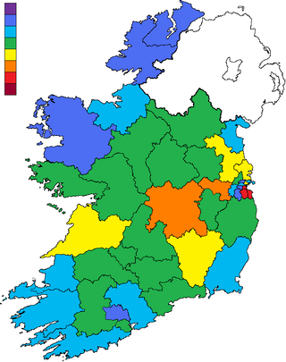

Slide 6
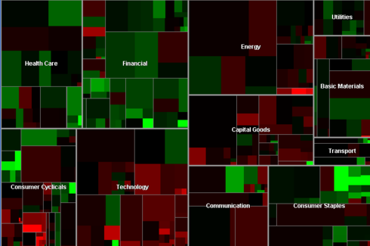

Slide 7
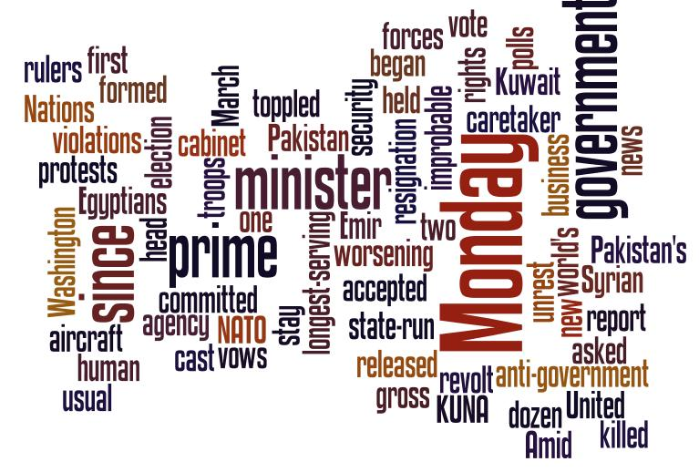

Slide 8
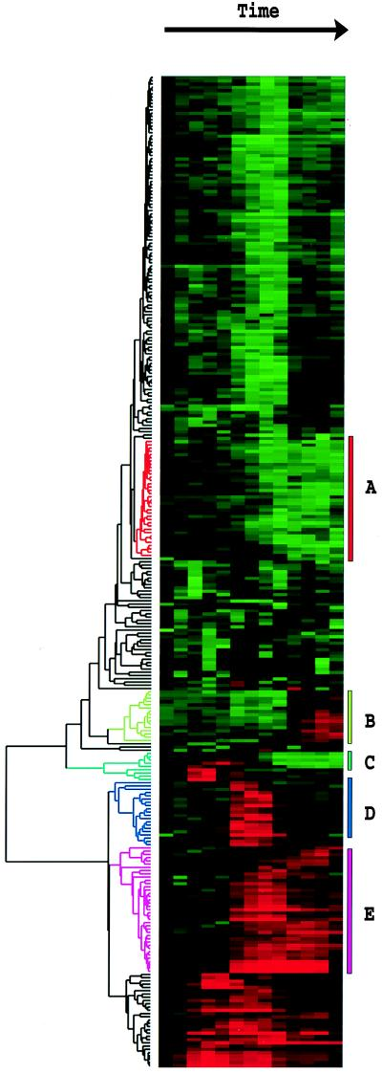

Slide 9
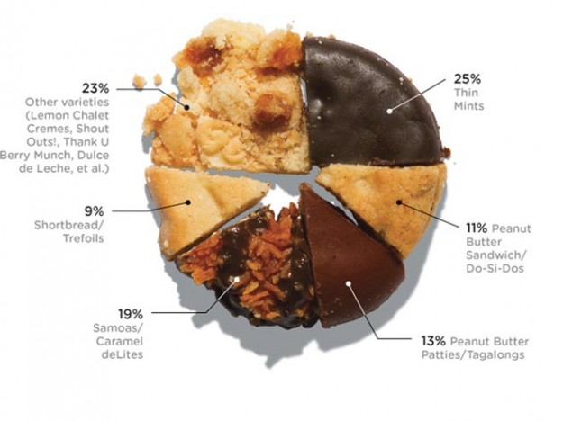

Slide 11
Output layer
2nd hidden
layer
1st hidden
layer
Input data

Slide 12
Outlook
sunny
overcast
rain
overcast
humidity
P
windy
high
normal
true
false
N
P
N
P

Slide 13
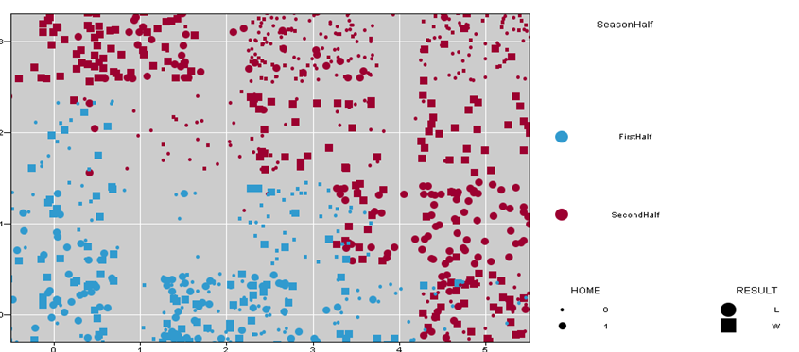

Slide 14
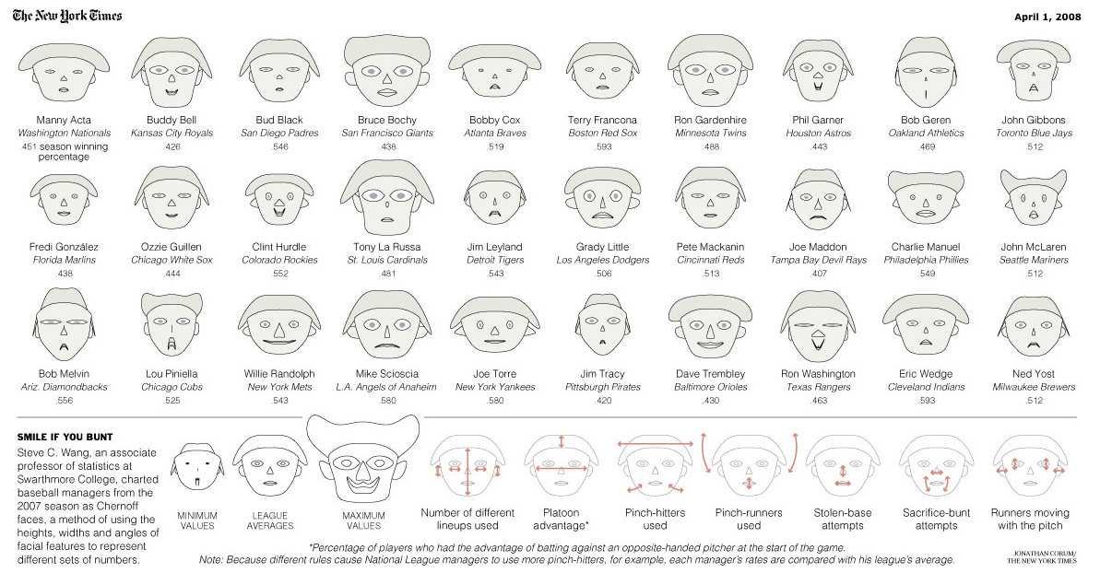

Slide 15
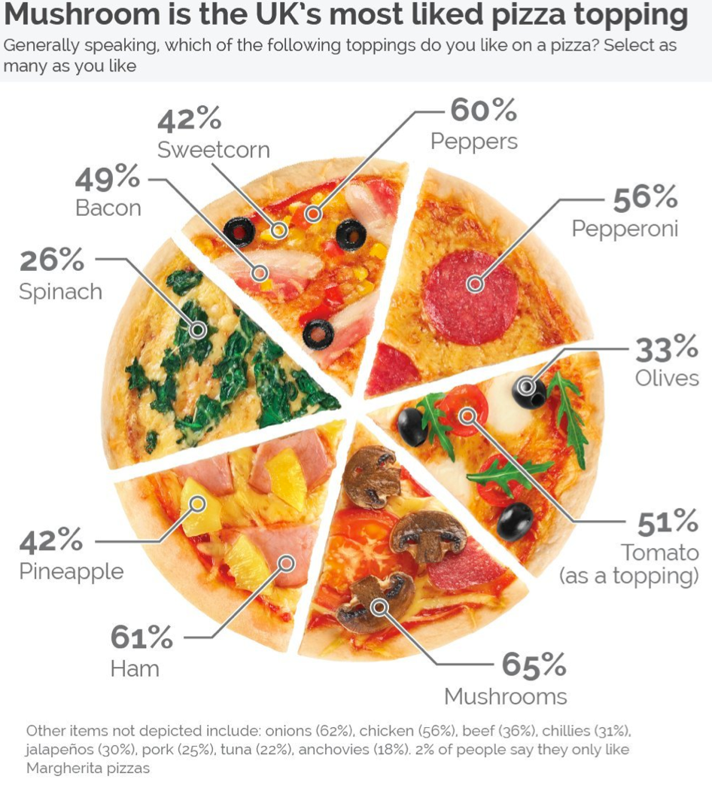
Nominee for Worst graphic in the world?
Generally, pie charts are terrible
The #s on this pie chart add up to 485%
Each slice is the same size even though it represents (multiple) different values
Sweetcorn on pizza? Really?

Slide 16
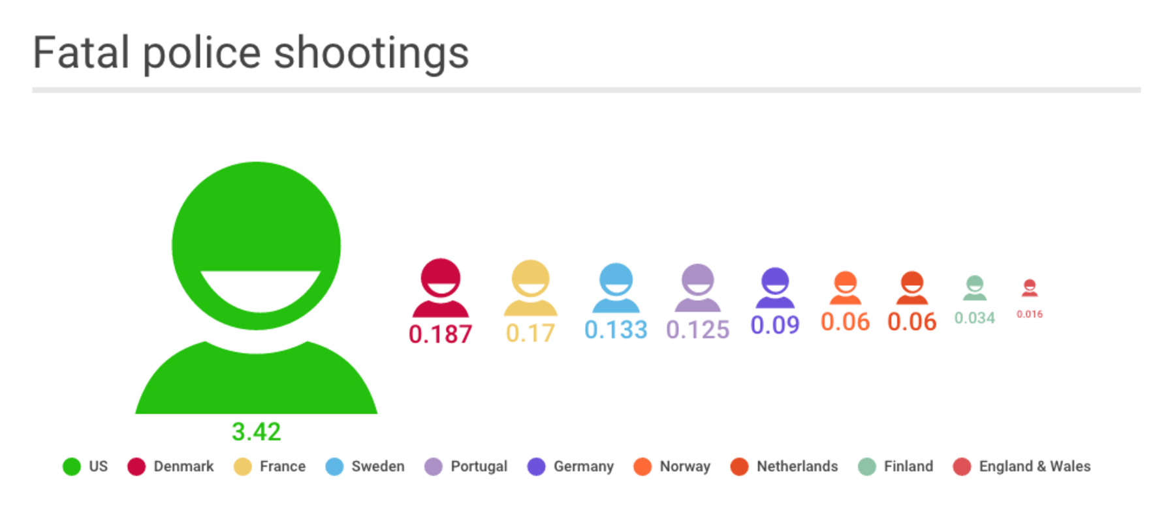
Nominee for Worst graphic in the world?

Slide 17
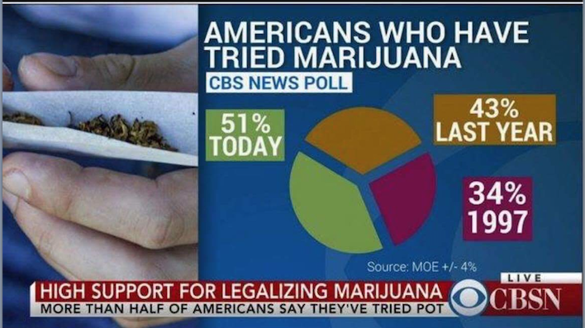
Nominee for Worst graphic in the world?

Slide 18
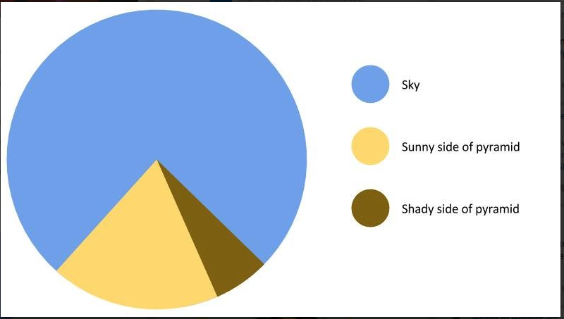
Nominee for Worst graphic in the world?

