Slide 1
Lab 3 Guidance/Hints
Lab 3 – you may use the combined titanic dataset posted on CLE website or you may use your own dataset from labs 1 and 2.
Lab 3, Q2 – In your matrix, should you select “include missing values” or not?
Please be sure to submit your lab by Sunday, August 13!

Slide 2
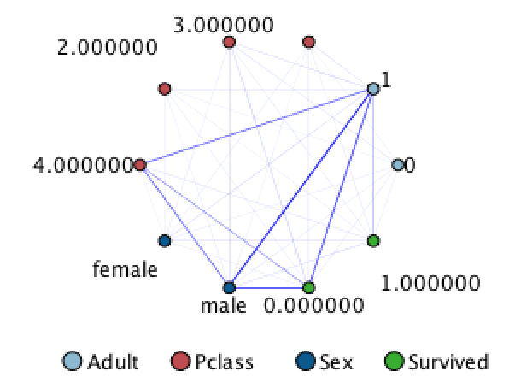
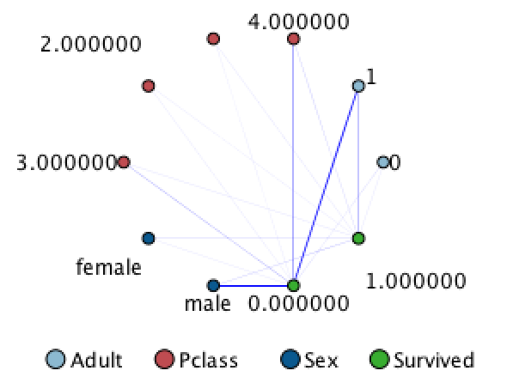
Lab 3 - Webs
A web in SPSS shows the strength of relationships between two or more variables.
Can either be non-directed (left) or directed (right) – doesn’t matter which one you choose as the interpretation is similar, however, select the default (non-directed) as it may be easier to interpret

Slide 3
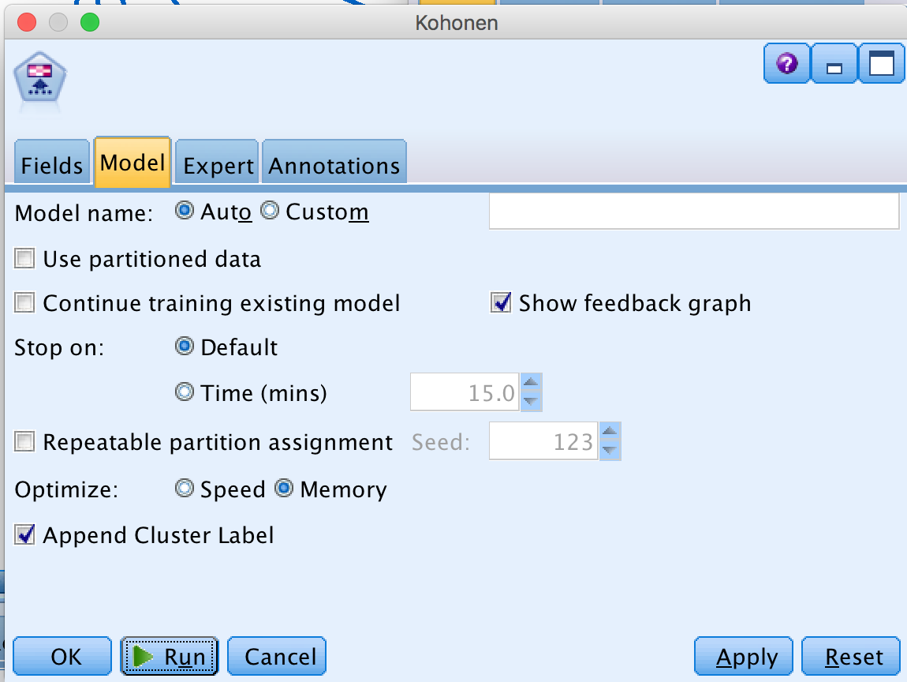
Lab 3 – Kohonen Model
Be sure to deselect “use partitioned data” under the model tab of your Kohenen dialog box, unless you are using partitioned data (recommended that you do use partitioned data)…

Slide 4
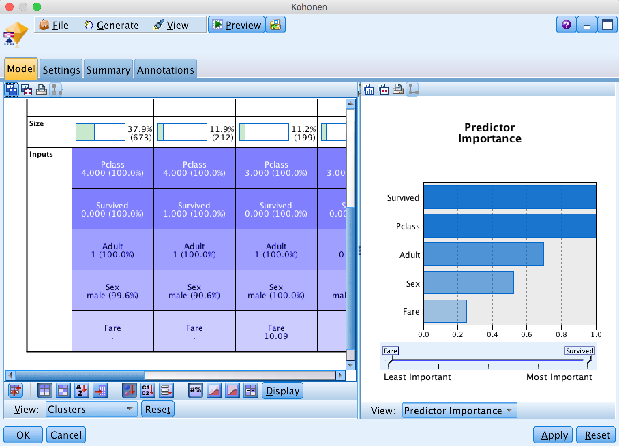
Lab 3 - Kohonen Model
Take a look at the predictor importance on the right make sure the results are what you expect…
Remember that the predictor importance is for which variables define the CLUSTERING and not the outcome. This is not a classification algorithm.
You can use the kohonen model to narrow down a list of variables that can be used to describe the data

Slide 5
Homework 3 – Guidance/Hints
Don’t forget to include screenshots of your dialog boxes to receive full credit for your homework! (not needed for lab)
HW3, Q7: try your best to provide as much granularity as possible to the steps needed. You can assume that each step has an associated time stamp. For example, step # 132 occurred on Thursday, August 10, 2017 at 07h 12m 45.234 sec.
Your final project component 1 is due MONDAY, AUGUST 14

