Slide 1
Biostat 202: Opportunities and Challenges of “Big Data”:
Machine Learning 1:
Regression
John Kornak
Division of Biostatistics
Department of Epidemiology and Biostatistics
08/14/2017

Slide 2
Overview of machine learning lectures
4 lectures
Machine Learning “definition”
Supervised vs. unsupervised Machine Learning
Regression (supervised prediction)
Classification (supervised prediction)
Validation and testing
Cross-validation
Bagging and boosting
Clustering (unsupervised)
Data reduction techniques (unsupervised)
IBM SPSS Data Modeler examples throughout

Slide 3
Overview of this lecture
Machine Learning and the big picture
Supervised vs. Unsupervised Machine Learning
Prediction using:
  Linear regression
  Multiple regression
Validation

Slide 4
Machine Learning?
Machine Learning
Data Mining
Data Science
Statistical Learning

Slide 5
Machine learning
Machine learning is a subfield of computer science that evolved from the study of pattern recognition and computational learning theory in artificial intelligence. In 1959, Arthur Samuel defined machine learning as a “Field of study that gives computers the ability to learn without being explicitly programmed”
Machine learning is a type of artificial intelligence (AI) that provides computers with the ability to learn without being explicitly programmed. Machine learning focuses on the development of computer programs that can teach themselves to grow and change when exposed to new data.
We are not trying to create AI, but rather use some machine learning algorithms for the purpose of prediction or identifying patterns in data.

Slide 6
Supervised vs unsupervised
Supervised Learning
Have data where you know outcome in order to train the model
Train the model to predict future outcomes from sets of predictors
Unsupervised Learning
No specified outcomes
Separate data points into groups with “similar” properties (clustering)
Or reduce data to fewer variables in some way that still captures important structure of the data
Prediction: Regression (continuous outcomes) and classification (categorical outcomes)
Clustering and data reduction

Slide 7
Supervised vs. unsupervised
Machine Learning
Supervised
Regression (continuous outcome)
Classification (categorical outcome)
Unsupervised
Clustering
(grouping observations)
Data Reduction (transforming variables)

Slide 8
Prediction problems
Predict the CD4 count in a patient 6 months from now based on current CD4, viral load, demographic and lifestyle variables
Predict whether a patient will develop breast cancer based on genetic, demographic, and lifestyle variables
Predict whether or not, and what type of dementia a patient has based on MRI of the brain (a running example for these lectures)

Slide 9
Definitions
Instance (also Item, Record) = observation:
  an example, described by a number of attributes,
  e.g. a day can be described by temperature, humidity and cloud status
  e.g. a person can be described by age, gender, blood pressure and level of physical activity
Attribute or Field = variable
  measuring aspects of the Instance, e.g. temperature
Class or Label = class or group
  grouping of instances/observations, e.g. disease type

Slide 10
Definitions
Target. Also called outcome, response, dependent variable – the variable that you want to predict
Input. Also called predictor, covariate, independent variable – the variables you will use to predict
Modeler also has variable roles of Record ID (identification variable like medical record number), split (for separate analyses of subgroups), and partition (for assessing training/testing).

Slide 11
Regression
Start simple with one predictor
We will move onto multiple predictors later…

Slide 12
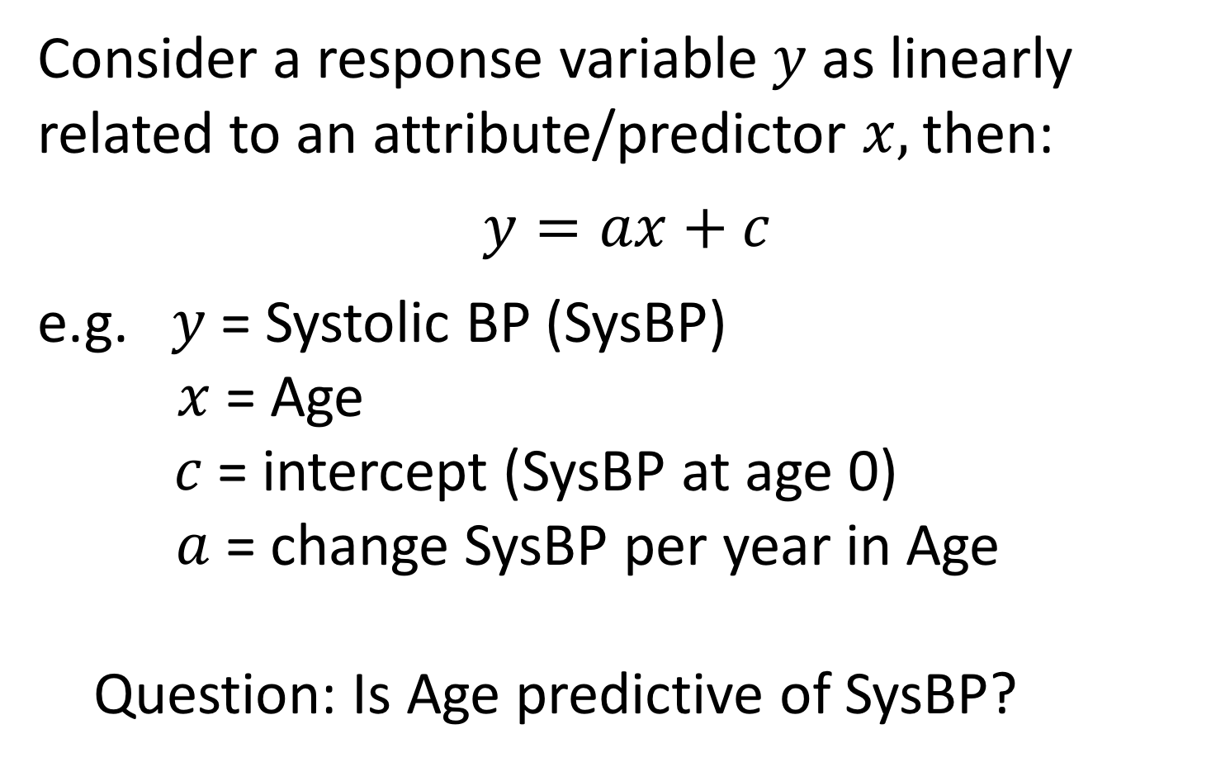
Linear Regression
Consider a response variable $y$ as linearly related to an attribute/predictor $x,$ then:
$$y=ax+c$$
e.g. $y$ = Systolic BP (SysBP)
$x$ = Age
$c$ = intercept (SysBP at age 0)
$a$ = change SysBP per year in Age
Question: Is Age predictive of SysBP?

Slide 13
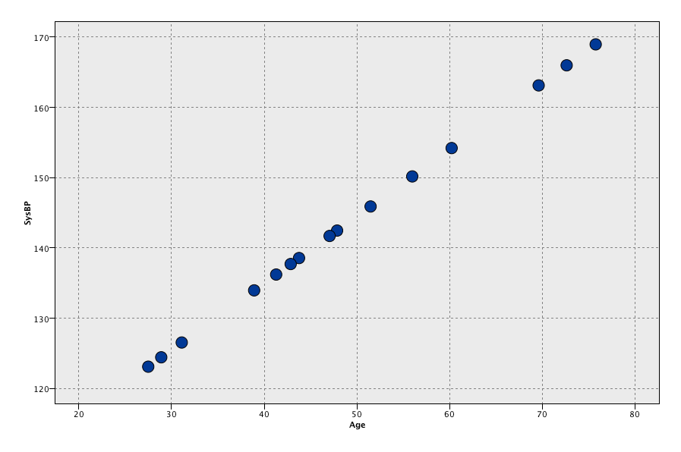


Fitting linear regression
$$y$$
SysBP
Age
$$x$$

Slide 14
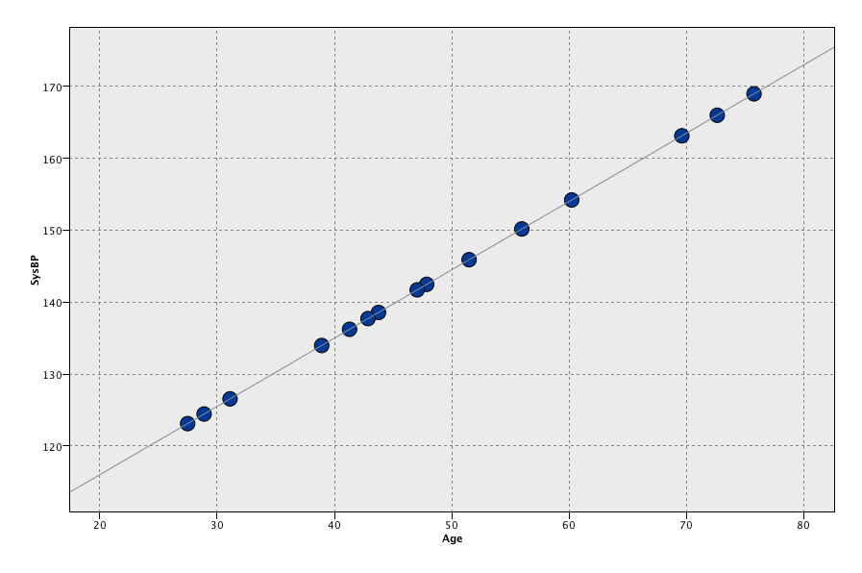
Fitting linear regression
$$y$$
SysBP
Age
$$x$$

Slide 15


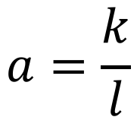
Fitting linear regression
$$y$$
slope
$$a=\frac{k}{l}$$
SysBP
$$k$$
Intercept?
$$l$$
Age
$$x$$

Slide 16

Fitting linear regression
$$y$$
slope
$$a=\frac{k}{l}$$
SysBP
$$k$$
intercept
$$l$$
$$c$$
Age = 0
Age
$$x$$

Slide 17
Fitting linear regression
But data (almost) never lie on a perfect straight line. The data also contain:
  Measurement error
  Between subject variability (e.g. not all people of a certain age have the same Systolic BP)

Slide 18
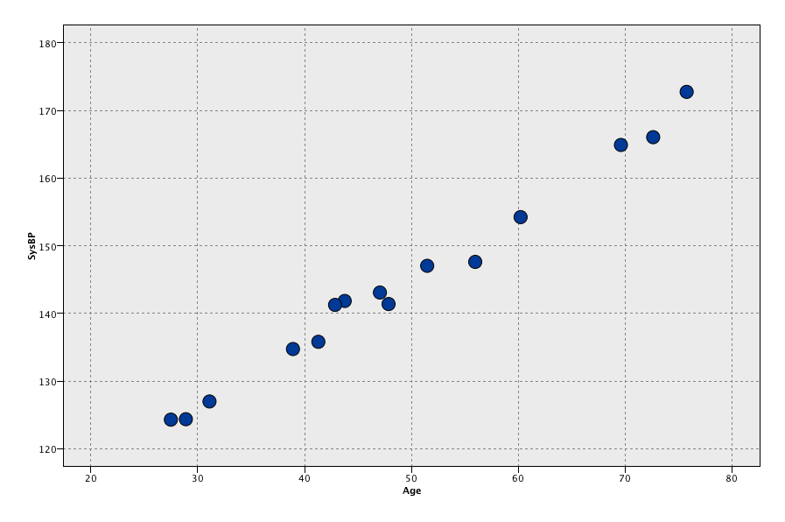
Data with measurement error
SysBP
Age

Slide 19
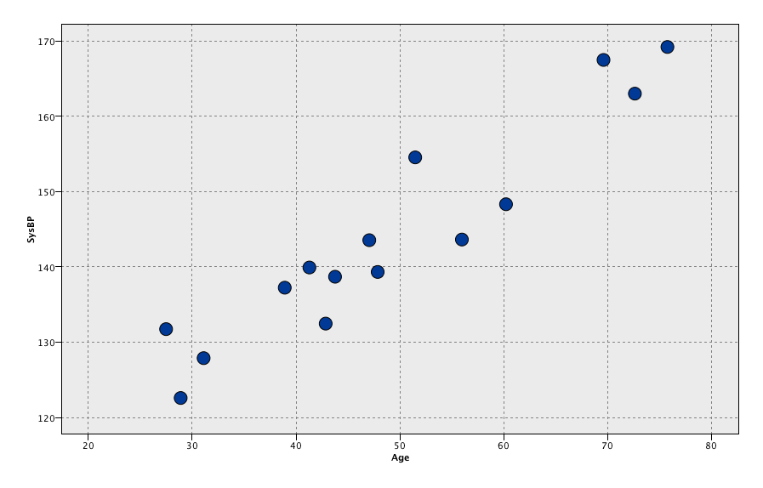
Data with measurement error plus biological variability
SysBP
Age

Slide 20
How to choose a fitted line?
SysBP
Age

Slide 21
How to choose a fitted line?
SysBP
One possible line
Age

Slide 22
How to choose a fitted line?
SysBP
We want to fit a straight line to give us a relationship, but which one is ‘best’?
Age

Slide 23

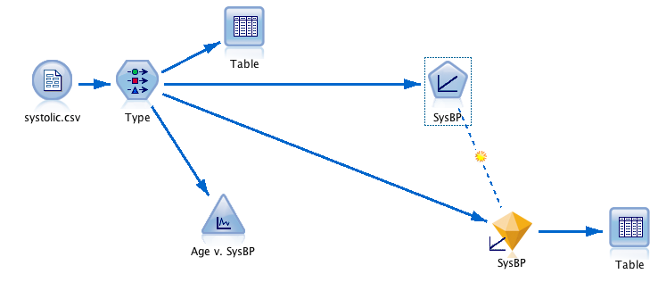
IBM Modeler linear regression stream
Modeling tab

Slide 24
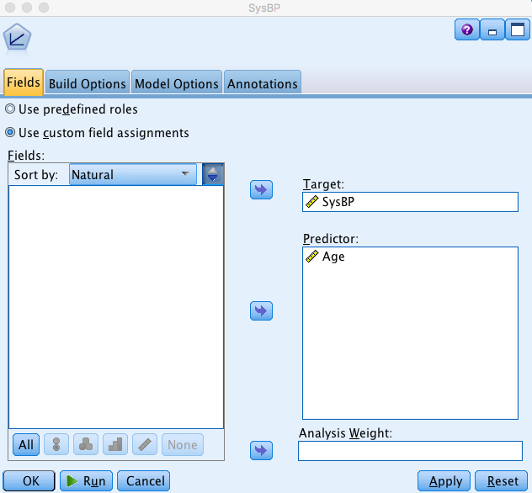
IBM Modeler Linear Node

Slide 25
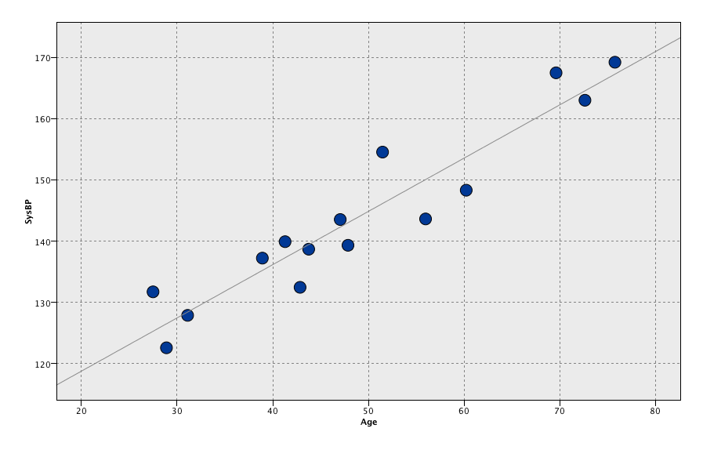
Fitted line from Linear node
SysBP
What defined “best”?
Age

Slide 26
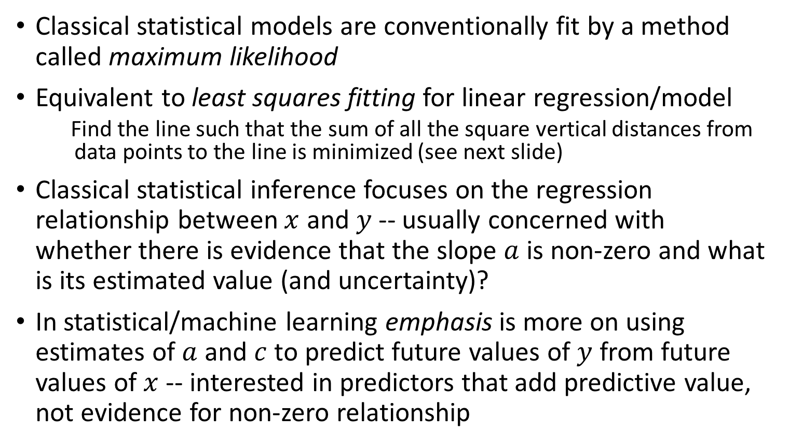
Model Fitting
Classical statistical models are conventionally fit by a method called maximum likelihood
Equivalent to least squares fitting for linear regression/model
  Find the line such that the sum of all the square vertical distances from data points to the line is minimized (see next slide)
Classical statistical inference focuses on the regression relationship between $x$ and $y$ -- usually concerned with whether there is evidence that the slope $a$ is non-zero and what is its estimated value (and uncertainty)?
In statistical/machine learning emphasis is more on using estimates of $a$and $c$to predict future values of $y$ from future values of $x$ -- interested in predictors that add predictive value, not evidence for non-zero relationship

Slide 27

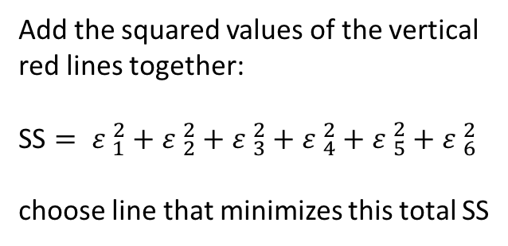







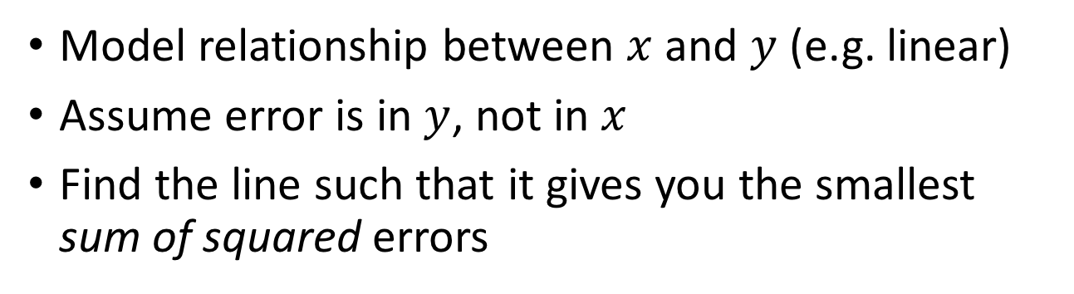



Least Squares
Model relationship between $x$and $y$ (e.g. linear)
Assume error is in $y$, not in $x$
Find the line such that it gives you the smallest sum of squared errors
$$a=\frac{k}{l}$$
$$ε_{6}$$
$$ε_{5}$$
Add the squared values of the vertical red lines together:
SS $= {ε }_{1}^{2}+{ε }_{2}^{2}+{ε }_{3}^{2}+{ε }_{4}^{2}+{ε }_{5}^{2}+{ε }_{6}^{2}$
choose line that minimizes this total SS
$$ε_{4}$$
$$ε_{5}$$
$$k$$
$$ε_{2}$$
$$ε_{3}$$
$$ε_{1}$$
$$l$$
$$c$$

Slide 28
Making a prediction
SysBP
Predicted SysBP
Age
New subject age 40

Slide 29
Why straight line? What about?
SysBP
Age

Slide 30
Or even?
SysBP
Age

Slide 31
Or even?
SysBP
Age
Overfitted?

Slide 32
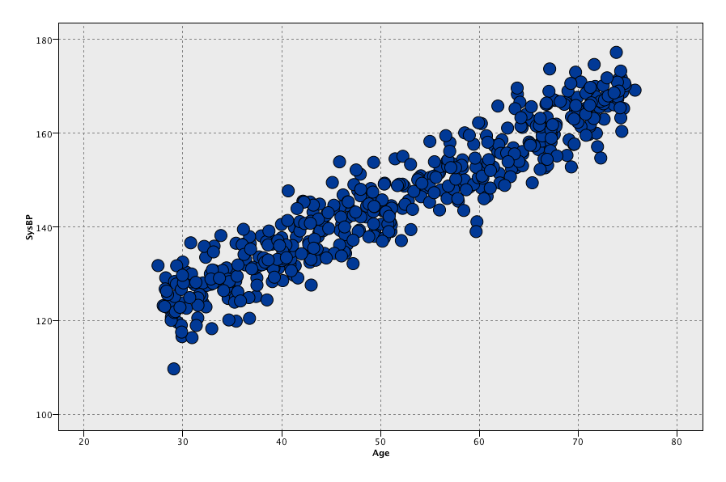
What about with more data?
SysBP
Age

Slide 33
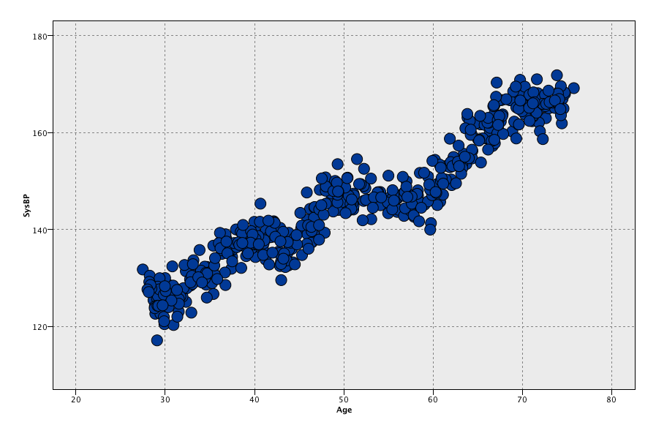
What about this data?
SysBP
Age

Slide 34
Big Data – Large N and Large P
Big data can be thought of in two ways
Large N = large number of subjects – implies more information for fitting complex models or ones with many predictors
Large P = large number of predictors, or complex relationships between predictor and outcome, or between predictors (interaction terms)

Slide 35
The trade-off for more complex models
Want to find “true” predictive patterns in the data
Idea is to use some measure of external “prediction quality” (e.g. least squares) in order to assess what level of complexity is best given a particular dataset
Want to avoid overfitting spurious detail: i.e. don’t want to make the model capture apparent patterns due to noise, but we want to capture true underlying patterns
Solution – independent validation – reserve some data that has not been used in model fitting for the purpose of model evaluation and comparison – we will look at this briefly later, and in more detail on Thursday

Slide 36
The SysBP dataset example
Helmut Spaeth, Mathematical Algorithms for Linear Regression, Academic Press, 1991, page 304, ISBN 0-12-656460-4.
Data available at: http://people.sc.fsu.edu/~jburkardt/datasets/regression/regression.html as the x03.txt dataset
I have put Modeler friendly version on CLE
The systolic blood pressure was measured for 30 people of different ages.

Slide 37
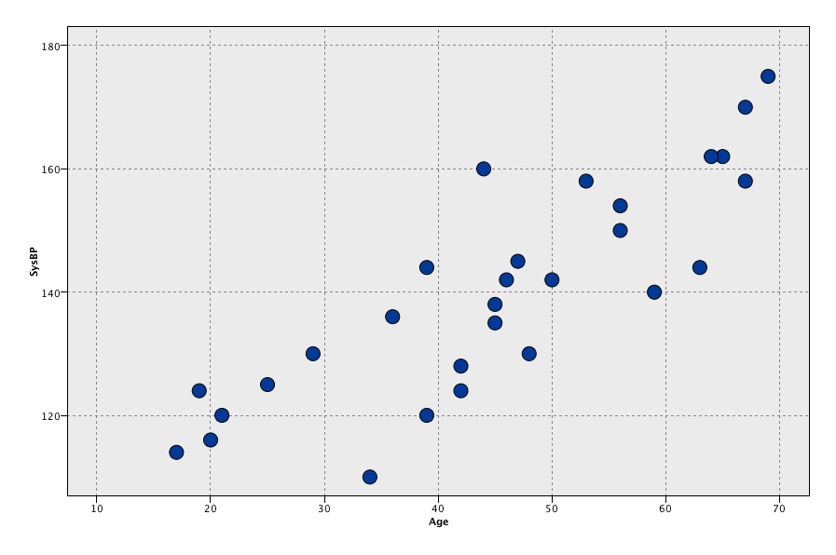
The SysBP dataset
SysBP
Age

Slide 38
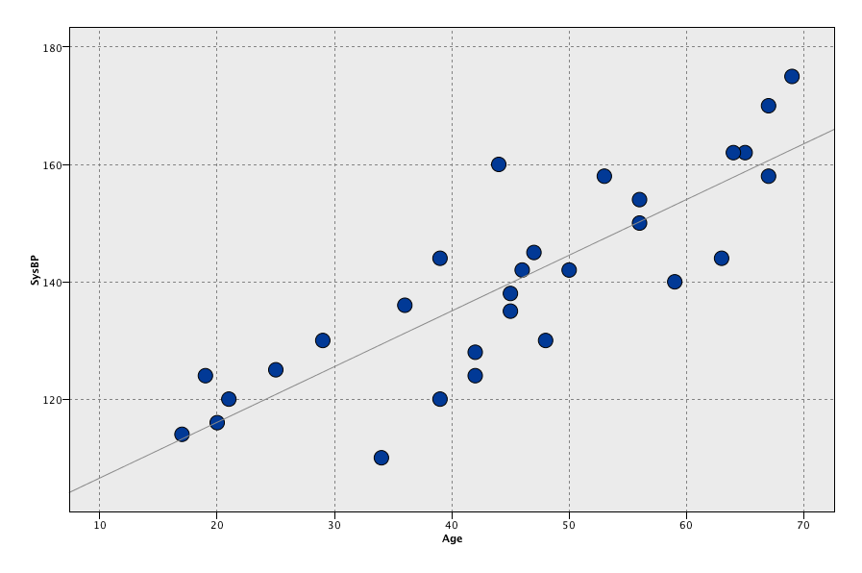
The real dataset with fitted line
SysBP
Age

Slide 39
The real dataset
Anything suspicious?
SysBP
Age

Slide 40
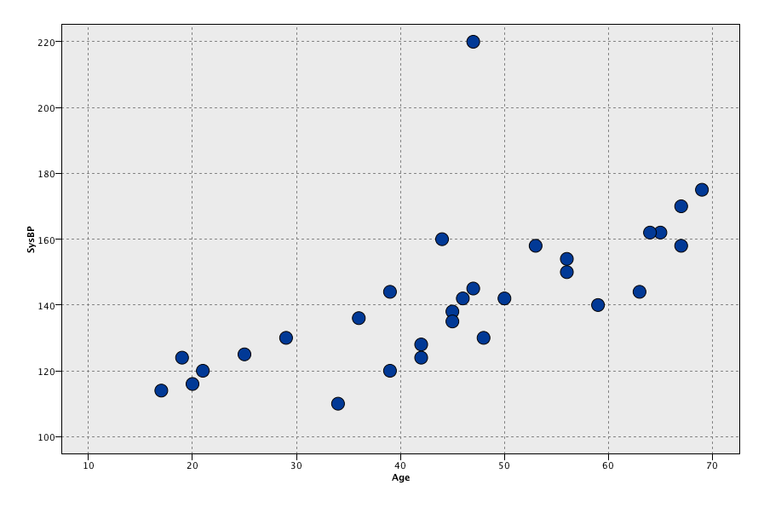
High blood pressure subject
SysBP
Age

Slide 41
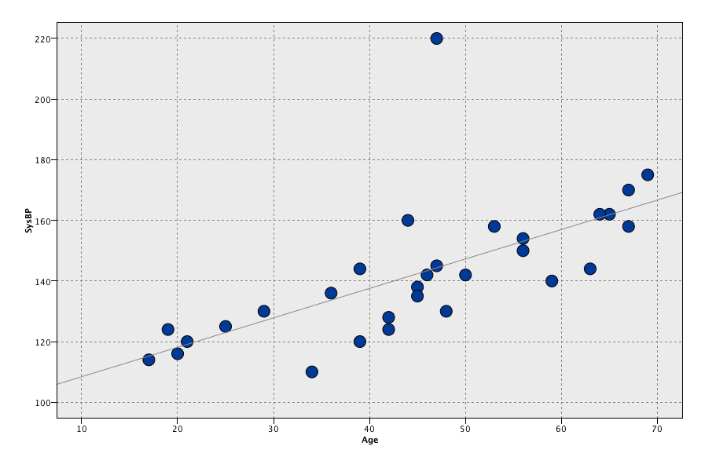
Fitted line
SysBP
Age

Slide 42
The real dataset
SysBP
Original LS line with data point removed
Age

Slide 43
The real dataset
Anything else suspicious?
SysBP
Age

Slide 44
Is anything going on here?
Continuing with outlier dropped…
SysBP
Age

Slide 45
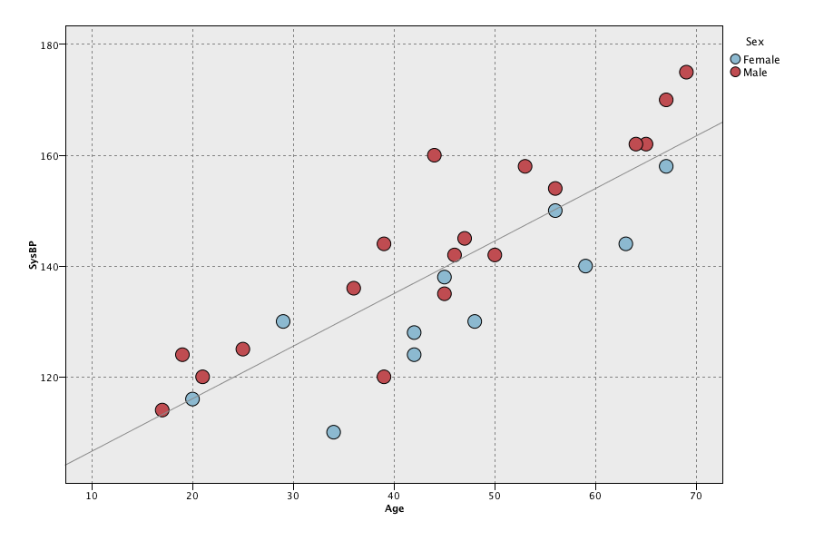
Separate by Sex
Sex
Blue F
Red M
SysBP
Age

Slide 46
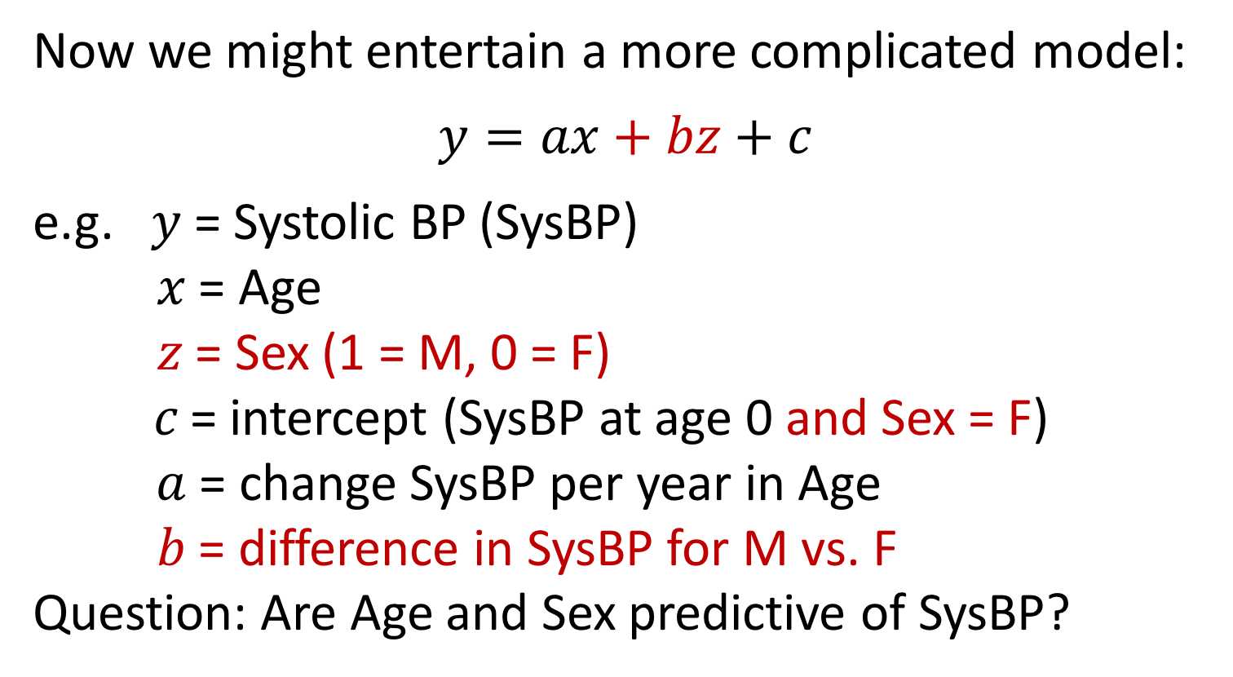
Multi-predictor models
Now we might entertain a more complicated model:
$$y=ax+bz+c$$
e.g. $y$ = Systolic BP (SysBP)
$x$ = Age
$z$ = Sex (1 = M, 0 = F)
$c$= intercept (SysBP at age 0 and Sex = F)
$a$ = change SysBP per year in Age
$b$ = difference in SysBP for M vs. F
Question: Are Age and Sex predictive of SysBP?

Slide 47
Age and Sex as predictors
Sex
Blue F
Red M
Gray line = original fit, no sex predictor
SysBP
Age

Slide 48
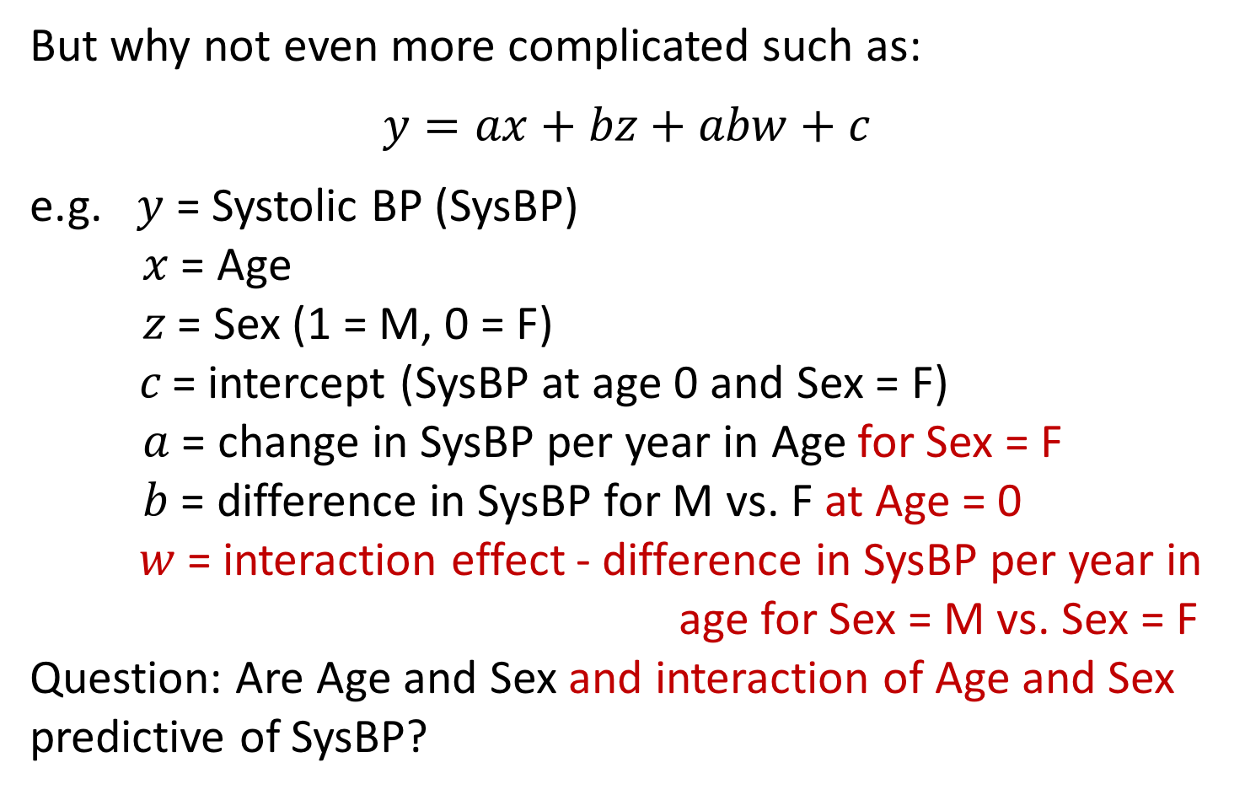
And interactions
But why not even more complicated such as:
$$y=ax+bz+abw+c$$
e.g. $y$ = Systolic BP (SysBP)
$x$ = Age
$z$ = Sex (1 = M, 0 = F)
$c$= intercept (SysBP at age 0 and Sex = F)
$a$ = change in SysBP per year in Age for Sex = F
$b$ = difference in SysBP for M vs. F at Age = 0
$w$ = interaction effect - difference in SysBP per year in
age for Sex = M vs. Sex = F
Question: Are Age and Sex and interaction of Age and Sex predictive of SysBP?

Slide 49
Age and Sex interaction
Sex
Blue F
Red M
Gray line = original fit, no sex predictor
SysBP
Age

Slide 50
Actually, no sex variable is in the dataset – I made it up for illustrative purposes
The doctored dataset is what is available on CLE in case you want to play with it…

Slide 51
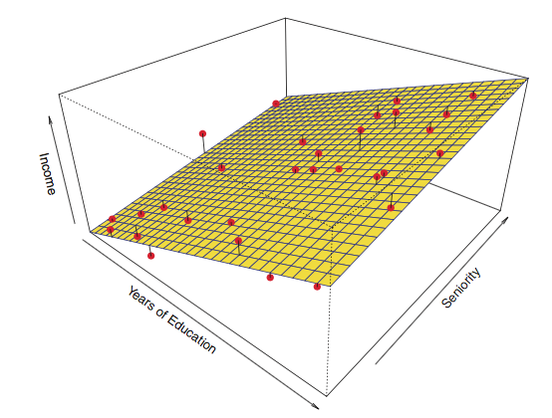
Linear least squares with 2 (continuous) predictors
SysBP
Adapted
From ISLR
BMI
Age

Slide 52
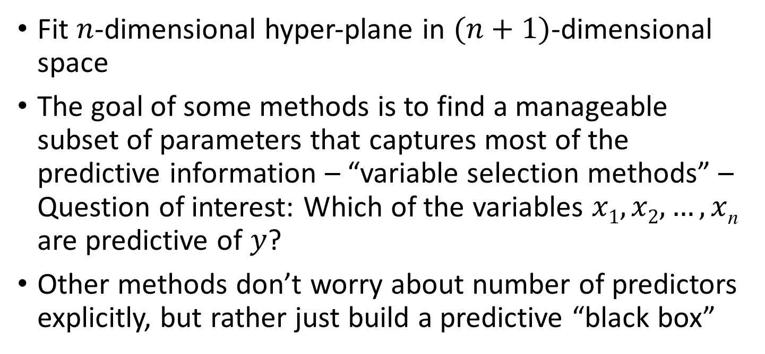
Many predictors
Fit $n$-dimensional hyper-plane in $(n+1)$-dimensional space
The goal of some methods is to find a manageable subset of parameters that captures most of the predictive information – “variable selection methods” – Question of interest: Which of the variables $x1,x2,…,x$_{n} are predictive of $y$?
Other methods don’t worry about number of predictors explicitly, but rather just build a predictive “black box”

Slide 53
Wine dataset
Wine Quality dataset from UCI Machine Learning Repository https://archive.ics.uci.edu/ml/datasets.html (I also placed on CLE)
Freely available dataset relating to Portuguese “Vinho Verde”
P. Cortez, A. Cerdeira, F. Almeida, T. Matos and J. Reis. Modeling wine preferences by data mining from physicochemical properties. In Decision Support Systems, Elsevier, 47(4):547-553. ISSN: 0167-9236.
Use objective test predictors (alcohol level, PH, acidity, etc.) to predict wine expert subjective assessments: median of 3 experts scoring 0 (very bad) to 10 (very excellent)
No missing attributes
We will focus on the “red variant” dataset (on CLE)

Slide 54
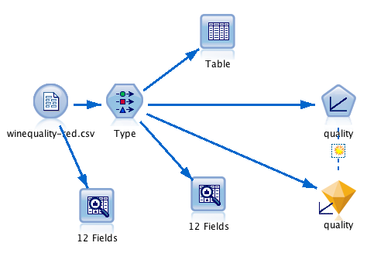
Multiple Regression Stream

Slide 55
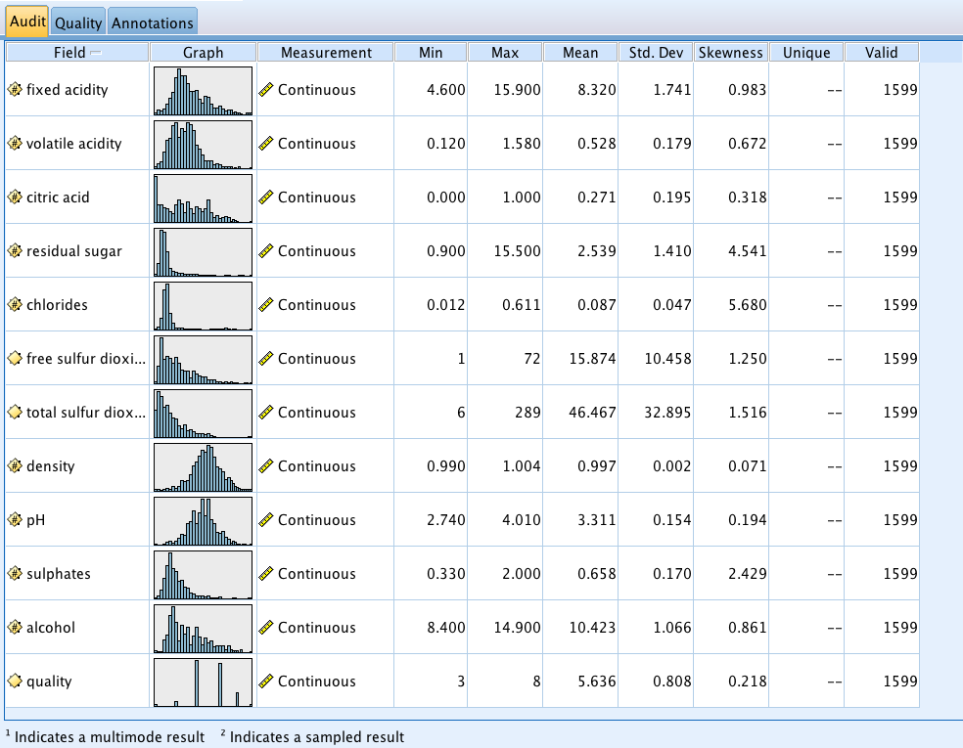
Data Audit prior to Type

Slide 56
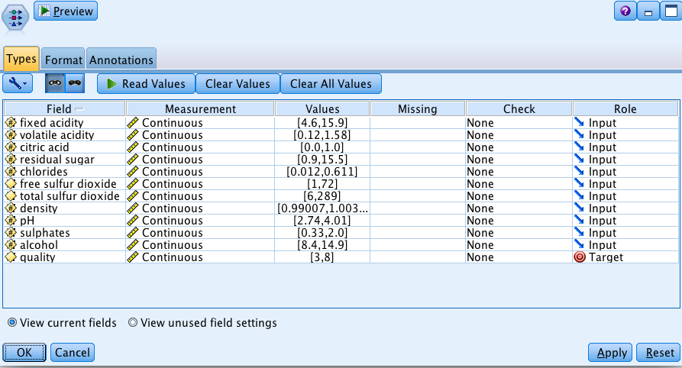
Type Node

Slide 57
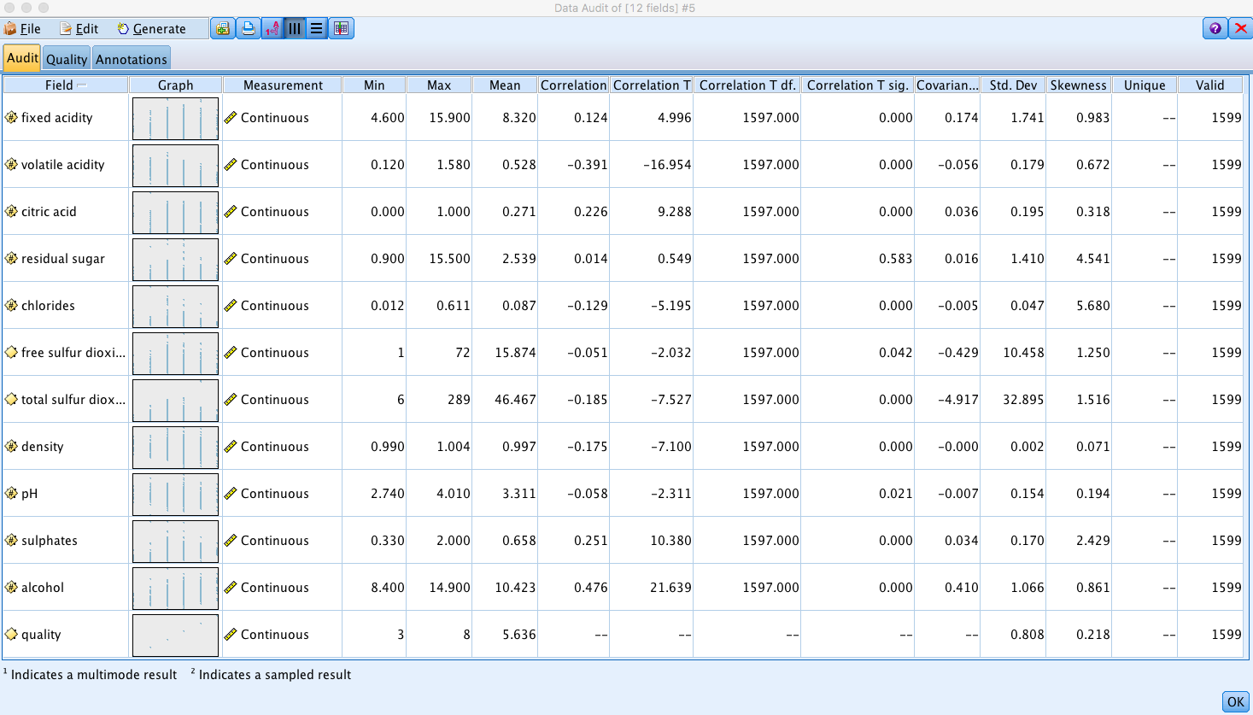
Data Audit post Type

Slide 58
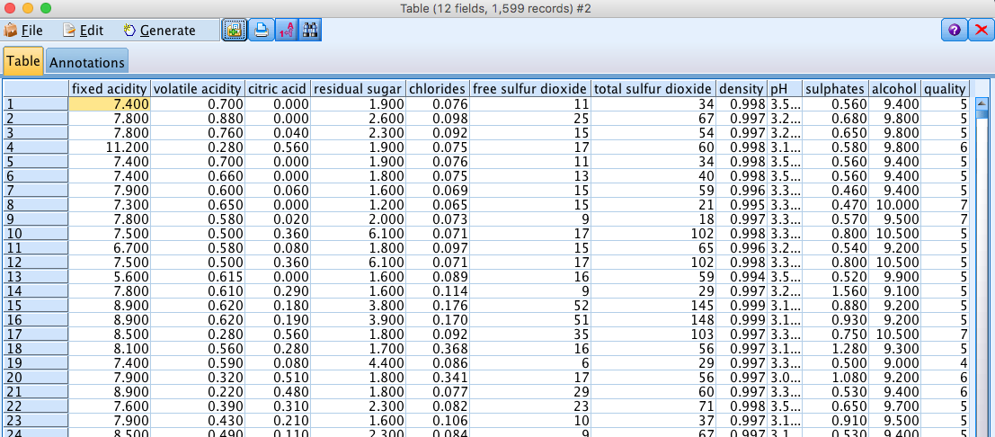
Output of Table node
.
.
.
.
.
.

Slide 59
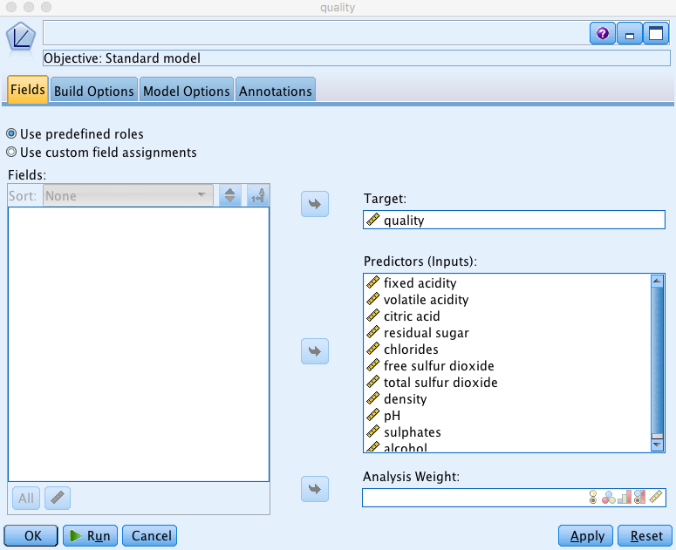
Linear node

Slide 60
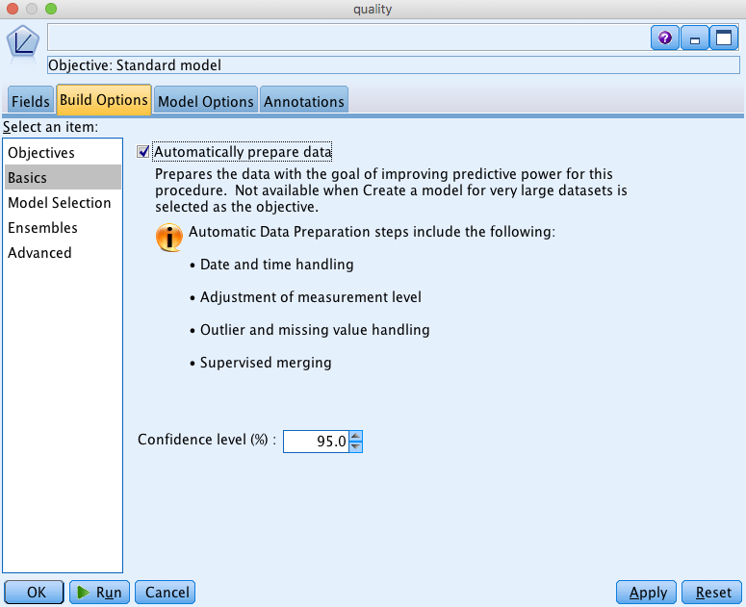
Linear node

Slide 61
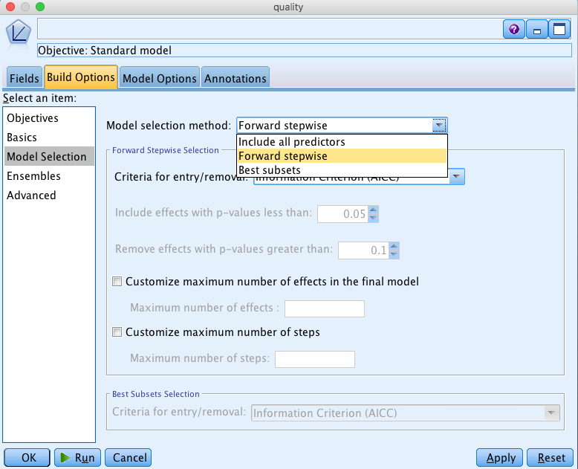
Linear node

Slide 62
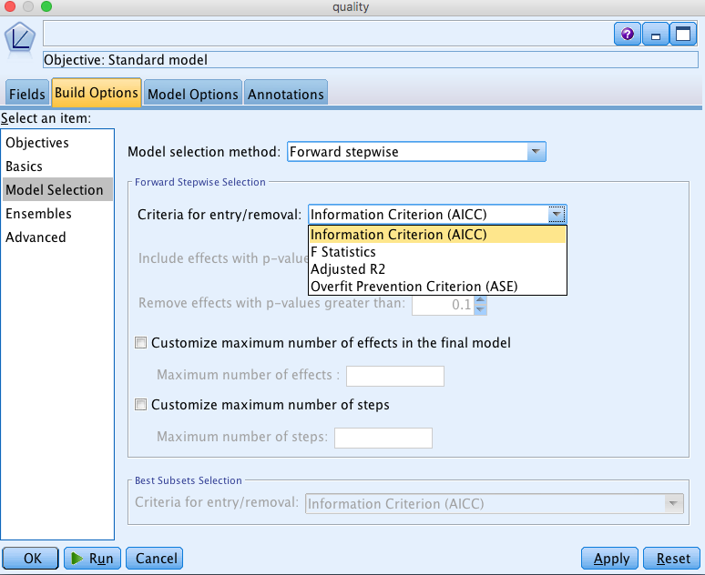
Linear node

Slide 63
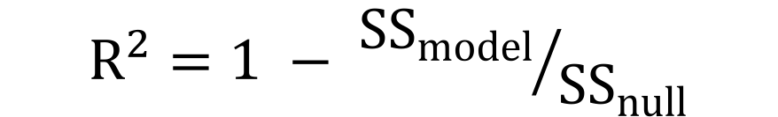
R²
0
0
Null Model R² = 0
Regression Model R² = 0.4
40% of variance is explained by regression line
$$R^{2}=1 − {{SS}_{model}}/{{SS}_{null}}$$
Adjusted R² also adjusts for the number of predictors/model complexity

Slide 64
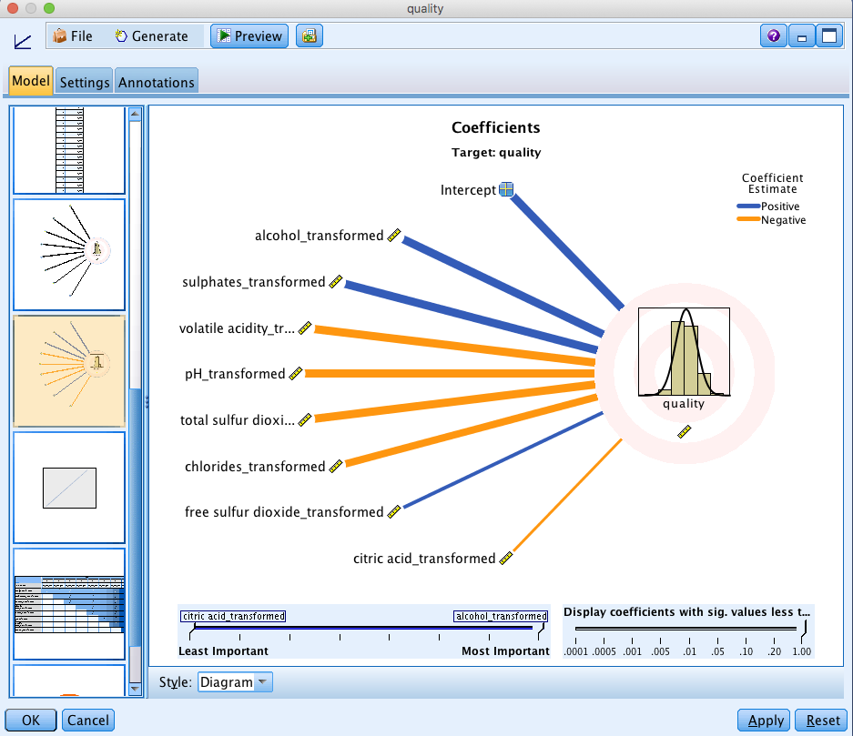
Golden Nugget

Slide 65
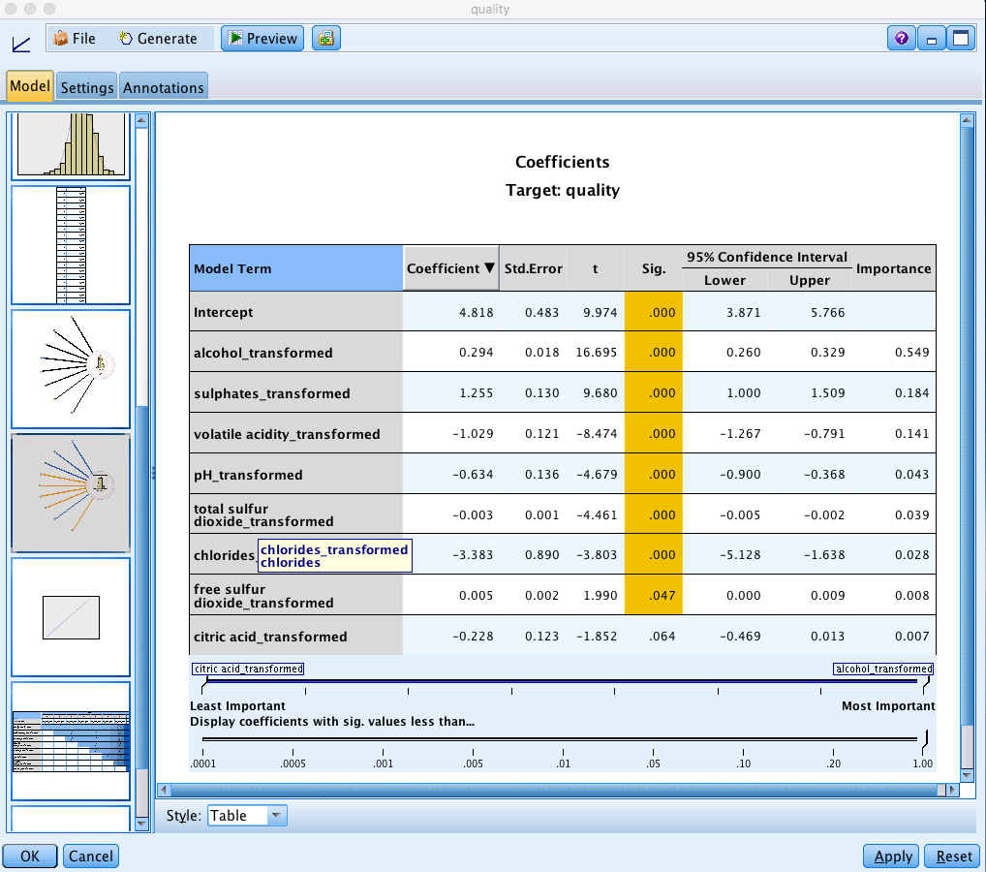
Coefficients

Slide 66
Estimating best model without overfitting
How to choose between different models/algorithms?
Idea is to use “prediction quality” (e.g. SS) to assess what level of complexity is best given a particular dataset
But we can’t use the same data we fit the model to in order to assess how well it did – could be perfect fit but not generalize to other data – each model is subject to overfitting – e.g., in genetics project we have > 6500 candidate genes but only 72 observations!
So we deliberately leave data aside for “testing”…

Slide 67
Training/Test
Randomly split data into training and test sets (often ~2/3 for train, 1/3 for test)
Build a regression model using the training set and evaluate it using the test set
Best if you have a lot of instances/observations (at least 100, preferably > 1000)
Alternative when data set is not so big is to use cross-validation – discuss in later lecture
Need a metric by which to evaluate…

Slide 68
Evaluation of best model
Possible evaluation measures in Modeler:
  Correlation -- correlation coefficient between the observed target values and model estimated target values
  Relative Error (1- R²)
  Number of fields – number of variables included in the model – “smaller will be simpler model with less chance of overfitting”

Slide 69
Thursday’s Lecture
IBM Demo – Auto Numeric Node
The classification prediction problem
  Logistic regression
  Classification trees
  Support Vector Machines

