Slide 1
Dates in STATA
Sankari Ayyaluru
Adapted from material by Yiwey Shieh, MD

Slide 2
How are dates treated in STATA?
Dates can be recognized in many formats in STATA:
  8/8/17 or 8/8/2017
  8-8-2017
  August 8, 2017
Dates are treated as string variables, which we need to convert to numerical (float) variables.
Notes:
Numeric: only numbers
String: may contain letters, numbers, other characters.
Variable type is important because it indicates what you can and cannot do with a variable.

Slide 3
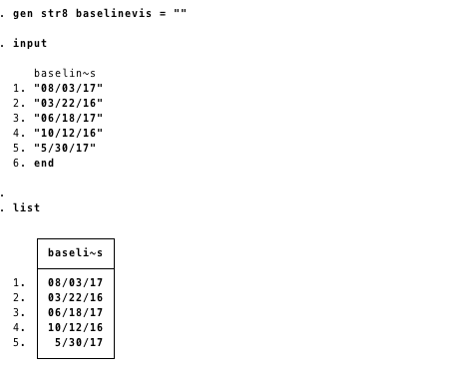
Step 1 Input dates
Execute commands under step 1 of do file and open data browser to inspect data:

Slide 4

How STATA thinks about dates
1/1/1960
1/3/1960
12/31/1960
0
1
2
364
STATA recodes dates as # of days elapsed from a reference date
  January 1, 1960 = 0
  January 2, 1960 = 1
  January 3, 1960 = 2
  December 31, 1960 = 364
Makes it “easy” for STATA to manipulate dates mathematically

Slide 5
Cleaning STATA dates
Need to convert to STATA-recognizable date to perform analysis
  Generate a new date variable using date function
  Identify the “old” string variable which contains the date
  Tell STATA what format it was in (e.g. month, day, year)
  Compare old and new results

Slide 6
Generating a new date variable
For 2-digit years, the “top year” that should be interpreted
New variable name
Date function
  generate baselinevisnew = date(baselinevis, “MDY”, topyear)
Old variable name
How the date is arranged
*NOTE: your original date variable can be “date-like” (e.g. 8/10/1970) or can be in a true string format (August 10, 1970) --- STATA can figure it out.

Slide 7
Dates: 2 Digit Years
NOTE: STATA issues with 2-digit years (8/10/76)
  Will get “missing values” generated
  Two ways to fix this
    Format dates to 4 digit years in Excel, then copy to STATA
    Add “topyear” cutoff to the STATA command.
    Anything beyond topyear = previous century
    generate baselinevisnew = date(baselinevis, “MDY”, 2010)
    8/03/17 = August 03, 1917
    9/10/10 = September 10, 2010 ← top year
    03/22/16 = March 22, 1916
    9/10/09 = September 10, 2009

Slide 8
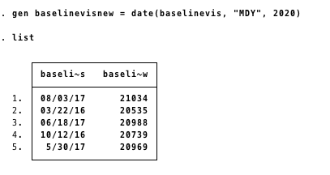
Step 2 Convert baseline visit dates to STATA-recognizable dates

Slide 9
What do these numbers mean??
The numbers that emerge in STATA after generating baselinevisnew are meaningless to most humans
The solution is to reformat using the following command:
  format datevariable %td
    %td = regular date (other formats available using STATA help)

Slide 10
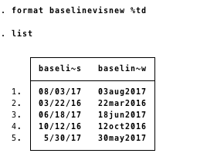
Step 3 Re-format baselinevisnew

Slide 11
Dates: A series of commands
Date conversions usually 2-commands plus checking
  generate baselinevisnew = date(baselinevis, “MDY”)
  format baselinevisnew %td
  browse baselinevisnew baselinevis
  drop baselinevis

Slide 12
What else can we do with dates?
We can add and subtract numbers to dates and find time elapsed between dates.
  gen delta = followup1 – baselinevisnew
  If you want this as # of hours:
    gen delta_hrs = (followup1 – baselinevisnew) * 24

Slide 13
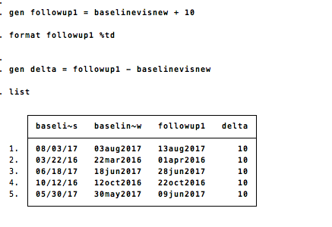
Step 4 Simple addition/subtraction with dates

Slide 14
What if you only want part of date?
Extract components of the date into new variables (columns)
  gen nameofdayvariable = day(datevariable)
  gen weekdayvariable = dow(datevariable)
    Lists as 0(Sunday) - 6(Saturday)
  gen monthvariable = month(datevariable)
  gen yearvariable = year(datevariable)

Slide 15
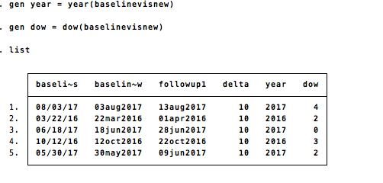
Step 5 Extracting components of dates

Slide 16
Comparing dates
Suppose you wanted to categorize patients by a date
  Patients starting ARV < 1996 = pre-HAART
Using literal dates
  Formatted as day month year (01jan1960)
  Must be denoted by parenthesis
  Must use pseudocommand td
  Example: td(01jan1960)
Example
  gen prehaart = 0
  replace prehaart = 1 if artstart<= td(01jan2006)
  replace prehaart =. if artstart ==.

Slide 17
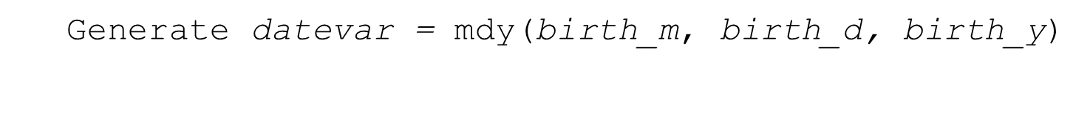
MDY command
Date components housed in separate variables
birth_m | birth_d | birth_y
7 | 4 | 1953
1 | 18 | 1948
6 | 28 | 1949
5 | 30 | 1960
STATA can concatenate these for you
New variable name
mdy date function
Name of month, day, and year variables
Notes:
Don’t forget to format %td

