Slide 1
Statistics for Life:
Pearls vs Sand
Charles E. McCulloch
Head
Division of Biostatistics, UCSF
DCR, 2017

Slide 2
Statistics – pearls vs. sand
Roles of statistics
Example: poor sleep and dementia
Descriptive statistics
P-values
Choice of statistical analysis
Standard errors
Confidence intervals
Stata illustration
Summary
Notes:
I want to identify the role of statistics in clinical research and teach you about some of the commonly used statistical tools.

Slide 3
Roles of statistics in clinical research
Designing studies
  Sample size choice
  Comparing study designs
Descriptive statistics
  Describe the data in the sample
Inferential statistics
  What the results in the sample tell you about the population.
Notes:
Statistics plays a role in three broad aspects of research.

Slide 4
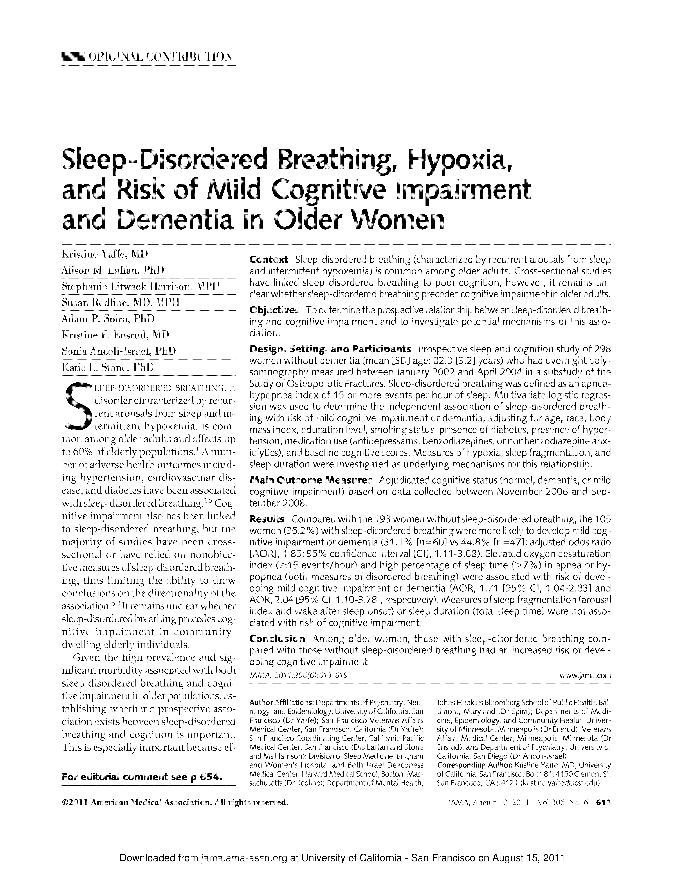
Example: Yaffe et al JAMA 2011
Is sleep-disordered breathing prospectively related to mild cognitive impairment in elderly women?
About 300 women (average age 82) participated in a sleep sub-study of the Study of Osteoporotic Fractures in 2003. About 5 years later, adjudicated measures of mild cognitive impairment (or worse) were determined.
Notes:
Will carry this example through most of the lecture. Does poor quality sleep seem to be related to later cognitive impairment?

Slide 5
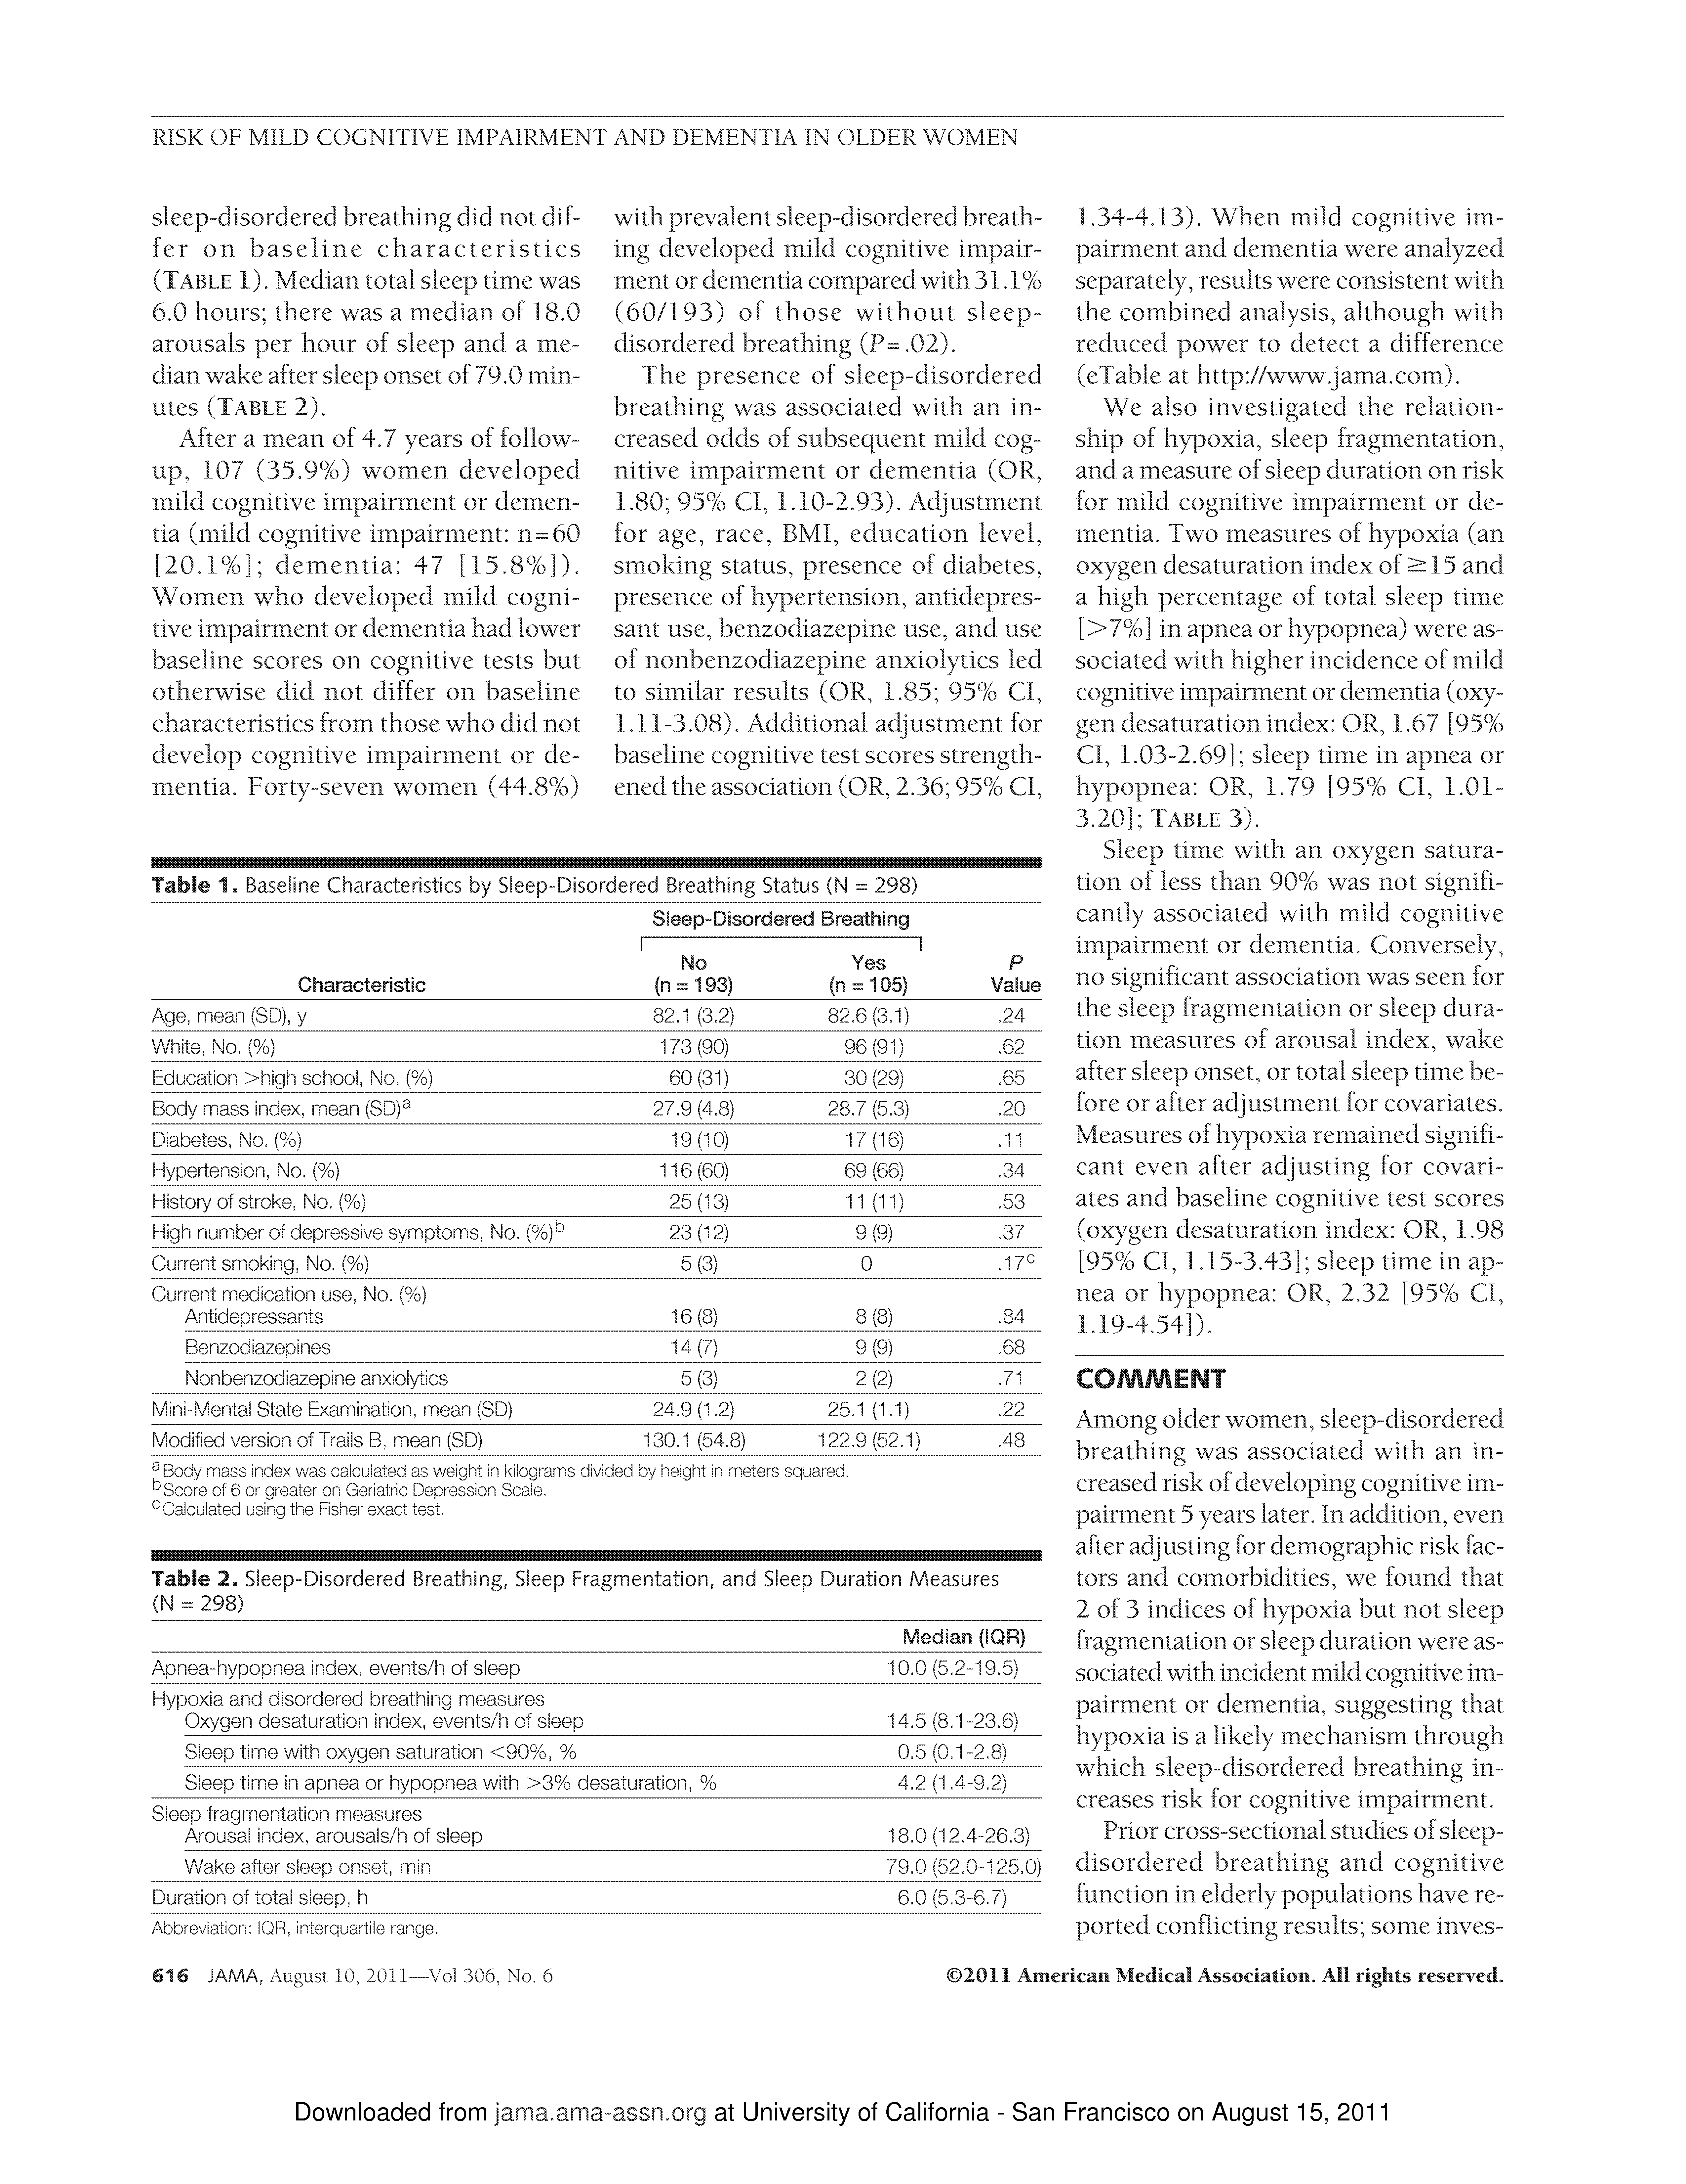
Sleep/dementia – Table 1
Notes:
A well-written research article almost always tells you about the participants in the study via what is called “Table 1”. Among other things, this allows the reader to gauge the generalizability of the results.

Slide 6
Typical descriptive statistics
For numeric variables
  Mean and standard deviation (SD)
    +/- 2 SDs contain about 95% of the data values
  If skewed: median and interquartile range (IQR)
    Median: 50/50 above and below (50th percentile)
    IQR: 75th percentile – 25th percentile
For categorical variables
  Frequencies
Notes:
Skewed means that, when observations are away from the middle of the data, they tend to be on either on the high or on the low side. For example, when cholesterol values are abnormal, they tend to be high.

Slide 7
Sleep/dementia – Table 1
Notes:
Age is given as mean and SD. White is given as percent.
(Ahead) Table 1 also often lists another column (p-values).

Slide 8
Results Table:
Poor sleep/cognition
Cognitive Impairment |  | Low (N) | (<4.5hr) (%) | High (N) | (>6.5hr) (%)
Yes |  | 41 | 42% | 37 | 37%
No |  | 57 |  | 62
Total |  | 98 |  | 99
Total sleep time
Conclusion?
Notes:
Let’s look at data from the cognitive impairment study displayed as a 2x2 table.
Across the columns are the women divided by quality of sleep. On the left it shows that 98 got less than 4.5 hours of sleep per night. And of them, 41, which is 42% later were judged as cognitively impaired.
On the right are the women who got 6.5 hours of sleep or more per night. Of that group, 37, or 37% later were judged as cognitively impaired.
Is this evidence of an association between poor sleep and cognitive impairment among older US women? Or is this attributable to chance and the fact we only looked at about 200 women (in this part of the study).
Let’s consider more formally what we would like to conclude from the data.

Slide 9
How do we use this data to infer to a population?
Population of older US women.
Want to know if the results seen in this sample of N=298 can be reliably extrapolated to the population.
Is the data consistent with a null hypothesis of no difference in the rates of cognitive impairment in the population? Or indicative of a relationship in the population?
Inferential statistics.
Notes:
No difference in the rates of cognitive impairment in comparing the low and higher quality sleeps categories.

Slide 10
Chance of a result as or more extreme as observed
Assume null hypothesis true.
In this instance, that older US women with lower sleep time have the same chance of cognitive impairment as those with a higher time.
Calculate the probability of a result as or more extreme as observed.
Called the p-value

Slide 11
P-value
If the p-value is small, then there are two possibilities:
The null hypothesis is true and something highly unusual occurred,
OR
The null hypothesis is false, and we can conclude there is a difference or relationship.
Notes:
(Next slide) To give you a better feel, here is a more extreme table.

Slide 12
Poor sleep/cognition
Total sleep time
Cognitive Impairment
Low
(N)
(<4.5hr)
High
(N)
(>6.5hr)
Yes
41
42
37
36
No
57
56
62
63
Total
98
99
More extreme

Slide 13
Poor sleep/cognition
Cognitive Impairment |  | Low (N) | (<4.5hr) (%) | High (N) | (>6.5hr) (%)
Yes |  | 41 | 42% | 37 | 37%
No |  | 57 |  | 62
Total |  | 98 |  | 99
Total sleep time
Conclusion?

Slide 14
Interpreting p-values – rules of thumb
P<0.05 is widely accepted as the cut-off point for rejecting the null hypothesis. Values less than 0.05 are commonly described as statistically significant.
P>0.10: consistent with the null hypothesis.
  But doesn’t prove it.
0.05<P<0.10: suggestive that the alternative hypothesis is true.
0.01<P<0.05: supportive of the alternative hypothesis. Statistically significant.
P<0.01: strongly supportive of the alternative hypothesis. Statistically significant.

Slide 15

PPPs – some sand
P-value Pet Peeve1: Authors who describe a statistically significant result as “significant” without the “statistically” qualifier.
  Statistically significant = detectable difference (of any magnitude)
  Significant difference = difference of important magnitude.
P-value Pet Peeve2: Authors who describe a lack of a statistically significant result as no effect or no association.
  Absence of evidence is not the same as evidence of absence.
  Need to consider confidence intervals to assert the latter.

Slide 16
P-value example: N Engl J Med 2010, p.363
BACKGROUND
The optimal management of a torn anterior cruciate ligament (ACL) of the knee is unknown.
METHODS
We conducted a randomized, controlled trial involving 121 young, active adults with acute ACL injury in which we compared two strategies: structured rehabilitation plus early ACL reconstruction and structured rehabilitation with the option of later ACL reconstruction if needed. The primary outcome was the change from baseline to 2 years in the average score on four subscales of the Knee Injury and Osteoarthritis Outcome Score (KOOS) — pain, symptoms, function in sports and recreation, and knee-related quality of life.
Notes:
This study compared delaying knee surgery to see if it was needed among those with knee injuries.

Slide 17
P-value example: N Engl J Med 2010, p.363
Results
There were no in the change in the KOOS4 score from baseline to 2 years between the group assigned to rehabilitation plus early ACL reconstruction and the group assigned to rehabilitation plus optional delayed ACL reconstruction (mean scores, 39.2 and 39.4, respectively; absolute difference, 0.18; 95% confidence interval, −6.5 to 6.8; P = 0.96, adjusted for baseline KOOS4 score).
significant differences
Notes:
Note use of word significant instead of stat significant. SD of KOOS4 in this study was about 12. So that is a ½ SD difference. By Cohen scale, that is a moderate sized difference.
Statistical method: linear regression (numerical outcome, adjusting for baseline score).

Slide 18
P-value Practice
Cognitive Impairment |  | No (N) | (%) | Yes (N) | (%)
Yes |  | 60 | 31% | 47 | 45%
No |  | 133 |  | 58
Total |  | 193 |  | 105
Sleep Disordered Breathing
Conclusion?
Probability of extreme result by chance
Notes:
Let’s go back to the cognitive impairment study and look at other ways to describe poor quality sleep.
45% of those will sleep disordered breathing were later diagnosed with cognitive impairment, but only 31% of those without.
P=0.02 – statistically significant.

Slide 19
P-value Practice
Cognitive Impairment |  | Low (N) | (<61min) (%) | High (N) | (>106min) (%)
Yes |  | 31 | 31% | 44 | 44%
No |  | 68 |  | 57
Total |  | 99 |  | 101
Waking Min after Sleep Onset
Conclusion?
Probability of extreme result by chance
Notes:
Here is a similar table, but divided according to waking minutes after going to sleep.
Almost same rates here, but not statistically significant. Why?
Smaller sample (ignoring the middle group).

Slide 20
Sleep/dementia – Table 1
Notes:
Where do p-values come from? That is the role of “statistical hypothesis tests” which come in may different flavors.

Slide 21
Generating p-values
Statistical hypothesis tests generate p-values, sometimes via arcane calculations.
Appropriate test depends on nature of the variable studied as well as the outcome.
Common situations
  Binary outcome, compare groups: chi-square test, Fisher’s exact test.
  Binary outcome, compare groups, adjusting for predictor variables: logistic regression.
  Numerical outcome, compare groups: t-test
  Numerical outcome, compare groups, adjusting for predictor variables: linear regression
  Survival analysis (time to event), compare groups: Kaplan-Meier curves, log rank test.
  Survival analysis, compare groups, adjusting for predictor variables: Cox proportional hazards regression.
They all generate a p-value, so the key is to figure out what the null hypothesis is and interpret the p-value.
Notes:
Methods are divided by the nature of the outcome variable (e.g., cognitive impairment).
As we learned earlier in this course, in observational studies (like the cognitive impairment study) we may want to adjust for confounders to make a more convincing case for drawing causal conclusions.

Slide 22
Standard errors – understanding the accuracy of data from samples
A key ingredient in statistics is the standard error or SE. From sample to sample, calculated statistics approximate their average value in the population, give or take a standard error or two.
By knowing the SE you can delineate reasonable or unreasonable values of the unknown average values in the population.
Notes:
While I won’t explain the calculations in any detail, they are based on the key idea of a standard error (or SE).

Slide 23
Using standard errors
Suppose a sample of 105 participants gives a proportion of 0.45 with a SE of 0.05 (rate of cognitive impairment in the disordered breathing group). What can we say about the possibility that the true value (if we evaluated all older women in the U.S.) is as low as 0.30?
Range of reasonable values is 0.45 plus or minus 2×(0.05) or (0.35, 0.55).
0.30 not reasonable for a population value.
For a binary outcome with a sample size of n and a proportion of p, the SE is given by
Notes:
So can exclude from consideration that the rate is as low as 0.3.

Slide 24
Standard Errors (SE) vs. SD
Tip:
Use standard deviations (SDs) to quantify the spread of data values in a sample or population.
Use standard errors (SEs) to quantify the precision of a sample estimate of a population quantity.
For example, if the purpose of a table or graph is to describe the variability of the data use SD. If the purpose is to suggest that the true average values in the population may differ use the SE.

Slide 25
Confidence Intervals
A confidence interval (CI) gives an interval that has a known probability of covering the unknown population value.
The interpretation of “95% confidence” intervals is that, on average, they cover the true population value 95% of the time
CI is often given by: estimate ± 2(SE).

Slide 26
Confidence Intervals and Hypothesis Tests
The value of 1 for a relative risk or odds ratio corresponds to the special case of equal risk.
There is a direct correspondence between confidence intervals and hypothesis tests: A confidence interval for a relative risk or odds ratio contains the value 1 if and only if the hypothesis test cannot reject the null hypothesis (using 95% confidence and p-value cutoff of 0.05).
Also, a confidence interval for a difference contains 0 if and only if the hypothesis test cannot reject the null hypothesis of the difference being 0 (equal values).

Slide 27
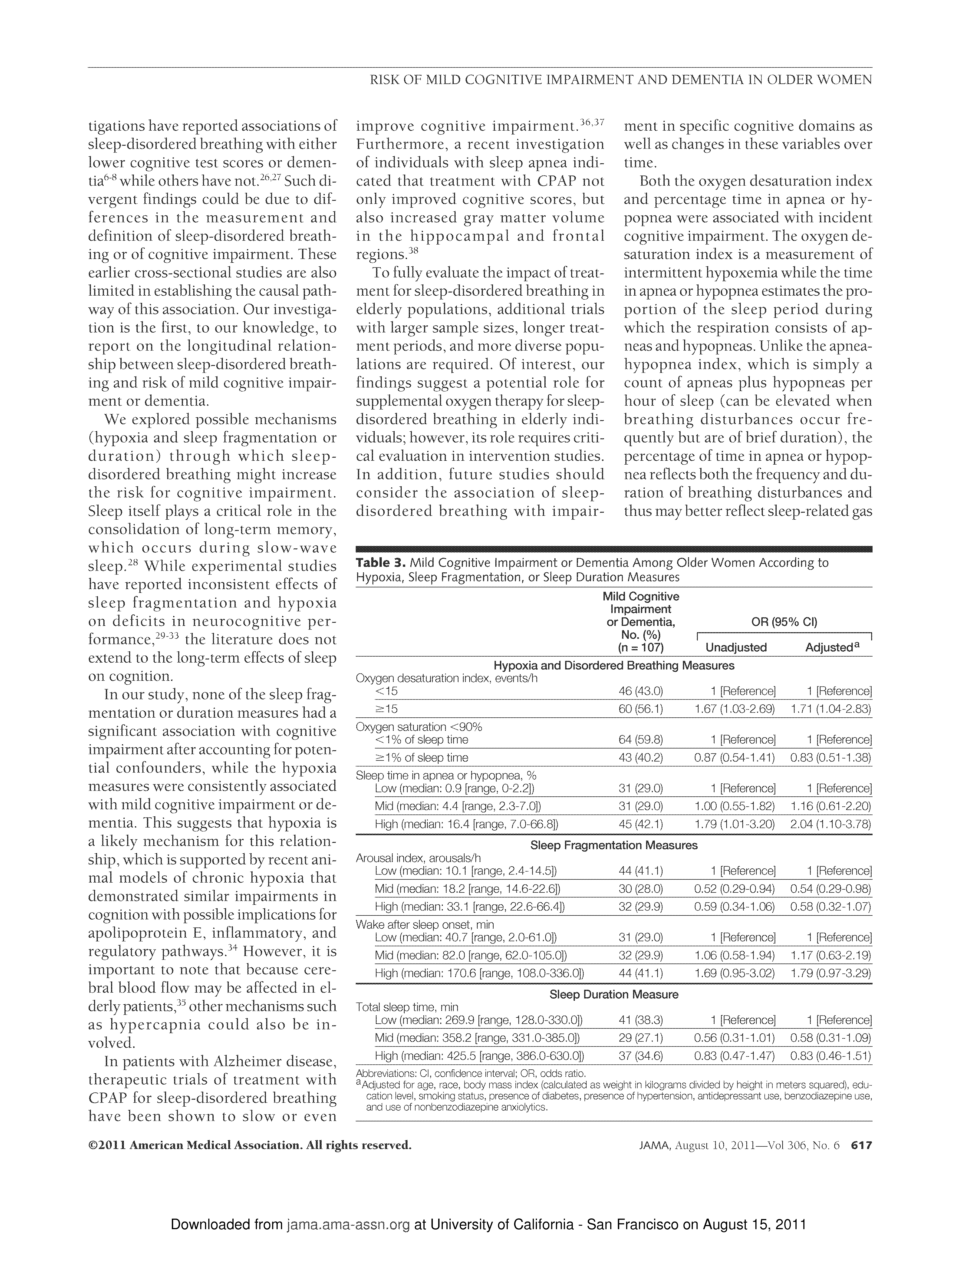
Prions
Notes:
Pearls: clear table, easy to see adjusted and adjusted results. Adjustment factors listed in footnote.
Do CIs overlap 1?

Slide 28
Adjustment using multivariate models
A key reason to use multivariate models is to allow adjustment for confounders.
The Yaffe article used logistic regression with adjustment variables that included age, race, body mass index, education level, smoking status, presence of diabetes, presence of hypertension, antidepressant use, benzodiazepine use, and use of nonbenzodiazepine anxiolytics.
Strengthens the inference of causation.

Slide 29
Confidence Intervals in “Negative” Studies
When H_{O} is not rejected, the confidence interval gives additional information about the magnitude of the differences and can be quite useful for interpreting “negative” (not statistically significant) findings.
If the confidence interval is narrow, the possible effects will be quite limited. If it is wide, the study might be non-informative.

Slide 30
Example: Harris, Bebe-Donk and Alshafie (BMC Cancer 6: 27, 2006) study the relationship of breast cancer to use of COX-2 inhibitors in a case-control study at a single hospital. They find (their Table 2) the following odds ratios and 95% confidence intervals (CI):
COX-2 OR = 0.29, CI (0.15, 0.59)
Acetaminophen OR = 1.02, CI (0.39, 2.20)
Baby aspirin OR = 0.77, CI (0.42, 1.41)
“Neither acetaminophen nor baby aspirin (81 mg) had any effect on the relative risk of breast cancer.”
Notes:
For users of COX-2 inhibitors, the odds of breast cancer were 29% that of those who did not use COX-2 inhibitors.
Over-interpretation:
Acetaminophen might have increased the odds by more than two-fold.
Baby aspirin might have reduced the risk to 42% that of non-users.

Slide 31
Stata software
Fisher’s exact test from the Yaffe article:
“Forty-seven women (44.8%) with prevalent sleep-disordered breathing developed mild cognitive impairment or dementia compared with 31.1% (60/193) of those without sleep-disordered breathing (P=.02).”
Notes:
Here is a phrase out of the Yaffee article.
How do researchers typically derive such results?

Slide 32
Stata software
cogn_impair | sleep_dis
| 0 1 | Total
-----------+----------------------+----------
0 | 133 58 | 191
| 68.91 55.24 | 64.09
-----------+----------------------+----------
1 | 60 47 | 107
| 31.09 44.76 | 35.91
-----------+----------------------+----------
Total | 193 105 | 298
| 100.00 100.00 | 100.00
Fisher's exact = 0.023
1-sided Fisher's exact = 0.013
Notes:
Here is a phrase out of the Yaffee article.
How do researchers typically derive such results?

Slide 33
Stata software
Logistic regression for cognitive impairment data.

Slide 34
Stata software
Logistic regression for cognitive impairment data.
.
. logistic cogn i.wake
------------------------------------------------------------------------------
cogn_impair | Odds Ratio Std. Err. z P>|z| [95% Conf. Interval]
-------------+----------------------------------------------------------------
wake |
2 | 1.063539 .3249723 0.20 0.840 .5843353 1.935728
3 | 1.693265 .5001159 1.78 0.075 .9491125 3.020873
|
_cons | .4558824 .098795 -3.62 0.000 .2981175 .6971369
------------------------------------------------------------------------------

Slide 35
Summary
Roles of statistics.
Inferential: p-values, standard errors, confidence intervals.
P<0.05. Statistically significant. Detectable difference, not necessarily important.
Use confidence intervals to interpret “negative” studies and importance.
Use multivariate adjustment for confounders.

Slide 37
Statistical vs Practical Significance
 |  | Difference between Male and Female Avg Cholesterol
Sample size per group |  | 20 mg/dl | 10 mg/dl | 1 mg/dl
N=10 |  | p=0.12 | p=0.43 | p=0.94
N=100 |  | p≈0 | p=0.01 | p=0.80
N=10,000 |  | p≈0 | p≈0 | p=0.009

Slide 38
Statistical vs Practical Significance
 |  | Difference between Male and Female Avg Cholesterol
Sample size per group |  | 20 mg/dl | 10 mg/dl | 1 mg/dl
N=10 |  | p=0.12 | p=0.43 | p=0.94
N=100 |  | p≈0∗∗ | p=0.01∗∗ | p=0.80
N=10,000 |  | p≈0∗∗ | p≈0∗∗ | p=0.009**
**Statistically significant.

Slide 39
Statistical vs Practical Significance
 |  | Difference between Male and Female Avg Cholesterol
Sample size per group |  | 20 mg/dl | 10 mg/dl | 1 mg/dl
N=10 |  | p=0.12* | p=0.43* | p=0.94
N=100 |  | p≈0∗ | p=0.01* | p=0.80
N=10,000 |  | p≈0∗ | p≈0∗ | p=0.009
*Perhaps practically significant.

Slide 40
Statistical vs Practical Significance
 |  | Difference between Male and Female Avg Cholesterol
Sample size per group |  | 20 mg/dl | 10 mg/dl | 1 mg/dl
N=10 |  | p=0.12* | p=0.43 | p=0.94
N=100 |  | p≈0 | p=0.01 | p=0.80
N=10,000 |  | p≈0 | p≈0 | p=0.009**
*Not statistically significant, perhaps practically significant.
**Statistically significant, but not practically significant.

