Slide 1
Sample Size and Power
Steven R. Cummings, MD
Director, S.F. Coordinating Center
2017

Slide 2
Outline
The question
The ingredients for sample size estimates
Calculating the sample size
Ways to reduce your sample size

Slide 3

The Key to Long Life?
Resveratrol
In the skin of red grapes

Slide 4
The Key to Long Life?
Resveratrol
In the skin of red grapes
Makes mice
  Run faster
  Live longer

Slide 5
The Key to Long Life?
Resveratrol
In the skin of red grapes
Makes mice
  Run faster
  Live longer
Mimics ‘sirtuin:’
senses energy in cells; stimulates production of mitochondria.

Slide 6
What I want to show
My research question:
“Does consuming resveratrol extend healthy life?”

Slide 7
How Many Participants?
Essential
Do it early because:
Estimating the sample size forces you to specify the essential features of your study
It forces you to think clearly

Slide 8
Sample Size Ingredients
Testable hypothesis
Type of study
Statistical test
  Type of variables
Effect size (and its variance)
Power and alpha
  The probabilities of getting wrong answers

Slide 9
Sample Size Ingredients
Testable hypothesis
Type of study
Statistical test
  Type of variables
Effect size (and its variance)
Power and alpha

Slide 10
What’s wrong?
“Does consuming resveratrol extend healthy life?”
Vague
To estimate sample size, it must be a testable hypothesis

Slide 11
My research question
“Does consuming resveratrol extend healthy life?”
Turn it into a testable hypothesis
  Study design
  Specific type of measurement
  Population to be studied

Slide 12
“Consuming resveratrol”
Needs to be quantifiable
I could measure resveratrol intake in a cohort, then follow-up for survival free of disease…

Slide 13


An alternative to
“Consuming resveratrol”
A more rigorous design: randomized placebo-controlled trial
A known quantity of resveratrol vs. placebo
Comparing red wine to placebo would be difficult
But resveratrol supplements are widely available

Slide 14
A specific, measured, predictor
Resveratrol supplements vs. placebo

Slide 15
I need a measureable outcome
“Extend healthy life”

Slide 16
I need a measureable outcome
“Extend healthy life”
Lower mortality rate

Slide 17
The question is becoming a hypothesis
Do people randomized to get a resveratrol supplement have a lower mortality rate than those assigned to get placebo?

Slide 18
I must specify the population
Do people randomized to get a resveratrol supplement have a lower mortality rate than those who get a placebo?

Slide 19
In whom?
Elderly men and women (≥70 years)
  Because the question applies to both genders
  Because they have a relatively high mortality rate
    I’ll have enough ‘events’ within a feasible period of study

Slide 20
The research hypothesis
(AKA the‘alternative’ hypothesis)
Men and women > age 70 years randomized to get a resveratrol supplement have a lower mortality rate than those who get a placebo.
However, it cannot be tested statistically
Statistical tests only reject null hypothesis - that there is no effect

Slide 21
The Null Hypothesis
Men and women > age 70 years randomized to receive a resveratrol supplement do not have lower mortality rate than those who receive placebo
Can be rejected by statistical testing

Slide 22
Ingredients for Sample Size
 Testable hypothesis
Type of study: Descriptive or Analytical

Slide 23
Descriptive studies
Only one variable
Sample size is based on the desired width of the confidence interval
What proportion of centenarians (≥100 years old) take resveratrol supplements?
  Confidence interval for proportions
What is the mean red wine intake of centenarians?
  Confidence interval for the mean

Slide 24
Descriptive studies
Only one variable
Sample size is based on the desired width of the confidence interval
What proportion of centenarians (≥100 years old) take resveratrol supplements?
  Confidence interval for proportions
What is the mean red wine intake of centenarians?
  Confidence interval for the mean
Not covered today

Slide 25
Analytical studies
Have predictor and outcome variable(s)
They have comparisons / associations
  For example:
  Compare the mean red wine intake in centenarians vs. 60-80 year olds
  People who get resveratrol have lower mortality than those who get placebo

Slide 26
Ingredients for Sample Size
 Testable hypothesis
 Type of study: analytical → RCT
Statistical test
  Type of variables
Effect size (and its variance)
Power and alpha

Slide 27
Type of statistical tests
Depends on the types of variables
This works for
most study planning

Slide 28
The types of variables?
Men and women > age 70 years randomized to receive a resveratrol supplement do not have lower mortality rate than those who receive placebo
Dichotomous: resveratrol or placebo
Continuous: mortality rate

Slide 29
The types of variables?
Men and women > age 70 years randomized to receive a resveratrol supplement do not have lower mortality rate than those who receive placebo
Dichotomous: resveratrol or placebo
Continuous: mortality rate
What’s wrong?

Slide 30
The types of variables?
Men and women > age 70 years randomized to receive a resveratrol supplement do not have lower mortality rate than those who receive placebo
Dichotomous: resveratrol or placebo
Continuous: mortality rate
  The proportion who died by certain times
  For example, 10% at 1 year

Slide 31
The types of variables?
Men and women > age 70 years randomized to receive a resveratrol supplement do not have lower mortality rate than those who receive placebo
Dichotomous: resveratrol or placebo
Continuous: mortality rate
  The proportion who died by certain times
  For example, 10% at 1 year
Comparing survival times:
survival analyses

Slide 32

The types of variables?
Men and women > age 70 years randomized to receive a resveratrol supplement do not have lower mortality rate than those who receive placebo
Dichotomous: resveratrol or placebo
Continuous: mortality rate
  The proportion who died by certain times
  For example, 10% at 1 year
Comparing survival times:
survival analyses

Slide 33
The test for this randomized trial for the proportion who die

Slide 34
Ingredients for Sample Size
 Testable hypothesis
 Type of study: analytical (RCT)
 Statistical test
   Type of variables
Effect size
Power and alpha

Slide 35
Estimating the effect size
For randomized trials,
Start with the expected rate in the placebo
Usually available from population or cohort studies
In this case, we know the mortality rates by age:
3-4% per year*; for a 3 year study: 10%
* ~ mean annual female/males @ 78 yrs

Slide 36
Effect size the hardest part
What should I assume for the effect of resveratrol on mortality?

Slide 37
Effect size the hardest part
Ways to choose an effect size:
What is likely, based on other data?
Do a pilot study
Estimate based known effects on biomarkers
What difference is important to detect?
  “We don’t want to miss a __%_ difference”
What can we afford?

Slide 38
The effect of resveratrol on mortality rate?
What is likely, based on other data?
  No data in humans!

Slide 39
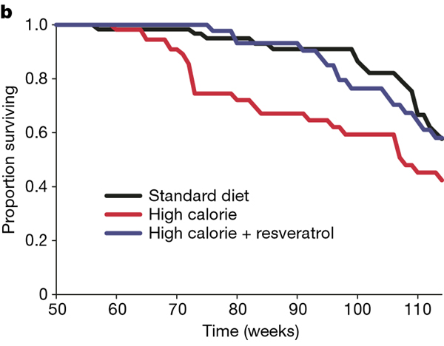
Resveratrol pronged survival of mice fed high calorie diet
~ 25%
Baur, Nature 2006

Slide 40
The effect of resveratrol on mortality rate?
What is likely, based on other data?
Pilot study?
  Good for feasibility
  Small pilot studies generally produce unreliable estimates of effect size

Slide 41
The effect of resveratrol on mortality rate?
What is likely, based on other data?
Do a pilot study
Estimate based on known effect of reservatrol on biomarkers that predict mortality
  For example, effects on cognition, walking speed, kidney function
  No trials of resveratrol on “markers” for mortality

Slide 42
The effect of resveratrol on mortality rate?
What is likely, based on other data?
Do a pilot study
Estimate based on effect on biomarkers
What difference is important to detect?
  I don’t want to miss a 1% decrease!
What difference can we afford?
  1%: the trial will be too big & expensive
  5%: the study will be smaller and cheaper
9% vs 10%

Slide 43
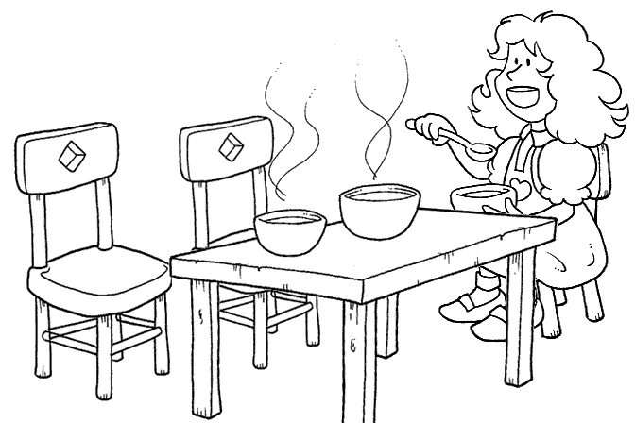
The Science of Effect Sizes
Too large!
Smaller effect is important to health
Larger effect is important for your budget
5%

Slide 44
The Science of Effect Sizes
Too large! Too small!
Smaller effect is important to health
Larger effect is important for your budget
5%
1%

Slide 45
The Science of Effect Sizes
Too large! Too small! Just right!
It requires
good judgment,
balancing science
and feasibility
Smaller effect is important to health
Larger effect is important for your budget
2%
5%
1%

Slide 46
The effect size
Men and women > age 70 years randomized to receive a resveratrol supplement do not have lower mortality rate than those who receive placebo
It would be important to find (I don’t want to miss) a 20% decrease
Placebo rate: 10%
Resveratrol rate: 8%

Slide 47
Ingredients for Sample Size
 Testable hypothesis
 Type of study: analytical (RCT)
 Statistical test
   Type of variables
 Effect size (and its variance)
Power and alpha

Slide 48
α (alpha)
The probability of finding a ‘significant’result if nothing is going on
“Type 1 error”

Slide 49
To convince people that an effect is not due to chance
Customarily, a result is ‘statistically significant’ if P<0.05
In other words,
Probability of a type I error = 5%
α (alpha) = 0.05

Slide 50
I will need to convince skeptics
Very small chance that a positive result is an error
α (alpha) = 0.01
P<0.01
A smaller α means larger sample size

Slide 51
Two-sided vs. one-sided α
A 2-sided α assumes that the result could go either way
  Recognizes that you have two chances of finding something that isn’t really there
    Resveratrol decreases mortality
    Resveratrol increases mortality
A 1-sided hypothesis assumes that the result could, plausibly, go only one way

Slide 52
One-sided α
You may believe that your effect could only go one way!
  Resveratrol is‘natural.’ It could not increase mortality!
Be humble.
  The history of research is filled with results that contradicted expectations

Slide 53
One-sided α?
There is a universal consensus: vitamin D is good for muscle and bone!
Vitamin D trial (Sanders et al, JAMA 2010):
  ~1500 IU of vitamin D/d
  Significantly increased the risk of falls and fractures in elderly women and men
A 1-sided test is almost never the best choice

Slide 54
β (beta)
The probability of missing this effect size in this sample, if it is really true in the populations
AKA Type 2 error

Slide 55
Power (1- β)
The probability of finding this effect size in this sample, if it is really true in the population

Slide 56
If it’s true, I don’t want to miss it
The chance of missing the effect (β)
is “customarily” 20%
In other words
Probability of a type II error = 0.20
β (beta) = 0.20
Power = 1- β : 0.80
“80% power”

Slide 57
I really don’t want to miss it
β = .10
Power (1- β) = 0.90
Greater power requires a larger sample size

Slide 58
We have all of the ingredients
 Testable hypothesis
 Type of study: analytical (RCT)
 Statistical test: Chi-squared
 Effect size 10% vs 8%
 Power: 0.90; alpha: 2-sided 0.05

Slide 59
Calculating the sample size
From tables
From an online calculator

Slide 60
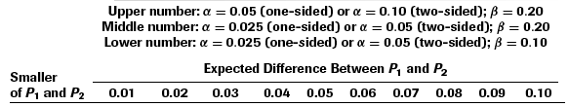
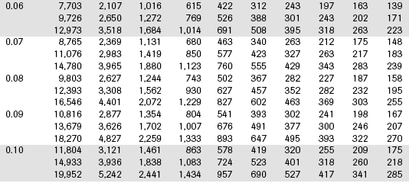
From Table 6B.2, Designing Clinical Research
Comparing two proportions
2-sided α = 0.05
Power = 0.90
Treatment
rate

Slide 61
From Table 6B.2
Sample size: 4,401
Per group!
Total: 8,802
Does not include drop-outs
  20% drop-out: 11,002 total sample size!

Slide 62
Online Calculator
http://www.sample-size.net/
CTSI sample-size
(Will demo at the end)

Slide 63
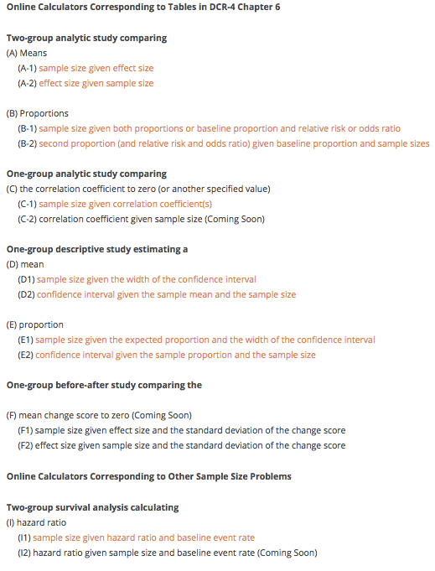
Menu

Slide 64
Menu

Slide 65
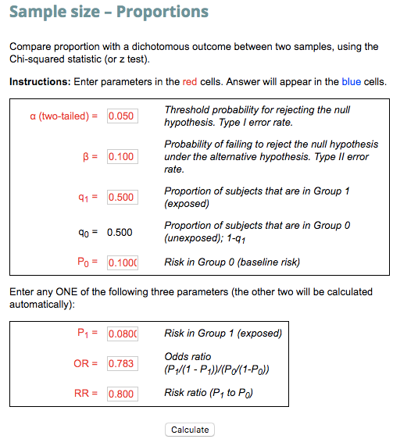

Slide 66
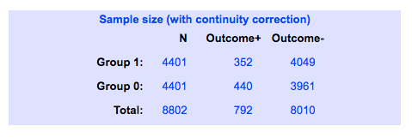

Slide 68
How to reduce your sample size

Slide 69
To test the effect of resveratrol on mortality
Sample size = 8,810!

Slide 70
To test the effect of resveratrol on mortality
Sample size = 11,002!
To account for dropouts

Slide 71
Appropriate responses
Shock and awe
Depression
Anxiety
Consider alternative approaches

Slide 72
Alternatives
Tweak α: one-sided
  Almost never appropriate
Tweak the power: 0.80

Slide 73
From Table 6B.2
Comparing two proportions
2-sided α = 0.05
Power = 0.80
Treatment
rate

Slide 74
Alternatives
Tweak α: one-sided
  Almost never appropriate
Tweak the power: 0.80
  Modest effect: 3,308 (6,616 total)
  (not including loss to follow-up)

Slide 75
Alternatives
Increase the effect size
  10% vs. 6% (4% difference)
  Resveratrol reduces mortality by 40%!

Slide 76
From Table 6B.2
Comparing two proportions
Treatment
rate

Slide 77
Increasing the effect size
10% vs. 6%
Makes a big difference!
769 / group; 1,538 total (no dropouts)
However, still large (and not affordable)
Not believable

Slide 78
Alternatives: a new hypothesis
Change the outcome measure
  Continuous measurement
  A precise measurement
A‘surrogate’for mortality rate:
  Strongly associated with mortality rate
    and
  Influenced by resveratrol
Walking speed

Slide 79
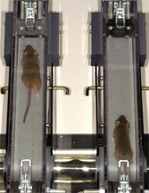
Mice on resveratrol
Mice fed resveratrol
  Live 25% longer
  Run faster
  Have greater endurance

Slide 80
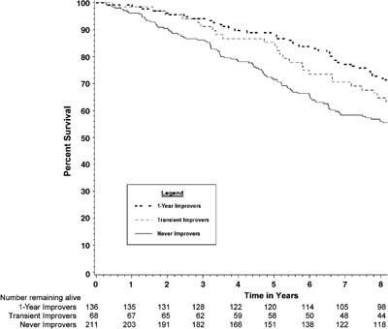
People who walk faster live longer
Faster by ≥0.1 m/s
Slower
~20% decreased
mortality rate

Slide 81
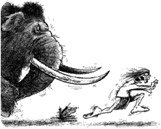
Fast walkers have lower mortality
An evolutionary perspective

Slide 82
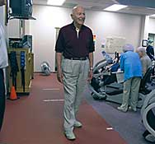
Walking speed
Easy and cheap!
Measure time over a 6 meter course

Slide 83
New endpoint needs a new hypothesis
Among 70 year old men and women, those randomized to resveratrol will not have a greater change in walking speed than those assigned to placebo.

Slide 84
The new ingredients
 New testable hypothesis
 Type of study: analytical (RCT)
 Statistical test?
  Continuous variable
  Difference between means

Slide 85
Type of statistical tests
Depends on the types of variables

Slide 86
The new ingredients
 New testable hypothesis
 Type of study: RCT
Statistical test: t-test
Effect size: “standardized effect size” E/S

Slide 87
Standardized effect size: E/S
Sample size depends on the ratio of E/S
  E: Effect size (difference in means)
  S: Standard deviation for measurement
You need smaller sample size if
  Greater effect (E)
  More precise measurement (lower SD)

Slide 88
Effect size for change in walk speed?
Faster by ≥0.1 m/s
Slower
~20% decreased
mortality rate

Slide 89
Human cohort studies
0.1 m/s corresponds to a 20% decreased mortality rate
Faster by ≥0.1 m/s
Slower
~20% decreased
mortality rate

Slide 90
What we need to determine E/S for our trial
Effect size (E) for change in walking speed
  Decline in the placebo group = -0.1 m/s
  Prevented by resveratrol = 0 m/s
  Difference (effect size) = 0.1 m/s

Slide 91
What we need to determine E/S for our trial
Effect size (E) for change in walking speed
+0.1 m/s
I need S: Standard deviation
Standard deviation of the change

Slide 92
S
(Standard deviation for the endpoint)
Standard deviation for gait speed
  Cross-sectional data: 0.25 m / sec
However, we are interested in change
Standard deviation of change in speed?
  Often more difficult to find because cross-sectional surveys are more common than longitudinal studies
Longitudinal study: SD of change = 0.2

Slide 93
E/S
E: Effect size: 0.1 m/sec difference in change
S: Standard deviation: 0.2 m/sec
E/S = 0.5

Slide 94
The new ingredients
 New testable hypothesis
 Type of study: analytical (RCT)
 Statistical test: t-test
  Continuous variable
  Difference between means
Effect size: 0 vs. 0.1 m/sec change
  E/S = 0.5
 Power: 0.80; 2-sided alpha: 0.05

Slide 95
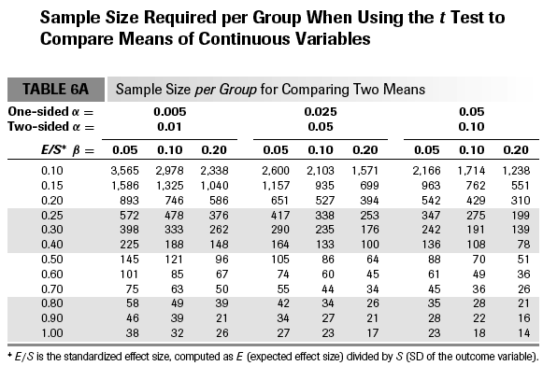

Slide 96
The new ingredients
 New testable hypothesis
 Type of study: analytical (RCT)
 T-test
 Effect size: E/S = 0.5
 Power: 0.80; alpha: 0.20
Sample size: 64 per group; 128 total
With 20% drop out: 160 total

Slide 97
Menu

Slide 98
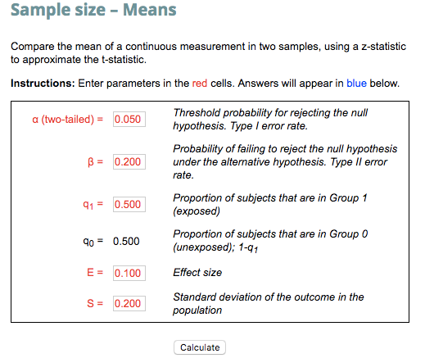


Slide 100
Summary
Estimate sample size early
Systematically collect the ingredients
Effect size is the most difficult - and important - judgment
Alternatives that reduce sample size
  Compromise power
  Increase effect size
  Use continuous outcomes

Slide 101
Thank you

