Slide 1
Immediate commands
An immediate command does not require stored data to operate
  Calculator (display )
  Statistical & epidemiological immediate commands
    (end in the letter i)

Slide 2
Immediate commands: Statistics
  cii confidence interval calculator
    cii means/proportions #obs #mean #sd [, level(#)]
  ttesti T test calculator
    1 sample:
    ttesti #obs #reportedmean #standard deviation #hypothesized mean
    2 sample:
    ttesti #obs1 #mean1 #sd1 #obs2 #mean2 #sd2

Slide 3
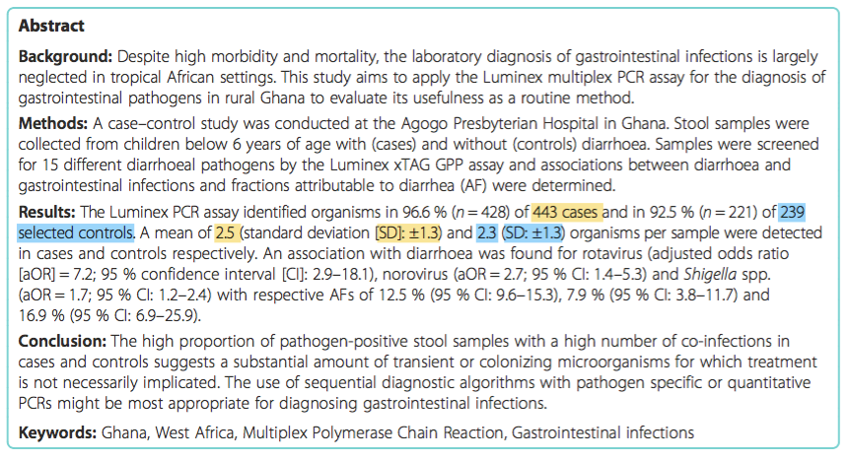
Practice Part 1
Calculate the 95% confidence interval around the mean number of diarrhea pathogens per stool sample in cases _______
Calculate the 95% confidence interval around the mean number of diarrhea pathogens per stool sample in controls _______
    cii means #observations #mean #standard deviation
Eibach D, Krumkamp R, Hahn A, et al. Application of a multiplex PCR assay for the detection of gastrointestinal pathogens in a rural African setting. BMC Infectious Diseases. 2016;16:150. doi:10.1186/s12879-016-1481-7.
Notes:
Number of different pathogens in children with and without diarrhea
Cases – with diarrhea
cii means 443 2.5 1.3
(2.378611, 2.621389)
Controls – without diarrhea
cii 239 2.3 1.3
(2.134344, 2.465656)

Slide 4
Practice Part 2
Conduct a ttest to test if the mean number of pathogens is different between cases and controls
    ttesti #obs1 #mean1 #sd1 #obs2 #mean2 #sd2
Eibach D, Krumkamp R, Hahn A, et al. Application of a multiplex PCR assay for the detection of gastrointestinal pathogens in a rural African setting. BMC Infectious Diseases. 2016;16:150. doi:10.1186/s12879-016-1481-7.
Notes:
ttesti 443 2.5 1.3 239 2.3 1.3

Slide 5
Immediate commands: Epidemiology
Examples:
  iri incidence rate calculator
    iri #exposed_cases #unexposed_cases #exposed_time #unexposed_time
  cci odds ratio calculator (case-control study)
    cci #exposed_cases #unexposed_cases #exposed_controls #unexposed_controls
  csi risk/ risk ratio calculator (cohort study)
    cci #exposed_cases #unexposed_cases #exposed_not_cases #unexposed_not_cases
Notes:
Incident rate is from the time of entry until they develop the outcome of interest
Odds ratio: the ratio of the odds of a disease in the those exposed to to a risk factor compared with the odds of that disease in those not exposed.
e.g. odds = risk of a disease / (1-risk)
Risk ratio: the risk for an outcome in one group divided by the risk in the comparison group
Odds ration and risk ratio are similar when a disease is rare in both the exposed and unexposed

Slide 6
QUIZ 3
Diarrhea
Controls
Calculate the odds ratio ______
Cases
5
+
64
Rotavirus
379
234
-
    cci #cases_(+)rotavirus #cases_(–)rotavirus #controls_(+)rotavirus #controls_(–)rotavirus
Eibach D, Krumkamp R, Hahn A, et al. Application of a multiplex PCR assay for the detection of gastrointestinal pathogens in a rural African setting. BMC Infectious Diseases. 2016;16:150. doi:10.1186/s12879-016-1481-7.
Notes:
cci 64 379 5 234 = 7.9

Slide 7
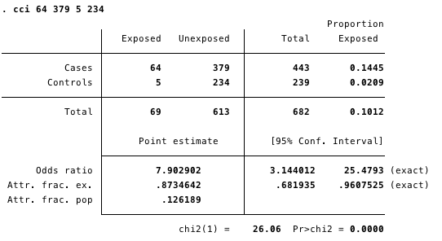

Slide 8
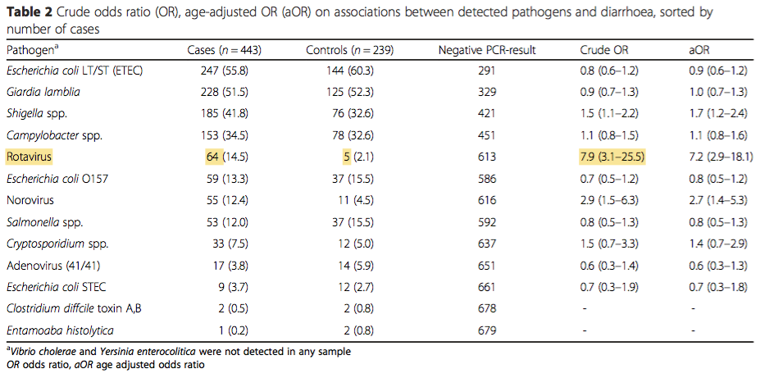
Eibach D, Krumkamp R, Hahn A, et al. Application of a multiplex PCR assay for the detection of gastrointestinal pathogens in a rural African setting. BMC Infectious Diseases. 2016;16:150. doi:10.1186/s12879-016-1481-7.

